Slide 1
GIS and Remote Sensing Application to support Research Activities Solomon Islands National University
Theme: “Sustainable Management for Coastal Areas through Remote Sensing and GIS“.
November 28th 2024

Slide 2
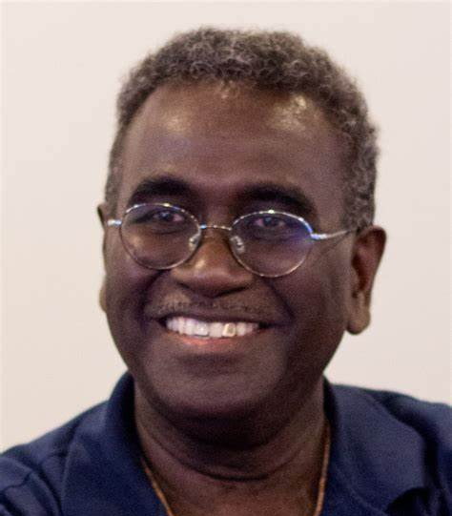
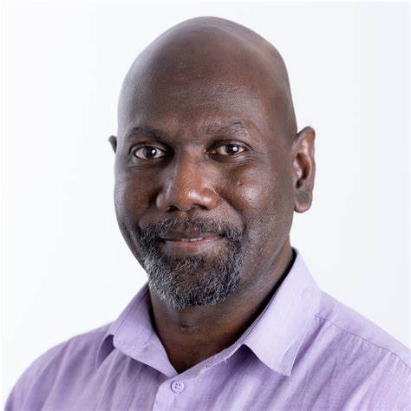
SINU Faculties and Departments
Vice Chancellor
Dr Transform Aqorau
Pro VC Academic
Dr Eric Katovai
Pro VC Corporate
Dr William Parairato
Faculties | Administration | Support Services
Faculty of Business & Tourism Studies Faculty of Science & Technology Faculty of Nursing, Medicine & Health Sciences Faculty of Agriculture, Forestry & Fisheries Faculty of Education & Humanities Distance & Flexible Learning | Office of the Vice Chancellor Council Senate and Secretariat Institutional Planning & Development Department Finance Department Human Resources Department Office of Research; and Marketing & Promotion Office | University Library Business Investment & Commercial Services Information & Communications Technology Department Property & Campus Management Department

Slide 3
Importance of GIS and Remote Sensing use in Solomon Islands
Disaster Management
Solomon Islands is vulnerable to natural disasters such as cyclones, floods, and tsunamis (Reid, 2018).
The country consist of small Islands which is in “constant recovery mode”(World Bank, 2021).
GIS and Remote Sensing has significant potential in disaster risk management and adaptation work.
Sustainable Resource Management Practices
Support research on natural resource management, in areas of forestry, fisheries, and land-use planning and others.
Supports CBRM, ICZM, Marine Spatial Planning, Coastal Zone Management and others.

Slide 4
Importance of GIS and Remote Sensing Application
Solomon Islands National University
Build the GIS user community within the University and externally
Aids in research activities, including data collection and survey of research parameters
Geographical isolation of Islands (Provinces) in Solomon's requires GIS and remote sensing work to backup research/training activities concerning coastal areas and resources

Slide 5
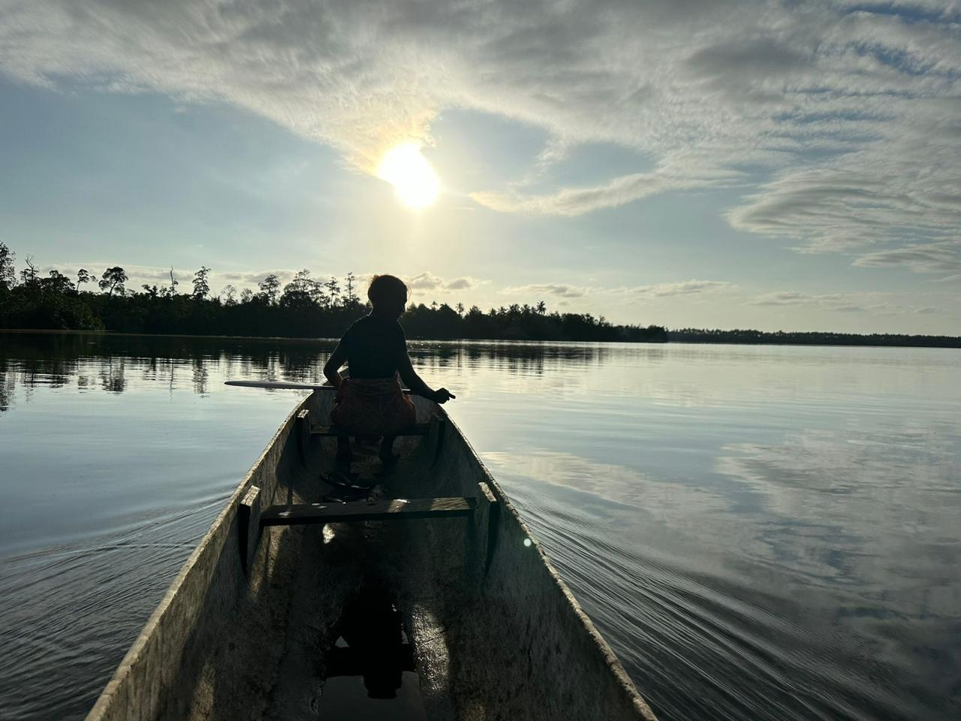
GIS and Remote Sensing Application in Research Activities – Shared Experiences and Challenges

Slide 6
Mapping of Fishing Activities to Fishing Grounds
Research on fishing communities and fishing activities
Network map (Artisanal fish production chain in Solomon Islands) through complementing site names and spatial data online.
ArcGIS was used in data analyses and Mapping
Challenge: inconsistency and limitations with data of coastal communities and villages

Slide 7
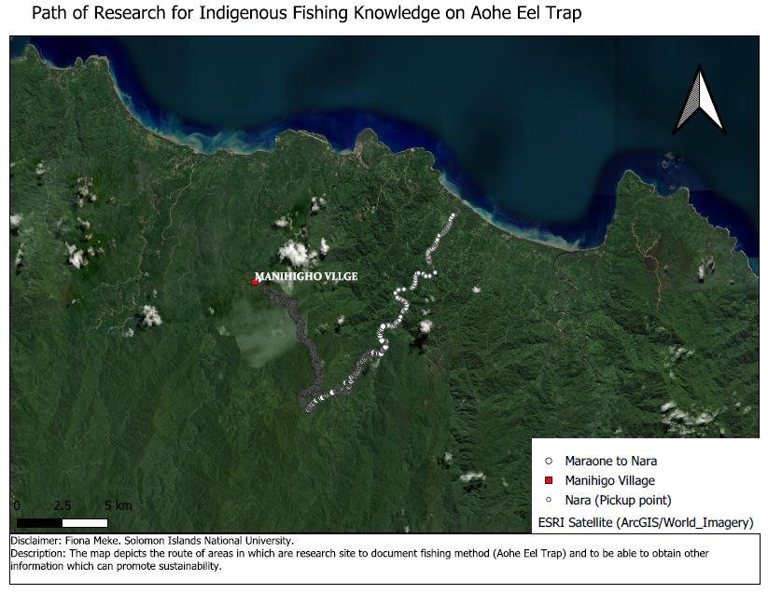
Research Site Mapping and DSM Data Collection
Research Site: Makira Province
Use of Survey tool (Kobo Tool Box) and QGIS for research sites (3 sites - coastal and terrestrial)
Remote sensing (UAV) - (DSM) to support environmental parameters
GIS & RS to support data for ecology of eel fish, sustainable practices of fishing

Slide 8
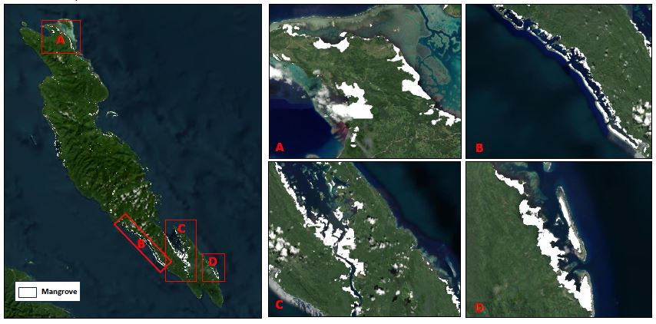
Solomon Islands Mangrove Mapping to Support Mangrove Policy Framework
Geospatial data review in aid of Mangrove Mapping in Solomon Islands. This is to support the Development of an Integrated Coastal Zone Management (ICZM) Plan to protect the mangroves through Ecosystem based adaptation solutions and Mangrove Policy Framework.
Data: Land features, coastline and ocean cover, boundaries and temporal data
It involves the comparison of AI data and local data to bring out the suitable output
Challenge: Capacity building and training required to support locals involve in the technical deliberations of data review.
Notes:
Check local data: Does the administrative boundary cover the coastline or ocean?

Slide 9
Challenges/Needs
Specialized Training and Expertise
Lack of spatial data to support implementation of mapping coastal site and ecosystems in Solomon Islands
Low Local Demand at the University Level
Satellite imagery is usually procured, only Landsat & low resolution data are freely available.

Slide 10
Way Forward
GIS and Remote Sensing application is highly valuable for research work.
With the right investments and support GIS & RS can improve governance, resource management activities, and disaster preparedness in the country.
Enhance research at the University level which can aid in promoting sustainable coastal planning and development practices.

Slide 11
Way Forward
Review and accredit courses that promote the relevant GIS and RS uses to support research on coastal resource management.
Train and recruit more expertise in this field to support training delivery.
Strengthen relationship between NDMO (gov’t) and SINU, regional and International bodies in coastal research efforts and sustainable practices.

Slide 12
Acknowledgement
A sincere acknowledgement to the following for their support;
UNITAR & UNOSAT - Khaled Mashfiq
NORAD
SPC
NDMO - Director & Ms Joy Papao

Slide 13
Tagio tumas!

