Slide 1
Spatial climate & hydrology insights: Tools to reduce uncertainty and empower decision-making
Presentation for the Pacific Islands GIS and Remote Sensing User Conference 2024, Suva
25 – 29 November 2024
Hannah Marley, Alan Porteous, James Sturman, Bernard Miville, Lawrence Kees, Graham Elley, and Luke Wang
Notes:
Bula and Kia ora
My name is Hannah and I’m a Climate Application Scientist at NIWA in Aotearoa, NZ.
Today I’m going to be sharing with you some of the tools we’ve been developing to provide spatial climate and hydrology insights, in order to reduce uncertainty and empower decision-making.

Slide 2



Acknowledgement of Pacific partners
Vanuatu Meteorology & Geo-Hazards Department
Samoa Electric Power Corporation
Samoa Meteorology Division
Fiji Meteorological Service
Notes:
Before we get started, I’d just like to acknowledge our Pacific partners who have collaborated with us on the tools I’m going to show today.
They’ve all given their permission for me to share the tools we’ve developed together.

Slide 3
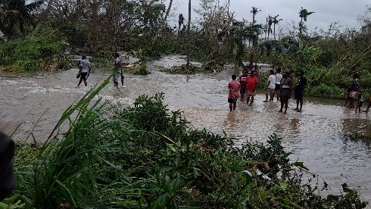
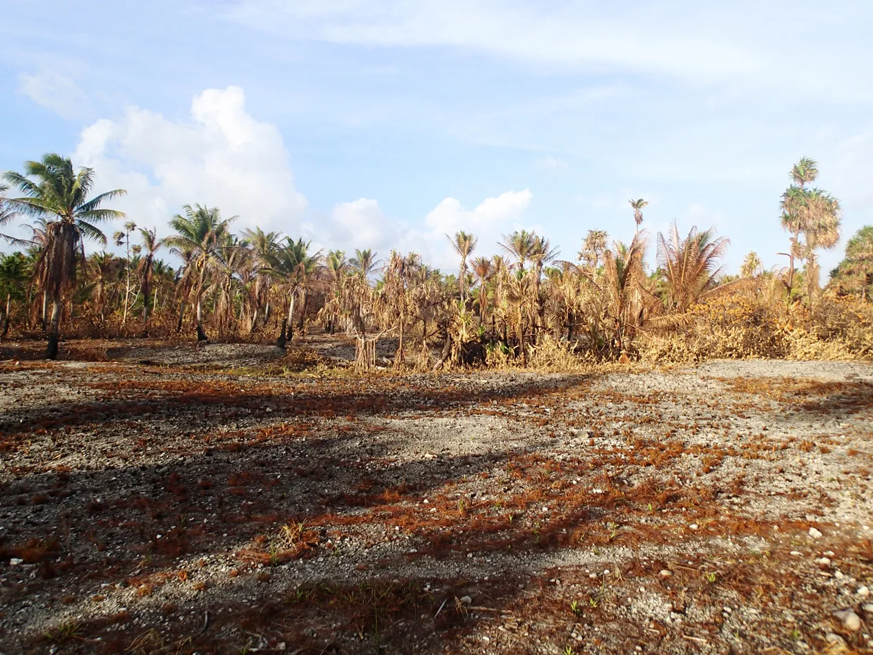
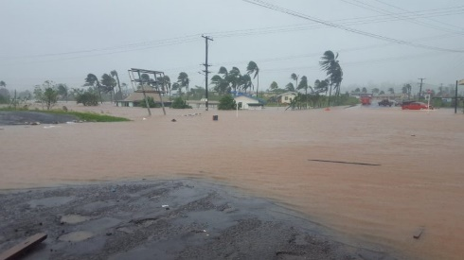

Climate impacts weather and hydrology in the Pacific
As global temperature rise, we expect:
          Tropical cyclones to become more intense
          Coastal flooding to increase
          Droughts and heat waves to become more severe
          These events put natural resources and infrastructure at risk and threaten communities
Notes:
All of us in this room know that the climate impacts on weather and hydrology in the Pacific are significant.
As global temperatures rise, we expect:
Image sources:
TC impact: https://www.fao.org/newsroom/detail/tropical-cyclones-judy-and-kevin-fao-mobilizes-to-safeguard-food-security-and-rural-livelihoods-in-Vanuatu
Drought: https://www.pacificrisa.org/tag/vanuatu/
Flooding/TC: https://floodlist.com/australia/fiji-tropical-cyclone-ana-january-2021

Slide 4
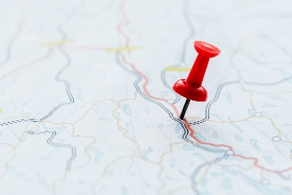
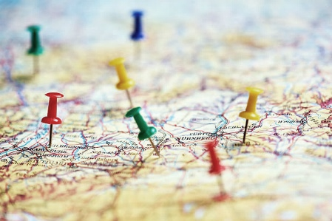



Recognising these events is critical for decision-making
It is critical for decision-makers to have the ability to quickly:
          Recognise these events
          Place them into context
          Use them to inform decisions
To do this, decision-makers need an understanding of the spatial and temporal variability of weather, climate, and hydrological processes
Notes:
Recognising these events is critical for decision-making.

Slide 5
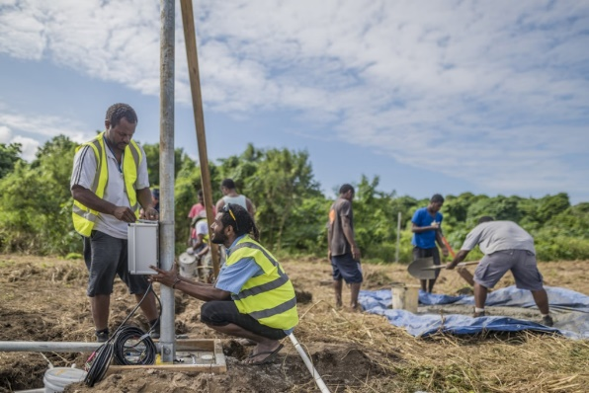
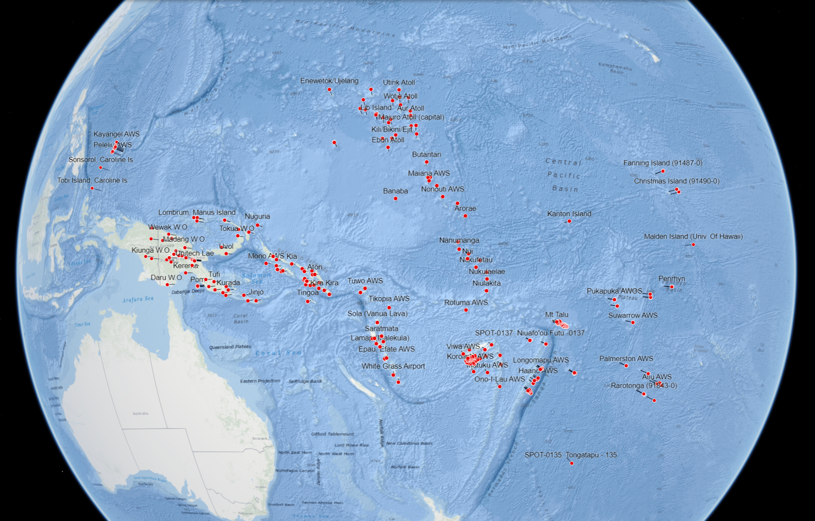
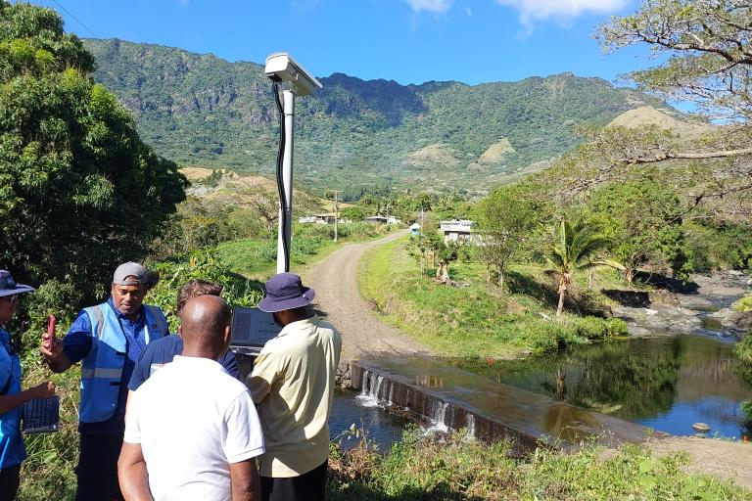
Pacific observational climate and hydrology networks
Ongoing efforts throughout the Pacific are being made to:
          Strengthen and expand the observational climate and hydrology networks
          Enhance the collection of data through improved station density
Involves collaborative work with the World Meteorological Organization (WMO) and National Meteorological and Hydrological Services
Notes:
Image sources:
https://wmo.int/media/announcement/wmo-hydrohub-innovation-call-pacific-island-countries-project-concluded

Slide 6

Gaps and challenges
Hinders effective decision-making
Limits the ability to fully leverage the observational networks that are being expanded in the Pacific Region
Hard to access
Difficult to interpret
Abundant data
Challenging to communicate
Need for robust, user-friendly platforms for decision-makers!
Notes:
However, there are a few important gaps and challenges. While these networks offer abundant data, it’s a bit like this data is locked away in a black box. Because it’s:
Hard to access
Difficult to interpret
And challenging to communicate

Slide 7


Bridging the gap: Development of innovative tools
Three examples of user-friendly dashboards tailored for decision-makers
Aim: Reduce uncertainty around weather & climate events and hydrological processes
To capture spatial variability
To produce a range of real-time observations and forecasts
Use of station data
Significantly enhance accessibility and usability
Notes:
We’re working on bridging this gap through the development of innovative tools.
Today I’m going to share 3 examples of user-friendly dashboards that we’ve developed that have been tailored for decision-makers
Aim
The tools I’m going to show make use of station data:

Slide 8
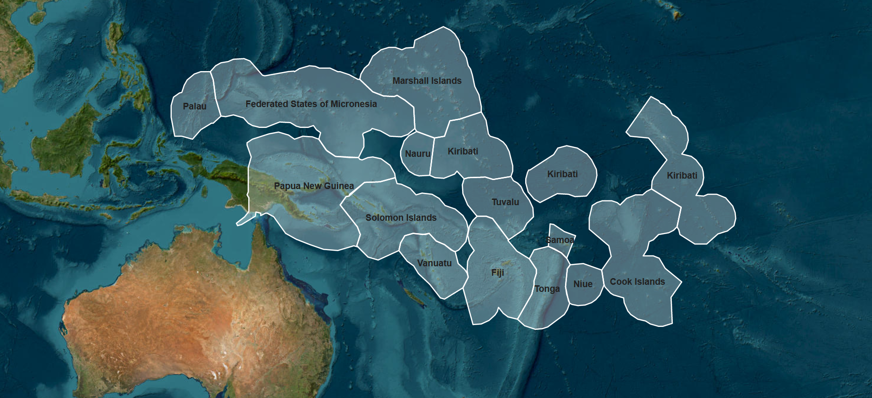
Notes:
Under the COSPPac project (which I’ll mention a bit later), we work with 14 different Pacific Island countries. Today I’m going to take you on a journey to three of these countries and show a tool we have developed in collaboration with each country. The first country we’re going to visit is Vanuatu

Slide 10
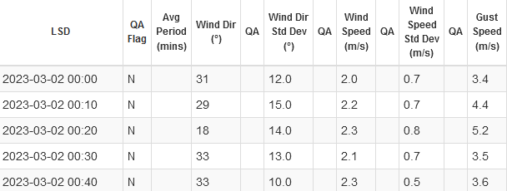
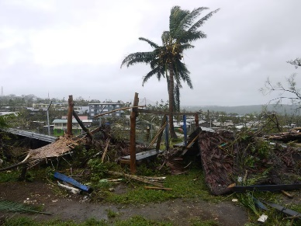
Extremes Dashboard for the Pacific: Vanuatu Example
Partner
Their Challenge
A Path to Action
Success
?
Hard to decipher if current weather is extreme
Difficult to track in real-time
Spatial extent of current extreme weather is unknown
Difficult to quickly identify and communicate information about an extreme weather event
Vanuatu Meteorology & Geo-Hazards Department (VMGD)
Notes:
And the tool I’m going to demonstrate for Vanuatu is the Extremes Dashboard for the Pacific.
In Vanuatu, our partner is VMGD.
Their challenge is that the data coming in from their weather stations are numbers in a database.
This makes it: Difficult…
In the next few slides I’m going to go through our Path to Action and the Success of this path.
Image sources:
1. Port Villa destroyed homes – World Vision

Slide 11
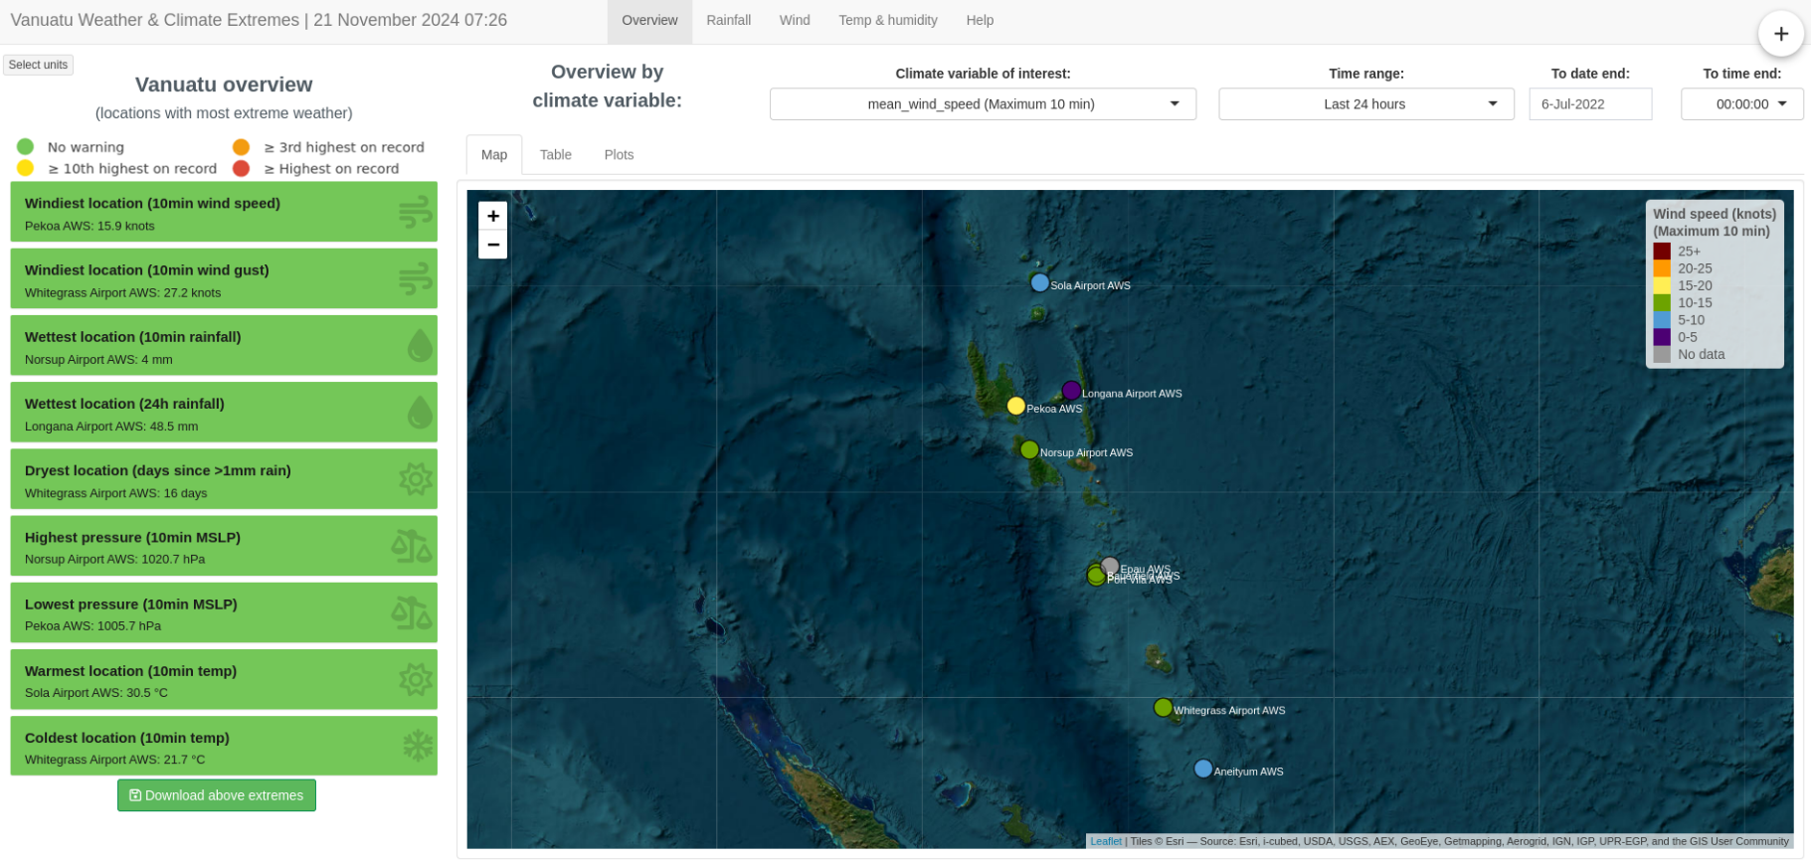
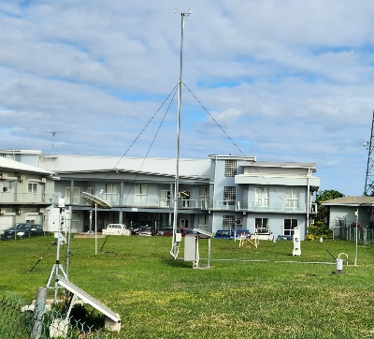
Extremes Dashboard for the Pacific: Vanuatu Example
A Path to Action
Real-time interactive dashboard
Internal use by Met Services
To give a quick view of what’s going on at weather stations in real-time
Notes:
Our pathway to action has been to develop a real-time interactive dashboard.
This is for internal use by Met Services
To give a quick view of what’s going on at weather stations in real-time.
The dashboard displays weather variables measured at weather stations around the country, including wind, rain, dry days, atmospheric pressure, temp

Slide 12

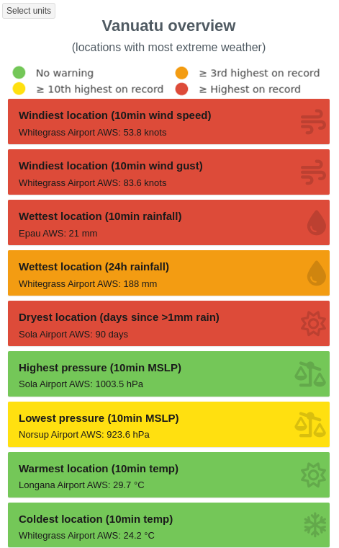
Extremes Dashboard for the Pacific: Vanuatu Example
A Path to Action
Identify extreme weather
Tropical Cyclone Judy
1 March 2023
No warning
≥ 10th highest on record
High winds
≥ 3rd highest on record
≥ Highest on record
A lot of rain
Low atmospheric pressure
Notes:
The dashboard uses a traffic light system to identify extreme weather events.
So here we have a normal day in Vanuatu where nothing out of the ordinary is happening – so everything is green.
And here’s what the dashboard was showing when TC Judy came through during March 2023.
You can straight away see that there’s something extreme happening, and that this relates to high winds, a lot of rain, and low atmospheric pressure

Slide 13

Extremes Dashboard for the Pacific: Vanuatu Example
A Path to Action
Identify spatial extent of extreme weather
Notes:
The dashboard also identifies the spatial extent of extreme weather.
So again, here’s what the dashboard for Vanuatu looks like on a normal day with no extreme weather – here we’re showing wind measured at the weather stations across Vanuatu.

Slide 14

Extremes Dashboard for the Pacific: Vanuatu Example
A Path to Action
Tropical Cyclone Judy
1 March 2023
Identify spatial extent of extreme weather
Notes:
When we flick to when TC Judy was present, the map shows exclamation marks for all stations measuring extreme winds.
So the user can straight away see that the high winds were focused around the mid to lower islands of Vanuatu.

Slide 15
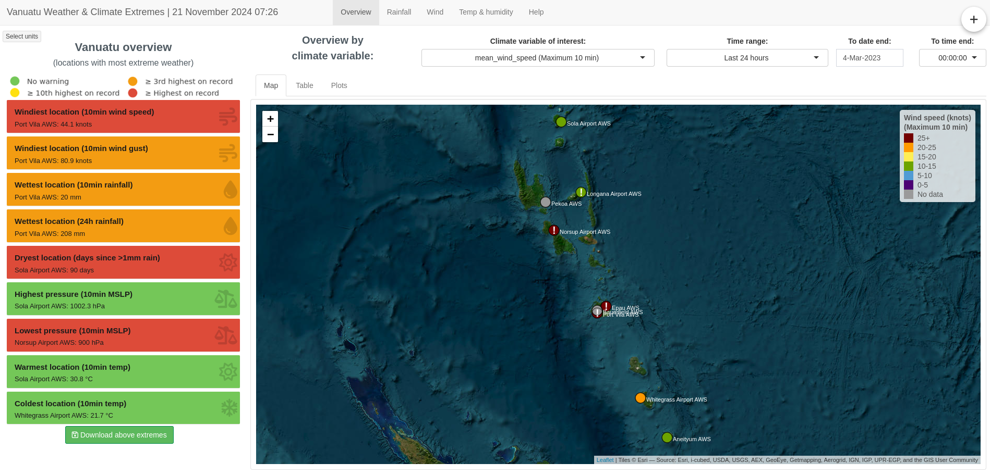
Extremes Dashboard for the Pacific: Vanuatu Example
A Path to Action
Tropical Cyclone Kevin
3 March 2023
Identify spatial extent of extreme weather
Notes:
Whereas, when TC Kevin came through Vanuatu a couple of days later, you can see this time the high winds were focused around the middle islands of Vanuatu.

Slide 16
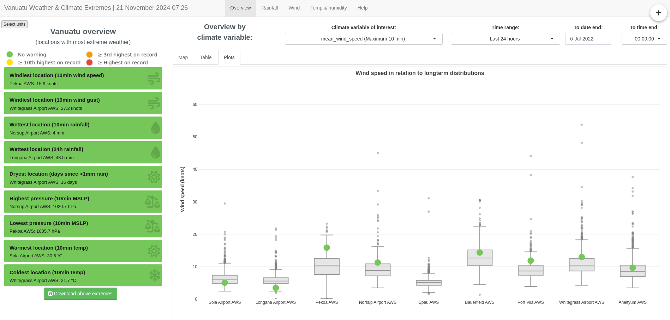
Extremes Dashboard for the Pacific: Vanuatu Example
A Path to Action
Identify spatial extent of extreme weather
Notes:
The dashboard also shows where the current measurements sit in relation to the long-term distributions measured at each site, represented by boxplots.
Again using the traffic light system.
The sites represented by each boxplot are ordered according to latitude (northern latitudes to the left, southern latitudes to the right), to offer a different spatial representation of what’s happening across the country.

Slide 17
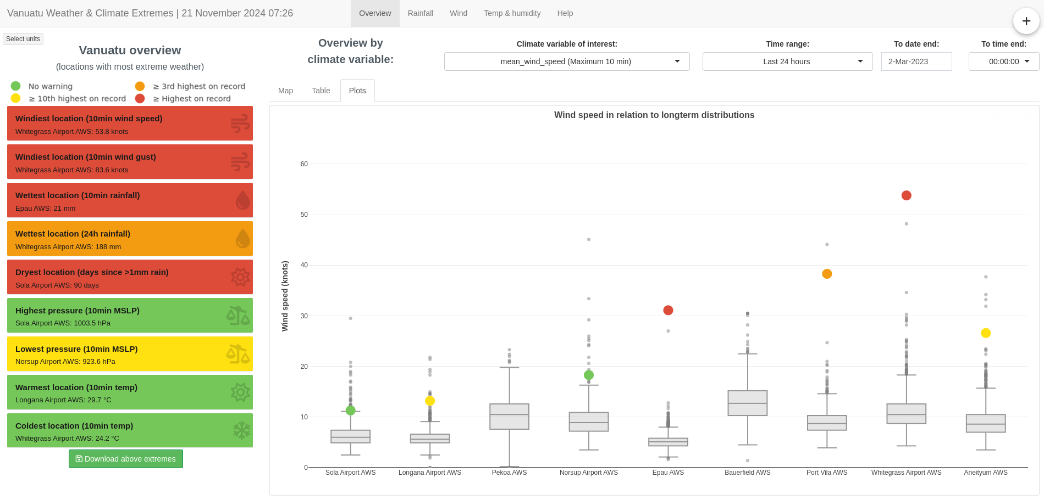
Extremes Dashboard for the Pacific: Vanuatu Example
A Path to Action
Tropical Cyclone Judy
1 March 2023
Identify spatial extent of extreme weather
Notes:
When we flick to when TC Judy was present, we can see the extreme values (represented by the yellow, orange, and red dots), in relation to the distributions of data recorded historically.
And again, the user can straight away see that the high winds were focused around the mid to lower islands of Vanuatu (the sites represented by the boxplots to wards the right-hand side).

Slide 18
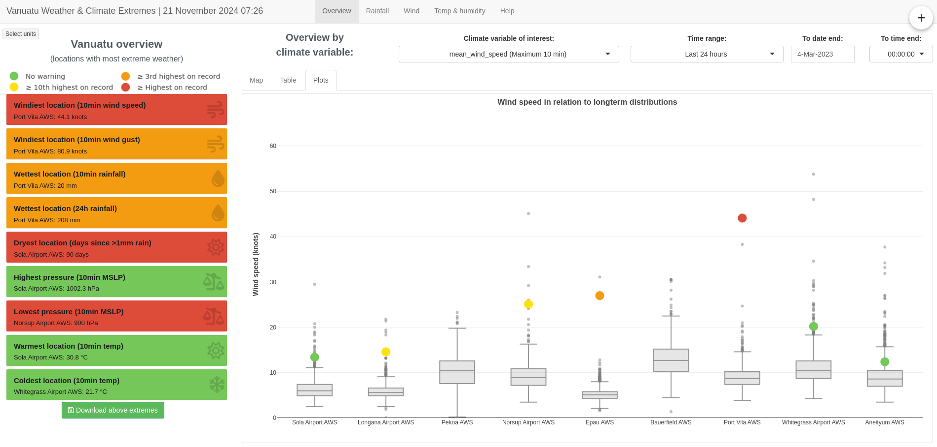
Extremes Dashboard for the Pacific: Vanuatu Example
A Path to Action
Tropical Cyclone Kevin
3 March 2023
Identify spatial extent of extreme weather
Notes:
And when TC Kevin came through Vanuatu a couple of days later, you can see this time the high winds were focused around the middle islands of Vanuatu, represented by the middle sites shown here.

Slide 19
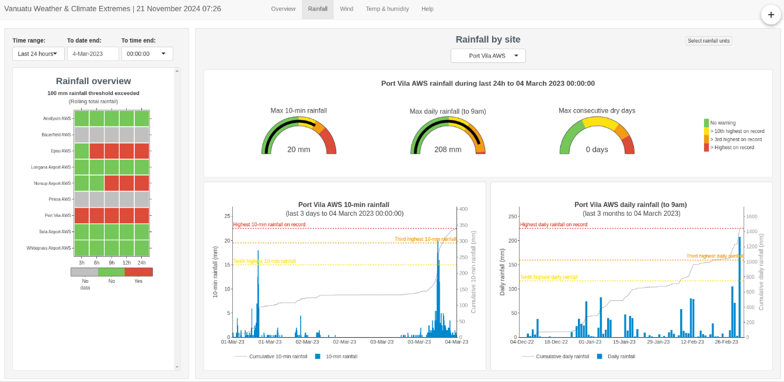
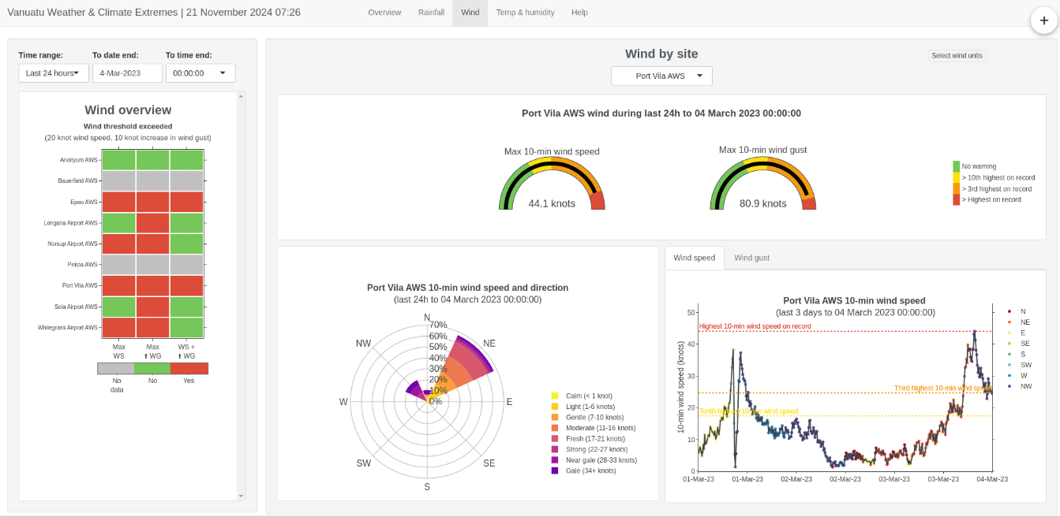
Extremes Dashboard for the Pacific: Vanuatu Example
A Path to Action
Site-specific information on weather extremes
All data and graphs able to be downloaded from dashboard in a format that is easy to communicate to general public, media, etc
Notes:
Today I’m going to share the development of innovative tools to bridge this gap.
To do this, I’m going to show you 3 examples…

Slide 20
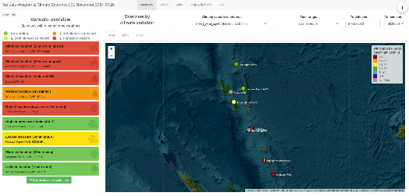

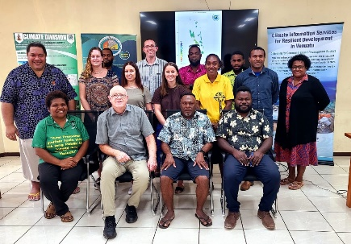
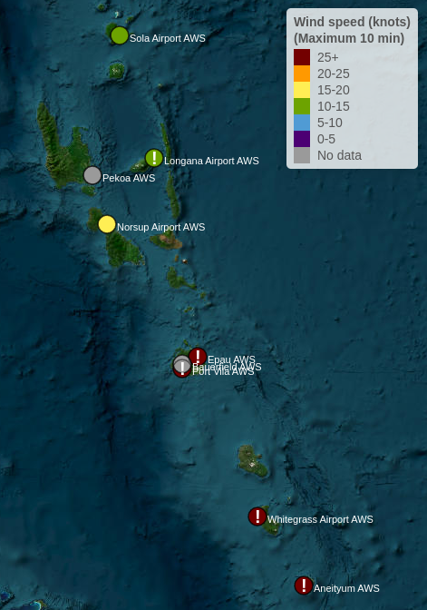
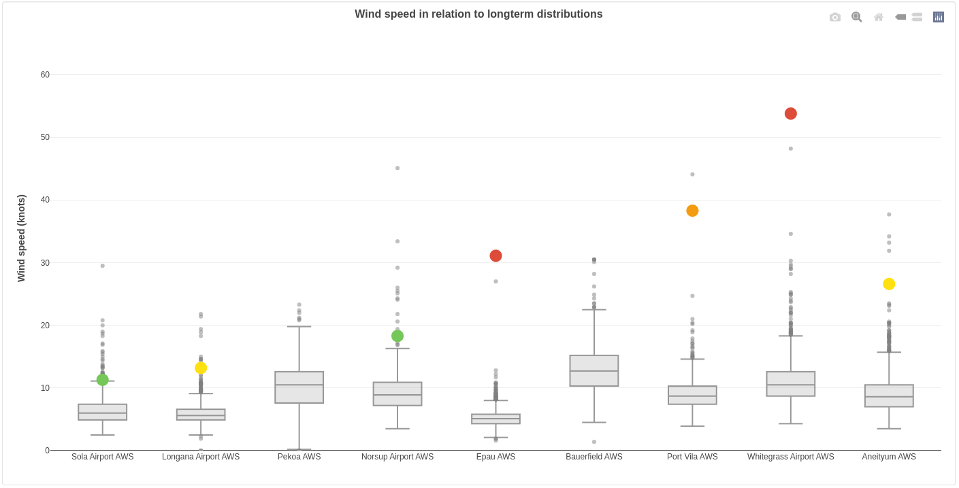
Extremes Dashboard for the Pacific: Vanuatu Example
Partner
Their Challenge
A Path to Action
Success
Real-time interactive dashboard
Easier to quickly identify and communicate information about extreme weather events, because the data is:
?
Easy to access
Available in real-time
Easy to interpret
In a format to communicate
Hard to decipher if current weather is extreme
Difficult to track in real-time
Spatial extent of current extreme weather is unknown
Difficult to quickly identify and communicate information about an extreme weather event
Vanuatu Meteorology & Geo-Hazards Department (VMGD)
Identify extreme weather
Identify spatial extent
Notes:
As we’ve seen, the pathway to action here has been:
The development of an interactive dashboard that displays the data in real-time
It uses a traffic light system to quickly identify extreme weather events
It allows a spatial representation of extreme weather events
This successfully addresses the challenges VMGD have, as it is:
Easier to quickly identify and communicate info about extreme weather events, because the data is:
Easy to access
Available in real-time
Easy to interpret
In a format to communicate out to the public, media etc
Pic: Thank you to VMGD for their collaboration on this project

Slide 21
Notes:
Under COSPPac, we work with 14 different Pacific Island countries. Today I’m going to take you on a journey to three of these countries and show a tool we have developed in collaboration with each country. The first country we’re going to visit is Vanuatu

Slide 22
Notes:
We’re now going to visit Samoa

Slide 23
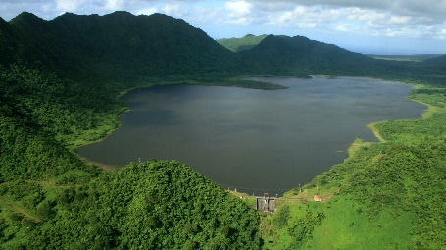
Afulilo Dam Water Storage Outlook Module (Samoa)
Partners
Their Challenge
A Path to Action
Success
Samoa is going
100% renewable
Samoa Electric Power Corporation (EPC)
Samoa Meteorology Division (SMD)
Afulilo Hydro Scheme produces 47% of the Samoa’s renewable energy
Water stored in dam <- rainfall
Rainfall in Samoa highly variable
Exacerbated by climate change
Difficult to manage the available water in the dam when planning energy production
Notes:
The next tool I’m going to share is the Afulilo Dam Water Storage Outlook Module we’ve developed in Samoa.
Our partners on this project are the Samoa Electric Power Corporation (EPC) and the Samoa Meteorology Division (SMD).
Their big picture challenge is that Samoa is going 100% renewable, and the Afulilo Hydro Scheme produces 47% of the Samoa’s renewable energy
However, the water stored in the dam is influenced by rainfall. Rainfall in Samoa can be highly variable. This variability is exacerbated by climate change.
All of this makes it difficult to to manage the available water in the dam when planning energy production.
In the next few slides I’m going to go through our Path to Action and the Success of this path.

Slide 24
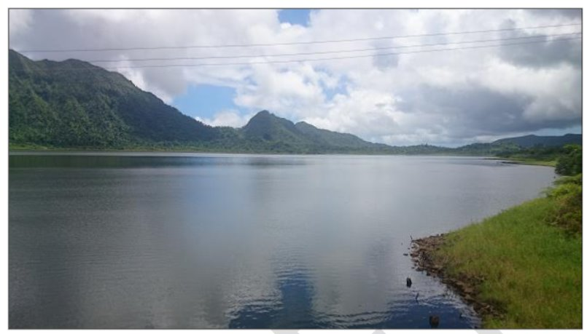

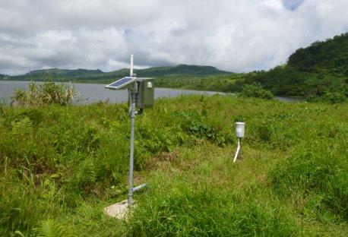
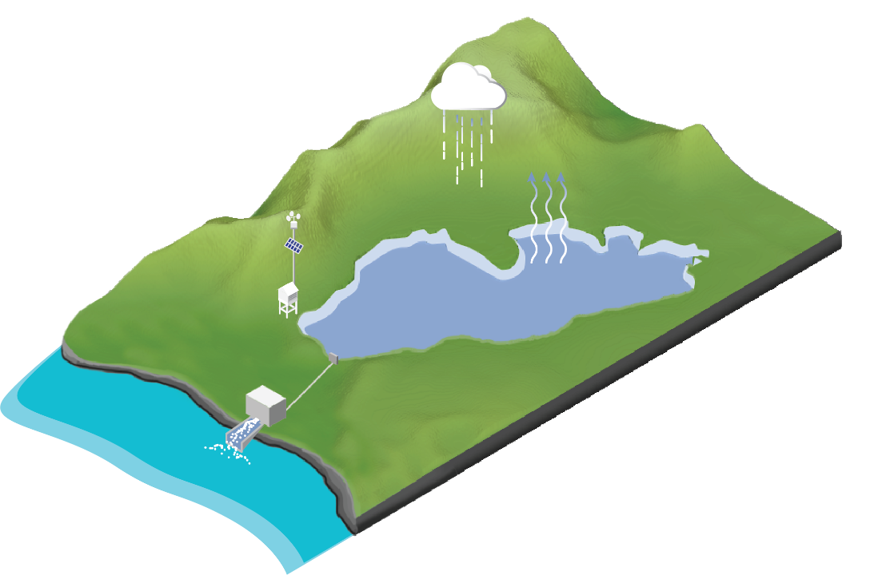
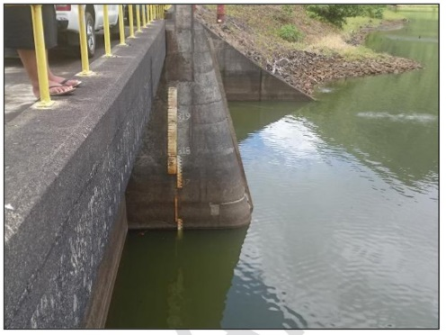
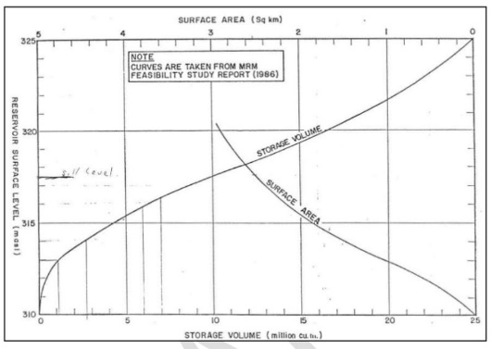
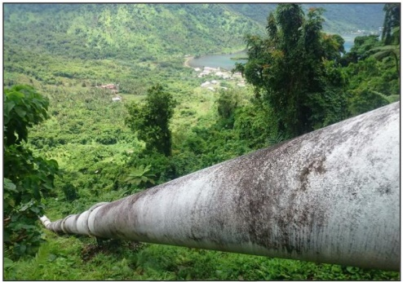
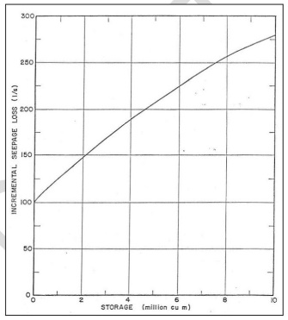
Afulilo Dam Water Storage Outlook Module (Samoa)
A Path to Action
1. Afulilo water balance model
Rainfall and
catchment runoff
Surface area and
evaporation
Dam water level
Surface area and
storage volume
Outflow and
power generation
Seepage and
storage volume
Notes:
This has been an on-going project, with the development of a water valance model for the Afulilo Dam catchment back in 2012.
This was in collaboration with the Aus BoM.
I’m not going to go into too much detail here, but the model includes the main inputs and outputs of water into the dam. Including:

Slide 25


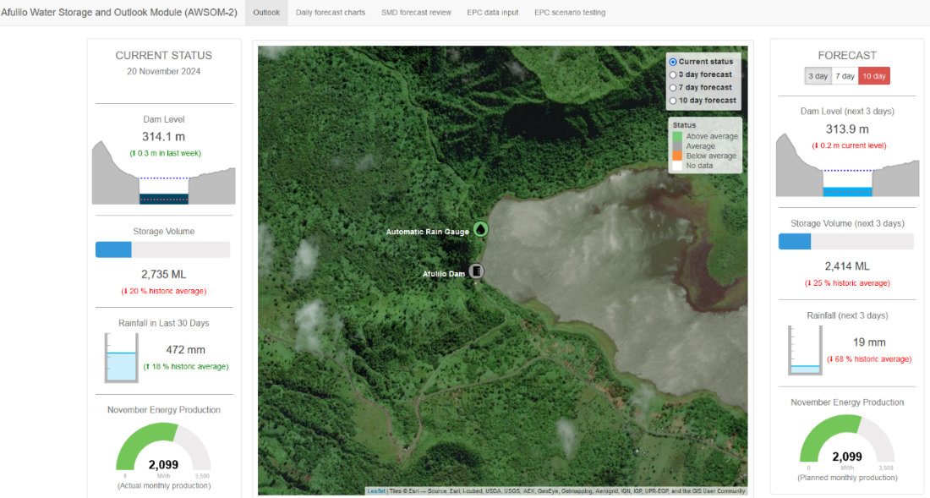



Afulilo Dam Water Storage Outlook Module (Samoa)
A Path to Action
2. A interactive dashboard
Climate Data
Forecast dam status
Rainfall (real time)
Evaporation
Afulilo Water Balance Model
Hydrological Data
Water Storage Forecast
Dam Level (real time)
Dam inflows
Dam outflows
Infrastructure Data
Forecast Data
Planned Power Generation
Rainfall Forecasts (weather models)
Forecast summary & review
Notes:
From this, we have developed an interactive dashboard that uses this water balance model to not only visualise the current status of the dam level and storage volume,
But to also use forecast rainfall to provide forecasts of the dam level and storage volume.
So we’re using climate, hydrology, and instrastructure inputs (some of which are measured in real-time).
As well as forecast data, including planned power generation from EPC, rainfall forecasts from global weather models, and forecasts summaries from SMD.

Slide 26

Notes:
I’ll just zoom in to show the front page of the dashboard.
It has the current status on the left-hand side – showing dam level and storage volume, and rainfall received in the catchment
And the forecast dam status on the right-hand side, with the ability to select the forecast for 3 days, 7 days, and 10 days into the future.
The buttons light up if the dam level is forecast to reach critical levels, so here it’s showing red for the 10 day forecast because the dam is forecast to reach a critically low level in 10 days from when I took this screenshot.

Slide 27
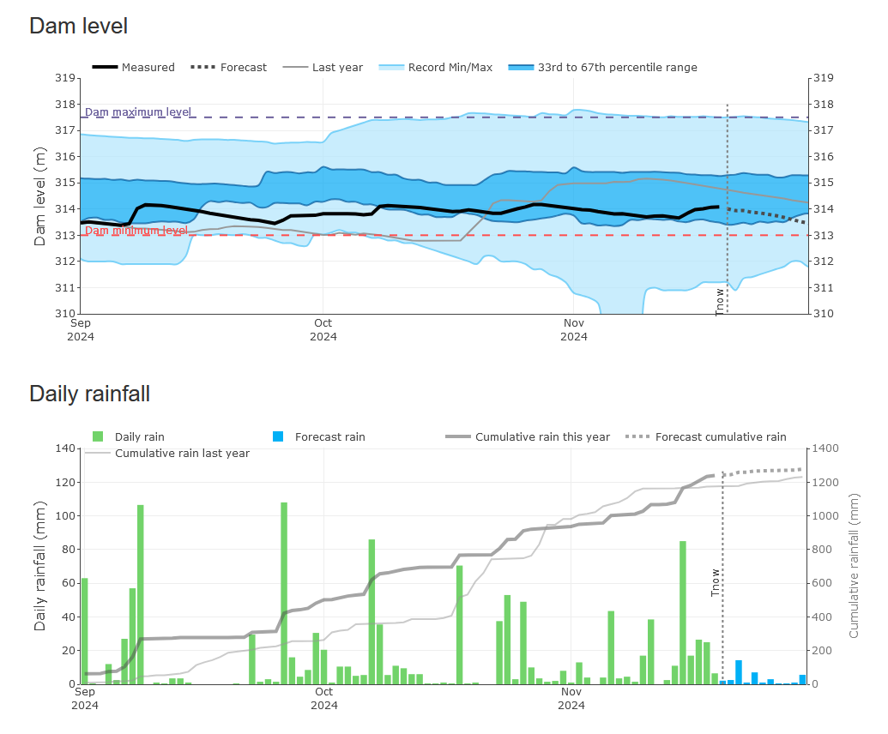
Notes:
The dashboard also has other tabs to give more detail into the dam level and rainfall over time, including the forecast rainfall and dam level response.

Slide 28
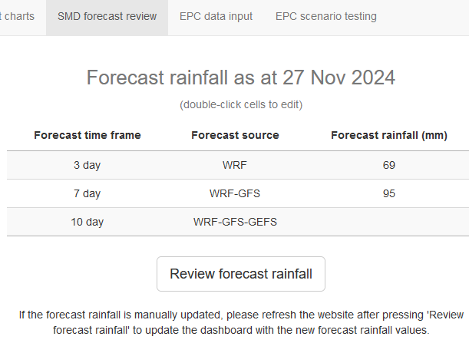
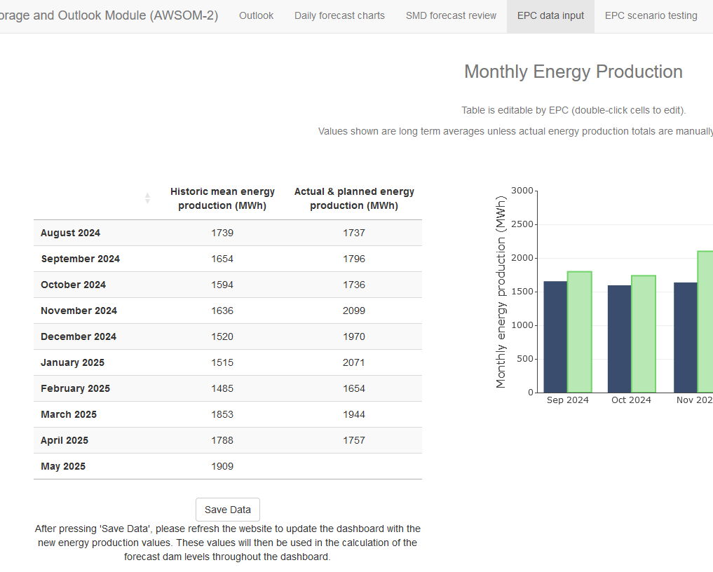
Notes:
The dashboard has input areas for both the Samoa Met Division and EPC to contribute data, which is used to update the water balance model running behind the visualisations.

Slide 29
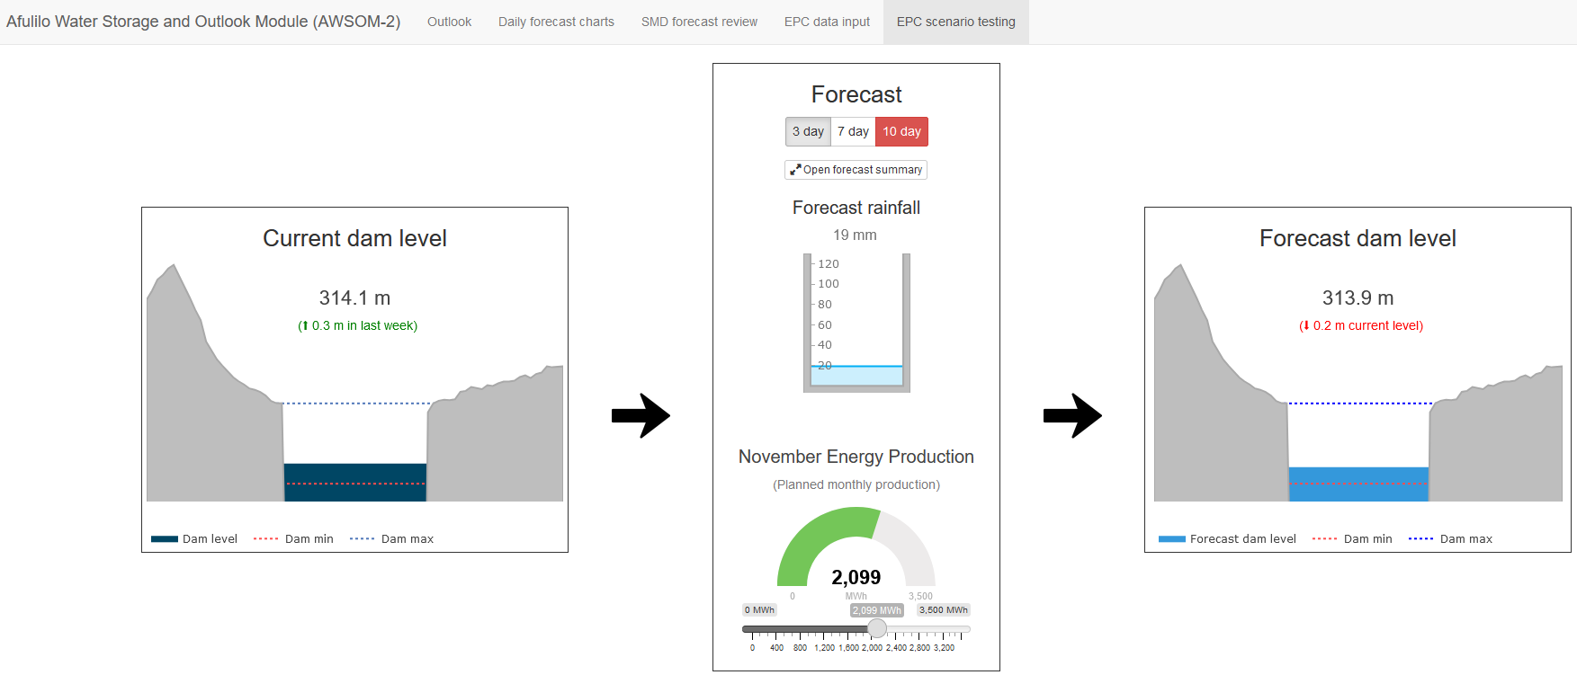
Notes:
And it has a scenario testing tool that allows the Energy company to test different energy production scenarios, taking into account the forecast rainfall, to make sure the Afulilo dam is staying within it’s critical limits.

Slide 30
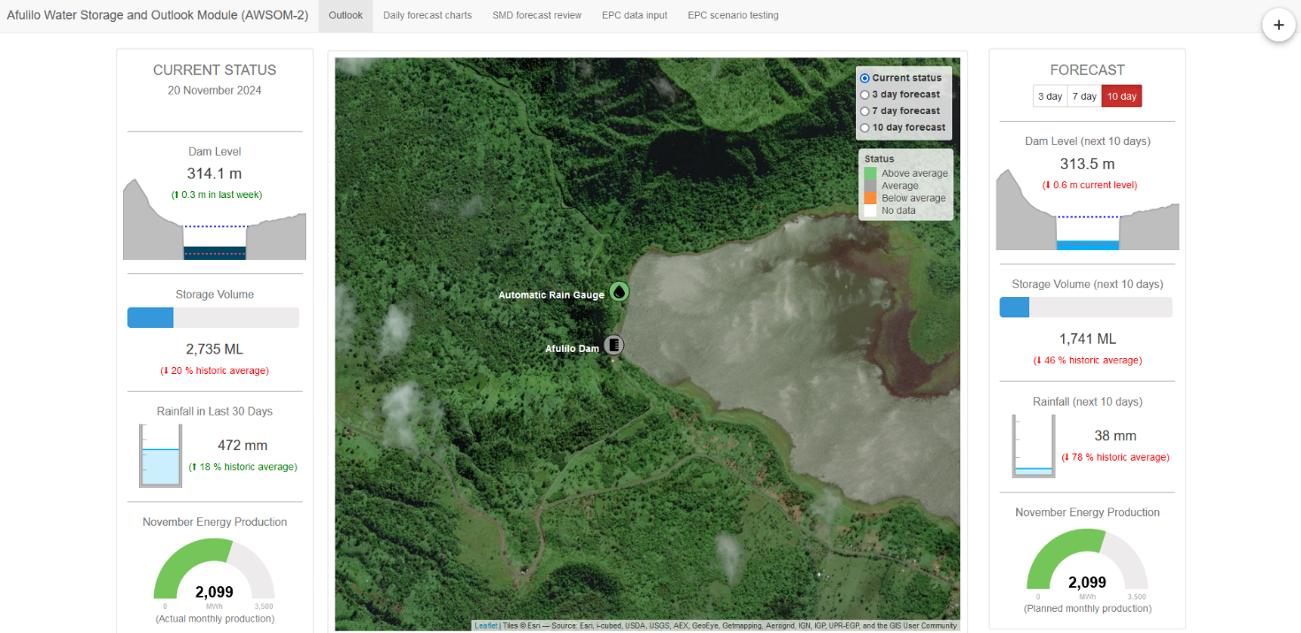

Afulilo Dam Water Storage Outlook Module (Samoa)
A Path to Action
3. Automated email alerts (currently testing)
Notes:
Lastly, we’re currently testing an email alert feature that alerts users when the dam level is forecast to reach critically low or high levels, and reminding them to check in with the dashboard and with the SMD for more local weather information.

Slide 31
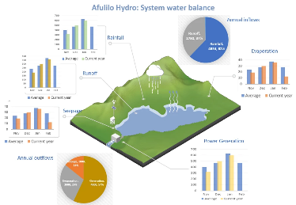

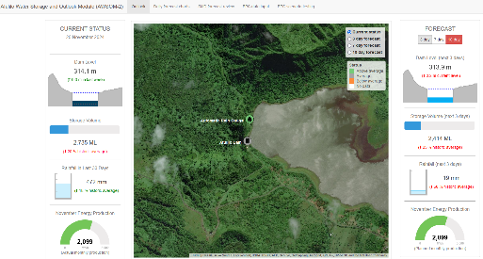
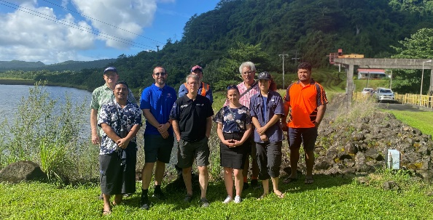
Afulilo Dam Water Storage Outlook Module (Samoa)
Partners
Their Challenge
A Path to Action
Success
1. Afulilo water balance model
Samoa is going
100% renewable
Easier to manage the available water in the dam when planning energy production, because the data is:
Samoa Electric Power Corporation (EPC)
Samoa Meteorology Division (SMD)
Afulilo Hydro Scheme produces 47% of the Samoa’s renewable energy
Easy to access
Available in real-time
Easy to interpret
Water stored in dam <- rainfall
Rainfall in Samoa highly variable
Exacerbated by climate change
Difficult to manage the available water in the dam when planning energy production
2. An interactive dashboard
3. Automated email alerts
Notes:
As we’ve seen, the pathway to action here has been:
The development of a water balance model for the Afulilo Catchment.
The development of an interactive dashboard.
Automated email alerts.
In terms of the success of this project, it is now easier to manage…
And this project has really fostered collaboration between all the involved parties. Here at the Afulilo Dam: EPC, SMD, MNRE, and NIWA

Slide 32
Notes:
We’ll zoom back out, and this time we’ll visit Fiji

Slide 34
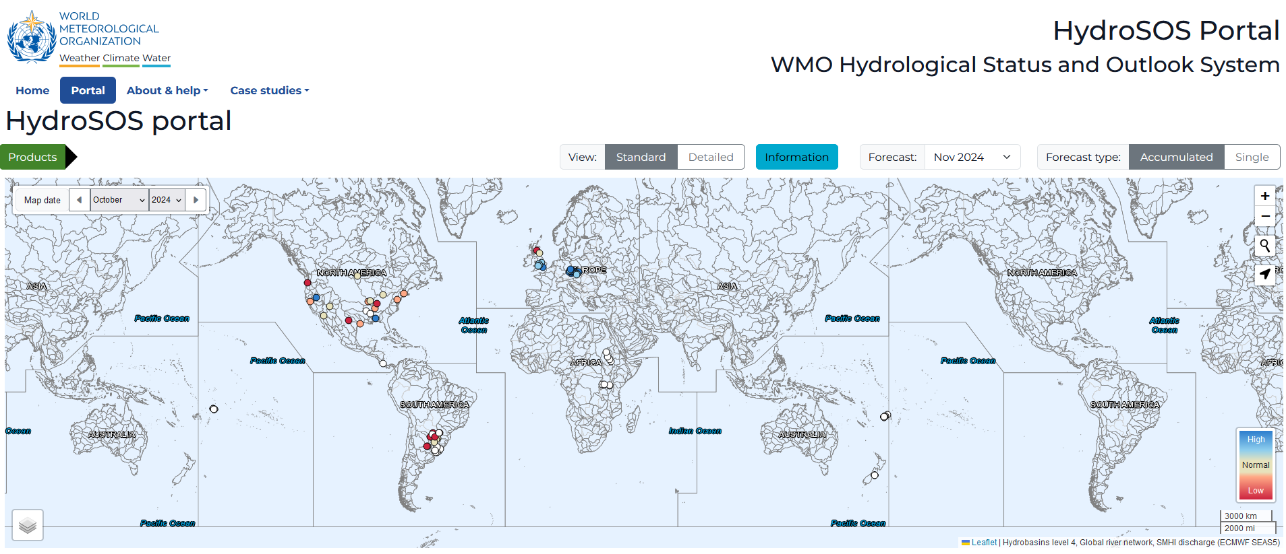



HydroSOS Portal for the Pacific: Fiji Example
Background
WMO: Global Hydrological Status and Outlook System (HydroSOS)
Aim: To help produce standardised information on the current state of the water resources at sites around the world
Fiji is a contributor to the WMO HydroSOS portal
Notes:
As background to the tool I’m going to show:
The WMO has a website called the Global Hydro Status and Outlook System (or HydroSOS).
The aim of this website
Displays river flow, river level, rainwater, and groundwater

Slide 35
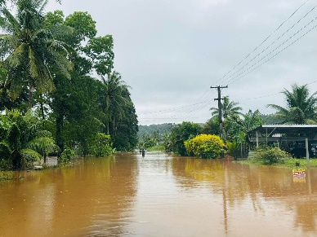

HydroSOS Portal for the Pacific: Fiji Example
Partner
Their Challenge
A Path to Action
Success
?
Difficult to visually check stats sent to WMO HydroSOS Portal
Difficult to track hydrological events in real-time
Spatial status of real-time hydrological processes unknown
Challenge to quickly identify and communicate information about hydrological processes
Fiji Meteorological Service
Notes:
The tool I’m going to show here is a HydroSOS portal for the Pacific that helps Pacific countries contribute to the WMO HydroSOS portal.
Our Partner in this particular example is the Fiji Met Service.
Their original challenge was that it’s difficult to visually check the data sent to the WMO HydroSOS Portal.
This extended into a wider interest in visualising their hydrological data, with the challenges being:
It’s difficult to track hydro events in real-time,
The spatial status of real-time hydrological processes is unknown.
And as a result, it’s a challenge to quickly identify and communicate information about hydrological processes.
In the next few slides, I’m going to go through our Path to Action and the Success of this path.

Slide 36
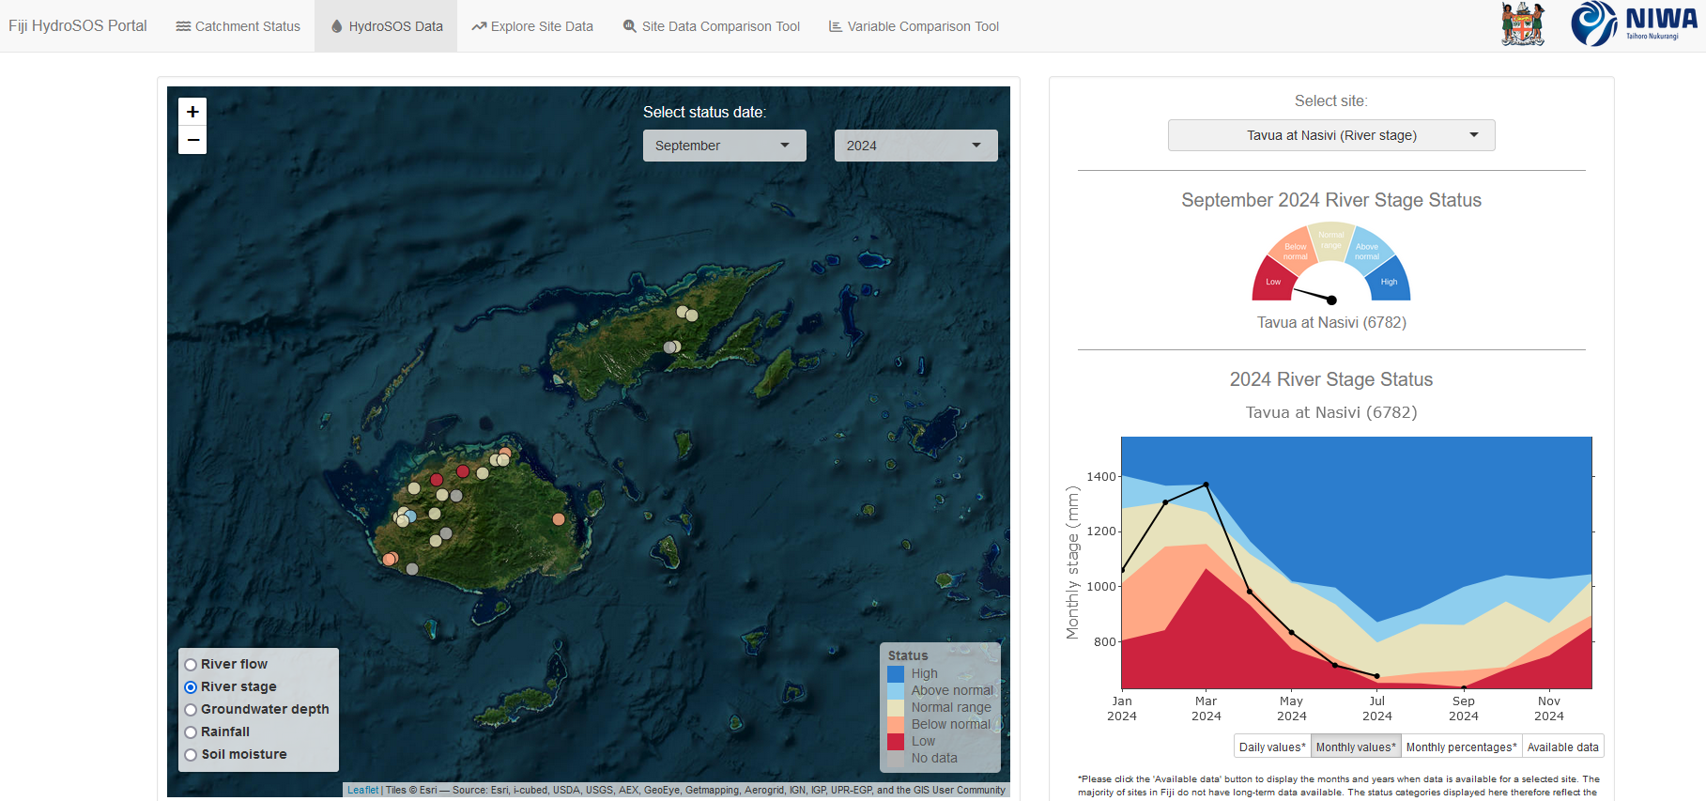
1. Real-time interactive dashboard
Spatial representation of hydrological status at sites across Fiji
River level, river flow, groundwater depth, rainfall, soil moisture
Status calculated following method given by WMO
Notes:
So the dashboard shows the hydrological status all the sites across Fiji, for things like river level, etc, following the method given by the WMO to calculate hydrological status

Slide 37
HydroSOS Portal for the Pacific: Fiji Example
A Path to Action
1. Real-time interactive dashboard
Visually check hydro statistics that will feed into WMO HydroSOS portal
If any issues, ability to dig into problems by looking at site-level data
Notes:
Our path to action has been to develop a real-time interactive dashboard that allows a visual check of the HydroSOS data before it’s fed to the WMO portal.

Slide 38
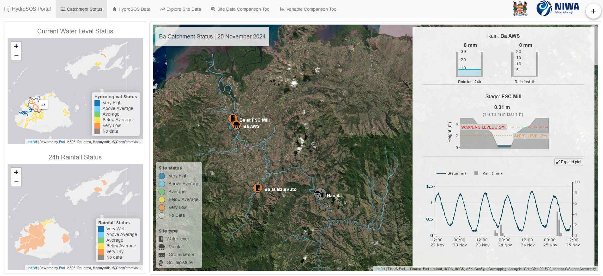
HydroSOS Portal for the Pacific: Fiji Example
A Path to Action
2. Identify and track hydro events
Extended into the addition of a Catchment Status tab:
          Way to identify and track hydro events in real time
          Separate to WMO HydroSOS, but of interest to Hydrology departments
Notes:
This extended into the addition of a way to identify and track hydro events in real time – so this is separate from the WMO HydroSOS, but of interest to Fiji Met Service.

Slide 39
HydroSOS Portal for the Pacific: Fiji Example
A Path to Action
2. Identify and track hydro events
Country view of catchment status:
          Water level & rainfall
          Based on representative sites within each catchment
          Interactive, select catchment of interest by clicking on river lines or catchment boundaries
Notes:
The Catchment Status tab provides a country view of catchment status, for current water level and 24h rainfall.
This status is based on representative sites within each catchment.
It’s interactive, so you can select the catchment of interest by clicking on the river lines or catchment boundaries

Slide 40
HydroSOS Portal for the Pacific: Fiji Example
A Path to Action
3. Spatial links between catchment variables
Within catchment status:
          Status of individual sites (water level, rainfall, groundwater, soil moisture)
          Interactive, select site of interest to update visualisations
          Includes thresholds for flood warnings and alarms where available (e.g. water level)
          Demonstrates spatial links between variables, e.g. catchment response to rainfall
Notes:
Once the user has selected their catchment of interest you can see the within catchment status.
This provides the status at individual sites.
It’s interactive, you can select your site of interest and it will update the visualisations
These visualisations include thresholds of flood warnings and alarms where available (e.g. water level)

Slide 41
…
…
Notes:
I’ll just show a few examples of some of the catchments around Fiji. Ba Catchment: a few water level sites. Tidal influence at this WL site

Slide 42
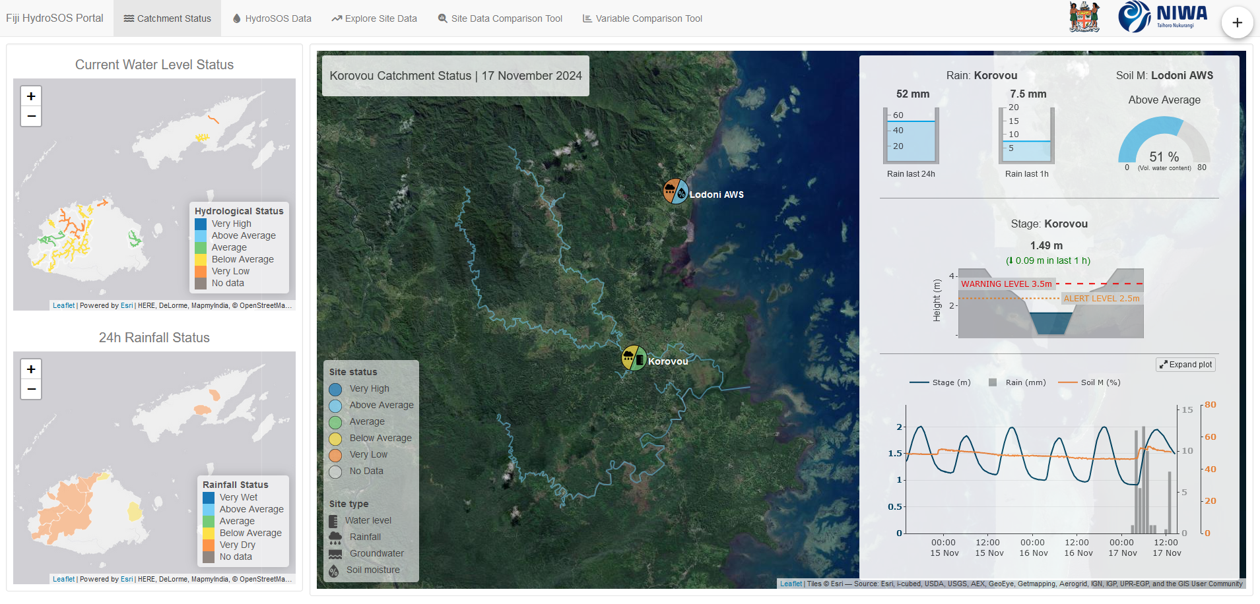
…
…
Notes:
Korovou Catchment, water level, soil moisture, and two rainfall sites. Soil moisture response to rainfall.

Slide 43
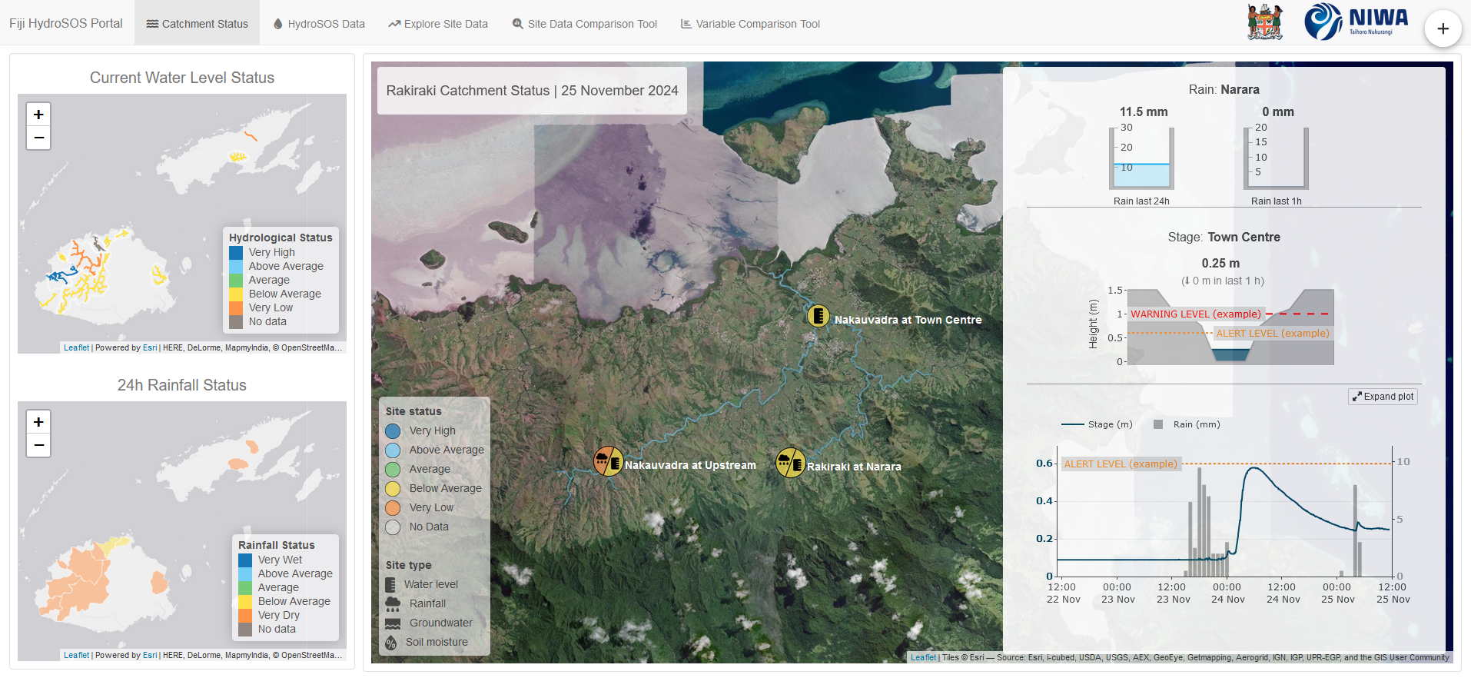
…
Notes:
Rakiraki Catchment – number of water level sites, rainfall. Here you can see that, while all water level sites are now back to below average, this site has recently experienced a rapid increase in water level.

Slide 44
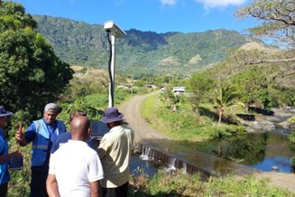
HydroSOS Portal for the Pacific: Fiji Example
Partner
Their Challenge
A Path to Action
Success
Real-time interactive dashboard
Easier to quickly check hydro data, and to identify and communicate info about hydro events, because the data is:
?
1. Visually check HydroSOS data
Easy to access
Available in real-time
Spatial representation of catchment processes
Difficult to visually check data sent to WMO HydroSOS Portal
Difficult to track hydrological events in real-time
Spatial status of real-time hydrological processes unknown
Challenge to quickly identify and communicate information about hydrology processes
Fiji Meteorological Service
2. Identify and track hydro events
3. Spatial links between catchment variables
Notes:
The HydroSOS Dashboard was
originally developed as a tool for Met Services to check the data that is feeding into the public WMO HydroSOS portal (which I’ll show soon).
It has since been extended into includ
was a product requested by Met Directors from around the Pacific. In Vanuatu, our lead is VMGD.
Their big picture challenge is …
However, …
In the next few slides I’m going to go through our Path to Action and the Success of this path.

Slide 45

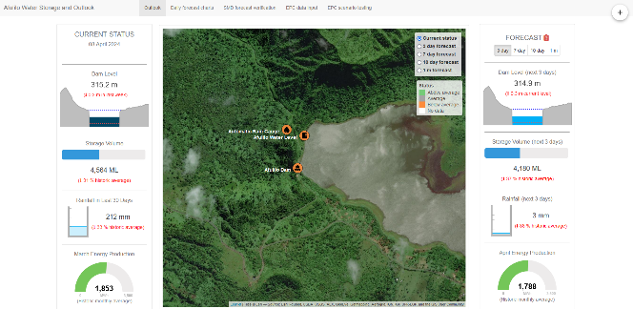
Summary
Benefits of tools:
Allow spatial data to be communicated in new and impactful ways.
Can be developed for specific end-user needs to empower decision-making
Can be used to reduce the uncertainty around weather and climate events and hydrological processes
Notes:
In summary, I’ve demonstrated that the development of tools like the ones I’ve shown
Allow…

Slide 46
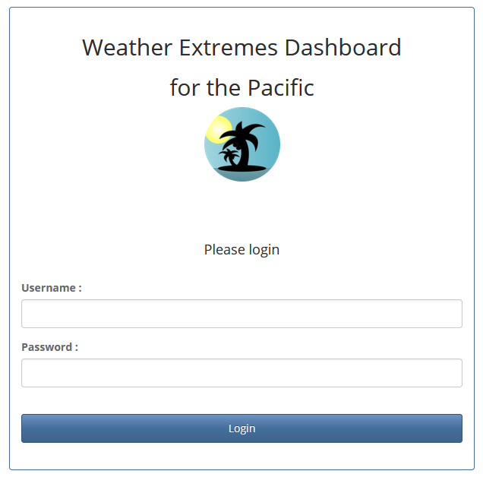


Summary
Benefits of tools:
Allow spatial data to be communicated in new and impactful ways.
Can be developed for specific end-user needs to empower decision-making
Can be used to reduce the uncertainty around weather and climate events and hydrological processes
All dashboards are password protected to maintain data sovereignty and protect access

Slide 47



Importance of Continued Improvement
To ensure stakeholders have the necessary resources to navigate an increasingly variable climate:
✓
✓
✓
✓
✓
          Regular maintenance of sites
          Continued expansion of observational networks
          Improve data quality
          Refinement of the tools built upon them
Notes:
But I do want to recognise the importance of continued improvement

Slide 48



Acknowledgement of funding
The majority of this work has been funded under the COSPPac project
Funded by the Australian and New Zealand governments
To support Pacific Island countries to adapt to and mitigate the impacts of climate variability
Parts of the HydroSOS portal were funded by WMO
Notes:
Before I finish, I just want to acknowledge our funders.
The majority of this work has been funded under the COSPPac project – Climate and Oceans Support Program in the Pacific.
COSPPac is funded by the Australian and NZ governments
To support Pacific Island countries to adapt to and mitigate the impacts of climate variability
In addition, parts of the HydroSOS portal were funded by WMO.
Thank you to our funders, this work wouldn’t be possible without them.

Slide 49
Vinaka and Thank You
Hannah Marley
Climate Applications Scientist, NIWA
Hannah.Marley@niwa.co.nz

