Slide 1
MapSafe: A complete Open-source tool for achieving geospatial data sovereignty
Pankajeshwara Sharma, Michael Martin, and David Swanlund*
Department of Environment, University Of Auckland *Department of Geography, Simon Fraser University
Transactions in GIS Journal (September 2023)
DOI: https://doi.org/10.1111/tgis.13094

Slide 2
Geospatial Data Sovereignty
Maps have historically been used for creating certain power and authority imbalances
Data sovereignty has become increasingly relevant today due to data harvesting and increased surveillance through big data, geoweb, and the cloud.
Cloud encryption approaches only provide on/off protection with no middle setting.
These challenges require a solution that enables cloud geospatial data storage & sharing with users with varying levels of trust, without compromising security.
However, geospatial data security is a multi-faceted challenge
Notes:
Data sovereignty aims to ensure data guardians have control over data.

Slide 3
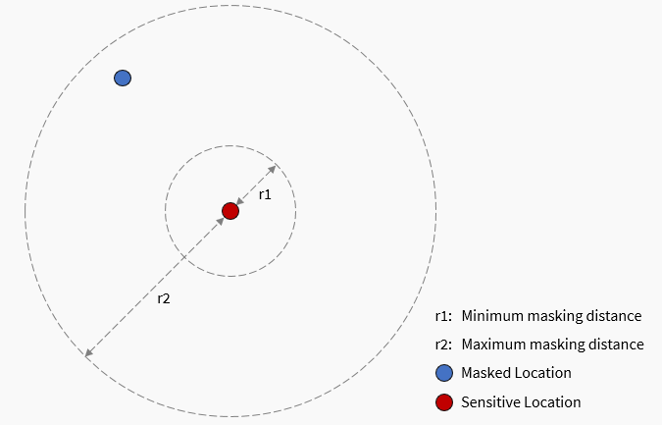
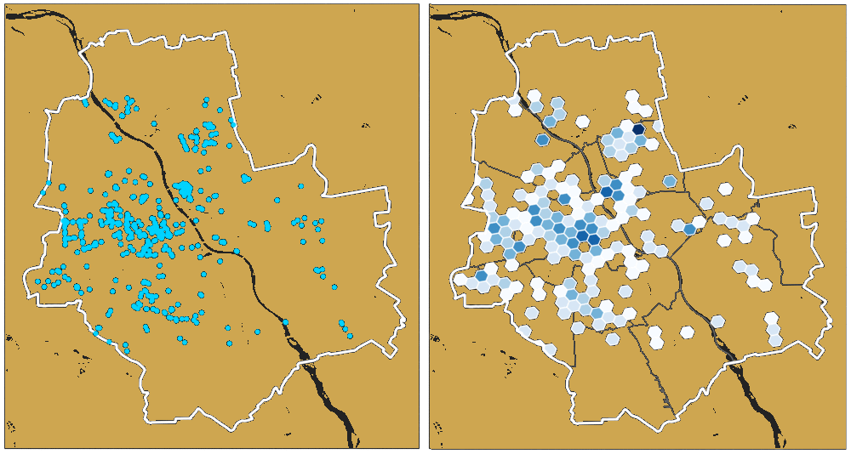
Geospatial Data Security Concerns
Anonymising - meant for untrusted users where only the spatial patterns are revealed - Geomasking transforms coordinates - Binning aggregates points
Encryption protects the original data for trusted users, but it can still be tempered with
Notorisation is necessary to verify the originality of encrypted data – e.g., hash values.
Problems: both the encrypted data and the hash value can be replaced and, the need to accommodate different trust levels
Masking shifts the original locations
Binning aggregates locations
Notes:
A common approach to protecting geospatial data is through masking.
There are several geomasking techniques.
Halo masking, for instance, shifts the original locations to random location and degree.
The user can provide the minimum and maximum distance
Similarly, binning aggregates data. Hexagonal binning for instance shows the density of points within hexagons on a grid
These techniques are useful for giving users an approximate idea of the location.
This is useful for sharing datasets between untrusted individuals, such as when reporting crime locations in news reports.
But what about the need to share the original dataset. Encryption can be used for protection, but how can we be sure that the encrypted data has not been tampered with or replaced.
A cryptographic hash function can be used to compare the before and after hash value of the data.
However, both the encrypted data and the hash value can be replaced
Moreover there is a need to accommodate different trust levels

Slide 4
MapSafe.xyz Architecture
Jane, needs to safely transmit newfound oil drill sites in North Coromandel
Bill, the CEO based overseas
who needs to view the drill sites
These functions run client-side in the browser meaning geospatial data never leaves the computer unprotected
Notes:
We propose the MapSafe tool that offers a complete solution to geospatial data sovereignty.
The geomasking, encryption and notarisation implemented at the core – the browser.
This way all necessary sections are carried out in the browser and no data leaves the SDOs computer unprotected.
SDOs can keep the encrypted data on their computer or share it via the cloud.
Sovereign data parties can first verify the dataset, decrypt and then display the dataset.

Slide 5
First Step: Anonymisation - Geomasking
GeoMasking transforms coordinates without affecting spatial patterns for users who only need to view approximate locations.
Use the MaskMy.XYZ masking library
Jane can choose a min and max values to transform coordinates within a buffer.
Privacy Rating: Spuirll’s measure has been included to help determine best masking parameters.
Red dots are original locations while Blue ones are masked locations.
Notes:
The first step is obfuscation.
After Jane uploads the dataset, she can perform geomasking.
We use the Halo masking library offered via the maskmy.xyz tool.
Jane can choose the minimum and maximum masking boundaries.
In addition, determining if the chosen parameters are adequate, we have included Spuirlls measure.
This measure computes …

Slide 6
First Step: Anonymisation - Hexagonal Binning
Alternatively, Jane can use hexagonal binning to capture the density of drill site locations.
Uses Uber’s h3-js hexagonal-binning library
Binning resolution = the spatial resolution
Buffer Radius = the coverage
Balancing Utility and Privacy: Depending on the area, a resolution needs to be chosen to show some level of detail and buffer radius to cover the region.
Points are aggregated into Hexagons.
Notes:
An alternative to geomasking, Jane can perform hexagonal binning.
The Uber’s h3-js hexagonal binning library is used.
To balance utility and privacy, binning resolution and buffer radius allows Jane to specify the resolution and coverage

Slide 7
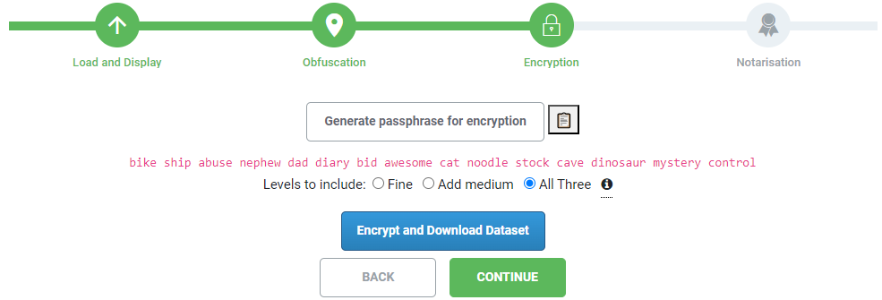
Second Step: Multi-Level Encryption
Each level is encrypted inside the previous one using a shorter passphrase
Can choose levels to include - Level 1 = [original] - Level 2 = [Level 1 + masked or binned] - Level 3 = [Level 2 + more masked or binned]
Generate random 15-term passphrase
Jane has the option to encrypt one, two, or three levels.
Jane can share the encrypted volume by herself or from the cloud controlling access via varied lengths of main passphrase.
Notes:
After obfuscated dataset is then encrypted in a nested manner.
There are three levels, the innermost has the original, the middle has the masked or binned dataset.
The outer level contains the more masked or more binned layer. Basically, they are using double the user provided parameters.
The encryption uses 5 terms to encrypt the outer layer, 10 for the middle layer, and 15 for the inner level.

Slide 8
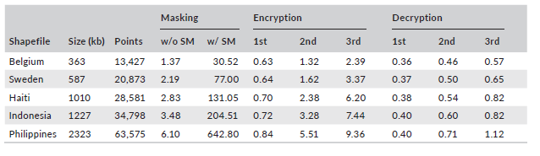
Browser based Encryption-Decryption performance
Masking and Encryption times increase with the number of points and file size respectively.
Spuirll’s measure takes time. Without it, masking is fast.
For triple encryption, an average of 6 sec per MB – while decryption is 0.8 sec per MB.
Times are fast and practical since sensitive datasets are unlikely to be huge in size.
Notes:
Masking times are .
Without the Spuirll’s measure,
Encryption times are exponential as they increase with the number of points and file size respectively.
They are exponential because each additional encrypted file is a larger encrypted file.
Nevertheless, these are reasonable times for practical use within web browsers.

Slide 9
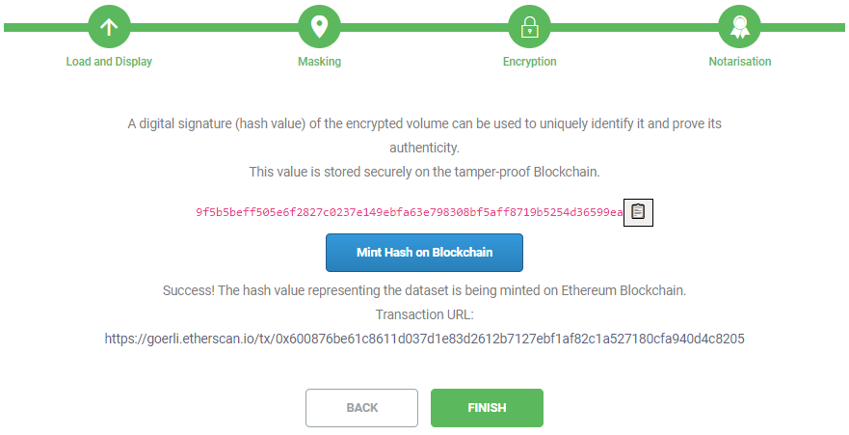
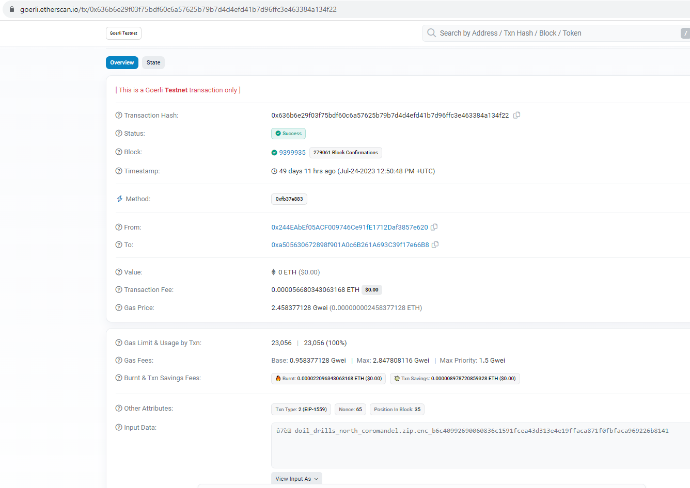
Final Step, Blockchain Notarisation
Finally, Jane can notarise the encrypted volume’s details on Ethereum blockchain.
MetaMask is needed to carry out the transaction,
The details will be minted under her Ethereum blockchain address.
Notes:
In the final step, Jane can encrypt the encrypted volume’s filename and the hash value is minted on the blockchain.
The SHA256 hash value is computed and appended to the filename.
Minting can take time depending on the queue, thus, once its sent for minting, the URL link will be shown to Jane.

Slide 10
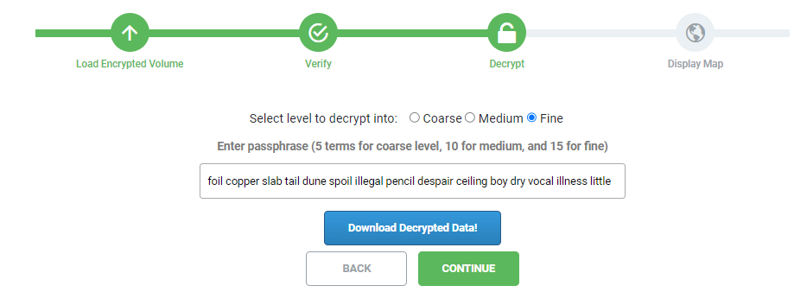
Verification and Display
This way, Bill can later verify the authenticity of the received encrypted volume.
Then decrypt and display the original dataset. Bill will be provided with the full passphrase, while other users would be given a shorter one.
Notes:
Since Bill will be sent the full 15 term passphrase, he can view the original dataset.
Bill can verify the authenticity of the encrypted volume before decrypting and displaying the dataset.
Other users with lesser privileges will view an obfuscated version of the dataset.
Mention about key transfer techniques.
Here you can see, once Bill loads the encrypted volume, its hash value is computed and he compare with that stored on the blockchain
Afterwards, he can provide the 15 term passphrase to decrypt to the most inner level

Slide 11
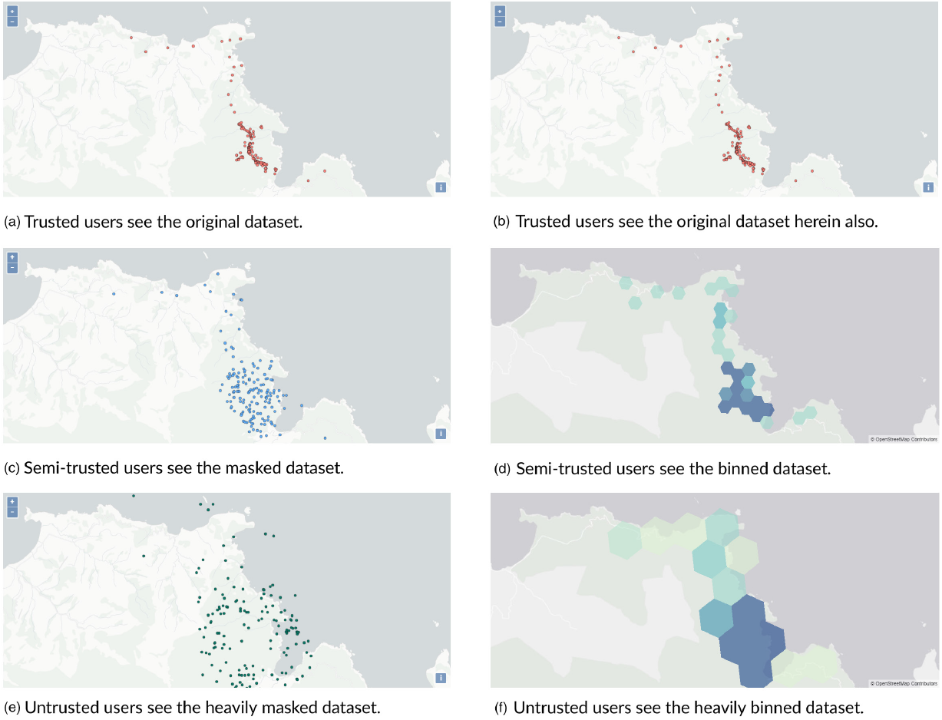
Verification and Display
Masked (left) or binned (right) datasets are displayed after verification. - Trusted users in both cases see the original (a) or (b), - semi-trusted see medium coarse (c) or (d), while - untrusted users see coarse dataset (e) or (f).
Notes:
Depending on their privileges, users will see a corresponding version of the dataset.
Bill will see the original dataset,
However, other users, with a lesser privileges will see an obfuscated version, ether masked or binned.

Slide 12
Full (3 minute) video of Reasons Miner Tool is on: https://youtu.be/nrB9Jk1OFXo

Slide 13
Full (3 minute) video of Reasons Miner Tool is on: https://youtu.be/nrB9Jk1OFXo

Slide 14
Summary
MapSafe furnishes security functions at the core – the web browser.
Geomasking alters coordinates preserving spatial patterns while Hexagonal binning discloses the densities of locations only
The original and obfuscated datasets are then encrypted on different trust levels.
a public record corresponding to this encrypted volume notarised on the blockchain furnishes a trustless approach to data sharing.
SDOs can govern geospatial data circulation, access, and use, fostering self-determination, data governance, and sovereignty
The tool aids compliance with data privacy laws and shields organizations from legal risks and fines.
Notes:
– providing a complete solution where no data leaves their computer unprotected
This final volume is shared with intended parties directly or through storage on the cloud.
- The tool can help organizations to comply with data privacy laws and regulations, and protect them from legal liability and fines.

Slide 15
Acknowledgements
The project was undertaken at the University of Auckland and was funded from the Ministry of Business, Innovation and Employment (Ngā Rākau Taketake – Myrtle Rust and Kauri Dieback Research, C09X1817).
We are also grateful to Dean Henderson, Cecilia Arienti, and Waitangi Wood for their guidance in this project.

Slide 16
Thank you
Questions

