Slide 1
Pacific Islands GIS and Remote Sensing User Conference 2024
THEME: ‘’Sustainable Management of Coastal Areas through remote sensing and GIS’’
Presenter: Johnny Tarry NIMAU
Snr. Monitoring and Evaluation Officer,
PARTneR II Country Liaison,
Vanuatu PGRSC Focal-Point
Department of Climate Change, MOCC, Vanuatu
Notes:
Brief introduction on the Theme along with Vanuatu Context and align with the national priorities through the PARTneR II Project

Slide 2
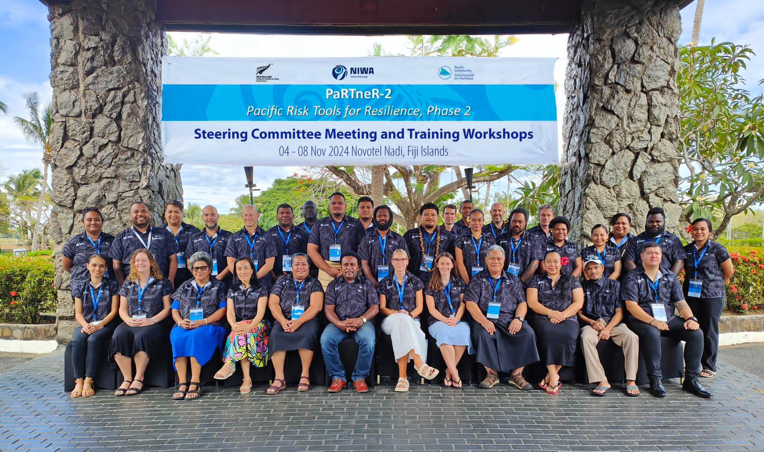
Hazard Exposure and Losses to Extreme Wave Levels Exacerbated by Climate-induced Sea-Level Rise in Vanuatu Islands Contexts
¹ National Institute of Water and Atmospheric Research Ltd Taihoro Nukurangi, Te Whanganui-a-Tara Wellington 6021, Aotearoa New Zealand
² The Pacific Community, SPC Geoscience Division, Suva, Fiji
³ Catalyst IT, Ōtautahi Christchurch 8011, Aotearoa New Zealand
⁴ Climate change and National Disaster Management Office, Ministry of Climate Change and Adaptation, Vanuatu
Johnny Nimau⁴, Rebecca Welsh¹, Ryan Paulik¹, Shaun Williams¹, Juli Ungaro¹, Cyprien Bosserelle¹, Rose Pearson¹, James Battersby¹, Luisa Hosse¹, Antonio Espejo², Tim Beale³, Herve Damlamian², Litea Biukoto², Judith Giblin², Thompson Auri², Kaliopate Tavola²
Notes:
Introduction to PARTneR II Project through Funding support from New Zealand –MFAT and Managed by NIWA and SPC in partnership with Vanuatu, Samoa, Cooks Island, Tonga, Tuvalu and RMI.

Slide 3
PARTneR-2 Project
Aim: Pacific Island Countries are more resilient to the impacts of climate change through risk-informed decision making.
Countries involved: Cook Islands, Republic of Marshall Islands, Samoa, Tonga, Tuvalu, Vanuatu

Slide 4
Sea Level Rise in Vanuatu
Expected to impact 25% – 50% of people in Vanuatu Islands.
SLR has risen 1.5mm per year in Vanuatu from 1900 to 2008 (almost 10cm).
Coupled with vertical land movement.

Slide 5
Step 1: Hazard Maps
 | PARTneR-2 Countries
ARI | MHWS, 5, 10, 25, 50, 100, 250
SLR | 0-2m in 10cm increments
Where? | Available on Nexus: https://nexus.pacificdata.org
Luganville, Vanuatu ARI100 from 0 – 2m

Slide 6
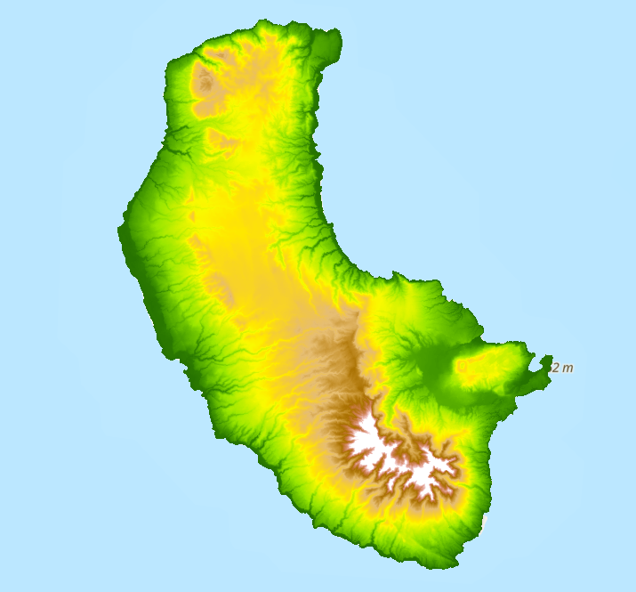
Digital Elevation Models
DEM: A digital representation of bare ground topography with trees, building and other ground cover excluded.
PARTneR-2 Countries
5m cell size. Down-sampled LiDAR and up-sampled FABDEM where LiDAR is not available.
Tanna, Vanuatu Digital Elevation Model

Slide 7
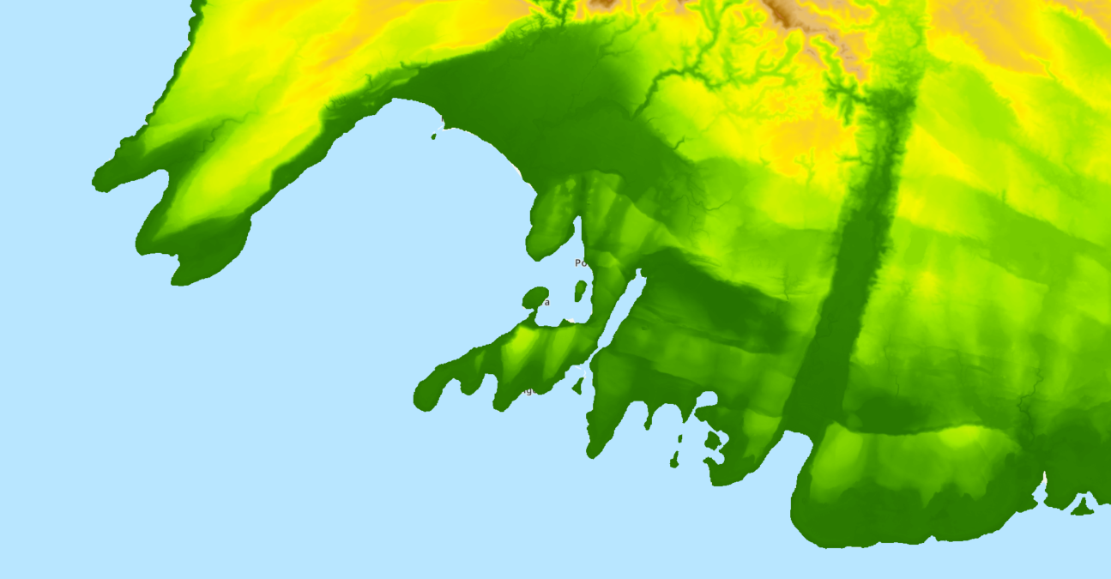
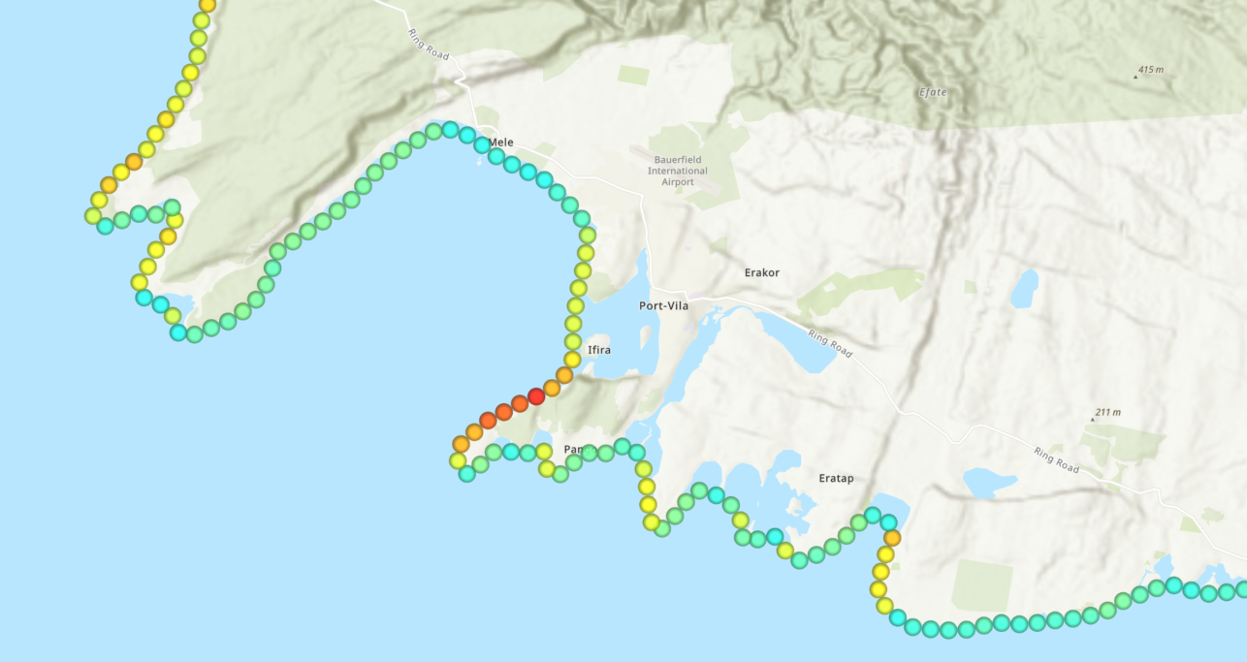
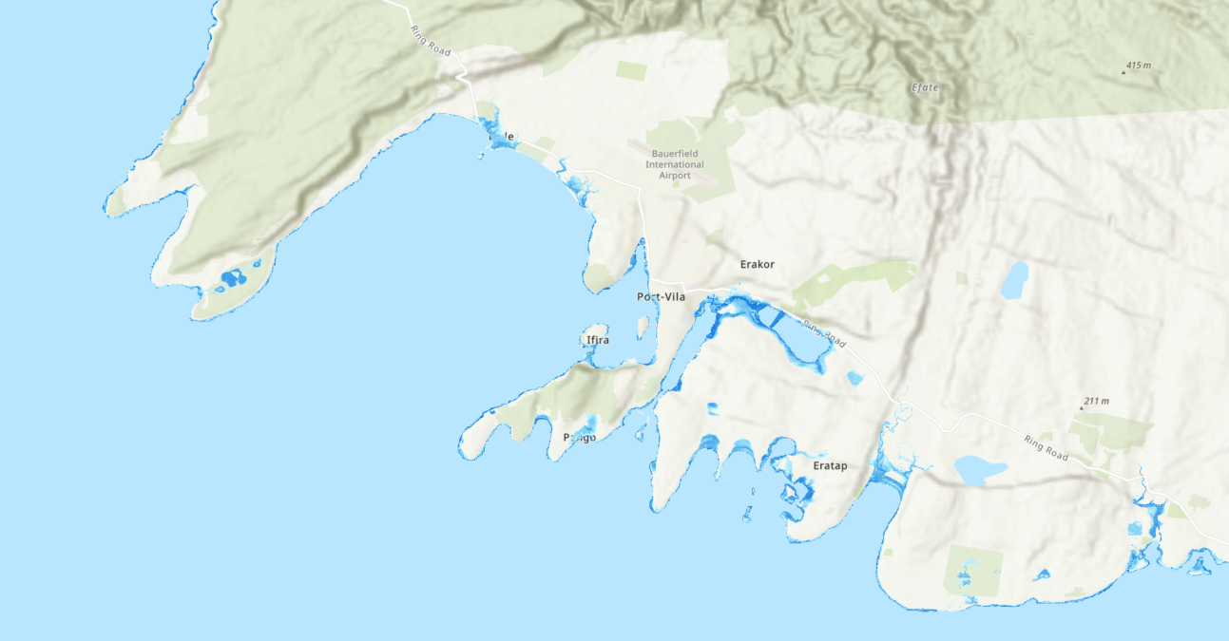
Bathtub Model Process
Digital Elevation Model
Total Water Levels
National SLR Maps
Port Vila, Vanuatu

Slide 8
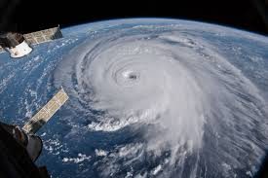
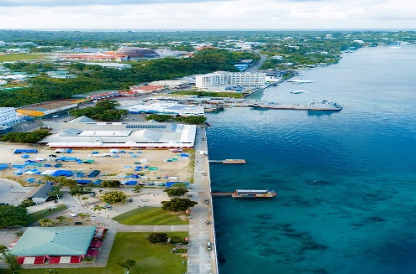
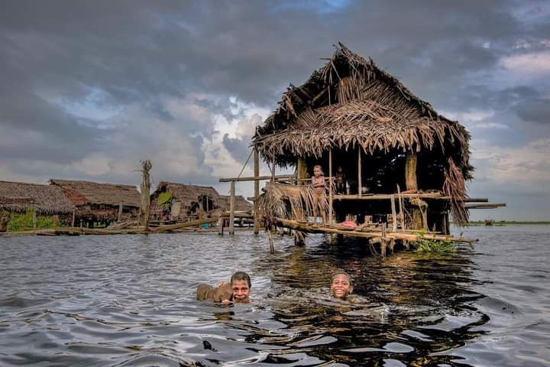
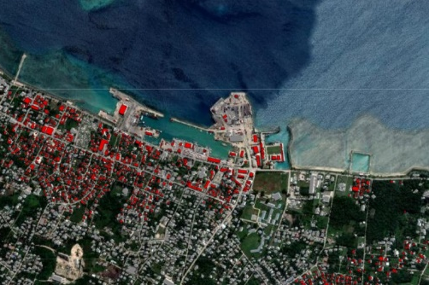
Risk Models
Hazard Information
Exposure Information
Vulnerability Models
Impacts
e.g. Flooding, Coastal Inundation, Wind, SLR, Drought
e.g. Buildings, People, Infrastructure, Crops
Calculate how the hazards impact the exposure layers
Tailored Maps, Tables, Reports, Dashboards

Slide 9
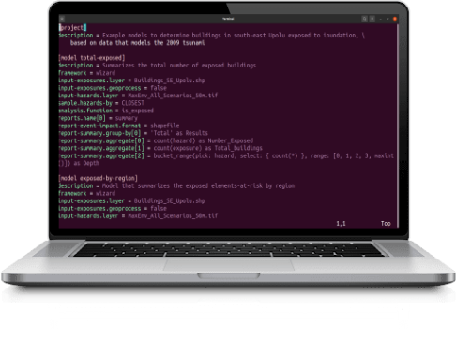
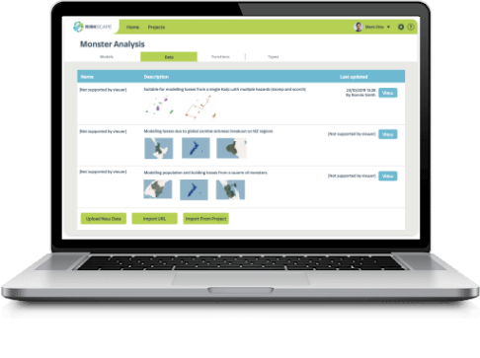
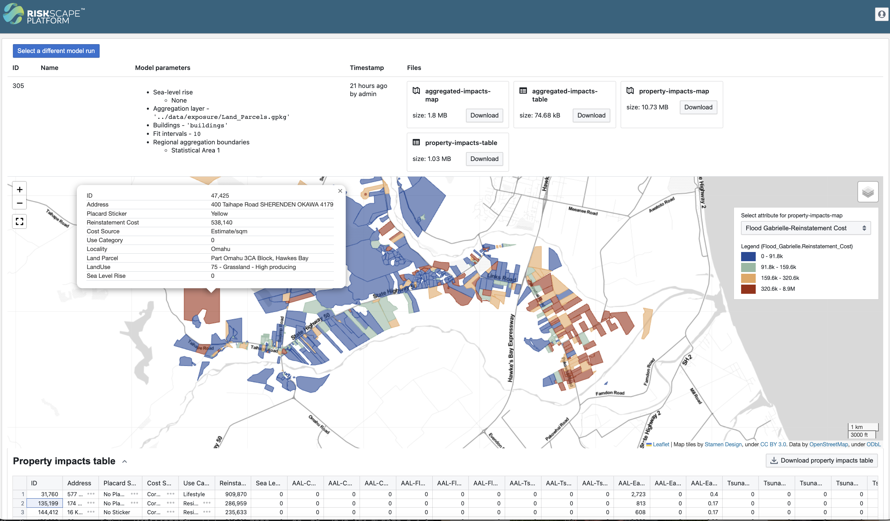
RiskScape
https://riskscape.org.nz/
Risk decision support tool.
Open-source spatial data processing application used for multi-hazard risk analysis.
Highly customisable from simple exposure models to computationally intensive probabilistic models.

Slide 10
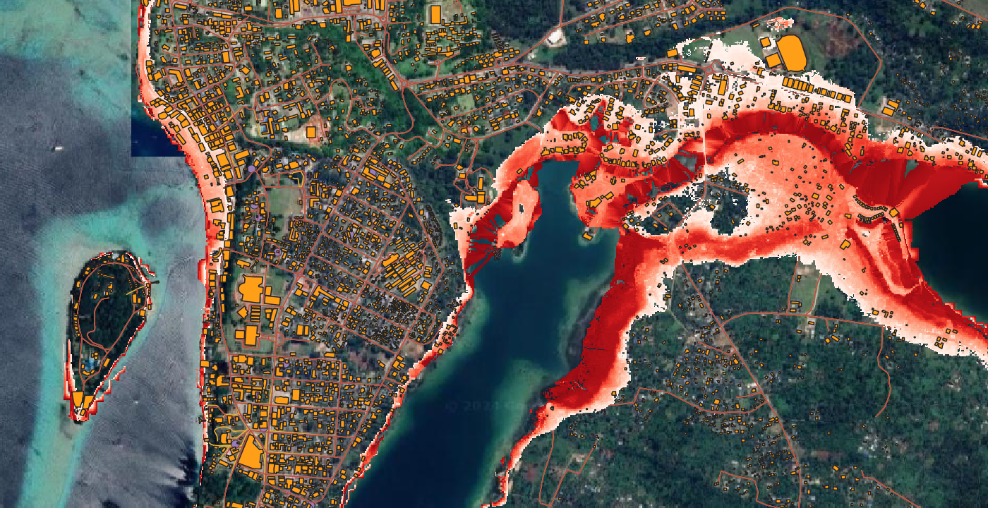
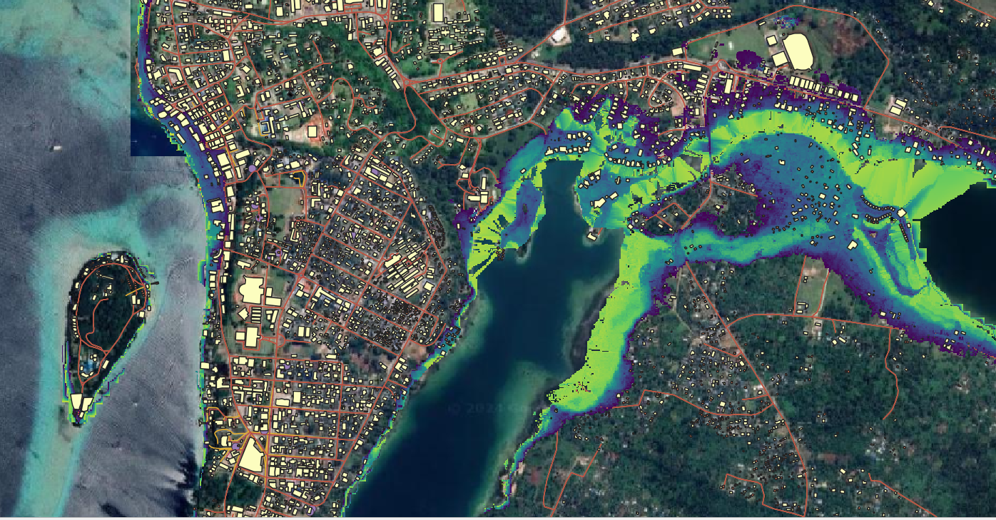
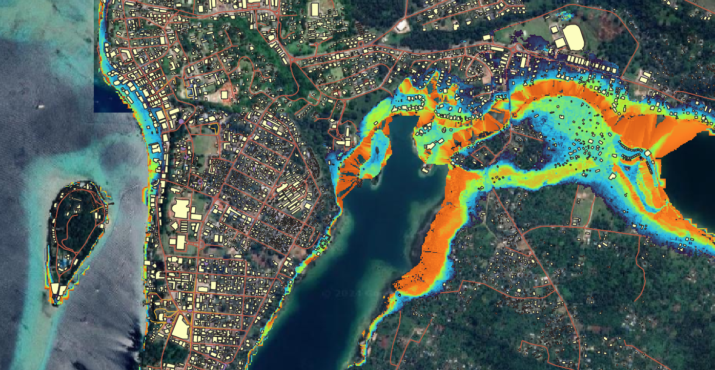
Port Vila FloodDepth 5 _1.0
Port Vila FloodDepth 10 _0.5
Port Vila FloodDepth 25_0.5
Port Vila FloodDepth 50 _0.5

Slide 11
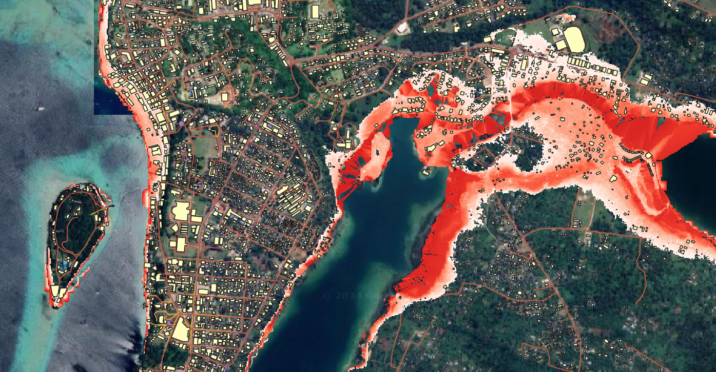
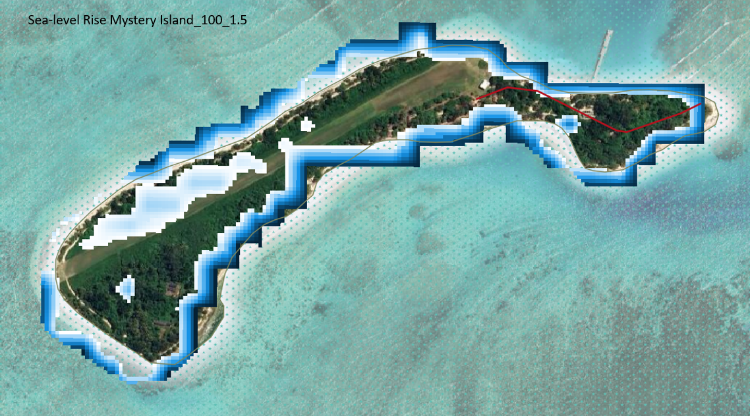
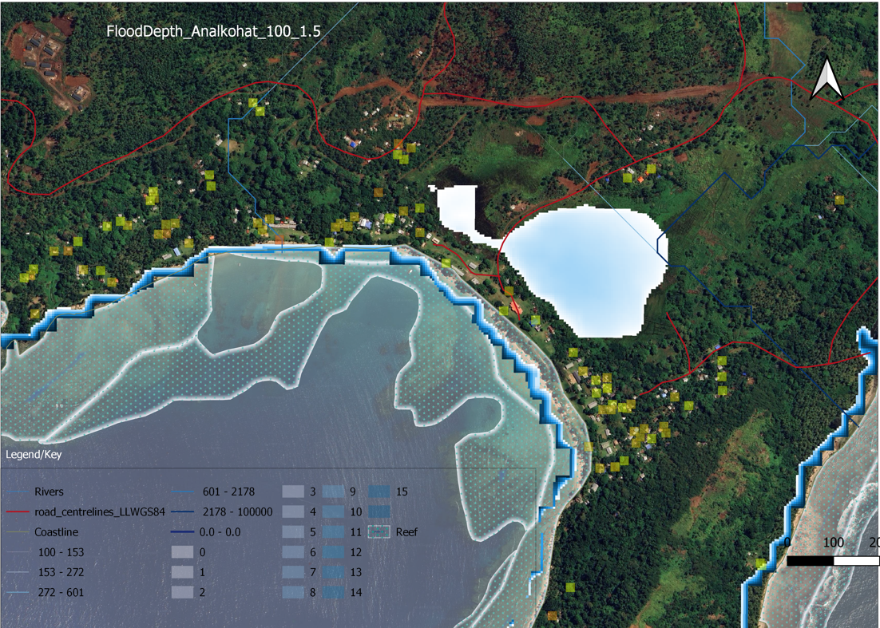
Port Vila FloodDepth 100 _0.5
Port Vila FloodDepth 250 _1.5

Slide 12
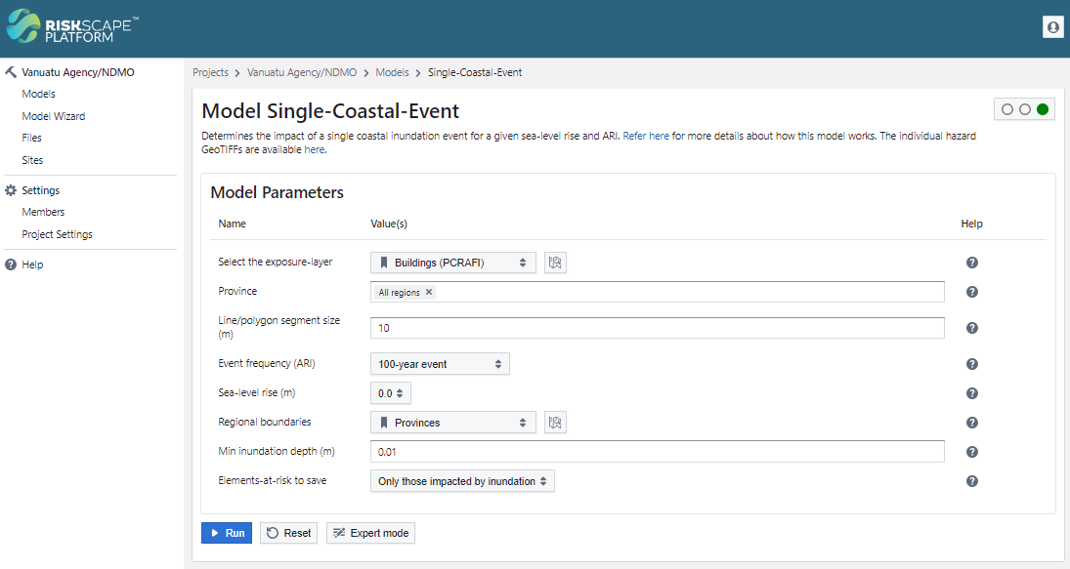
RiskScape Platform

Slide 13
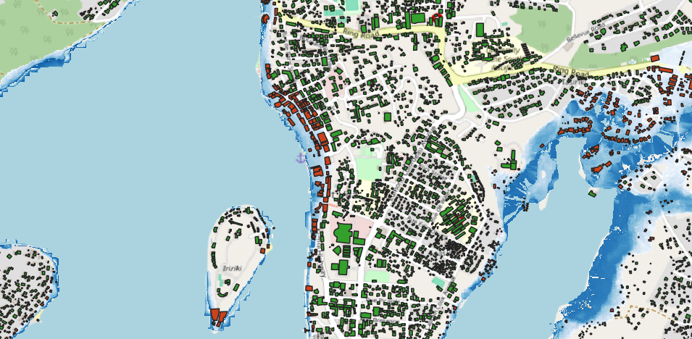
Exposure
Single-Event Model
The Single-Event Model calculates loss and exposure to a range of different assets e.g. buildings, population, crops, infrastructure, at an individual asset scale and aggregated to region and use type.
Loss
Vanuatu - ARI100 with 1.0m SLR
Zoomed in to part of Port Vila, Vanuatu - ARI100 with 1.0m SLR

Slide 14
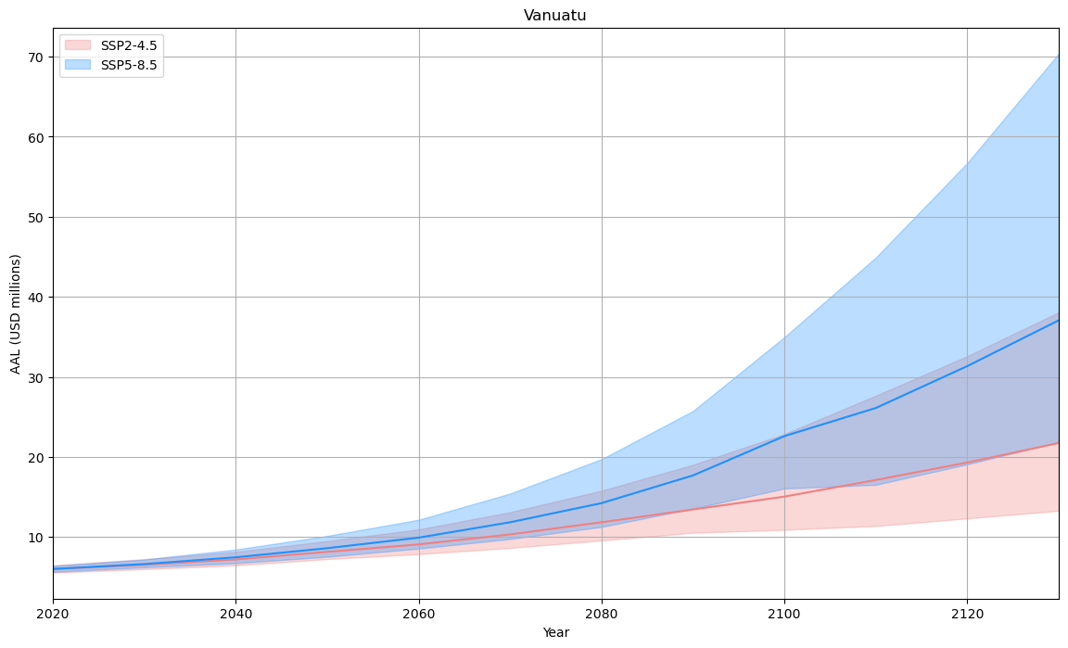
Average Annualised Loss
Average Annualised Loss (AAL): Expected loss per year, averaged over many years. It is rough measure of the ‘riskiness’ of a set of exposures.

Slide 15
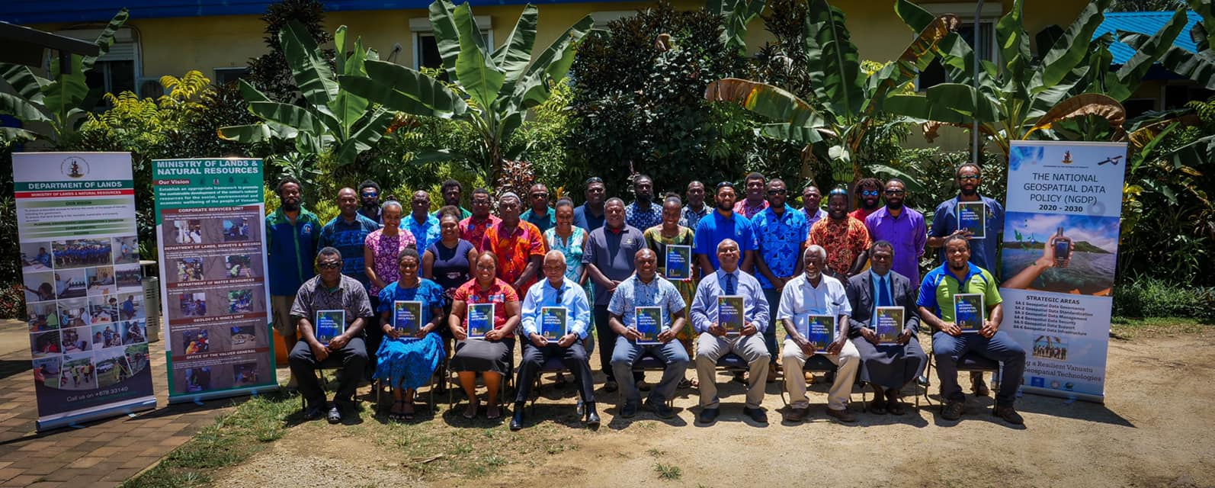
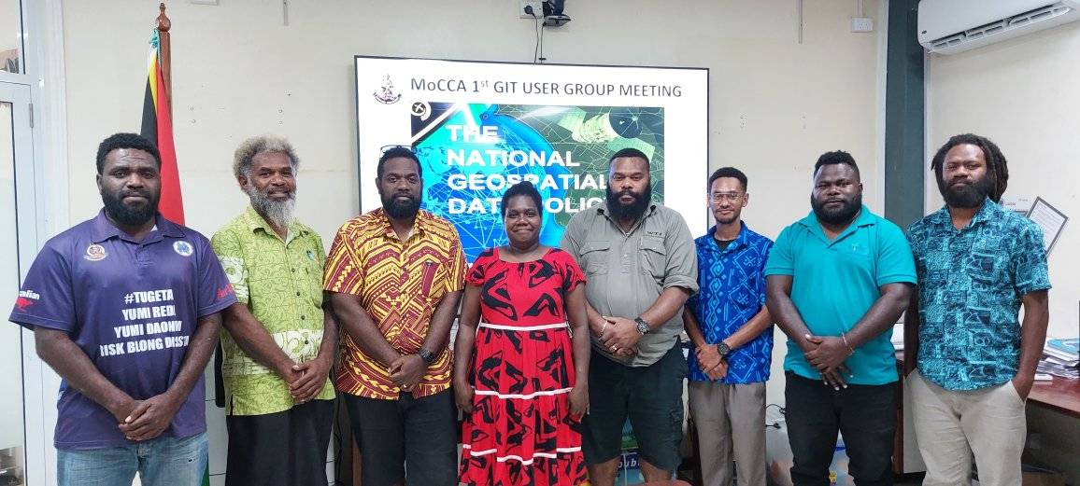
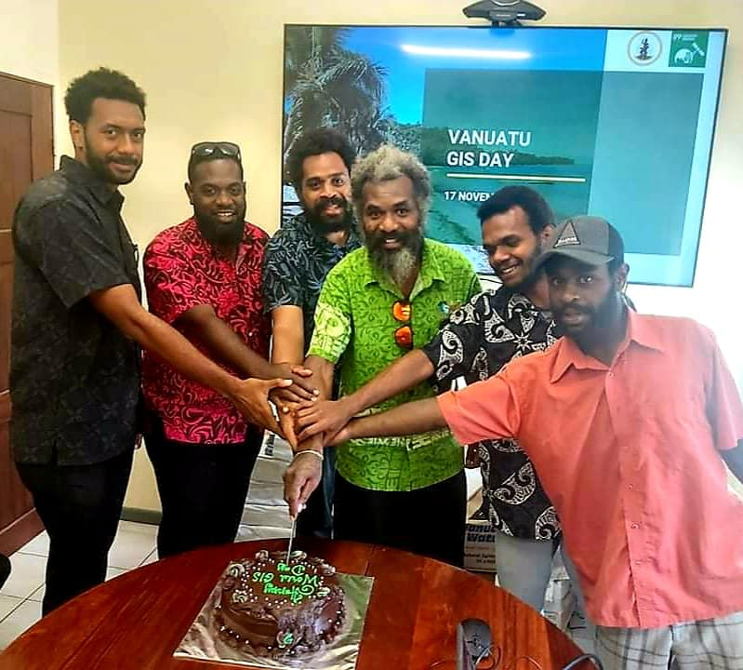
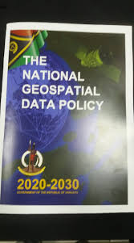
Vanuatu GIS Users
MOCC GIS Users
National GIS User group

Slide 16
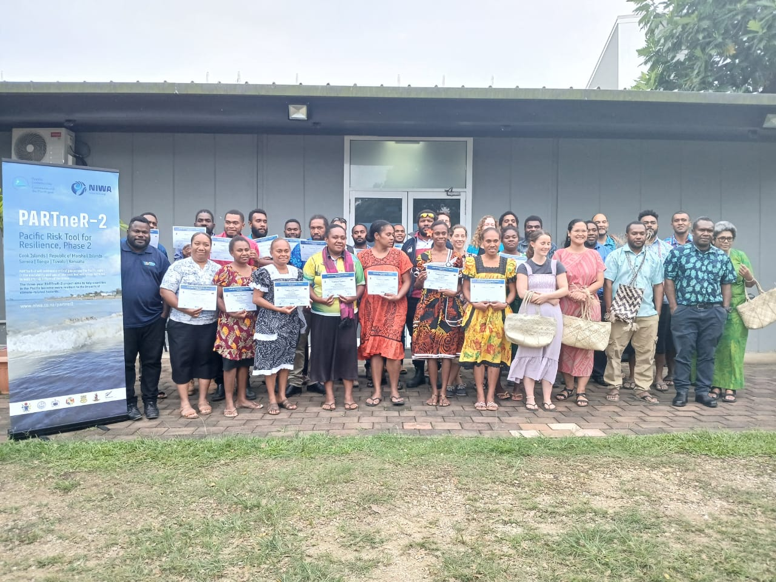
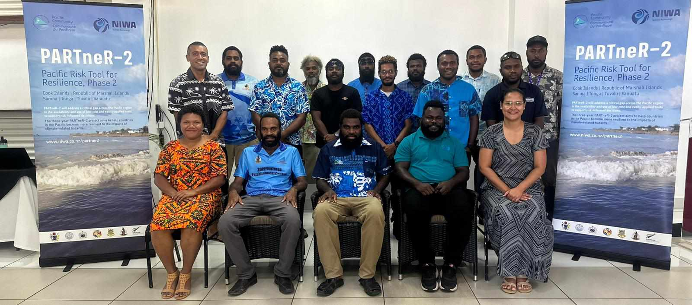
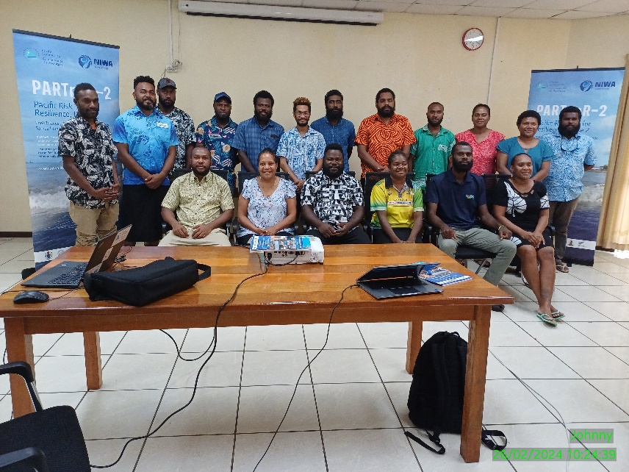
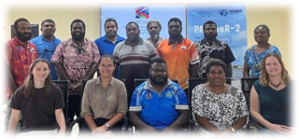
Capacity Building- GIS initiatives

Slide 17
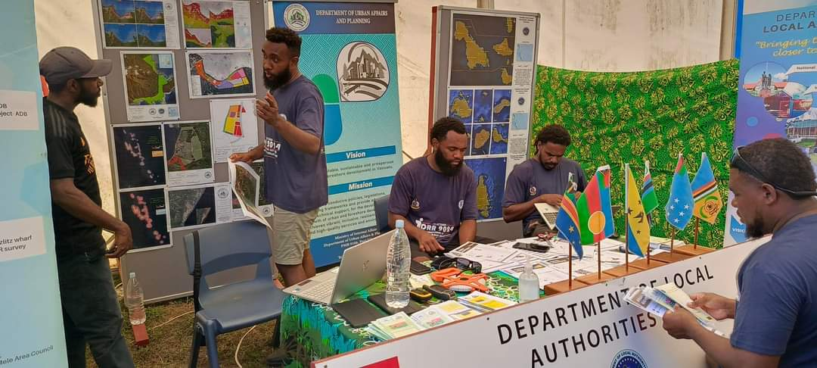
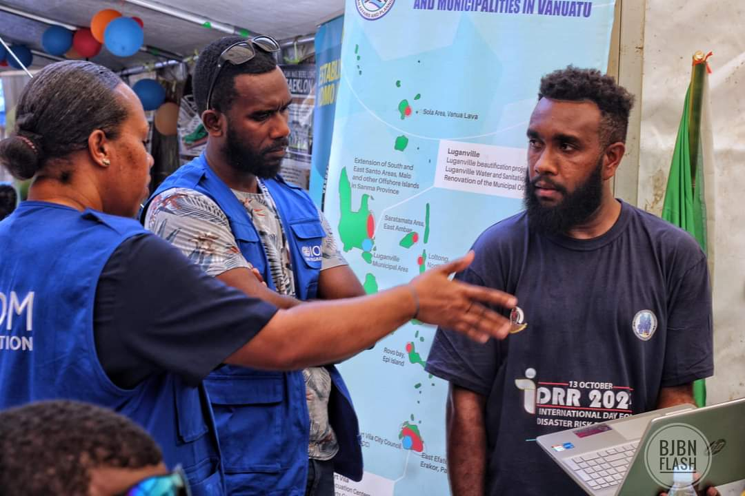
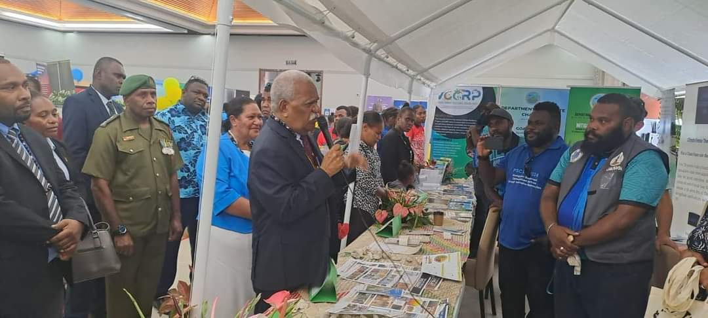
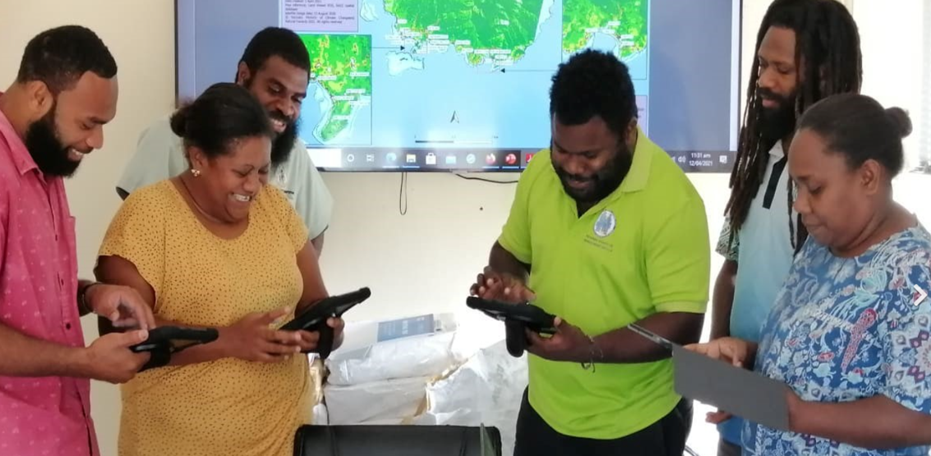
GIS Products developed to inform decision making, Plannings, Preparedness, Response, Recovery
Notes:
Challenges encountered: Lack of resources, capacity building, data collection/sharing, and capital to ran the GIS show

Slide 18
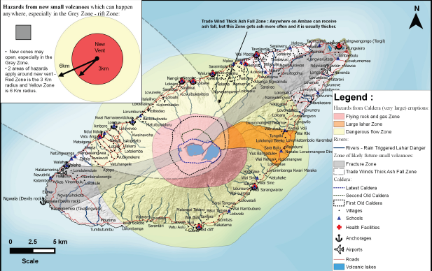
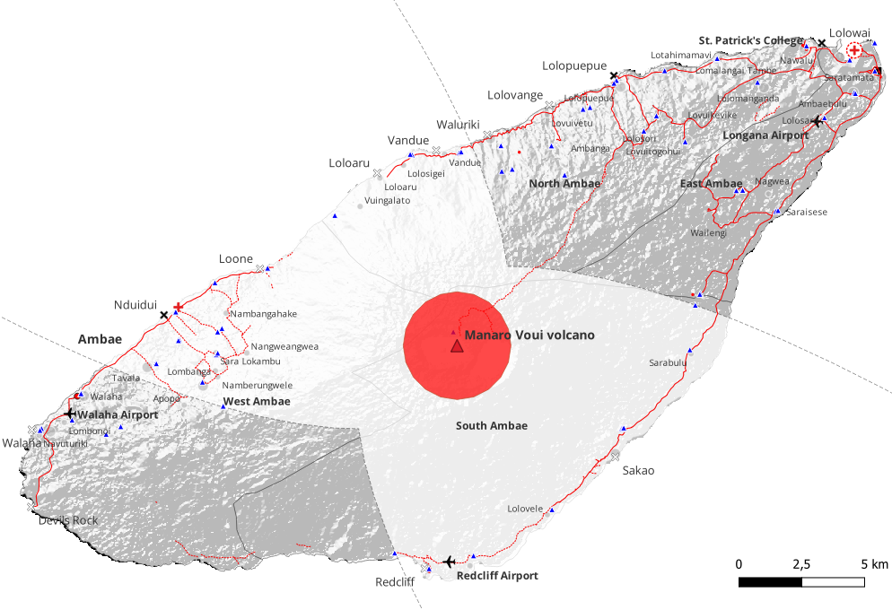
Manaro Volcano Exposure Map
Volcano Hazards and Evacuation Route

Slide 19
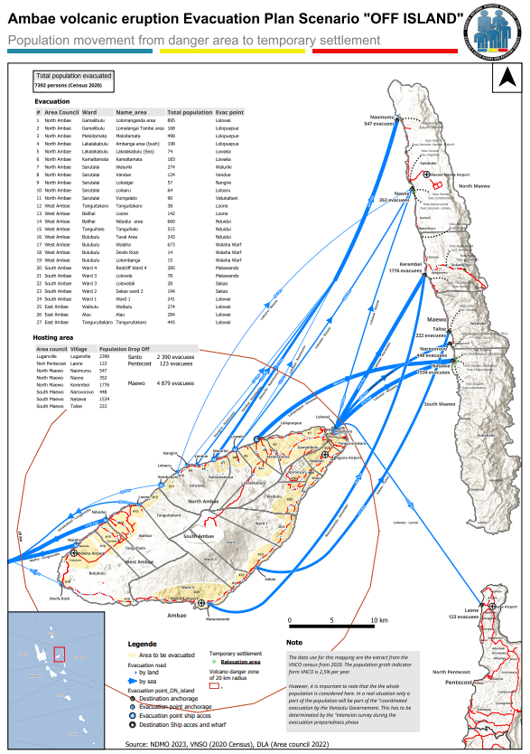

Slide 20
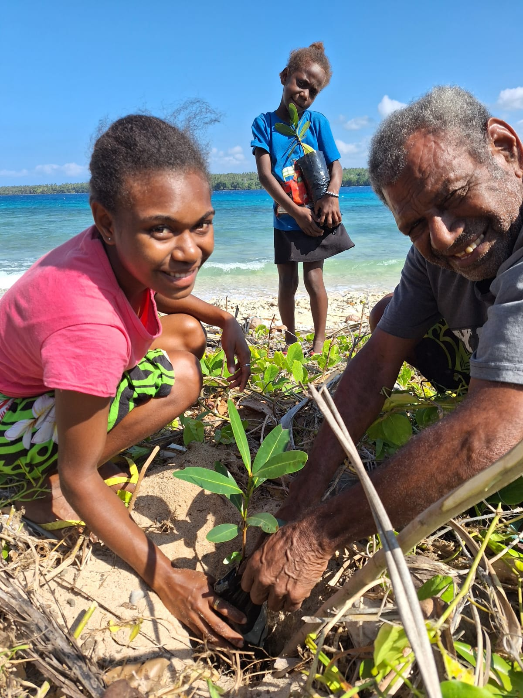
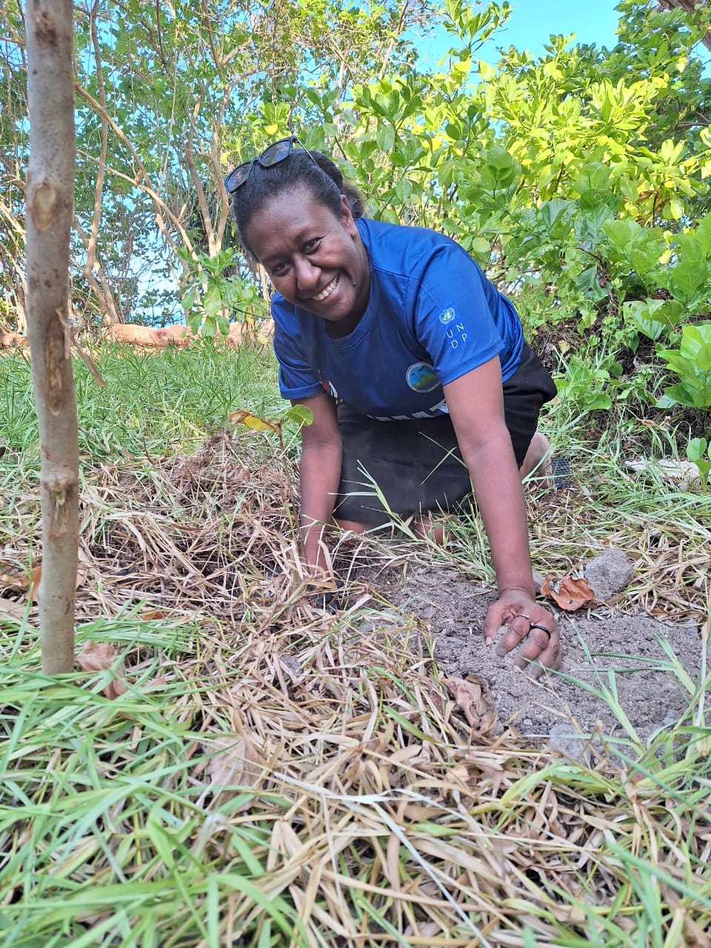
Coastal Rehabilitation: Mitigation and Adaptation Best Practices
Notes:
Challenges include a lack of resources, capacity building, data collection/sharing, and Capital to act on the risk-informed information.

Slide 21
Tangkiu tumas
Contact: johnie@vanuatu.gov.vu

