Slide 1
Whanganui GeoSpatial Stack
Implementing Open Source GIS Solutions
at Whanganui District Council

Slide 2
About Whanganui
Whanganui District is located on the west coast of the North Island of New Zealand.
The Whanganui River is New Zealand's longest navigable river, stretching for 290km from the slopes of Mount Tongariro to the Tasman Sea
Most of Whanganui's population (48,700 and growing) lives in the central urban area at the mouth of the Whanganui River
Whanganui > Wellington = 195km by road (2.5 hours)
Whanganui > Auckland = 444km by road (5.5 hours)

Slide 3
GIS Team
Simon Nitz
GIS Lead
GIS Administration
GIS Development
GIS Data Management
Darryl Couper
GIS Officer
GIS Customer Service
GIS Data Management
G

Slide 4
FOSS4G is part of our GIS Strategy
“Council is actively pursuing an open source first policy for GIS applications and software”

Slide 5
Open Source GIS

Slide 6
Why Open Source GIS?
Flexible licensing with no vendor lock in
Development driven by community worldwide, not vendor marketing department
Agile technology adoption and quicker innovation
Reliable with faster maintenance and bug fixing
Uses open standards accessible to everyone
Successful projects enforce teamwork rules and strictly review change – no cowboys!

Slide 7
Why Not Vendor GIS
Vendor marketing determines way forward
Do it vendors way not our way
Restrictive Licensing
Number of users determined by $$$
Innovation much slower
Bug fixes much slower
Vendor standards are not necessarily open standards
Opinion's expressed above are based on my own experiences!

Slide 8
Open Source Licensing
In general Open Source Licensing…
provides royalty free (re)use of software
has no licenses costs
guarantees access to the source code
enables the source code to be audited and modified
allows redistribution of the software with no additional costs

Slide 9
Whanganui GeoSpatial Stack

Slide 10
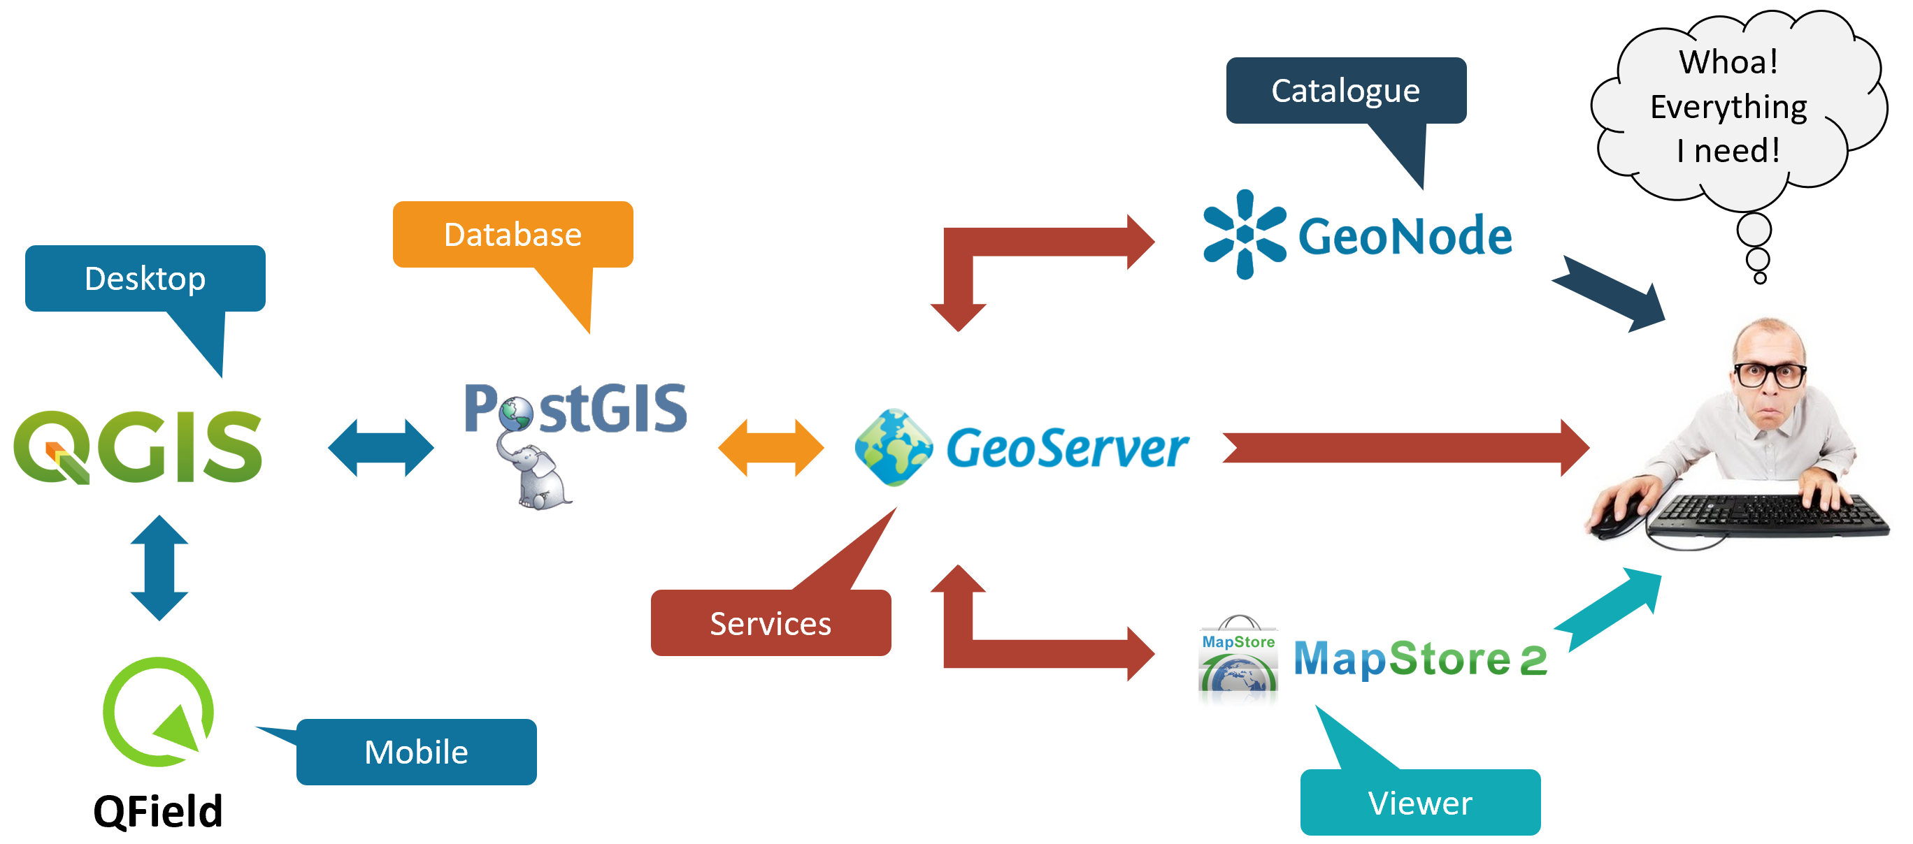
GIS Stack

Slide 11
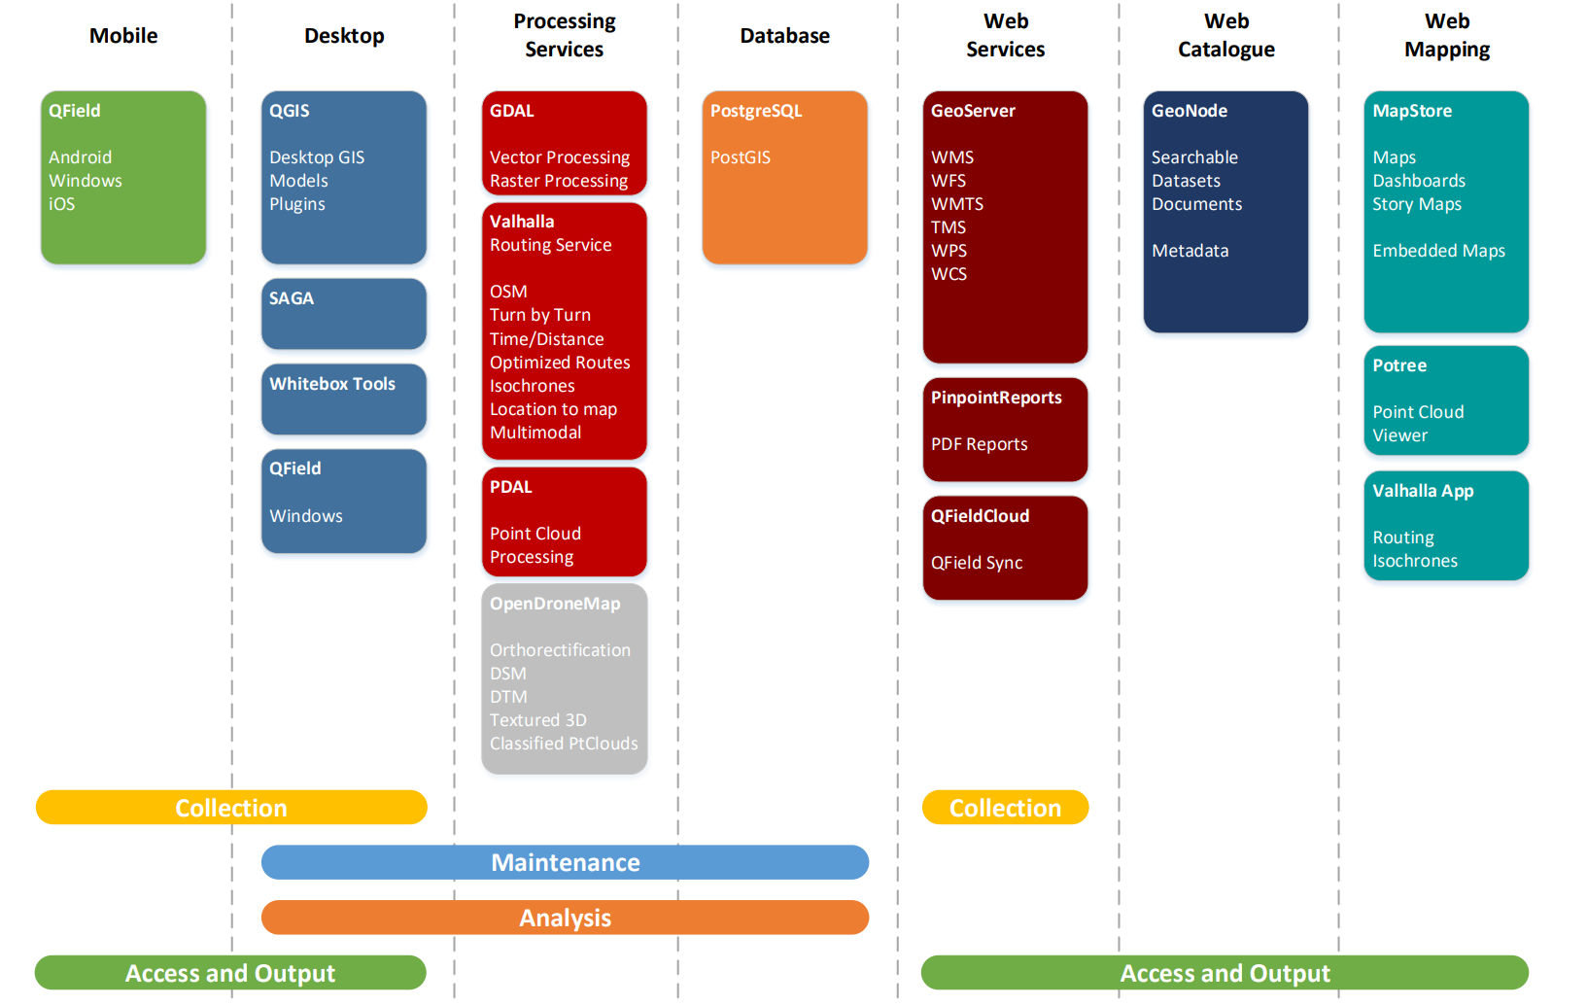
GIS Stack

Slide 12
Stack Solutions Maturity
Approx. Project Age
Contributors*
11 years
108
13 years
249
21 years
309
22 years
66
21 years
482
* Figures from project GitHub repositories 03/02/2023

Slide 13
Comparative Vendor Solutions
ArcGIS Apps, Web AppBuilder for ArcGIS, LocalMaps, IntraMaps,…
Viewer
Catalogue
ArcGIS Online, ArcGIS Open Data
Services
ArcGIS Enterprise, Apollo
Database
ArcGIS Enterprise, ArcSDE
Desktop
ArcGIS Pro, MapInfo Pro, Hexagon
Mobile
QField
ArcGIS Collector, Survey 123, GBM Konnect…

Slide 14
Benefits to Council
Significant Recurring Cost Savings
Zero annual software license fees
Greater Functionality
New functionality driven by community
Improved Service Levels
No loss of Integration
Property and Rating System
Asset Management System
Document Management System
ePlan Integration

Slide 15
A closer look

Slide 16
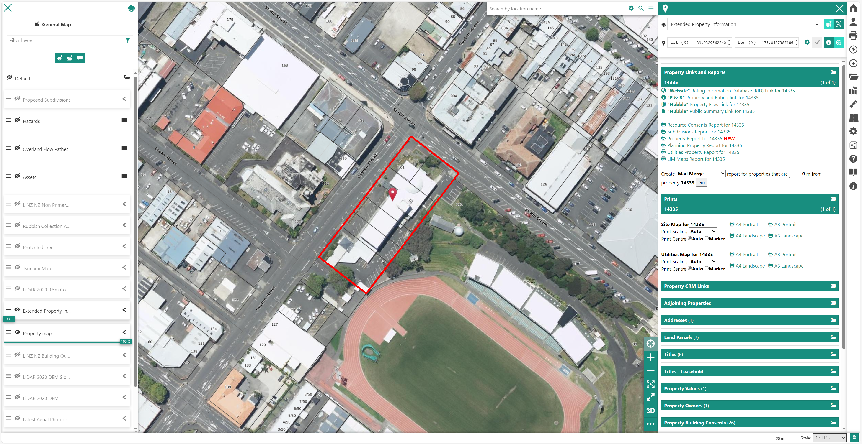
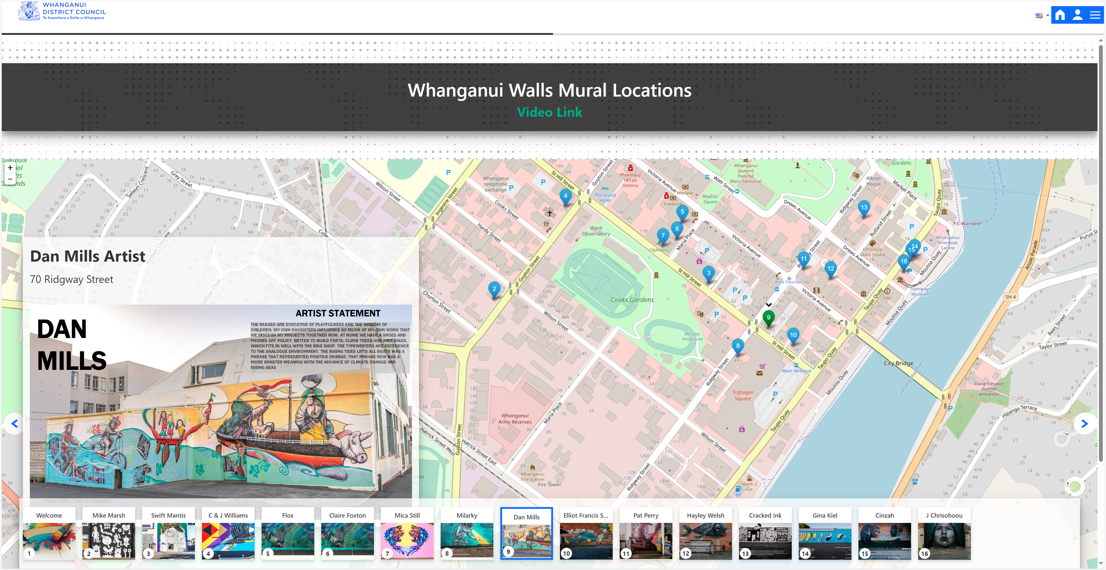
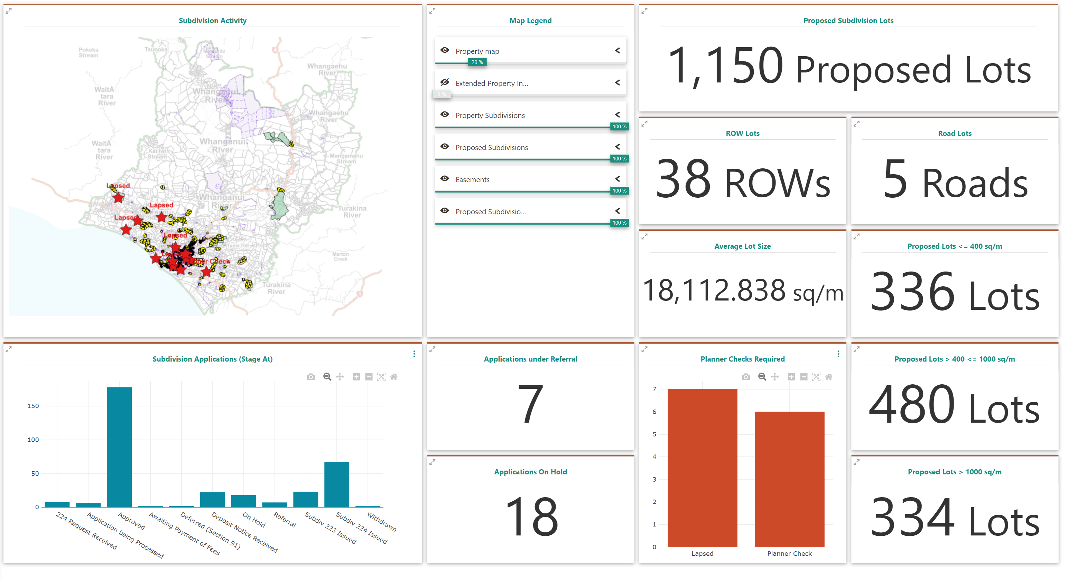
Web Mapping
Maps
Geo Stories
Dashboards

Slide 17
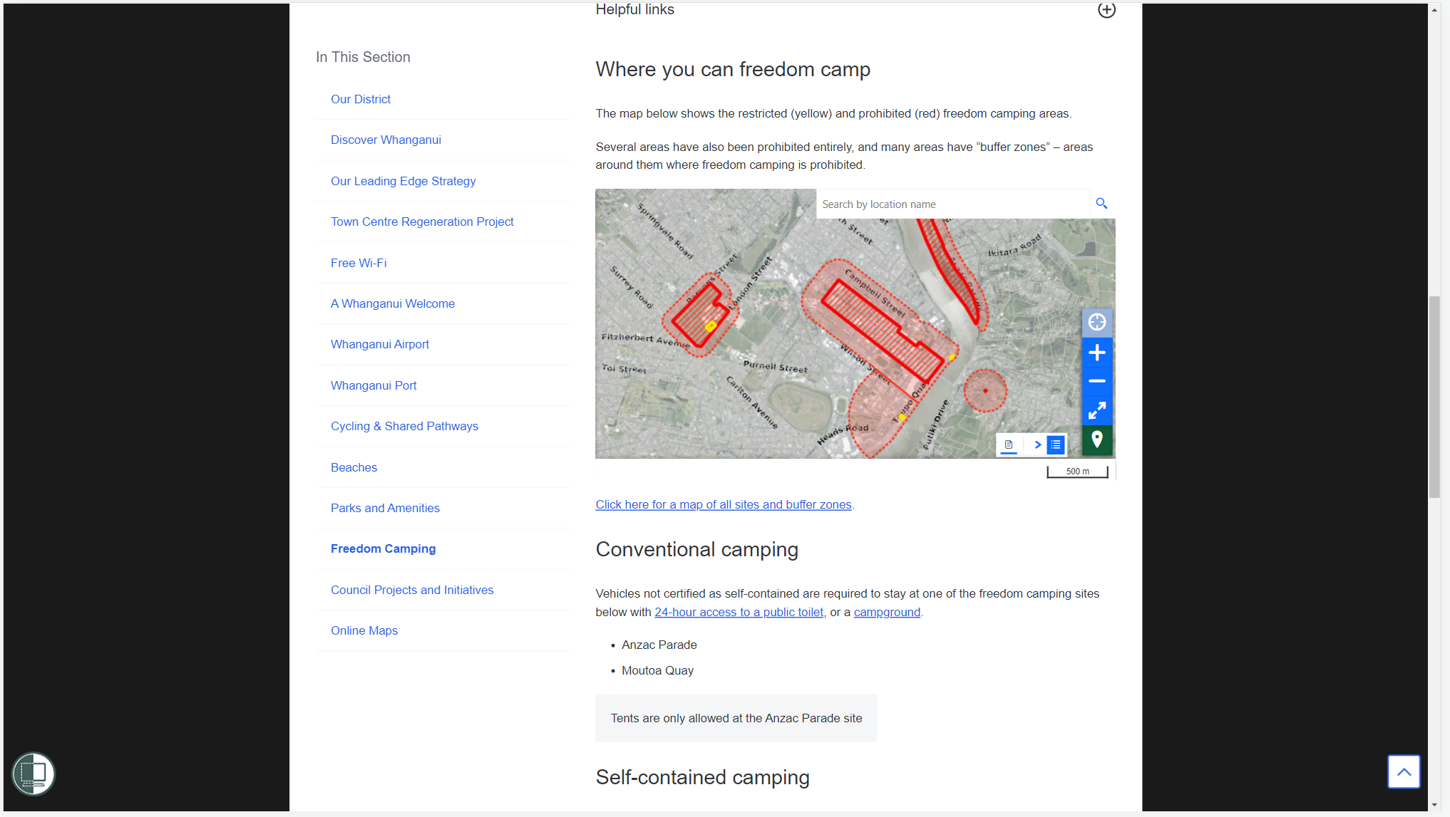
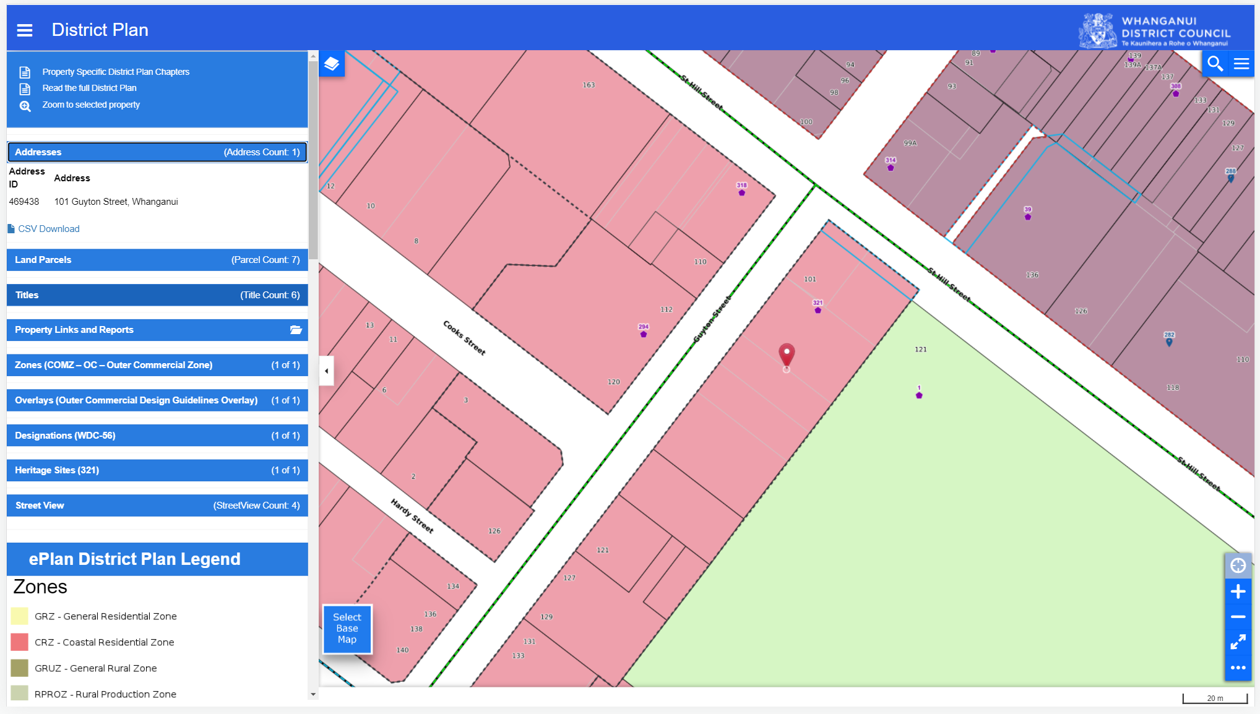
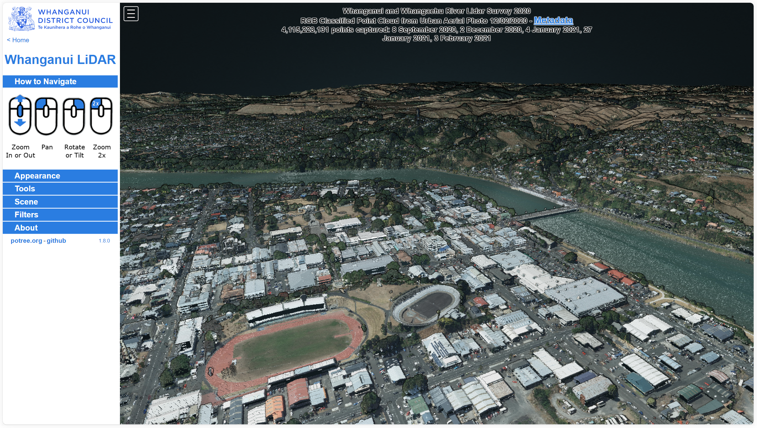
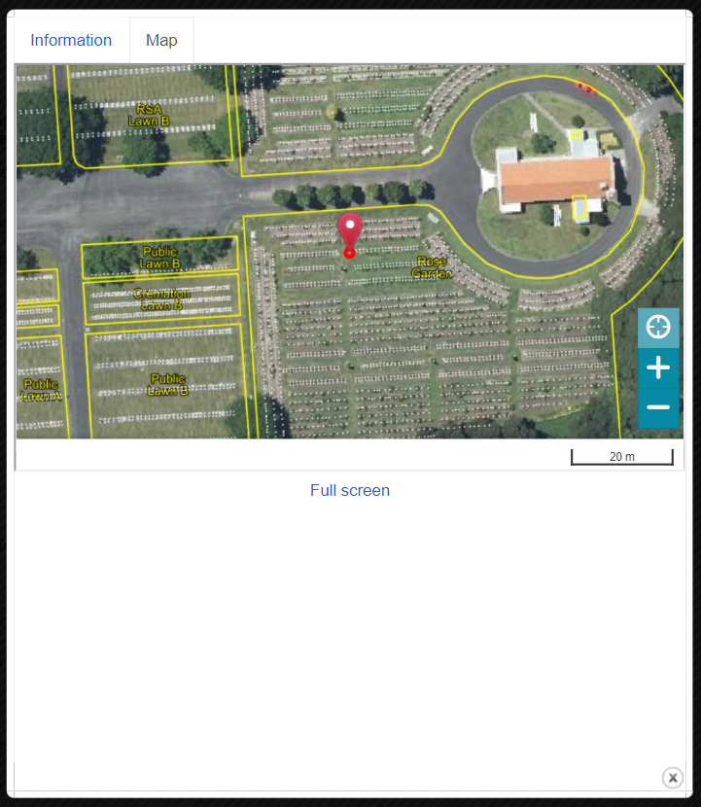
Web Mapping
Embedded Maps
ePlan
District Plan
Integration
LiDAR

Slide 18
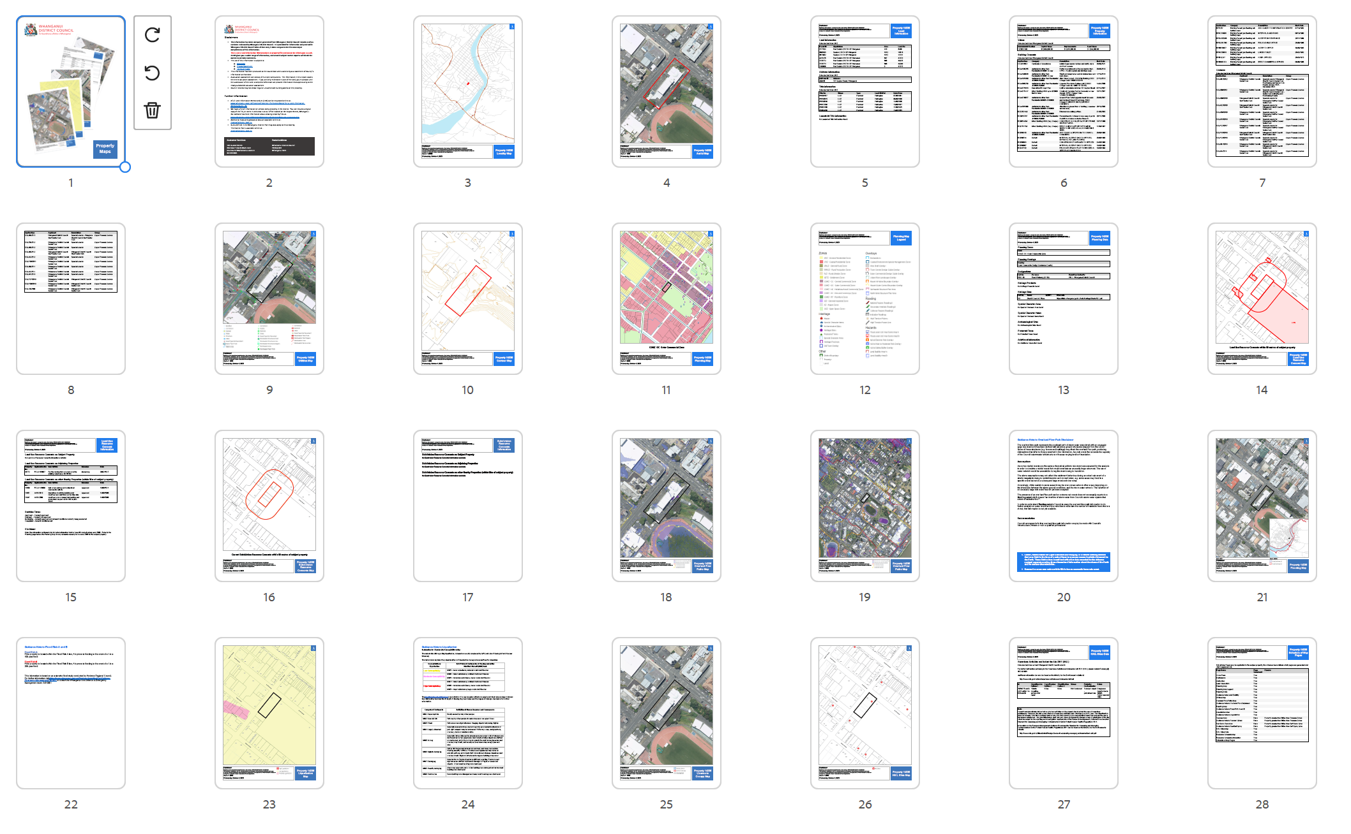
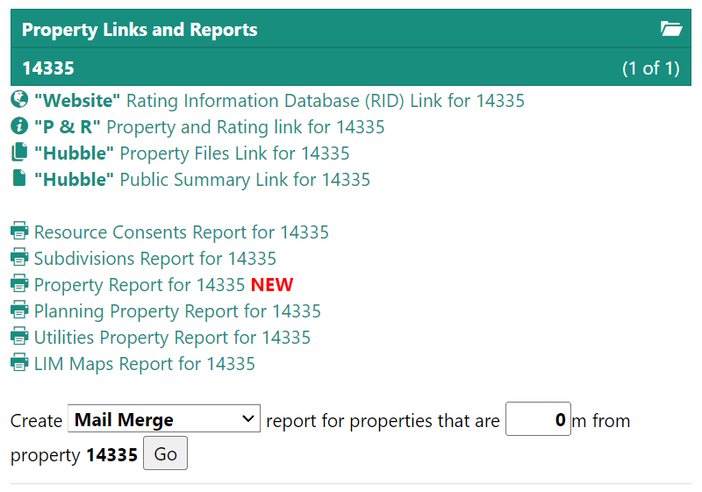
Web Mapping
One Click
Comprehensive
Reports

Slide 19
Still haven’t Spent any Money on Licensing

Slide 20
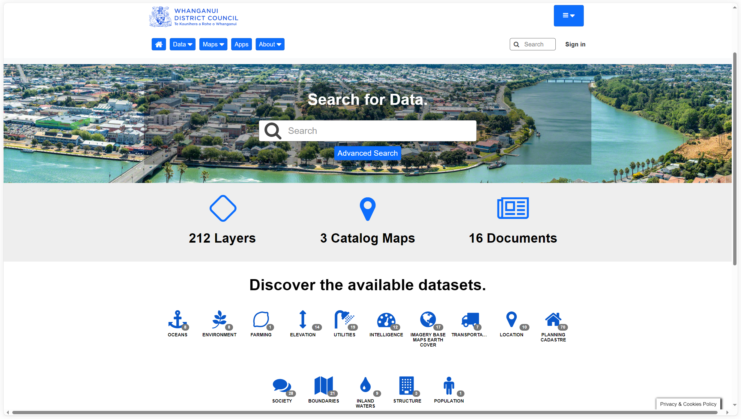
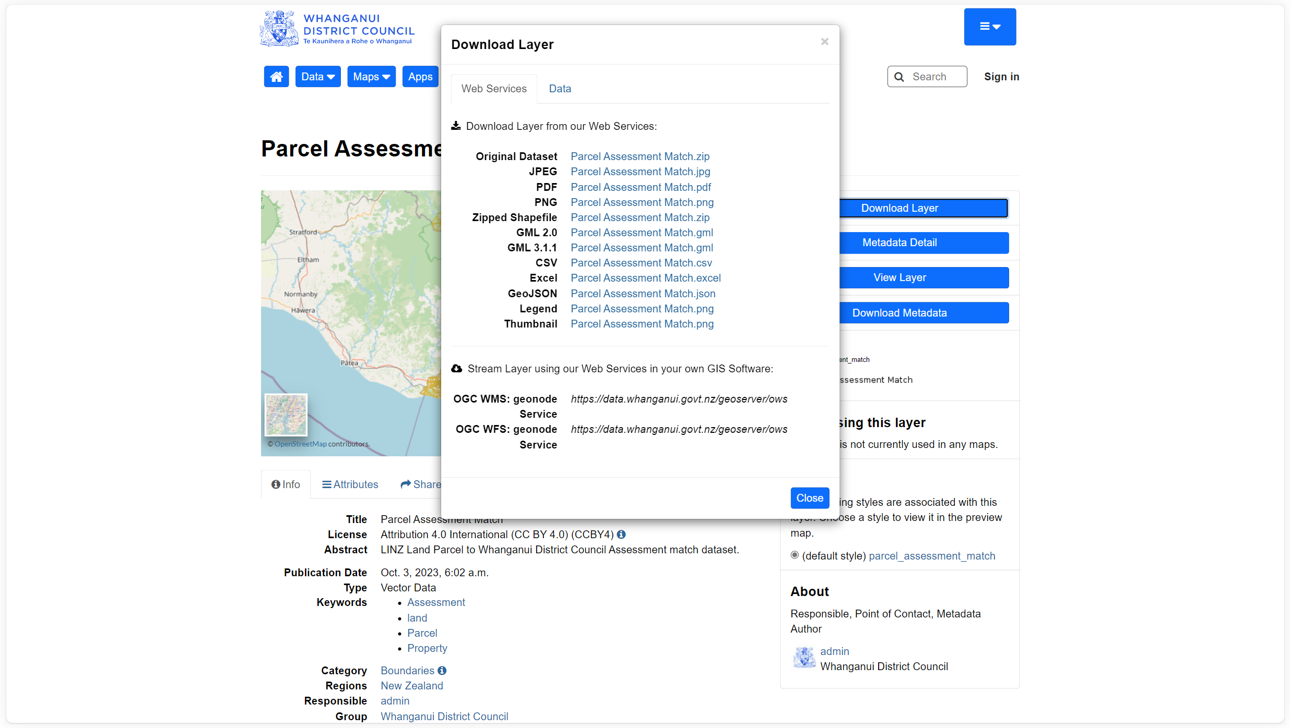
Web Catalogue
Metadata and Downloads
Searchable

Slide 21
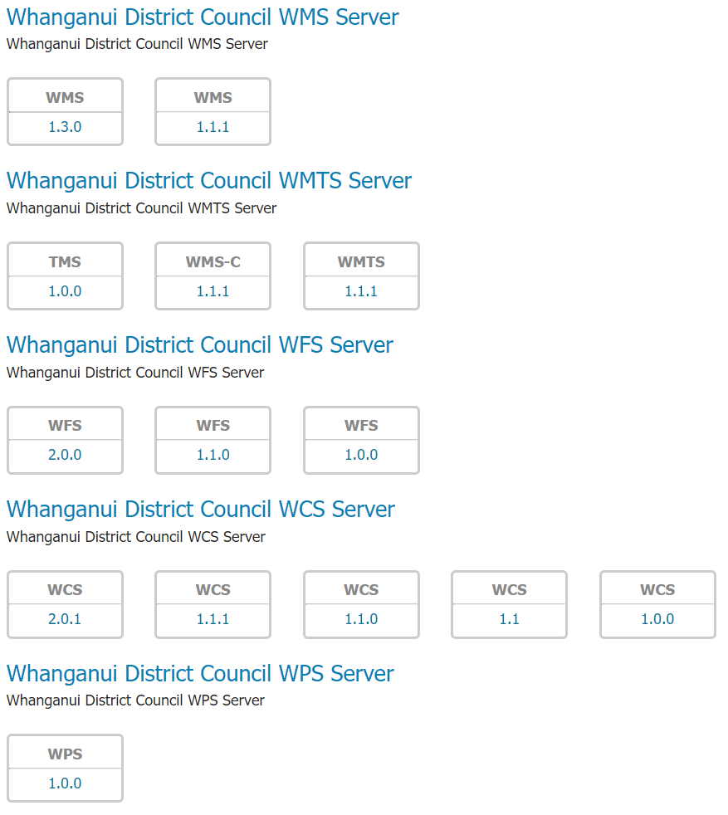
Web Services
GeoServer
for a
data centric approach
OGC Compliant
Web Services

Slide 22
Still haven’t Spent any Money on Licensing

Slide 23
Database
Unsurpassed
Spatial Functions
One source of truth
Centralised
Data Management
Pre-process Data
Stored Procedures

Slide 24
Processing
LINZ Data Service
Processing
Routing
and
Isochrones
Aerial Photo
Processing
LiDAR
Processing

Slide 25
Still haven’t Spent any Money on Licensing

Slide 26
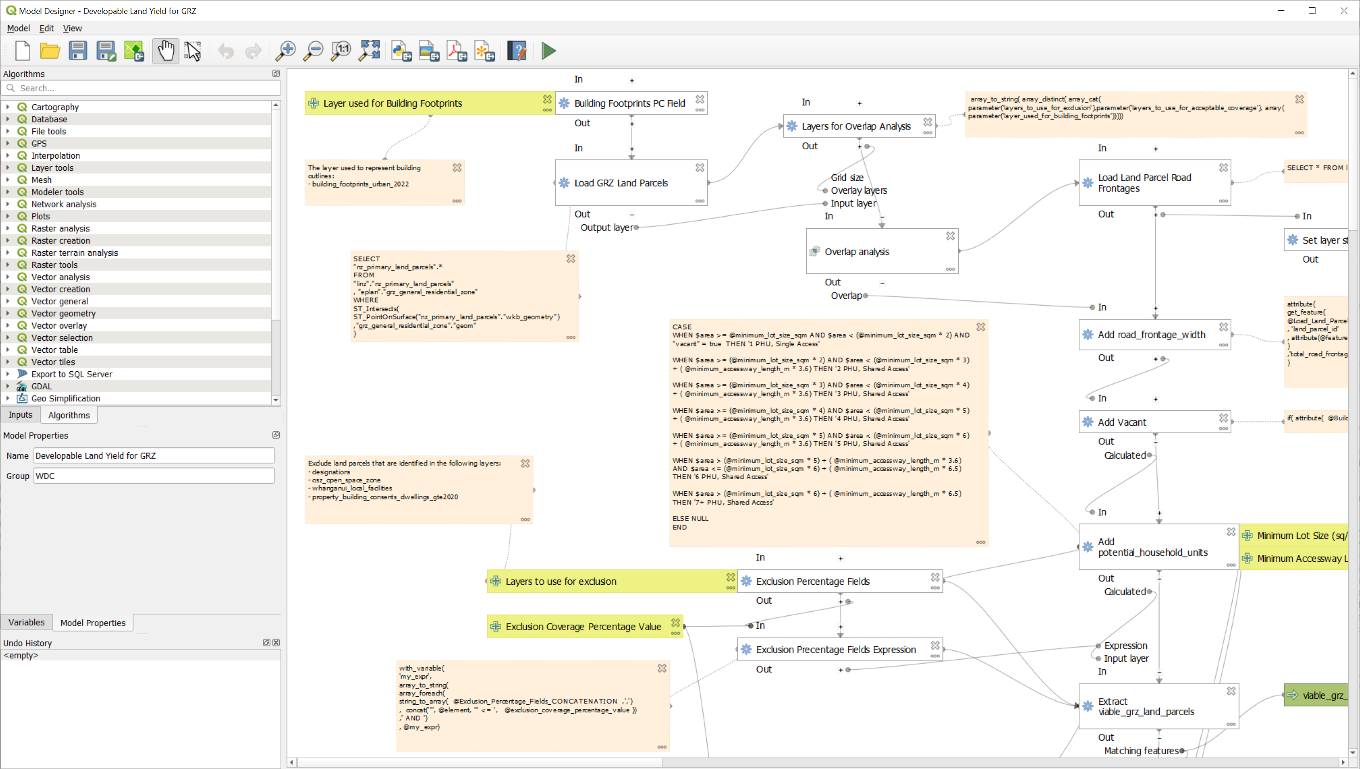
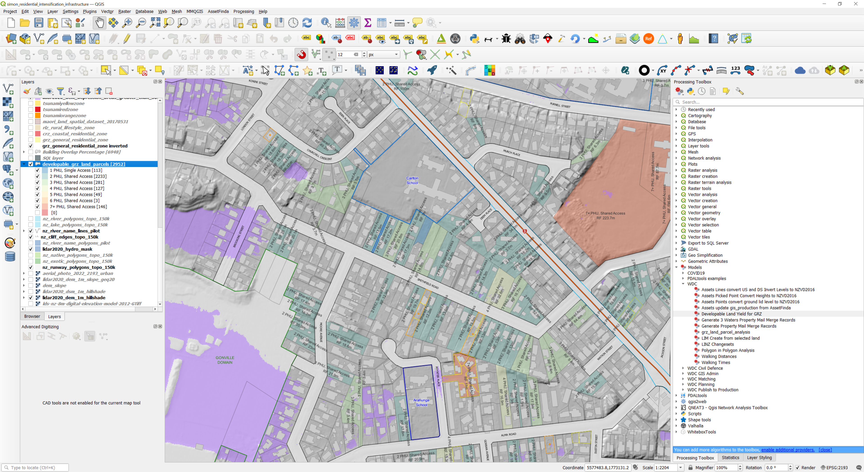
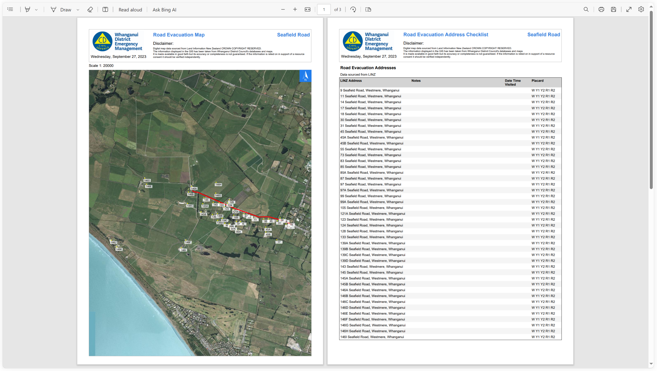
Desktop
Processing Models
Mapping and Analysis
Output

Slide 27
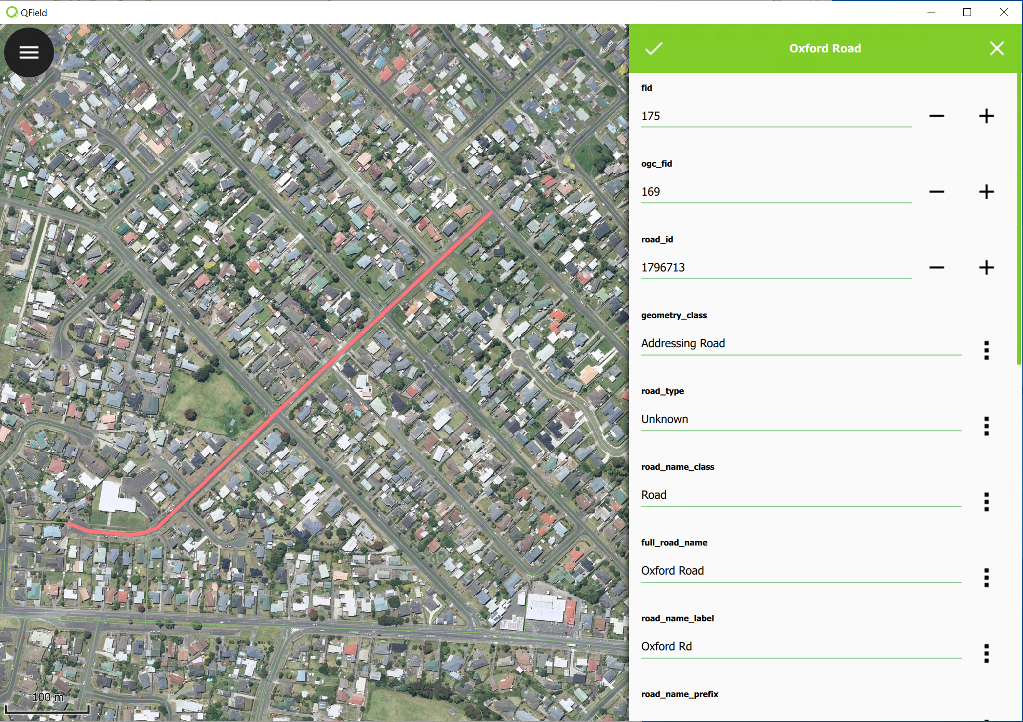
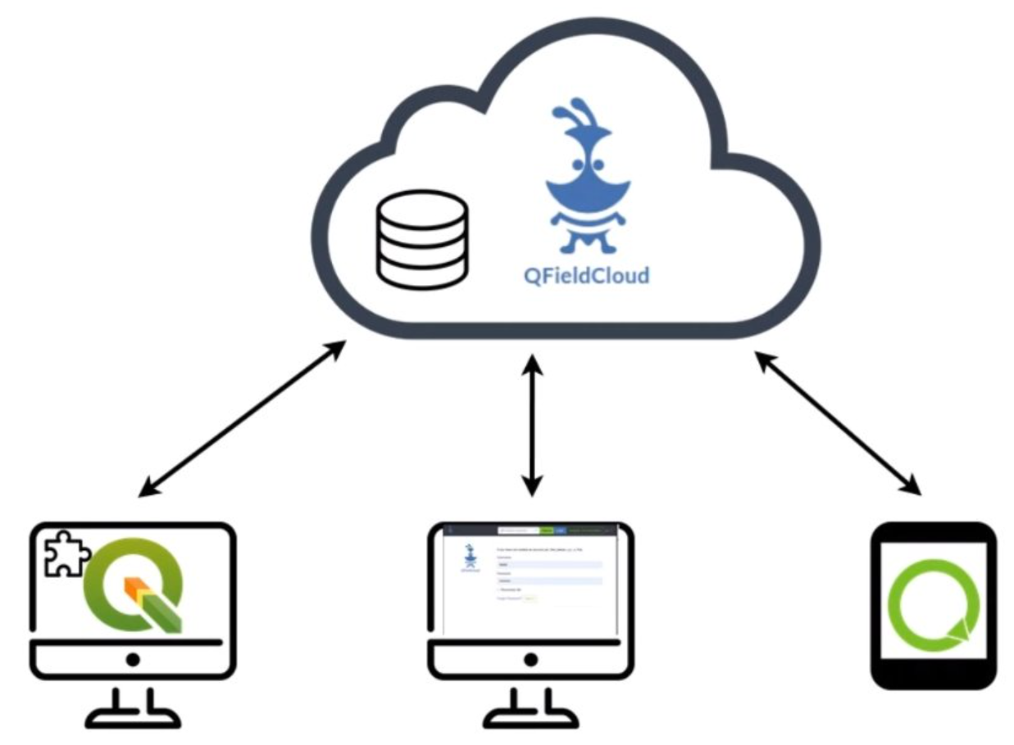
Mobile
QField
Android Tablets
or
Windows Surface
Simple field
data collection
Syncing via QFieldCloud and QGIS

Slide 28
Still haven’t Spent any Money on Licensing

Slide 29
My Questions To You
How much do you currently spend on Licensing?
How much capability do you get from that spend?
Could you have spent that money better elsewhere?
Staff development
Develop new features
Data capture
Does everyone in Suva drive a Toyota Prius?!

Slide 30
Future

Slide 31
Where to Next
Contribute more to FOSS4G communities
Support forums
Run workshops
Code and Documentation
Local Govt. sharing (where possible)
At Whanganui DC
3D Twin? https://github.com/tudelft3d/City3D
Greater use of PostGIS
Create GIS staff upskilling programme

Slide 32
Reflections on Local Govt GIS in NZ
Changing to Vendor A from Vendor B will not fix your data issues!
Is vendor lock-in being driven by dumbing down of GIS skills?
Is innovation decreasing as organisations accept vendors word/methodology as gospel?
Open Source GIS frees up resources to improve data and upskill staff!
Opinion's expressed above are my own based on 35+ years working in and around NZ Local Govt!

Slide 33
Simon Nitz
Geospatial Lead
Whanganui District Council
New Zealand
simon.nitz@whanganui.govt.nz
2025.foss4g.org

