Slide 1
GIS Application in Development Planning in Rural Administrative Areas in Namatanai Rural LLG, New Ireland Province, Papua New Guinea

Slide 2
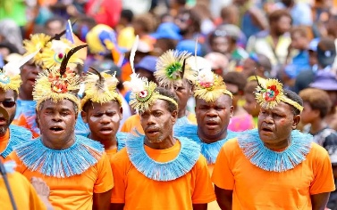
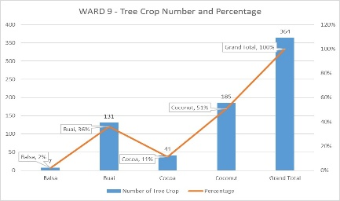
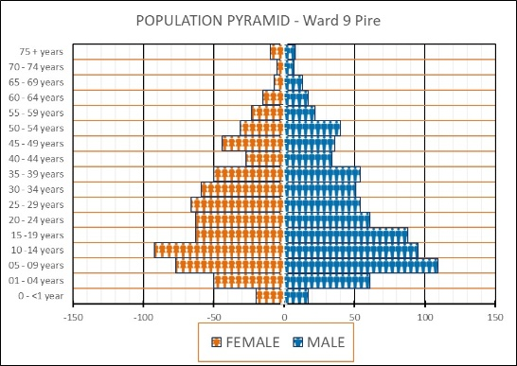
Papua New Guinea
Bill Rua - Port Moresby
George Tebegetu – New Ireland Province

Slide 3
Introduction
Pacific Digiskills Service, an ICT & GIS professional services business
PDS employs an integrated approach that combines strategies to deliver customer-focused solutions.
Through close collaboration with clients and solution partners, Pacific Digiskills offers a broad perspective on ICT industry solutions, providing research-backed methodologies and up-to-date standards that set its clients apart.
With a strong hands-on approach and practical, ready-to-use solutions, Pacific Digiskills Service has quickly earned a reputation for excellence among industry leaders.

Slide 4
Vision
"Empowering Papua New Guinea with GIS, cloud, and ICT innovations for smarter data insights, sustainable growth, and impactful environmental solutions."

Slide 6
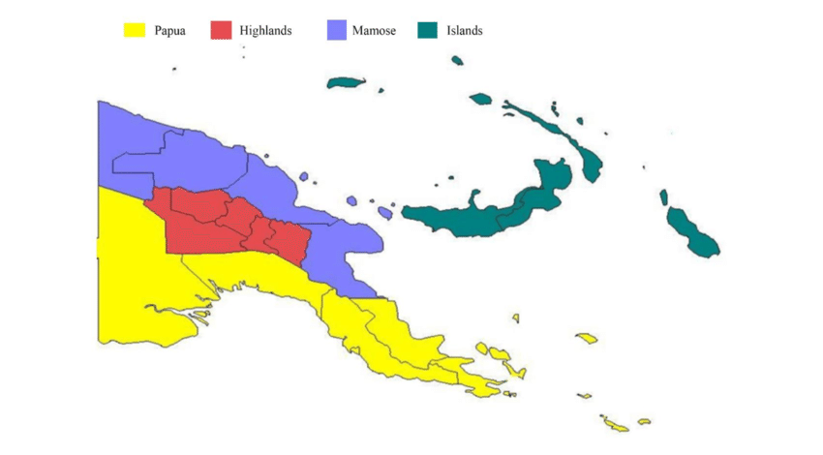
Regions in Papua New Guinea

Slide 7
Provinces in Papua New Guinea

Slide 8
Work Alignment with PNG Government Policies

Slide 9
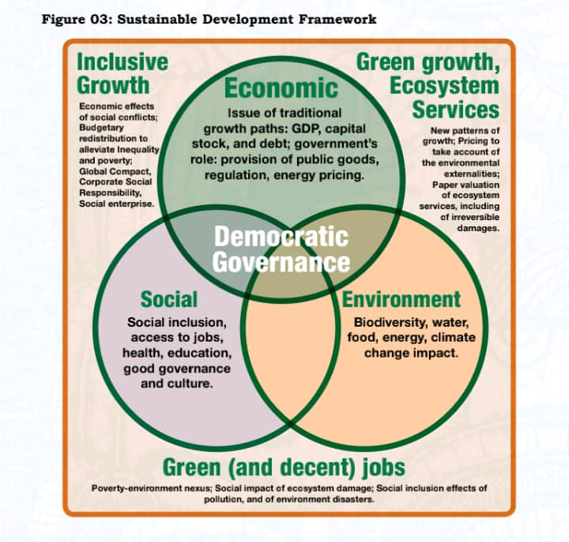

Slide 10
Alignment to PNG Government Policies and Plans

Slide 11
GIS Application in Development Planning in Rural Administrative Areas in Namatanai Rural LLG, New Ireland Province, Papua New Guinea
Questionnaire Design - Kobo Toolbox
Electronic Survey Deployment - Enumerators
Enumerator Training
Survey Implementation – Field Work (2 months + 70 persons)
Data Cleaning + Data Preparation for QGIS
Import Data into QGIS
Mapping of Specific Development Agenda – SDGs
Presentation of Findings to Local Level Government Council

Slide 12
Provinces in Papua New Guinea

Slide 13
Questionnaire Design - Kobo Toolbox

Slide 14
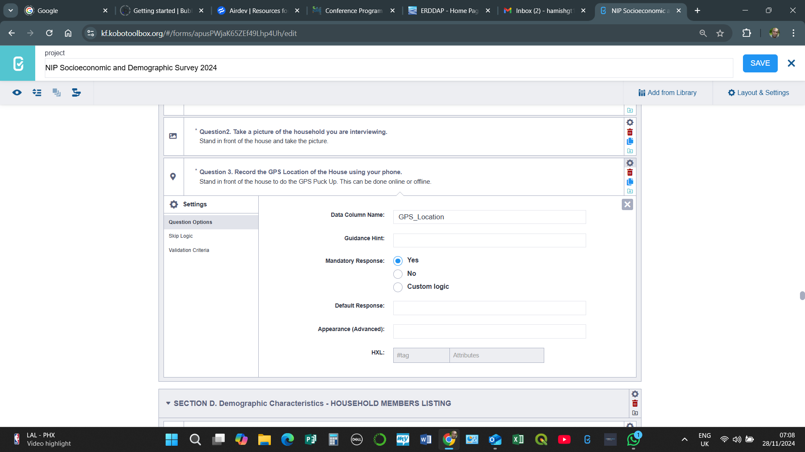
GPS Points capture design in Questionnaire

Slide 15
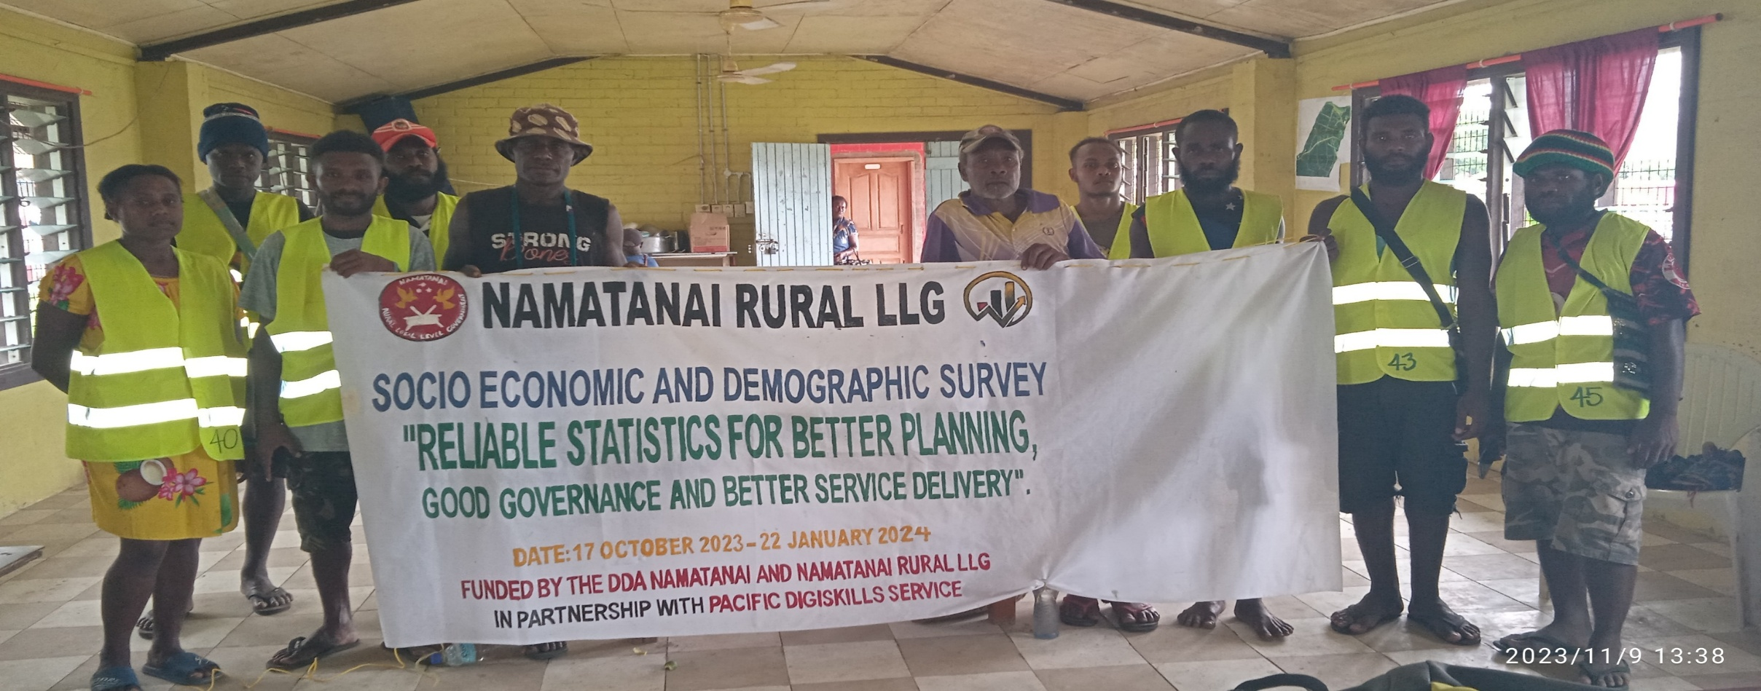
Electronic Survey Deployment - Enumerators
Link: https://ee.kobotoolbox.org/x/nOGJUNHt

Slide 16
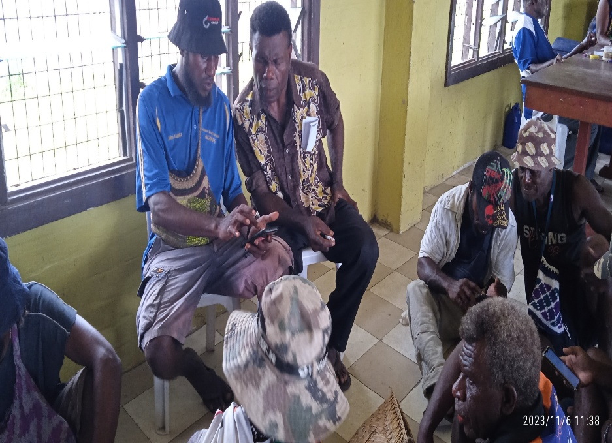
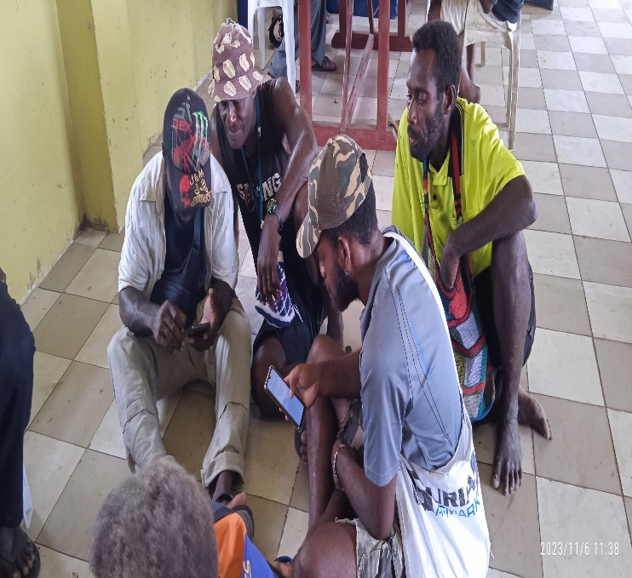
Enumerator Training
Government Officers and Youths

Slide 17
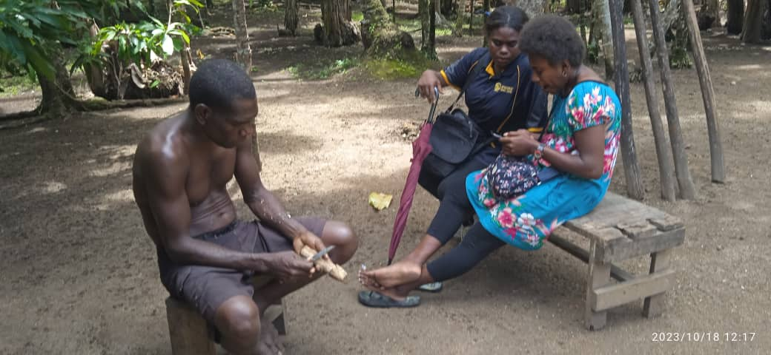
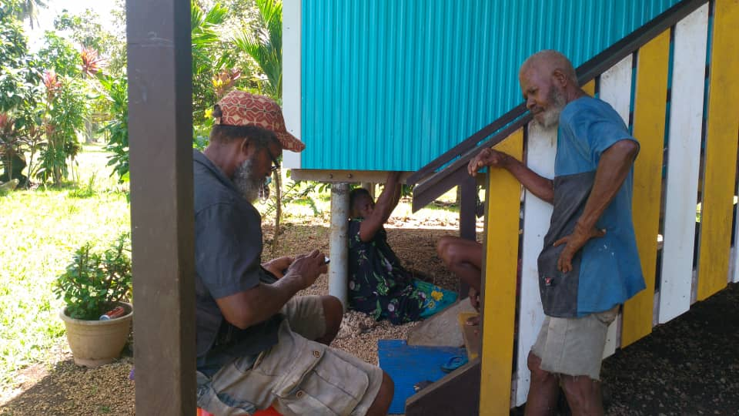
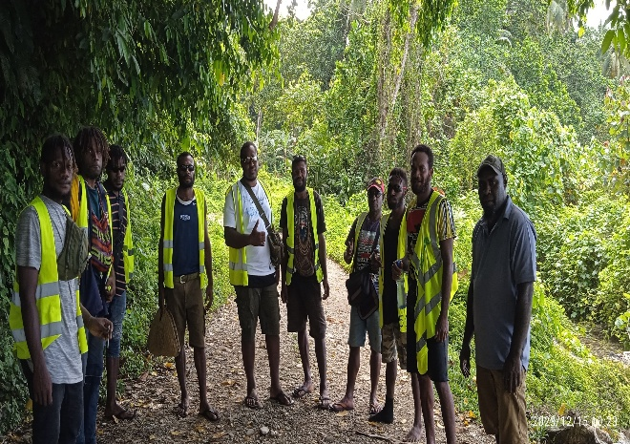
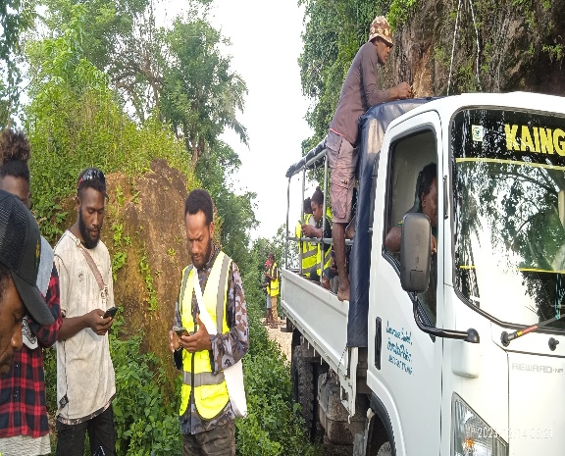
Survey Implementation – Field Work (2 months + 70 persons)
Actual Data Collection

Slide 18
Data Cleaning + Data Preparation for QGIS
Kobo
Data Collection
Microsoft Excel
Data Cleaning an Formatting
QGIS
Visual Representation and Mapping

Slide 19
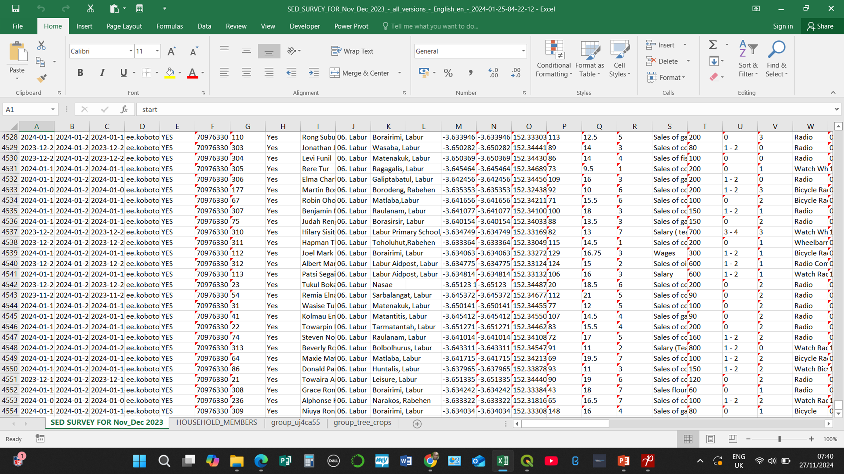
Field Data from Kobo

Slide 20
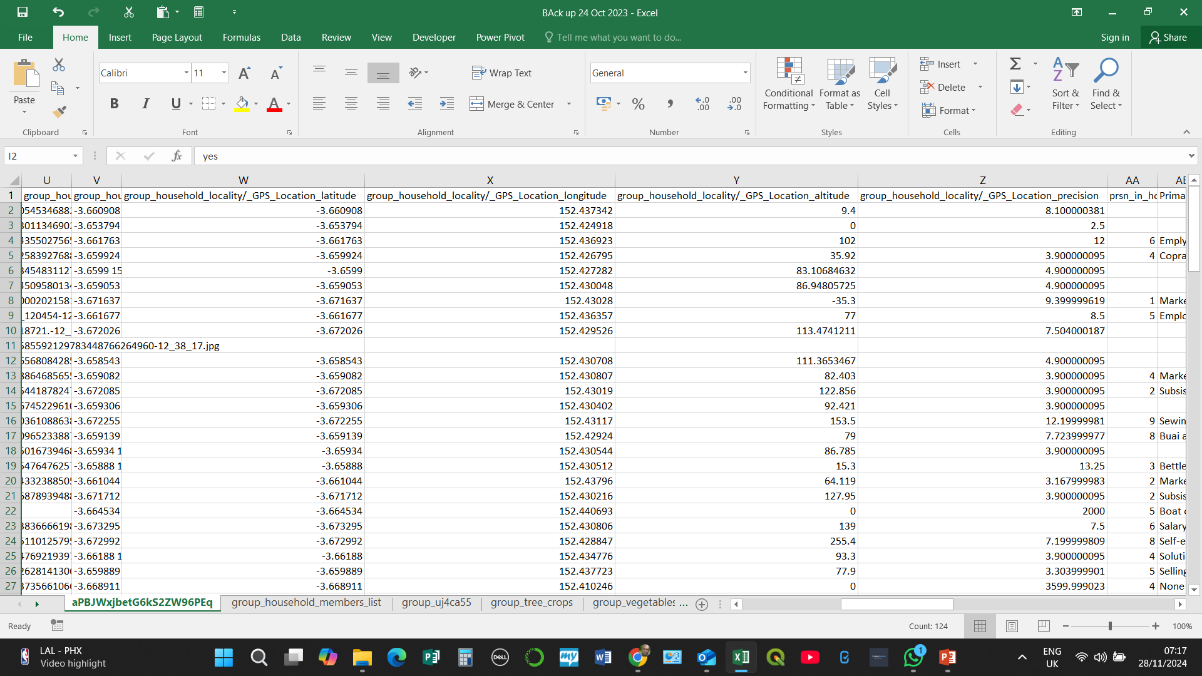
GPS Points Latitude, Longitude, Altitude and Precision

Slide 21
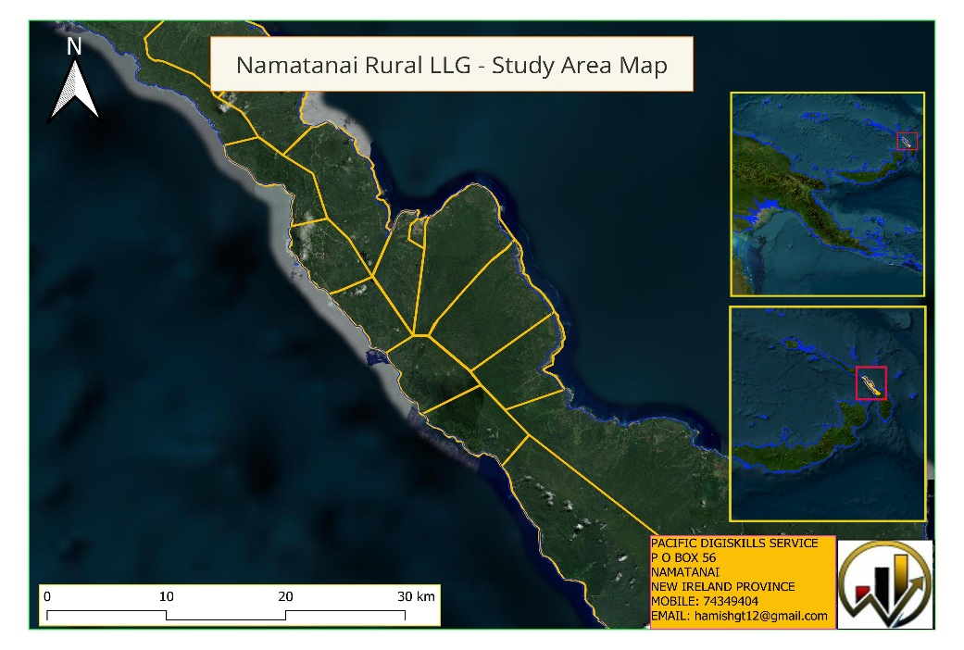
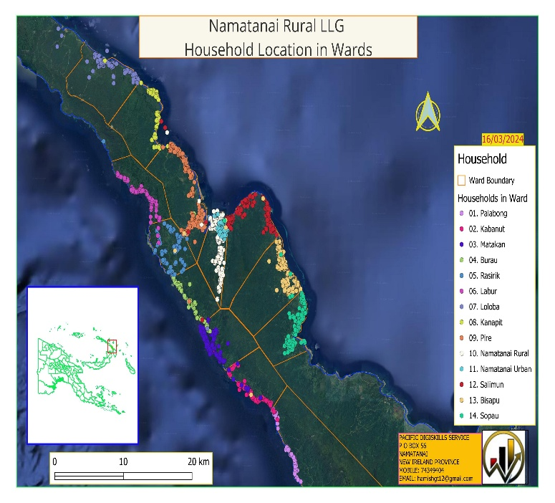
Import Data into QGIS
CSV
Text FIle

Slide 22
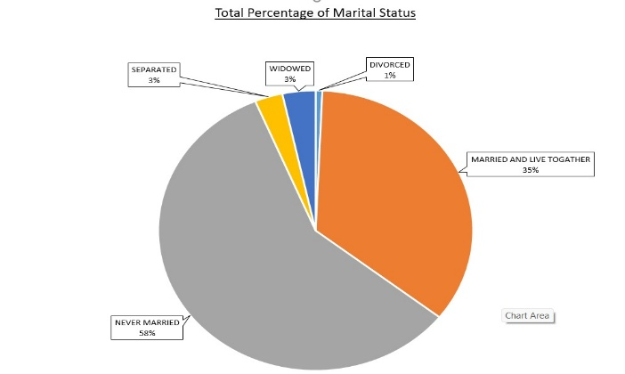
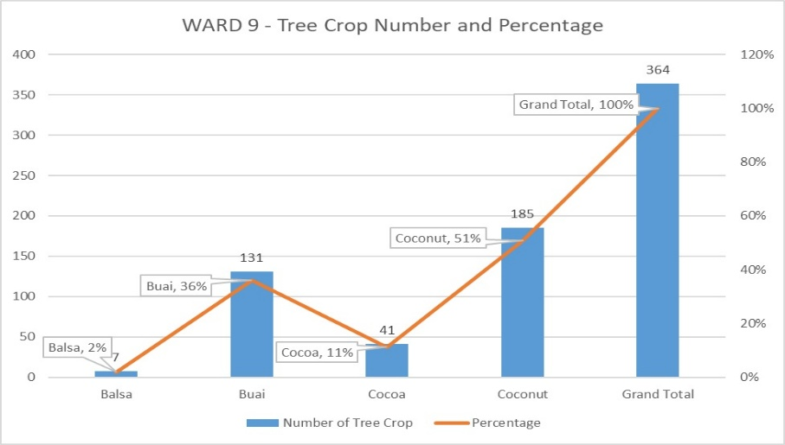
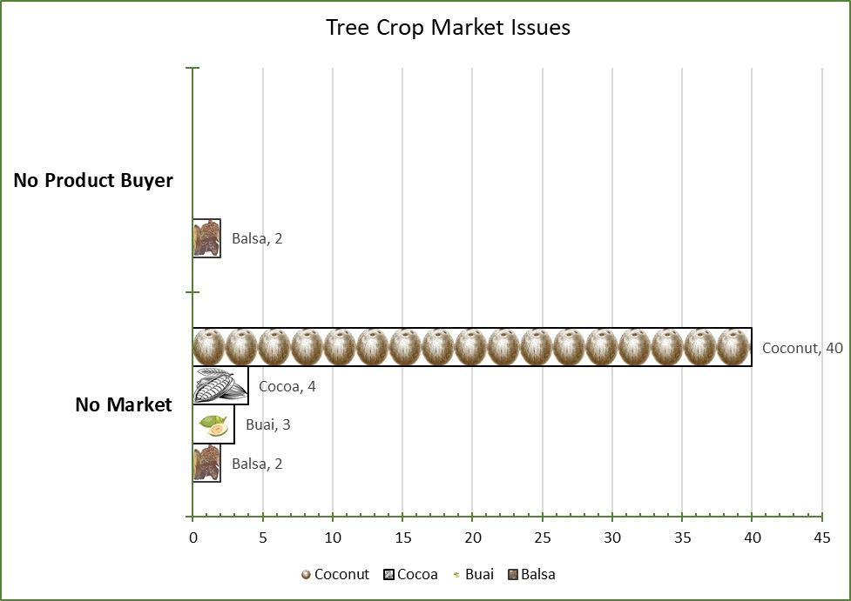
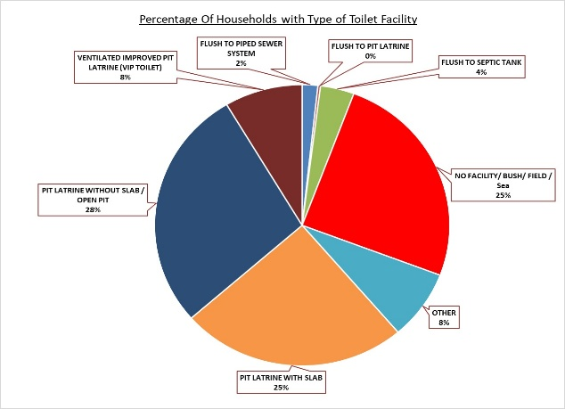
Mapping of Specific Development Agenda – SDGs

Slide 27
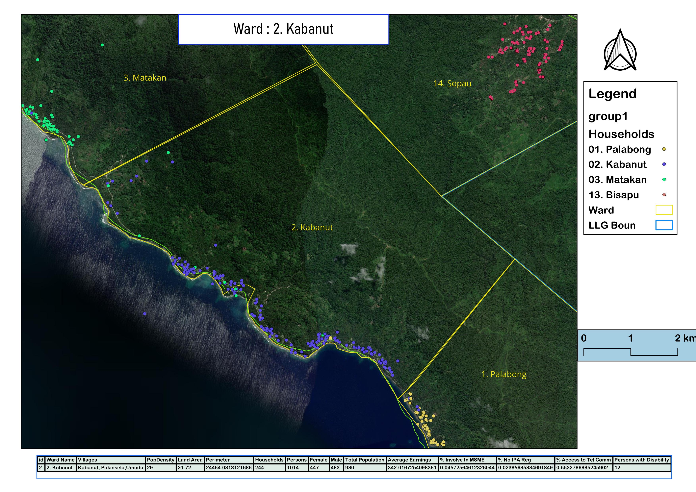
Example of Specific Ward Mapping

Slide 28
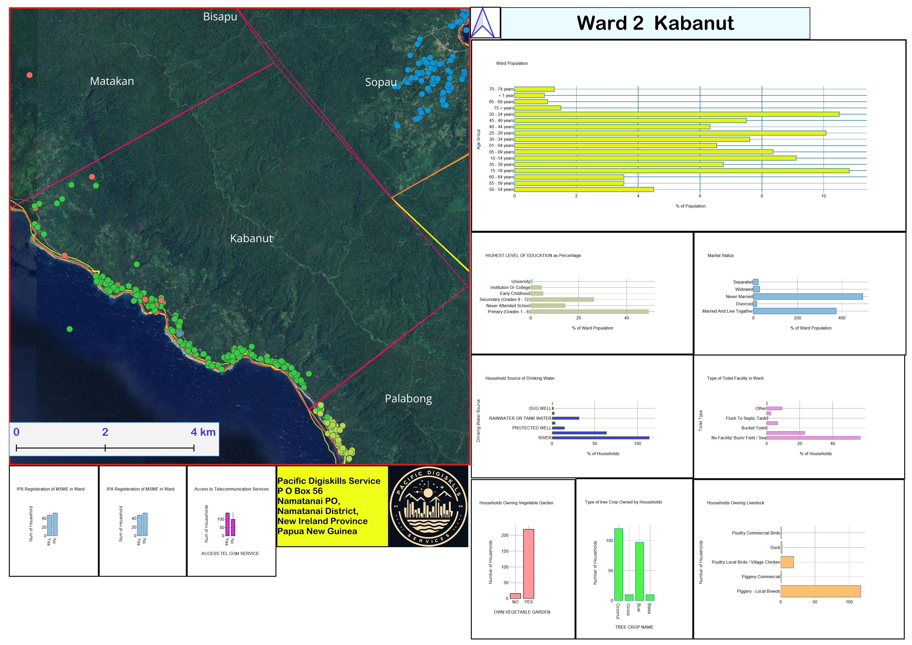
Statistics and Graphs – QGIS Data Plotly Plugin

Slide 30
Presentation of Findings to Local Level Government Council

Slide 31
Challenges
GPS
Enumerators Mobile Phones.
Drone for Aerial Images.
Updated High-Resolution Satellite Images (50 m).
Administrators do not understand the importance of GIS.
Availability of other GIS Software.
High Volume of Data

Slide 32
Our Take from attending Pacific GIS and Remote Sensing Users Conference 2024
Application of GIS and Remote Sensing in our maritime province
GIS Applications in monitoring sea level rising – Shoreline
Disaster Management, Awareness and Planning - Earth Quakes and Tsunami
Mangroves – Identification and Mapping
Reefs and Corals – Mapping
Geospatial Analysis

Slide 33
Tank yu tumas ol wantok!
End

