Slide 1
Connecting Through Cartography: Sharing Reference Resources in French Polynesia.
Yoann RONCIN
Land afffairs of French Polynesia
Deputy manager of Cadastre and topograic unit – PGRSC focal point of French Polynesia
v.0
28/11/2024

Slide 2
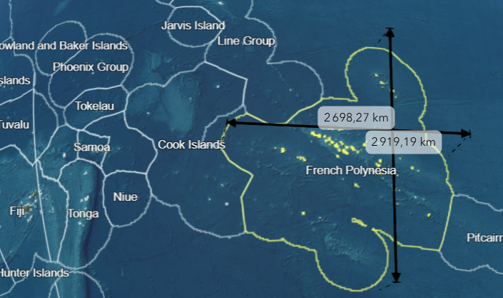
Context
A big territory !
5.5 millions km²
3 800 km² of land – 118 islands
Population : 279 000
Notes:
Society archipelago

Slide 3
Context
A challenge !
5 persons : 2 GIS analyst – 2 surveyor / cartographer – 1 field helper
1
production and management of cartographic references;
to conserve and update the administration's heritage of satellite images and aerial photographs;
to maintain and develop the geodetic and general leveling networks of French Polynesia;
to coordinate, manage and disseminate the administration's production of geographic data;
to lead the geographic information sector and promote its development in the administration.
2
3
4
5
Stakeholders
Private sector : surveyors, architects, engineering departments, graphist, etc
Education / research : Researchers, students
General public
Answering their needs
Connecting them to our data !

Slide 4
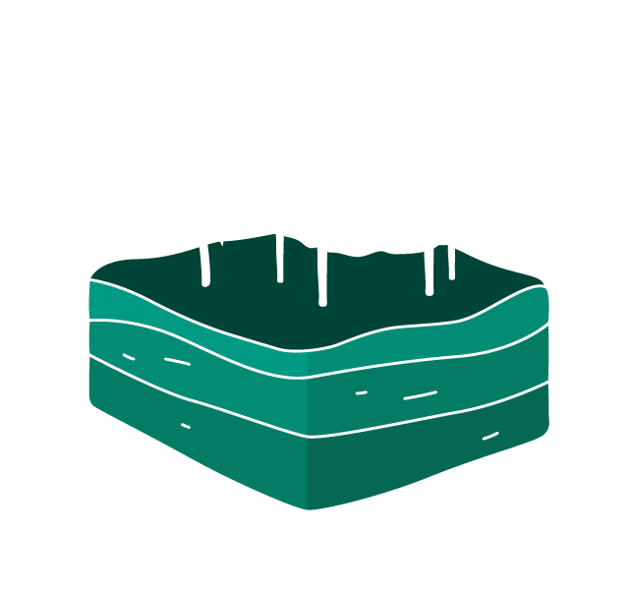
The program
I. Imagery
II. Vector
III. Geodesy

Slide 5
I. Imagery
Historic imagery
27 269
834
images
catalogs
1952 - 2010
118 islands 3800 km²

Slide 6
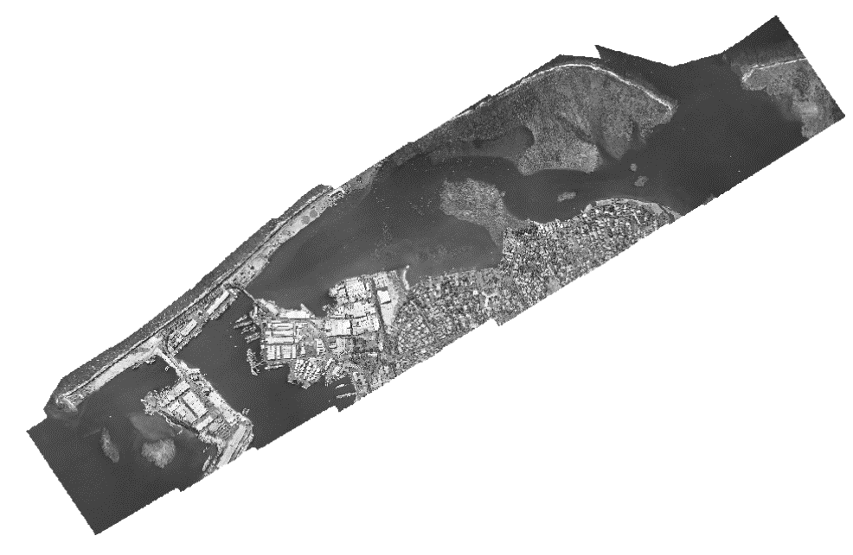
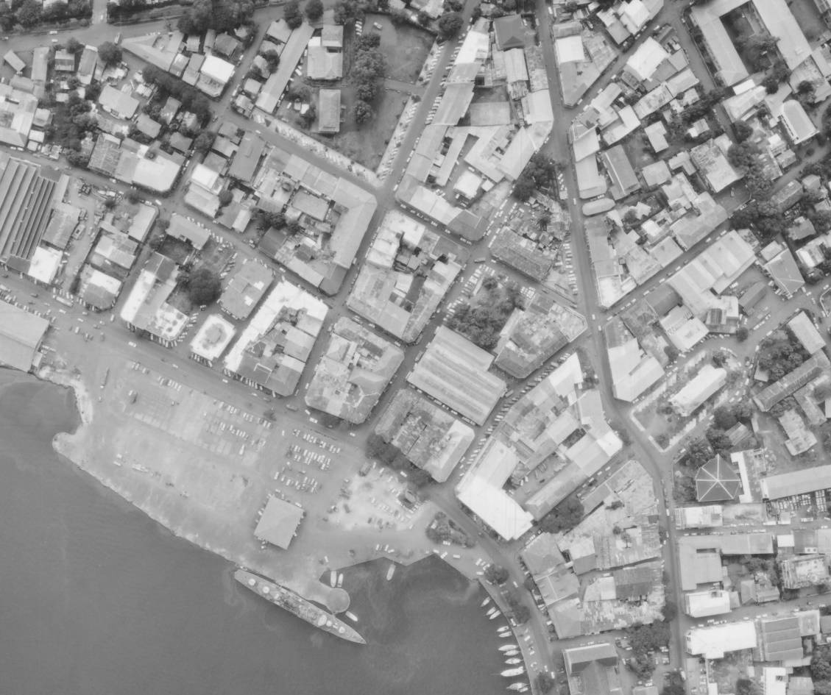
I. Imagery
Historic imageries
Usage :
Coastline change
Landuse : vegetation, usucapion, etc
Frame camera pictures to orthomosaics –> 52 catalogs
More products to come !
Ortho 1982 – 1/5 000e
1/6 000e 1967 - IGN

Slide 7
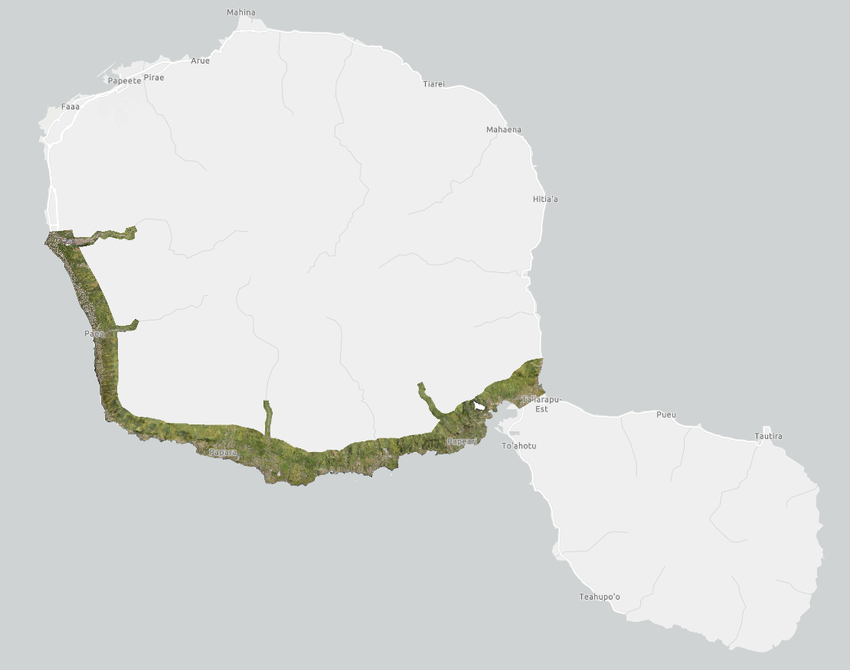
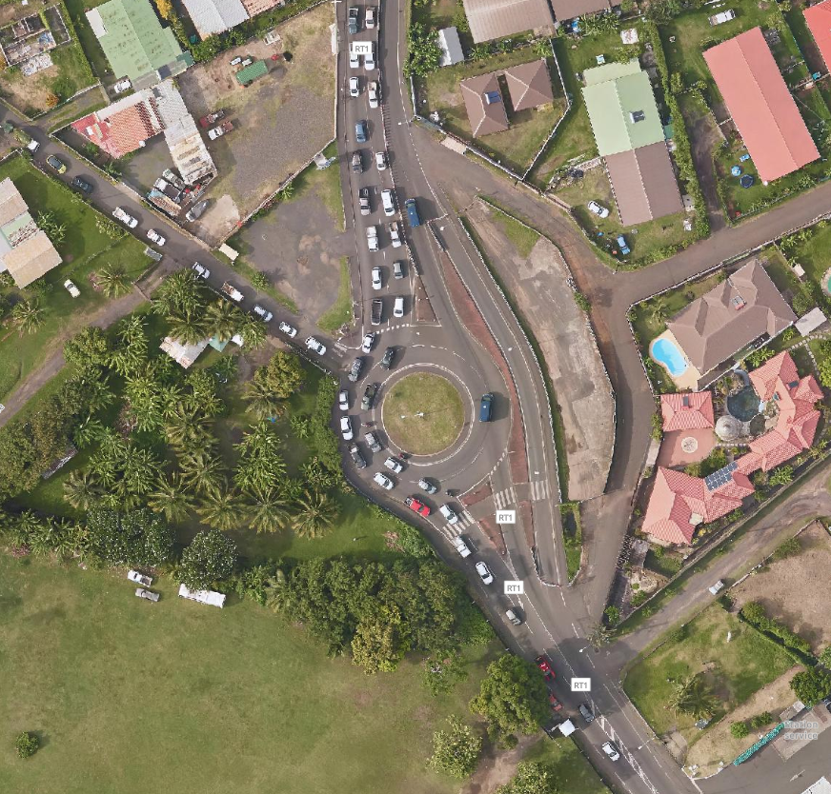
I. Imagery
New imagery
Usage :
Important needs for high resolution/recent orthomosaics !
Disponible sur tefenua.data.gov.pf
High resolution imagery : 7 cm (web: 15cm)
Satellite imageries :
Working closely with Data terra (Dinamis) : Pleiades and Pléiades Neo
Goal : access to Pléiades imageries with licensing for the whole public sector

Slide 8
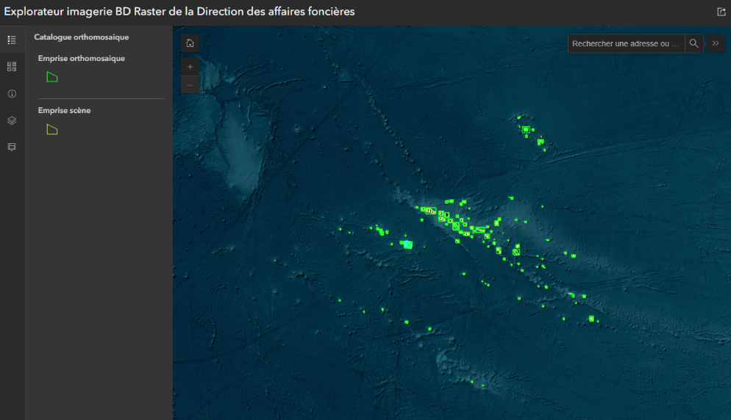
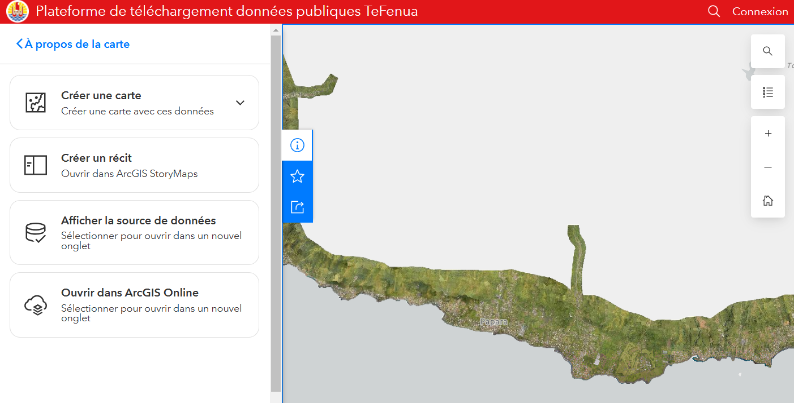
I. Imagery
Accessing imageries
Opendata portal ressources :
Applications
Contents
www.tefenua.data.gov.pf
Identify the imagery that you need : Imagery database explorer
Work with the imagery : Raster image service
Notes:
Une entrée : portail opendata. Contient application et ressources.
Application permet identfication des produits. Certains des produits sont ouverts : distribution sur le web avec un flux.
Autres, mécanisme export et conformité aux licences. TPKX pour aller sur le terrain, imagerie brute, orthomosaics

Slide 9
II. Vector
Topographic database BD TOPO
Themes
Referentials (REF): geodetic, leveling, stereo-preparation benchmarks, geodetic and projection systems.
Location (LOC): islands, administrative boundaries.
Edification (EDI): buildings, surface constructions, linear constructions.
Hydrography (HYD): rivers, hydrographic surfaces, lagoons.
Land use (SOL): natural or exploited vegetated areas.
Orography-Relief (REL): contour lines, embankments, spot elevations.
Road network (VOI): road axes and edges, road furniture.
Toponymy (NOM): points of interest, oronyms, hydronyms, place names
1 000 000 features
89 islands covered
1 / 5000 e
Update rate 5-10 years
Usage : background topographic map, reference information for the whole territory, GIS analysis.

Slide 10
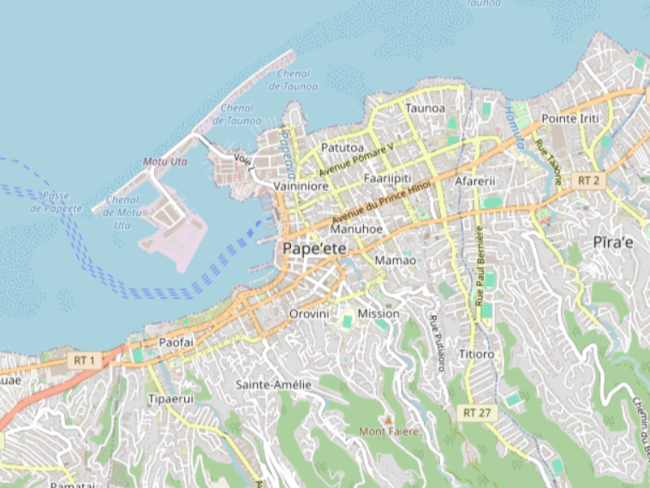
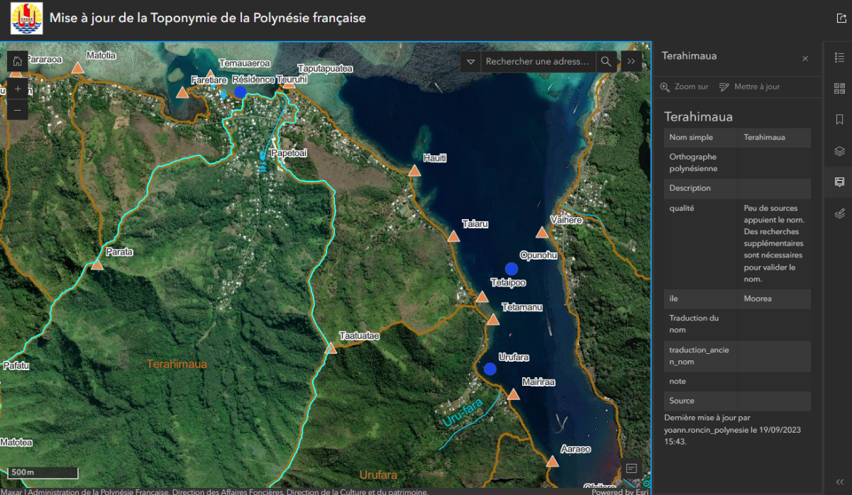
II. Vector
Topographic database BD TOPO
1 000 000 objets
89 îles couvertes
Openstreetmaps
Opendata
Thematic applications
1 / 5000 e
Fréquence MAJ 5 à 10 ans
Openstreetmaps - Papeete
Graphy and management of toponyms (’eta – tārava)

Slide 11
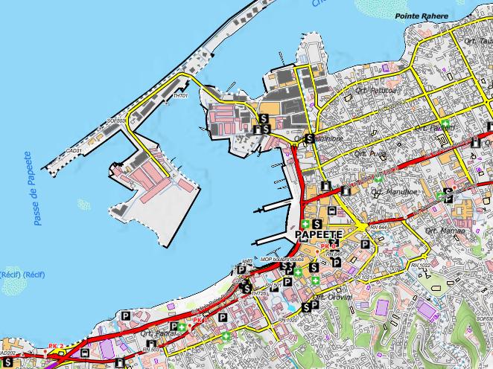
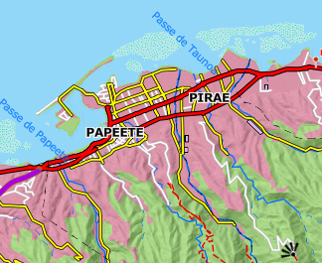
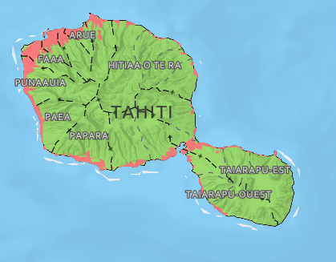
II. Vector
Work in progress
1 000 000 objets
Web first !
Cartographic generalization + sharing
89 îles couvertes
1 / 5000 e
Fréquence MAJ 5 à 10 ans
1/500 000e
1/25 000e
1/5 000e
Vector tiling : high efficiency – lightweight – custom styling
Simplify the features collected : more dynamic and transverse cartography

Slide 12
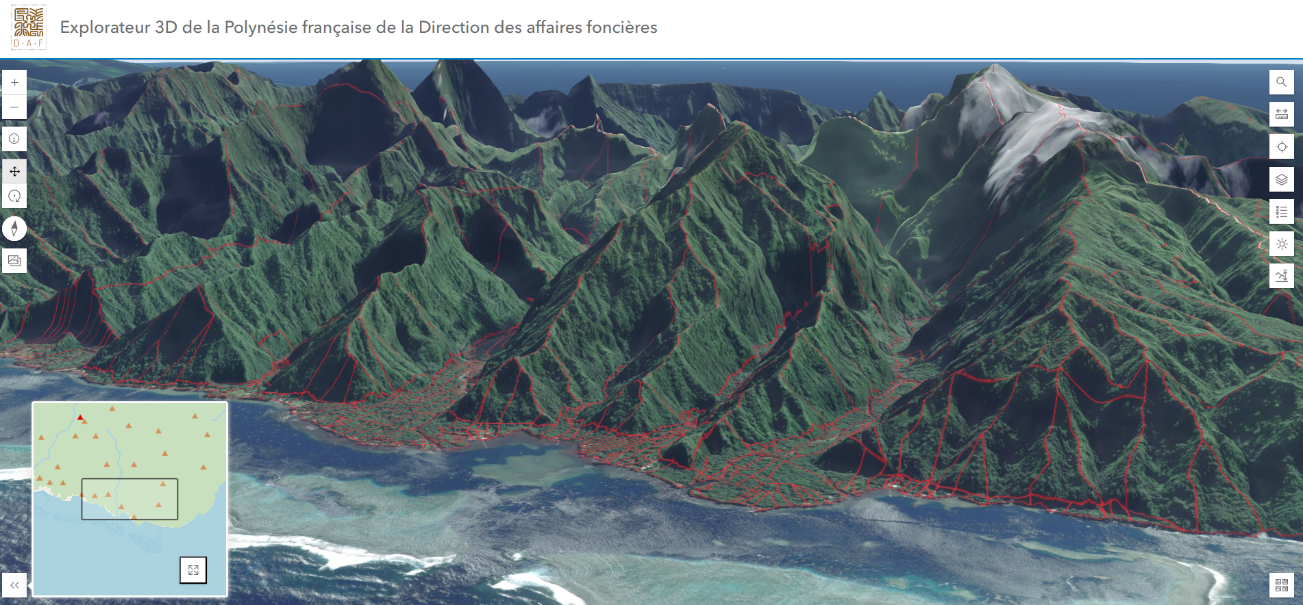
II. Vector
Cadastre
1 000 000 objets
Land parcels updated daily in opendata
FORMAT : gdb, gpkg, feature service, wfs
Fréquence MAJ 5 à 10 ans
Different vision of the territory !

Slide 13
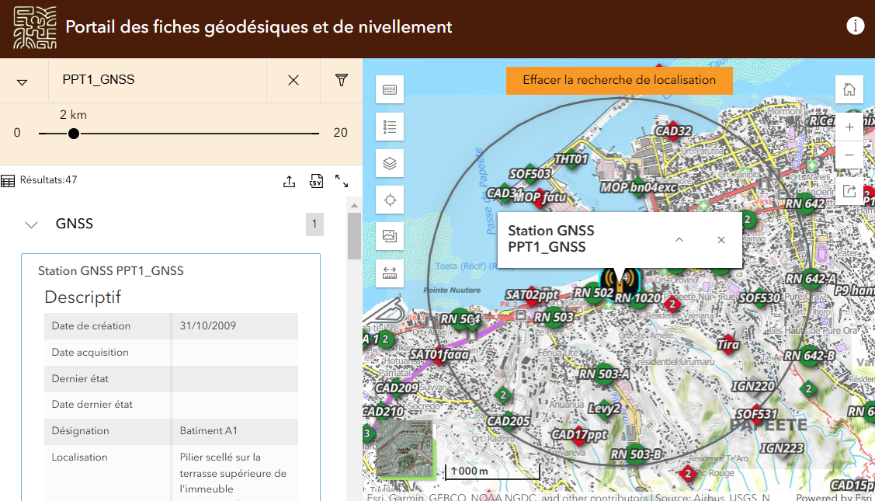
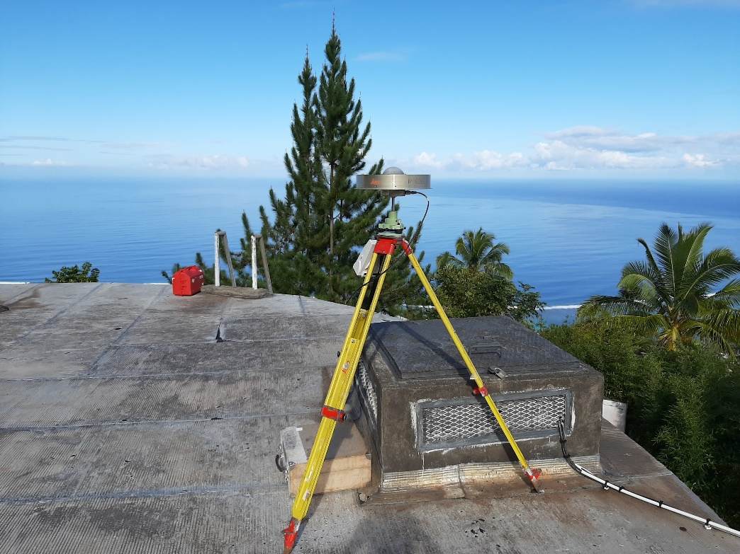
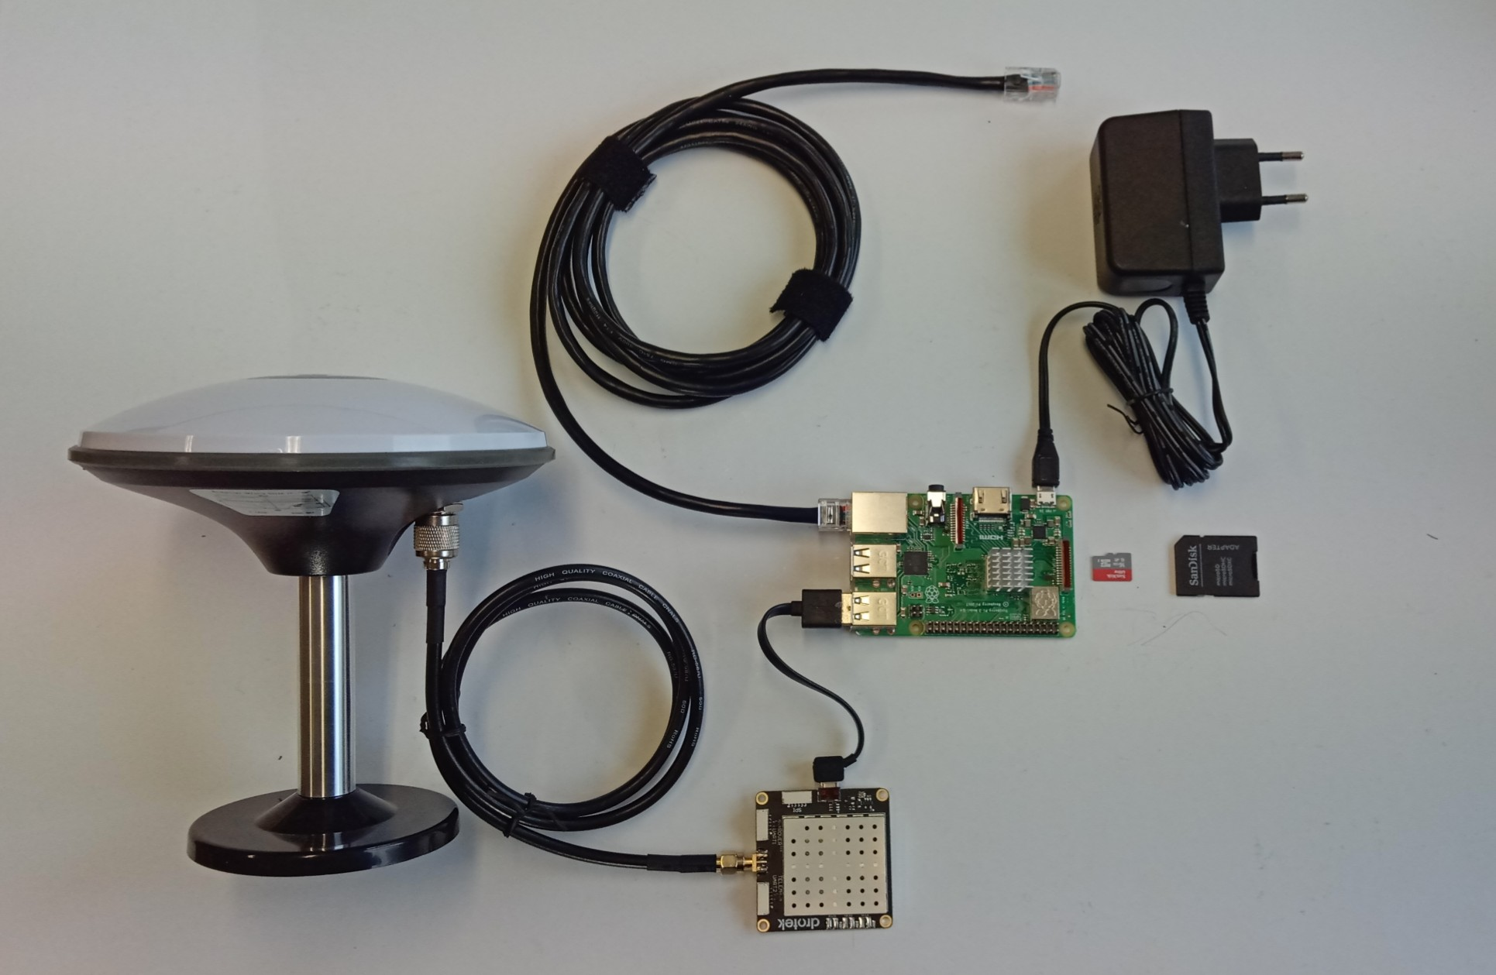
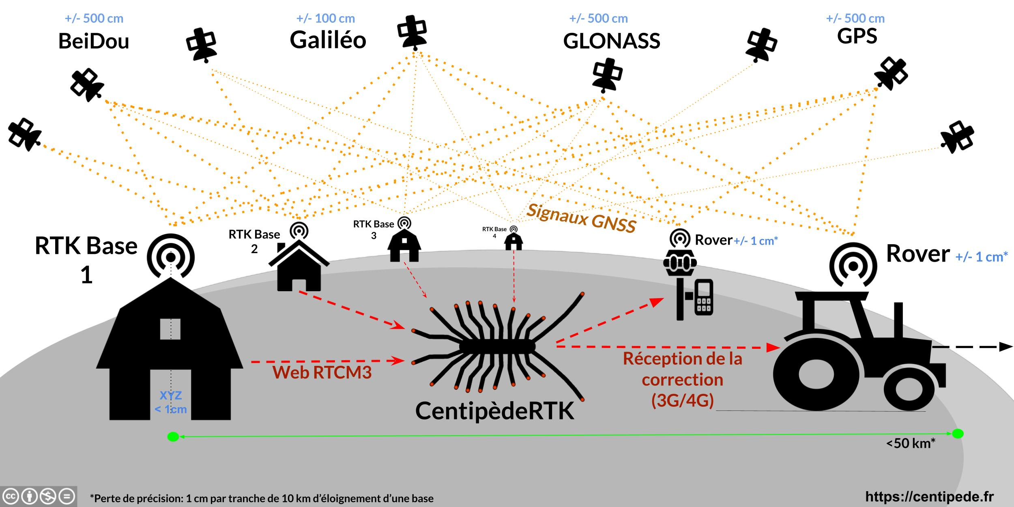
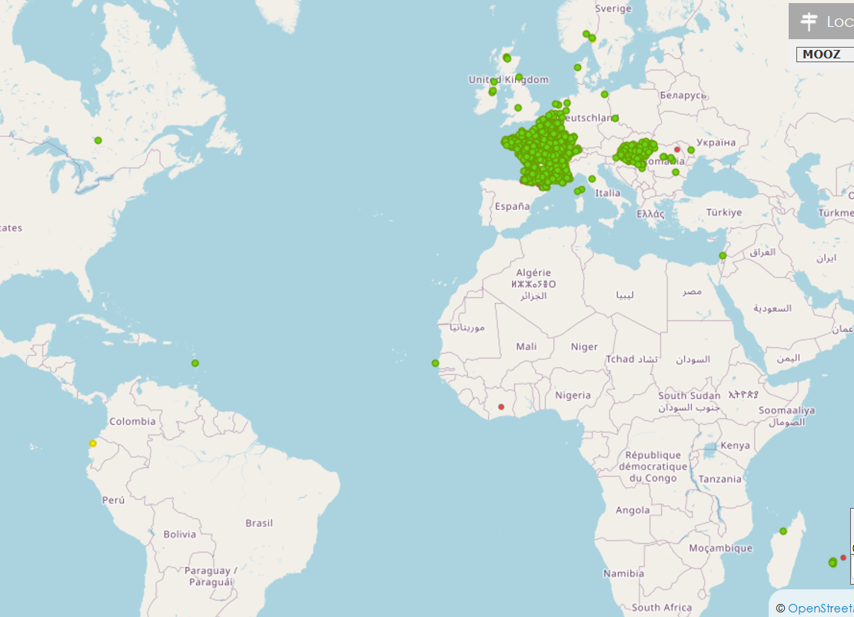
III. Geodesy
Geodesic database BD REF
7 000 elements / 8 000 measurements
Finding the best reference :
GNSS base
Levelling network
Geodesic reference point
Future plans
Reference georeferencing ground targets
Reference coordinate system : ITRF – PPP measurements
Experimenting Centipède
250 – 300 euros / 10x cost factor
Centipede RTK – lowcost base station for RTK
Openstreetmaps of GNSS

Slide 14
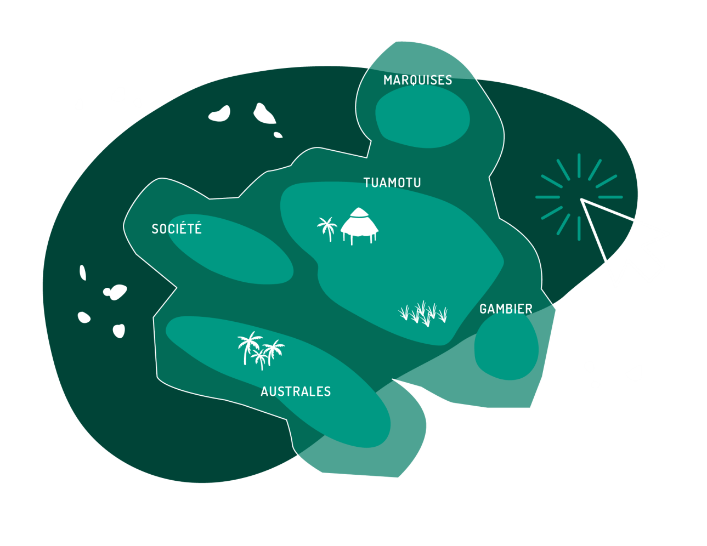
Let’s keep in touch !
Linkedin
Linkedin : https://www.linkedin.com/showcase/section-cadastre-topographie
https://www.service-public.pf/daf/cadastre/cellule-topo_accueil/
topo.daf@administration.gov.pf
Commandes de cartes
https://www.mes-demarches.gov.pf/commencer/daf-carte-topo

Slide 15
Connecting Through Cartography:
Sharing Reference Resources in French Polynesia.
Questions ?
Yoann RONCIN : yoann.roncin@administration.gov.pf
https://www.linkedin.com/in/yoannroncin/

