Slide 1
WE BELIEVE EVERYONE HAS A PLACE IN SPACE

Slide 2
Who wants to work in the space industry?

Slide 3
Apparently, A Lot
195 Countries
91 Countries with assets in space
75 Countries with Space Agencies
23 Countries with Active Satellite Manufacturing
Spending growth 8% increase per year
$1.8 trillion by 2035
$750B
$630B
$546B
Source https://www.spacefoundation.org/wp-content/uploads/2024/03/SpaceFoundation_2023-Annual-Final-Web.pdf#:~:text=URL%3A%20https%3A%2F%2Fwww.spacefoundation.org%2Fwp
https://www3.weforum.org/docs/WEF_Space_2024.pdf

Slide 4
Why do governments want to get into Space
NASA
Apollo Program 7:1 ROI
Current Program 40:1 ROI
UK
ESA Involvement Program 9.8:1 ROI
ESA
1 person-year directly sustained by the ESA investments in ExoMars and ESM supports about 2 additional jobs in the wider economy.

Slide 5
What does your Country’s Economy Want?
Reduce Risk National Security & Sovereignty
Reduce Economic Vulnerability and Stagnation
Reduce Brain Drain and Innovation Deficit
Notes:
Emerging economies face significant threats to national security and sovereignty due to their reliance on foreign space technologies and data. Without independent space capabilities, these countries are vulnerable to strategic disadvantages, loss of control over sovereign assets, and insecure satellite data critical for military and national operations.
The economies of emerging countries are at risk of stagnation and vulnerability due to a lack of diversification and investment in high-tech industries. Studies by NASA and ESA show that space-related investments can yield an impressive ROI of 8:1, highlighting the potential economic benefits. Investing in the space sector can stimulate advanced manufacturing, create high-tech jobs, and strengthen economic resilience by diversifying into a promising and lucrative industry.
Emerging countries are experiencing a brain drain as top talent migrates to nations with more advanced technological opportunities. By fostering a robust space sector, emerging nations can retain talent, develop a skilled workforce, and position themselves as innovation hubs, driving technological advancements and boosting global standing and influence.

Slide 6
Space Industry and Space Economy
Downstream Space Activities
Operations: Satellite and ground system operations, including leasing and direct service provision.
Data Distribution: Cloud-based platforms for geospatial product access and distribution.
Device Supply: Production of consumer market devices (e.g., GNSS equipment, terminals).
Service Supply: Direct-to-home services (TV, broadband), navigation, mapping, and communications.
Value-Added Services: Processing and transforming data from multiple sources into usable information, often by companies outside the traditional space sector.
Upstream Space Activities
Research: Fundamental and applied research conducted by universities, public research.
Support Services: Finance, insurance, legal services, and consulting.
Engineering Support: R&D, design, testing, and engineering services.
Material Supply: Provision of passive and active components (e.g., cables, transistors, semiconductors) for space systems.
Equipment Design and Manufacturing: Production of electronic, mechanical, and software systems for space and ground applications.
System Integration: Development of complete satellites, launch vehicles, and terrestrial systems like control centres and telemetry stations.

Slide 7
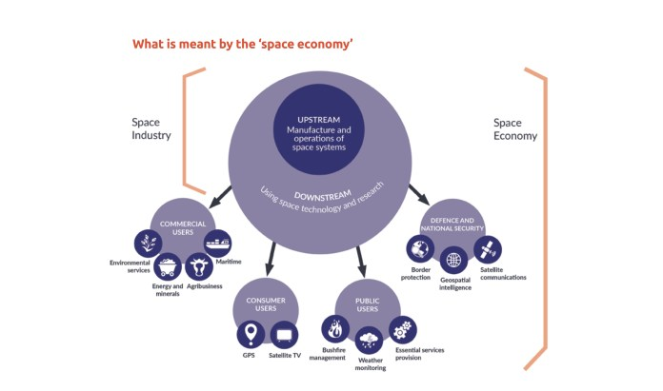
Where are You in the Space Economy?

Slide 8
Question
Why Now is the right time?
Space 2.0 matters

Slide 9
Question
Is it the right time?
Who has heard of the Gartner Hype Curve?

Slide 10
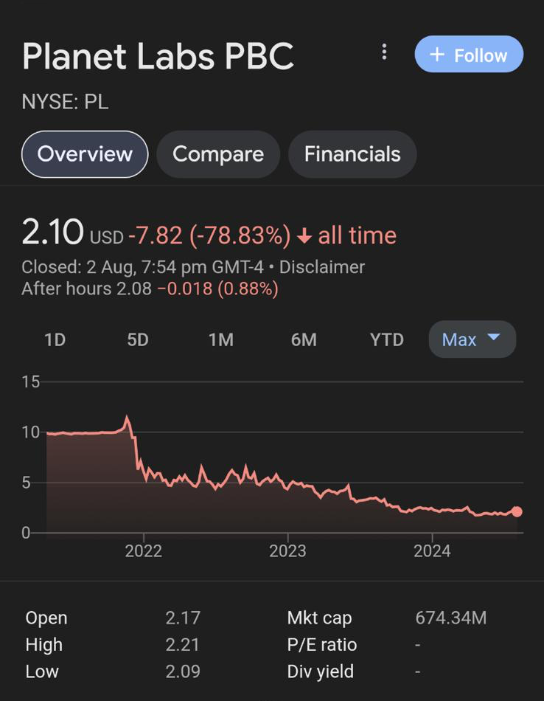
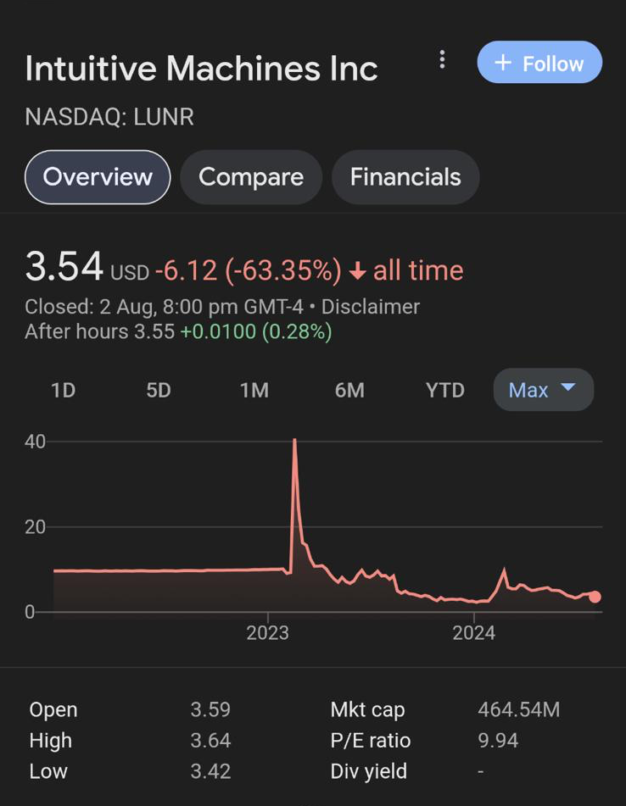
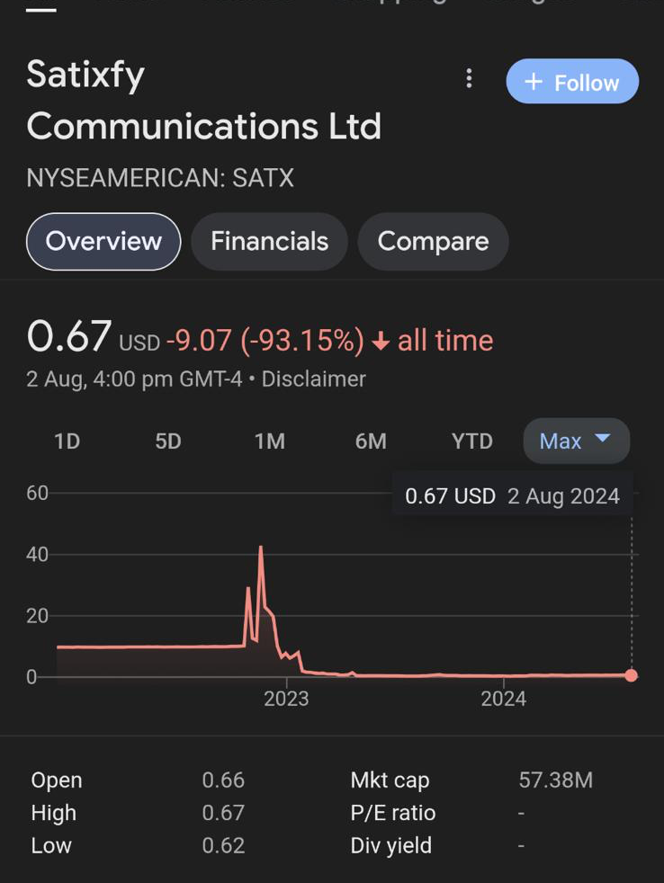
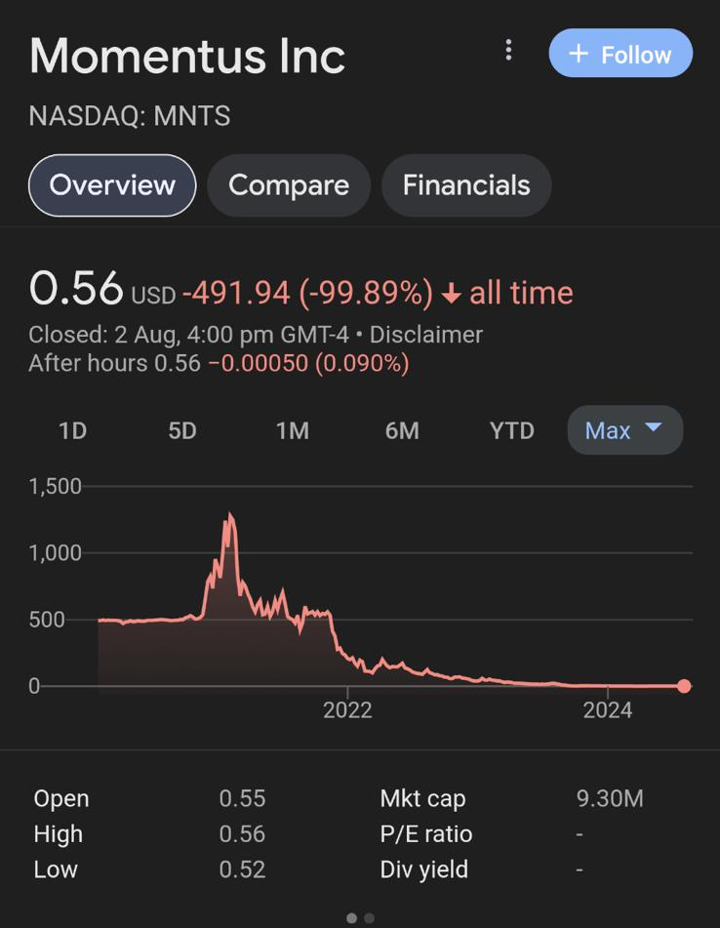
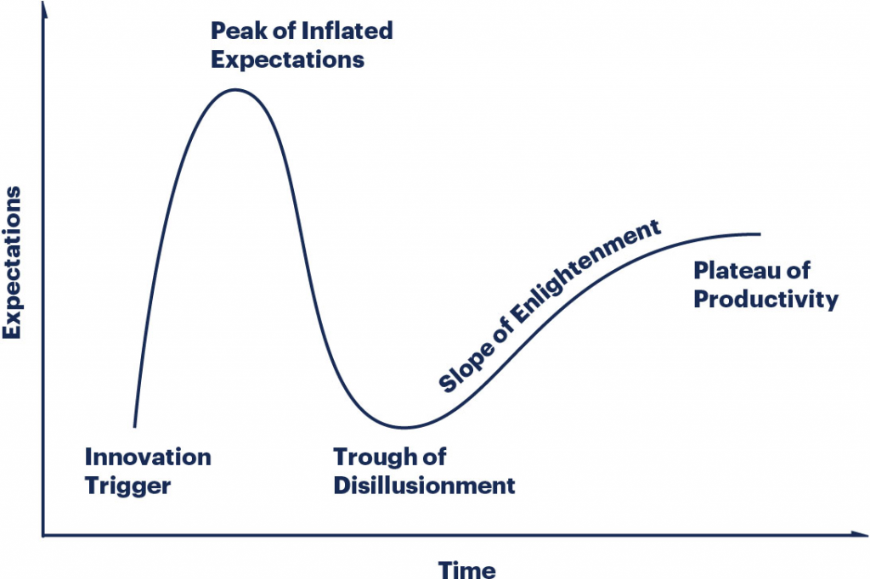
Where is Space on the Gartner Hype Curve?
2020
So Why Would Anyone even think about starting a Space Company?
Virgin Orbit went bust
Southern Cross Space was born
We are here

Slide 11
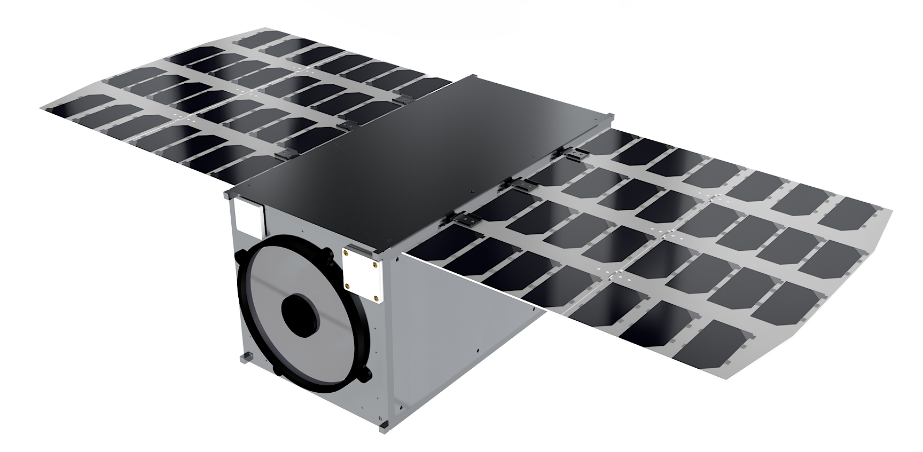
What I learnt
Opportunity
Access to Space
Sovereign Manufacture
Sovereign Download
Analytics
Knowledge Transfer
Design
11
The U class is for Universities
Reduced Hardware options
Reduced commercialisation options.
No knowledge transfer.
No analysis.
No in country capacity or capability.
Many payloads never make it to Space.
Emerging Space Needs
Sovereign Capability and Capacity
A modular solution for >50kg Satellite Busses.
Sovereign Ground Stations.
Partnerships in design.
Knowledge Transfer
Orbital Management Services
Longer-term engagements.
Old Space Outsourcing and Products
Outsource everything
Premium components cost
None or limited knowledge transfer.
No Downstream analytics.
Black box solutions with limited capacity building.
Long design and build phases.

Slide 12
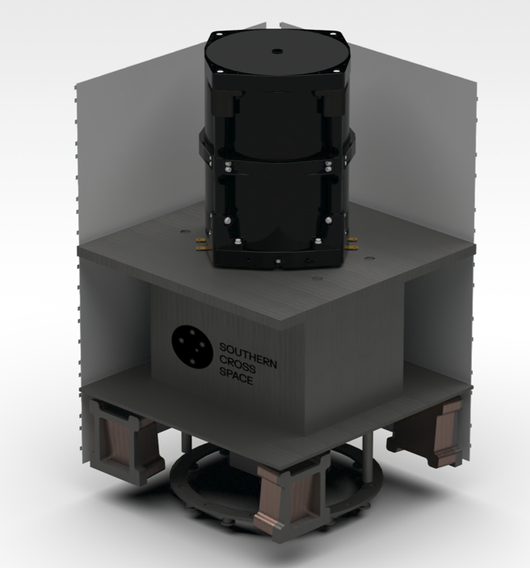
Intellectual Property
What we are doing different
MICROSATELLITE
High resolution
Technical specifications
COTS Components or developed by SatRev (On-Board Computing, Electric Power System)
Satellite design owned by Southern Cross Space
Assembled and Integrated in-house
Tested in local partners facilities
Southern Cross Space will own the Intellectual Property for Assembly, Integration and Testing (AIT)
12
Spectral bands | RGB+NIR → 7 multispectral bands
Image resolution | 1.5m to 0.5m
Mass | 50 kg
Communication | UFH, S-Band an X-Band
Propulsion | for orbit correction and deorbiting
Rendering of a Southern Cross Space MicroSatellite
Notes:
Assembly
Skills to assemble certain set of components as designed by sister company SatRev. Up to the design and sharing the same level of expertise. This process involves constructing the satellite frame and installing electronic components like computers, sensors, and communication systems. Precision and care are essential to avoid damage to sensitive parts, often requiring specialized tools and cleanroom conditions.
Integration
Integration of assembled Components with Bus of MicroSat. Subsystems are interconnected to work cohesively. This includes linking electrical systems and ensuring subsystem compatibility, such as power, data handling, and instruments. Software is also installed, and initial integrated system tests begin. The goal is to achieve a fully operational satellite.
Testing
The CubeSat undergoes extensive testing to ensure it can endure space's harsh conditions. Environmental tests simulate extreme temperatures, vacuum, and launch vibrations. Functional tests check operations like power generation and communication. System-level tests confirm the satellite works as a whole, and is run with use of local testing facilities.

Slide 13
Pacific Nations - What Is your place in Space?
If you controlled space, would it include:
Priority towards regional access?
Real time Access?
Emergency Response?
Climate Change monitoring?
Agricultural focus?
Maritime Domain Awareness?
Notes:
Emerging economies face significant threats to national security and sovereignty due to their reliance on foreign space technologies and data. Without independent space capabilities, these countries are vulnerable to strategic disadvantages, loss of control over sovereign assets, and insecure satellite data critical for military and national operations.
The economies of emerging countries are at risk of stagnation and vulnerability due to a lack of diversification and investment in high-tech industries. Studies by NASA and ESA show that space-related investments can yield an impressive ROI of 8:1, highlighting the potential economic benefits. Investing in the space sector can stimulate advanced manufacturing, create high-tech jobs, and strengthen economic resilience by diversifying into a promising and lucrative industry.
Emerging countries are experiencing a brain drain as top talent migrates to nations with more advanced technological opportunities. By fostering a robust space sector, emerging nations can retain talent, develop a skilled workforce, and position themselves as innovation hubs, driving technological advancements and boosting global standing and influence.

Slide 14
Who wants to work in the space industry?

Slide 15
WE BELIEVE EVERYONE HAS A PLACE IN SPACE
Contact us: contact@scspace.au

