Slide 1
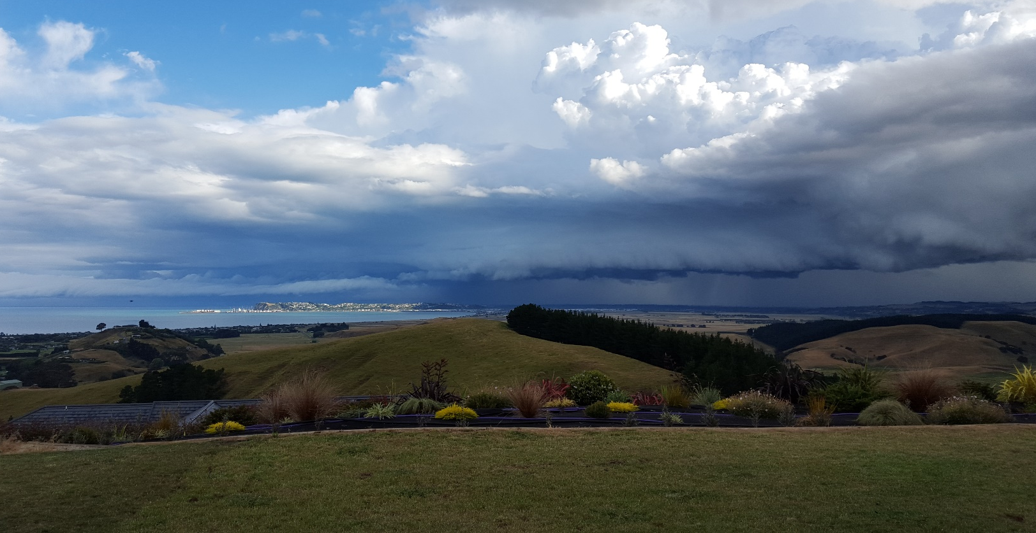
Tracking
Storm
Simon Nitz

Slide 2
This presentation is not about Storm Tracking!

Slide 3
This presentation is about Tracking Storm!
Censored

Slide 4
Why?
Storm likes to undertake missions outdoors
Missions for Storm can take a couple of days to complete
It would be nice to know how far through his mission he is!
Carry me!

Slide 5
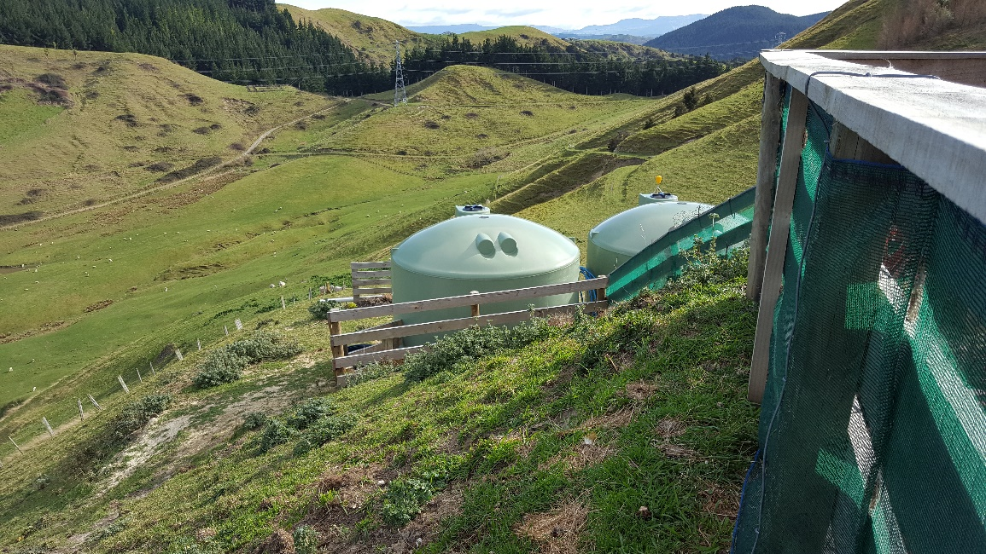
Terrain

Slide 6
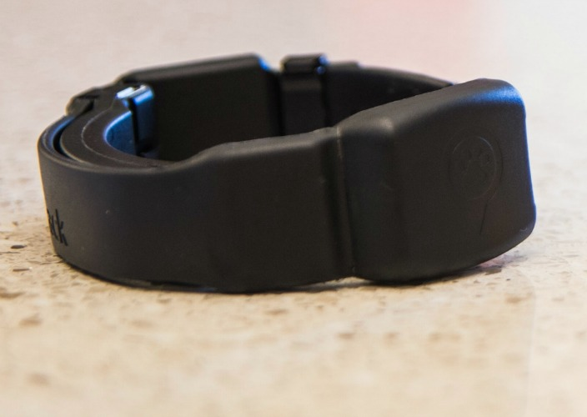
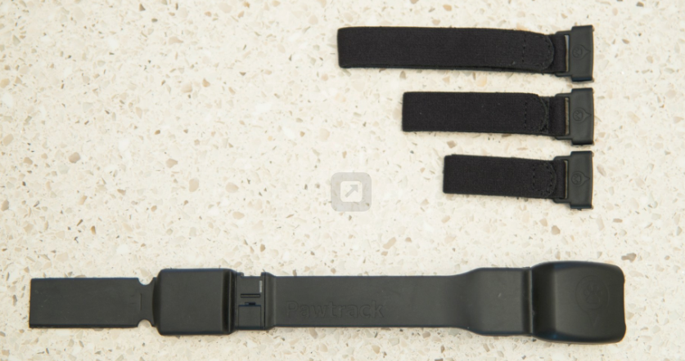
Tracking Technology
http://pawtrack.com/
Cat GPS Collar
GPS/3g/2g/Wifi/Glonass

Slide 7
Tracking Technology

Slide 8
Online Tracking Site

Slide 9
Online Tracking Site

Slide 10
Online Tracking Site

Slide 11
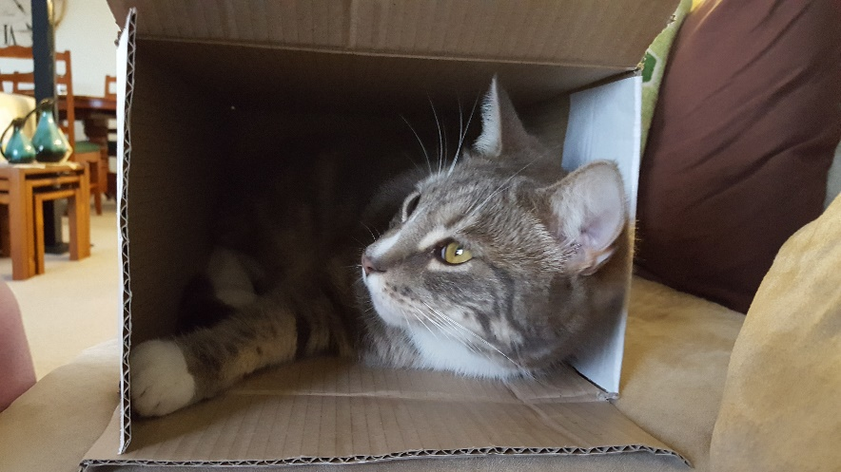
Online Tracking Site Limitations
Can I get the raw data?
What about track lines?
What is Storms territory?
How many km does he travel?
Think outside the box!

Slide 12
Raw Data
No web service available
However I can “scrape” the raw data from the website!

Slide 13
Raw Data to Useful Data
With a little bit of scripting, the json data can be uploaded to PostGIS database…
psql.exe -U postgres -d StormDatabase -q -t -A -0 -z -c "create temporary table temp_json (values text) on commit drop;copy temp_json from 'C:\storm\storm.json’; insert into storm20170214 select * from json_populate_recordset(null::storm20170214, (select values::json from temp_json));"

Slide 14
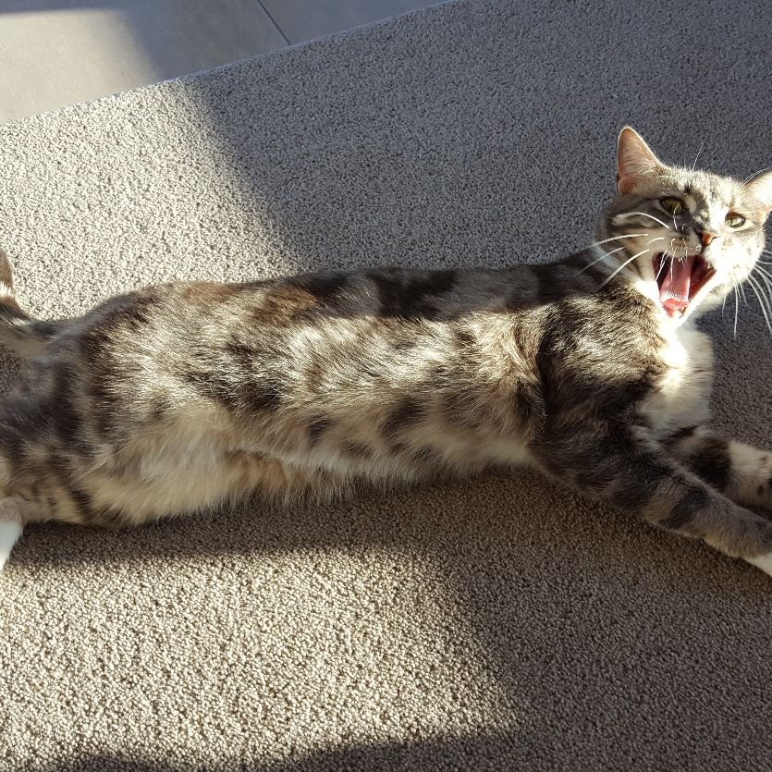
A little bit of PostGIS Magic
Create some useful database views:
View with geometry points
View with line segments
View with polygon defining territory
It’s magic!

Slide 15
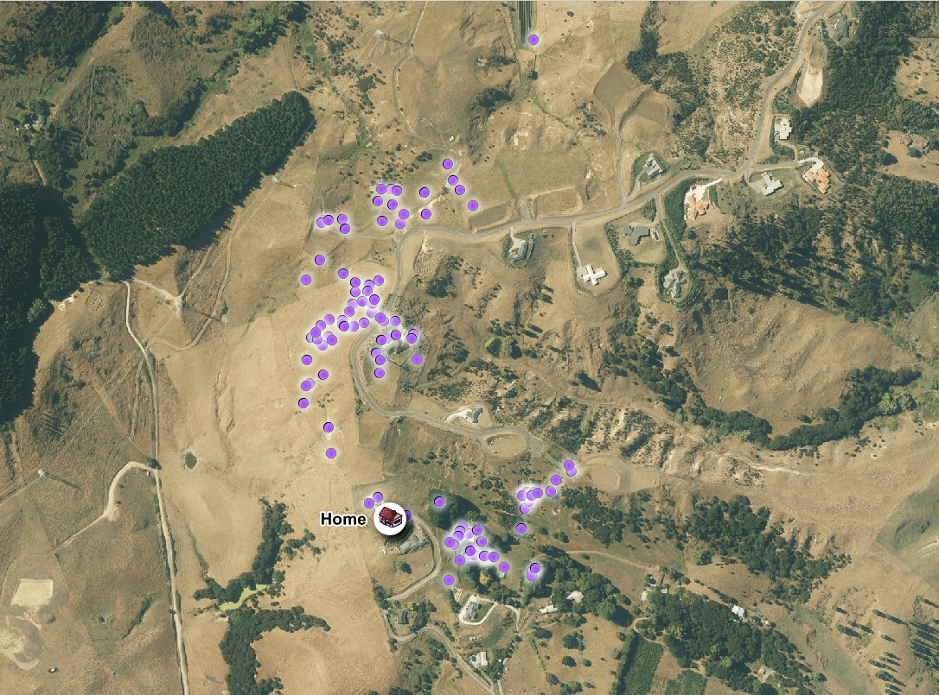
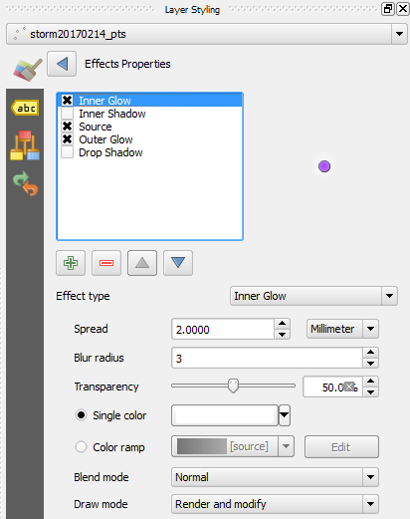
QGIS
Points

Slide 16
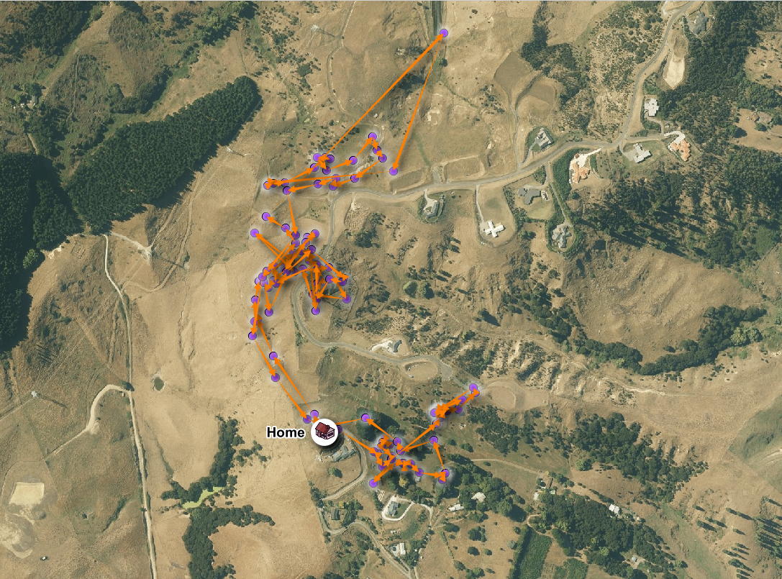
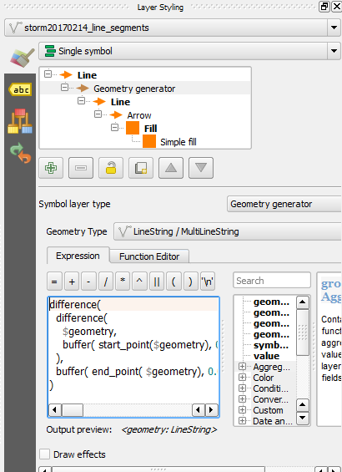
QGIS
Lines

Slide 17
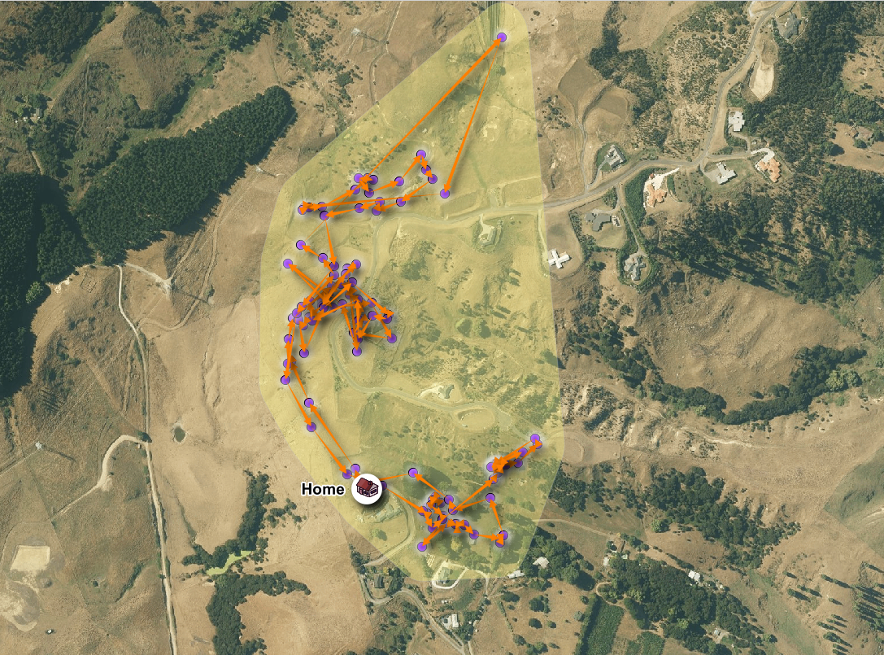
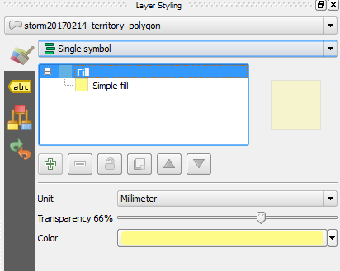
QGIS
Polygon

Slide 18
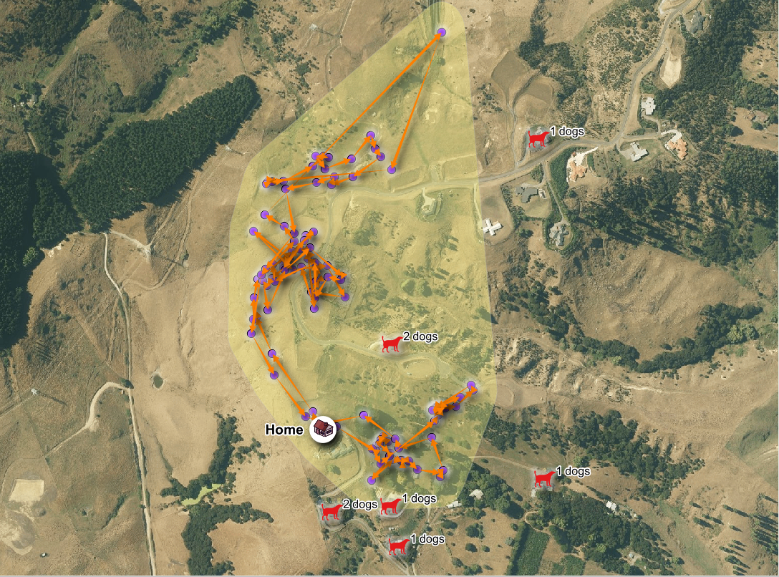
QGIS
Why those particular areas?
Dogs!

Slide 19
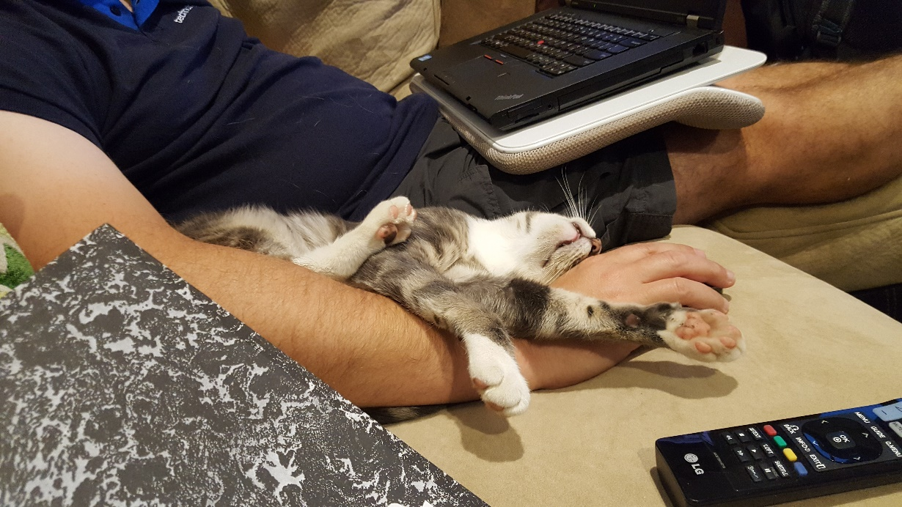
After a mission!
This mission was over a 12 hour period on the night of 14 February 2017
Storms mission covered over 5km
12 hours of sleep is required before the next mission!

Slide 20
Thanks

