Slide 1
Réseau régional des universités des iles du Pacifique
2024 Pacific GIS & Remote Sensing User Conference
25th November 2024

Slide 2
PIURN
Founded in 2013 under the name Pacific Islands Universities Research Network, PIURN brings together 15 Member Universities of Pacific Islands Countries and Territories (PICTs).
In 2023, the consortium renamed the network, wishing to broaden the scope of its action and to strenghten its impact at the regional level.
PIURN Vision
To collectively empower the Pacific Universities to become key contributors to finding solutions for challenges facing the region
PIURN Mission
To empower the new generation of Pacific leaders, researchers and professionals to better serve the needs and aspirations of the Pacific communities, in accordance with the education, research and technology pillar of the 2050 Strategy for the Blue Pacific Continent.

Slide 3
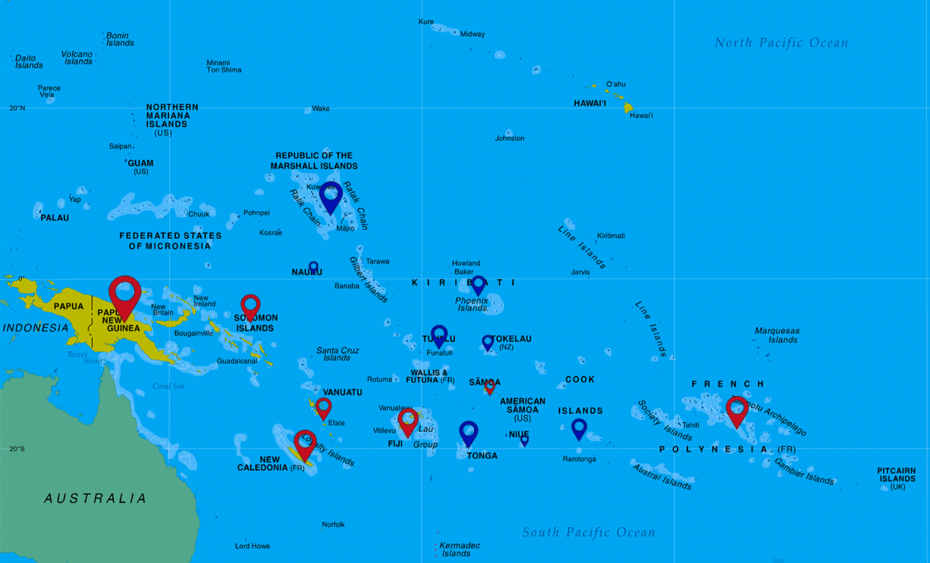
PIURN – Location of Member universities
French Polynesia
Fiji
New Caledonia
Papua New Guinea
Samoa
Solomon Islands
Tonga
Vanuatu
The network is also present all over the Pacific
with USP 12 regional campuses, including :
- Cook Islands
Kiribati
Marshall Islands
Nauru
Niue
Tokelau
Tuvalu

Slide 4
PIURN 15 Members Universities

Slide 5
PIURN Organisation
The PIURN Board is the high level body shaping the network’s development strategy. It is formed by of PIURN members’ VC, or their representatives. It is chaired by the University of the South Pacific (USP) and University of New Caledonia (UNC). The board meets at least once a year (physically, in normal conditions).
The PIURN secretariat is jointly managed by USP and UNC.

Slide 6
PIURN Objectives
Generate knowledge through research and on priority challenges in the Pacific region, aligned with the SDG’s
Share physical and intellectual resources manner, to facilitate quality research
Develop shared research training initiatives
Collectively work with regional and international organizations
Strengthen research content in the curriculum and in teaching, with a focus on strengthening the postgraduate training and enhancing joint degrees at the Masters and PhD levels
Protect and apply local and indigenous knowledge systems
Provide research policy advice at the regional and national levels
Use the knowledge generated through research for the well-being of the Pacific Island communities.

Slide 7
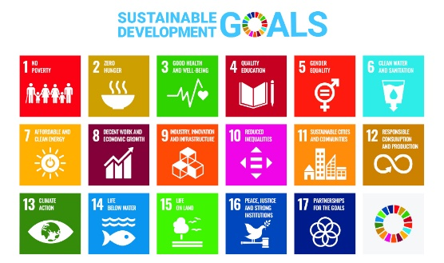
PIURN Strategic Research Themes and SDGs
2015-2030
PIURN is labelled by the United Nations as a SDG Action : #SDGAction39993
All PIURN Projects are aligned with the United Nations’ Sustainable Development Goals (SDGs).
PIURN has 4 main strategic research themes
Food Security & Nutrition, and Health & Non- Communicable Diseases
Climate Change & Biodiversity, including Land Degradation
Capacity Building, and Data & Statistics
Social Development, Gender Equality & Education

Slide 8
PIURN Call for Proposals
PIURN collaborative scientific projects are multidisciplinary and contribute to explore concrete solutions to the Pacific Challenges. PIURN Projects have to bring together at least 2 Universities from the network. External partners are invited to collaborate to PIURN Projects.
Since 2017, calls for proposals funded by UNC and USP were launched as an incentive to promote research collaboration within the network.
USP and UNC have funded a 26 projects for a total of 909 091 FJD – 614 514 AUD – 383 448 euros
Examples of Projects:
Air Pollution in Pacific Island Cities: PM_{2.5} Measurements, elemental Composition and Bio- monitoring - USP, FNU, UNC and University of Massuchetts
SOSPADIS SOcio‐SPAtial Dynamics of Informal Settlements in Fiji and Vanuatu – UNC, USP and Massey University
Financial Literacy, cognitive skills and youth socialization in the South Pacific – UNC, USP, FNU and NUS

Slide 9
PIURN Projects – Impact Assessment
- 28 Research collaborative projects
- 2 534 000 euros attracted for research grants, following PIURN Projects
- 14 publications
- 9 communications in regional or international conferences and workshops
- 50+ students involved in the research work of the PIURN projects
- 7 full-time internships with thesis
- A contribution to the development of a regional initiative coordinated by SPC (Pacific Data Hub)
- Major global visibility given to the PIURN network through the project on migrations and climate change and especially the projection of the 52’ documentary called ‘Nations of Water’ in France, the USA and Spain (with a Spanish translation)

Slide 10
PIURN as a catalyst for regional academic initiatives
Pacific Women Lead (PWL) at SPC
The University of the South Pacific (USP) leads a research project on Barriers to Women Leadership in Pacific Universities , with an emphasis on Science, Technology, Engineering and Mathematics (STEM), in partnership with FNU, SINU, NUS and PIURN. Western Sydney in collaboration with Science in Australia Gender Equity (SAGE) Ltd are partnering in the project. The grant was developed within PIURN.
Budget: 450 000 AUD, funded through DFAT
Date : 2024-2025

Slide 11
PIURN as a catalyst for regional
academic initiatives
FALAH: Family Farming, Lifestyle and Health project - multidisciplinary project, led by University of New Caledonia aligned with the SGDs, explores the impact of climate change on food security and practice of the Pacific population’s health.
Partners: USP, SINU, NUV, Australian Universities (UoW, UNSW, Usyd), European Institutions (Toulouse University)
Budget: 1.3 million euros (2.1 millions AUD) from the European Commission Horizon 2020 Marie Curie program
An additional funding of 300 000 euros (486 700 AUD), through the EU-RERIPA Call 3 Living Labs has been secured to launch the CHANCES Project (Climate cHANge and the futures of Coastal communitiES), with USP, UNC, NUV and SINU, to study the changes in livelihood practices and lifestyles, especially in the context of climate change impacts on vulnerable territories subject to coastal vulnerability and sea level rise.
Field sites: Fiji, Solomon Islands and Vanuatu
.

Slide 12
PIURN Conferences
The network hosts a Conference every two years. These conferences highlight the work of the Pacific researchers and students, showcase the PIURN projects and establish new collaborations.
In 2014, the University of New Caledonia organized the 1st PIURN Conference.
In 2016, the National University of Samoa introduced the theme of “Addressing the Challenges of Sustainability in the Pacific Islands” for the 2nd Conference.
In 2018, the University of French Polynesia hosted the 3rd PIURN Conference, on the theme of “Traditional knowledge, academic knowledge and current universities’ research dynamics in the Pacific region ”.
In November 2021, the first virtual Conference was hosted by Solomon Islands National University, and explored the theme of “Shaping our Tomorrow Today: Research, Innovation and Practice in the Pacific”
July 2023 marked the 5th Conference of the network, organized by USP Cook Islands Campus, with the theme “Exploring this Sea of Islands”

Slide 13
6th PIURN Conference
The 5th PIURN Conference will be organized and hosted, Papua New Guinea University of Technology, in Lae, in July 2025.
Theme and Save the date will be announced in the coming weeks.

Slide 14
Contact us:
Mathilde Souchon
PIURN Coordinator
mathilde.souchon@usp.ac.fj
+679 323 1451
www.piurn.org

