Slide 1
Copernicus Data Space Ecosystem
Access to Copernicus Sentinel data and beyond
24 Nov. 2024
Notes:
I am very pleased to be here today. My name is Rémi Andreoli, and I am presenting the Copernicus Data Space Ecosystem today as PGRSC Board member.
Indeed, PGRSC is the Copernicus Relay for the Pacific Region since 2020 and is acting as information and point of contact for all the Pacific Islands users who need assistance with Coperniscus data and service

Slide 2
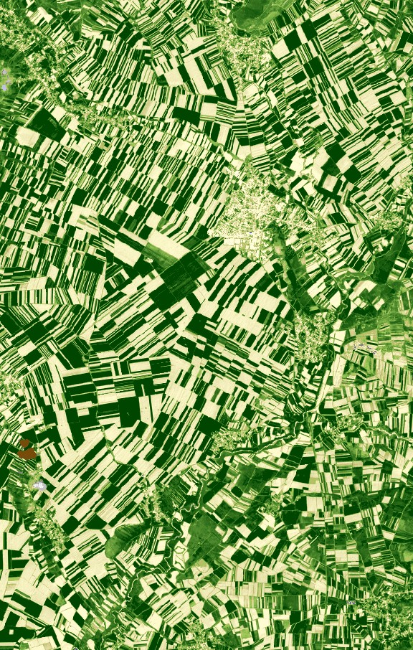
Rationale
„Copernicus must strive for digital excellence. We want Copernicus data to be easily accessible and usable. At the same time, we need a powerful data analytics environment to attract new users, in particular from non-space sectors.”
Thierry Breton, ex-Commissioner for Internal Market
Notes:
Copernicus is the Earth observation component of the European Union’s Space programme, looking at our planet and its environment. It offers information services that draw from satellite Earth Observation and in-situ (non-space) data.
The European Commission manages the Programme. It is implemented in partnership with the Member States, the European Space Agency (ESA), the European Organisation for the Exploitation of Meteorological Satellites (EUMETSAT), the European Centre for Medium-Range Weather Forecasts (ECMWF), EU Agencies and Mercator Océan, the European Environment Agency (EEA), the Joint Research Center (JRC)
Since the beginning of the programme, We want Copernicus data to be easily accessible and usable, meaning data can be easily find and easily used.

Slide 3
Copernicus architecture
Notes:
Copernicus is not only satellites and data collection, it is a full ecosystem consisting in:
Constellation of satellites managed by the European space Agency (ESA) which will recha more than 30 satellites in 2030
Completed by contributing missions from partners worldwide, both private and public
Organized in 6 services that also
Transform the data into valude added products available through cloud-based platforms.

Slide 4
Copernicus Data Space Ecosystem
What is Copernicus Data Space Ecosystem?
Streamlined data access with API-s
Additional
EO Data
CCM Data
Federation and user identity services
Sentinel Data
Cloud Computing Capacity
Online Code Labs and Interfaces
Copernicus Browser
Open
Ecosystem
Onboard Code Repositorites
Notes:
Copernicus data space ecosystem primarily revolves around Sentinel Data, directly from EU satellites.
To complete the data generated and refine the information derived from them as well as cover their limitations, additional data is used from in situ sensors, and Copernicus Contributing Missions (CCM).
This wealth of data is then streamlined through application programming interfaces and made available through user interfaces.

Slide 5
Sentinel Data
What is Copernicus Data Space Ecosystem?
Sentinel Data
Notes:
The sentinel data component

Slide 6
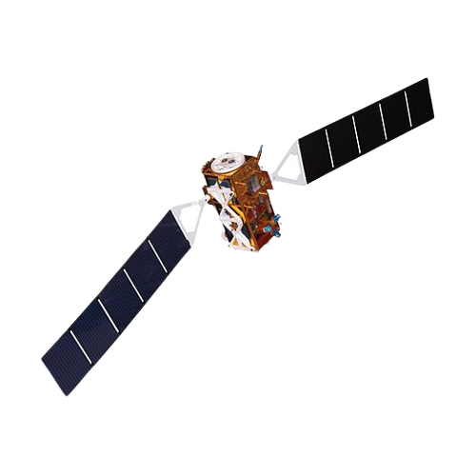
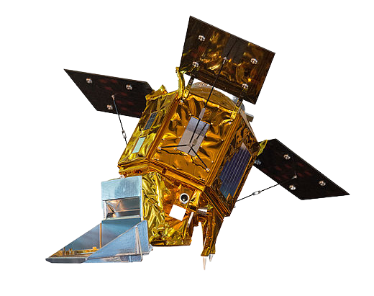
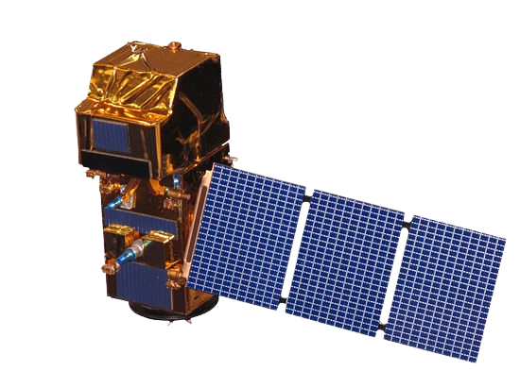
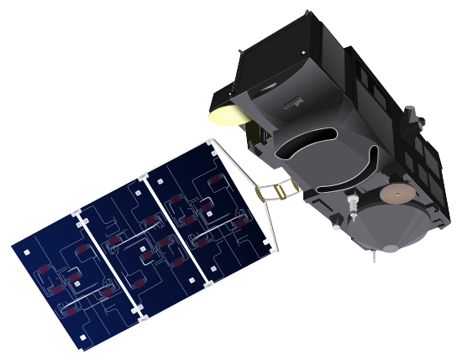
Immediately Available Data: Portfolio Overview
All Copernicus Sentinels User Level Data
Copernicus Contributing Missions Coverage Datasets
VHR European Coverage Dataset
Copernicus Digital Elevation Model
Sentinel-1 and Sentinel-2 cloudless mosaics
Copernicus Sentinels Auxiliary data
Copernicus Sentinels Engineering Data
Sentinel-1
Sentinel-3 Land
Sentinel-2
Sentinel-5P
Notes:
Is composed by all the Copernicus Sentinels satellites (1, 2, 3, 5) and the copernicus contributing missions coverage data sets that includes:
VHR data over European Union
Worldwide coverage Digital Elevation Model
Sentinel mosaics, both sentinel-1 and Sentinel-2
Auxilary data
And Copernicus Sentinels Engineering Data

Slide 7
Immediately available data: Sentinels
Sentinel-1 (RADAR)
GRD SAFE-COG
GRD SAFE (last year)
OCN
SLC
L0 RAW (Europe full, ROW last year)
Sentinel-2 (Optic)
L1C
L2A
Sentinel-3 (SAR and Optic)
OLCI L1/L2 NRT and NTC (NRT last year)
SLSTR L1/L2 NRT and NTC (NRT last year)
SRAL L1/L2 NRT, STC and NTC (STC last month, NRT last year)
SYN L2 STC, NTC (STC last month)
Sentinel-5P (Atmospere)
Level-1B NTC
Level-2 NRT and NTC (NRT last month)
If not explicitly stated otherwise, worldwide coverage, full and up-to-date collection
Notes:
If not explicitly stated otherwise, worldwide coverage, full and up-to-date collection
It means that Pacific Island countries are covered and included in ESA tasking plan

Slide 8
Additional datasets
What is Copernicus Data Space Ecosystem?
Additional
EO Data
CCM Data
Sentinel Data
Notes:
In addition to Sentinel data, copernicus is providing acces to thrid parties contributing mlission and EO datasets

Slide 9
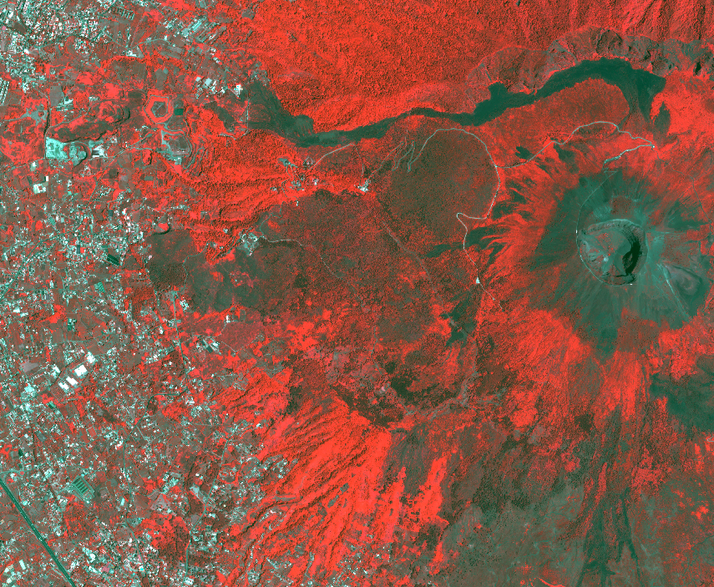
Copernicus Contributing Missions (CCMs)
CCMs supply additional data beyond the Sentinels to Copernicus to ensure that a whole range of observational requirements is satisfied.
VHR Optical Data
SAR Data
DEM Data
The main users of CCM data are the Copernicus services, which address several key thematic areas.
Other Copernicus users are also able to access certain CCM collections, depending on their eligibility.
Current availability via Browser/Odata/STAC (04/2024):
VHR Europe (2014-2016, 2017-2019, 2020-2022)
VHR Urban Atlas (2006, 2009, 2011-2013)
Notes:
CCM data are entirely accessible to Copernicus Services and the entities in charge of developing these services, mostly benefitting European citizens. Though, other users outside of Copernicus Services (and related implementing institution) are also able to access certain CCM collections, depending on their eligibility

Slide 10
Additional EO Data
Name | Type | Accessibility | Time range/Extent
Sentinel-2 Mosaics | Optical | OpenSearch, Sentinel Hub, Browser | 2020-2021/Global
Copernicus DEM | Elevation model | OpenSearch, Sentinel Hub, Browser | 2018/Global
SMOS L1/L2 | Soil Moisture | OpenSearch, OData | 2009 - ongoing
ENVISAT MERIS | Optical | OpenSearch, OData | 2002-2012
Landsat 5 / 7 / 8 | Optical | OpenSearch, OData | 1984-2013 / 1999-ongoing / 2013 – ongoing/Europe
Copernicus Land Monitoring Service | Processed products | S3 | Europe
Copernicus Marine Environment Monitoring Service | Processed products | S3 | Global/European/individual water bodies
Copernicus Atmosphere Monitoring Service | Processed products | S3 | Global
Sentinel-1 RTC | SAR | OpenSearch | 2018-Present/Global
Sentinel-1 CARD-BS | SAR | OpenSearch | 2014-Present/Europe
Sentinel-2 Land cover | Processed products | OpenSearch | 2017/Europe
Notes:
Additionnal EO Data
Sentinel-1 RTC, Radiometrically Terrain corrected data

Slide 11
Copernicus Browser
What is Copernicus Data Space Ecosystem?
Copernicus Browser
Notes:
To make all these data availble, Copernicus set up and maintain a web browser at dataspace.copernicus.eu

Slide 12
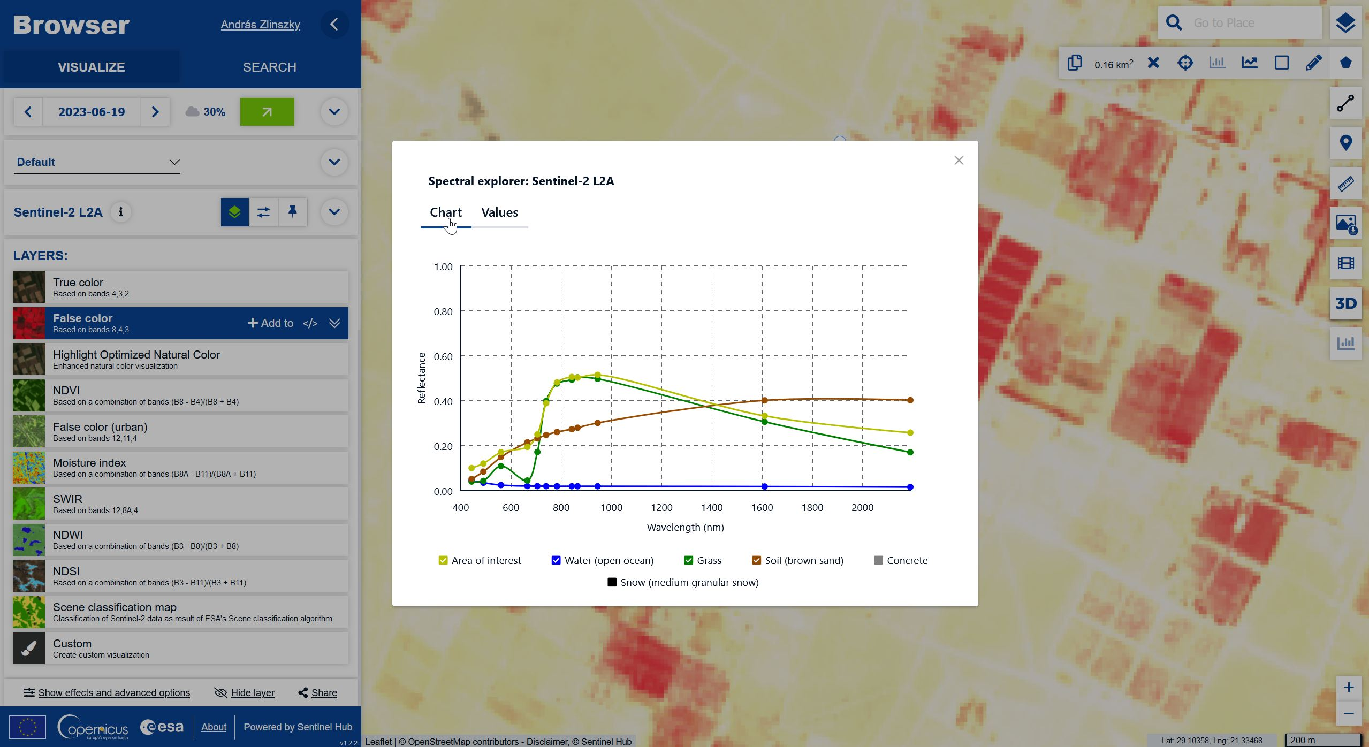
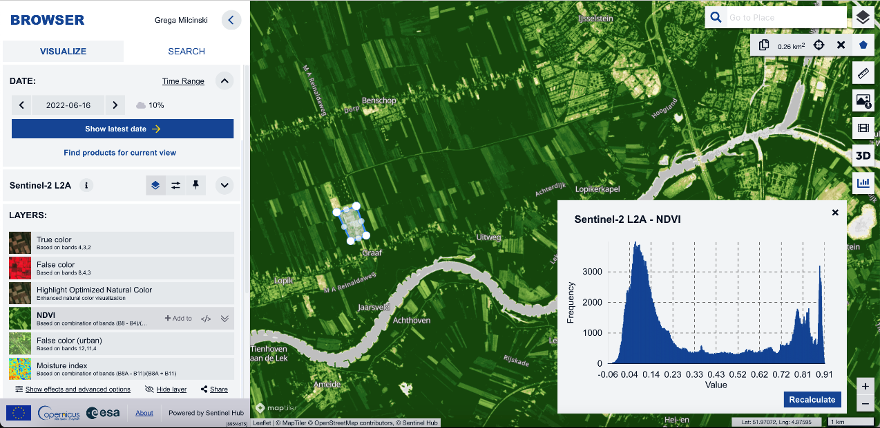
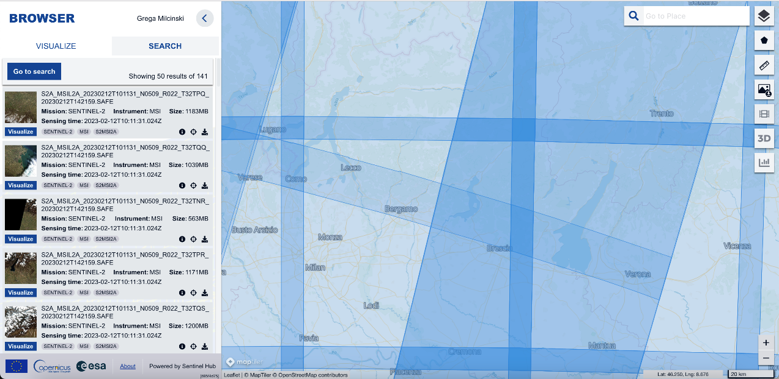
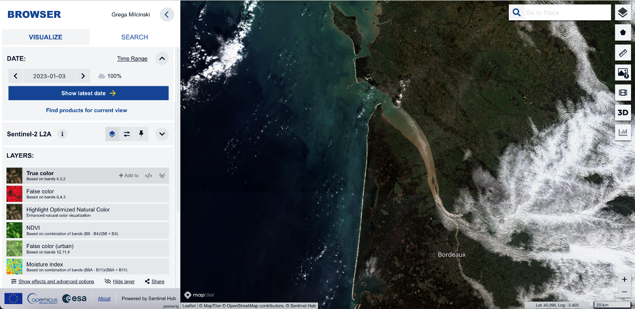
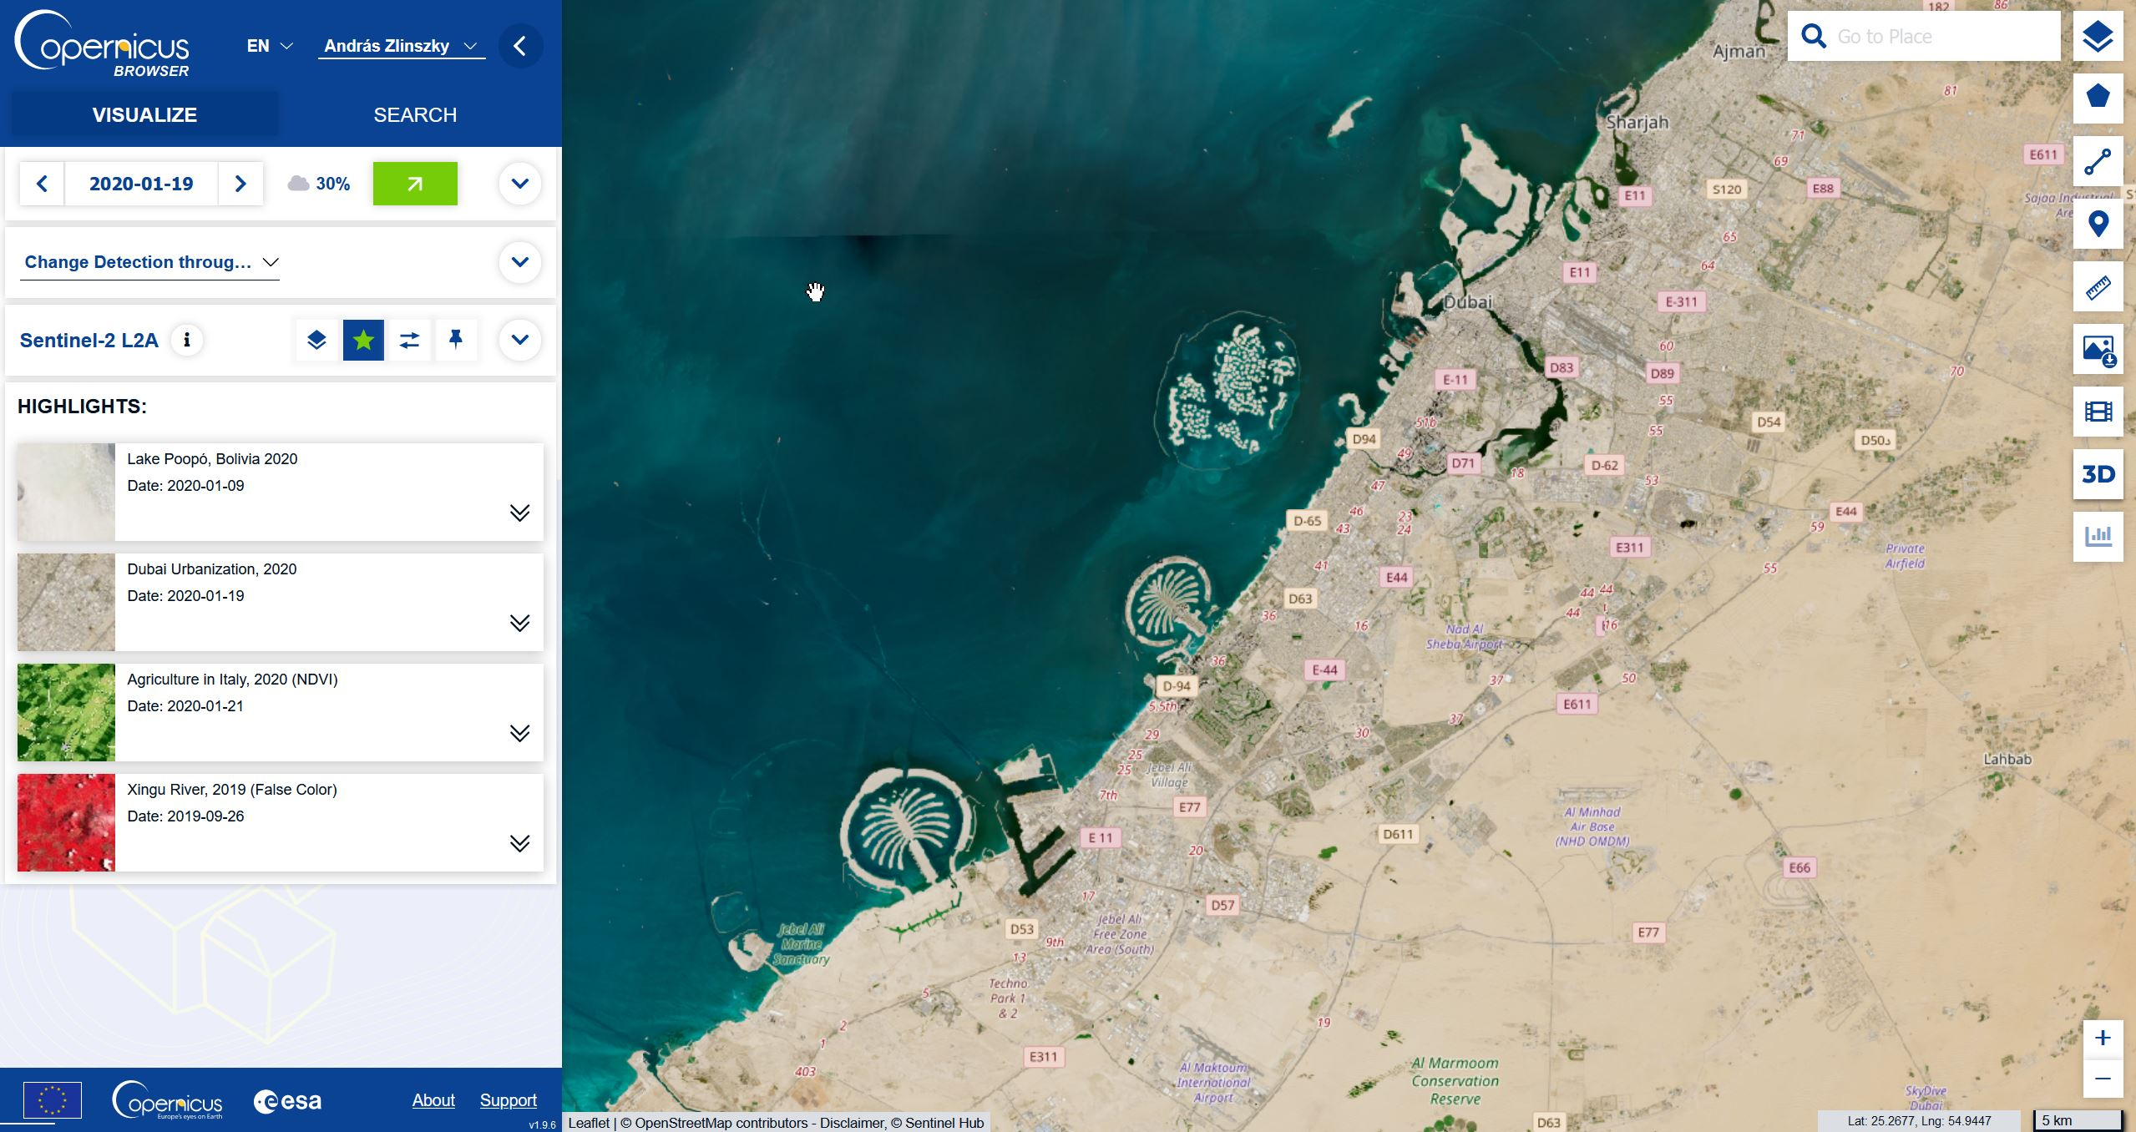
Copernicus Browser
Search, query and download all User Level Products
Interactive visualisation and analysis of most important data collections
Export:
subset of the data (also in print quality)
Comparison,
time-lapses,
area analysis and more
Direct sharing of images via short url-s, education themes and highlights

Slide 13
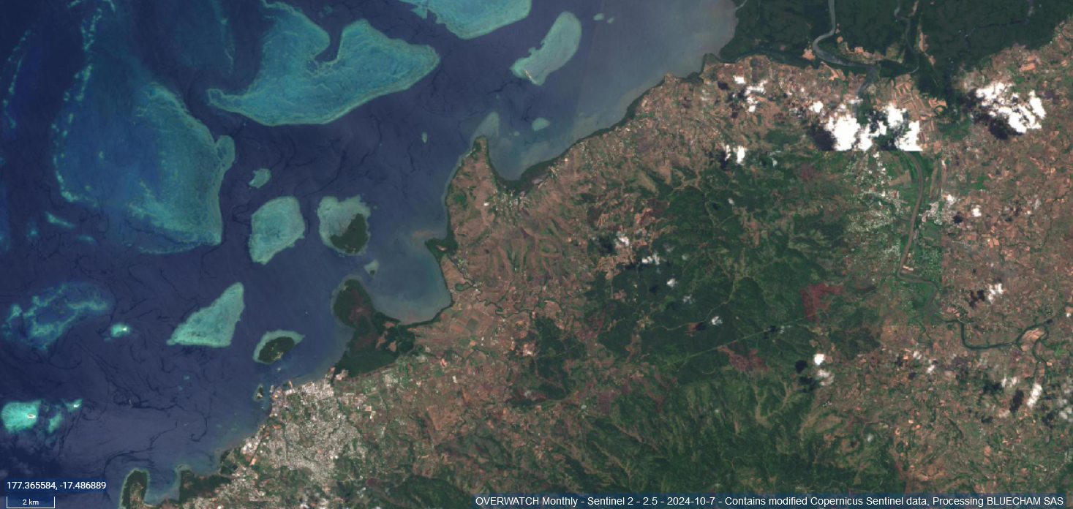
Some examples

Slide 14
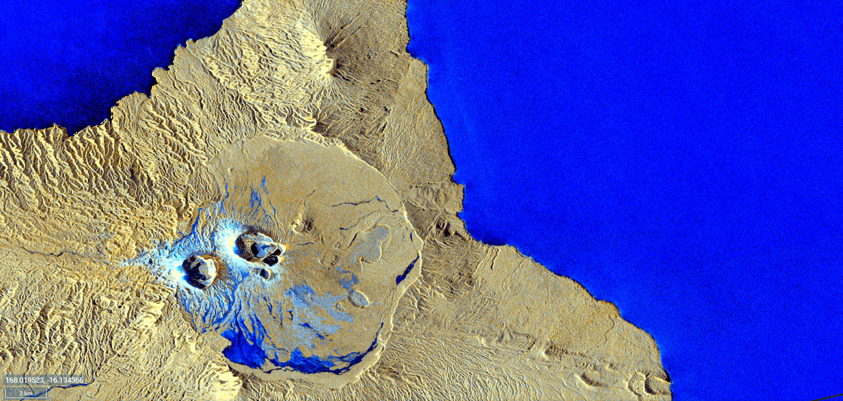
Some examples

Slide 15
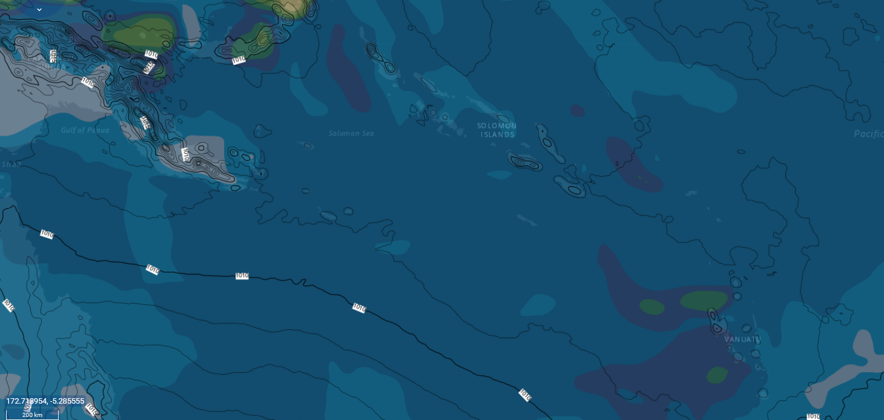
Some examples

Slide 16
API access
What is Copernicus Data Space Ecosystem?
Streamlined data access with APIs
Notes:
Access to Copernicus data streamlined through Application Programming Interfaces centralising and streamlining the data to make it available to User Interfaces.

Slide 17
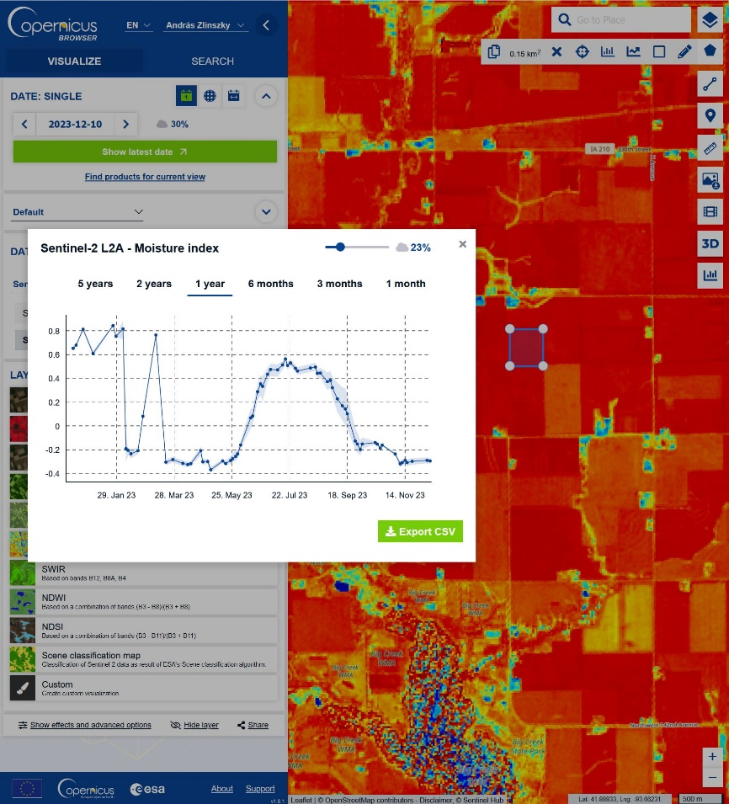
Data access and processing API-s - overview
Discovery/catalogue (STAC, OData, OpenSearch)
Query the Data Catalogue and return GeoJSON feature collections
Download products (S3, OData)
Access to full product via zipper interface and access or direct access to any file or byte range
Streamlined access (Sentinel Hub, OpenEO)
Catalogue APIs → return list of datasets
Visualisation (OGC) → returns a map
Process (instant, batch) → returns raster product
Statistical (instant, batch) → returns calculation results
Bring your own data (COG, zarr) → makes your own data compatible with the online datasets
openEO → Format and language-independent scalable processing
Sentinel-2, Moisture index time series near Knoxville, Tennessee, USA

Slide 18
Code resources & Interfaces
What is Copernicus Data Space Ecosystem?
Online Code Labs and Interfaces
Notes:
Quick overview of the online interfaces, labs or notebooks for users to make use of the data, with various level of knwoledge or expertise required and covering a wide array of applications (different use cases, from ice monitoring to soil erosion).

Slide 19
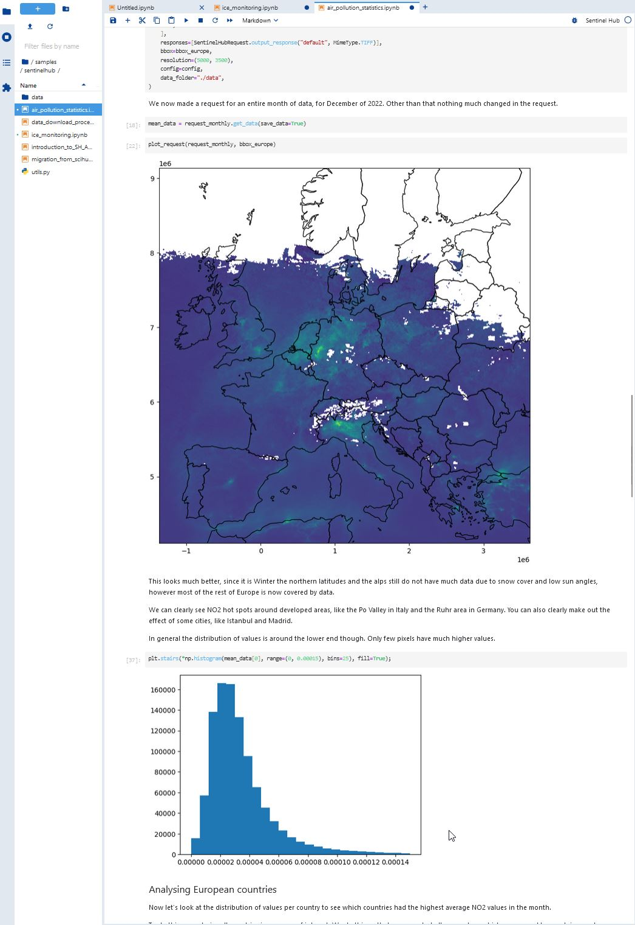
Jupyter Notebooks
JupyterLab: on-board server infrastructure with dependencies installed and direct access to data collections
OData
OpenEO
Sentinel Hub
Available tutorial notebooks for a wide range of use cases from beginner to expert level
Air pollution
Ice monitoring
NDVI Time series generation
Soil erosion
Wildfire monitoring
Cloud computing
Reuseable code blocks for operational use
Code repository on GitHub https://github.com/eu-cdse

Slide 20
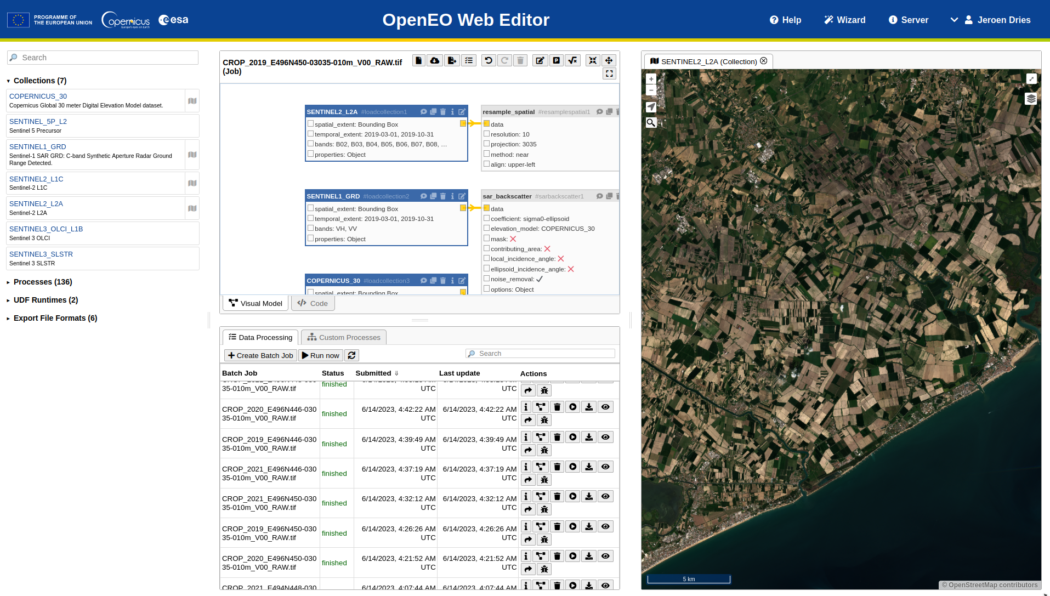
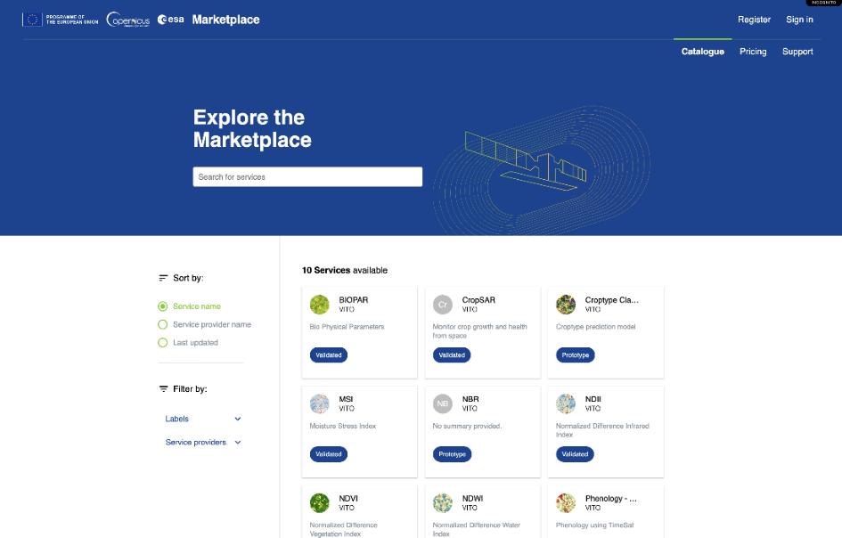
Interfaces for code development: openEO
openEO – code-agnostic, datacube-based API suite for advanced EO data processing based on an intuitive interface
Excellent scalability
Several access options, including
OpenEO GUI
Jupyter Notebooks
Algorithm Plaza – processing chain prototyping and commercialization

Slide 21
Onboard code repositories
What is Copernicus Data Space Ecosystem?
Onboarding
Notes:
How to access the Copernicus Data Space Ecosystem, how to understand it and how to make use of it:
-onboarding through self registration and documentation available to get familiar with ther ecosystem.

Slide 22
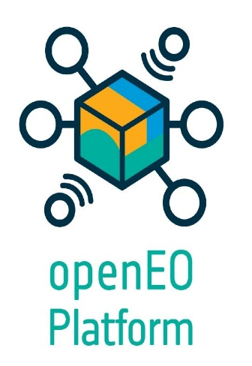
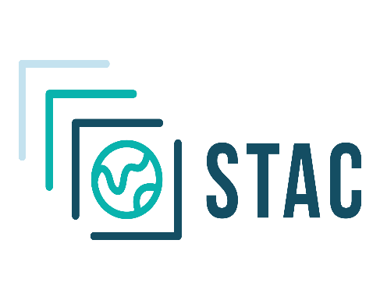
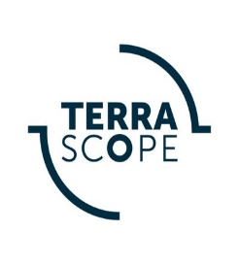
Ecosystem – Onboarding & Federation
Onboarding:
Easy onboarding through self-registration
Supported onboarding for e.g., start-ups and more complex technical implementations Open to all - science, government, business, start-ups,
that endorse the published eligibility criteria
Federation:
Interoperability based on established open standards e.g., OIDC, STAC, openEO
References – CREODIAS, DLR, Dunia, LSADC, WEkEO, Terrascope
Dunia
Submit the application form on the web portal

Slide 23
Ecosystem help center - Documentation

Slide 24
Ecosystem help center – Community Forum

Slide 25
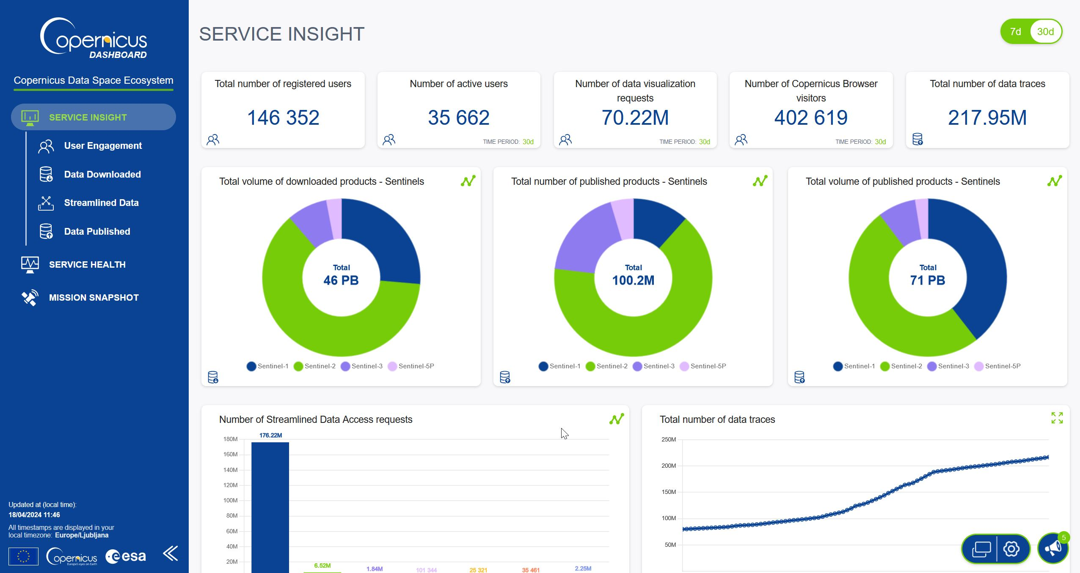
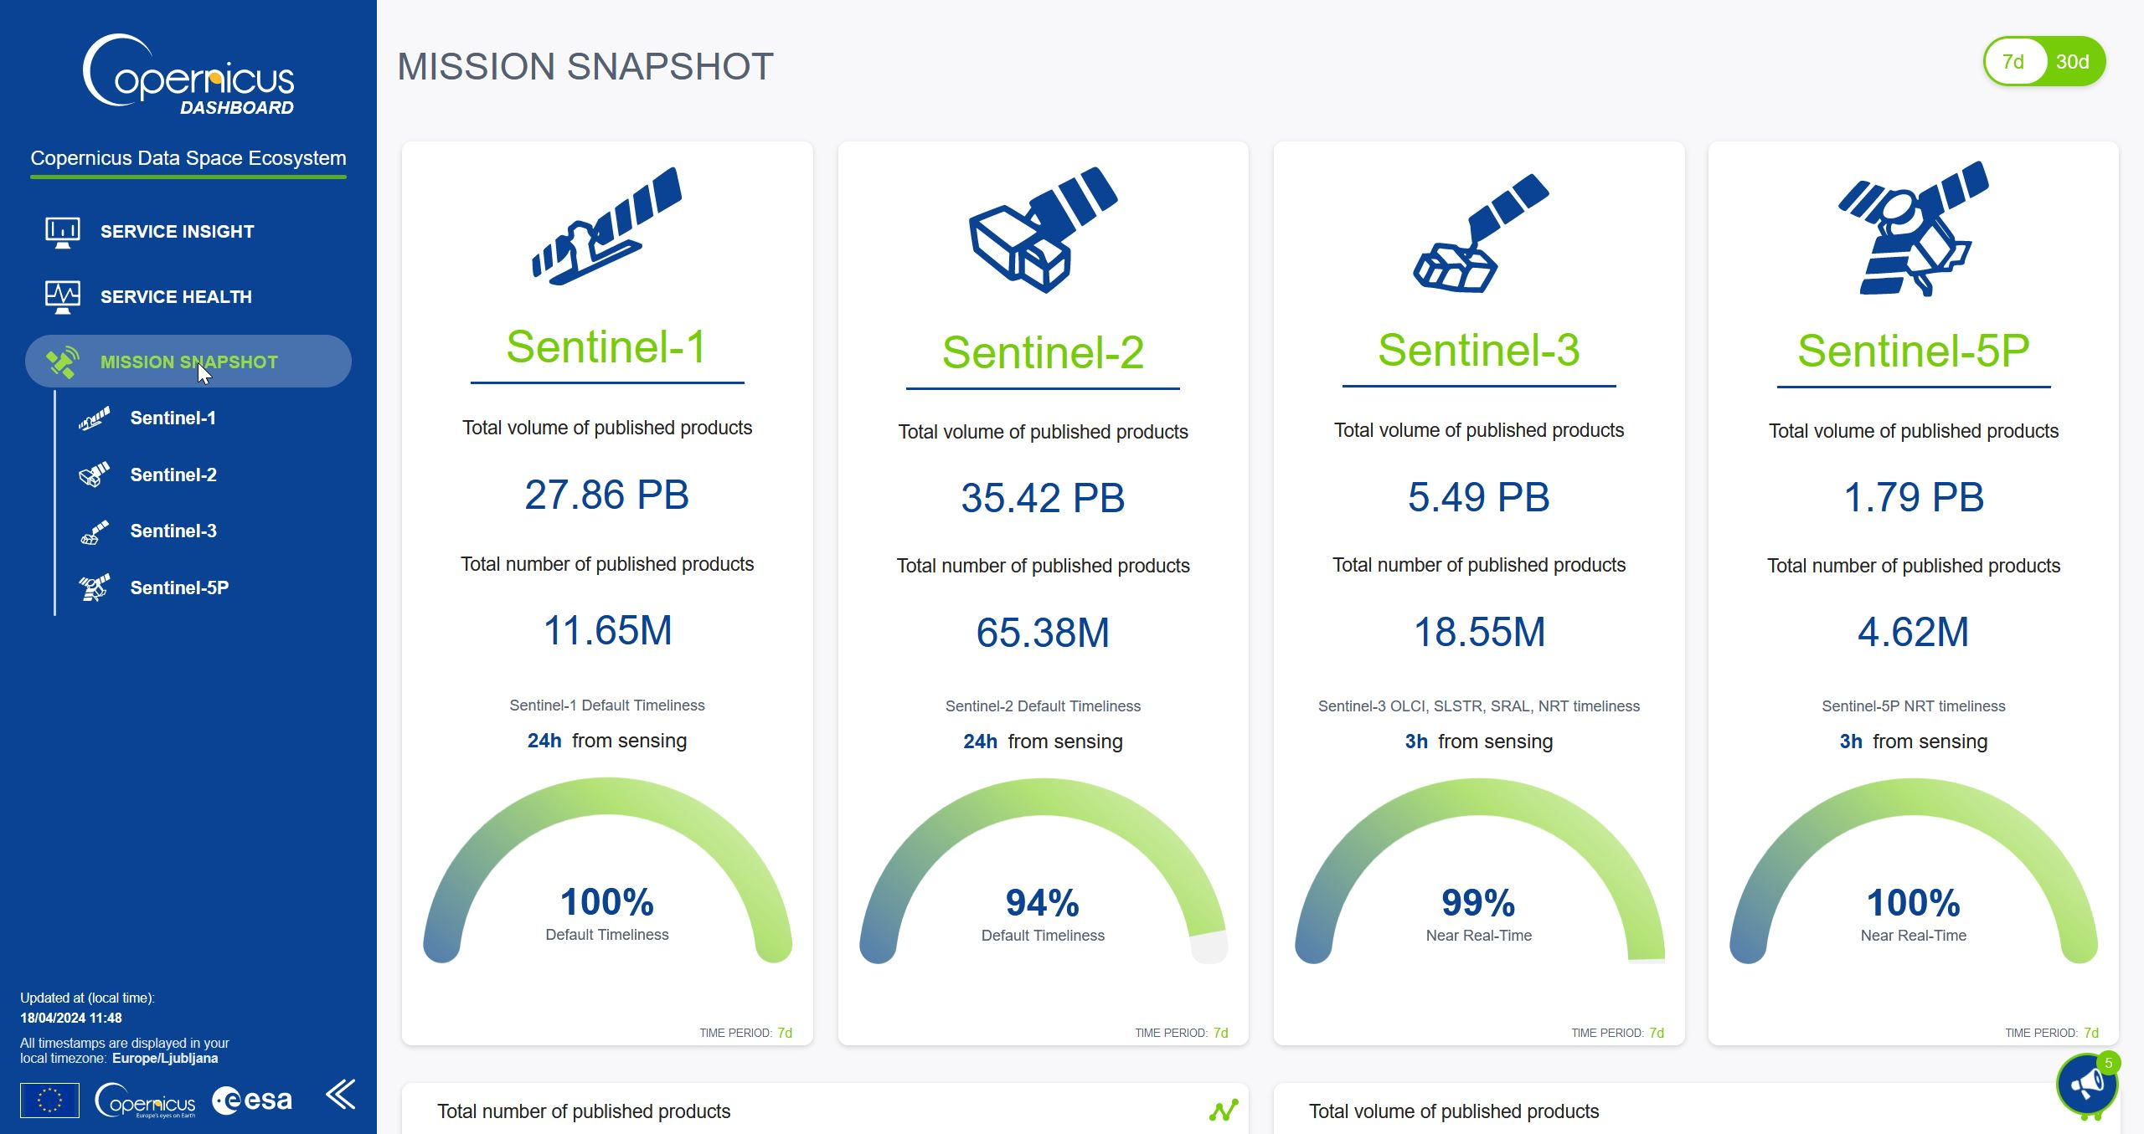
Ecosystem Dashboard
Real-time dashboard for following ecosystem health and use
Instant service news banner
User counts and types
Published and downloaded data volumes
Streamlined data access units
Service health
Earth Observation Mission snapshot

