Slide 1
Data Terra, e-Infrastructure of Research for Earth and Environment System
Jean MASSENET Coordinator for Oceania
Pacific GIS & Remote Sensing User Conference 25th November, 2024

Slide 2
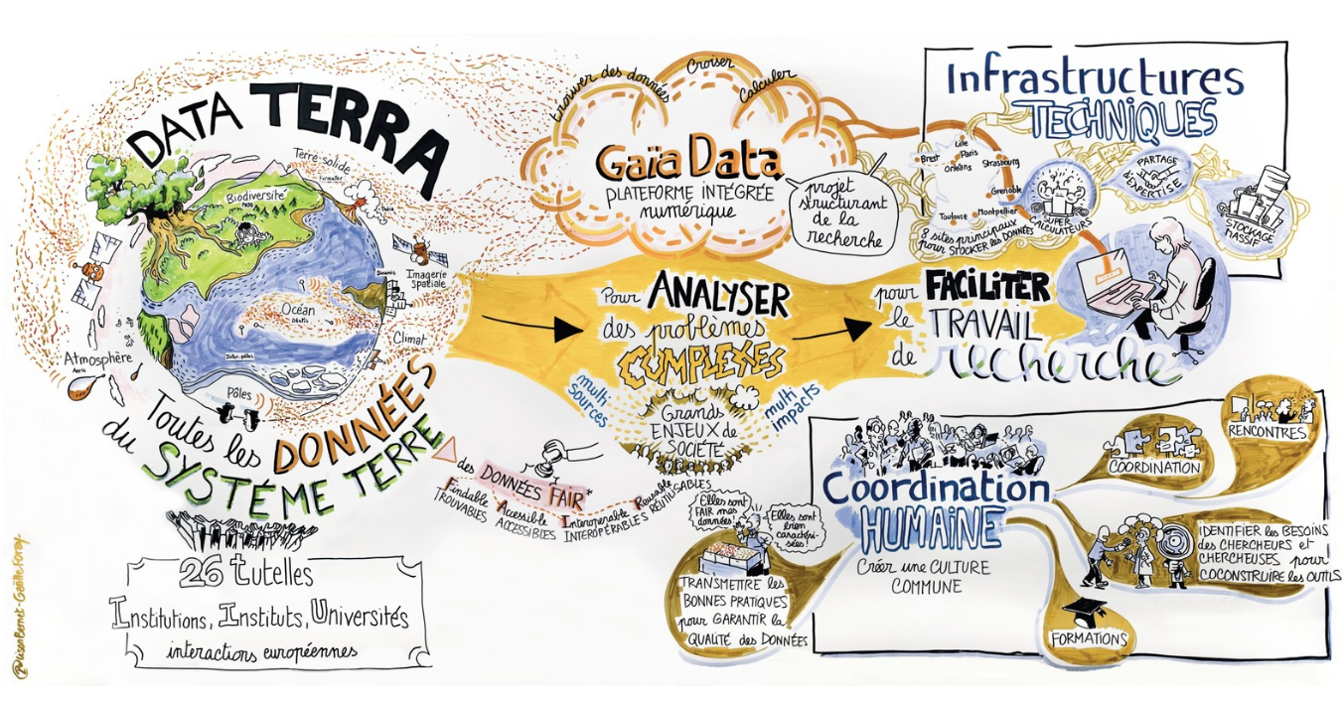
Develop a global system for accessing and processing multi-source data
and developing services to observe, understand and predict
the functioning and evolution of the Earth system in an integrated manner
CONTEXT
2

Slide 3
Community of Oceania Geospatial 2025
An initiative serving the sustainable development of Pacific Island Countries & Territories

Slide 4
Proposed plan for this COG-25 session
Presentation of the COG-25 project and its added value for the regional geospatial community
Origins: where this initiative came from
Perspective: what the long-term vision is about
Proposed method: how we can reach together our common goals
COG-25 Talanoa session
Discussions with the audience, facilitating the bottom-up process to consolidate collectively and inclusively the actions to be led through this COG-25 project

Slide 5
Origins of the project

Slide 6
Philosophy of collaborative development
Main considerations:
Know better each other to work better together and favorize collaboration
Ensure inclusivity (public/private) & facilitate bottom-up process
Guaranty concertation and determine collegialy both needs & priorities
Mutualize & rationalize resources while adressing common issues
Target efficiency for a better support to operational needs of decision-makers (through RDI)
Create a market, supporting local economic development
Representative
local animations
Inclusive community collaboration
Institutions
Ensure ‘’bottom-up’’ to feed
country-scale geospatial strategies
Private sector
Civil society
Support to Sustainable Development
Research & Education

Slide 7
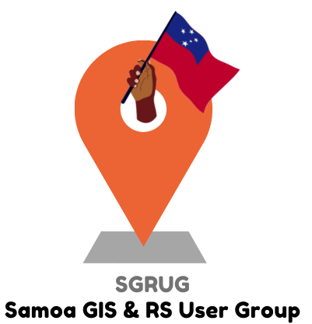
Need for representative local animations
Mission : To structure, federate & animate
the local geospatial community
Role : Catalysing geospatial community
& incubating inclusive collaborative projects
Events with plenary sessions et networking
Collective intelligence workshops leading to concrete actions at S-LT & common projects

Slide 8
Challenges of regional collaboration
Fundamental priority of
local communities structuration
Integration of the regional community
Several challenges and needs but not enough resources, even at long term
Common issues for all Pacific Island Countries & Territories (PICTs)
A wealth of know-how to share (ex VU participatory monitoring of water resources)
Opportunities of fundings dedicated to our coveted region
Needs from funders for better monitoring tools and greater visibility
Opportunity to structure a regional market for our local private companies
Representation to the global community

Slide 9
Gathering stakeholders to better support PICTs
A worldwide first, in Nouméa, for the benefit of Pacific Island Countries and Territories (PICTs)
Main objectives:
Catalyze the regional dynamic in the geospatial field as well as the structuring of the regional community
Ensure to make the most of such a gathering of stakeholders: experts, decision-makers, funders, students…
Enhance capacities for collaboration and allow mutualization of resources between PICTs
Achievements:
6 regional projects +
Main conclusion:
Necessity to support emergence of « local champions » in order to favorize the structuring of local communities and to facilitate collaborations within Pacific Islands for mutual sustainable develoment

Slide 10
Perspective behind a single project

Slide 11
A dual strategic vision to go forward
SUPPORT THE SUSTAINABLE DEVELOPMENT OF PACIFIC ISLANDS
BY FACILITATING INFORMED DECISION-MAKING THROUGH GEOSPATIAL
Some key stackeholders to consider
Support the emergence of local champions and the structuring of local communities
Local collaboration framework enabling inclusive collaborative processes, as well as coordination, mutualization and rationalization at local scale
Catalyze the regional geospatial dynamic with all Pacific Island Countries and Territories (PICTs)
Regional collaboration framework enabling inclusive collaborative processes, as well as coordination, mutualization and rationalization at regional scale

Slide 12
A dual strategic vision to go forward
SUPPORT THE SUSTAINABLE DEVELOPMENT OF PACIFIC ISLANDS
BY FACILITATING INFORMED DECISION-MAKING THROUGH GEOSPATIAL
Animations as fundamental base
Support the emergence of local champions and the structuring of local communities
Local collaboration framework enabling inclusive collaborative processes, as well as coordination, mutualization and rationalization at local scale
Catalyze the regional geospatial dynamic with all Pacific Island Countries and Territories (PICTs)
Empower regional initiatives
Integrate international initiatives
Regional collaboration framework enabling inclusive collaborative processes, as well as coordination, mutualization and rationalization at regional scale
& lead to inclusive collaborative projects

Slide 13
A dual strategic vision to go forward
Consolidating the Regional Dynamic: Geospaial4PICTs (G4P)
A data & services infrastructure serving PICTs’ sustainable development, estimated 24M€
Co-construction phase
Pre-project
2023
2024
2025
2026
Consolidating the Local Dynamic of each PCIT

Slide 14
Proposed method & added value

Slide 15
Using LinkedIN to facilitate communication

Slide 16
Organizing milestone events to ensure alignment
Technical plenaries
Researchers
100% free of charge for participants
Technicans from institutions
Institutional plenaries
Students
Informal social
side events
Private sector
Trainings sessions
Environmental associations
Inclusive
TALANOA discussions
Institutional decision-makers
2025 ?
Collective intelligence workshops
Politics

Slide 17
Leading regional projects to work better together
Get to concrete operational solutions through regional inclusive collaborative projects
Ensure long-term vision through capacity building and knowledge transfer

Slide 18
VINA VAKALEVU
MAURUURU ROA
MERCI BEAUCOUP
MALO ‘AUPITO
TANGKYU TUMAS
OLETI ATRAQATR
MALO SI OFA

Slide 19
TALANOA SESSION

Slide 20
Community of Oceania Geospatial 2025
An initiative serving the sustainable development of Pacific Island Countries & Territories

