Slide 1
Pacific Rainwater Harvest Using Spatially Enhanced Image Data
Pacific Islands GIS and Remote Sensing User Conference
Suva, 2024 Wolf Forstreuter

Slide 2
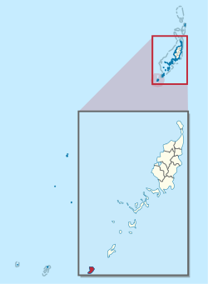
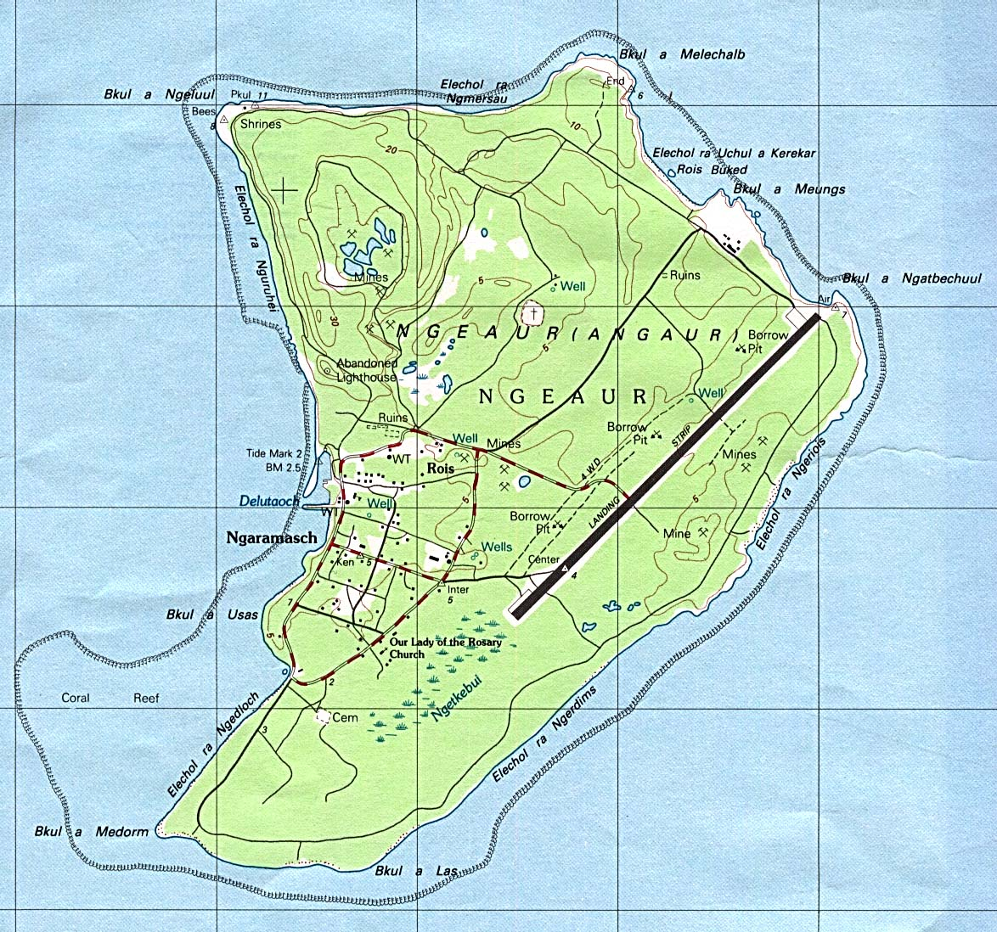
Angaur Island in Palau
Notes:
Angaur is a coralline island located some 10 km south-west of Beliliou at the southern tip of the main group of islands in the archipelago, and is situated outside of the lagoon and enclosing reef for this main group. Angaur is surrounded by a thin reef which encloses a narrow lagoon, though for the most part the reef is so small and low that it offers little impediment to the waves which break directly on the steep cliffs which ring the island. The highest point on the island, a small hill north-west of Rois, is only 40 m above sea level, and most of the island is less than 10 m above sea level.

Slide 3
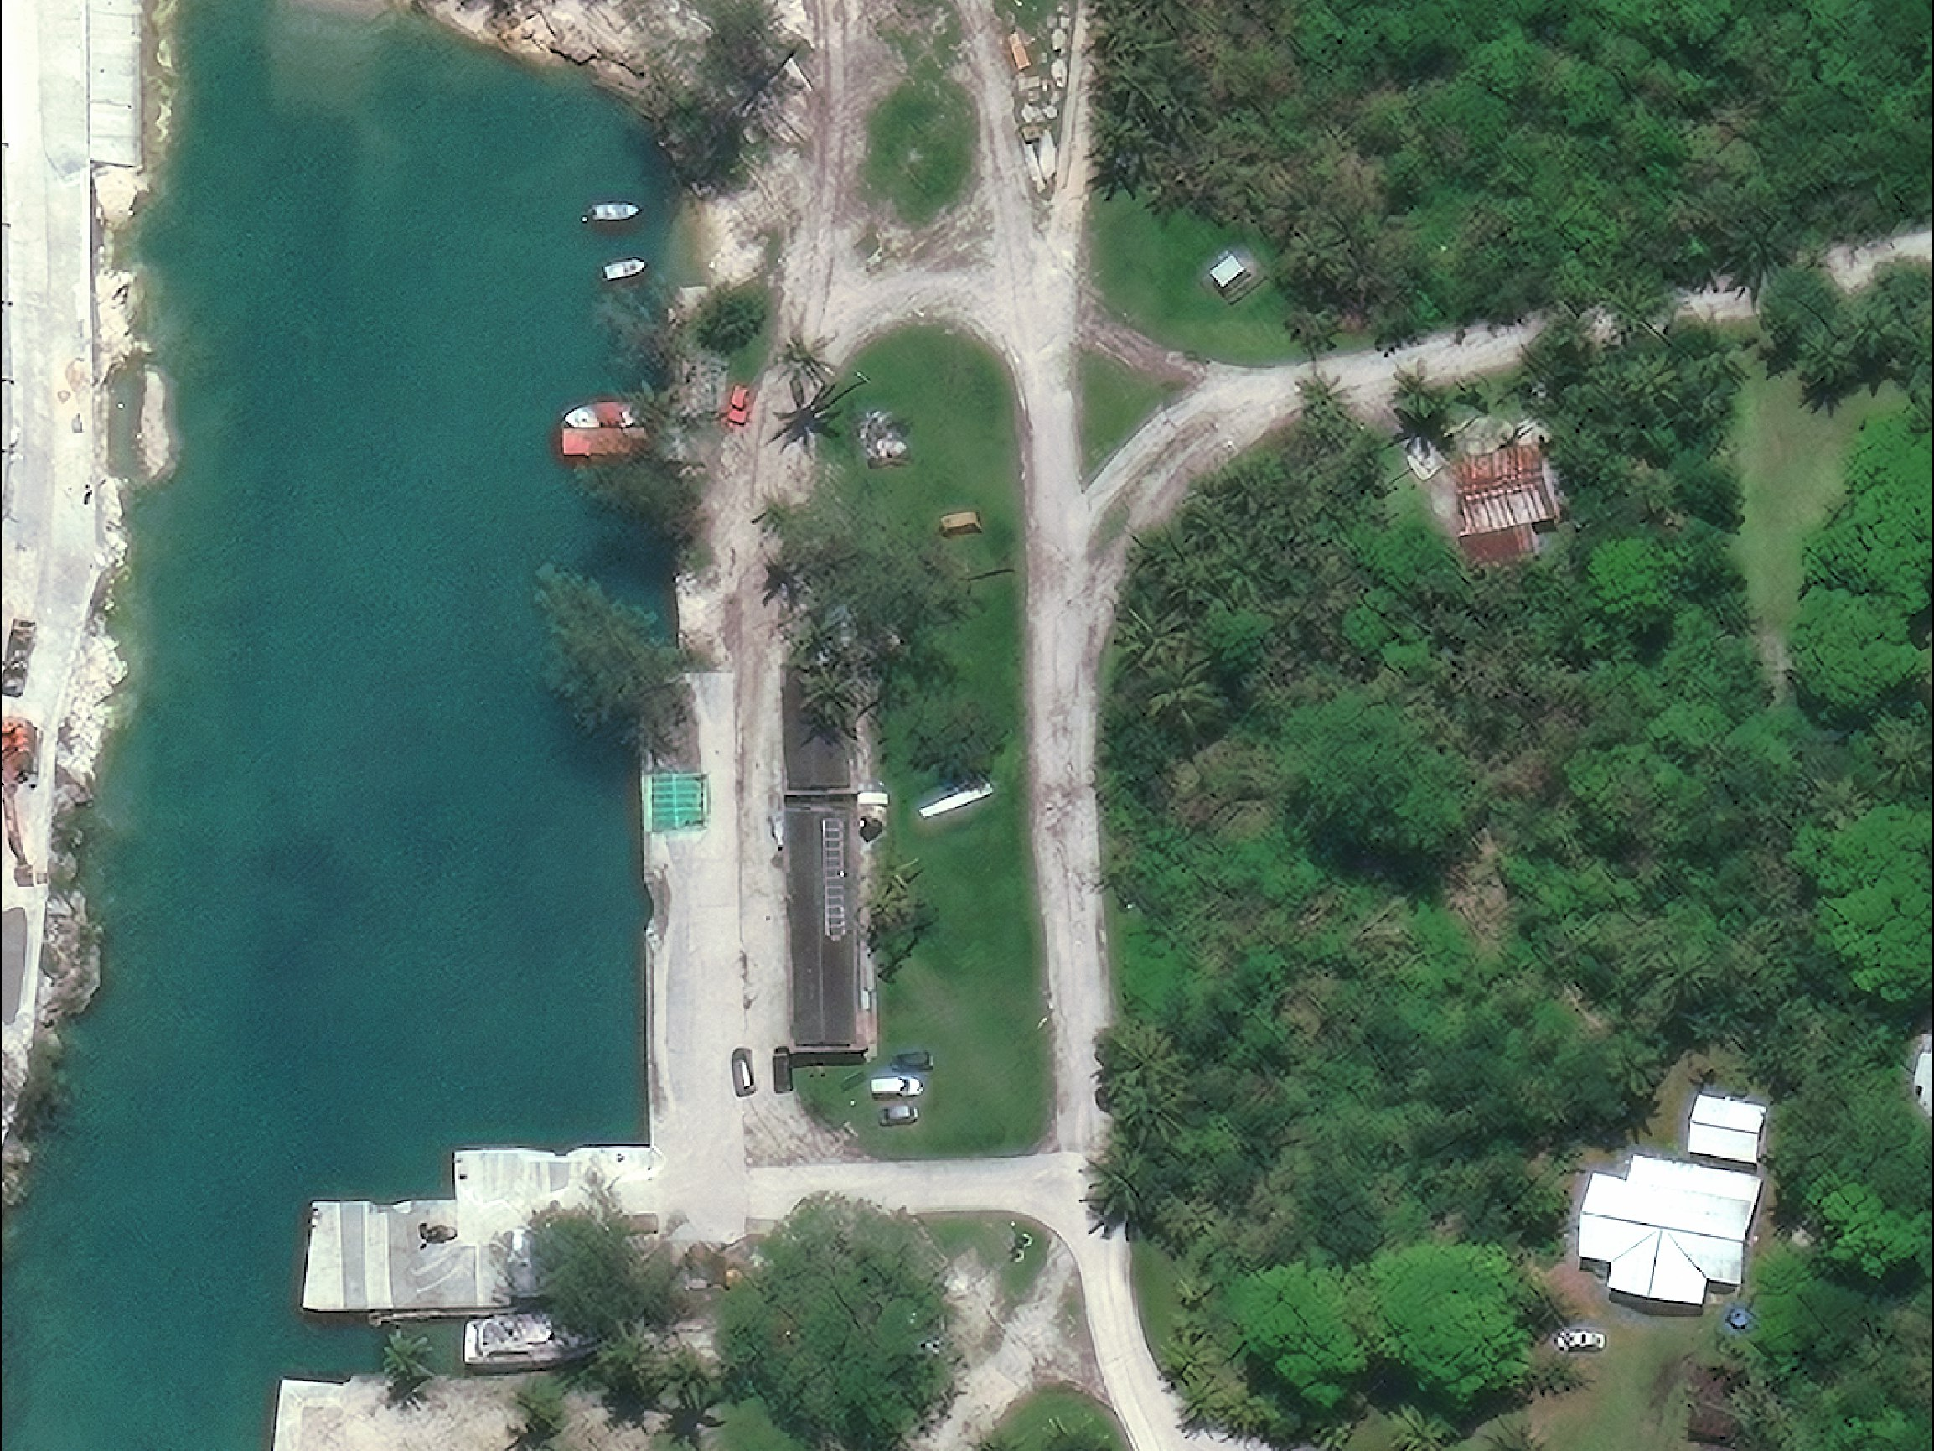
15 cm High Definition
WorldView-3 image – 20 May 2021 – © MAXAR Technologies Int.

Slide 4
Roof Capture with Drones
Cost estimation:
Team (3 people 5 days DSA $ 300/day)
Drone ($10,000 / 3 / 52 ↓ $ 64 /day)
GNSS ($15,000 / 3 / 52 ↓ $ 96 /day)
Drone image processing 5 days 2 people
Transport cost
Salary, insurance
= > $ 5,000 to $ 10,000

Slide 5
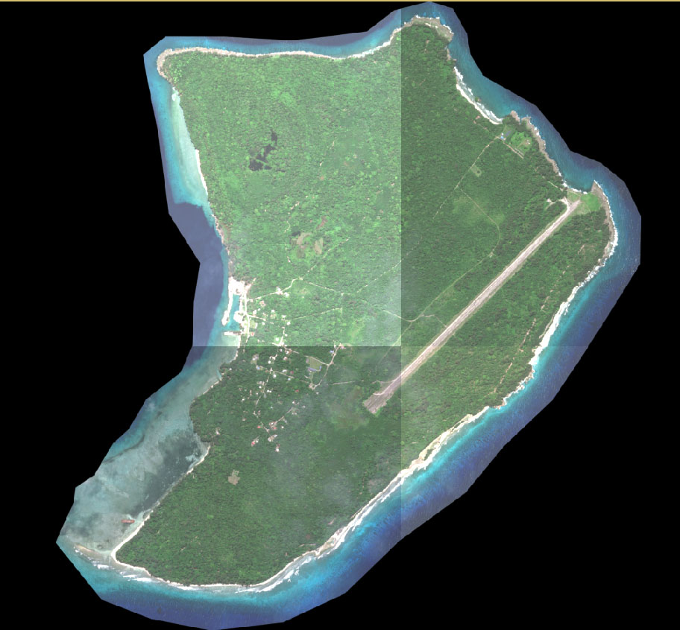
15 cm Satellite Image
12 km²
$US 312

