Slide 1


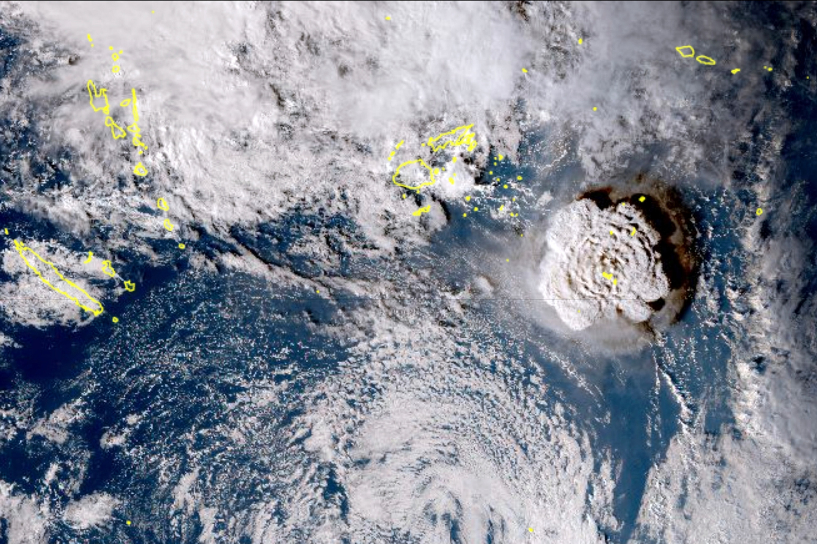
Geospatial as a Tool for Informed Disaster Risk Management: NDRMO Tonga's Path Forward
National Disaster Risk Management Office, Tonga
Presenter’s
Lu’isa Taunga
‘Ofa Masiwawa
Notes:
1

Slide 2
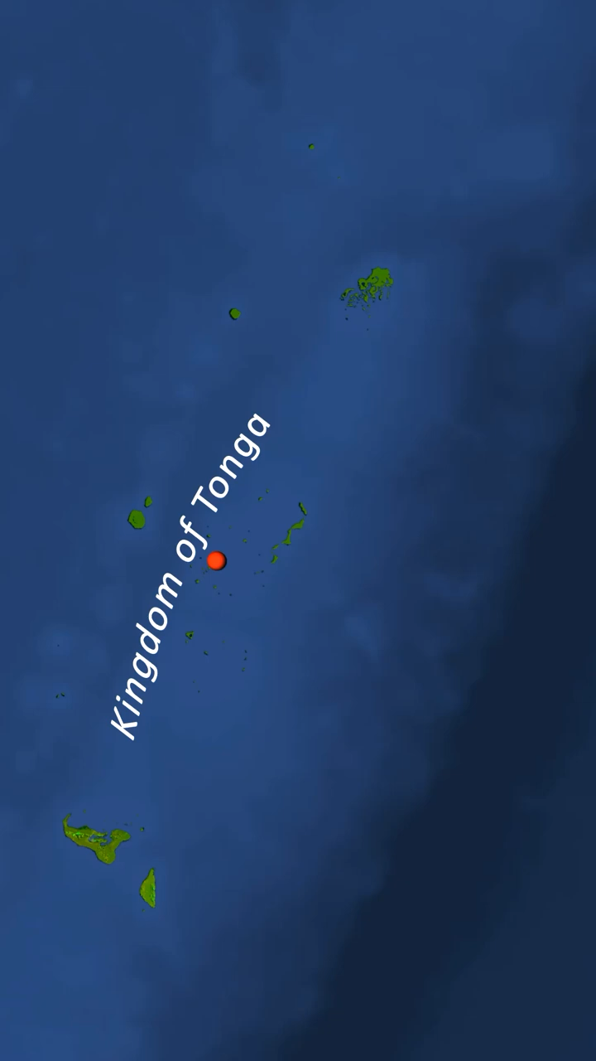

Where is Tonga?

Slide 3
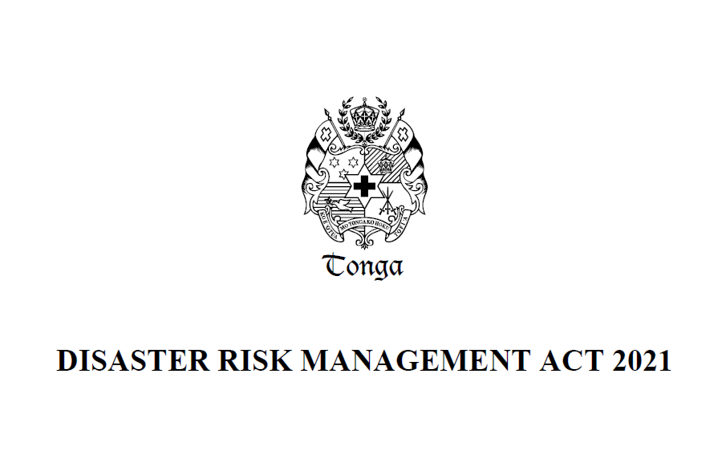
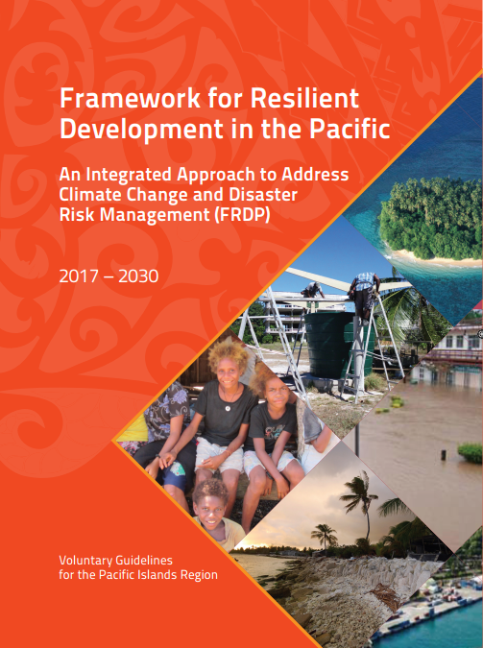
NDMRO Core Functions
Advisory role to decision makers on matters related to DRR
Coordination of disaster preparedness, response, and recovery activities and process
NDRMO Mandate
(S.32 of DRM Act)
DRM Policy strengthening and mainstreaming
Lead damage assessments and analysis
DRM Communication, Training and Awareness
DRM Data Management
Notes:
Government Stakeholders & Responders Awareness and Training in DRM Act and Policy
Design and develop awareness packages for Clusters
Design and develop training package for Authorized Officers (s.107) – NERT
External Partners and Public Awareness and Training in DRM Act and Policy
Design and develop public awareness packages
Design and develop training packages for communities, and stakeholders.
Formalization of Cluster System – Division Four DRM Act
Establishment of inter-cluster coordination committee (s.51)
Review of SOPs for inter-cluster coordination
Revision of existing TOR for clusters
Cluster Annual Planning – incorporated within CP process
Support towards development of cluster response/recovery plans
Key feature of the Act is shifting Tonga from emergency focus reactive approach to prevention focus. Within Act also is core function of NDRMO scaled up to include the whole disaster cycle
Island DRM Committees – Division Five DRM Act
Development of TOR in line with Section 56 of the Act
Conduct consultations and formalize memberships
Provide necessary training support
Establishment of Island Emergency Operations Centers, particular those with no offices (s.73)

Slide 4
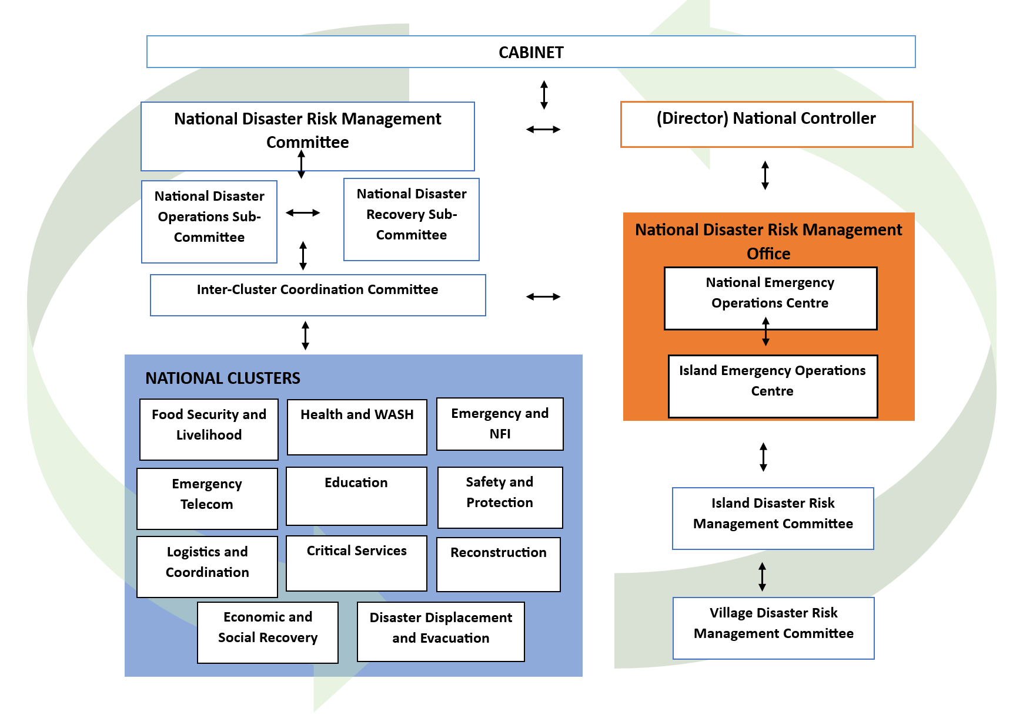
DRM Structure

Slide 5
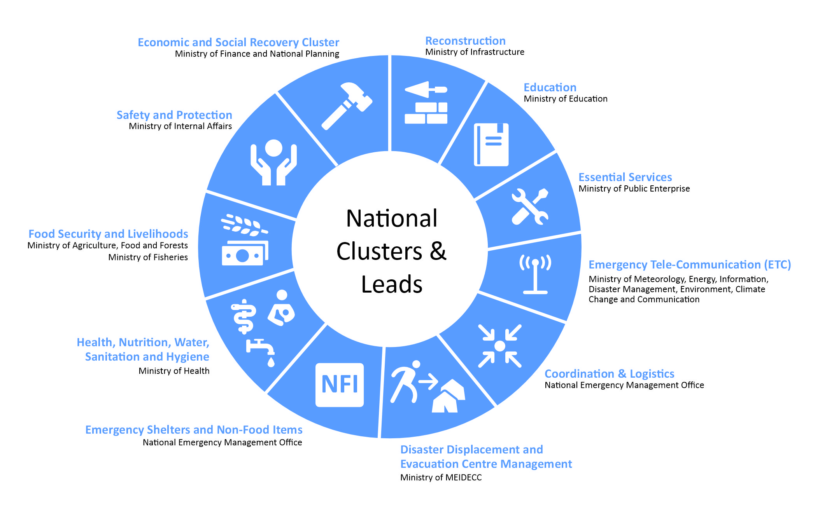
Central Coordination Mechanism formalized through the Act
Notes:
Government Stakeholders & Responders Awareness and Training in DRM Act and Policy
Design and develop awareness packages for Clusters
Design and develop training package for Authorized Officers (s.107) – NERT
External Partners and Public Awareness and Training in DRM Act and Policy
Design and develop public awareness packages
Design and develop training packages for communities, and stakeholders.
Formalization of Cluster System – Division Four DRM Act
Establishment of inter-cluster coordination committee (s.51)
Review of SOPs for inter-cluster coordination
Revision of existing TOR for clusters
Cluster Annual Planning – incorporated within CP process
Support towards development of cluster response/recovery plans
Island DRM Committees – Division Five DRM Act
Development of TOR in line with Section 56 of the Act
Conduct consultations and formalize memberships
Provide necessary training support
Establishment of Island Emergency Operations Centers, particular those with no offices (s.73)

Slide 6


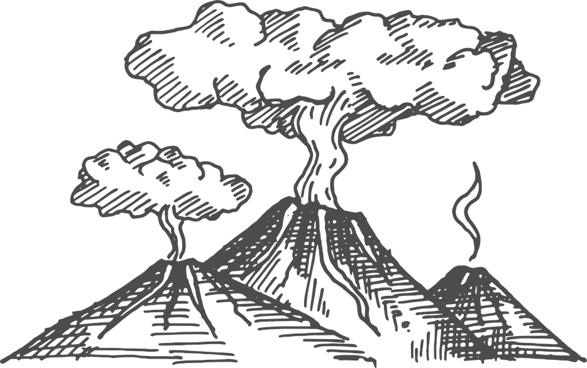


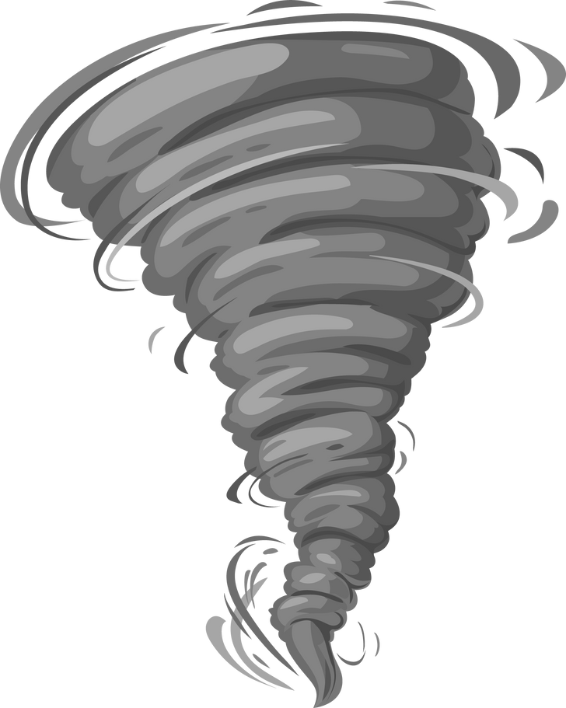

Tonga’s Risk Profile
Tropical Cyclone
Earthquake
Volcanic Eruption
Flooding
Drought
Tornado
Tsunami

Slide 7

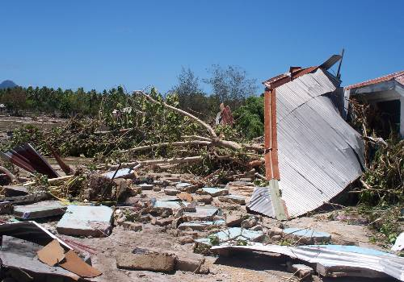
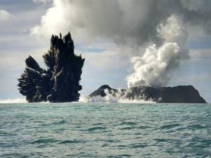
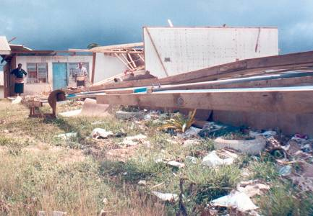
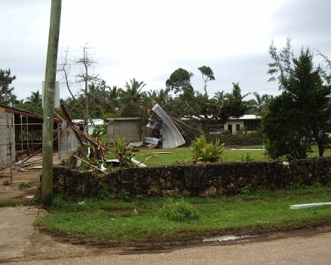
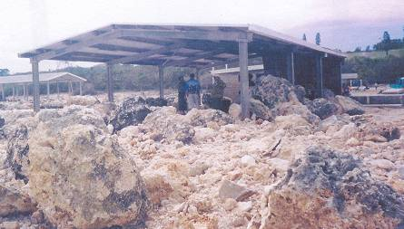
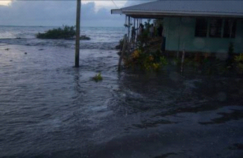
Tonga’s Risk Profile
Mohemohe ‘a Kuli Fafangu, Niuafo’ou
I he 1946
Tsunami 2009
  Second most vulnerable country in the world, in terms of its geographical location
  A small island developing nation
15 March 2009, Hunga Tonga Hunga Ha’apai
TC Waka 2001($104m)
Tornado, Ha’akame ‘i Sepitema 2004
Storm Surges Eua – $1.4 miliona
Flooding, Lifuka 2009

Slide 8
January
February
December
Natural Hazards
Season(months)
October
August
November
June
September
Tropical cyclone
July
April
May
March
Dry Season (Drought)
Tropical Cyclone
Earthquake/
Volcanic eruption/
tsunami
Notes:
* Hoko Fakafoki (Mofuike/ Mo’ungaafi/ Peaukula) – tatau pe mei Jan to Dec ‘ikai ‘ilo taimi hoko ai

Slide 9
Research & Training Division
Field Assessment
Kobo Tool
Drone
Information Education Communication
DRR IEC materials to be disseminated for awareness
Disaster Risk Reduction Awareness
Community/ Stakeholders
Internal
Tsunami Drill
* Schools
* Communities
* Private organisations/ Stakeholders
Of Evacuation Centre(s)
Tsunami Evacuation Routes
Revising of Village Emergency Management Plans
* Following HTHH
* New DRM Act, 2021
Research & Information Management
* Cataloguing of Existing Information / Data into a Dashboard
* Digitizing of Data and information
* Updating of Social Media

Slide 10


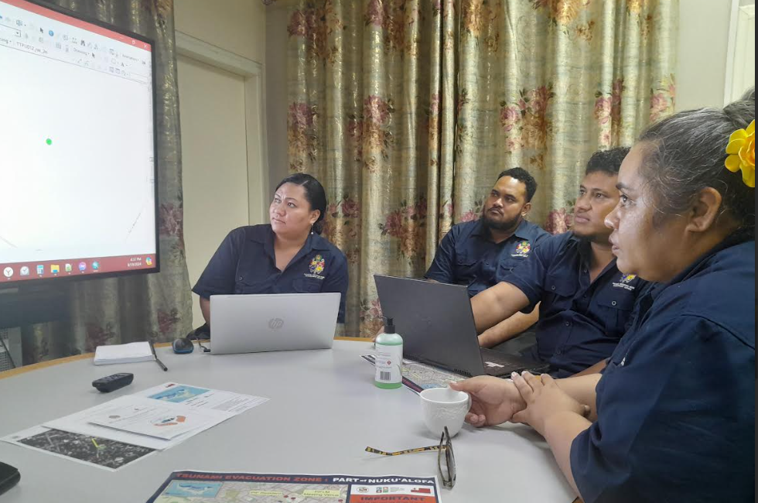
Research & Training Division
Mafua-’i-Vai’utukakau Maka
(Director of NDRMO)
Lu’isa Taunga
(HOD – R&T)
‘Ofa Masiwawa
(GIS – Officer)
Sione Sunia
(PaRTneR 2- Project Coordinator)
Sila Manu
(Disaster Works Officer)
Sioeli Lolohea
(PaRTneR 2 – Project Coordinator)
Notes:
1.7.2013
Aisea
‹#›

Slide 11
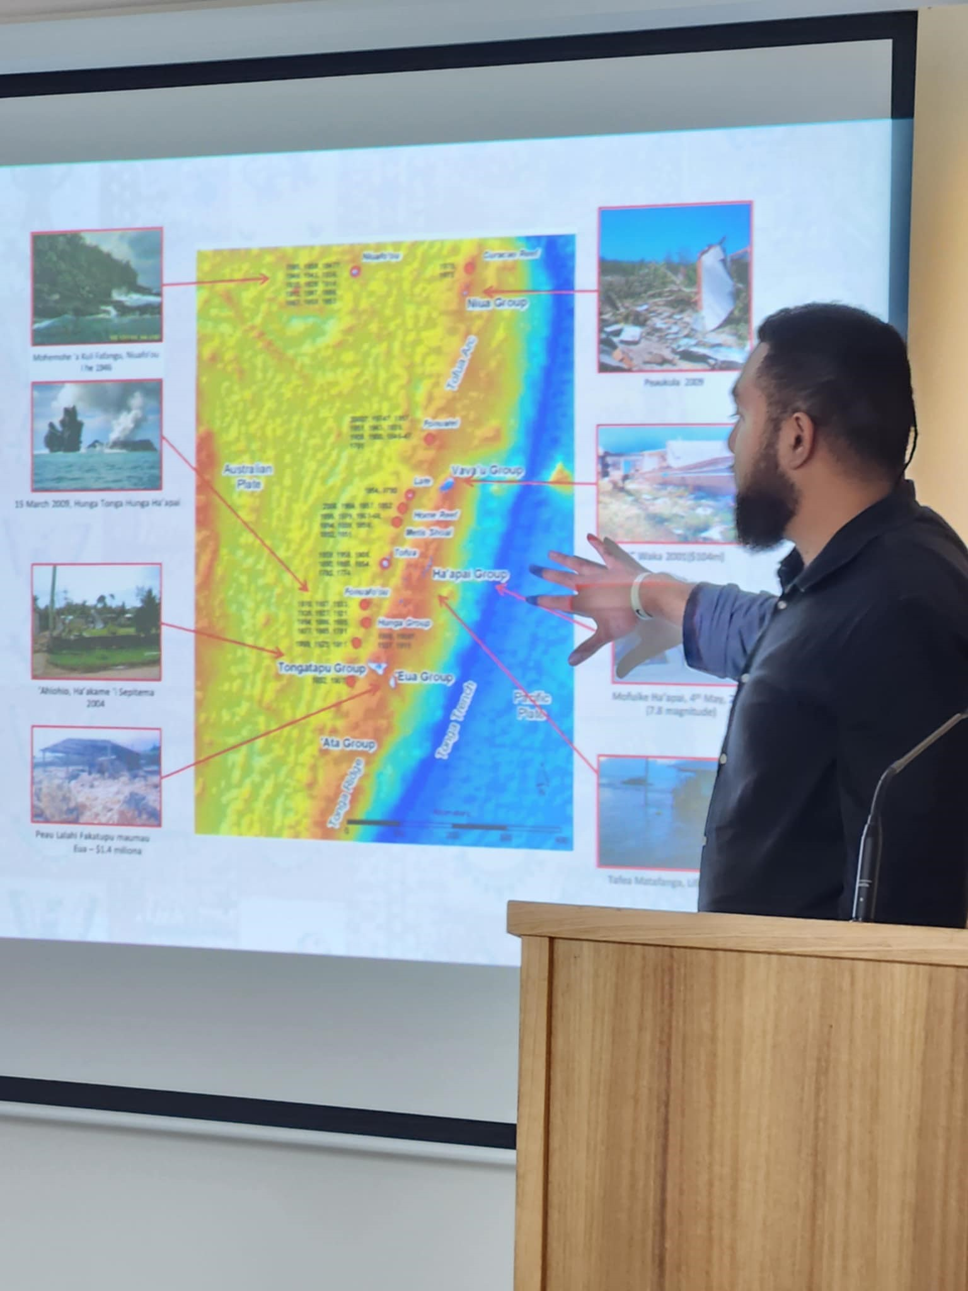
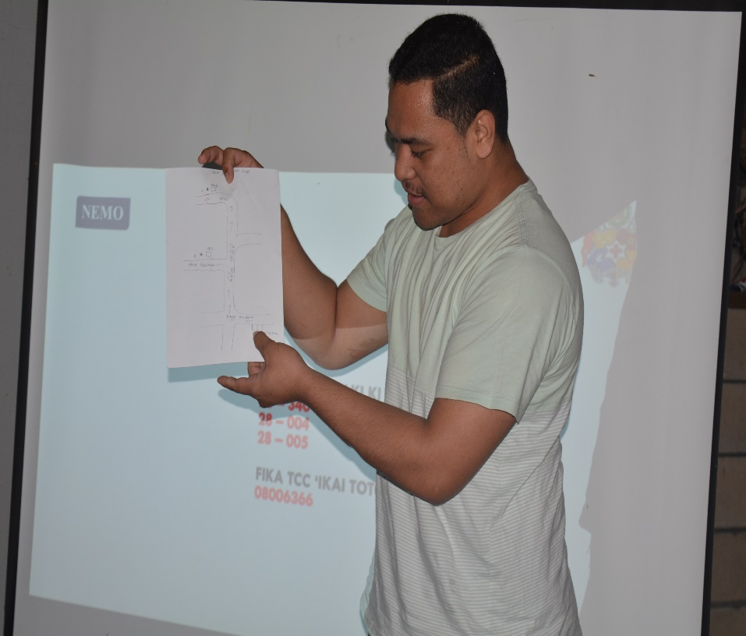
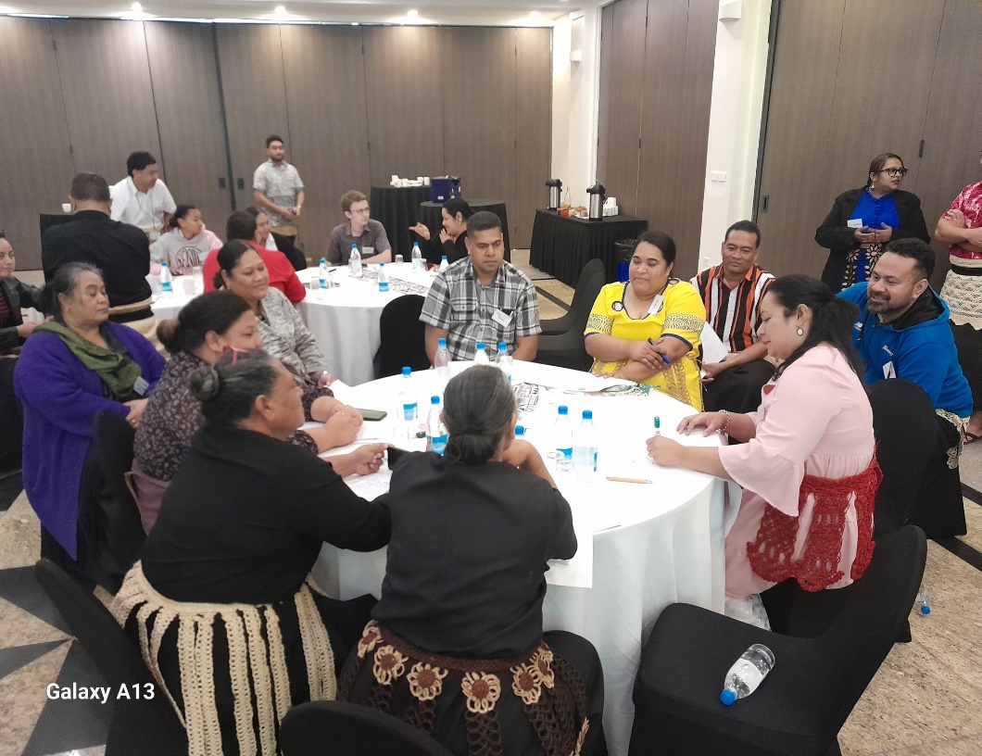

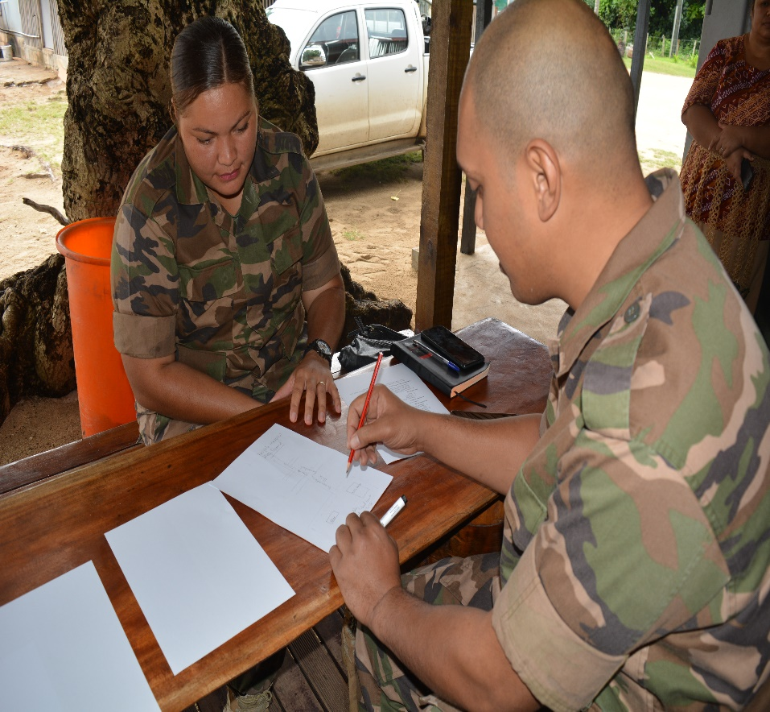
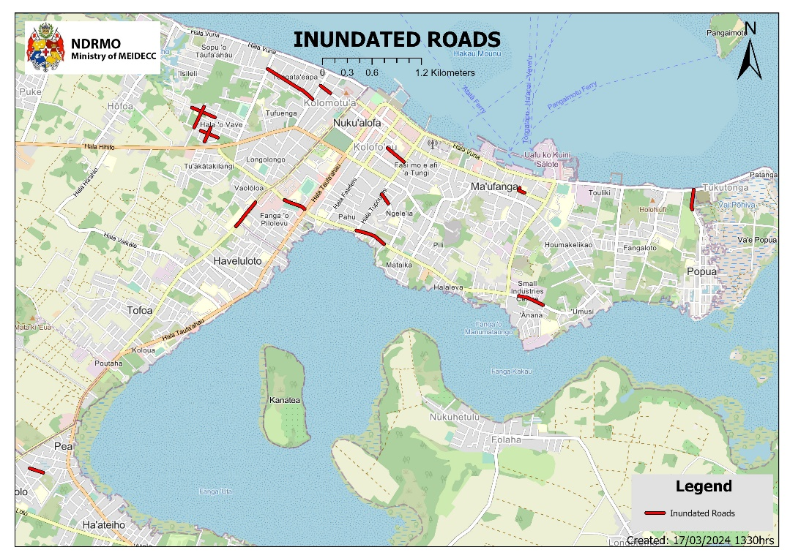
GIS Support
Awareness
Capacity Awareness
DRR Planning
Logistica Planning & Response
Notes:
1.7.2013
Aisea
‹#›

Slide 12


GIS in NDRMO
Evolvement of GIS in NDRMO, Tonga
2015 - 2016
  Idea of GIS evolved
  Traditional Mapping
2016 - 2017
  Basic GIS Training
  Team of two
2017 - 2018
  Commenced automation of surveys
  Exposed to various GIS platforms
2018 - 2020
  Basic Mapping Products
  Idea of Earth Observation
2021 - 2024
  Formalize GIS in DRM
  Establish Remote Sensing Relations

Slide 13


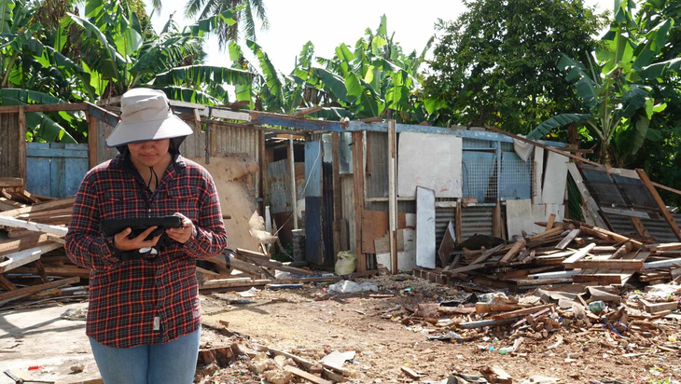
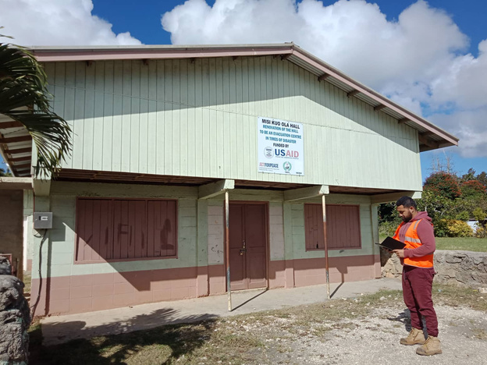
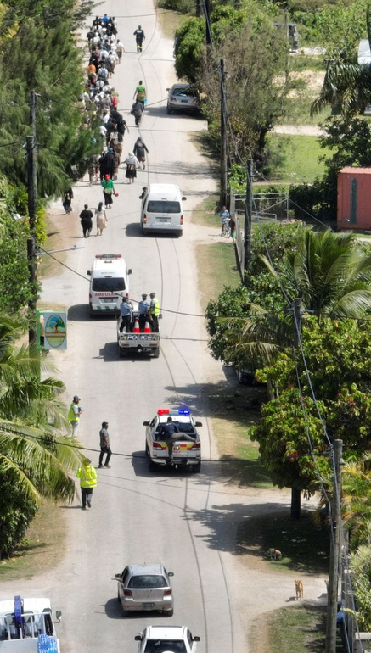
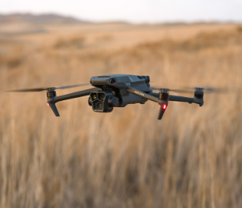
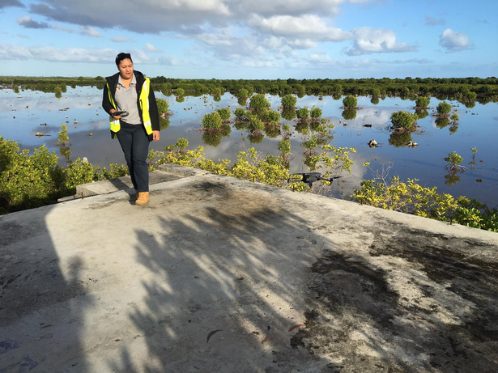
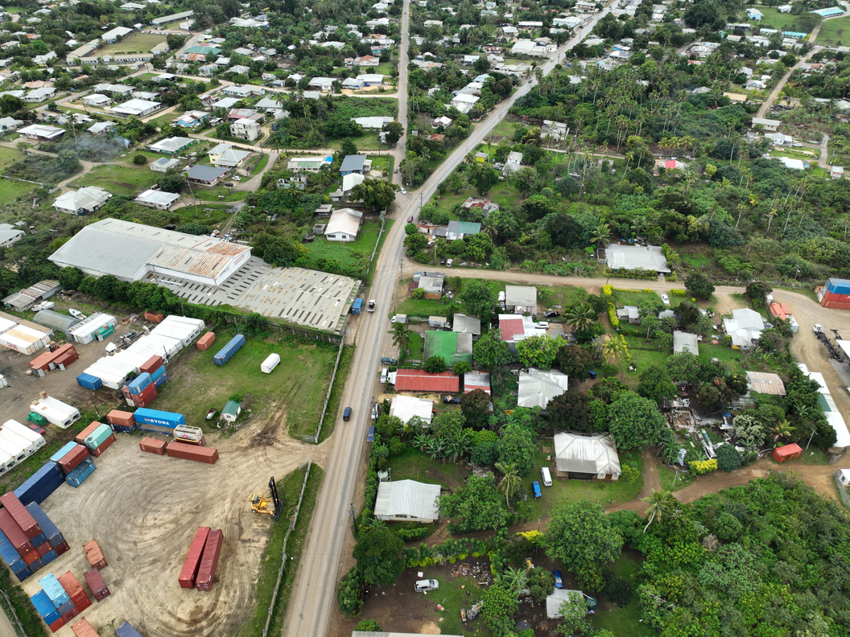
NDRMO GIS Community of Field Practice
Government of Tonga
Government of Tonga
GIS in NDRMO
Data Collection
Drone Footage

Slide 14
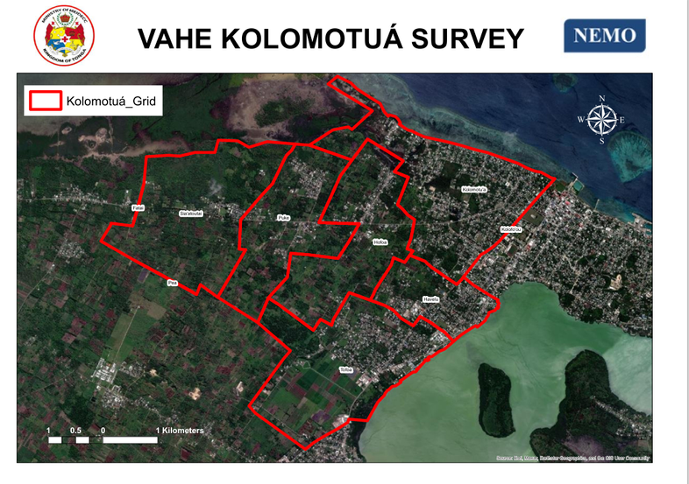
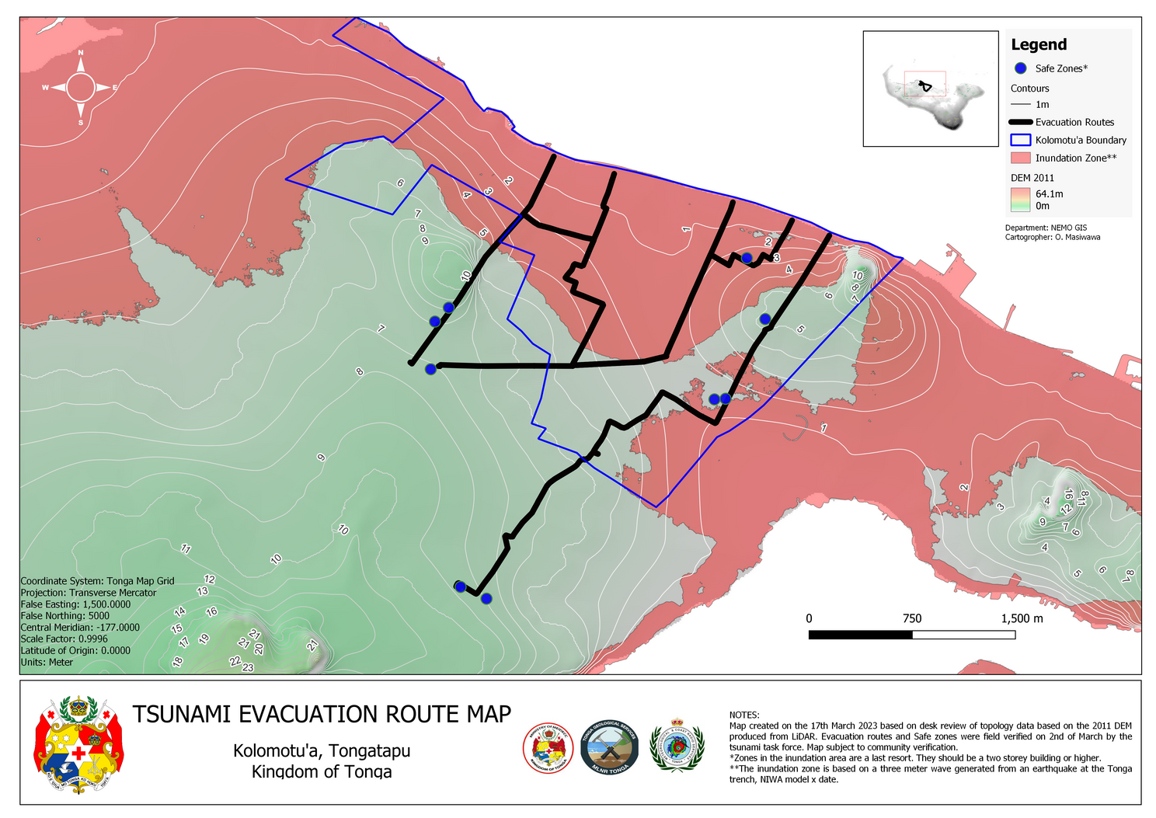
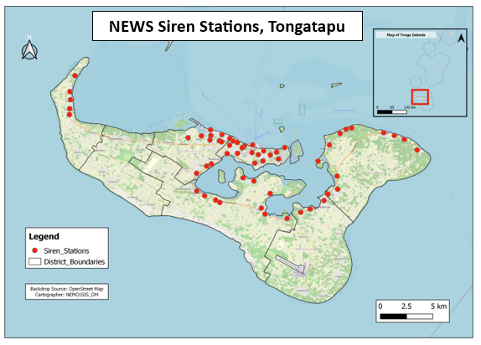
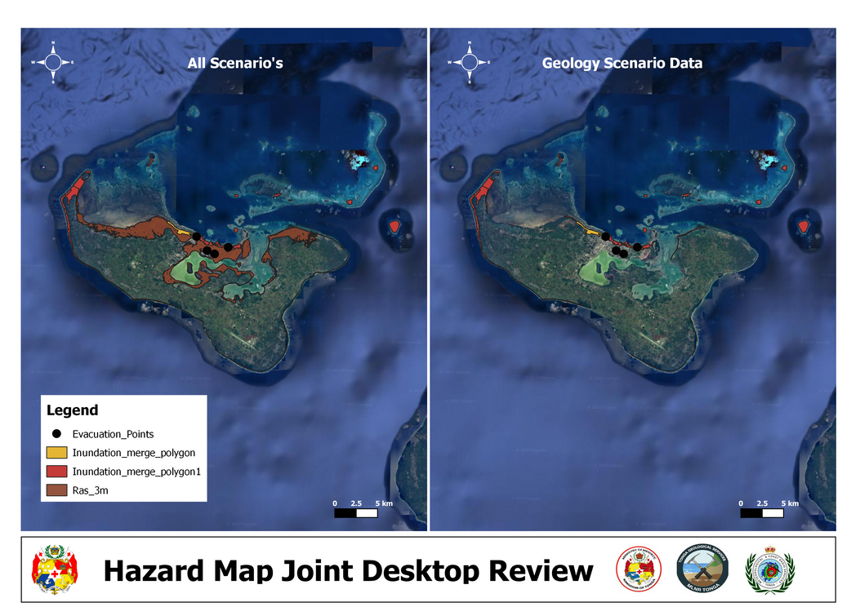
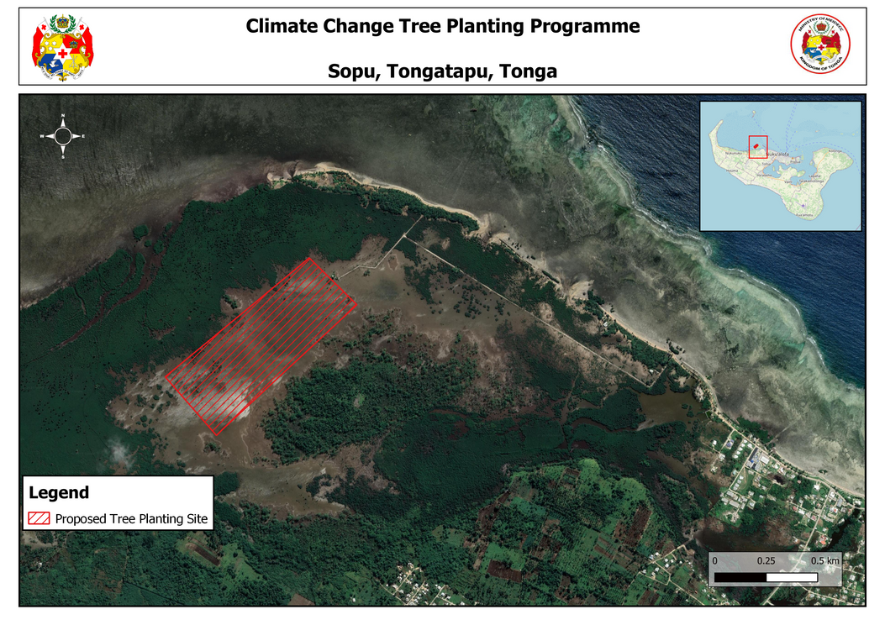
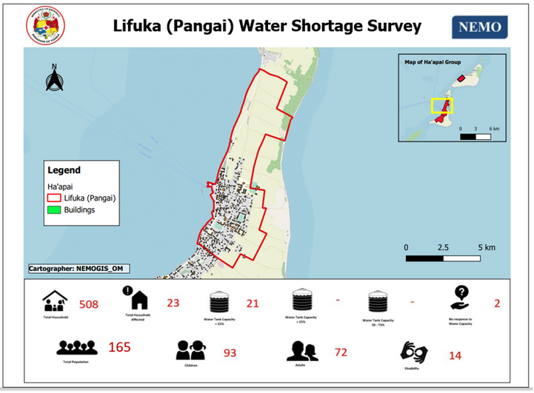
GIS in NDRMO
NDRMO GIS Community of Practice

Slide 15





NDRMO GIS Milestones 2024
Leveraging into Modern Community of Practice

Slide 16
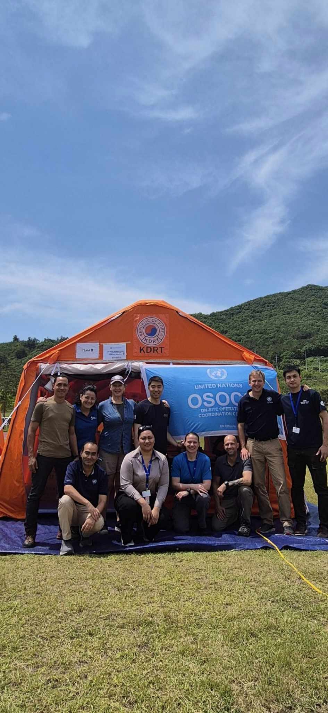
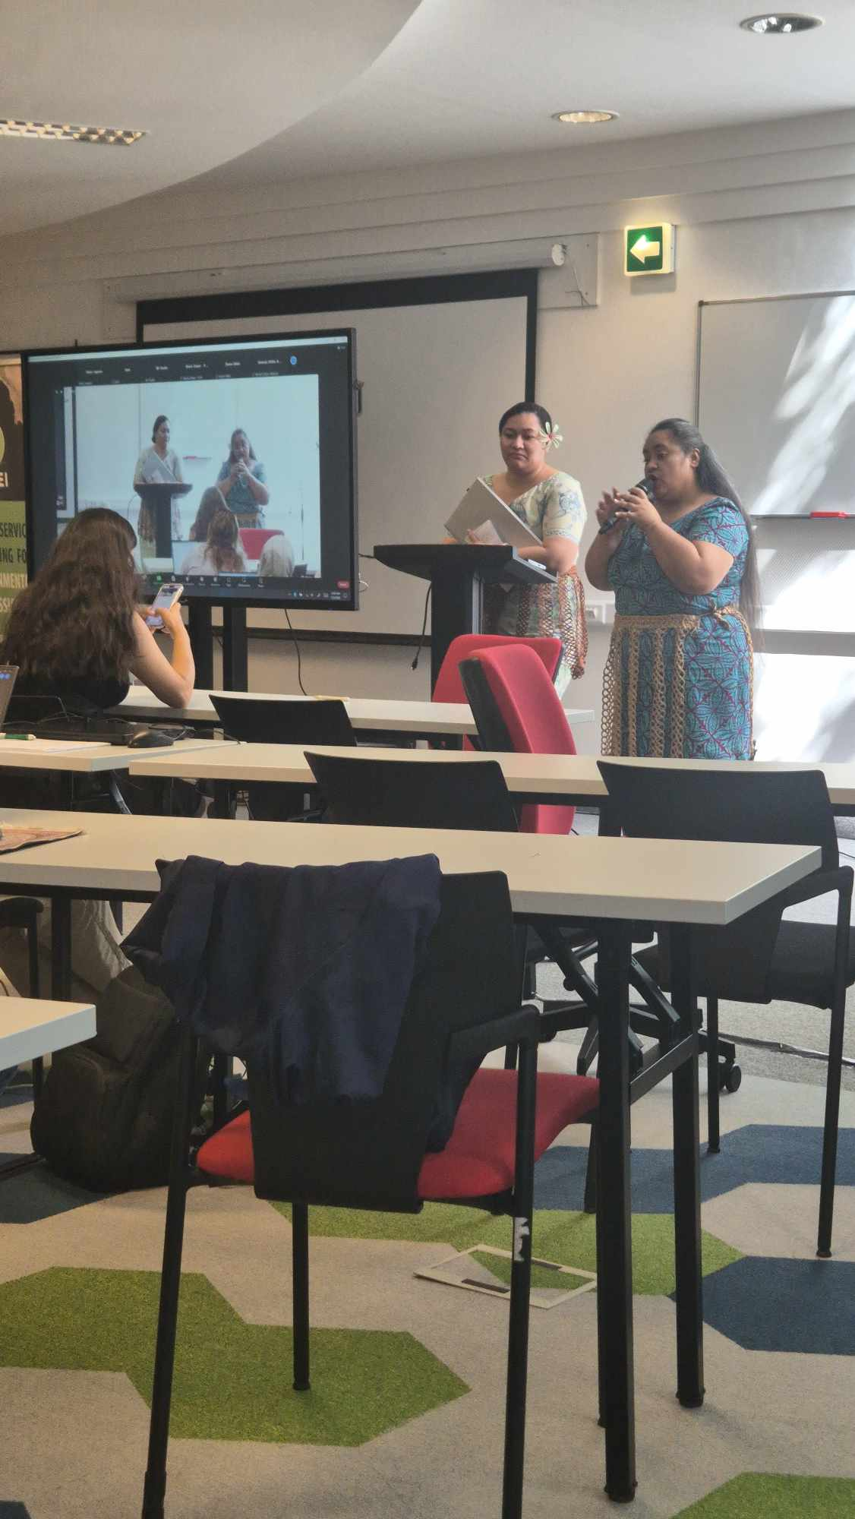
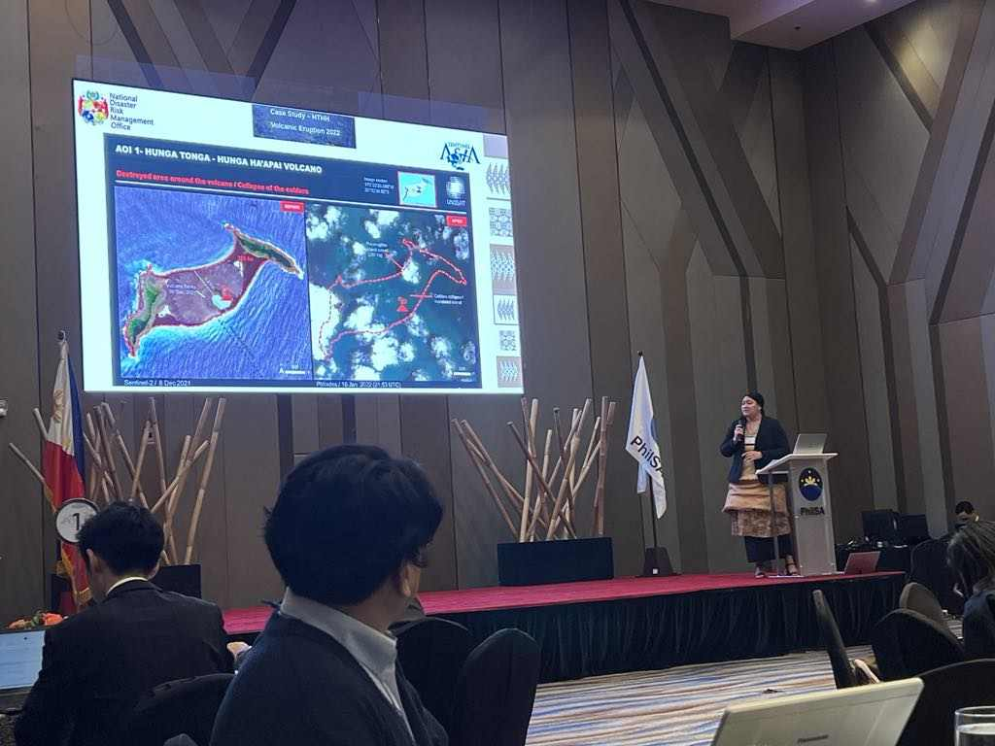
Partnerships
European Geospatial Summer School
Sentinel Asia
UNDAC

Slide 17
Leveraging into Modern Community of Practice – Why?
  Intensification of the scale of Hazards
  Multiple Hazards Occurrence
  Require Timely Response
  Robust Visualization to facilitate prioritized areas affected
  Quality Information for Critical Decision-making
  Transition from Tradition to Modern Visual Practices – RS as Geospatial Solution.

Slide 18
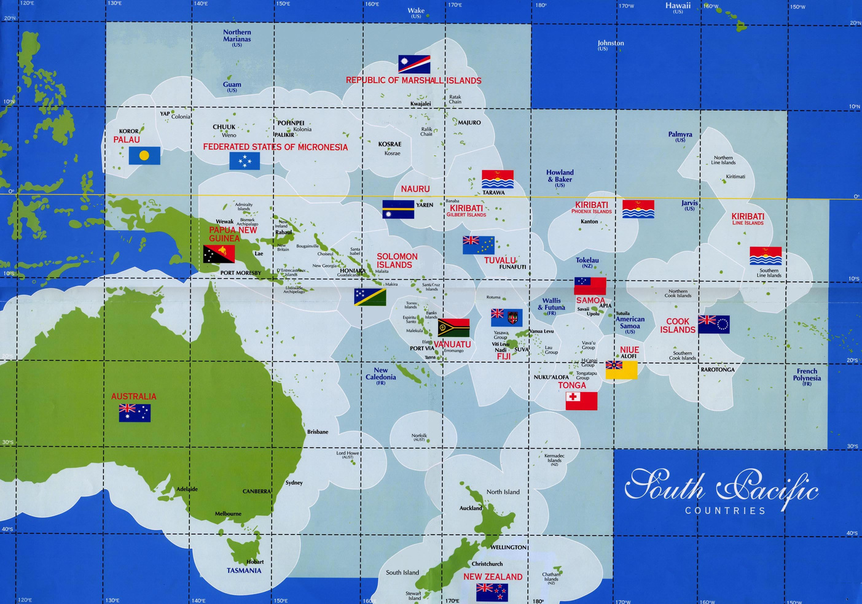

Satellite Community of Practice in the Past
Only Regional

Slide 19
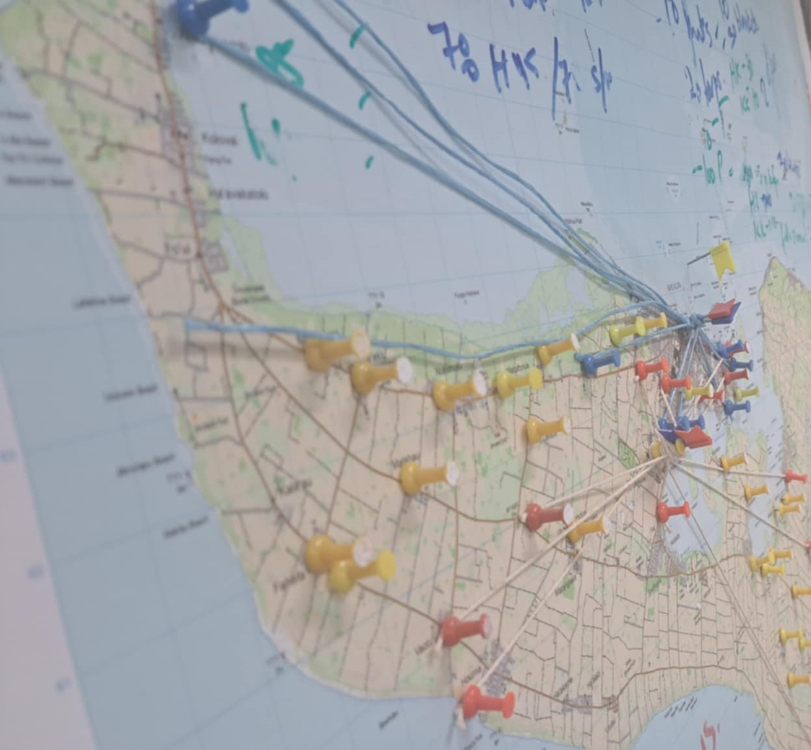
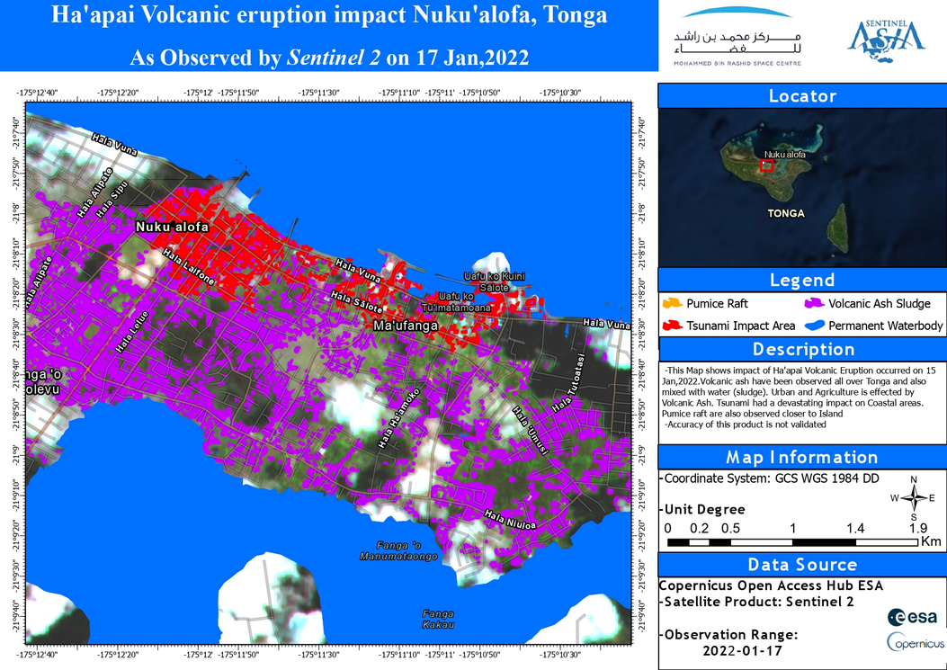
Barriers of Past COP

Slide 20
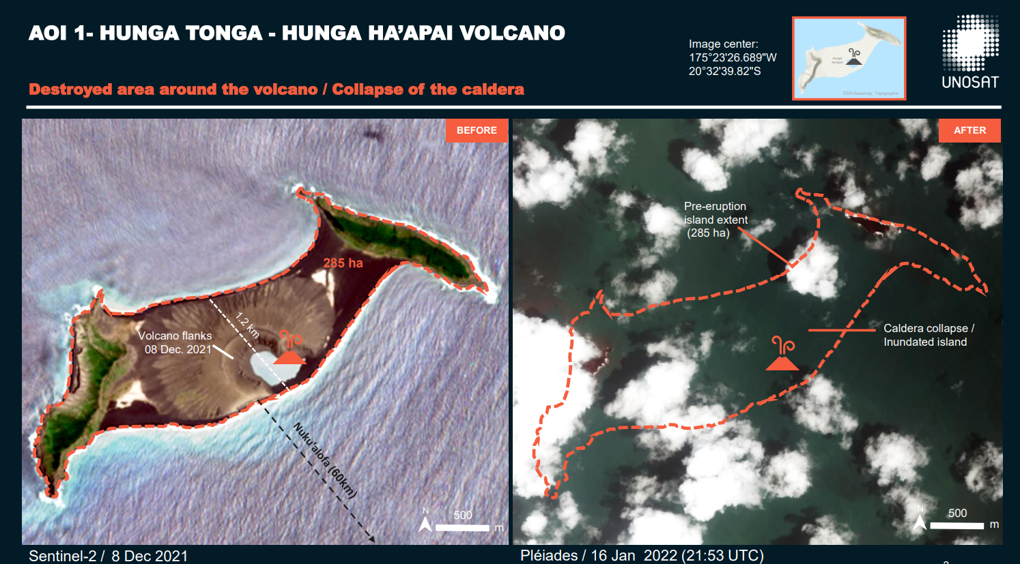
Case Study – HTHH Volcanic Eruption 2022

Slide 21
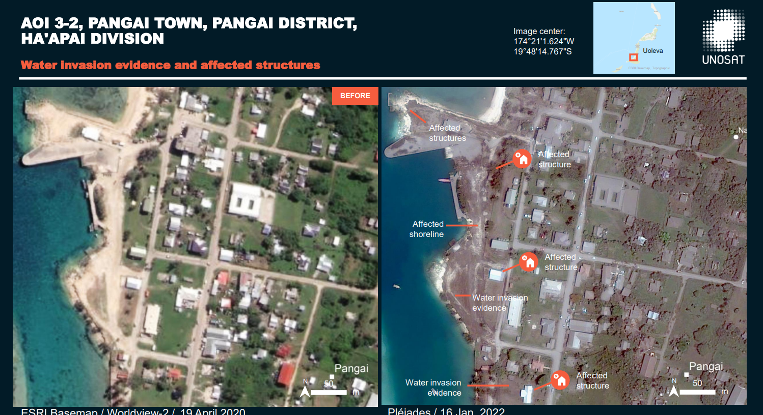
Case Study – HTHH Volcanic Eruption 2022

Slide 22
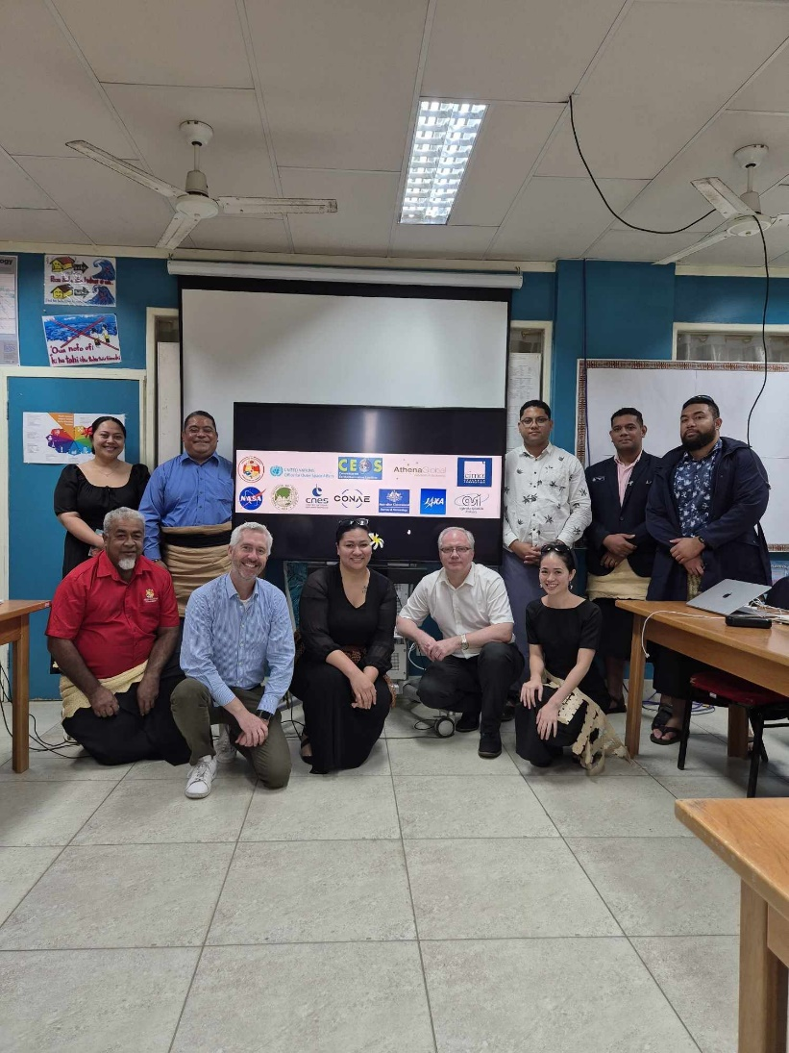
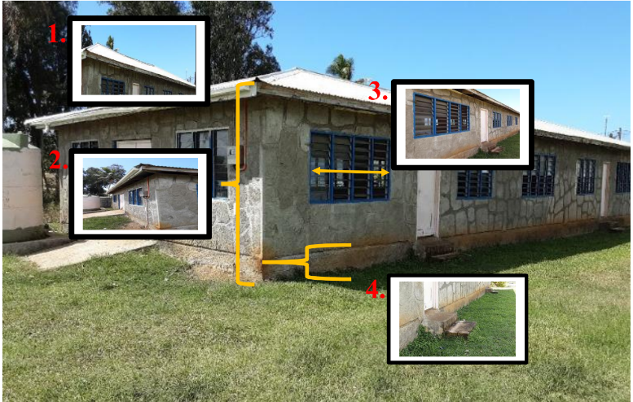
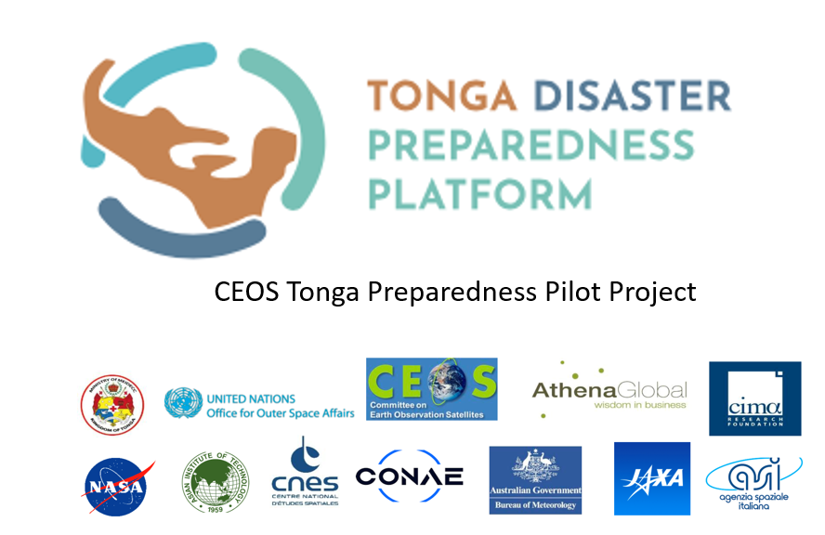
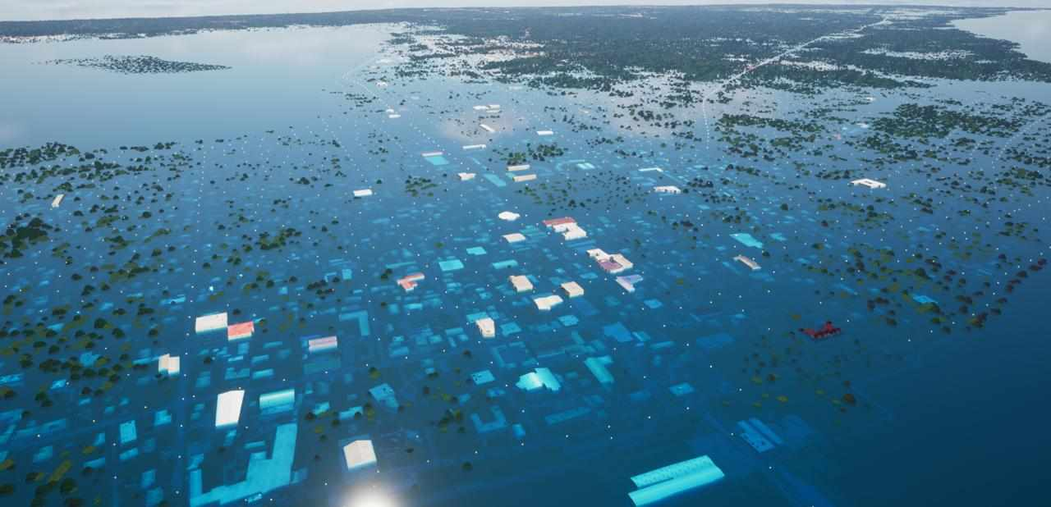
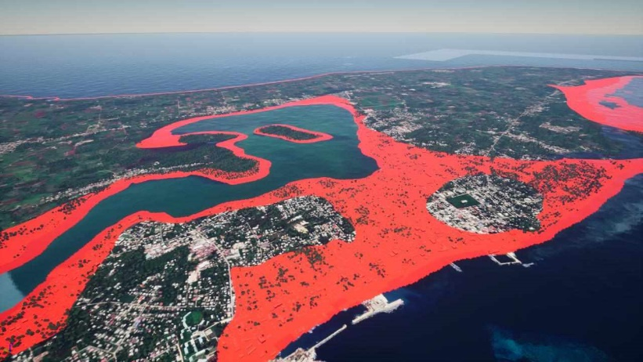
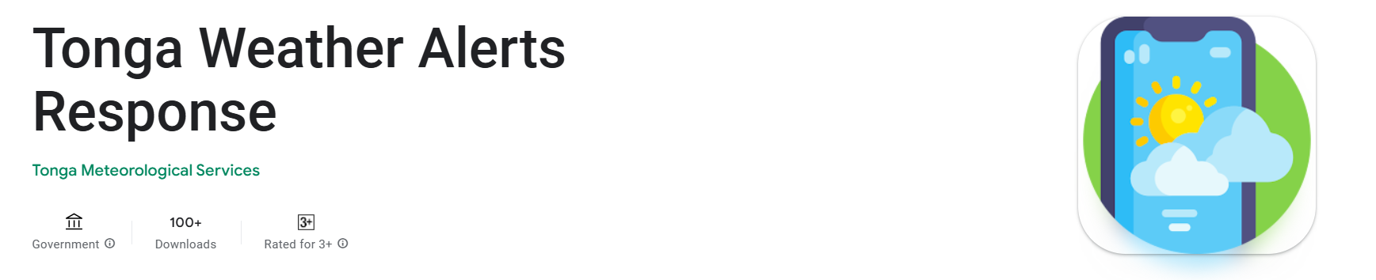
Current Project 2024

Slide 23
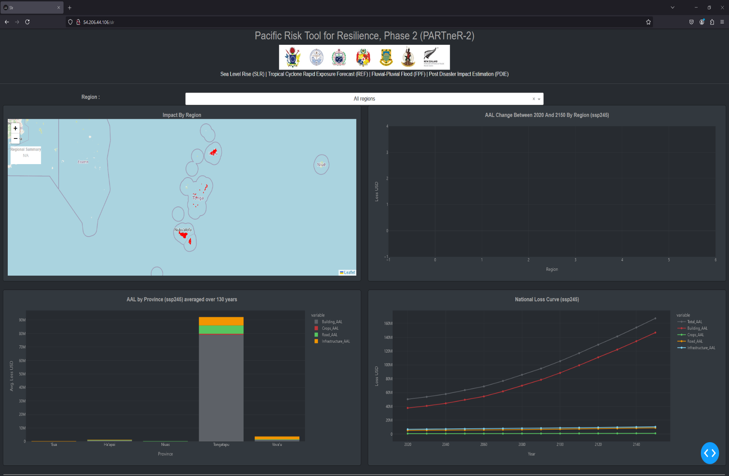
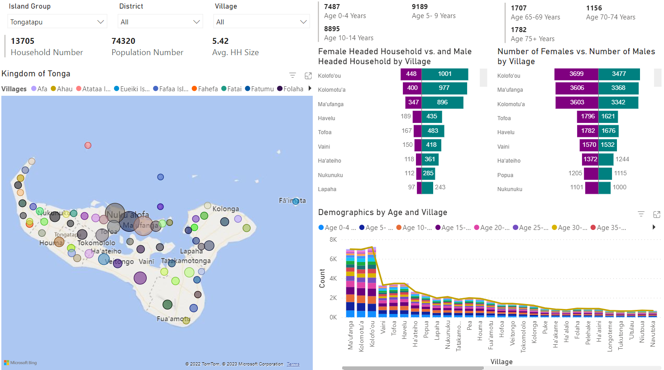
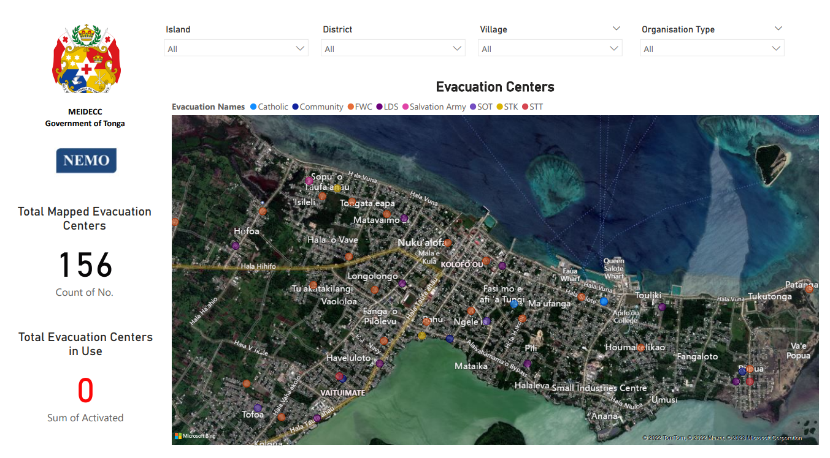
Current Project 2024

Slide 24
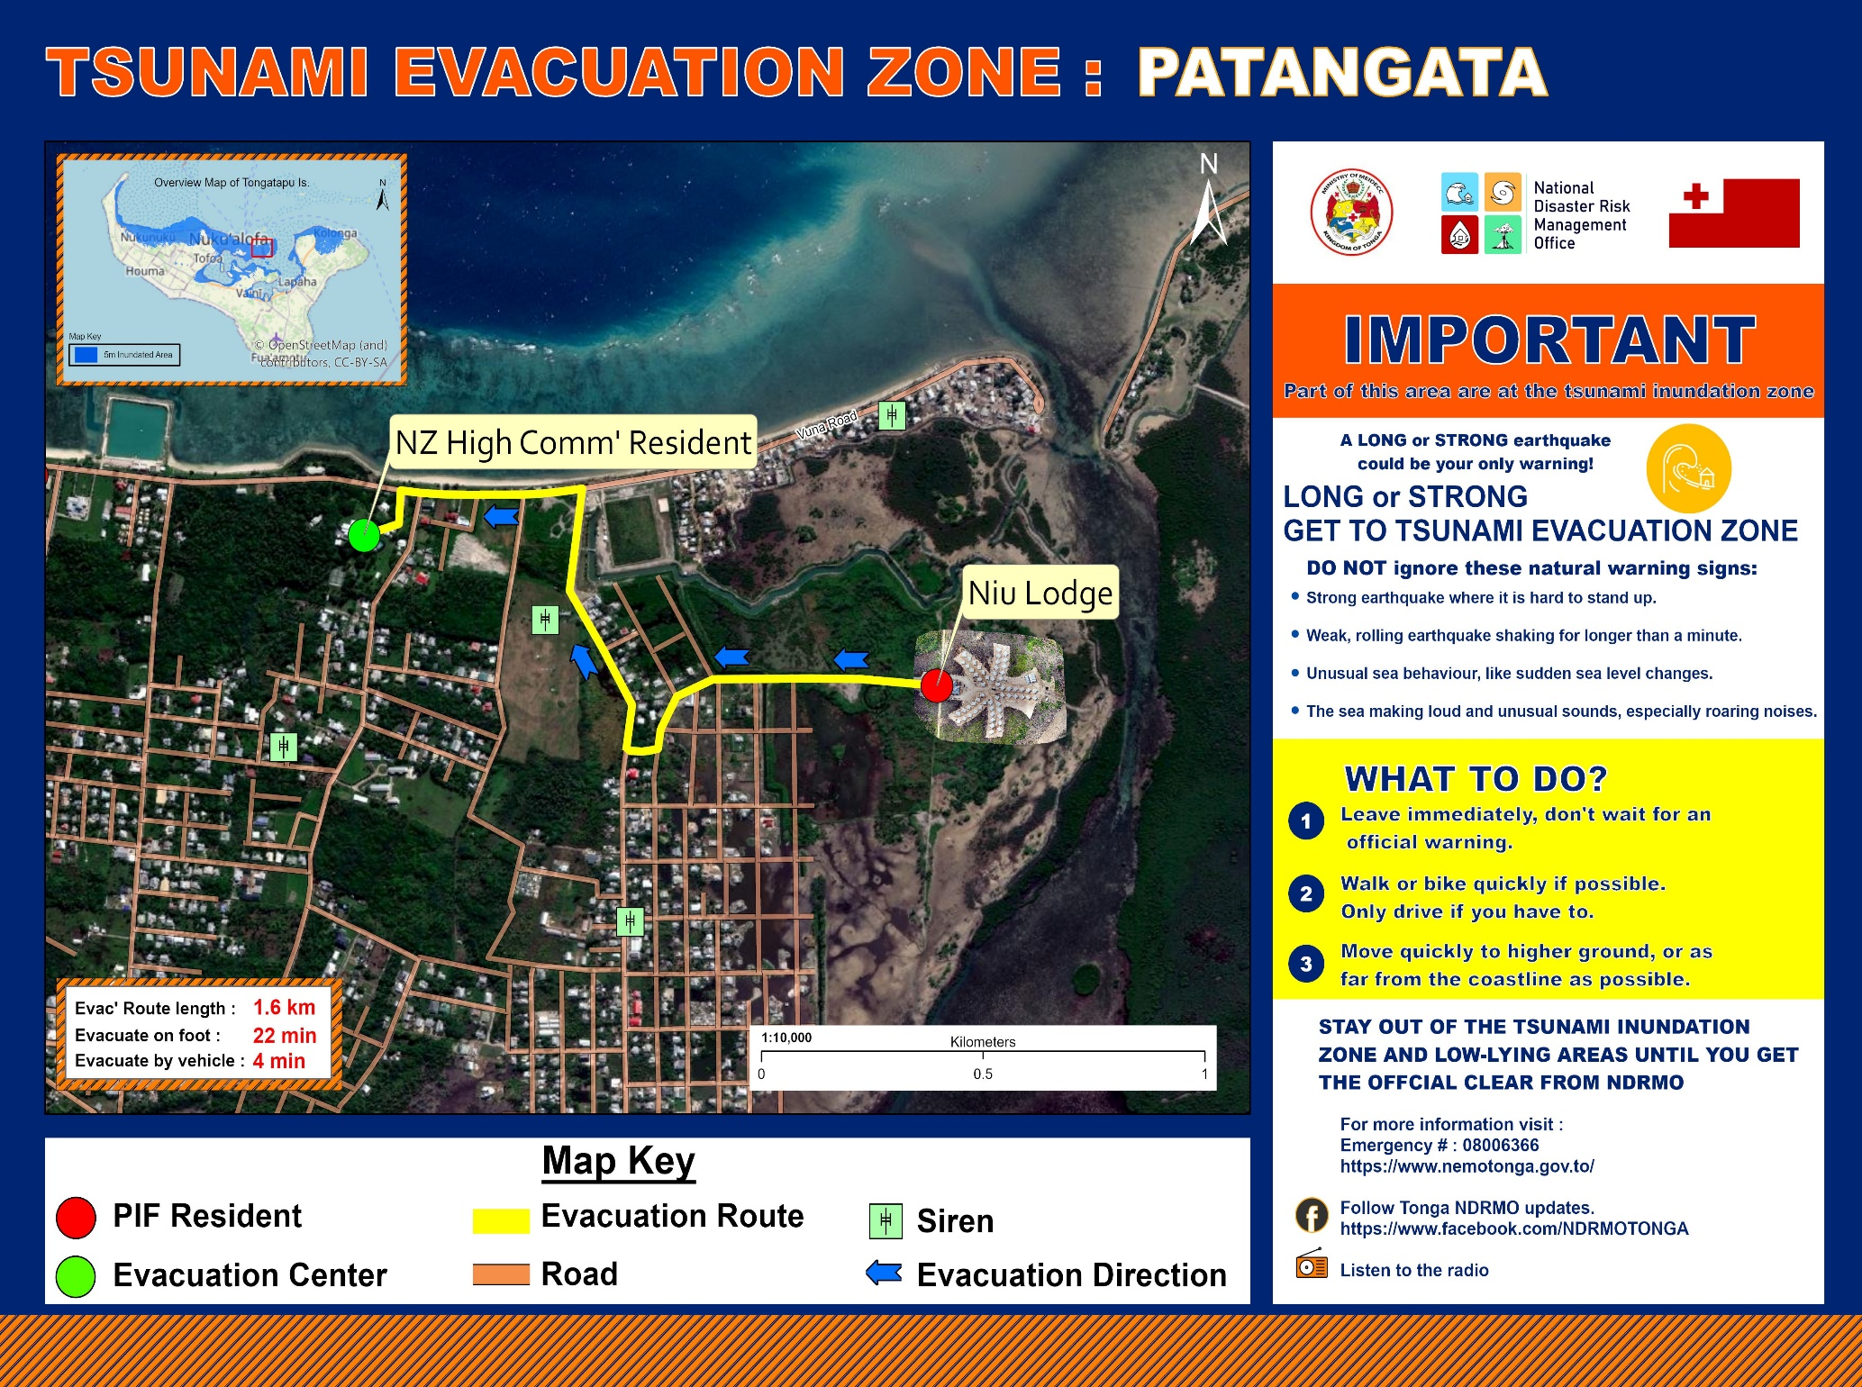
Current Project 2024

Slide 25










Challenges
Lack of awareness of satellite advancements
Lack of imagery analysis capacity
Timeliness
Lack of analysis capacity
Prolonged procedures for response & prioritization
Images are very costly for SID combating climate change
Low resolution imageries
Accessisbility
Notes:
16

Slide 26
Recommendations
  Empower SID Disaster Management Officers: Enhance the capabilities of SID disaster management officers through advanced satellite technologies.
  Strengthen GIS Capacity: Improve the skills of disaster management GIS officers in satellite analysis to enhance their effectiveness.
  Accelerate Access to High-Resolution Images: Streamline the provision of high-resolution satellite imagery to support development in small island regions.
  Enhance Satellite Archive Utilization: Improve the use of archived satellite data to better understand trends and support multi-hazard risk assessment in Tonga.
  Mentorship and Internship Opportunities: Provide mentorship and internship programs for our GIS disaster management team to develop their analytical skills at the national level.
Notes:
17

Slide 27























Malo ‘Aupito
Contacts: Free Toll 0800638 | Landline 26340
Email: nemo@mic.gov.to
Website: nemotonga.gov.to FB: National Emergency Management Office
Notes:
1.7.2013
Aisea
‹#›

Slide 28


