Slide 1
Forest Management Model: Mapping and Monitoring of Invasive Species (FIT Project)
Elenoa Biukoto
Earth Observation Technical Officer -
Pacific Community (SPC)
elenoab@spc.int
Other team members
Jalesi Mateboto
Adi Loraini Baleilomaloma-Kasainaseva
Nicholas Metherall

Slide 2
Implementing the SPC Strategic Plan: SPC 9 DIVISIONS

Slide 3
Background – Mapping of Invasive Species in Fiji and Tonga
The project aims to support Tonga and Fiji with their forest and landscape restoration efforts through the development of a localised plant invasive species models to spatially prioritise action and inform policy makers.
GEM and LRD are collaborating and working closely with MAFF/MoFF to run capacity building activities that will use Open-source tools such as QFIELD, QGIS, and DEP to build capacity to collect and analyse data in an efficient manner
Overall goal is to Improve Forest and Landscape Health
Funding with Intent (FIT) project with support from the Ministry of Foreign Affairs and Trade (MFAT) NZ.

Slide 4
Ecological threats to biodiversity
Invasive species are capable of causing extinctions of native plants and animals, reducing biodiversity, competing with native organisms for limited resources, and altering habitats.
They weaken and killed native vegetation with endangered species being especially vulnerable. This can result in huge economic impacts and fundamental disruptions of land-based ecosystems.
In Fiji and Tonga during our scoping visits in March 2024, invasive species like Merremia peltata, Cordia alliodora, Spathodea campulata (African Tulip), Leucaena leucocephala and Acacia spp are causing a lot of challenges on the forest and agriculture ecosystems.
However, the extend of infestation and the volumes are not known.

Slide 5
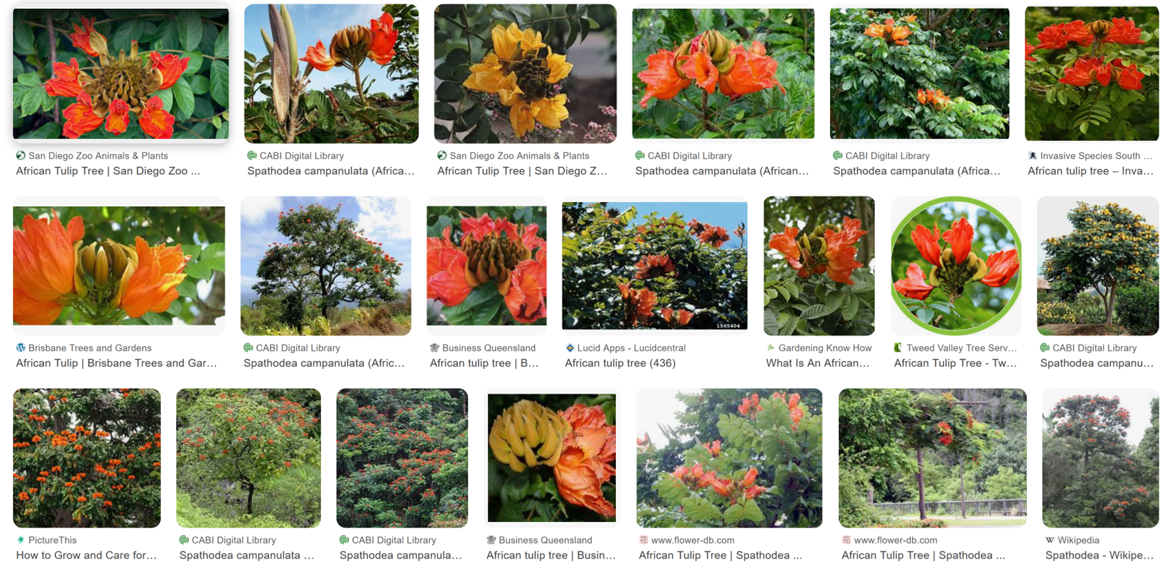
African tulip (Spathodea campanulata)

Slide 6
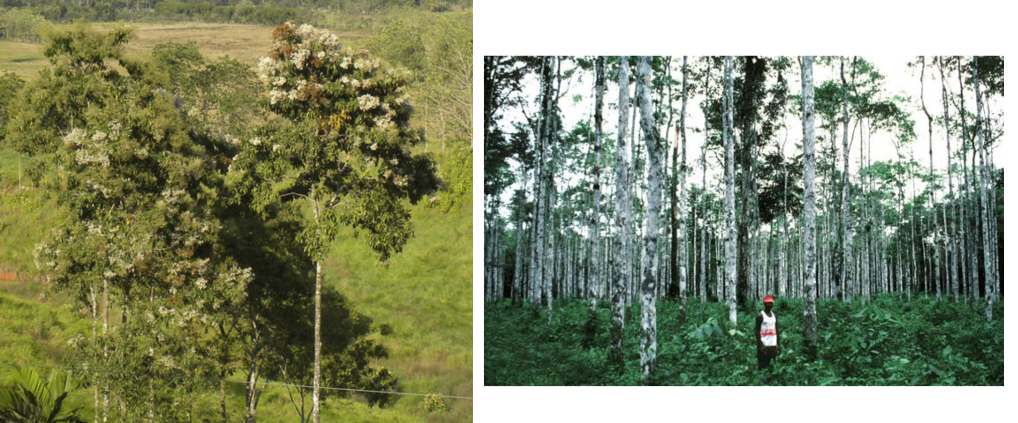
Salmwood (Cordia alliodora)

Slide 7
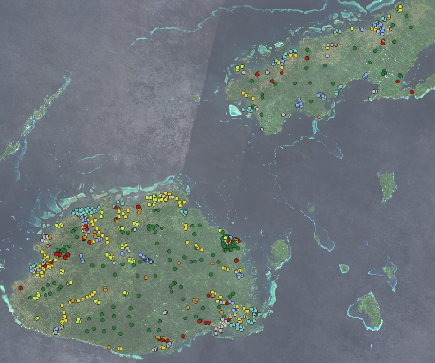
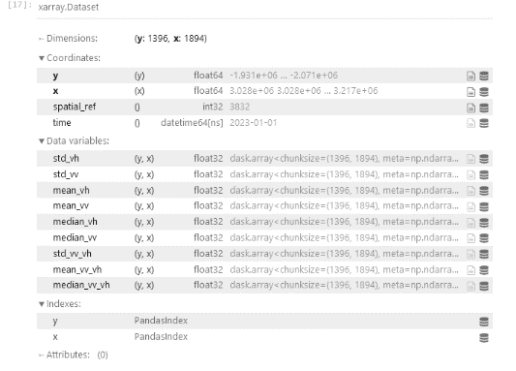
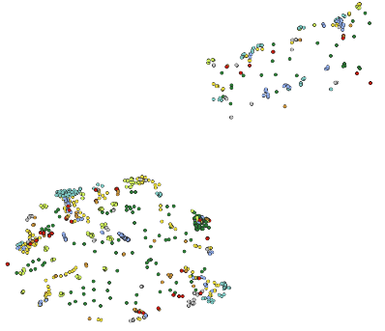
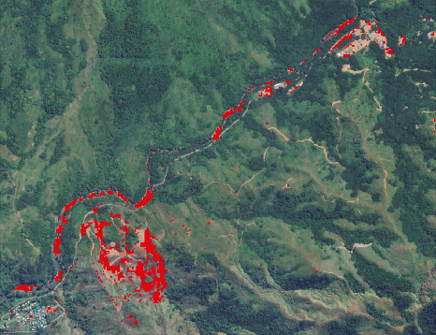
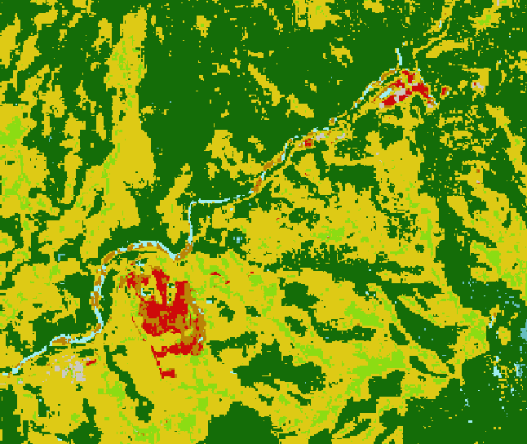

Slide 8
Working with Digital Earth Pacific (DEP) and wider advisor team
Alex Leith AuSpatious
Brian Killough NASA / CEOS

Slide 9
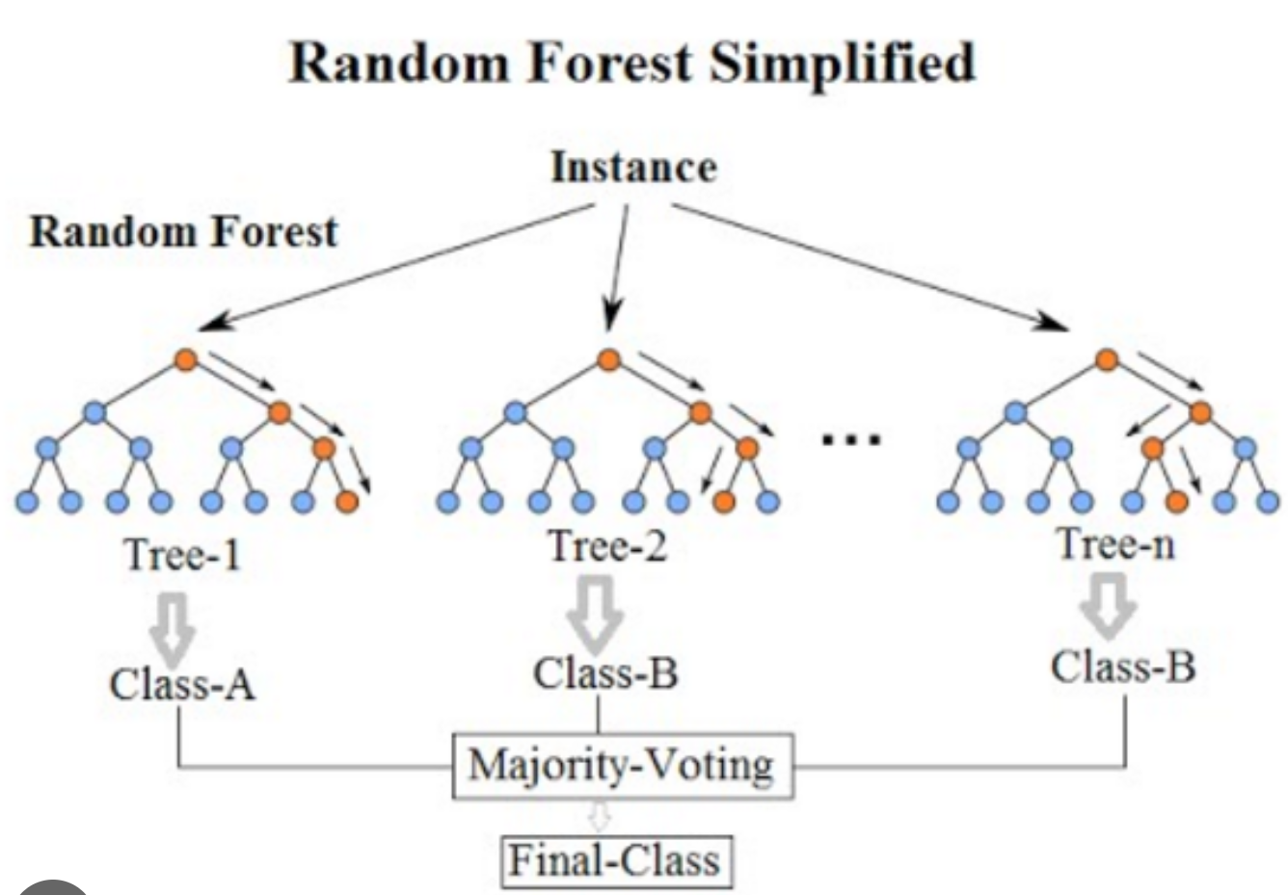
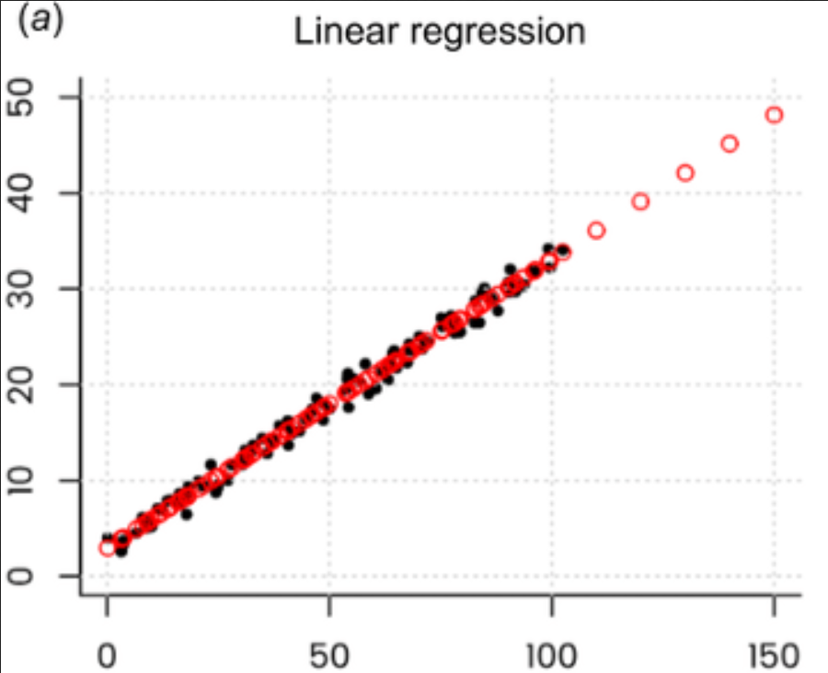
Two main machine learning approaches
In this processing we cover two main approaches to ML Learning
Randomforest models 2. Regression models

Slide 10
Capacity Building for QGIS and QFIELD in Tonga and ML – Ground Data Collection
Invasive species mapping for Salmwood (Cordia) and African Tulip (Tulip)

Slide 11
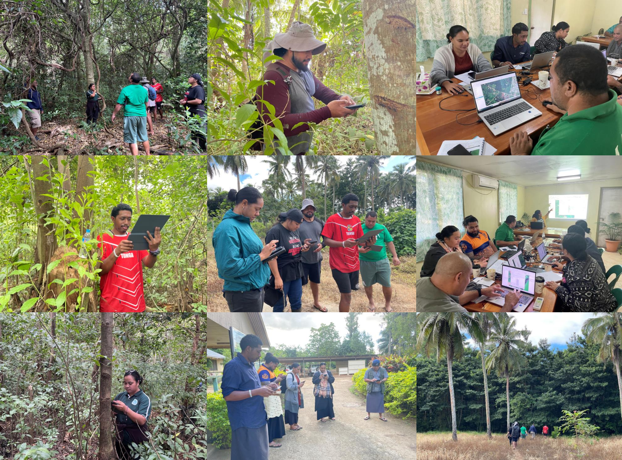
Tonga - Toloa Ground Data Collection with QFIELD

Slide 12
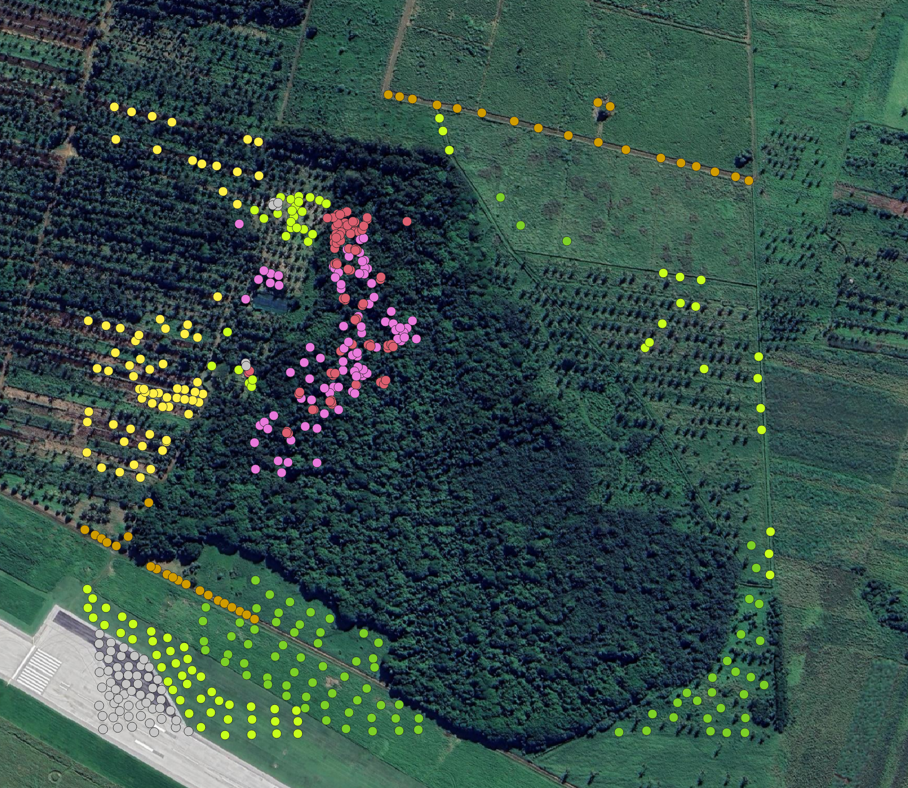
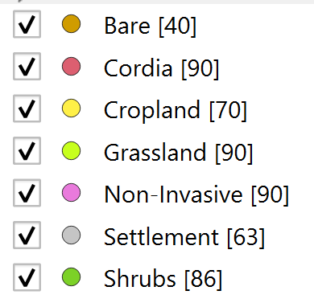
TOLOA FOREST TRAINING DATA
529(90)
Min Y : -21.236246,
Min X : -175.164532
Max Y : -21.224749,
Max X : -175.150529

Slide 13
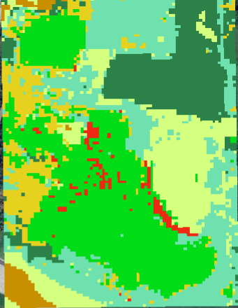
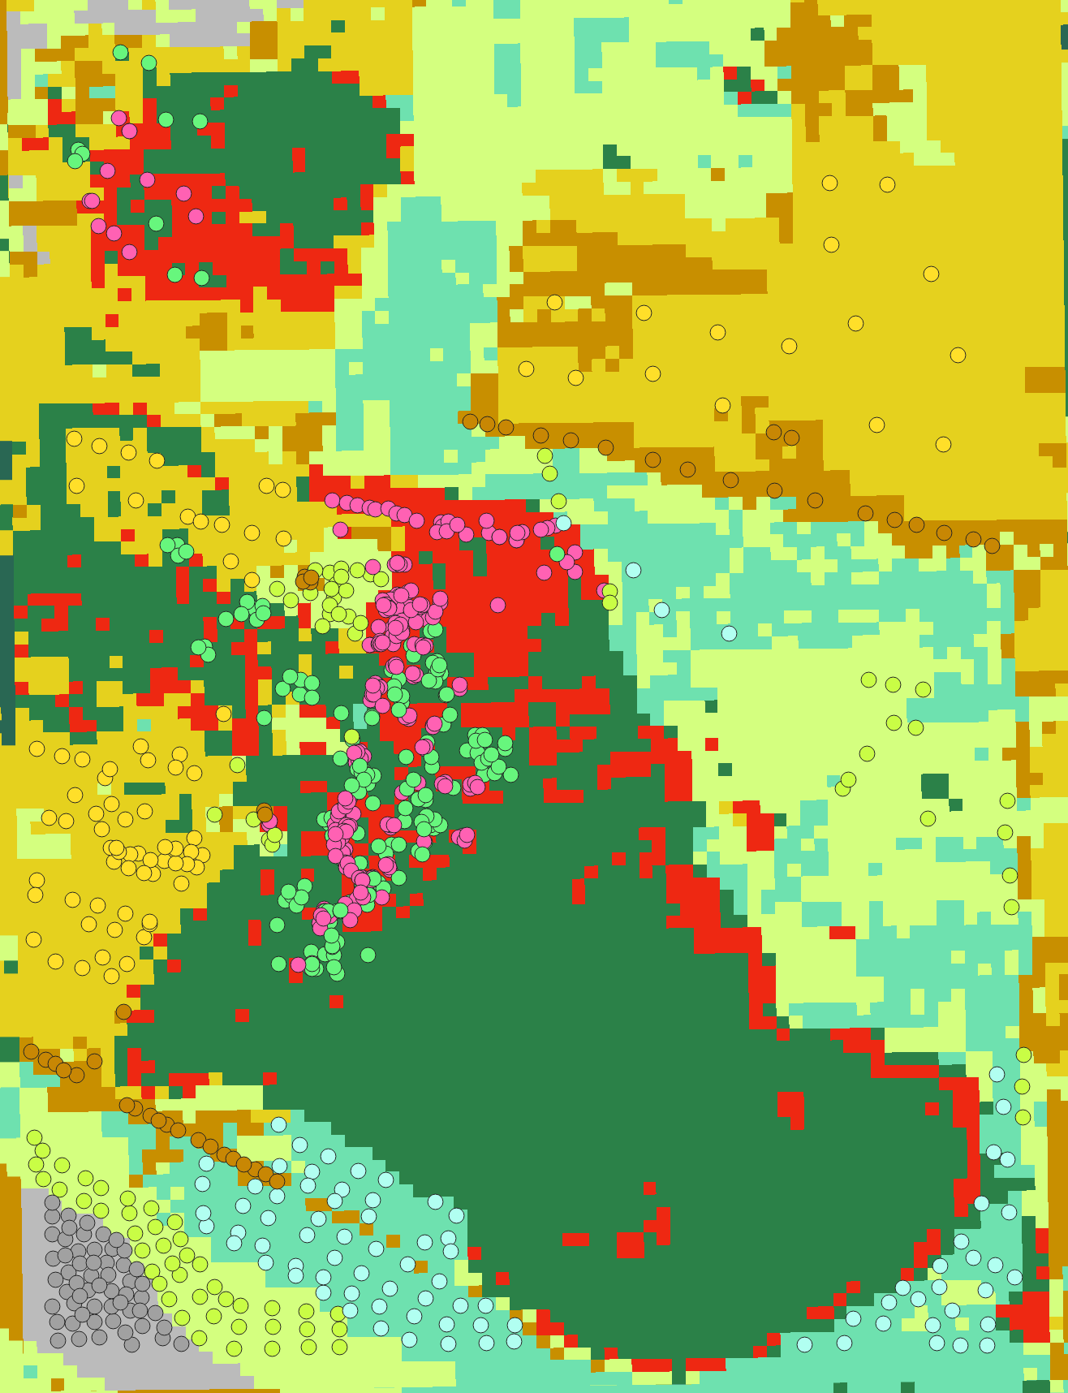
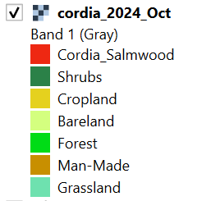
Final Version of the Data Collection using ML on Toloa Ground Points

Slide 14
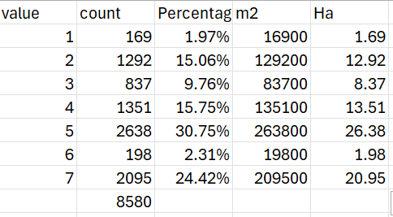
Raster Analysis – Unique Values

Slide 15
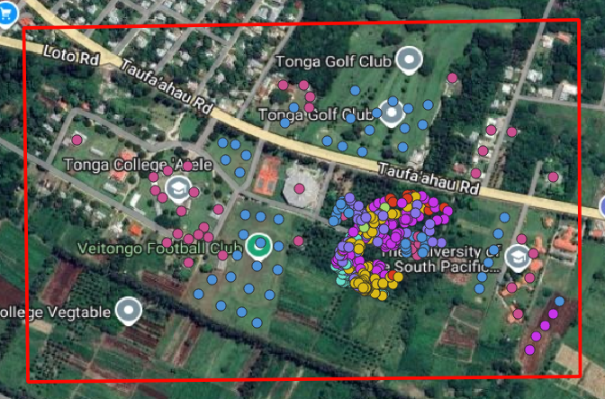
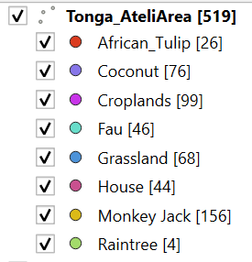
ATELE FOREST TRAINING DATA
519 (29)
Min Y : -21.186588
Min X : -175.227610
Max Y : -21.179780
Max X : -175.218832

Slide 16
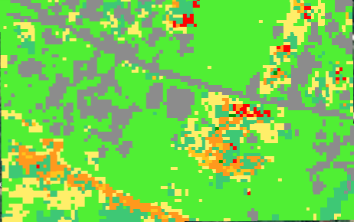
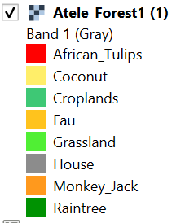
Final Version of the Data Collection using ML on Atele Ground Points

Slide 17
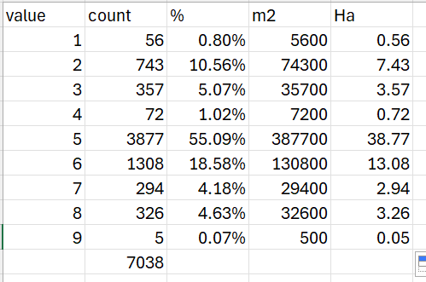
Raster Analysis – Unique Values

Slide 18
Capacity Building for QGIS and QFIELD in Fiji and ML – Ground Data Collection
Invasive species mapping for Cordia Salmwood and African Tulip

Slide 19
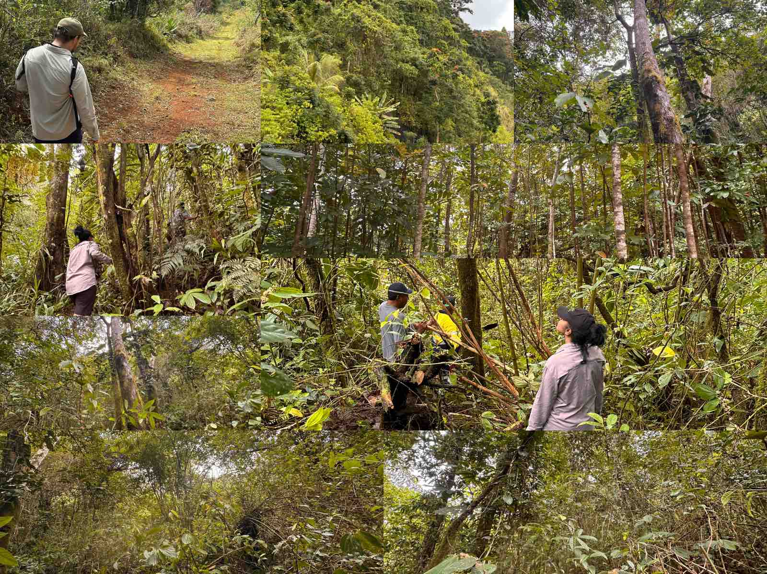
Fiji - Ground Data Collection using QFIELD

Slide 20
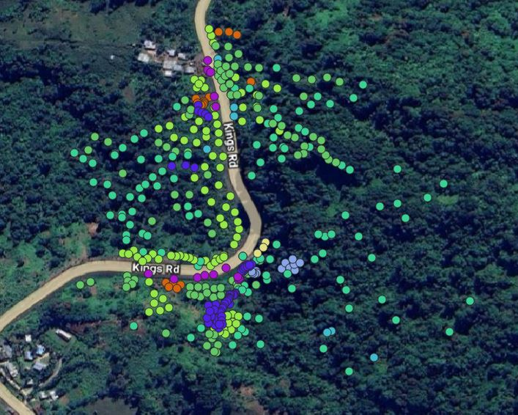
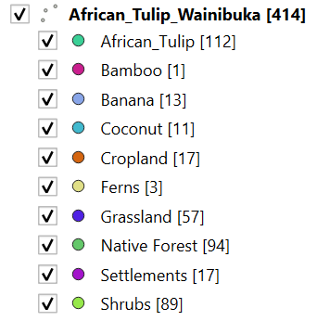
Wainibuka FOREST TRAINING DATA
414(112)
min_lat = -17.772398
min_lon = 178.401739
max_lat = -17.766376
max_lon = 178.407854

Slide 21
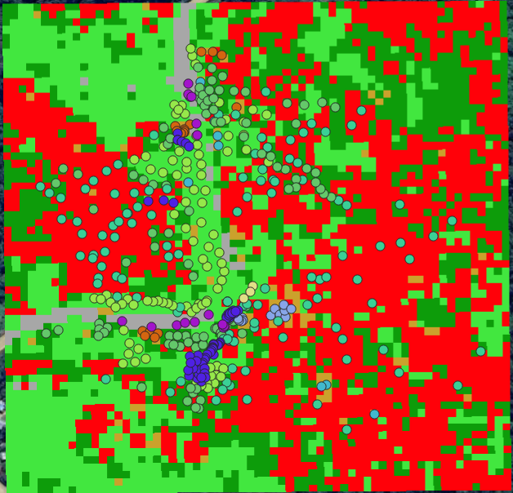
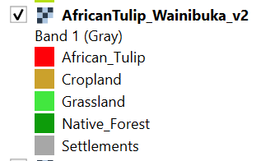
Final Version of the Data Collection using ML on Wainibuka Ground Points

Slide 22
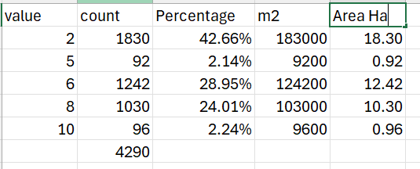
Raster Analysis – Unique Values (QGIS)

Slide 23
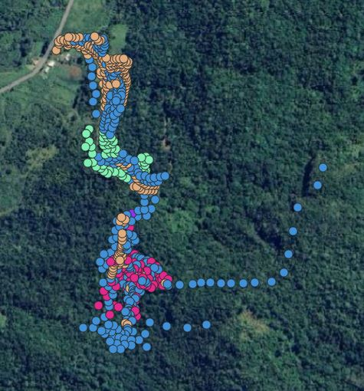
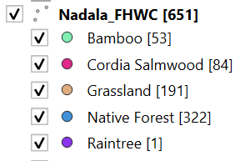
NADARIVATU - FHWC FOREST TRAINING DATA
651(84)
min_lat = -17.631319
min_lon = 177.968450
max_lat = -17.621633
max_lon = 177.975529

Slide 24
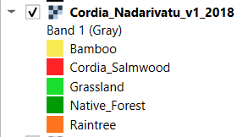
Final Version of the Data Collection using ML on Nadarivatu Ground Points

Slide 25
Raster Analysis – Unique Values (QGIS)

Slide 26
Capacity Building Workshop – FIT Fiji
QField and QGIS basic training (Open-Source tools)
Constructing individual field forms including invasives form through QGIS for QField cloud or cable.
Experience field form in forest areas using Invasives form and personal field forms.
Go through data cleaning process, ML classification, and further analysis through QGIS.
Repeat the process for better accuracy.

Slide 27
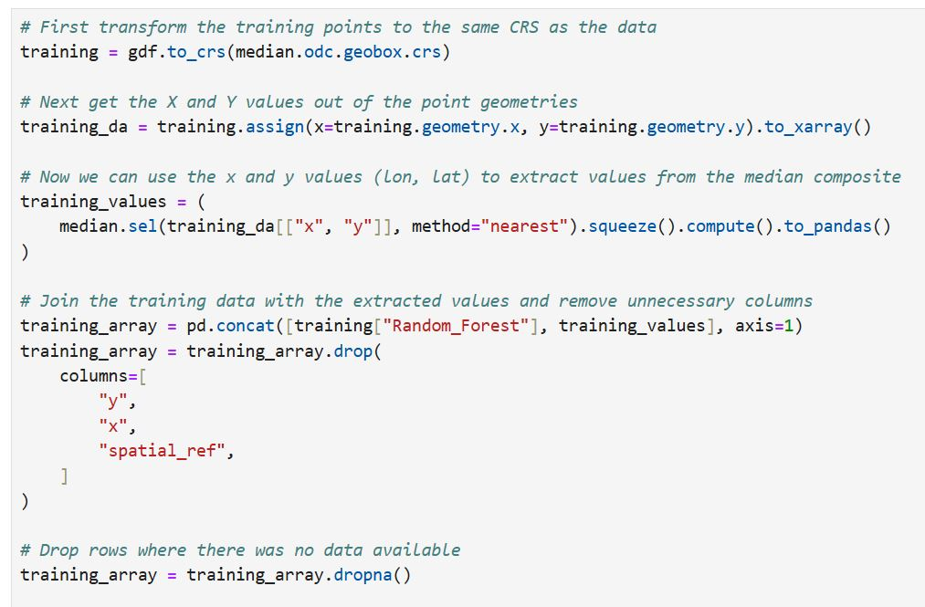
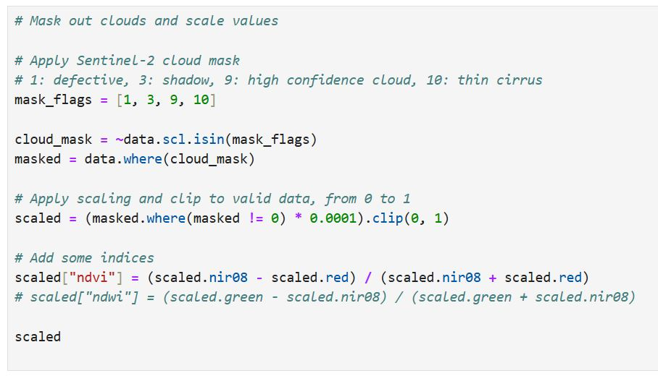
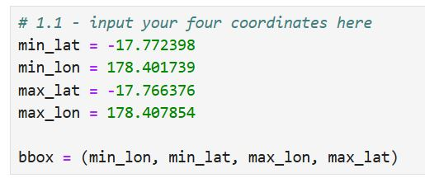
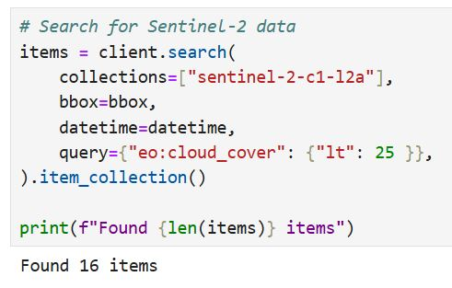
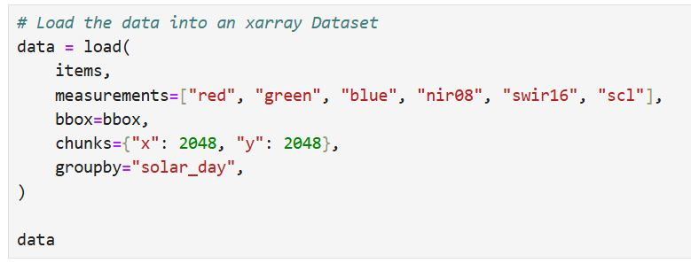
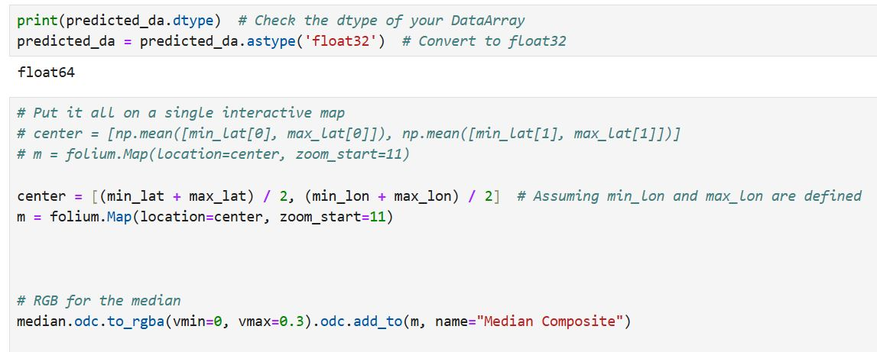
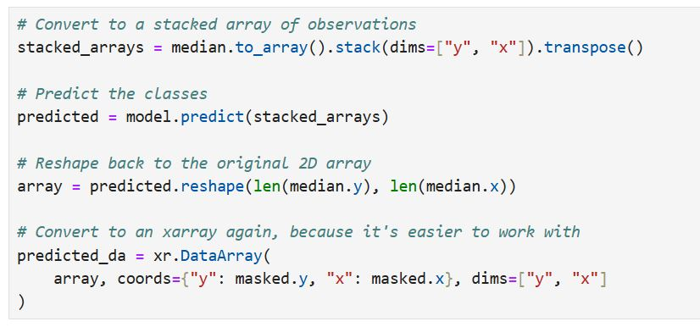
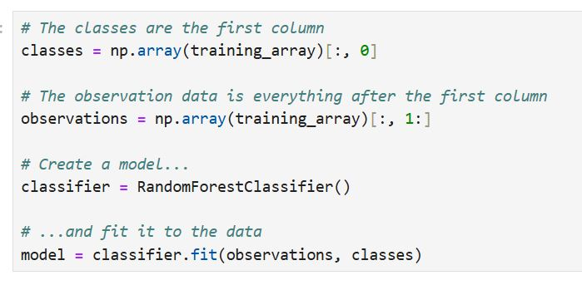
ML – Python Script for Detection

Slide 28
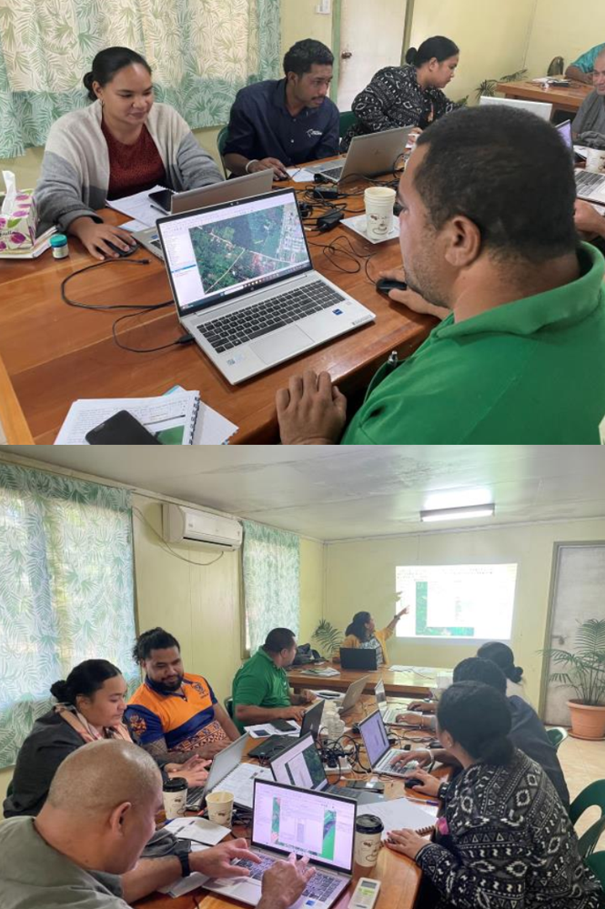
Why code? / Why Python?
Automated Data Processing
Flexibility
User Friendly
4. Visualization & Reporting

Slide 29
Vinaka and Malo…

