Slide 1

Detection of Abnormal Sea Surface Temperature in the Korea Waters from Satellite Products
Detection of Abnormal Water Temperature from Satellite Sea Surface Temperature Product
WON-JUN CHOI and CHAN-SU YANG
Sea Power Reinforcement: Security Research Department, Korea Institute of Ocean Science & Technology
Notes:
Hello, Everyone. I'm Wonjun Choi working at Korea Institute of Ocean Science & Technology (KIOST).
My presentation is Detection of Abnormal Sea Surface Temperature in the Korea Waters from Satellite Products.

Slide 2
1차 학위논문 발표 Comment
Comment
제목 : 좀 더 구체적인 방향으로 연안쪽에 포커스 지역적인
수산과학원 이상수온 기준이 국제적인 레퍼런스가 있는지, 저널에 인용된 기준으로
위성 SST 부이 비교 : 위성 SST의 장단점, 목적성을 이용하여 결과를 풀어나가야함
ALWT , MHWs ,CWM : 약어에 대한 설명
결과와 결론을 구별하기 위한 필요성
결론 : 결과에 대한 의의를 찾아가는 방향
고수온 현상이 어느 지역에 주로 생겼다 → 이것이 의미하는 바가 무엇인지
분포에 대한 영역이 다름, 열역학과 관련이 있을때 어떤 영향?
결론부분에서 coast와 open sea , coast region으로 표기를 변경
CWM 탐지 영역에 대한 위치와

Slide 3
연구성과
학술논문 (3건: KCI 1, Scopus 2)
Analysis of Spatio-Temporal intensity of Sea Fog in Yellow Sea Using Visibility Data of Ocean Research Stations (ORS) and Baengnyeongdo (한국연안방재학회, 공동저자)
Recent Trends of Abnormal Sea Surface Temperature Occurrence Analyzed from Buoy and Satellite Data in Waters around Korean Peninsula(KJRS, 제1저자)
Shoreline Changes and Erosion Protection Effects in Cotonou of Benin in the Gulf of Guinea (KJRS, 공동저자)
학술대회 (15건: 국내 10, 국외 5)
Detection of Marine Heat Waves and Cold Water Mass along the coast of the Korean Peninsula using Satellite SST(한국해양학회, 국내, 제1저자)
OIL SPILL DETECTION TECHNIQUE WITH AUTOMATIC UPDATING USING DEEP LEARNING AND OIL SPILL INDEX (IGARSS, 미국, 공동저자)
TRENDS OF ABNORMAL SEA SURFACE TEMPERATURE OCCURRENCE USING BUOY AND SATELLITE SST DATA(ISRS, 일본, 제 1저자)
Satellite Application Algorithms for Coastal and Marine Spatial Planning in the Pacific Island Countries: A Case Study in Funafuti, Tuvalu (PGRSC, 피지, 공동저자)

Slide 4
연구성과
지식재산권 (3건: SW 1, 특허 2)
원격탐사 이미지에서 파장과 파향 산출 (SW)
해수면 온도 산출 방법 및 이를 수행하는 프로그램이 기록된 컴퓨터 판독이 가능한 기록매체(특허, 출원)
냉수대 탐지 방법 및 시스템(특허, 접수)

Slide 5
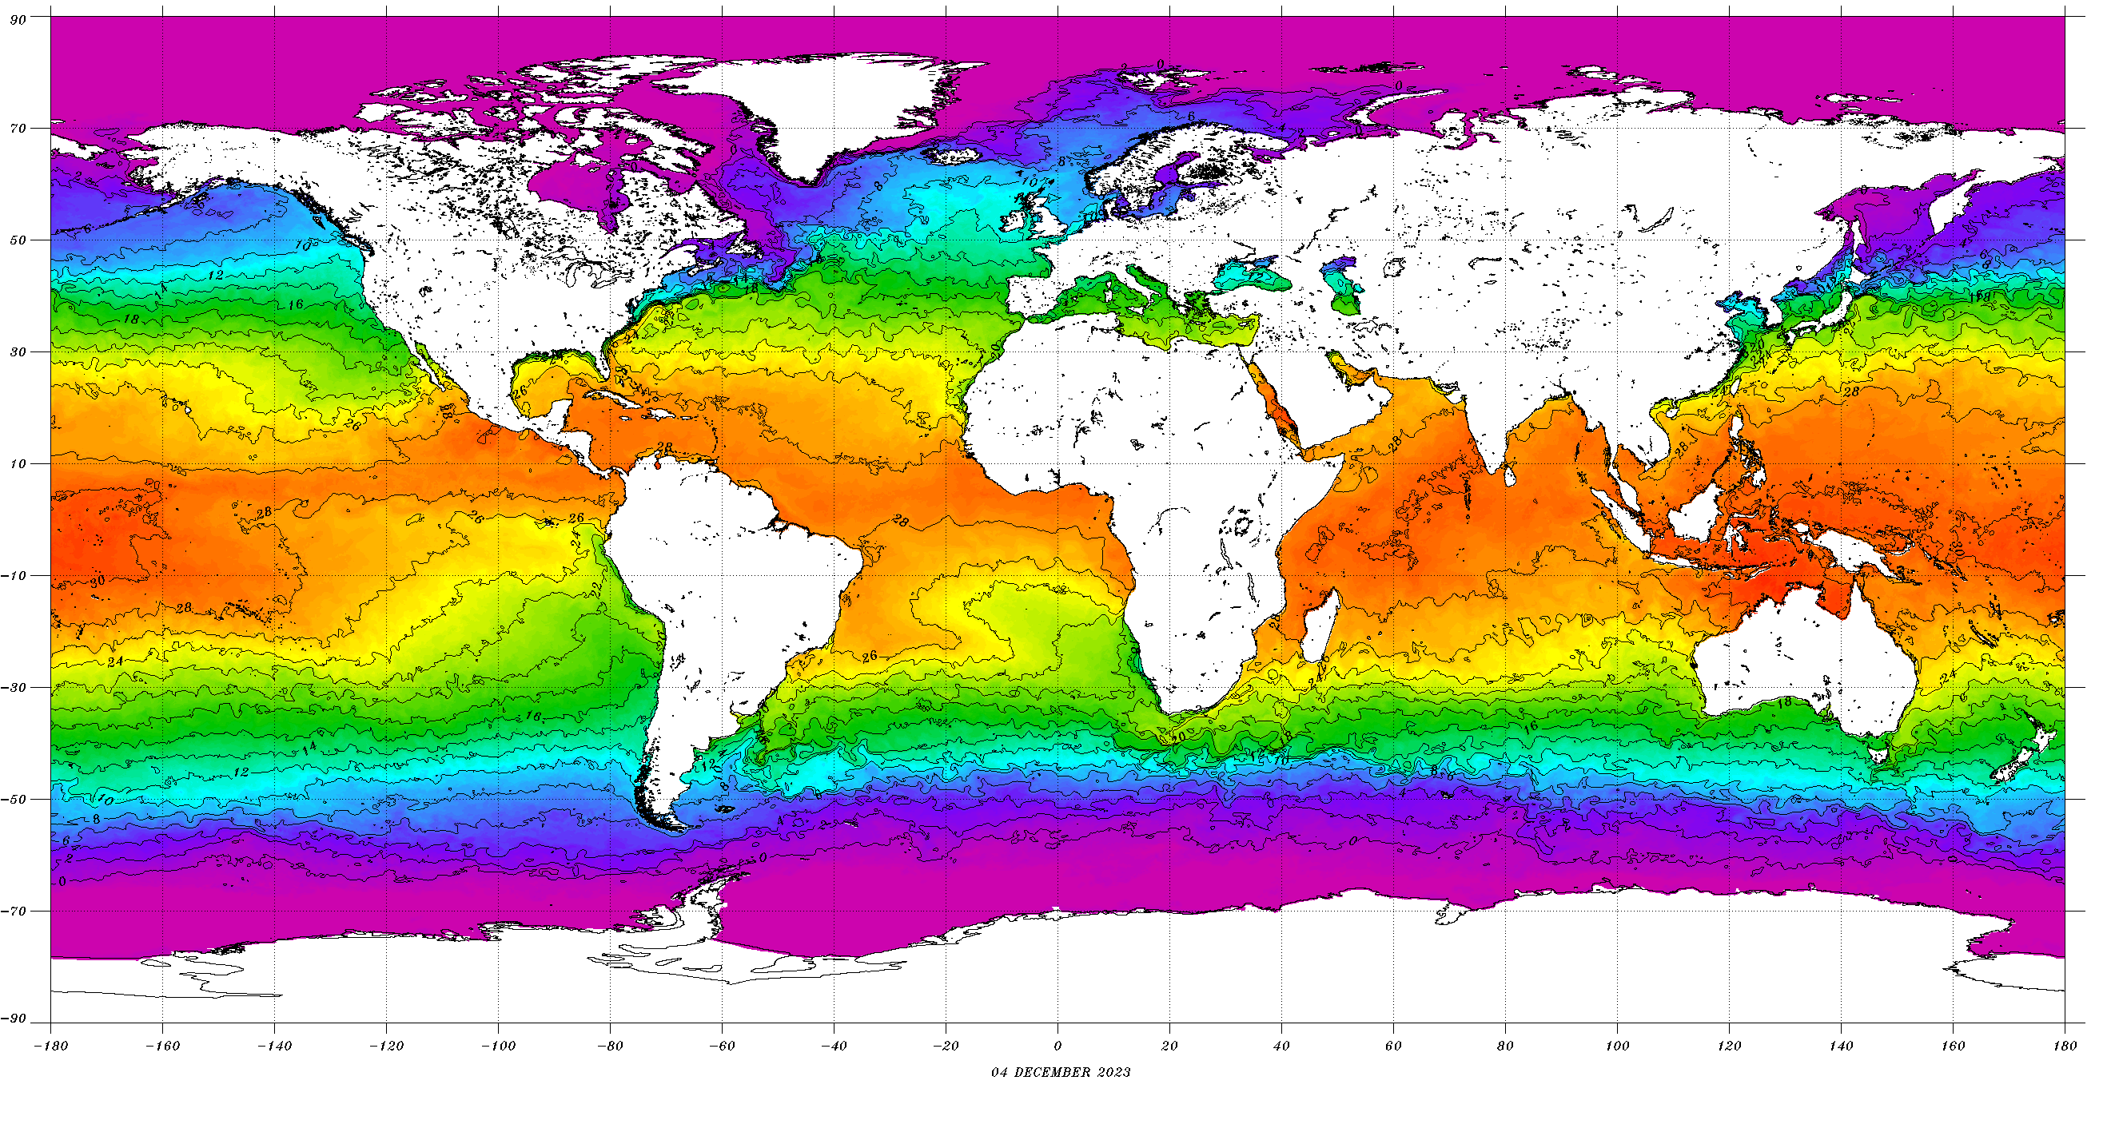
Introduction
Sea Surface Temperature (SST)
Ocean : Large heat-storage capacity
Sea surface: Ocean ↔Atmosphere
Factor of energy flow : SST, wind speed, air temperature, cloudiness …
Understanding the global climate system
Notes:
The ocean is a large storage of heat capacity
And in particular the surface serves as a link between the ocean and the atmosphere.
So SST is important for understanding the global climate system.
Ocean은 큰 열용량 저장소로서 특히 해양 표면은 해양과 대기를 이어주는 역할을 한다.
열의 흐름에 있어서 중요한 인자인 SST는 전지구적인 기후 시스템을 이해하는데 중요하다.

Slide 6
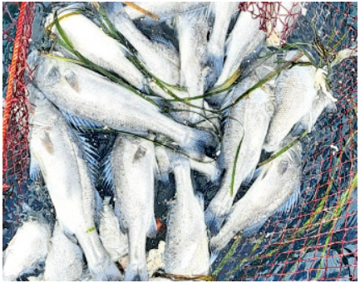
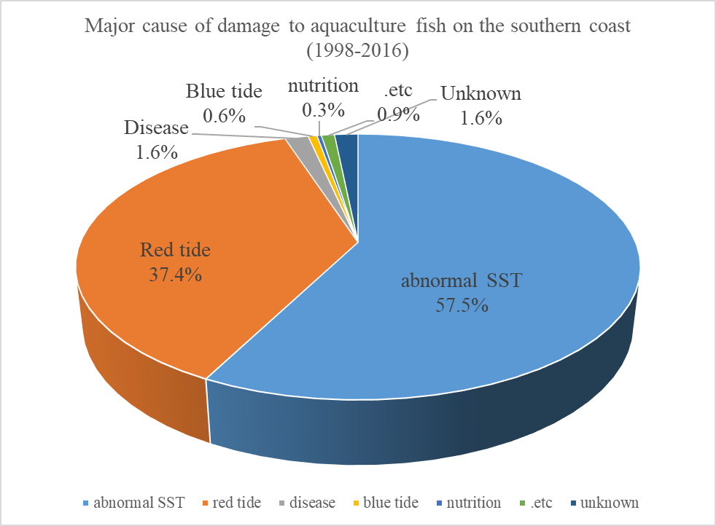
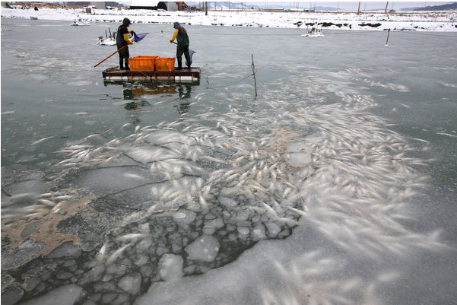
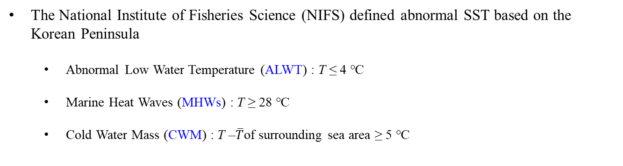
Introduction (Background)
Abnormal SST
The National Institute of Fisheries Science (NIFS) defined abnormal SST based on the Korean Peninsula
  Abnormal Low Water Temperature (ALWT) : T ≤ 4 ℃
  Marine Heat Waves (MHWs) : T ≥ 28 ℃
  Cold Water Mass (CWM) : T –$\overline{T}$of surrounding sea area ≥ 5 ℃
Damage caused by abnormal SST around Korean Peninsula
Major causes of cultivated fish damage on the southern coast of the Korean peninsula (1998~2016)
abnormal SST→ 57.5%
(Case of MHWs in Geoje in 2021)
(Case of ALWT in Muan in 2021)
Notes:
Recently, due to climate change such as global warming, abnormal SST occurs.
The National Institute of Fisheries Science (NIFS) in South Korea defines abnormal SST around the Korean Peninsula as follows:
Abnormal Low Water Temperature (ALWT) is when the water temperature is 4 degrees or less,
Marine Heat Waves (MHWs) are 28 degrees or more,
and CWM refers to a sea area where the water temperature is 5 degrees cooler than the surrounding area.
According to a report published in 2016, abnormal SST accounted for 57.5% of farmed fish dead.

Slide 7
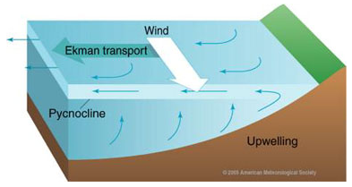
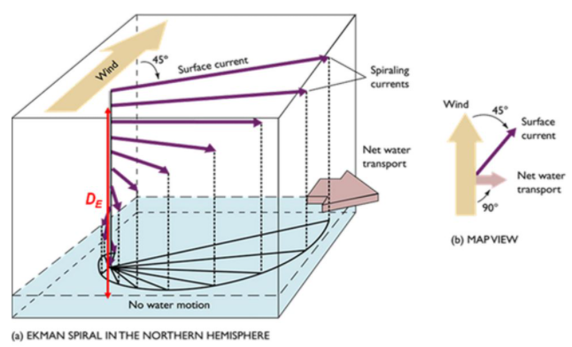
Introduction (Background)
Cause of Abnormal SST occurrence
ALWT & MHWs (Nan et al., 2015)
  Intensity and flow of the Kuroshio Current
  Atmospheric high and cold wave
  Hot and diluted water from the Yangtze River
CWM
  Yellow Sea Bottom Cold Water (YSBCW) and Tide
  Upwelling : deep and cold water mass rises toward the surface as the wind move
  Wind : southwest wind → 3m/s (7days) , 4m/s (3days)
Notes:
Many researchers have studied the causes of abnormal SST.
The main causes of ALWT and MHWs are 1. Intensity and flow of the Kuroshio Current, 2. Atmospheric high and cold wave, and 3. Hot and diluted water from the Yangtze River in China.
Cold water mass is caused by wind.
If the wind is continuous, the Ekman transport will move the surface water mass to the open sea, and the deep, cold water mass will fill the surface space. This process is called upwelling, and the East coast of the Korean Peninsula is affected by southwest winds.
많은 연구자들은 Abnormal SST의 원인들을 연구하였다.
ALWT와 MHWs의 발생 원인은 대표적으로 1. Intensity and flow of the Kuroshio Current, 2. Atmospheric high and cold wave, and 3. Hot and diluted water from the Yangtze River in China 이다.
Cold Water mass는 바람에 의하여 발생한다.
바람이 지속적으로 발생할 경우, Ekman transport로 인해 표면의 수괴가 외해로 이동하고 깊고 차가운 수괴는 빈자리를 채우게 된다. 이러한 현상을 upwelling이라 칭하고, 한반도의 동해안은 남서풍의 영향을 받는다.

Slide 8
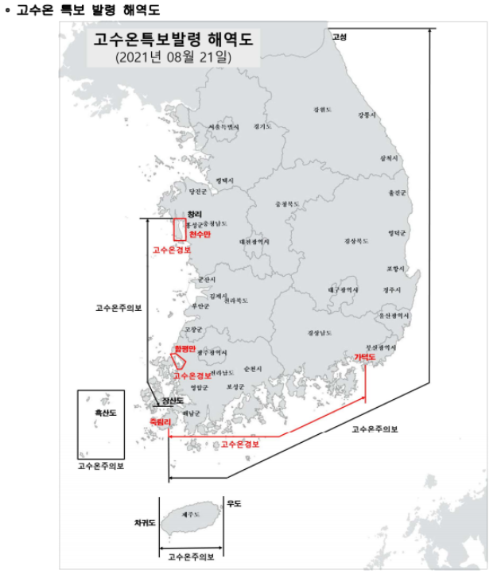
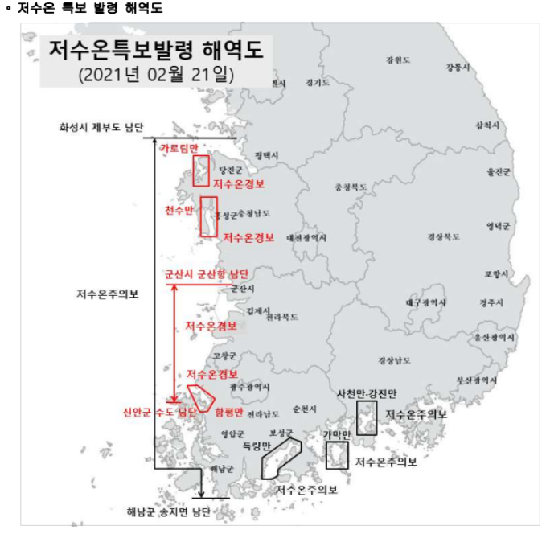
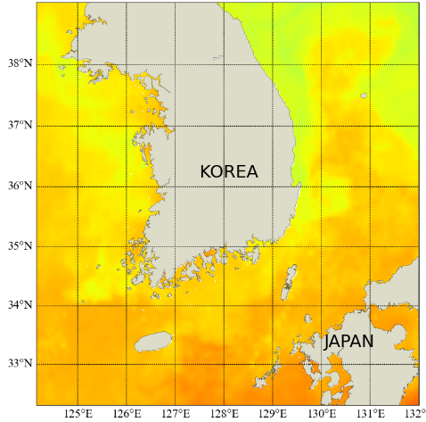
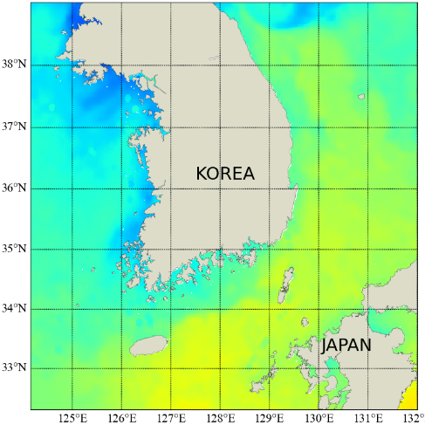
Introduction (Purpose)
Importance of abnormal SST using spatial SST
Point Temperature
Spatial SST
The National Institute of Fisheries Science (NIFS) is operating the Real-time Information System for aquaculture environment.
Using ship and buoy observation data
Forecast by sea area by classifying observation points into specific sea areas
Use of spatial sea surface temperature using numerical models or remote survey data
Development of abnormal temperature detection techniques using spatial SST
Notes:
In order to prevent damage from abnormal SSTs, NIFS uses field observation data collected by ships and buoys.
However, this method can obtain a continuous and accurate water temperature value, but there are spatial limitations.
Therefore, in this study, abnormal SSTs are detected using satellite SSTs without empty space.
Abnormal SST의 피해를 막기위해서 NIFS는 배와 buoy로 수집한 현장관측자료를 사용한다. 하지만 이러한 방법은 지속적이고 정확한 수온값을 얻을 수 있지만 공간적인 제약이 존재한다. 그래서 이 연구에서는 빈 공간이 없는 위성 SST를 이용하여 Abnormal SST를 탐지하고 최근 경향성을 제시한다.

Slide 9
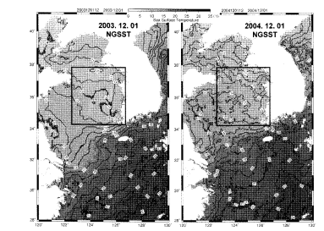
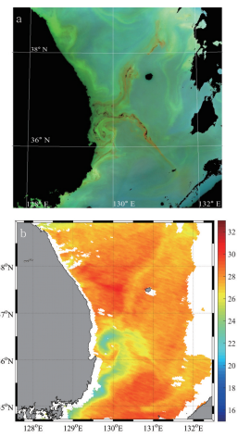
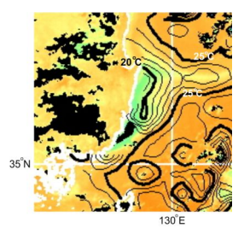
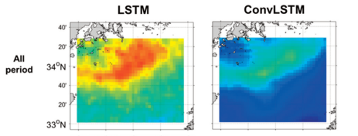
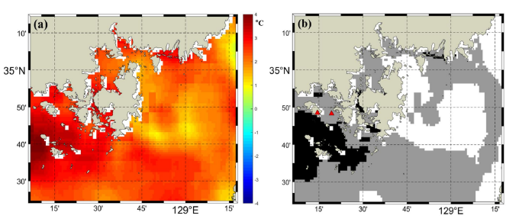
Introduction (Purpose)
Previous Study
Moon and Yang (2009)
Yoon and Yang (2016)
Choo (2016)
Jung et al. (2020)
Kim and Yang (2019)
Analysis of SST characteristics
Correlation with other factors
→Detection of abnormal SST using real-time satellite SST

Slide 10
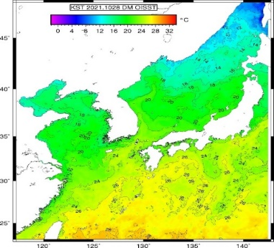
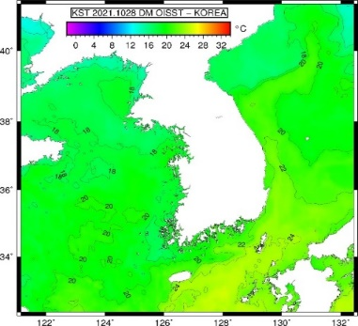
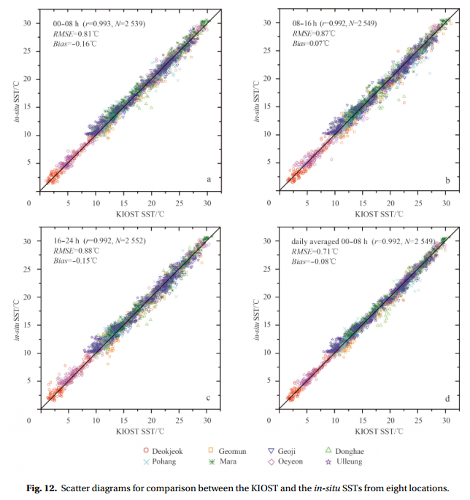
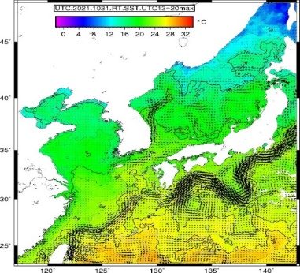
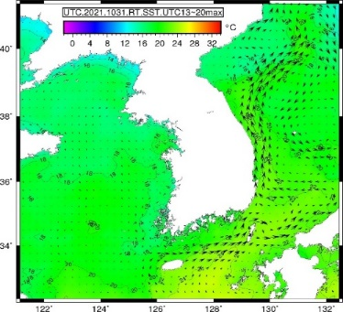
Data (Satellite SST)
KOOS SST
The Korea Institute of Ocean Science & Technology (KIOST) is developing and producing the Korea Operational Oceanographic System (KOOS) SST using multi satellite SST ( AVHRR, MODIS, AMI, VIIRS, GMI, Sentiel-3)
KOOS SST is produced daily through the optimal interpolation (OI) algorithm
Resolution: 1km Accuracy: 0.71 ℃
Notes:
The Korea Institute of Ocean Science & Technology (KIOST) is developing and producing the KOOS SST product using multi satellite SST such as AVHRR, MODIS, AMI, VIIRS, GMI, Sentinel-3).
KOOST SST is produced daily through the optimal interpolation algorithm and has 1km resolution, 0.71 degree accuracy.

Slide 11
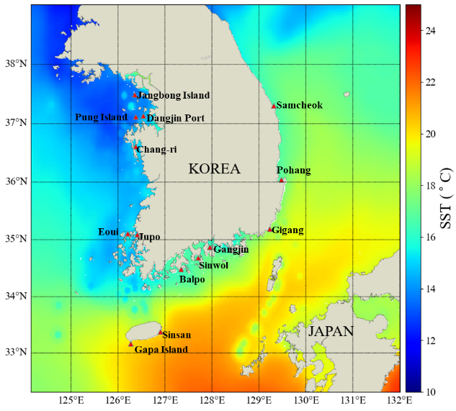
Data (Buoy)
Buoy Temperature
Long-term data can be collected by mooring at a specific location on the sea for marine meteorological observation purposes
Foreign substances at sea level or temporarily affected resulting in error values
Proceed with Quality Control (QC)
  Physical limit check
  Standard deviation check
  Spike check
  Durability check
14 Buoy SSTs are used for coastal evaluation of abnormal SST distribution
Notes:
In this study, Buoy data were also used for comparison with Satellite SST results.
Although the Buoy data has the strength of collecting continuous data, there is a possibility that error values can be generated due to external factors.
Therefore, the Buoy data was pre-processed through the Quality Control process as follows,
and we used the data of 14 Buoy around the Korean Peninsula.
이 연구에서는 Satellite SST 결과와 비교를 위해 Buoy 자료도 사용하였다.
Buoy 자료는 지속적인 데이터를 수집할 수 있는 강점을 가졌지만, 외부 요인에 의해서 오류값이 발생할 가능성이 있다.
그래서 Buoy 데이터는 Quality Control 과정을 통해 아래와 같은 전처리 프로세스를 진행하였고 우리는 한반도 주변의 14개 Buoy 데이터를 사용하였다.

Slide 12
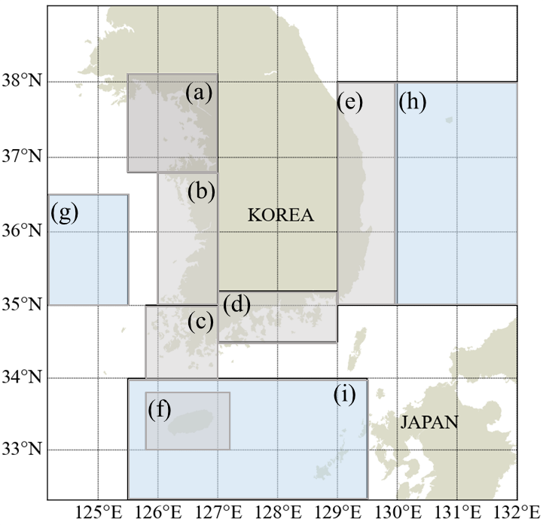
Study area
Study area according to SST characteristics
ALWT & MHWs
  (a) the Gyeonggi Bay, (b)- (f) coastal regions along the coast of Korea, (g) the Yellow Sea, (h) the East Sea, and (i) The northeastern East China Sea
CWM
  (a) Goseong-Uljin, (b)Samcheok-Guryongpo, (c)Pohang-Gijang
ALWT & MHWs
CWM
Notes:
Since the sea area around the Korean Peninsula has different characteristics, the study was divided into several sea areas.
For the study of ALWT and MHWs, the sea area was divided into 6 coast areas and 3 open sea.
(a) the Gyeonggi Bay , (b) to (f) the coastal regions along the coast of Korea, (g) the Yellow Sea, (h) the East Sea, and (i) the northeastern East China Sea.
Since CWM occurs mainly in the East Sea, it has been divided into (a) Goseong-Uljin, (b) Samcheok-Guryongpo, and (c) Pohang-Gijang.
한반도 주변의 해역은 서로 다른 특징을 가지고 있기 때문에 여러 해역으로 나눠서 연구를 진행하였다.
ALWT와 MHWs의 연구를 위하여, 해역을 A는 the Gyeonggi Bay , b에서 f는 coastal regions along the coast of Korea, g는 the Yellow Sea, h는 East Sea, i는 the northeastern East China Sea로 나눴다.
CWM는 동해안에 주로 발생하기 때문에 (a) Goseong-Uljin, (b) Samcheok-Guryongpo, (c) Pohang-Gijang으로 나눴다.

Slide 13
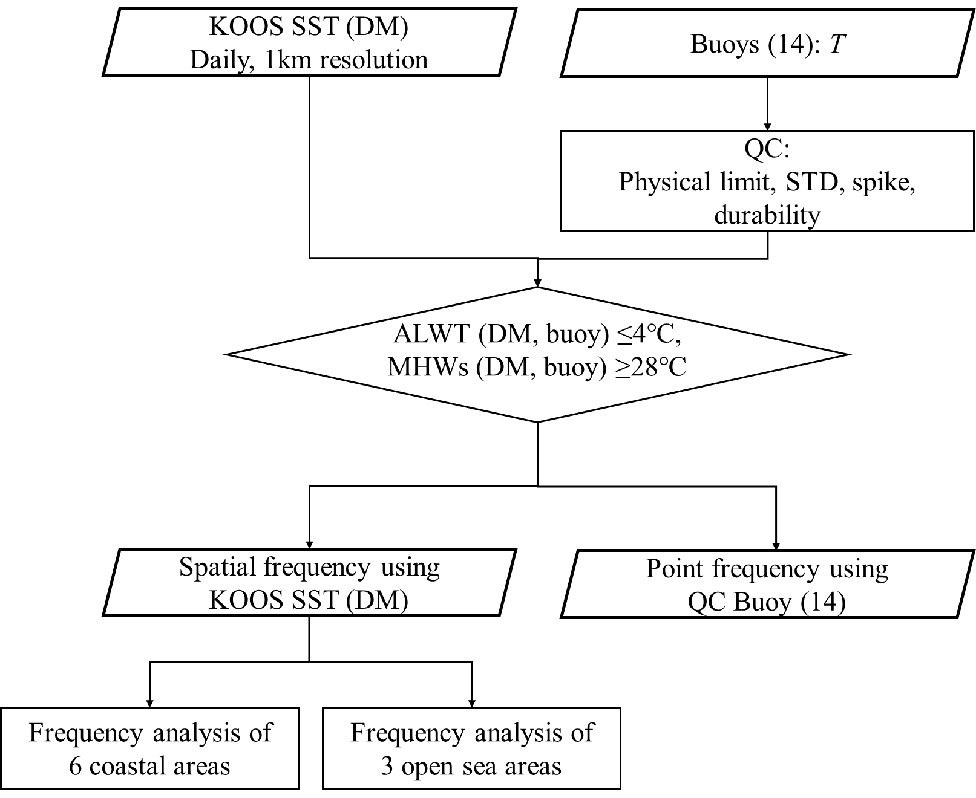
Method(ALWT & MHWs)
ALWT & MHWs Detection (Satellite and Buoy)
Study Period: 2020.08.01~2021.07.31
KOOS SST compared single pixel values and SST threshold value for all pixels
QC buoy temperature data was compared with the SST threshold value in buoy case
The SST threshold value was referred to the threshold value for issuing breaking news by NIFS
ALWT: 4℃ or lower
MWHs: 28℃ or higher
Notes:
This slide explains methods for detecting ALWT and MHWs.
KOOS SST compared single pixel values and SST threshold value for all pixels.
QC buoy temperature data also compared with threshold value.

Slide 14
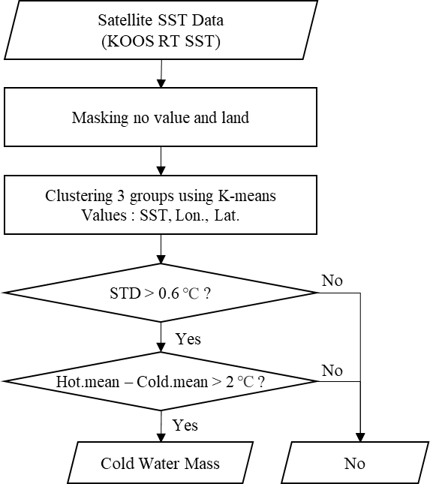
Method(CWM)
CWM Detection algorithm
Estimated CWM area : K-means clustering
Threshold method : STD, Difference of the groups
Estimated Part
Threshold Part
Notes:
This is a flowchart for detecting CWM.
CWM detection algorithm is divided into estimated part and threshold part.
The Estimated part uses K-means clustering to determine the group with the lowest water temperature and
The threshold part determines whether the group is CWM or not.
이 그림은 CWM를 탐지하기 위한 flowchart이다.
CWM 탐지 알고리즘은 Estimated part와 Threshold part로 나눠진다.
Estimated part는 K-means clustering을 이용하여 수온이 가장 낮은 집단을 판단하고
Threshold part는 그 집단이 CWM인지 아닌지 판별한다.

Slide 15
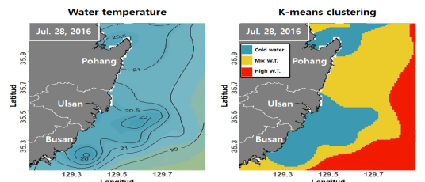
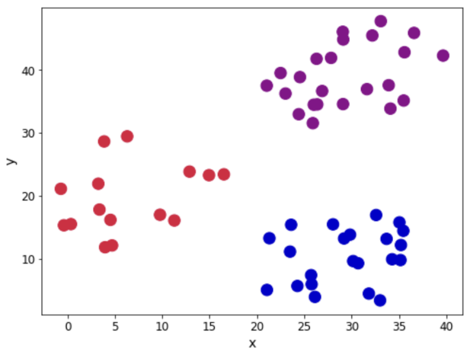
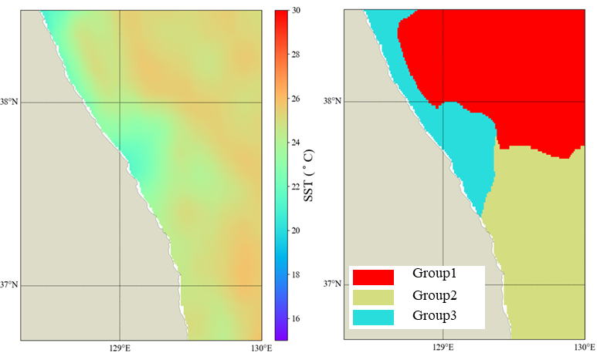
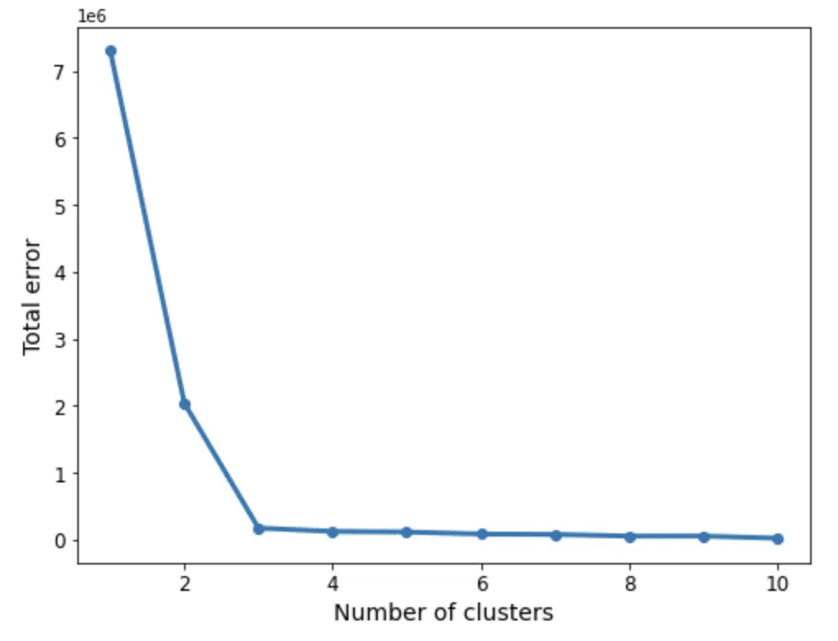
Method(CWM)
K-means clustering
A type of clustering algorithm
Unsupervised Learning Method
Clustering K groups of similar objects within a data set
K : the number of groups
Using Elbow Plot Method for determining optimal K
2021.7.14
Notes:
K-means clustering is a type of clustering algorithm that is an unsupervised learning method.
Clustering similar objects within the dataset with the number K and previous studies have shown that the optimal K for CWM is 3.
K-means clustering은 클러스터링 알고리즘의 한 타입으로 unsupervised learning metho이다.
데이터셋 내에서 비슷한 객체를 K라는 수로 클러스터링하고 선행연구에서 CWM을 위한 최적의 K는 3인 것이 연구되었다.

Slide 16
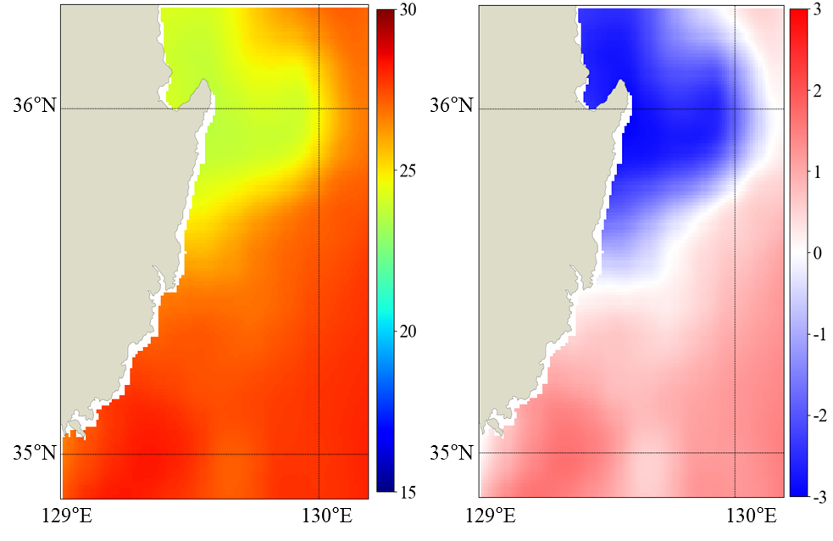
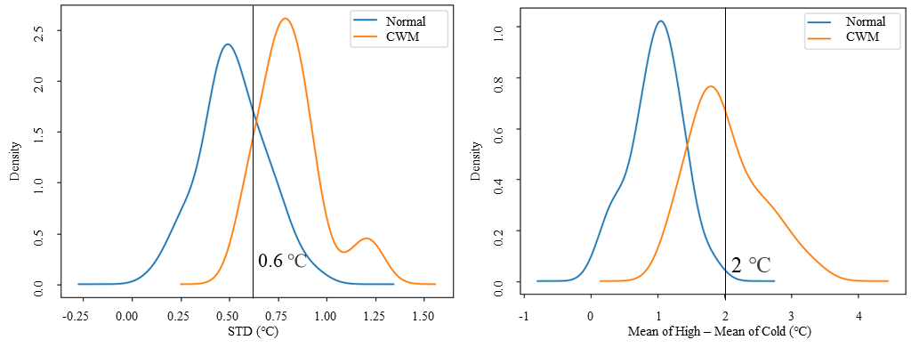
Method(CWM)
Threshold Method
Relationship between Group3 and the CWM
1step : STD of SST in the region
2step : difference average SST between Group1(highest SST) and Group3(CWM estimated area)
SST (℃)
Deviation (℃)
Notes:
We analyzed water temperature data from 2020 and 2021 to determine the threshold value.
Threshold part shows the relationship between the group with the lowest water temperature and the cold water mass.
The first step is using standard deviation, and the second step is using the difference in water temperature between groups.
Based on these analyses, the optimal threshold values are 0.6 degrees and 2 degrees, respectively.
우리는 Threshold 값을 결정하기 위해서 2020년과 2021년 수온 자료를 분석하였다.
Threshold part는 수온이 가장 낮은 집단과 냉수대의 관계를 나타내고 있으며,
첫번째 step은 표준편차를 이용한 방법이고 2번째 step은 집단간의 수온차이를 이용한 방법이다.
이러한 분석을 통해 최적의 threshold value는 각각 0.6 degree와 2 degree 이다.

Slide 17
Method(CWM)
Evaluation of CWM Detection algorithm
Ground truth : 2022 CWM
Accuracy , Precision, Recall, F1 score, FAR
Confusion matrix |  | Predicted
 |  | Positive | Negative
Actual | Positive | True Positive (TP) | False Negative (FN)
 | Negative | False Positive (FP) | True Negative (TN)
Notes:
The following indicators were used to evaluate the newly proposed algorithm.
We used the 2022 CWM as ground truth data.
The indicators are Accuracy, Precision, Recall, F1 score, and FAR.
새로 제안한 알고리즘의 평가를 위해 아래와 같은 지표들을 사용하였다.
우리는 Ground truth 자료로서 2022년의 CWM을 사용하였고
지표들은 Accuracy, Precision, Recall, F1 score, FAR 이다.

Slide 18
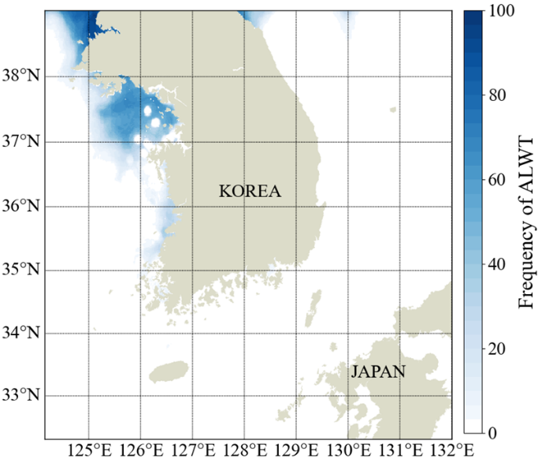
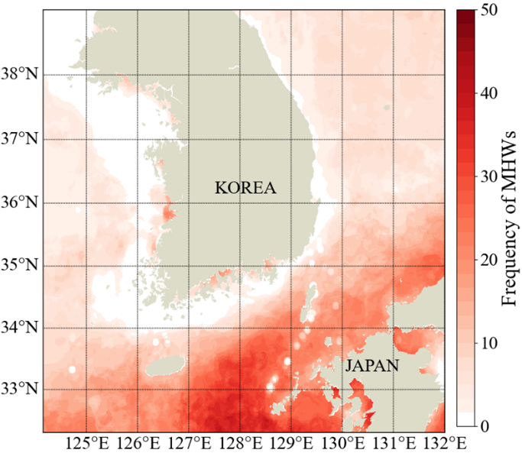
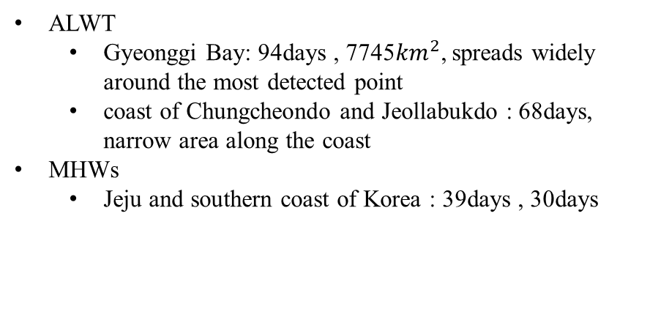
Result (ALWT & MHWs)
Spatial frequency of ALWT & MHWs (1 Year)
ALWT
  Gyeonggi Bay: 94days , 7745${km}^{2}$, spreads widely around the most detected point
  coast of Chungcheondo and Jeollabukdo : 68days, narrow area along the coast
MHWs
  Jeju and southern coast of Korea : 39days , 30days
Notes:
This is the result of analyzing the incidence trend using data for one year.
ALWT occurred 94 days in Gyeonggi Bay and is widespread.
It occurred 68 days on the west coast and had a narrow shape along the coast.
MHWs occurred 39days and 30days of Jeju and the south coast, respectively.
In the case of Gyeonggi Bay and Jeju, the frequency increased from the coast to the open sea, and in the case of the west and south coasts, the frequency increased from the open sea to the coastal direction.
1년동안의 ALWT와 MHWs 발생 경향성을 분석한 결과
ALWT는 Gyeonggi Bay에서 94일 발생하였고 넓게 퍼져있는 형태를 하고 있었다.
서해안은 68일 발생하였고 연안을 따라 좁은 형태로 발생하였다.
MHWs는 제주와 남해안에 각각 39일 30일 발생하였다.

Slide 19
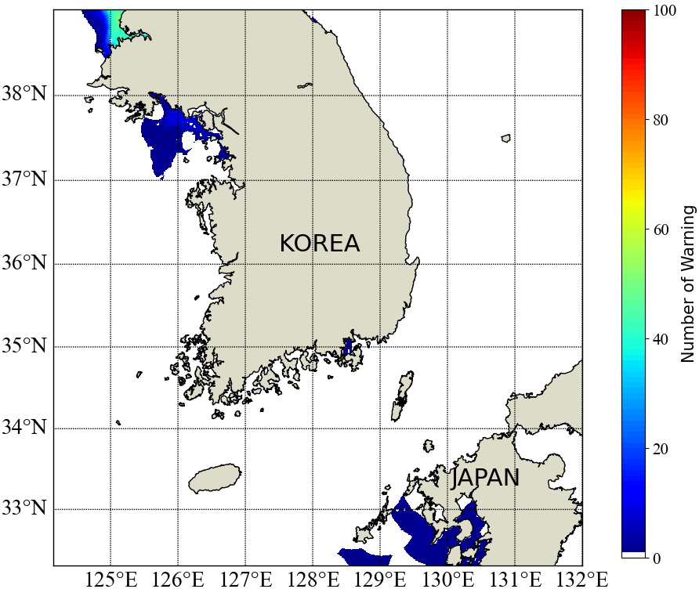
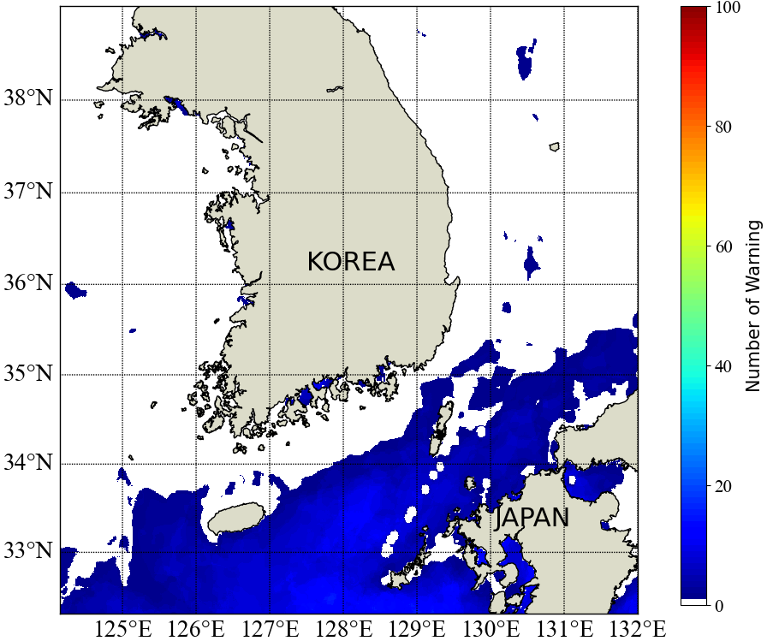
Result (ALWT & MHWs)
Spatial frequency of ALWT & MHWs (1 Year)
  Warning
    ALWT : T ≤ 1 ℃
    MHWs : T ≥ 30 ℃
16%
Number of ALWT Warning
Number of MHWs Warning
91%
60%
54%

Slide 20
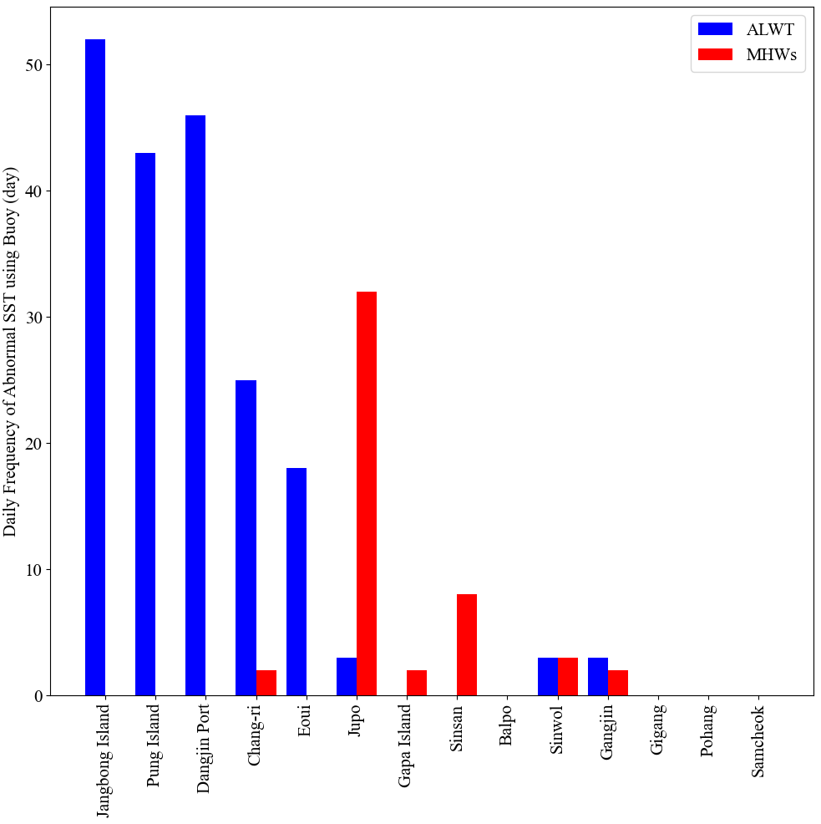
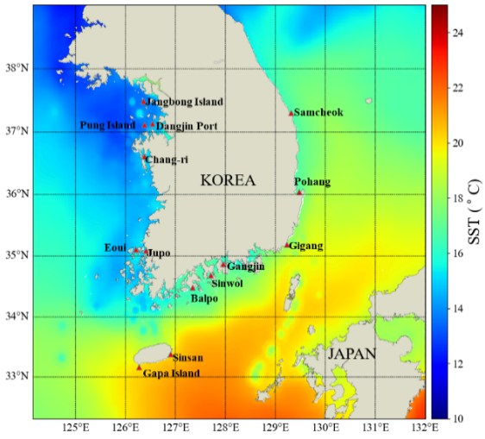
Result (ALWT & MHWs)
Frequency of ALWT and MHWs at Buoy Location
Janbong Island, Pung Island, Dangjin Port (경기만)
  ALWT: 52days, 43days, 46days
  MHWs: No detection
Chang-ri, Eoui, Jupo (서해안)
  ALWT: 25days, 18days, 3days
  MHWs: 2days, No detection, 32days
Gapa Island, Sinsan (제주)
  ALWT: No detection
  MHWs: 2 days, 8days
Balpo, Sinwol, Gangjin (남해안)
  ALWT: No detection, 3days, 3days
  MHWs: No detection, 3days, 2days
Gigang, Pohang, Samcheock (동해안)
  ALWT: No detection
  MHWs: No detection
Notes:
Buoy와

Slide 21
Result (ALWT & MHWs)
Frequency of ALWT and MHWs at Buoy Location
ALWT
  The only in Buoys, located on the west and south coast
  Buoys located in Gyeonggi-bay detect ALWT 47days on average
MHWs
  As a result of comparing the location of the buoy with the corresponding KOOS SST result, the frequency of buoy detection was the lower except for Jupo
  Due to the number of errors in MHWs detection, detection method was modified later through applying near surface oceanic temperature gradients presented by Minnett and Kaiser-Weiss (2012)
Southern coast
Western coast
Notes:
Buoy detection results were compared with Satellite SST results.
The blue bar is the result of a satellite detection, and the green bar is the result of a buoy detection.
Only buoys located on the west and south coasts detected ALWT, while buoys located in Gyeonggi-bay averaged 47 days of detection.
ALWT detection results showed similar trends in satellites and buoys.
In the case of MHWs, we can see that the number of detections by satellites is higher, with the exception of Jupo Buoy.
In the case of Jupo, it seems that the error is large, since Jupo buoy is located on a closed coast.
The detection results of MHWs differed between satellites and buoys, and the satellites' SSTs appear to be high overall.
Buoy 탐지 결과와 Satellite SST 결과를 비교하였다.
Blue bar는 위성 탐지 결과이고 green bar는 buoy 탐지 결과이다.
서해안과 남해안에 위치한 부이들만 ALWT를 탐지하였고 Gyeonggi-bay에 위치한 Buoy들의 탐지 횟수 평균은 47일이었다.
ALWT의 탐지결과는 위성과 부이에서 비슷한 경향이 나타났다.
MHWs의 경우 Jupo Buoy를 제외하고 위성의 탐지횟수가 더 많은 것을 볼 수 있다.
Jupo의 경우 닫혀있는 연안에 위치하고 있기 때문에 탐지 횟수의 오차가 큰 것으로 보인다.
MHWs의 탐지 결과는 위성과 부이에서 상이하였고 위성의 SST가 전체적으로 높게 나타나는 것으로 보인다.

Slide 22
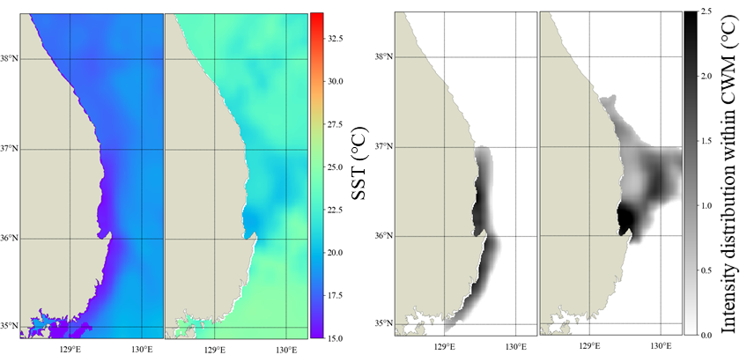
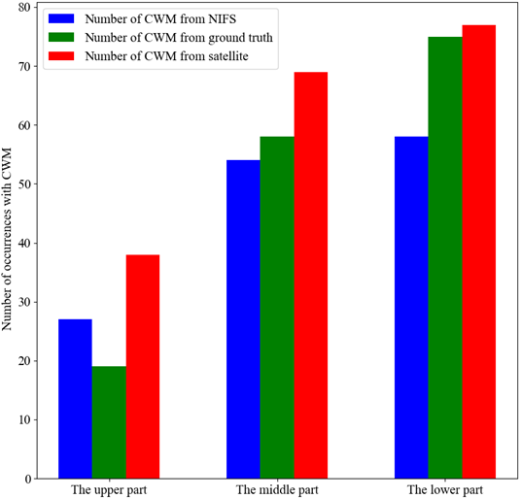
Result (CWM)
Detection of CWM
Notes:
Next are the results of CWM.
The top is the SST visualization figure, and the bottom figure is the CWM detection result.
On the left, you can see a long narrow shape along the coast.
In the case of the right side, it can be seen that it exists form that spreads out widely from Guryongpo.
For quantitative evaluation, we compared the breaking news provided by the NIFS with the results of visual observations and satellite detections.
다음으로 CWM의 결과이다.
위쪽은 SST 가시화 그림이고 아래의 그림은 냉수대 탐지 결과이다.
왼쪽의 경우 연안을 따라 좁은 형태로 길게 냉수대가 존재하는 것을 볼 수 있고
오른쪽의 경우 구룡포에서 넓게 퍼져나가는 형태로 존재하는 것을 볼 수 있다.
우리는 정량적인 평가를 위해 NIFS에서 제공하는 속보와 육안으로 관측한 결과, 위성 탐지 결과를
비교하였다.

Slide 23
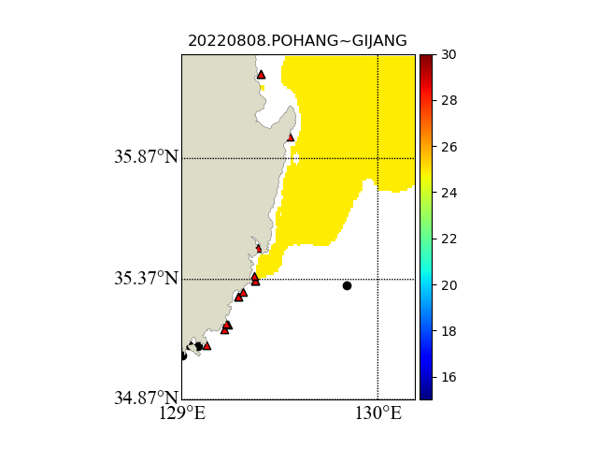
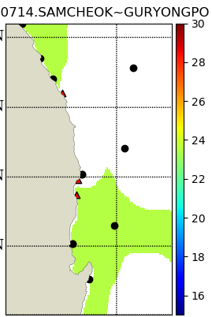
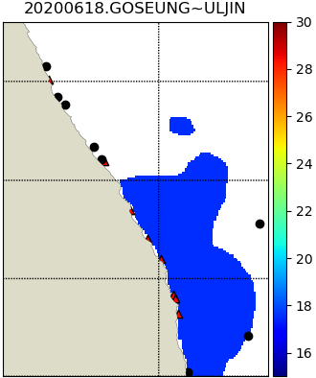
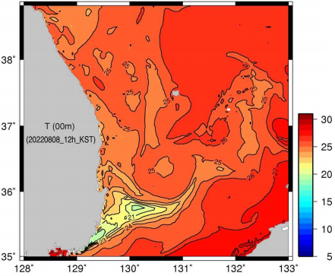
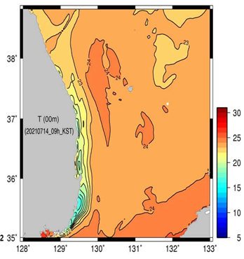
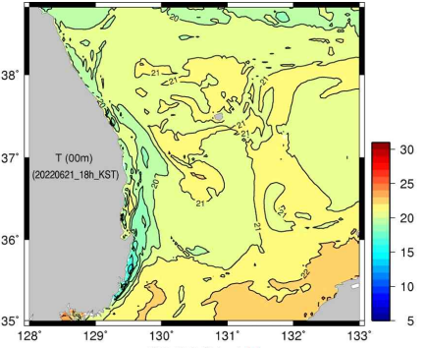
Result (CWM)
Evaluation of Detection CWM algorithm
Regions | Accuracy | Precision | Recall | F1 score | FAR (False alarm rate)
Goseong~Ulgin | 0.833 | 0.625 | 0.833 | 0.714 | 0.167
Samcheok~Guryongpo | 0.857 | 0.912 | 0.897 | 0.904 | 0.263
Pohang~Gijang | 0.914 | 0.972 | 0.933 | 0.952 | 0.333
Notes:
The Pohang-Gijang showed the best indicators among the three seas divided for CWM analysis.
Its accuracy was 0.914 and its F1 score was 0.952.
However, the FAR was also high, which means that the algorithm has a lot of false positives in the Pohang-Gijang sea areas.
As a result of discussing, it seems that the water temperature analysis process included a large number of Pohang-Gijang datasets to determine the threshold value
Pohang-Gijang 해역은 CWM 분석을 위해 나눈 세개의 해역 중 가장 좋은 지표를 나타냈다.
그것의 정확도는 0.914였고 F1 score은 0.952 였다.
하지만 FAR 또한 높았고 이것은 알고리즘이 포항-기장 해역에 False Positive가 많다는 것을 의미한다.
우리는 이러한 결과에 대해 상의를 해본 결과, Threshold value를 정하기 위한 수온 분석 과정에서 포항-기장의 수온 데이터셋이 많이 포함되어 나타난 결과로 보인다.

Slide 24
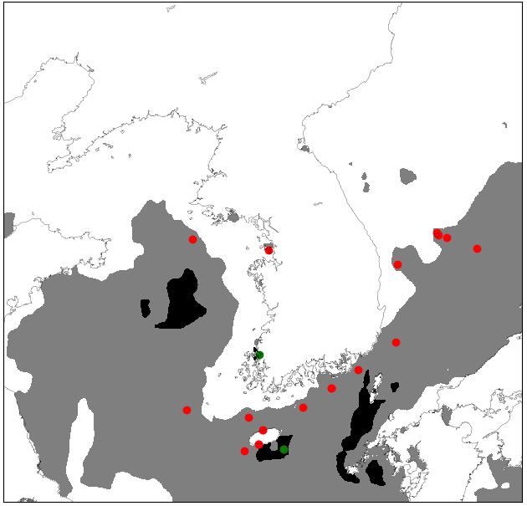
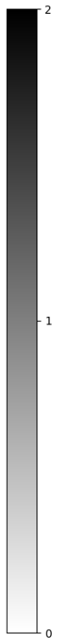
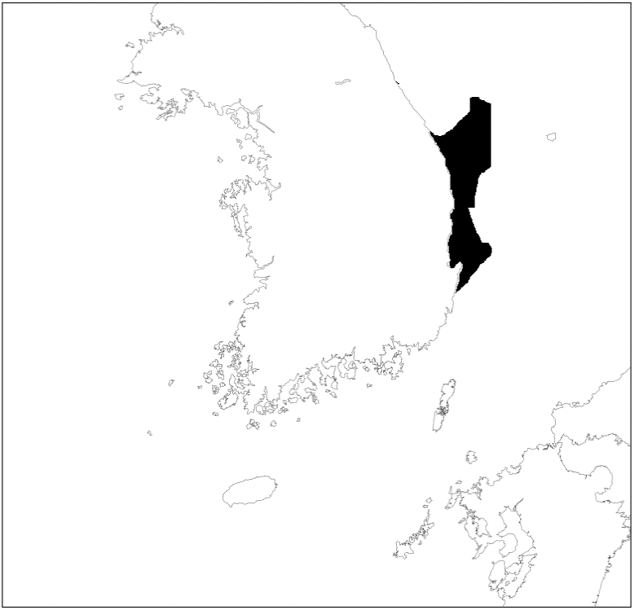
Result (CWM)
Notes:
각각 성능지표에 대한 단위를 제시

Slide 25
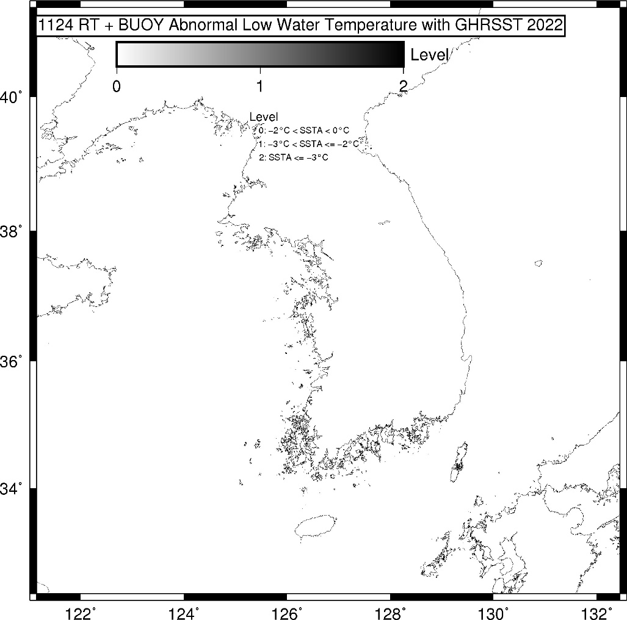

Application using the Abnormal SST detection method
Daily Detection Result
Notes:
Based on the previous announcement, KIOST is sharing the ALWT and MHWs results via email every day.
The figures are calculated on November 24 and show that ALWT was not detected, but MHWs were detected significantly.
이러한 것들을 하였고 이것을 남태평양에 적용하는 방법

Slide 26

Need for High-Resolution SST Production for the South Pacific
Notes:
What do you think is the most important thing for these detections?
We think it's about delivering accurate SST products quickly.
KIOST in South Korea produces high-accuracy SSTs in semi-real-time,
But South Pacific does not produce them in real time.
There are good data such as GHRSST, but there are limitations of Time delay
I think we need to produce high-resolution SSTs without any gaps in real time.
이러한 탐지를 위해 가장 중요한 것은 어떤 것이라고 생각하나요?
우리가 생각하기에는 정확한 SST 생산물을 빠르게 전달하는 것이라고 생각한다.
한국은 높은 정확도의 SST를 준실시간으로 생산하고 있지만 South Pacific의 경우 실시간으로 생산하고 있지 않다.
GHRSST와 같은 좋은 자료들이 있지만 분명 한계점이 존재하고 빈 틈 없는 고해상도의 SST 생산이 필요하다고 생각한다.

Slide 27

Need for High-Resolution SST Production for the South Pacific
Notes:
We can use SST to identify short-term and long-term changes.
This visualization shows Sea Surface Temperature (SST) Anomaly data from the Jet Propulsion Laboratory (JPL) Multi-scale Ultra-high Resolution (MUR) Sea Surface Temperature Analysis.

Slide 28

Need for High-Resolution SST Production for the South Pacific
Multi-model annual mean SST differences (C°) scenarios: 2050 (minus 1980–1999)
Notes:
Many researchers believe that SST will rise steadily, and will rise over a stronger, larger area, as shown in the figure below.

Slide 29




Application plan for abnormal SST detection in Fiji
Aquaculture activity & coral bleaching
Notes:
So I thought about how to apply the Abnormal SST detection method in Fiji.
Fiji is farmed for tilapia, and the ideal temperature for tilapia is 27 to 32 degrees.
Detecting the temperature using a threshold would be helpful for Fijian aquaculture.
In addition, corals that exist around Fiji are bleaching due to rising water temperatures.
It seems that it can be used for the purpose of preventing bleaching by creating a map such as the area of interest.
지속성에 대한 이야기
Abnormal SST 탐지 방법을 피지에서 적용할 방안에 대해서 생각을 해봤다.
피지에서는 틸라피아에 대한 양식업이 활발하게 이루어지고 있고 틸라피아의 적정 서식 온도는 27도에서 32도이다.
해당 온도를 threshold 온도를 이용한 탐지를 진행한다면 피지 양식업에 도움이 될 것 같다.
또한 피지 주변에 존재하고 있는 산호들이 수온의 상승으로 인해 백화현상이 나타난다.
백화현상 관심 지역 같은 지도를 생성하여 예방하는 목적으로 사용이 가능할 것으로 보인다.
Effect of High Temperature on Survival, Growth and Feed Conversion Ratio of Nile Tilapia, Oreochromis niloticus , N.P. Pandit* and M. Nakamura

Slide 30
Thank you

