Slide 1
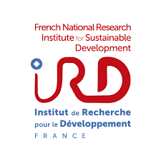
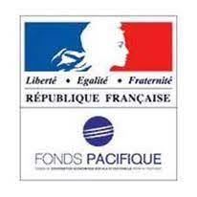


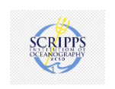

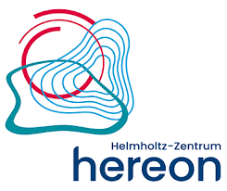

Enriched waters South of Fiji: cruise validation of ocean color for future satellite monitoring of coastal waters
Dupouy Cécile ^{1*}, Singh Awnesh ², Whiteside A.³,
Rodier M.¹, Oursel B.¹, Bhairy N.¹, Frouin R.⁴, Mounier S.¹, Goutx M.¹, Tedetti M.¹, Röttgers R.⁵, Margirier F.⁶, Murakami, H. ⁷, Andreoli, R.⁸
Aix Marseille Université, CNRS/INSU, Université de Toulon, IRD, Mediterranean Institute of Oceanography, France
PaCE-SD, USP, Suva, Fiji
Niwa, Christchurch, New Zealand
Scripps Institution of Oceanography, La Jolla, USA
Hereon GmbH, Germany
ALSEAMAR
JAXA
BLUECHAM
Notes:
Christchruch

Slide 2
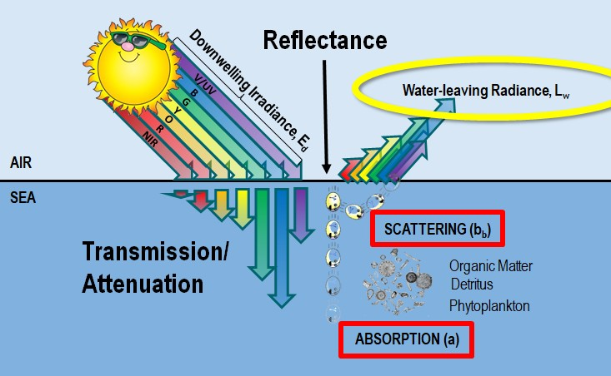
What is Ocean Color Remote Sensing?
A technology or scientific field that involves the use of satellite sensors to measure the color of the ocean’s surface to gain information about optical properties and indicate the presence of marine constituents.
Instruments measure light either reflected or emitted from the ocean surface at different wavelengths. Its color is determined by various substances.
Remote Sensing Reflectance (R_{rs})
R_{rs}=L_{w}/E_{d}
Gordon et al. 1988
Morel et al., 1981
Downwelling irradiance (E_{d})
Flux of light passing down through the sea surface into the water column.
Water-leaving radiance (L_{w})
A measure of how much light is leaving the sea surface and subsequently propagates to the top of the atmosphere.
Photo: Jeremy Werdell, NASA
Notes:
In observing these drivers in the region, ocean color remote sensing plays a significant role.
Rrs is the ratio between the water-leaving radiance (Lw) and the downwelling irradiance (Ed).
RRS=Lw/EdRRS = Lw/EdRRS=Lw/Ed
Figure 2.2 Spectral variation of IOPs where A) shows absorption across wavelengths for particles and sea water (no particulates in the ocean), and B) shows backscattering coefficients across wavelengths from normal sea water conditions to abundant particulate material. Illustrations adapted from CoastWatch Satellite Course at
https://coastwatch.gitbook.io/satellite-course/lectures/ocean-color.

Slide 3
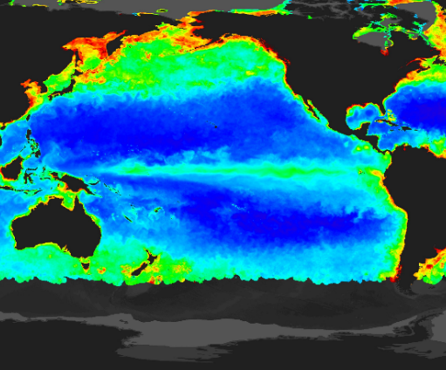

Role of Ocean Color Remote Sensing in Monitoring Chl-a
Ocean color remote sensing plays a crucial role notably for analyzing chlorophyll response in Case 1 (e.g., open ocean) and 2 (e.g, coastal complex environments) waters.
Free satellite data has significant potential for coastal and open ocean applications, particularly in resource-limited Pacific Island nations.
Adapted from: NASA’s Goddard Space Flight Center at https://earthobservatory.nasa.gov/images/6735/a-world-of-chlorophyl.
By studying ocean color patterns, specifically Chl-a, insights can be gained into understanding phytoplankton community distribution.
Notes:
The utilization of free satellite data has significant potential for coastal and open ocean applications, particularly in resource-limited Pacific Island nations.
Ocean color remote sensing plays a crucial role in monitoring dynamic ecosystems, particularly for the detection and analysis of chlorophyll response to Case 1 and 2 waters. By studying ocean color patterns, specifically chlorophyll (Chl-a), insights can be gained into understanding phytoplankton community distribution and their responses to changing environmental conditions. This information is important for the Fiji-Tonga region for understanding the ecological consequences of coastal runoff, such as sediment and nutrient discharge, as well as the aftermath of volcanic eruptions, which introduces massive quantities of ash and other material into the ocean. This study aimed to investigate Chl-a variability in Fiji and Tonga by exploring two potential factors: volcanic eruptions off Tonga (in 2019 and 2022) and land runoff during heavy rain events in Laucala Bay, Fiji. Important for the Fiji-Tonga region for understanding the ecological consequences of coastal runoff, and the aftermath of volcanic eruptions.This study aimed to investigate Chl-a variability in Fiji and Tonga by exploring two potential factors: volcanic eruptions off Tonga (in 2019 and 2022) and land runoff during heavy rain events in Laucala Bay, Fiji.

Slide 4
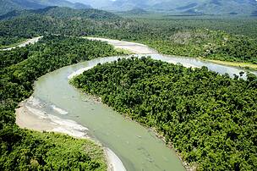
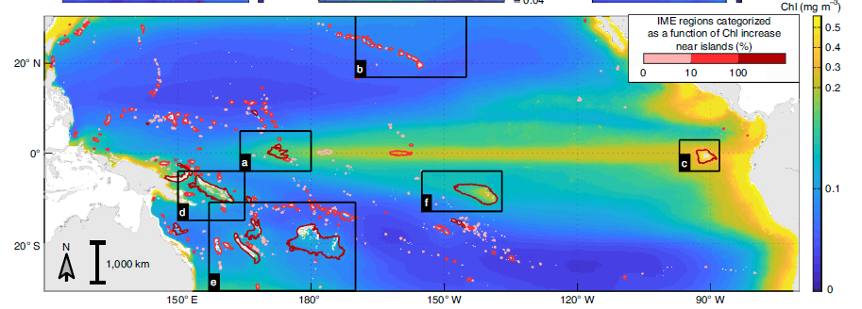
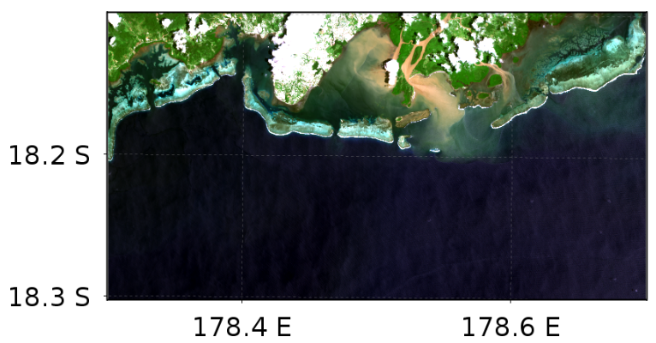
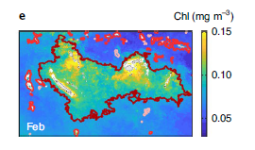
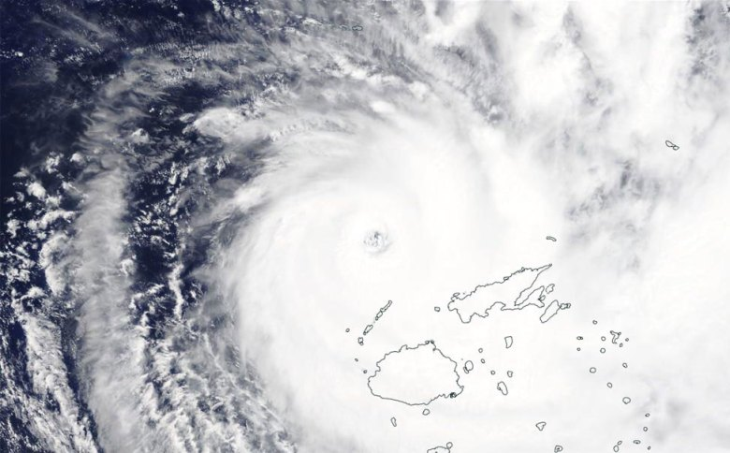
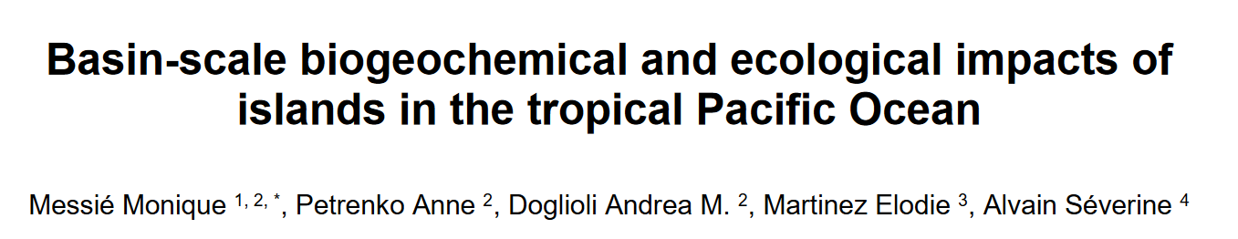
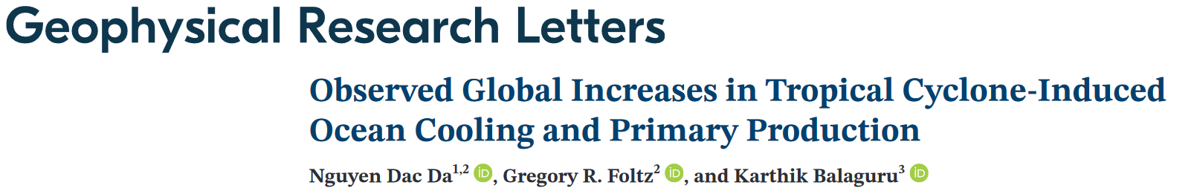
Enrichments from islands
Riverine environments (Source: https://www.wwfpacific.org/)
Messie et al. 2022 - The main map represents the 2002–2018 average Chl (from MODIS data) in the region (30° S–30° N).
Photo: NASA Worldview

Slide 5
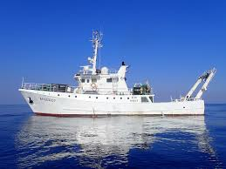
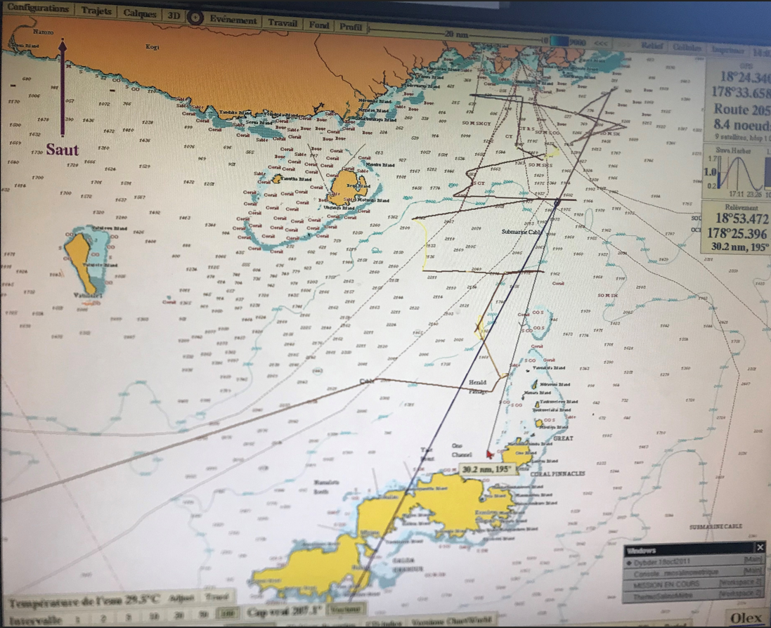
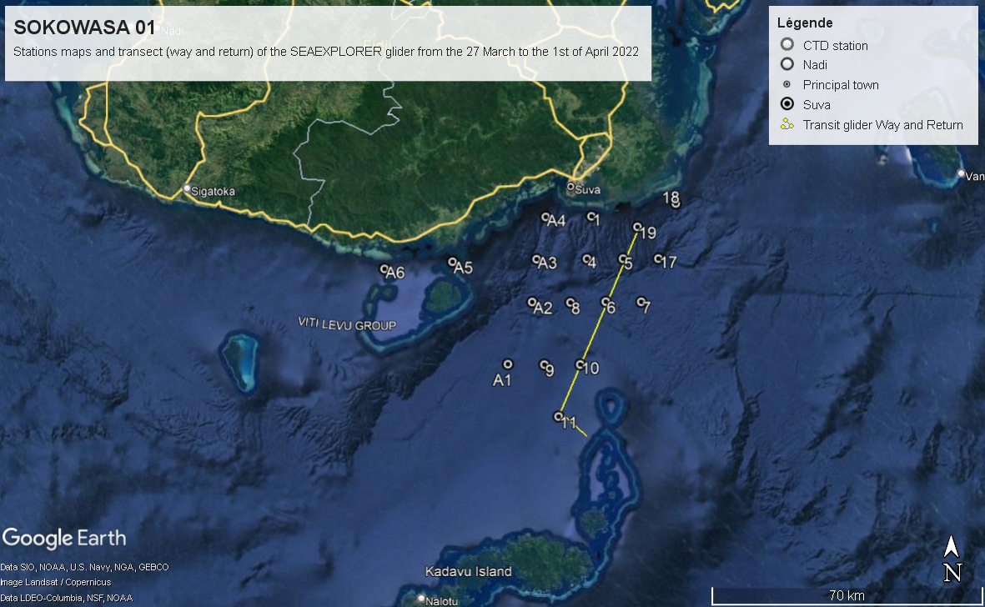
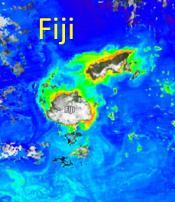
Southern Fiji Kadavu Oceanographic Water Survey on Alis – SOKOWASA

Slide 6
Objectives of the SOKOWASA cruise
Tropical islands ‘s oceanic biogeochemical environments may be influenced by continental forcing. The impact of the large Rewa River plume South of the main island of Viti Levu (Fiji) on the microbial processes i.e. carbon and nitrogen fluxes, fisheries richness or coral resources of the Fijian archipelago is unknown.
The objective of SOKOWASA were:
to determine the extension and nature of the plume (if any) by acquisition of optical and biological data in situ (profiles and glider)
To use these data in order to interprete satellite imagery, and to determine the richness of Southern waters off the Southern Viti Levu coast
Southern-Fiji-Kadavu Oceanographic Water Survey on ALIS - SOKOWASA [March 27-April 1, 2022]

Slide 7
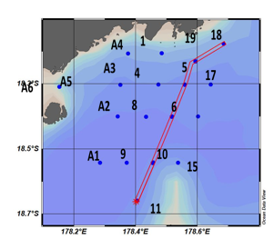
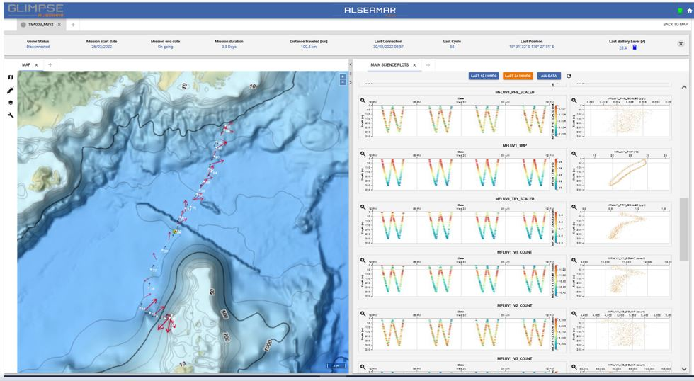
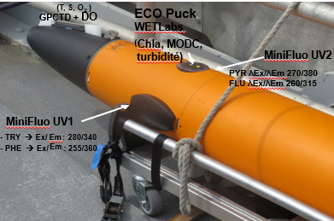
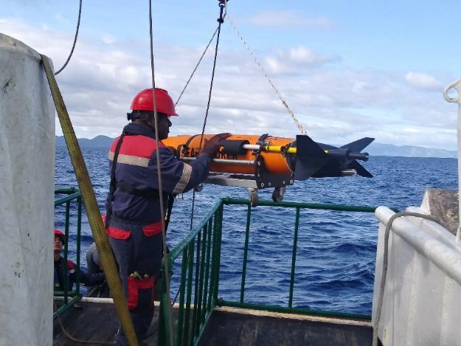
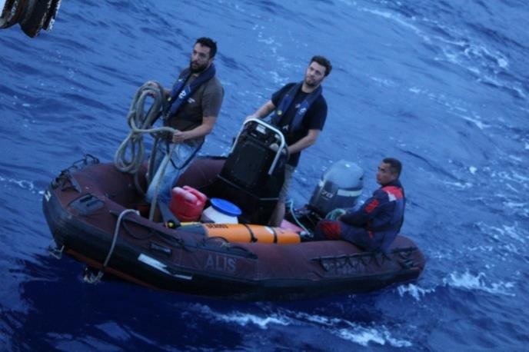
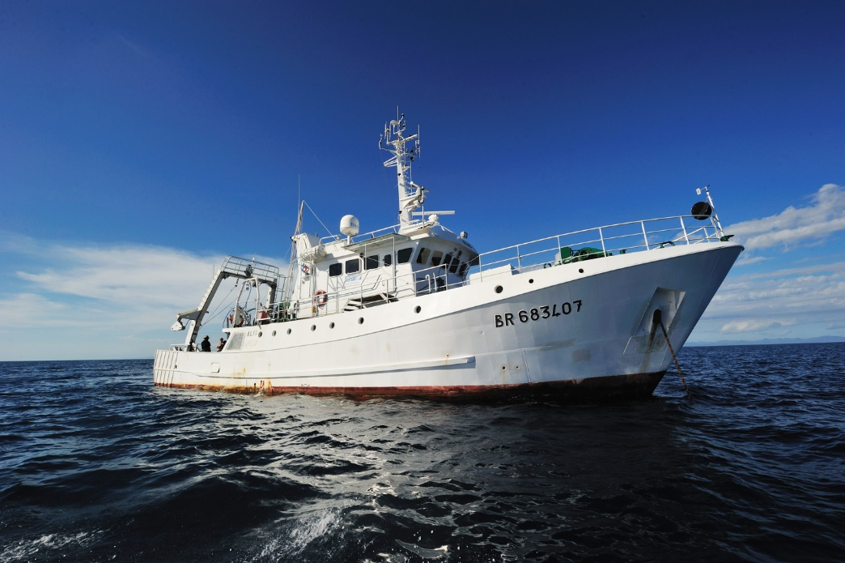
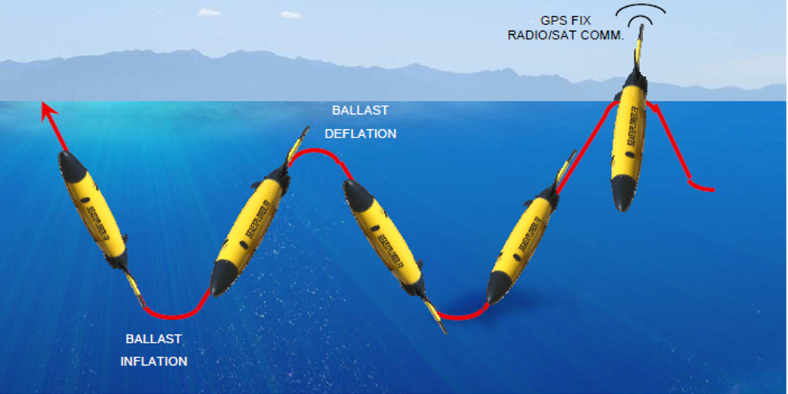
Glider section
Deployment of the glider SeaExplorer SEA003 (SAM – M.I.O.)
Glider = sub-marine drone (2-300m)
Equipped with Chla turbidity sensors
South-North Kadavu-Laucala Bay (2 days and 4hours)

Slide 8
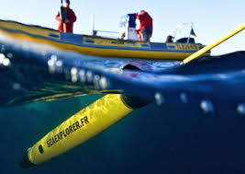
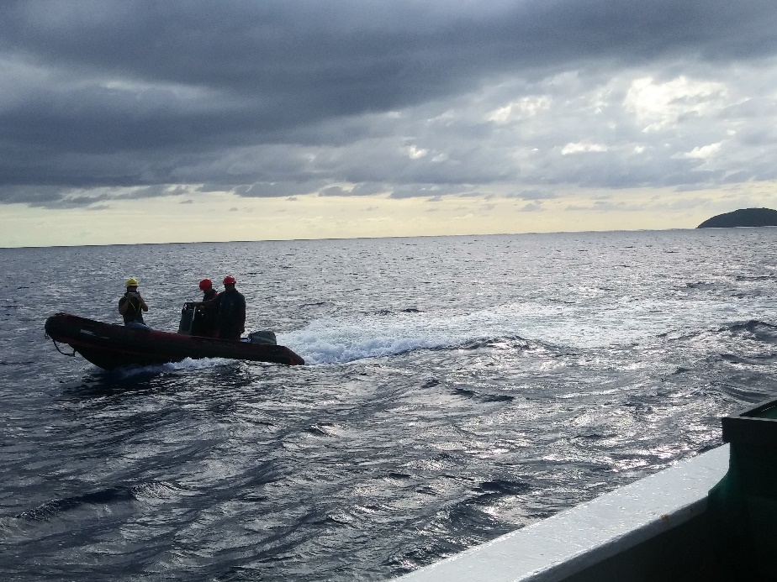
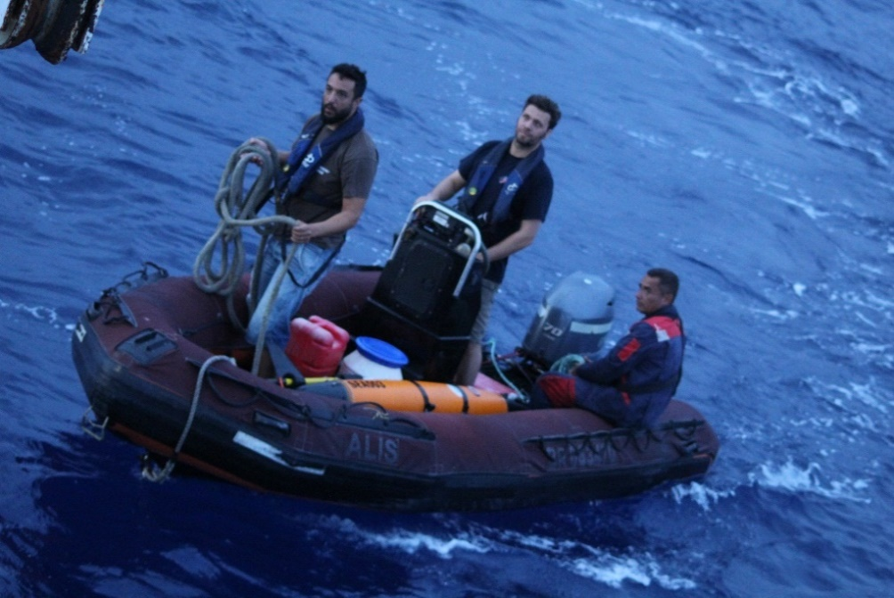
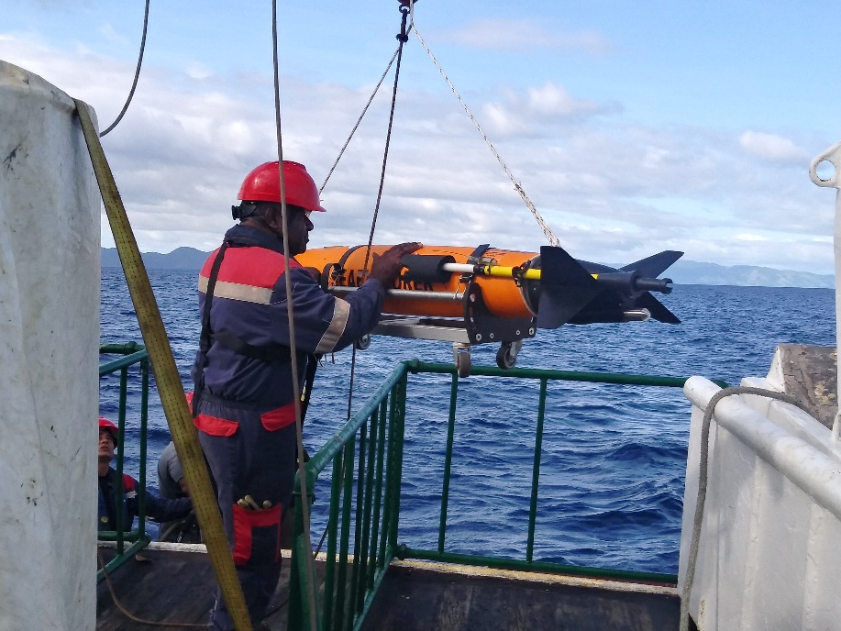
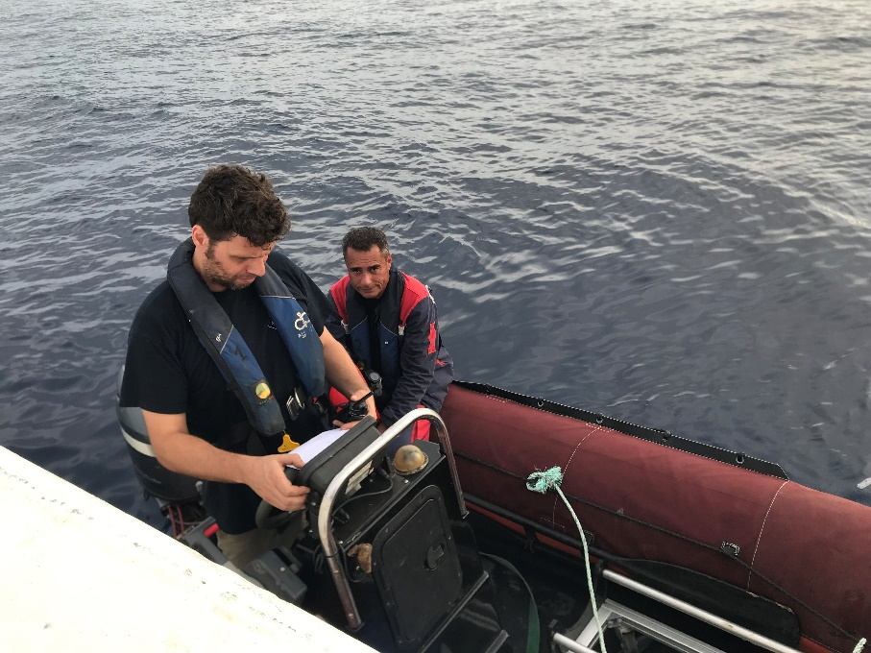
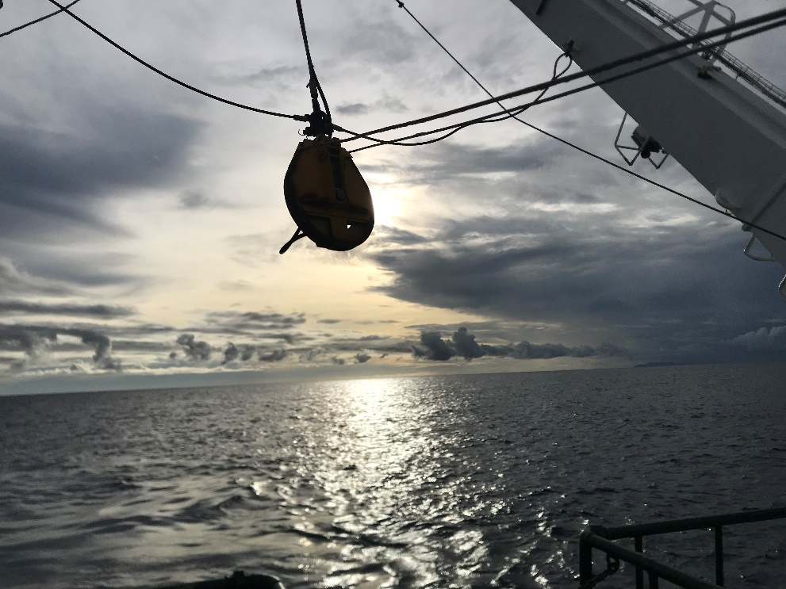
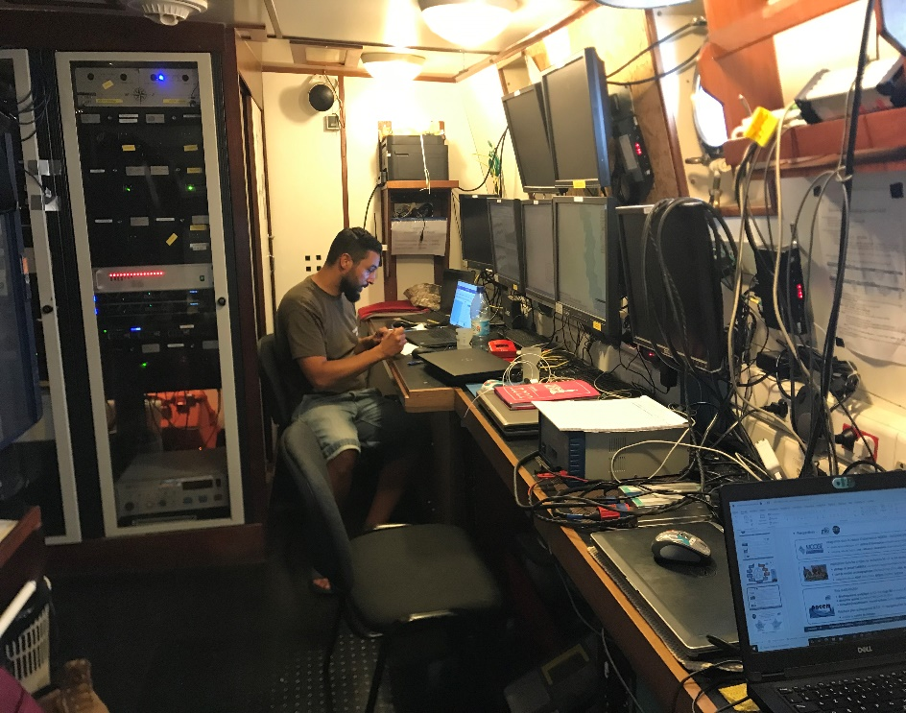
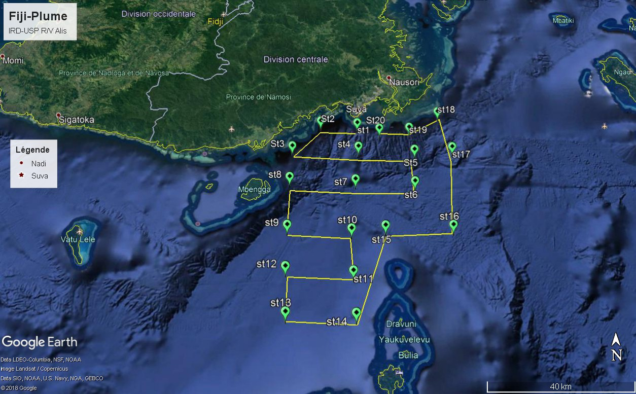

Slide 9
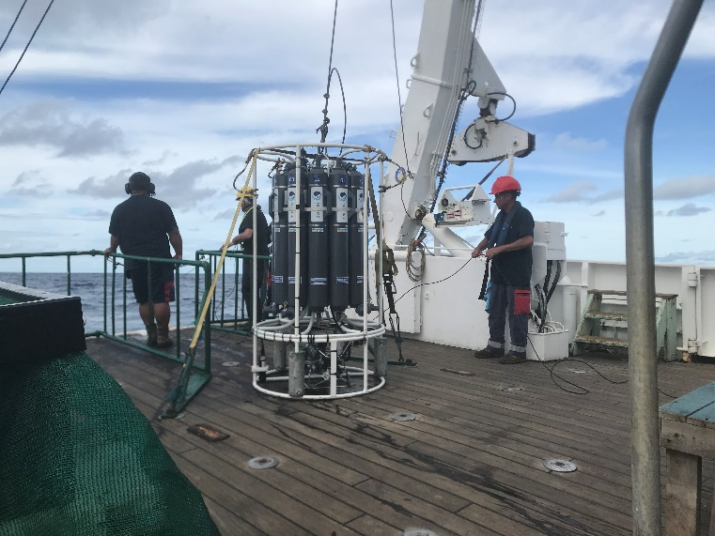
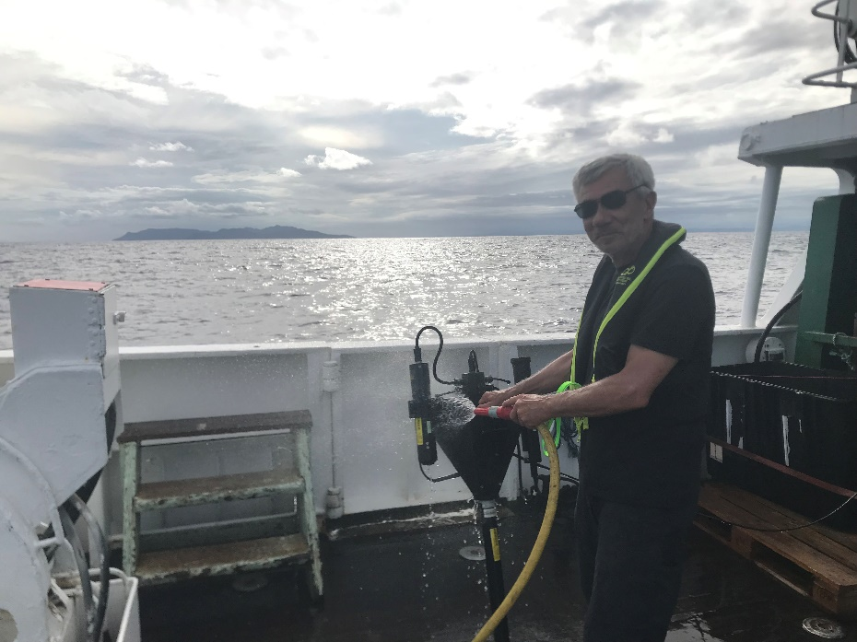
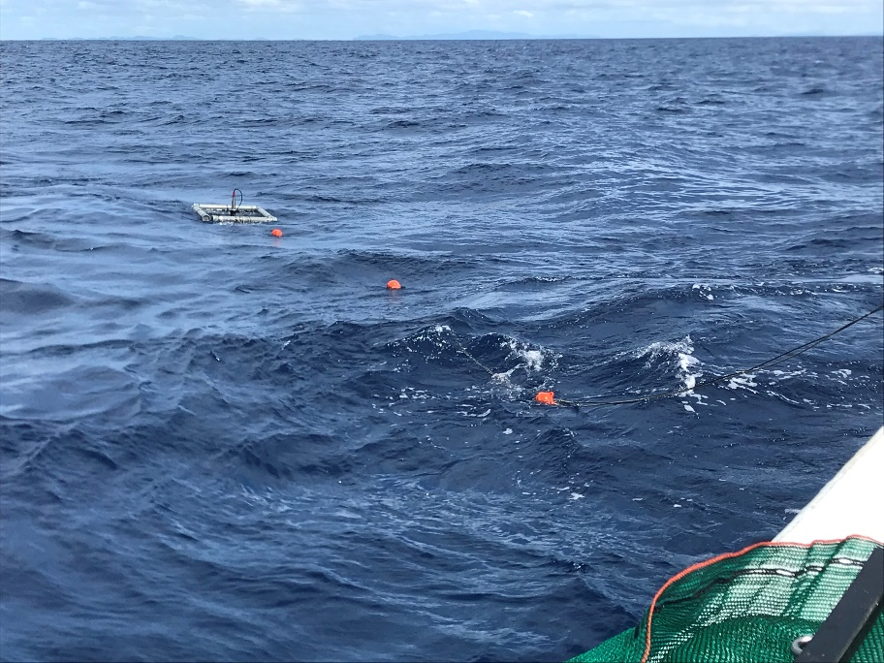
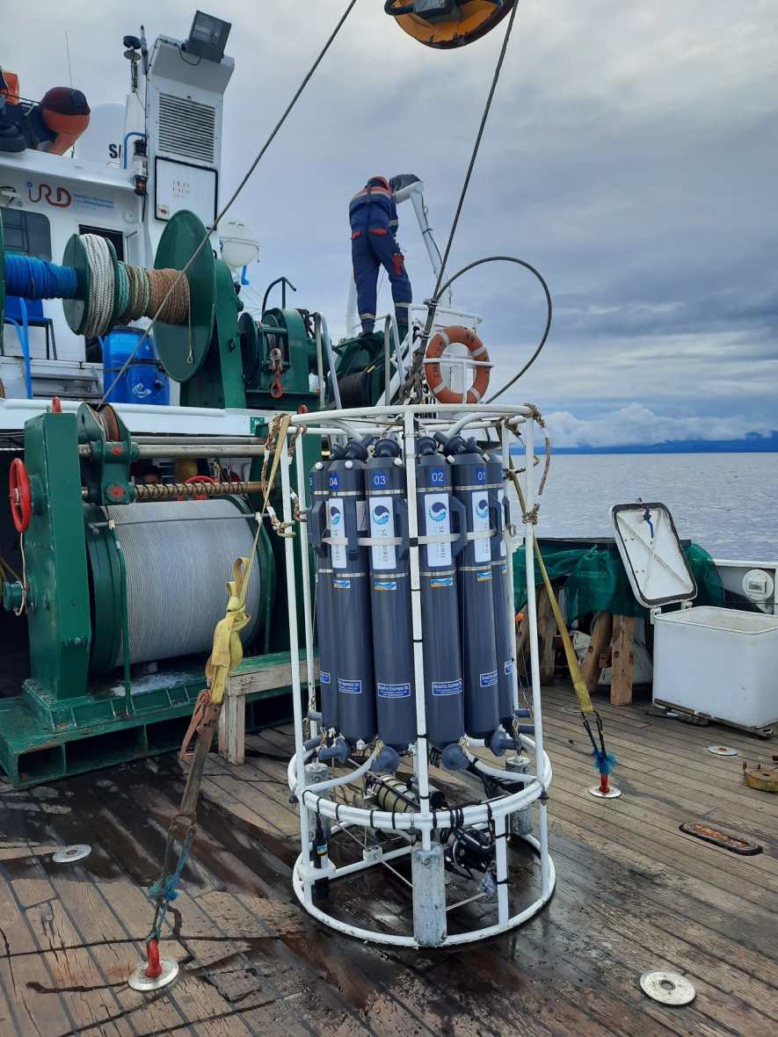
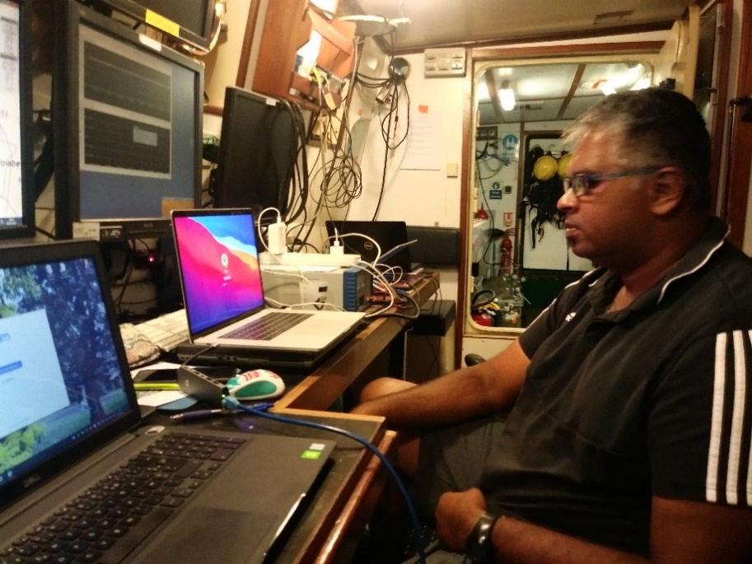
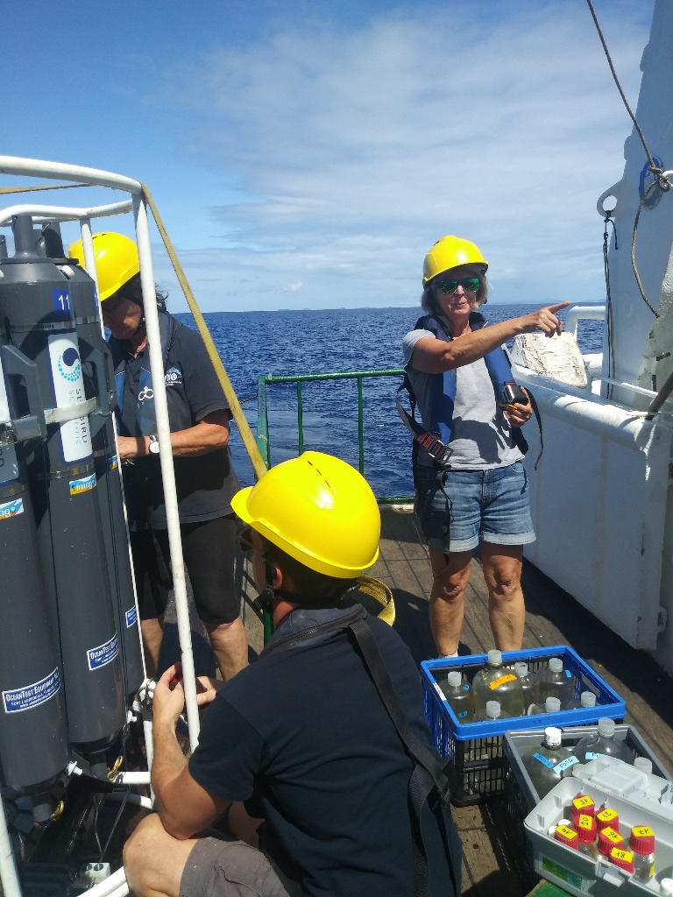
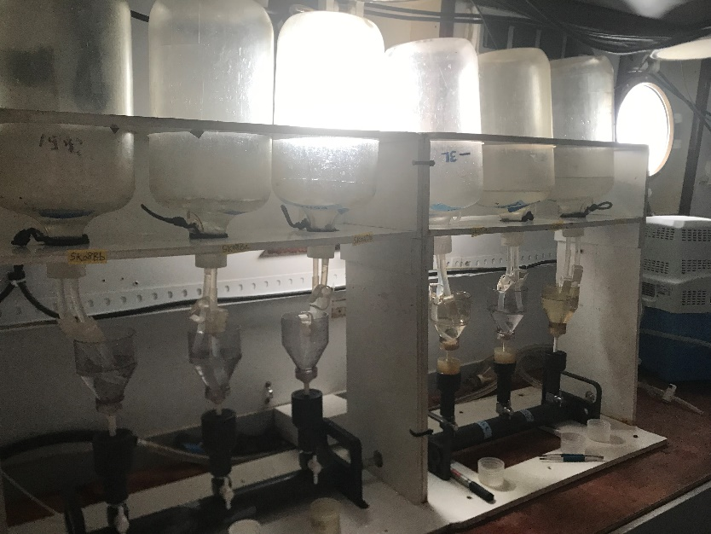
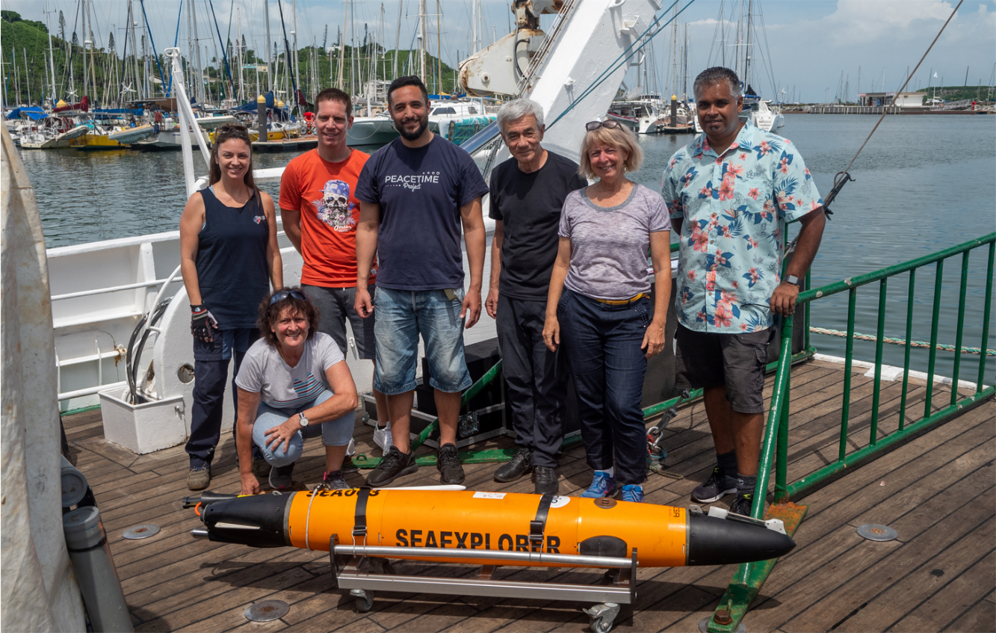

Slide 10
Extension and nature of the plume
SOKOWASA took place during a strikingly dry period without strong rains before and during the cruise. Wind was quite low, currents were to the North-East
What were the consequence of this meteorological situation on Chlorophyll and turbidity plumes in the ocean South of Viti Levu ?
In situ maps of Temp, Salinity, Chla and turbidity, sections of the CTD and of the glider sensors are examined (March 27-April 1, 2022)
Turbidity and Chlorophyll map (April 3, 2022) from Sentinel 2 is processed

Slide 11
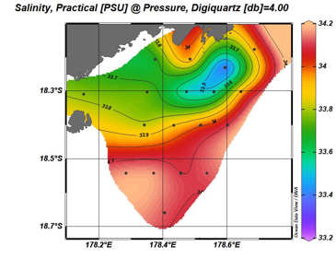
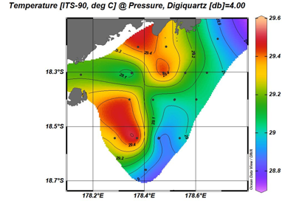
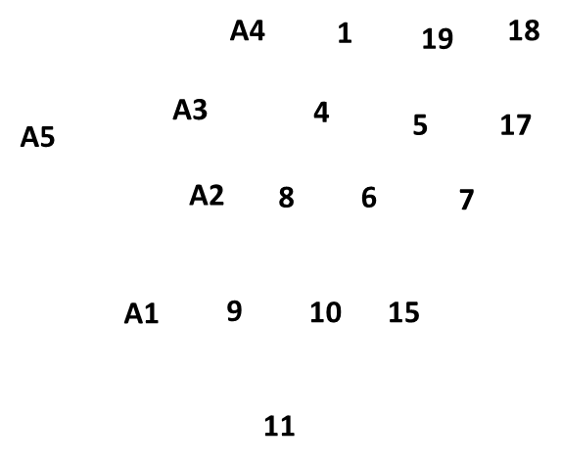
IN SITU STATIONS DATA
The extension of continental waters was quite low :
the lowest salinity is observed only at station 19, fresh waters extend to 18.4°S, while warm waters extend further South (18.6°S)

Slide 12
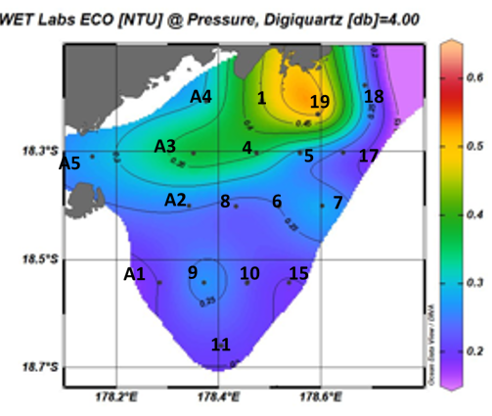
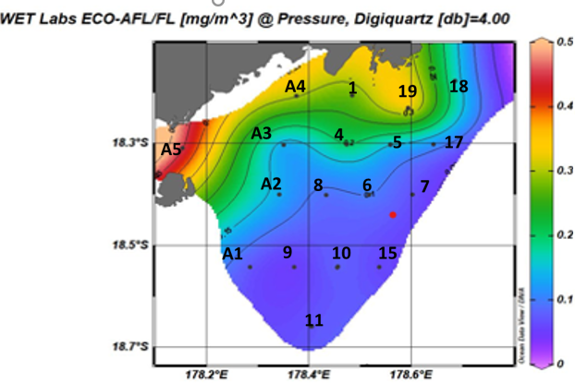
IN SITU STATIONS DATA
CTD Turbidity
CTD fluorescence
The extension of waters is also traced by a higher turbidity (related to the
Laucala Bay) and by rich-chlorophyll (phytoplankton biomass) waters off the coast
(18.3°S)

Slide 13
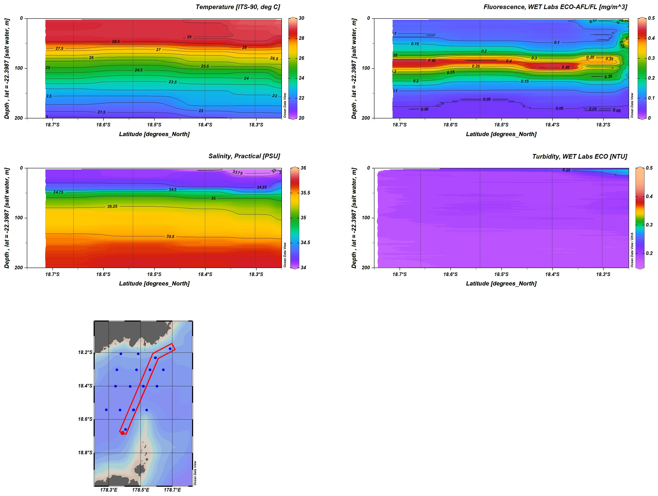
CTDs
T°C
Chla Fluorescence
Salinity
Turbidity
St11
St19
St18
St18
St19
St11
Notes:
6 CTDs between Station 11 (South) and Station 18 (North) (northen than St19 = the glider could not go further because of shallow canyons encountered)
The 6 CTD sections show that only the first 20 meters are impacted by the plume in temperature, salinity, chla and turbidity
The 5 CTD sections show a reduced extension towards the south (18.4°S)
The plume is decoupled from the rich deep layer
At 100m layer (not visible by satellite) is well described by both CTD and glider: it is rich in phytoplankton (deep chla maximum), and in detritus related to the phytoplankton

Slide 14
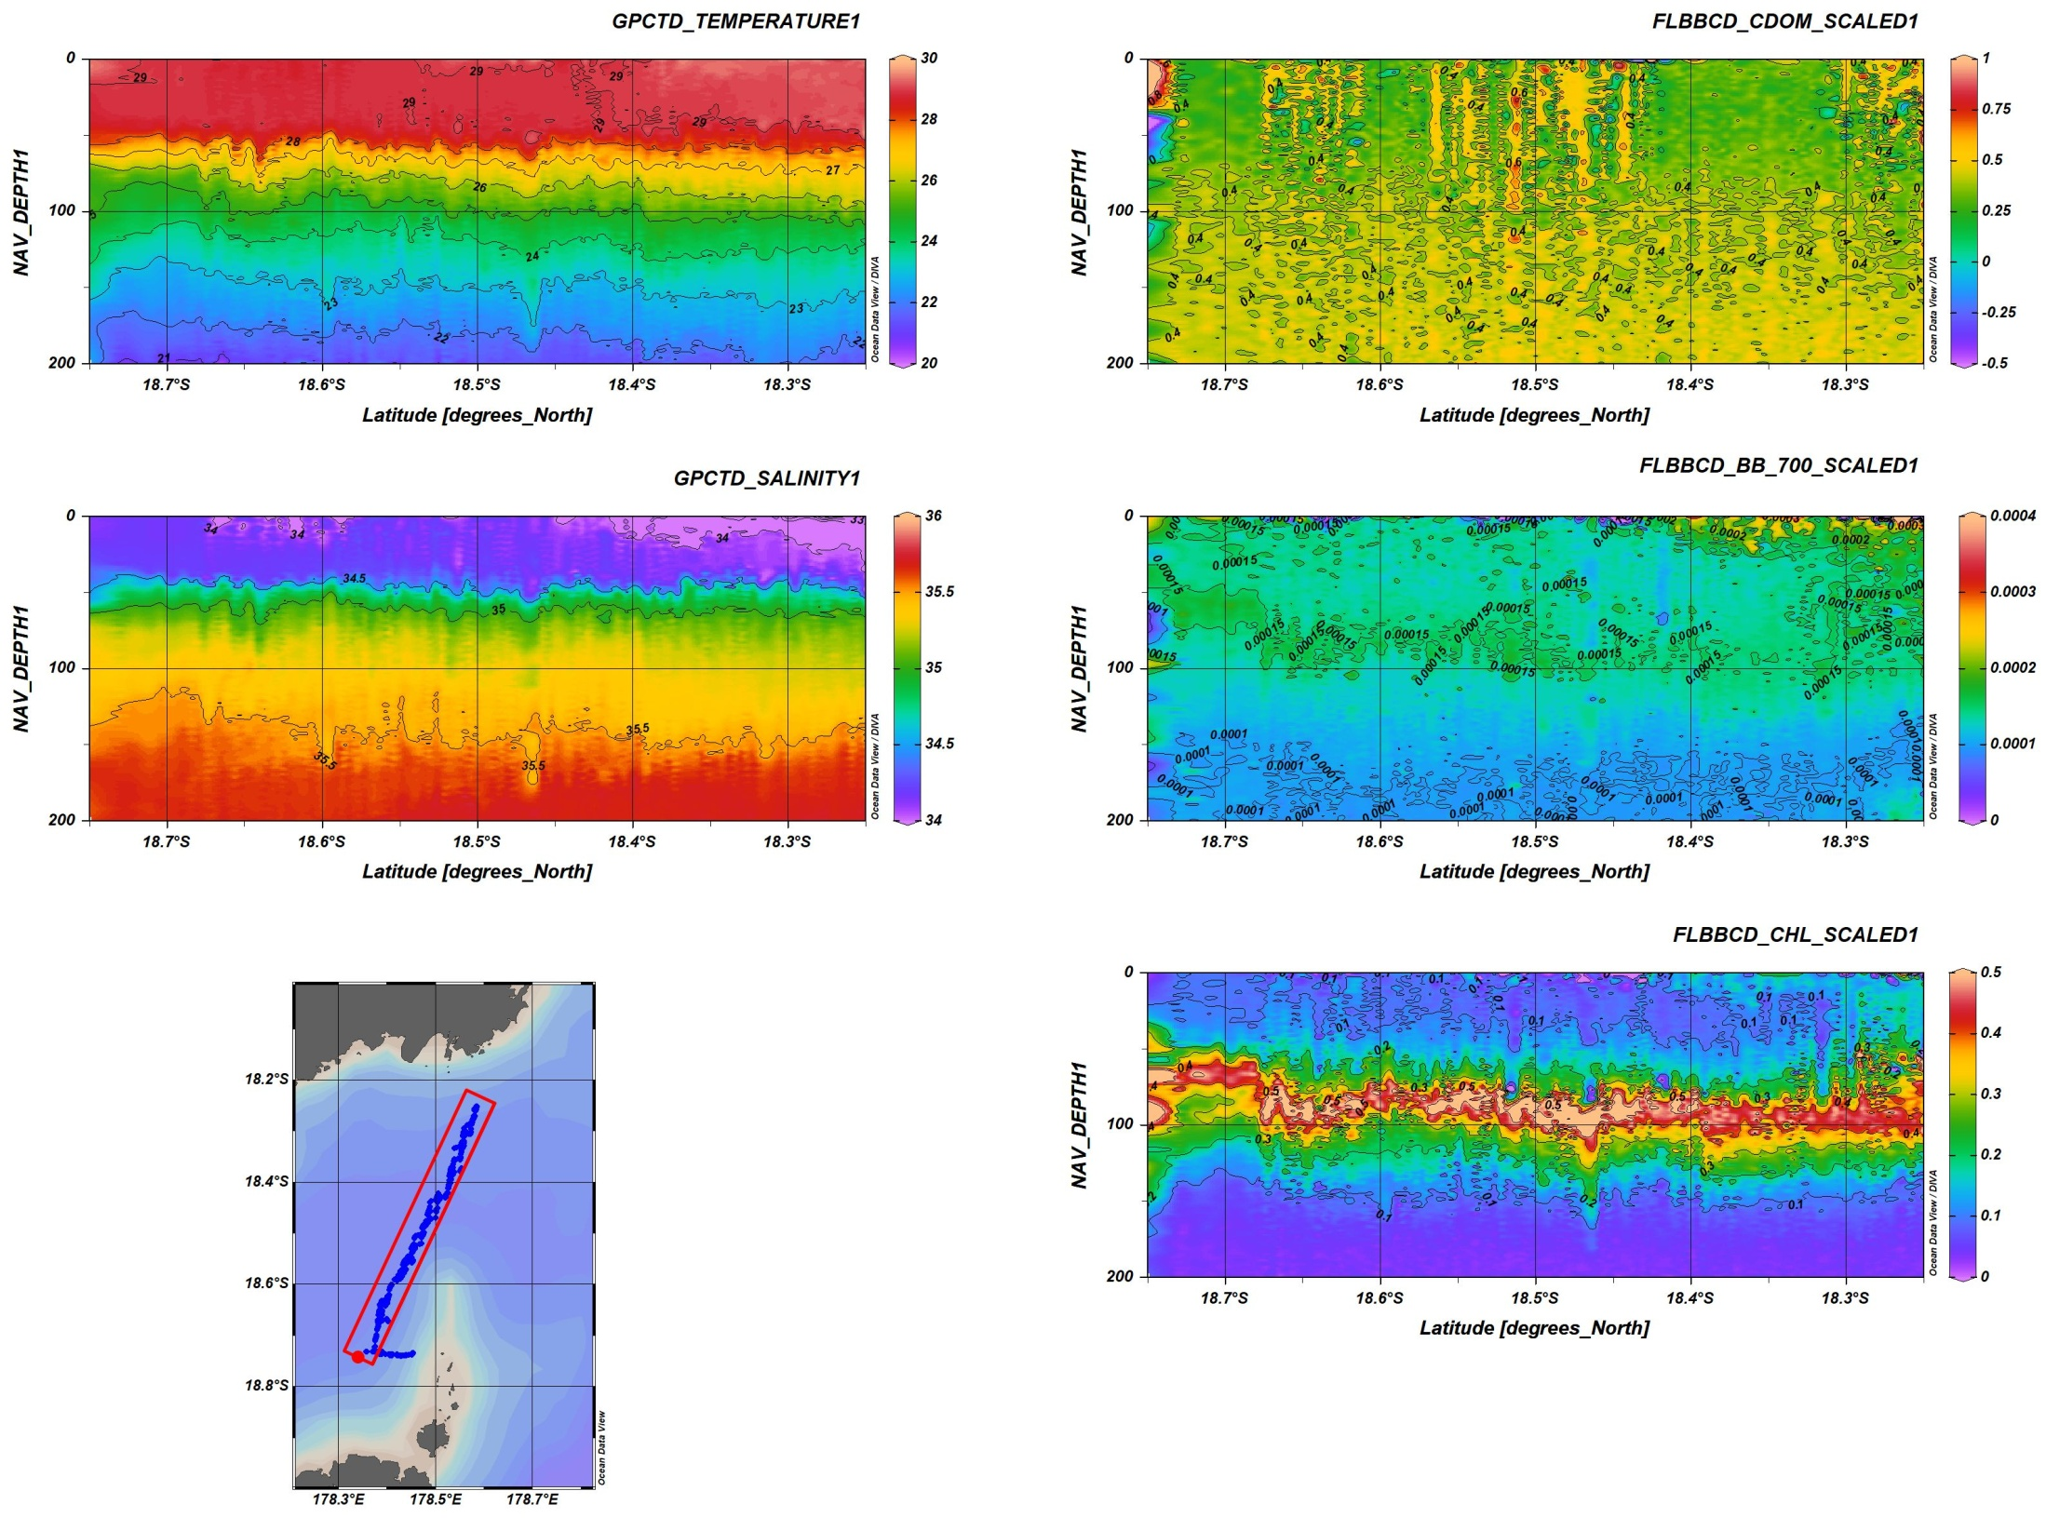
glider
T°C
CDOM
Salinity
Bbtot 700nm
Superficial plume
< 20 meters
Legs 1-2 Plume
Chla Fluorescence
St19
St11
St11
St19
Notes:
Between Station 11 (South) and Station 19 (North):
The glider sections show that only the first 20 meters are impacted by the plume in temperature, salinity, chla and turbidity
The glider sections show a reduced extension towards the south (18.4°S)
The plume is decoupled from the rich deep layer
At 100m layer (not visible by satellite) is well described by both CTD and glider: it is rich in phytoplankton (deep chla maximum), and in detritus related to the phytoplankton
The glider brings an infinity of details on the structure of the different layers !

Slide 15


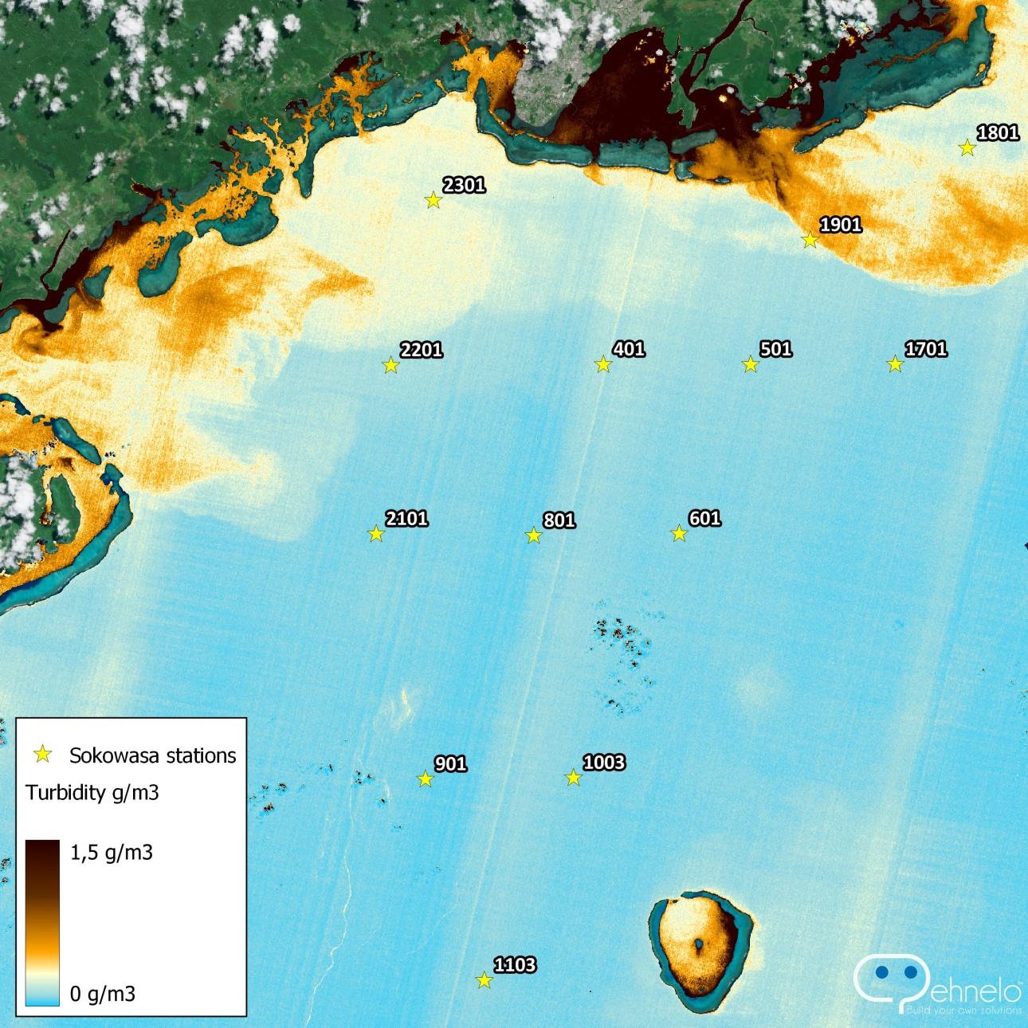
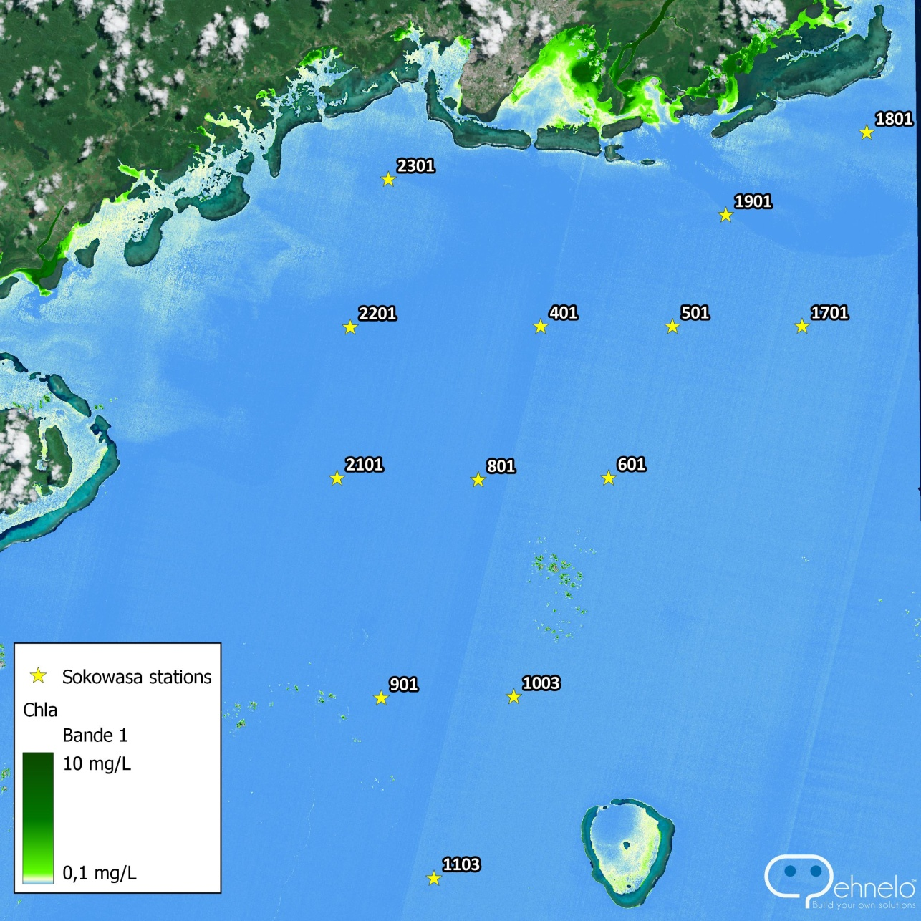
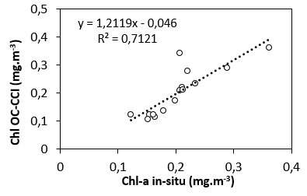
Operational transfer to QVX Platform
Turbidity – 2022-04-03
Chla – 2022-04-03
Notes:
Sentinel 2 images of turbidity and chlorophyll show similar patterns of the plume extension South of Fiji, allowing a detailed description of enrichments at the coast with a small plume (station 19) (dry period)
Suggests a spatial coupling between turbidity and chlorophyll during the typical dry period encountered during the SOKOWASA cruise
Regressions between in situ Chla and turbidity and those from algorithms are encouraging
Field calibration of scientific algorithm benefits to all users in the Pacific by continuous transfer to the analytic tools deployed within the QVX Platform.
Turbidity and Chla can be computed in the cloud, without any other isntallation than a web browser, exploiting Copernicus Sentinel data archives and continuous acquisitions.

Slide 16

In situ and S2 comparison
3 groups of waters :
- Coastal turbid waters, - Chlorophyll-rich – Clear oceanic stations
Notes:
Not necessary if no time to present this:
TriOS Ocean color in situ measured spectra show a graduation between the most turbid stations at the coast (Red ellipse, and brown colored spectra on the right) the chlorophyll-rich stations in the middle (green ellipse and green spectra) and Clear oceanic stations (blue ellipse at the South and blue spectra)
Sentinel 2 images of chlorophyll is surprisingly low and does not reflect the chla distribution as measured at sea. This might be due to a problem of the algorithm.

Slide 17
Interpretation of the satellite imagery
Sentinel 2 images of turbidity and chlorophyll show similar patterns of the plume extension South of Fiji, allowing a detailed description of enrichments at the coast with a small plume (station 19) (dry period)
Suggests a spatial coupling between turbidity and chlorophyll during the typical dry period encountered during the SOKOWASA cruise
Regressions between in situ Chla and turbidity and those calculated from Sentinel 2 algorithms are encouraging

Slide 18


Use of ocean color 1: Regional survey with Copernicus
Copernicus Marine Service (CMEMS) OLCI – 300 m spatial resolution images showing interpolated chlorophyll-a values from 2022-01-01 to 2022-12-01.

Slide 19




Operational transfer to QVX Platform
Deployed QVX Platform in the Pacific
New Caledonia
Vanuatu
Papua New Guinea
Fiji
Tonga
French Polynesia
Wallis-et-Futuna
Australia
New Zealand
Notes:
The analytics are available with several online applications allowing cloud computing, view and download in GIS compliant format as well as banking in DATACUBE as geographic time series.

Slide 20
Conclusions
  SOKOWASA showed a surficial (20 m) impact of land to the ocean typical dry period:
    Southern fijian waters are enriched in phytoplankton, which may be benefital for the whole oceanic food chain and reefs around Fiji (deep layer at 100 meters are well described by the glider).
    The satellite imagery detects turbidity/phytoplankton rich waters at the coast
  The usefulness of ocean color to monitor water quality South of Fiji is shown to detect the influence of climate change (with long Copernicus series) and at the land ocean interface (with high resolution data) with Qënelö : an example of successful operational transfer

Slide 21



Thank you for your attention.

