Slide 1
USE OF GIS AND RS TECHNOLOGIES IN MAHOGANY PLANTATION MANAGEMENT IN FIJI
GIS AND REMOTE SENSING USERS’ CONFERENCE, NOVEMBER 25-29, 2024
SUVA, FIJI

Slide 2
BACKGROUND
Government of Fiji, through the then Forestry Dept, initiated forest plantation programmes in Pine and Mahogany in the 1960s.
Pine in the western degraded dry grassland areas and Mahogany on the wet Central/Eastern (logged over natural forests) of Viti Levu and Vanua Levu; lands mostly leased from iTaukei landowners through TLTB
In 1998, mahogany programme hived out of the Forestry Dept; Fiji Hardwood Corporation Limited (FHCL) was formed; 2003 Act privatized FHCL; est. Fiji Mahogany Trust; two shareholders, government and Fiji Mahogany Trust (FMT); 2010 MIDA repealed the 2003 Act, created the Mahogany Industry Council (MIC)and also removed the FMT shareholding.
FHCL is currently 100% owned by the Fiji Government under the control of MIC
Review of legal framework and industry structure is being carried out

Slide 3
ROLE OF FHCL
State/Govt.
Forest Industries
Fiji Mahogany Trust/Forest Based /Landowning Units
Fiji Hardwood Corporation Limited

Slide 4
FOREST RESOURCE
FHCL has a total leased estate of 75,223 ha
122 iTaukei leases on land belonging to 232 landowning units (Mataqali)
7 state leases
41,325 ha of mahogany plantations in 13 Stations; 7 stations in Viti Levu (24,611 ha) and 6 stations in Vanua Levu(16,713) ha
10,850 hectares of mixed hardwoods; and 23,048 hectares of unstocked areas

Slide 5
VITI LEVU PLANTATIONS

Slide 6
VANUA LEVUPLANTATIONS

Slide 7
APPLICATION OF GIS AND REMOTE SENSING
GIS and RS technologies have been used by FHCL for the past 20 years
Initially using MapInfo software and later transitioned to QGIS
Recently we have ventured into ArcGIS Pro

Slide 8
APPLICATION OF GIS AND REMOTE SENSING
Monitoring of Areas
GIS technology is essential in the continuous updating of spatial data to monitor areas such as;
Leased areas and the landowning units
Planting and stock maintenance
Area selection and measurements for pre – harvest inventory
Harvesting schedule
Available timber volume

Slide 9
APPLICATION OF GIS AND REMOTE SENSING
Plantation Management
Plantations are managed through management units such as compartments with boundaries following natural features e.g. rivers and ridges, or roads, while taking into account LOU, district and provincial boundaries.
Mahogany stocked areas and composition are confirmed through the use of google earth and data collected through Qfield
Harvested areas are assessed through, displays from satellite imageries and data collected through handheld GPS, Avenza Maps and Qfield

Slide 10
APPLICATION OF GIS AND REMOTE SENSING
Cont.’
Replanted areas data are collected through Garmin GPS, QField and Kobo tool box
Location of plantations and information of stockings are displayed publicly through our dashboard on the company website

Slide 11
APPLICATION OF GIS AND REMOTE SENSING
FUTURE PLANS
Assessment of lease boundaries in collaboration with ITLTB through the use of drones and Trimble GPS
Integration of drones in the assessment of plantation stands and non-plantation areas
Purchase of Atlas Geomaster to enhance our capacity in the inventory of all our plantations
Utilization of all these tools in supporting the company's bid to attain FSC forest certification.

Slide 12
CHALLENGES
Financial Constraints
Technical expertise and training
Infrastructure Limitation

Slide 13
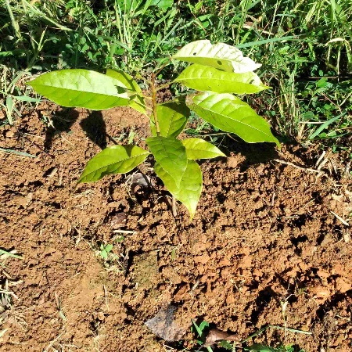
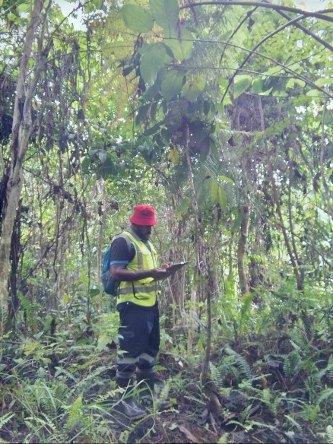
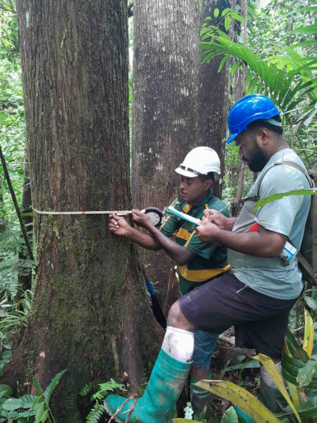
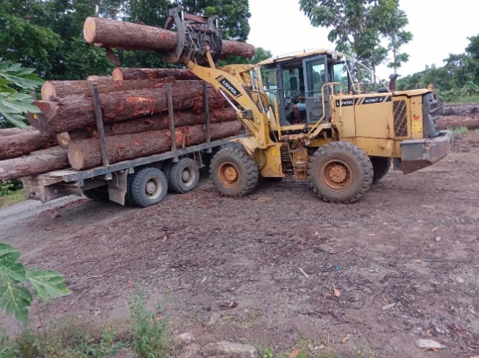
VINAKA
Fiji Hardwood Corporation Ltd
310 Princess Road, Suva
www.fijihardwood.org

