Slide 1
A cloud-based solution for trustless indigenous data sovereignty: Protecting Māori biodiversity management data in Aotearoa New Zealand
Pankajeshwara Sharma, Michael Martin, David Swanlund², Cecilia Latham³, Dean Anderson³, and Waitangi Wood⁴
University Of Auckland, Simon Fraser University², Manaaki Whenua Landcare Research³, and Wai Communications Ltd⁴
DOI: https://onlinelibrary.wiley.com/doi/abs/10.1111/tgis.13153
Transactions in GIS Journal

Slide 2
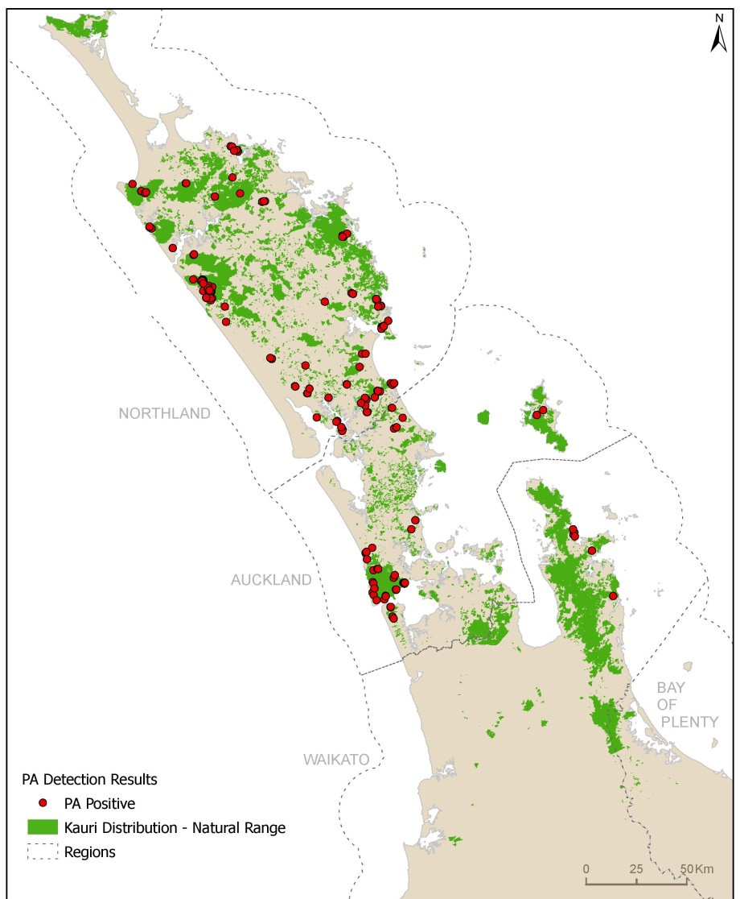
Indigenous Geospatial Data Sovereignty
Indigenous data has historically been misused, risking cultural and ecological harm.
Objective: Empower Māori sovereignty over biodiversity data in New Zealand through cloud-based solutions​.
The Challenge of Data Sovereignty
Key Issues: Privacy risks, lack of control in cloud environments, and potential misuse by third parties.
Need: Secure, self-managed data storage scheme without reliance on external parties.
Kauri Dieback Distribution 2020 (kauriprotection.co.nz)
Notes:
Data sovereignty aims to ensure data guardians have control over data.

Slide 3
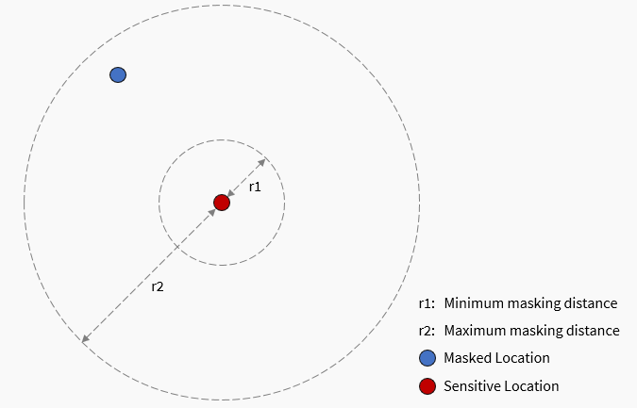
Geospatial Data Security Concerns
Anonymising - for untrusted users
Geomasking transforms coordinates
Binning aggregates points
Encryption protects the original data, but it can still be tempered with on cloud
Notorisation to verify the originality of encrypted data – e.g., hash values.
Challenges:
both encrypted data and hash can be replaced
need to accommodate different trust levels
Halo masking displaces the locations
Notes:
A common approach to protecting geospatial data is through masking.
There are several geomasking techniques.
Halo masking, for instance, shifts the original locations to random location and degree.
The user can provide the minimum and maximum distance
Similarly, binning aggregates data. Hexagonal binning for instance shows the density of points within hexagons on a grid
These techniques are useful for giving users an approximate idea of the location.
This is useful for sharing datasets between untrusted individuals, such as when reporting crime locations in news reports.
But what about the need to share the original dataset. Encryption can be used for protection, but how can we be sure that the encrypted data has not been tampered with or replaced.
A cryptographic hash function can be used to compare the before and after hash value of the data.
However, both the encrypted data and the hash value can be replaced
Moreover there is a need to accommodate different trust levels

Slide 4
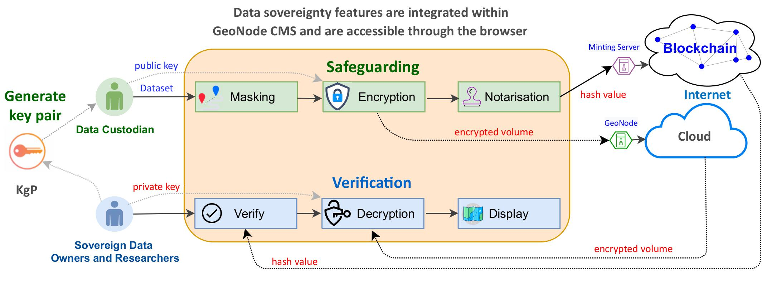
Indigenous Geospatial Data Sovereignty Platform
Notes:
We propose the MapSafe tool that offers a complete solution to geospatial data sovereignty.
The geomasking, encryption and notarisation implemented at the core – the browser.
This way all necessary sections are carried out in the browser and no data leaves the SDOs computer unprotected.
SDOs can keep the encrypted data on their computer or share it via the cloud.
Sovereign data parties can first verify the dataset, decrypt and then display the dataset.

Slide 5
Indigenous users and roles within MMFS
The Matauranga Māori Framework for Surveillance (MMFS) has these users:
data custodians - person collecting data
researchers
sovereign data owners (the BMAs).
Any data uploaded by the custodian should be linked to the Biodiversity Management Areas (BMAs).
First, each user generates a Public-Private key pair.
Notes:
An alternative to geomasking, Jane can perform hexagonal binning.
The Uber’s h3-js hexagonal binning library is used.
To balance utility and privacy, binning resolution and buffer radius allows Jane to specify the resolution and coverage

Slide 6
Browser-Based Data Security
Benefits for Indigenous Geospatial Data Management
Ensures secure sharing of sensitive data among stakeholders.
Promotes trust in collaborative projects by maintaining data confidentiality and integrity.
Supports compliance with privacy laws and regulations.
Sensitive data never leaves the user's computer unprotected.
Prevents cloud providers or third parties from accessing information.
Multi-Party Access:
Allows sovereign data owners and selected collaborators to decrypt data.
Automatically assigns decryption rights based on data ownership.
Notes:
After obfuscated dataset is then encrypted in a nested manner.
There are three levels, the innermost has the original, the middle has the masked or binned dataset.
The outer level contains the more masked or more binned layer. Basically, they are using double the user provided parameters.
The encryption uses 5 terms to encrypt the outer layer, 10 for the middle layer, and 15 for the inner level.

Slide 7
Masking and Encryption-Decryption performance
Masking: ~10,000 points/sec without Spruill’s measure.
Encryption: ~3 MB/sec and Decryption: ~4 MB/sec.
Practical times since sensitive datasets are unlikely to be huge in size.
Notes:
Masking times are .
Without the Spuirll’s measure,
Encryption times are exponential as they increase with the number of points and file size respectively.
They are exponential because each additional encrypted file is a larger encrypted file.
Nevertheless, these are reasonable times for practical use within web browsers.

Slide 8
Full (3 minute) video of Reasons Miner Tool is on: https://youtu.be/nrB9Jk1OFXo

Slide 9
Benefits for Indigenous Communities
Control and Sovereignty:
Indigenous communities retain control over their geospatial data.
Enables secure sharing while preserving cultural and sovereign rights.
Trust and Transparency:
Promotes data sharing within communities.
Supports legal use in place-based conflicts.
Aligns with indigenous governance frameworks like the MMFS.
Case Study: Aotearoa New Zealand
Data sharing for biodiversity and biosecurity under indigenous sovereignty.
Recognition of Māori authority through secure encryption and masking.
Outcome:
Elevates Māori knowledge in environmental management.
Protects cultural data governance.

Slide 10
Final Reflections
Relevance to Industry:
Mitigates risks associated with data breaches and unauthorized access.
Encourages compliance with privacy laws and ethical data practices (e.g., GDPR)
Promotes trust and collaboration across diverse stakeholders.
Call to Action:
Industries can adopt such solutions to responsibly manage sensitive geospatial data.
Engage in collaborations with indigenous communities to enhance ethical data governance.
Notes:
Data sovereignty aims to ensure data guardians have control over data.

Slide 11
Acknowledgements
The project was undertaken at the University of Auckland and was funded from the Ministry of Business, Innovation and Employment (Ngā Rākau Taketake – Myrtle Rust and Kauri Dieback Research, C09X1817).

Slide 12
Thank you
Questions

