Slide 1
Integrating GPS-enabled Technologies and Workflows into Fisheries Surveys
Bradley Eichelberger
Division of Fish and Wildlife
Northern Mariana Islands

Slide 2
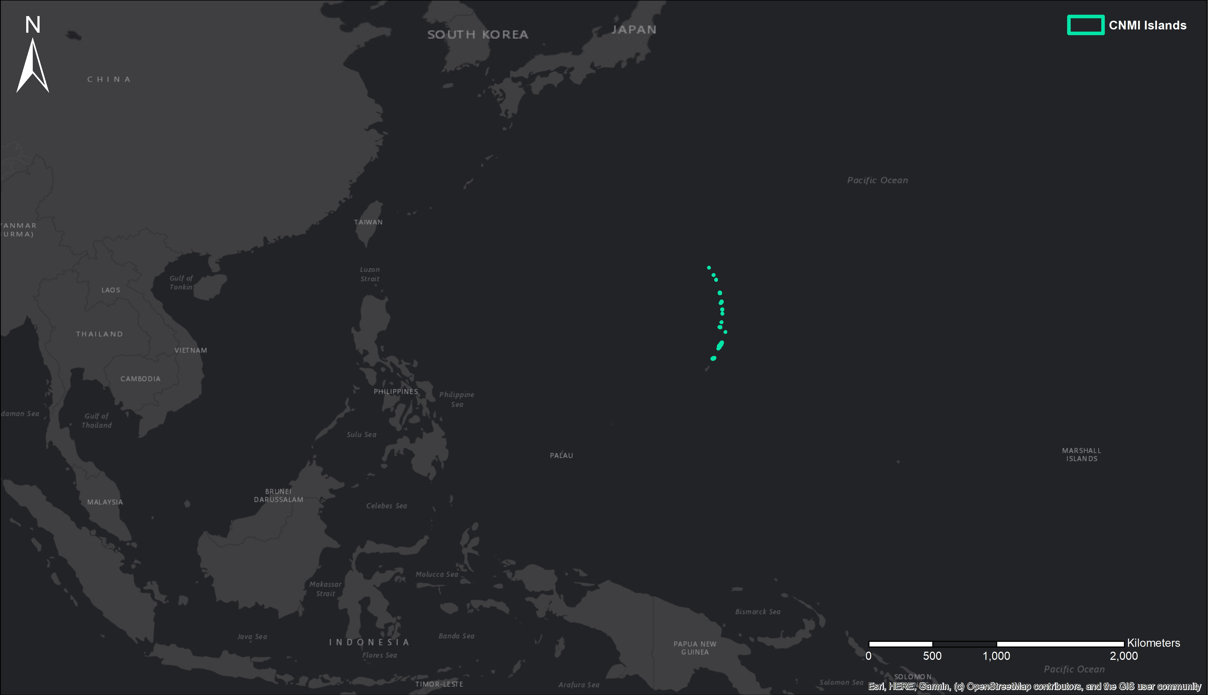

Slide 3
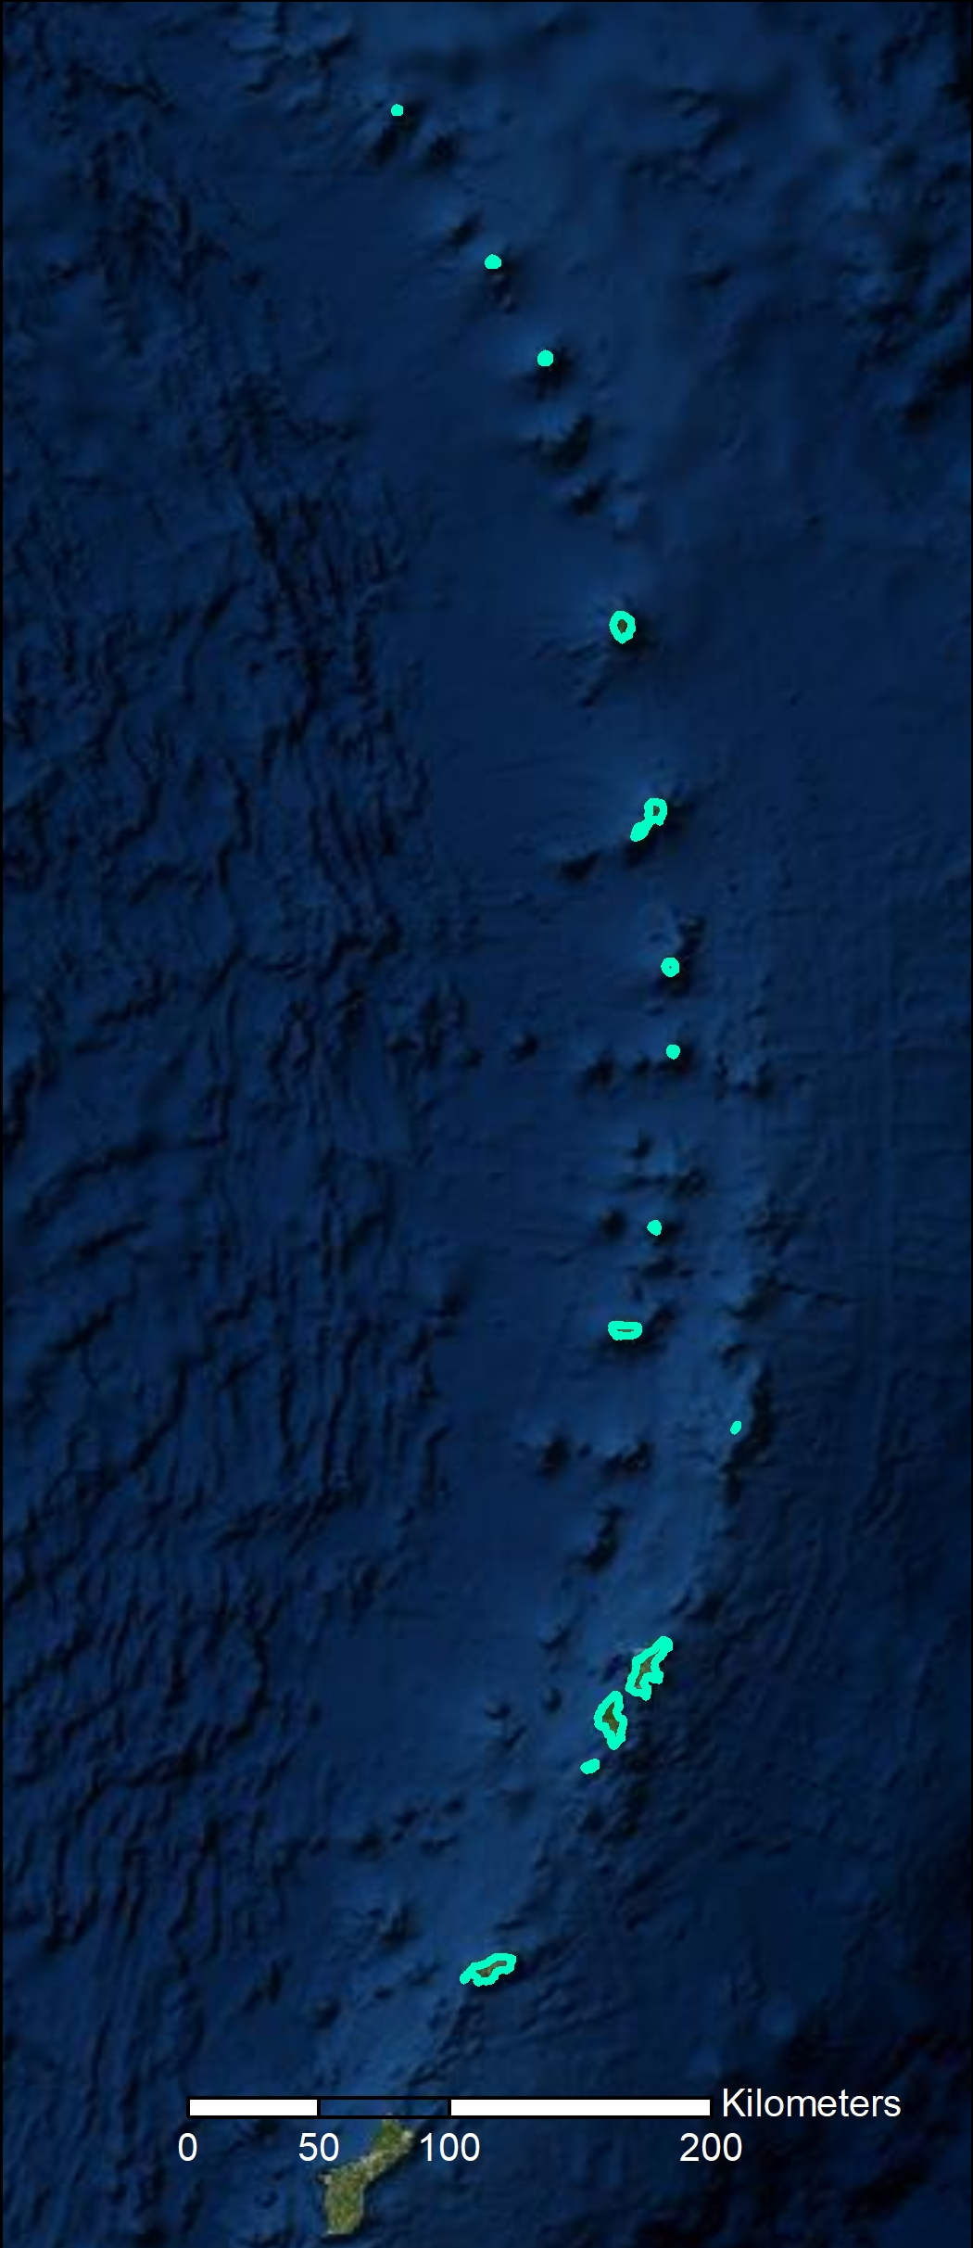
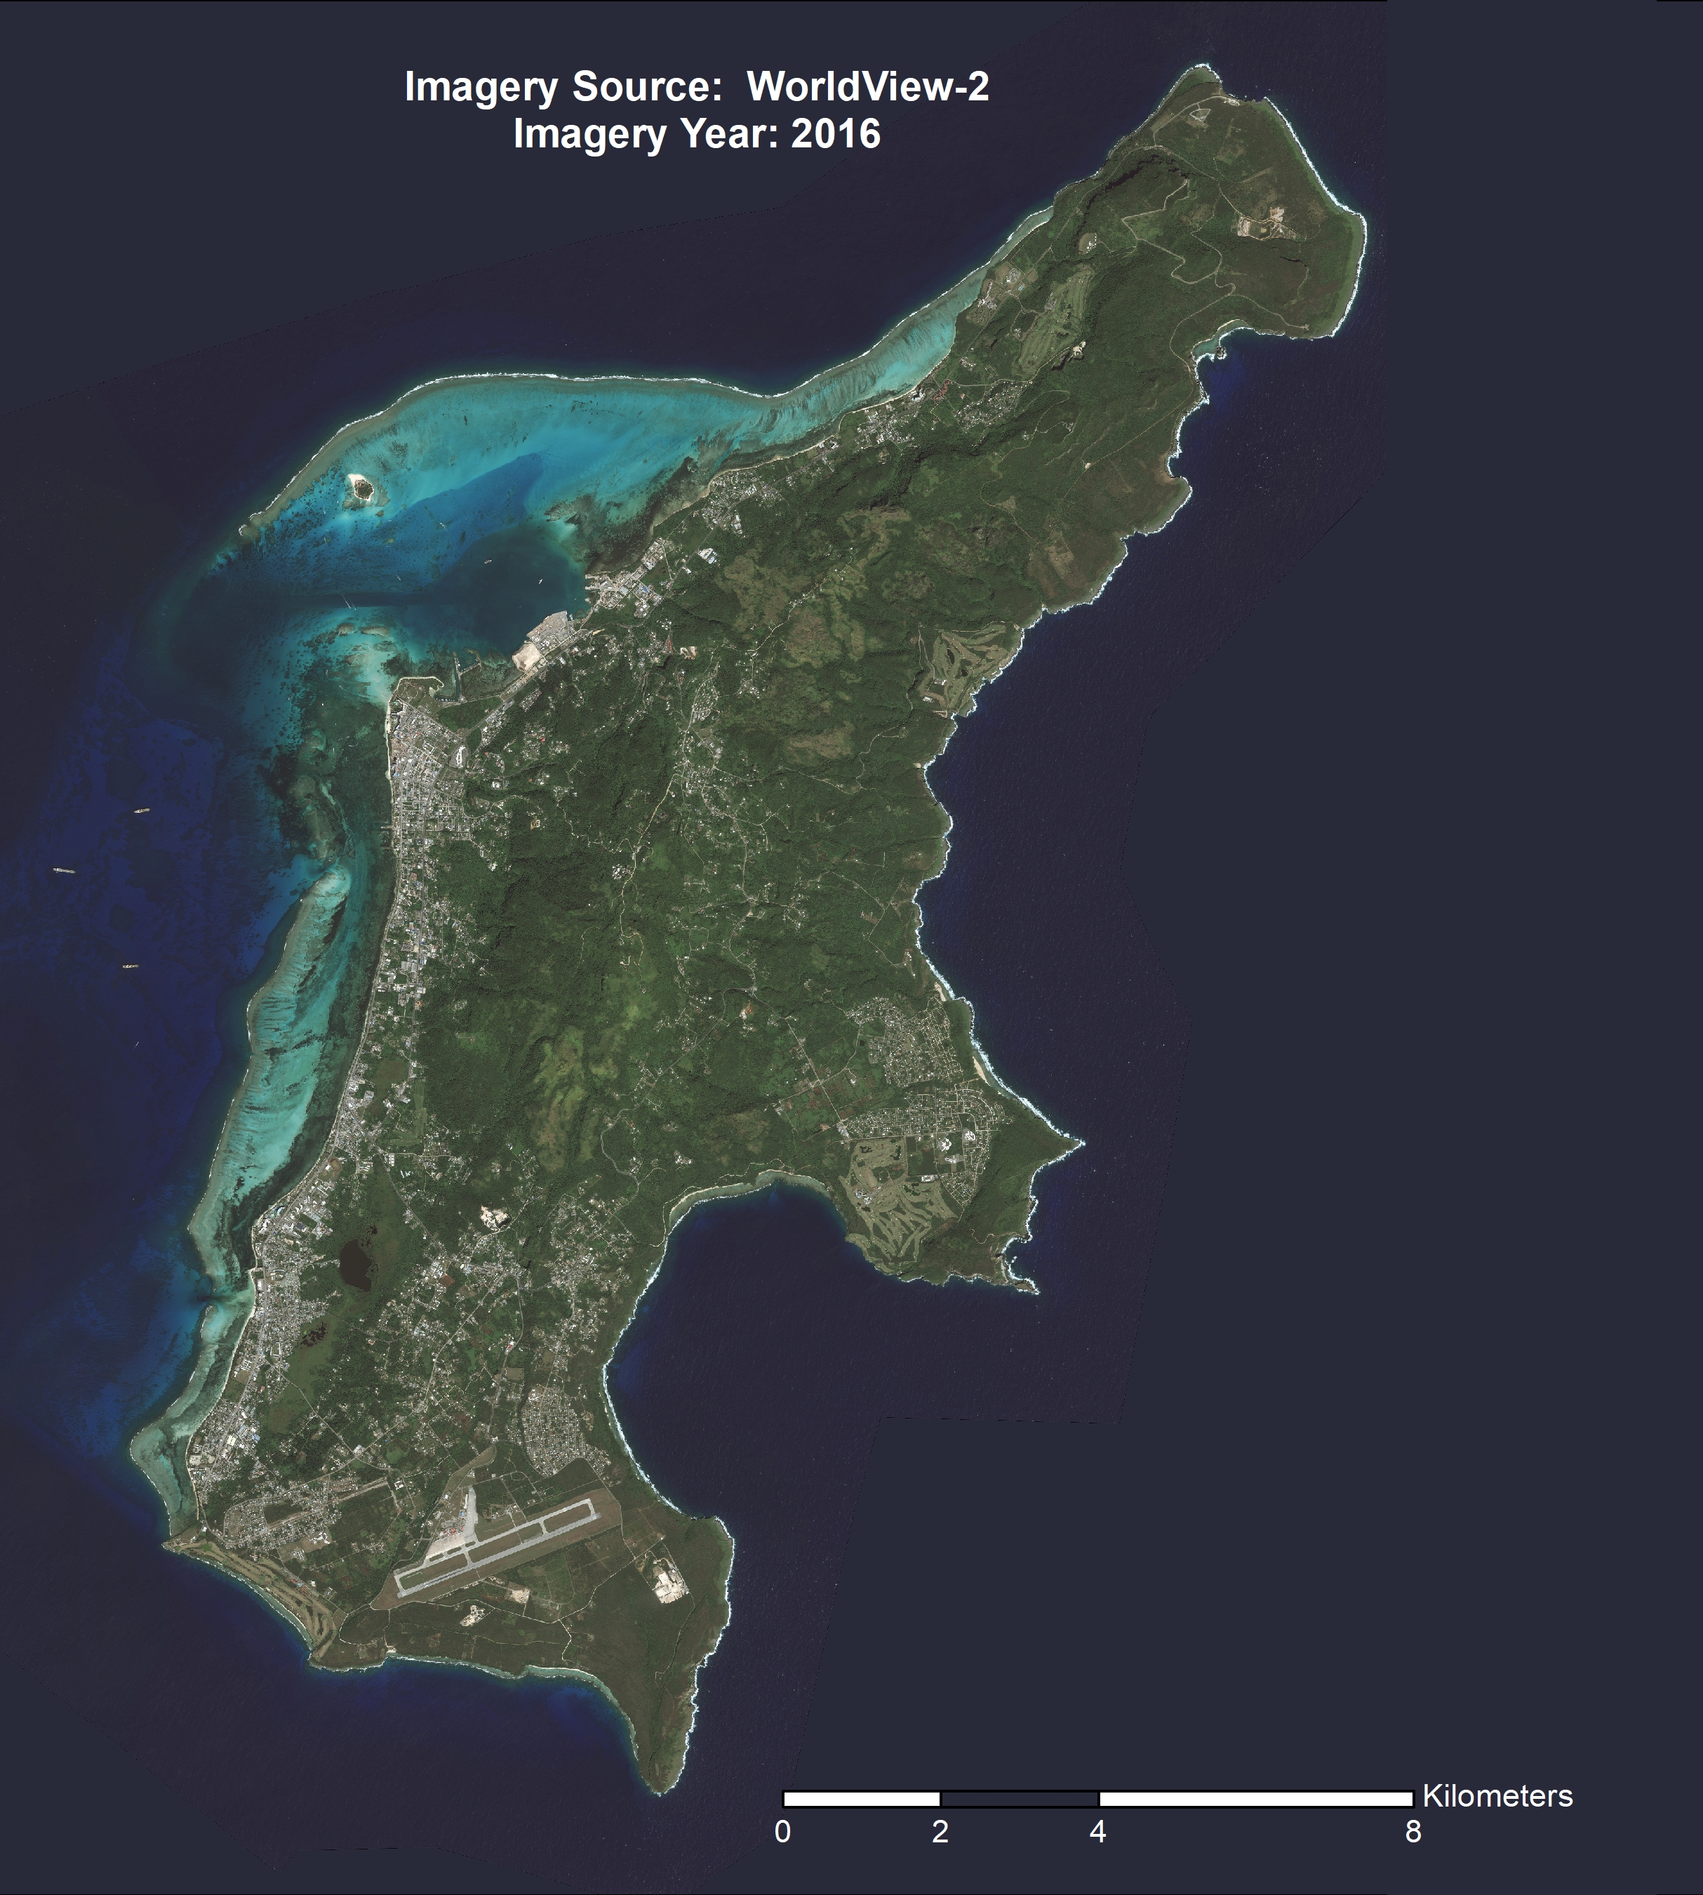
Northern Islands
Saipan
Population: 43,385
Area: 115.28 km² (44.55 mi²)
Saipan, Tinian, and Rota

Slide 4
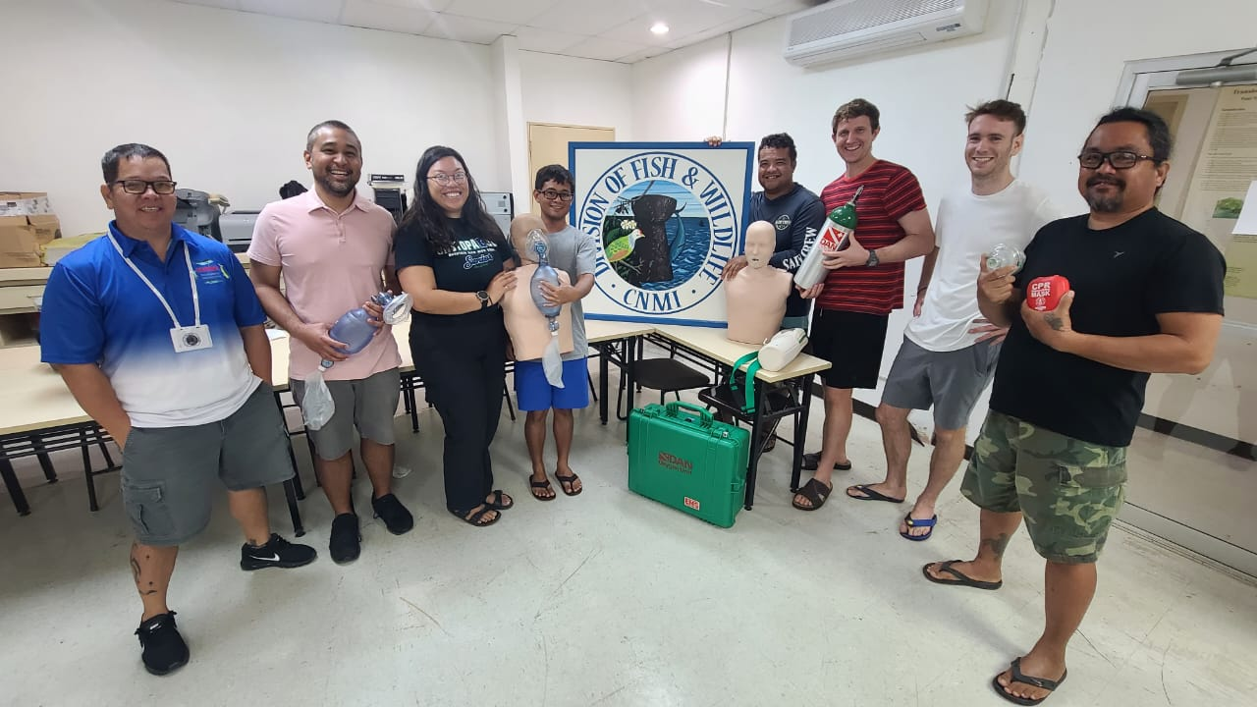
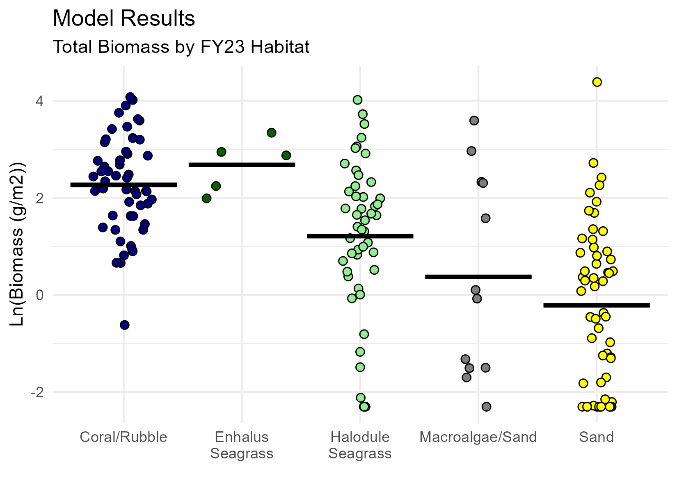
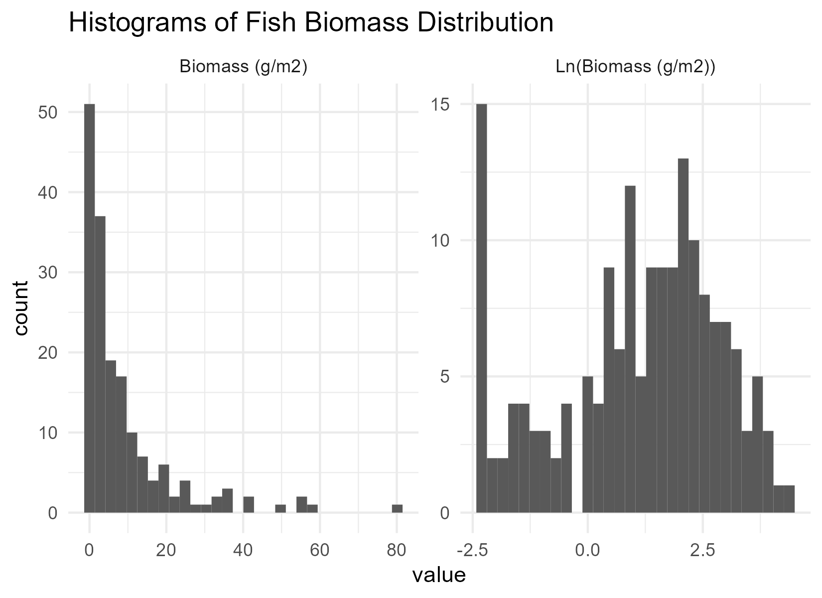
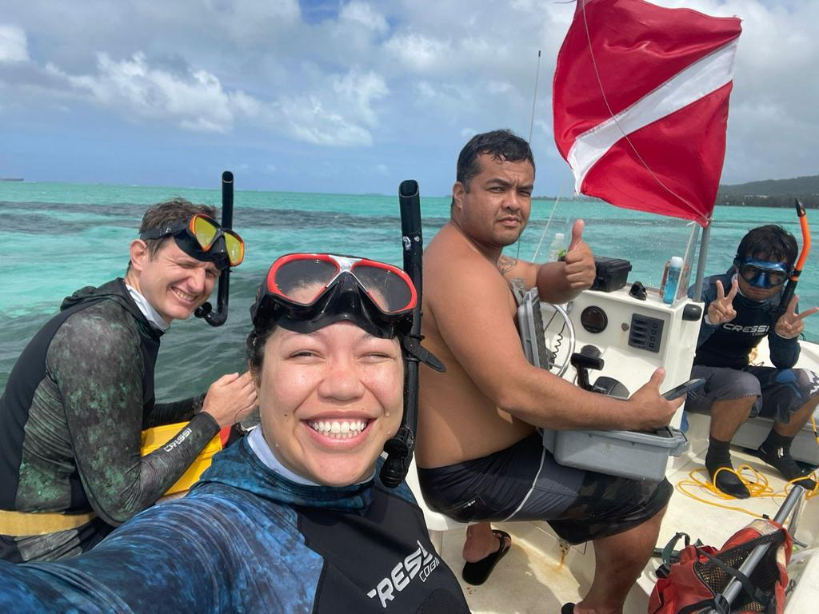
Division of Fish and Wildlife
Fisheries Research and Development Section (FRDS)
Monitors CNMI’s nearshore fishery resources
Provides recommendations for fisheries management

Slide 5
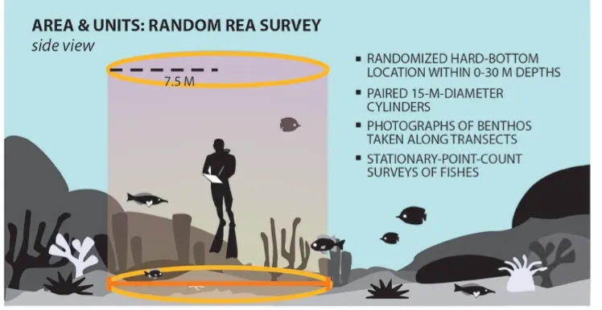
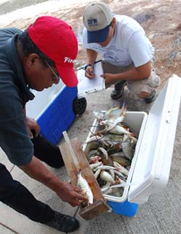
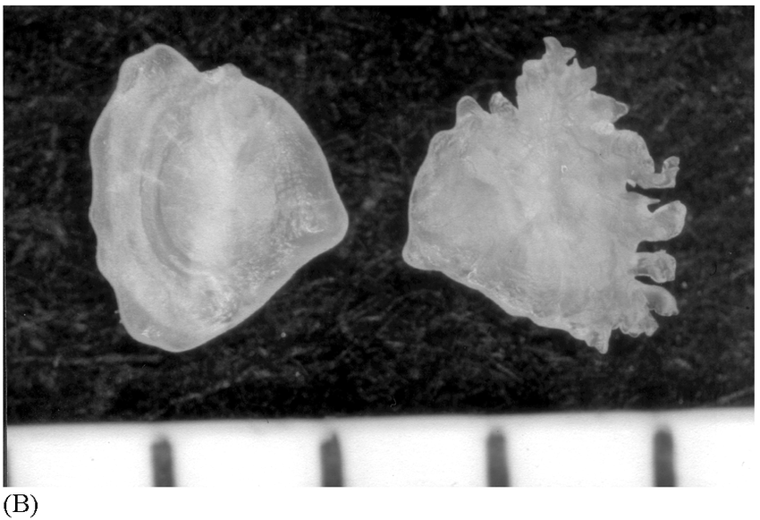
Division of Fish and Wildlife
Fisheries Independent Surveys
172 random stratified sites in Saipan lagoon
Halodule seagrass, Enhalus seagrass, Sand, and Coral/Rubble
Stationary point counts
Variable radius circle at fixed minute survey
Abundance, biomass, diversity, habitat cover
Fish Life History
Harvest fish to measure length, weight, age, sex, gonads, and otolith (ear bone)
CREEL Surveys – Fisheries Dependent
Vendors (commercial purchase invoices)
Fisherman along select shoreline routes

Slide 6
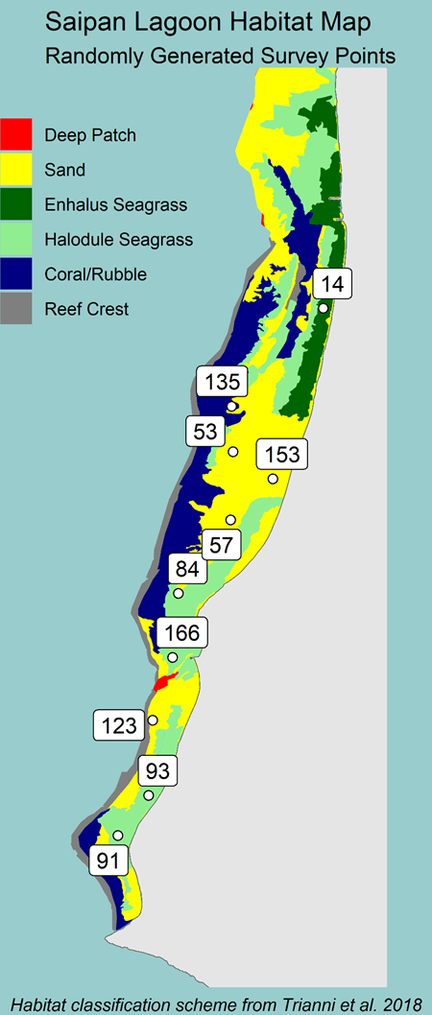
Fisheries Independent Surveys
Garmin GPS units
Qfield on Cellular Phones
135
(X, Y)

Slide 7
Fisheries Independent Surveys
135
(X, Y)

Slide 8
Fisheries Independent Surveys
135
(X, Y)

Slide 9
Fisheries Independent Surveys
135
(X, Y)
Python Script – GeoPandas
Species info using site coordinates

Slide 10
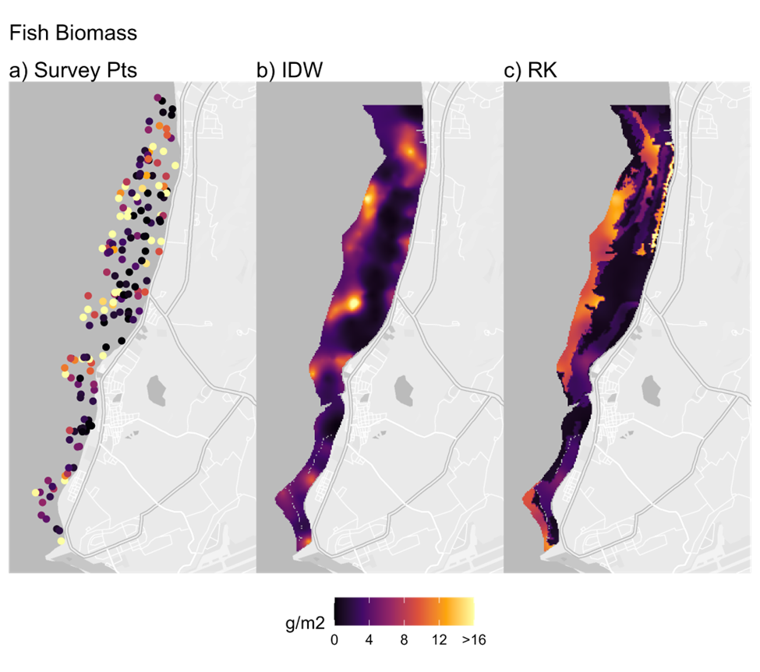
Fisheries Independent Surveys
Need to create spatially explicit maps to best manage the resources
Create models to map the overall distribution of fish abundance, biomass, and diversity in the central and southern lagoon.
Identify biomass, abundance, and species diversity hotspots.
Provide examples of model use for estimating the impact of lagoon habitat modification.

Slide 11
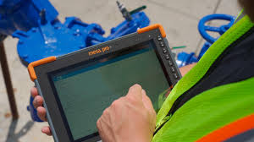
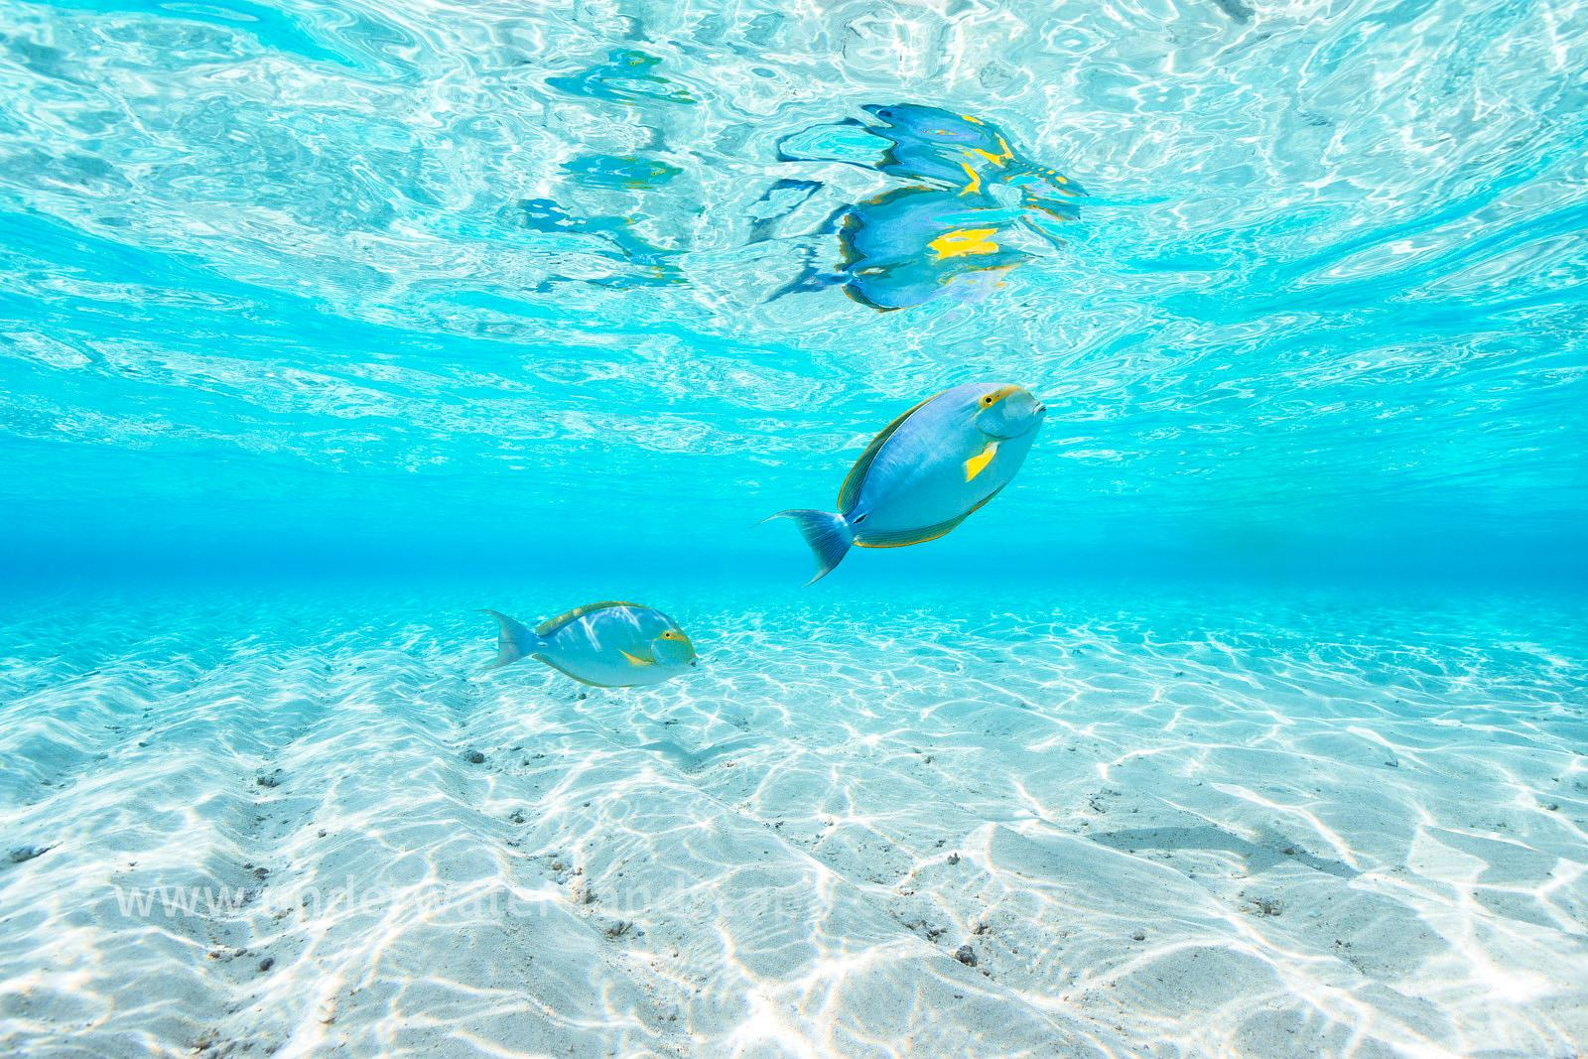
Improving Spatial Data Collection
Mesa Juniper 4 Tablets with uBlox GPS (1-2 meters accuracy)
Intramaps Roam and Qfield
Boat mounted
Show bathymetry, satellite imagery, and historic species points
Take site reference photos and able to review bathymetry to adjust locations
Garmin MK3 GPS dive watch
Surface point location or log snorkel tracks

Slide 12
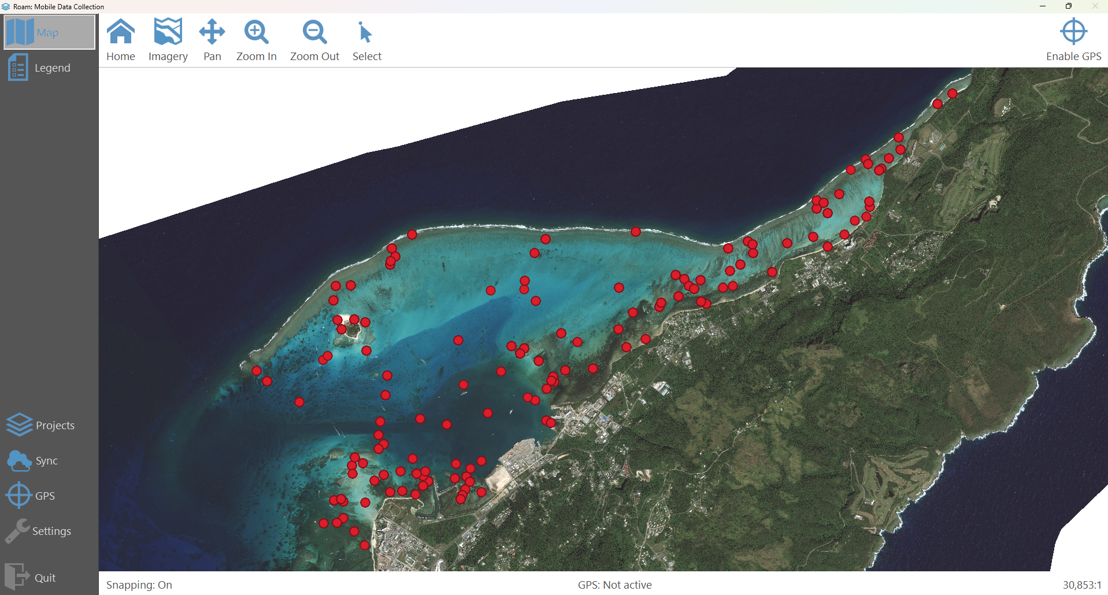

Slide 13
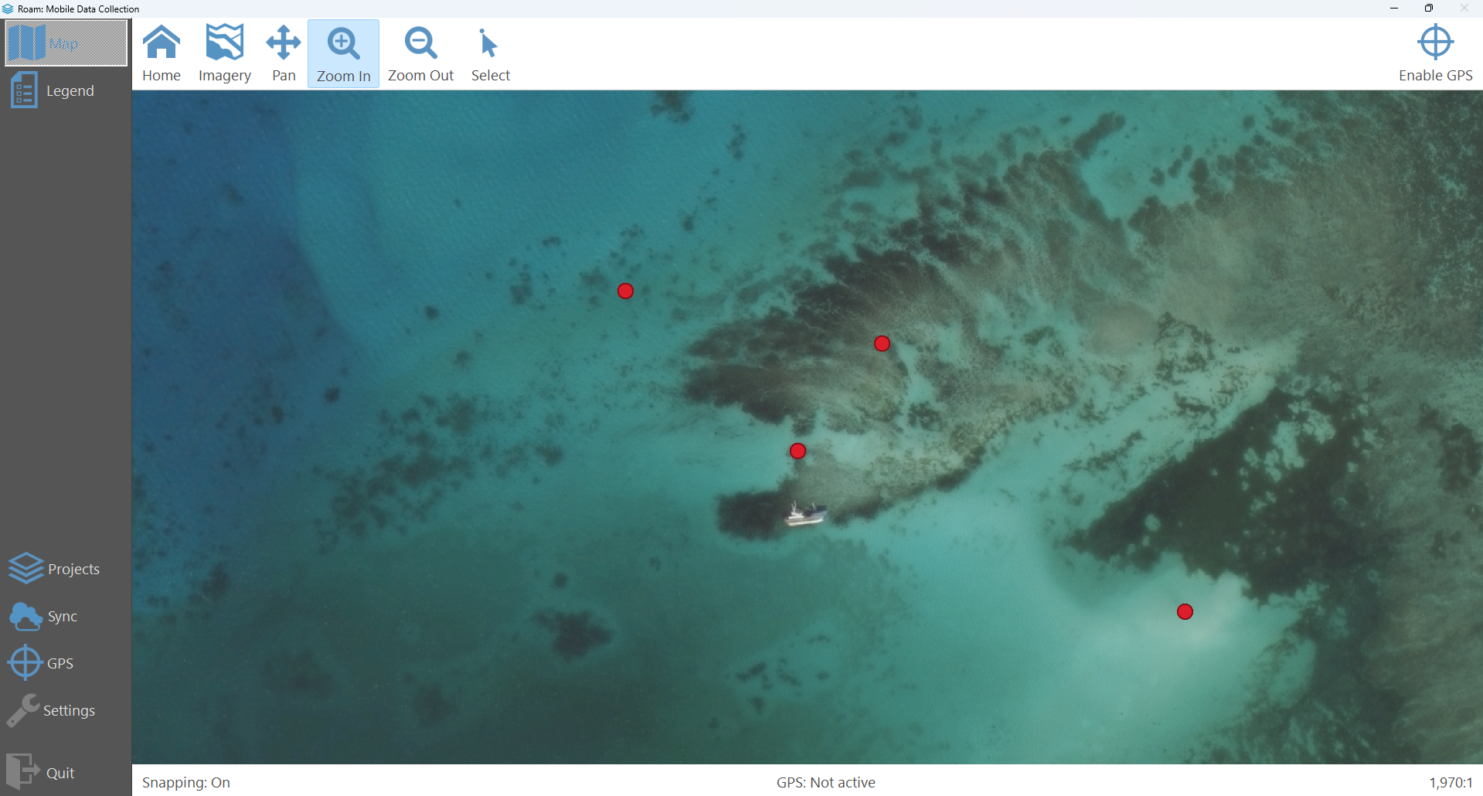

Slide 14
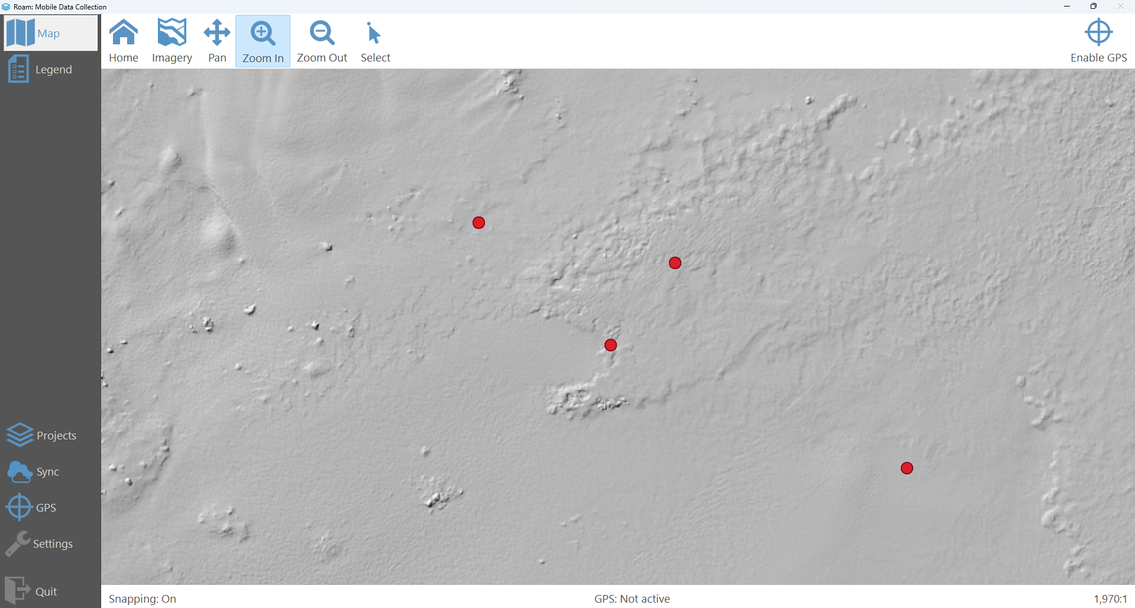

Slide 15
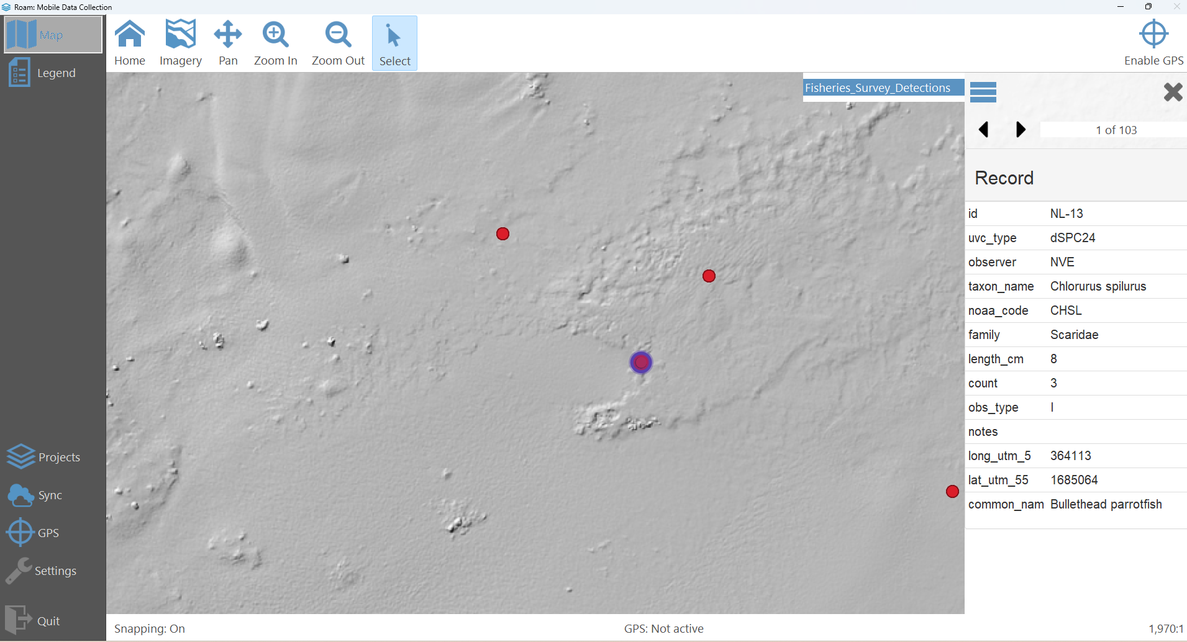
Improved Navigation
Historic Species Records

Slide 16
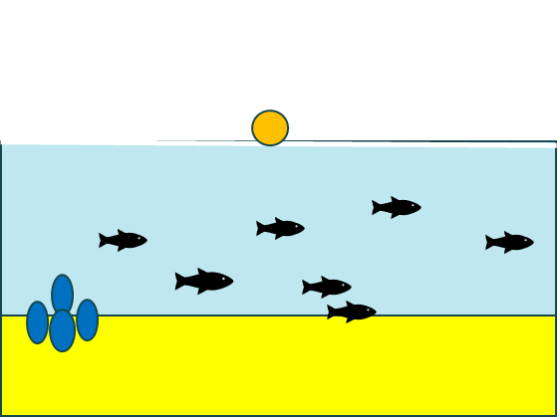
Improving In-water Spatial Data Collection
Garmin MK3 dive watches
Ability to surface and take a point to increase spatial accuracy
For snorkel surveys, record time as factor/covariate to better understand bias

Slide 17
Putting It All Together
Ultimate goal is to extrapolate to manage the resource for the people
Produce models using generalized linear models and regression kriging (RK)
Increasing spatial data collection is key to improve these models and reduce error

Slide 18
Next Steps
Create a pipeline to allow new data to update models at regular intervals
Integrate IntraMaps Roam or other app for Creel Surveys to improve spatial collection at fisherman surveys

Slide 19
Vinaka Vakalevu and Questions?
Funding Provided by United States Fish and Wildlife Service
Wildlife & Sport Fish Restoration Program

