Slide 5
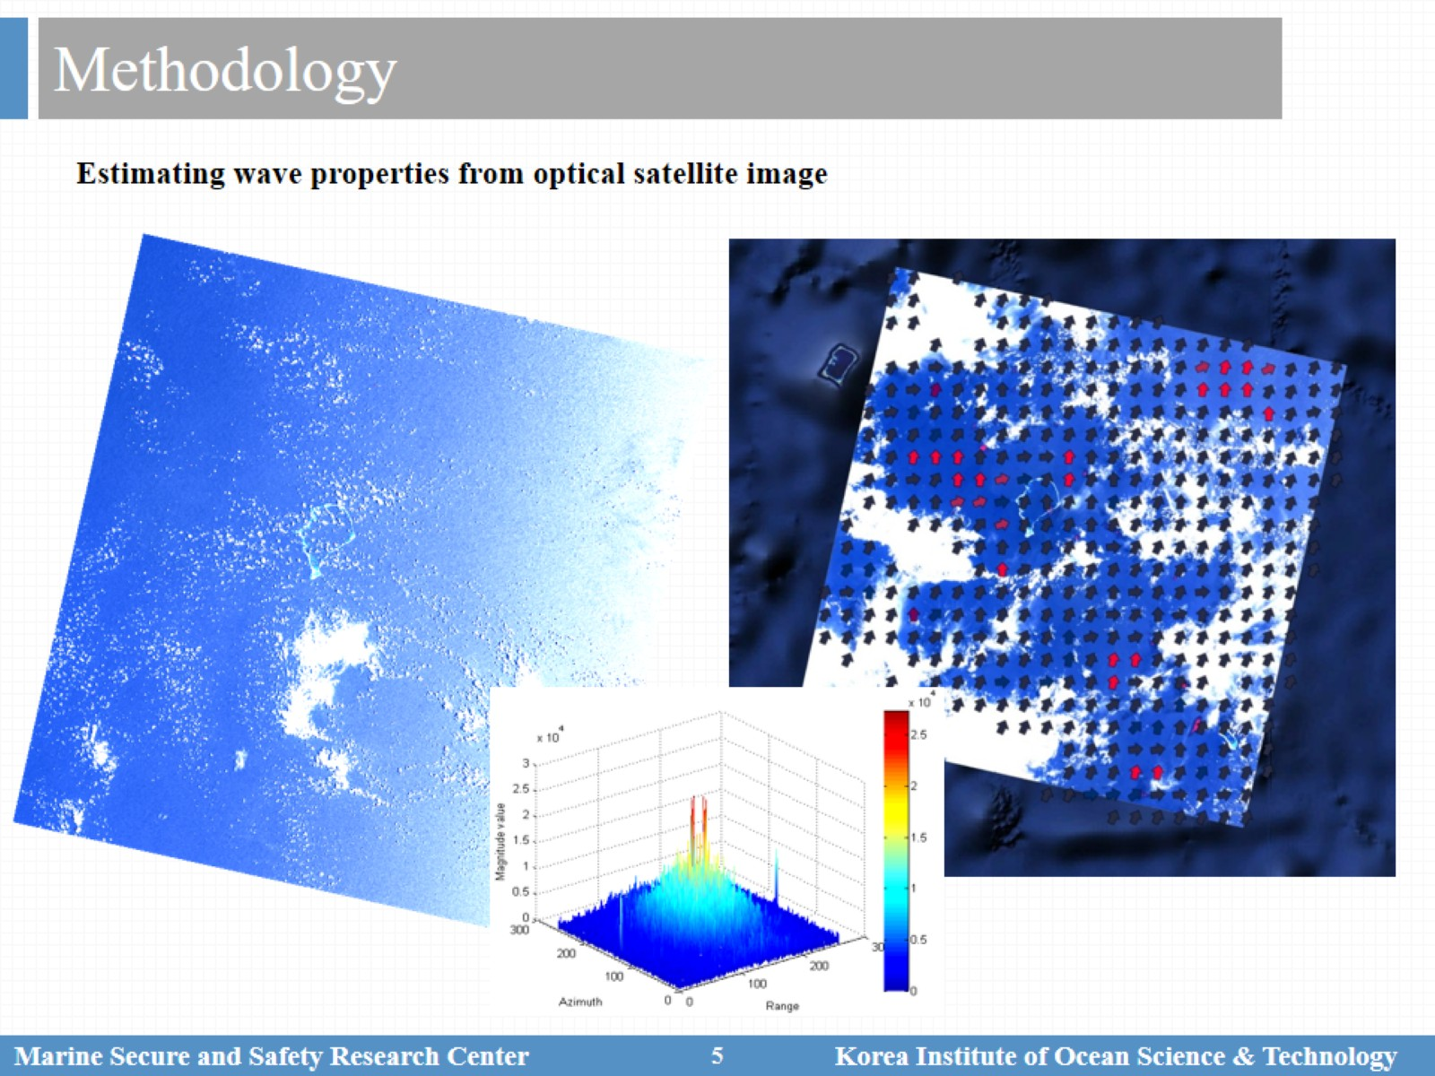
Methodology

Slide 6
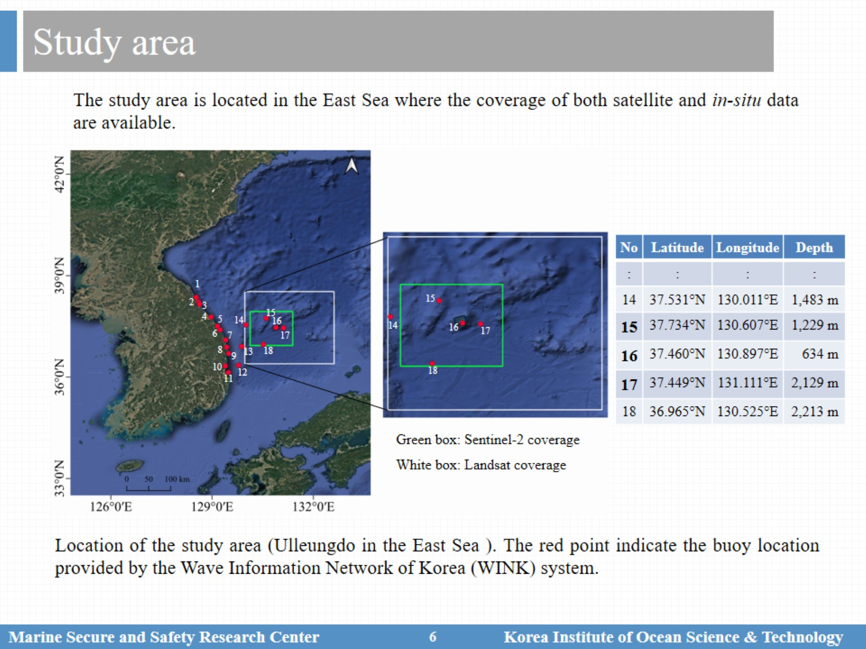
Study area

Slide 7
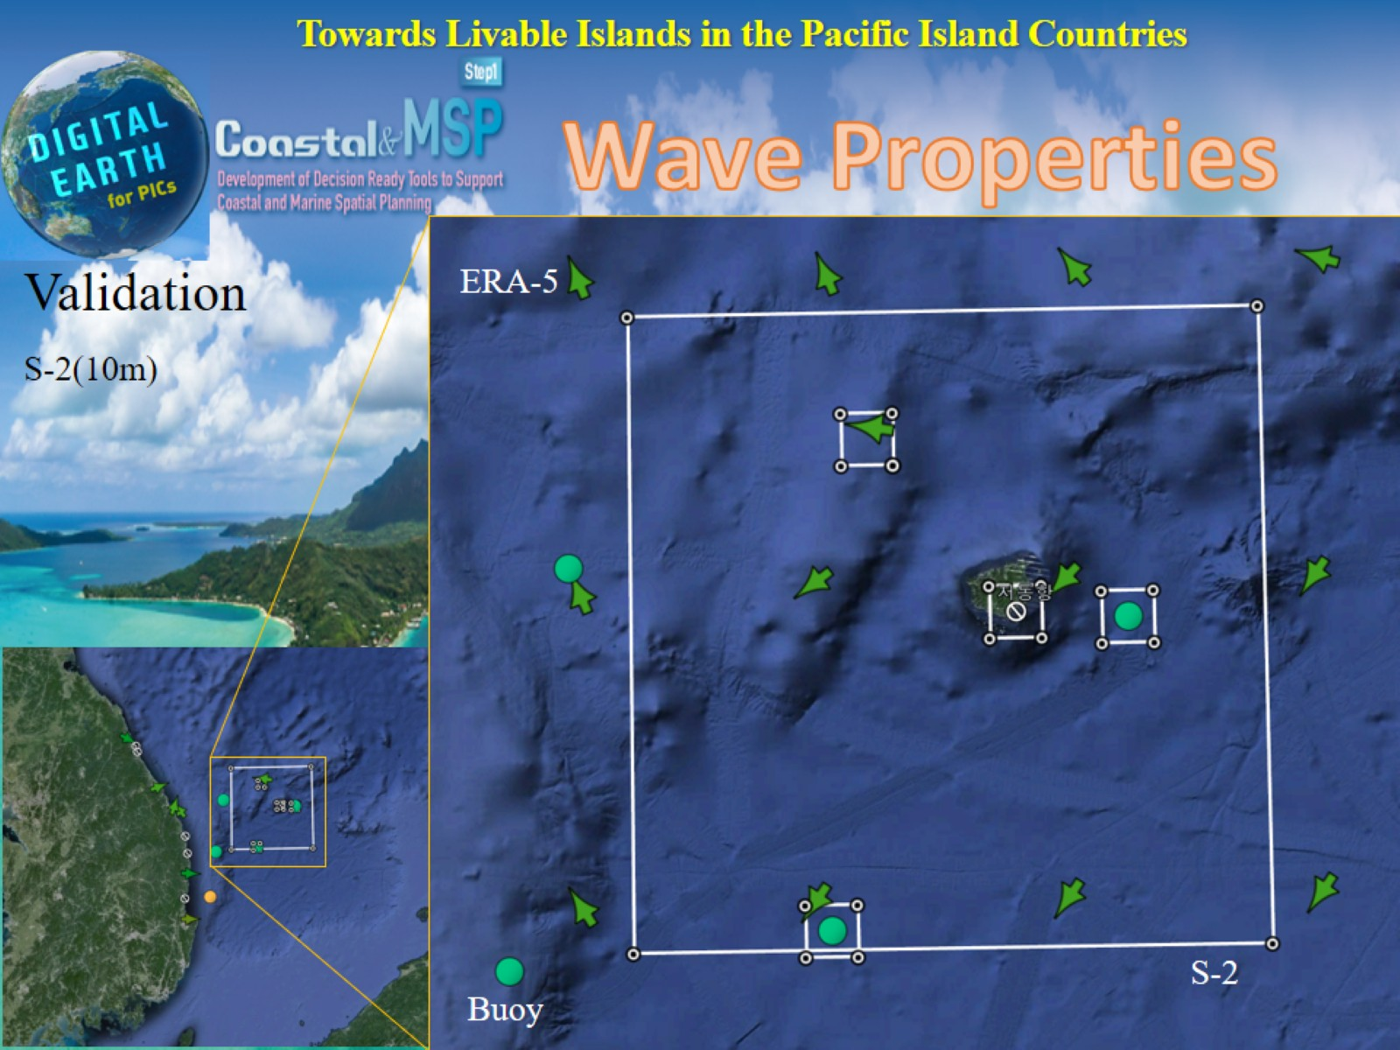

Slide 8
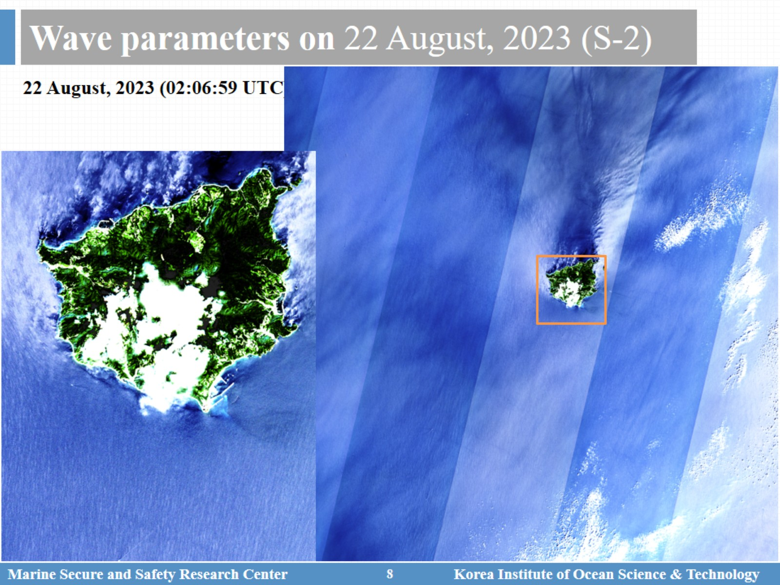
Wave parameters on 22 August, 2023 (S-2)

Slide 9
Wave parameters on 22 August, 2023 (S-2)

Slide 10
Wave parameters on 22 August, 2023 (S-2)

Slide 11
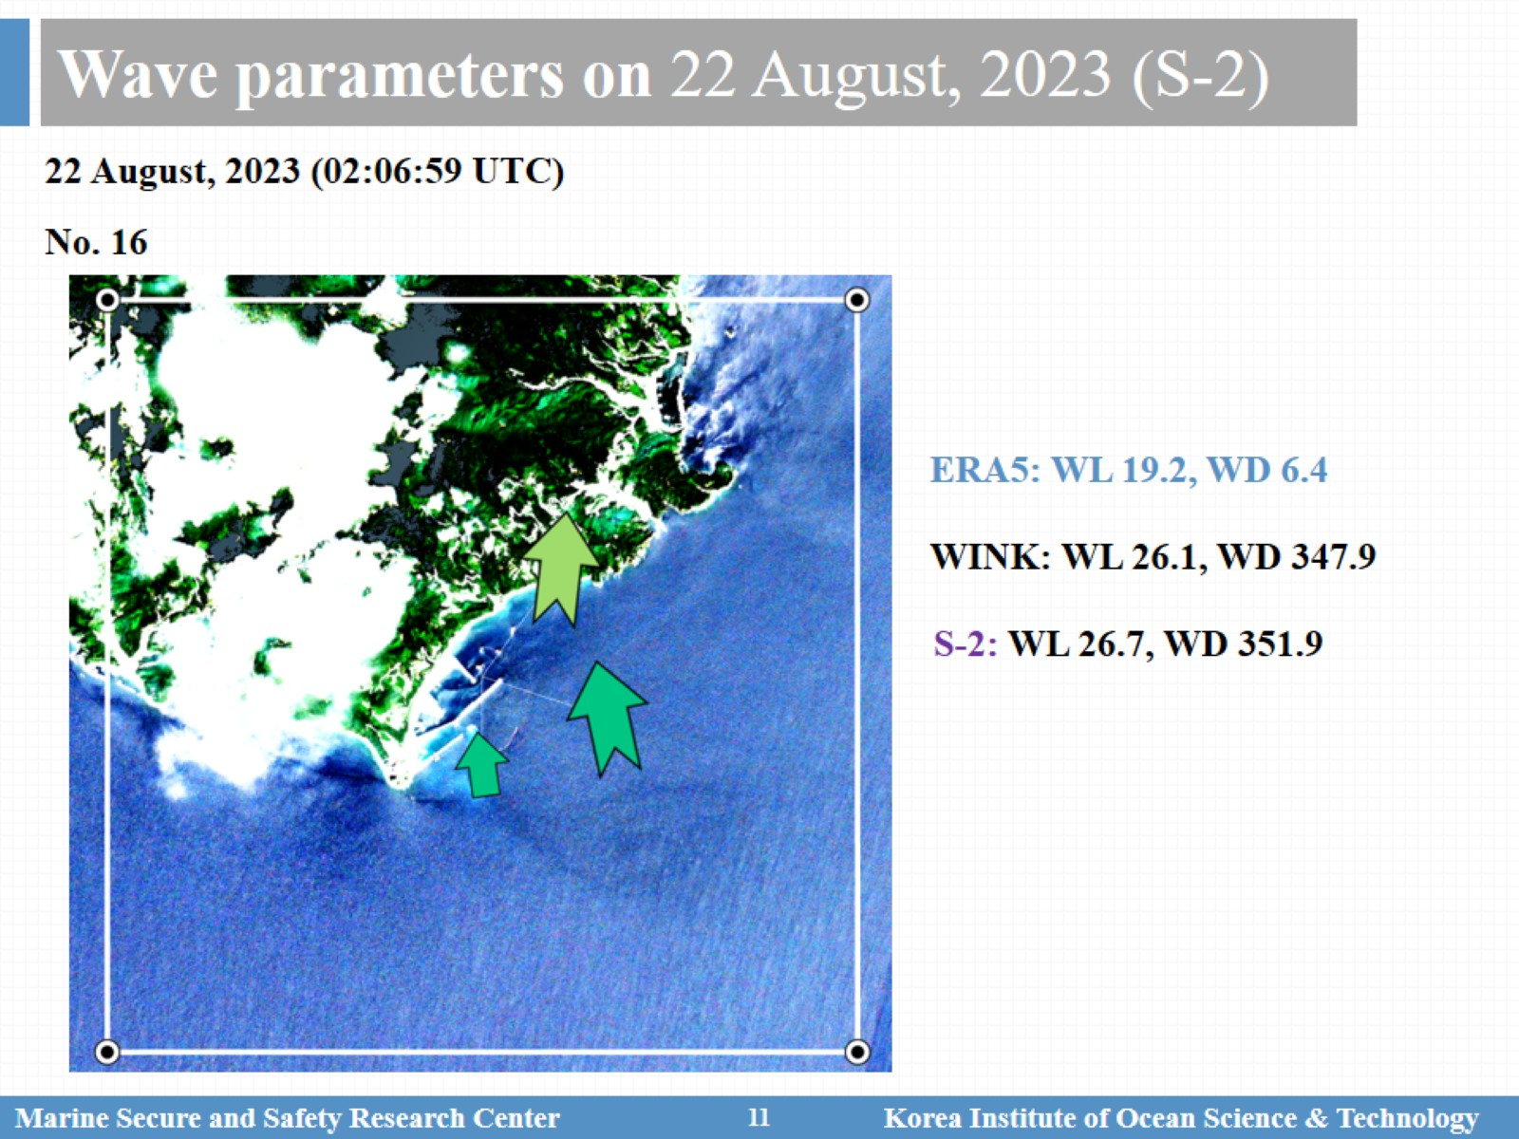
Wave parameters on 22 August, 2023 (S-2)

Slide 12
Wave parameters on 22 August, 2023 (S-2)

Slide 13
Wave parameters on 22 August, 2023 (S-2)

Slide 14
Wave parameters on 22 August, 2023 (S-2)

Slide 15
Wave parameters on 22 August, 2023 (S-2)

Slide 16
Wave parameters on 28 June, 2023 (S-2)

Slide 18
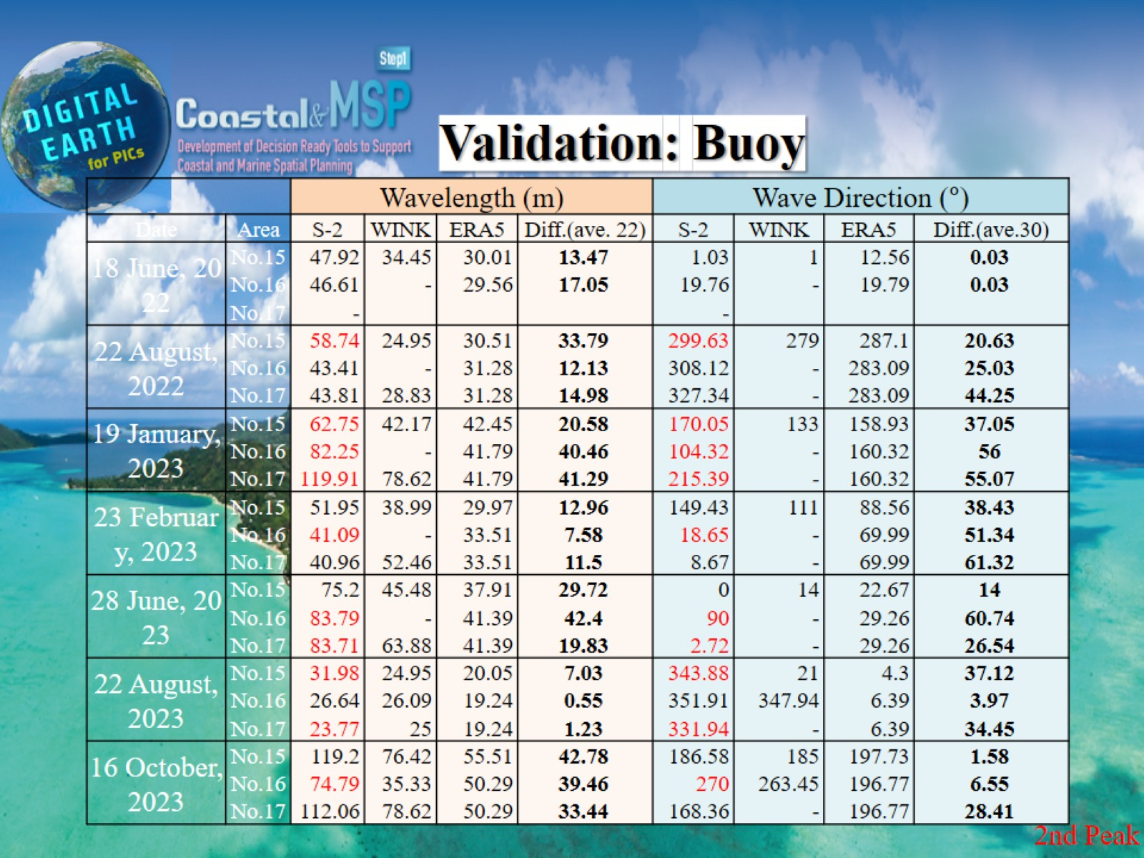

Slide 19
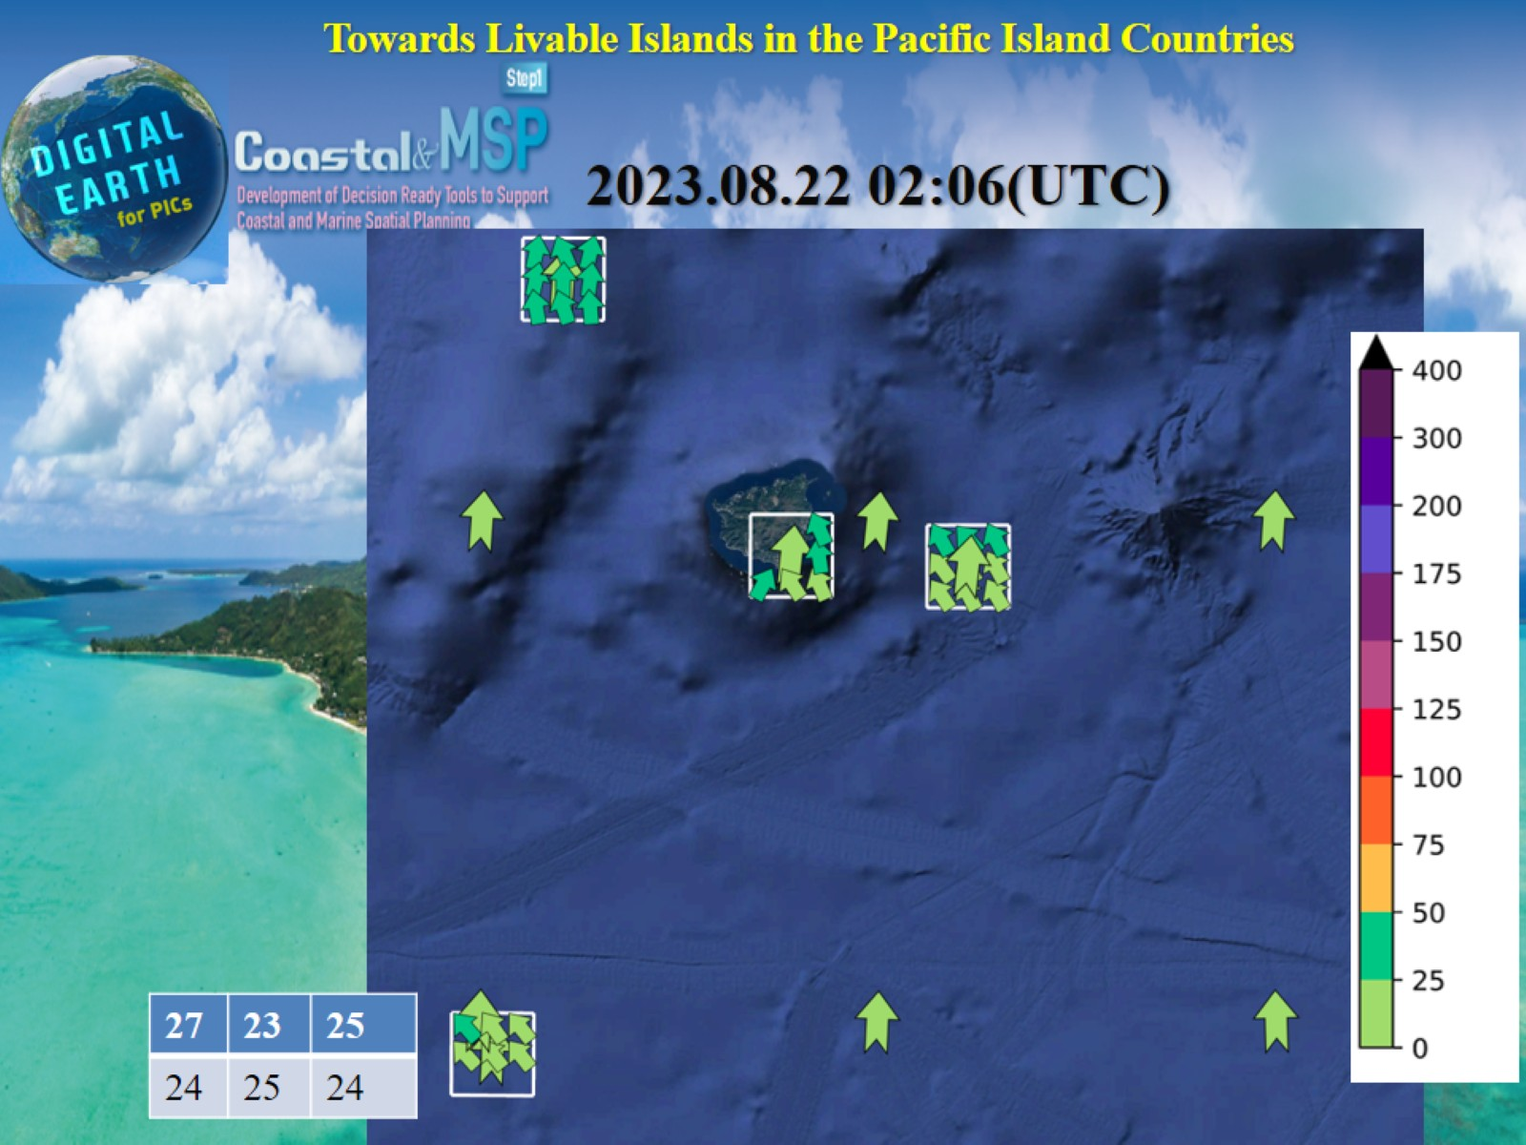

Slide 20
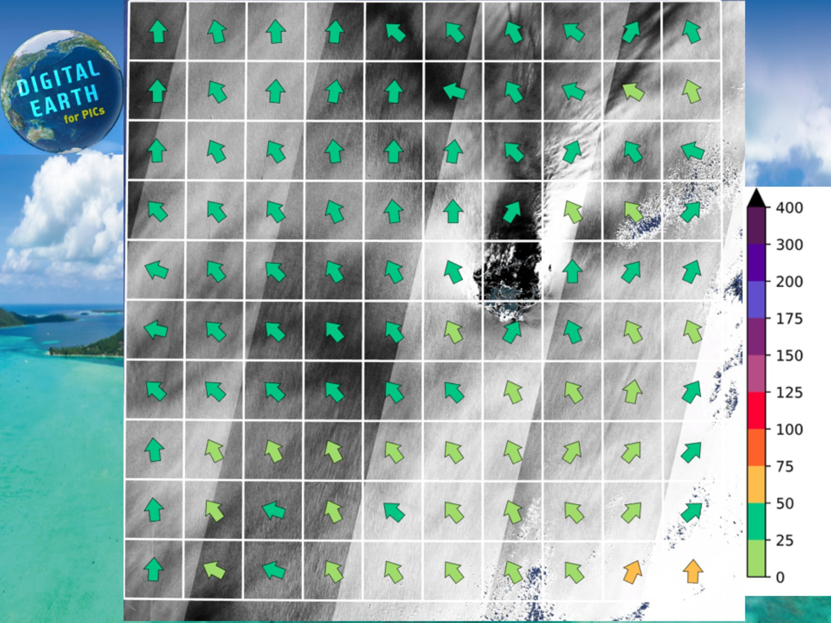

Slide 21
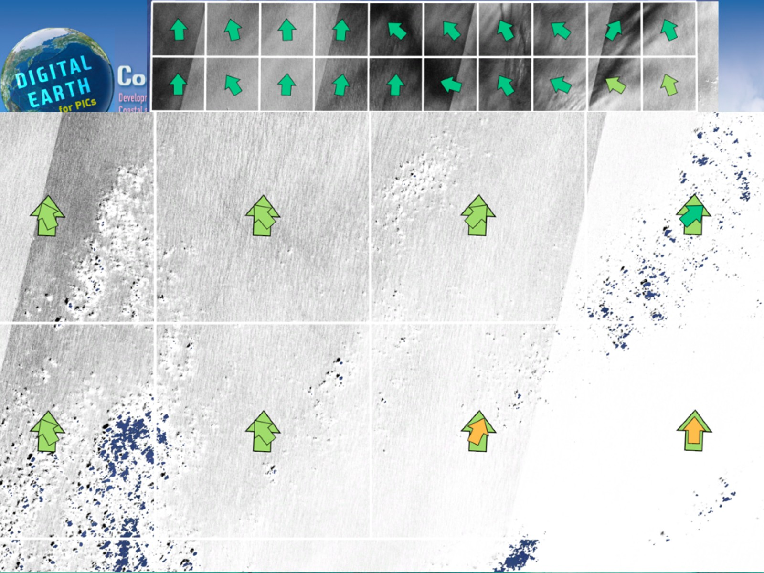

Slide 23
Application in Tuvalu

Slide 24
Estimate wave parameters: Example

Slide 25
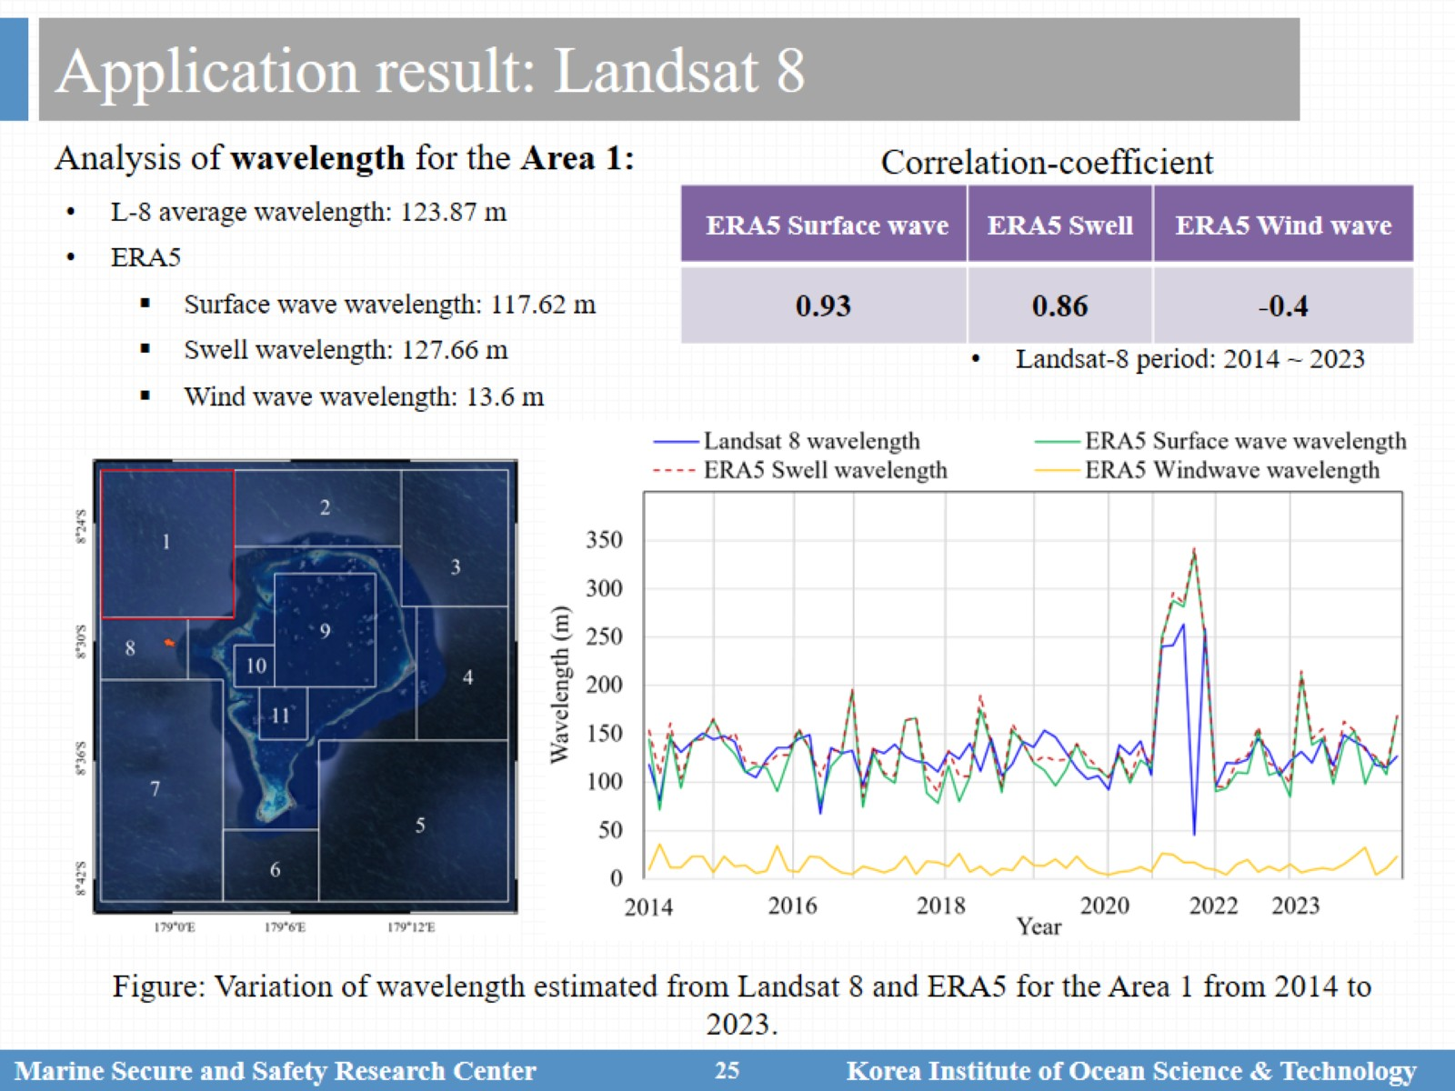
Application result: Landsat 8

Slide 26
Application result: Landsat 8

Slide 27
Application result: Sentinel-2

Slide 28
Application result: Sentinel-2

Slide 29
Conclusion

