Slide 1
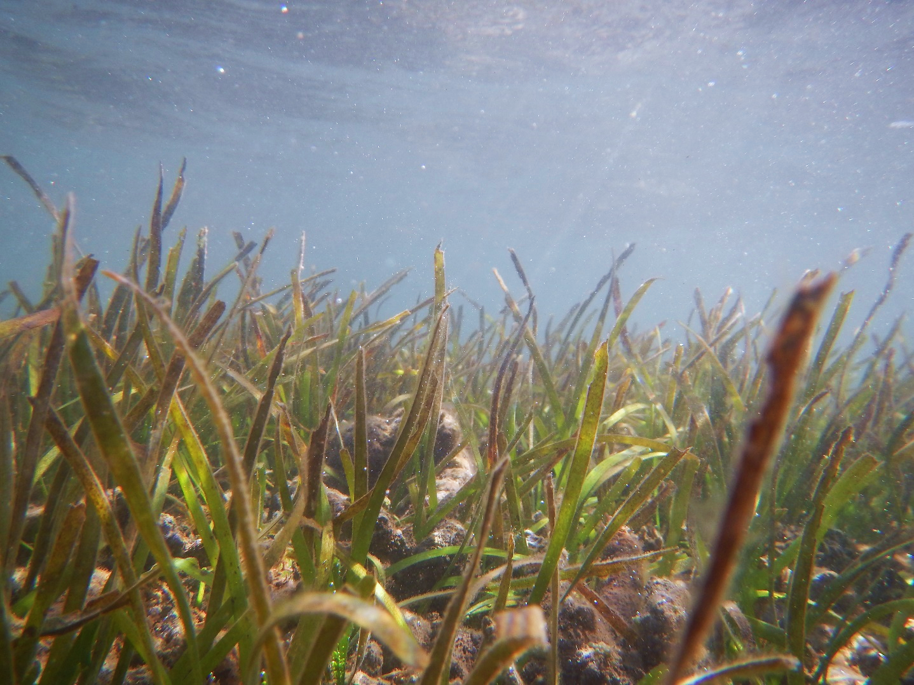







Mapping The Extent Of Seagrass Ecosystems Through Supervised Classification and Cloud Computing
Role of Digital Earth Pacific in the MACBLUE Project
Presenter: Shyam Lodhia
Affiliation: GIZ
Notes:
Good Morning everyone!
Ever wondered how cloud computing is making waves even in the most unexpected places?
Today, I am excited to share a glimpse into a project I am involved in, focused on mapping seagrass and mangroves.
It may sound simple, but the impact is far reaching.
So let dive in...
I am Shyam Lodhia, and today I would like to present to you

Slide 2
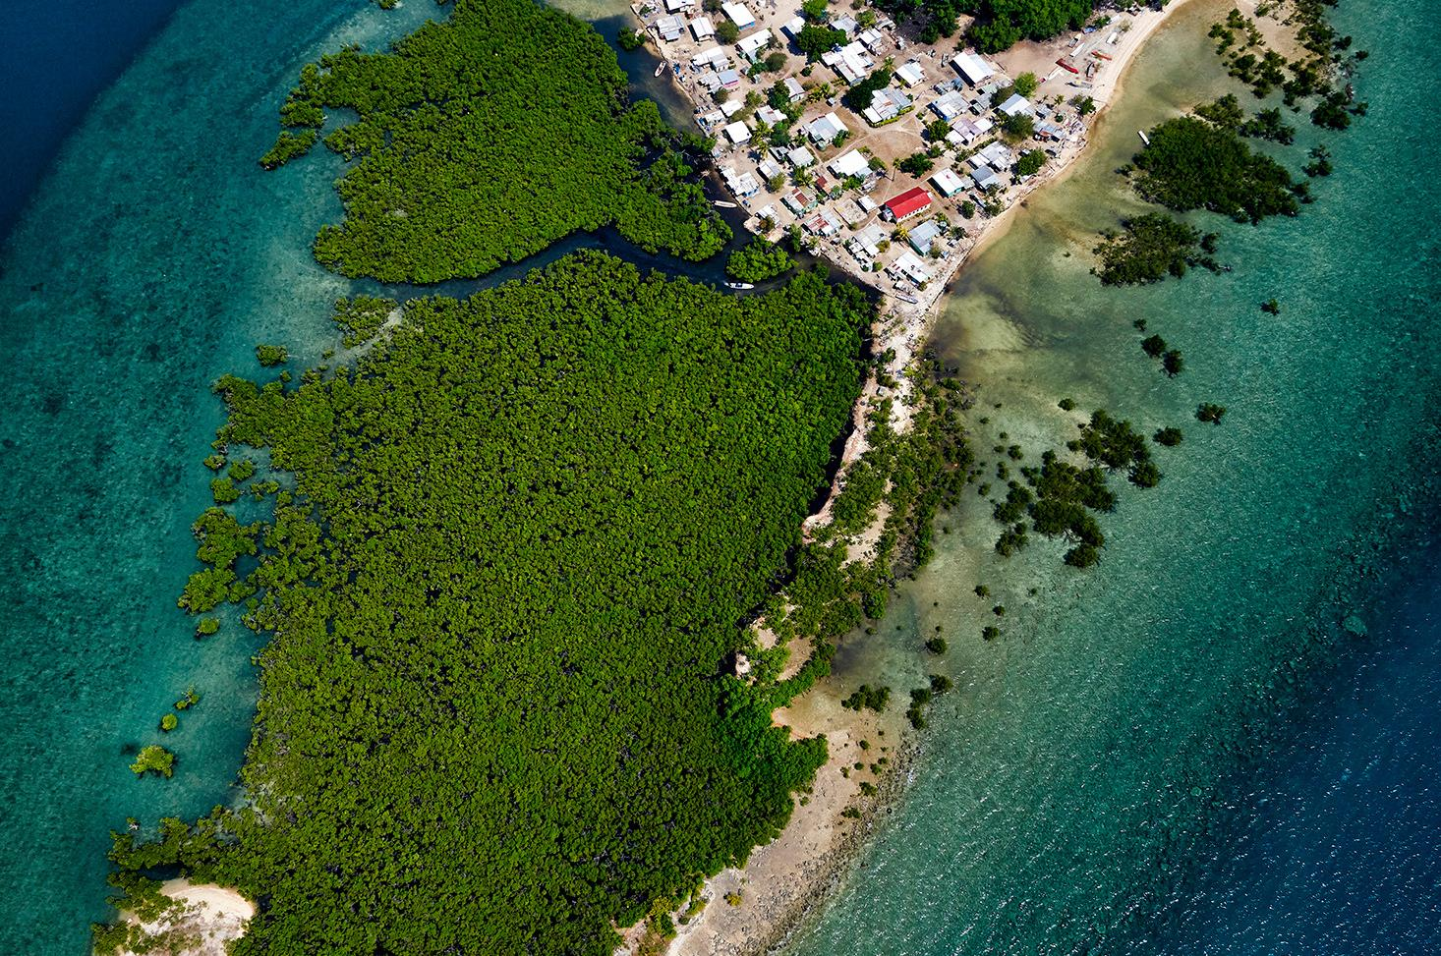
Content
What is MACBLUE
MACBLUE Goals
Digital Earth Pacific (DEP) and its role in MACBLUE
Field data for machine learning
Remote sensing and workflows
Example of results
Blue carbon field data collection
Measurement, Reporting and Verification (MRV)
Next steps
Conclusion

Slide 3
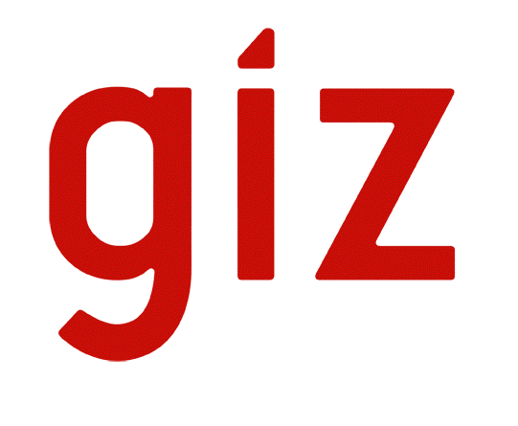
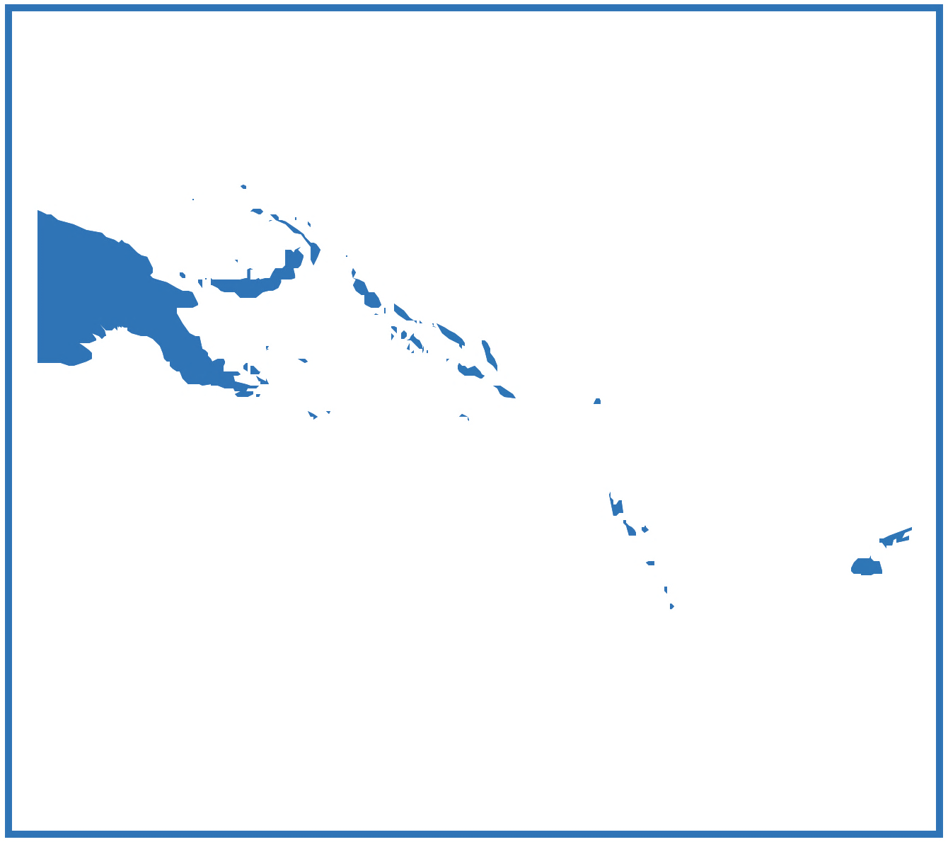


What is MACBLUE
Commissioned:
German Federal Ministry of Environment, Nature Conservation, Nuclear Safety and Consumer Protection (BMUV) under the International Climate Initiative (IKI).
Implemented:
GIZ, in close collaboration with regional partners SPC and SPREP.
Partner Countries:
Fiji, Papua New Guinea, Solomon Islands, Vanuatu
Objectives:
Mapping Seagrass and Mangrove Ecosystems
Quantifying Ecosystem Services
Strengthening Policies and Regulations
Effective Management and Rehabilitation
Knowledge Sharing
Notes:
Introduction:
The Management and Conservation of Blue Carbon Ecosystems (MACBLUE) project aims to strengthen coastal biodiversity conservation and management through protection and rehabilitation incentives for coastal carbon sinks in Pacific Island countries. It is commissioned by the German Federal Ministry for the Environment, Nature Conservation, Nuclear Safety and Consumer Protection (BMUV) and implemented by the Deutsche Gesellschaft für Internationale Zusammenarbeit (GIZ) GmbH in close collaboration with regional partners The Pacific Community (SPC) and Pacific Regional Environment Programme (SPREP).
The project will utilize innovative remote sensing approaches to map the extent of seagrass and mangrove (SaM) ecosystems in Fiji, Papua New Guinea, the Solomon Islands and Vanuatu and will assess and model related carbon storage capacity, carbon emission potential and ecosystem services.
The resulting data will allow inventories of associated natural capital and will support government partners in their efforts to strategically develop and implement conservation, management, and rehabilitation efforts.
Partner Countries:
Fiji, Papua New Guinea, Solomon Islands, Vanuatu
Objectives:
Mapping Seagrass and Mangrove Ecosystems
Quantifying Ecosystem Services
Strengthening Policies and Regulations
Effective Management and Rehabilitation
Knowledge Sharing

Slide 4
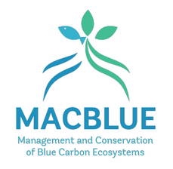
MACBUE Goals
I
II
III
IV
V
Mapping and monitoring
the extent of
SaM ecosystems
Documenting and quantifying ecosystem goods and services
Assessing policy and incentive options for conservation and rehabilitation
Identifying and managing
national SaM priority sites
Sharing and communicating concepts, lessons learnt & instruments
Strengthening Coastal Biodiversity Conservation and Management through Protection
and Rehabilitation Incentives for Coastal Carbon Sinks in Pacific Island Countries
* SaM - Seagrass and Mangrove
Notes:
Project Components:
Output I: Seagrass and mangrove populations mapped at national level and documentation regarding changes in coverage.
Output II: Associated ecosystem services with emphasis on carbon stocks, emission factors and anthropogenic threats.
Output III: National policies and regulations strengthened to provide incentives and sustainable mechanisms for conservation and rehabilitation of SaM ecosystems.
Output IV: Effective management and rehabilitation regimes are developed, applied, and demonstrated at priority sites, as a basis for national replication.
Output V: Conservation and sustainable management of SaM will be shared on the national, regional, and international level.

Slide 5
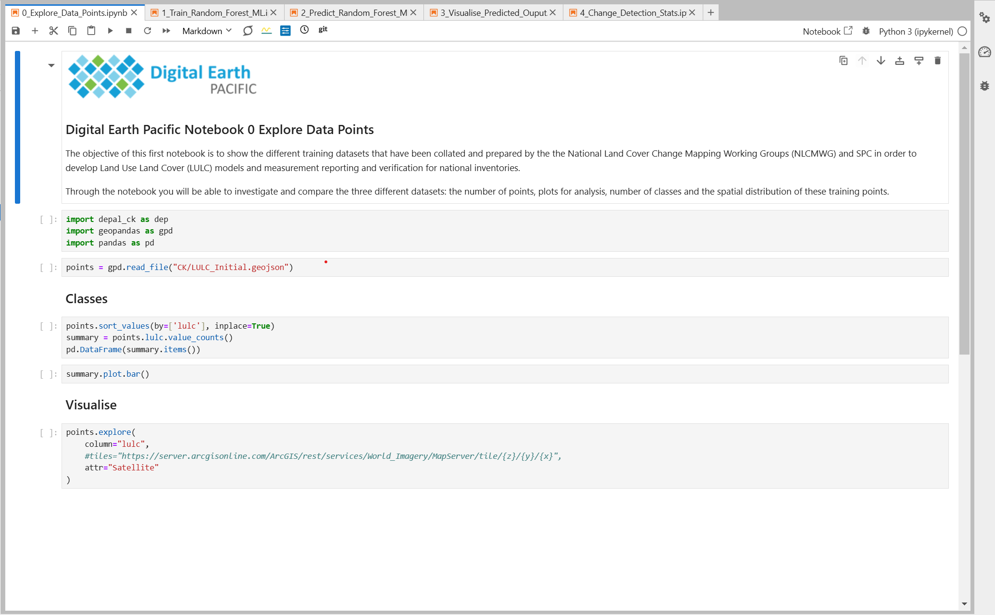
What is Digital Earth Pacific (DEP)?
Digital Earth Pacific is a cloud computing platform designed to deliver an operational earth and marine observation system.
Notes:
Digital earth pacific is a cloud computing platform designed to deliver an operational earth and marine observation system. It takes decades of satellite data and makes it easily accessible and usable.
Digital earth pacific is powered by Microsoft's Planetary Computer, indicating a reliance on advanced cloud computing capabilities provided by Microsoft. This association suggests a commitment to leveraging cutting-edge technology for earth observation.
The platform is designed to empower decision-makers across the Pacific by providing easy access to historical satellite data.
The program is founded on a demand-driven, co-creation process, emphasizing the identification of needs and priorities of the communities served. This approach ensures that DEP addresses real-world challenges faced by Pacific communities.
In the context of the MACBLUE project, the utilization of DEP for mapping the extent of seagrass and mangrove ecosystems demonstrates a commitment to leveraging advanced technology for environmental monitoring and conservation efforts.

Slide 6
Digital Earth Pacific’s role in MACBLUE
Training data
DEP generated extent maps
DEP
Carbon stock & emission factors
Ecosystem service valuation
Policy & Regulation reform
Soil core
BC assessment data
Biomass
Output 1
Output 2
Output 3
MACBLUE Goals
In the context of the MACBLUE project, the utilization of Digital Earth Pacific for mapping the extent of seagrass and mangrove ecosystems aligns with the MACBLUE projects first objective.

Slide 7
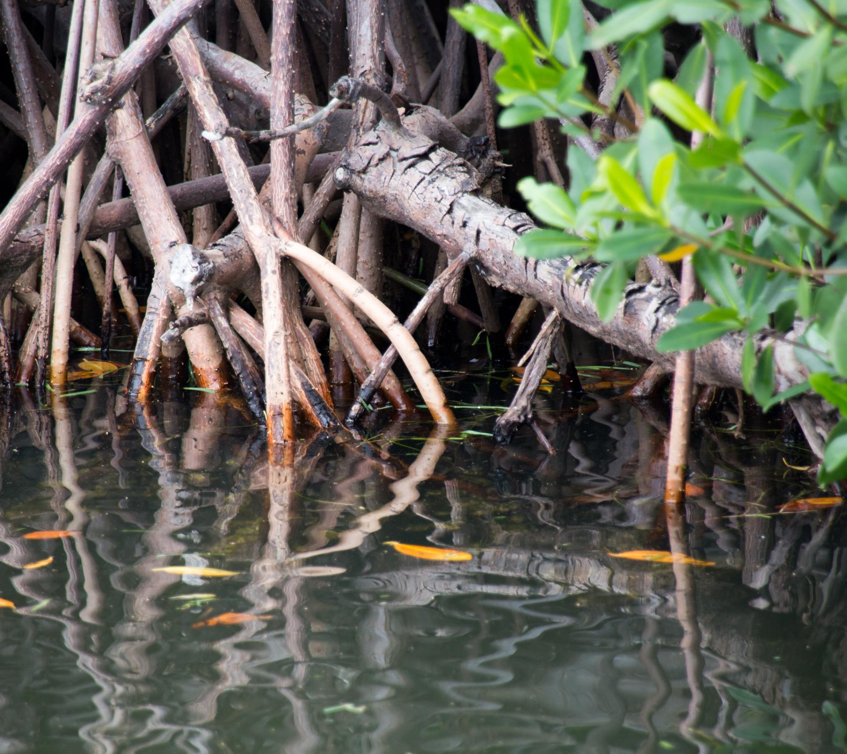
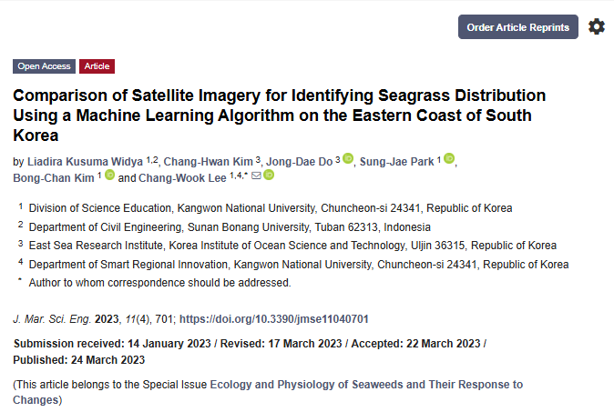
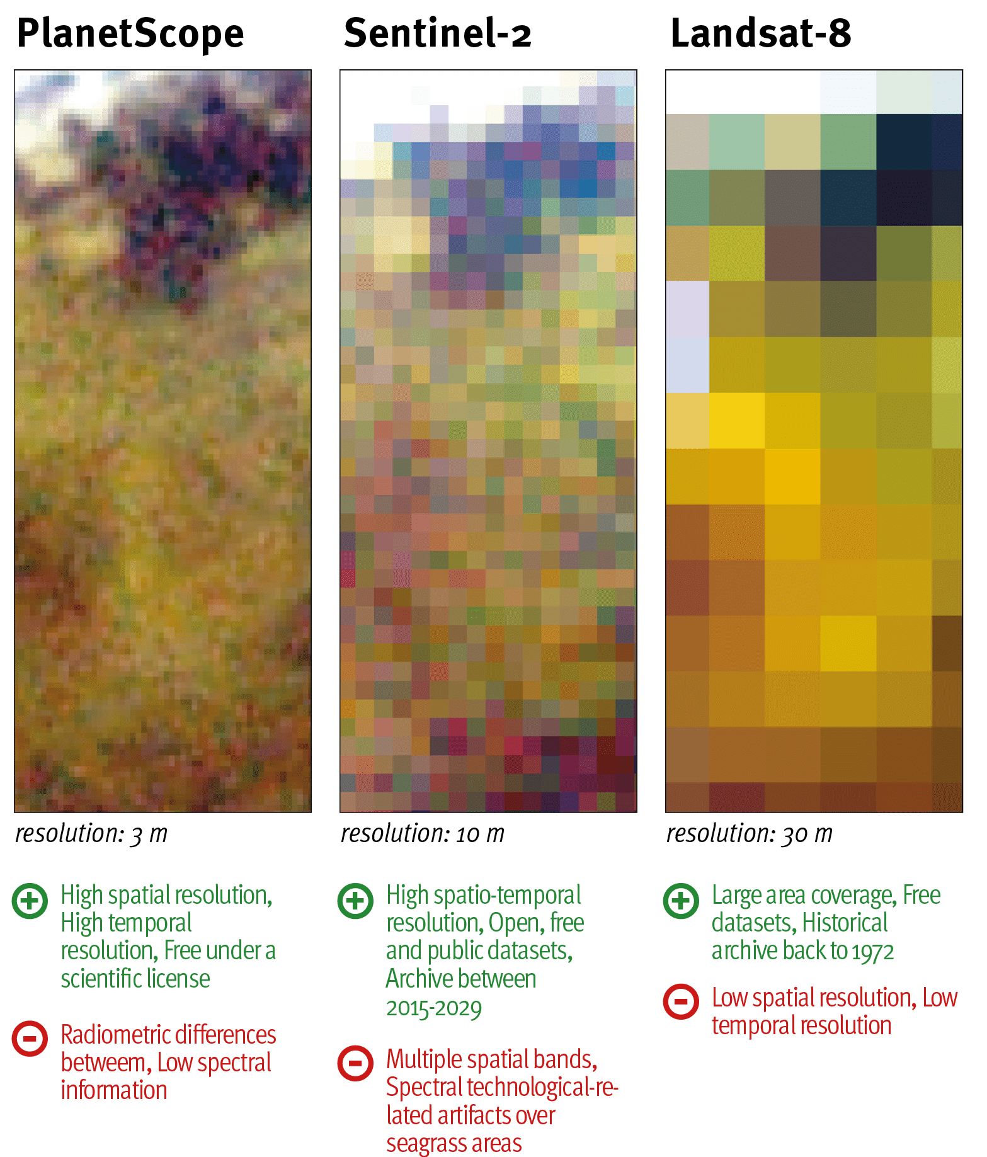
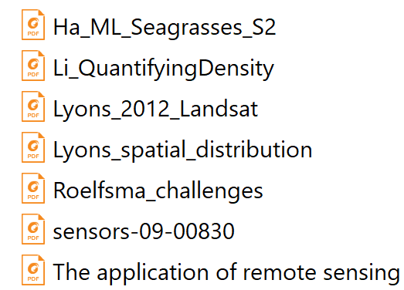
Research on Remote Sensing Satellites and Sensors for Seagrass Classification
Scientific papers researched on seagrass mapping
Source: Seagrass from above – drones and satellites
Notes:
Various sensors and machine learning algorithms were considered based on recent research and published articles.
Machine learning algorithm is based on supervised classification using RF decision trees.
RS sensor data:
Sentinel – 2 RS data was chosen based on its:
medium resolution (10m)
regular revisit times
good coverage in the Pacific region (specially in the project countries)
free open-source access

Slide 8
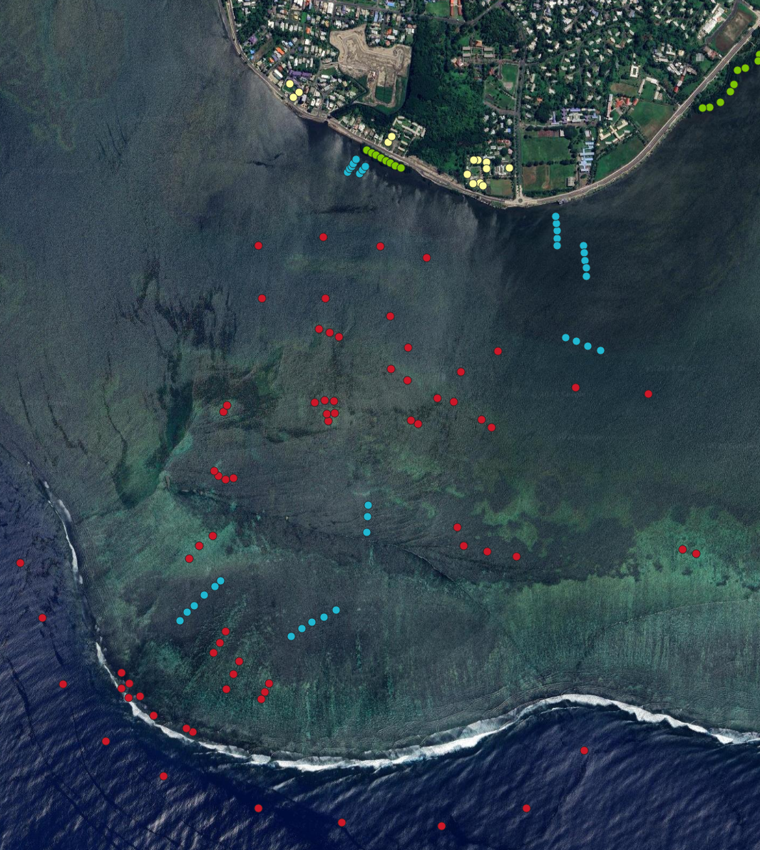
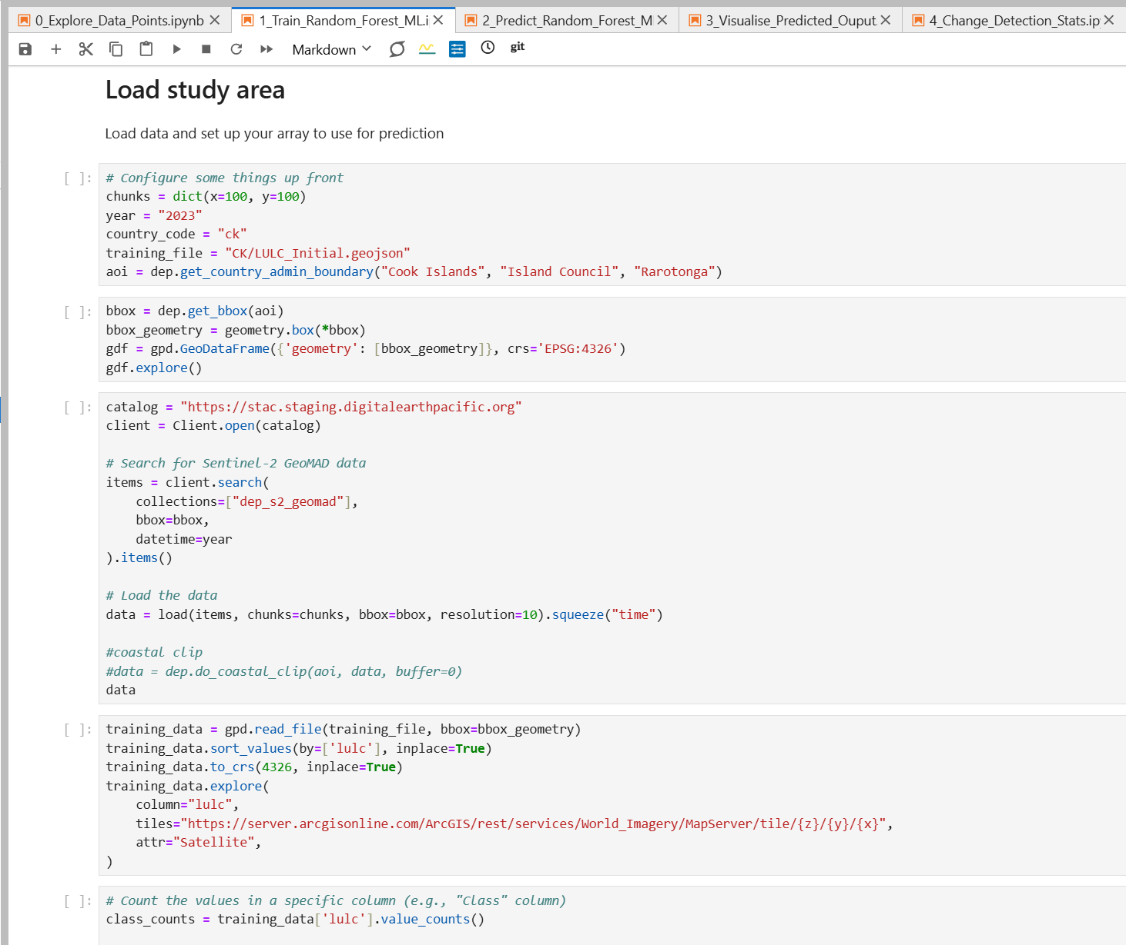
Field Data for Machine Learning
Training data points
Supervised classification using training data
Training data
Notes:
Training data is collected from areas of interest using forms created on QGIS. The forms are used in the field using Qfield installed on mobile devices.
High quality and varied training data is very important for accurate supervised classification.
Basic workflow = Forms created on QGIS -> Data collected via Qfield -> Training data is “cleaned” & sorted -> “Cleaned” training data is imported as assets in the supervised classification ML model -> Extent maps -> Verified with ground truthing data which is collected during BC field sampling.

Slide 9
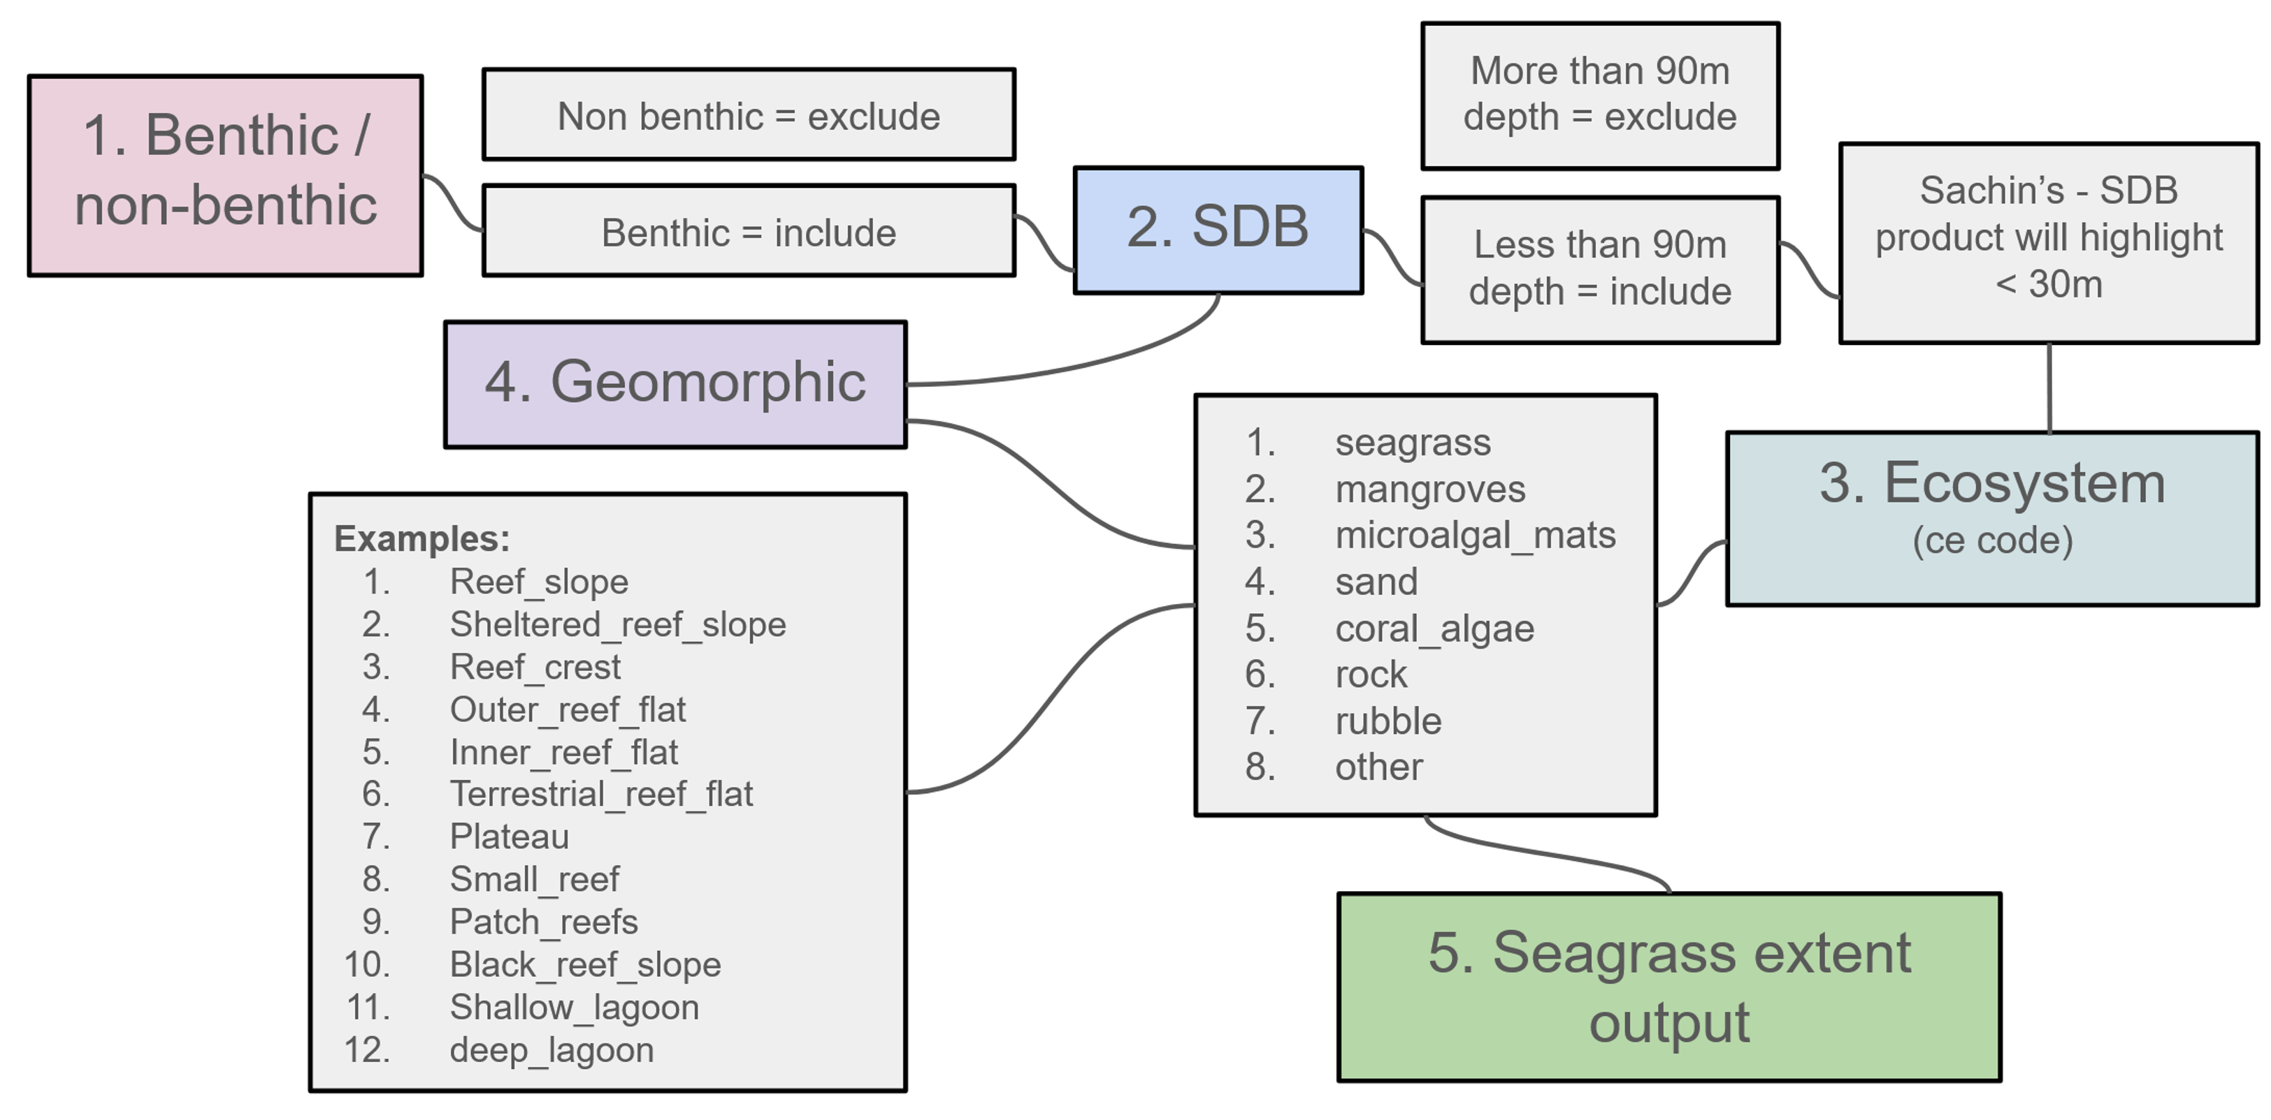
Simplified benthic supervised classification workflow
Training data acquisition
Training data preprocessing
DEP analytics hub
Notes:
Benthic = ocean topography (ocean surface)
Non-benthic = water column
SDB = "Satellite derived bathymetry using deep learning" refers to a technique where deep learning algorithms are used to analyze satellite imagery to estimate the depth of water bodies, essentially creating a map of the underwater topography (bathymetry) by leveraging the complex patterns in the reflected light captured by the satellite sensor; this method is particularly useful for shallow coastal areas where traditional bathymetric surveys can be difficult or expensive to conduct.

Slide 10
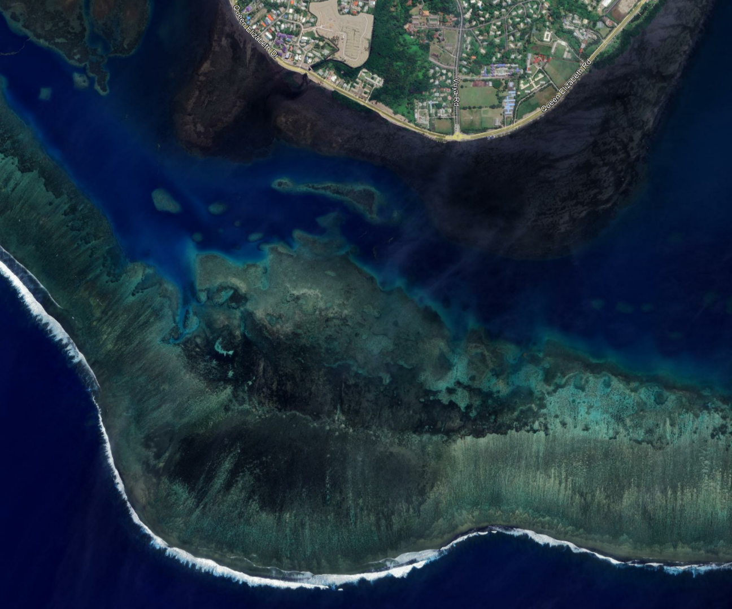
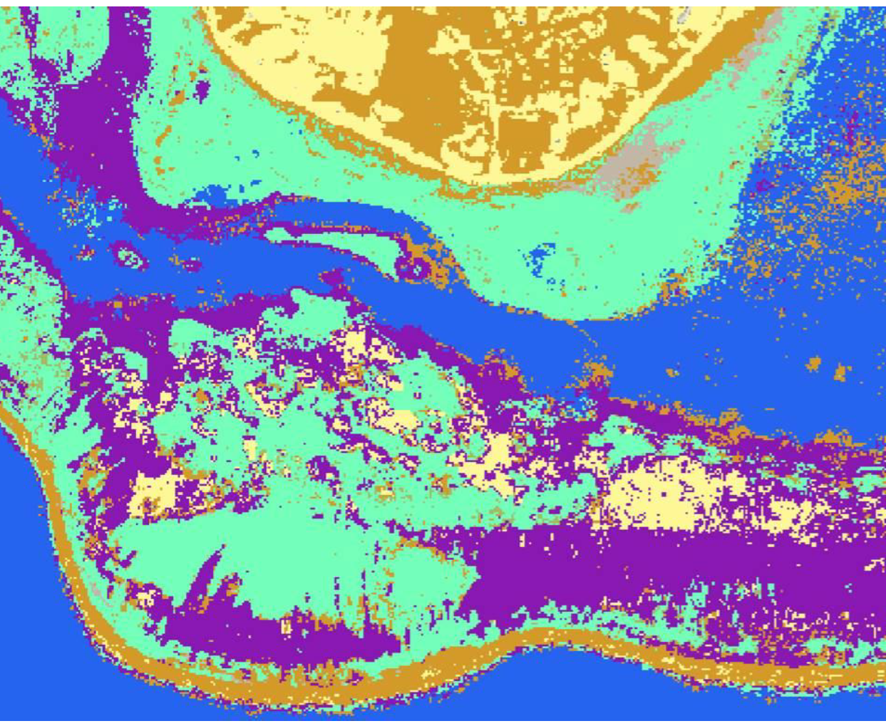
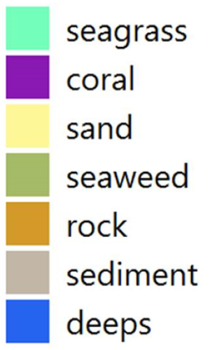
Digital Earth Pacific Outputs: Seagrass Mapping Results
Google Satellite Image
DEP ML Seagrass Map
Notes:
Example of benthic classification achieved via DEP using field training data.

Slide 11
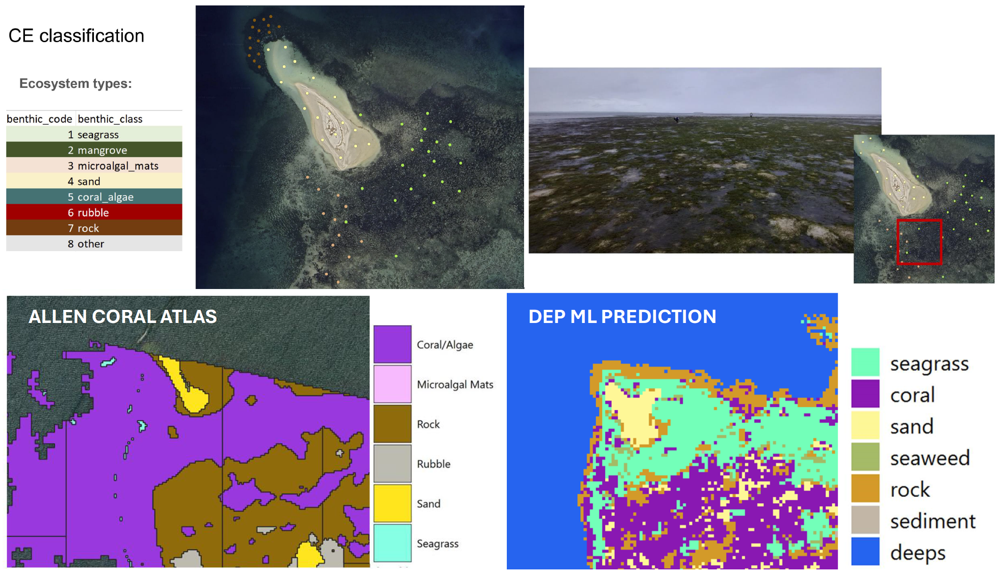
Comparison of results against existing global model outputs for Fiji
Both benthic classification maps below are of the Suva Sandbank
GLOBAL MODEL PREDICTION
The resulting extent maps from DEP are more detailed and map the different benthic classes more accurately when compared to the global model.
Notes:
Comparison of results between DEP and current existing global models

Slide 12
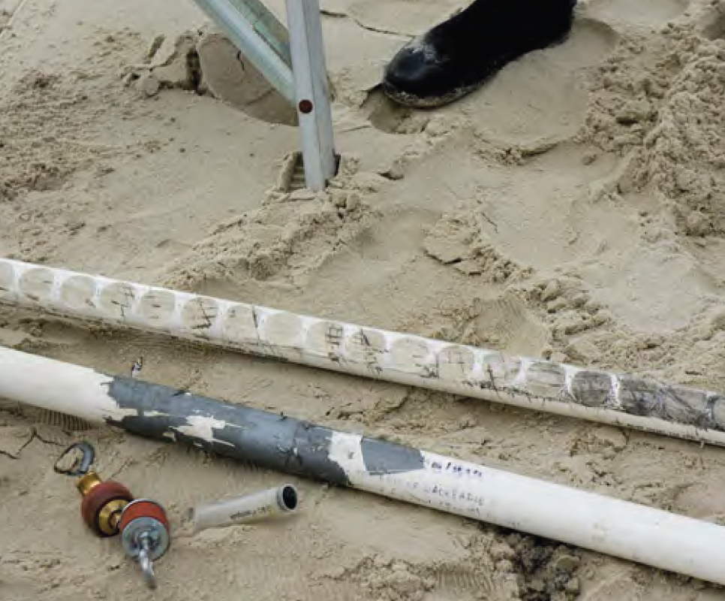
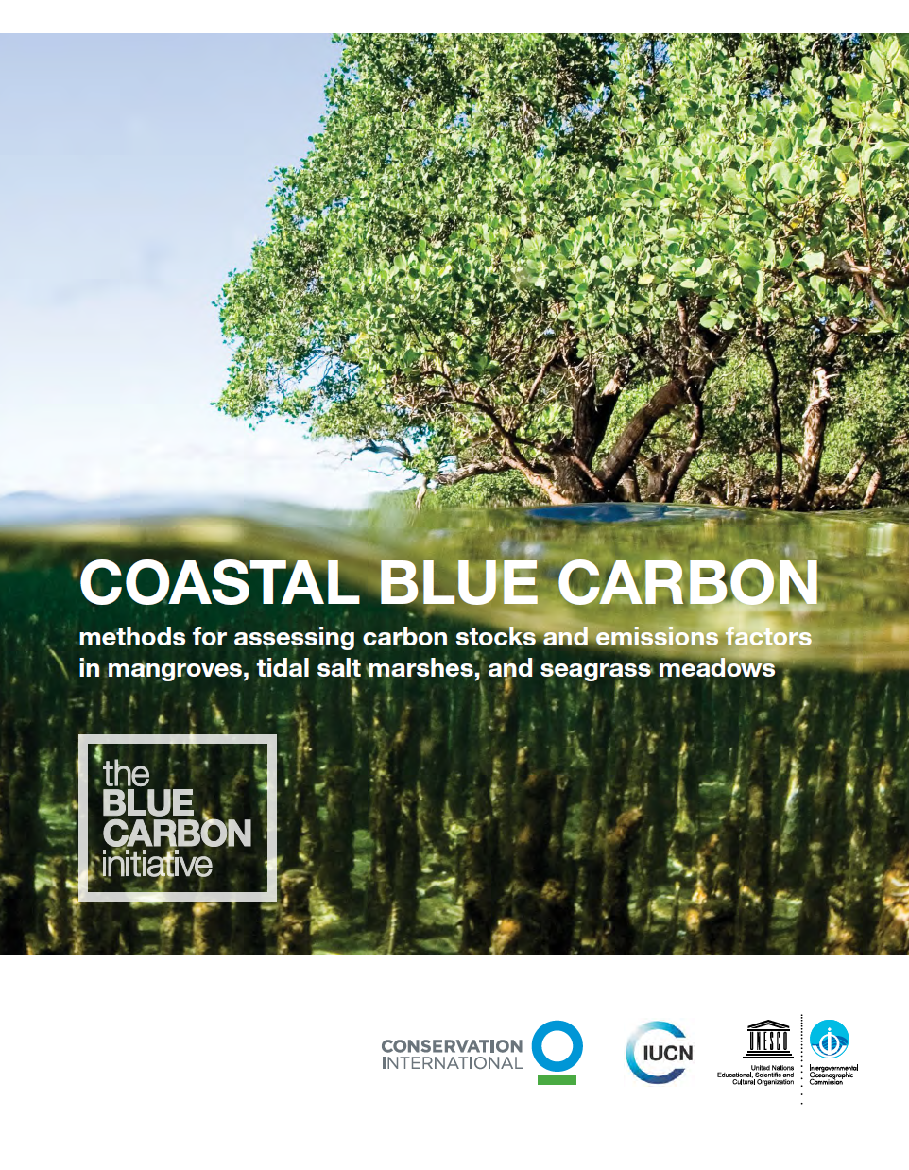
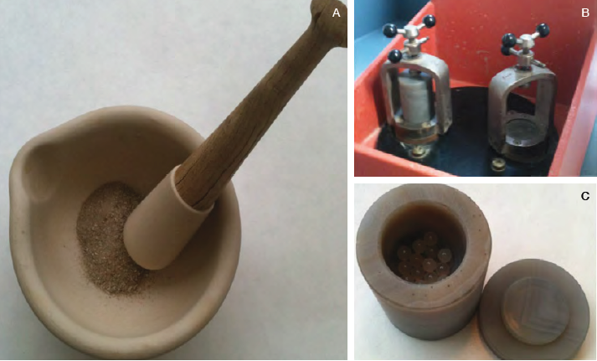
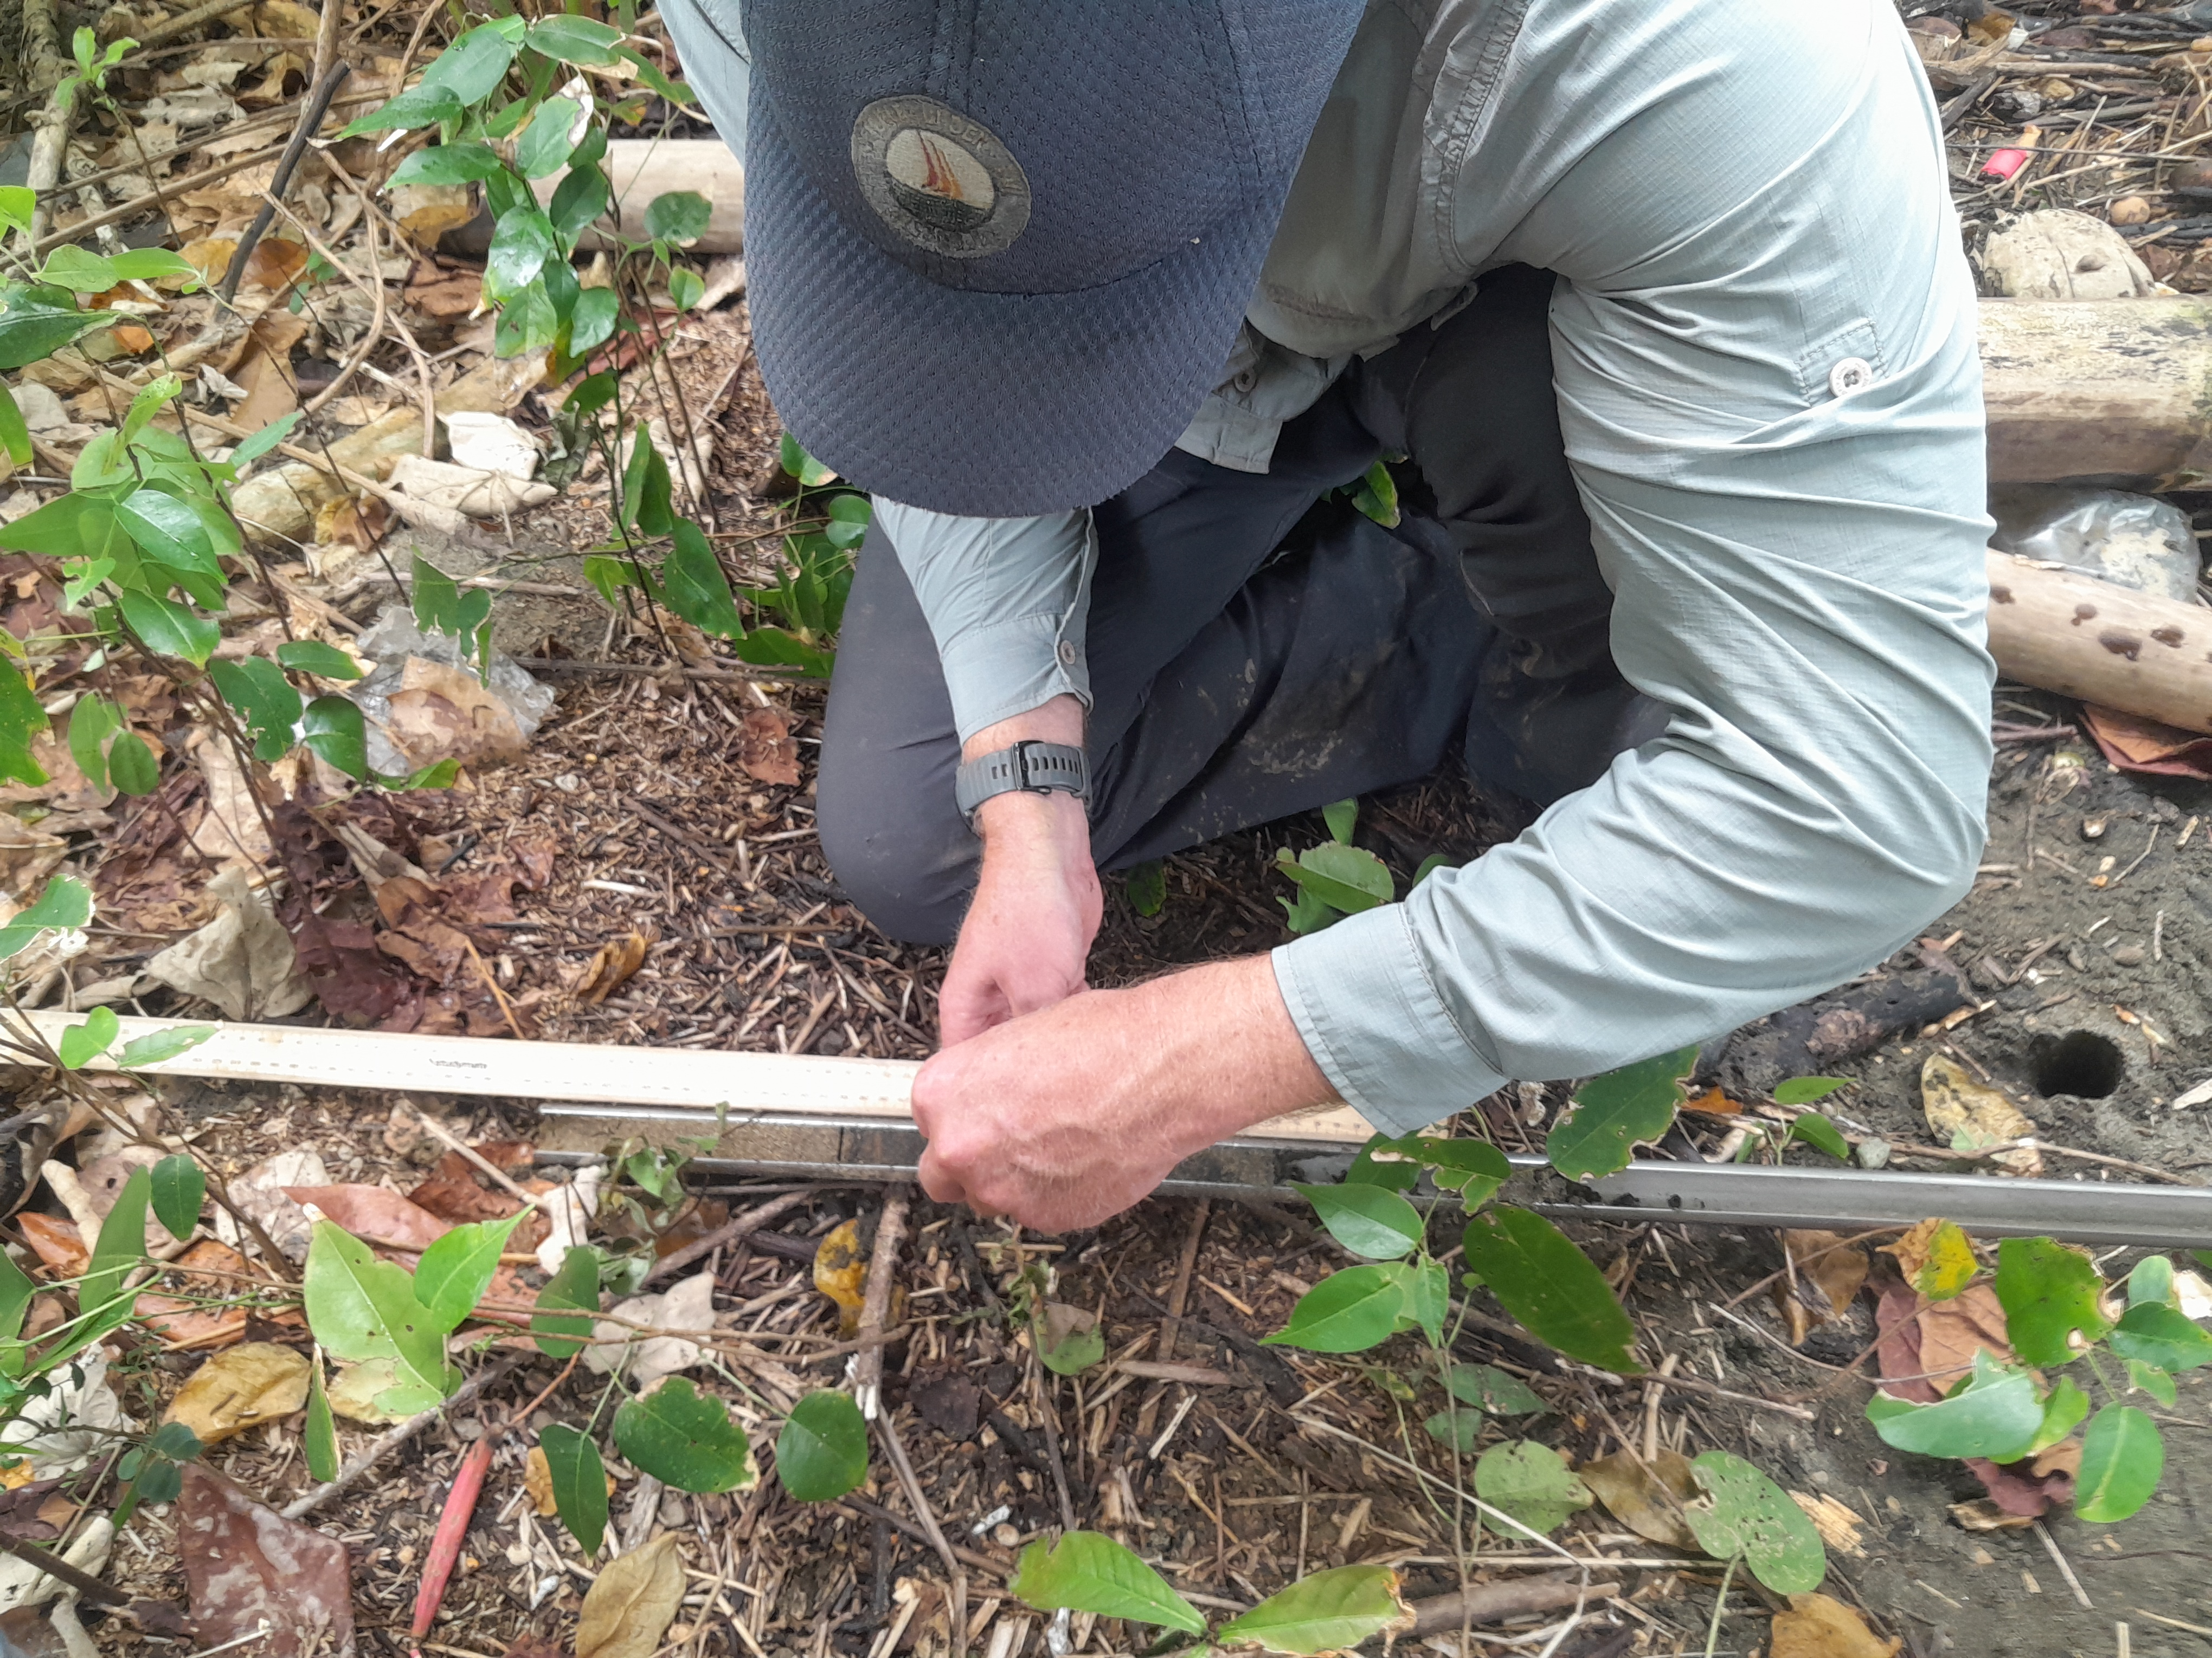
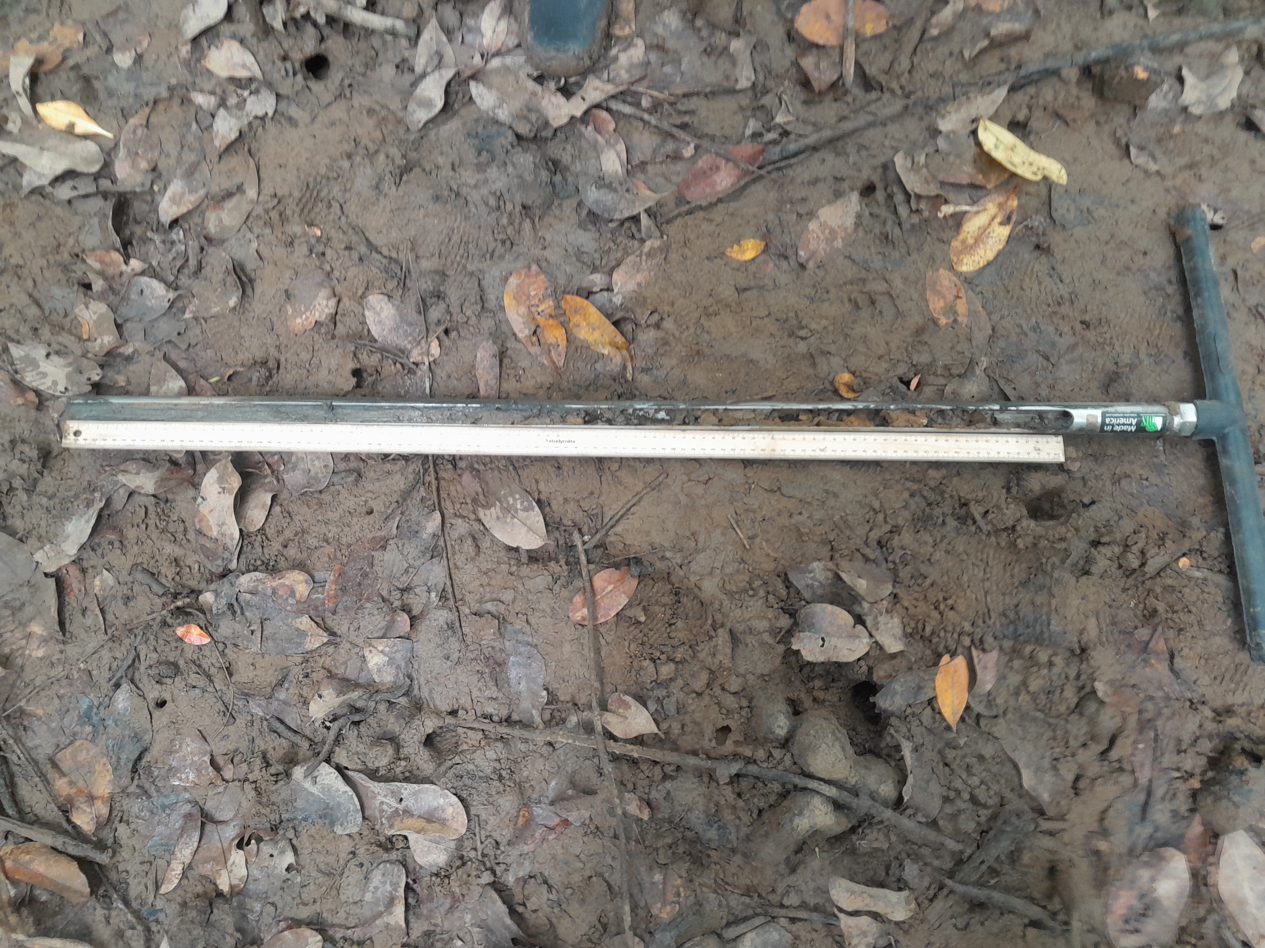
Blue Carbon Sampling: Methodology and Applications
Sample preparation for analysis
Blue Carbon Initiative Manual
Field sample collection
Notes:
The guide that was used for blue carbon field sampling methodologies for seagrass and mangrove ecosystems:
Seagrass biomass assessment (3 x approx. 13.5 cm diameter cores, to a depth < 30cm, dried and weighed in-situ.)
Mangrove biomass assessment (observational only)
Soil carbon samples (3 x 1m narrow gauge auger cores per site, divided by depth intervals (0 - 15 cm, 15 - 30 cm, 30 - 50 cm, 50 - 100 cm), ~4g per depth collected for laboratory analysis)
Rapid threat assessment (observational only)
Rapid biodiversity assessment (observational only)
Field validation of remote sensing (observational only, using photos)

Slide 13
Combination of Remote Sensing and Blue Carbon field data to assess stored carbon in blue carbon ecosystems
Extent Maps from Digital Earth Pacific
AG biomass, species, average C stock values
Estimates on Stored C & Emission factors
Remote sensing for seagrass and mangrove ecosystems
Blue Carbon field samples
Tier 2 values for seagrass & mangrove ecosystems
*AG - Above ground
*C - Carbon
Notes:
How the extent maps and field data can be used to accurately estimate stored carbon in seagrass ecosystems.

Slide 14
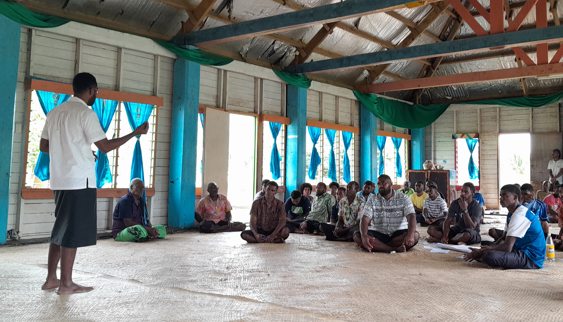
Next Steps
Short term action:
Analysis and Interpretation
Community Engagement and Needs Assessment
Tailoring Conservation Strategies
Long term action:
Development of Conservation Policies
Implementation of Monitoring Programs
Capacity Building and Training
Education and Awareness Campaigns
Notes:
Short term action:
Analysis and Interpretation
Community Engagement and Needs Assessment
Tailoring Conservation Strategies
Long term action:
Development of Conservation Policies
Implementation of Monitoring Programs
Capacity Building and Training
Education and Awareness Campaigns

Slide 15

Conclusion
By utilizing the capabilities of Digital Earth Pacific in conjunction with blue carbon field samples, the ecosystem services valuation of blue carbon ecosystems can be quantified.
Why is this important? This can be an important pillar in establishing policy/regulation changes to effectively manage and conserve coastal ecosystems.
Notes:
Add a visual summary slide with key achievements (e.g., maps, field data integration, carbon stock estimates).
Reinforce the broader implications of this work for Pacific Island countries and global blue carbon efforts.
By utilizing the capabilities of Digital Earth Pacific in conjunction with blue carbon field samples, the ecosystem services valuation of blue carbon ecosystems can be quantified.
Why is this important? This can be an important pillar in establishing policy/regulation changes to properly manage and conserve coastal ecosystems.

Slide 16


MACBLUE
Digital Earth Pacific (DEP)
Notes:
For more information on the MACBLUE project and Digital Earth Pacific, please feel free to scan the following QR code.

Slide 17

Questions & Discussion
“How can DEP outputs influence coastal conservation policies in the Pacific?”
Notes:
“How can DEP outputs influence coastal conservation policies in the Pacific?”

Slide 18
Thank you.
Vinaka Vakalevu.
Tagio Tumas.
Tenkju tru.
Dhanyavaad.
Tankiu tumas.
Notes:
Thank you for listening and to those who are interested in our Friday workshop, please scan the QR code to register. Space is limited to 15 participants.

