Slide 1
Road Inundation Mapping Tool – Vanuatu Climate Futures Portal
Climate-Resilient Infrastructure Planning for Vanuatu
Raviky Talae

Slide 2
Introduction to Vanuatu's Climate Challenges
Overview:
Vanuatu is highly vulnerable to sea-level rise, storm surges, extreme weather events and heavy rainfall.
Climate change threatens essential infrastructure, especially roads.

Slide 5
The Role of the Road Inundation Mapping Tool
Objective:
Helps planners, engineers, and policymakers assess road vulnerability under future climate scenarios.
Supports decision-making for resilient infrastructure development.

Slide 6
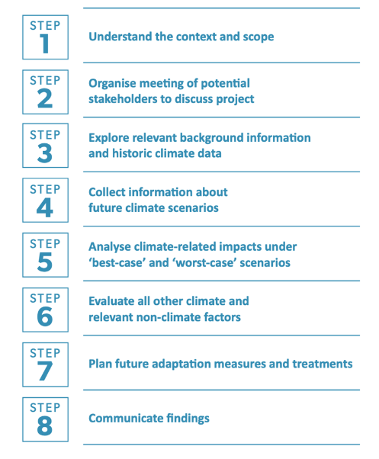
How the Tool Works
Key Inputs:
GIS data (topography, elevation, and road network)
Climate projections (sea-level rise, storm surge, rainfall patterns)
Extreme weather scenarios

Slide 7
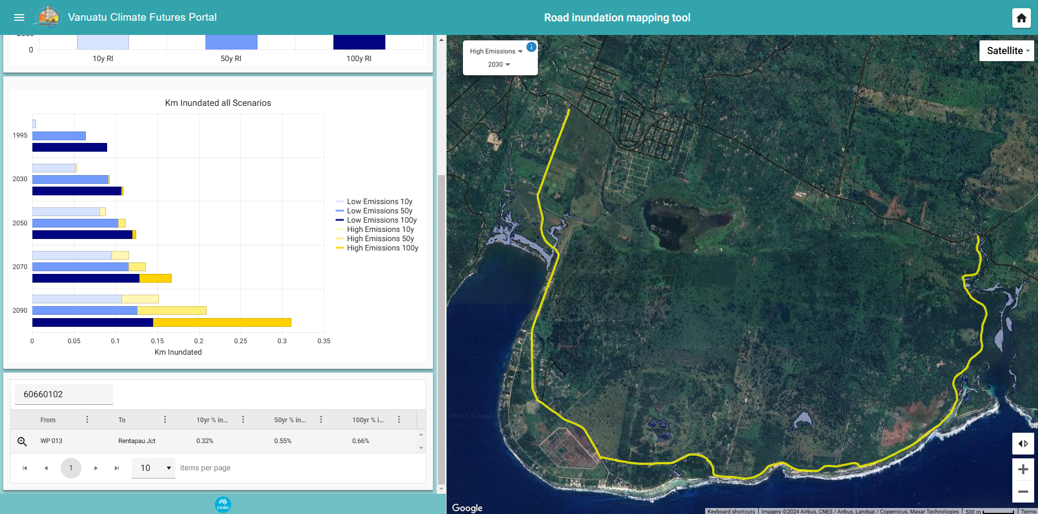
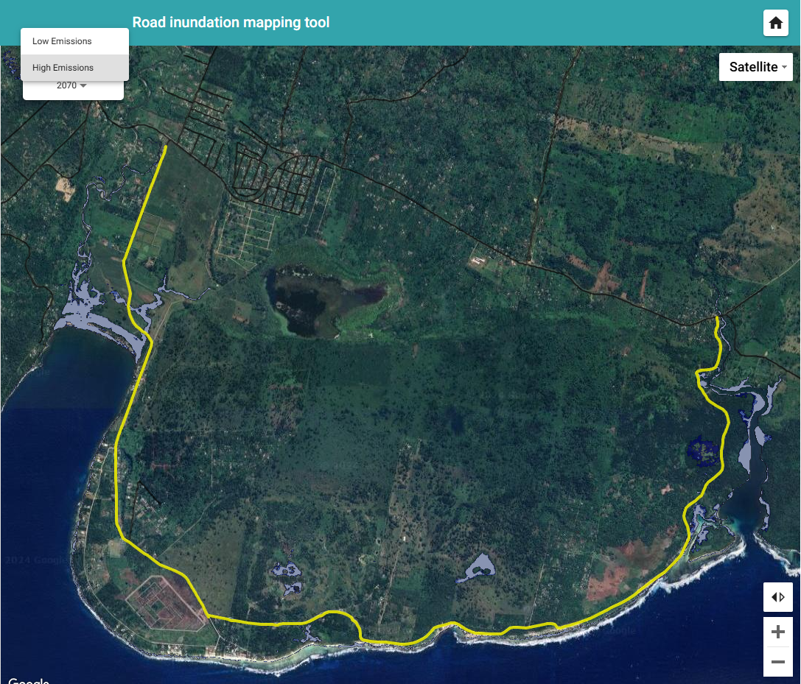
Features of the Tool
Interactive Maps: Explore road segments vulnerable to inundation
Scenario Options: Assess impacts under various climate emission scenarios

Slide 8
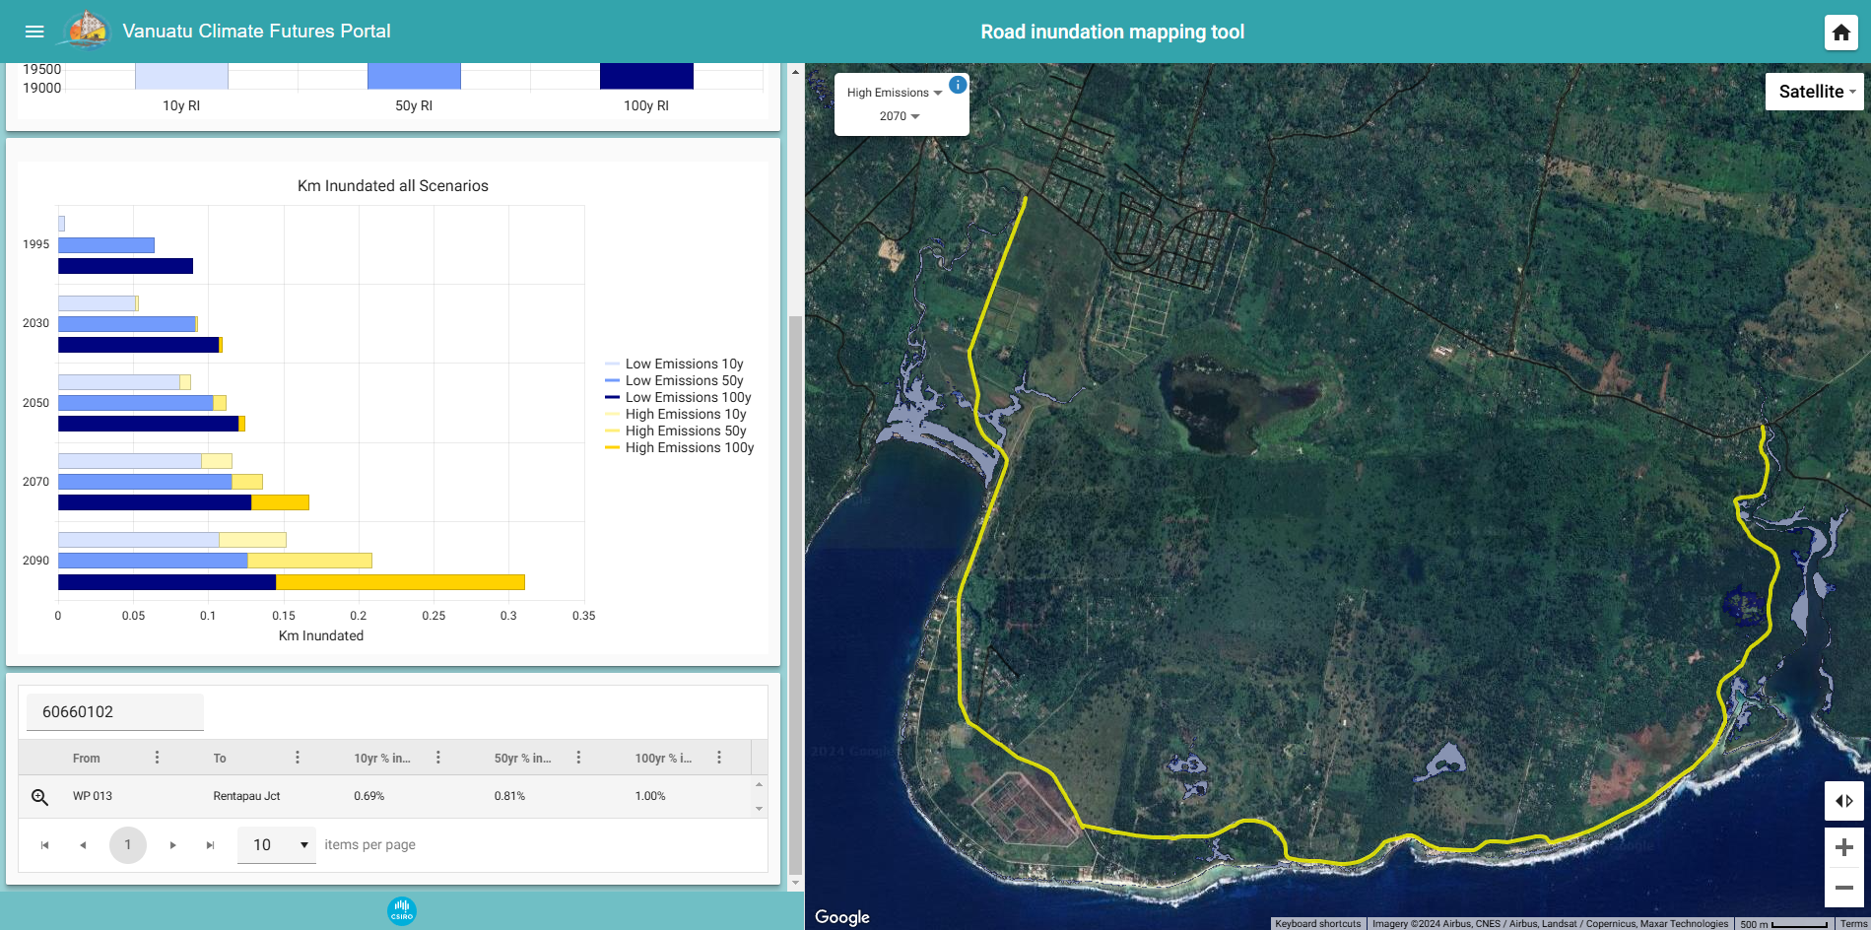
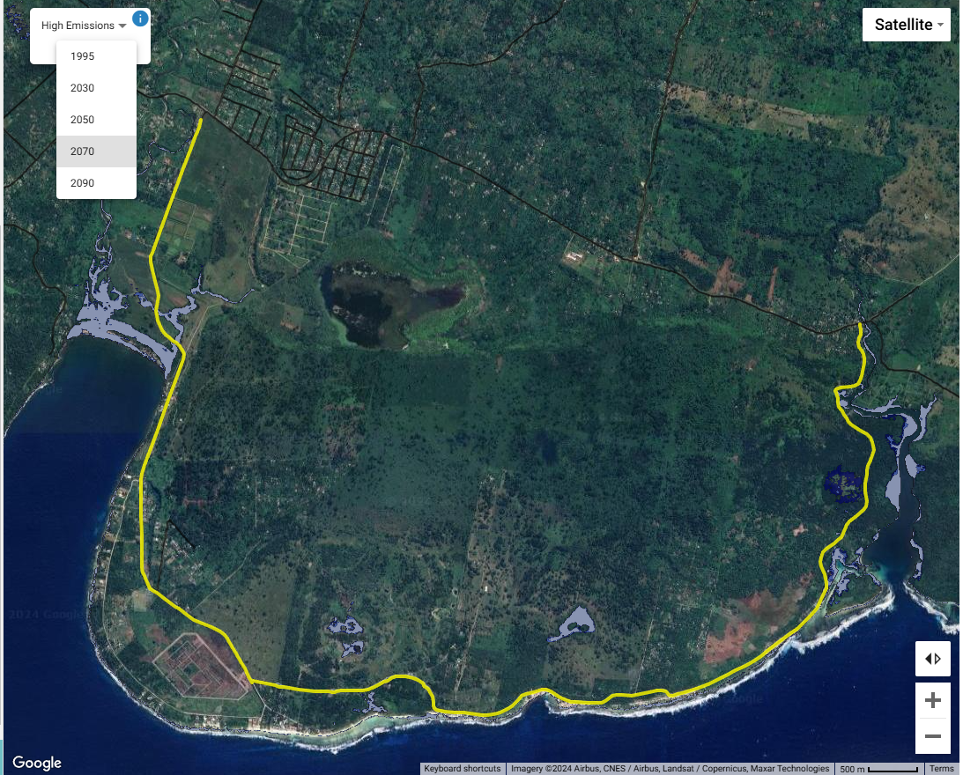
Features of the tool
Interactive Maps: Explore road segments vulnerable to inundation
Scenario Options: Assess impacts under various climate future projections

Slide 9
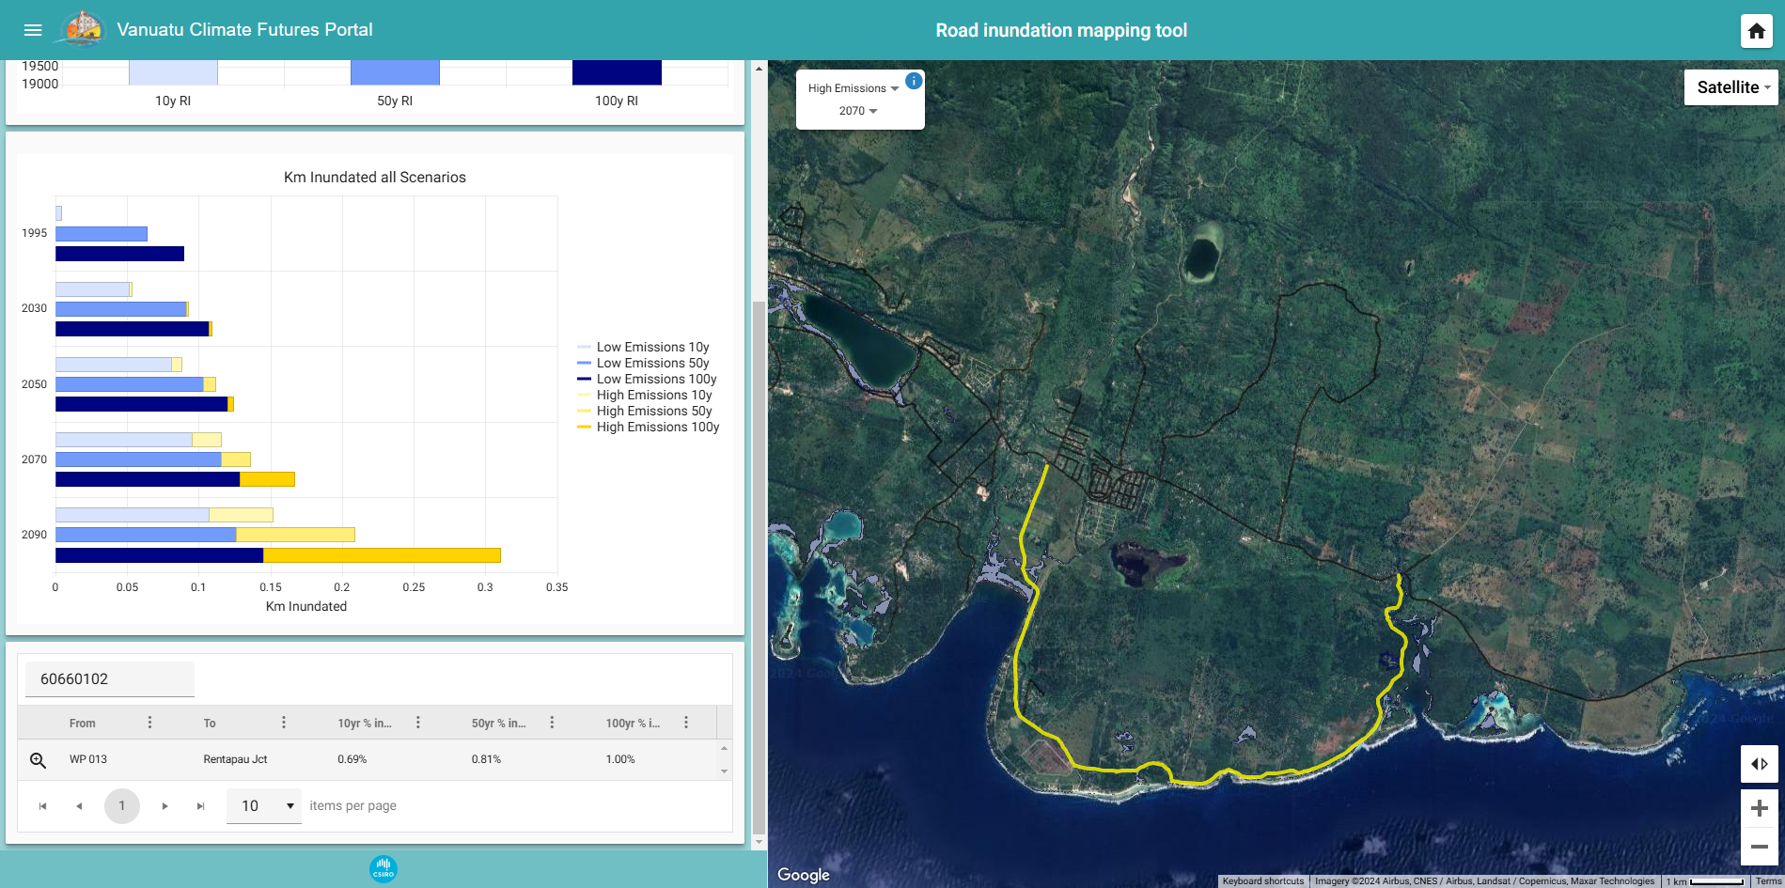
Applications for Infrastructure Planning
Use Cases:
Identify roads at risk and prioritize upgrades or new construction
Plan evacuation routes and emergency services access
Optimize infrastructure investments based on future risks

Slide 10
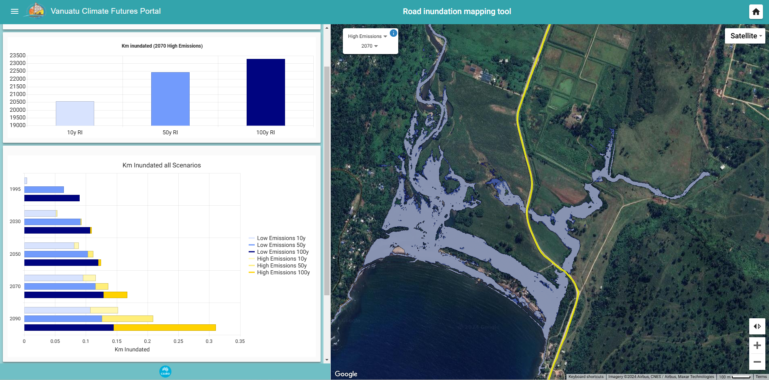
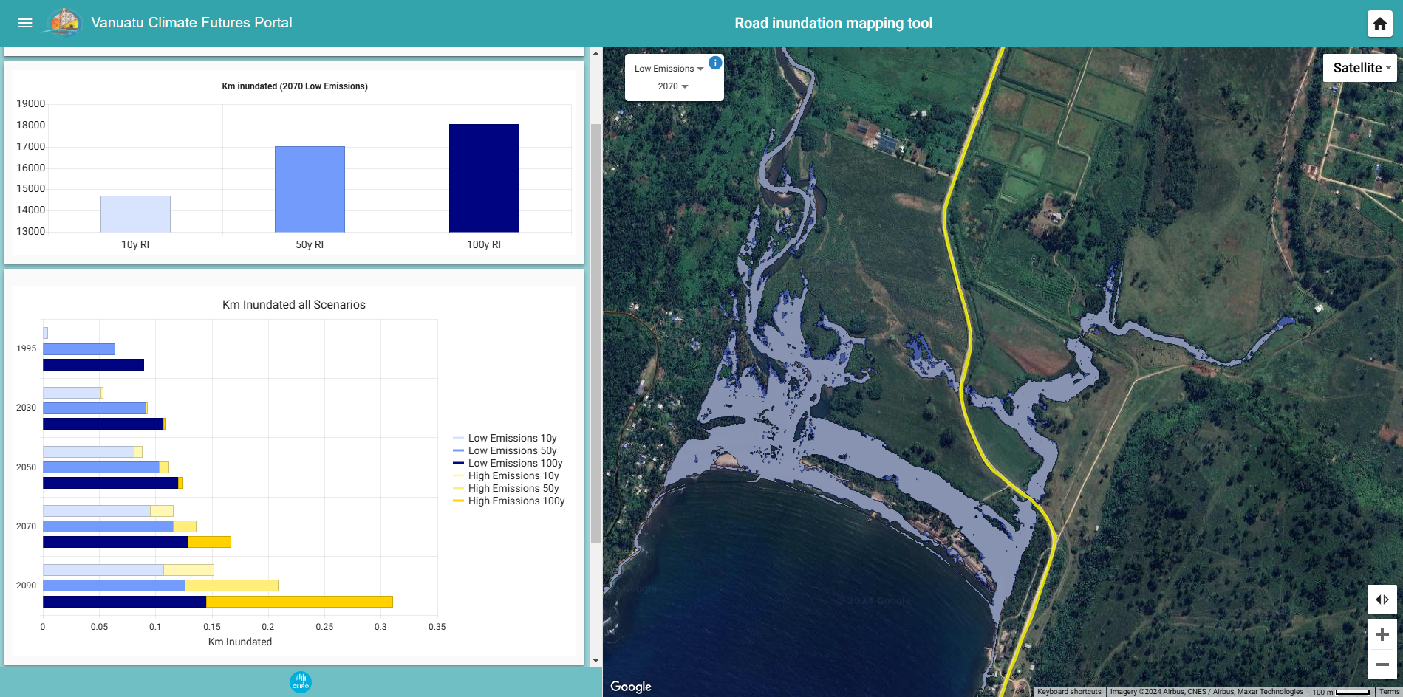
Benefits and Impact of the Tool
Key Outcomes:
Better infrastructure resilience
Informed, data-driven decisions for policymakers
Reduced long-term economic and social disruptions from climate events

Slide 11
Challenges and Future Developments
Challenges:
Data gaps and maintaining updated information
Ensuring tool accessibility and user training
Future Plans:
Expand the tool to cover other infrastructure types
Collect more Lidar data to include other islands

Slide 12
Conclusion
Summary:
The Road Inundation Mapping Tool offers a vital solution for climate-resilient infrastructure in Vanuatu.
Encourages planners and policymakers to adopt proactive strategies based on data-driven insights.

Slide 13
Vinaka

