Slide 1
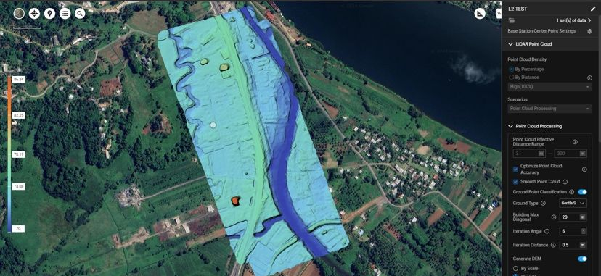
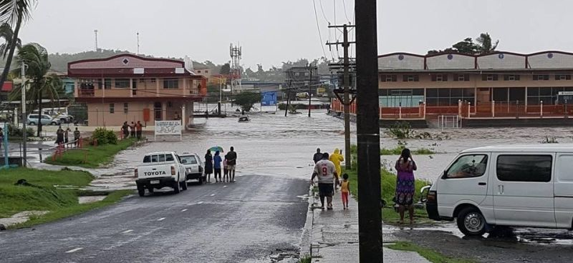
Geospatial Data for the Pacific
Notes:
Bula and good morning Olketa
my name is Solomon, you can call me Solo, im from the Solomon islands. I am the operations manager at Kahuto Pacific, today I’m filling in for Chris, who has had to head to the US for some work and I know he really wanted to be here to share this himself as him, Jonina and a team of others have been pouring hours into this really exciting project.
I was a bit nervous when Chris asked me to present but he reminded that the only way we’re going to be able to drive down the cost of data acquisition in the pacific, is by working together and sharing our mission of making high resolution LiDAR and imagery geospatial products available to the Pacific..
It is also humbling to be part of such a great line up of presenters and I’ve really enjoyed hearing the different projects going on around the pacific. Today my presentation will be a brief overview of the Moana Data Service and what motivated us as a company to work towards establishing this exciting new data service made available locally.

Slide 2
Pacific Island Countries have outdated and limited access to credible land and ocean information.
Costs to acquire land information are some of the highest in the world (ageing survey industry, limited uptake in new technology, outdated datums/poor survey control)
Duplication of data - No alignment in strategic areas for mapping by the government/donors.
No central depository or aerial mapping national standard
The Pacific has a data problem
Notes:
There are many contributing factors that have lead to the current data problem.
The pacific has some of the highest costs of data acquisition in the world, with mostly US and Australian based companies servicing the pacific. Mobilizing a plane to get in country alone costs close to $200,000 - if the weather gets bad, you can look at sharp increases in costs as planes are not cheap to keep on standby in bad weather. (the pacific weather)
Limited local capacity to help procure, quality control and organize aerial LiDAR and imagery surveys is a significant issue. SPC and external consultants are often used which has its own challenges and down flow effects which we see today.
Individual ministries procuring there own LiDAR surveys and not coordinating with other ministries and SOEs to work together and create a cost effective method to utilize one mobilization for multiple jobs. In many cases we see areas get surveyed multiple times.
The current model of overseas companies dropping in to do work is no longer sustainable. Profit is what drives them and the pacific needs a local solution, who are invested in the Pacific

Slide 3
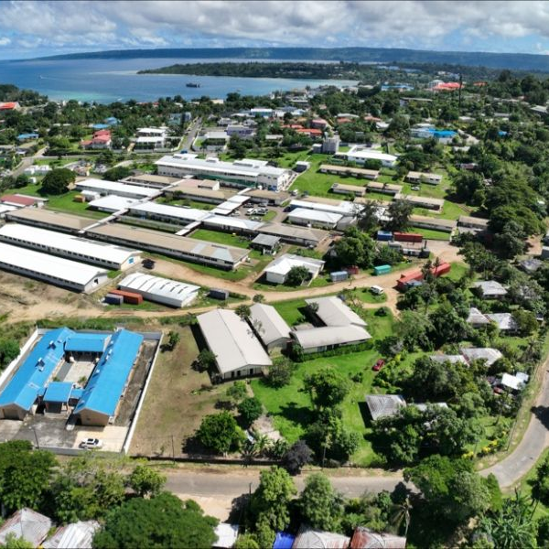
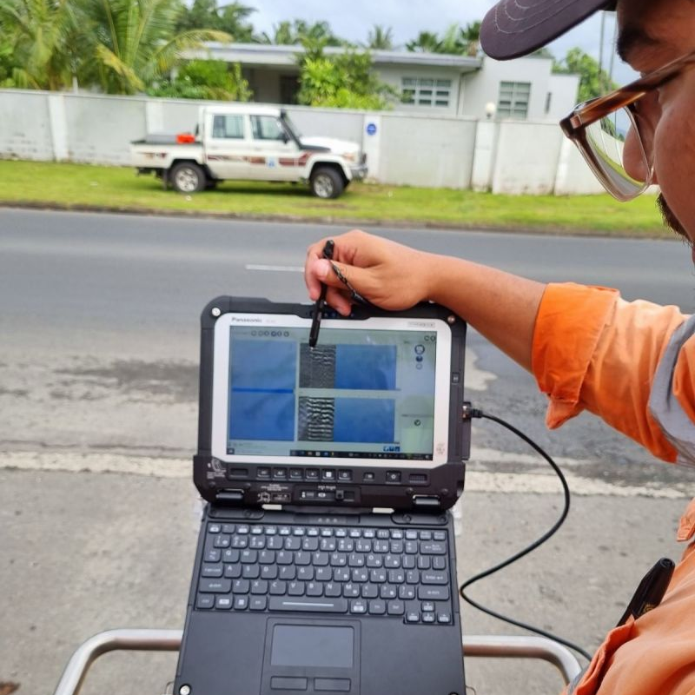
A sustainable data service
The Pacific Island Governments for the protection of its people and environment, need access to a geospatial data service that will allow more informed policy decisions that will drive safer and more prosperous communities in a rapidly changing climate impacted world.
Notes:
Pacific Island countries and development partners for a long time, have been talking about open data and sharing data. While many great initiatives are helping serve the Pacific, Pacific Island countries still lack, direct access to reliable, up to date survey and geospatial data.
With the threat of climate change and challenging economic and social issues ahead of us, the Pacific Island countries need access to a sustainable data solution to help inform decisions that will protect and help our local pacific communities thrive.

Slide 4
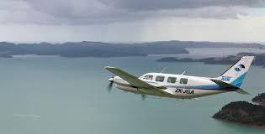
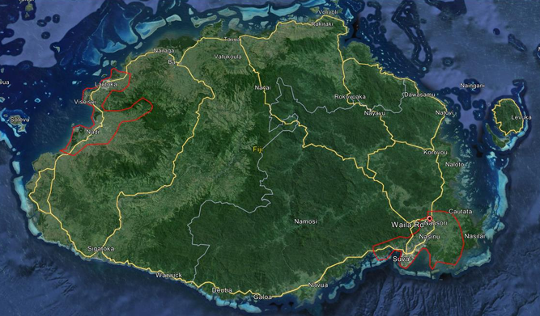
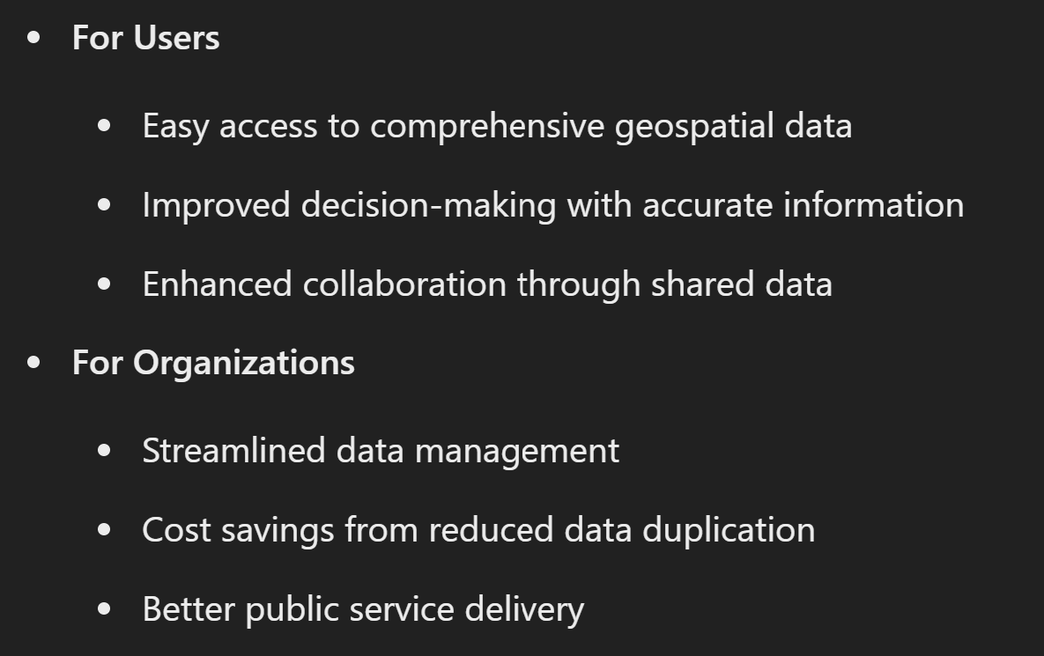
Phase 1. Build the Sandbox
Acquire 700 square kilometers of Airbourne LiDAR and Imagery
Final deliverables processed and loaded into Moana platform
Open Platform to the Government and stakeholders
Notes:
So what are we doing about it??
In March/April 2025, Kahuto will be acquiring its first LiDAR and imagery data sets for the Moana Data service. 2 locations have been selected over the 2 main urban areas of Viti Levu. The two areas identified in red cover the Nausori, Suva, Veisari areas in the central division and Yako, Nadi, Lautoka in the Western division. The area covers approximately 700square kilometers in area,, and the LiDAR and imagery final data sets will be loaded into our Moana Data service.
Come and see me afterwards if you have a project coming up next year and want to piggy back on top of this acquisition and keep your costs down. As mentioned earlier, it costs $200,000 just to get the plane into the country and this is a great opportunity to get your project mapped at a significant discount - plus other government ministries or SOEs who need the data will be able to access it (if allowed) and save money on an entire dedicated survey.

Slide 5
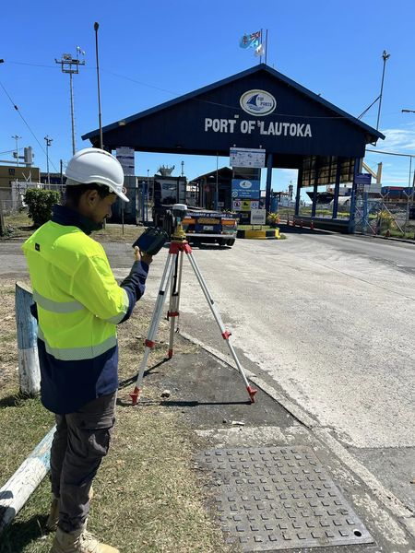
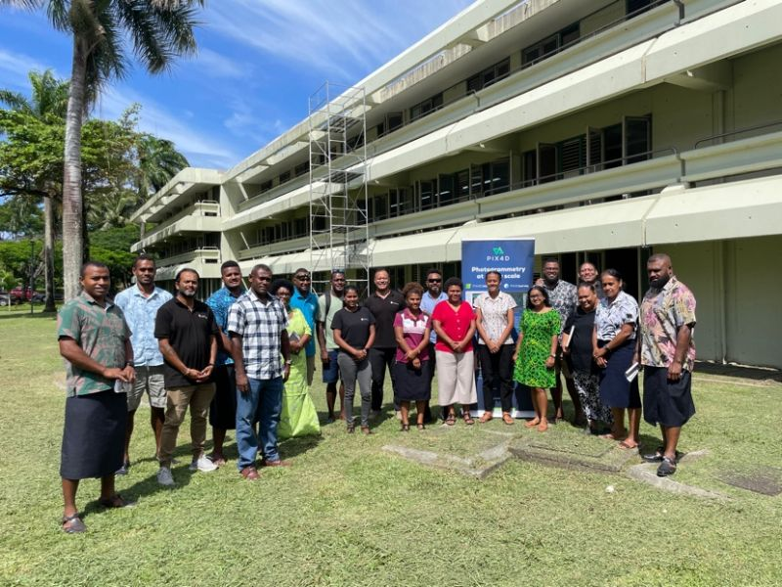
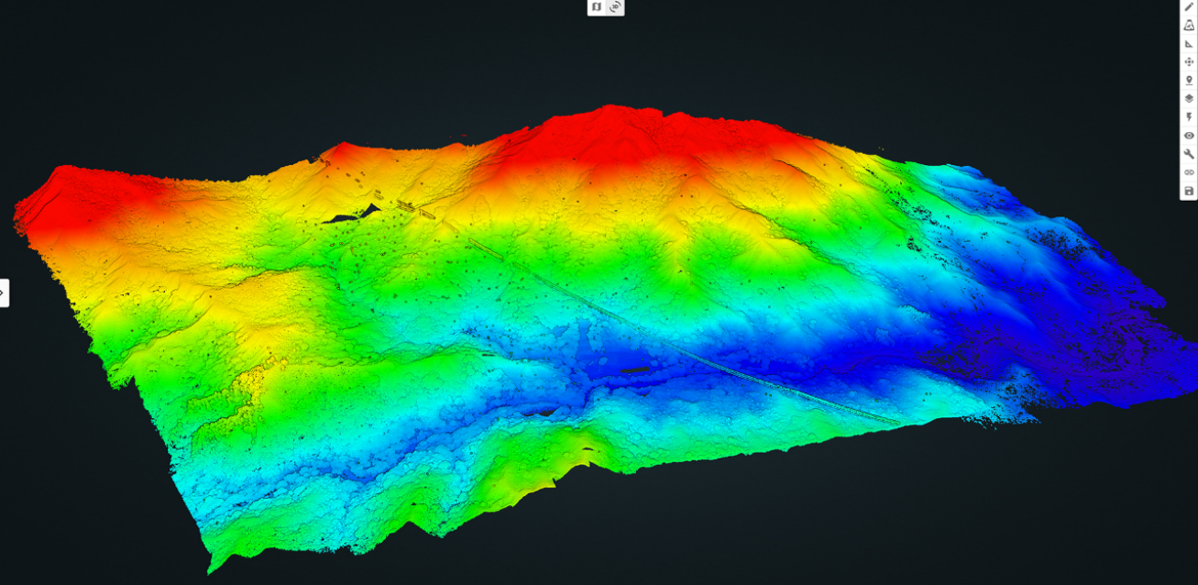
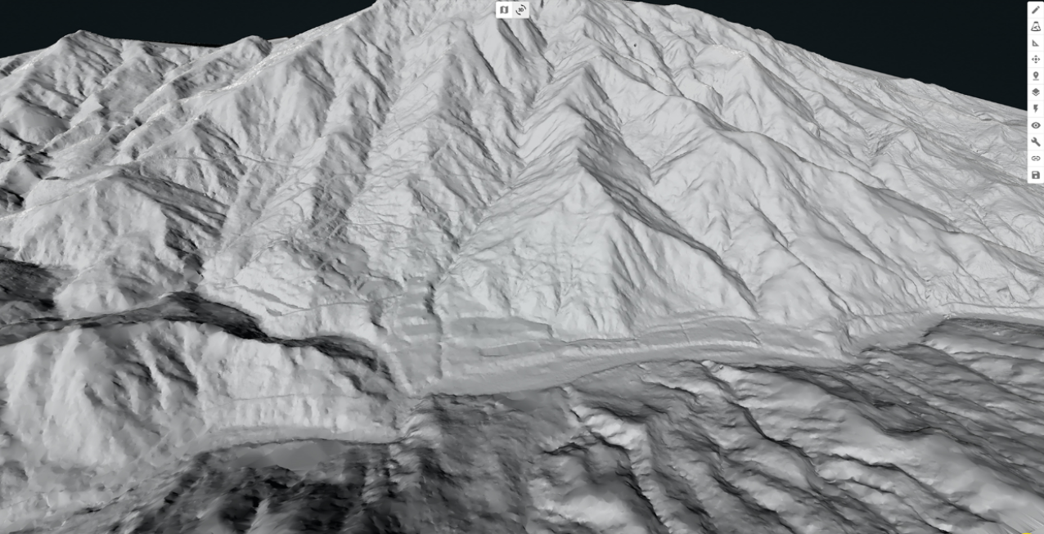
The Vision
Simplicity
Accuracy
Up to Date
Collate
Collaborate
Digital Land Information at a click
Ensuring geospatial accuracy for engineering decisions and deformation monitoring
Acquire new high quality LiDAR, Imagery and bathymetry around critical areas of the pacific, updating key areas of interest regularly
Make historic datasets available via the portal to ensure maximum benefit from the data along with quality control and metadata
Empower communities to leverage geospatial information to inform sustainability
Notes:
The vision for our Moana data service is to make high resolution LiDAR and imagery geospatial products accessible for policy makers in government, researchers and academics, private sector, consultants and conservationists working in the pacific.
Accuracy- is a huge concern for both fixed wing and aerial drone surveys in the pacific. We’ve come across countless examples of drone surveys and aerial LiDAR surveys that have been provided and are not fit for purpose. With the Moana data service, we aim to introduce a national specification for aerial surveys. Our good friends at Landpro will fly our first acquisition using the LINZ spec and we will use these learnings to adopt a standard for individual pacific countries.
There is a treasure trove of aerial survey data that has been captured already across many pacific island countries. Vanuatu for example has had recent LiDAR surveys and we aim to utilize this data by quality controlling it and loading it in to Moana. This will enable powerful change detection with new surveys capturing potential changes.
Collaborate. We want to create one common source of truth to enable meaningful collaboration and more impact for our pacific communities. Once we get this first acquisition done in fiji, we will be looking on to the rest of the pacific to start the Moana Journey.

Slide 6
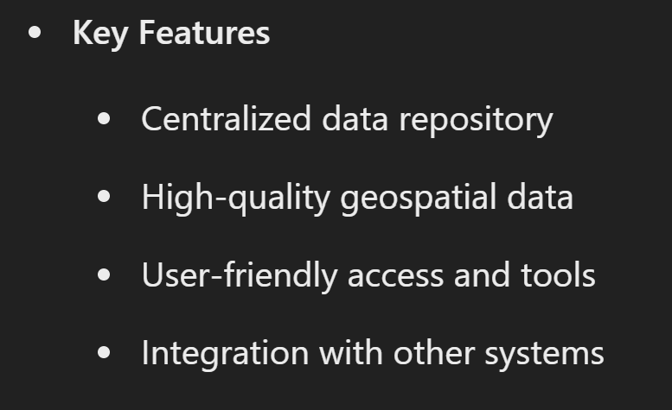
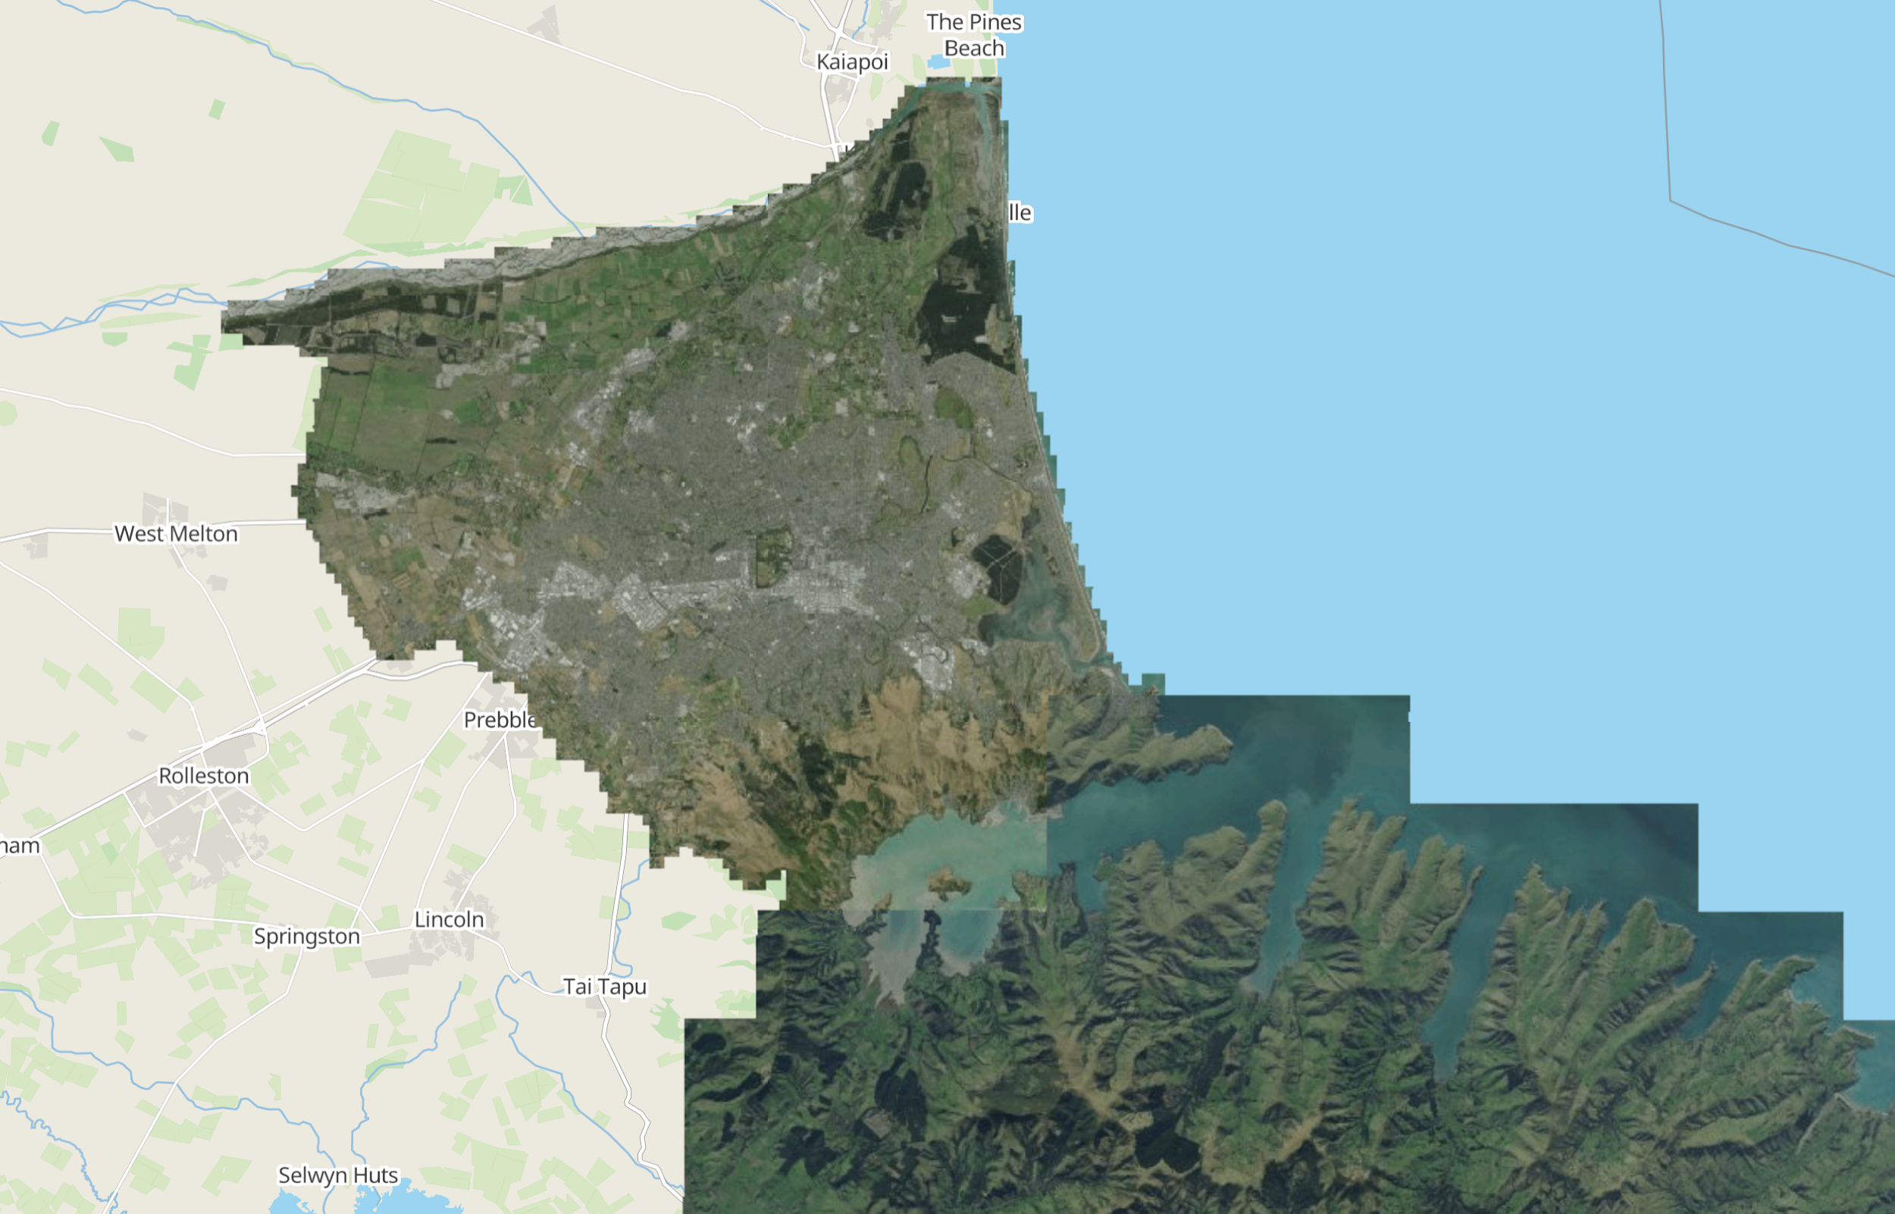
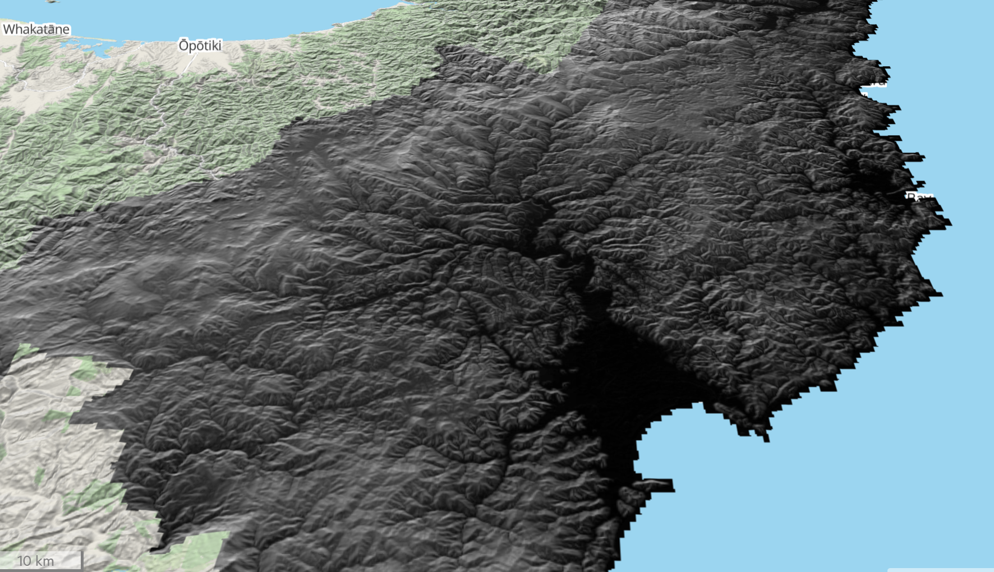
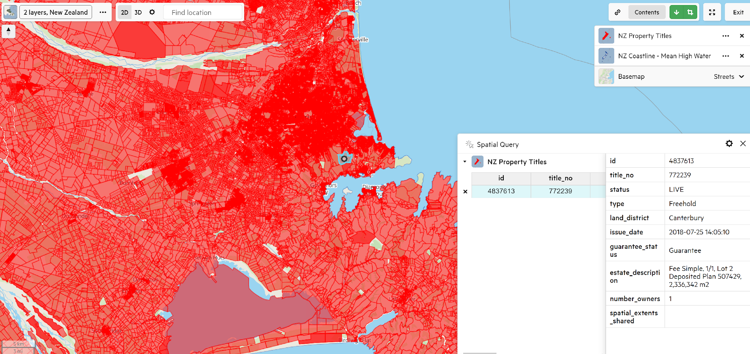
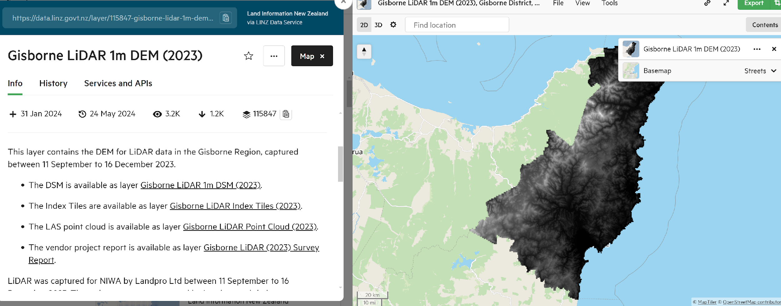
Overview of Digital Moana Data Service
Notes:
Moana data service is inspired by the highly effective Land Information New Zealand or LINZ data service. We’ve seen the positive down stream effects of LINZ and how a unified data repository promotes collaboration and quality informed decision making.
The screen shots on the slide are taken from LINZ and show data captured in New Zealand, after the major cyclone Gabriel which caused billions in damages and was one of New Zealand costliest weather events in history.
The Moana data service will have the same look and feel as we are adopting the same back end platform that the LiDAR and imagery products are loaded into. Meaning we have a tested system ready to serve high quality geospatial products.
Key features of the system include
-centralized data repository, when working in the pacific consultants and researchers often have to scour through multiple sources to find usable data sets which is often outdated.
-High quality geospatial data , as mentioned previously - we will QC historical data sets we load in and look to adopt a national specification to ensure all new acquisitions meet a spec fit for purpose.
-user friendly access and tools. The system is web based and will be accessible online.
-integration with other systems. Moana will allow plug ins from Esri- Arc platform.

Slide 7
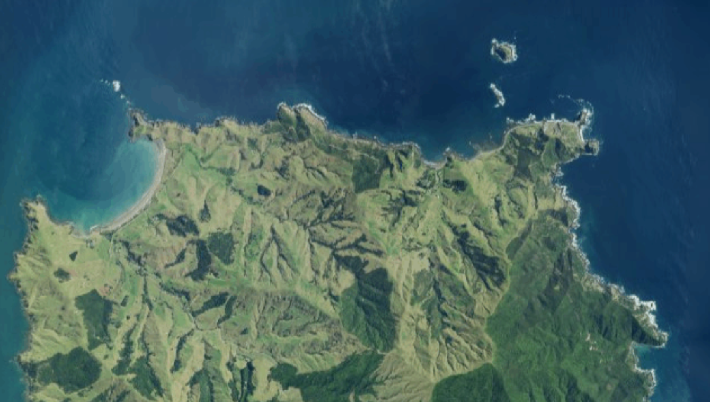
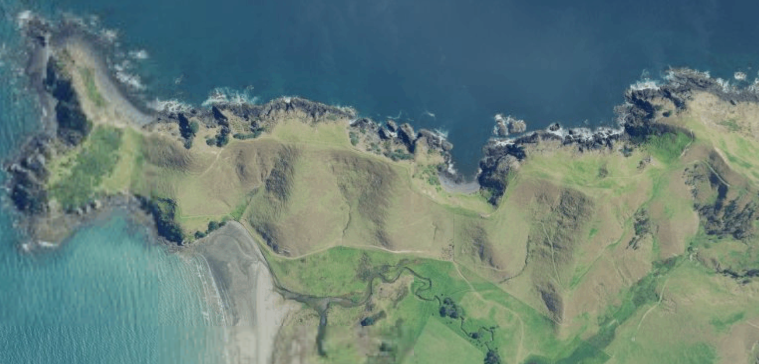
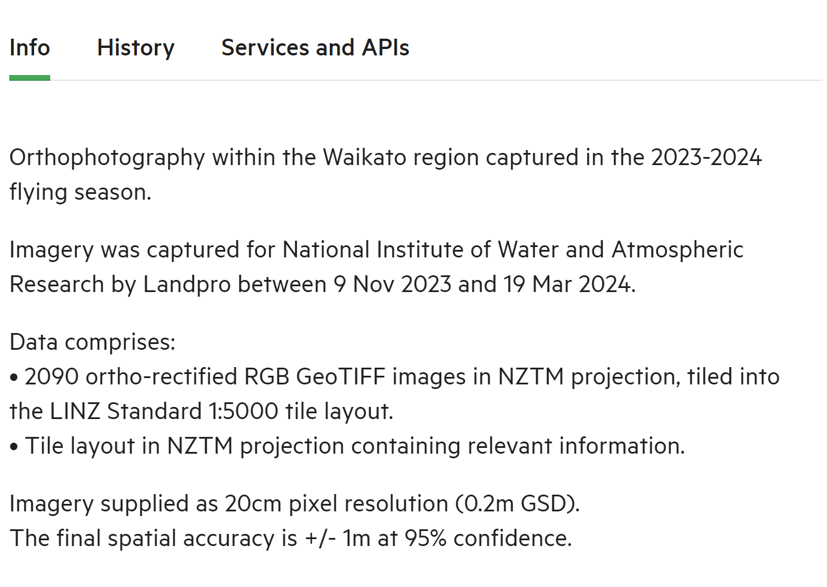
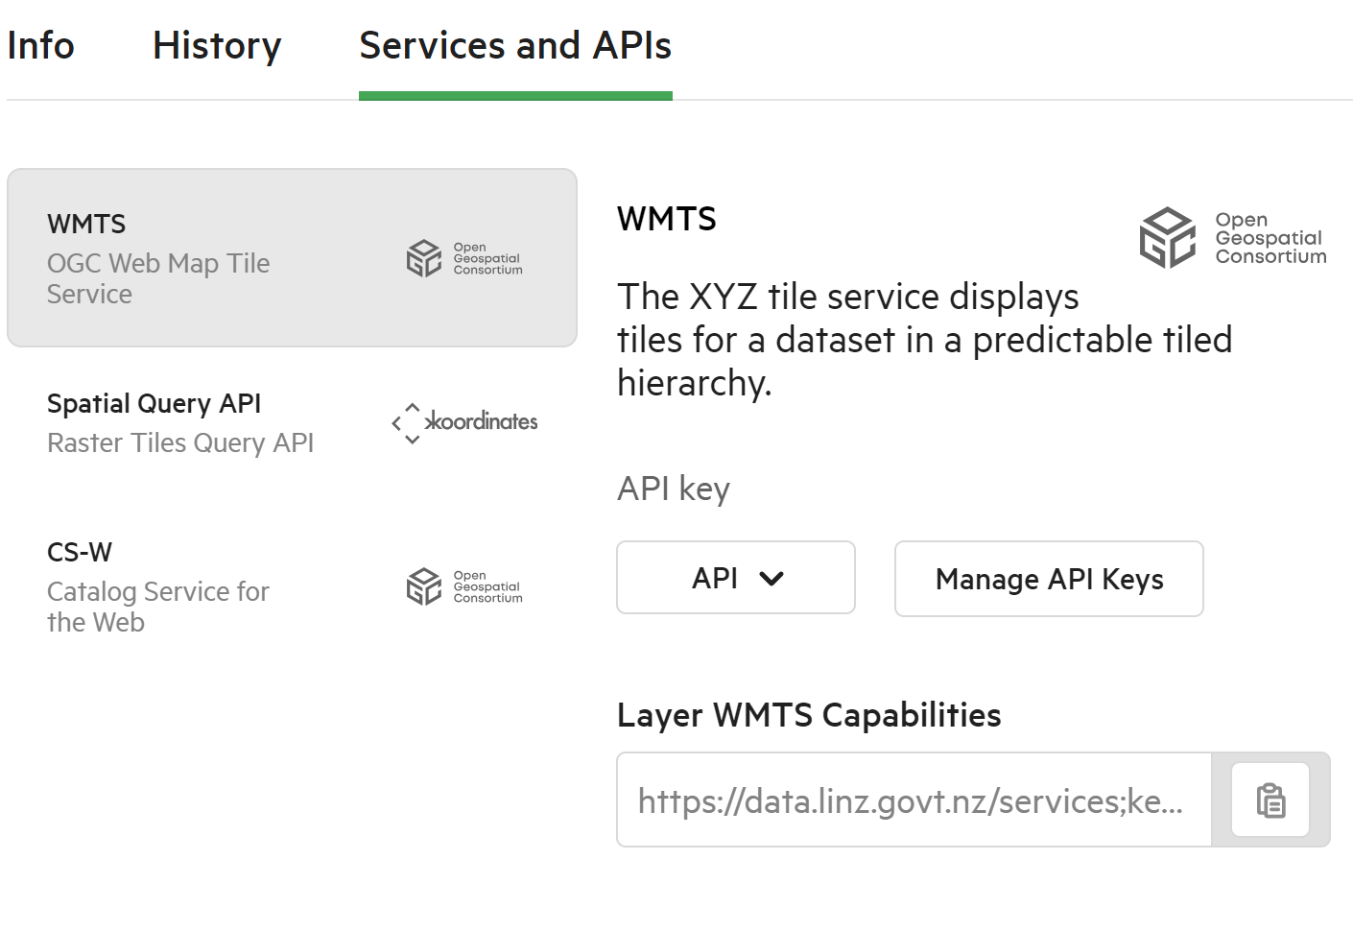
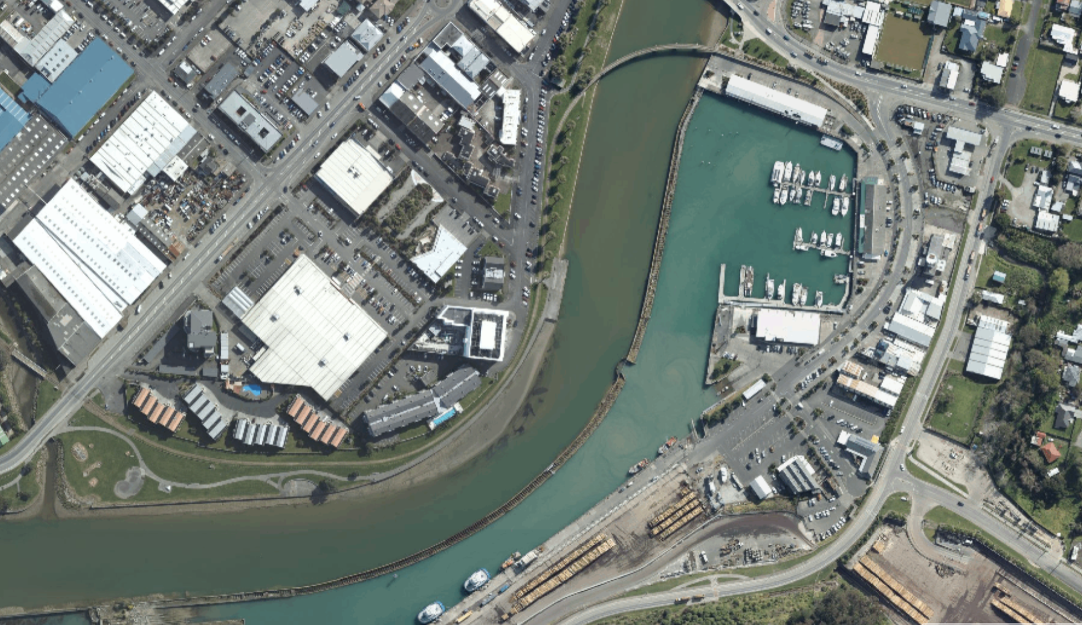
Benefits of Digital Moana Data Service
Notes:
What are the benefits of Moana
easy to access comprehensive geospatial data
Improved decision making with accurate decision making (users will be able to rely on a single source of truth and have confidence in the data used for a wide range of applications)
Enhanced collaboration through shared data. We believe Moana will break the deadlock that has long existed in the pacific and enable meaningful collaboration across government, academia and private sector.
For a long time organizations have pushed their own agendas and projects which has hurt the pacific and we hope that the Moana platform will bring together policy makers and practitioners to drive better decisions across the Pacific.

Slide 8
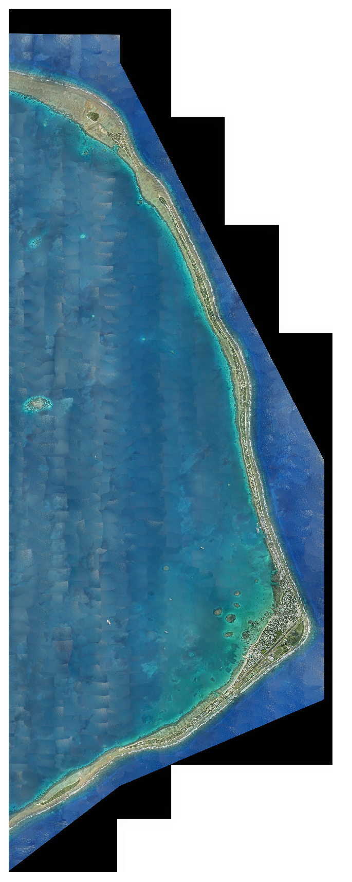
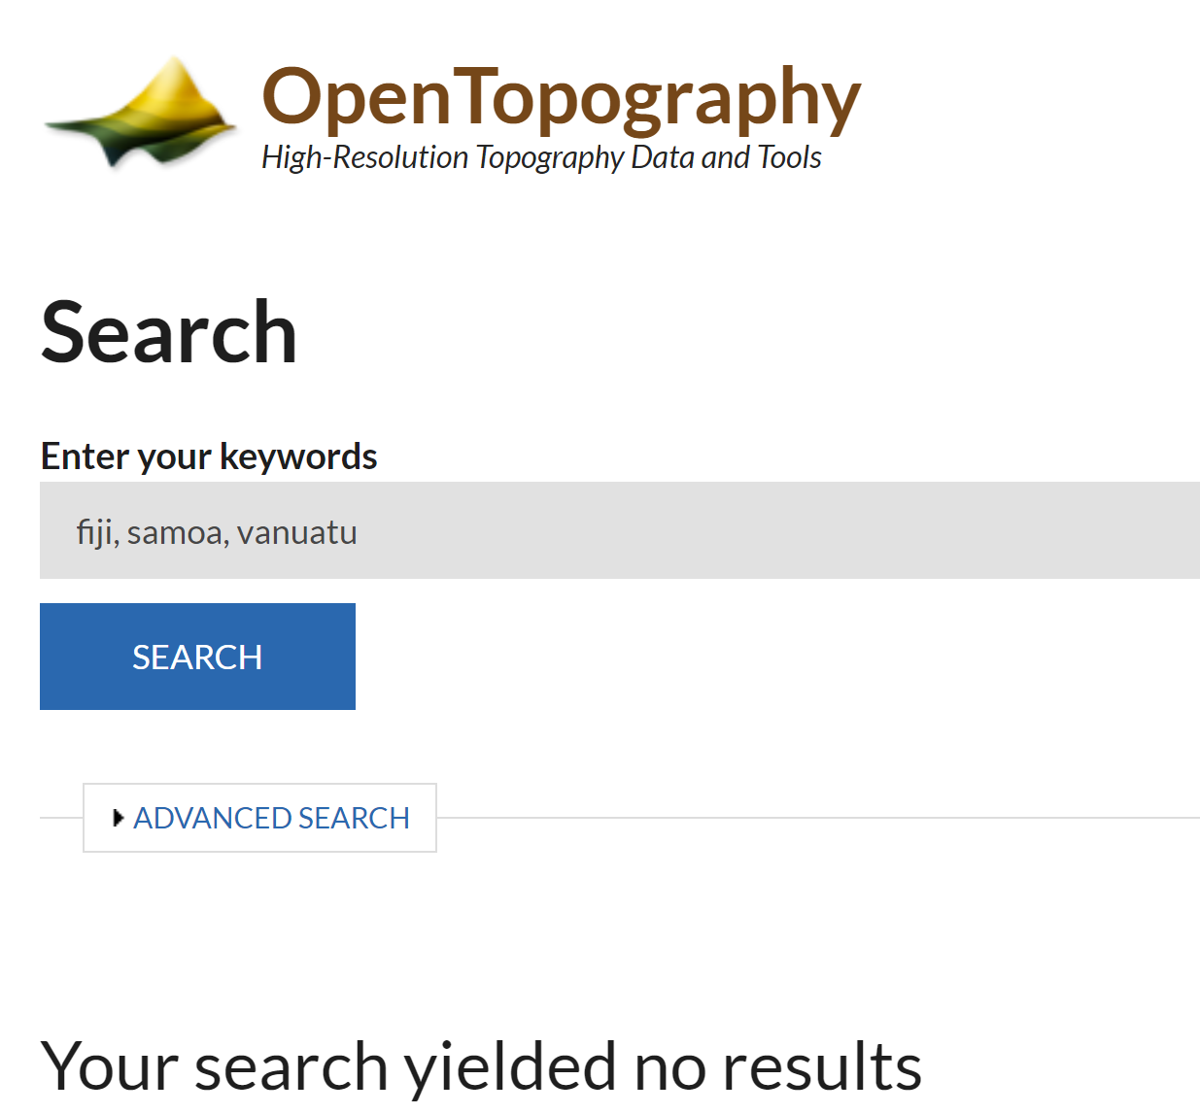
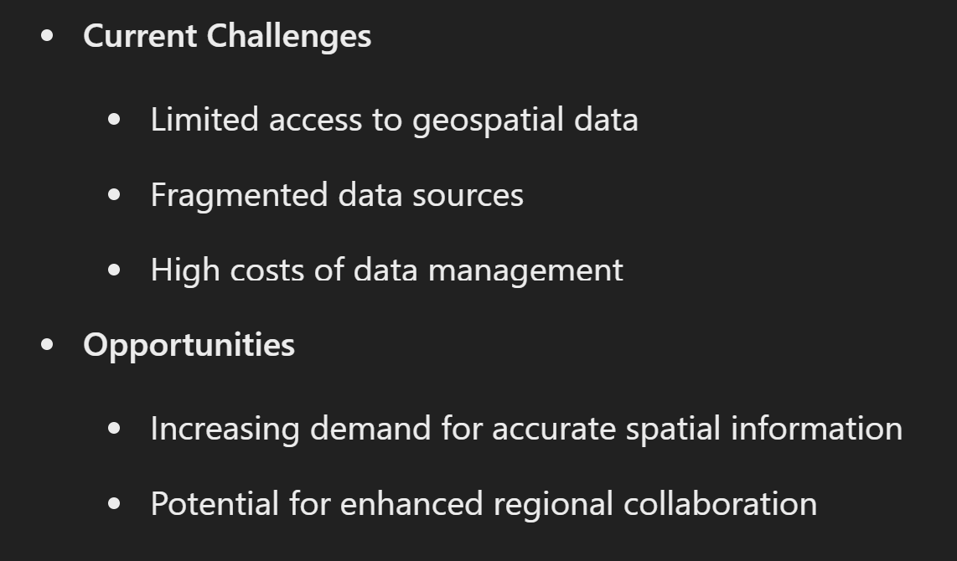
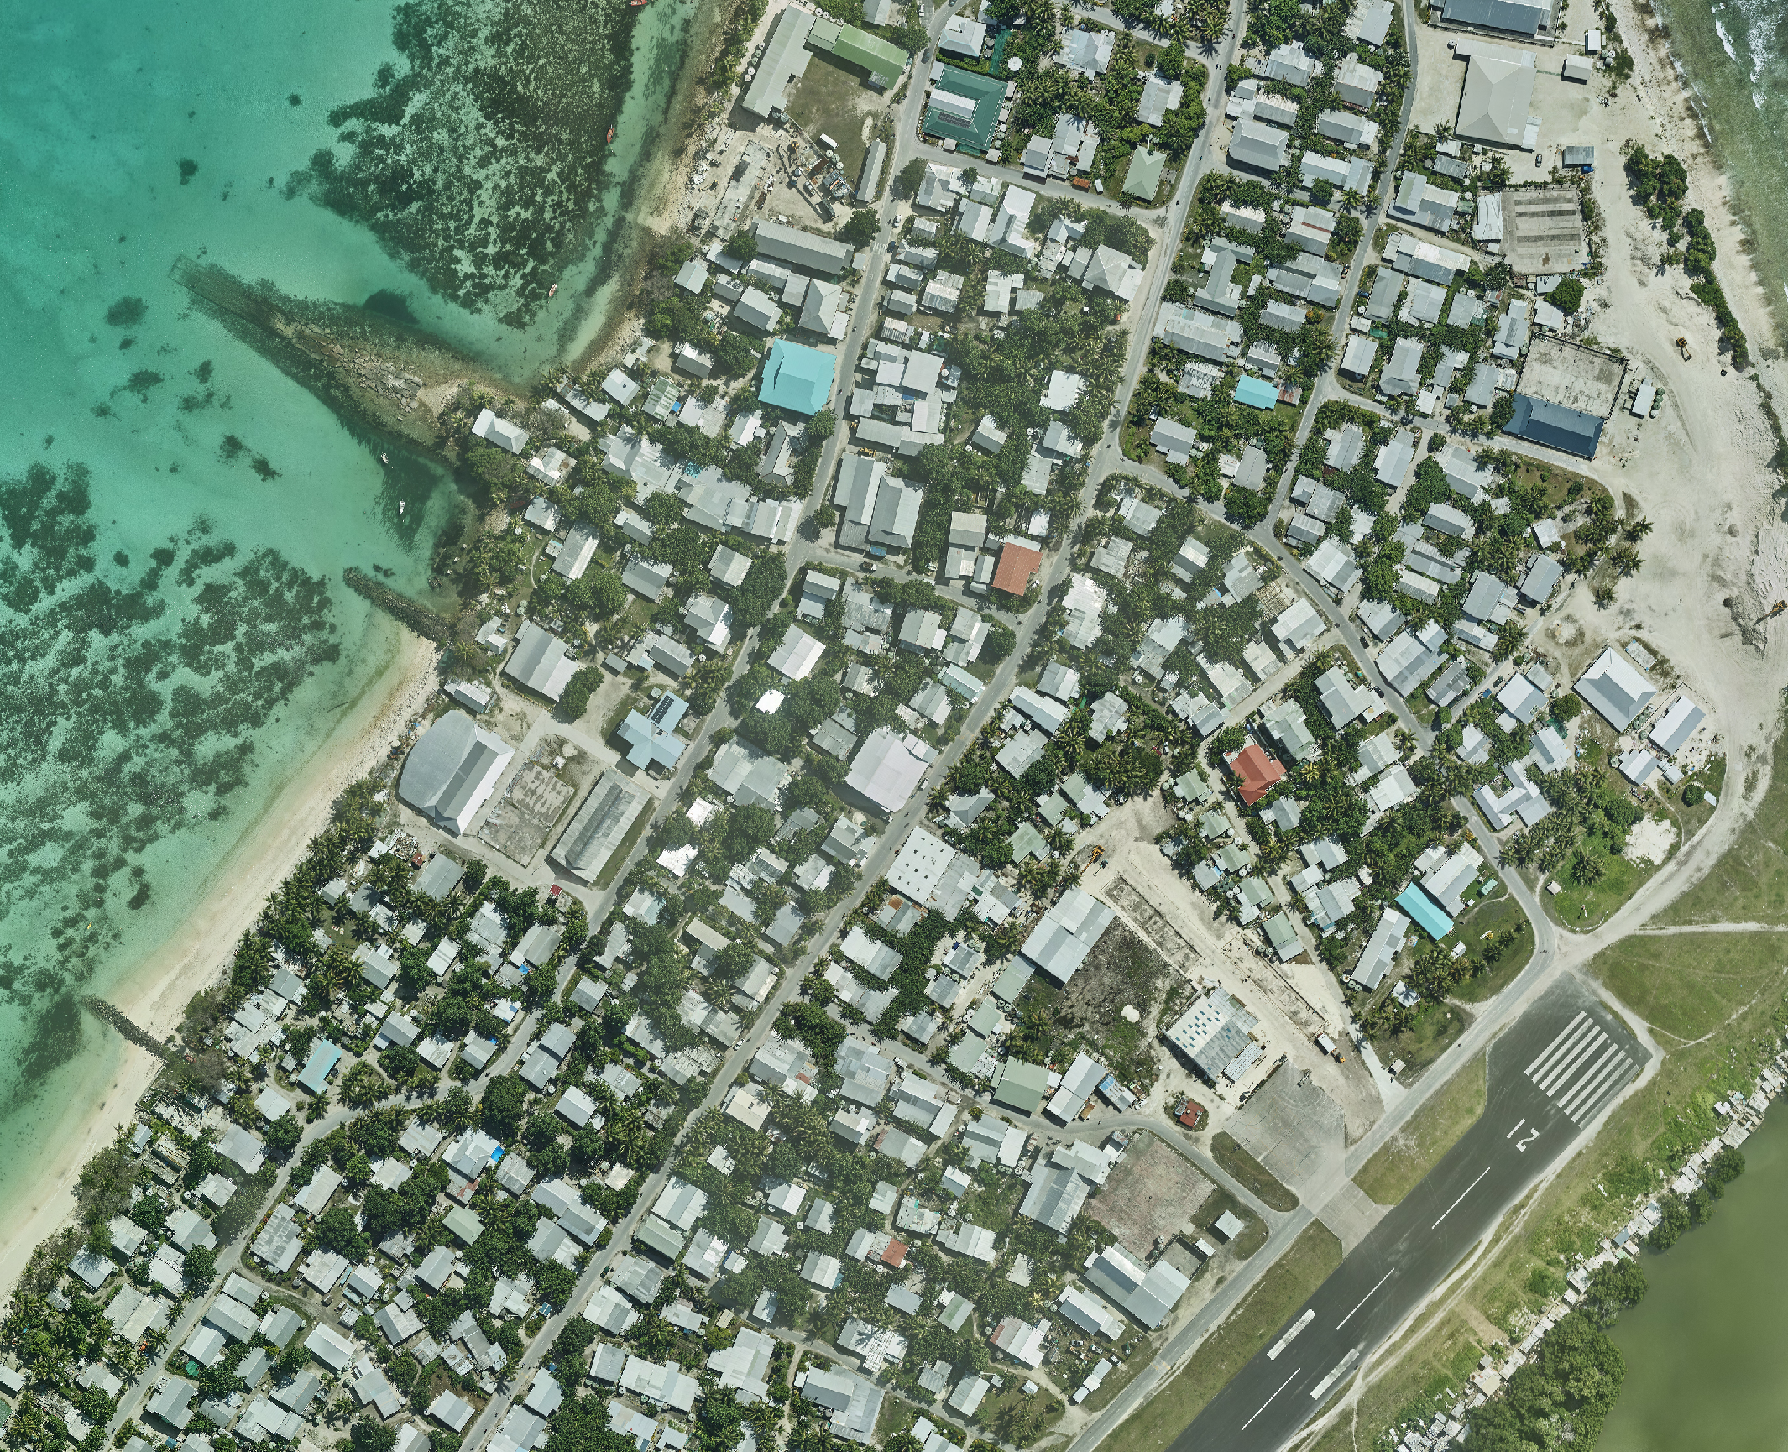
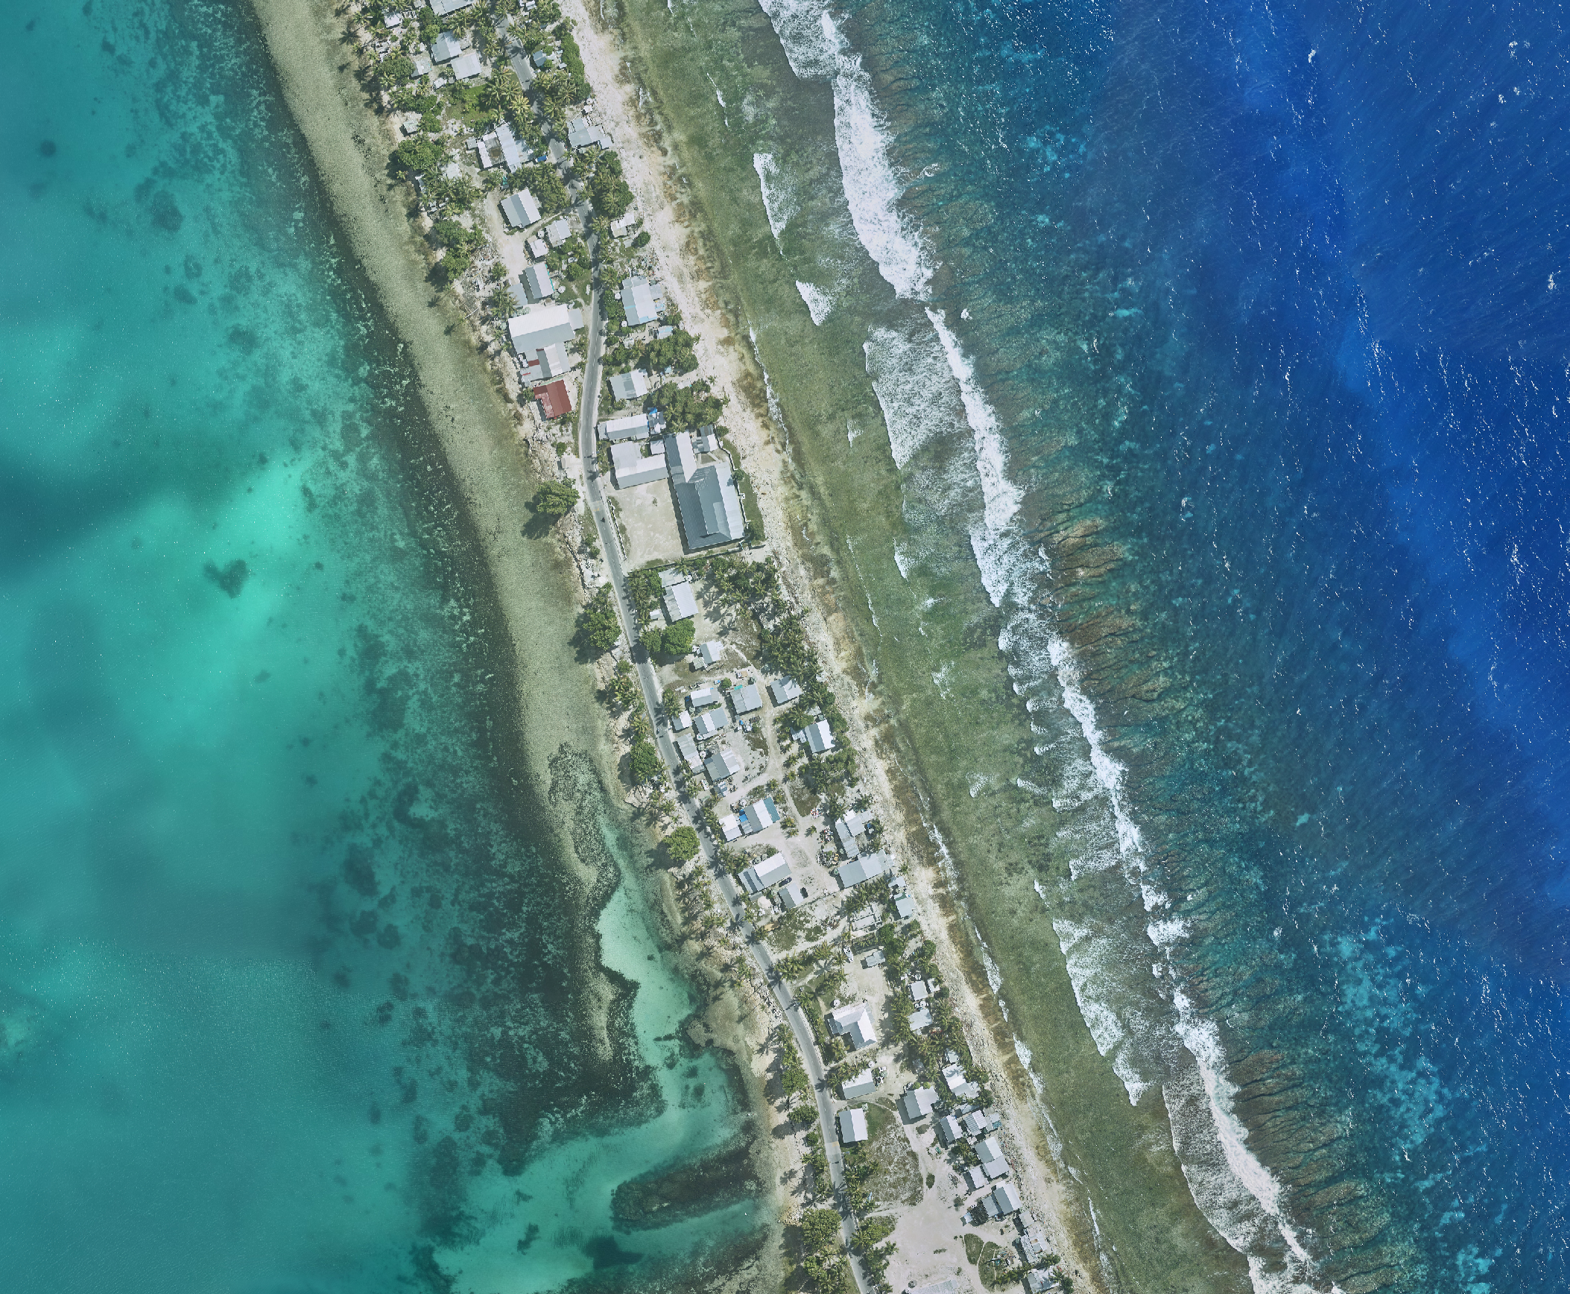
Pacific Island Context
Notes:
Being in the pacific we may feel sometime like we are limited being a tiny island in a big ocean. But in this day and age through use of technology we have internet at a touch of a finger, I cant see why we cant have accurate geospatial data just as accessible, especially with the ongoing risks our islands are facing. The goal is to enable a more cohesive regional collaboration through Moana

Slide 9
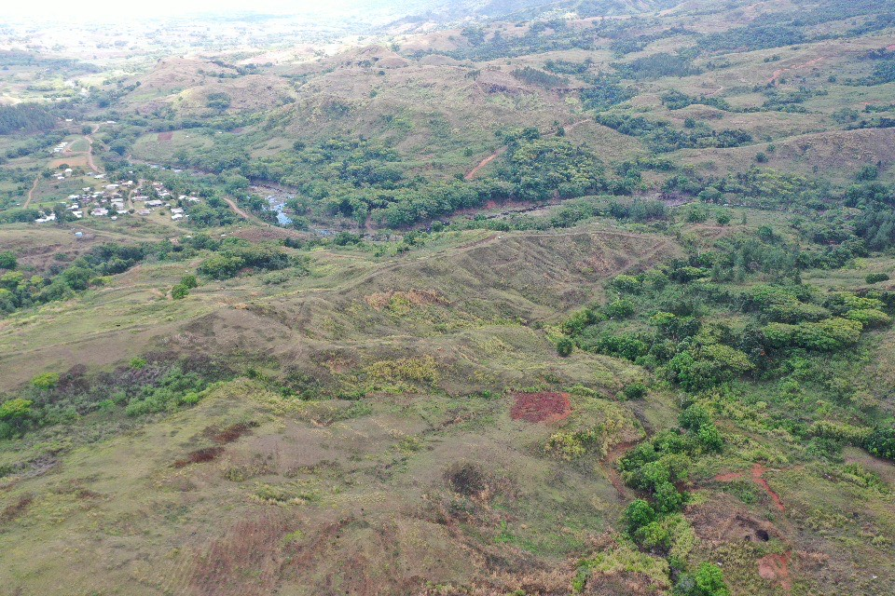
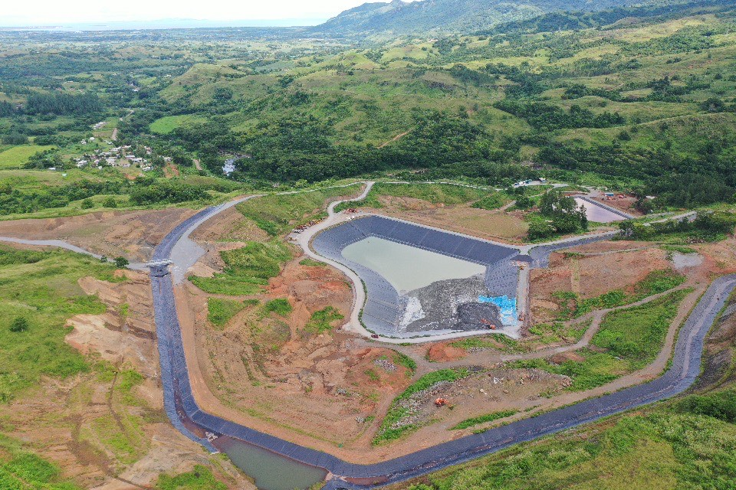
Lion One metals required an aerial LiDAR survey to inform dam failure modeling for Tailings Dam in close proximity to Korebebe Village
Survey was required urgently and traditional survey methods would have been time costly and also hazardous for surveyors working across steep and dangerous terrain
Notes:
High resolution LiDAR and imagery plays a vital role safe guarding our communities by informing critical applications such as flood modeling and hazard/landslide assessments.
In 2022 our team conducted an aerial LiDAR and imagery survey of Lion One’s Tuvatu Gold Project in Sabeto Nadi.
Mine engineers specifically requested a LiDAR survey, for a as built survey of the recently competed tailings dam and to inform dam failure modeling. As you can see in the pictures above, Korembebe village sits in close proximity to the tailings dam on the left. Reliable and accurate data was critical in this application and engineers needed to understand potential flow paths if the dam was to fail.
Traditional survey methods would have taken time and also put survey field teams in dangerous, unstable and steep terrain. The detail from LiDAR provides a more comprehensive data set that engineers could rely on. The 3D point cloud provided an excellent visual aid. when the client presented the report to the village, which gave great comfort to the village knowing the mine operators had taken comprehensive measures to ensure the safety of the village in the event of a dam failure.

Slide 10
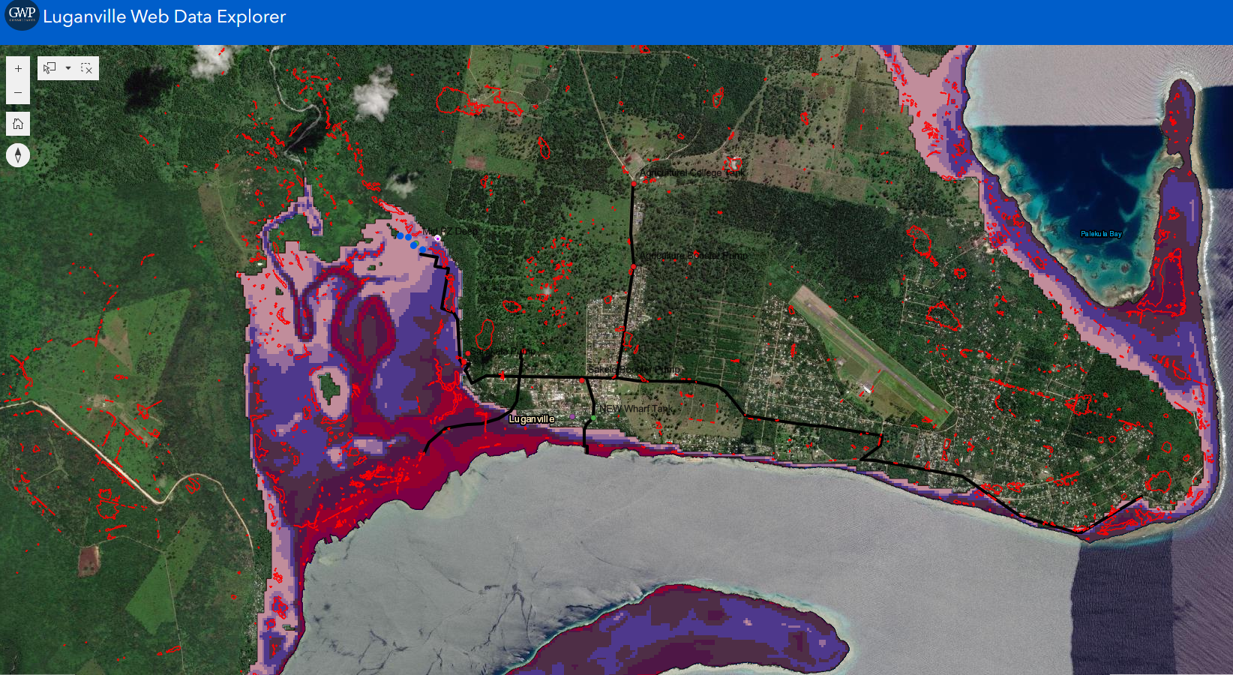
Why is it important
Infrastructure Risk Exposure Mapping - Vanuatu
Tsunami and Sinkhole proximity to water supply system
Notes:
Some other examples of larger scale LiDAR at work in the Pacific.
Our partners at GWP consultants used LiDAR to conduct infrastructure risk exposure mapping in Luganville, Vanuatu
Kahuto has partnered with GWP consultants who are world renowned earth and water resources technical and advisory consultancy. Moana aims to empower consultants both local and international.

Slide 11
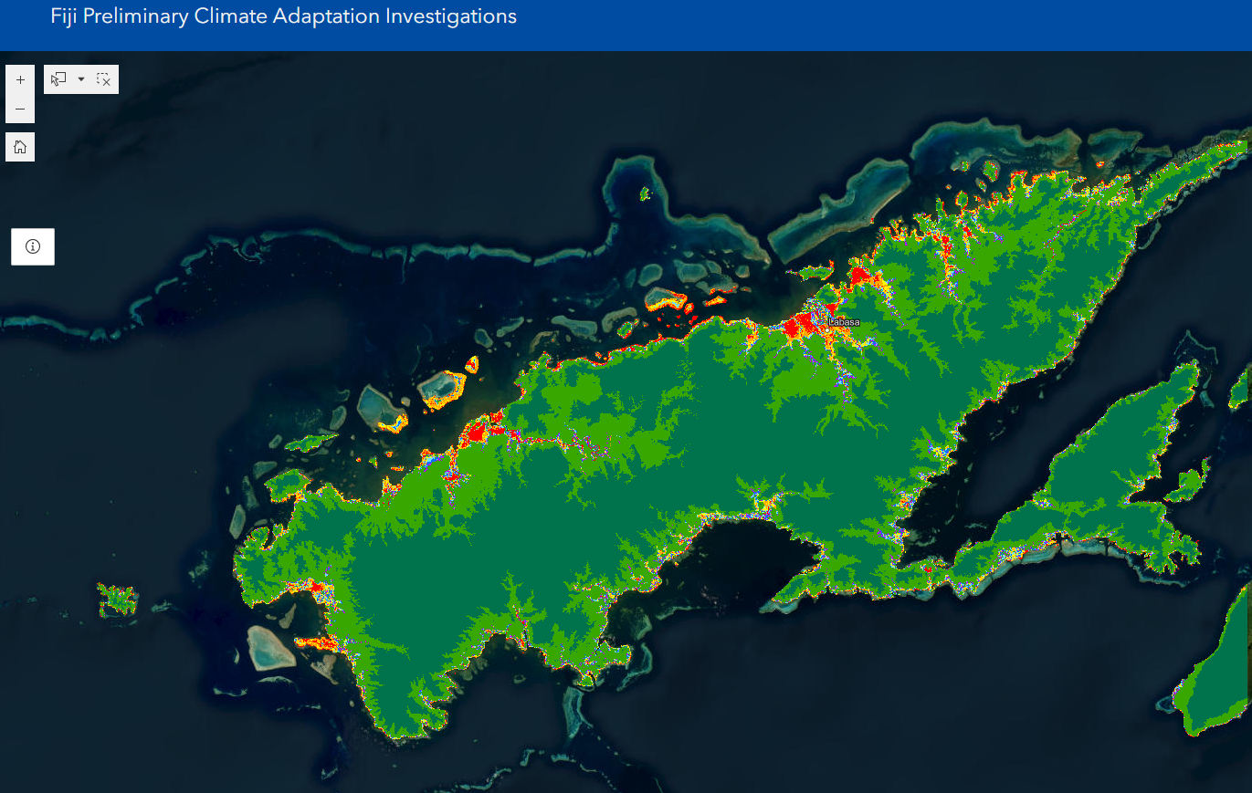
Remote sensing digital terrain model analysis – Vanua Levu
Colour elevation banding – as proxy to coastal surge and tsunami inundation risk
Notes:
Another example, this time using remote sensing - digital terrain model analysis in Vanua Levu.
The Fiji Government has significant investment in the pipeline to develop Vanua Levu and geospatial data will be critical to help inform strategic planning and ensure infrastructure is safeguarded from climate change.

Slide 12
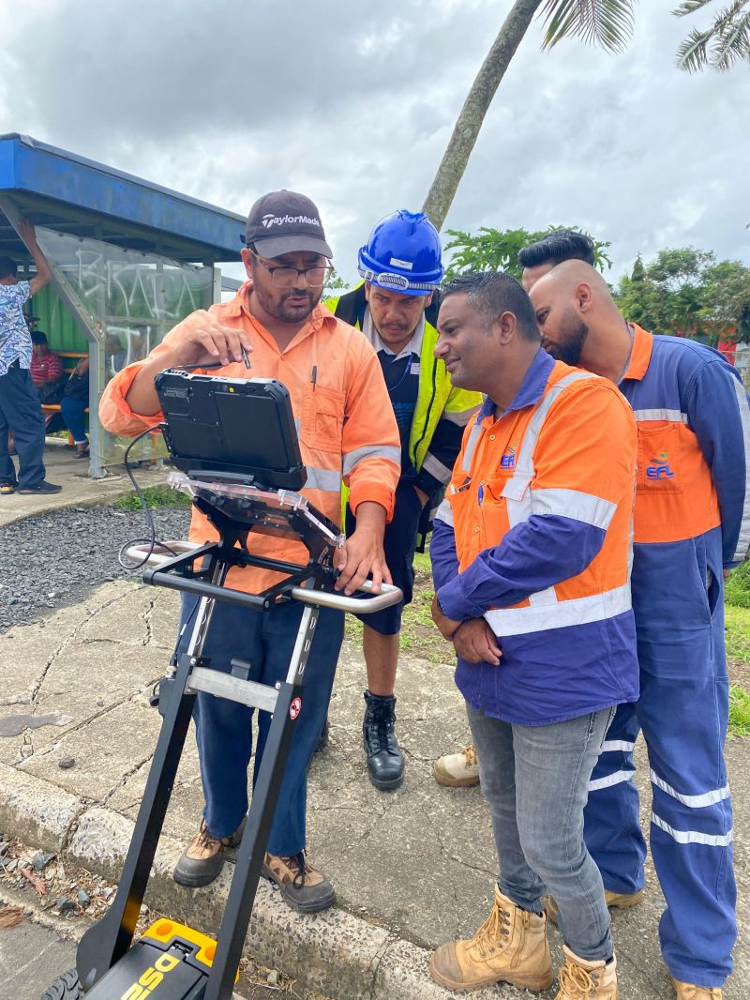
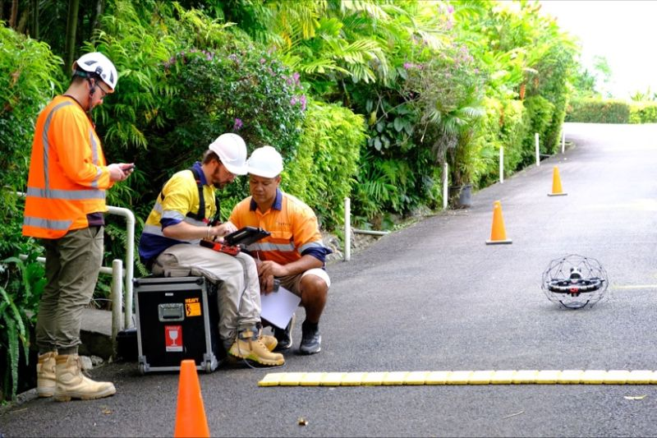
Notes:
collaboration is vital in small island development states and we’ve been privileged to have the opportunity to work alongside some fantastic companies who are invested in seeing our locally driven solutions succeed in the Pacific
We would like to acknowledge Landpro who have provided guidance and support to ensure our first acquisition is a success.
We have recently partnered with Bluespatial, an Australian based company who provide Hydrographic and bathymetry survey. This is an exciting collaboration as we aim to merge both land and sea geospatial products through Moana.
GWP provide expert hydrological, geophysical and large scale GIS capabilities… and experience working on large infrastructure projects in the UK and across many SIDS countries. Their experience and expertise will be invaluable.
The Pacific is in desperate need for a locally led solution that is sustainable and fit for purpose. The current model is not working and we are prepared to take the risk as a private firm to see the Moana data service come to life. It won’t be easy and certainly ain’t cheap but we are Pacific Islanders at heart and want to make a difference.
Tagio tumas and Thank you everyone for listening… (wait for the clap)
Unfortunately I won’t be able to take questions as I have had no involvement in the Moana data services development stage. My role at Kahuto has been purely on overseeing our drone survey operations .and if you do have questions please feel free to come and see me afterwards and I can forward inquiries onto the team.

