Slide 1

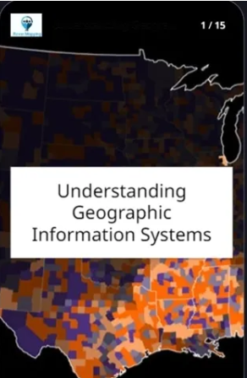

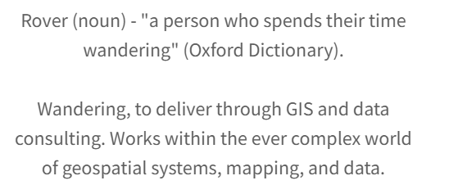
MAPPING THEME
HOW TO MAP DATA FROM GEOSPATIAL APIS (AS A NON CODER)
PGRSC CONFERENCE - SUVA, FIJI (NOV 2024)
https://rovermapping.com.au

Slide 2
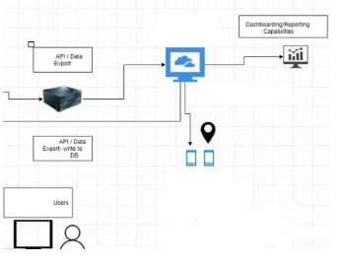

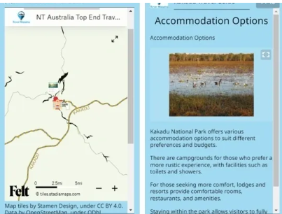
ABOUT US
Rover Mapping has been running since 2023 and is led by
Matt Smith, a specialist GIS consultant and trainer with over 11 years experience.
Rover Mapping undertake GIS implementations (web gis and field data capture), integration services, data processing, training and mentoring
Matt Smith
GIS and Data Consultant (Principal) @ Rover Mapping

Slide 3
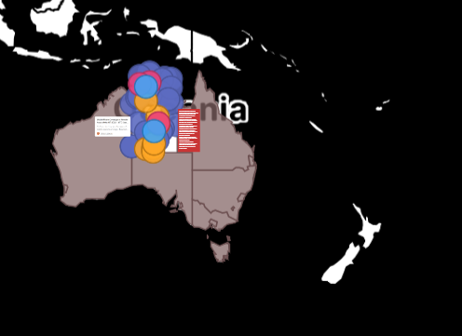
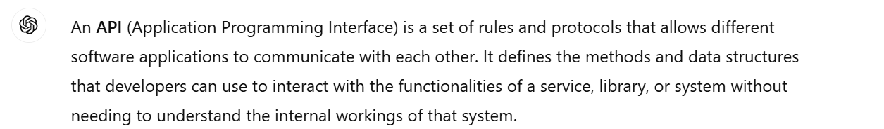
01
APIs are constantly changing the way GIS professionals work with data. Open APIs are available in some parts of the region incorporating fire incident, road congestion, infrastructure maintenance and live weather data
AN EVOLUTION IN GEOSPATIAL DATA - INSIGHTS FROM AUSTRALIA
APIs have given us the opportunity of re - thinking where and how we process data
02
03
Generative AI tools have opened the doors for non coders to map data from API. ChatGPT - API definition below

Slide 4
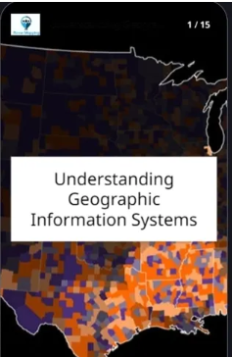
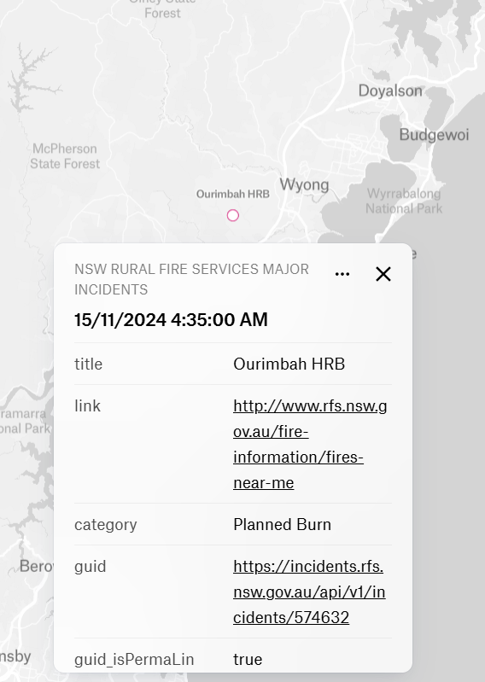
CONTENT
01
Embarking on the journey
02
About APIs data formats
03
How to process data from open APIs (even as a non coder)
04
What to watch out for (with AI tools)
05
Custom Examples (Open Data - creative commons)

Slide 5
WHY IS IMPORTANT TO KNOW STUFF ABOUT GIS CODE?
01
MODERN GIS ARCHITECTURE
REQUIREMENTS
- EMBARKING ON THIS JOURNEY
OLD SCHOOL VENDORS, OPEN SOURCE AND EVERYHING IN BETWEEN
02
IN THE 2020S, ITS CRUCIAL TO KNOW ABOUT FRONT AND BACK END SOLUTION ARCHITECTURE. YOU DON’T HAVE TO BE THE EXPERT, BUT YOU SHOULD BE ABLE TO HAVE A CONVERSATION
CAN I EASILY INTEGRATE THIS APP WITH OTHER DATA SOURCES? CAN I WORK TO KEEP MY DATA EASILY UP TO DATE
03
03

Slide 6
ITS ALL ABOUT SOLUTION ARCHITECTURE !!!!!!!!!!!!!!!!!!!!!!!
01
DOES MY APP INCLUDE AN API THAT doesn’t need extensive development experience ??
02
HOW EASY IS IT TO INTEGRATE MY APP -
what do I want to spend most of my time doing ???? what is cost effective?

Slide 7
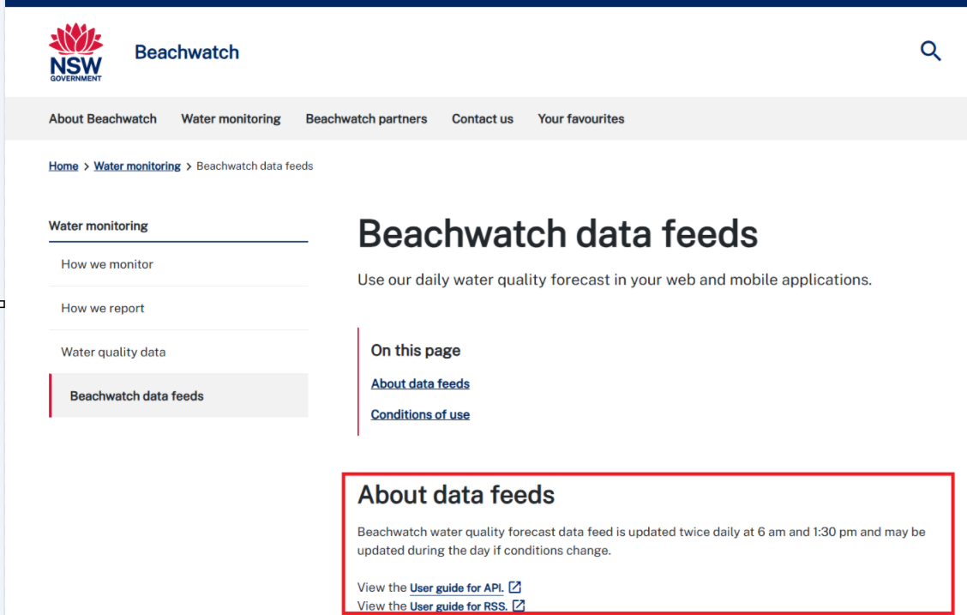
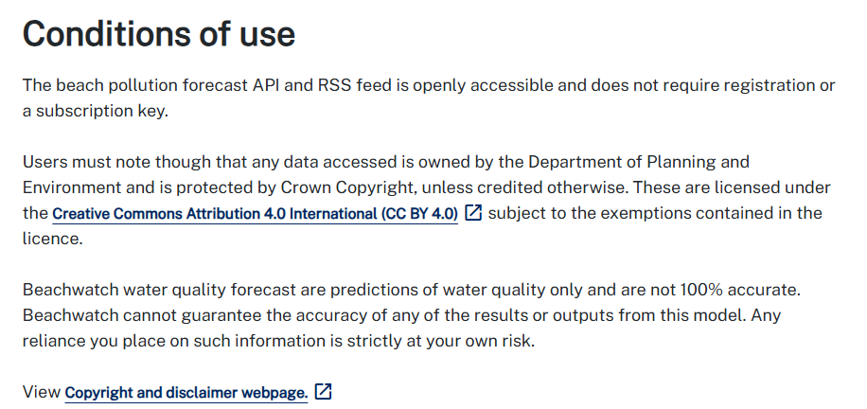
NAVIGATING FEED INFO PAGES - PART 1
https://beachwatch.nsw.gov.au/waterMonitoring/beachwatchDataFeeds
Look into the data source - format, conditions of use, are permissions and/or keys required to access the data?

Slide 8
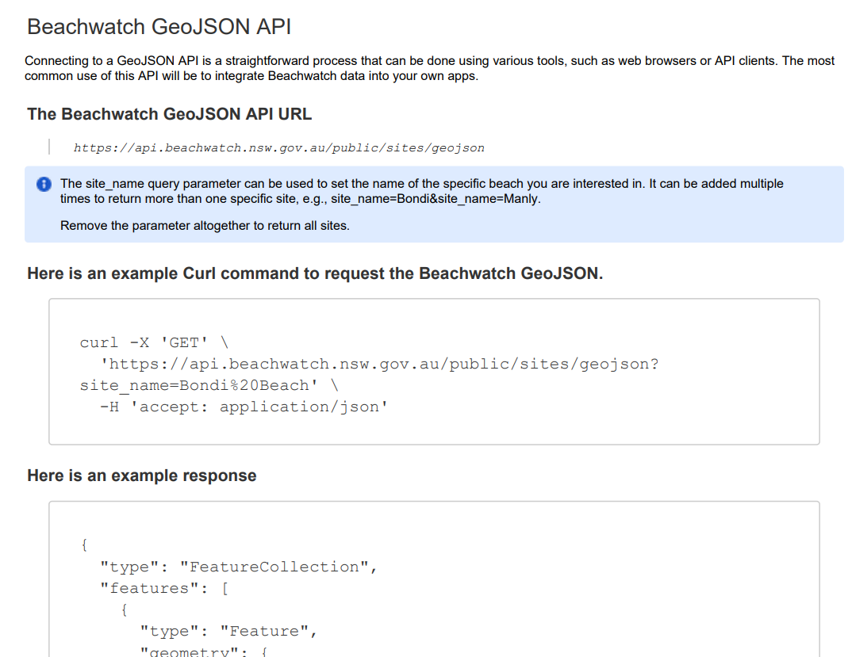
NAVIGATING FEED INFO PAGES - PART 2
https://beachwatch.nsw.gov.au/waterMonitoring/beachwatchDataFeeds
Which code will I use?
Curl - client url library which comes with my windows PC?
Or Python - open source installers to integrate with other apps. Libraries may allow me enhance my skills !!

Slide 9
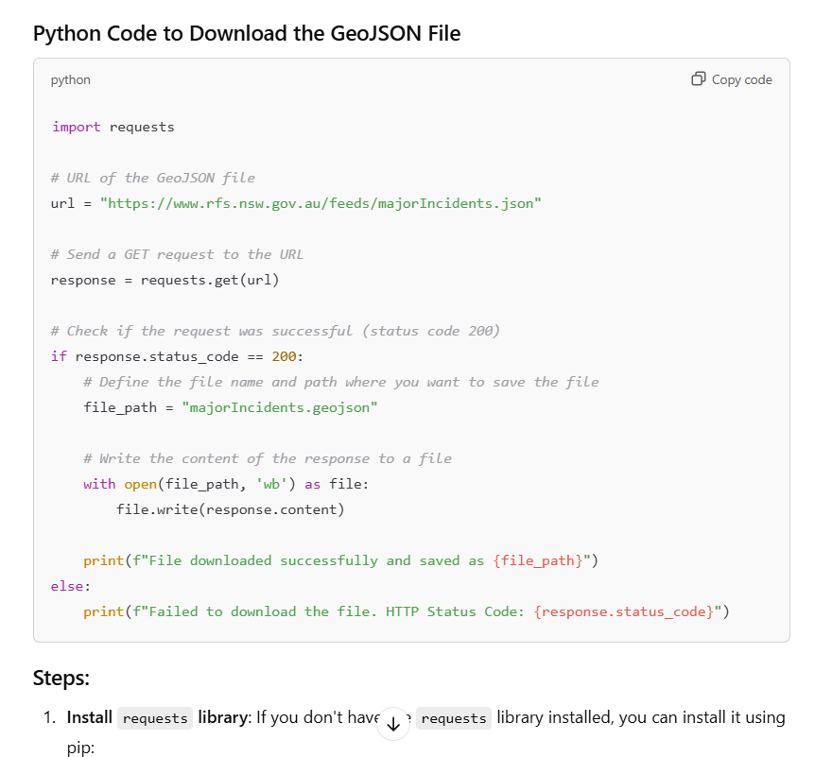


ABOUT GEOJSON DATA FEEDS
SIMPLEST APPROACHES
- DOWNLOAD GEOJSON FILE STRAIGHT FROM SOURCE TO LOAD IN manually to your GIS
OR
Load directly into your app using a python API

Slide 10
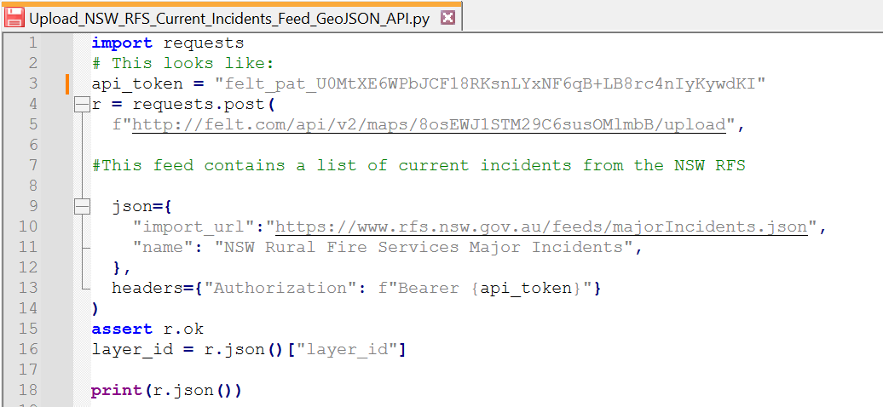

NEW SOUTH WALES - RURAL FIRE SERVICE
Current incidents geojson feed
(no authentication)
GEOJSON FEED > API >
WEB MAP (using the felt application for now)

Slide 11
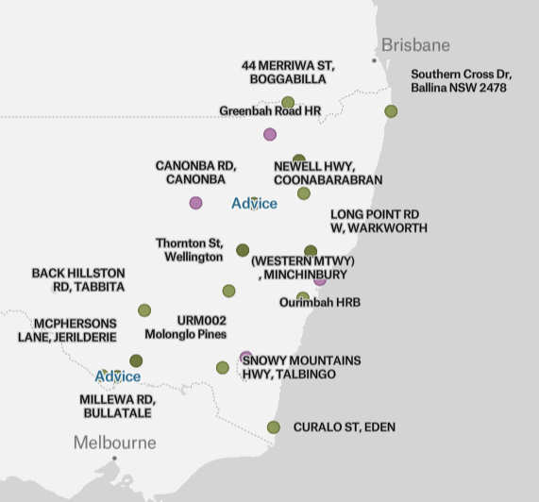


THE RESULT !!!
A DYNAMIC MAP WITH DATA STRAIGHT FROM THE API - another application
Applications talking to each other !!!

Slide 12
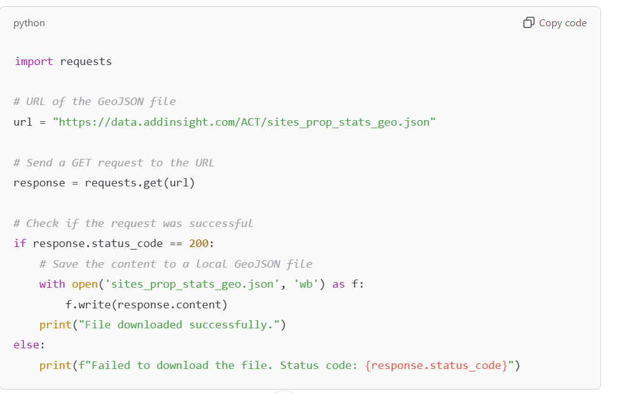

THIRD PARTY REST API
OBTAIN A KEY IF NEEDED
PREVIEW THE DATA ONLINE
DOWNLOAD THE DATA AS JSON
TRANSFORM THE JSON ONTO THE MAP (using your application API) AND/OR LOAD INTO A DATABASE (using custom code or procedure)

Slide 13
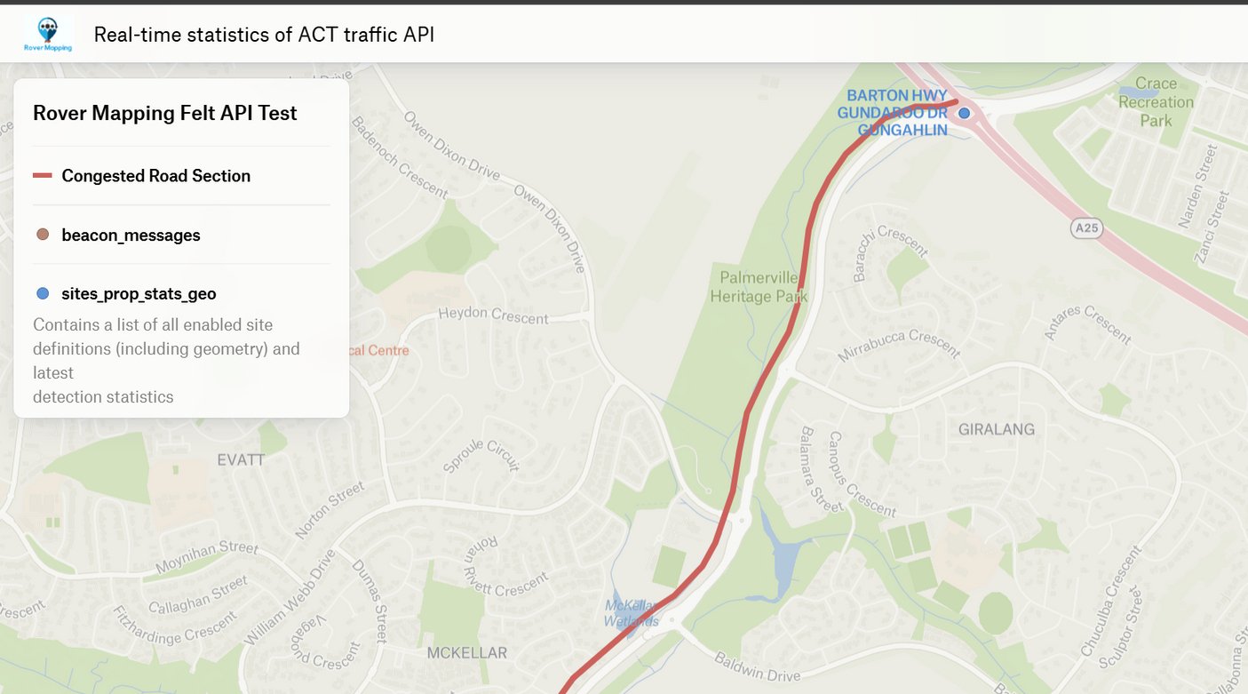
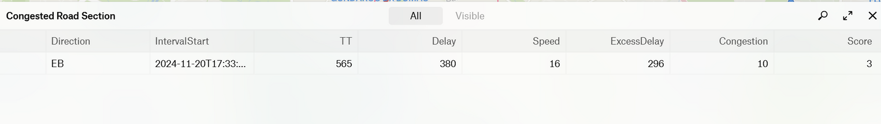
AUSTRALIAN CAPTIAL TERRITORY - ROAD INCIDENTS FEED
Bluetooth detection devices placed on major roads to monitor traffic flow
REST API > GEOJSON FILE
OR
OR REST API > MAP

Slide 14
CLOSING REMARKS
01
Watch out with the AI tools
Make sure you learn to interpret the code if using the AI tools to generate scripts. The tools may not be around for free long term, but my belief is that generative AI and application APIs should technical documentation better for GIS analysts who don’t come from a dev background
02
Next Steps:
More ETL (extract, transform, load) - embedding live data from APIs into datasets will help us as GIS professionals show that the power of GIS is ever - growing
More reading - NZ live weather feed into ESRI hosted feature classes (author Bruce Harold)
https://community.esri.com/t5/arcgis-data-interoperability-blog/etl-pattern-scheduling-web-tools/ba-p/1546641

Slide 15
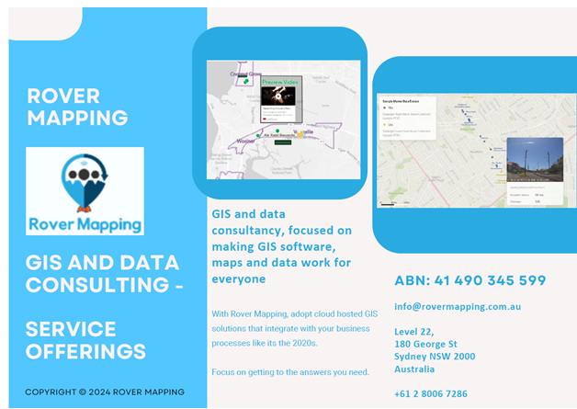
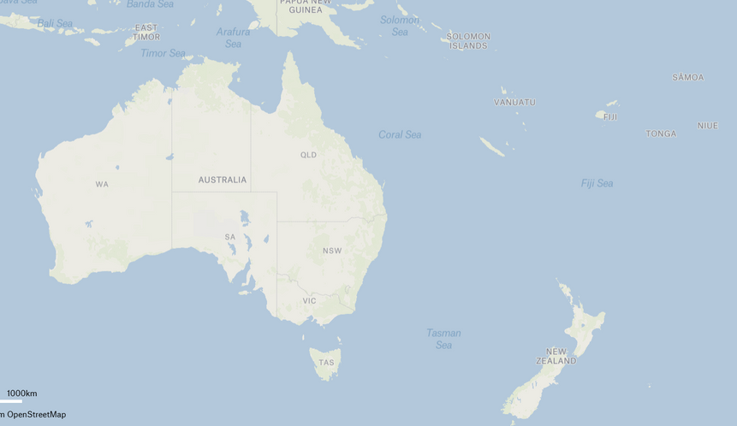
THANK YOU AND ENJOY THE CONFERENCE !!
matt.smith@rovermapping.com.au
info@rovermapping.com.au
+61 2 8006 7286
Contact us with further questions or assistance with;
  GIS application solution design
  GIS Integration
  Data Processing,
  Application hosting,
  Training
  Mentoring

