Slide 1
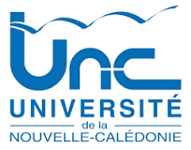


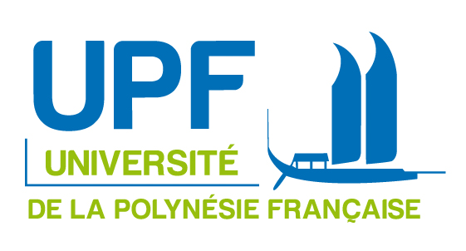

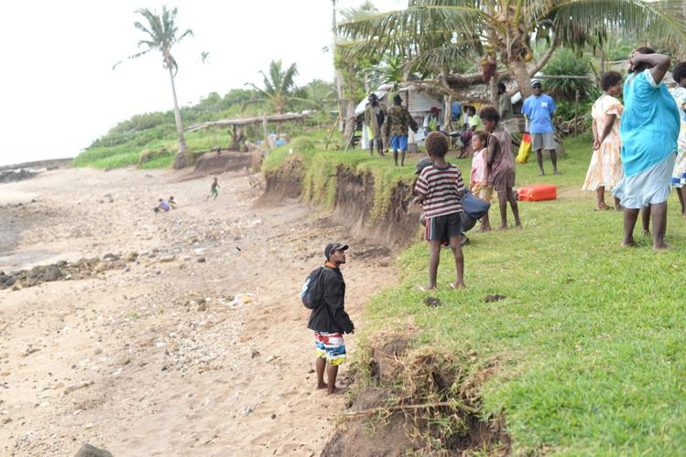
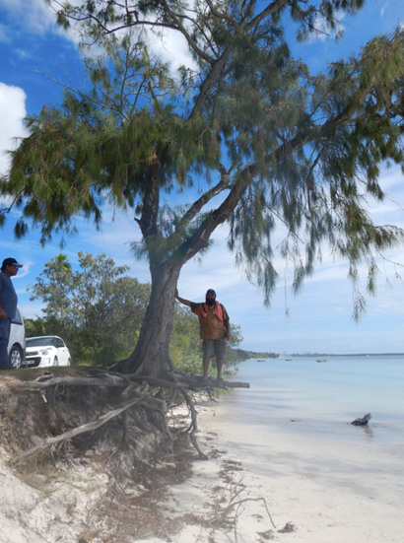


Shoreline monitoring and management using GIS and remote sensing to improve resilience in the Pacific islands against coastal erosion
Pascal DUMAS^{2,1}, Michel ALLENBACH^{1,3} Matthieu LE DUFF²
© Oblic, Ouvéa Island , New Caledonia 2020
© Climate change department/ Vanuatu, 2019
Dr Pascal DUMAS
Assistant Professor in Geography and Geomatics
University of New Caledonia
Research Unit : UMR 228 ESPACE-DEV / IRD / ART GeoDev
Benoit Stoll, Pascal Michon, Julie Daniellot-Dejoux,
Juliette Peinaud, Noe Duval, Solène Cazaux
Notes:
Bula, Vinaka everybody. My name is P. Dumas. I am an associate professor in geography at the University of New Caledonia.
I was able to take part in this conference thanks to the support of Data Terra, which I would like to thank.
You should know that the University of New Caledonia is one of the member of ART GéoDEV of New Caledonia (there is 9 ART in France). It’s a regional/local organisation with the main objective of structuring, federating and supporting users of New Caledonian geospatial data.
About my presentation I will talk about the shoreline monitoring and management using GIS and remote sensing.
This project has received funding from the University of New Caledonia, the PIURN Programm and the french Pacific Fund program.
Currently there are 2 partners of the PIURN network in this project : the University of French Polynesia and the National University of Vanuatu
3 Masters students worked on this project: one in New Caledonia (Noe Duval), one in Vanuatu (Juliette Pienaud) and one in French Polynesia (Julie Daniellot-Dejoux), co-supervised by Benoit Stoll.
And the last think to know is that this project began last year and will continue for another year and a half.

Slide 2
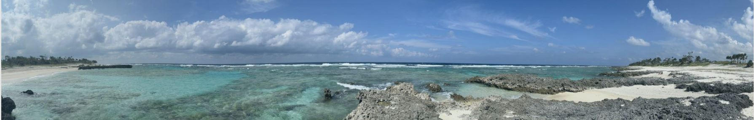
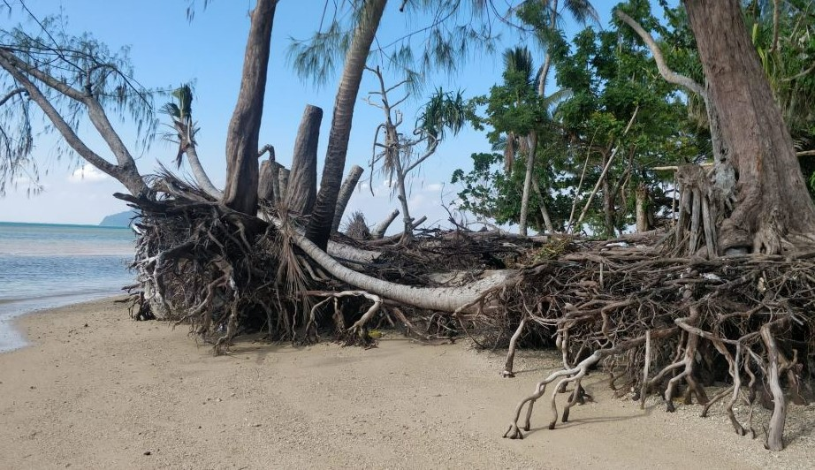
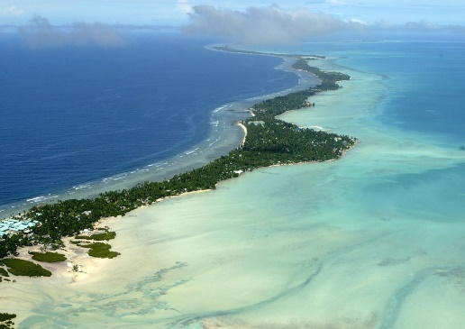
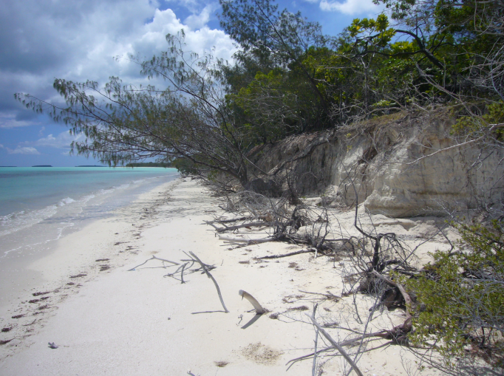
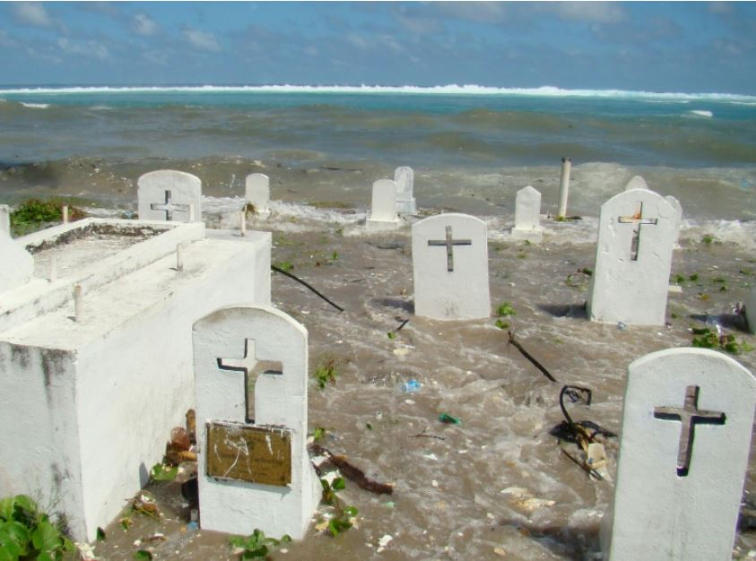
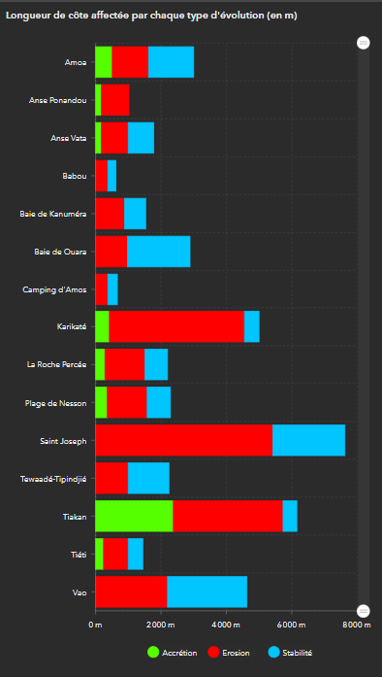

Context Methods Results
70% of the world's sandy coasts are eroding
The low-lying islands of the Pacific are particularly vulnerable to the risks of coastal erosion and marine submersion (examples of Tuvalu and Kiribabi in the media)
Paonangisu beach – Vanuatu
Tuvalu
Ouvea –New Caledonia
New Caledonia, and in particular the Loyalty Islands, is no exception
In 2020, according to the “Observatoire du Littoral de Nouvelle-Calédonie (OBLIC)”, a dozen sites were monitored (43 km of sandy coastline):
- 33% of coasts are stable
- 18% of coasts are accreting
- 49% of coasts are eroding
Notes:
Let's start with some background information
Currently 70% of sandy coasts around the world are currently are eroding
The Pacific zone is no exception, on the contrary because the low-lying islands of the Pacific are particularly vulnerable to the risks of coastal erosion and marine submersion.
In New Caledonia, according to the “Observatoire du Littoral de Nouvelle-Calédonie (OBLIC)” (it’ a local coastal observatory) a dozen sites were monitored (43 km of sandy coastline):
- 33% of coasts are stable
- 18% of coasts are in accretion
- 49% of coasts are in erosion

Slide 3
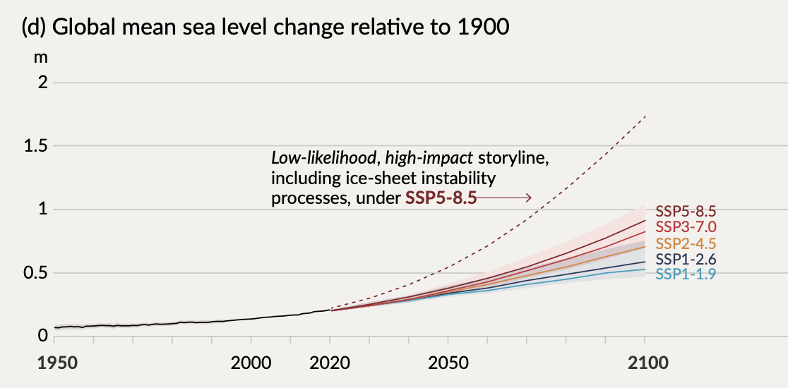
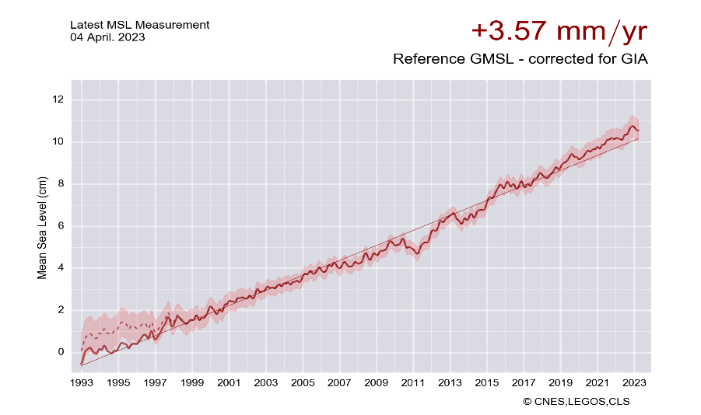
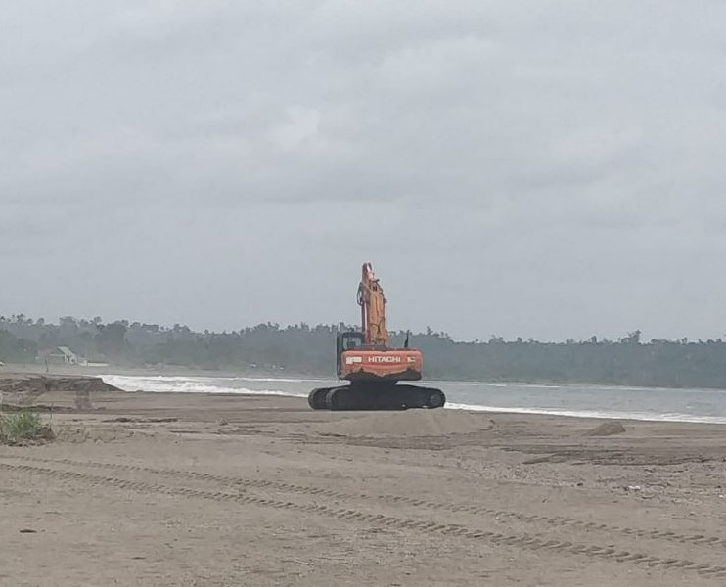
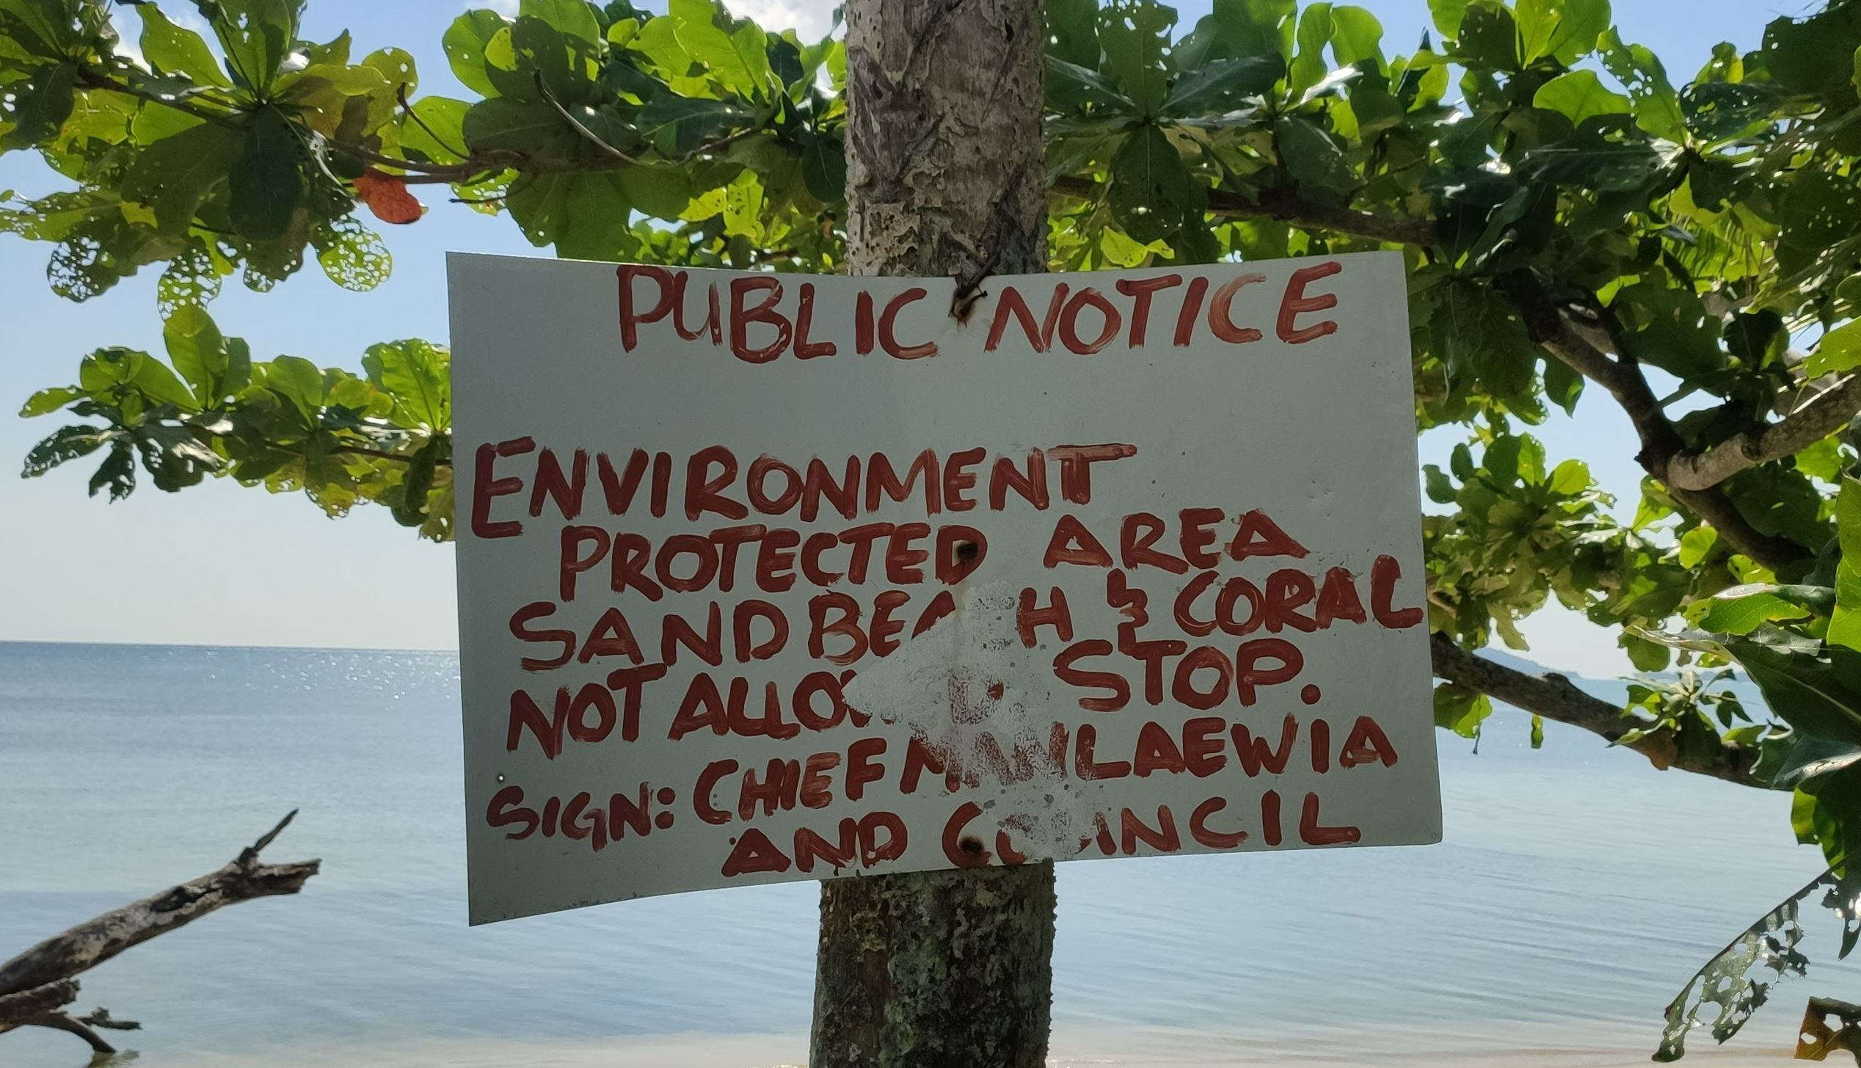
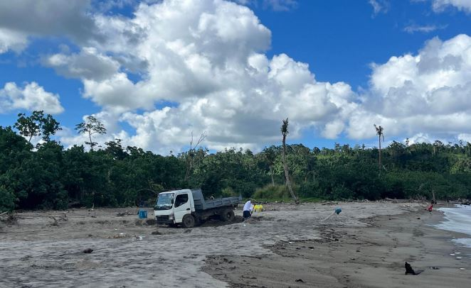
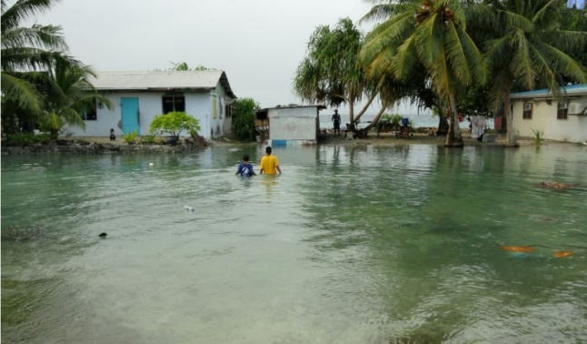
Context Methods Results
high vulnerability :
by climate change and its consequences: Global sea-level rise, Increased intensity of extreme events (cyclones, depressions...) :
Marine submersion phenomenon
Increased erosion (retreat of coastline)
Land salinization
- Anthropogenic practices to be taken into account in natural imbalances (sand and coral extraction, urbanization, dams, etc.).
Sea level rise
Mele beach / Vanuatu _2023
Majuro –Marshall islands, 2011
Notes:
These sandy coasts are highly vulnerable to climate change and its consequences such as sea level rise, or increased frequency and intensity of extreme events (cyclone).
In coastal areas, this means more marine submersion, more erosion (with the retreat of the coastline) and land salinization.
But we must not forget that natural factors, and in particular meteorological and marine factors (wind, wave, ENSO..), are not the only ones to blame.
Anthropogenic actions are also often to blame for coastal degradation and retreat of the coastaline. Sand extraction, in particular, is a very common practice in the Pacific islands (as shown in the photo).

Slide 4
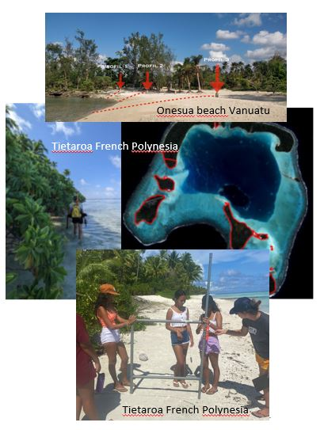
Context Methods Results
In this context where people and local communities are asking questions about their future,
we will try to provide some answers on the subject of coastline monitoring and management.
Project objectives :
Laying the foundations for a coastal observatory in the region with the PIURN partners
        Analyze and characterize shoreline trends in order to predict its future evolution. Identify areas at risk
        Better understand morpho-sedimentary changes and shoreline mobility taking into accont the local and global forcing factors and also the human activities
        Develop a program of participatory coastline measurements
        Awareness local population to coastal erosion and climate change
Notes:
In this context where people and local communities are asking questions about their future, we will try to provide some answers on the subject of coastline monitoring and management.
In fact, we want to lay the foundations for a coastal observatory in the region to start with a few countries and then with more partners.
The fisrt objective is to analyze the morpho-sedimentary changes and shoreline mobility to identify the sites at risk.
The second objective is to better understand the dynamics of the coastaline, taking into account the local and global forcing factors (wind and wave exposure, the effects of extreme events (cyclones, tropical depressions), or ENSO Oscillation and sea-level rise, when the data are available.
The third objective, but note the least (because it’s an important part of this project) : is take in account le local communities in this project and to develop a program of participatory coastline measurements and raise local awareness of coastal erosion and climate change.

Slide 5
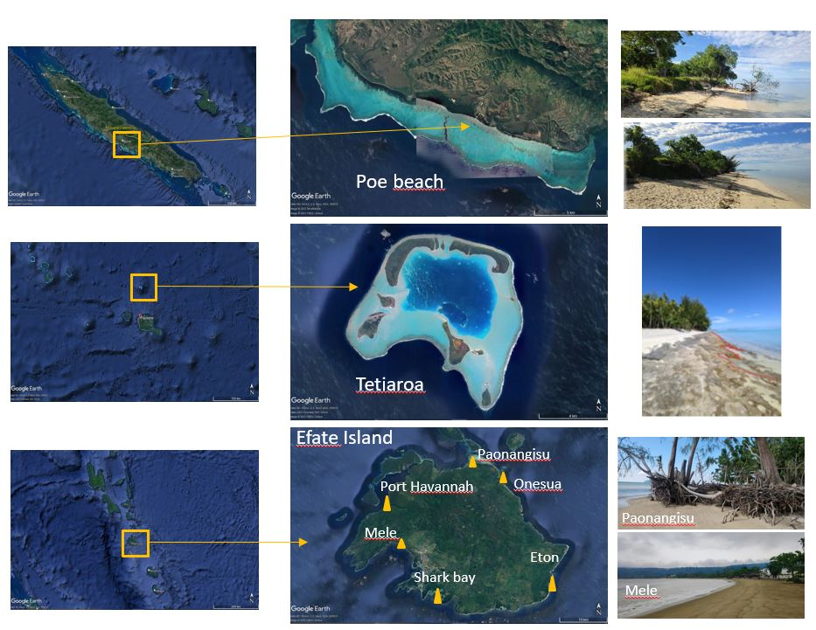
Context Methods Results
Study locations
New-Caledonia
        Poe beach
French Polynesia
        Tetiaroa
Vanuatu
        Mele beach
        Onesua beach
        Paonangisu beach
        Eton
        Shark bay
        Port Havannah
Notes:
About the study locations of this project, we have 8 sites located in 3 different countries.
The fisrt one is located in New-Caledonia at Poe beach which is a very touristic area but where erosion is severe.
The second site is located at Tetiaroa in French Polynesia. This site is important because morpho sedimentary dynamics are rapid.
And we have also in this project 6 sites in Efate Island in Vanuatu : Mele beach, Onesua beach; Paonangisu beach, Eton, Port Havannah and Shak Bay.
These sites were selected with the government of Vanuatu because they are beaches marked by severe erosion.

Slide 6
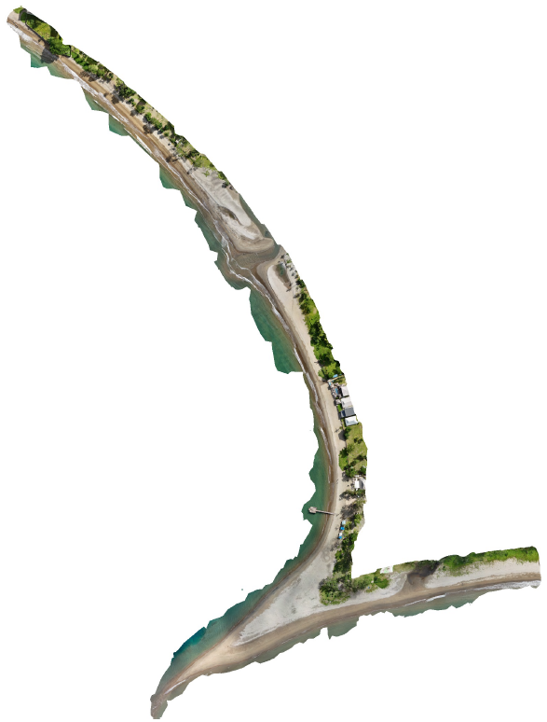
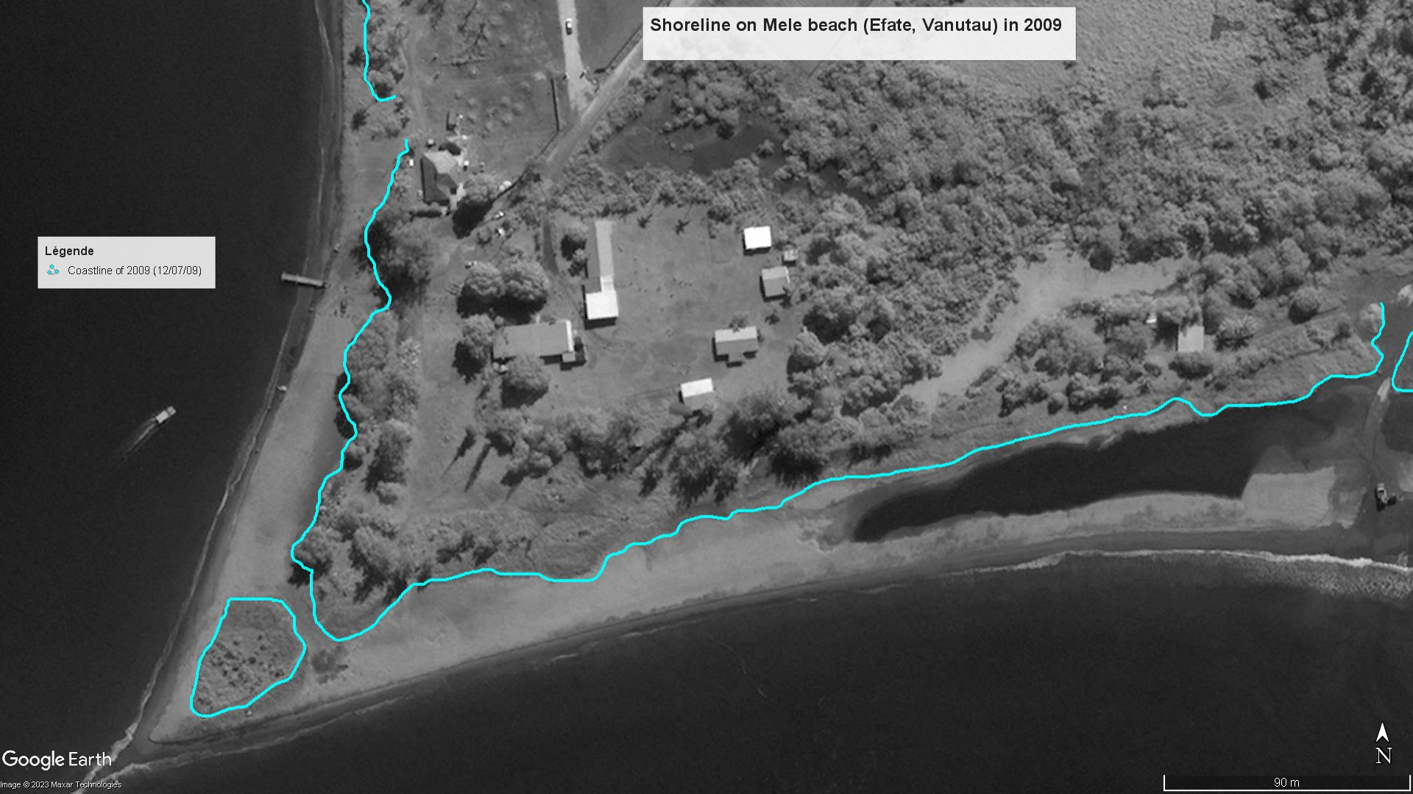
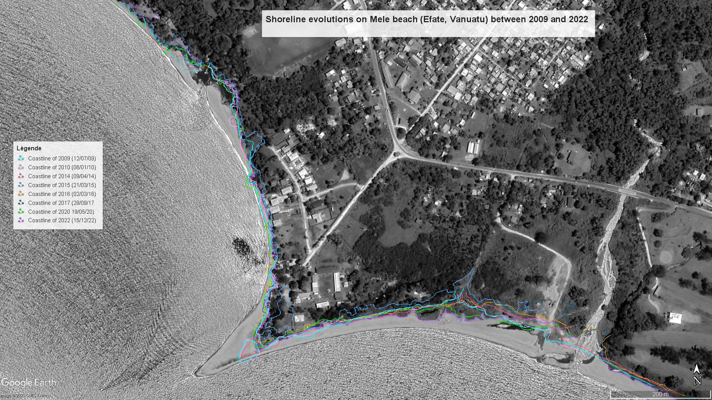
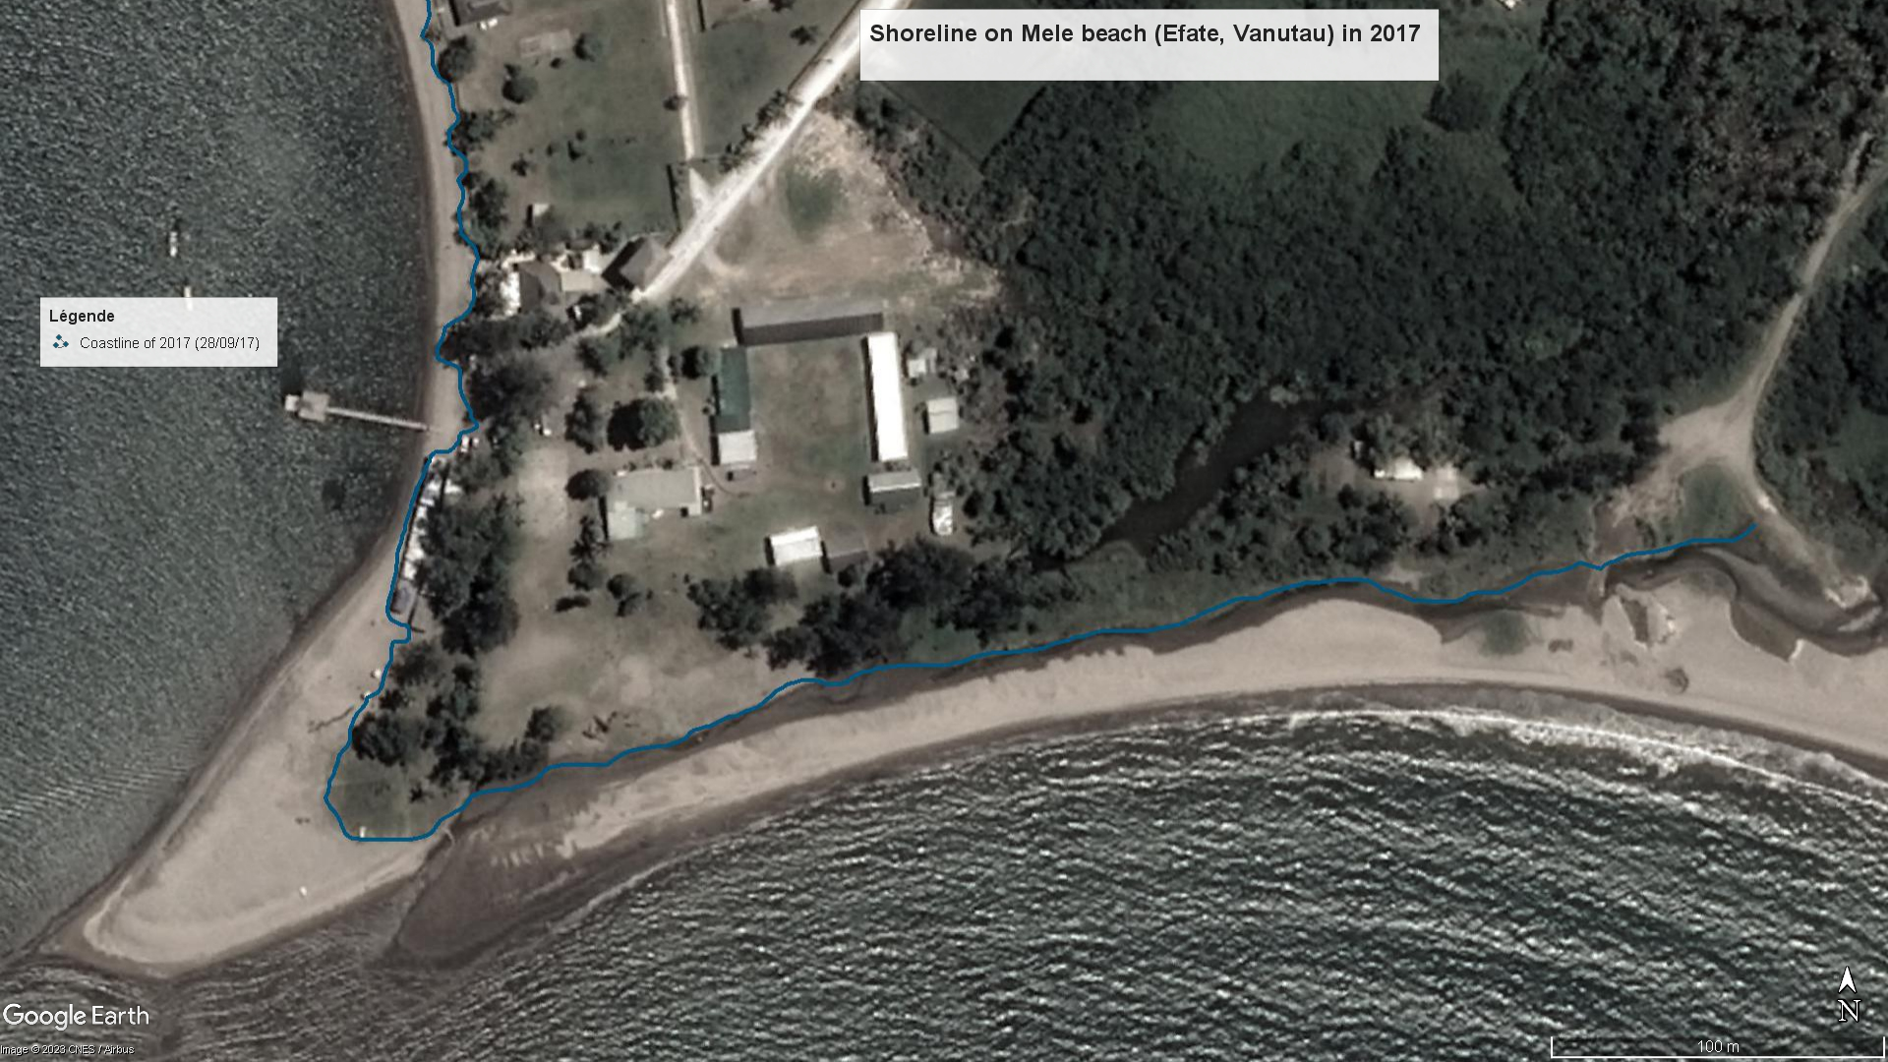
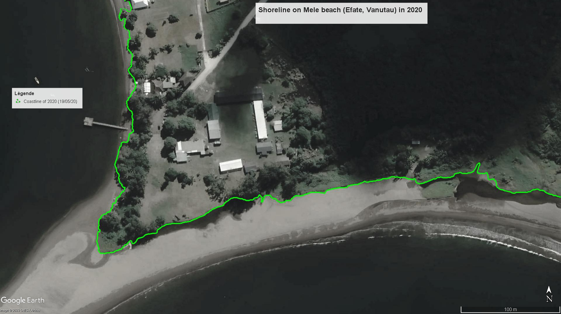
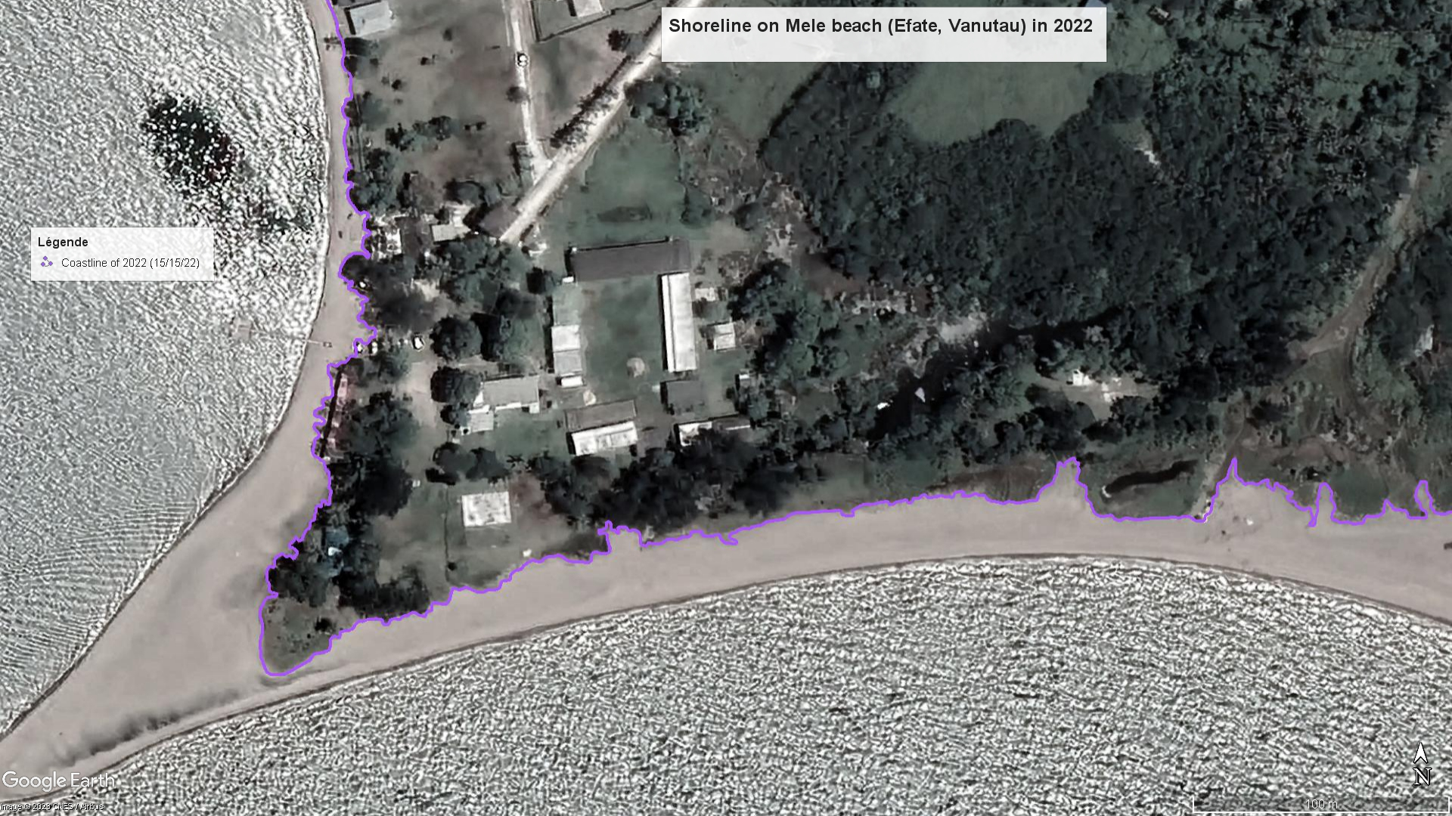
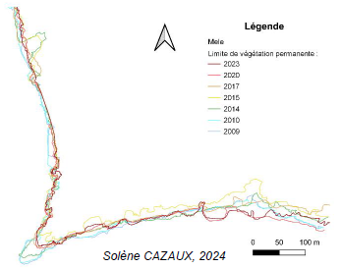
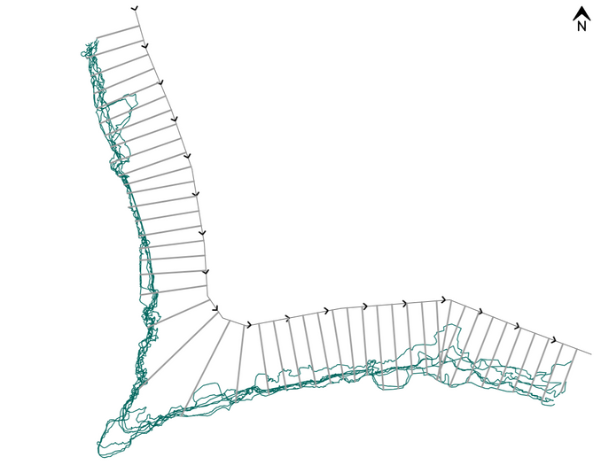
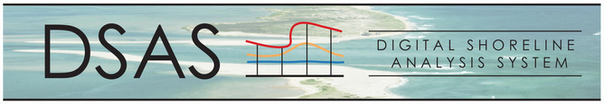
Context Methods Results
How to monitor coastline evolution ?
Implementation of different coastline monitoring methods
Diachronic study using visual-interpretation of satellite images and aerial photography
This approach consists to digitalize the position of the coastline (defined as the limit of permanent vegetation, which is an indicator visible from the sky) at different times.
2009
April 2024
Recent UAV
data acquisition
2017
2020
2022
A classic approach and one of the most used
Examples at Mele Beach
Efate Island / Vanuatu
Limit of permanent vegetation
2024
2023
2020
2017
2015
2014
2010
2009
This software computes the rate of shoreline change using historical
shoreline positions represented in a GIS.
Erosion rates are calculated
on transects every 10 m
Notes:
Now the first question is : how to monitor coastline evolution
In this project we use different coastline monitoring methods :
The first one is a classic approach and one of the most used : it’s the diachronic study using satellite images or aerial photo.
The objective digitalize on the images positions of the coastline at different times.
This method provides precise information on the position of the coastline (defined as the limit of permenant vegetation, which is an indicator visible from the sky).
After, this first step it’s easy to compare in a GIS the position of the different coastlines to calculate shoreline dynamics.
To do this we use DSAS : Digital Shoreline Analysis System. It’s like a plugin extension that you can install with ArcGis or QGIS GIS. This software computes the rate of shoreline change using historical shoreline positions.

Slide 7
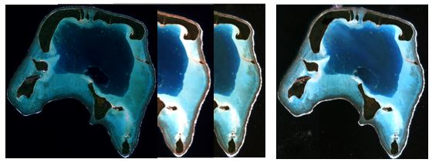
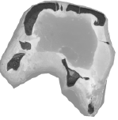
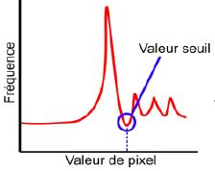
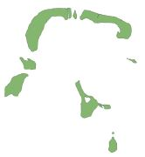

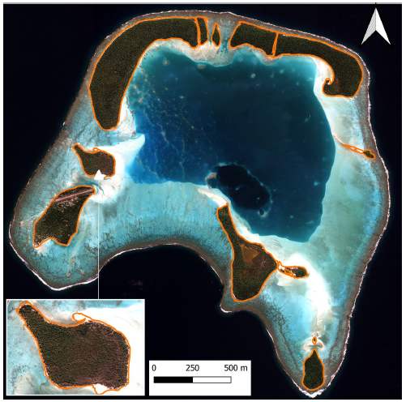
Context Methods Results
How to monitor coastline evolution ?
Method (Qgis)
Satellite Images
- Automatic coastline extraction
Raster calculator DDWI (Green-IR)
Raster Image B&W
Histogram
Threshold value
(smallest value
between 2 peaks)
Threshold value
apply to the image
Images used : Pléiade (50 cm resolution, multispectral R,V,B,IR)/ 2014, 2016, 2019, 2022 (taken at the same time with the same tide)
Pixel value
Vector image
Binary raster image
Extraction of the land/water layer
DDWI « Direct Difference Water Index »
DDWI = Green – NIR (Abdelhady et al., A Simple, Fully Automated Shoreline Detection Algorithm for High Resolution Multi-Spectral Imagery -2022)
- Advantage : Fast, reliable and applicable to all high-resolution satellite images (R,V,B,IR), objective approach
- Disadvantage : Image cleaning procedure required (when image is cloudy and after the vector process / artefacts to erase)
Raster
to vector
Limit of water extracted from DDWI for each image
Shoreline analysis between 2014
and 2022
Notes:
Another approach use in this projet was an automatic coatline extraction tested in French Polynesia
For do this we use Pleiades satellite images at fifty centimeters resolution.
A new but very simple algorithm was used : it’s the DDWI for Direct Difference Water Index.
This algorithm consists of subtracting the near infrared band from the green channel.
I am not the time to present the method but the different processes consist to separate water surfaces from land surfaces.

Slide 8
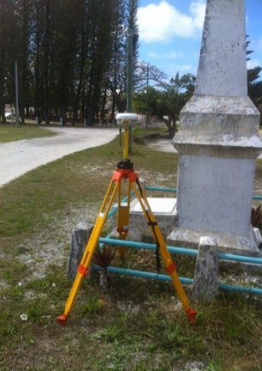
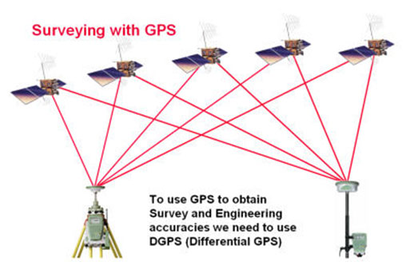
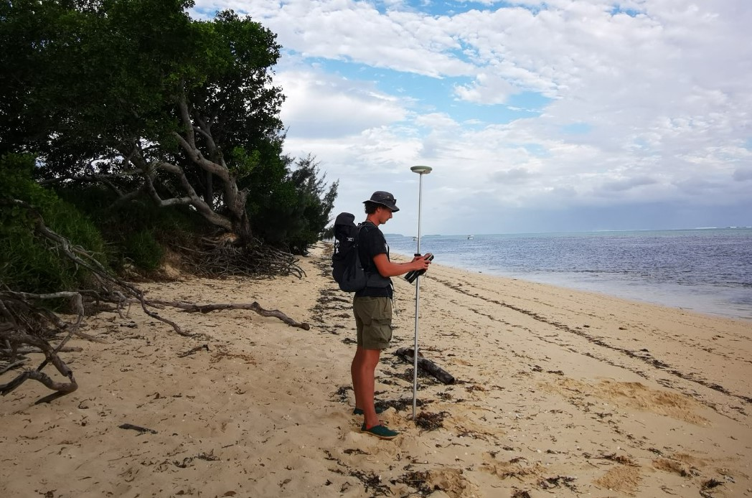
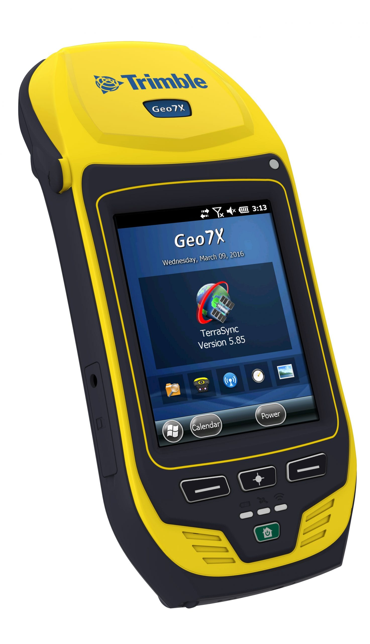
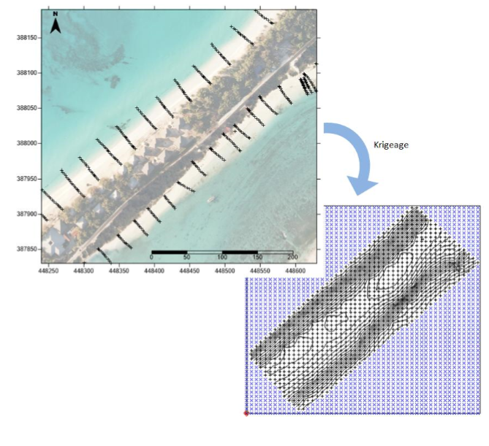
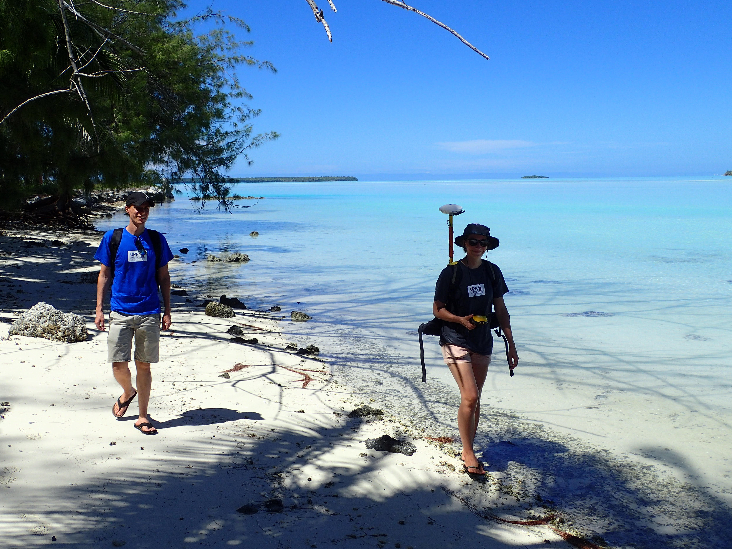
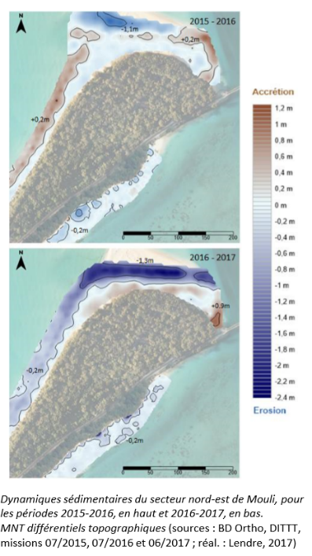
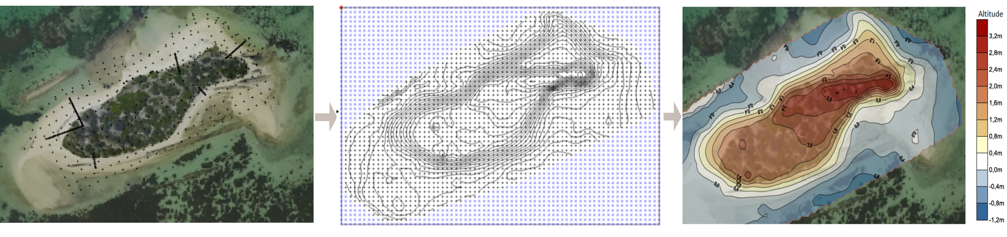
Context Methods Results
How to monitor coastline evolution ?
Implementation of different coastline monitoring methods
Topographic surveys using a DGPS (Differential Global Positioning System)
This instrument (used by surveyors) makes it possible to carry out very precise topographic surveys of beach morphology and the position of the coastline (centimetric precision model)
DGPS
Base station
DGPS
Mobile
Beach profil
Kringing method interpolation to obtain a DEM
Accretion
A digital elevation model (DEM) to analyze the micro-topography of the coast /beach
Erosion
Differential DTM (2021-2022 above)
Differential DTM (2022-2023 bottom)
Notes:
Another method take in account in this project is the use of the Differential Global Positionning System (DGPS).
As you know this tool provides geographic positioning with centimeter or millimeter accuracy (in real time or after post-processing).
We have used this tool to delimit directly one the filed the most recent coastline but also to make beach profiles (transect from the bottom of the beach to the top of the beach).
After processing the positioning data using interpolation methods, we can obtain a digital elevation model to analyze the micro-topography of the coast.
And finally, by comparing digital elevation models at different dates, we can map areas of erosion and/or accretion.

Slide 9
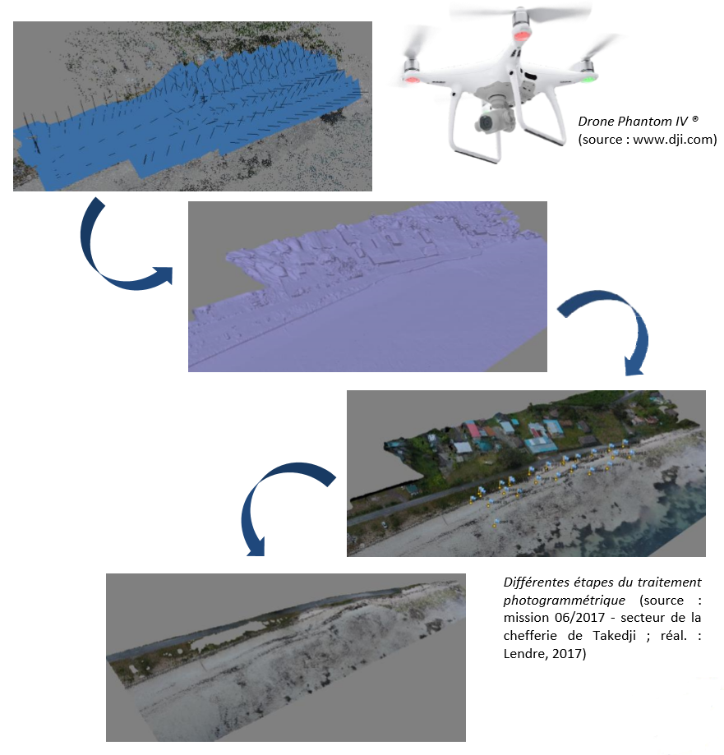
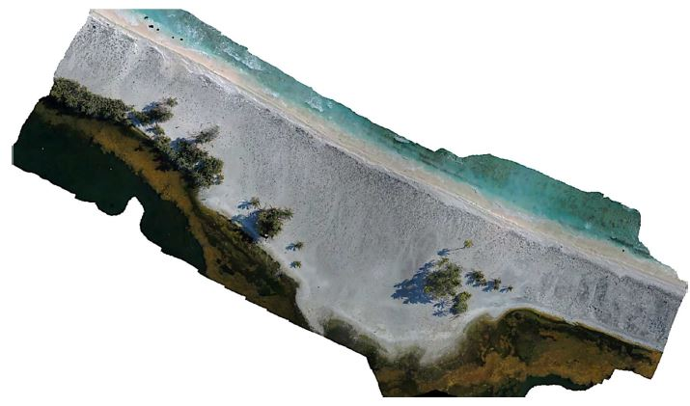
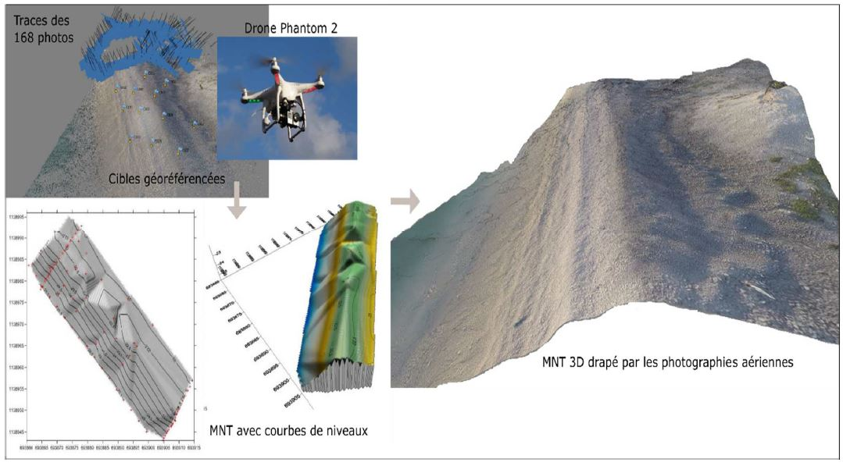
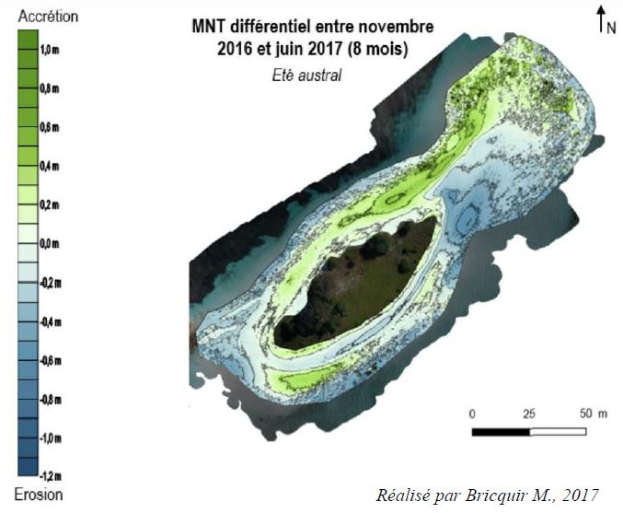
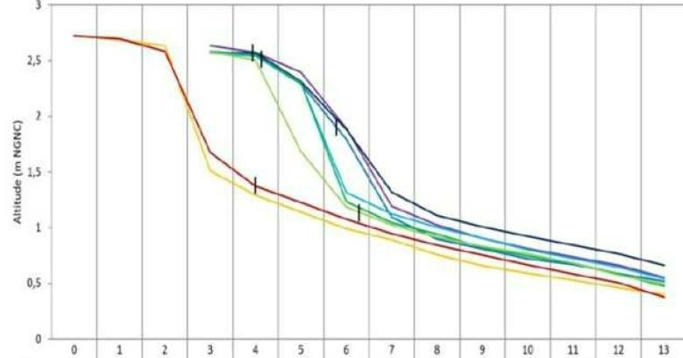
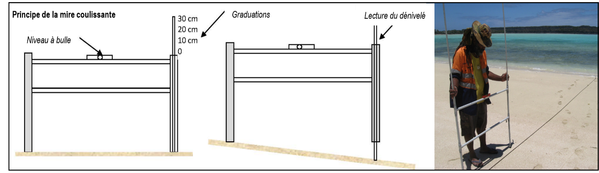
Context Methods Results
How to monitor coastline evolution ?
- Photogrammetric surveys using UAVs (RTK model)
Production of orthophotographs, 3D models and Digital Surface Models (DSM) of the beaches with high topographic accuracy (centimetric resolution)
These products are very interesting for monitoring the morpho-sedimentary dynamics of the coast
- Using the Emery frame to create beach profile
Useful instrument for measuring beach topography of the beach along a transect: the measurement between two points separated separated by 1 meter
Beach profil : Topography from the top of the beach to the bottom
March
2023
May 2023
December 2022
With several profiles of the same transect at different dates, we can have a good understanding of the evolution of the coastline (beach in erosion or accretion)
This instrument is very easy to use, making it possible to set up a participatory approach with local communities
Notes:
About the other monitoring methods used in this project :
We use the drone. Today drones can be used to carry out (produire) analyses such as : orthophotographs, 3D models and Digital Surface Models (DSM) of the beaches with high topographic accuracy (at centimetric resolution). All of these products are very interesting for monitoring the morpho-sedimentary dynamics of the coast.
And finally, in contrast to the complex use of drone, we use in this project one of the simplest methods for monitoring beach dynamics : it’s the Emery frame.
The Emery frame is a very useful instrument for measuring beach topography of the beach along a transect : a measurement between two points separated by one meter provides the topography from the top of the beach to the bottom (difference of elevation between these 2 points of the frame).
The objective is to make a mesurement of the same transcet at differents dates and compare the profiles to observe the dynamics of the coast (and see if the beach is in erosion or in accretion).
This instrument is very easy to use, making it possible to set up a participatory approach with local communities who can take the measurements themselves.

Slide 10
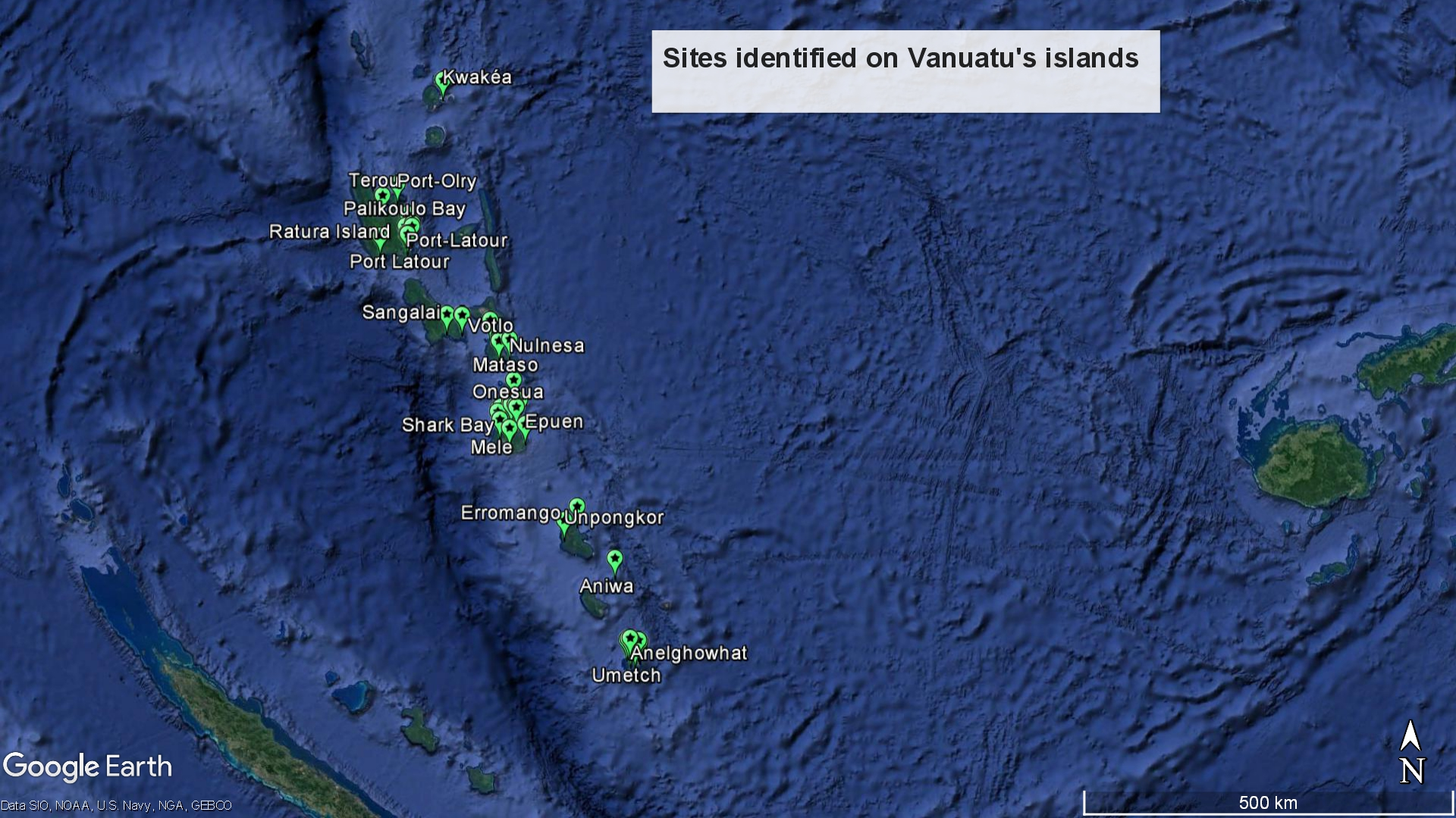
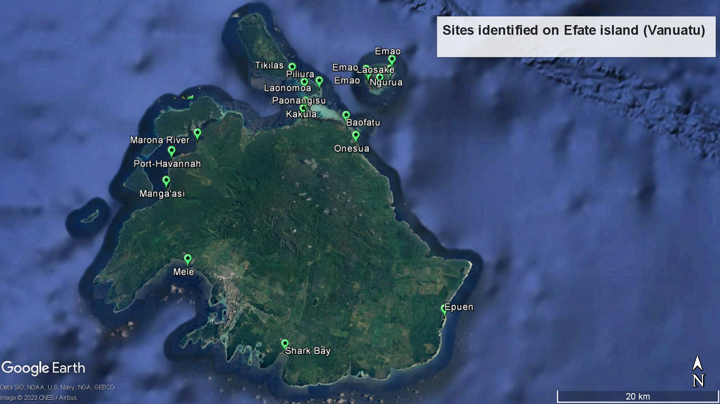
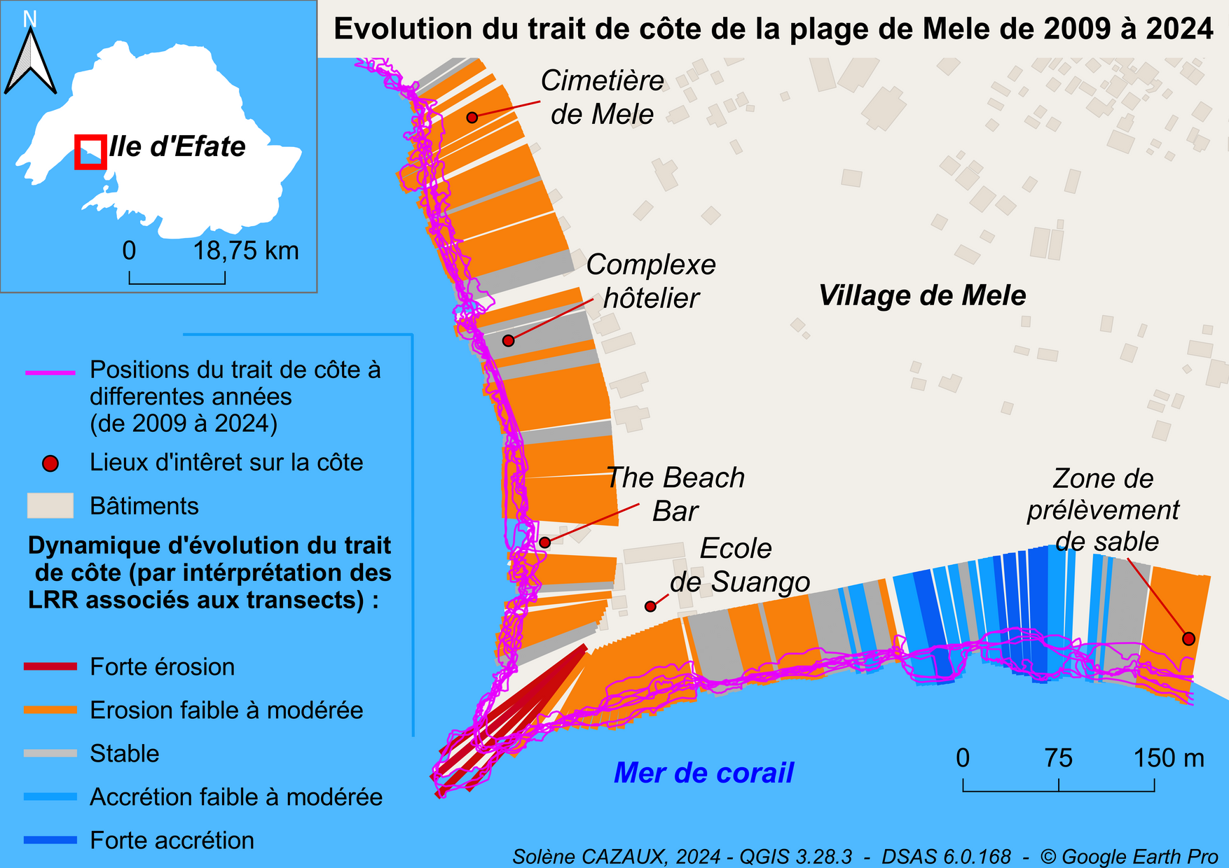
Context Methods Results
First results – Examples in Vanuatu
Islands | Identified sites
Efate | Mele Beach
 | Shark Bay
 | Epuen
 | Onesua (Sara Beach)
 | Baofatu
 | Paonangisu
 | Marona River Estuary Mouth
 | Port-Havannah
 | Manga’asi
Nguna | Tikilas
Pele | Piliura
 | Laonomoa
Kakula | Sandy Spire
Emao | Laosake
 | South of Marow (x2 coasts)
 | Ngurua
 | North Beach
Aniwa (IsawaÏ) | The entire eastern facade
Malekula | Luwoy
Kwakéa | Kwakéa
Identification of severe erosion sites (significant shoreline dynamics)
In Vanuatu, after a visual-interpretation analysis of satellite images (between 2010 and 2022) of the entire archipelago shoreline (most of the large islands), 35 sites were highlighted by severe erosion
Example of sites in severe erosion
Multi-temporal approach to shoreline evolution and characterization of erosion rates
Evolution of the Mele beach coastline from 2009 to 2024
Evolution process | % of coastline impacted | Erosion rates
Severe erosion | 1,9 % | - 3,28 m/an
Moderate to low erosion | 58,4% | - 0,88 m/an
Stable | 22,4% | -0,07 m/an
Moderate to low accretion | 12,1% | + 1,14 m/an
High accretion | 5,1% | +2, 37 m/an
Average rate for the site |  | -0,33 m/an
The tip of the beach has the highest rate of erosion ( - 3m /an)
Highlighting sedimentary dynamics
Notes:
About the results : I will present you just some first results with examples in Vanuatu
The fisrt step was the identification of severe erosion site (where the dynamics of the coastaline is the most important).
In Vanuatu for example after a visual-interpretation analysis of satellite images (between 2010 and 2022) 35 sites were highlighted by severe erosion.
For the most interesting sites, and where there are high stakes (such as housing, roads, human infrastructures) a precise multi-temporal approach of coastaline evolution was done to have a better characterization of erosion rates.
For example here at Mele beach, for each transect the rates of erosion or accretion is calculated in meters using DSAS software.
on this very popular beach, important rates of erosion have been recorded at the tip of the beach (with a retreat of 3 m per year) and 60 per cent of the beach is eroding .
It's important to understand that the coastline is always moving. It's only natural. What we're looking for, are medium- and long-term trends to identify erosion or accretion processes.

Slide 11
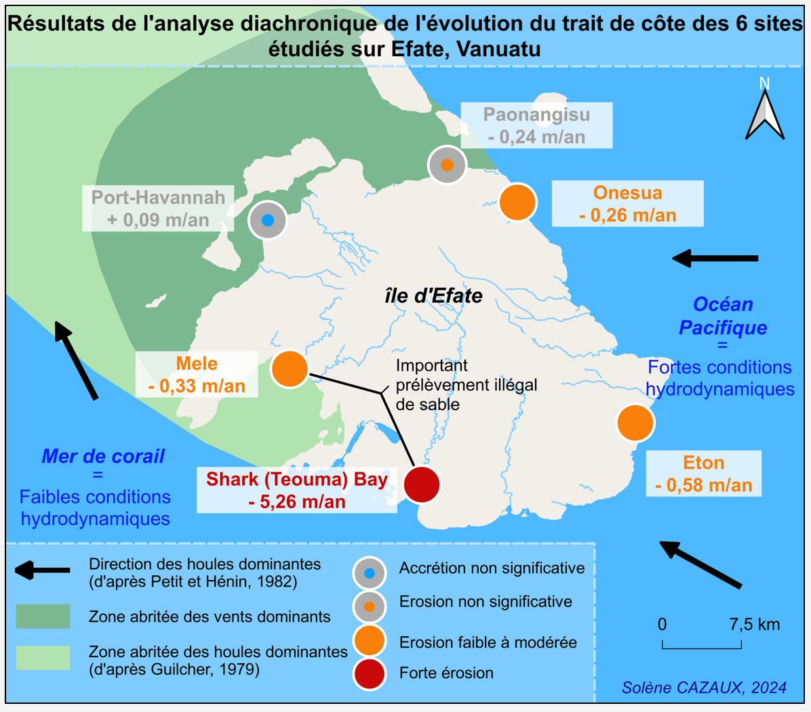


Context Methods Results
First results : Examples in Vanuatu
Results of a diachronic analysis of the evolution of the coastline
Efate Island Vanuatu
In addition to Mele, 5 other sites were studied on Efate
No significant accretion
No significant erosion
Low to moderate erosion Severe erosion
Mele beach : Factors linked to hydrosedimentary functioning
Mouth
- Erosion rates and the sectors most affected were defined for each study site
Sand collection area
- The annual retreat of the coastline has been calculated. Some sites are very badly affected, such as Shark Bay, where the coastline is retreating by more than 5m per year (between 2008 and 2024)
Direction of swell
Longshore drift
- For each study site we have highlighted the natural and anthropogenic factors to explain the current dynamics
Notes:
In addition to Mele beach, 5 other sites were the subject of a specific study :
For each study site erosion rates and the sectors most affected were defined.
The annual retreat of the coastline has been calculated. Some sites are very badly affected by erosion. It’s the case at Shark Bay, where the retreat ot the coastline is more than 5m per year (between 2008 and 2024)
For each study site we have highlighted the natural factors (as the longshore drift or the direction of swell) and anthropogenic factors (as sand extraction) to explain the current dynamics.

Slide 12

Context Methods Results
Evolution of the sandy barrier beach on Baoafatu (Efate /Vanuatu) between 2009 and 2022
(source: Google earth)
Notes:
Just a quick video showing the geomorpho sedimentary evolution of the Baoafatu beach between 2009 and 2022.
This position of the coastline corresponds to the passage of cyclone PAM in 2015, when hundreds of cubic meters of sand were transported on land.
Over the years, we have seen a return to equilibrium.

Slide 13

Context Methods Results
First results – French Polynesia
Coastline position between 2016 and 2023 – Tahuna Iti - Tetiaroa
Motu | Year | Area (m²) | Gain / loss | Total percentage
Tahuna Iti | 2023 | 91 167 | 16 679 m² | 22,4 %
 | 2022 | 87 793
 | 2019 | 75 058
 | 2016 | 74 488
the coastline is very mobile
Notes:
Just a quick slide for see what’s happening at Tetiaroa in French Polynésia
In this case 4 coastline were take in account (obtained by DDWI extraction and DGPS acquisition).
In fact, once again, we can see that the coastline is very mobile.
In just seven years, the surface of the island has increased by more than 20 percent.
This can be explained by the fact that over this period the region has been subject to important meteorological and marine forcing (as cyclone, Nina oscillation)

Slide 14









Context Methods Results
First results on the participative approach
Vanuatu's coastlines in the face
of climate change
Awareness workshops
Working with : middle school students
and teachers
Topics such as coastline dynamics,
coastal vulnerability, consequences of climate
change on the coastal zone, the coastal erosion, etc.
Teaching aids : posters and PowerPoint presentations
Measurement workshop with Emery frame
Awareness workshops were completed by measurement sessions directly in the field, using the Emery framework
Objective :
Know how to use the frame independently to make beach profiles and have a regular monitoring of the beach topography (every month, or after a cyclone for example). These profiles will be made by teachers with their students and sent to the project coordinator
Field measurement on May 29, 2023 Mele beach
Notes:
Just talk quickly about the participative approach.
We have set up workshops on awareness workshop among schoolchildren.
We have worked with middle school students and teachers on topics such as coastline dynamics, the coastal vulnerability, the consequences of climate change on the coastal zone, the coastal erosion, etc.
To do this, we used teaching aids such as posters and PowerPoint presentations (an example of poster in this photo).
These workshops were completed by measurement sessions directly in the field, using the Emery framework in each country.
Objective : know how to use the frame to make beach profiles and regularly monitor beach topography (every month, or after a cyclone for example).
These profiles will be made by teachers with their students and sent to the project coordinator to collect the date in a database.

Slide 15
Context Methods Results
Outlook
Continue current monitoring of study sites
Open new coastline monitoring sites
Involve new partners in the PIURN network in the development of the coastline observatory.
Continue to develop a participative approach
Rely more on the DATA TERRA network to benefit from their expertise and the possibility of acquiring more very high-resolution satellite images
Notes:
Continue current monitoring of study sites : the objective is to collect new data each year to feed the coastal observatory
Open new coastline monitoring sites for example at Santo in Vanuatu and Loyalty Islands in New-Caledonia
Involve new partners in the PIURN network to participate at the development of the coastline observatory.
I'm thinking in particular of the Cook Islands and Fiji. On this point, we have had a PhD student for a year, Lency Muna. Lency comes from the Solomon Islands, did all his studies in Fiji and is now working on the subject of coastal submersion, erosion and adaptation by local populations in Fiji
Continue to develop participatory approach to collect some data from the field
Rely more on the DATA TERRA network to benefit from their expertise and the possibility of acquiring very high-resolution images

Slide 16


Vinaka Vakalevu
Merci pour votre attention
Contact : Pascal DUMAS
Pascal.dumas@unc.nc

