Slide 1



A Usable Encryption Solution for File-Based Geospatial Data within a Database File System
Pankajeshwara Sharma,
Michael Govorov* and Michael Martin
Department of Environment, University Of Auckland
*Department of Geography, Vancouver Island University,
Journal OF CYBERSECURITY AND PRIVACY
(APRIL 2024)
DOI: https://www.mdpi.com/2624-800X/4/2/15

Slide 2

About Me
Aug 24 – Present, Associate Professor at The University of Fiji
2021 – 23, Research Fellow at the University of Auckland (Indigenous Data Sovereignty project).
2003 – 06, MSc Computing from USP (Security Solutions for Spatial data in-storage)
Six years as a software developer in the public & private sector in Fiji and NZ
Fijian Drua’s narrow victory over Crusaders – March, 2023
Notes:
A little about my background.
I currently work on building a data sovereignty tool at Auckland University.
I completed by PhD at Otago university in 2021.
I have taught in a similar position at the University of Fiji.
I also have experience working in the industry as a software developer within public and private sector.
There my wife on an auckland harbour boat ride after being released from the lockdown in december.
There is us on our graduation in Dunedin as yoga teachers

Slide 3
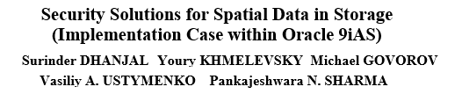
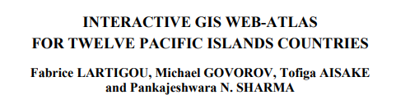
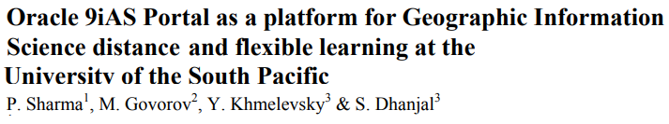
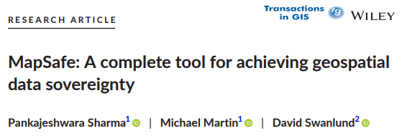
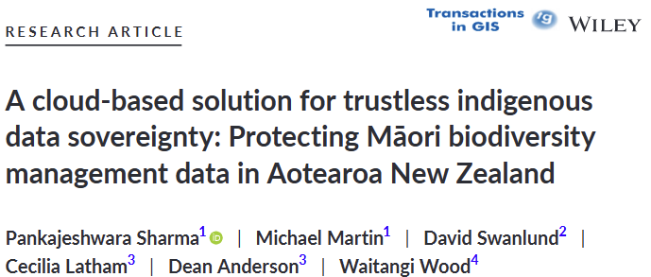
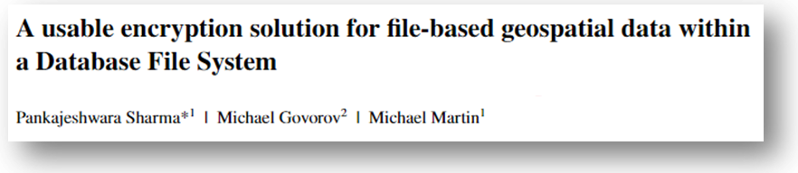
Background in GIS data security
2004-7
(MSc USP)
2021-23
(PostDoc)
Notes:
A little about my background.
I currently work on building a data sovereignty tool at Auckland University.
I completed by PhD at Otago university in 2021.
I have taught in a similar position at the University of Fiji.
I also have experience working in the industry as a software developer within public and private sector.
There my wife on an auckland harbour boat ride after being released from the lockdown in december.
There is us on our graduation in Dunedin as yoga teachers

Slide 4
Enterprise Geospatial File Data Security
Spatial data challenges:
  Data silos: Organisational spatial data scattered data across multiple servers
  Cloud service offers data storage and management solutions at a lower cost
Explore alternative robust on-premise data storage solution:
  Centralize spatial files into a secure, accessible localised data repository.
  Implement strong data protection mechanisms for files.
  Minimize workflow disruptions while enhancing security.
  However, security and usability are often in conflict.
Notes:
Data sovereignty aims to ensure data guardians have control over data.

Slide 5
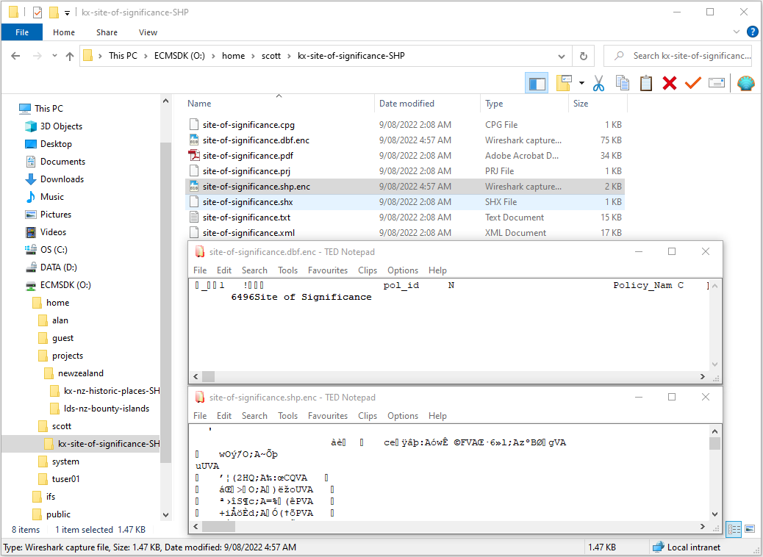
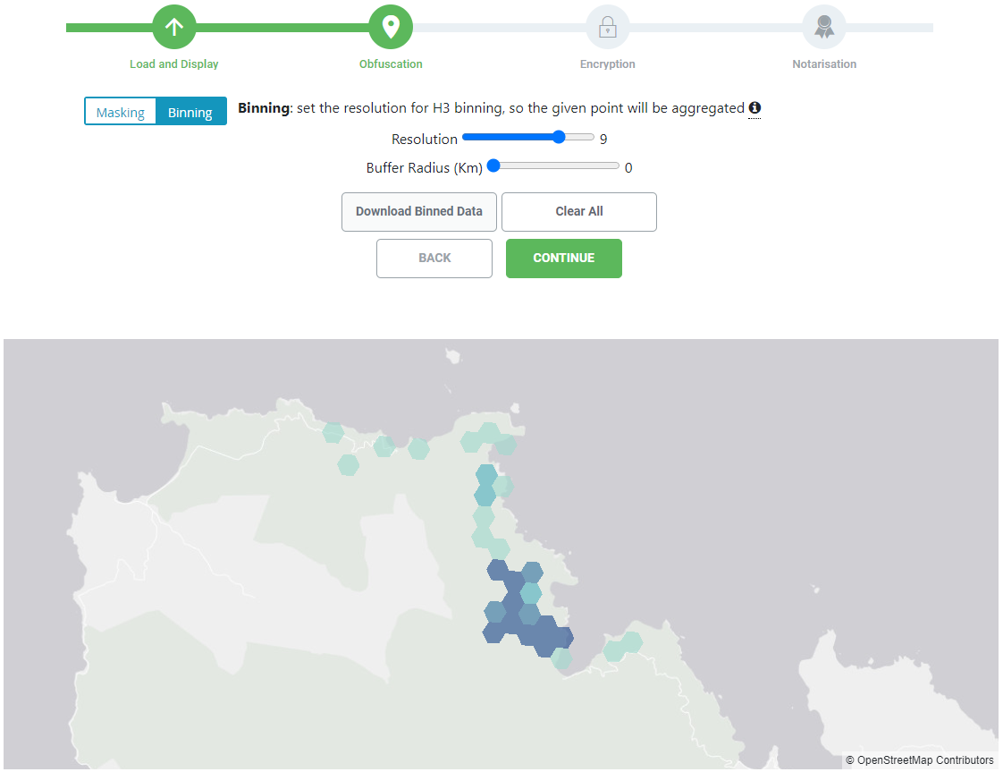
Enterprise Content Management SDK (ECMSDK)
Open Source platform¹
O:\ Drive:
  Mounts as a logical drive.
  Content stored in the Oracle/PostgreSQL Database
Features:
  Supports most common protocol services for file access (SMB, HTTP, etc)
  Content management:
  file versioning, check-in and check-out, indexing and searching
¹www.ecmsdk.com
Notes:
An alternative to geomasking, Jane can perform hexagonal binning.
The Uber’s h3-js hexagonal binning library is used.
To balance utility and privacy, binning resolution and buffer radius allows Jane to specify the resolution and coverage

Slide 6
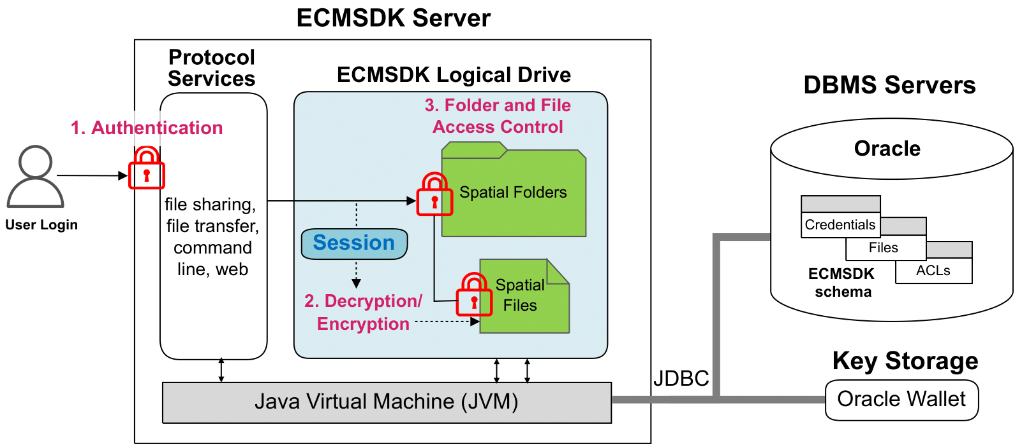
Proposed Security Solution Overview
Database File System (DBFS):
  Centralized file storage with advanced DBMS capabilities.
  Reduces data silos and enhances data accessibility.
Core Features:
  AES-based encryption for confidentiality.
  Automated encryption-decryption for usability.
GIS files of various formats can be stored centrally within the database and protected using authentication, authorisation, and encryption without changing how they work with existing GIS applications.
Notes:
We propose the MapSafe tool that offers a complete solution to geospatial data sovereignty.
The geomasking, encryption and notarisation implemented at the core – the browser.
This way all necessary sections are carried out in the browser and no data leaves the SDOs computer unprotected.
SDOs can keep the encrypted data on their computer or share it via the cloud.
Sovereign data parties can first verify the dataset, decrypt and then display the dataset.

Slide 7
Automated Encryption-Decryption
Automatically encrypted before logoff and decrypted after login
Single-User Files for encryption
  Files to be encrypted can be specified by adding an .enc file extension.
Multi-User Files for encryption
  A catalogue has files and the ids of users who should have access
Prevent double-encryption and double-decryption by checking for other users’ active sessions

Slide 8
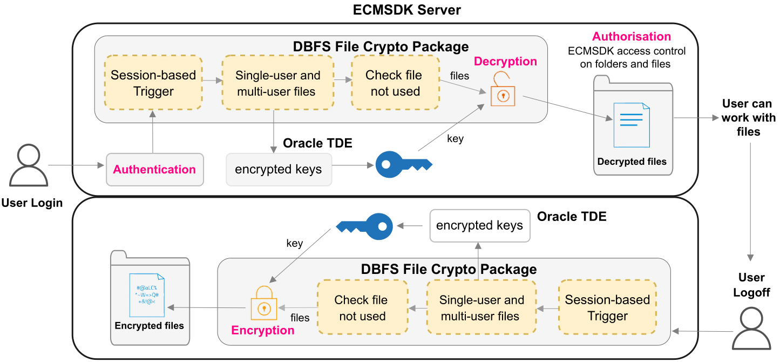
Encryption Solution Architecture
ECMSDK enforced user authentication and authorisation
Session-based Trigger invokes decryption and encryption
Encryption ensures security during storage and transfer.
GitHub repo contains code and detailed instructions²
GIS users authenticate via their DBFS account, decrypt files upon session creation,
and access them through the DBFS access control model. The bottom region shows
encryption during user logoff.
²https://github.com/sharmapn/DBFSFileCrypto
Notes:
The first step is obfuscation.
After Jane uploads the dataset, she can perform geomasking.
We use the Halo masking library offered via the maskmy.xyz tool.
Jane can choose the minimum and maximum masking boundaries.
In addition, determining if the chosen parameters are adequate, we have included Spuirlls measure.
This measure computes …

Slide 9
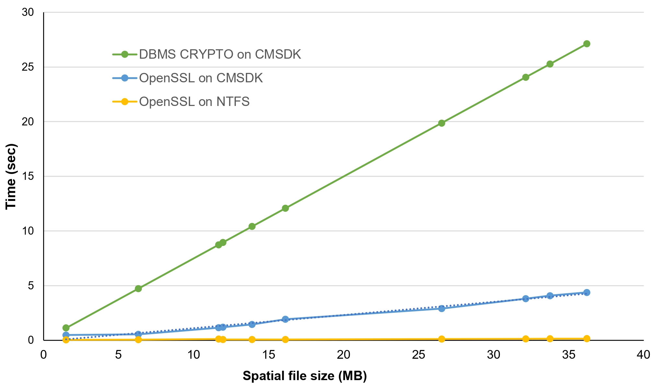
Performance Comparison
Working with files ECMSDK and NTFS
Encryption-Decryption
A difference of about 1–2 seconds for processing GIS
files in ECMSDK compared to Native Windows filesystem.
OpenSSL on ECMSDK vs OpenSSL on Windows NTFS to encrypt files takes on average, 15 times longer, it still promises as an average time of 8 Mb/sec which is quite reasonable.

Slide 10
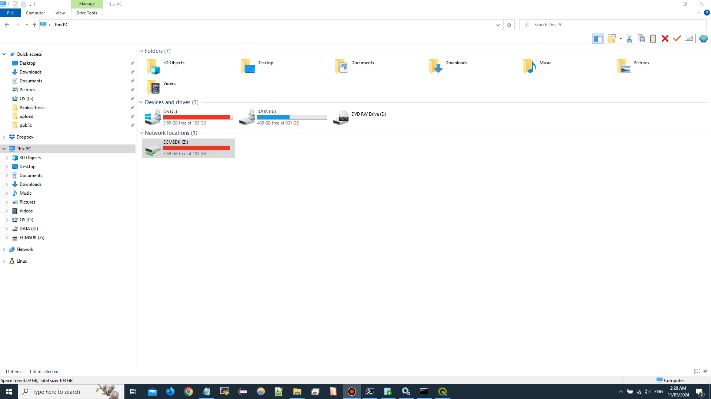
Full (3 minute) video of Reasons Miner Tool is on: https://youtu.be/nrB9Jk1OFXo

Slide 11

Summary
Key Achievements
  Open Source solution consolidates diverse spatial files into a secure, centralized repository.
  Implements a practical, user-friendly encryption solution that integrates seamlessly with existing GIS workflows.
  Balances robust security with usability, ensuring minimal impact on end-user operations.
Implications
  Promotes safer data sharing and compliance with legal frameworks, enhancing trust in geospatial data management.
  Serves as a model for integrating secure, usable encryption in other domains.

Slide 12


Acknowledgements
This research was motivated by USPNet's data security concerns for GIS/RS distance education. We are very grateful to the University Research Committee at USP for financial support for the project.
The project began at USP in 2003, with extensions and experiments conducted at The University of Auckland in 2022.

Slide 13

Thank you
Questions

