Slide 1
Women in GIS
Elevating Public Health Solutions through Spatial Analysis
Subtitle: Spatial Insights for Public Health and Empowering Women in GIS
Presenter : Neha Naidu
2024 Pacific Islands GIS & Remote Sensing Conference

Slide 2
Background – Typhoid in Northern Division of Fiji​
Goal of the project:​
Strengthen typhoid surveillance in Northern Division​
Vaccinate the whole Northern Division against typhoid ​
Impact of Typhoid Vaccination on Public Health Using GIS
This study explores the transformative role of typhoid vaccination in enhancing public health by integrating diverse data sources—clinical, environmental, and vaccination data—through the power of Geographic Information Systems (GIS).
Objective: To visualize and analyze the relationships between vaccination coverage, disease prevalence, and environmental factors such as elevation and water access.
Approach: Using GIS, we combine demographic and spatial data to identify patterns, risks, and areas for targeted intervention.
Outcome: The analysis provides actionable insights to improve vaccination strategies, reduce typhoid incidence, and address socio-environmental challenges, particularly those affecting vulnerable populations.

Slide 3
Environmental sampling principle
Modelling based on GIS elevation, waterways and population data
&
Human knowledge of historical hotspots
Map of 35 sampling spots
Monthly sampling
(Moore swab)
DNA extraction & qPCR detection of
Salmonella Typhi

Slide 4
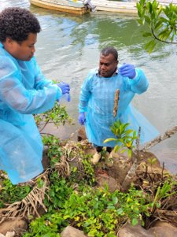
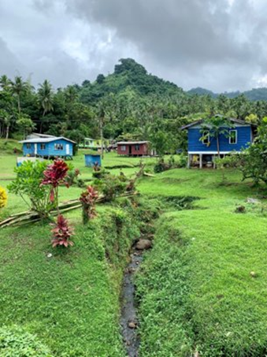

Slide 5
Environmental Surveillance – what did we do?
Monthly sampling of 35 points to detect Salmonella DNA and collect physico-chemical properties of water
Designed and installed a laboratory to process water samples and detect DNA (PCR)
Able to monitor presence of Salmonella DNA in the environment
Generated a map of sampling points across the island based on remote sensing and GIS data
Trained the team in molecular detection of Salmonella DNA
Env. Surv.
Vaccination
Clinical Surv.

Slide 6
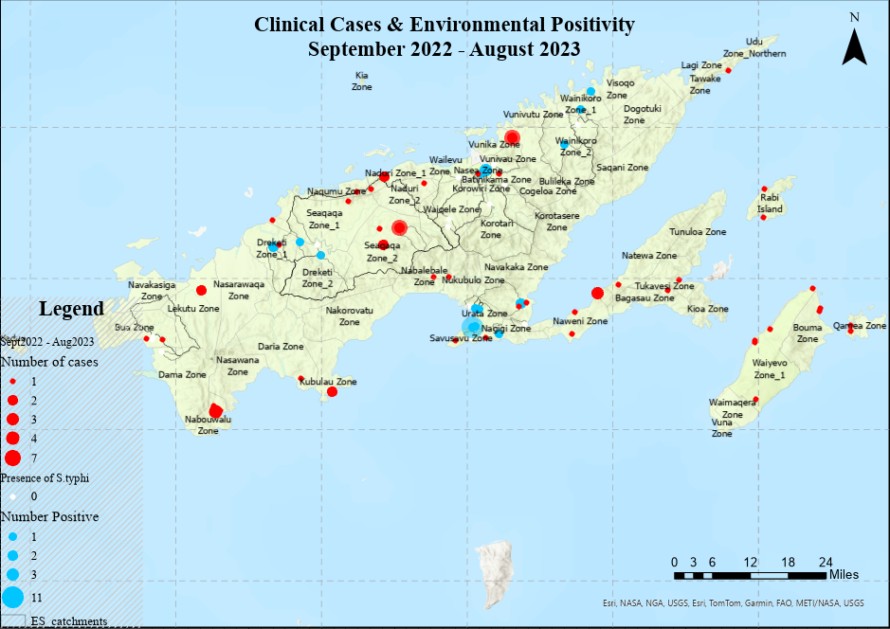
Map of clinical cases and ES positivity, pre-campaign (preliminary)

Slide 7
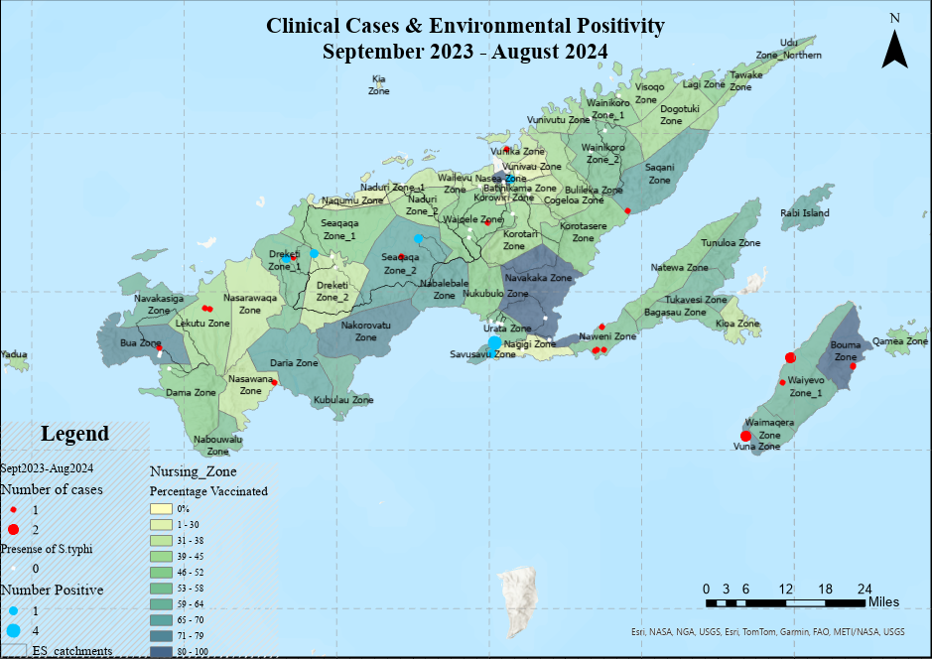
Map of clinical cases and ES positivity, post-campaign (preliminary)

Slide 8
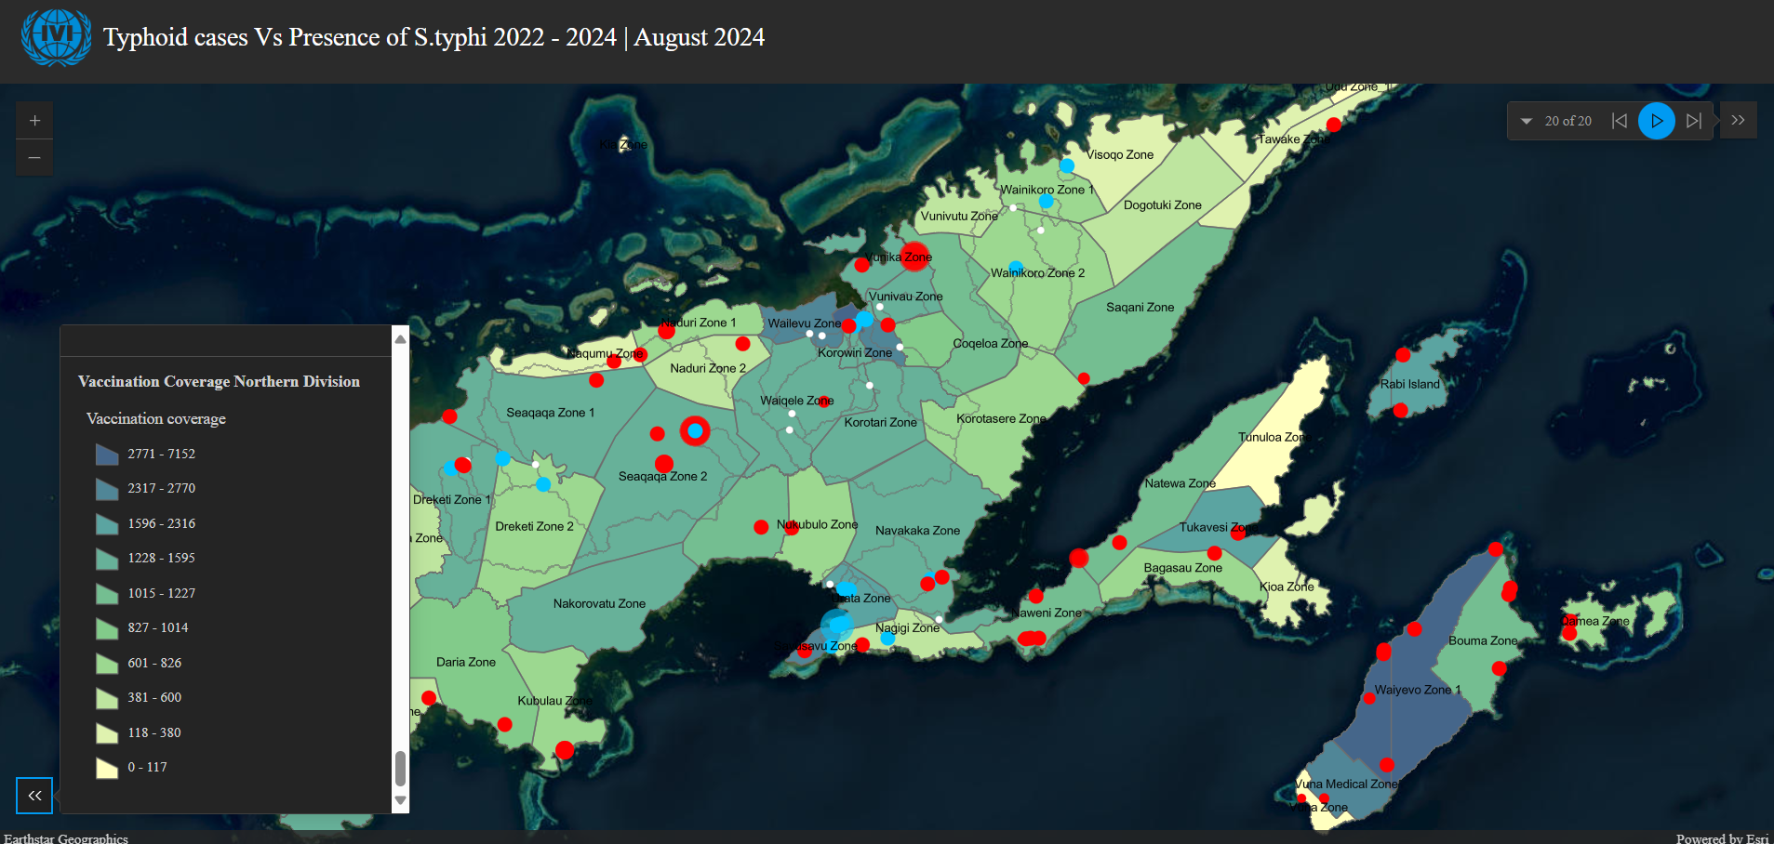
‎Instant App

Slide 9
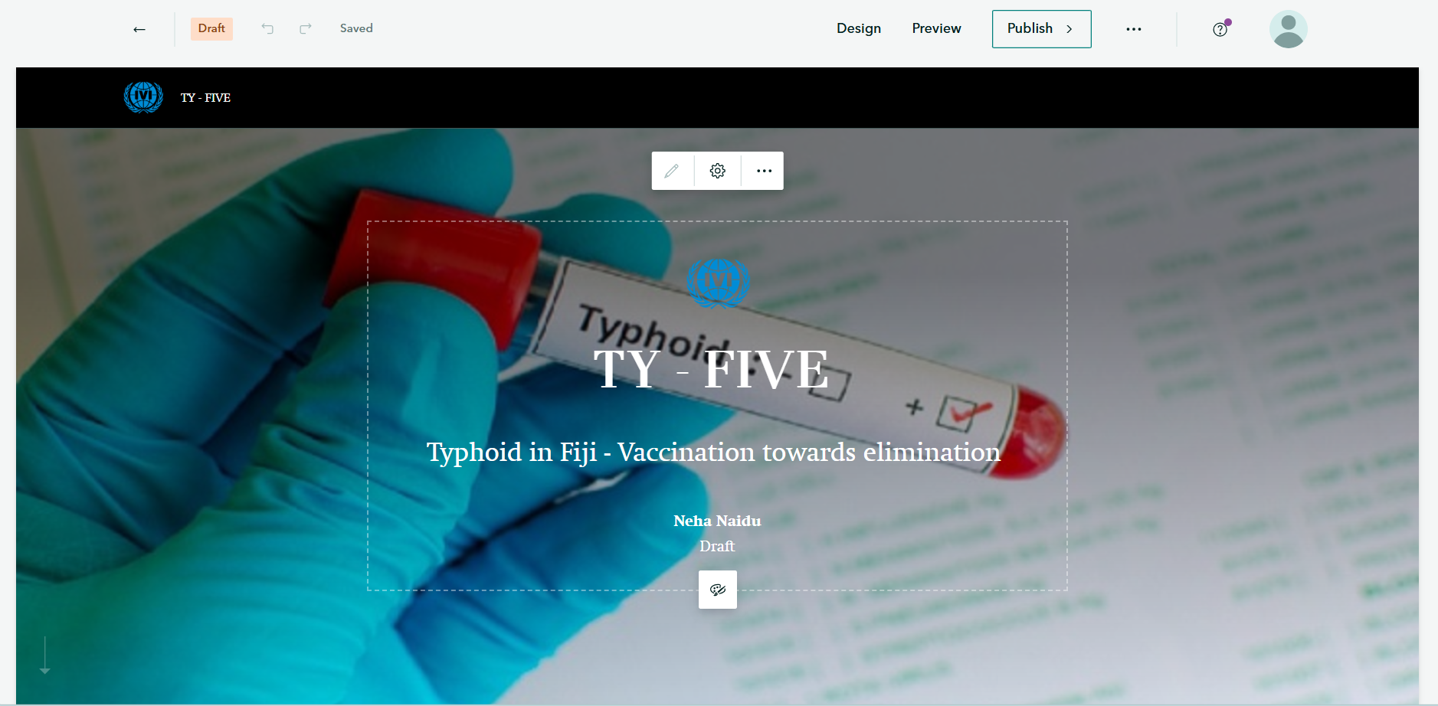
Story Map

Slide 10
Ty-FIVE summary and impact
Environmental Surveillance
Typhoid Vaccination
Clinical Surveillance
Streamlined clinical surveillance
Increased testing
Faster case & outbreak detection
Case-control study ongoing
Established environmental surveillance system (de novo)
Able to detect Salmonella DNA in the environment
Showed that environmental prevalence decreased similarly to clinical cases after vaccination (proxy?)
~70,000 doses of TCV given to 9 months to 65 years old
52.7% coverage of target population
Case reduction & no cases in vaccinated

Slide 11
Where are we now?
Continuing vaccination data analyses
Continuing Clinical and Environmental Surveillance of Typhoid in the Northern Division
Offering vaccine in health centers for those who may have missed during the campaign
Birth cohort vaccination (9 months to 5 years old at MCH clinic)
Implementing a case-control study for vaccination effectiveness

Slide 12
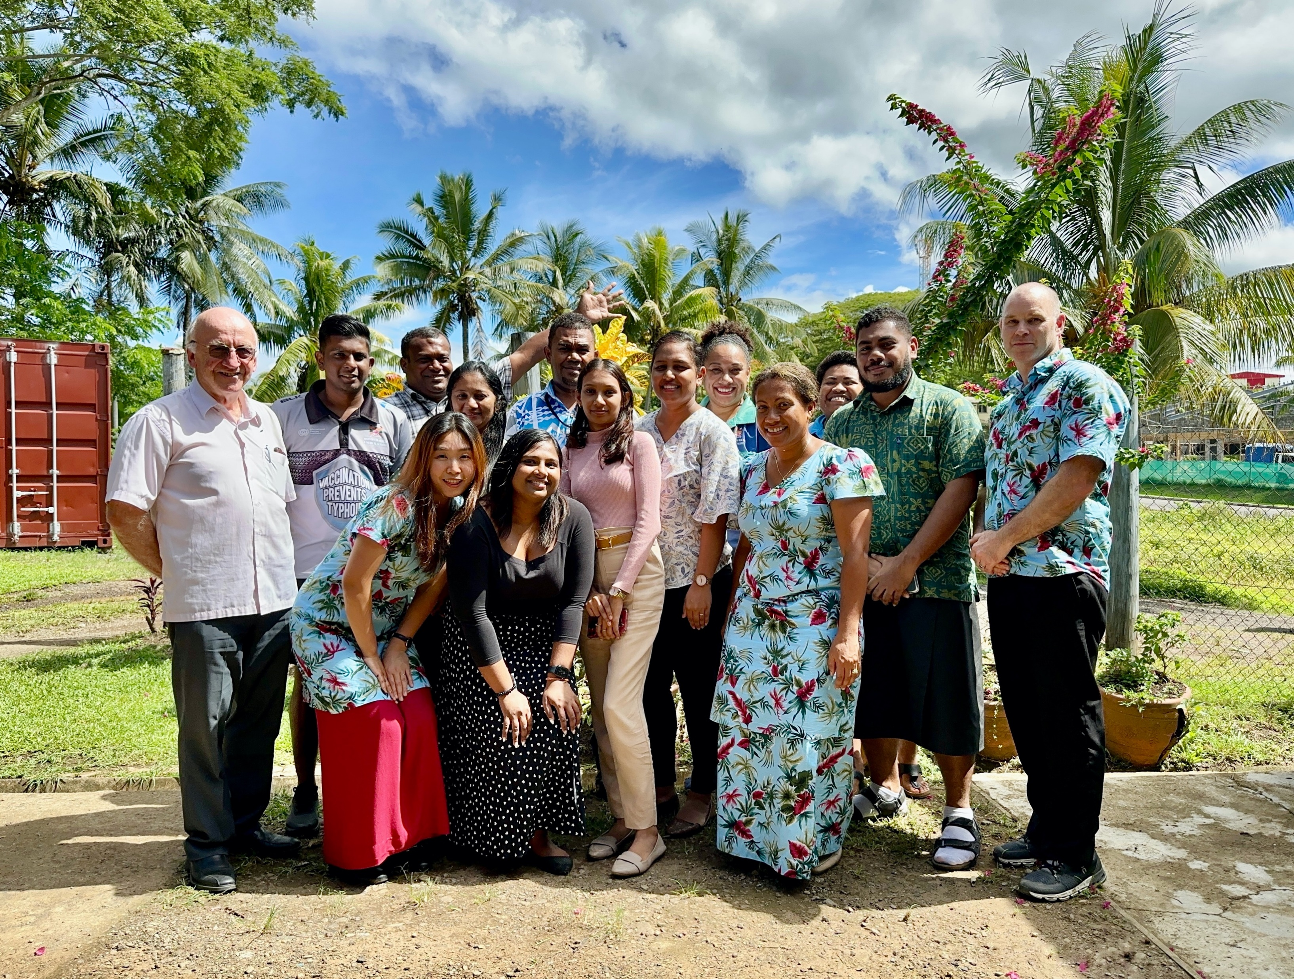
The Ty-FIVE consortium – a major team effort with Fiji MOH!
Murdoch Children’s Research Institute (Melbourne)
Prof. Kim Mulholland (co-Principal Investigator)
Peter Doherty/University of Melbourne
Prof. Richard Strugnell
Dr. Aneley Getahun
Fiji Ministry of Health and Medical Services
Dr. Rachel Devi, Head of Family Health
Sr. Litiana Volavola, EPI Coordinator, Fiji
Dr. Tiko Saumalua, Divisional Medical Officer Northern
Dr. Jemesa Tudravu, Permanent Secretary for Health
Dr. Daniel Faktaufon, Principal Medical Officer, FCDC
Mr. Vimal Deo, Chief Health Inspector
Dr. Aalisha Sahukhan, Head of Health Protection
Imperial College London
Prof. Nicholas Grassly
Dr. Christopher Uzzell
University of Washington, Seattle, USA
Prof. J. Scott Meschke
Mr Jeff Shirai
Dr. Nicolette Zhou
Ms Nicola Beck
UNICEF
Mr James Robertson
IVI team in Fiji
Dr Alumita Vuakanisakea (Project Lead)
Orisi Cabenatabua (Laboratory Officer)
Komal Aswhini (Project Administrator)
Aseri Bale (Laboratory Officer)
Ashweeni Kumar (Vaccination Nurse)
Sikeli Gavidi (Laboratory Assistant)
Merewairita Kau (Surveillance Officer
Neha Naidu (GIS officer)
IVI team in Seoul
Dr. Florian Marks (co-Principal Investigator)
Dr. Raphael ‘Rafi’ Zellweger (IVI lead, Principal Investigator for Environmental Surveillance)
Hea Sun Jenny Joh (Researcher)
Hwayoung Kim (Project Administrator)
Juyeon Park (Statistician)
Young Ae You (Statistician)
Esther Lee (Data Management)
Jae-woong Lee (Data Management)
Alyssa Cho (Associate Researcher)
Funding:
Korean Support Committee (KSC)
Bill & Melinda Gates Foundation
UNICEF (in kind): ES lab containers

Slide 13
THANK YOU

