Slide 1
Resilient Mapping of Low-Localised Groundwater Resources Potential in Nadi, Viti Levu Island, Fiji using The Art of Remote Sensing, Geospatial Techniques and GIS-Artificial Intelligence (Machine Learning)
Masters by Research Thesis in Engineering Science and Technology Synopsis
Malakai T Tadulala¹, Satyanarayan N Shashtri^{2,} Nichollas Rollings³, Ronesh Sharma¹, Joeli Varo⁴, Todd E Dennis¹
^{malakaittadulala@gmail.com}
¹Collage of Engineering, Science, and Technology, Fiji National University, Samabula Derrick Campus, Suva, Fiji
² School of Ecology and Environment Studies, Nalanda University, Rajgir Nalanda Bihar, India.
³School of Geography, Earth Science and Environment, Laucala Campus, The University of the South Pacific. Suva, Fiji.
⁴School of Business Management, Mathematics and Engineering, Geomatics, Land Management, Laucala Campus, The University of the South Pacific, Laucala Campus, Suva, Fiji.
Notes:
Title
Before diverge to the slide I would like acknowledge my sponsors Fiji National Higher Degree by Research (HDR) for the opportunity to share my knowledge and skills in this platform
Not forgetting all the related supervisors bearing with me with my study and field data collection and tireless supervision middle of the night for guidance and motivation

Slide 2
[1.0] Prelude
Part A (Why, What, How and Where?)
Introduction & Background
Research Design, Methods & Methodology
Findings & Discussion
Summary
References
Part B (Practicalities – How?)
ArcGIS Pro 3.2.2
Final Ground Resources Potential Zones
Notes:
Discuss about outline of the presentation devised into 2 categories
1st Category ( background report and literature findings methods & methodology, Summary, Limitations, References
2nd Category ( The practicability - Geospatial techniques and GWPZ)

Slide 3
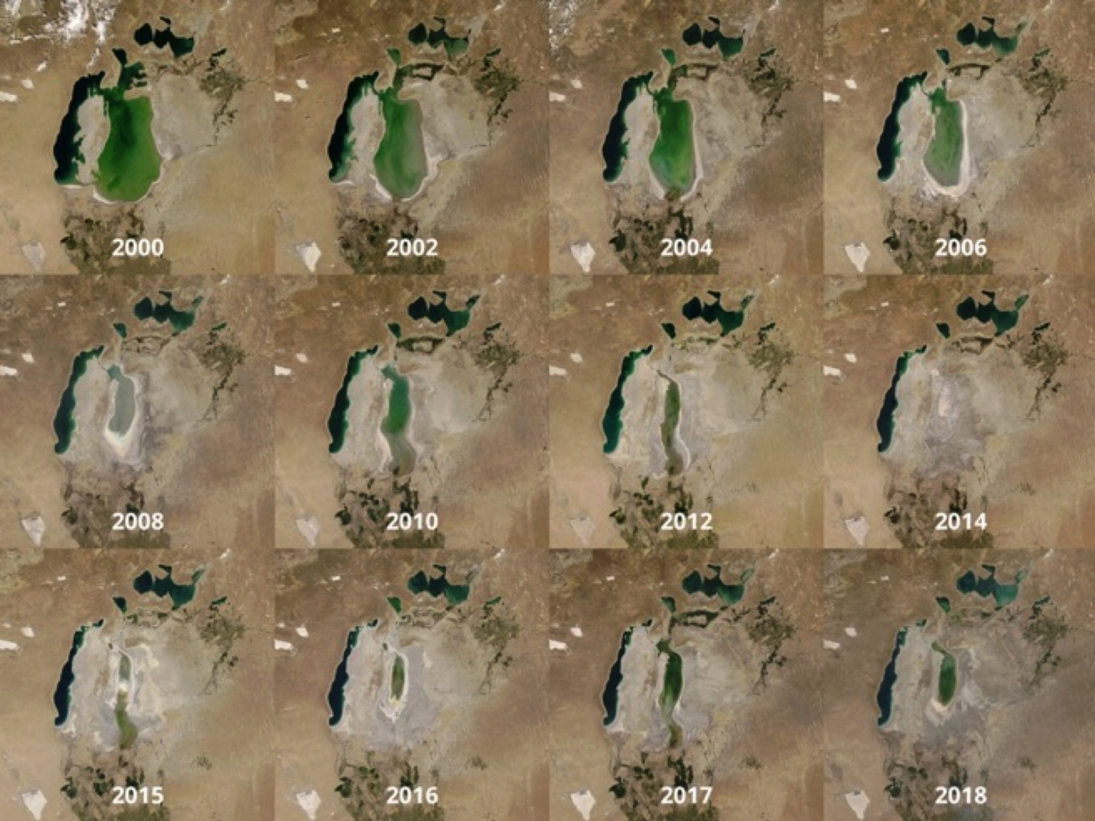
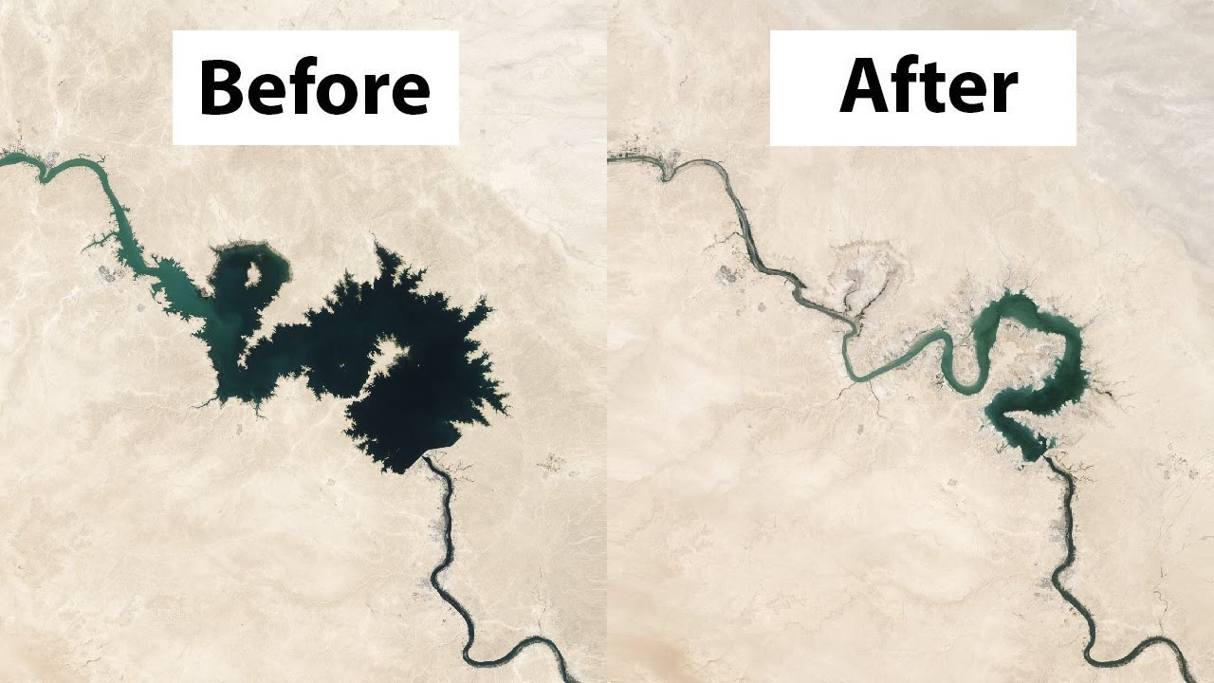
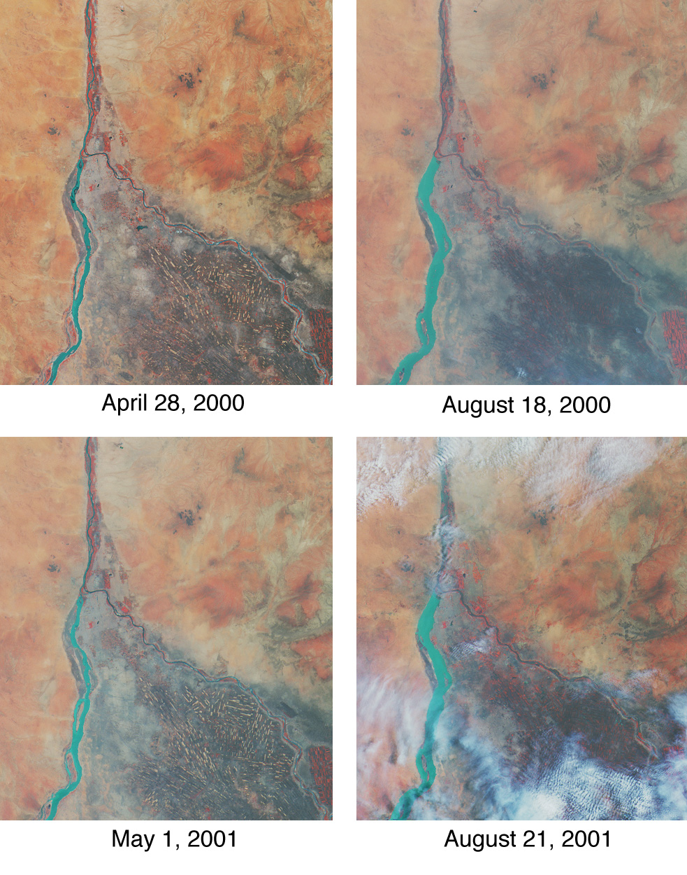
[1.0] Introduction
[1.2]Climate Crisis:
<Transboundary Water Courses
>Water related conflicts
>Political sanctioned of Trade, Goods & Services
Diminishing of surface water table
Fig 1 Aral Sea - https://www.planeta.com/aral-sea/
Fig 3. Euphrates River (https://www.youtube.com/watch?v=9Bv7at-rc6Y)
Fig 2 Nile River https://earthobservatory.nasa.gov/images/1718/nile-river-fluctuations-near-khartoum-sudan
Notes:
Decline of Transboundary Water Courses (Lakes, Rivers, Streams) shared among 2-3 continents – River Nile, Aral Sea, and the Euphrates River
Increase in water related conflicts (Gaza and Israel) causing geopolitical tension.
Political sanctioned of Trade, Good & Services for instances the River Nile
Decline in surface water table

Slide 4
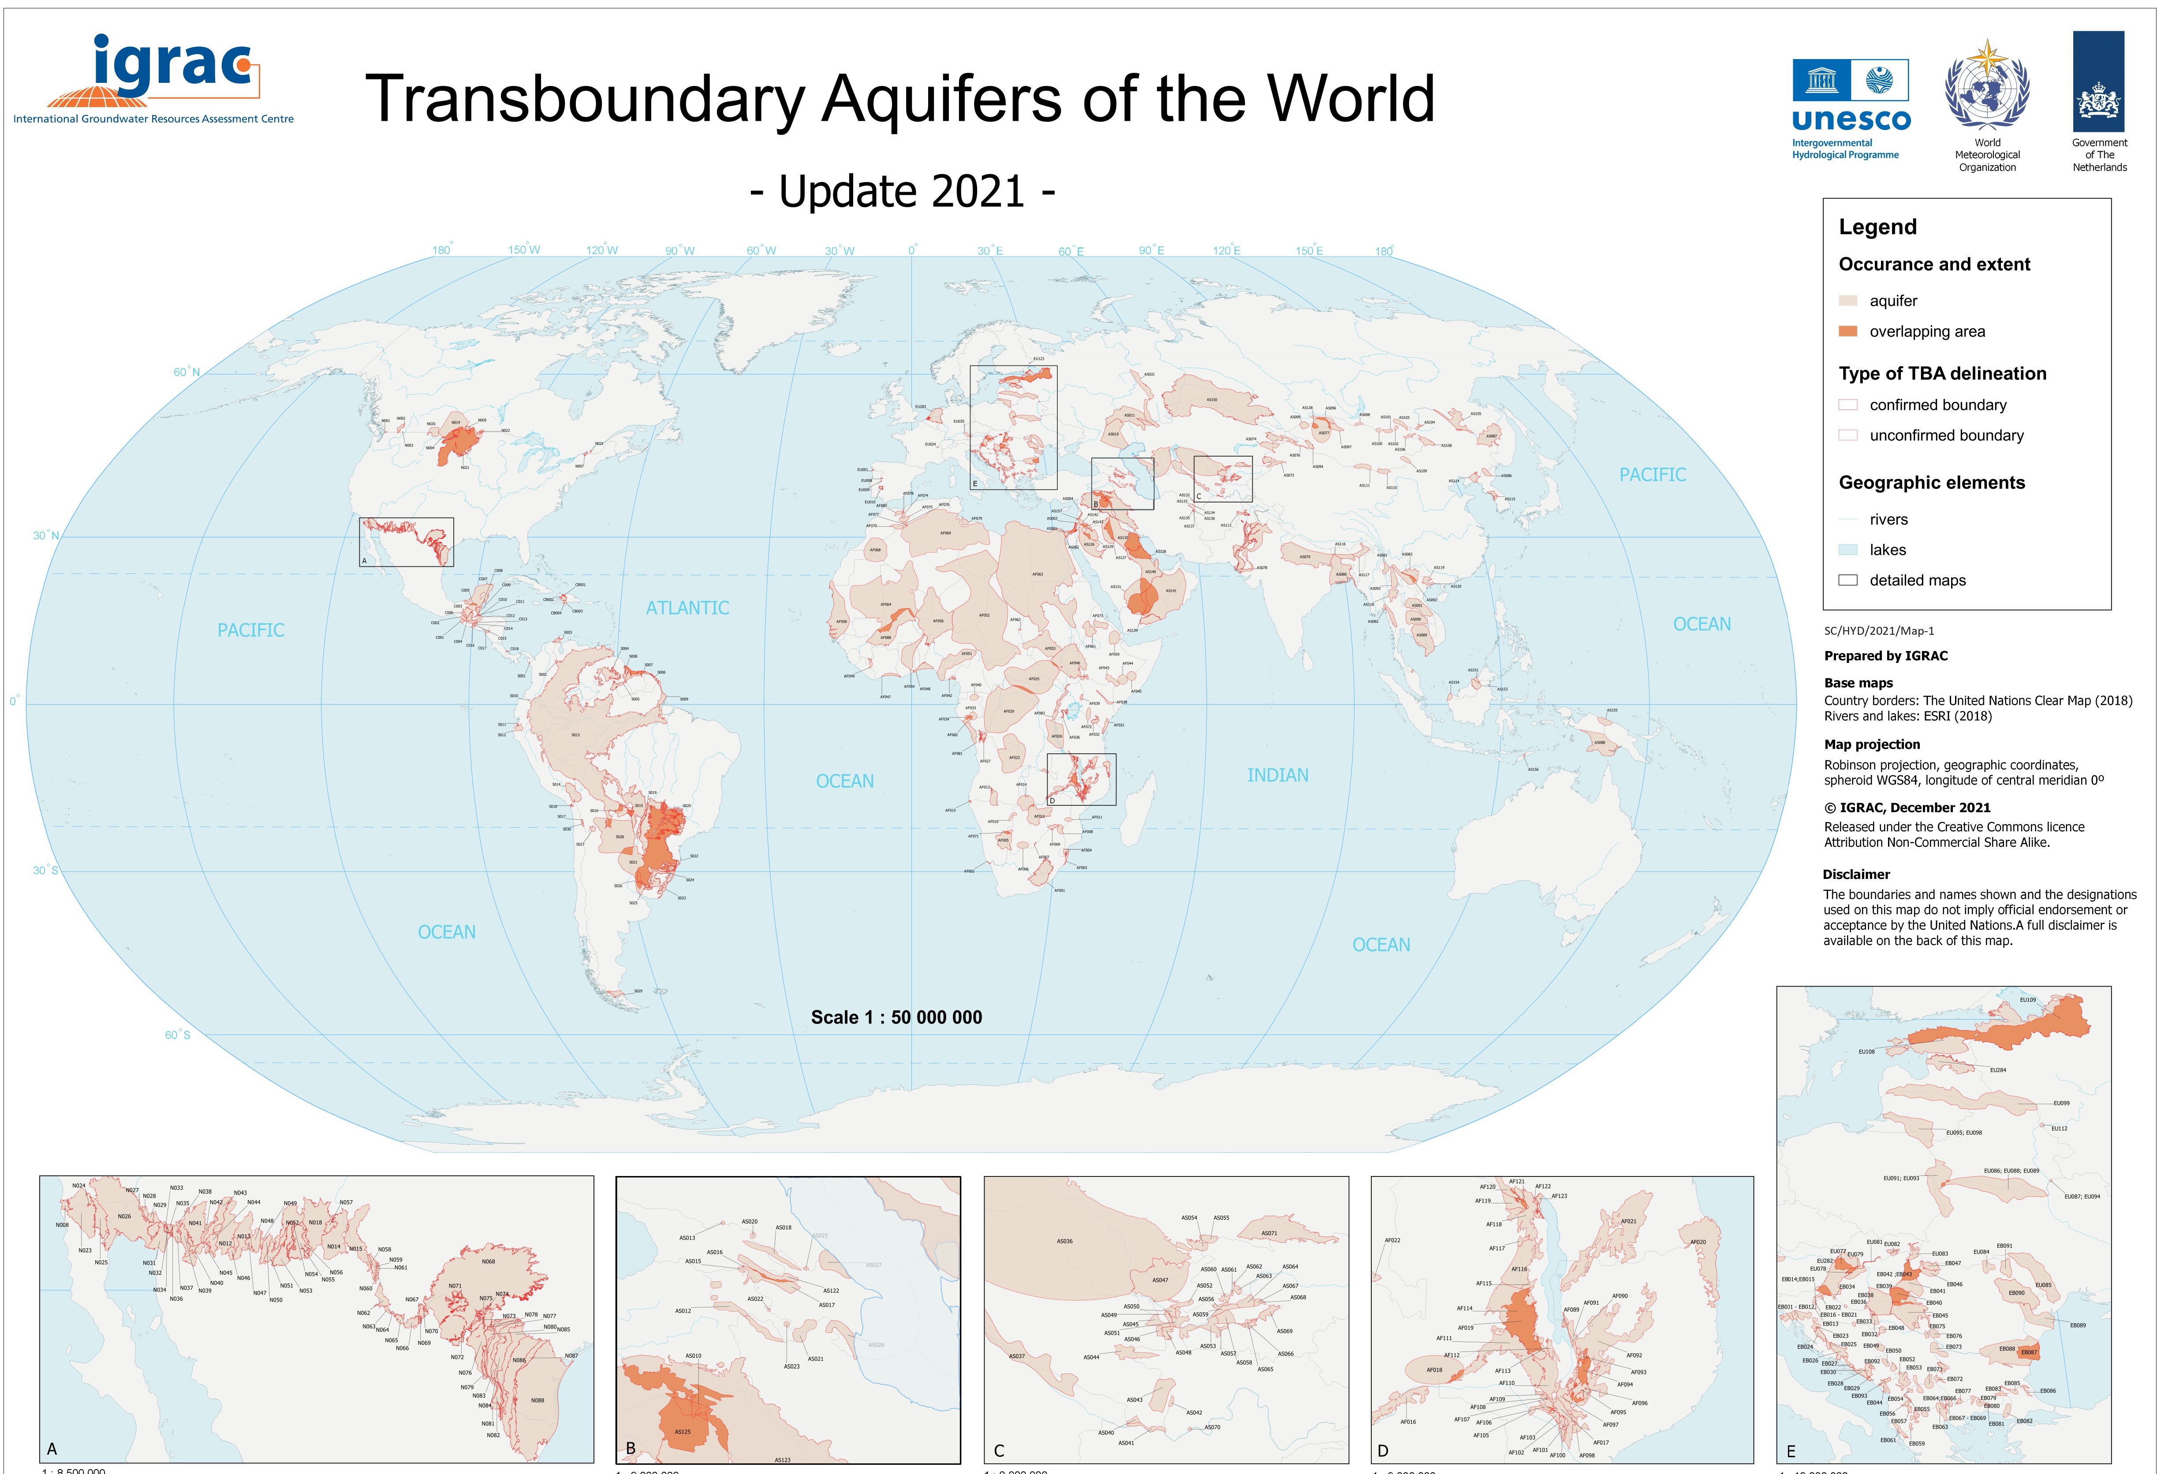
[1.0].Introduction
[1.2] Climate Crisis:
>Transboundary Aquifers
<Water Availability
>Water Demand (users)
Decline GW Table
Fiji ?
Fig 4. Transboundary Aquifers(IGRAC, 2021)
Notes:
Considering the said strange phenomenon of natural disasters, crisis is inevitable process to ignore. But, with all hope humanity must embrace resilient strategies with strong political will that are able cope with its social -economic well-being mainly on the minimum natural and mineral resources at their disposal.
In Fiji Most communities of farmers must resort boreholes hence, is quite difficult for farmers and village communities to locate groundwater availability. Therefore, had to resort to water diviners, private groundwater exploration drillers and Ministry of Lands and Mineral Resources Department of Fiji, but sometimes deemed a failure and is a costly exercise. Therefore, the application of low costs methods using the art of remote sensing and GIS under the influenced of the open and closed softwares. The study focuses on the art of Remote Sensing and GIS Geospatial Artificial Intelligence (Machine Learning) to underpinned low-negligible groundwater potential in the said Nadi, Viti Levu Island.

Slide 5
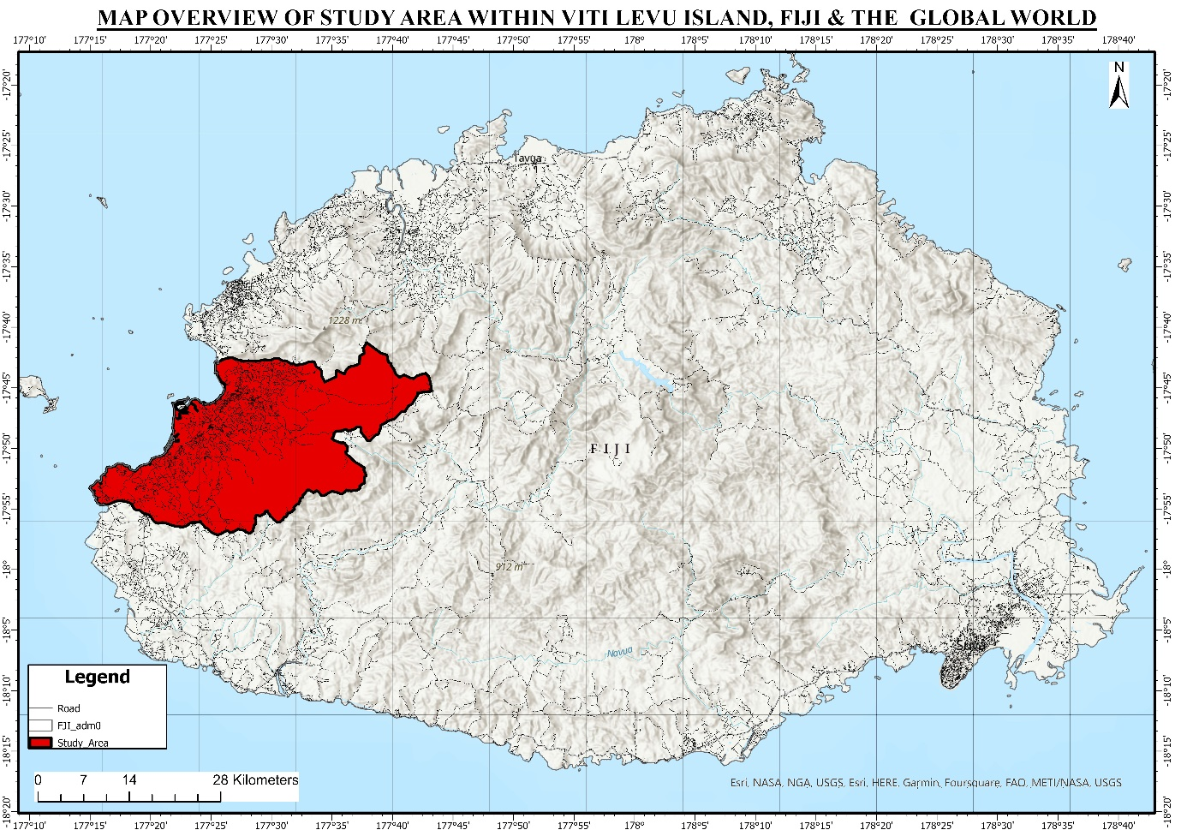
[2.0] Methods and Methodology
[2.2] Study Area:
Digitised Area 178 Km2
Nadi City, W Viti Levu, Fiji
Known Meguinyah Aquifer( Gale, 1988, 1991)
Karstic Nadi Group Formations (Rodda, 1966; Gale, 1988, 1991)
Fig. 5 The study area depicts the Nadi City, Western Viti Levu, Fiji
Notes:
Study Area 178 kilometers to understand the dimension of groundwater characteristics collecting bore-wells, information datasets
Located in the study area of W Viti Levu Island
Early 1980s 1990s PWD was exhausted with intermittent water supply whereby
Karstic Nadi Group expected less in the low-localised groundwater potential

Slide 6
[2.0] Introduction
[2.2] Objectives:
To determine resilient groundwater potential using open-closed source datasets and softwares
2. To determine and evaluate resilient Groundwater Potential using ArcGIS Geo-statistics, Statistics and Artificial Intelligence:
Conceptual Model – Analytical Hierarchy Processes (AHP), Frequency Ratio (FR); and
Numerical Model – Artificial Neuron Networking (ANN).
3. To determine the validation of Groundwater Potential Zone (GPZ) using PQWT Geophysics EM Resonance Survey, Sensitivity Analysis (AOC)-Bore Wells

Slide 7
[2.0] Methods and Methodology
[2.4] Softwares
Arc GIS 10.8.2
ArcGIS Pro 3.2.2
Geomatica 2010
Rockworks 2022
Excel (Frequency Ratio and AHP calculation)
R Studio + GEE for numerical modelling
ANN (Opensource) python and java scripting
Google Earth Engine (GEE) python or java scripting
[2.3] Datasets
Open Sourced datasets
OpenStreetMap Data Pacific (http://download.geofabrik.de/australia-oceania/fiji-latest-free.shp.zip )
DIVA GIS - (https://www.diva-gis.org/gdata)
Closed Sourced datasets
ArcGIS 10.8.2;
GEE (Paid) ( Sentinel 2A, Landsat 8, SRTM, GRACE 2.2);
Approved datasets (stakeholders)
Notes:
Meta datasets, collected and collated from the following open and closed sourced platform, institutions, and organisation below:
Open-source datasets from the -
OpenStreetMap Data Pacific Basefiles - (http://download.geofabrik.de/australia-oceania/fiji-latest-free.shp.zip )
Diva GIS -- (https://www.diva-gis.org/gdata)
Closed source datasets from the conventional methods -
Arc GIS 10.8.2 – Paid platform using ArcGIS online
Google Earth Engine -Paid platform ( Sentinel 2A, Landsat 8, SRTM, GRACE 2.2);
Authorised datasets from the Mineral Resources Department, USP, and relevant institutions and organisation.
Softwares
Analysis of datasets thoroughly prepared using the following open-closed softwares below:
Arc GIS 10.8.2;
ArcGIS Pro 3.2.2;
Geomatica 2010;
Rockworks 2022;
Excel (Frequency Ratio and AHP calculation);
R Studio + GEE for numerical modelling ANN (Opensource) python and java scripting;
Google Earth Engine (GEE) python or java scripting.

Slide 8
[2.0] Methods and Methodology
[2.3] GEE, ArcGIS-Geostatistics, & Statistics
Conceptual Modelling
Analytical Hierarchy Process (AHP) ( Saaty, 1980; Triantaphyllou and Sánchez, 1997; Klaus D. Goepel, 2013; Patra, Mishra and Mahapatra, 2018; Moodley et al., 2022).
Frequency Ratio (FR) (Althuwaynee et al., 2014; Naghibi et al., 2015; Al-Abadi, Ghlaib and Shahid, 2017; Falah et al., 2017; Das, 2019a; Hasanuzzaman et al., 2022)
Weighted Overlay Analysis WOA(AHP – FR GM Fusion)
(Patra, Mishra and Mahapatra, 2018; Kanagaraj et al., 2019; Kaur et al., 2020; Moodley et al., 2022)
Numerical Modelling
Artificial Neuron Networking (ANN)
[1]. AHP (FR) in Groundwater Occurrence
(1) AHP GM - CI = λmax – n
n-1
(2) Normalised (CI) with condition & variable. By calculating Eigenvector (V) for normalised RI matrix
(3) CR = CI /RI
[2].Frequency Ratio (FR) in Groundwater Occurrence
FR GM =(∑ groundwater occurrence pixels)
(∑classes pixels FR)
[3].WOA (AHP –FR Fusion) in Groundwater Occurrence
WOA %(AHP-FR Fusion) = Rf_{(AHP-FR Fusion)} + LD_{(AHP-FR Fusion)} + Li_{(AHP-FR Fusion)} + DEM_{(AHP-FR Fusion)} +As_{(AHP-FR Fusion)} +Rn_{(AHP-FR Fusion)} +Geom_{(AHP-FR Fusion)} +DD_{(AHP-FR Fusion)} +FS_{(AHP-FR Fusion)} +LULC_{(AHP-FR Fusion)} +NDVI_{(AHP-FR Fusion)} +PWB_{(AHP-FR Fusion)}

Slide 9
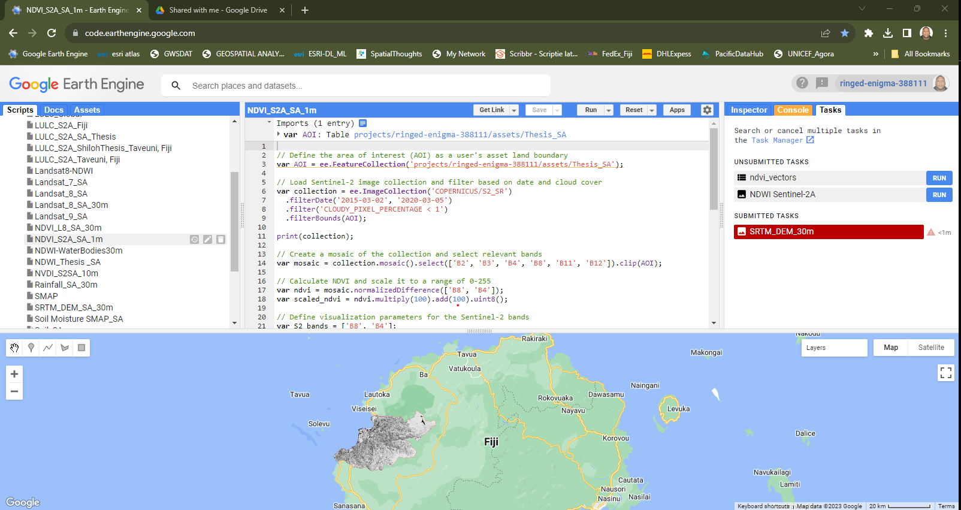
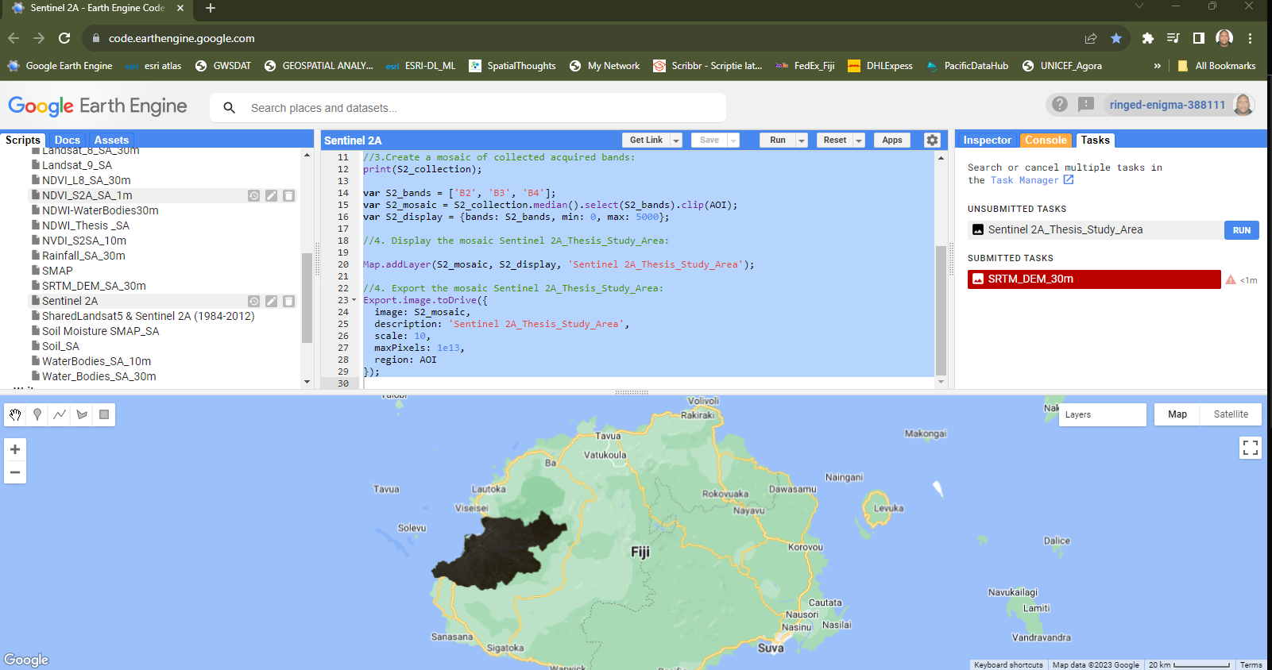
[3.0] Findings
[3.2] GEE Analysis:
GEE Paid Source derived
Sentinel 2A
LULC
NDVI
GEE Raster datasets used as baseline for ArcGIS Pro 3.2.2
Thematic layers
Surface layers
Subsurface layers
Fig. 6 GEE NDVI script analysis for greener vegetation depicts groundwater (1983-2023)
Fig. 7 GEE Sentinel 2A script analysis to deduce Lineament Density
Notes:
Surface datasets are:
To develop a slope, elevation, aspect, roughness, and contour map from DEM- SRTM raster continuous to vector discrete;
To develop rainfall from raster continuous to vector discrete
To develop a geomorphological map from raster continuous to vector discrete;
To develop a land use land cover map from raster continuous to vector discrete.;
To develop NDVI map from raster continuous to vector discrete;
Subsurface datasets are
To develop a soil map from raster continuous to vector discrete;
To develop borehole (locations, specific conductivity, transmissivity, borehole-log and flow rates) map from raster continuous to vector discrete.
To develop a geological map from raster continuous to vector discrete (lineament density, fault, and lithology)

Slide 10
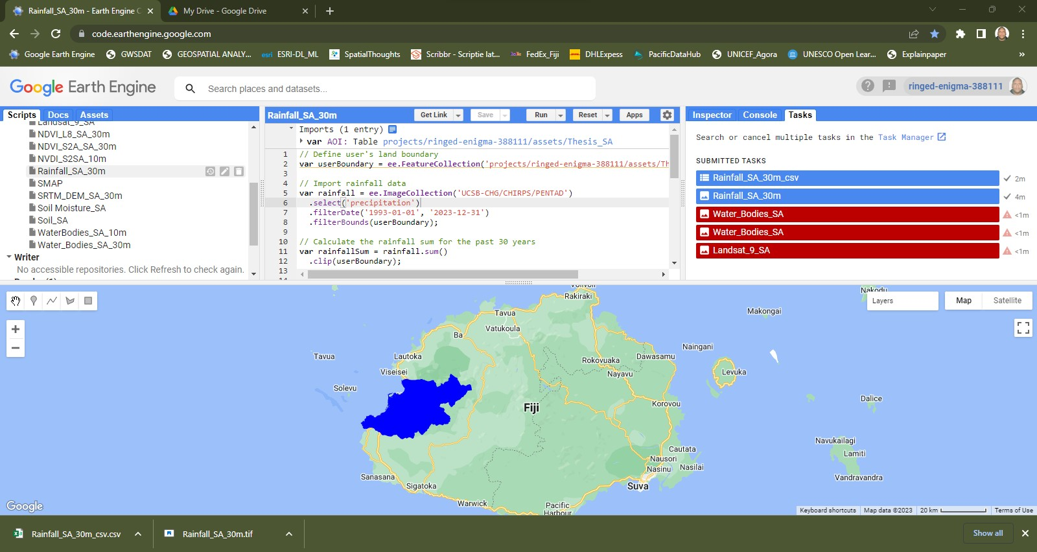
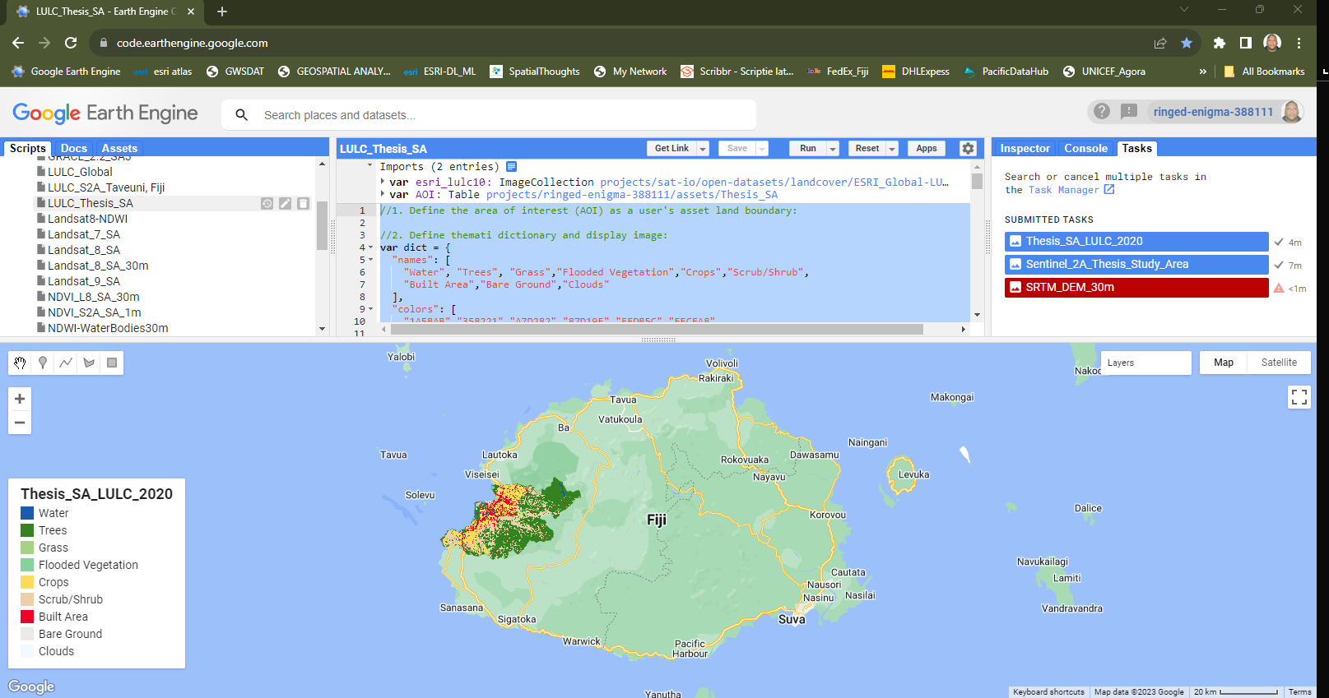
[3.0] Findings
[3.2]GEE Analysis:
GEE Paid Source derived
CHIRPS –rainfall (1983-2023) Graphs
Derived Thematic Layers -ArcGIS Pro 3.2.2 QA & QC analysis
Fig. 8 GEE CHIRPS script analysis for graph of rainfall (1983-2023)
Fig. 9 GEE LULC script analysis using Sentinel 2A (2010-2020)
Notes:
CHIRPS
Derived Thematic Layers -ArcGIS Pro 3.2.2 QA & QC analysis using clipping, digitisation and standardised grouping of classes

Slide 11
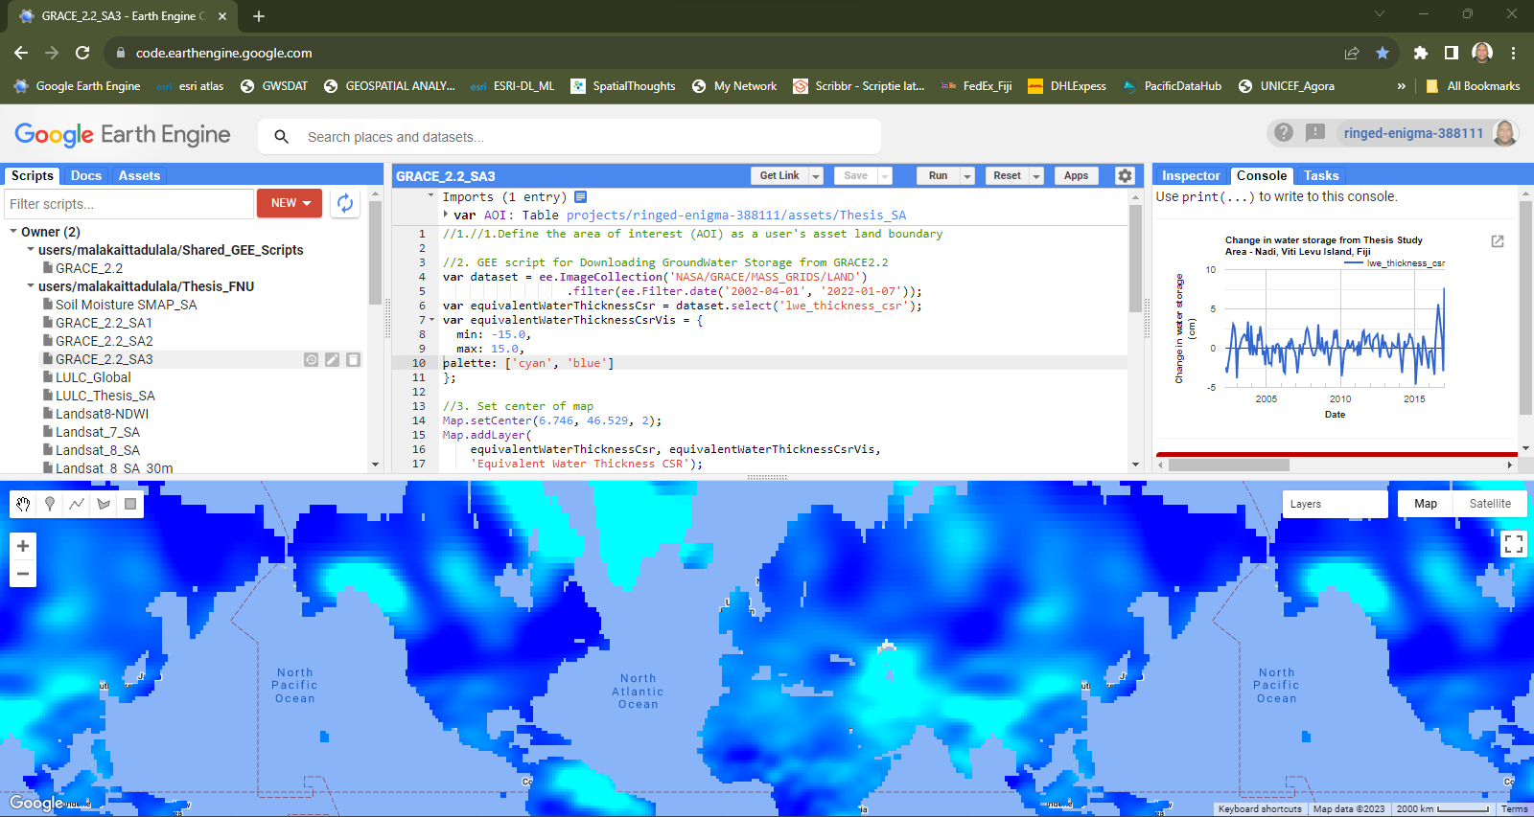
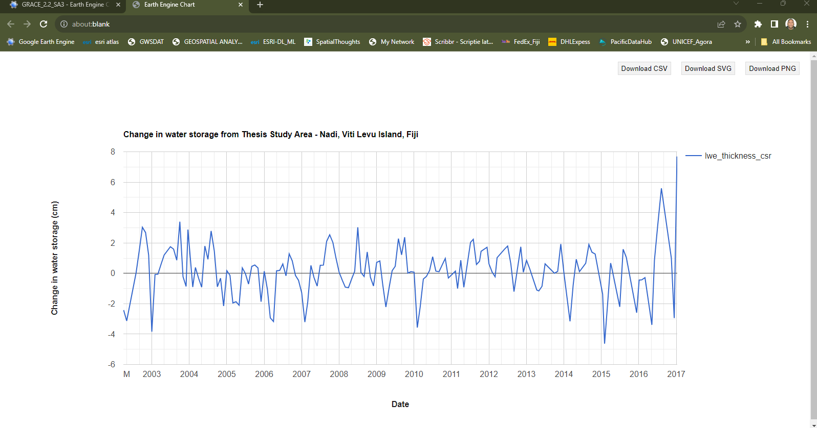
[3.0] Findings
[3.2]GEE Analysis:
GEE Paid Source derived
GRACE 2.2
- Groundwater Storage Changes (1983-2023) for Nadi, Viti Levu Island
ECOLAB Google Earth or ArcGIS analysis for understanding Groundwater Characteristics
Fig. 10 GEE GRACE script analysis for graph of rainfall (1983-2023)
Fig. 11 GEE GRACE script analysis using Sentinel 2A (1983-2023)

Slide 12
Part B (Practicalities – How?)
Open ArcGIS Pro 3.2.2

Slide 13
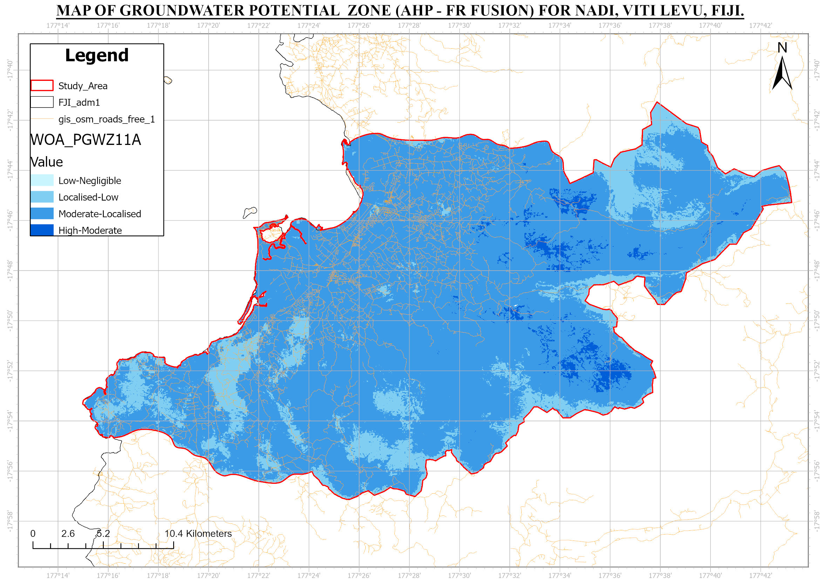
[4.0] Findings & Discussions
[4.2]GWZP:
AHP, FR, WOA
(AHP-FR Fusion) model sync perfectly
GWZP = WOA %(AHP-FR Fusion) = Rf_{(AHP-FR Fusion)} + LD_{(AHP-FR Fusion)} + Li_{(AHP-FR Fusion)} + DEM_{(AHP-FR Fusion)} +As_{(AHP-FR Fusion)} +Rn_{(AHP-FR Fusion)} +Geom_{(AHP-FR Fusion)} +DD_{(AHP-FR Fusion)} +FS_{(AHP-FR Fusion)} +LULC_{(AHP-FR Fusion)} +NDVI_{(AHP-FR Fusion)} +PWB_{(AHP-FR Fusion)}

Slide 14
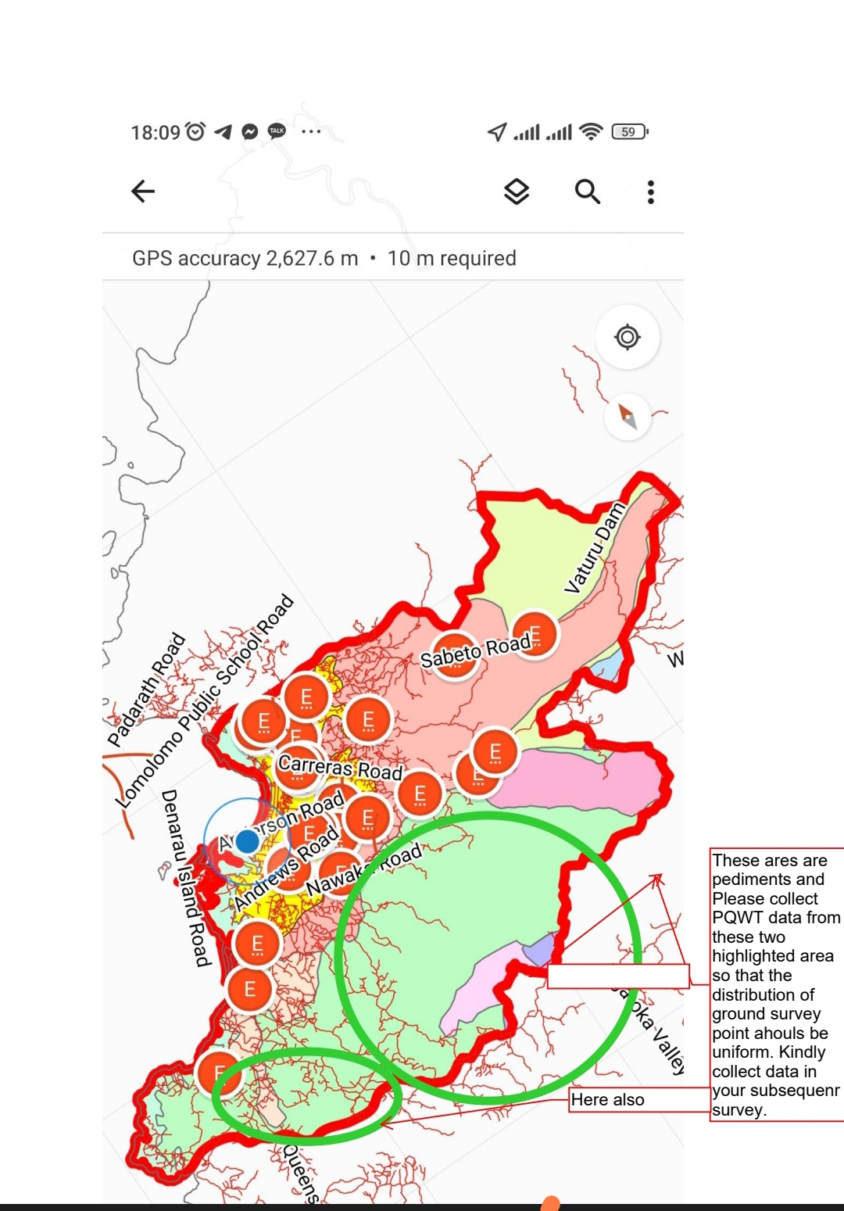
[4.0] Findings & Discussions
[4.2]GWZP:
Completed Field datasets the 1st Field Work
Used ArcGIS Field Map (Android Upload)
Real time datasets upload
Collect GPS Points
Collect GW Information
Supervisor monitor your fieldwork:
Dashboard (ESRI)

Slide 15
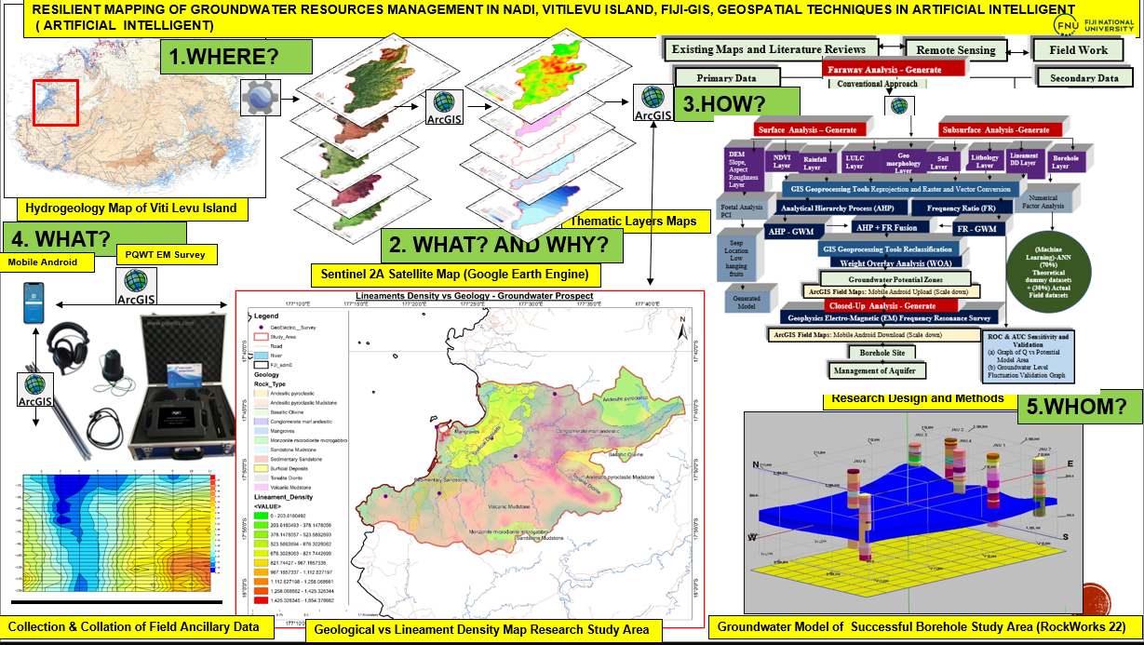
[5.0] Summary

Slide 16
[6.0] References
AQUASTAT (2012) The Aral Sea transboundary river basin.
Gale, I.N. (1988) Hydrogeological map of Vanua Levu and Taveuni / this map has been compiled by I.N. Gale MSc DUC as part of the series of reports and maps produced by the Groundwater Resources Assessment and Development Unit (GRADU), cartographer in charge: S. Nand ; cart. Edited by D. Sami et al. Fiji: -Mineral Resources Dept. Available at: https://catalogue.nla.gov.au/Record/5977346/Details?
Gale, I.N. (1991) ‘Hydrogeological map of Viti Levu’. [Suva]: Mineral Resources Dept.
García, L.E. (2008) ‘Integrated water resources management: A “small” step for conceptualists, a giant step for practitioners’, International Journal of Water Resources Development, 24(1), pp. 23–36. doi:10.1080/07900620701723141.
IGRAC (International Groundwater Resources Assessment Centre), 2021. Transboundary Aquifers of the World [map]. Edition 2021. Scale 1 : 50 000 000. Delft, Netherlands: IGRAC, 2021.
IPCC (2021) Sixth Assessment Report, ARC 6. Available at: https://www.ipcc.ch/report/ar6/wg1/ (Accessed: 7 October 2021).
Rodda, P. (Peter) (1966) Geology of Viti Levu, Fiji. Geology compiled by P. Rodda ... and R. B. Band. Drawn by R. Narayan. 1st ed. [Suva] Geological Survey of Fiji, 1966. Scale 1:250,000, Library of Congress. Available at: https://catalog.loc.gov/vwebv/citeRecord?searchId=4318&recPointer=0&recCount=25&searchType=1&bibId=5438249 (Accessed: 3 December 2021).
Schmeier, S. (2015) ‘The institutional design of river basin organizations – empirical findings from around the world’, International Journal of River Basin Management, 13(1), pp. 51–72. doi:10.1080/15715124.2014.963862.
Simons, C. (2014) GEF Pacific IWRM Demonstration Project Environmental and Socio-Economic Protection in Fiji: Integrated Flood Risk Management in the Nadi River Basin Final Report An Initiative of the Global Environment Facility Supported Project: "Implementing Sustainable.
UN Watercourses Convention (2014) South and East Asia - UN Watercourses Convention. Available at: https://www.unwatercoursesconvention.org/global-relevance/south-and-east-asia/ (Accessed: 20 August 2021).
Watson, B., Smith, M. and Simmons, C. (2012) ‘Mid-Term Report of the Fiji GEF Pacific IWRM Demonstration Project : “ Environmental and Socio-Economic Protection in Fiji : Integrated Flood Risk Management in the Nadi River Basin ”’, pp. 1–73. Available at: http://www.pacific-iwrm.org/mid-term-reports/GEF-Pacific-IWRM-Fiji-Draft-Mid-Term-Report.pdf (Accessed: 25 August 2017).

Slide 17
MALO – THANK YOU FOR LISTENING

