Slide 1
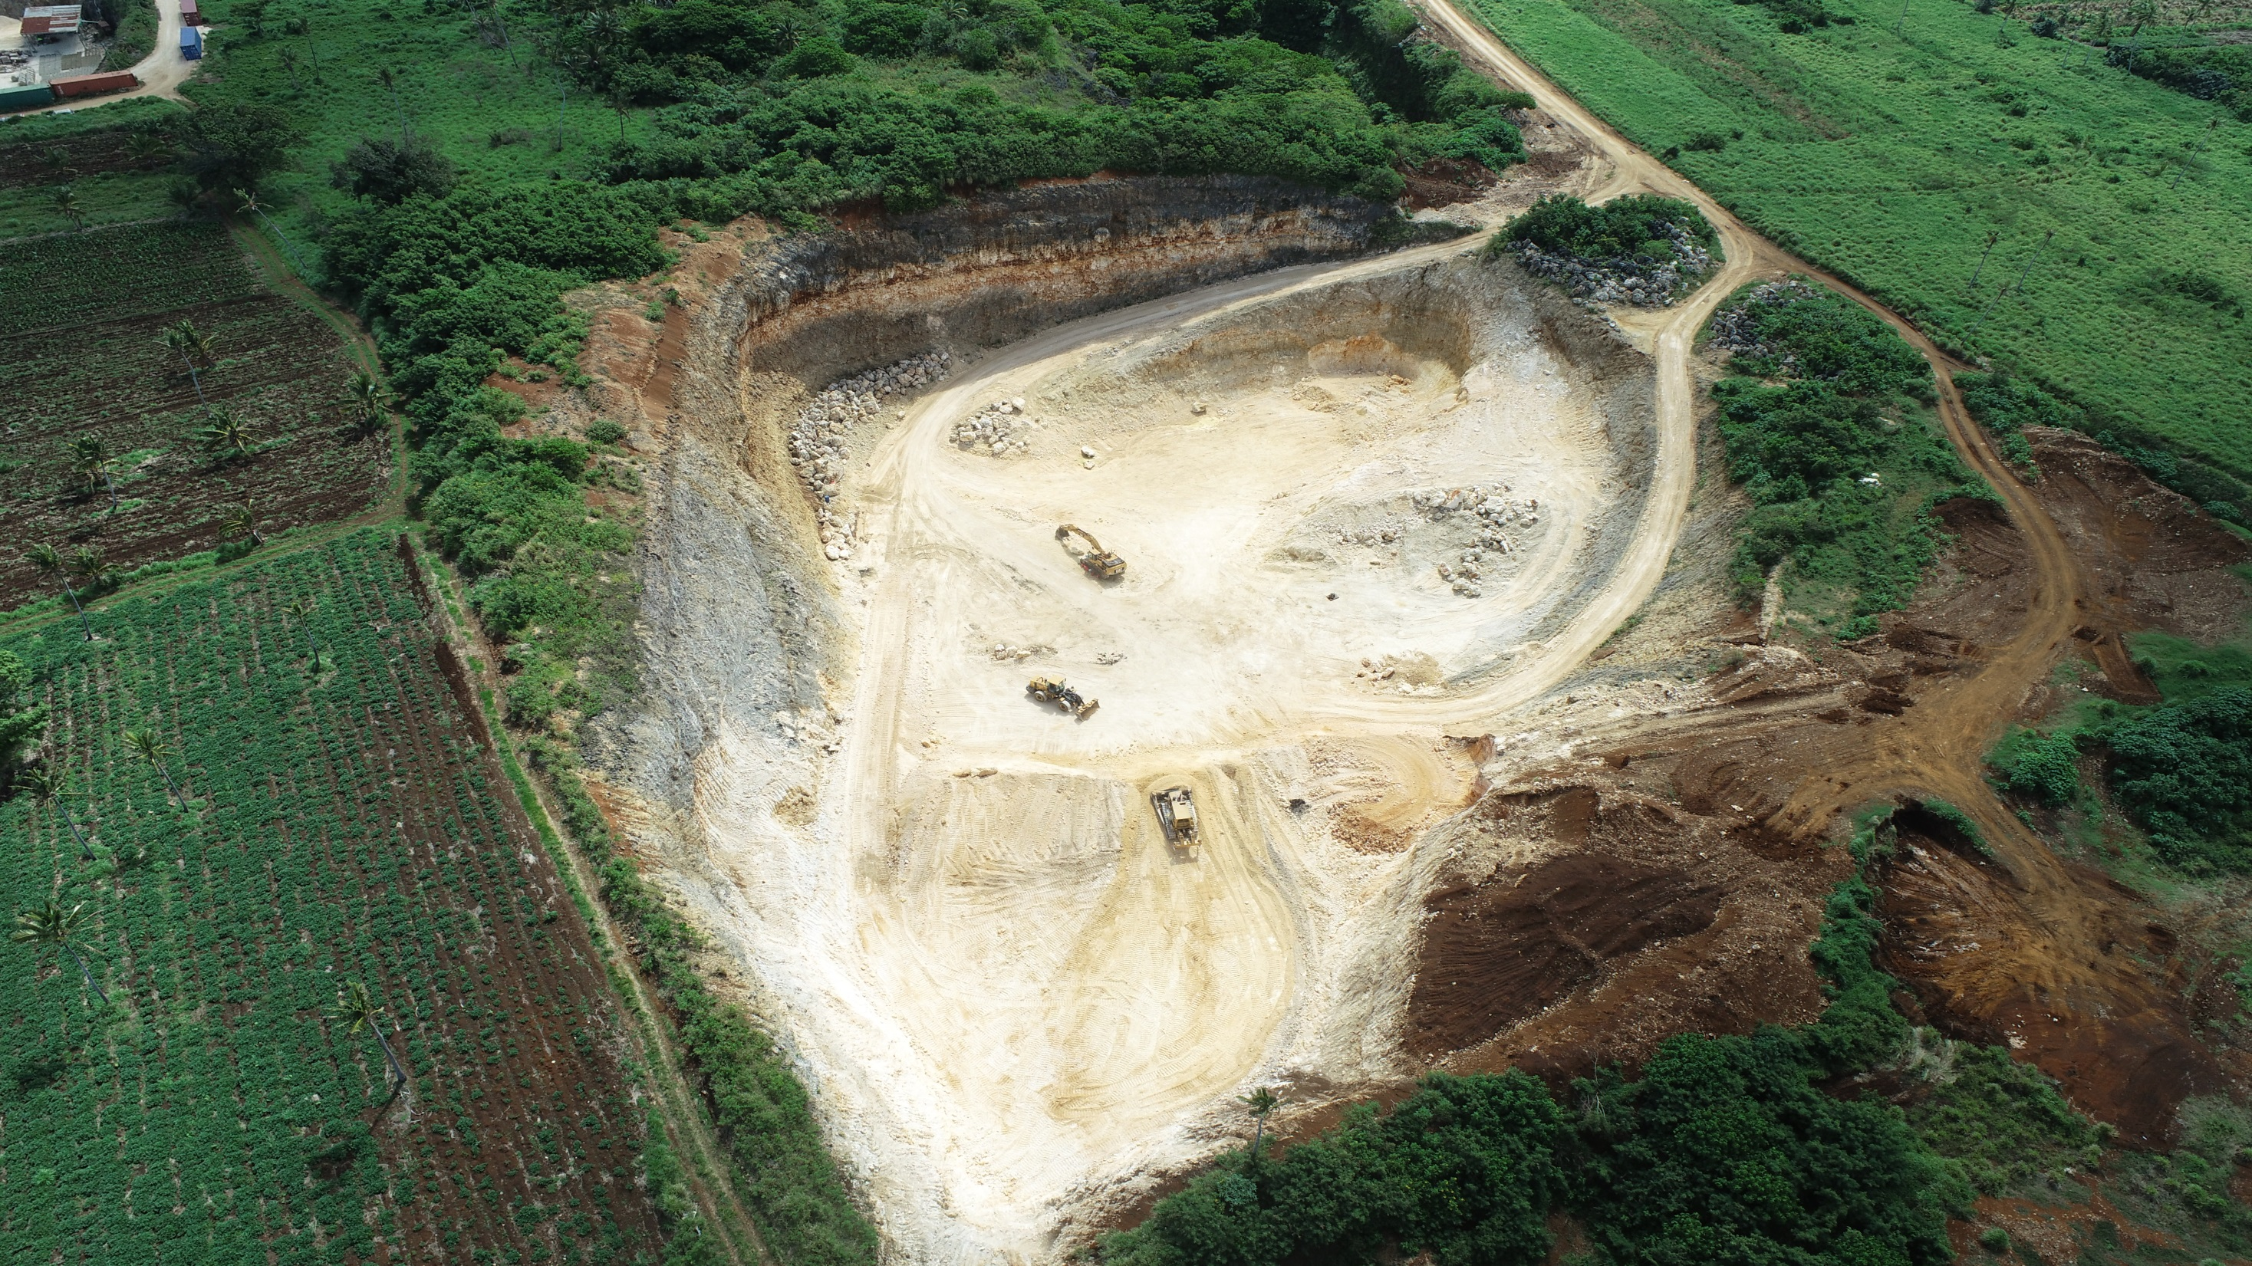
USING OF GIS & REMOTE SENSING APPLICATION FOR IMPLEMENTATION OF SUSTAINABLE QUARRY MINING IN TONGA
Government of the
Kingdom of Tonga
GIS SECTION | LGIS DIVISION
MINISTRY OF LANDS AND NATURAL RESOURCES
2023

Slide 2
Acknowledgement
I would like to express my special thanks and gratitude to the UN Spider Office for providing funds so that I can attend the 2023 Pacific Island GIS & Remote Sensing User Conference. I am very grateful for their funding support which is why I am here today.
I would also like to thank the 2023 Pacific Island GIS & Remote Sensing Conference organizers for giving me this golden opportunity to do my presentation during this remarkable event
Malo ‘Aupito

Slide 3
Agenda
Introduction
Methodology
Quarry Guidelines
Using latest DEM data to conduct Geospatial Analysis for Quarry Developments in Tonga
Volumetric Analysis (calculating quarry volume)
Determining Compliance of Quarry Companies with maximum excavation depth
Monitoring the current status of quarry developments in Tonga using UAV
Challenges
Recommendation
Conclusion

Slide 4
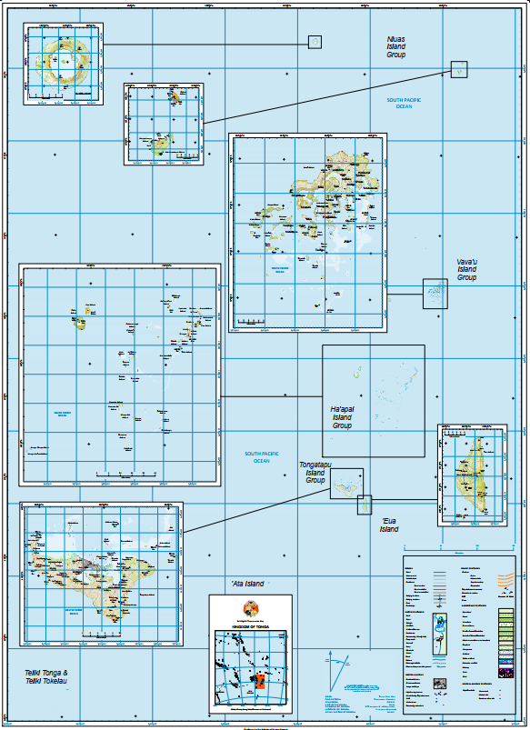
Map of the Kingdom of Tonga

Slide 5
Introduction
Background of the Kingdom of Tonga
An archipelago comprised of 176 Islands, with 36 island inhabited
Total Population : 100,651 (Tonga Census, 2016)
Geographical Location of Tonga : Stretches between “latitudes 15⁰“ & 23⁰ S“ and “longitudes 173⁰ and 177⁰ W”
5 Island groups of Tonga: ‘Eua, Tongatapu, Ha’apai, Vava’u, Niutoputapu & Niuafo’ou.
History of Quarry Developments in Tonga
Quarry developments have been existing for approximately 46 years now in the Kingdom of Tonga since 1977.
Using GIS & Remote Sensing application for quarry management.
This presentation will be focusing on the procedures of using GIS & Remote Sensing Application to monitor and sustainably manage quarry mining in Tonga

Slide 6
Process of Issuing Quarry Permit in Tonga
Land Owner submit application form to Ministry of Lands and Natural Resources & MEIDECC
Natural Resources Division of Ministry of Lands and Natural Resources conduct Geological survey for quarry proposed site
Department of Environment of MEIDECC prepare EIA report
Permit for quarry development issued by Ministry of Lands and Natural Resources
Quarry Development starts its operation

Slide 7
Methodology
The following are software and data which were used to carry out geospatial analysis for quarry developments in Tonga
Mapping Software
ArcGIS Pro – Used for volumetric analysis calculations and det55ermination of compliance of quarry operators with recommended maximum excavation depth.
Geospatial Layers used in Geospatial Analysis Activities
DEM Data
Latest DEM data per Island groups:
Tongatapu & Ha’apai [Lifuka] – LIDAR 2011 (2m Resolution)
‘Eua, Vava’u, Niuatoputapu – Quick bird 2004 (10m Resolution)
Quarry Allotment Layer
10m setback Layer

Slide 8
Cont.
Updating of the Quarry Analysis
Data Acquisition
Using of UAV (Dji Phantom 4) for Quarry Mapping
Processing Software
Pix4D
Drone Data that is used for Quarry Mapping
DTM
DSM
Contour
Mosaic

Slide 9
Quarry Guidelines
A setback of 10m from the boundary (land parcel)
5m average thickness of topsoil and mixed soil and coral layer (maximum height for benching)
3m depth limit to mean sea level (Maximum Excavation Depth)

Slide 10
Geospatial Analysis for Quarry Developments in Tonga
Quarry Volumetric Analysis Data are consist of:
Standard Extractable Volume for potential sources of quarry
Remaining Extractable Volume (active and abandoned quarry)
Estimated Extracted Volume (active and abandoned quarry)\
Determining compliance of quarry operators with maximum excavation depth
3m above water table

Slide 11
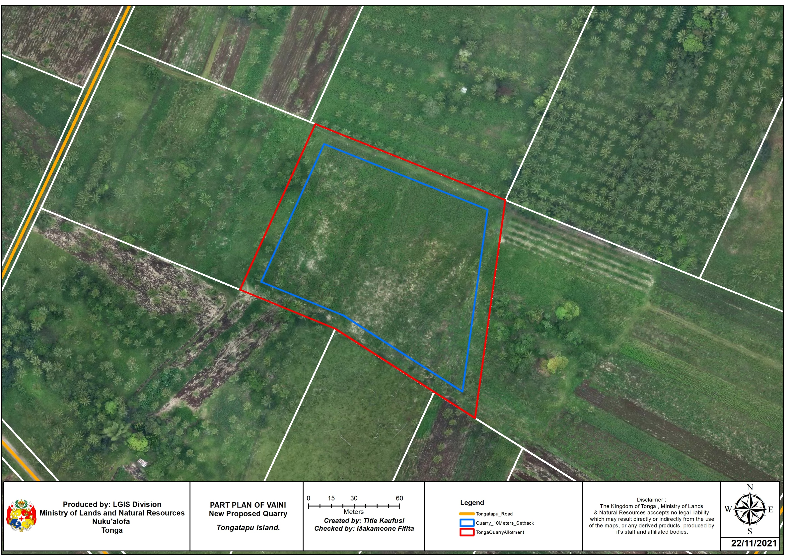
Quarry Map as per Guidelines

Slide 12
Tools that are used to calculate; Standard Extractable Volume, Remaining Extractable Volume and Estimated Extracted Volume.
Clipping Tool
Surface Volume

Slide 13
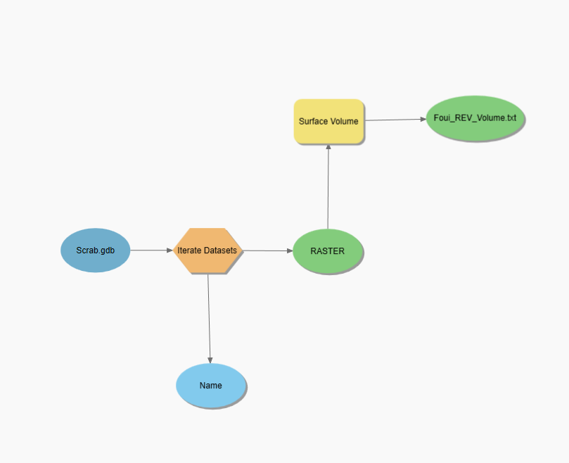
Using of Model Builder to calculate; Standard Extractable Volume, Remaining Extractable Volume & Estimated Extracted Volume simultaneously
Figure 1. Using Model Builder to Clip LiDAR DEM 2011 using 10m set back layer in ArcGIS Pro
Figure 2. Using Model Builder to calculate quarry volume using clipped dem and selected 10m set back layer from Figure 1in ArcGIS Pro

Slide 14
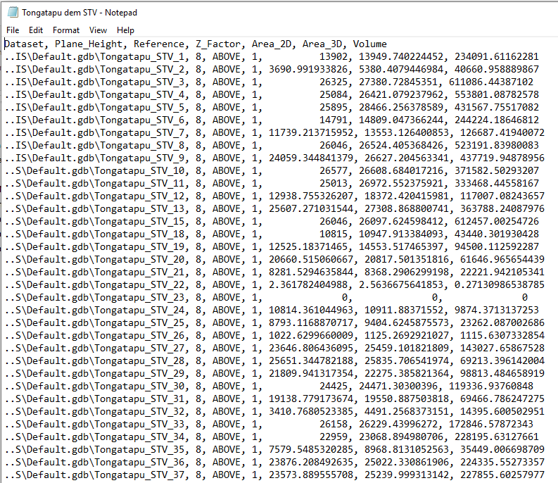
Output of Model Builder after calculating standard volume, remaining volume & estimated extracted volume (text file)

Slide 15
Linking Quarry Volumes with Attribute Table of 10m setback Layer in ArcGIS PRO
Result of Model Builder Calculations (text file)
Copy text file into excel and convert into CSV file
Add CSV file into Arc Pro and then joint it with required fields (Standard Extractable Volume) in the 10m setback layer
Convert Volumetric Unit from cubic meter into tonnes

Slide 16
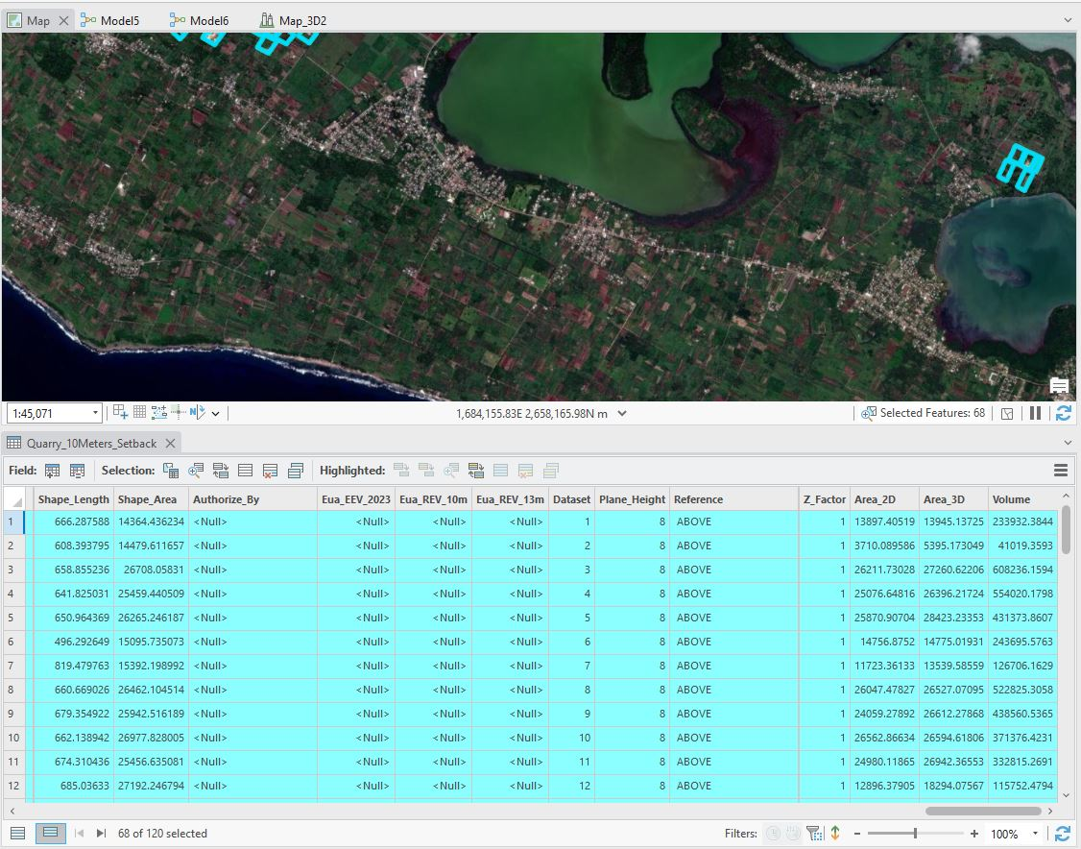
Joining and copying of volume calculation into Quarry 10m setback layer

Slide 17
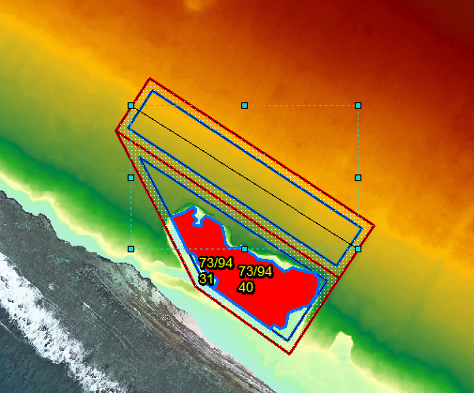
Standard Extractable Volume

Slide 18
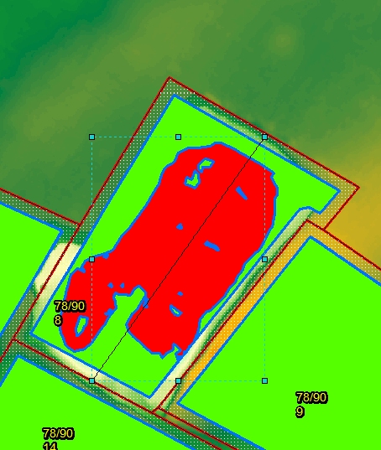
Remaining Extractable Volume & Estimated Extracted Volume

Slide 19
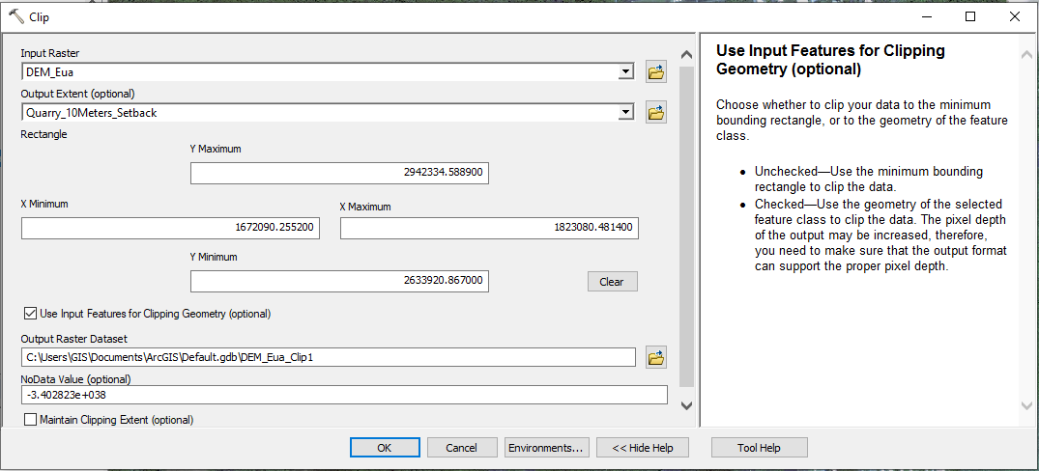
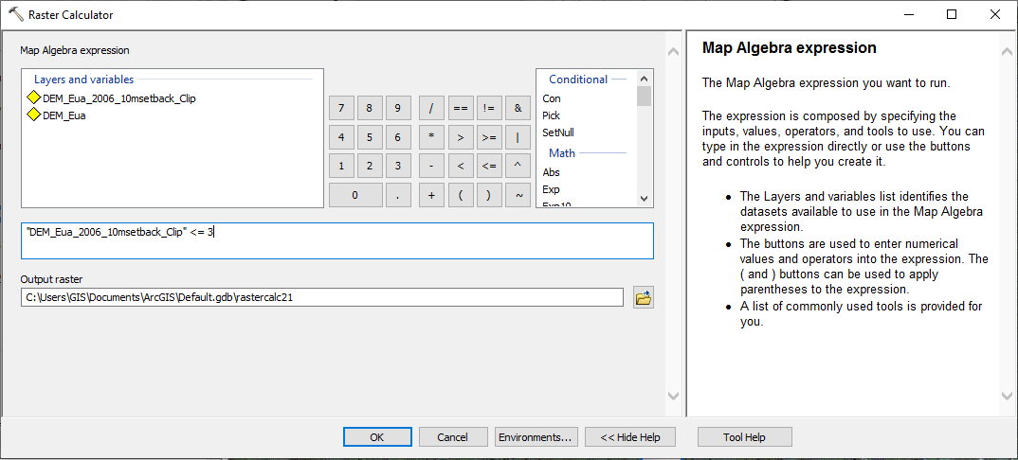
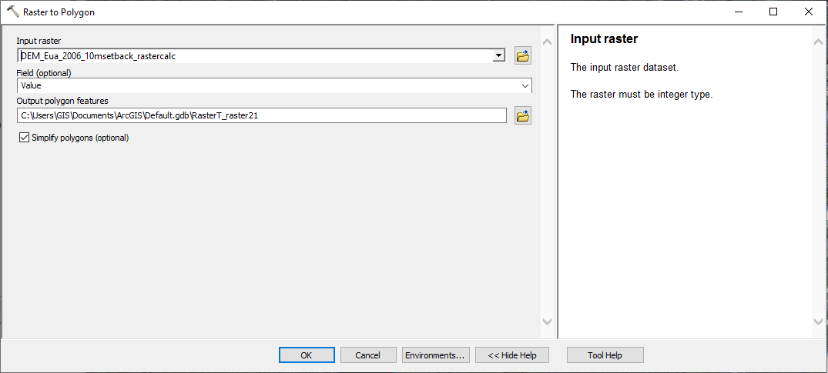
Tools that are used to determine the compliance with the maximum excavation depth in ArcGIS Pro
Clipping Tool
Raster Calculator
Raster to Polygon

Slide 20
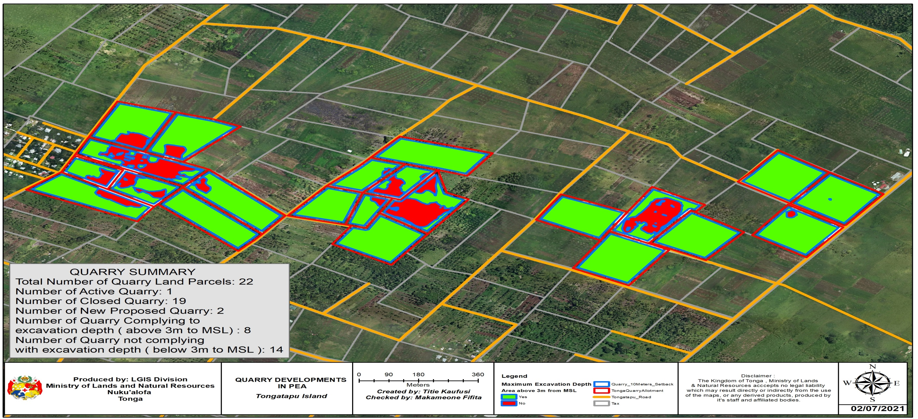
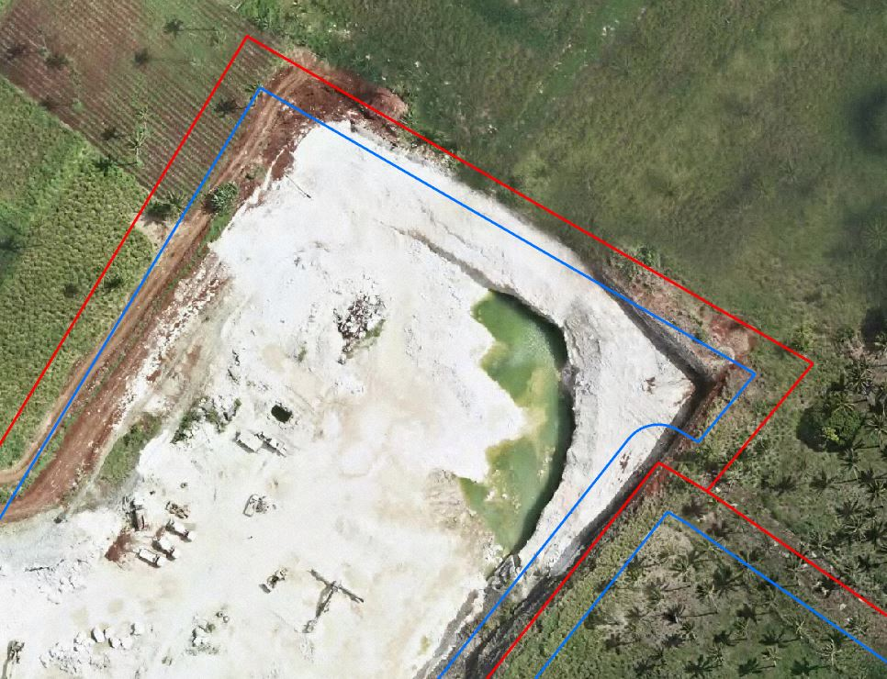
Using ArcGIS Pro to determine compliance of Quarry Operators with Quarry Maximum Excavation Depth

Slide 21
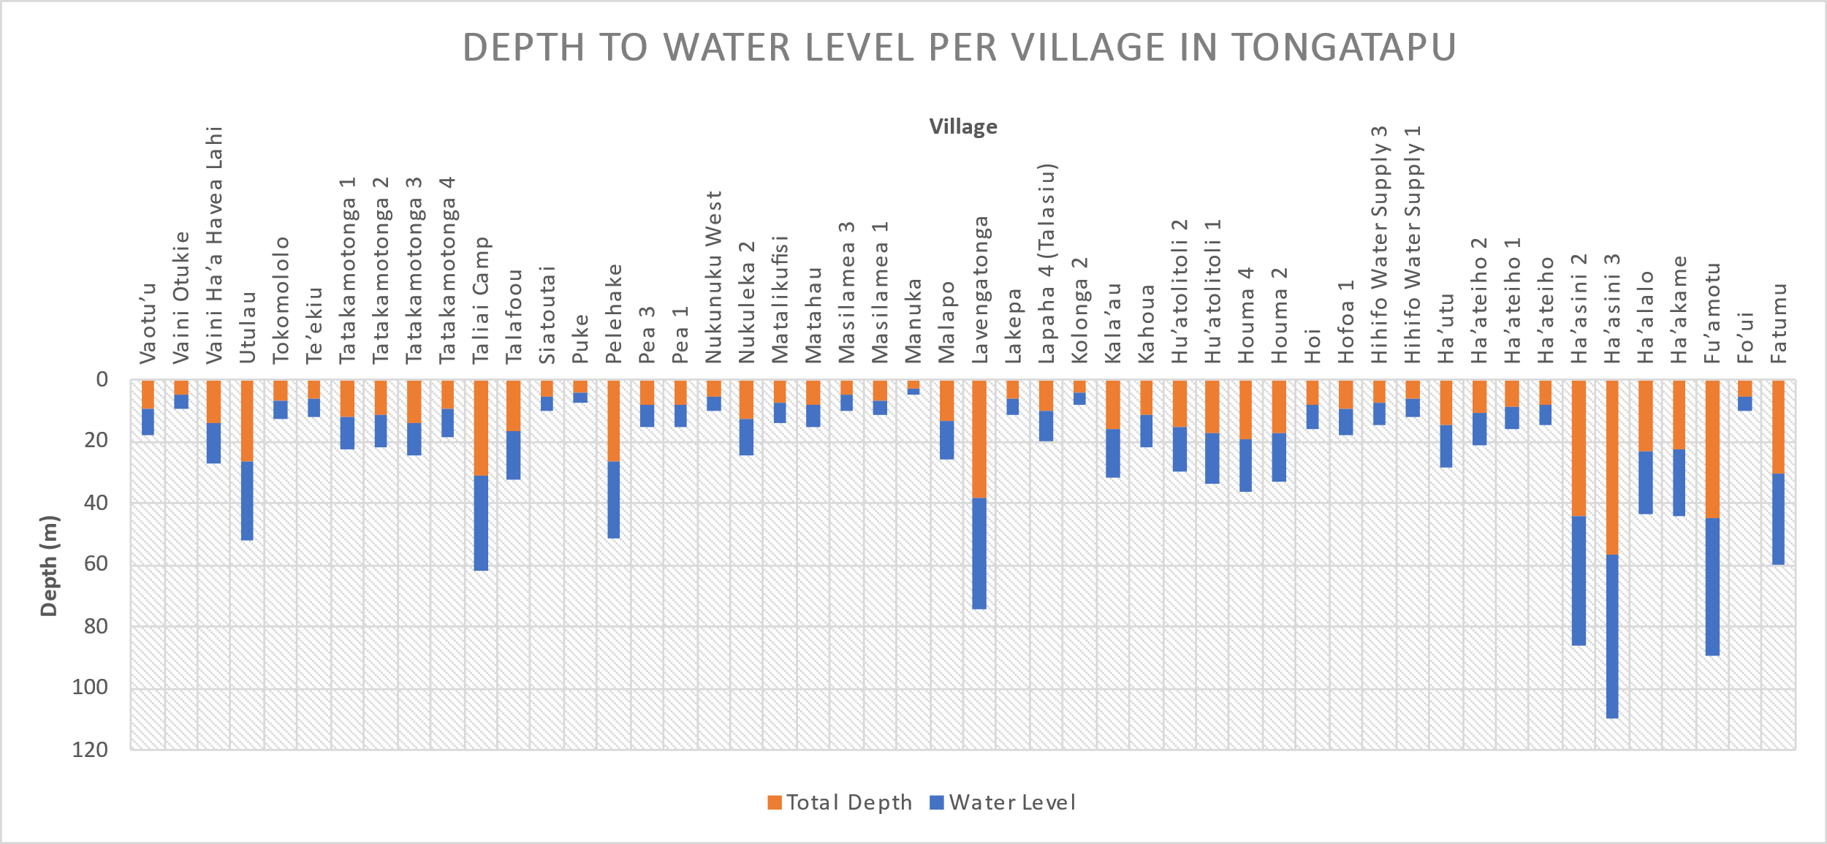
Depths to Water Level

Slide 22
Monitoring the current status of quarry development using UAV
Processing a 3D map of ‘Eua quarry site on Pix4D mapper

Slide 23
Monitoring the current status of quarry development using UAV
Viewing Online Imagery of ‘Eua Quarry in ArcGIS Pro
Note
The legend are as follows:
Red polygon are Quarry Allotment
Blue polygon are the 10m setback
Light grey color represents the tax allotment
Orange color represents the road

Slide 24
Monitoring the current status of quarry development using UAV
DSM data of ‘Eua Quarry

Slide 25
Monitoring the current status of quarry development using UAV
DTM data of ‘Eua Quarry

Slide 26
Monitoring the current status of quarry development using UAV
Mosaic Data of ‘Eua Quarry on ArcGIS Pro

Slide 27
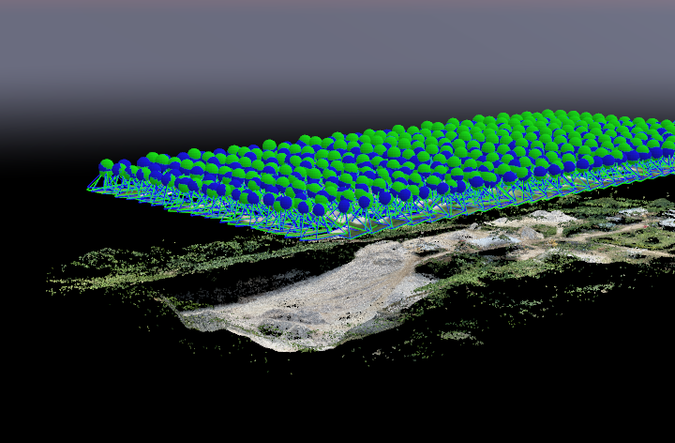
Monitoring the current status of quarry development using UAV
Viewing mosaic data of ‘Eua Quarry in Pix4D

Slide 28
Quarry Map with Volumetric Analysis Data
Map of ‘Eua Quarry with its volumetric analysis data

Slide 29
Remaining Volume & life time of quarry Developments per Island Group in Tonga
Total Standard Extractable Volume for potential sources of quarries & Remaining Extractable Volume for active and abandoned quarries (m3) and its lifetime per Island Group
Island Groups | Year of DEM data per Island Group | Standard Extractable Volume & Remaining Volume (m3) | Rate of Production per Year (m3) | Life time of Quarry Volume per Island Group (Yr) | Year of Final Production per Island Group
Tongatapu | 2011 | 10,424,650.80 | 50,000 | 208.493016 | 2219
Eua | 2004 | 10,461,399.27 | 50,000 | 209.2279854 | 2213
Haapai | 2004 | 89,804.32 | 50,000 | 1.79608642 | 2005
Vavau | 2004 | 20,041,648.26 | 50,000 | 400.8329653 | 2404
Niuatoputapu | 2004 | 14,839.81 | 50,000 | 0.296796277
TOTAL |  | 41,032,342.47 |  | 820.6468494

Slide 30
Challenges
Lack of funding
Lack of monitoring activities (quarry mapping) per quarter
Lack of Resources
Drones – LGIS Division only has 1 drone
Lack of Compliance from quarry companies with Quarry Guidelines as directed by Ministry of Lands and Natural Resources
Majority of Quarry Operations have extracted beyond maximum excavation depths & thus opens up water table.
Unmanaged quarry operations have extended into neighboring land parcels
No Awareness programs are done to notify the public about the quarry guidelines in Tonga
No geotechnical survey are done to determine bedding formation of soil and rock, hardness of bedrock and practical depth to underground water resources

Slide 31
Recommendation
Seek funding from international donors for purchasing GIS tools such as UAV, GPS, GCP etc.
That, quarry mapping are to be done on a quarterly basis using UAV
Make amendments to the maximum excavation depth on the quarry guidelines
Geotechnical surveys are to be done on each land parcel where quarry operation are taken place
Conducting of awareness programs to notify the public of the quarry guidelines set by MLNR
Conducting workshop with all quarry operators to update them of status of their quarry operations
Using geospatial data to assist decision makers in making informed decision making
Amending Tonga’s Land act to include quarry guideline set by MLNR

Slide 32
Conclusion
The Ministry of Lands and Natural Resources have successfully developed a quarry baseline database for each island groups in Tonga using GIS & Remote Sensing application. This quarry baseline database contains the land information, volumetric analysis data and the determination of maximum excavation depths.
However, the quarry baseline database needs to be updated on a quarterly basis by conducting quarry mapping with drones in order to manage the quarry developments in Tonga.

Slide 33
Any Question?

Slide 34
Thank you
Malo ‘Aupito

