Slide 1
Ministry of Health & Medical Services Update
Pacific GIS/RS Conference , 28th November, USP ICT Building, 2023

Slide 2
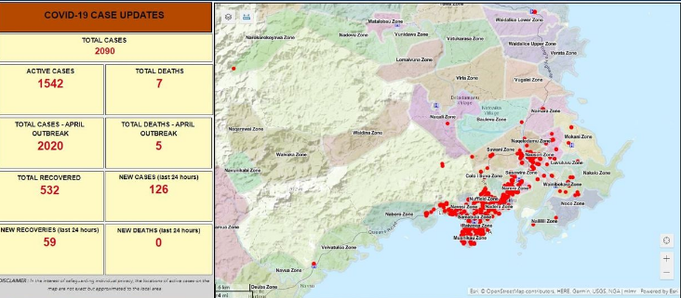
Back ground
New player (Infancy) to the GIS community in Fiji
Benefit from GIS during COVID 19 pandemic with data visualization through support of ML&RD
Procured an ArcGIS license in 2021 to support COVID 19 data visualization

Slide 3
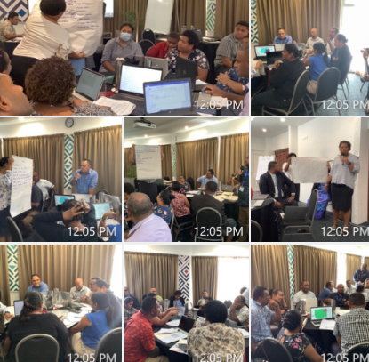
Activities to date
Established a position in Mohms with the Facility Health Programme 2022
Launch of a 5-year Digital Health Strategy
Endorsement of Health GIS Working group
Conducted an introductory Health GIS training in 2022 using Q-GIS with the support of MLMR, Fiji Roads and FBOS facilitators
In-house QGIS & Kobocollect pieces of training for HI’s

Slide 4
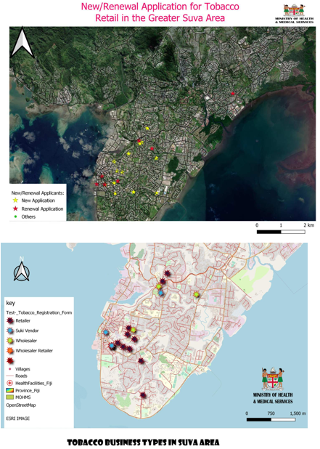
Projects
Description of Nursing Zones using GIS conducted by IMT & MLRD in 2021 for mapping cases during COVID 19
Conducted first Health GIS Advisory working group meeting with Ministry of Lands and Fiji Bureau of Statistics expertise
Mapping Health catchment areas with administrative and population boundaries
Developing GIS cluster map on risk groups for vulnerable population.
Provide GIS support to Mohms projects mapping activities
- KOICA/WHO Climate change & Health Surveillance project
- Ty-Five (Typhoid vaccination project)
- Environmental Health mapping projects e.g. Tobacco control

Slide 5
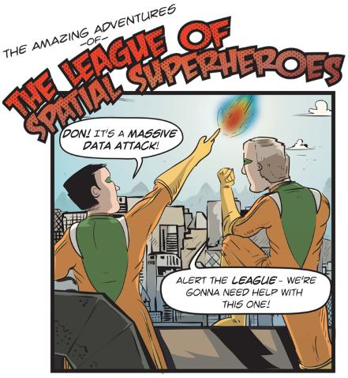
National GIS activities
Submitted support letter to Ministry Economy for GIS Enterprise license in 2020 Budget
Drafted MOU with Lands Department to include data sharing & and technical advisory
Conducted pilot projects with LRD during COVID-19 using ArcGIS e.g. Leptospirosis, mapping market produce, etc.
Participated in ML&RD GIS strategic plan development
Participated in Regional and national GIS initiatives FGIMC, UNGGIM

Slide 6
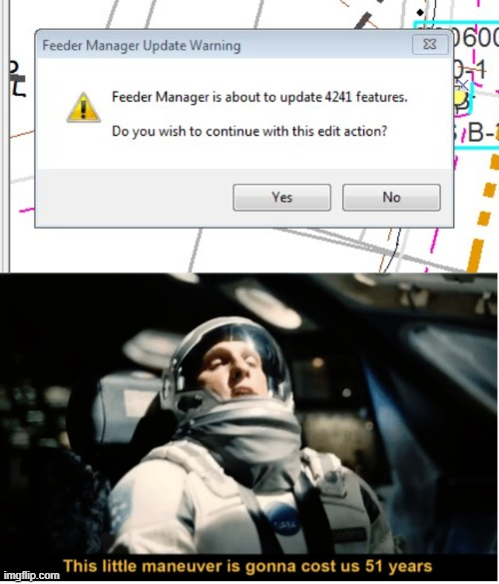
Future plans
Capacity Building in Health GIS for the Workforce
Participate in GIS enterprise architecture for whole government approach- Enterprise System for GIS
Strengthen internal GIS Governance structure with other sectors
Sharing & Collaboration - Information Sharing agreements with GIS Govt. institutions
WHO GIS Centre for GIS Health - Geolocated Health Facilities Initiative
Strengthen Health GIS Advisory working group activities

Slide 7
Vinaka
We look for your continuous support and mentoring. Please contact the following if interested in assisting and supporting the Health GIS Technical Advisory Group:
Ms. Salote Baleisuva : salote.baleisuva@ausfijifacility.org
Mr. Shaneel Prakash: IT Manager, MHMS shaneel.prakash@health.gov.fj
Mr. Vimal Deo: Chief Health Inspector vimal.deo@health.gov.fj

