Slide 1
Utilization of GIT for Climate Resilience in the Pacific
PGRSC - 27 November 2023
Presented By:
Joy Papao
Solomon Islands In-Country Technical Expert
United Nations Satellite Centre (UNOSAT) of UNITAR
Notes:
Distinguished guests, PGRS users and fellow country representatives..

Slide 2
Presentation Outline
• Project Scope & Deliverables
• Technical Trainings
• Awareness Raising Events
• Technical Backstopping
• Decision Support Application tools

Slide 3
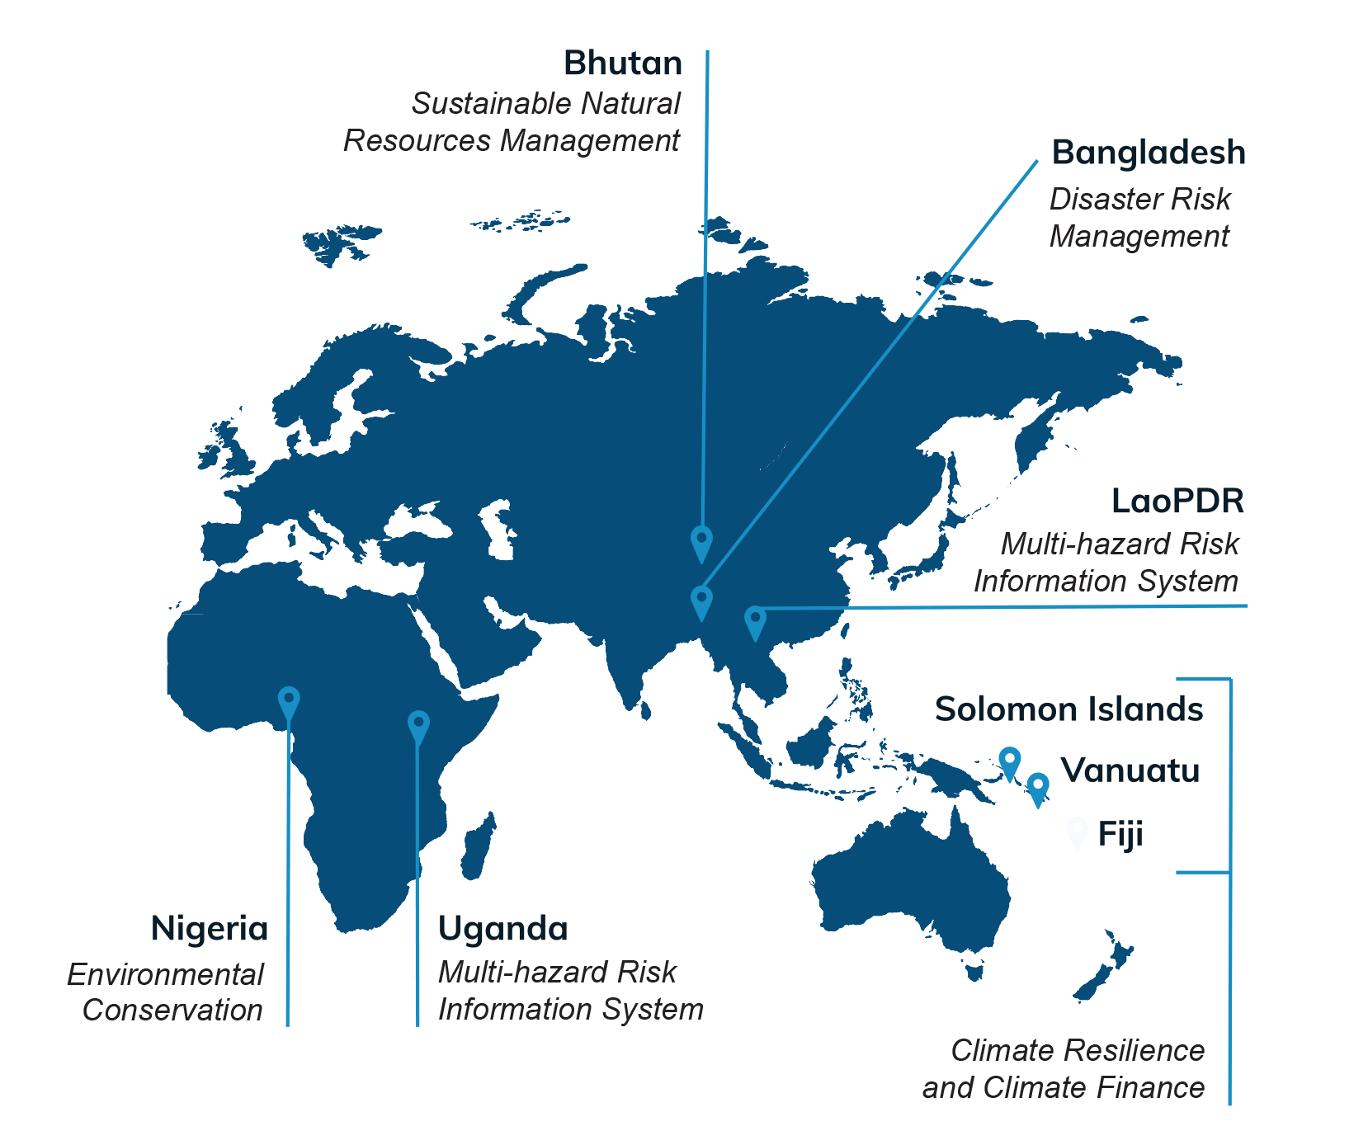
Project scope
Develop technical and institutional capacities of professionals in selected countries on the use of geospatial information technologies.
Apply geo-information technologies to tackle disaster risk but also environmental degradation, food security, and resilience in a changing climate.
“End-to-end capacity development” - solution and capacity development will go hand in hand.
Funded by the Norwegian Agency for Development Cooperation (NORAD)
3-year project (until June 2024)
8 target countries
Notes:
Strengthening Capacities in the use of geospatial information for improved resilience in Asia-Pacific and Africa
Focus on developed Geospatial Technologies for Climate Resilience – For Fiji, Vanuatu and Solomon Islands. In-country presence has built wider networks and solutions are more tailored towards country needs through trainings and technical backstopping support.

Slide 4
Project Deliverables
The project aims to develop custom-tailored solutions and sustainable capacities based on identified needs of focal point ministries and national stakeholders.
The solutions include:
Introductory and Advanced Technical Training courses to support learning needs of technical staff.
Customised Decision Support Applications.
Technical Backstopping through In-country Experts.
Knowledge products housed and served through a central Knowledge Hub.

Slide 5
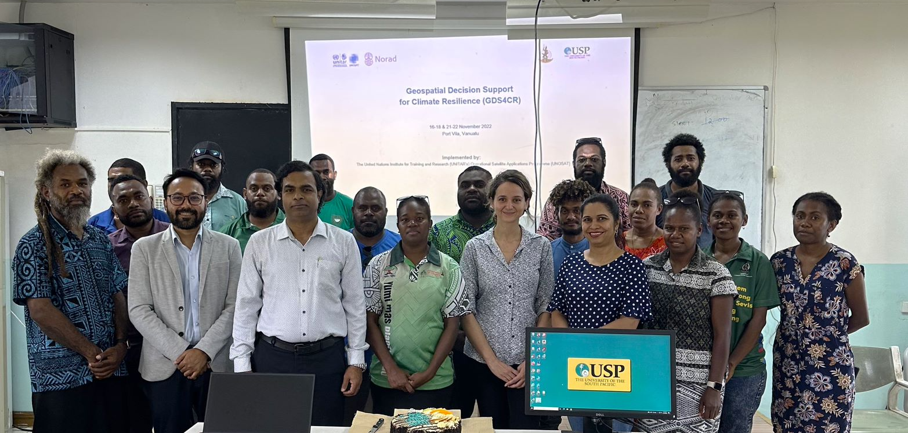
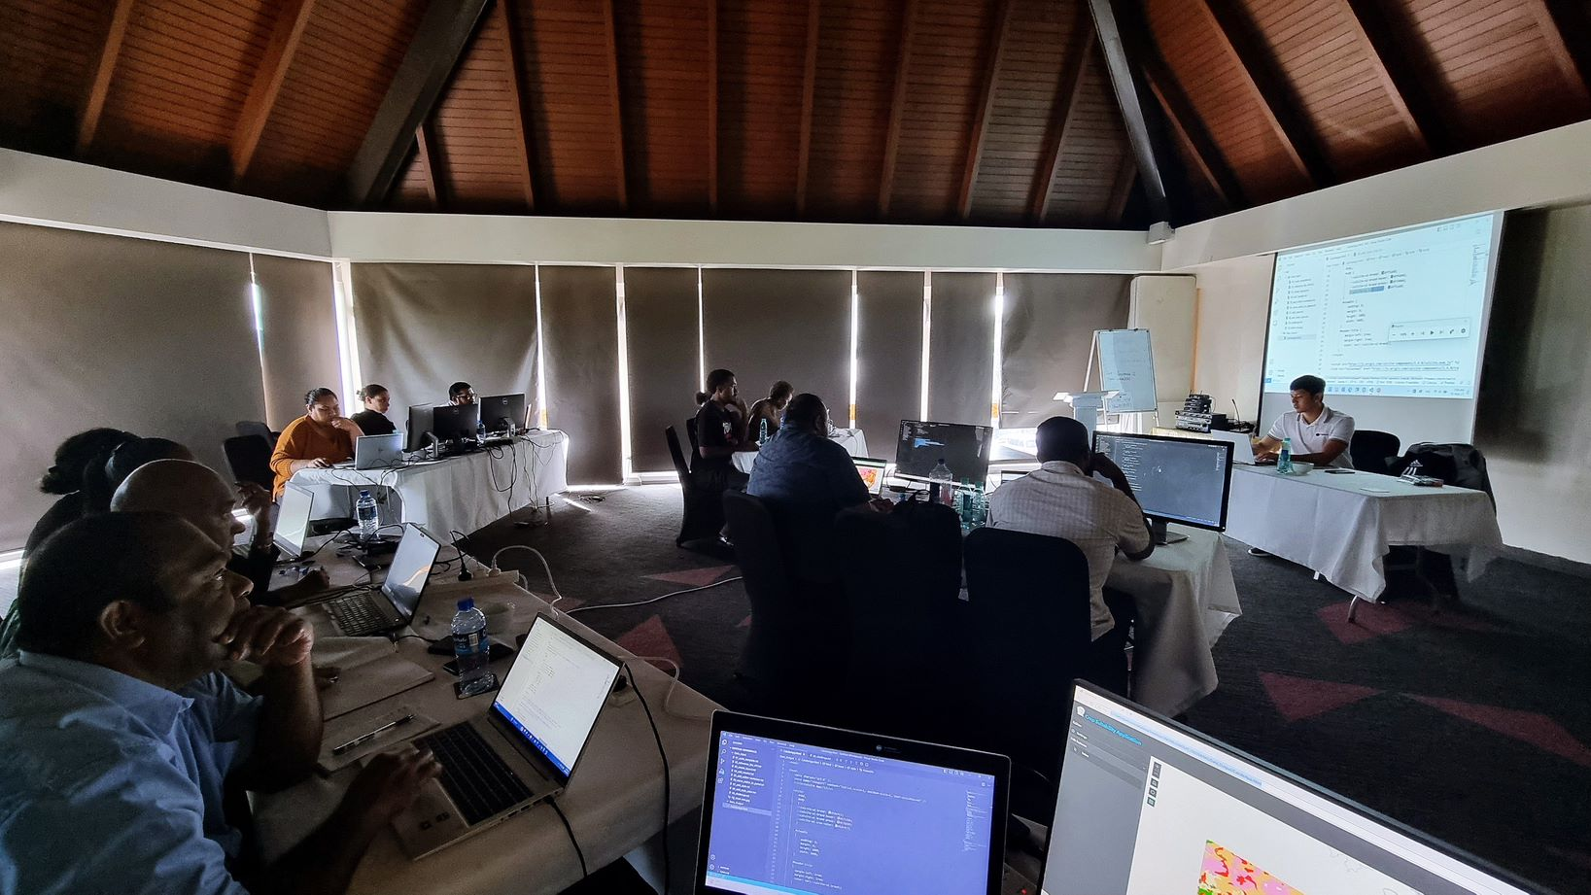
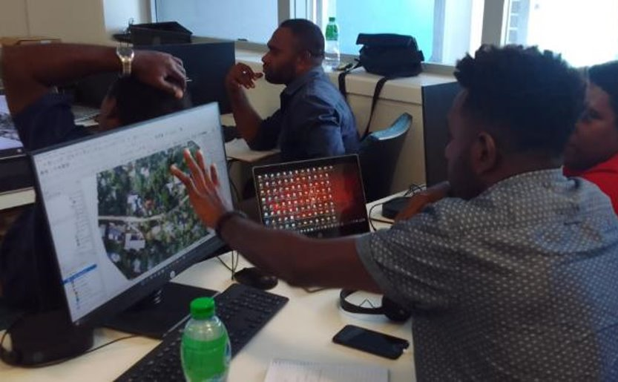
Technical Trainings
PARTICIPANTS
291
Vanuatu
DELIVERED TRAININGS
20
– 13 Pacific
Fiji
BENEFICIARY
55
Solomon Islands
Notes:
Pacific figures from Aleen?

Slide 6
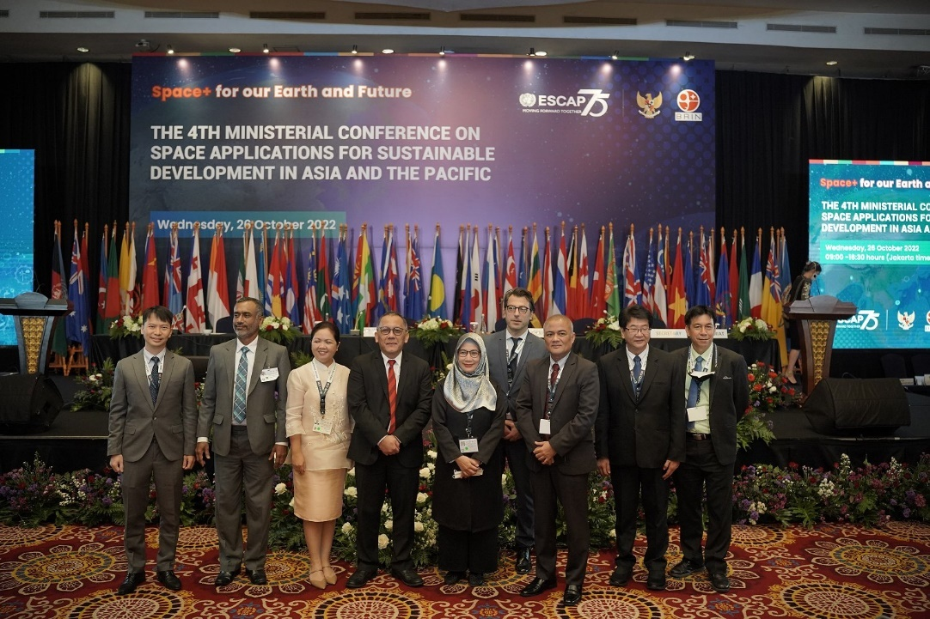
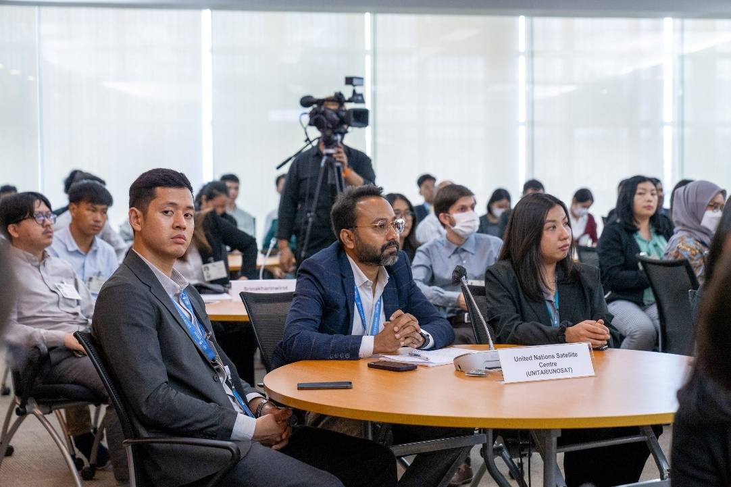
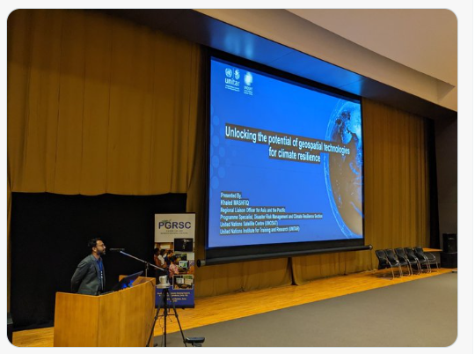
Awareness Raising Events
EVENTS
24​
ASIA ​
COP 27
4TH Ministerial Conference on Space Applications for Sustainable Development in Asia and the Pacific
11
PACIFIC
11
AFRICA
2
10th Asia Pacific Forum on Sustainable Development 2023
Pacific GIS&RS Users Conference 2022
Notes:
Advocacy on the support services nationally, regionally and globally

Slide 7
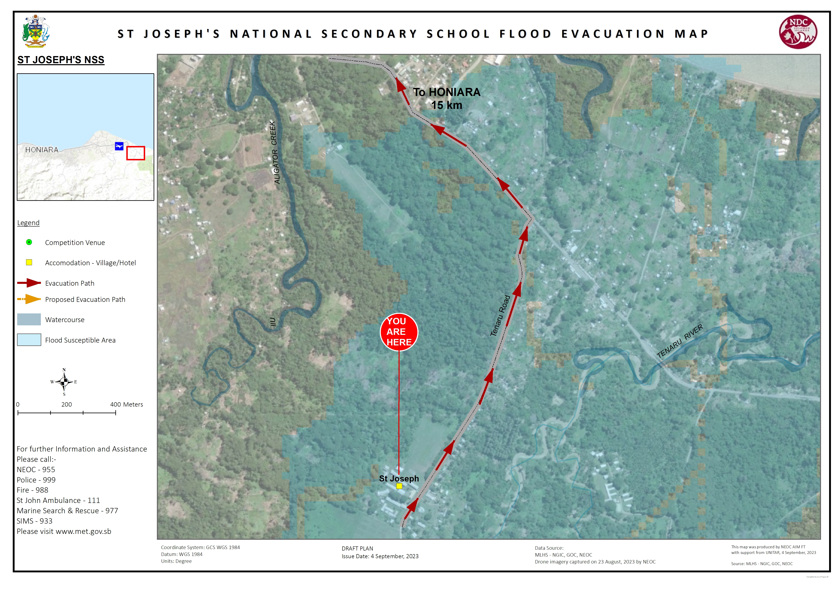
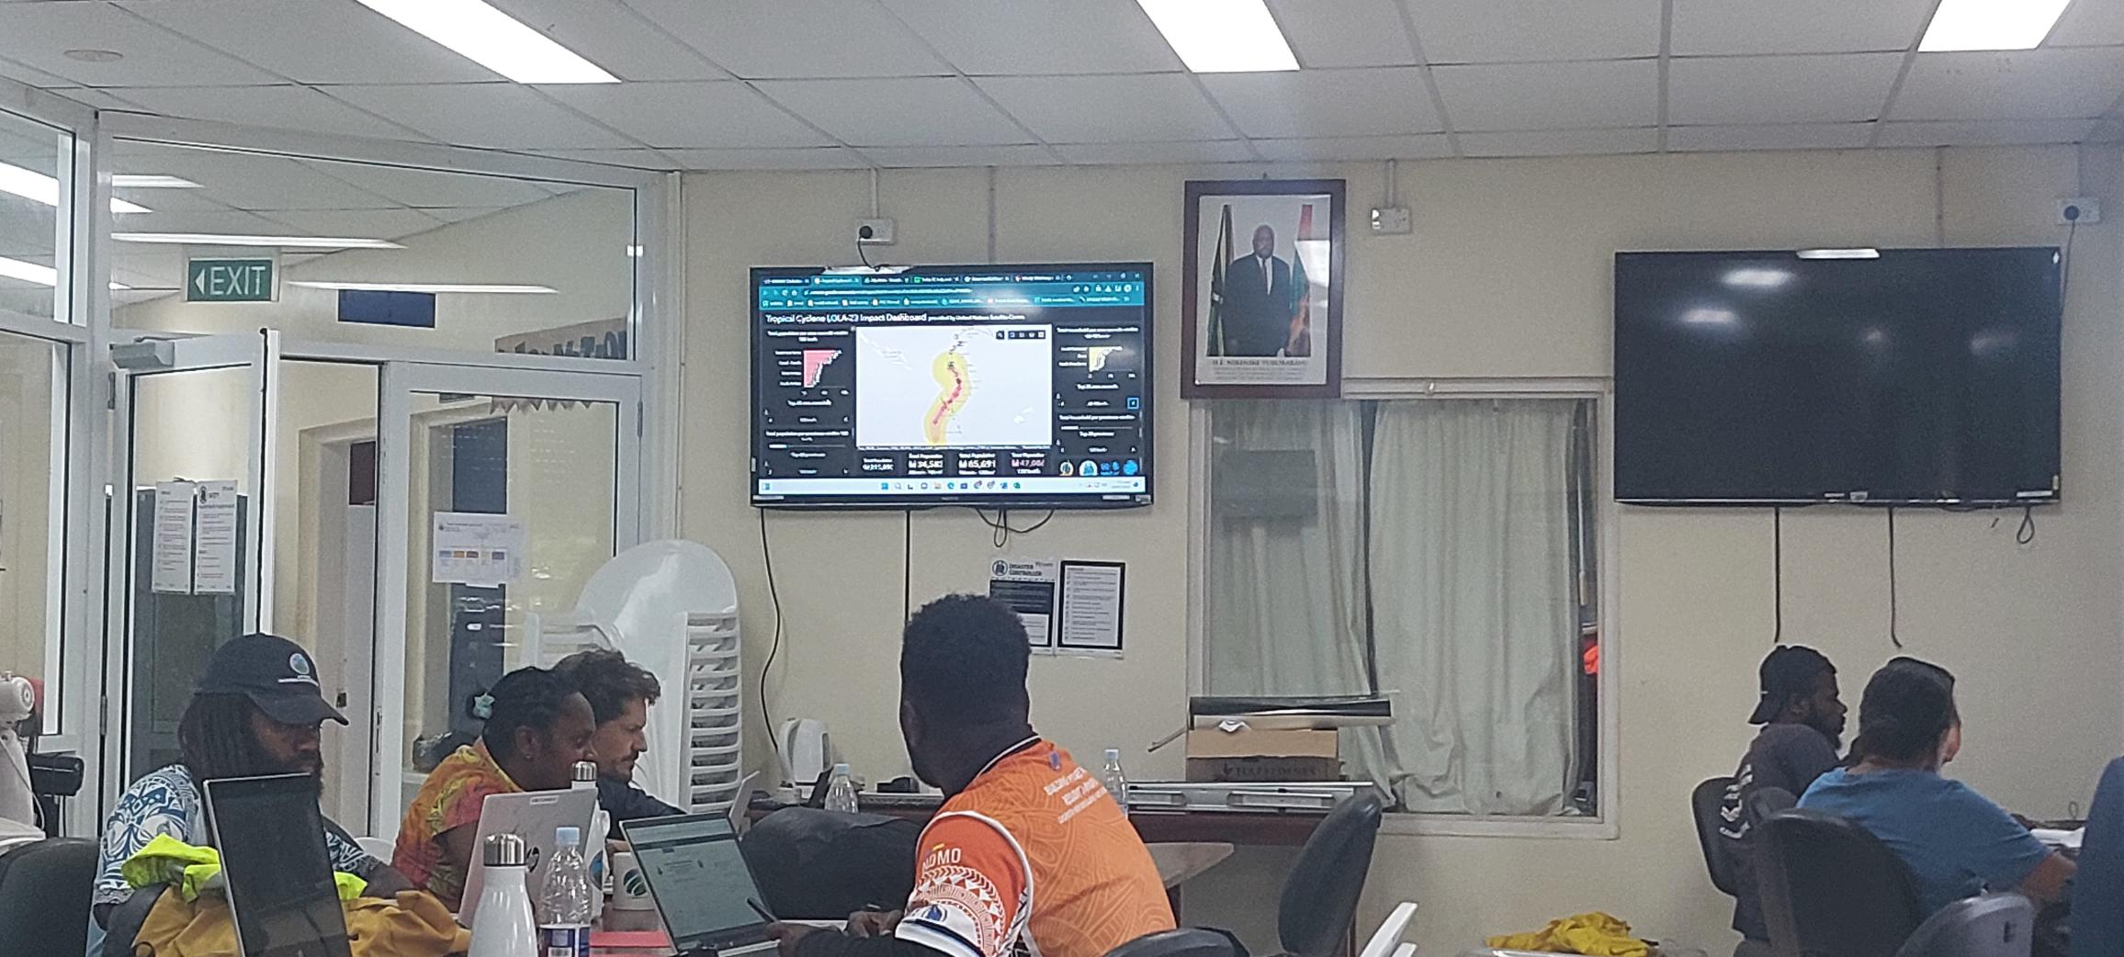
Technical Backstopping
TOTAL
148​
PACIFIC
93
EMERGENCY RESPONSE – TROPICAL CYCLONE LOLA
Vanuatu National Disaster Management Office
FLOOD RISK MAPPING
Solomon Islands National Disaster Management Office
ASIA & AFRICA
55
Notes:
Highlights
- Post TC Events
- PG2023
- NEOC operations

Slide 8
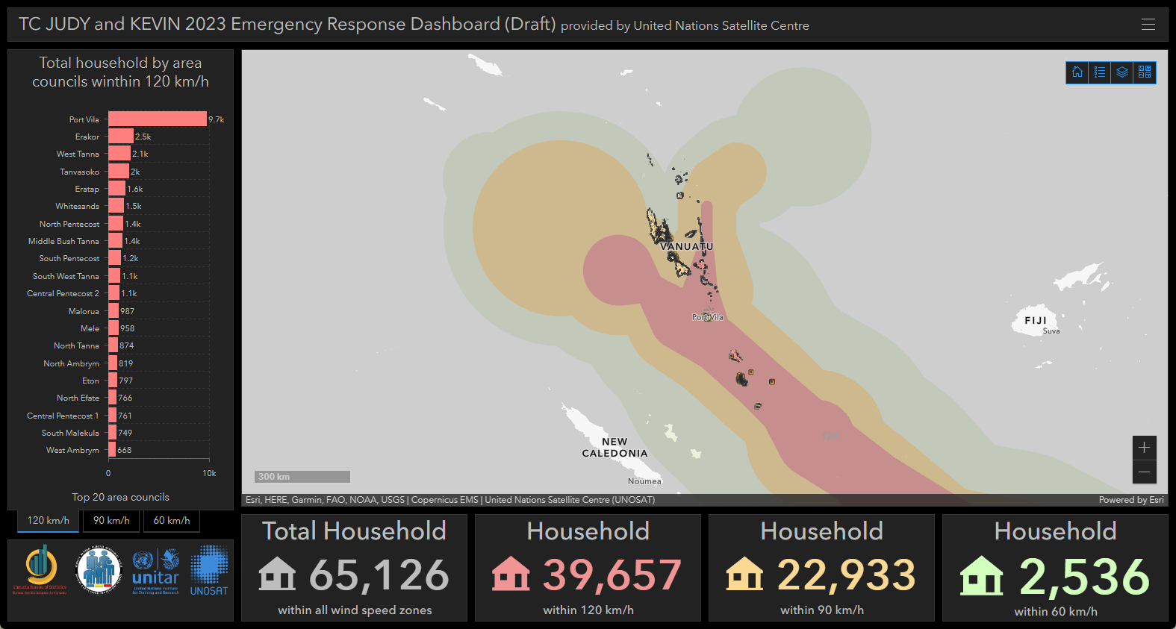
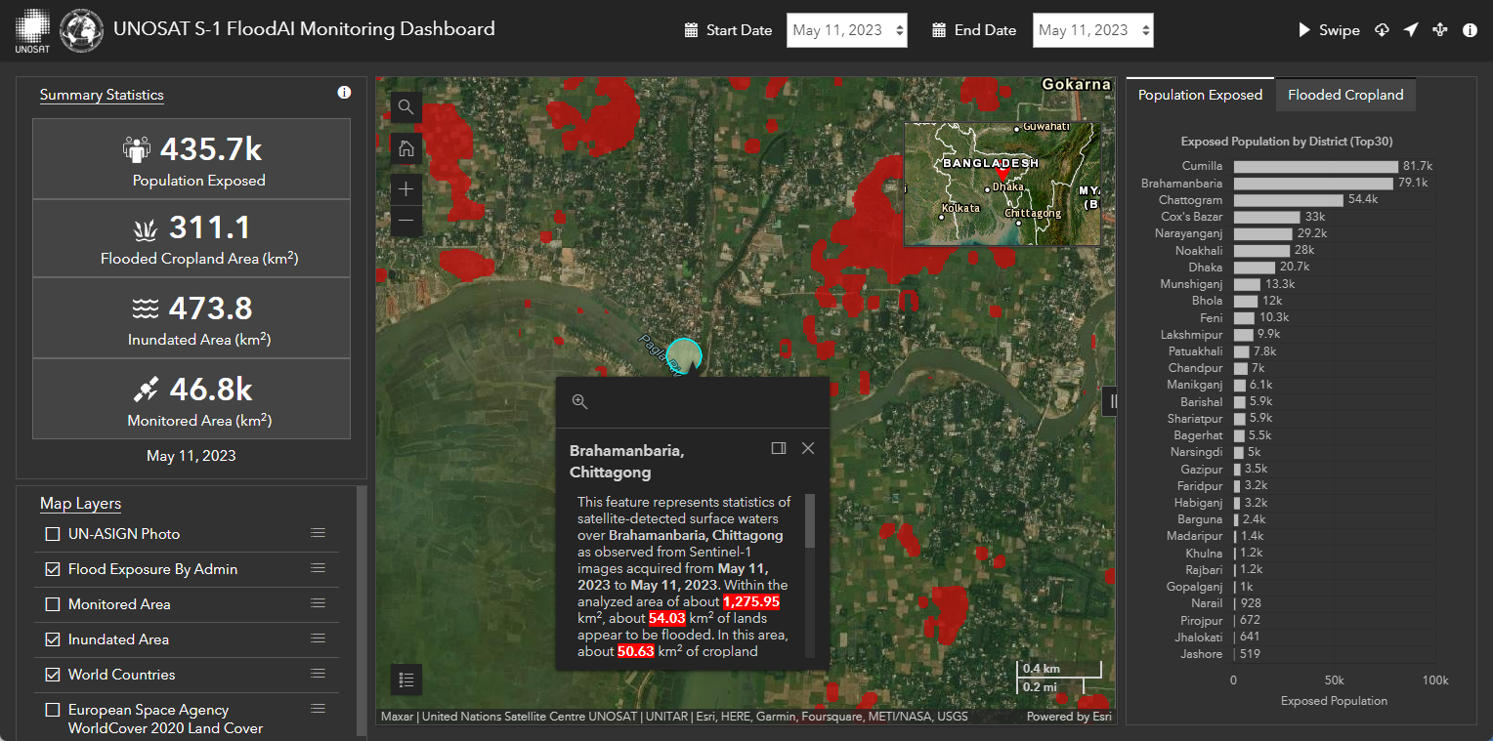
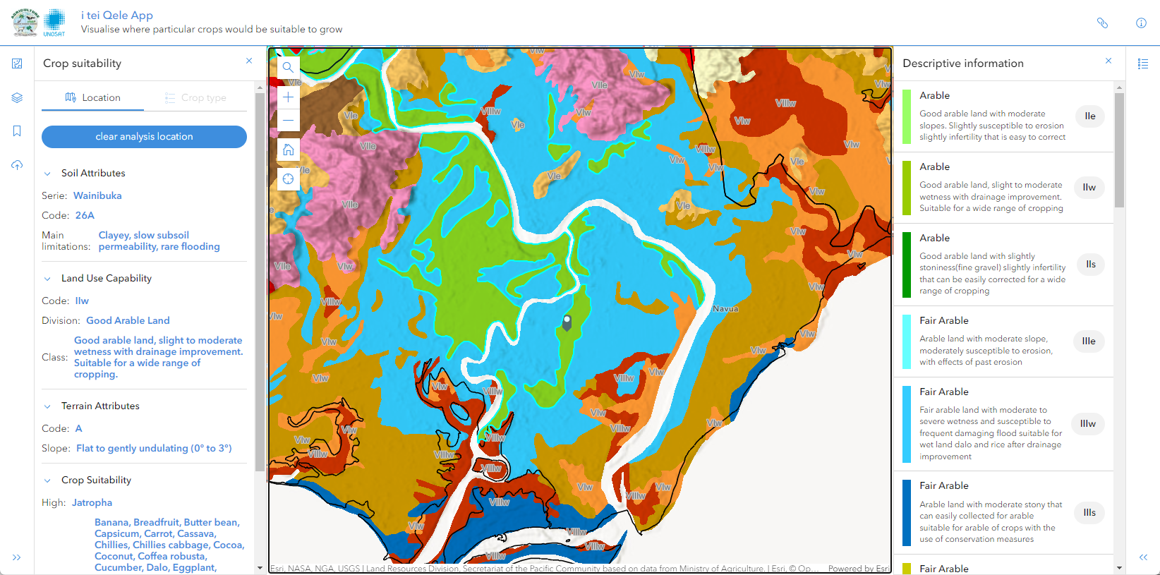
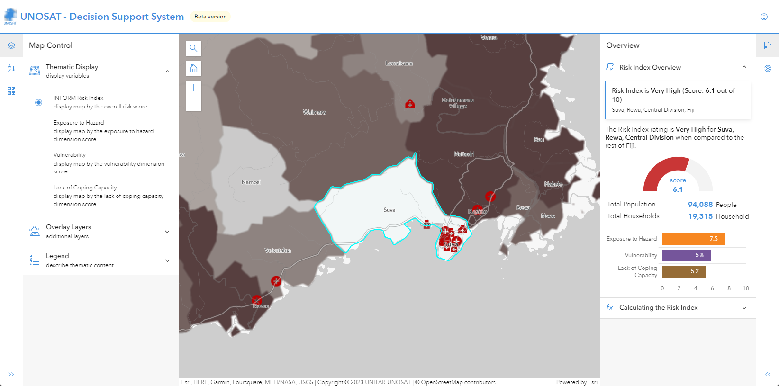
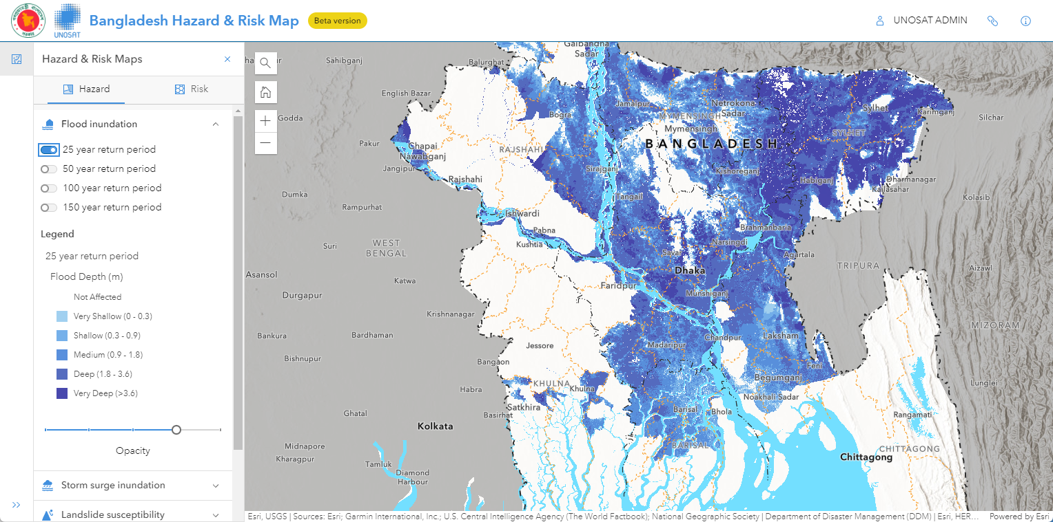
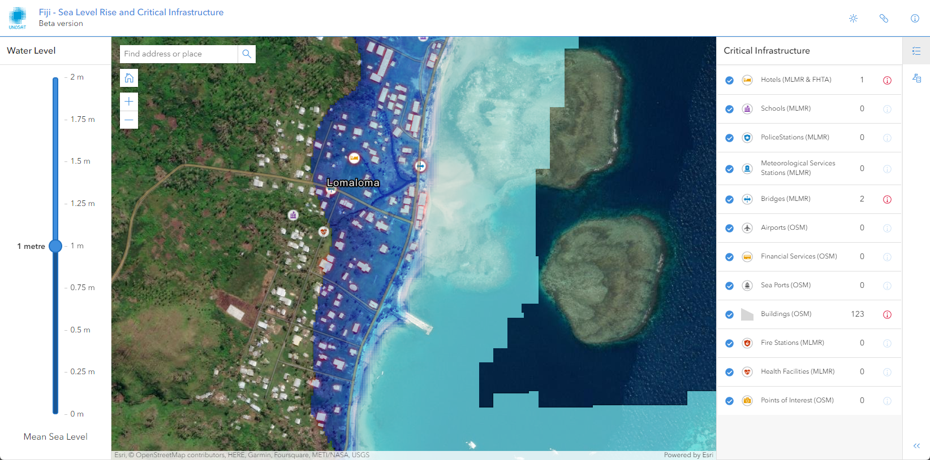
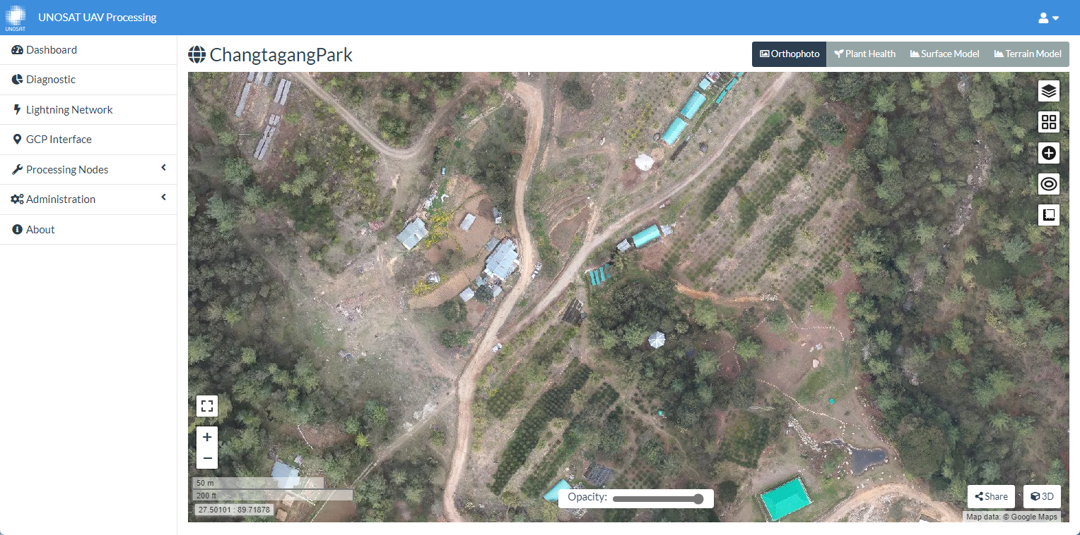
Decision Support Applications / Tools
LAUNCHED
15​
PACIFIC
6
ASIA & AFRICA
9
PENDING
7
Notes:
Example from Fiji: https://unosat-geodrr.cern.ch/apps/FJI/i-tei-Qele/
The app illustrates crop suitability areas in Viti Levu and Vanua Levu islands ~ 70,000 farming households to benefit from access to the application.
SLR – Critical Infrastructure This interactive webapp can measure the impact of different sea level rise scenarios on housing and relevant infrastructure. The elevation dataset was derived from FABDEM (Forest And Buildings removed Copernicus DEM) data.
Decision-makers can use the app to visualize areas highly impacted by projected SLR by 2090, which assists with coastal adaptation planning
TC Lola Dashboard - https://unosat-geodrr.cern.ch/portal/apps/dashboards/ca7acbbfe402480cb6d22d94cd76920e
This dashboard for NDMO visualizes the impact of cyclone winds on properties in Vanuatu – prioritize essential resources

Slide 9
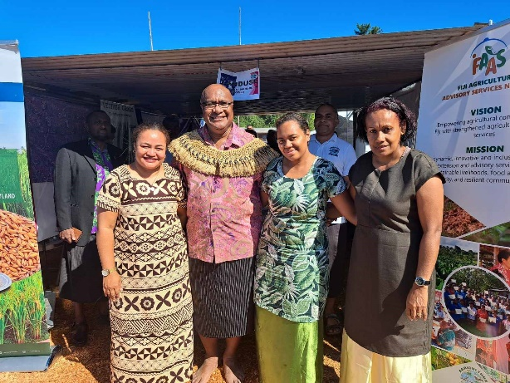
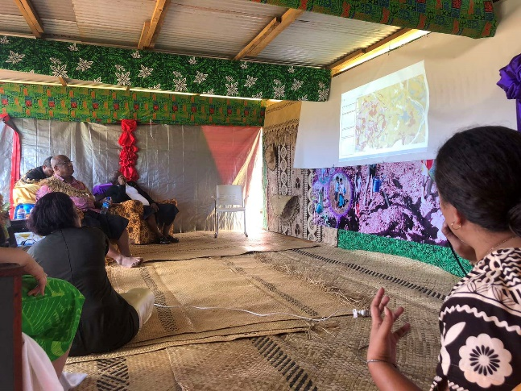
Fiji – i tei Qele App
The i tei Qele app illustrates crop suitability areas in Viti Levu and Vanua Levu islands in the Republic of Fiji. Crop suitability areas are summarized by Land Resources Division, Secretariat of the Pacific Community based on data from Ministry of Agriculture and Waterways Fiji.
The application allows famers to visualise where particular crops would be suitable to grow. Users can query by crop type or location and view a summary of soil mapping units, land use capability classes and the main soil limitations for an area of interest. Famers can use the application to assess the suitability of the land for selected crops the soil attributes and land qualities are compared with the individual crop requirements for optimum growth.
Go to Application
Notes:
Example from Fiji: https://unosat-geodrr.cern.ch/apps/FJI/i-tei-Qele/
70,000 farming household to benefit from access to the application.

Slide 10
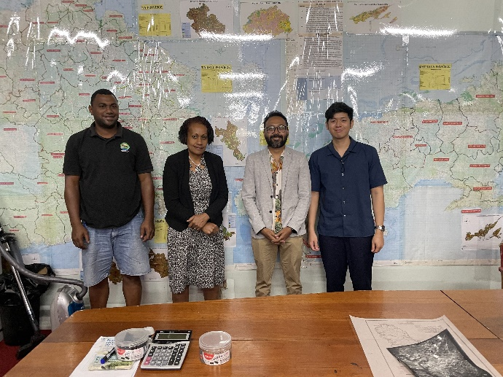
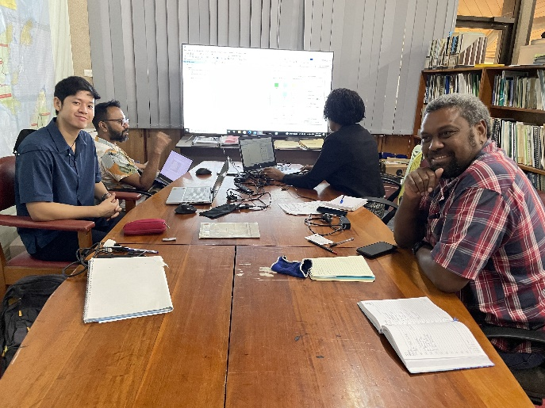
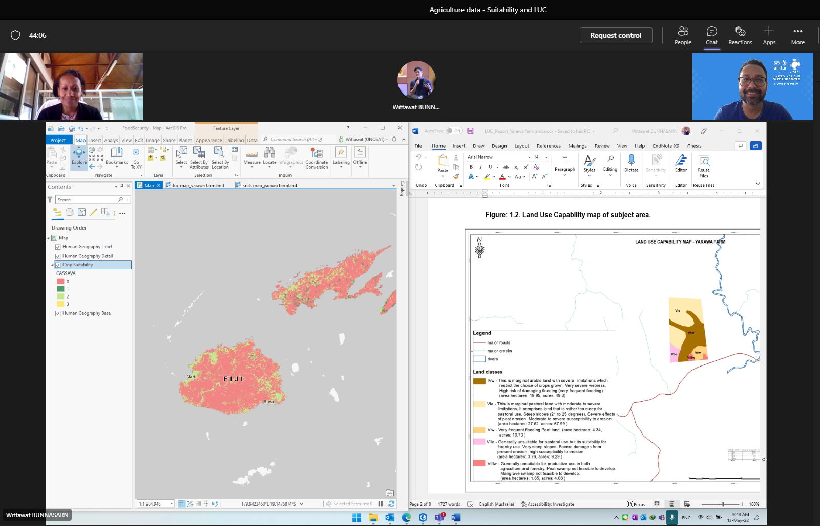
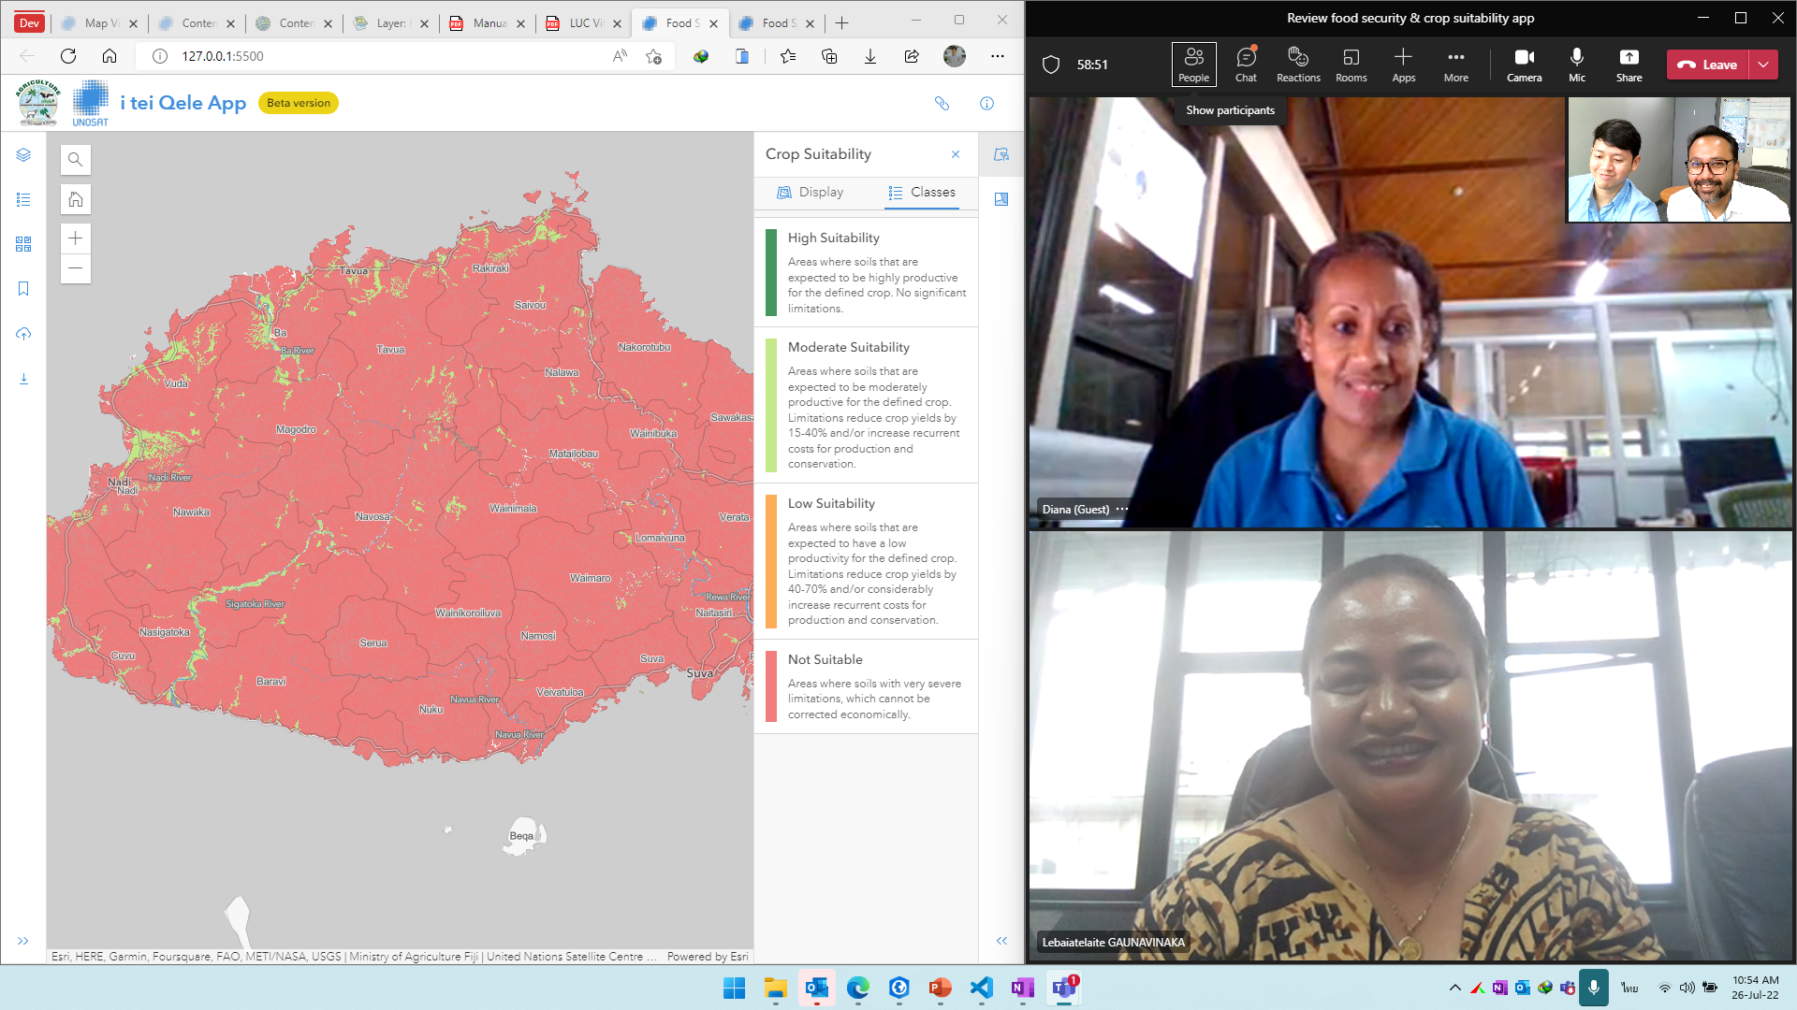
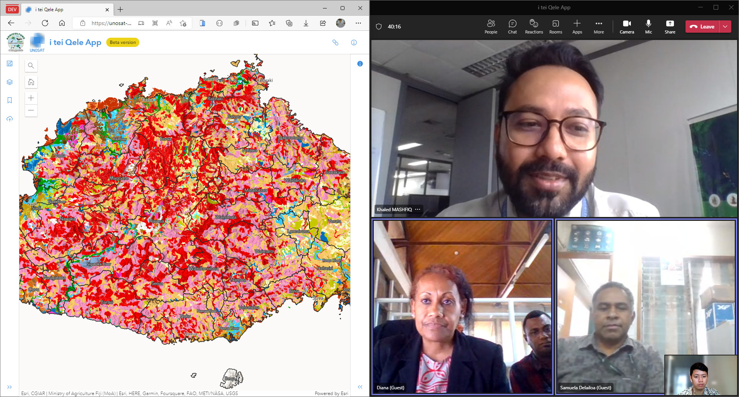
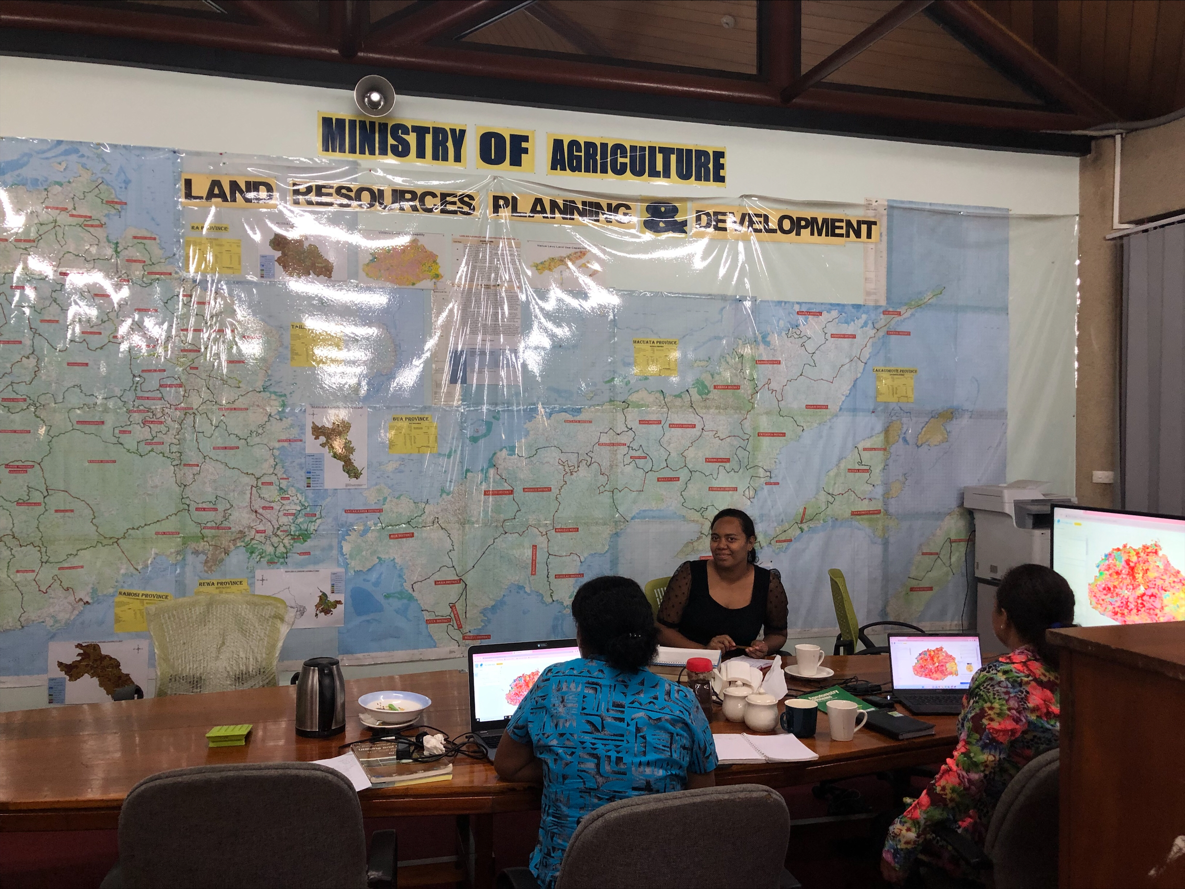
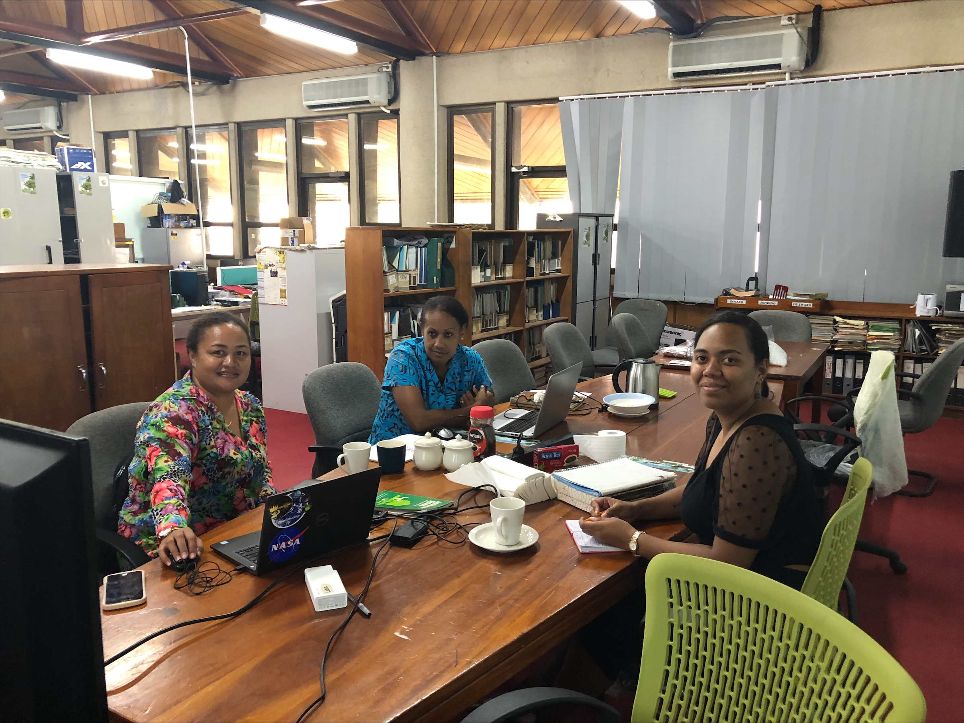
iTei Qele application development process
On March 22, 2022, UNOSAT and the Ministry of Agriculture convened in Suva, Fiji to engage in discussions regarding the app's user requirements.
13 May 2022
26 July 2022
10 November 2022
10 February 2023

Slide 11
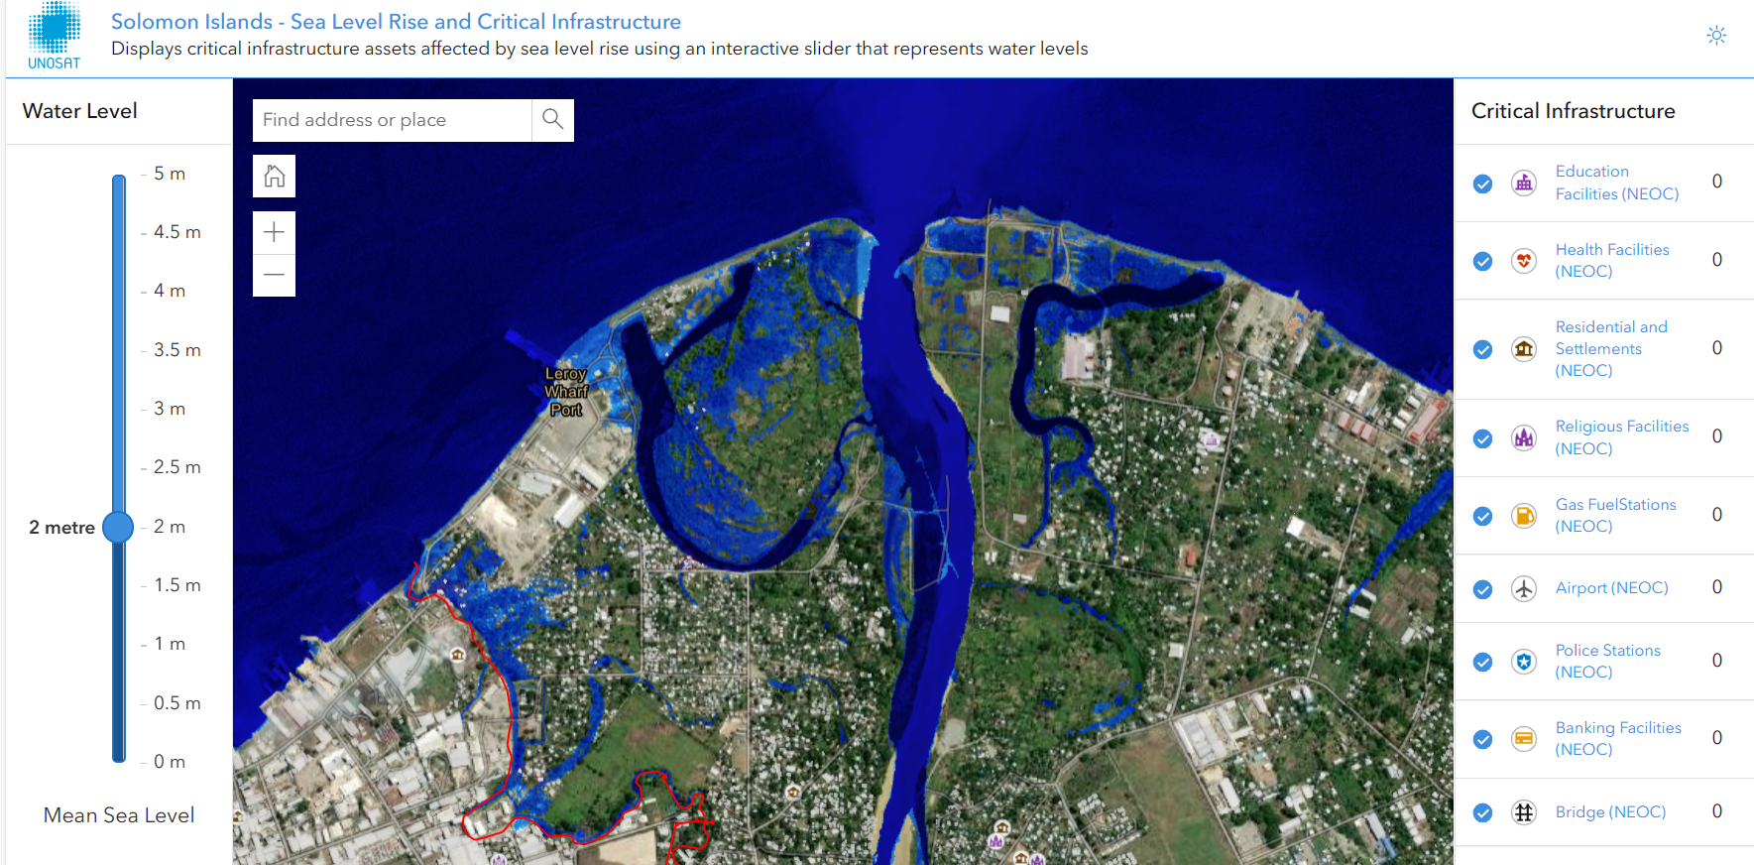
SLB - Critical Infrastructure and Sea Level Rise (Beta version)
This interactive webapp can measure the impact of different sea level rise scenarios on housing and relevant infrastructure. The elevation dataset was derived from FABDEM (Forest And Buildings removed Copernicus DEM) data.
Decision-makers can use the app to visualise areas highly impacted by projected SLR by 2090, which assists with coastal adaptation planning
Go to Application
Notes:
Example from Solomon - Solomon Islands - Sea Level Rise and Critical Infrastructure (cern.ch)

Slide 12
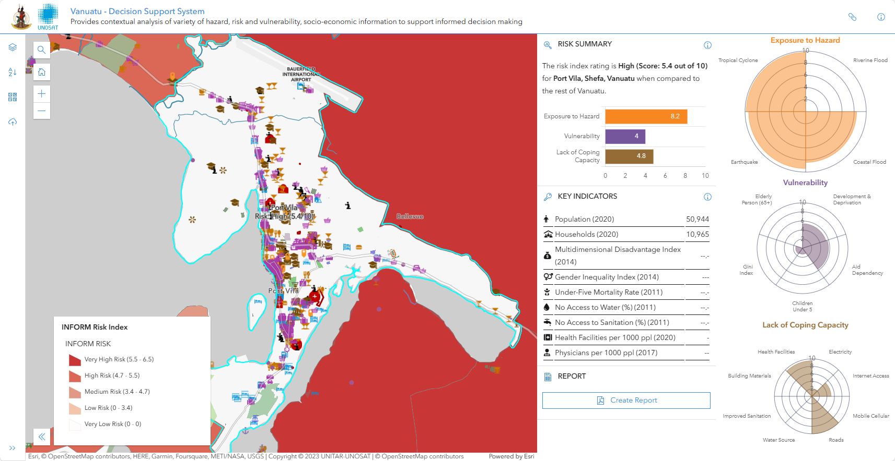
VUT – Decision Support System for DRM
Decision Support System (DSS) for enhanced Disaster Risk Reduction is a tool hosts a diverse set of data under the three dimensions of Risk INFORM Index (Exposure to Hazard, Vulnerability and Lack of coping capacity), which is a global, open-source risk assessment for humanitarian crises and disasters that can support decisions about prevention, preparedness and response.
This is based on 2020 Census data and Adm level 2 - municipality
Notes:
Vanuatu – DSS for DRM - https://unosat-geodrr.cern.ch/apps/VUT/DSS/

Slide 13
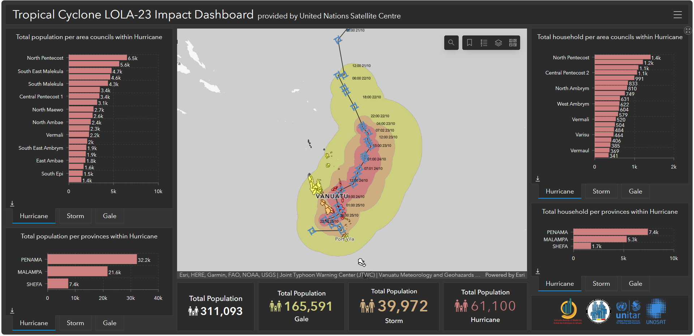
VUT – TC Lola Dashboard
Dashboard for VU NDMO
Visualizing impacts of TC Lola winds over homes, properties and population in Vanuatu.
This enables the prioritization of resources where needed.
,
Notes:
https://unosat-geodrr.cern.ch/portal/apps/dashboards/ca7acbbfe402480cb6d22d94cd76920e

Slide 14
What’s next?
Data to Decisions
Problems to Solutions
User centred applications
Country ownership building through co-creation
Questions?

Slide 15
@UNOSAT @UNITAR.unosat
/UNOSAT

