Slide 1
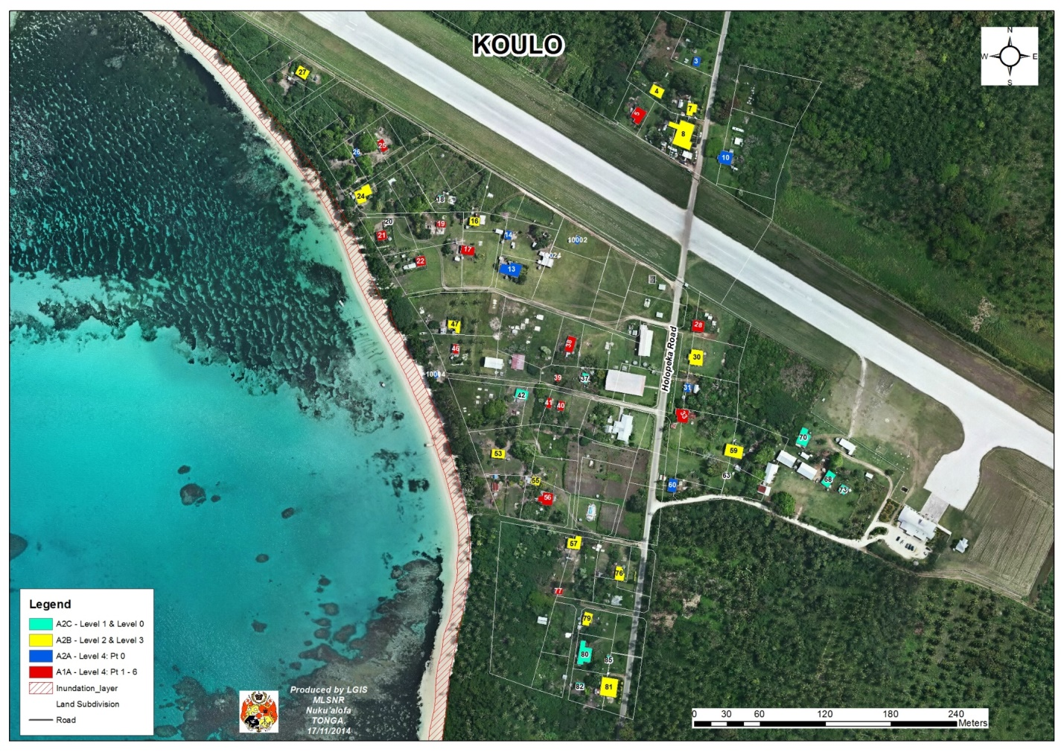
NATIONAL INTEGRATED GEOSPATIAL ACTION PLAN 2023 - 2027
KINGDOM OF TONGA
STRENGTHENING ARRANGEMENTS TOWARD AN INTEGRATED GEOSPATIAL MANAGEMENT
SEPTEMBER 2023

Slide 2
Content
IGIF – Integrated Geospatial Information Framework
Tonga National Geospatial Action Plan
Purpose of the NGAP
9 Strategic Pathways
Priority Strategic Pathways
Stakeholders-Leading Agency with list of actions
Budget and Implementation Schedule
Footages from NGAP Launch
Way Forward

Slide 3
Integrated Geospatial Information FRAMEWORK(IGIF)
The United Nations Committee of Experts on Global Geospatial Information Management (UN-GGIM) at its eighth session in August 2018 adopted the Integrated Geospatial Information Framework.
Overarching Strategic Framework provides a basis, a reference and a mechanism for countries to develop and strengthen their national and sub-national arrangements in geospatial information management and related infrastructures and capacities.
The Integrated Geospatial Information Framework envisages that governments will achieve sustainable social, economic and environmental development through the effective use of national geospatial information systems and capabilities for evidence-based policy and decision-making.
The IGIF vision is for the efficient use of geospatial information by all countries to effectively measure, monitor and achieve sustainable social, economic and environmental development – leaving no one behind.

Slide 4
TONGA –NATIONAL GEOSPATIAL ACTION PLAN
This Country Action Plan prepared by the Ministry of Lands and Natural Resources under the United Nations Development Account 11th tranche Project 1819D “Strengthening geospatial information management in developing countries towards implementing the 2030 Agenda.
With support from the Secretariat of the United Nations Committee of Experts on Global Geospatial Information Management (UN-GGIM)
assist Tonga to move towards, e-service, e-commerce and smart technologies and geo-analysis to improve services to citizens, build capacity for using technologies, provide evidenced based system and enhance informed government decision-making processes.
Especially on climate change and disaster management, facilitate private sector development, take practical actions to achieve a digital transformation, and to bridge the geospatial digital divide in the implementation of national strategic priorities and the 2030 Agenda for Sustainable Development.

Slide 5
Purpose
to strengthen geospatial information management in Tonga to support the implementation of the 2030 Agenda for Sustainable Development and its seventeen Sustainable Development Goals,
to support Tonga’s National priorities and to respond to national circumstances including emergency management.
as a mechanism to strengthen national geospatial management to elevate geospatial information to support the achievement of national development priorities toward achieving the Kingdom’s SDG goals and targets.
to provide the most appropriate and relevant actions to support and strengthen Tonga’s geospatial information management capabilities and make decisions about how to address the gaps, the priority of addressing the gaps, and how to proceed with resolving the gaps through actions.

Slide 6
Desired Future horizons
to successfully establish an organized, reliable and accurate baseline of geospatial information that allows effective and efficient use of geospatial information made possible by data sharing and data integration by MDAs in Tonga.

Slide 7
IGIM hopes to achieve the most desired of:
i. Governance and Institution: enhance work processes between agencies,
  simultaneous update and exchange of geospatial data and/or information.
  accountable and excellent administrative institution.
  multi-lateral coordinated collaboration to sustain knowledge, access to data etc.
Ii. Legal and policy frameworks are developed to guide and advance the resolution made by decision makers.
  Policy and regulation to enforce the National Spatial Planning Act 2012.
  Standards for geospatial data management.
  Promoting an enabling environment for coordination and collaboration including data sharing, exchange, dissemination and use.

Slide 8
Cont’d
iii. Data management use through technological advancement,
  smart transportation.
  real-time early warning system.
  online web GIS.
  UAV and systematic field data capture.
  automation of geospatial data digitalisation and referencing.
iv. Improve human capabilities, capacities and education and such as;
  Support career opportunities in geospatial related academic fields (Geophysicist, Geologist, GIS analysts, Environmental analyst, etc.).
  Establish a research centre to build data analyst capacity, data science and data management.
  Enhance in-country imagery capturing techniques, processing, storage, etc.

Slide 9
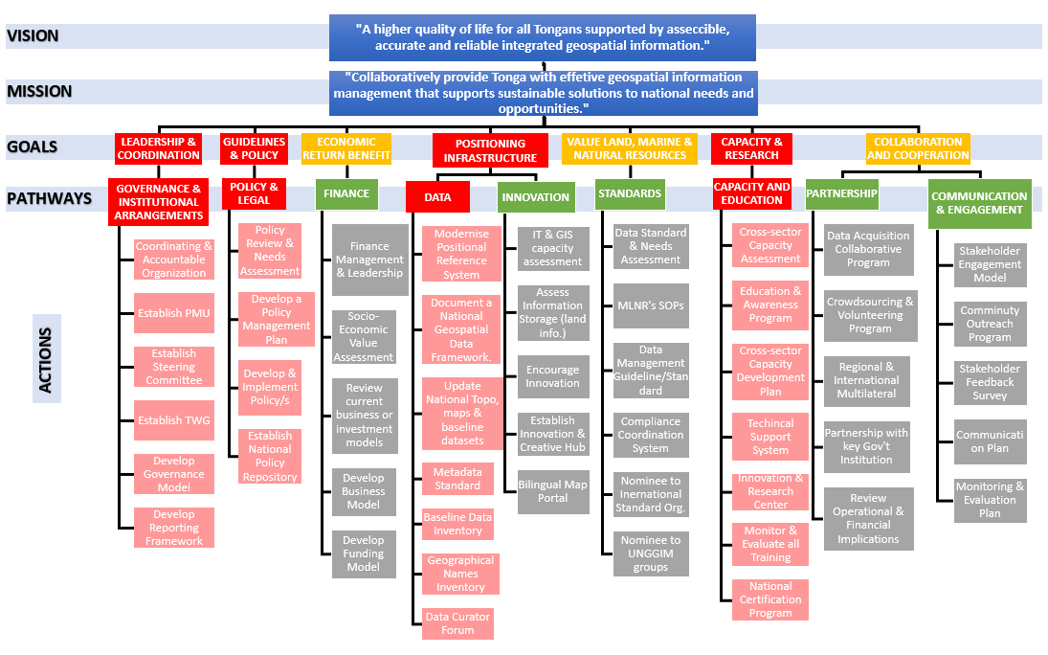

Slide 10
1. Governance and Institutions
  The absence of the national governance model to direct management of geospatial information.
  The fragmented and siloed institutional structures and lack of leadership create a wider gap in communication and management.
  Limited scope of the MLNR’s GIS capabilities.
  The lack of knowledge and awareness of the value and benefit of geospatial information.
2. Policy and Legal
No direct policy and legal framework that fully covers specific characteristics of managing geospatial information or integrated geospatial information management.
No statutory framework to cover institutional arrangements, divisional standard operating procedures, pricing and other related aspects of geospatial information management.
No policy, strategy or legal framework mentions geospatial data and information management.
Cooperative and Collaborative mechanisms are needed in place.

Slide 11
3. Data
  The absence of the location or geography component of the data decreases its quality, and ability to be spatially analyzed and integrated with other data.
  Lack of consistent, reliable and complete baseline datasets and updates.
  Inability to strengthen geospatial data management’s capabilities by government-led organizations.
  There is also a huge lack of understanding of the significance of geospatial reference systems for accurately managed geospatial information.
4. Capacity and Education
There are not enough graduates and qualified personnel in the field of geospatial information in Tonga. For instance; there are not enough geodetic experts in Tonga.
Lack of awareness on the significance of qualified geospatial professionals as well as a lack of educational and training opportunities for staff in different disciplines within the geospatial profession.

Slide 12
Major Gaps in Capability
The major gaps were collected from various stakeholders and categorized based on each of the nine Strategic Pathways (or themes) of the Integrated Geospatial Information Framework.
These identified gaps give an overview of the existing weaknesses in the four-priority pathway’s current national performances that need to be achieved.

Slide 13
Strategic Context and Rationale Alignment
Relationship to Sustainable Development Goals (SDGs)
global policy to guide the way countries collectively manage and transform the social, economic and environmental dimensions of people, planet and prosperity.
provides tremendous opportunity for the geospatial community to meet the unprecedented need for more data covering all aspects of sustainable development.
The 2030 Agenda requires new data acquisition and integration approaches and the need for “high quality, timely, reliable and disaggregated data, including earth observations and geospatial information”, and with commensurate new and innovative data sources and methods.
the integrative platform for all digital data that has a location dimension. All countries and all sectors need geospatial information for national development and decision-making.
Geospatial information has the very real potential for forming a new and emerging “data ecosystem” for sustainable development.
This project leverages the Integrated Geospatial Information Framework, developed by UN-GGIM and the World Bank in collaboration with Member States, to deliver training designed to assist Tonga to strengthen their geospatial information management capabilities and capacity.

Slide 14
APPENDIX 2: BUDGET ESTIMATES
Breakdown overview of the Budget Estimates for project activities identified in the Action Plan. The detailed and complete Budget Estimates is found in here or refers to the Attached Appendix 1: Budget Estimates.
* Currency in TONGAN Pa’anga - TOP
BUDGET ESTIMATES
Reference | Project Description | Original Funding ($) |  | Balance Funding ($) |  | Consultant Fees | Data and Technology | Office Resources | Others | Total Capital Required
 |  | Recurrent | Single Allocation | Recurrent | Single Allocation
SP1: Governance | Leadership, governance model, institutional arrangements and a clear value proposition | 100,000 | 960,000 | 50,000 | 783,000 | 300,000 | 377,000 | 100,000 |  | 2,670,000
SP2: Policy & Legal | Legal and policy framework to institute national geospatial legalization and policy. | 10,000 | 130,000 | 7,500 | 56,000 | 40,000 | 50,000 |  |  | 193,500
SP3: Financial | Business model, financial partnerships and identify investment needs, funding sources, and benefits realization milestones |  | 58,000 | - | 88,500 | 26,000 | 77,500 |  |  | 442,000
SP4: Data | Geospatial data framework and custodianship guidelines | 513,000 | 13,000 | 405,000 | 671,000 | 40,000 | 360,000 |  |  | 2,002,000
SP5: Innovation | Current and emerging technologies and processes with a view to applying innovative methods | 38,000 | 134,000 | 20,000 | 100,000 | 30,000 | 186,000 |  |  | 508,000
SP6: Standards | Best practice standards and compliance mechanisms | 30,000 | 61,500 | 10,000 | 71,000 | 30,000 | 30,000 |  |  | 232,500
SP7: Partnership | Cross-sector and interdisciplinary cooperation, industry and private sector partnerships, and international cooperation | 10,000 | 80,000 | 48,000 | 62,000 | 10,000 | 53,000 |  |  | 263,000
SP8: Capacity & Education | Capacity building programs and education systems | 35,000 | 222,000 | 39,500 | 660,000 | 160,000 | 691,000 |  |  | 1,807,500
SP9: Communication & Engagement | Recognize stakeholder’s (including the general community) buy-in is critical to success. | 5,000 | 30,000 | 11,500 | 82,000 | 20,000 | 20,500 |  |  | 169,000
 |  | Original Recurrent Budget | Original Single Allocation | Recurrent Budget - Balance | Single Allocation - Balance | Consultant Fees | Data and Technology |  |  | Total Capital Required
 | TOTAL | 741,000 | 1,688,500 | 591,500 | 2,573,500 | 656,000 | 1,945,000 |  |  | 8,195,500

Slide 15
Development Account Project-Tonga Action Plan – Actions, Budget, Schedule

Slide 16
Cont’d

Slide 17
Cont’d

Slide 19
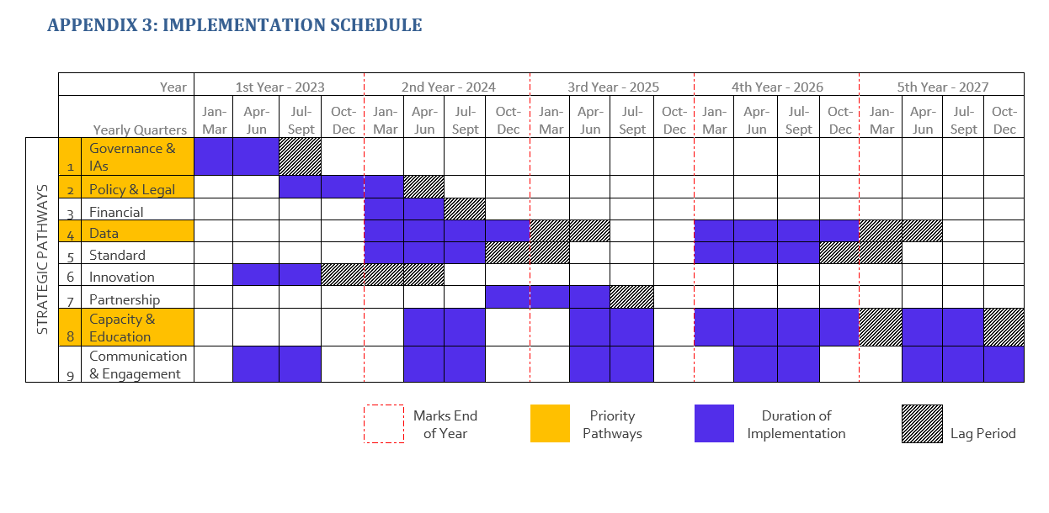

Slide 20
Way forward
Establish an SDG Data Hub (Dashboard)for Tonga, to monitor, manage and report the progress of SDGs and indicators in Tonga.
Support informed decisions upon a situations.

Slide 21


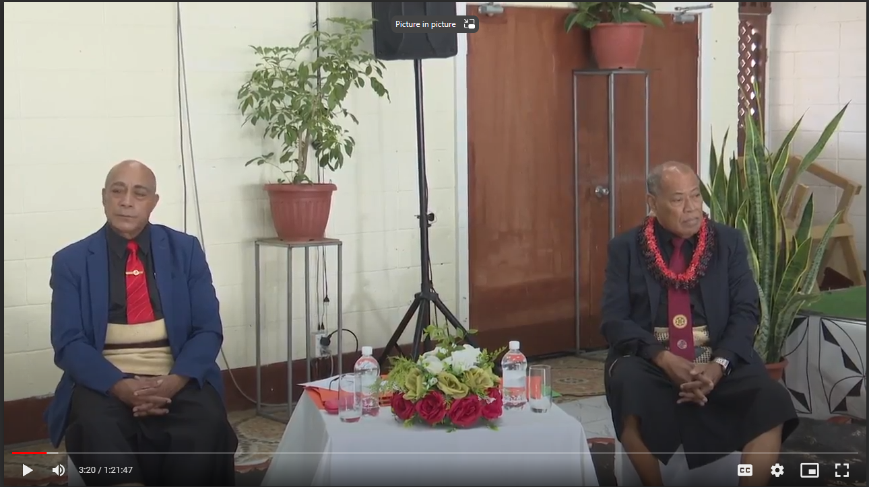
Footages from Launch Ceremony-NGAP

Slide 22


Slide 23
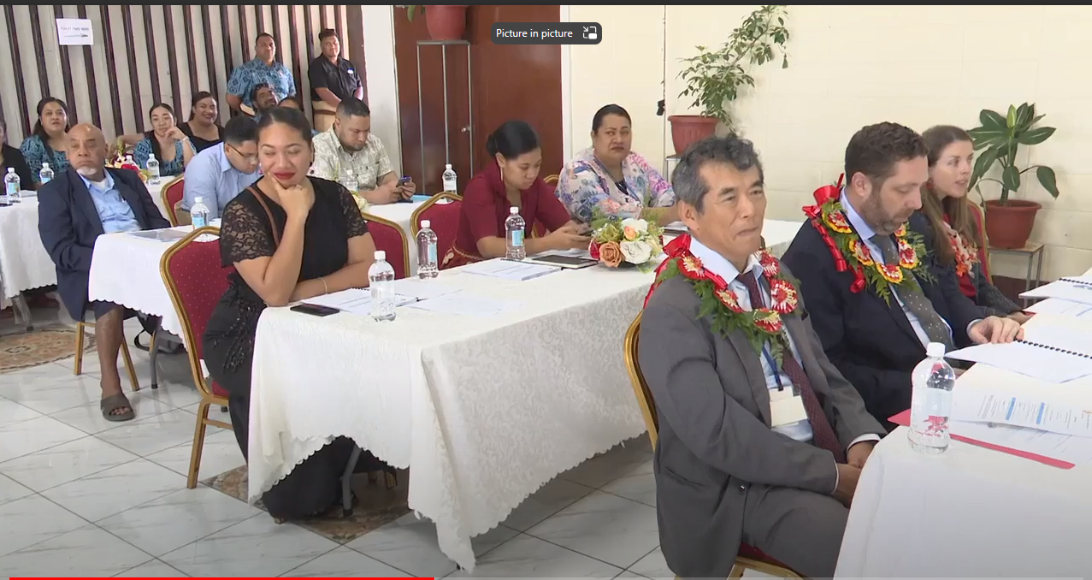

Slide 24
THANKS FOR LISTENING

