Slide 1
The State of OSGeo Oceania
Let’s grow together the Oceania GIS community!

Slide 2
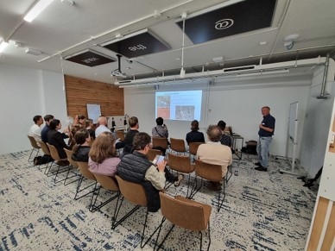
Bula! Ciao!
I am here because I love to give presentations (yeah right)
You can find me at elisa@kenex.co.nz

Slide 3
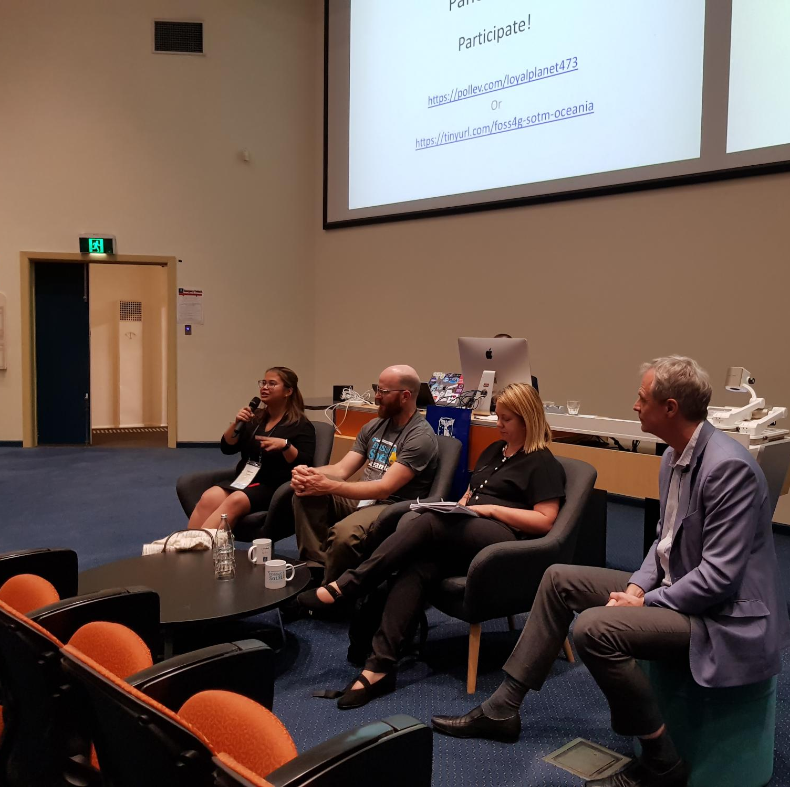
What is OSGeo Oceania
We are a Not For Profit company
Every year we run a conference in Oceania
And we do other cool things!
(mostly free to attend to, and mostly have food and drinks involved!)
Our Board is made up of people from Oceania
We have members all around the Pacific
We’re recognised as the local chapter for both OSGeo and OSM Foundation
We are all about supporting the open geospatial community in our region

Slide 4
A brief history
2019 Chair:
John Bryant
2021 Chair:
Ed Neerhut
2023 Chair:
Alex Leith
2018
2020
2022
Conference held in Melbourne
Supported by SSSI
Conference planned for Fiji
Distributed “hubs” conference held
Pacific Geospatial Conference
in Fiji with PGRSC
You are here!
Created OSGeo Oceania Ltd company
Conference held in Wellington
Distributed
event again
Conference
held in Auckland
2019
2021
2023
I WAS DEPUTY CHAIR!
2020 Chair:
John Bryant/Alex Leith
2022 Chair:
Jonah Sullivan

Slide 5
What we stand for:
Helping the Community grow and thrive
Promoting participation and inclusivity
Spreading knowledge, awareness (and good mojo)

Slide 6
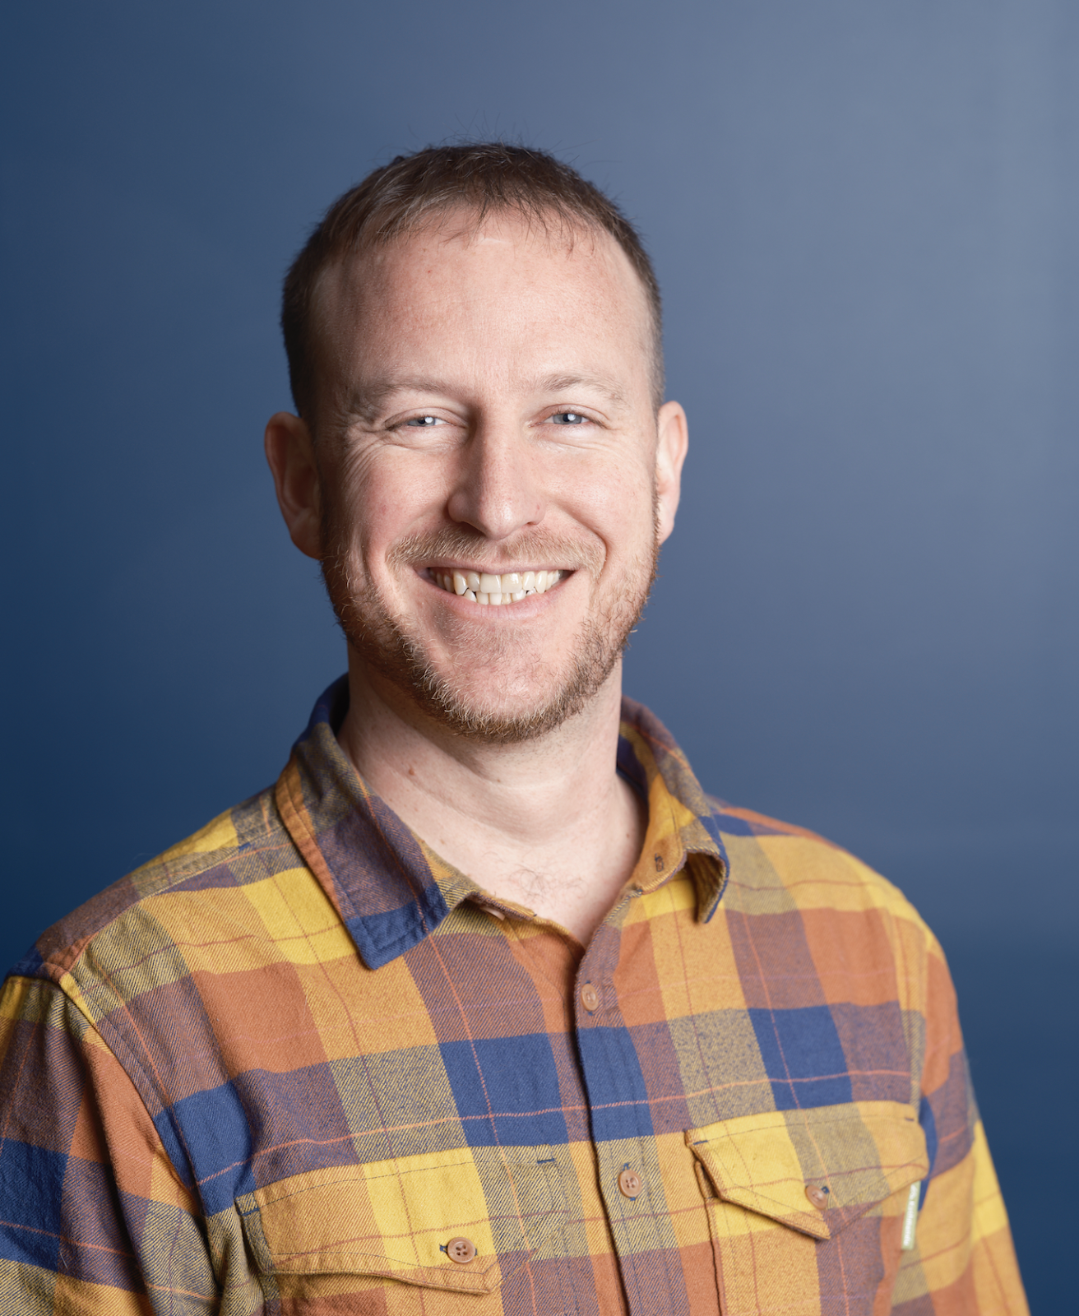
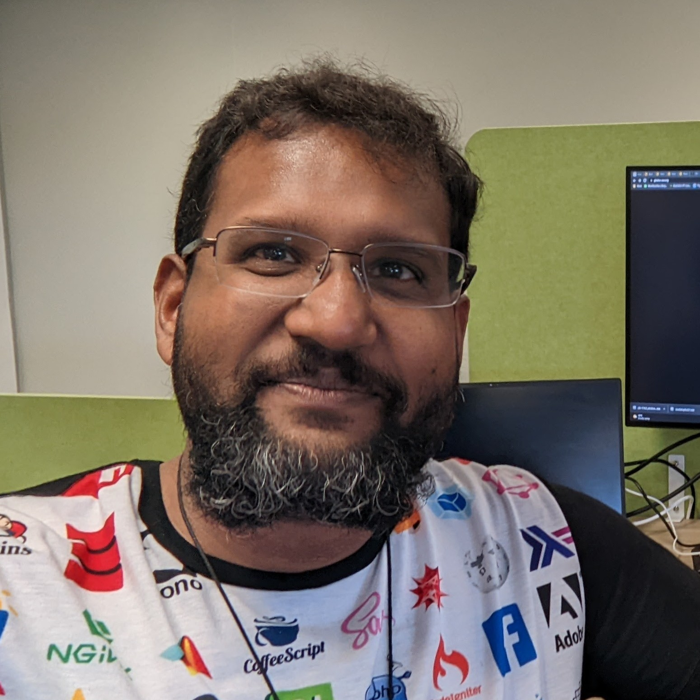
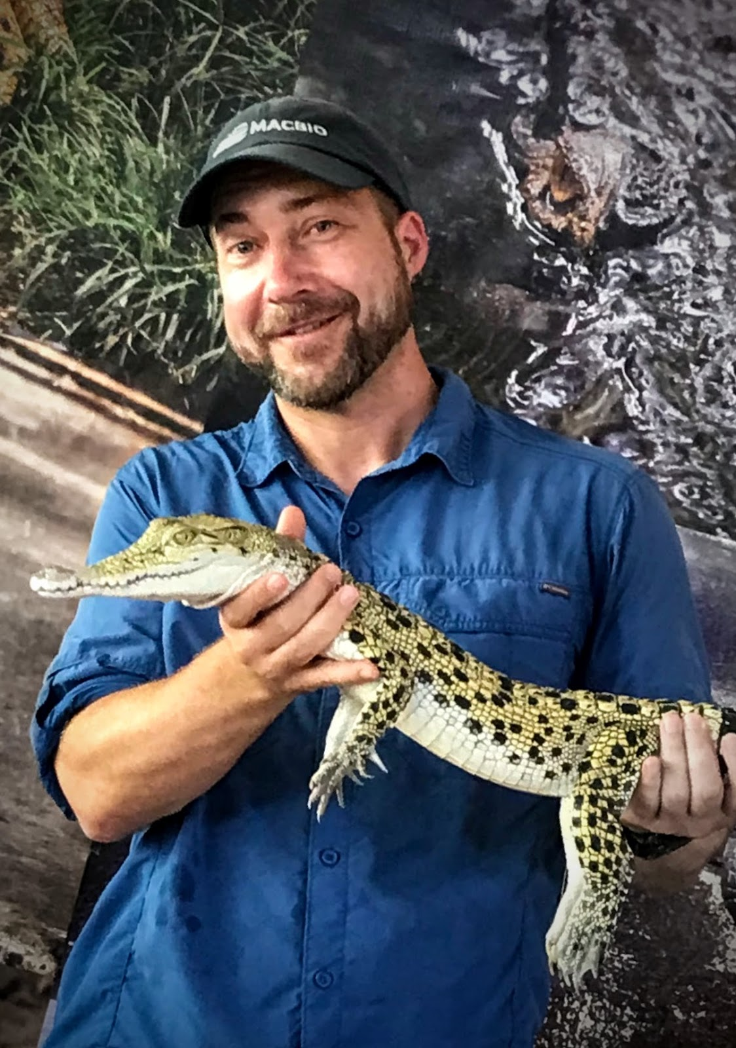
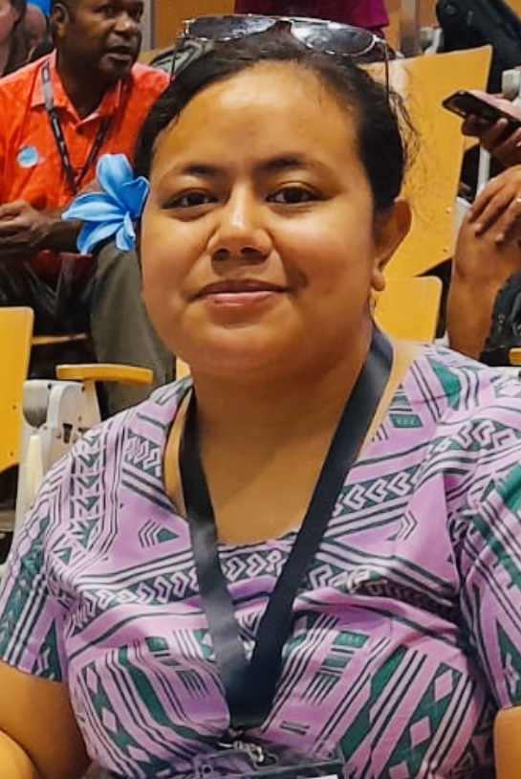
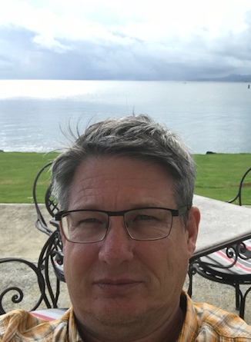
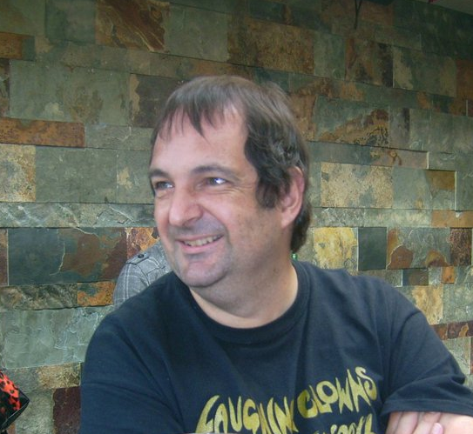
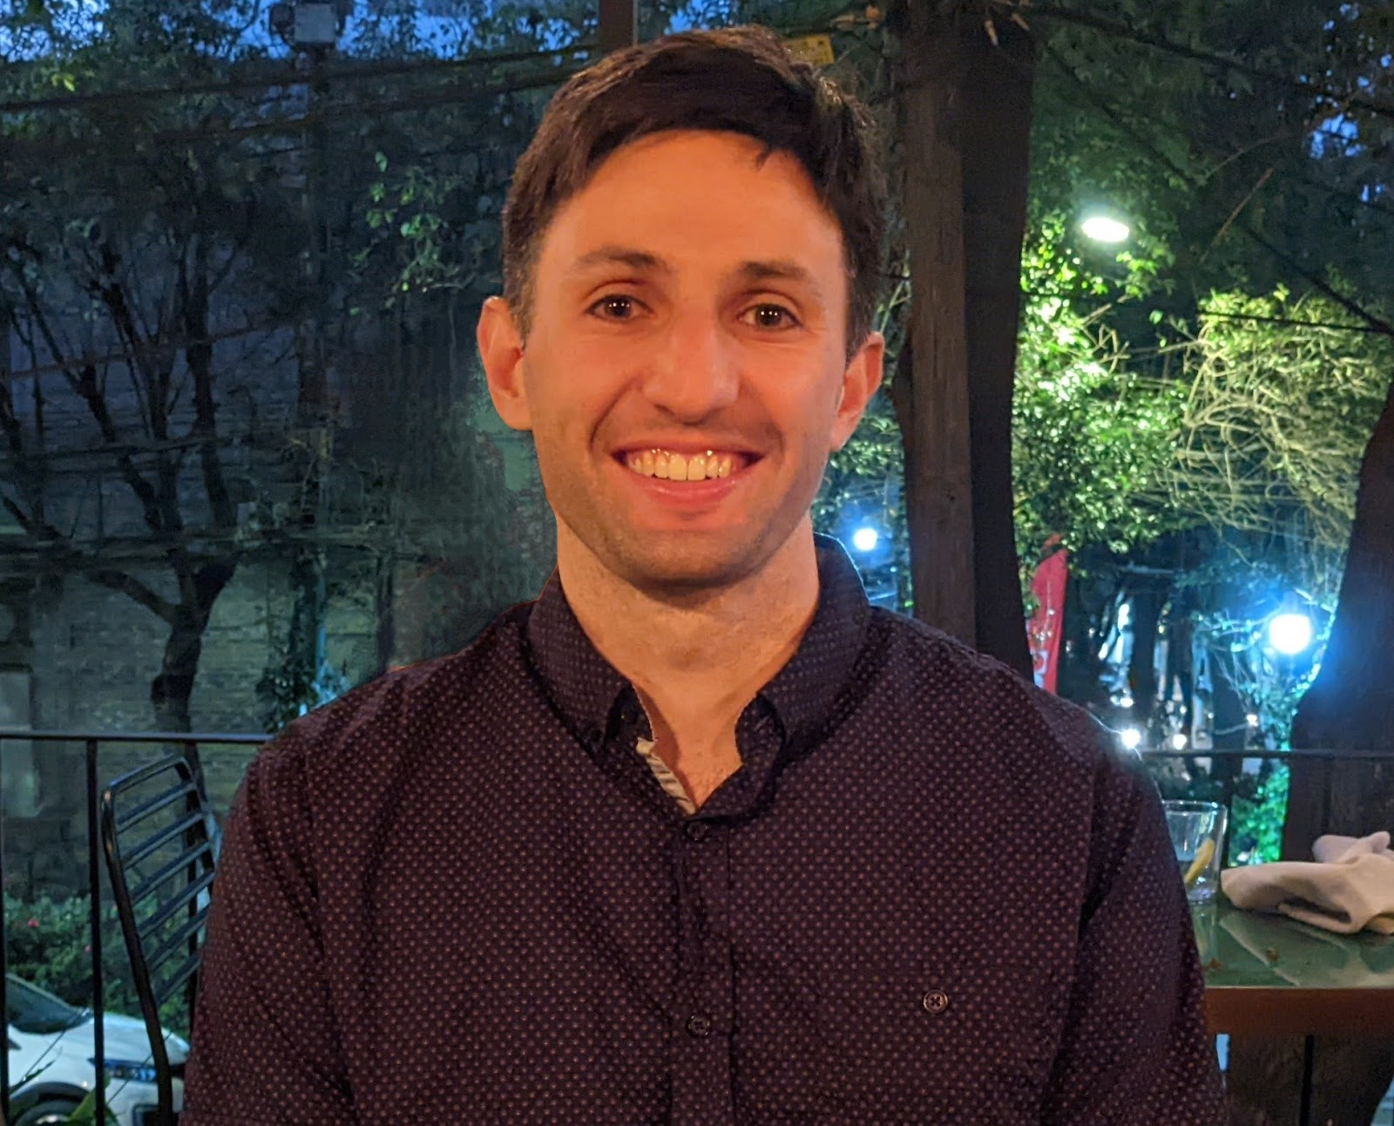
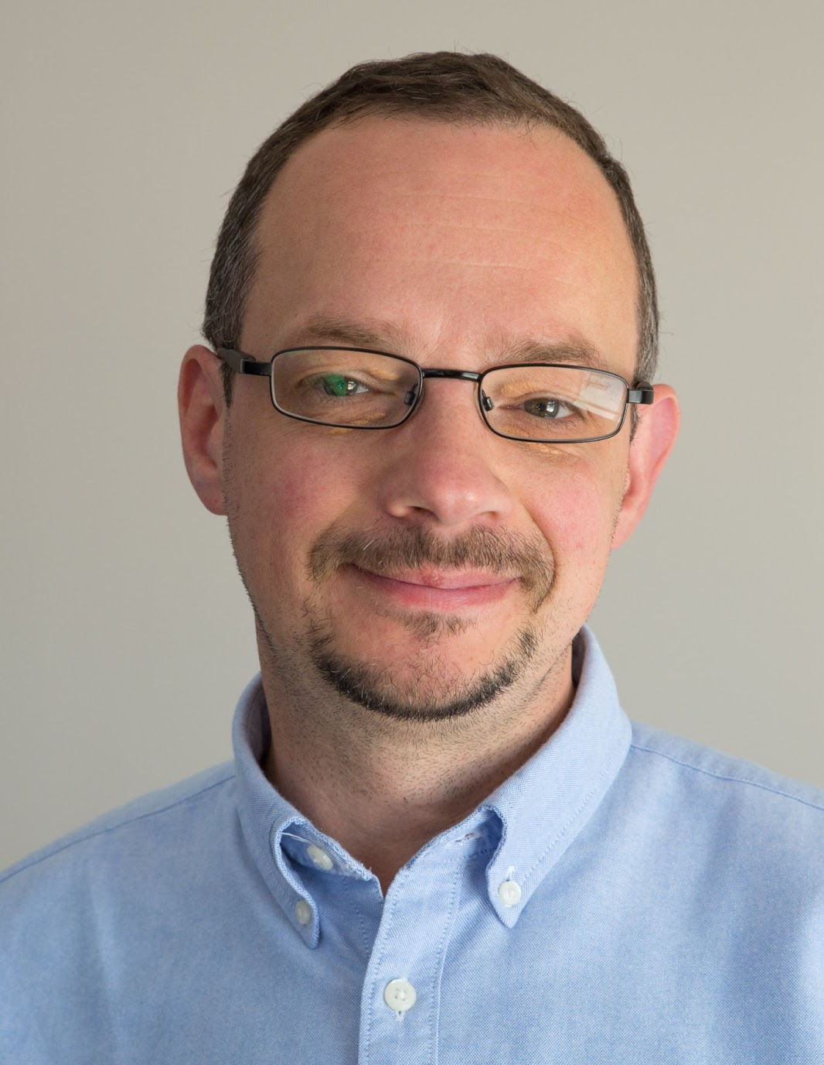
?
The current Board
Alex Leith (Chair and Treasurer)
Tish Dhar (Deputy Chair)
Jonah Sullivan
Ewen Hill
Greg Lauer
Rafael Kargren
Edoardo Neerhut
Tooa Brown
Alan Cheung
Nominations are now closed, time to vote!
New Board will take over in December
Each Board member has a two-year term
Half the Board changes each election
Some responsibility, but not hard
Plenty of scope for more and making a huge impact

Slide 7
Committees and Special Interest Groups
Financial Committee
Membership Group
Communication Group
Grant Commitee
QGIS Special interest Group
OSM Special Interest Group

Slide 8
Join Us!
Our main event:
The FOSS4G SotM Oceania Conference
Next year proposal (still pending): Hobart, Tasmania

Slide 9
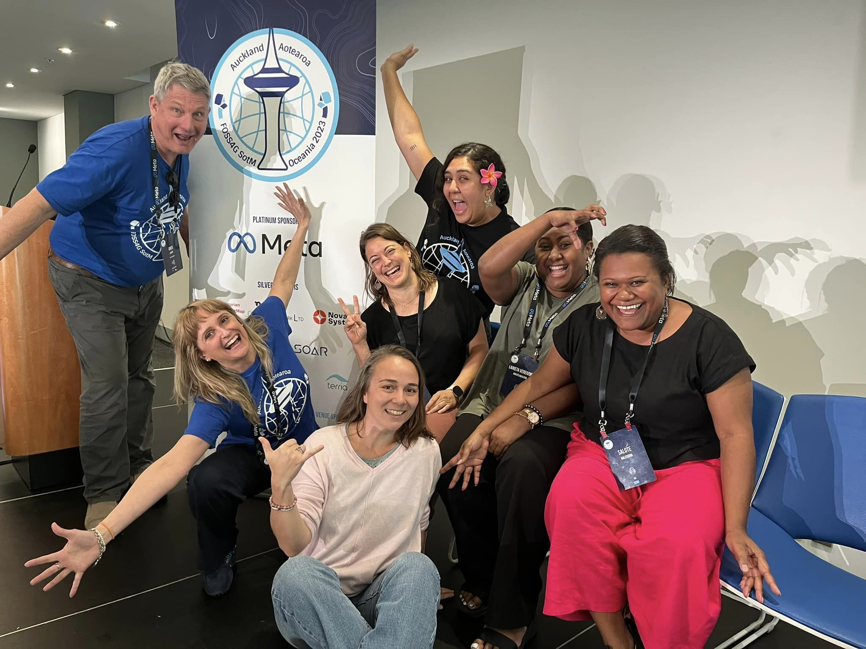
How we are giving back:
Provided $3,000 in support for other organisations, like QGIS and OSM
We’re working on:
MOUs with other organisations
Ideas around rewards and recognition
Thinking about how we might employ someone to increase our capacity
Do you have ideas?
Let us know!
Delivered over $11,000 in grants and microgrants for individuals
Supported travel grants at $20,000 this year

Slide 10
The grant program evolution
Travelling Grant Programme,
Good Mojo created
Microgrant program launched
First Large Grant Approved
2018
2021
2023
2019
2022
Travelling Grant Programme,
Good Mojo implemented
New Grant program launched!

Slide 11
The Grant structure
1
Microgrants
2
Small budget app
3
Big budget app
Tiers:
Open to everyone in Oceania!
Requirements:
Online form about the planned activity with info about:
the aim of the activity,
its alignment with the OSGeo Oceania mission,
the amount of funding requested and how it will be spent
Up to $250 AUD per app
Everybody can appy!
It requires a written application with the online form and info about:
Budget
Timelines
Outputs
Outcomes
Up to $1,000 AUD per annum
Only OO members can apply!
A bit more paperwork,
but worth it!
Up to $5,000 AUD per annum
Only OO members can apply!
It requires a written application with the online form and info about:
Budget
Timelines
Outputs
Outcomes
Risk-mitigation strategies
Measures of success
The big guns, need some legwork to get there, but yay to big initiatives!

Slide 12
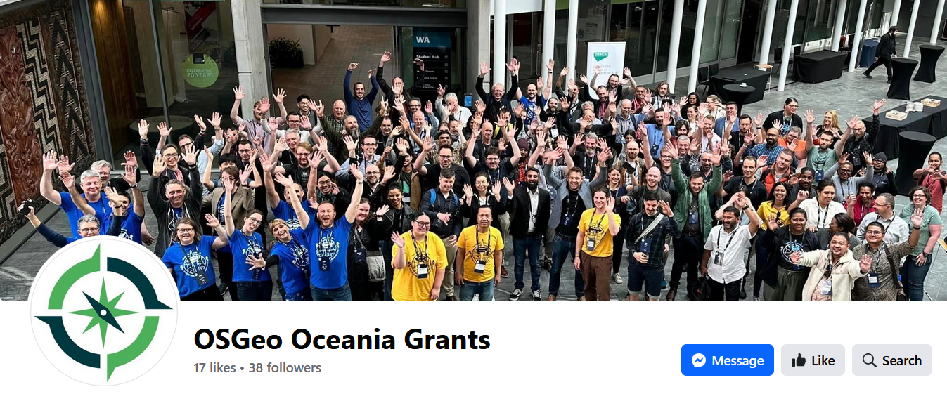
Founded projects
34 Microgrants all around Oceania (funded events in 9 different countries to date)
3 Small budget grants for:
Samoa GIS User group
CartoMobil’ite project (French Polynesia)
Perth Geogeeks group (Australia)
2 Big budget grants!
Coming soon: 1 Small budget grant for Women in Mapping (Kiribati)
GeoGeek Perth
G-SIG Timor-Leste

Slide 13
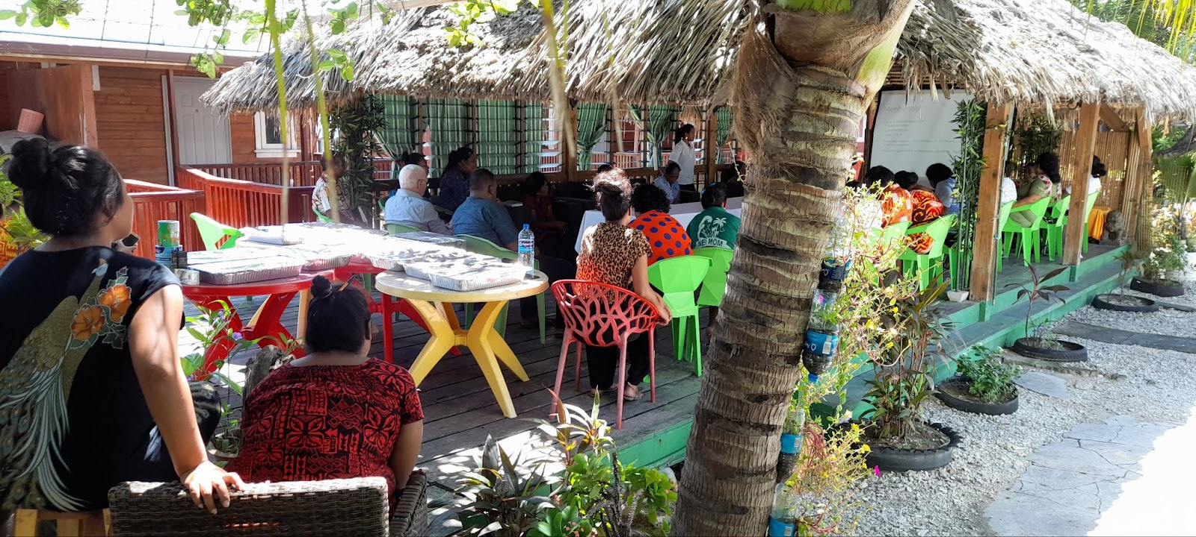
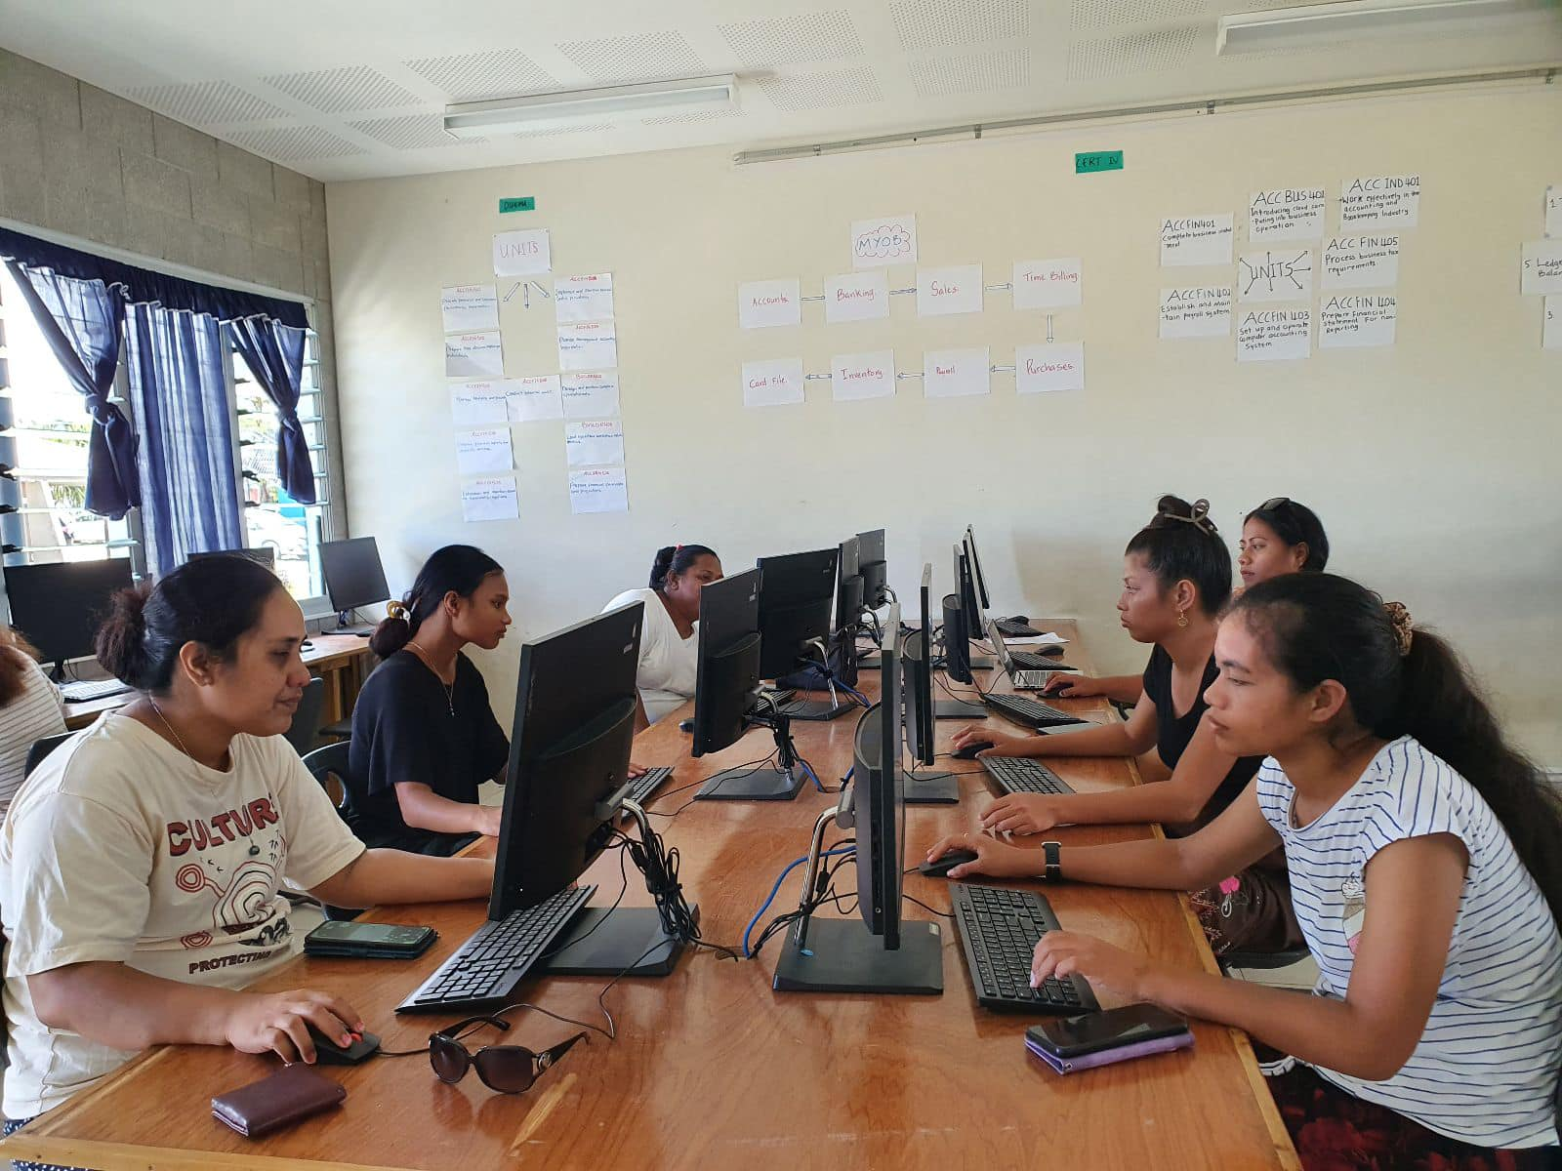
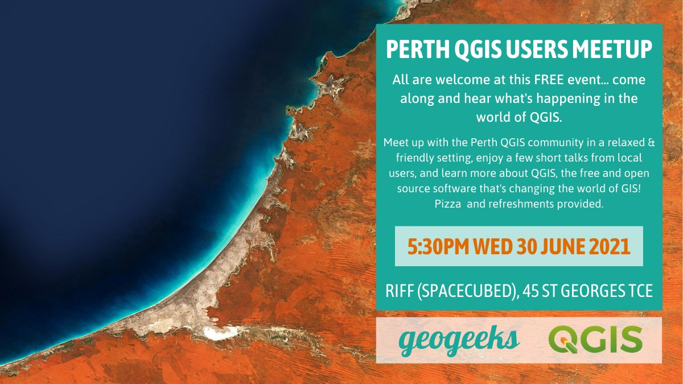
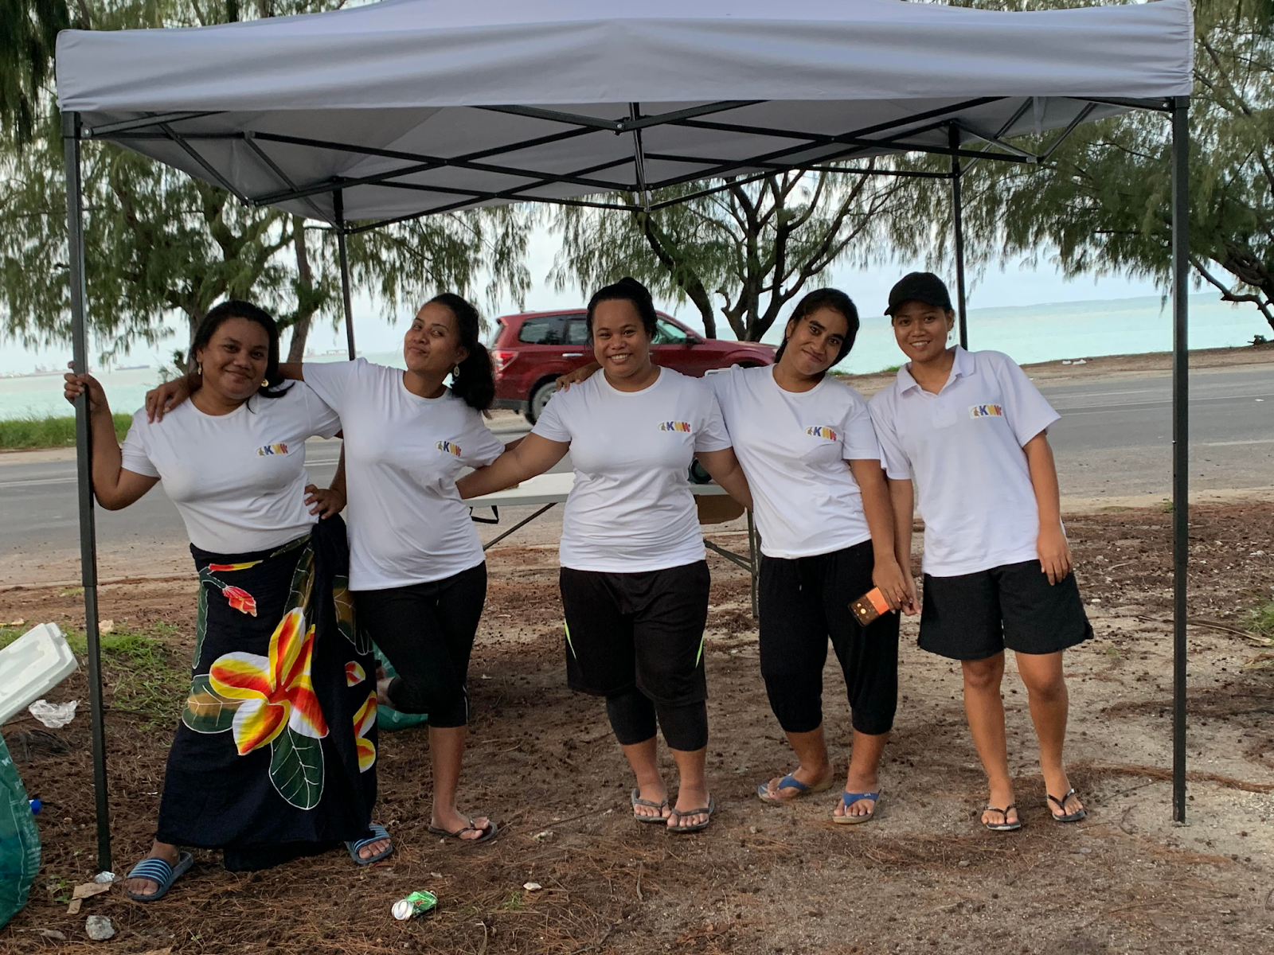
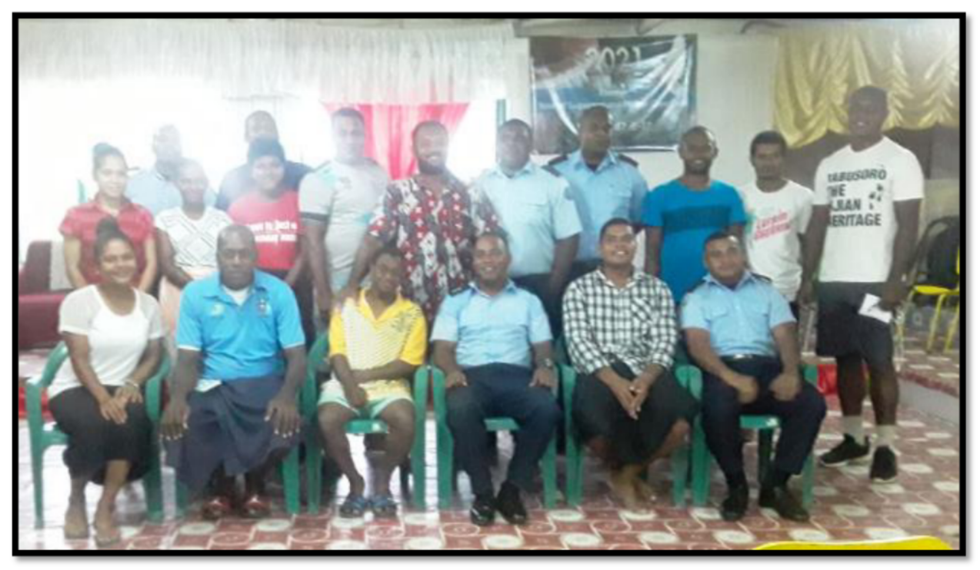
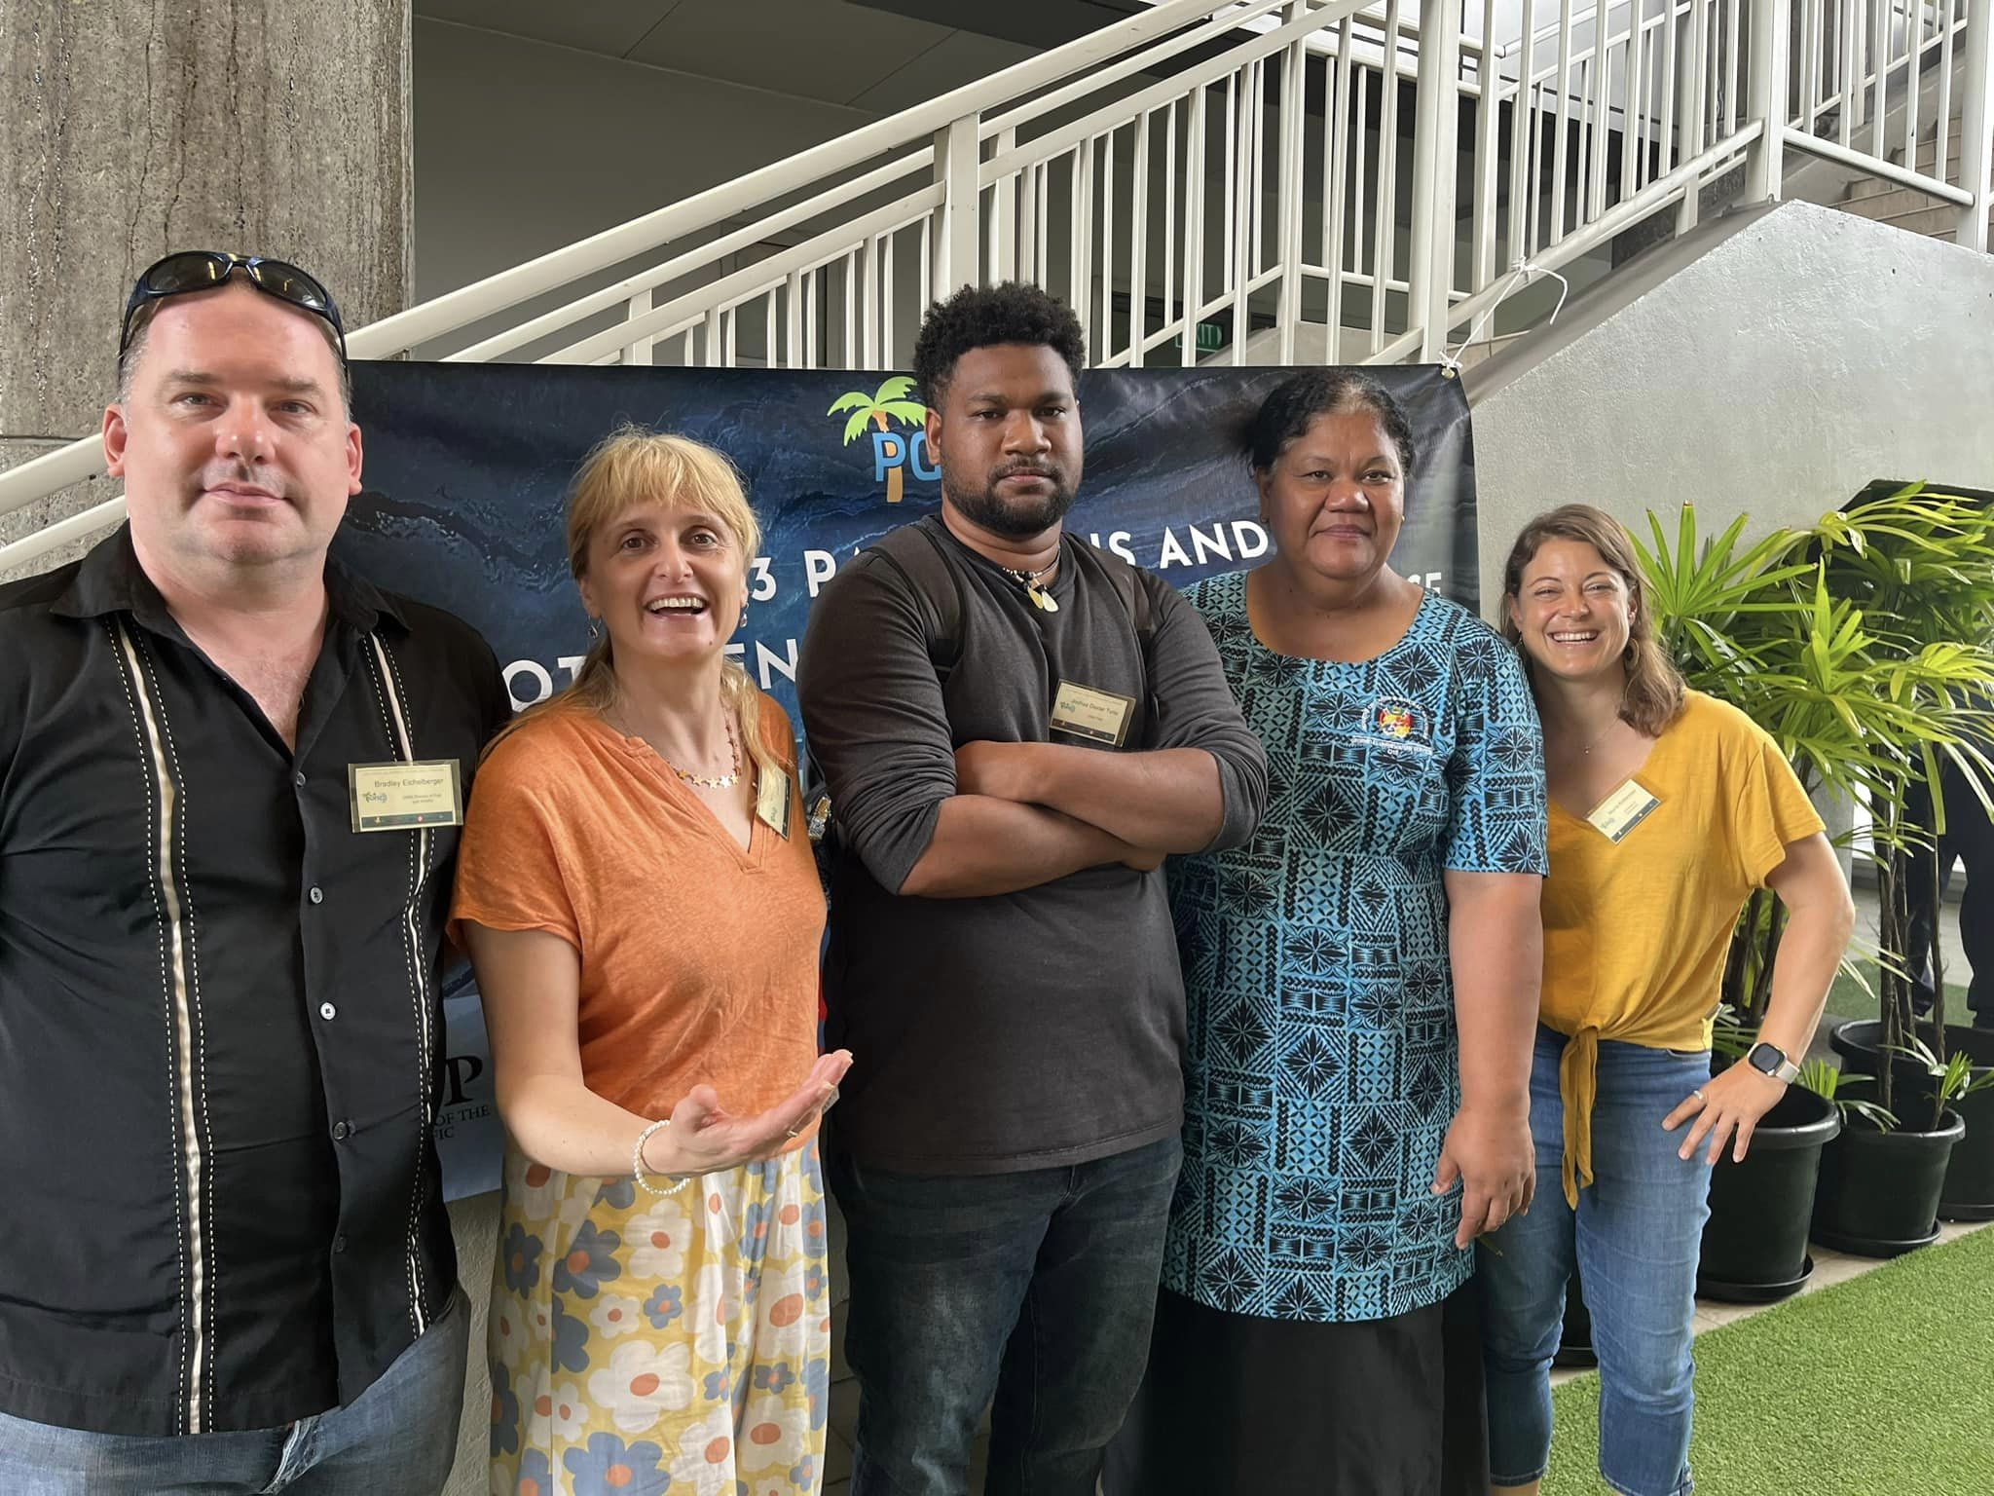
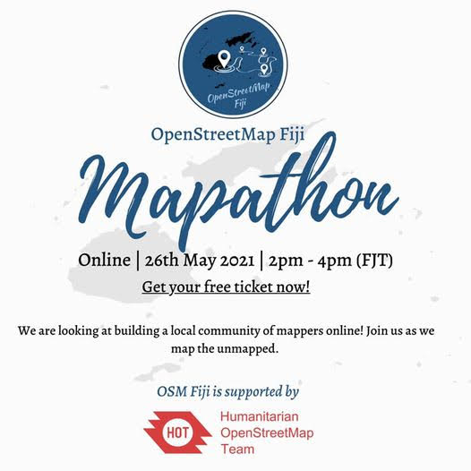
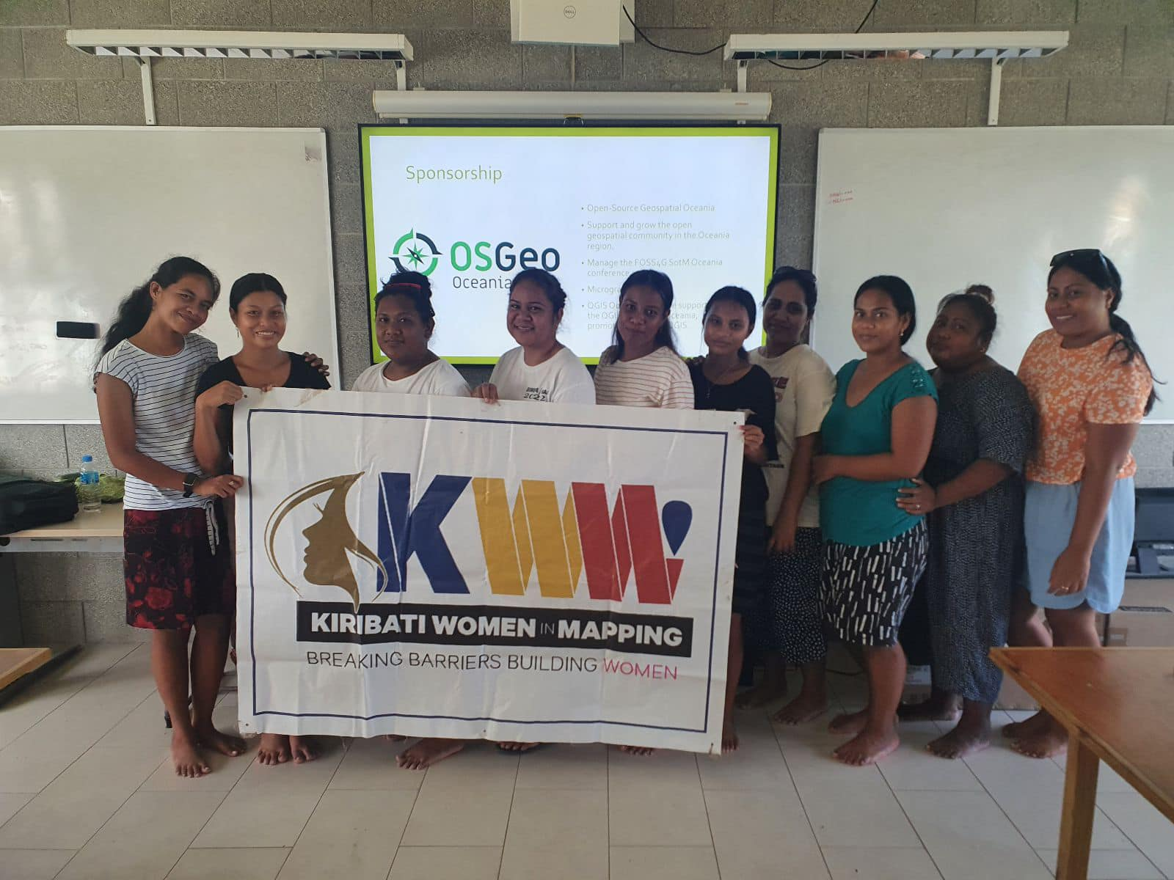
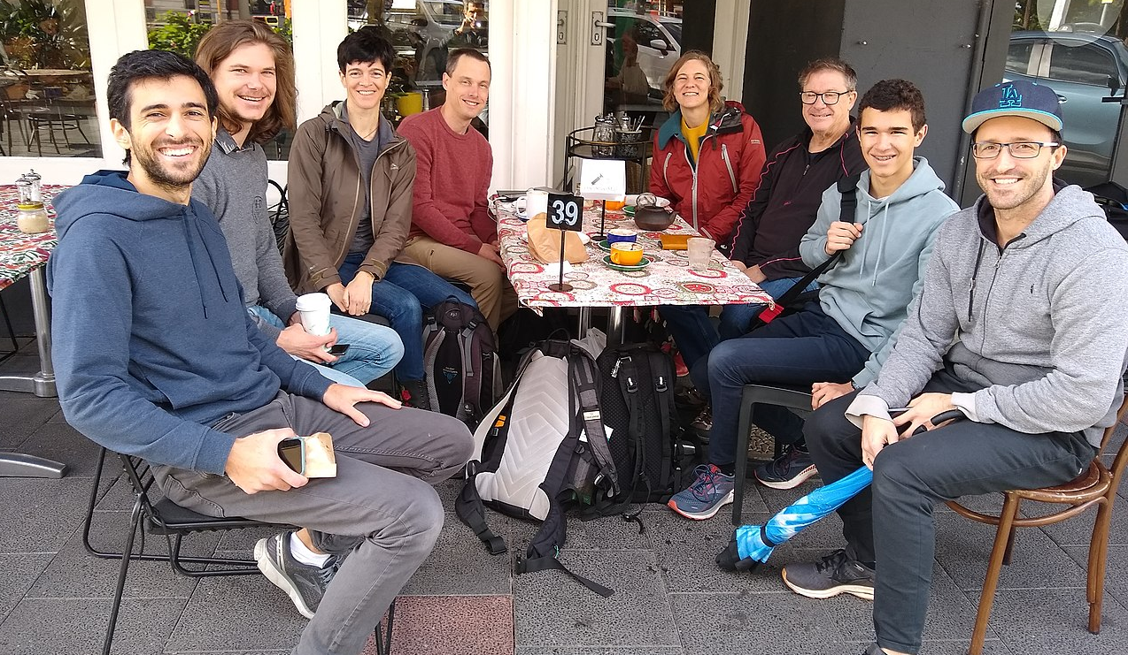
Founded projects
34 Microgrants all around Oceania (funded events in 9 different countries to date)
3 Small budget grants for:
Samoa GIS User group
CartoMobil’ite project (French Polynesia)
Perth Geogeeks group (Australia)
2 Big budget grants!
Coming soon: 1 Small budget grant for Women in Mapping (Kiribati)
GeoGeek Perth
G-SIG Timor-Leste

Slide 14
Join Us!
Member benefits:
Eligible for grants
Can vote in the Board elections
Can stand to be a Board member
It’s similar to being a charter member of OSGeo, in that a lot of the benefit is intangible. But it does mean you get to have a say in what we do.
Find out more: https://osgeo-oceania.org/members/

Slide 15
Vinaka, Grazie!
Do you have any questions?
More info at
https://osgeo-oceania.org/

