Slide 1



Digital Earth Pacific
DIGITAL PUBLIC INFRASTRUCTURE:
ENABLING DECISION-MAKING USING EARTH OBSERVATIONS AT SCALE IN THE REGION
Sachindra Singh
Geoinformatics Team Leader
Pacific Community (SPC)
sachindras@spc.int

Slide 2

Why DEP?
Countries have expressed a need for better access and capacity for applying Earth observation data to national development priorities and sustainable development.
Digital Earth Pacific deliver an operational Earth and ocean observation system that takes decades of satellite data and makes it easier to access and use, empowering decision-makers across the Pacific.
It will provide a fundamental digital infrastructure that will ensure every nation in the Pacific has access to tools, technologies and capacity to routinely monitor and track challenges from climate change, food insecurity or disaster risk through robust decision-ready products that are updated with every satellite overpass.

Slide 3
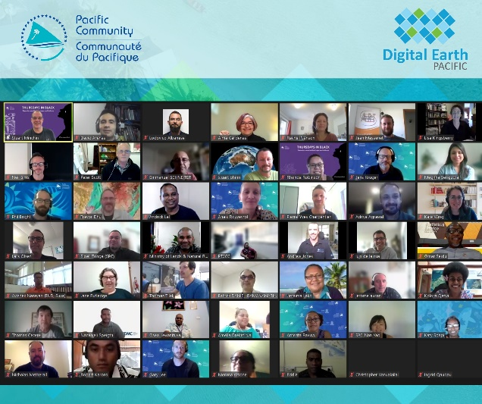
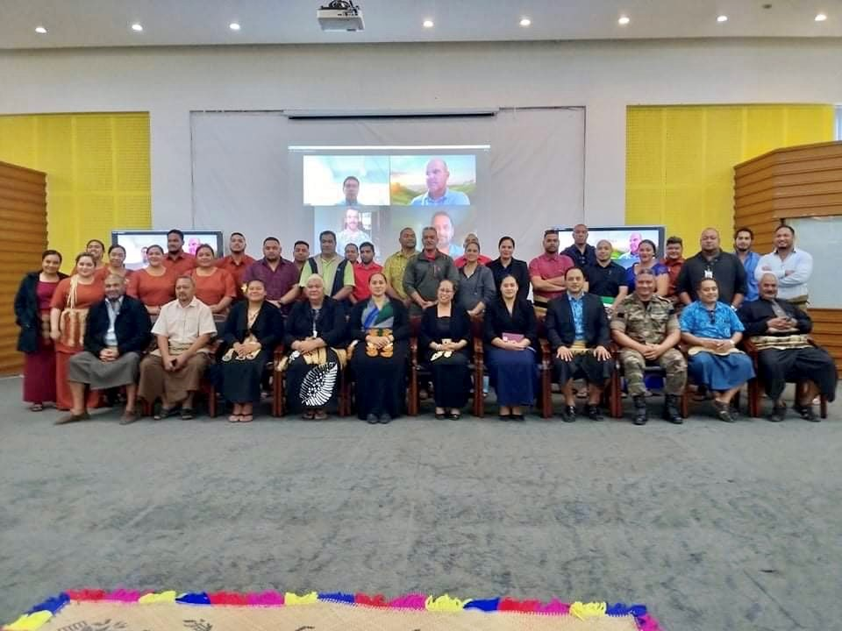
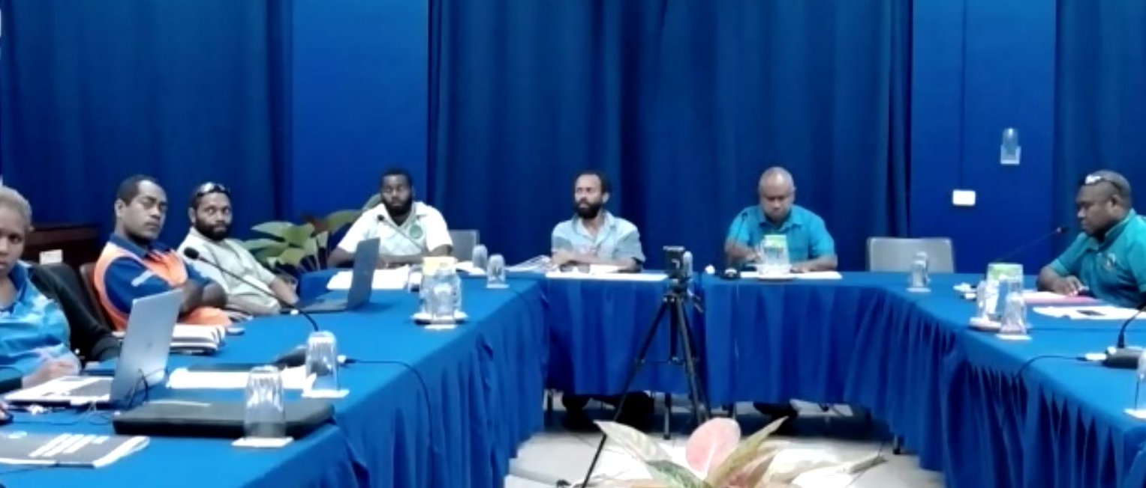
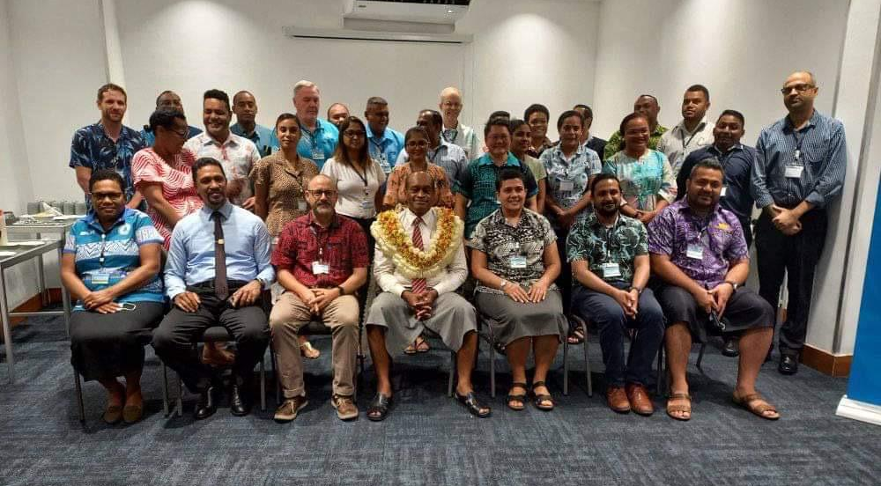
Needs Assessment Workshop
Virtual, Hybrid and Face-to-Face Consultations during the Pandemic Years (2020, 2021).
Vanuatu
Republic of Marshall Islands
Tonga
Fiji Islands
2 volcanic Islands
2 atoll-like States
Notes:
VU, TO World Risk Index 1,2

Slide 4
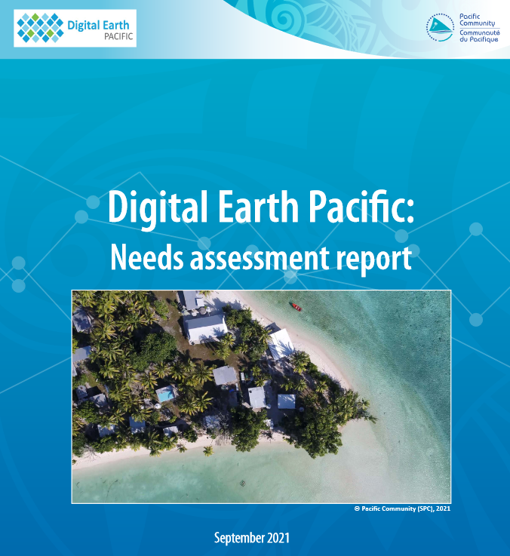
High Priority Needs Identified
Tier 1
Land Cover Change Detection Coastline Change Detection Agricultural Census Vegetation Indexes – Crop and Disease Detection
Tier 2
Hazards Impact Mapping - Cyclones, Tsunami, Droughts Digital Elevation Models - for Coastal Inundation Fishing Vessels Tracking - Unregulated Mapping Buildings and Population Mangroves Change Detection Near-Shore Bathymetry

Slide 5
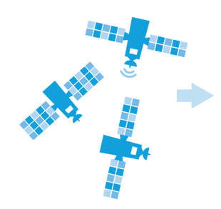
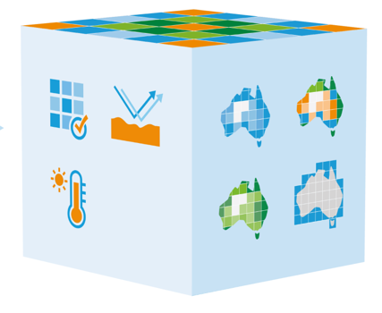
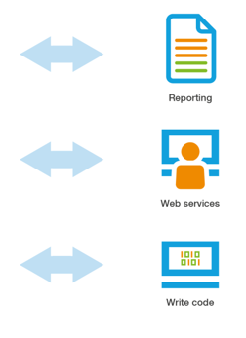
EO Decision Ready Products
Structured Time-Series
Data Cubes
Sentinel/Landsat
Observations
Analysis
Ready Data
Spatial
Products
Information
for decisions
Notes:
Technology advancements like cloud computing, and free and open satellite data in analysis ready format, is making it easier for EO to be accessed and used. Infrastructure such as the open data cube or Microsoft Planetary Computer allow for organizing these data archives with limited cost, while conducting analysis at scale to transform the images into decision-ready products.

Slide 6
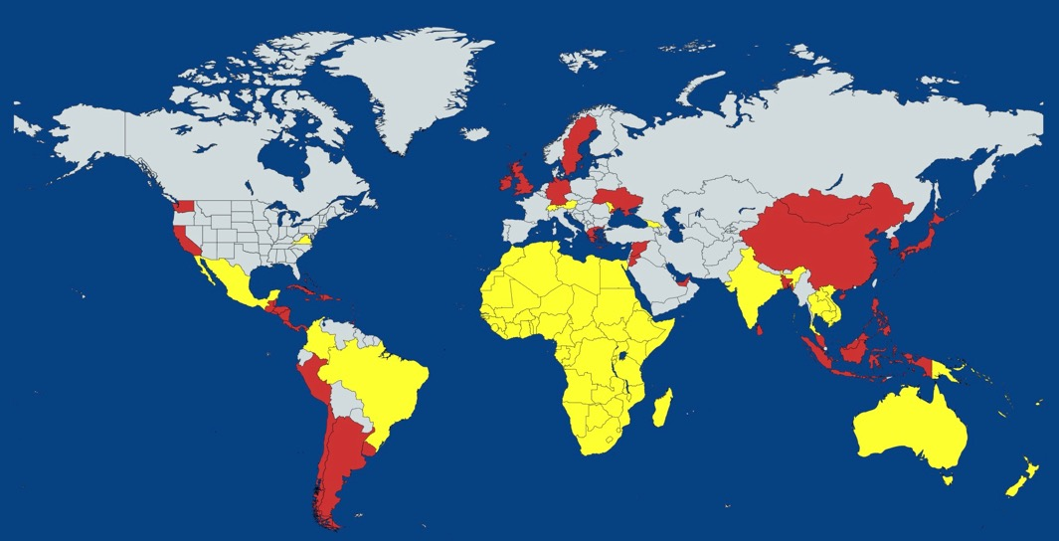



Digital Earth – Expanding Globally
Notes:
Main point here is that Digital Earth programs are developing globally and there are other national level implementations as well. We don’t want the Pacific to be left behind, and given the existential threat to the Pacific from climate change, the Pacific has an opportunity to be real innovators for how EO is applied to SIDS challenges.

Slide 7
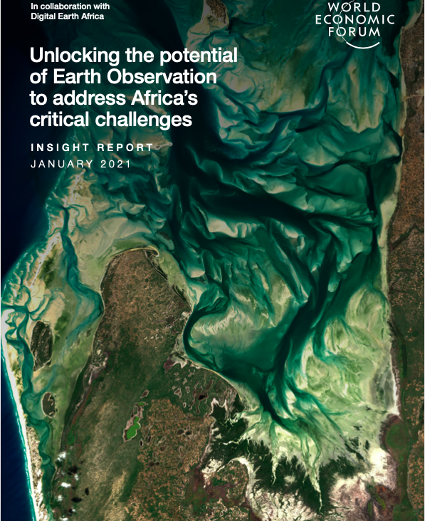
Economic Value of Digital Earth Programmes
Africa’s EO Industry: US$500m
Agricultural Productivity: US$900m
Illegal Mining: US$900m
$2.3billion USD per year impact on African economies for ~$7M/year investment.

Slide 8

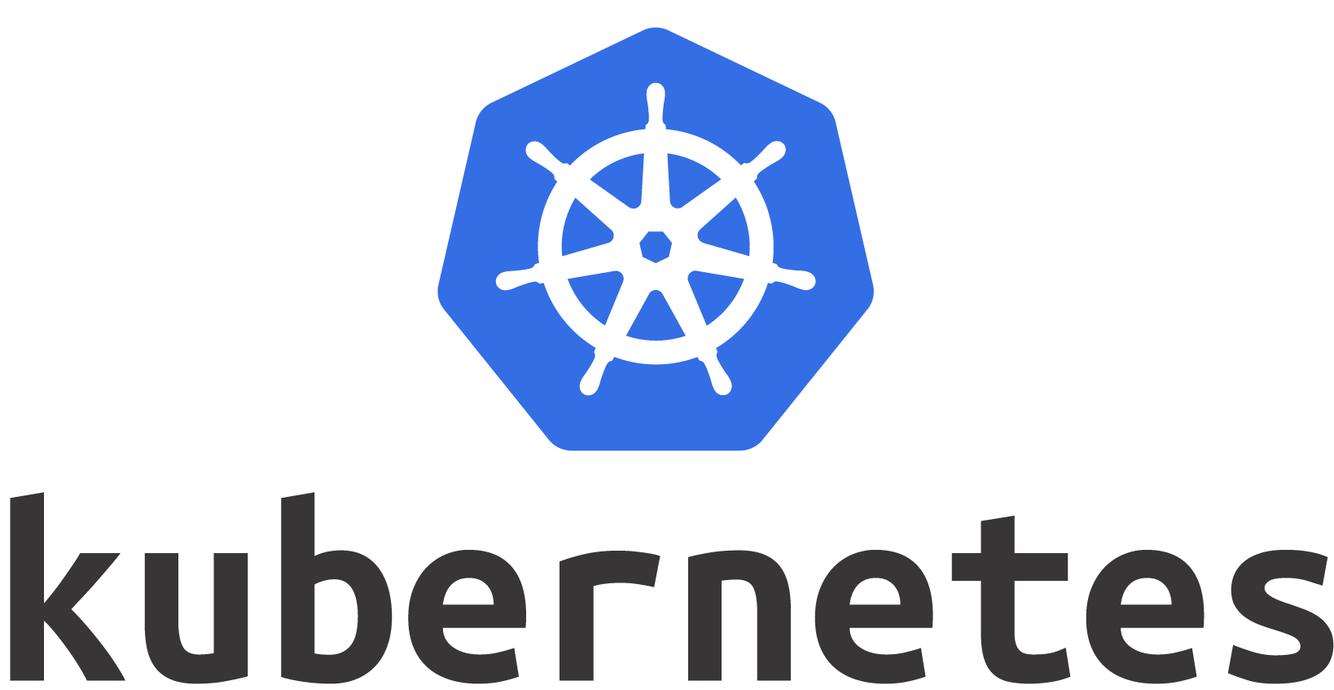
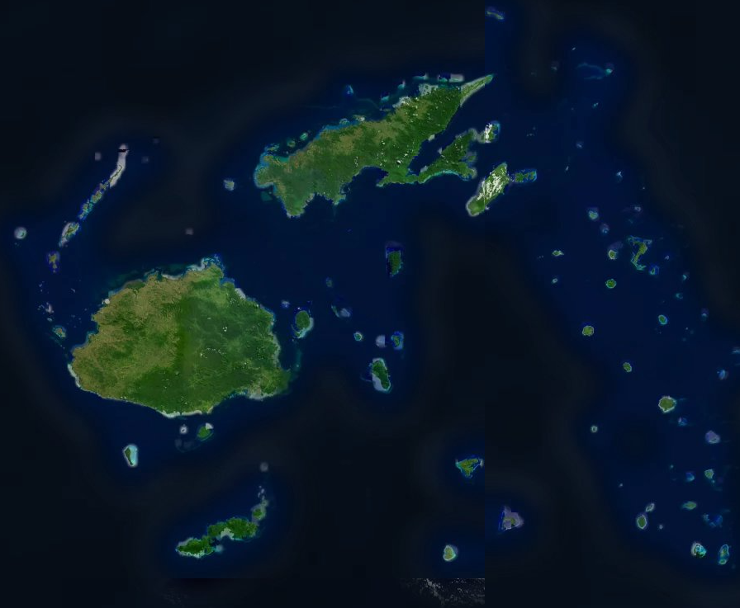

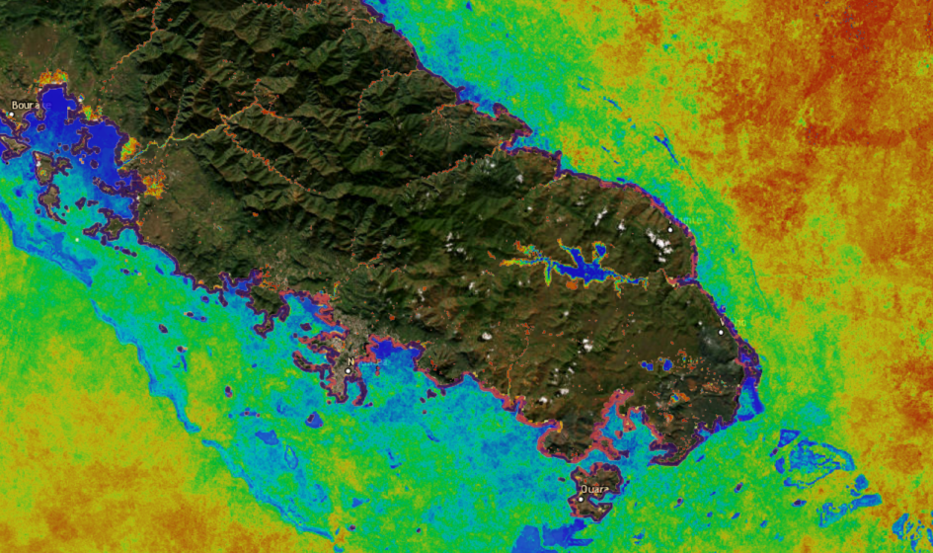
DEP in a (technical) nutshell
Digital Earth Pacific is an analytical geospatial cloud-native platform that makes decades of remotely-sensed analysis ready data (ARD) accessible via well-defined standards ; and enables users to perform highly scalable EO tempo-spatial analysis using open source data science libraries and models.
DEP Analytical Hub
built on RESUABLE components that combines live code, visualisations, documentation and configurations to enable EO analysis at scale.
Multi-spectral Satellite Data
Earth Observation Product

Slide 9

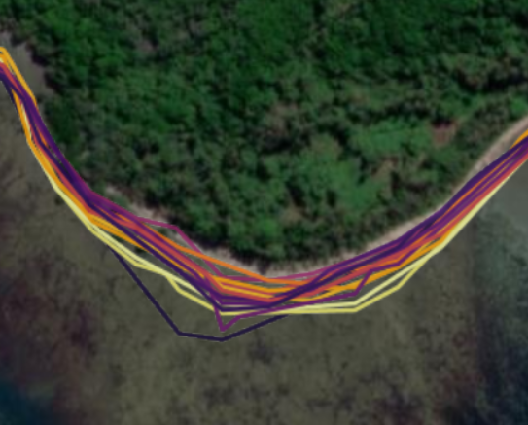
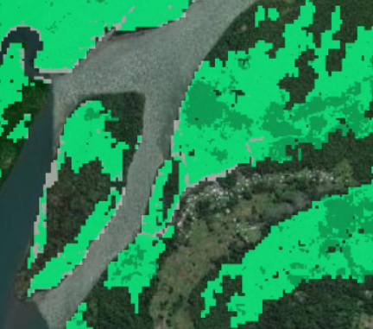
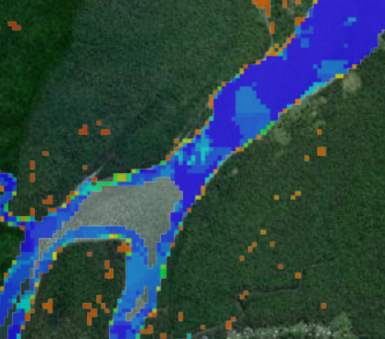
Earth Observation at Scale
22 years of coastline change
34k km of coastline for the Pacific (22 PICTS)
~10% of global coastlines
7 years of mangrove data
Illustrates loss and recovery
Accessed 450,000 Landsat and 300,000 Sentinel-2 satellite images
Processed over 500 tb of data
If on premises, it would cost 10s of millions USD to build the infrastructure + 300k annually to operate
Through cloud computing, we are doing this at $30,000 per year = 10x cost savings
20 years of Water Observations from Space (WoFS)
Useful for understanding flood zones and water security
If Landsat data was not made open, just these data would cost 450M USD
Notes:
320k scenes captured over 20 years = 100tb of data to generate 100gigs

Slide 10
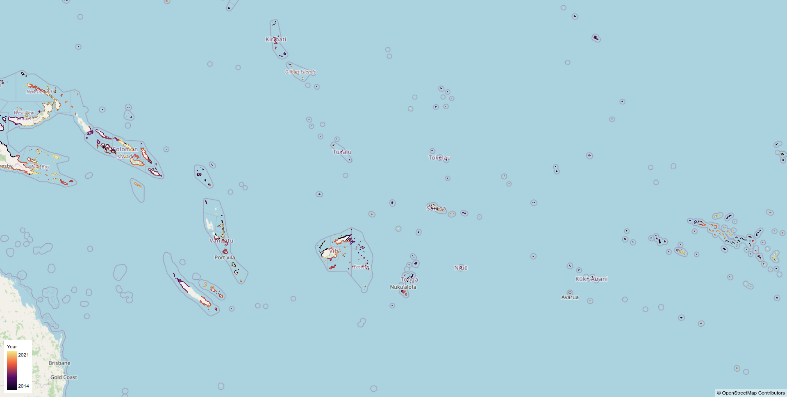
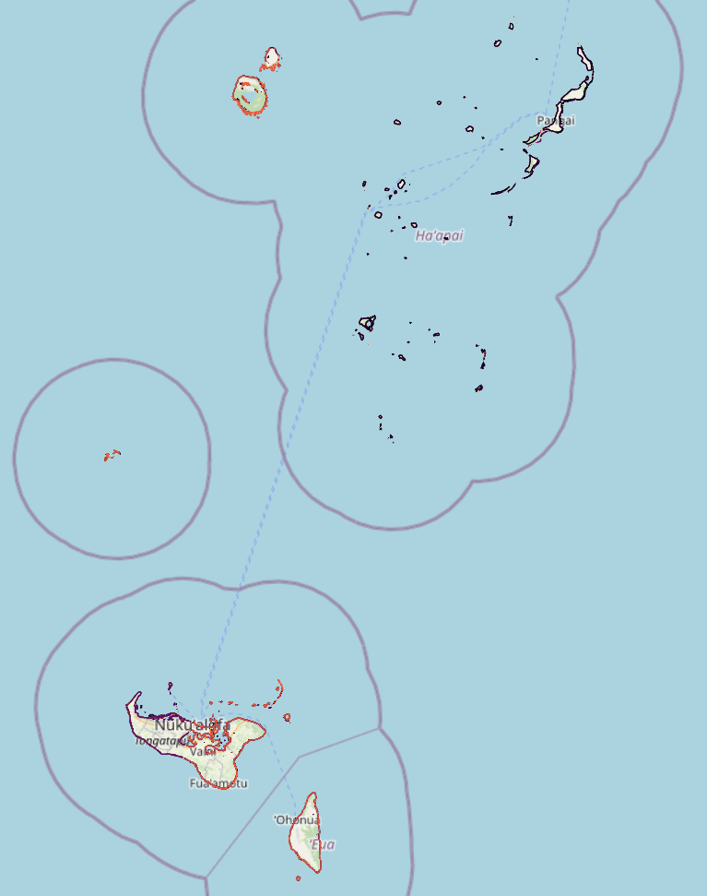
Regional Coastlines
Shoreline Change Extraction across 169 islands/atolls in Tonga.
Coastline Change across the past 3 decades for every Pacific Island Country and Territory, enabling ongoing monitoring of erosion (land loss) and accretion (where areas increase due to deposition).
Notes:
320k scenes captured over 20 years = 100tb of data to generate 100gigs

Slide 11
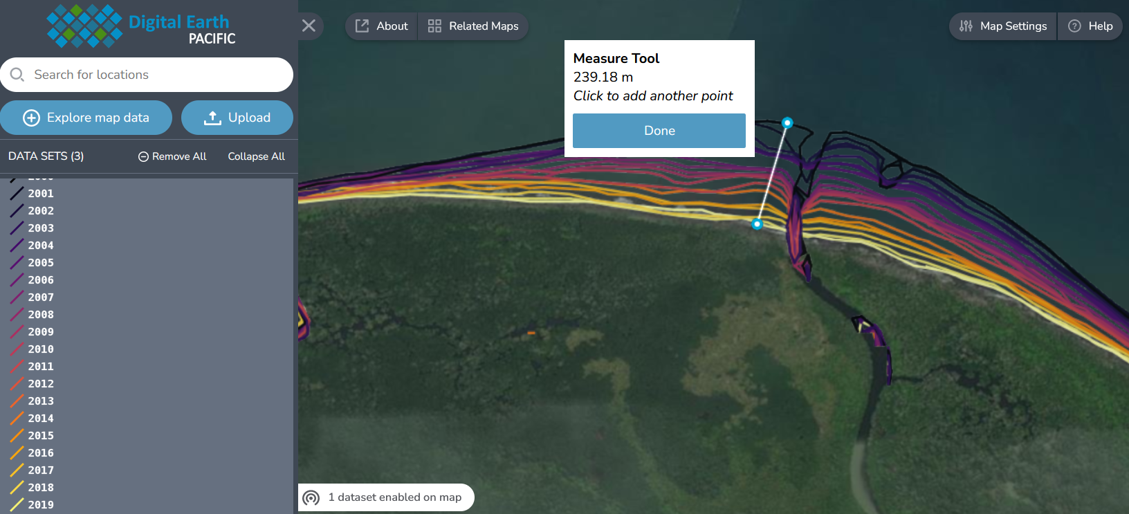
Karisoa, Papua New Guinea
240 meter change over 20 years, or 12 meters per year.
Notes:
Karisoa, Papua New Guinea
240 meter change over 20 years, or 12 meters per year.
The coastline change model applied to the Pacific through DEP accounts for approximately 35,000 km of coastline, or 10% of the total global coastline.

Slide 12

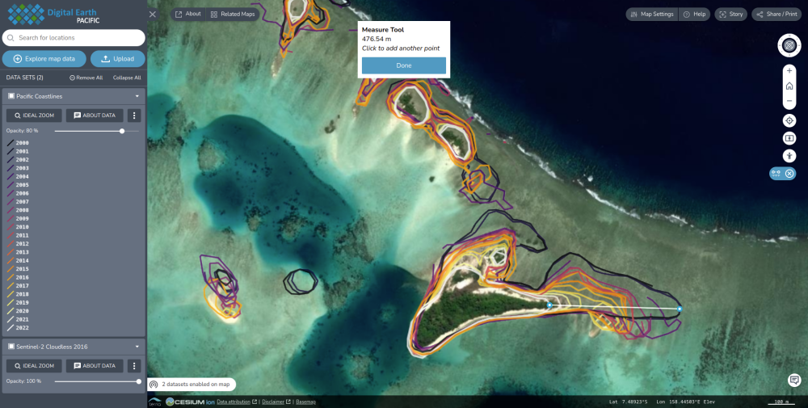
Hetaheta, Isabel Islands, Solomons.
Notes:
Karisoa, Papua New Guinea
240 meter change over 20 years, or 12 meters per year.
The coastline change model applied to the Pacific through DEP accounts for approximately 35,000 km of coastline, or 10% of the total global coastline.

Slide 13


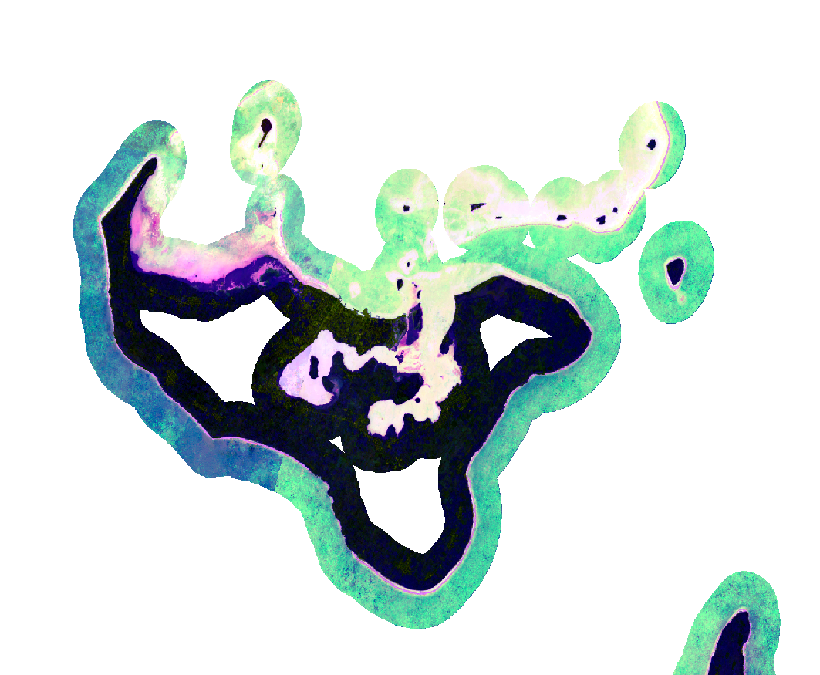
Regional Coastlines Methodology (1)
Rasterisation
Loading the available catalogue of Landsat satellite imagery across the PICTs.
Comparing the time of acquisition for each landsat image to the modelled tide height at that time, and filtering out observations during times of extreme high or low tides. The tidal model used is TPXO9-atlas down-scaled to 5 x 5 km² resolution across PICTS.
Masking clouds out of the remaining time series of Landsat observations and calculating the median value for each location within each year.
Deriving various water indices (such as the modified normalised differential water index [MNDWI]) from these annual summaries.
Various additional cleanup and filtering of raster values, including removing areas outside of the tidal zone, removing ephemeral noise from data, and gap-filling observations for locations with poor data in particular years.

Slide 14
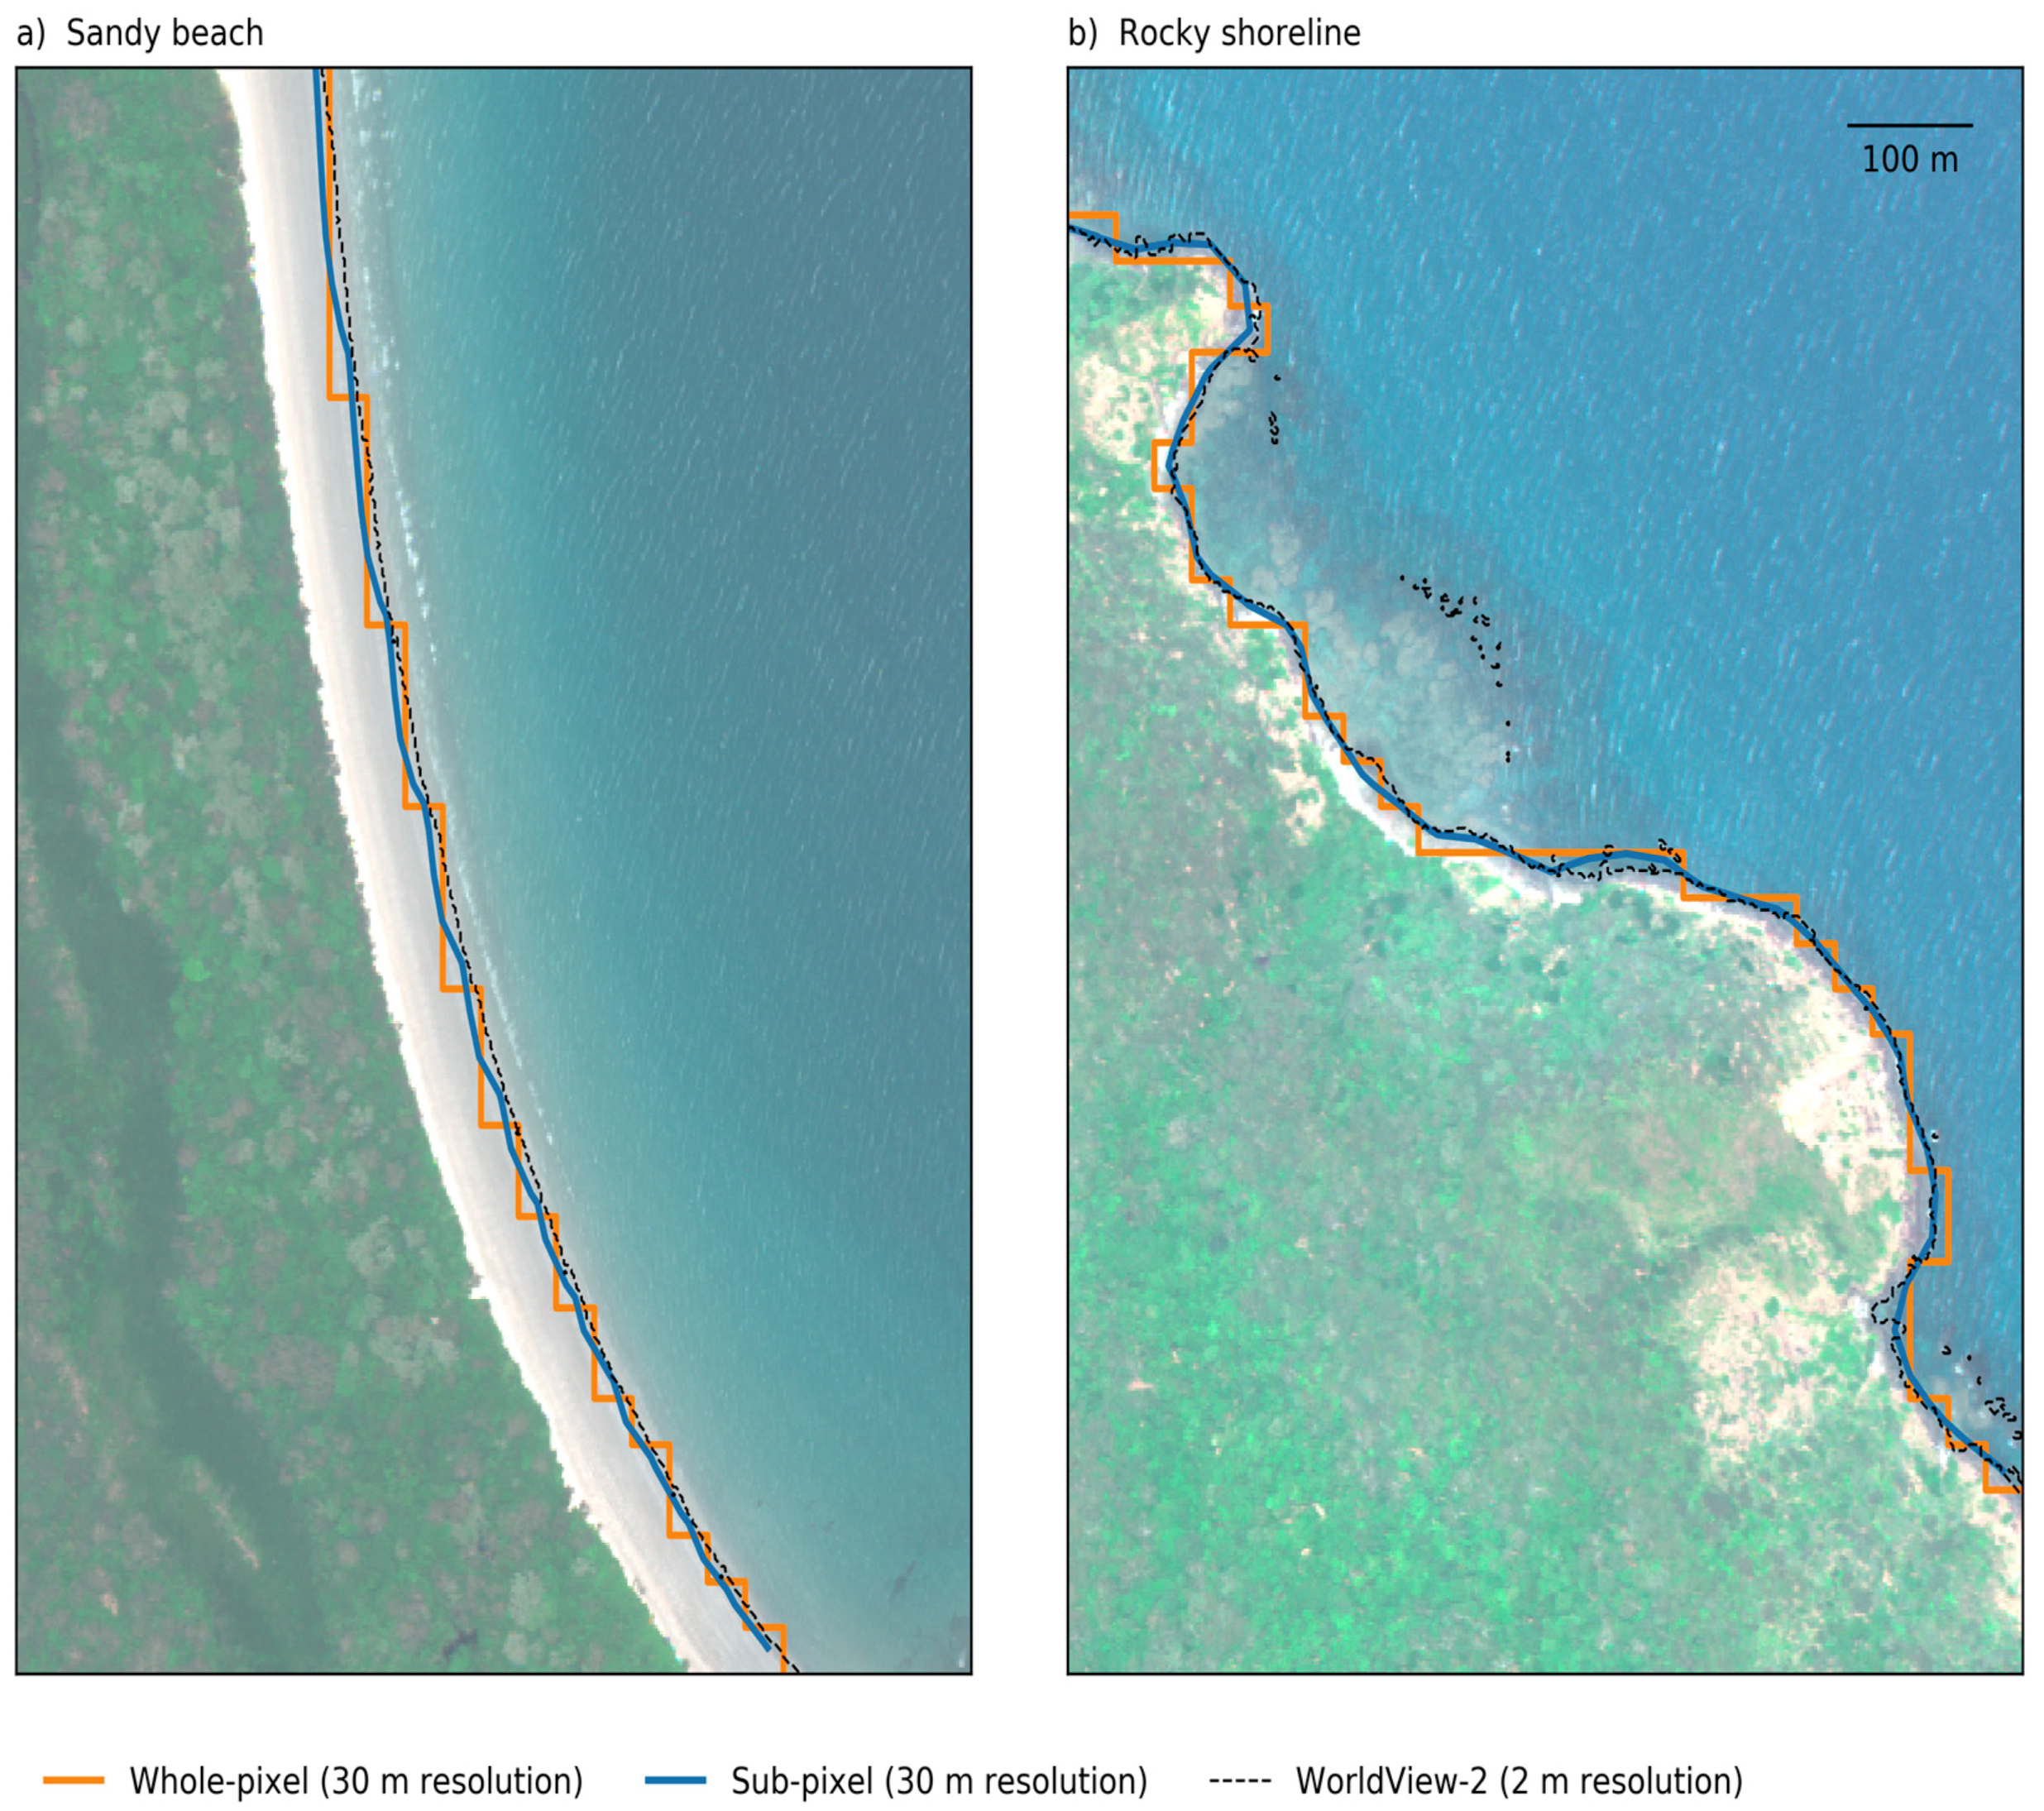
Regional Coastlines Methodology (2)
Vectorisation
The vectorisation process extracts the shoreline polylines using a sub-pixel contour water line extraction algorithm [1]. This is based on the marching squares algorithm and enables comparison of the relative water index values of two neighbouring pixels.
This comparison method is used to more precisely locate the boundary between land and water than the previous method of drawing a line directly along their pixel boundaries.
This results in higher fidelity coastlines extraction than would be possible with whole-pixel resolution of 30/m².
[1] Dr. Robbi Taylor-Bishop, Geoscience Australia

Slide 15
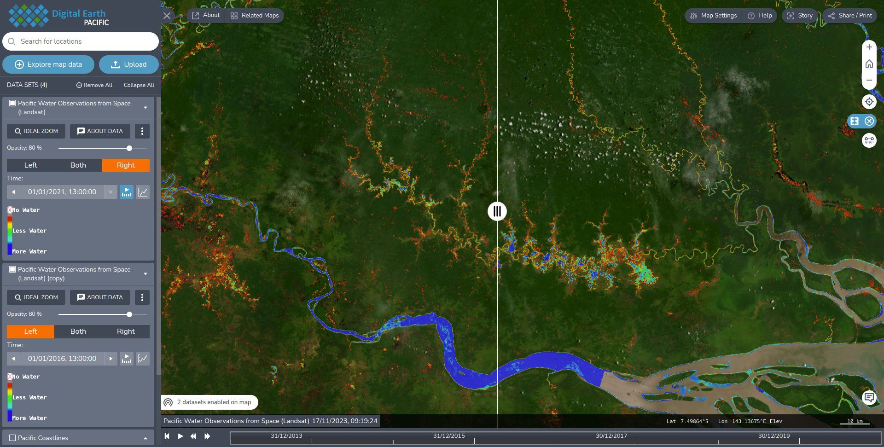
Changes in Water Bodies during and after El-Nino Drought 2015/2016. Able to detect flood plains - used for drought monitoring, disaster planning, water security.
Notes:
Karisoa, Papua New Guinea
240 meter change over 20 years, or 12 meters per year.
The coastline change model applied to the Pacific through DEP accounts for approximately 35,000 km of coastline, or 10% of the total global coastline.

Slide 16
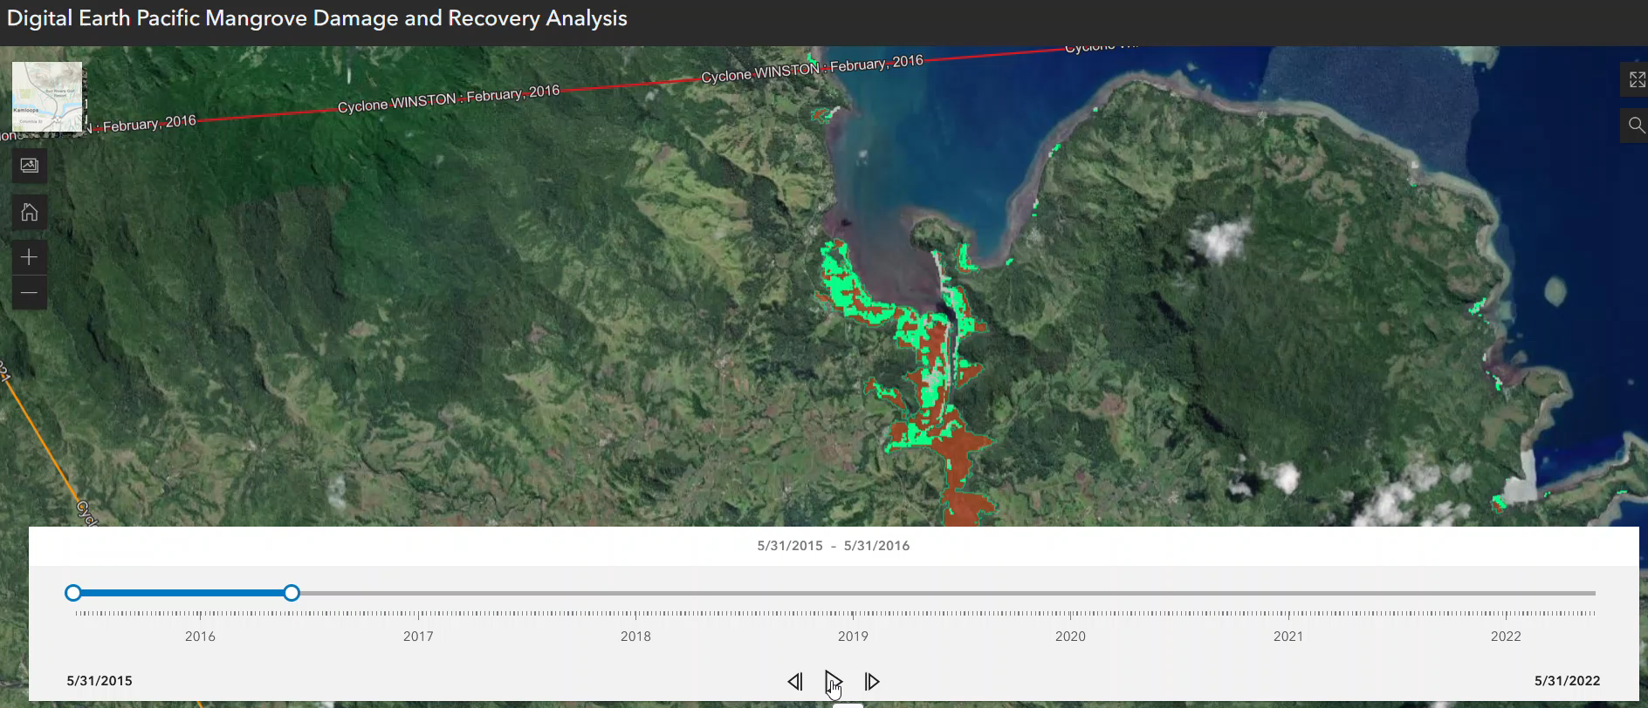
Mangroves Change Detection
Notes:
Through interoperability, we want DEP data and services to be accessible through additional platforms. We have partnered with Esri on their Pacific GeoPortal initiative to do exactly this. In this example, an animation illustrates the impact of Cyclone Winston on the damage and recovery process of mangroves in Viti Levu Bay, Fiji.

Slide 17
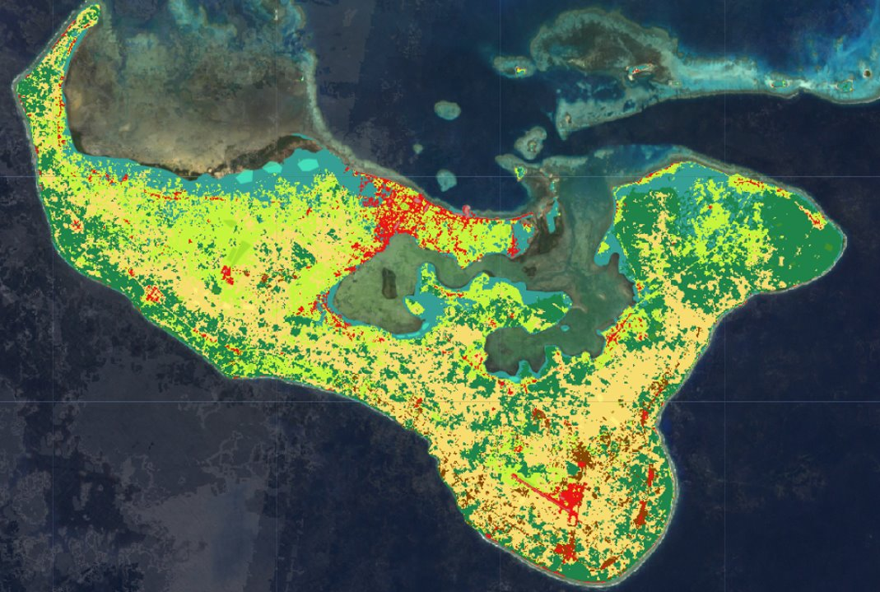
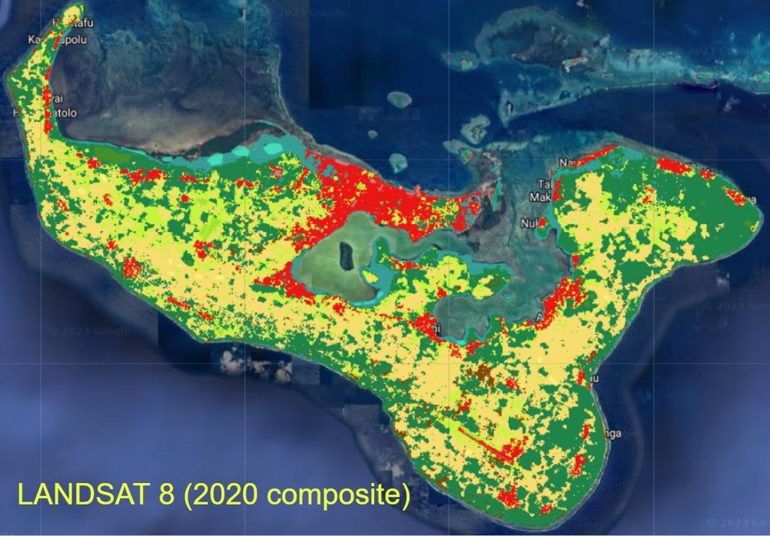
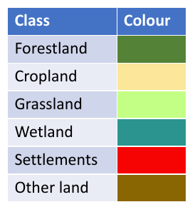
LULC Co-Creation National Maps
Digital Earth Pacific (DEP) – Tonga Remote Sensing Land Cover Assessment Skills Transfer (LCAST) Technical Capacity Building Workshop, 24 – 28 July 2023. Co-creation of Land Cover/Land Use classes and products with TO Stakeholders.
First regional DEP in-country workshop.
LandSat 7 2000 Composite
LandSat 8 2020 Composite

Slide 18
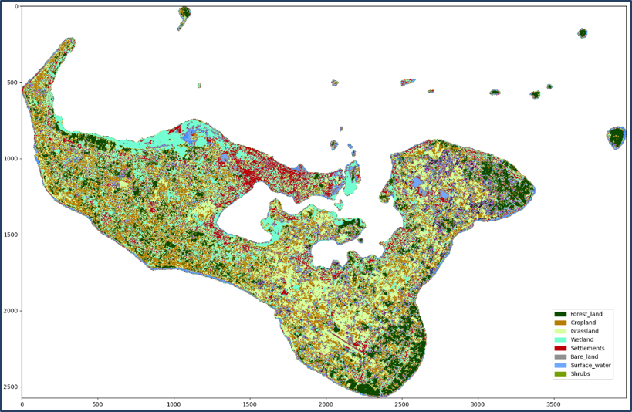
Land Cover and Land Use
Tonga Workshop on Land Cover / Land Use Classification; enabling participants to co-create and take ownership of EO data and technologies -
Updating National Landcover Map from 2006 to 2023
Change detection from 2017 – 2023
10m/2 annual mosaics from Sentinel 2
12 LULC (dynamic) classes
6000~ points collected, and aligned
24 participants across 9 ministries (50% gender ratio)

Slide 19
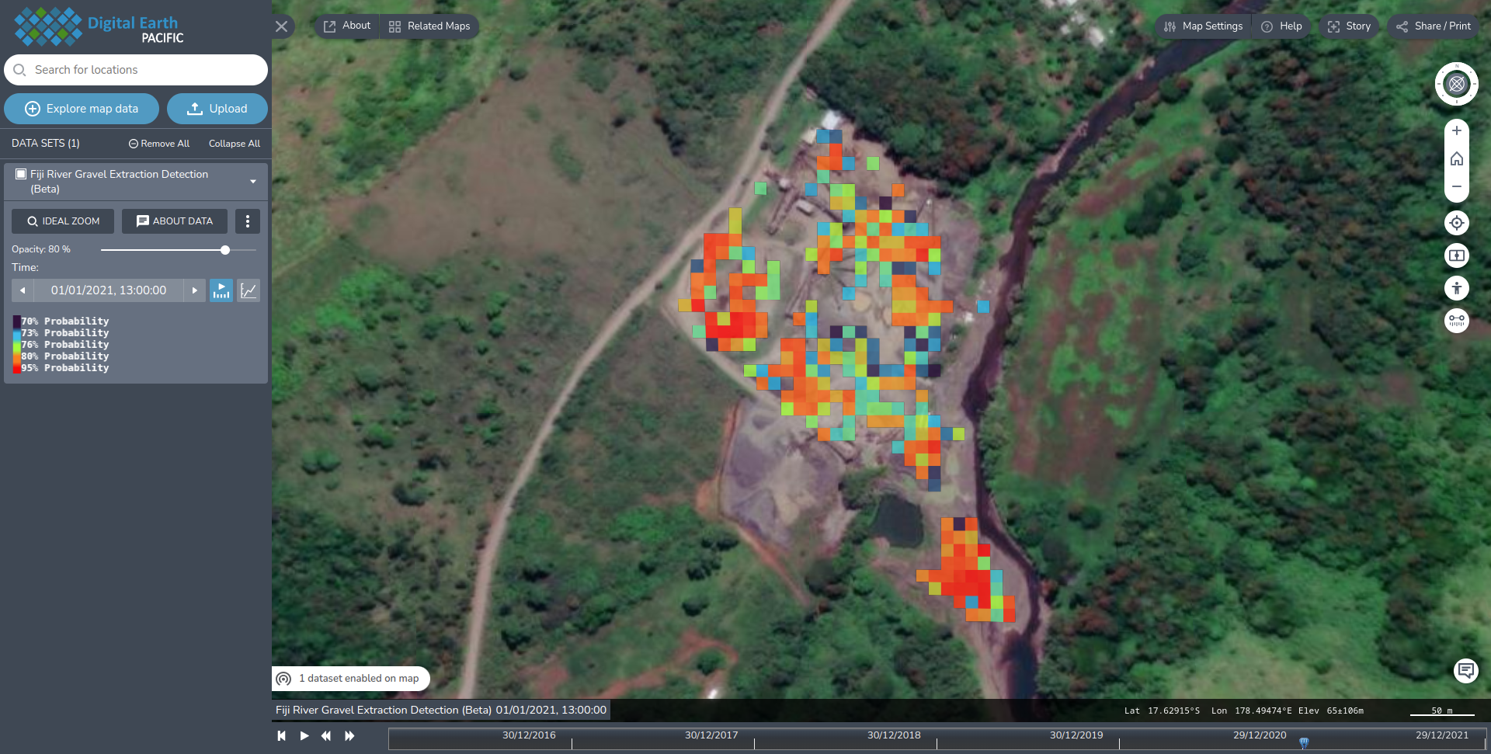
Fiji River Gravel Detection
Fiji Illegal River Extraction - formulated via a robust methodology employing remote sensing data (S2/S1) and machine learning algorithms to precisely identify and monitor the development of mineral extraction sites in Fiji. Consisting of two main phases—Data Preprocessing and Feature Extraction and Machine Learning-Based Classification—the methodology is tailored for adaptability across various geospatial contexts and mineral types.

Slide 20
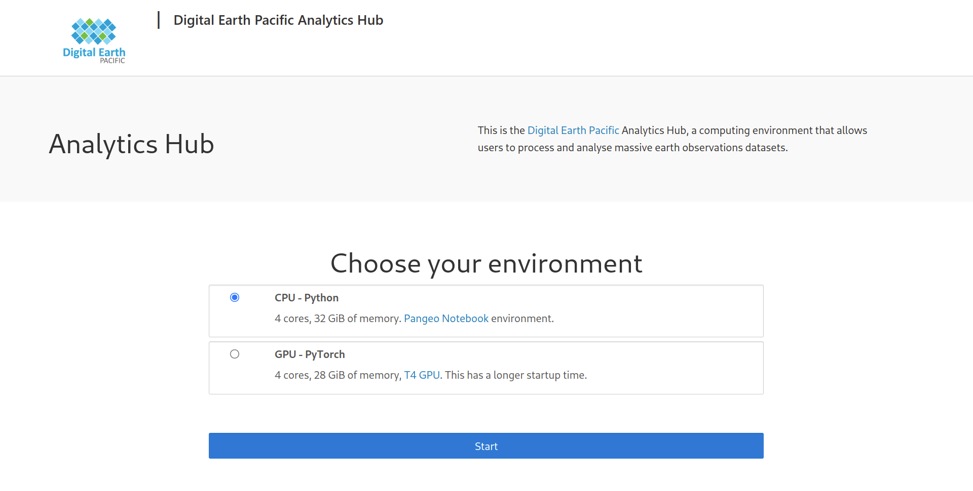
Analytical Hub for PICT Users
Self-scaling infrastructure enabling access to thousands of CPUs and terabytes of MEMORY enabling Earth Observation Analysis on a Regional Scale per User.

Slide 21
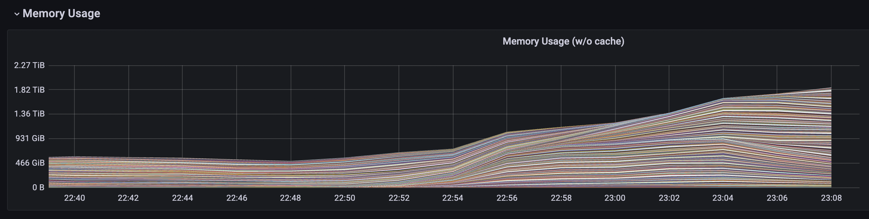
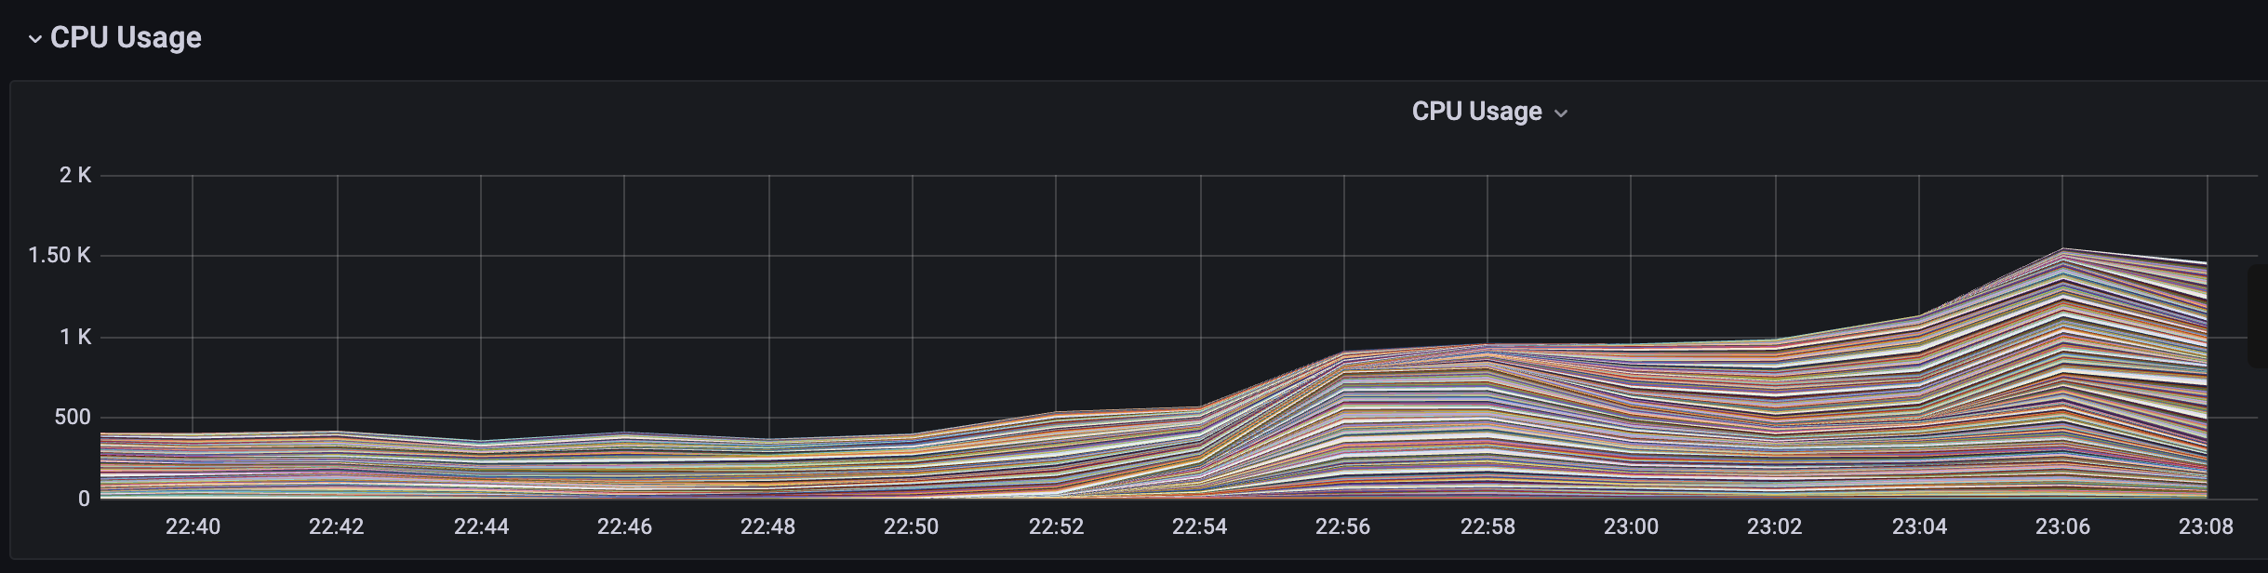
Large (Regional) Scaling Processing
2TB RAM
Usage
1500 CPUs
Usage
Self-scaling infrastructure enabling access to thousands of CPUs and terabytes of MEMORY enabling Earth Observation Analysis on a Regional Scale per User.
Self-scaling infrastructure enabling access to thousands of CPUs and terabytes of MEMORY enabling Earth Observation Analysis on a Regional Level per User.

Slide 22

DEPAL
Using Python for data science applications such as Earth Observations is the standard in academia and industry.
While the Python Language is relatively simple, and easy to learn, Earth Observation analysis uses large number of libraries which can be difficult and time-intensive to learn.
To alleviate and expedite capacity building for non-programmers and intermediate GIS technicians, DEP has implemented the DEP Abstraction Library (DEPAL) into the computing hub environment, which enables users to quickly undertake common tasks with:
Fewer lines of codes
Sane defaults
Pacific-oriented
Lower Barrier to Entry
Easy to use and learn
aoi = dep.get_country_admin_boundary(“Fiji”, “District”, “Ba”)
data = dep.get_gci(aoi, timeframe="2021-06-01/2023-07-30", period="monthly")
dep.visualise(data, cmap=”viridis”)

Slide 23
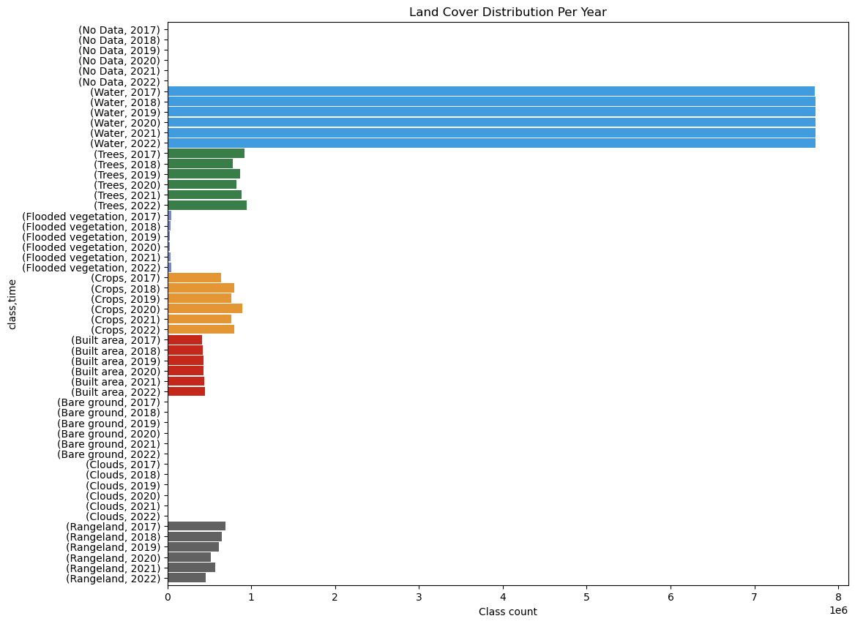
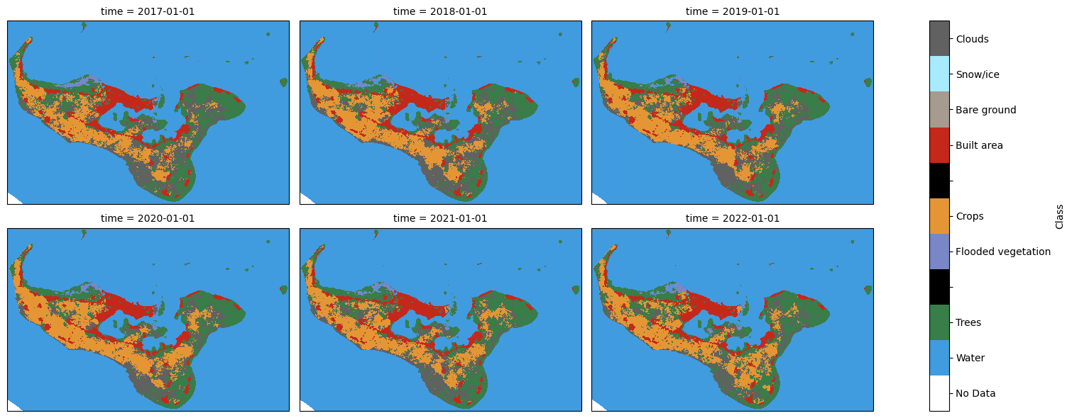
DEPAL Capabilities
Some examples of the functionalities provisioned by the abstraction library includes:
Defining “area of interest” (AOI) by Pacific Island Countries national, maritime and administrative boundaries,
Enabling using custom “area of interest” (AOI)
Rapidly querying satellite data catalog on images and banding,
Creating cloudless images
Undertaking multi spectral analysis e.g.: for vegetation, crops, disease detection
Visualising and analysing global Landcover models
Support functions for Landcover Generation

Slide 24
Centered on a demand-driven, user-centric design approach.
  Create a multi-stakeholder and inclusive governance structure that provides expert and political guidance, is transparent and provides for accountability.
  Create a strong engagement and outreach mechanism to keep users informed, drive input, support co-design and capacity development, and build buy-in.
  Develop an agile approach to technology development that is user-centric.
DEP Principles:
  Demand-driven.
  User-centric design.
  Accountability and transparency.
  Partnerships.
  Public goods.
  Open data ecosystem.
  Holistic capacity development.
  Diversity and inclusion.
  Nimble and agile.
  Interoperable

Slide 25
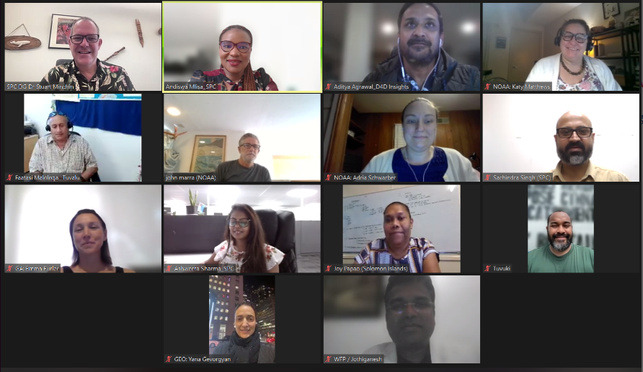
DEP Governance
Countries
  Cook Islands
  Fiji
  Papua New Guinea
  Marshall Islands
  Solomon Islands
  Tonga
  Tuvalu
  Vanuatu
Organizations
  Committee on Earth Observation Satellites (CEOS)
  Geoscience Australia
  Group on Earth Observations
  NOAA
  SPREP
  University of South Pacific
  World Food Programme
Notes:
NOTE

Slide 26
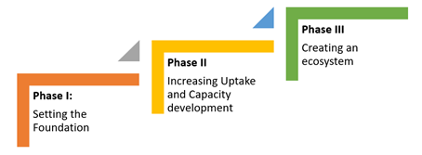
Roadmap 2022-2030
Phase 1 (2022-2024): Setting the Foundation
  Set the strategic foundations, iterating on the technical infrastructure and related use cases, engage stakeholders and develop a fully operational program.
Phase II (2025-2027): Increase Capacity, Uptake and Engagement
  Fully operationalize DEP. Existing capabilities will be leveraged and built upon to create new innovative, decision-ready products and applications with a focus on engagement, capacity development to ensure uptake and usage, and impact.
Phase III (2028-2030): Establish a Data Ecosystem
  DEP will have a network of data, users, applications and knowledge in place where data is flowing bidirectionally across organizations and platforms creating a data ecosystem approach. Governments, private sector and civil society are not only using data, products and services provided by DEP, but creating their own innovations powered by DEP.

Slide 27
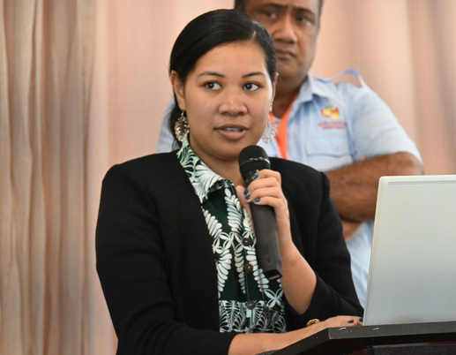
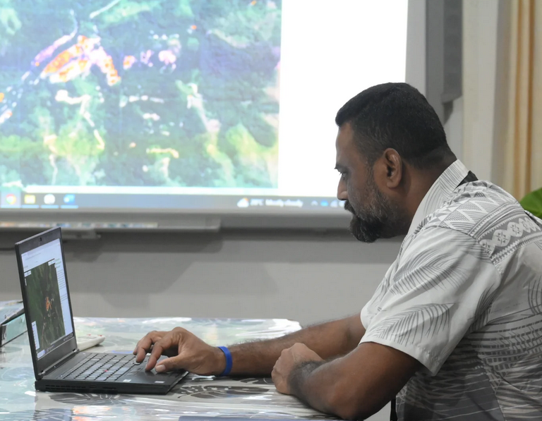
Stakeholder Feedback
Ahi'ahi Saipa’ia, Tonga Ministry of Agriculture, Food and Forests
The benefits of Digital Earth Pacific extend far beyond the walls of her role and team. According to her, the programme plays a pivotal role in elevating the Ministry's work, allowing them and other sectors to harness valuable information on agricultural land cover.
“It is also going to help by creating a time series of climate change in a way that the Ministry (Agriculture) and the government will be able to solve problems for independent and commercial farmers.”
Raymond Mohammed, Acting Director, Fiji Mineral Resources Department
“We face challenges in effectively regulating the sector. Illegal extraction places a strain on our resources, and in that regard, we need to be able to explore more effective ways of monitoring. We thank SPC and DEP for the platform, and after the demonstration today, I am very much excited about what the future holds for the ministry”.

Slide 28
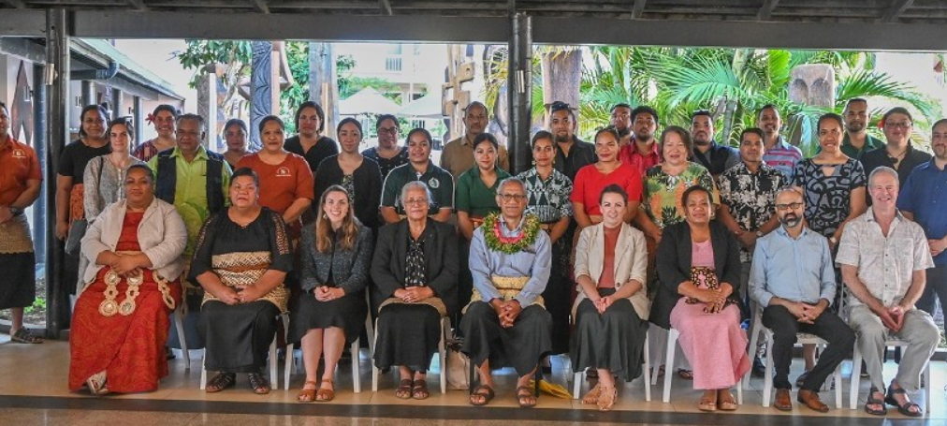
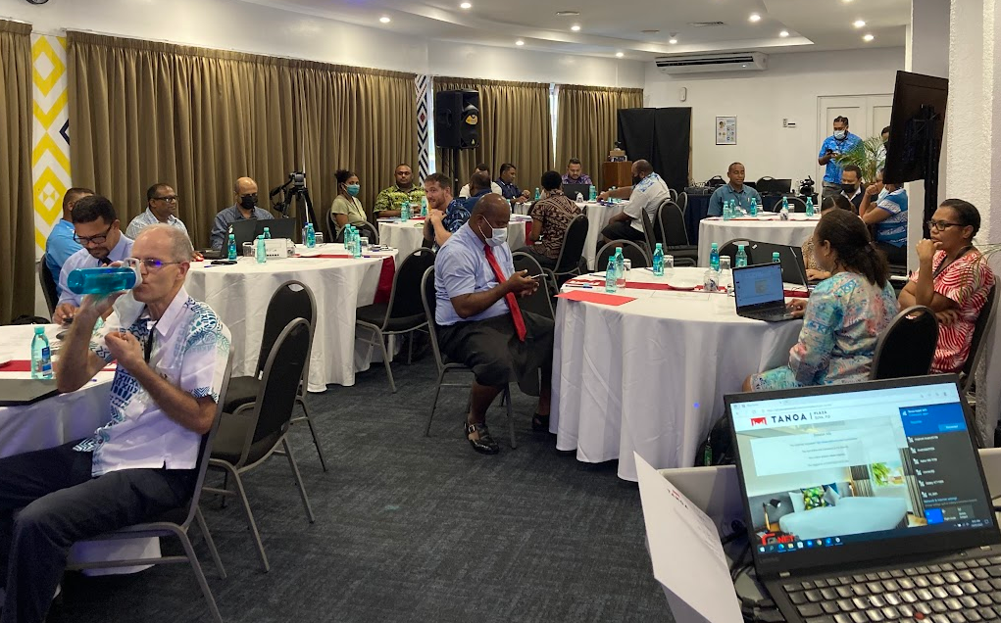
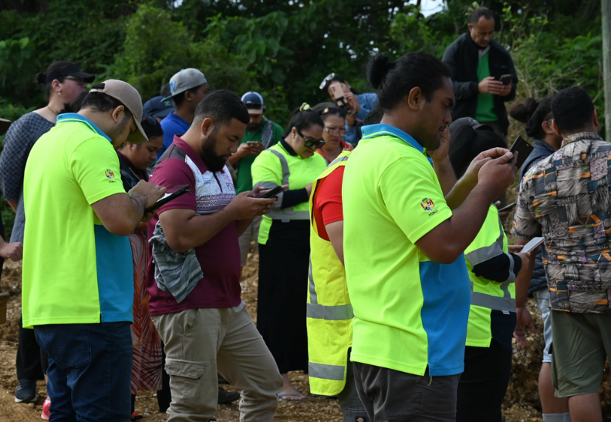
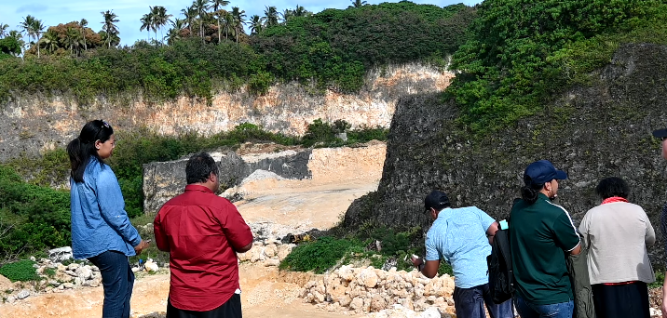
Call to Action
We want to engage with member countries to:
  Identify opportunities for broader showcasing of DEP
  Demonstrate current capabilities and products and understand relevance to your country
  Improve existing products through co-design
  Identify additional use cases and quick wins
  Identify opportunities for workshops focused on capacity development
Develop partnerships that support the long-term sustainability of Digital Earth Pacific
Embed DEP at the science-policy interface to drive action and decision making from DEP products and services
Improve access to satellite data

Slide 29
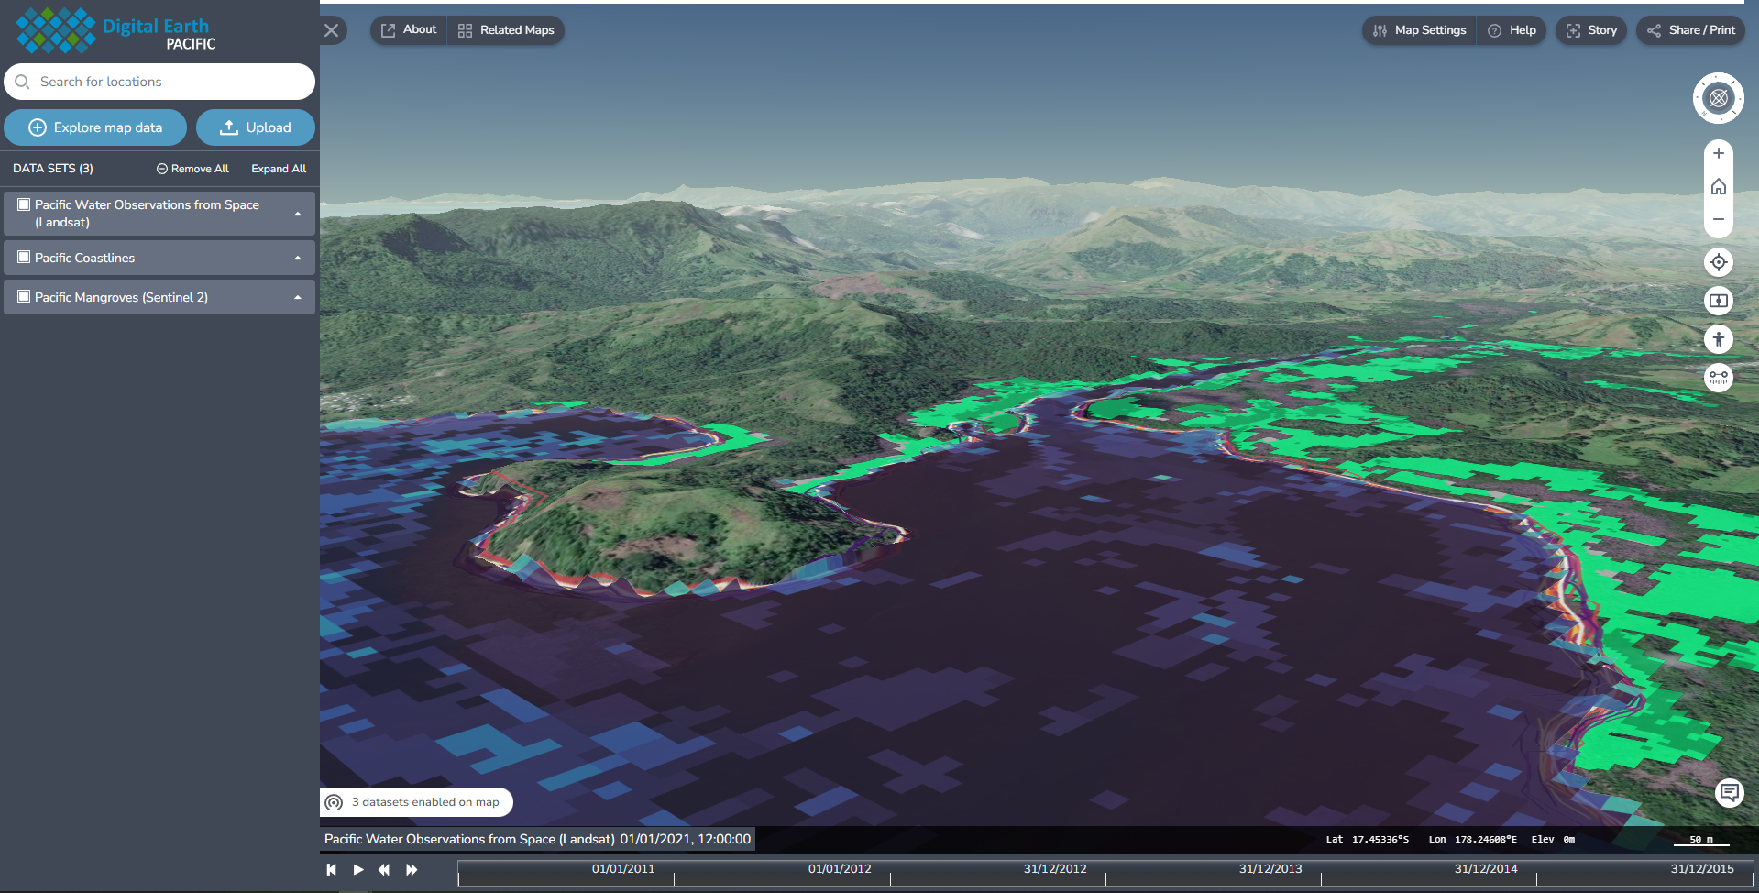
For More Information
www.digitalearthpacific.org
Contact us at dep@spc.int
@DEarthPacific

