Slide 1
Improving resilience through a coordinated(?) sustainable capacity building approach
Aaron Hick

Slide 2
Inspiration
I’m lucky to have a background as a volunteer gives me a unique opportunity to communicate
Inspired by the people who’ve showcased their work this week and discussions I’ve had./
I continue to see sub-optimal missed opportunities for engagement in the Pacific.
Why? WHY NOT?
Inspire a collective effort towards building knowledge and capacity in the Pacific geospatial community, fostering a sustainable path towards improved resilience
Notes:
Examples
Pick a topic from the week
We’re all here trying to do the best for our nations. My background in volunteering has given me a unique perspective on the engagement mode of consultants and vendors.
I was inspired to present this after yet another conversation with an international consultant earlier this year. This person had been in this particular SIDS for the first time for less than 48 hours to work on a project. He had yet to engage with any local staff however the conversation went along the lines of “it’s good that I’m here as people are too lazy to do this work themselves”. I was fuming (once again) and spent the next 10 minutes explaining my positive experiences with colleagues and the numerous unspoken reasons why there are different approaches and skills in the world. I believe this made a significant difference to his perspective, but it is an all-too-common experience for me, so I can’t even begin to imagine how it is for you!
There are plenty of examples of good practise that we can leverage and build on together, should be start communicating more effectively.
This is a prime forum to start this as we already use remotely sensed data regularly, why not leverage remote support / communication!

Slide 3
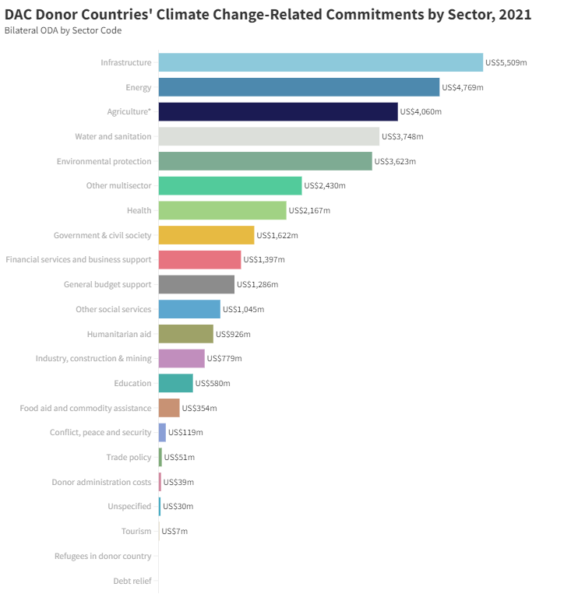
Observations
Many donor funded projects
Analysis / Infrastructure / other deliverable is great, but what else?
Are these delivering skills and knowledge to those who want and need them?
Access to data has never been easier?
Or has it? Congested space – usability? Low bandwidth scenario solutions?

Slide 4
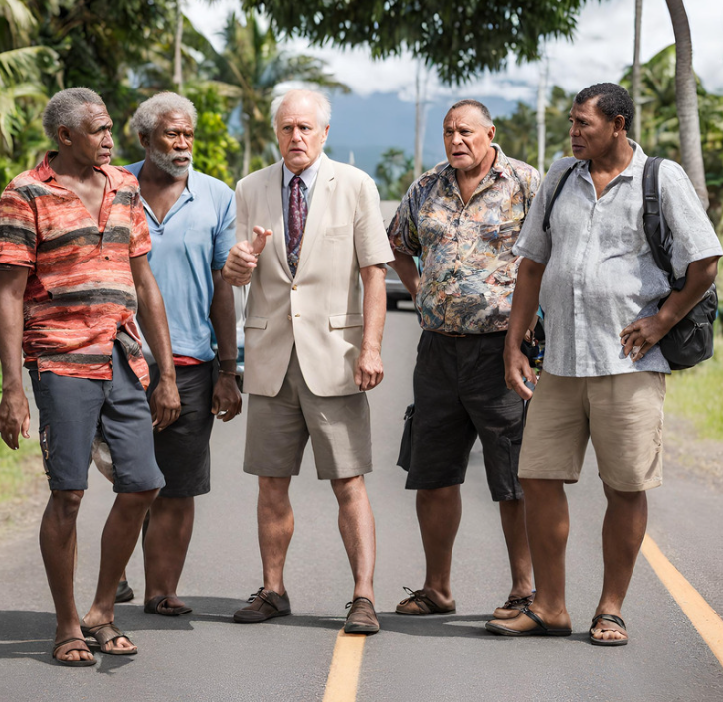
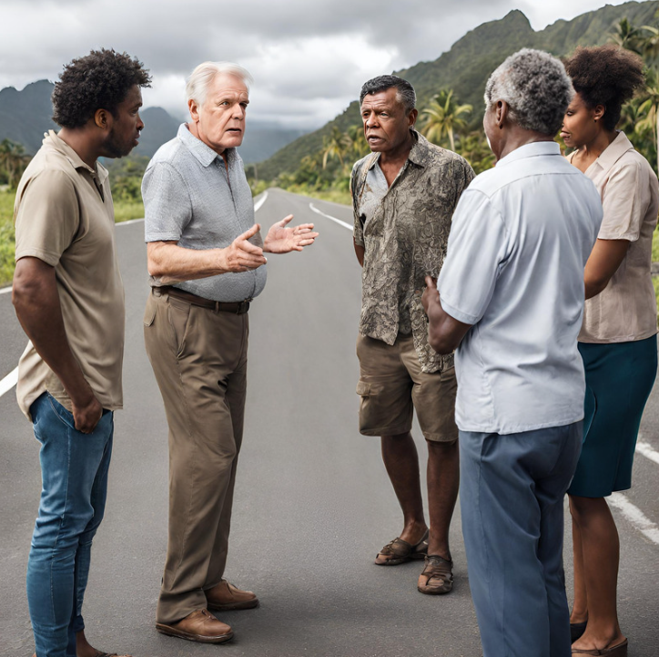
Observations
Consultants who do not or ineffectively upskill colleagues or interact effectively or understand needs
Many Donors / Organisations / Vendors / Consultants working in area with limited collaboration
Lots of telling, not so much listening

Slide 5
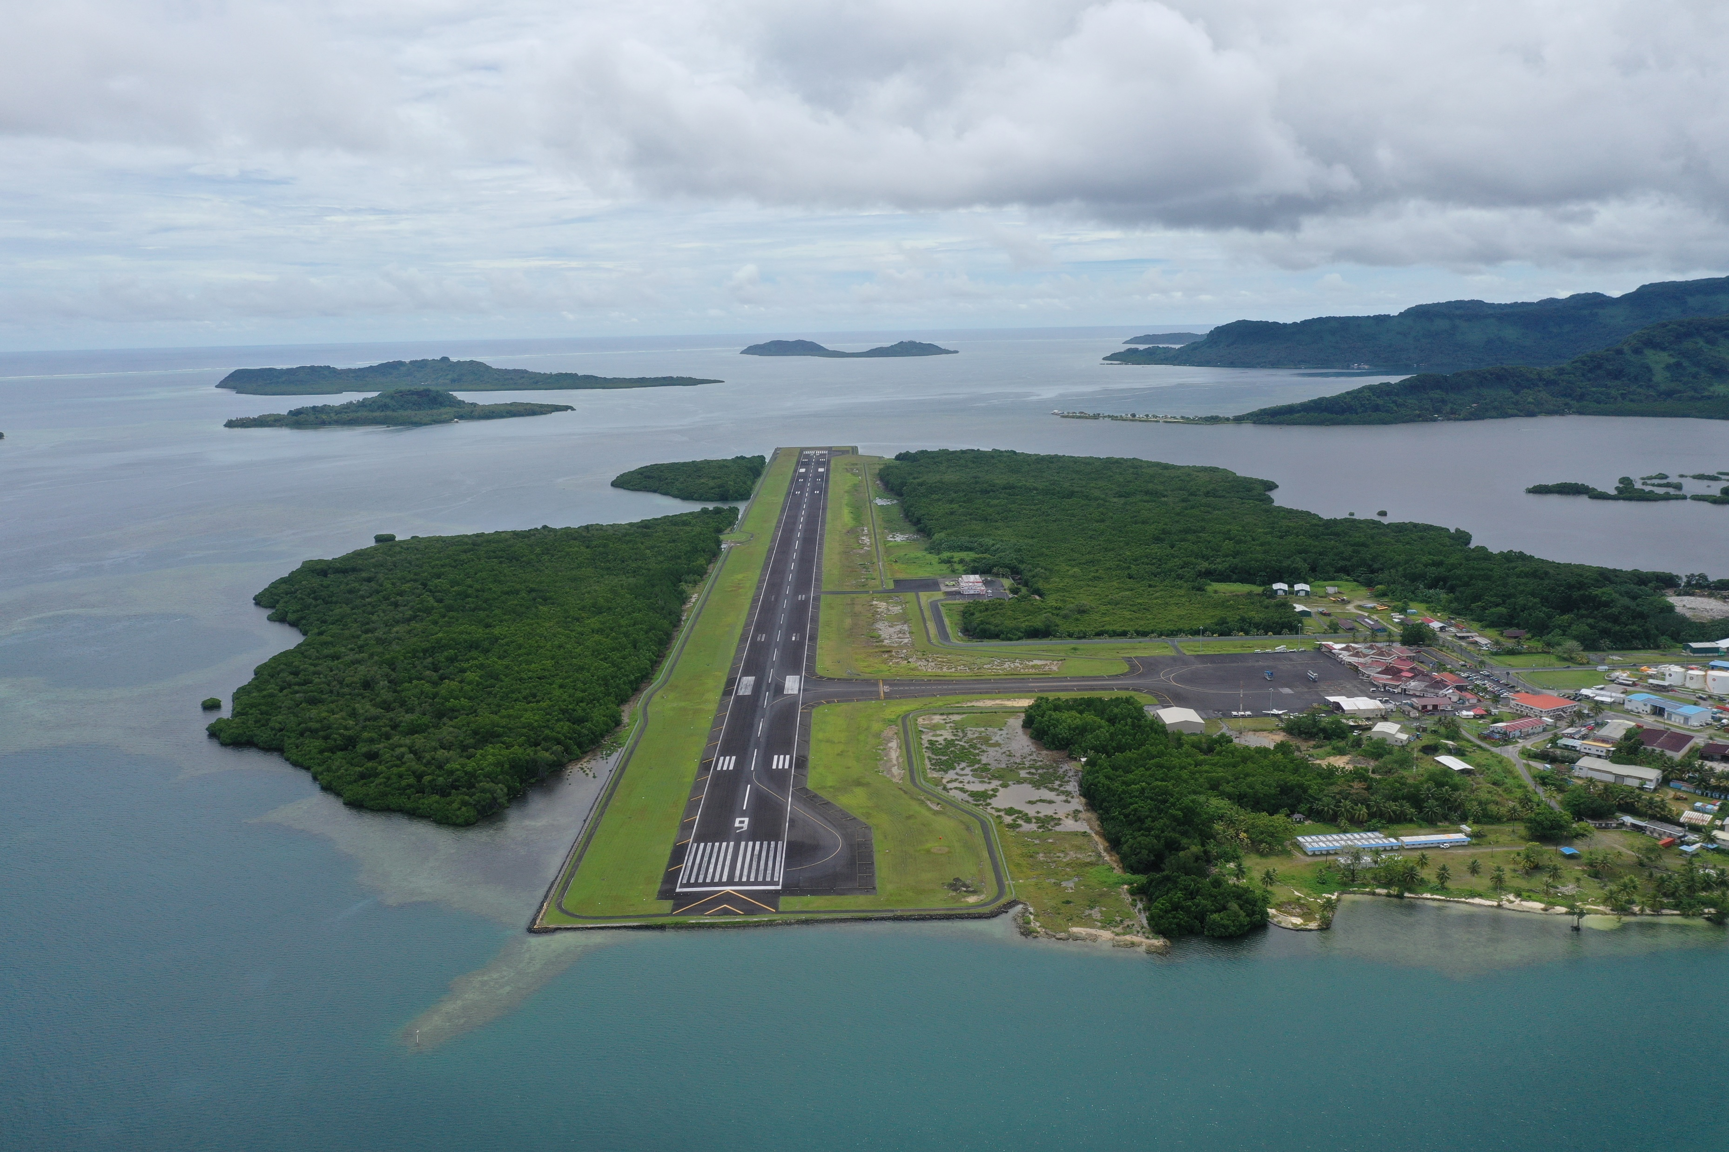
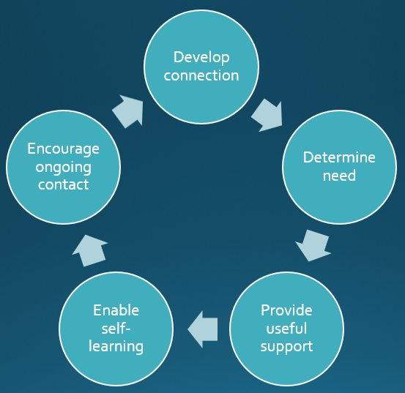
Personal Example #1
Micronesia
Port Project – Survey and GIS team
Exposure to RPAS, integration to aviation crew
Engineering / bathymetry team to do the same

Slide 6
Empirical Framework – Project Level

Slide 7
Empirical Framework – Project Level
Provide useful support
Enable self-learning
Encourage ongoing contact
Determine need
Develop connection

Slide 8
Empirical Framework – Project Level
Develop connection
Provide useful support
Enable self-learning
Encourage ongoing contact
Determine need

Slide 9
Empirical Framework – Project Level
Develop connection
Determine need
Enable self-learning
Encourage ongoing contact
Provide useful support

Slide 10
Empirical Framework – Project Level
Develop connection
Determine need
Encourage ongoing contact
Enable self-learning
Provide useful support

Slide 11
Empirical Framework – Project Level
Develop connection
Encourage ongoing contact
Determine need
Enable self-learning
Provide useful support

Slide 12
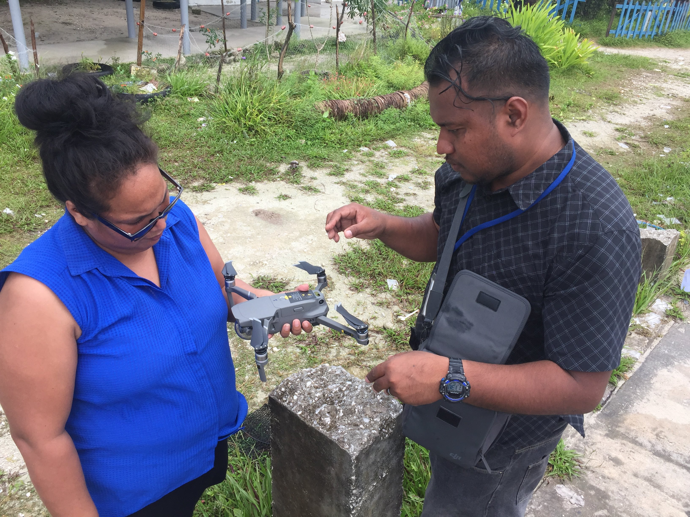
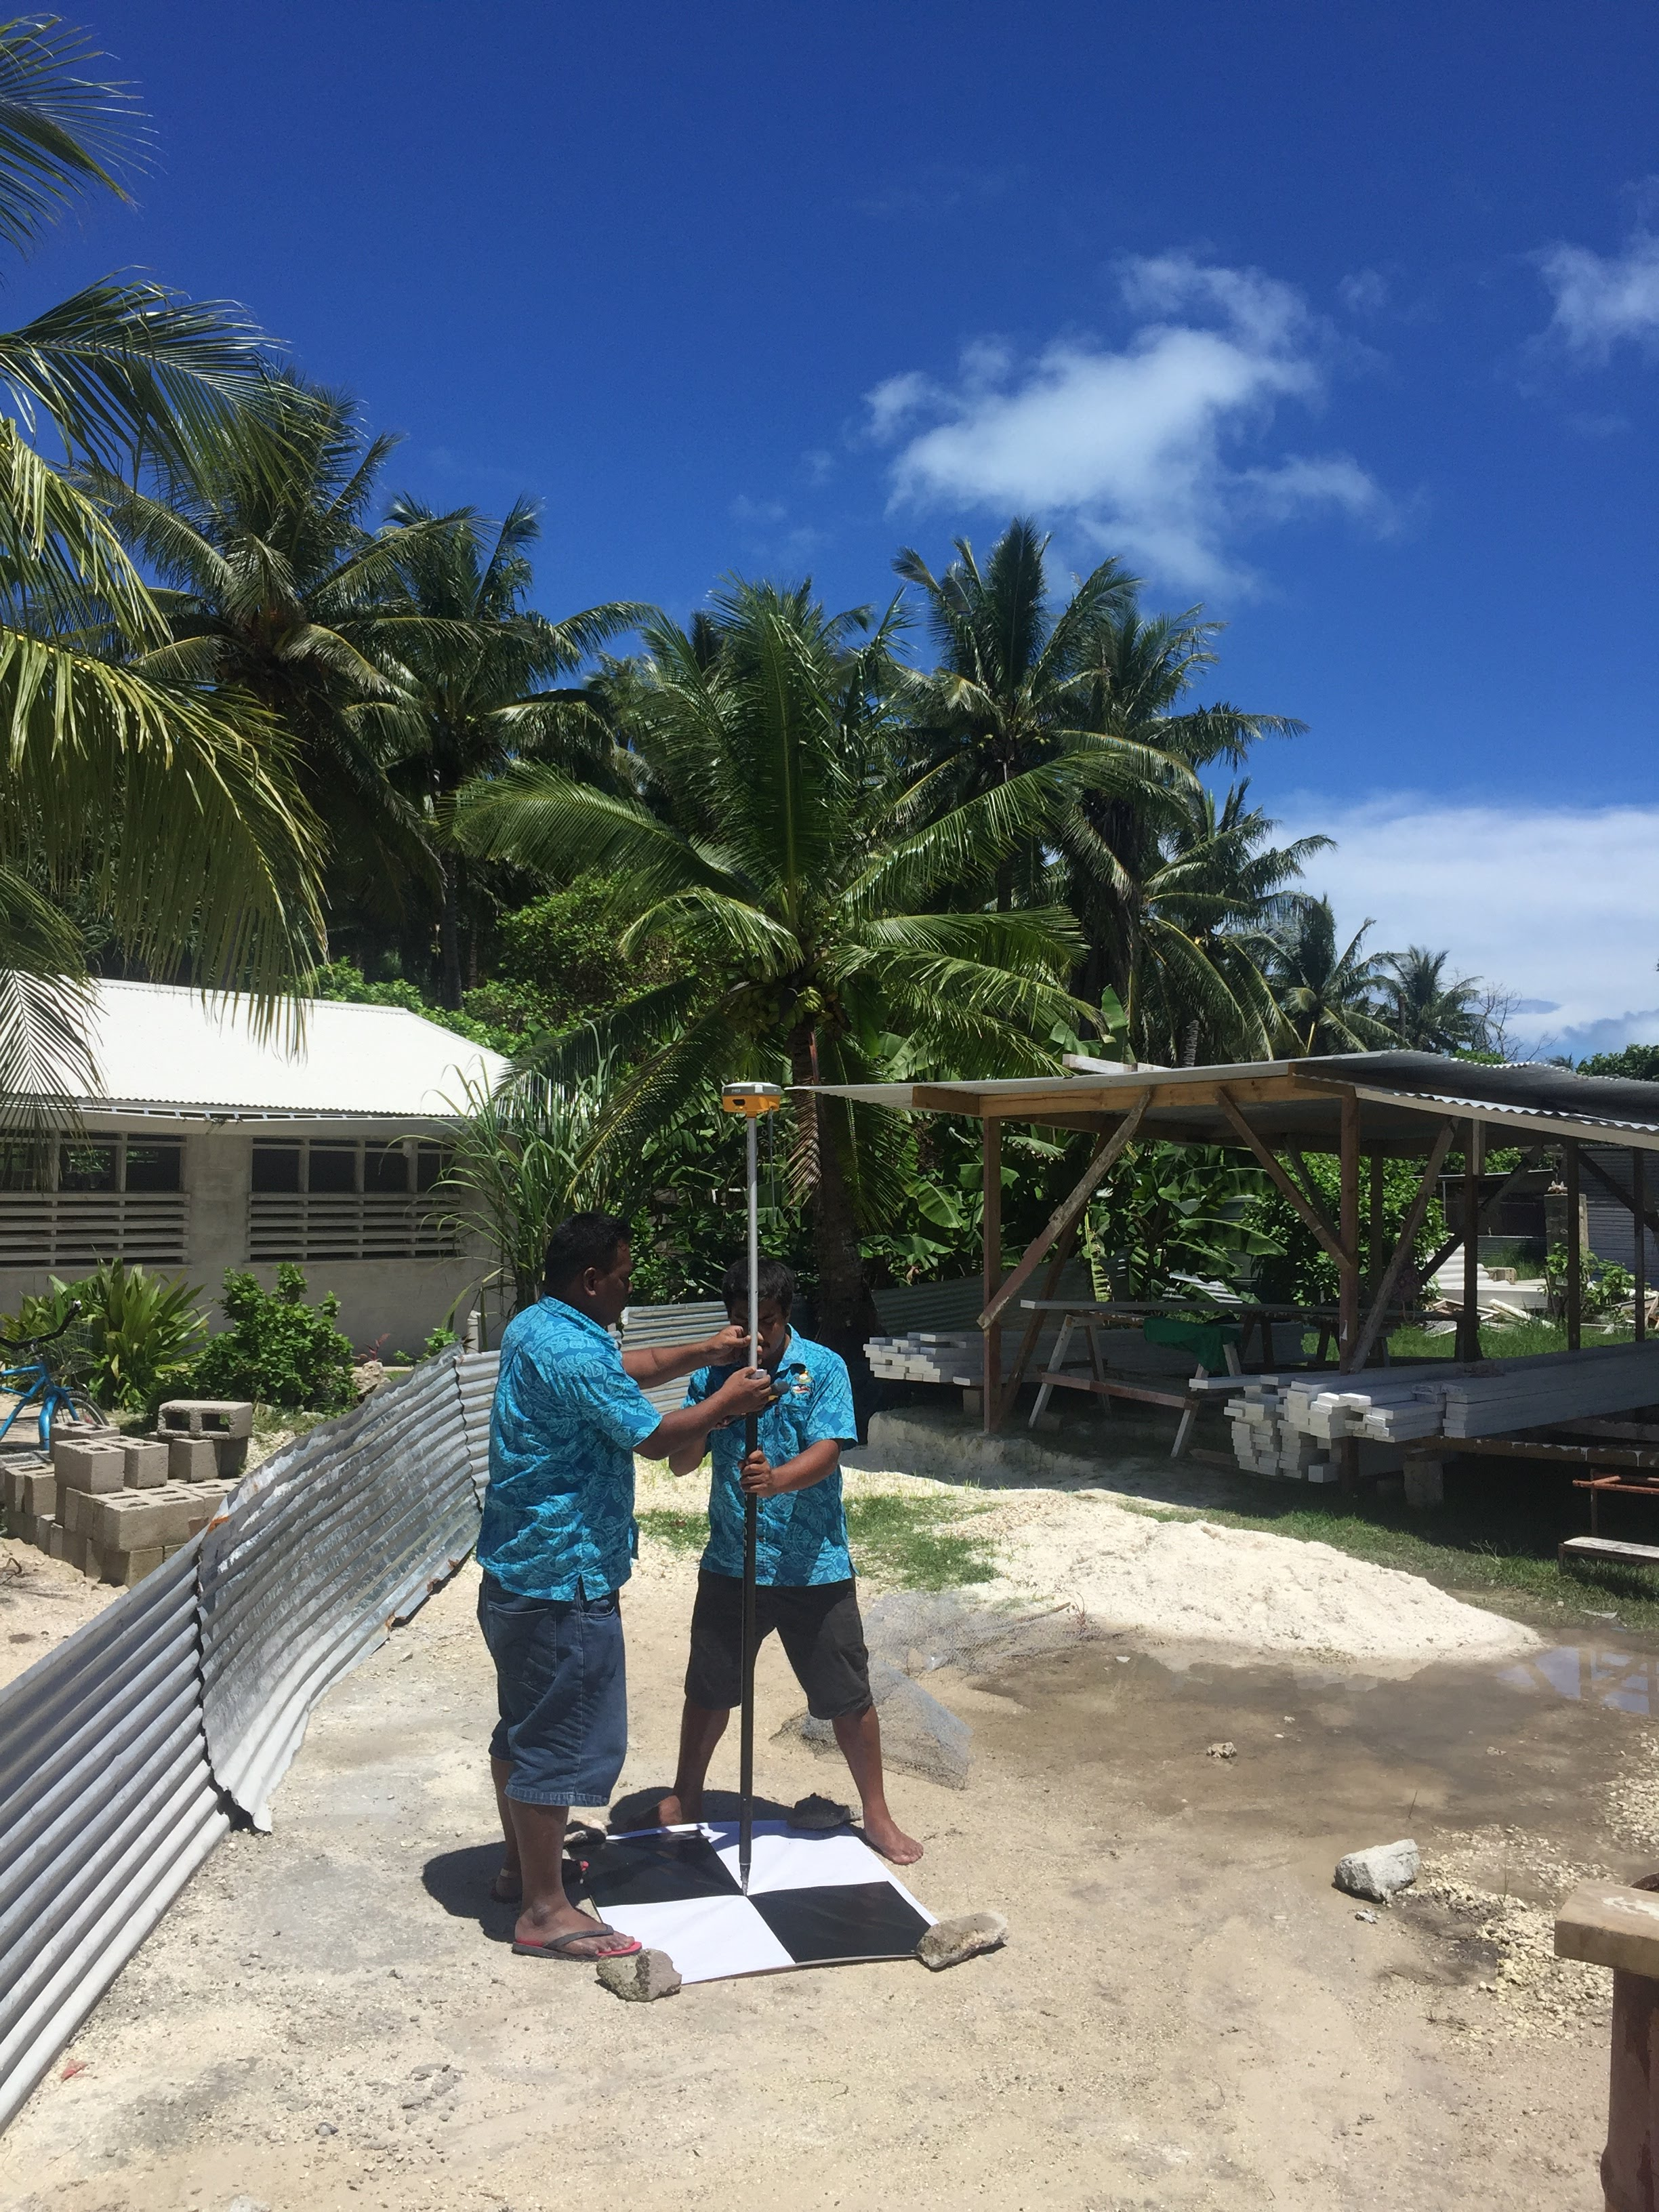
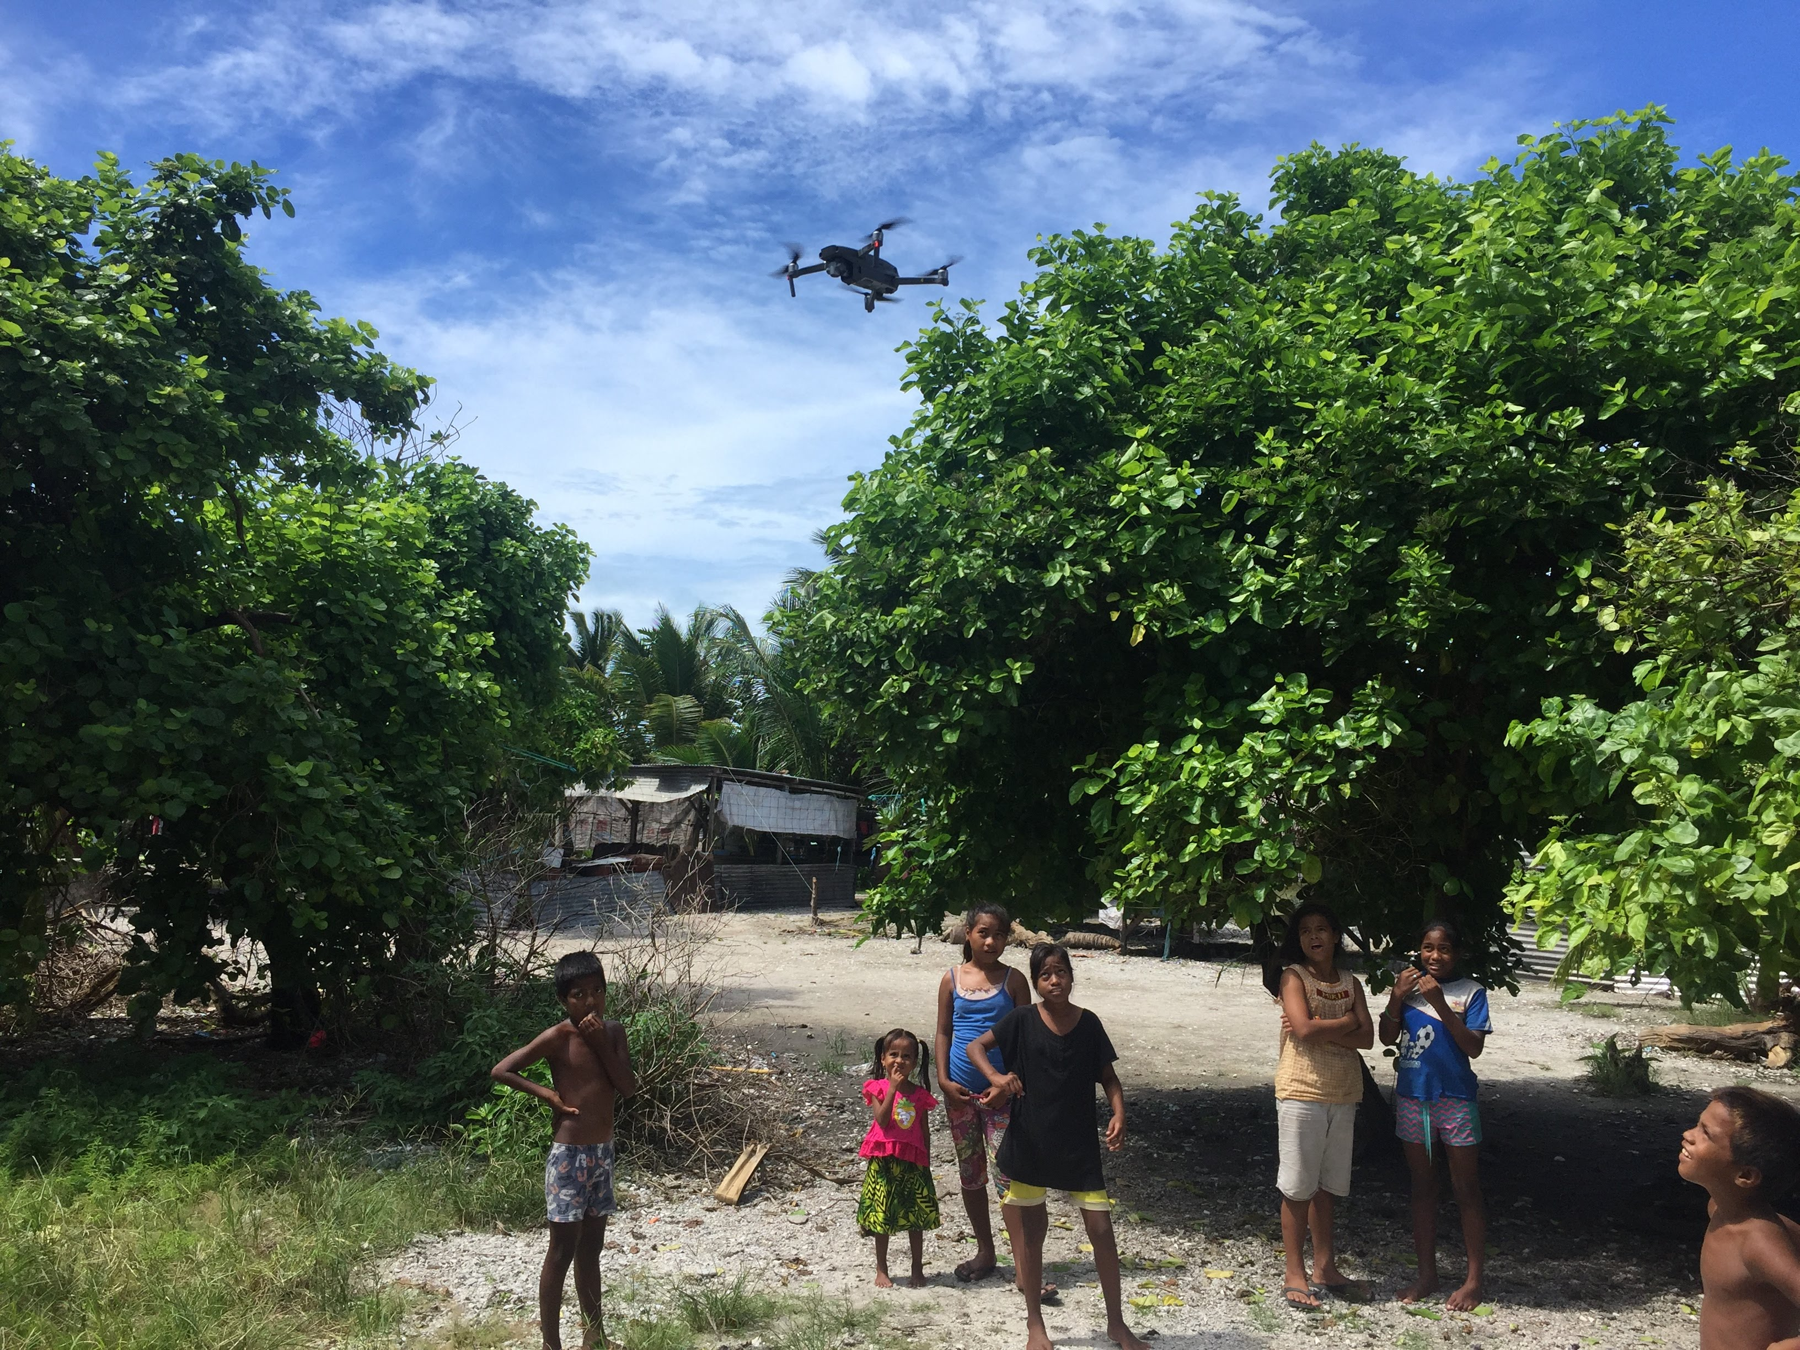
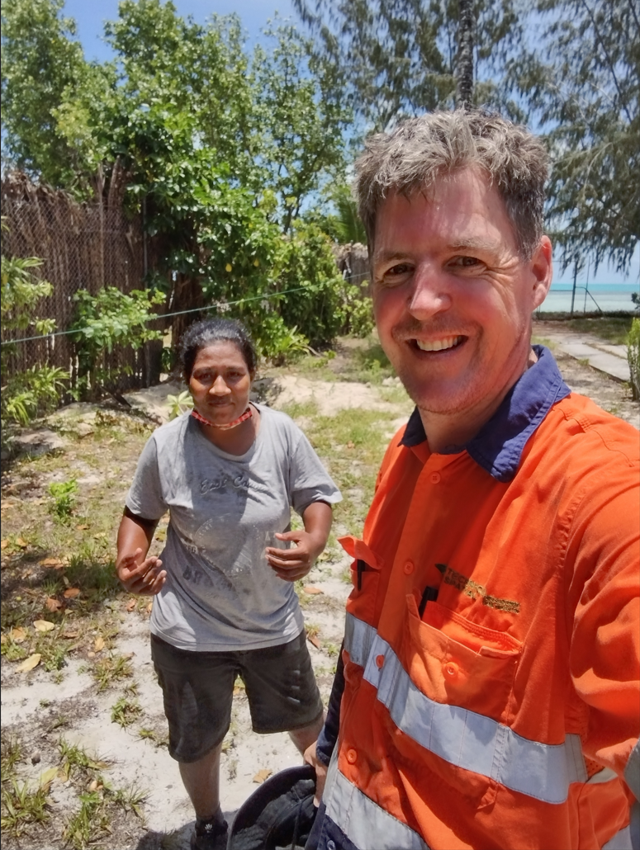
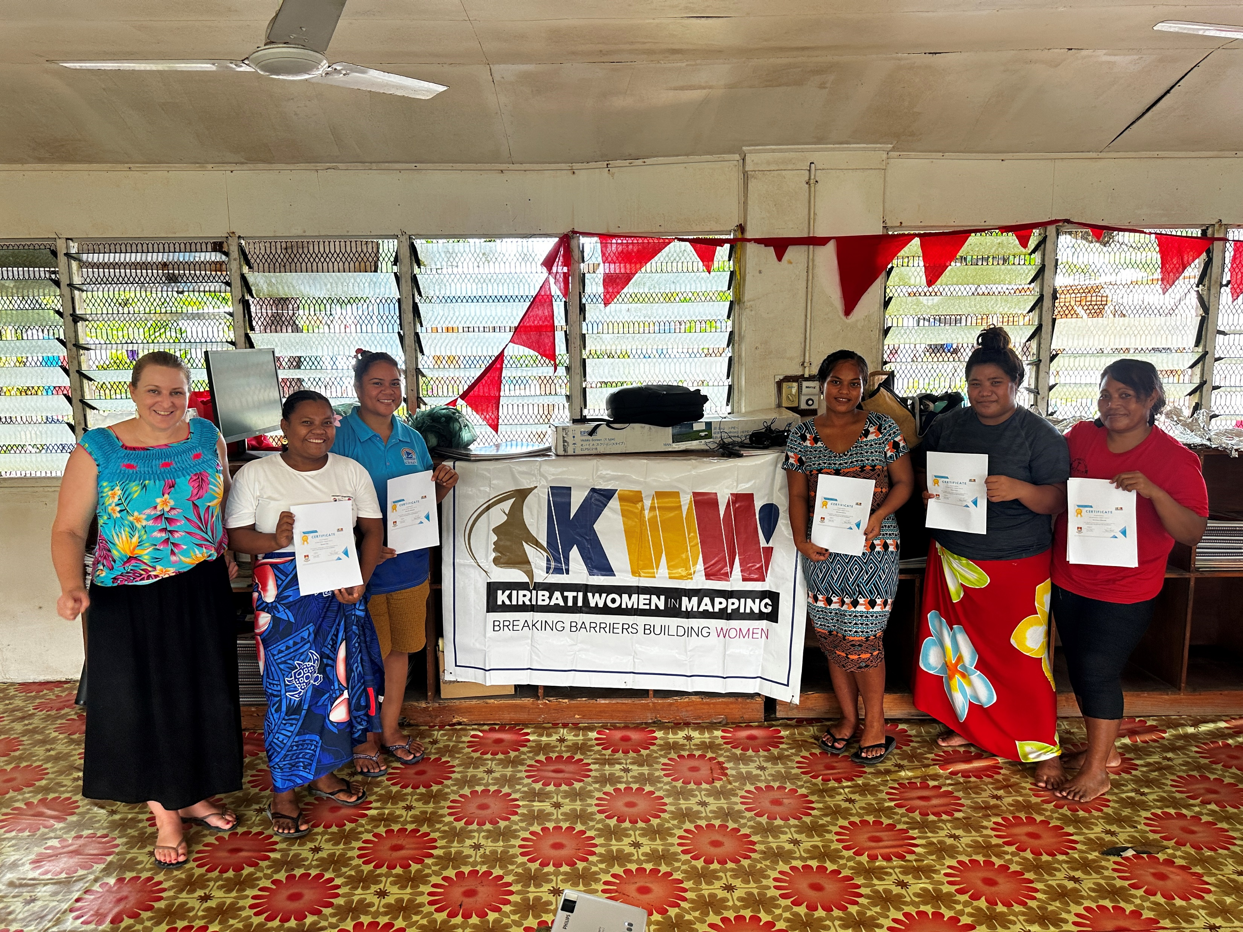
Examples #2
Project integration
Assistants, direct training and upskilling
KWIM

Slide 13
Support Considerations
BENEFIT
Directly relevant
TARGETED
At the right level / experience
STRUCTURED
As time will likely be short, can this be a staged delivery?
LONGEVITY
Software / Hardware cost implications

Slide 14
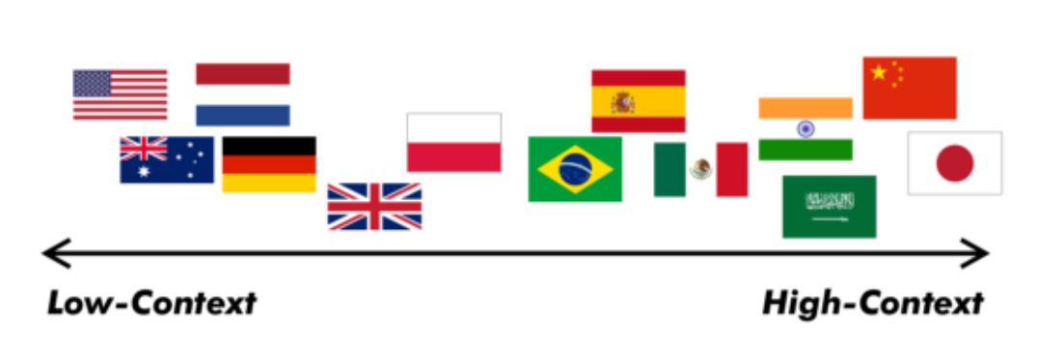
Communication Considerations
Styles
LOW CONTEXT
Info clearly stated
OK to clarify
Clear standards
More public information
Knowledge is transferable
HIGH CONTEXT
Implicit / Unspoken
Relationships are key
Trust is key
Facial Expressions
Non-verbal cues
?
Lower Context Higher Context

Slide 15
Communication Considerations
CONSULTANT / DONOR
PACIFIC HOST
Effort / proactive in communication – suitable format
Try to understand the need and deliver in a way that is useful
Provide support documentation
Develop network, encourage continued access to support
Responsive
Think about what you need
Not everything can be done at once!
Recognise that time will valuable
Try to outline any issues as they arise – availability etc

Slide 16
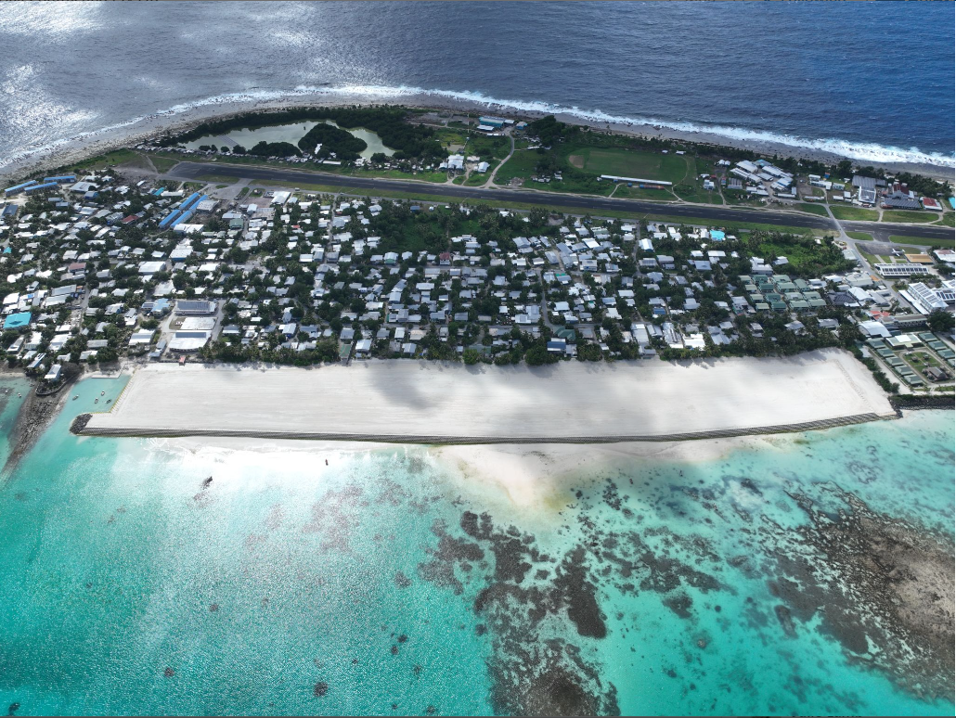
External Example
Hall Contracting in Tuvalu
Upskilling on tools, but also registered with Australian training provider to obtain a formal qualification for ongoing use.
DISCLAIMER:
Businesses / Vendors - claim your free advertising here next year!
Notes:
**NOTE: I have no connection to HALL but some FREE ADVERTISING for them based on this!**

Slide 17
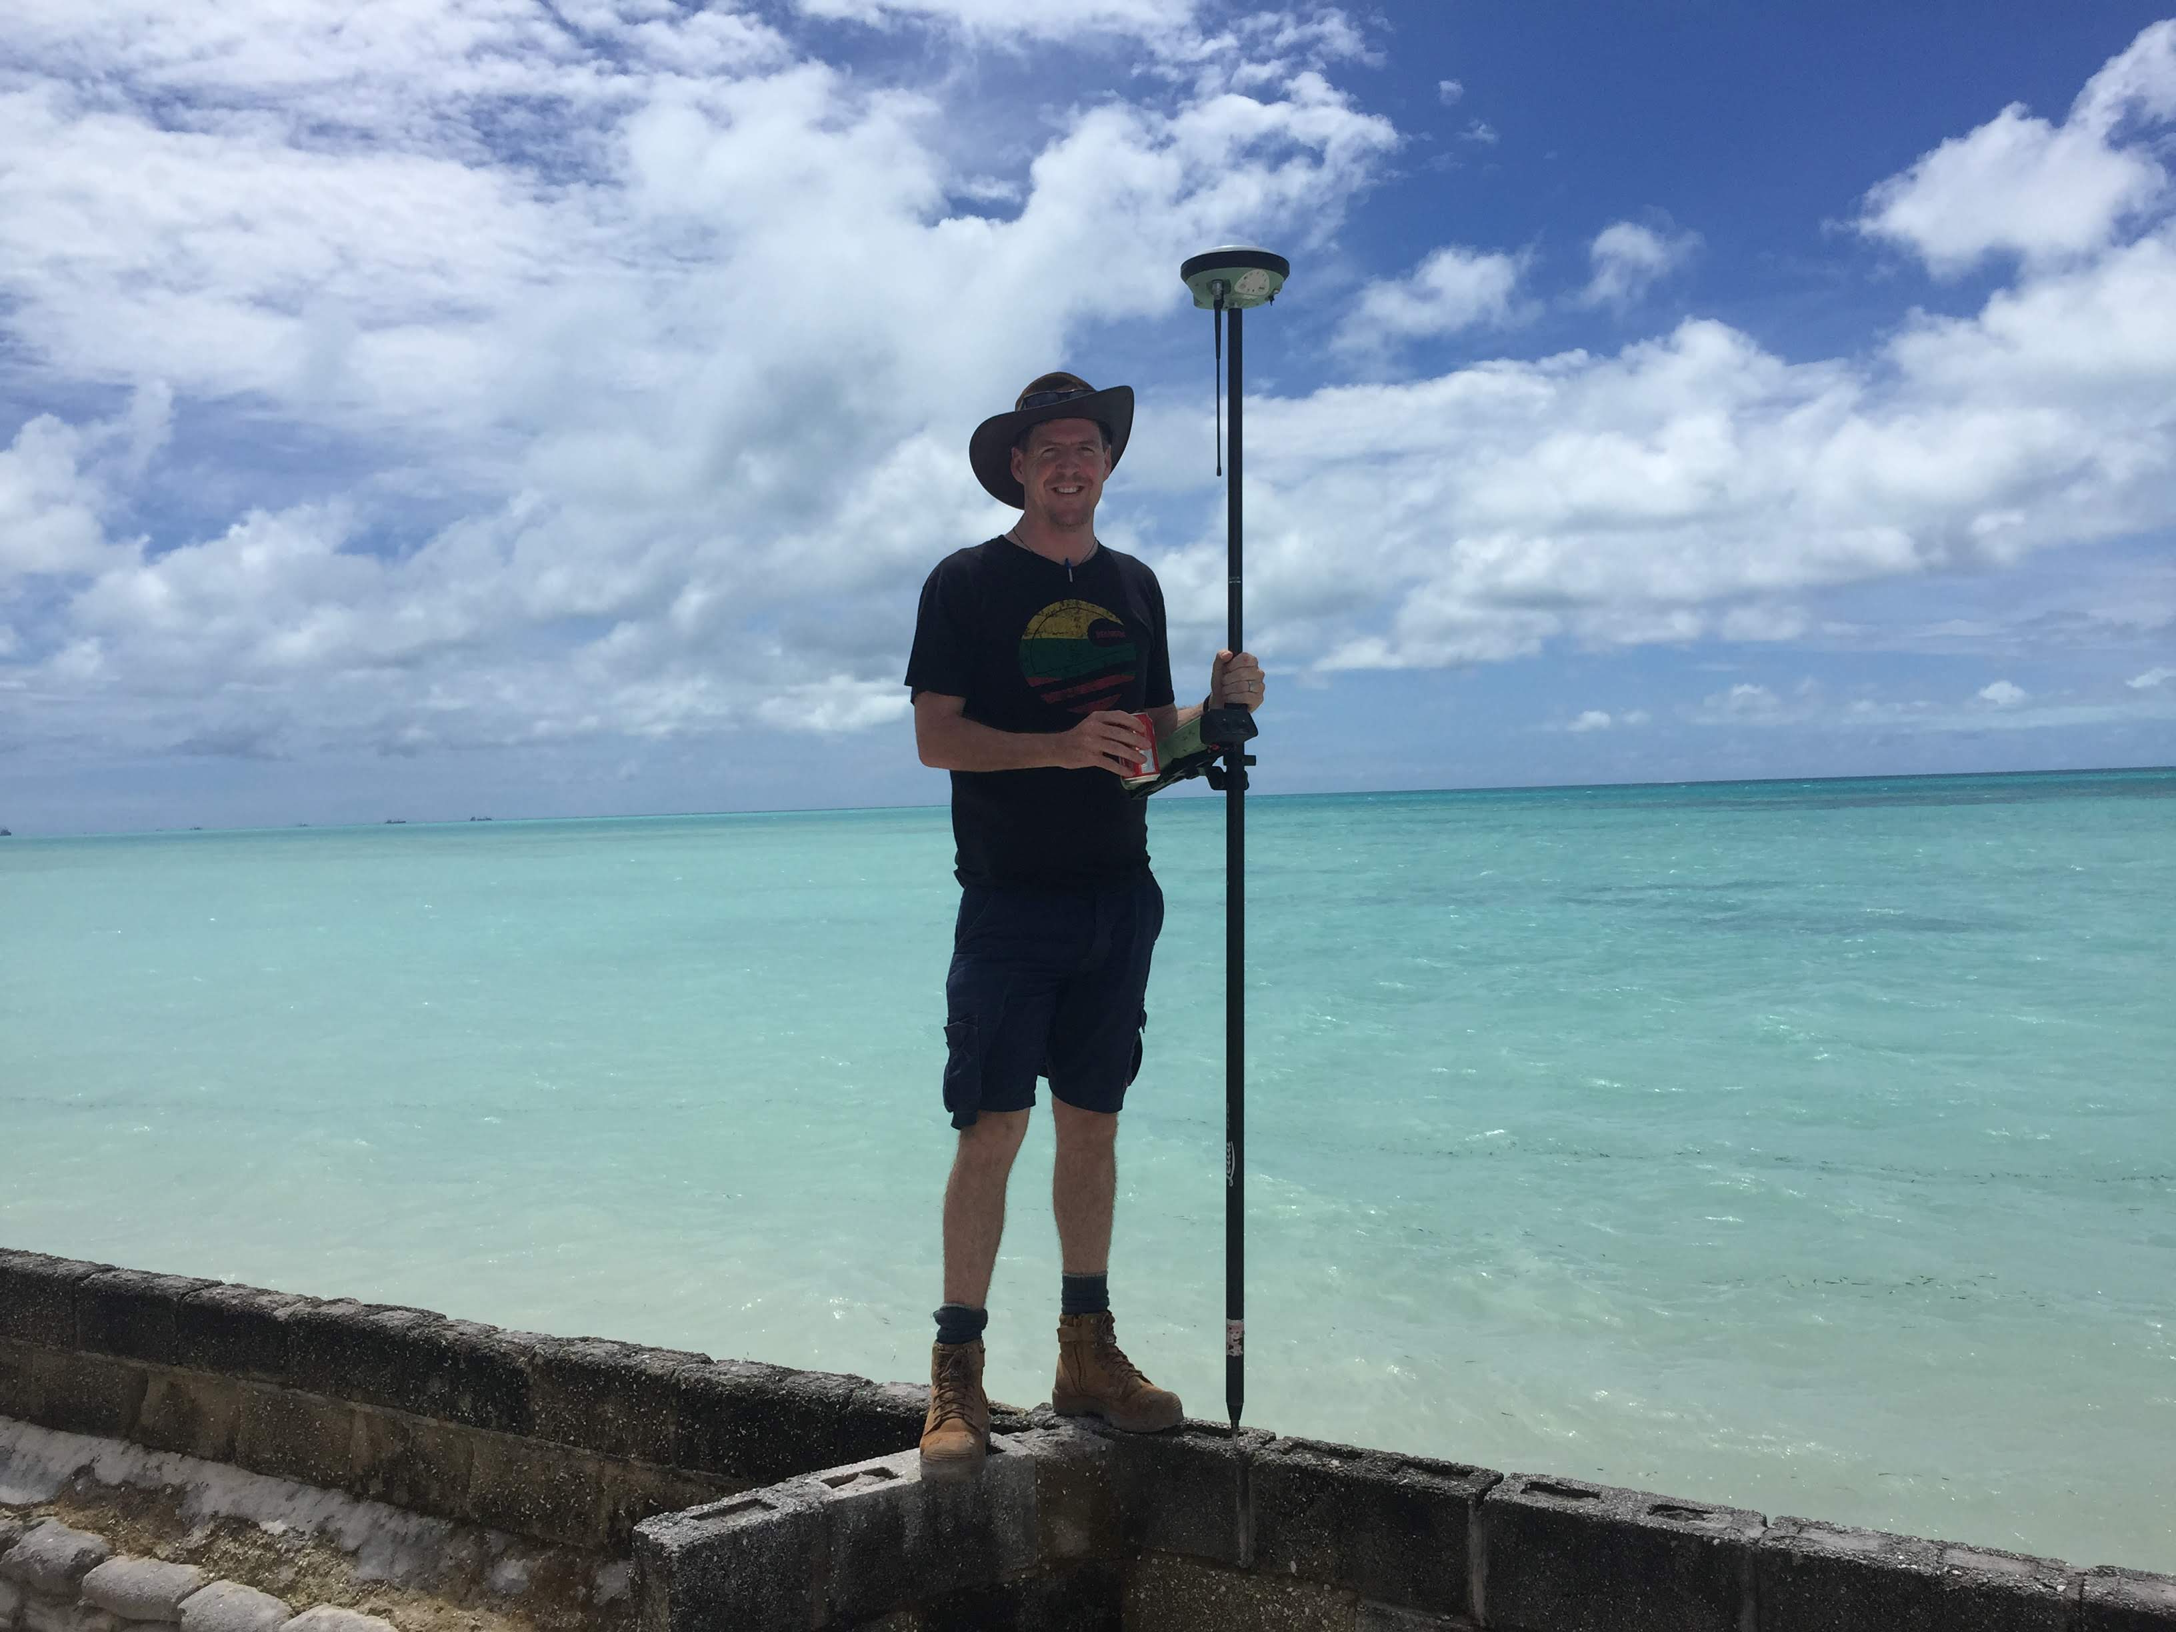
Need to convince your… ?
BOSS (BUSINESS)
Staff retention
Engagement
Social Good
Repeat business / expanded skills
Added value (more wins)
ESG – especially big consultancies are looking for / required to find ways of promoting this to the world.
Do yourself out of a job fallacy.
Plenty to go around, other opportunities and imagine how good it would be if you did!
Notes:
This slide is for the capitalists out there. Why should I – I’m all about the bottom line?
Competitive employment marker – stand out

Slide 18
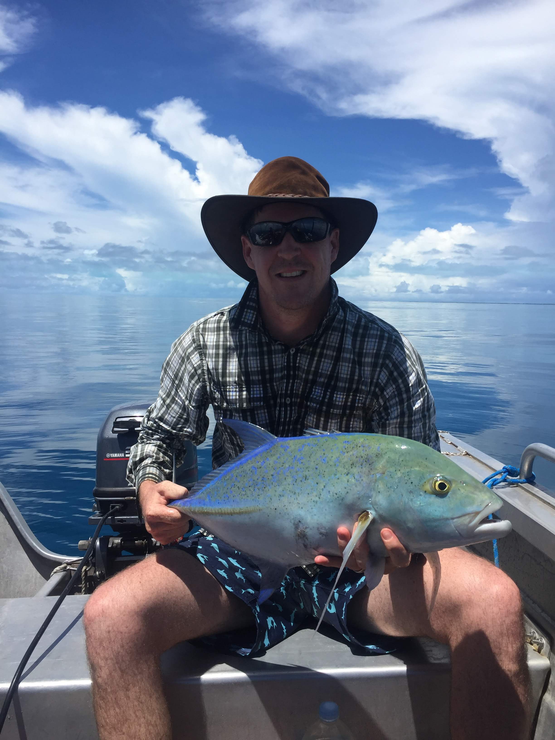
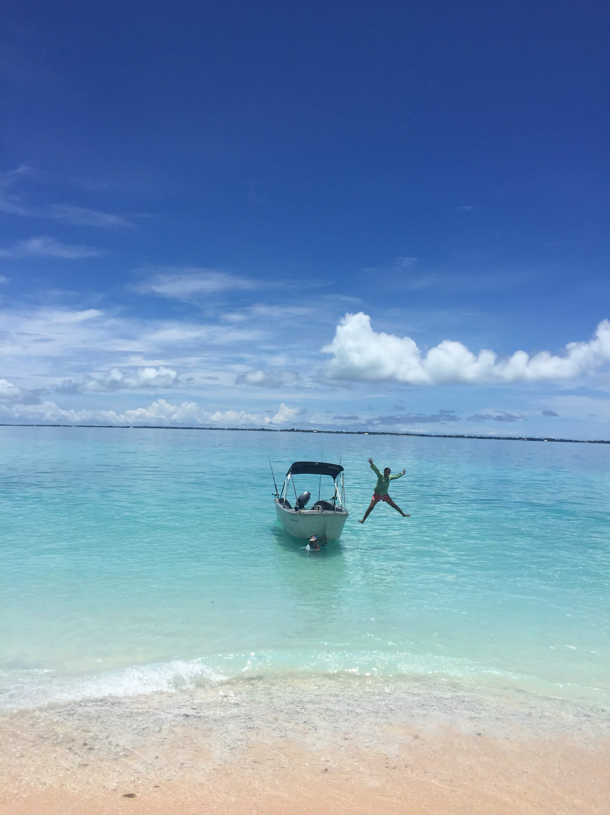
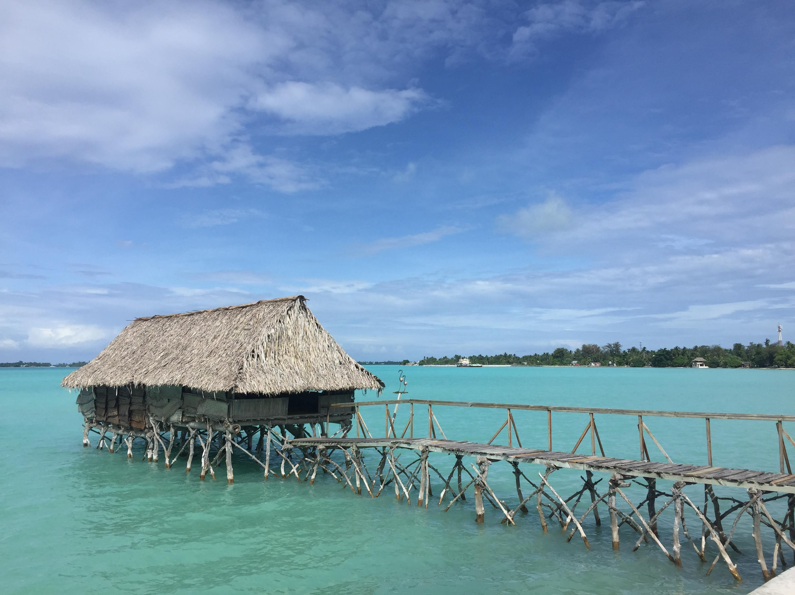
Need to convince your… ?
SELF (INDIVIDUAL)
Feeling of achievement / benefit / pride
Volunteer = feel like you get more out of it than you’re able to give.
My shirt & the opportunities you couldn’t replicate!
Notes:
This slide is for the capitalists out there. Why should I – I’m all about the bottom line?
Competitive employment marker – stand out

Slide 19
What to do?
When scoping projects and planning missions:
Donors – include budget for / deliverable of local capacity building
Businesses – allow / encourage employees to engage
Consultants – Just do it - Build your own network and lean on it! What have others done, can you follow on?
Pacifica – Request and expect support as part of projects (feel empowered to speak up and say what you need / want and ask for more!)
Encourage your government / ministry to expect and ensure donors incorporate knowledge sharing in projects

Slide 20
Opportunities
Any consultant project travel, or network you have already!
Leveraging donor projects
Wavell Heights High School / Brett Dascombe
Internships / Exchange Opportunities
Linkage with other Universities (USP/FNU?)
New Colombo Plan
Want to be involved? Have ideas? Reach out!

Slide 21
RECAP / Key areas of focus
Consider / Research communication differences
Target training at the right level (not one-size-fits-all)
Enable (really enable) follow-up support
Documentation
Facilitate / encourage communication, be proactive
Support networking
Let’s work together!

Slide 22
COME AND SAY:
Mauri, Bula, Kia Ora, Kia Orana, Hi, Halo, Ket imin, Kaselehlie, Mahalo, or teach me something new!
Let’s make collective effort towards building knowledge and capacity in the Pacifica geospatial community, fostering a sustainable path towards improved resilience!
PGRSC - Next year lets have a whole session on collaborations!!

Slide 24
Why not already?
No ease of linkages / network
Cultural differences – communication styles
Budget
Lack of understanding of need
No Expectation / Requirement? From project OR receiver
Lack of perceived benefit
Too hard? Too much Time required?
VERY Silo’d support
Weariness of those offering help

Slide 25
Project Based Example
Finnish Consulting Group
Software Purchase
Upskilling

Slide 26
Challenges
Solution
Networking and communication.
Scoping and targeting at correct level.
Integrating with / building on previous support / training.
Legitimate ongoing support and follow up.
Support weariness.
A central coordination and communication role?
!
!
!
!
!
!
!
!
!
!
!
!
!
!
!
!

Slide 27
Challenges
Solution
Networking and communication.
Scoping and targeting at correct level.
Integrating with / building on previous support / training.
Legitimate ongoing support and follow up.
Support weariness
A central coordination and communication role?
!
!
!
!
!
!
!
!
!
!
!
!
!
!
!
!

Slide 28
Network Building and Maintenance

Slide 29
SMARTART STILL
Develop connection
Determine need
Provide useful support
Encourage ongoing contact
Enable self-learning

Slide 30
Collaboration and Coordination
Source: OECD CRS, Based on the Rio Markers for Climate Change Mitigation and Adaptation

