Slide 1
Women in GIS Session
2023 Pacific GIS&RS User Conference
Presented By:
Joy Papao
Solomon Islands In-Country Technical Expert
United Nations Satellite Centre (UNOSAT) of UNITAR

Slide 2
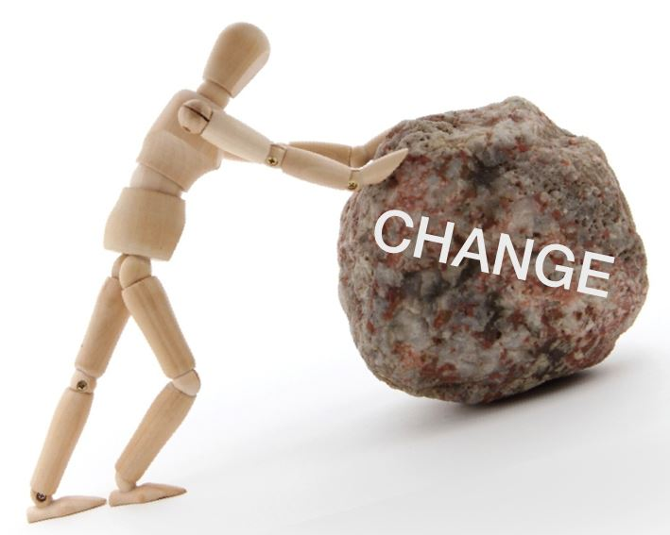
Be change agents
Become a mentor
Become a leader
Rally support
Be confident
Be innovative
Effective communication
Openness to change & experience
Notes:
Being a woman in a male dominated field has its challenges
To all women, girls who are keen to pursue a career in the field of GIS, RS, Surveying, Disaster Management, Emergency Management who mostly dominant by men
Be agents of change, to increase organizational effectiveness. Become a leader in our respective homes, communities, and organizations. Be vocal
Be confident to assert yourself to effectively communicate with others. Take risks to pursue new opportunities.
Communicate change, change is not easy but over time, it can be accepted.
Understand change and be open to it.
Become a mentor for others, especially women and girls
Rally support and build capacity
Be innovative with the changing technology, use mediums to effectively relay messages
Take risks We have to claim and own it “we can do it”

Slide 3
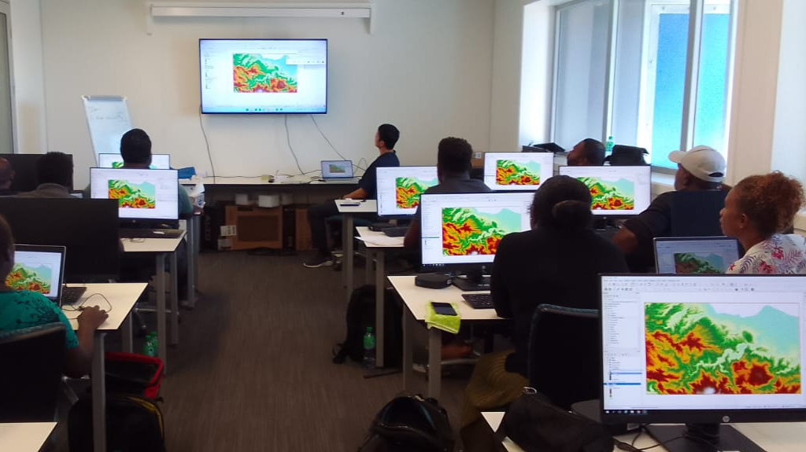
Tagio tumas Thank you

