Slide 1
Women in GIS
Government of Tonga
Pacific GIS and Remote Sensing User Conference
27th November – 1st December

Slide 2
Women in the Industry
Government of Tonga
Government
Asian Development Bank
Donor Support
Ministry of Lands & Natural Resources (GIS Department)
Ministry of Agriculture, Food & Forestry
Statistics Department
Ministry of MEIDECC (NDRMO)

Slide 3
Women in the Industry

Slide 4
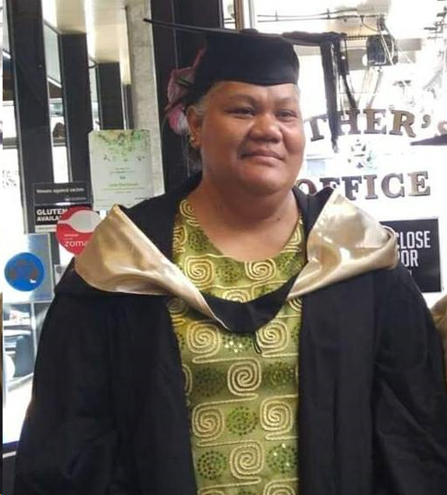
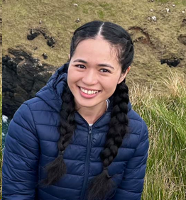
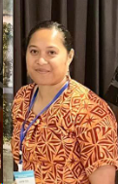
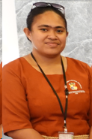
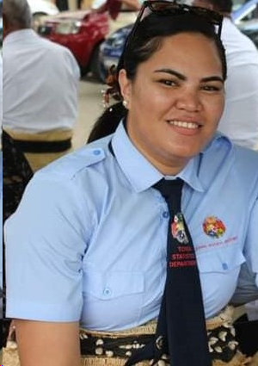
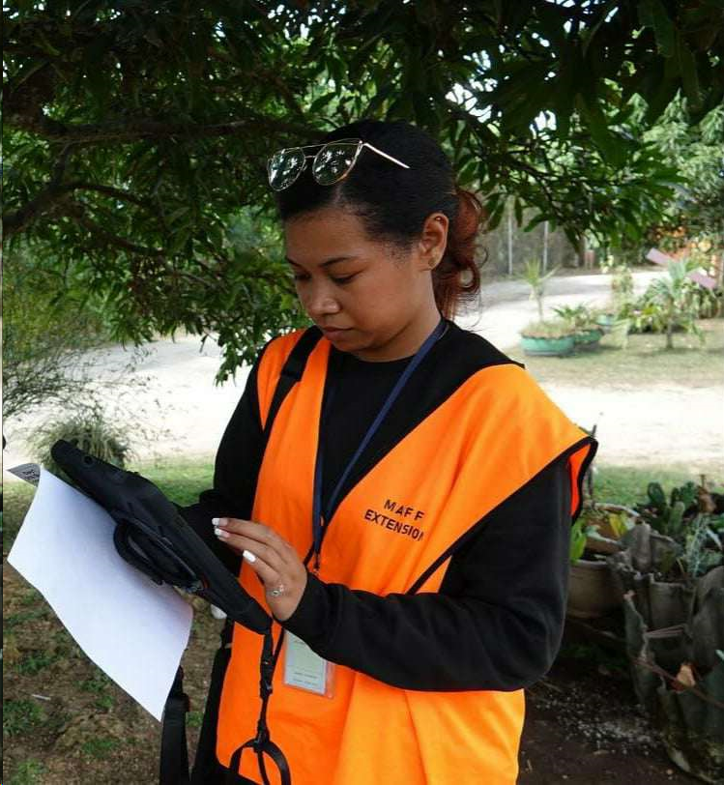
Women in GIS ~ Tonga
Government of Tonga

Slide 5
Malo ‘aupito vina’a va’alevu
Government of Tonga

