Slide 1
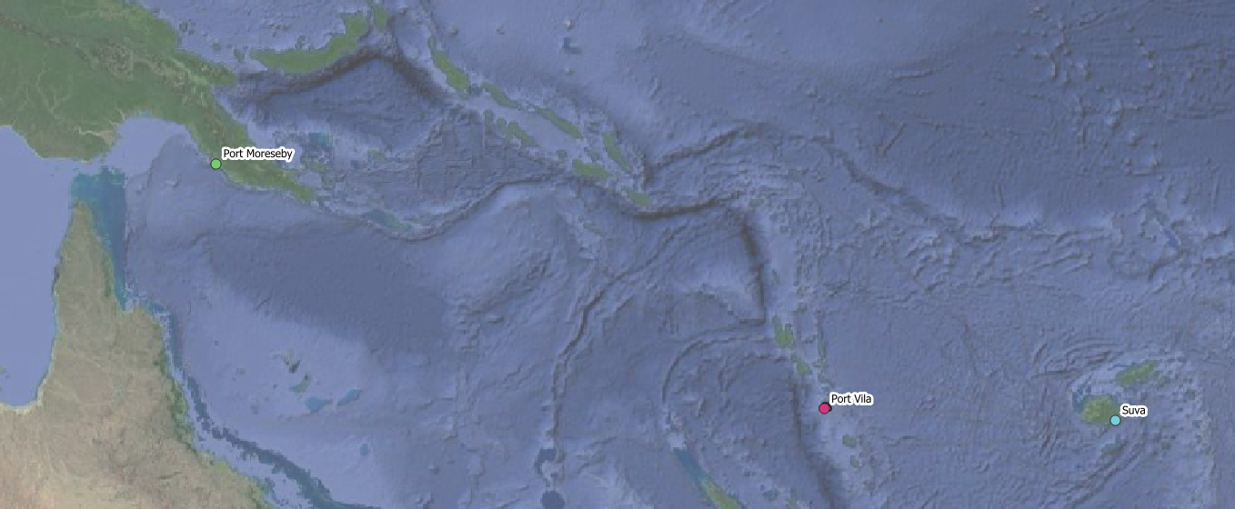
Inclusive urban WASH in Melanesian Pacific – influencing and strengthening planning systems for climate-resilient WASH in underserved settlements
PLANNING FOR CLIMATE RESILIENT AND INCLUSIVE URBAN WASH IN MELANESIAN PACIFIC
GEOSPATIAL & GIS DATASETS AND INTEGRATION – Sovaia Seru NOV 2023
Research partners
Funded by

Slide 2
“The problem”
……..& our research
Planning systems
Policies
Workforce / Capacity development
Financing
……
…..
…..
Urban informal/unplanned settlements:
Limited access to water and sanitation services that are inclusive and climate resilient
Climate hazards:
Flooding, cyclones, storm surge & sea level rise, heavy rain, droughts
Data, information & tools that can be used during scoping/early design of WASH services to settlements (“Planning support tools”)
Advocacy strategies to build support for improved services
Urban Governance systems

Slide 3
Uses of spatial data in this project
To support decision-makers to make informed decisions
Locate settlements, try to estimate population (+census data)
Spatially characterise settlements (WASH, tenure, environment, demographics etc)
Fieldwork planning & execution
Visualise and locate community-based and local data (e.g. HHS, WM, PGIS)
Explore and characterise climate-related risk (i.e. impacts, hazards, exposure, vulnerability)
Explore and characterise resilience (e.g. comparing HHS results to other spatial data)
Design or promote spatial tools to support risk informed decision-making

Slide 4
Spatial principles for the research process
Open source – software and data
Ethical – protection of IP and residents' interests, anonymity, accountability
Leverage existing and complementary tools and processes
Participatory & partnerships
Increase capacity across research team and region

Slide 5
LOCATING SETTLEMENTS

Slide 6
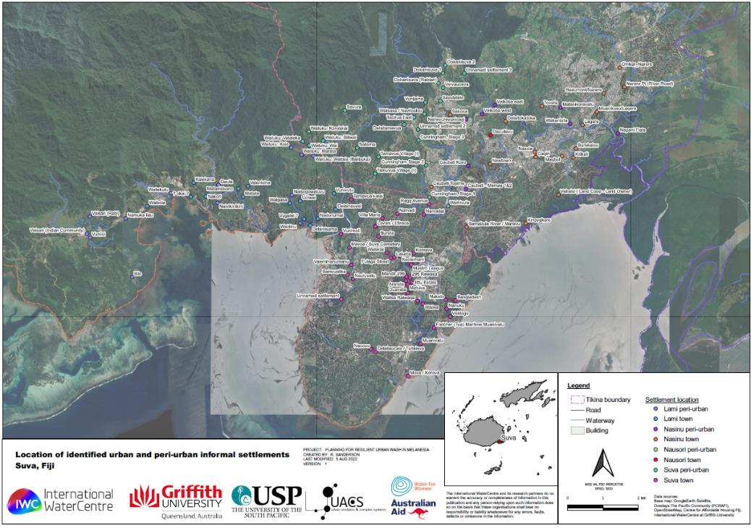
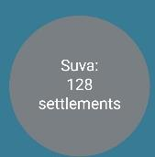

Slide 7
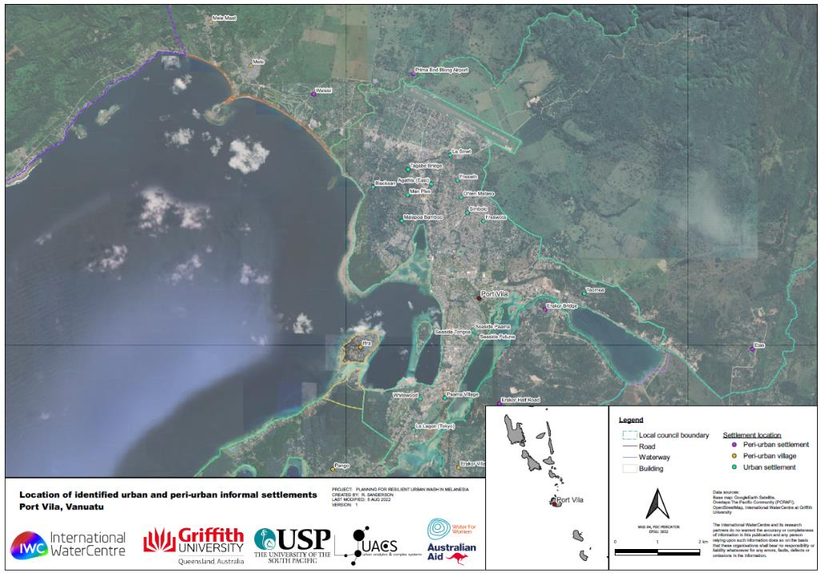
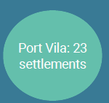

Slide 8
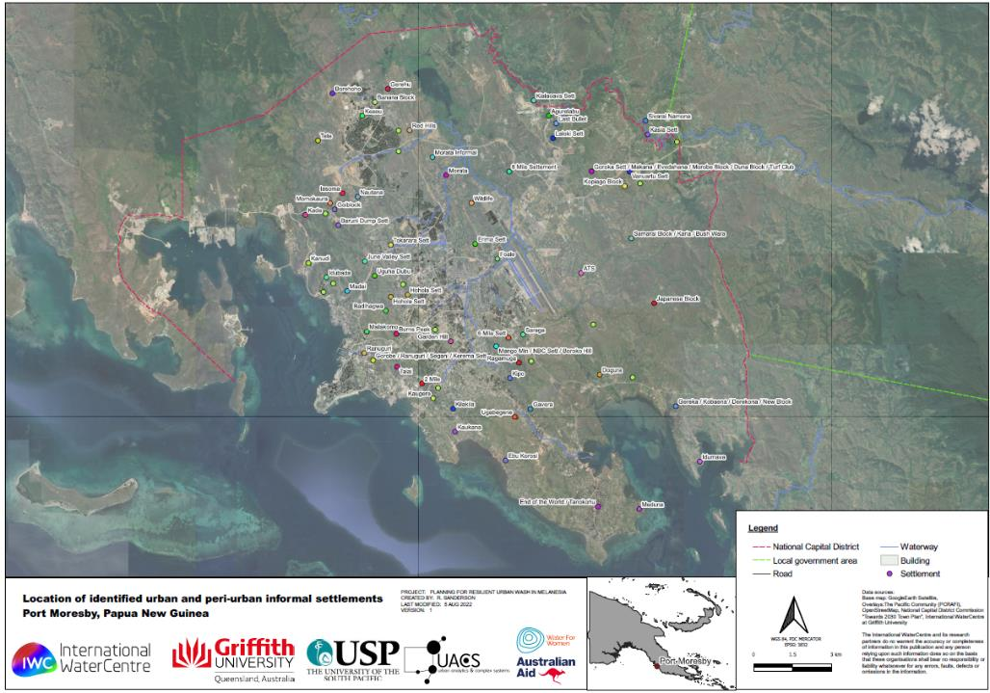
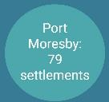

Slide 9
EXPLORING RISK INFORMATION (exposure, hazards and vulnerability)

Slide 10
Spatial data themes, layers and categories
Hazards
Climate hazard data – tidal inundation, coastal flood, river flood, inundation, flow paths, tropical cyclone, tsunami, heavy rain, drought, severe wind, landslide (rainfall trigger), landslide (earthquake trigger), earthquake, bushfire, urban heat exposure
Environmental proxies – distance to waterways, bluespot analysis, groundwater quality, soil type, vegetation cover, slope, height above SL
Climate data – temperature, precipitation, rainfall distribution, wind
Exposure
Base maps – satellite imagery
Demographics – population, distribution, composition, household size
Urban planning – administrative boundaries, road networks, building footprints
Vulnerability (and capacity!)
Base maps –topography/DEMs
Demographics – population, distribution, composition, household size
Urban planning – administrative boundaries, land tenure, road networks, household density,
WASH – water access, sanitation access, distribution networks, stormwater networks, groundwater use, water catchment zones, point source pollutants

Slide 11
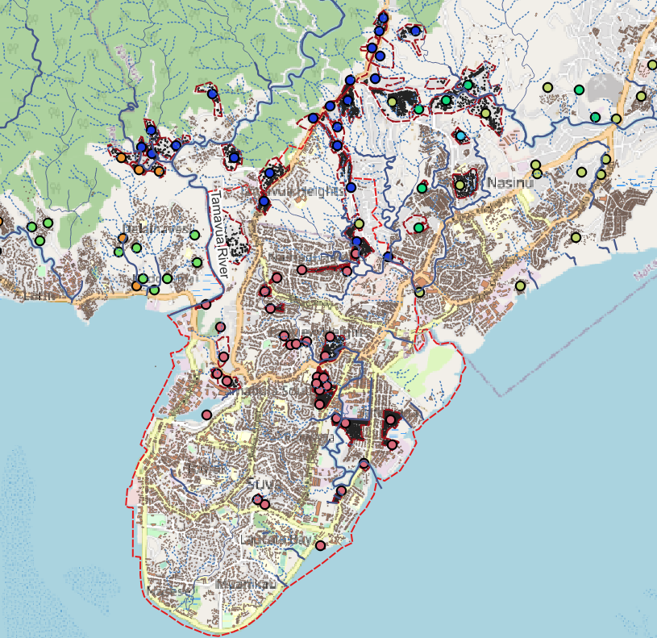
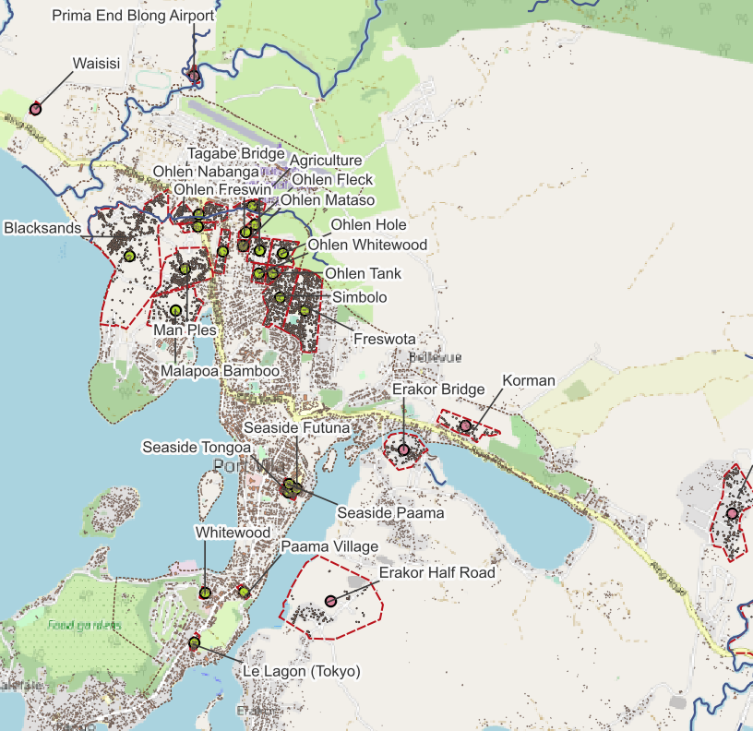
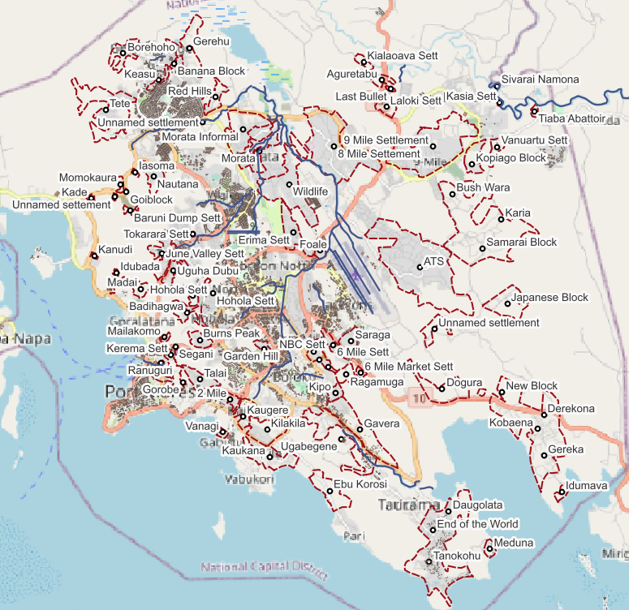
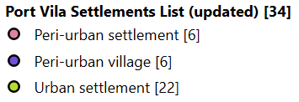
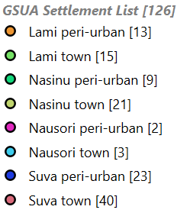
Exposure – people and settlements – remotely sensed, ground truth, and literature
Example – building footprints (regularly updated) and settlement locations
Suva
Port Vila
Port Moresby

Slide 12
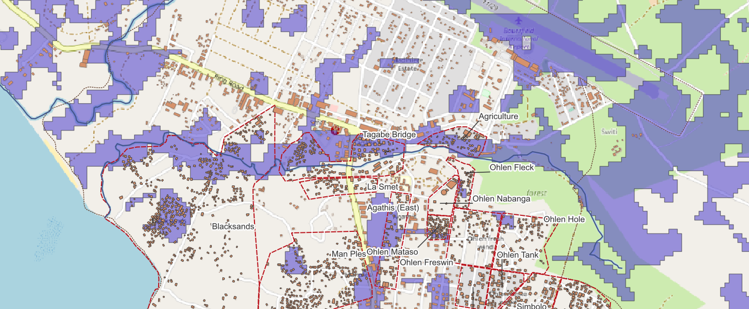
Hazards – flood and inundation - modelled flood mapping (predictive)
Modelled from surface and hydrology

Slide 13
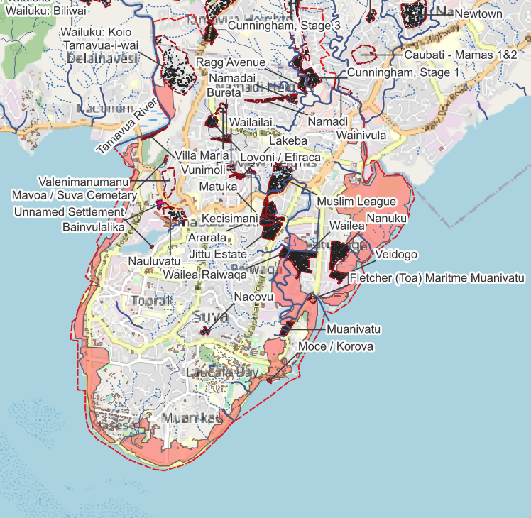
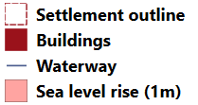
Hazards – sea level rise and coastal inundation (predictive)

Slide 14
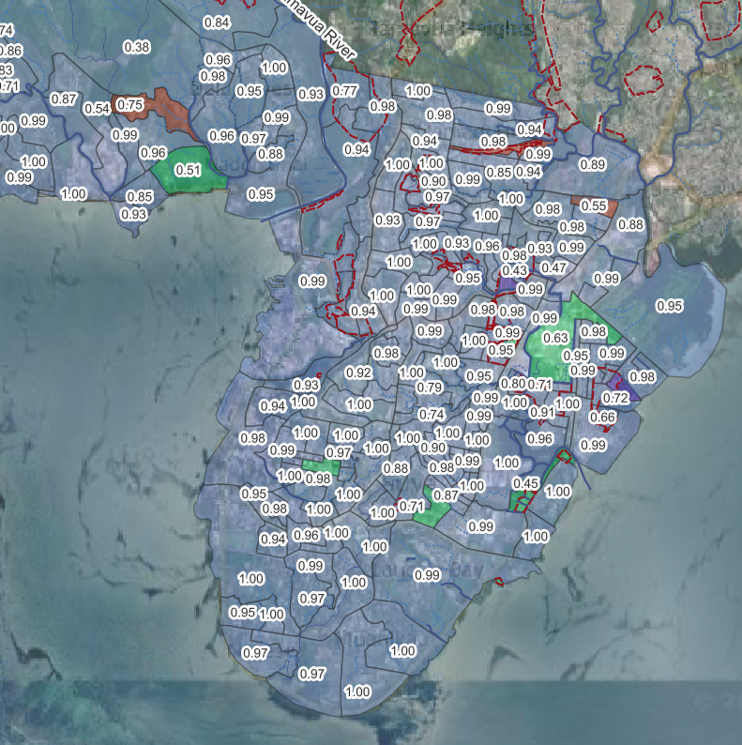
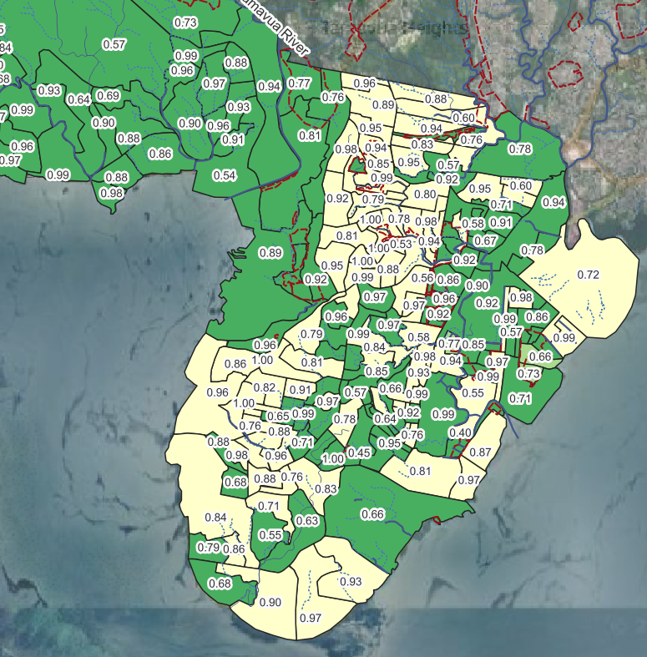
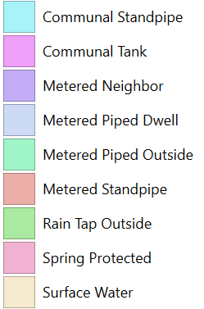
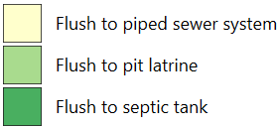
Vulnerability: adequacy of existing WASH
Example – Census data
0.56 – proportion of households with that type (most common)
0.56 – proportion of households with that type (most common)

Slide 15
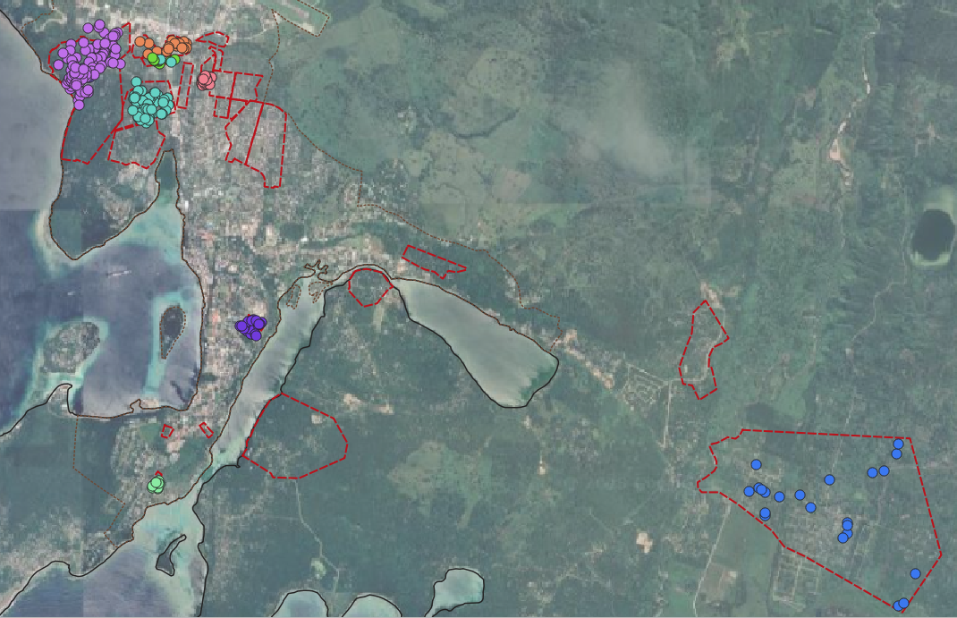
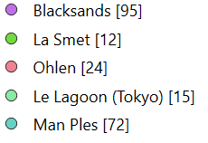
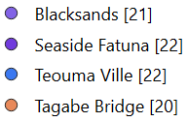
Visualise and locate community-based and local data (HHS)
Vanuatu – two rounds of household survey
Oct 2023 household survey – total 218 HH
July 2022 household survey – total 85 HH

Slide 16
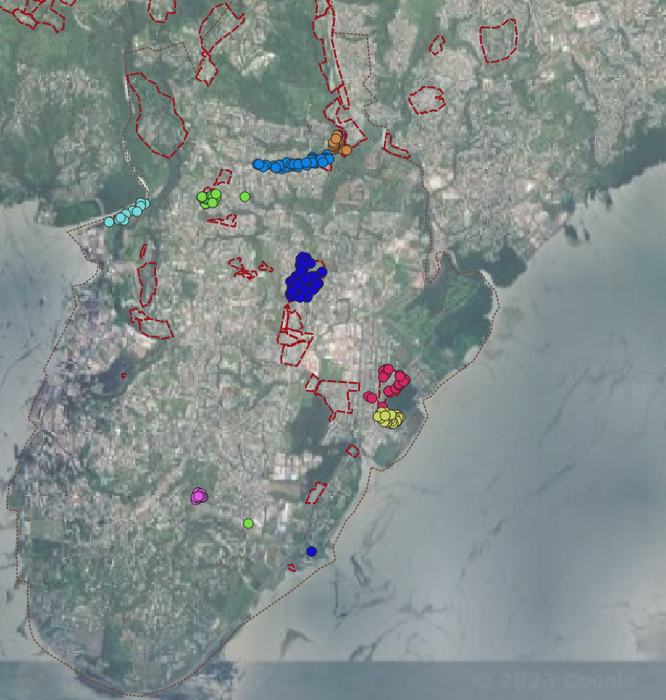
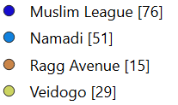
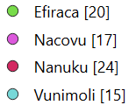
Visualise and locate community-based and local data (HHS)
Fiji – two rounds of household survey
Sep/Oct 2023 household survey – total 171 HH
July 2022 household survey – total 76 HH

Slide 17
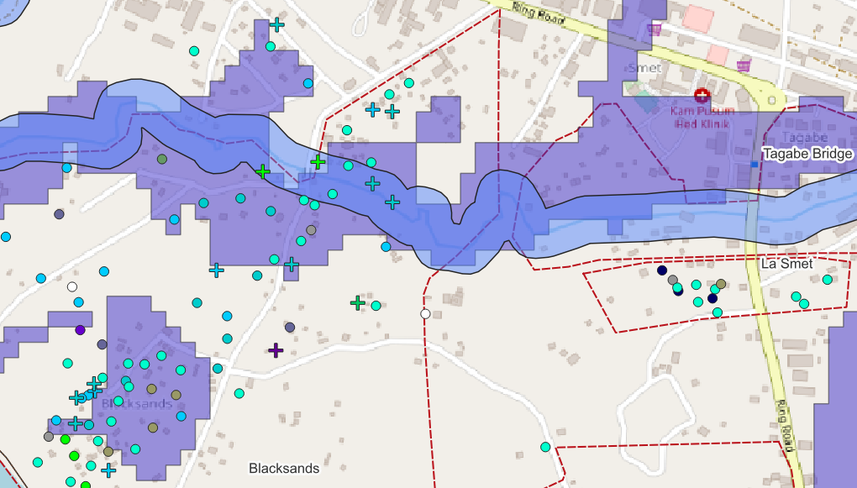
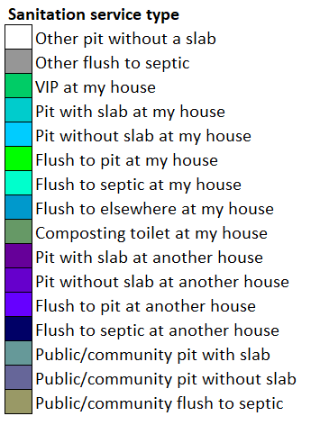
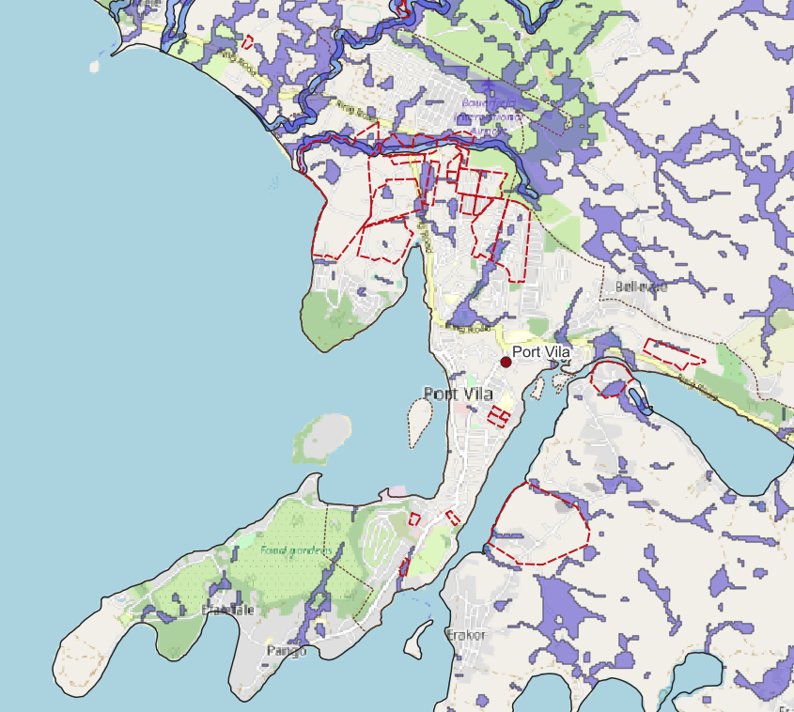
Toilet systems affected by flooding or inundation (Port Vila)
Notes:
It starts to become interesting when we overlay these different datasets and spatial layers.
For example, from our household survey, we can locate different examples of sanitation systems reported to us. Not just the toilet type, but also whether that’s a toilet at their house, a neighbours house, a public or community toilet, or otherwise.
This map is busy, but briefly – each point is a household, the colour reflects the sanitation system, while the symbol shape is reported impact from a particular hazard – in this case flood or inundation. The plus side is was affected.
Here, we’ve overlaid some of the flood and inundation hazard datasets we have, including predictive modelling and environmental proxies.

Slide 18
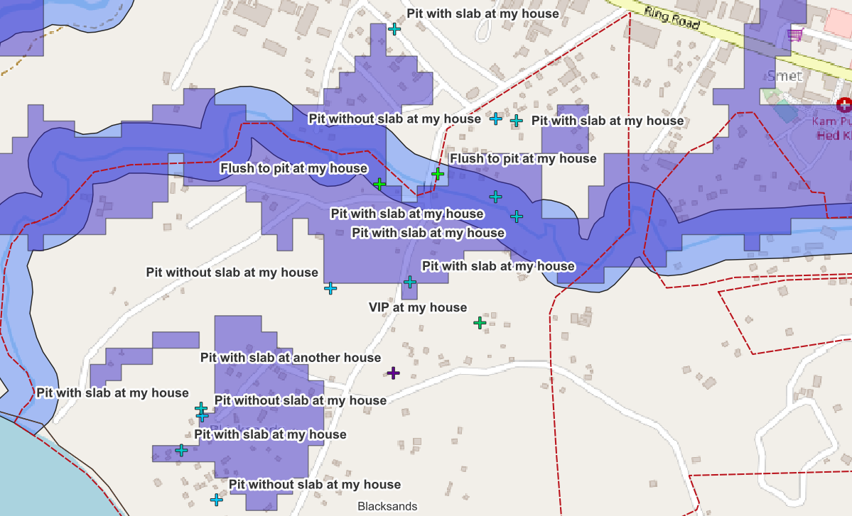
Toilet systems affected by flooding or inundation (Port Vila)
Notes:
Highlighting just those that were impacted, most of them are where we’d expect them in relation to the flood mapping.
However, also of interest is the types of sanitation service that are highlighted as impacted – all in this settlement were pit toilets of different types. All septic systems were excluded, as were all the public/community toilets of different types.

Slide 19
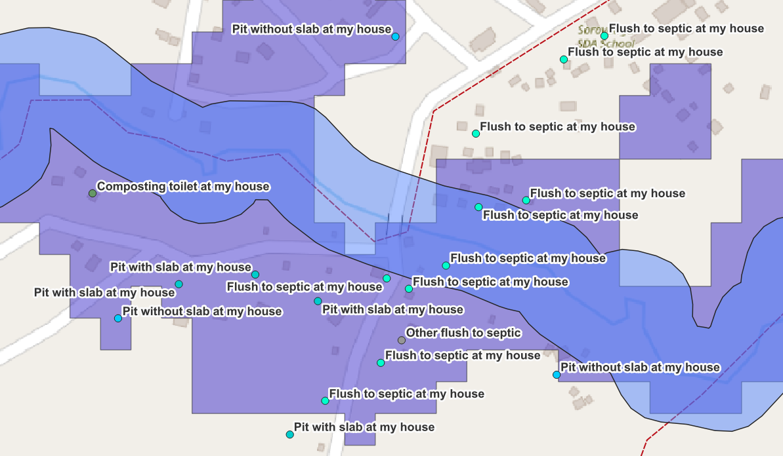
Toilet systems affected by flooding or inundation (Port Vila)
Notes:
We can also consider which systems within the areas we expect to be exposed to the hazard which did not report any impacts.
Why is this? What extra characteristics, capacities or specificities allowed those systems to withstand the hazards, and thus improve their resilience? And how can this be scaled and applied in other locations?

Slide 20
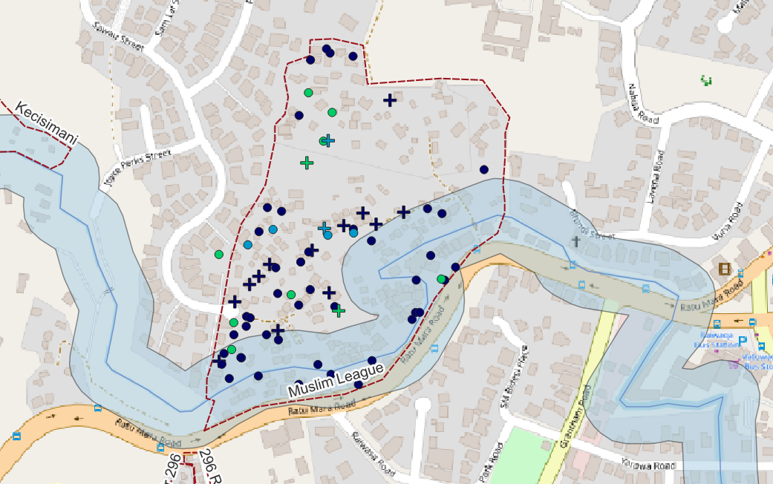
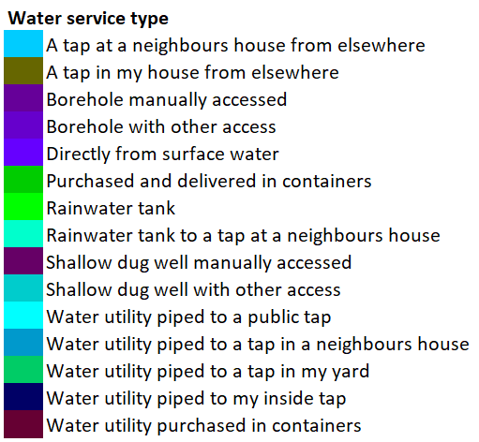
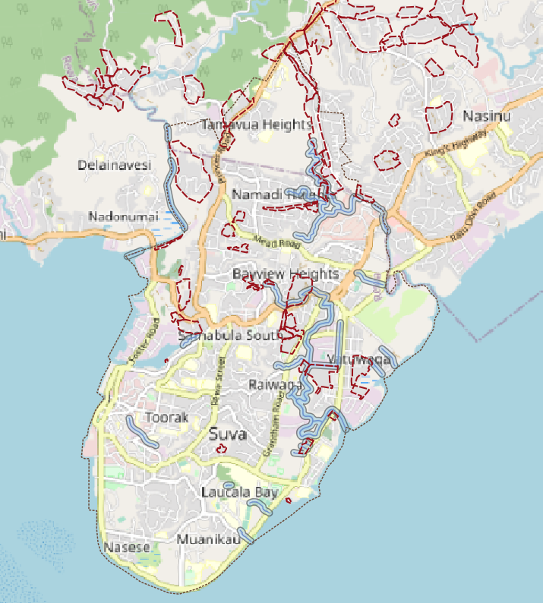
Water systems affected by cyclone or heavy rain (Suva)
Notes:
On the other hand, integrating results from household surveys about toilet types, access locations and experienced impacts from hazards sometimes doesn’t tell you the full story. This is Muslim League settlement here in Fiji, and the hazard is cyclone or heavy rain/storms. All residents had access to piped utility water, from taps either in their house, their yard, or a neighbours yard.

Slide 21
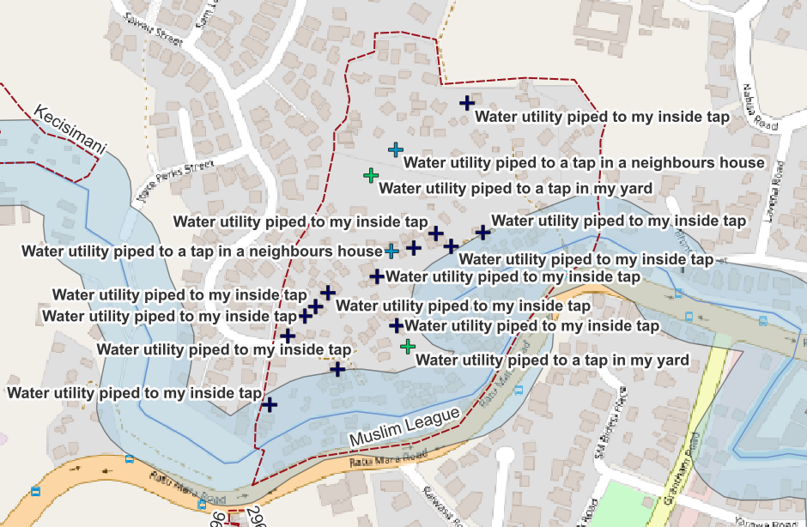
Water systems affected by cyclone or heavy rain (Suva)
Notes:
If we look just at those water service delivery models that were affected by cyclone or heavy rain, there is still a mix amongst the piped water services. This is also true when looking only at those systems not affected. So even though everyone is accessing piped utility water in one way or another, different households in the same settlement have different experiences with impacts and risks. There must be additional layers of capacity, vulnerability or exposure that can help explain some of these realised impacts.

Slide 22
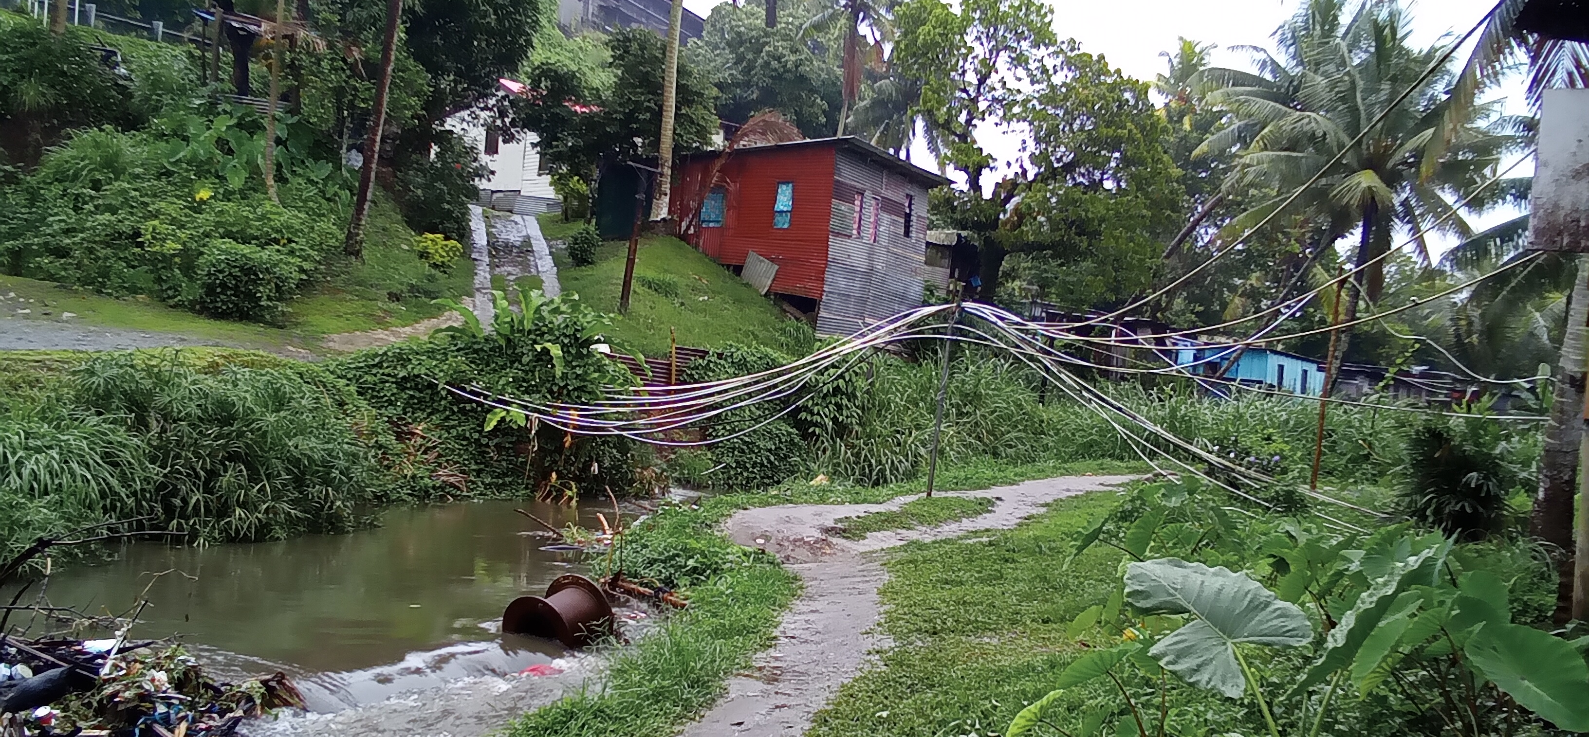
Notes:
This is a picture from Muslim League. These might be one of the situations that explains the previous slide – confirming that accessed to piped water does not necessarily mean climate resilient water access.

Slide 23
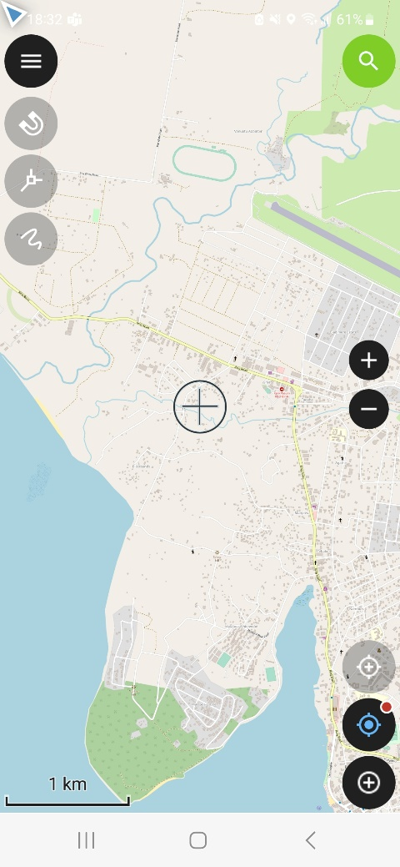
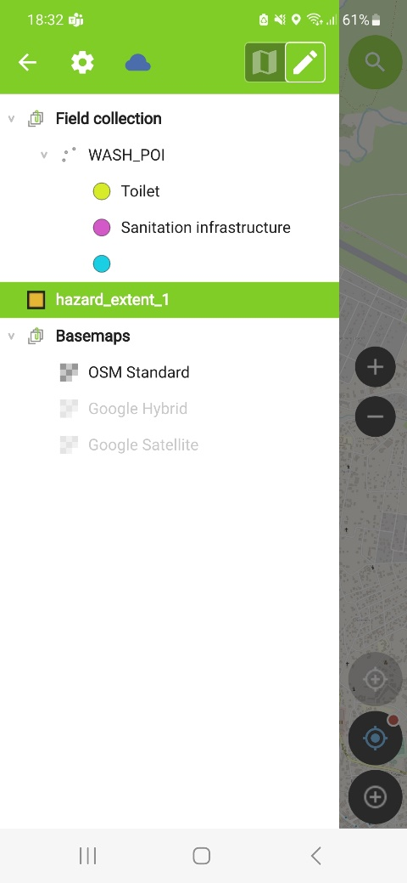
Creation & adding to spatial datasets – participatory GIS in settlements
Objectives for Participatory GIS activities:
Contribute hazard data from alternative and localised sources.
Collect WASH vulnerability data for localised sources.
Engage with communities on data collection activities.
Ground truth and fill gaps for remotely sensed and earth observation data.
Demonstrate a methodology for participatory planning engagement tools.
Activity 1
Hazard based P-GIS (maps of weather event extent - 2 settlements)
Digital platform (Qfield) to collect data and align with QGIS
Activity 2
WASH vulnerability data (WASH service responses to events, damaged or threatened infrastructure and services, distance to households - 3 settlements)

Slide 24
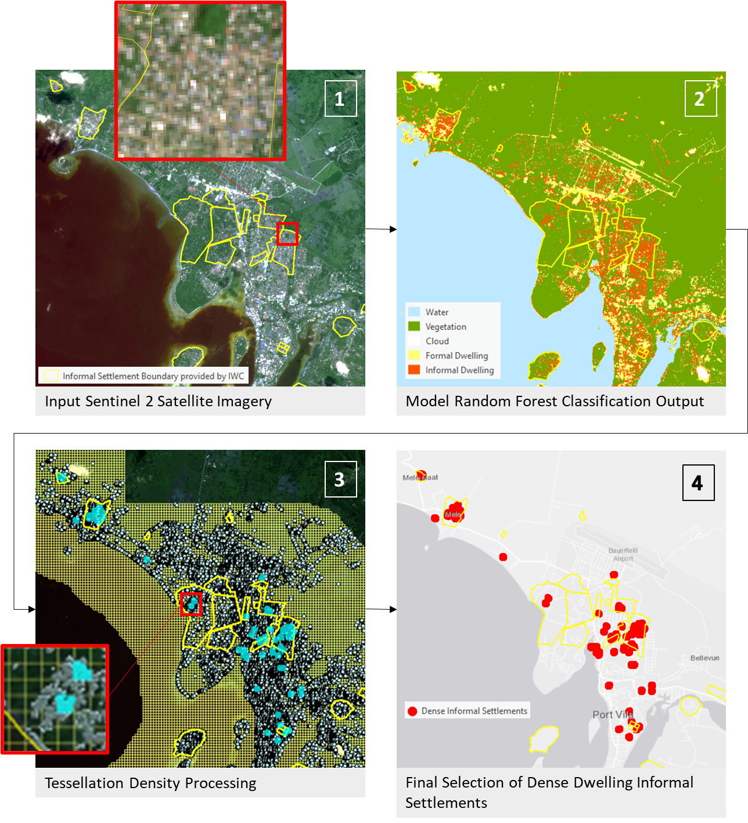
Creation & adding to spatial datasets – autonomous detection of settlements
As part of the project, we have developed a tool that can autonomously classify settlements from satellite imagery.
“…a pilot study based on machine learning techniques applied to remote sensing to autonomously detect urban landscape features from multi-spectral satellite imagery to assist in locating and mapping informal settlements. This pilot was intentionally designed as an accessible and low-cost process. It is conducted remotely without the need for in loco investigation using open-source data and programs. Techniques are simple to use and deploy, and have resulted in a new approach to map dense urban settlements in Melanesia.”

Slide 25
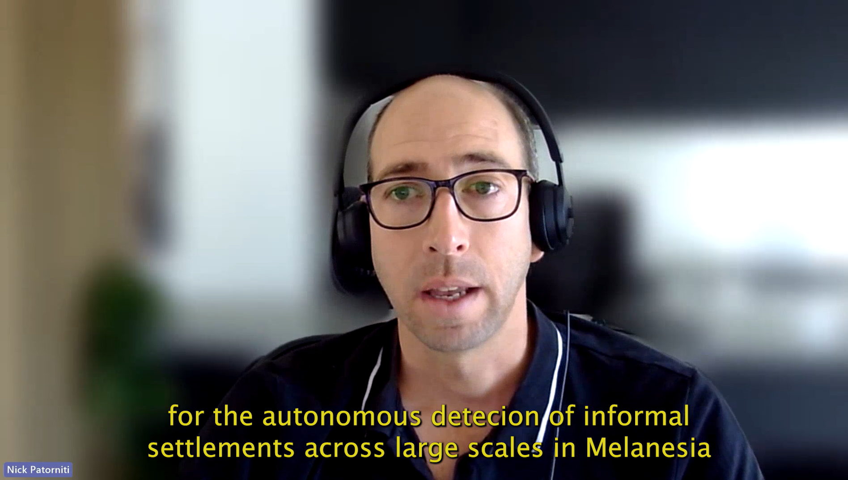
We want you to participate!
Does any of this interest you or are you working on topics related to this research?
We’d like to form an online Community of Practice, including people across the region.
We would offer free-of-cost online training opportunities, moderated discussion boards, and access to knowledge resources related to this area.
We are especially looking for:
- GIS technicians in government departments like urban planning, water and sanitation planning, MOHs, housing, water resources
- GIS technicians and other interested people in water utilities
- researchers and practitioners in spatial analytics
- remote sensing practitioners in regional bodies and global organisations
- anyone with interest!
Please email us your interest (contact details next slide) or come and speak to us at a break.

Slide 26
Vinaka vakalevu!
Questions?
Sovaia Seru – University of the South Pacific - ssofa1523@gmail.com / sovaia.seru@usp.ac.fj
Camari Koto – Fiji Research lead, USP - camari.koto@usp.ac.fj
Brisbane: IWC: Dr Regina Souter, Rosie Sanderson, Dr Benny Rousso, Dr Mark Love, Tayla Miller, Dr Ed Morgan, Kerryn Devenny UACS: Dr Nick Patorniti
Fiji: USP: Camari Koto, Sovaia Seru, Villiame Salusalu
Vanuatu: Dr Krishna Kotra, Daisy Unguna
PNG: UPNG: Dr Linus Digim’Rina, Elias Namosha WaterAid PNG: Navara Kiene, Donald Kanini [WaterPNG: Pipi Dai Boe]

