Slide 1
Fiji Lands Journey on Geospatial Development
Meizyanne Hicks
Ministry of Lands and Mineral Resources , Fiji

Slide 2
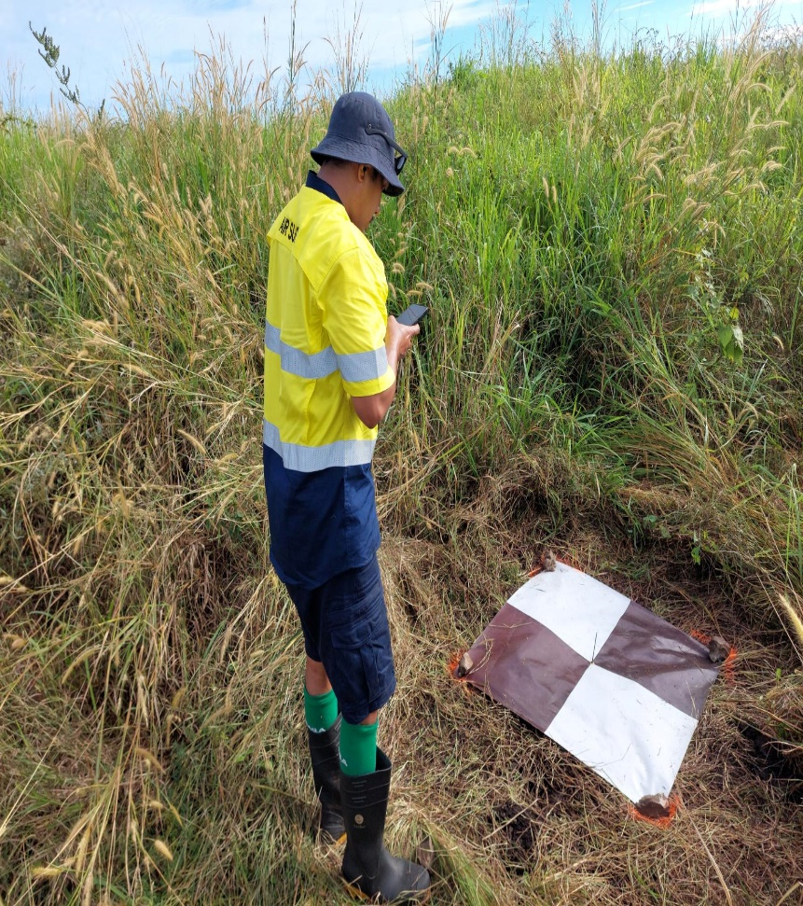
Fiji Lands Journey on Geospatial Development
Outline
Geospatial Information Management in Lands
Challenges
Aspirations

Slide 3
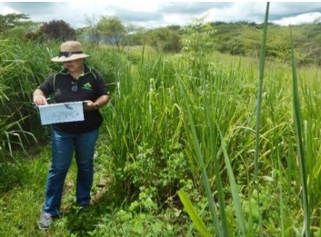
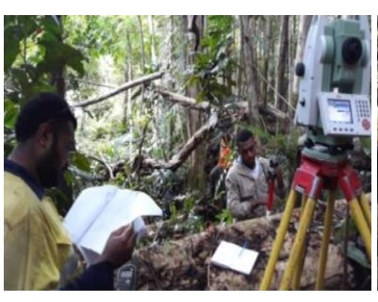
Fiji Lands Journey on Geospatial Development
Lands Department Responsibilities:
Administer State Land
Provide Valuation services on behalf of Government
Maintain National Geodetic network
Approval of all land survey plans
National Mapping
National geospatial data hub

Slide 4
Fiji Lands Journey on Geospatial Development
National Geospatial Data Hub
FGISS to become the central hub for storage
VanuaGIS platform using ArcGIS
Consolidate geospatial data at the department and sector level
Better have better responses and solutions
Desktop Based GIS
Centralised Databases (Clients & Servers)
Web-GIS Applications

Slide 5
Fiji Lands Journey on Geospatial Development
National Geospatial Data Hub

Slide 6
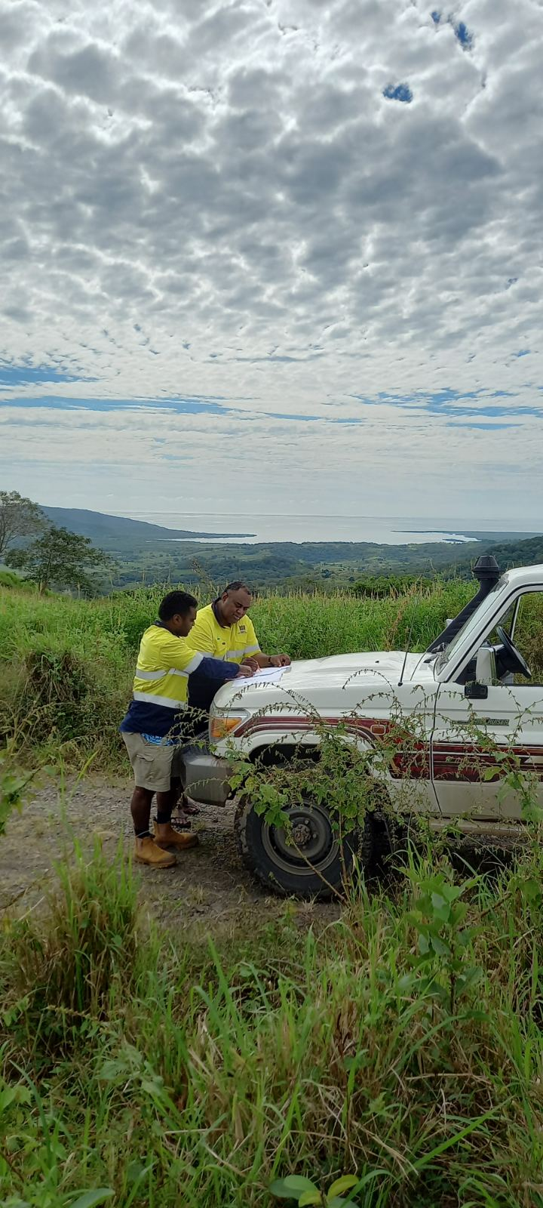
Challenges
National coordination of geospatial information across the country to actively collaborate to coordinate the collection, management and use of geospatial information
Reliable and accurate geospatial data
Keeping up with new technologies

Slide 7
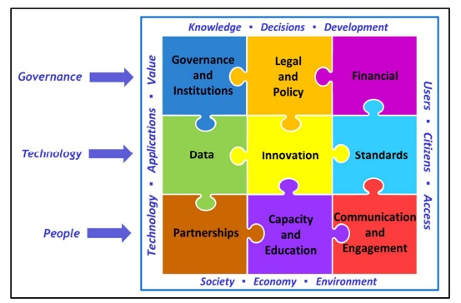
Aspirations - UNIGIF
Facilitate practice for accessing and exchanging spatial information and making it available
Be an enabler for the creation and management of spatial information
Promote the sharing of spatial information
Set policies/guides for spatial information for quality, consistency and inter-operability between datasets
Clarify roles and responsibilities, and reduce overlap duplication

Slide 8
Vinaka Vakalevu

