Slide 1
Remote sensing for monitoring invasive weeds and impacts of introduced natural enemies in Pacific Islands
Paul Peterson, Ben Jolly & Andrew McMillan.

Slide 2
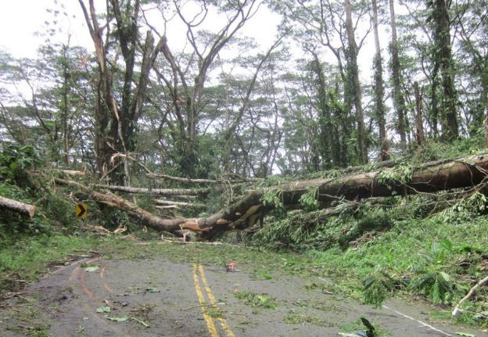
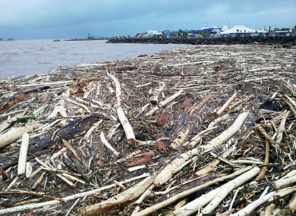
Climate change and invasive weeds in the Pacific
Increased CO² and temperature favour invasive weeds
Invasive weeds threaten natural ecosystem resilience and biodiversity
Invasive weeds also threaten community resilience following disturbances like cyclones by:
- exacerbating flooding and damaging infrastructure
- leading to soil loss and reducing water quality
- reducing food security
- causing human and animal health issues

Slide 3
Natural enemies for invasive weed control
Natural enemies have been used to help control invasive weeds in the Pacific since the 1910s. New Zealand is a world leader.
Establishment rates are high, and the safety record remains excellent.
New funding from the Ministry of Foreign Affairs and Trade in NZ since 2013 has allowed for renewed efforts to introduce natural enemies into the Pacific islands.
Efforts are now focusing on Managing Invasive Species for Climate Change Adaptation in the Pacific (MISCCAP) as part of a wider Pacific Regional Invasive Species Management Support Service (PRISMSS).

Slide 4
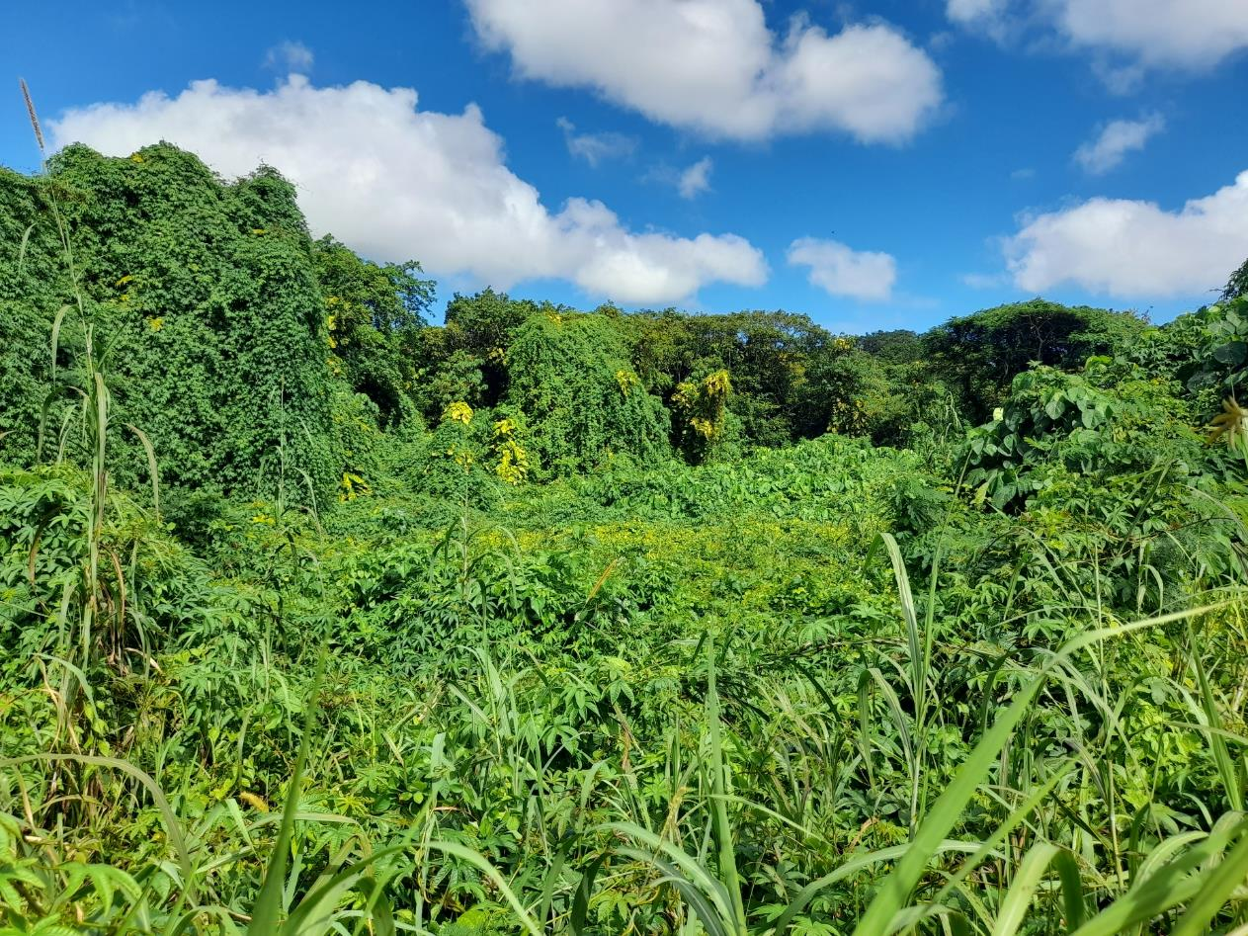
How do we know natural enemies are working?
Do they establish spread and reduce the weed population?
Historically we haven’t been very good at measuring impacts on weeds. It’s difficult from the ground.
Recent advances in remote sensing may provide better tools, i.e. increased resolution and reduced cost.

Slide 5
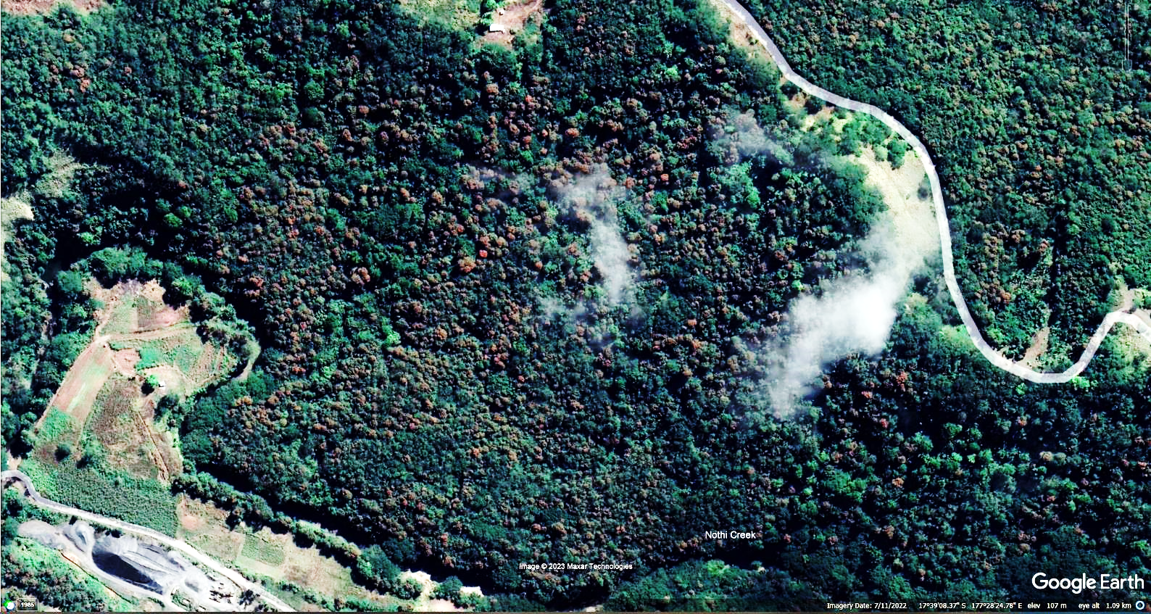
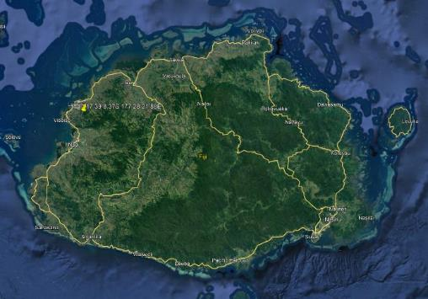
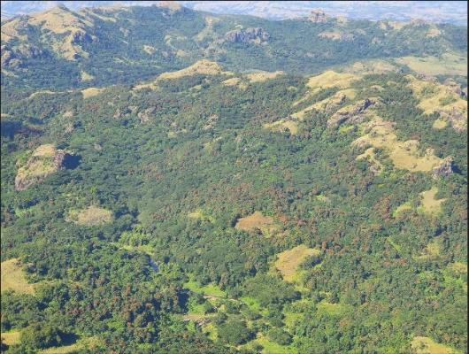
An aerial perspective can be useful.

Slide 6
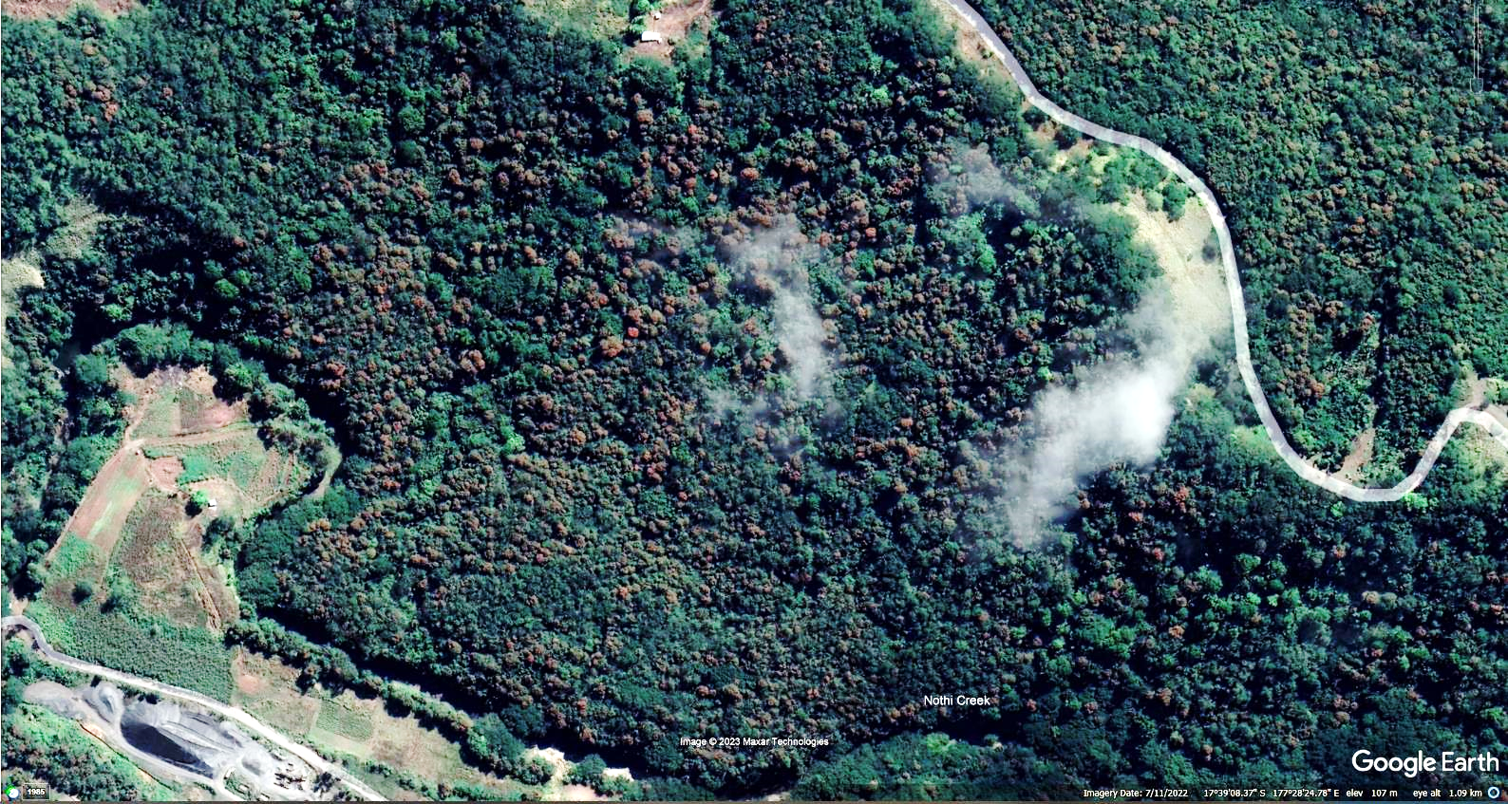
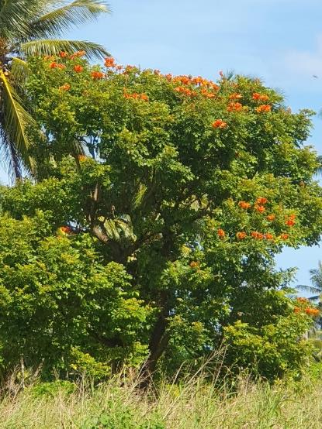
But to validate we need to scale down to individual features.
For example - red flowering trees

Slide 7
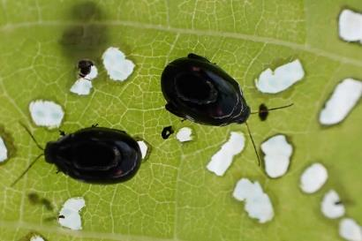
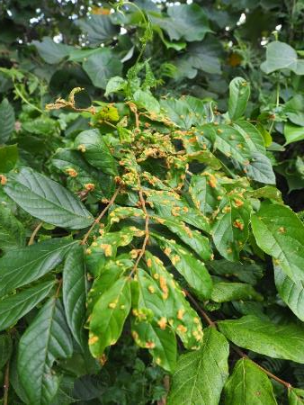
Natural enemy impacts can require validation at a minute scale.
Impact of mites and beetles on African tulip tree

Slide 8
Current project (2022-2024) to address dual goals
Develop methods to monitor invasive weeds and evaluate impacts of natural enemies.
Develop capability in the Pacific Islands so that weed control projects can be monitored and assessed locally.

Slide 9
Project team
Ben Jolly, Andrew McMillan, Paul Peterson – Experience with assessing natural enemy impacts on invasive weeds and drone pilots with experience in drone mission planning, hyperspectral sensing and LiDAR (MWLR).
Waisale Rakusanavanua – Drone pilot (School of Agriculture, Geography, Environment, Oceans & Natural Sciences, Laucala, Fiji).
Salmendra Ratnesh Chand – Drone pilot (Droneworks, Fiji).
Lawrie Cairns – Aerial photographer (Survey Services & Land Information, NZ).
Ewan Smith – Aeroplane pilot (Air Rarotonga Limited).
James Shepherd, Brent Martin (MWLR) – image analysis including AI experience.

Slide 10
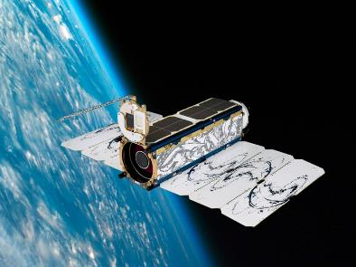
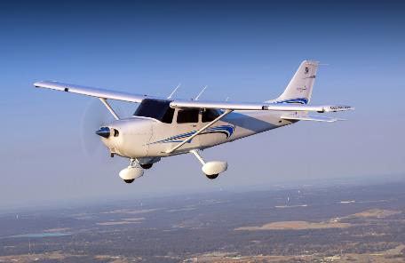
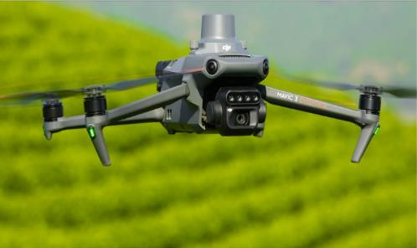
Trial remote sensing tools at different scales
50 cm 10 cm ≤4 cm

Slide 11
Satellite (SkySat imagery from Planet.com)
Pros
Regular
Covers large areas
Cons
Cloud cover
Relatively low resolution

Slide 12
Aeroplane (Pilot is Ewan Smith, photographer is Lawrie Cairns)
Pros
Covers moderately large areas
Cloud not always an issue
Better resolution than Satellite
Cons
Timing can be tricky (need good weather conditions)
Organizing plane and flights

Slide 13
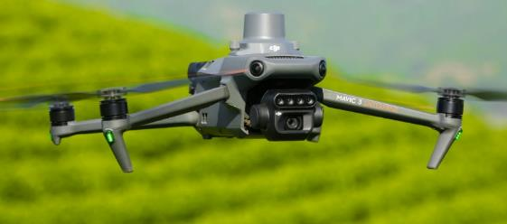
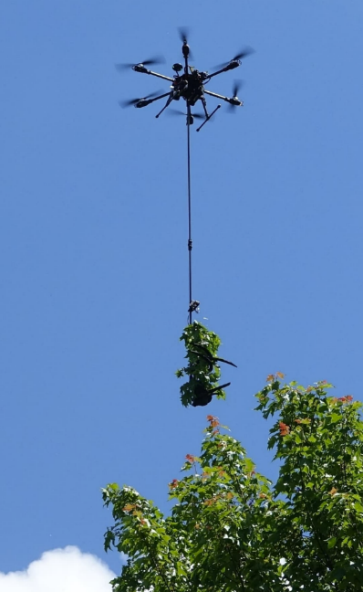
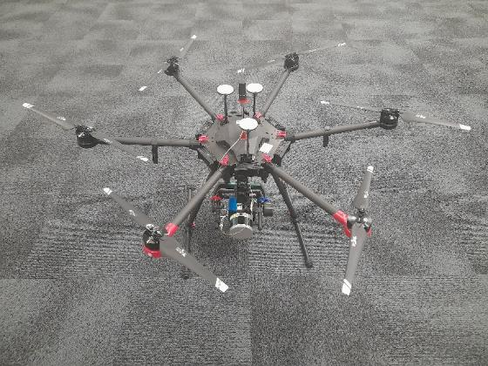
Drones (Waisale, Salmen, Ben, Andrew, Paul)
Pros
High resolution
Fly below cloud
Multi-purpose
Cons
Hard to cover large areas
Need permissions
Technically challenging
RGB + Multispec
Canopy sampler
Hyperspectral and LiDAR

Slide 14
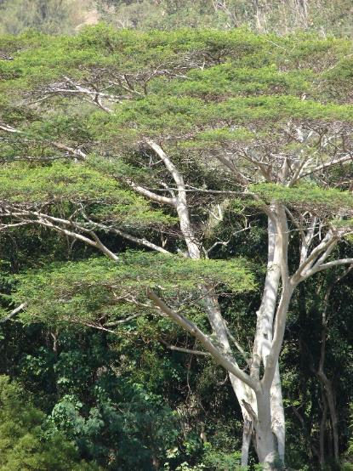
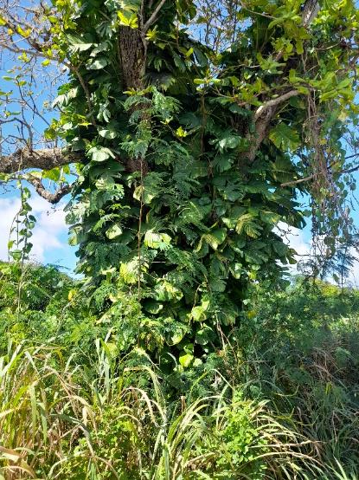
Test cases –Rarotonga and Niue focus
Spathodea campanulata
(African Tulip Tree)
Falcataria moluccana
(Tamaligi/Albizia)
Epipremnum pinnatum cv aureum (Taro vine)
(Taro vine)

Slide 15
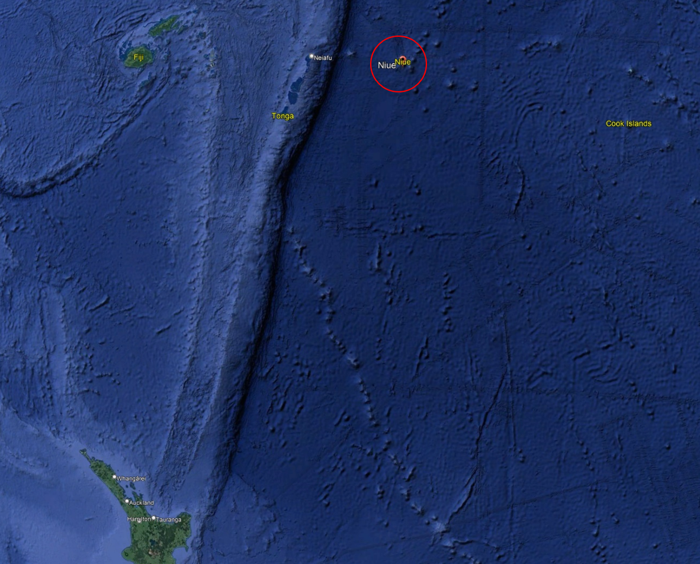
Niue 1st test case

Slide 16
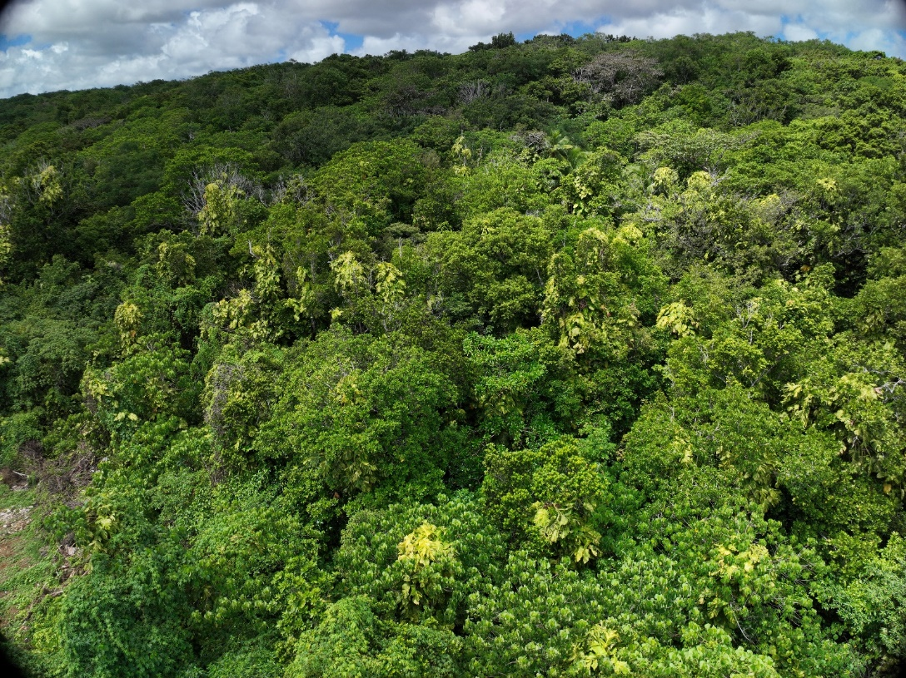
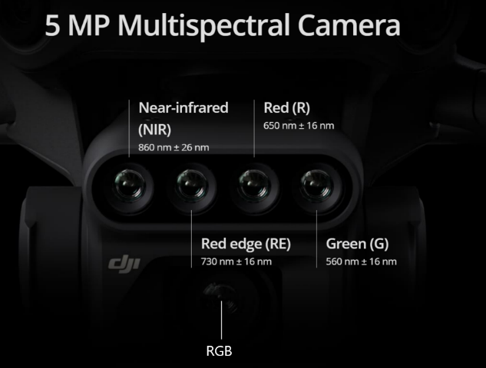
Taro vine imagery taken with Mavic 3M drone only
No prior knowledge
RGB

Slide 17
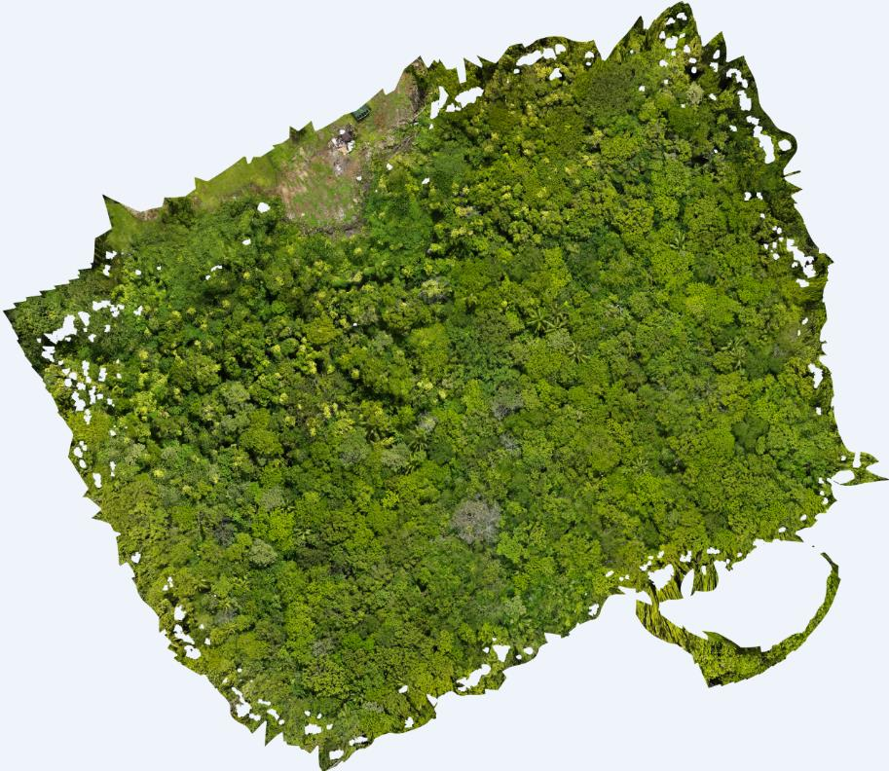
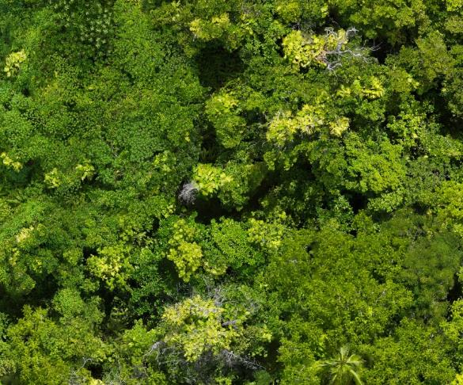
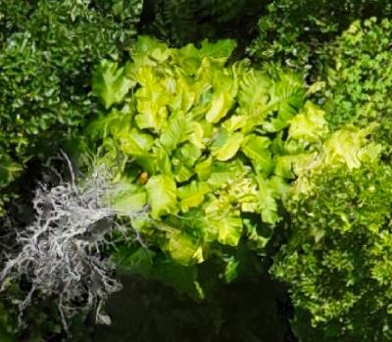
Taro vine – appears distinctive in visible range…

Slide 18
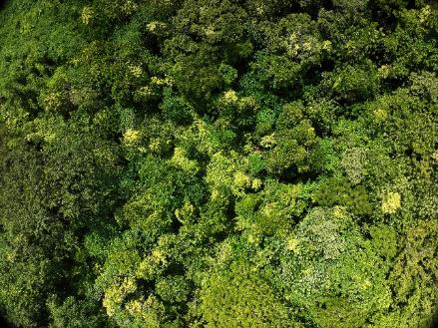
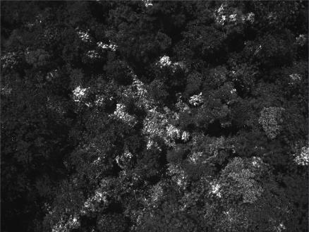
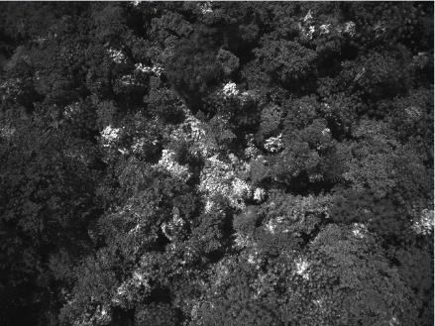
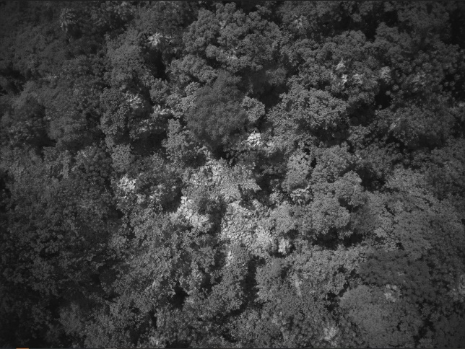
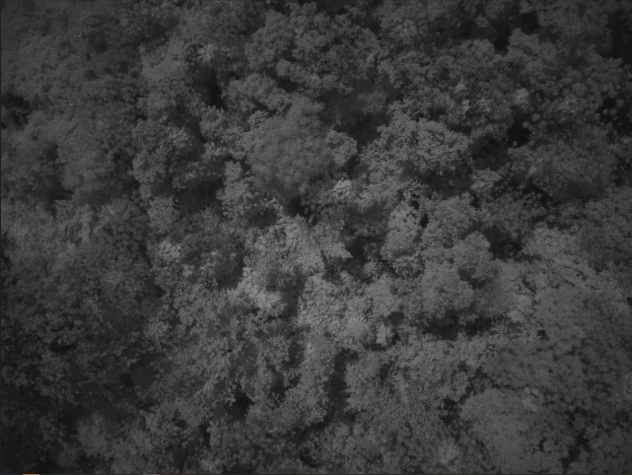
… and reflects strongly in both red and green wavelengths.
RGB Red (650 nm) Green (560 nm)
RE (730 nm) NIR (860 nm)
Less distinctive in RE and NIR wavebands but the slope of the red edge response may be useful?

Slide 19
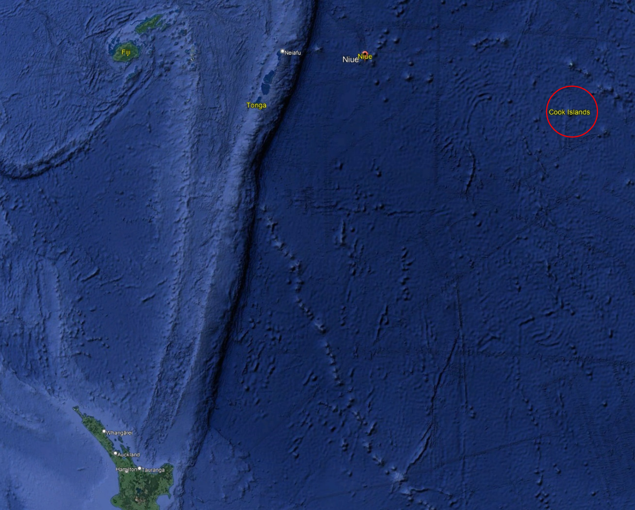
Rarotonga 2nd test case

Slide 20
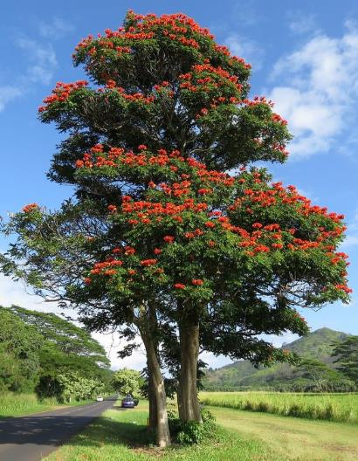
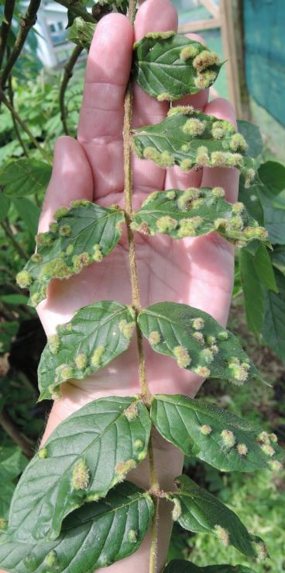
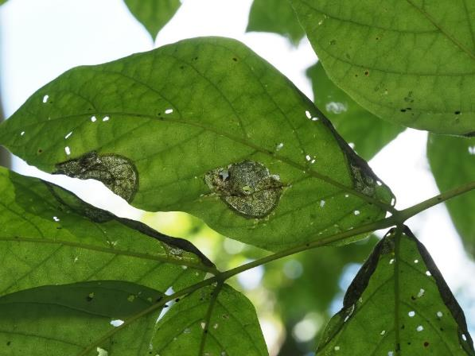
Natural enemies introduced onto African Tulip Tree in Rarotonga
Flea beetle 2021
Gall mite 2017

Slide 21
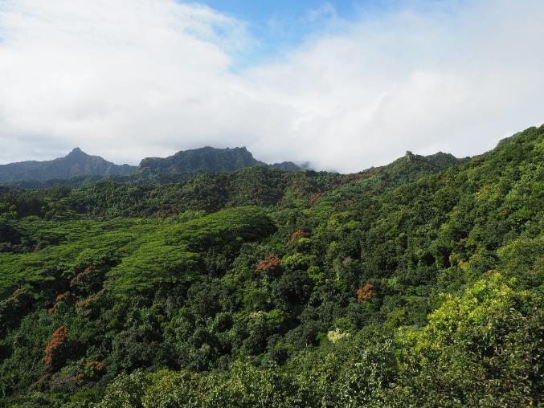
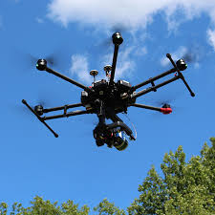
Multi-scale approach

Slide 22
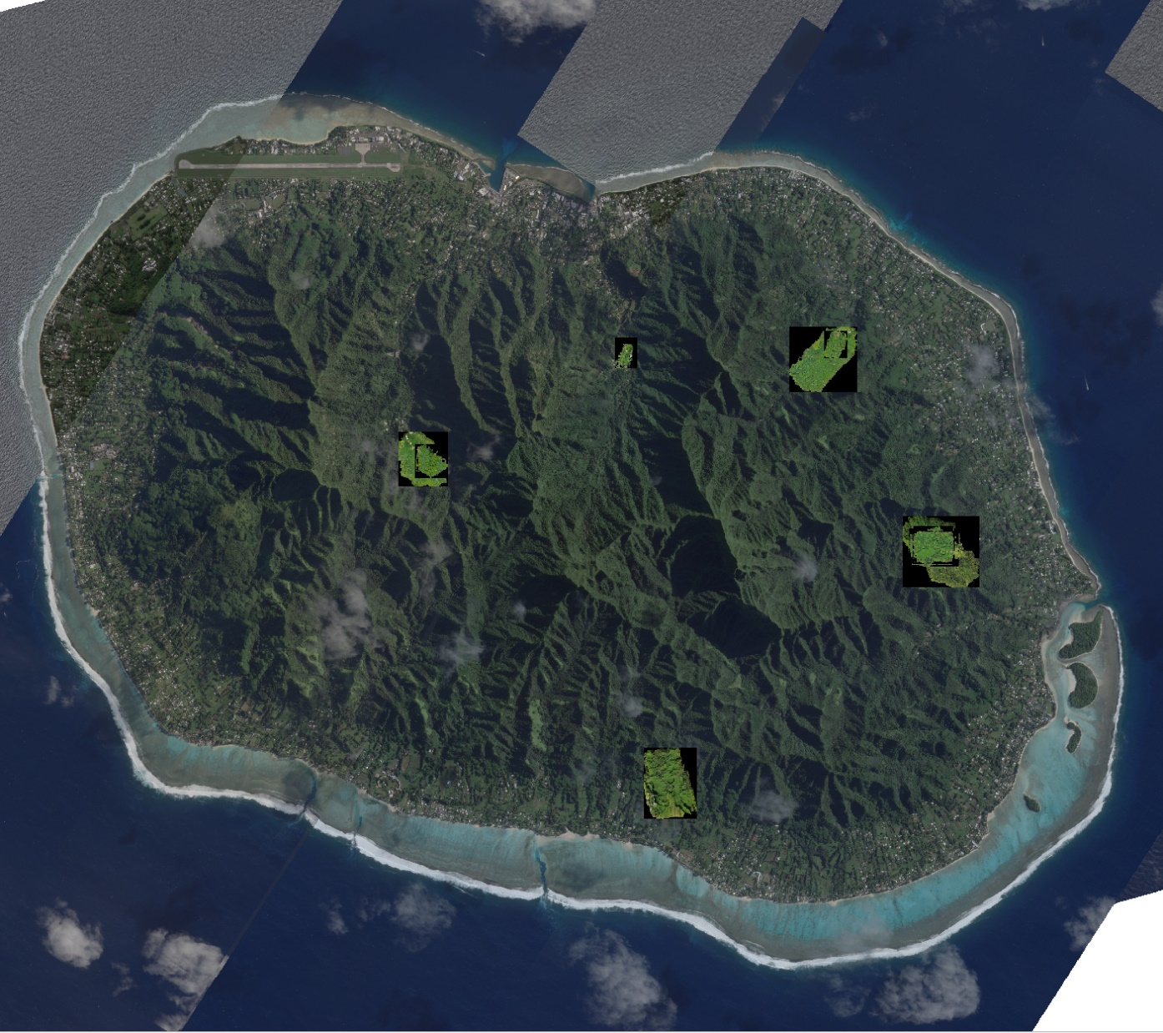
Satellite imagery with locations of drone surveys

Slide 23
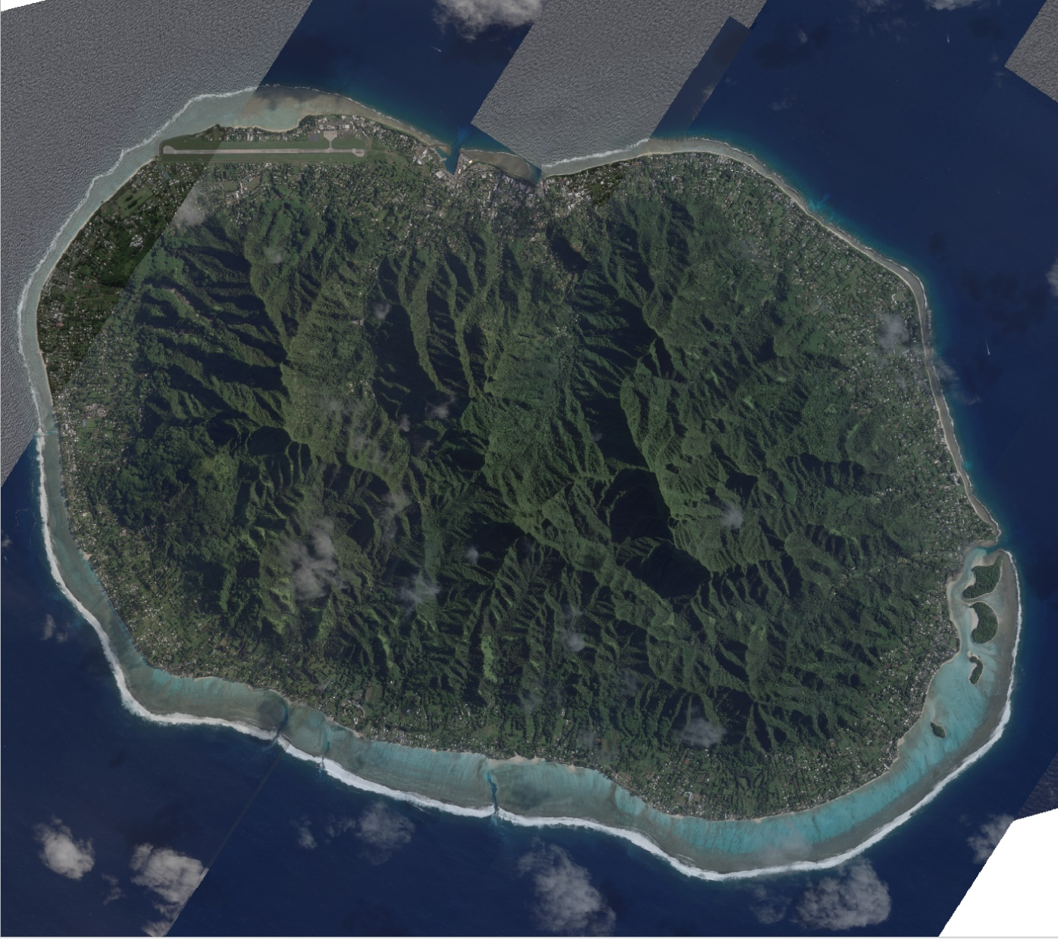
Zooming in on one drone survey location

Slide 24
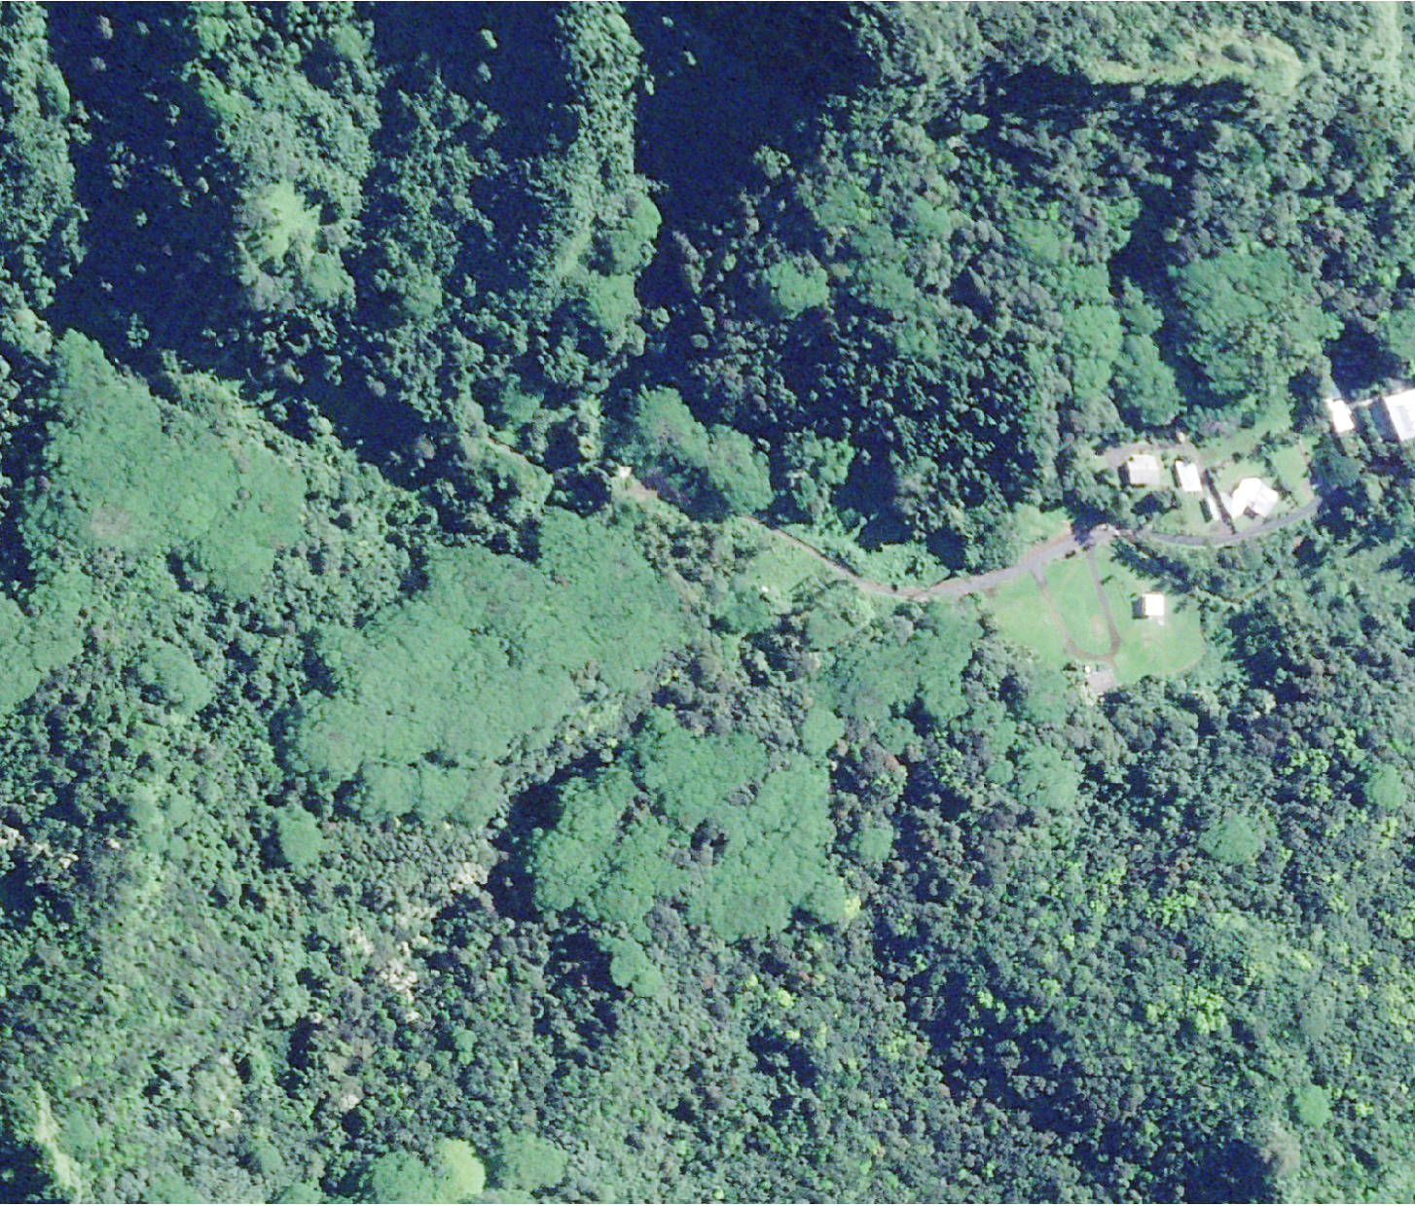
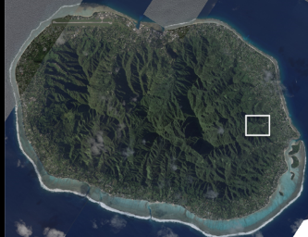
Satellite imagery 24/7/23

Slide 25
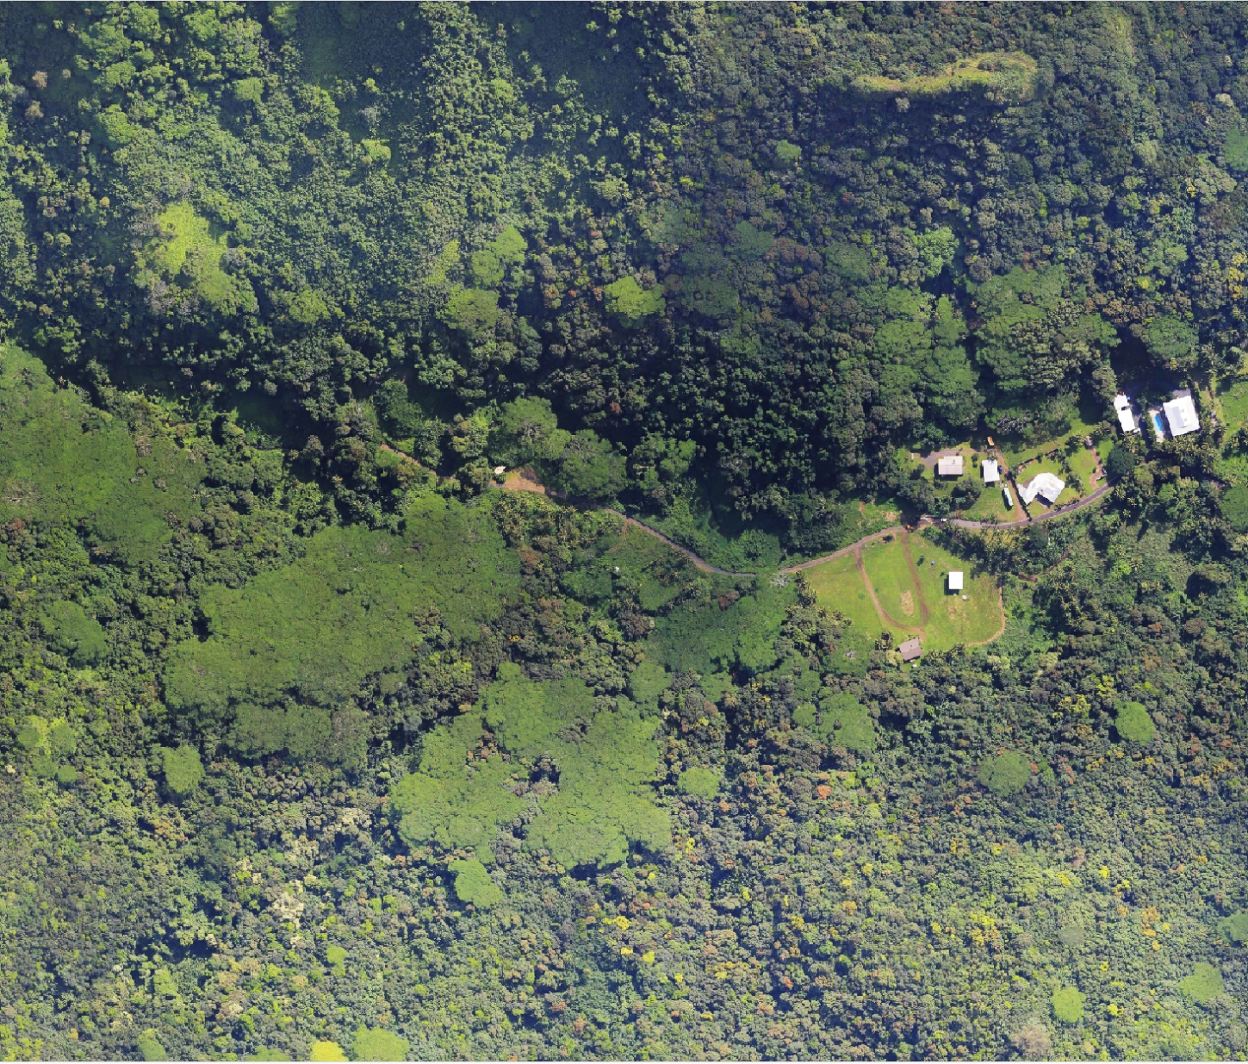
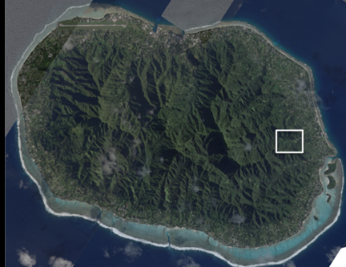
Aeroplane imagery 21/7/23

Slide 26
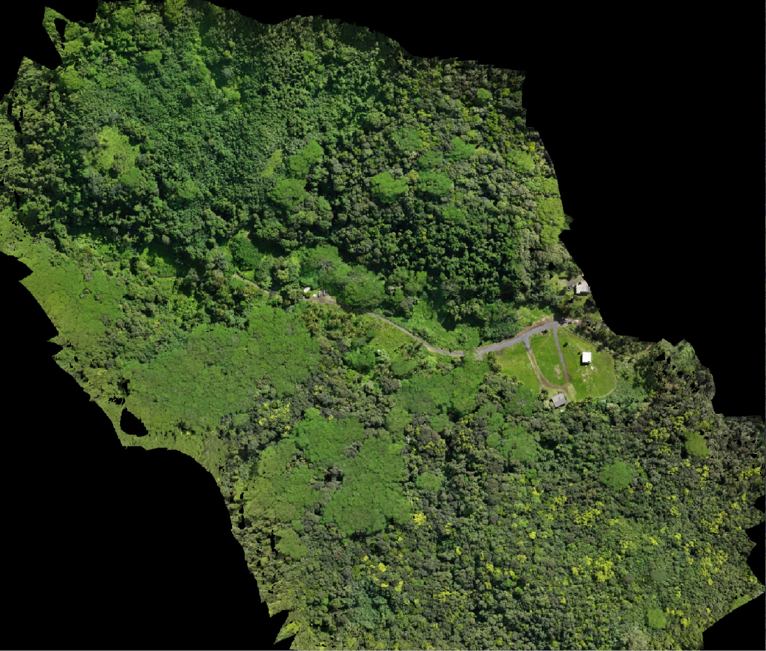
Drone imagery 11/8/23

Slide 27
Zooming in on one drone survey spot

Slide 28
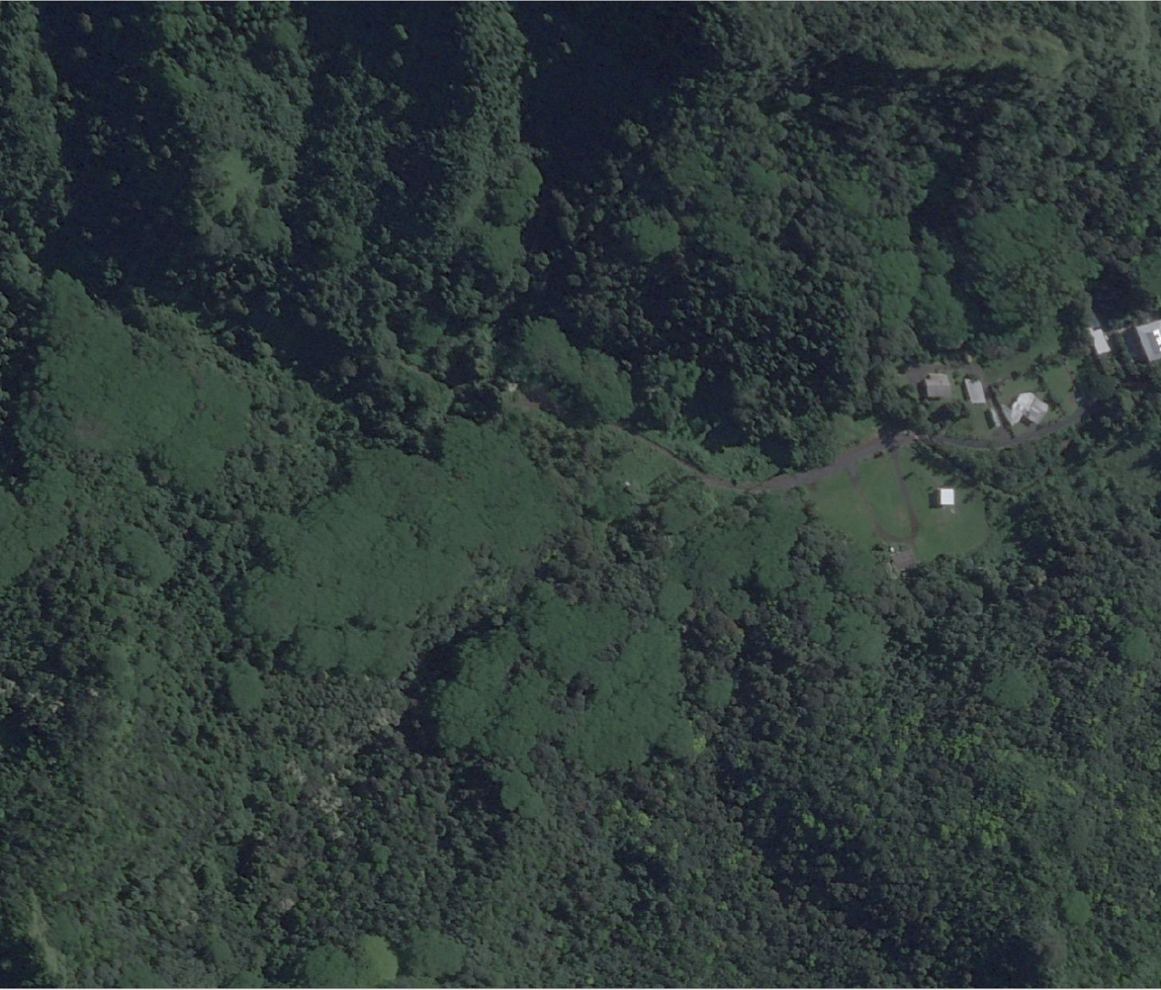
Satellite imagery (~50cm)
Satellite imagery (~50cm)

Slide 29
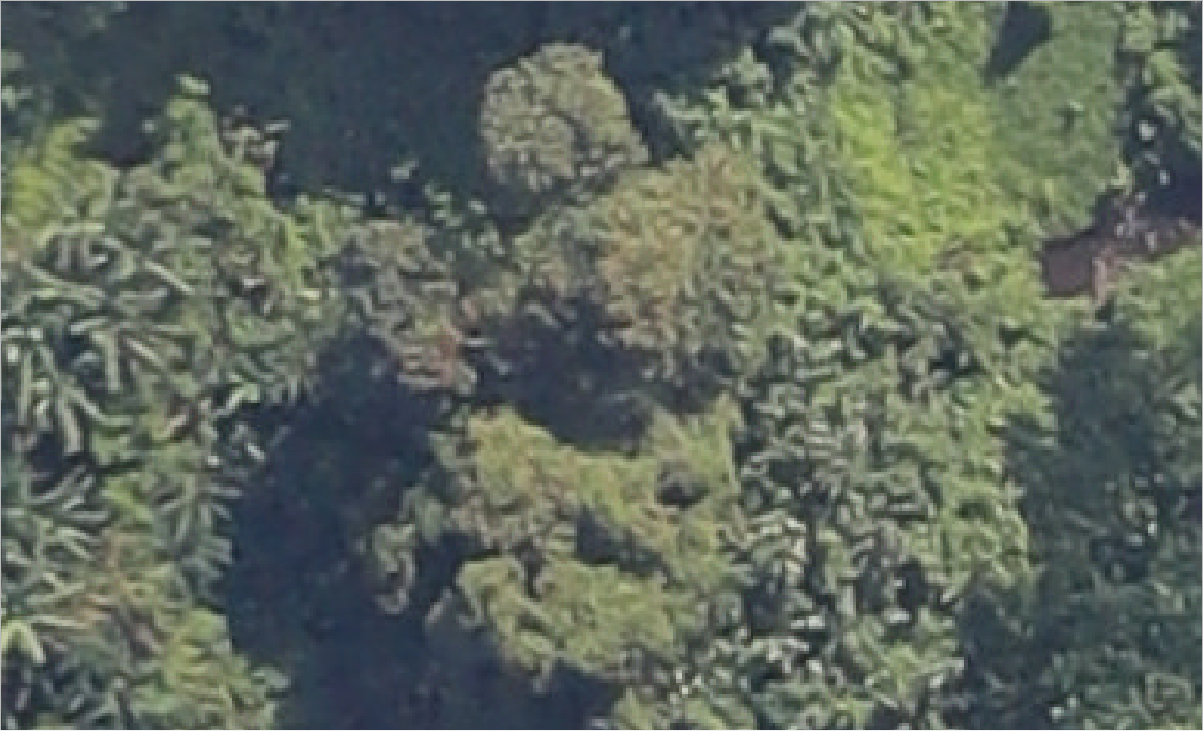
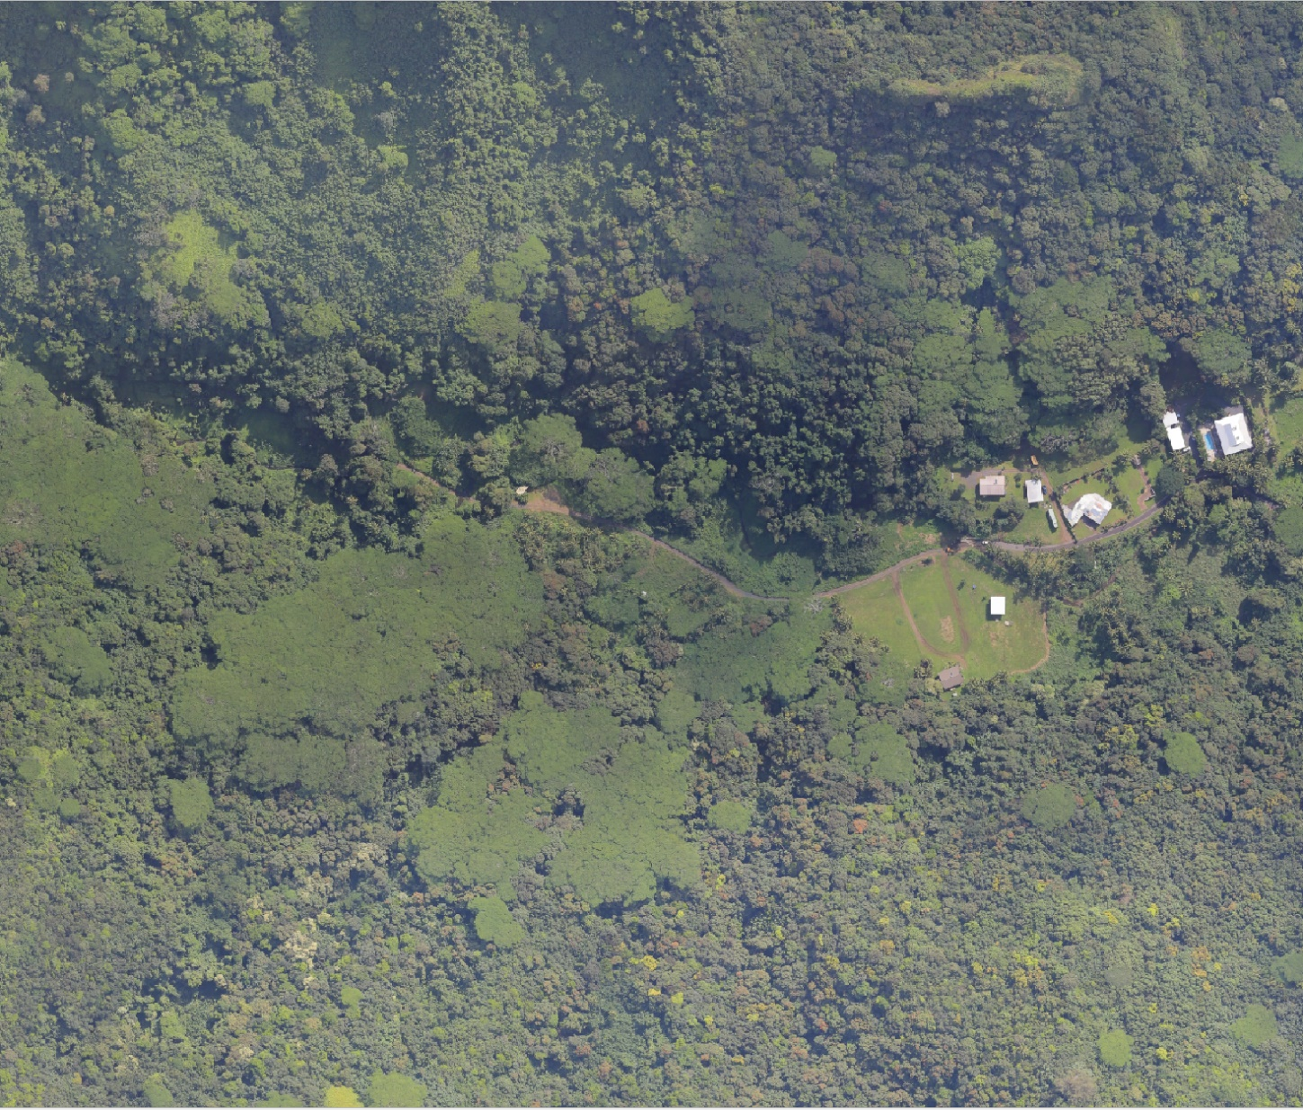
Aeroplane imagery (~10cm)
Aeroplane imagery (~10cm)

Slide 30
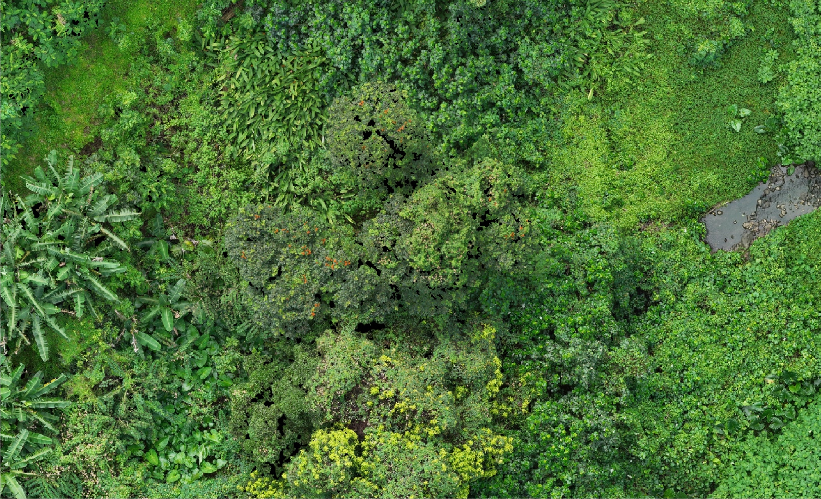
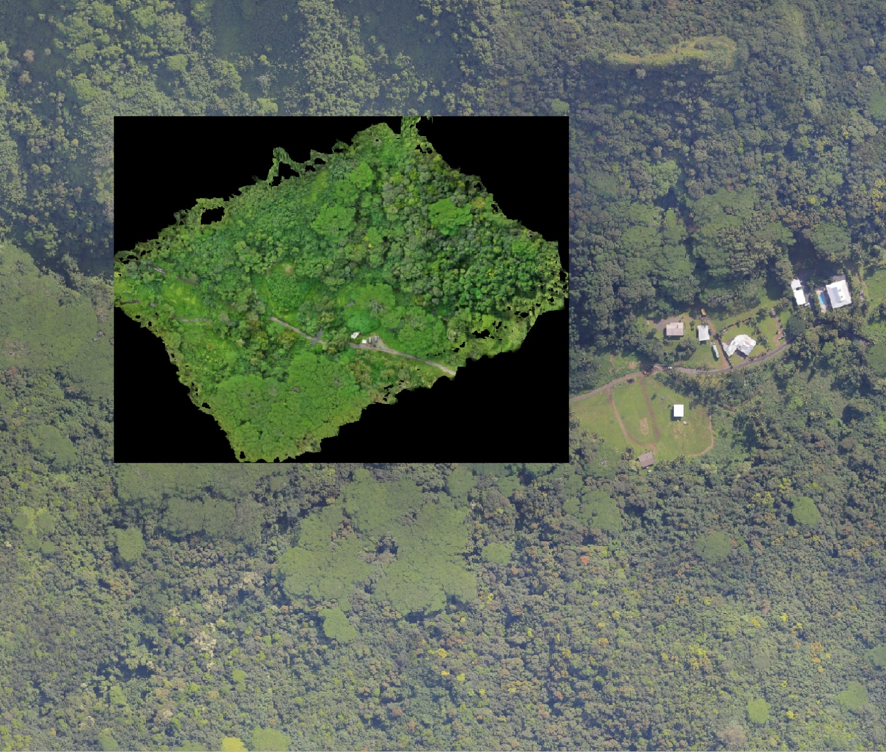
Mavic 3M imagery at 30m
Drone imagery (~2cm)

Slide 31
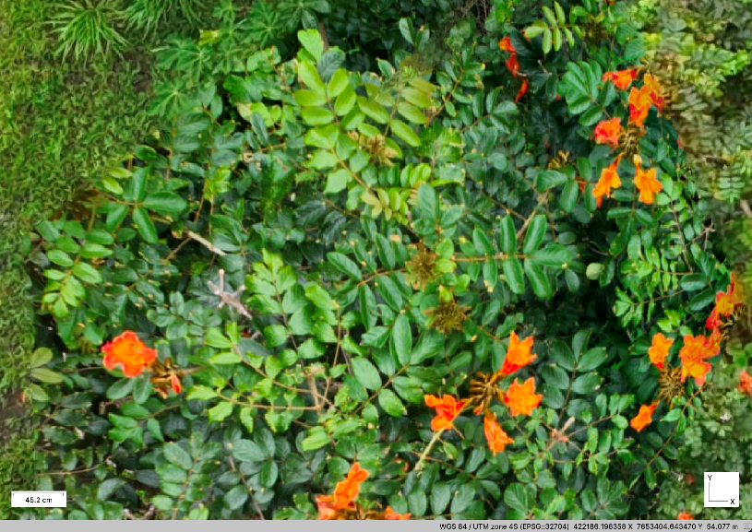
Drone imagery (< 1cm)
Galls visible from gall mite

Slide 32
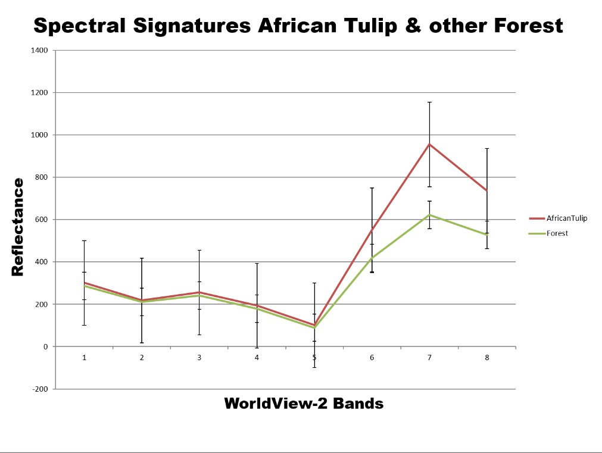
Near infrared data
African tulip tree flowers are visible in RGB but flowering can be incomplete, and timing is critical.
NIR may provide opportunities to detect ATT leaves so that mapping outside of the flowering season can be done (data from Litia Gaunavou and Wolf Forstreuter).

Slide 33
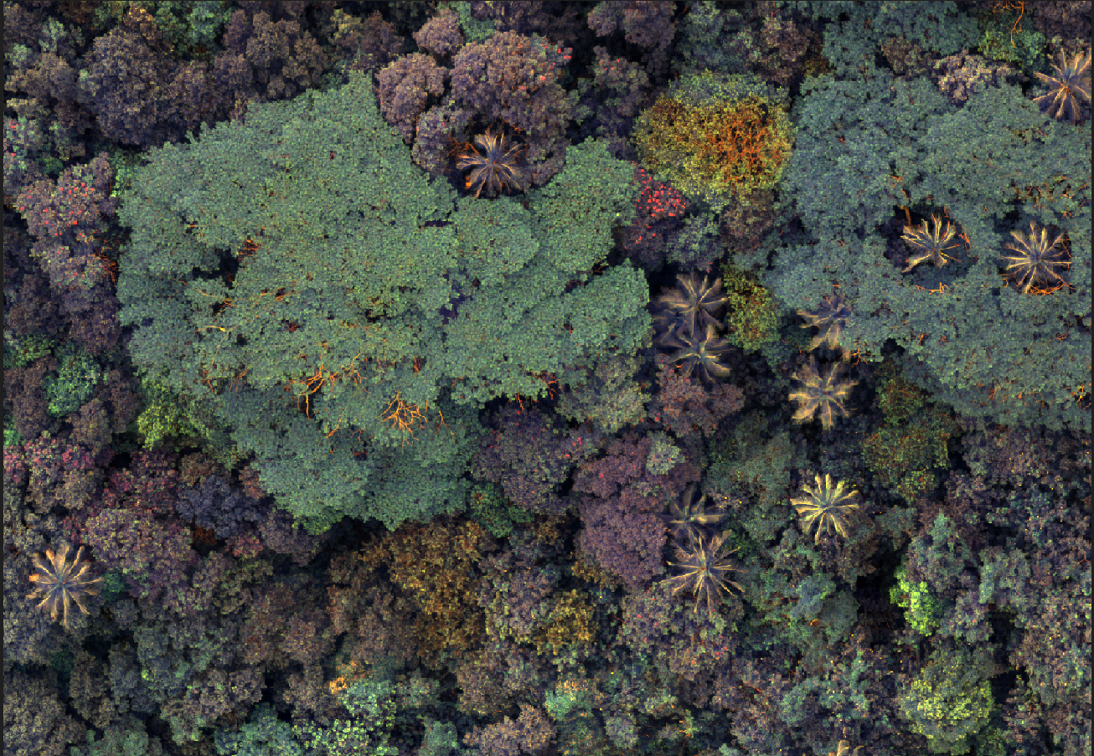
Mavic 3M drone multispec imagery (NIR)
African tulip tree foliage reflecting NIR?

Slide 34
Airborne hyperspectral data
Tamaligi
ATT

Slide 35
ASD measurements
No Galls
Galls
Checking reflectance from ATT leaves with and without galls with an analytical spectral device.
Notes:
Little bump around 400, Higher starting point for red edge (670 nm), lower ending point for red edge (760 nm).

Slide 36
M300 + claw/canopy sampler
The canopy sampler can be used to ground truth biocontrol damage
Beetle damage
Mite damage

Slide 37
Scale-appropriate imagery to answer questions
Question 1: Can we map ATT, Tamaligi and Taro vine? Manual? AI?
Question 2: If so, where are the weeds and how dense are the populations?
Question 3: Can we detect biocontrol agent damage?
Question 4: Can we detect impacts from biocontrol damage over time like a reduction in weed population density?

Slide 38
Acknowledgements
The NZ Ministry of Foreign Affairs and Trade are funding this work.
Nick Rollings formally of the University of the South Pacific helped to plan this project and provided local contacts to help develop methods.
Lynley Hayes and Quentin Paynter from the Manaaki Whenua – Landcare Research provided help with the project concept and advice on logistics.
Huggard Tongatule and his team from the Niue Department of Environment helped to take drone imagery.
Support was provided in the Cook Is. by the National Environmental Service team.

