Slide 1
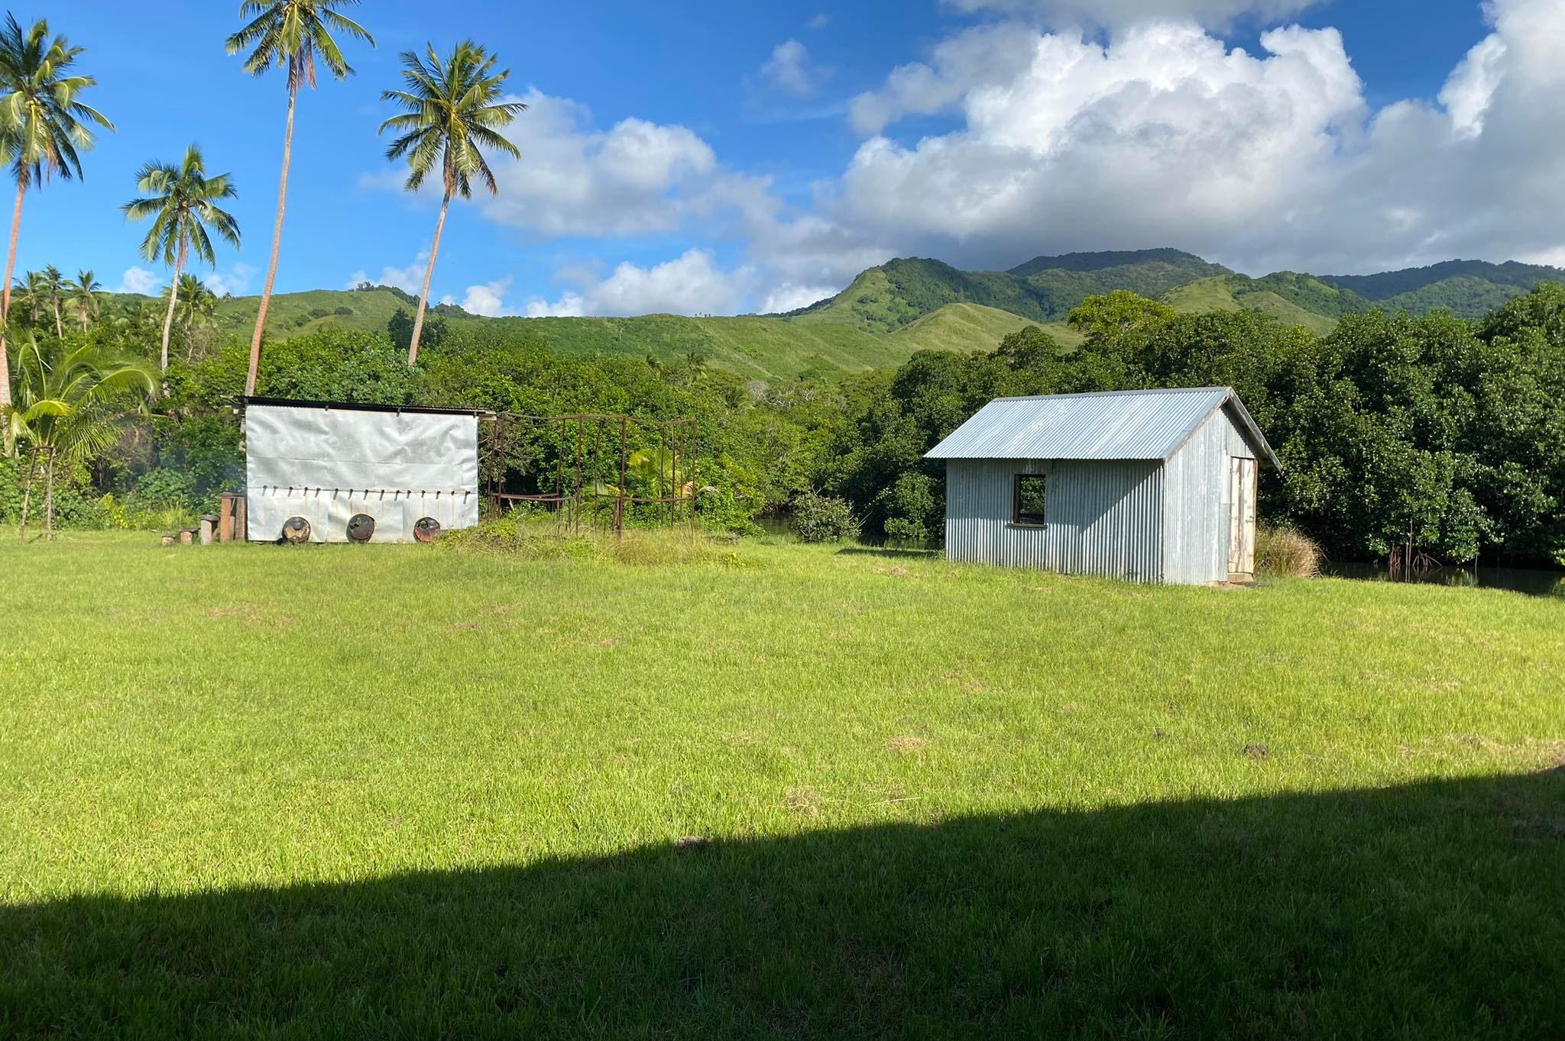
A strategic approach to geospatial development: Fiji in focus
Lanieta Rokotuiwakaya
Kimberley Worthy
Notes:
KIM & LANI
Introductions - name, job title, organisation, country.

Slide 2
Spatial Vision’s Annual Pacific Geospatial Skills Development Program
Supporting Pacific Islands geospatial professionals to develop geospatial knowledge.
Notes:
KIM:
The Australia Pacific Spatial Skills Development Program provides opportunity for an individual from a Pacific Island Country or Territory to advance their spatial skills with leading Australian spatial consultancy, Spatial Vision. Carried out over 12 weeks, the program provides the selected candidate the opportunity to deliver a geospatial project relating to their area of interest and demonstrate that a specific problem can be solved with spatial technology.
Introduce goals of project:
- Select a geospatial topic (must be environment/climate/sustainability related). Define problem statement.
- Carry out research to understand what is needed and how to address issue
- Prepare a set of recommendations
- Write and publish discussion paper

Slide 3
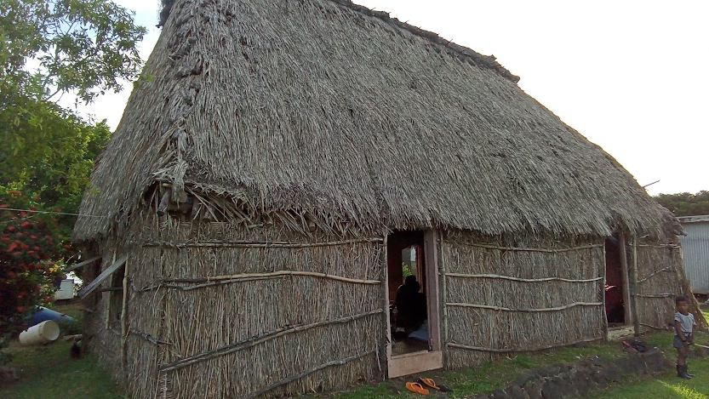
Project Topic:
Develop strategic recommendations in support of furthering Fiji’s geospatial capability.
Notes:
LANI

Slide 4
Current Initiatives
Source: UNGGIM, July 2022.
Notes:
LANI
●Committee supporting collaboration, consistent data standards, working toward easier integration.
●IGIF: integrated geospatial information framework, as recommended by the UN Committee of Experts on Global Geospatial Information Mgmt
●Policy fundamental piece – geospatial industry has a role in the industry to ensure that the region is maximising technology availables.
●Cannot meet SDGs without geospatial considered.
Pacific Island countries are committing to SDGs geospatial development. We heard from Tonga on Monday.
● Fiji Country-level Action Plan

Slide 5
Notes:
LANI
Geospatial plays a fundamental role in meeting country SDGs

Slide 6
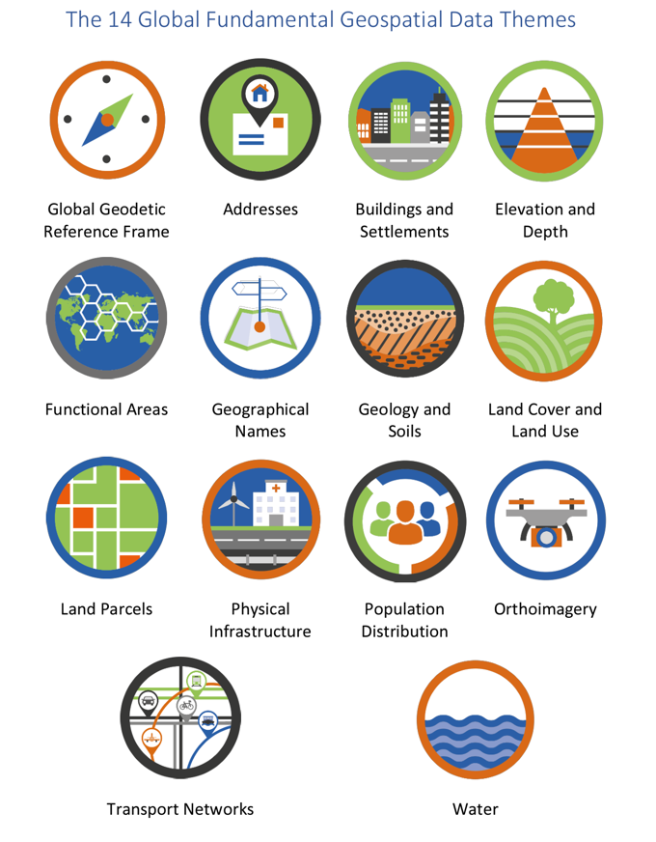
Notes:
KIM
To support SDGs,
UNGGIM recommendations
Detail IGIF
Foundational layers, underpin critical public services, and enablers to meeting SDGs

Slide 7
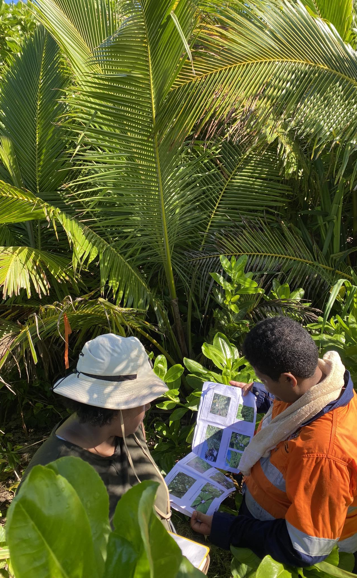
Agenda
Project methodology
Consultation
Key findings
Strategic recommendations
Notes:
KIM:
Recommendations focus on what key activities should take place short and long-term to support development of Fiji.
Development can include: smart data digital services, improved public services, greater environmental conservation impact…
This presentation will share with you the findings of this work so far..

Slide 8
1.Project Methodology
Notes:
Lani

Slide 9
Project Methodology
Select topic and define project objectives
Develop consultation schedule
Distribute surveys
Conduct interviews
Analyse findings and document requirements
Develop short and long-term recommendations against key themes
Write discussion paper
Notes:
LANI

Slide 10
2. Consultation
Notes:
Lani

Slide 11
Stakeholders Consulted
Structured Comprehensive Interview
Stakeholder | No of Participant | Seniority Level | Years of Service
Ministry of Health | 1 | Supervisory/Managerial Positions | More than 10 years
Ministry of Defence | 2 | Supervisory/Managerial Positions | More than 15 years
Ministry of Infrastructure | Scheduled | Scheduled | Scheduled
Notes:
LANI

Slide 12
Stakeholder Consulted Online Survey
Lion GIS and Research Services Ltd
Fiji National University
Pacific Community (SPC)
Pacific GIS & Remote Sensing Council
iTaukei Land Trust Board
University of the South Pacific
The University of New Caledonia
UNITAR
UN Staff
Fiji National University
Forestry
Fiji Bureau Of Statistics
21 total responses
Notes:
LANI

Slide 13
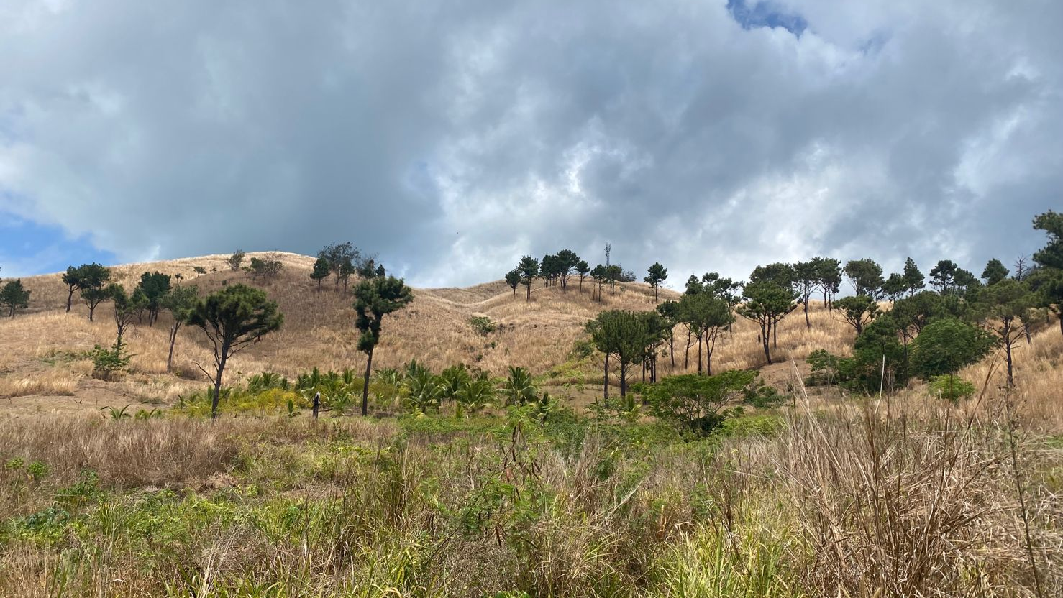
3. Key Findings
Notes:
Lani

Slide 14
Ministry of Health
Key findings:
Room for increased capacity
They need more advanced skills e.g. programming and processing big datasets
Some staff cover multiple roles, no dedicated geo resource
Implications of doing nothing:
Missed Opportunities for growth. Inability to scale operations to meet growing needs
Skill Gap: Inability to harness the full potential of advanced technologies.
Inefficient Data Handling:Hindered decision-making processes due to the absence of advanced skills.
Notes:
LANI

Slide 15
Ministry of Health
Requirements:
Map nursing boundaries in order to distribute pharmaceuticals and equipment to health facilities
Real-time visualisation of health cases (post-COVID requirement)
Determine location of health facilities relating to access, population and health catchment zones
Notes:
LANI

Slide 16
Ministry of Defence
Key finding:
Room for increased capacity
They require additional automated systems to capture and process data
Lack of human capacity to initiate or engage in geospatial work
Implications of doing nothing
Missed opportunities for optimizing processes and workflows
Continued reliance on manual and time-consuming data capture and processing methods
Missed chances for leveraging geospatial insights for informed decision-making
Notes:
LANI

Slide 17
Ministry of Defence
Requirements:
Resource Allocation
Investment in Training and Skill Development
Implementation of Automated System
Strategic Planning for Capacity Building
Notes:
LANI

Slide 18
Natural Disaster Management Office
Landbase data very important
Geospatial data critical to developing climate adaptation measures
Geospatial data serves as baseline for decision-making and planning
Building resilience can be furthered using geospatial solutions
Disaster response and historical analysis can be more efficient when using geospatial technology
Shoreline change data is needed to understand change impacts
Geospatial data informs areas requiring restoration
Notes:
LANI
Interview not taken place yet… This will occur at our next consultation..

Slide 19
Survey results
Notes:
LANI

Slide 20
Areas where survey respondents are using geospatial
Sustainable agriculture practices
Sustainable fishing practices
Land administration & use
Health services
Climate adaptation measures
Protecting oceans
Vulnerable coast assessment
Introduced species management
Notes:
LANI

Slide 21
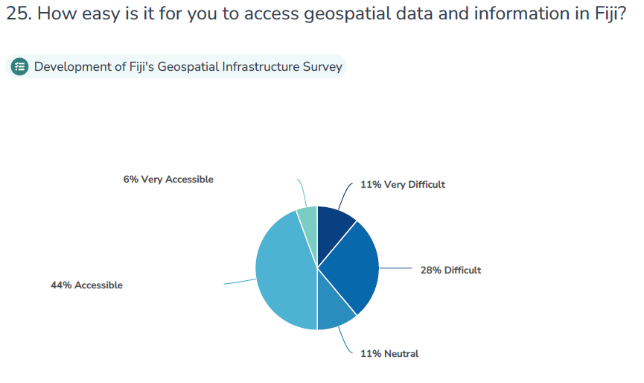
Notes:
LANI

Slide 22
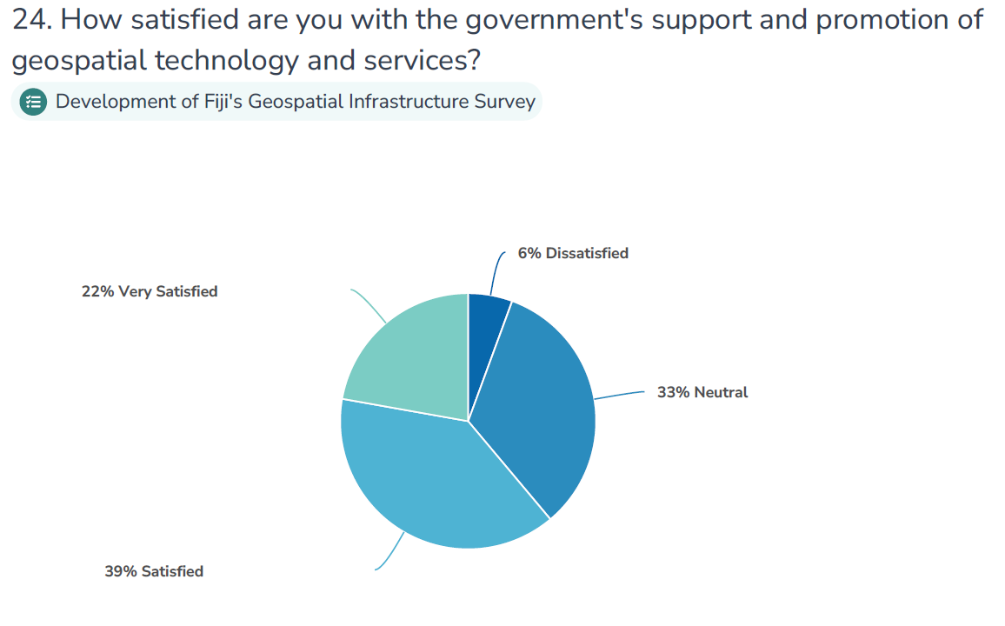
Notes:
LANI

Slide 23
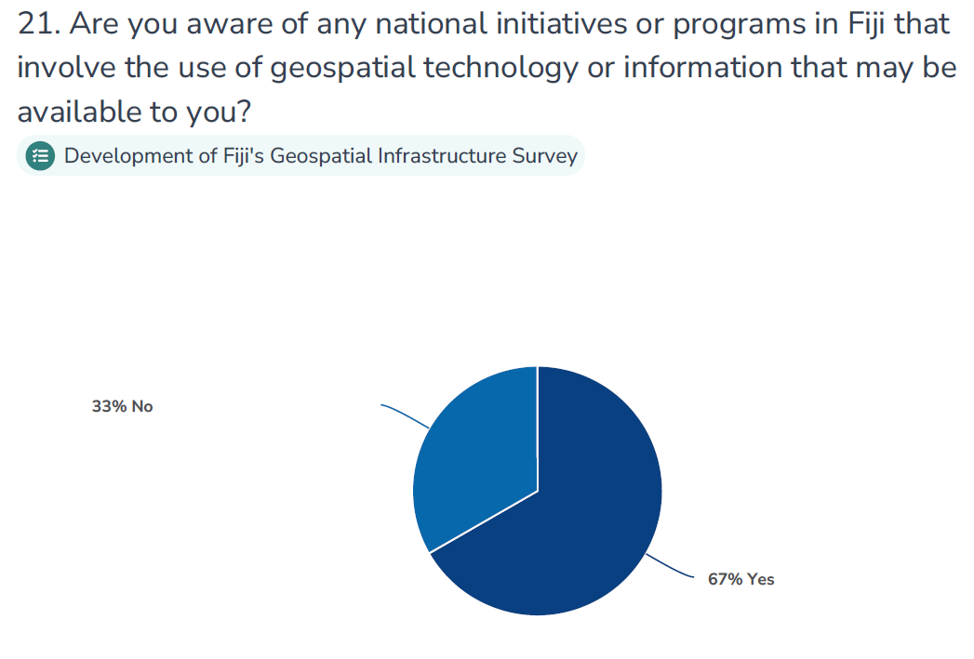
Notes:
LANI

Slide 24
Capability and capacity constraints include:
Lack of consolidated open data portal with metadata
Limited financing to support geospatial infrastructure and skills development
Much time spent training staff which takes away from operational delivery
Long time to make software decisions which impacts productivity
High staff turnover and lack of resourcing
Lack of GIS analysis skills
Lack of consistent data standards and interoperability between platforms/systems
Notes:
KIM

Slide 25
Respondents have concerns about the quality of and access to data available across Fiji:
Poor trust in data
Layers are outdated
Data does not align to imagery
Some approvals must be sought before use which takes time
Process for requesting data differs between Ministries
Some of the best data is not made available to the public / open
Inconsistent data standards and formats across Ministries
Duplication of data
Version control is problematic
Metadata is lacking
Notes:
KIM

Slide 26
Missing data that impacts project delivery:
SPL leases and wet leases
Lease master files, parcel boundaries and administration boundaries
High resolution satellite imagery
High resolution digital elevation models
Coastal erosion data
Village location data
Recent demographic statistics
Topology
Historical aerial imagery
Hydrology
Notes:
KIM

Slide 27
Respondents see the future of geospatial in Fiji to include:
Increased use of drone technology to improve disaster response
Data interoperability / standardisation across all Ministries, allowing for improved use of data
Mainstream adoption of geospatial technology across communities to map risk such as erosion
Monitoring of illegal logging and mining
BIM and 3D modelling
Relocation planning
Modelling disease outbreak and patterns
Notes:
LANI

Slide 28
Respondents have the following ideas for the enhancement of geospatial capability across Fiji:
Align geospatial development to the National Digital Transformation Plan
Progression of the UNGGIM country-level action plan
Improved data access and sharing
Consolidated open data portal with metadata
Clear process for requesting data from Ministries
Geospatial requires more attention and funding in order to deliver major projects
Need support to develop strong business cases to take to senior levels
More private sector involvement
Digitise all foundational data and make a single version accessible - assign ownership and responsibilities to management of these data layers
Notes:
KIM
All agreed GI technology has played a big role in decision-making and planning,

Slide 29
4. Recommendations
Notes:
Lani

Slide 30
Geospatial Needs
Consolidated data library
Access to data
Quality data
Metadata
Infrastructure
Governance + policy
Strategy
Skills development planning
Recent, high-res aerial imagery
Software access
Notes:
LANI

Slide 31
Strategic Recommendations LANI
Short-term | Long-term
Documentation of use cases and needs | Continued advisory from the Pacific Geospatial and Surveying Council
Development of action plans for those needing immediate support | Implementation of country-level action plan (IGIF, UN-GGIM) + framework for use of geospatial data
Awareness campaigns at organisation level | Human resource investment and up-skilling
Business case development for investment/funding | Data management plan and updating of fundamental layers
Improve accessibility of data – national data hub | Consider open-source software
National Geospatial Council?? | Develop metadata standard and management practices
Develop library of datasets | Incentives for private sector to get involved in GI
 | School awareness programs
Notes:
Break into themes: people, resources, skills, tech, capacity, governance (policy and committees) etc
Cannot wait for IGIF and governance, must act now to help Ministry Defence etc.
Fiji needs to build capacity within.

Slide 32
Short-term recommendations | Long-term recommendations
People
Strengthen data and Geospatial skills and capabilities training and education. Mobilise collaboration between the National government , considering working groups and shared positions / costs to bridge silos, and complement capacities. | Establish dedicated capacities and accountability for data and information management through job descriptions and performance measurement. Expand collaboration into whole of government approaches across sectors (horizontally) and subnational levels (vertically).

Slide 33
Short-term recommendations | Long-term recommendations
Governance
Establish maturity measurement, monitoring and evaluation for geospatial data, IM and sharing and demonstrate progress Mobilise leadership support for strengthening the institutionalisation of geo data and IM | Mobilise dedicated budgets (beyond technology) to cover geospatial data and IM costs. Research and develop organisational standards, frameworks, and guidance for whole of government approaches and interoperability

Slide 34
Short-term recommendations | Long-term recommendations
Processes
Collaboratively co-create comprehensive processes with both data users and producers, ensuring end-to-end optimization of information workflows, including improved access and sharing capabilities. | Develop and record workflows, protocols, standard operating procedures (SOPs), and guidance for the management of geo data, information, records, metadata, and resource description. This framework aims to enhance sensitivity to disaster data and facilitate information sharing.

Slide 35
Short-term recommendations | Long-term recommendations
Technology
Investigate tools and collaborative platforms designed for supporting workflows, visualization, analytics, business intelligence, etc., with the aim of measuring and monitoring geospatial data and processes effectively. | Enhance automation processes for metadata management and filing or storage systems.

Slide 36
Lanieta Rokotuiwakya
Kimberley Worthy
Notes:
Come and see me if interested in 2024 program.
You will see this work soon published…

Slide 37
Spatial Vision’s International Advisory
Evidence-backed policies
Capacity building
Digital transformation
Resilience strategies
Notes:
We are a spatial services company that has been around for 25 years, operating out of Australia.
See me if interested in our 2024 program.

Slide 38
Services underpinned by geospatial data and technology
Disaster risk assessment and management
Visualising hazards for decision makers
Flood monitoring
Land cover change detection
Disease outbreak mapping
Maritime boundary management
Coastline mapping
Landscape changes
Bushfire detection
Mangrove degradation
Forestry and environment
Fisheries -monitoring illegal fishing
Crop management
Water management
Notes:
Not exhaustive

Slide 39
Local challenges
Soil and erosion
Administrative boundaries
Electoral boundaries
Water quality
Land management and land use classification
Land reform
Food security
Crop suitability
Climate adaptation
Topographic map updates
Disaster risk reduction
Carbon trading
Notes:
These results gleaned from survey

Slide 40
Project Methodology
Gather evidence to understand Fiji’s geospatial development needs
Consultation with stakeholders
Document use cases and requirements
Develop recommendations & write paper
Notes:
LANI:
Consultation method:
- survey
- interviews
The challenges are consistent across the board - similar experiences amongst all Ministries consulted. There is an opportunity for greater collaboration.
Strategic recommendations: short and long-term across key themes

