Slide 1
Conference 27 Nov. - 1 Dec. 2023, FIJI
Improving Resilience in the Pacific Islands Through GIS and Remote Sensing
An Operational Vegetation Drought Processing Chain based on Google Earth Engine satellite imagery and meteorological products
M. Neuhauser*, H. Roussaffa, A. Peltier, M. Despinoy
Remote sensing and Geomatics company
French Development Research Institute
OEIL
Environment Observatory in New Caledonia
* Research Engineer
INSIGHT/IRD, Noumea, NEW CALEDONIA

Slide 2
CONTEXT and OBJECTIVES

Slide 3
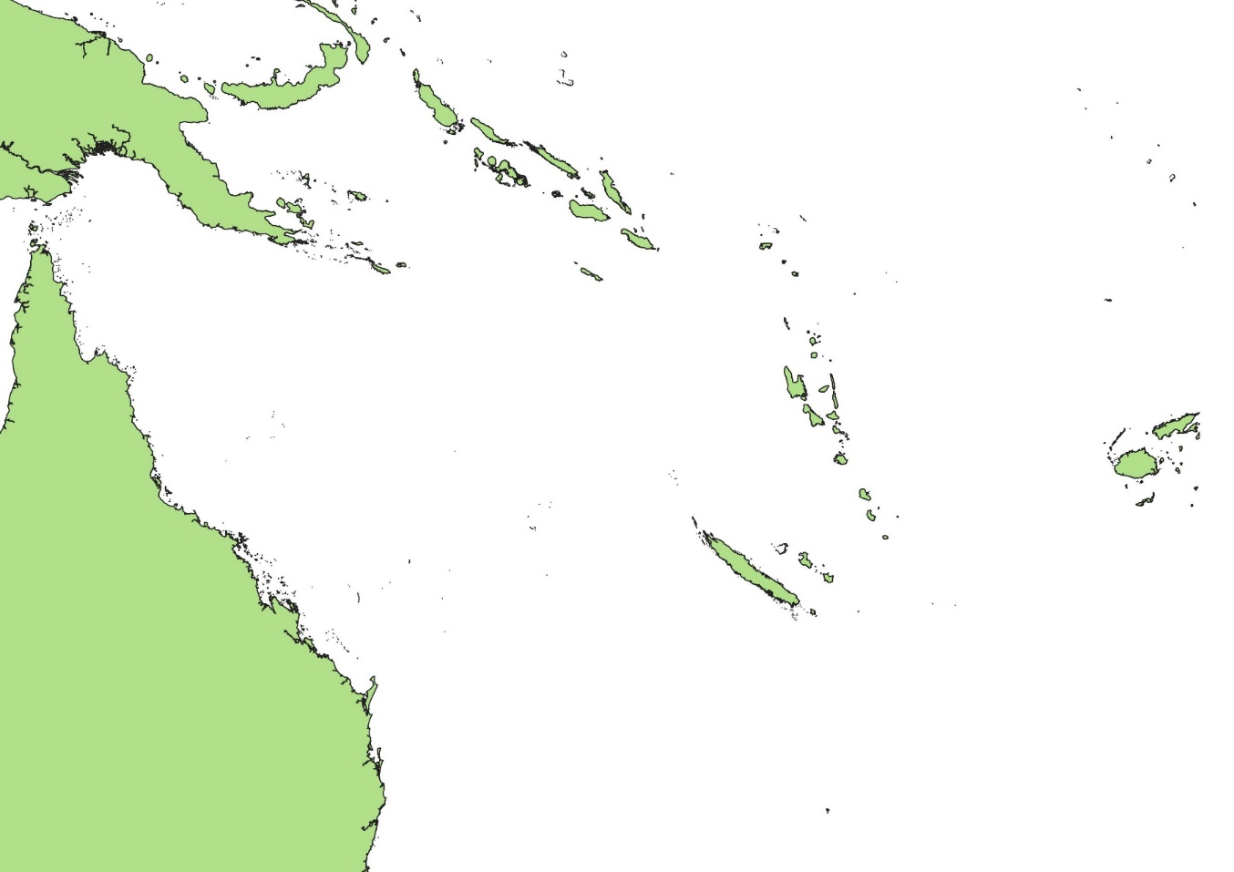
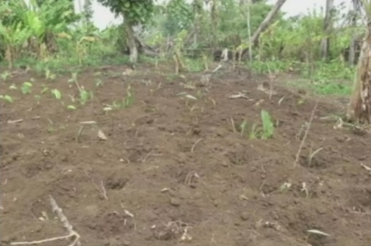
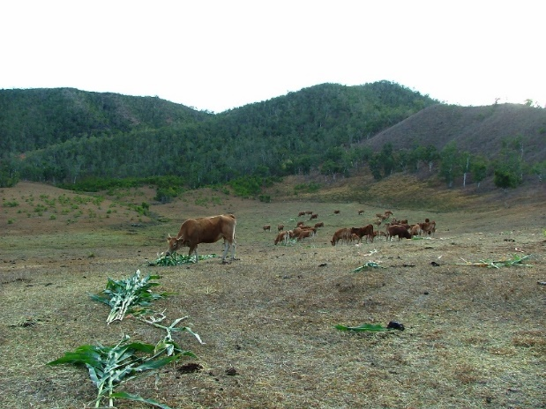
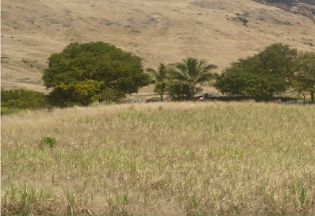
Drought in the Pacific Islands
VANUATU, 2015 : “Tanna Island particularly affected by drought“
NC 1ère
FRENCH POLYNESIA, 2021 :
"Polynesia undergoes an extreme drought”
Météo-France
NEW CALEDONIA, 2019 :
“Second warmest year since 1850”
Météo-France NC
WALLIS-et-FUTUNA, 2016 :
"Warmest and driest January in both Wallis and Futuna since the first weather records in 1971."
FIJI, 2010 : "Meteorological drought affected Fiji"*
Impacts on :
Biodiversity
Agricultural crops
Water ressource
* Extreme Weather and Climate Events and Their Impacts on Island Countries in the Western Pacific: Cyclones, Floods and Droughts (Kuleshov, 2014)
3
Notes:
- …
- These drought events are more and more observered and intense, and have undeniable impacts on biodiversity, water resources and agricultural crops

Slide 4
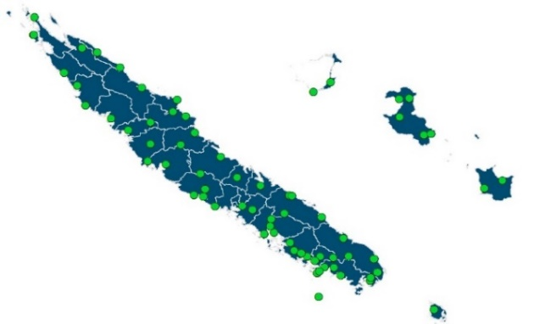
Drought in the Pacific Islands
The Rural Agency and Meteo France
facing the Drought Hazard :
Detection of meteorological drought
Purchase of drought food for farmers
Compensation for producers
Standardized Precipitation Index (SPI)
NEW CALEDONIA, 2019 :
“Second warmest year since 1850”
Météo-France NC
Compensation for producers
BUT…
Incomplete spatial coverage
Rainfall deficit ≠ Plant water stress
50 weather stations over the territory
4
Notes:
- To date in New Caledonia, the Rural Agency helps farmers to face drought hazard by providing
drought food and compensation.
This is possible thanks to rainfall information provided by Météo-France and enabling the detection of extreme drought.
However, this is done via in-situ weather stations, limiting the detection to localized areas on the territory
and informing on the rainfall deficit and not on the water stress of plants.

Slide 5
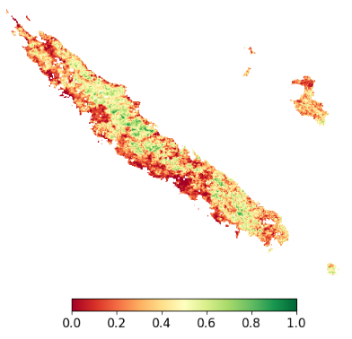
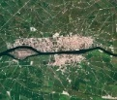
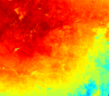
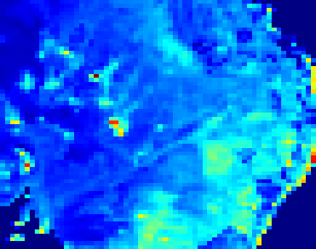
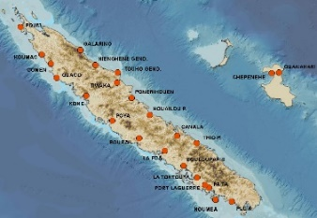
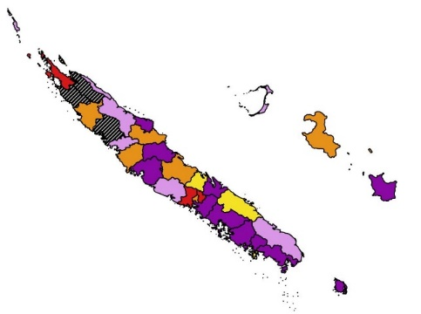
Space Climate Observatory, New-Caledonia (April 2021 – July 2022)
Current Indicator
Anomalies of surface indices
Complementary Earth Observation data
Development of Vegetation Drought indicators :
Spatialization and forecast
Evaluated from operational meteorological drought products (SPI)
Demonstrated relevance of products
SPATIALIZED = localization
Dry
Healthy
Vegetation
(Optical)
User platform
Surface Temperature
(Thermal)
Soil Moisture
(Microwaves)
Forecast Indicator
Long-range probabilistic forecast system
HISTORICAL = quantification
+1 month
+2 months
+3 months
No Data
Stop
Expert meteorological data:
precipitations, evapotranspiration
Decrease
Formation
Persistence
Increase

Slide 6
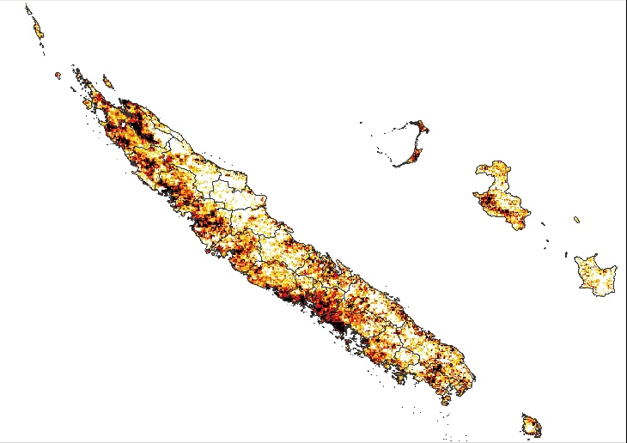
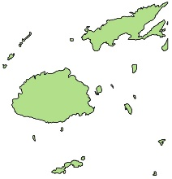
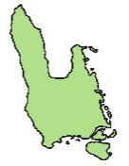
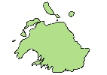
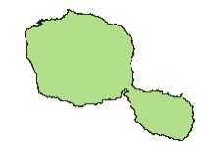
French Pacific Fund (ongoing project…)
Industrialization
New-Caledonia
Regionalization
Other Pacific Island Territories
Industrialization and Regionalization :
Operational implementation and production on New-Caledonia
Adaptation to other territories with new products
Fiji
Vanuatu
Google
Earth
Engine
French Polynesia
OEIL
Environment Observatory in New Caledonia
Remote sensing and Geomatics company
French Development Research Institute

Slide 7
INDICATORS DEVELOPMENT and EVALUATION

Slide 8
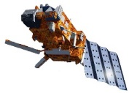
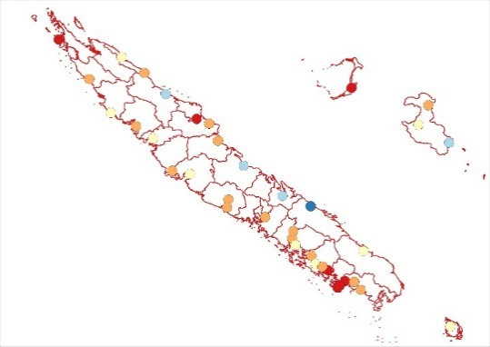
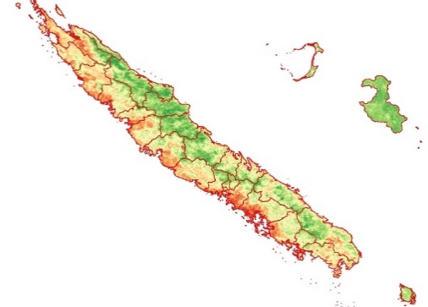
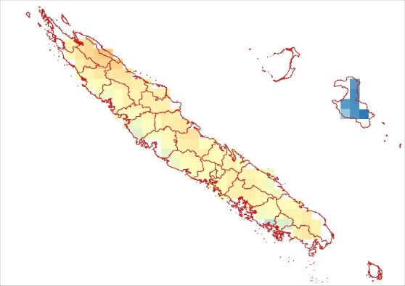
Methodology at GLOBAL SCALE
Drought information at global scale (entire territory)
Combined drought products (SPI, SPEI, MAI, VHI)
Agro-meteorological drought model (Sepulcre-Canto et al., 2012))
GLOBAL DROUGHT INDICATOR
PRECIPITATION DEFICIT
SOIL MOISTURE DEFICIT
VEGETATION STRESS
In-situ precipitations
SPI 3-months
40 stations
1981 - today
ASCAT (MetOp)
Moisture Anomaly Index (MAI)
12 km
2007 - today
MODIS (Aqua, Terra)
Vegetation Health Index
Combined anomalies of NDWI, LST
500 m
2000 - today
STANDARDIZED WATER BALANCE
SPEI 3-months
SPEI = f(P - ET) *
32 stations
1991 - today
* P = precipitations
ET = evapotranspiration
(Thornthwaite, 1948)
Wet
Wet
Healthy
Precipitation deficit
Soil moisture deficit
Stress

Slide 9
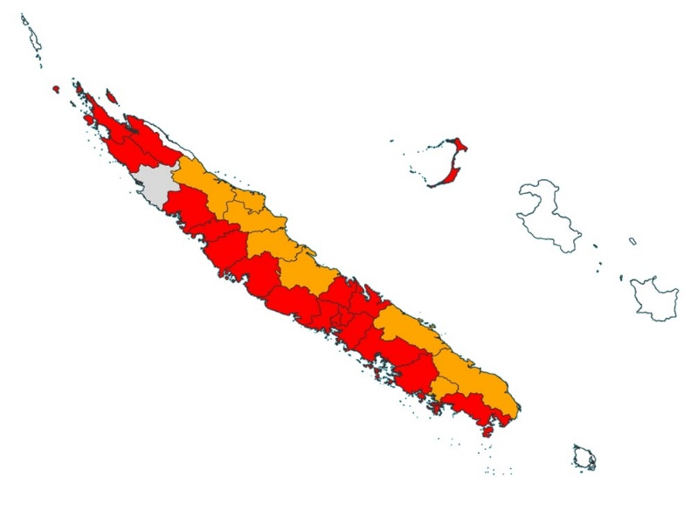
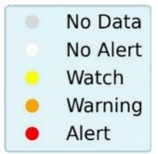
Methodology at GLOBAL SCALE
Drought information at global scale (entire territory)
Combined drought products (SPI, SPEI, MAI, VHI)
Agricultural drought cause-effect relationship (Sepulcre-Canto et al., 2012))
GLOBAL DROUGHT INDICATOR
PRECIPITATION DEFICIT
SOIL MOISTURE DEFICIT
VEGETATION STRESS
Watch
Warning
Alert
Drought Alerts :

Slide 10
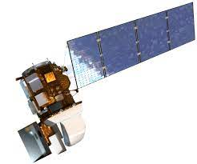
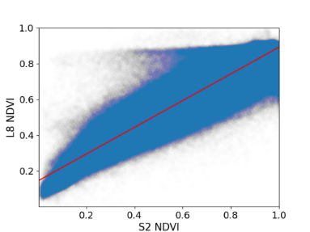
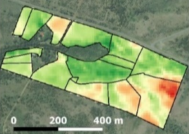
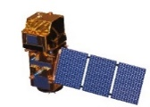
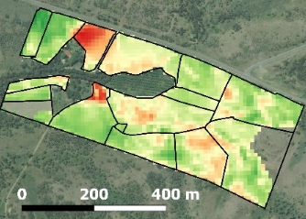
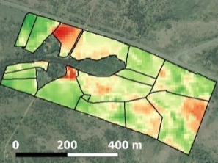
Methodology at LOCAL SCALE
Drought information at local scale (10 m)
Updated every 10 days
Focus on vegetation stress
LOCAL DROUGHT INDICATOR
Landsat (L7, L8, L9)
USGS Level 2 Reflectances
30 m
2000 - today
PRE-PROCESSING
COMPOSITING
Computing NDWI/NDVI time series
Clouds filtering and reprojection
Radiometric calibration
Decade (10-day) composition
Sentinel-2 (2A, 2B)
THEIA / ESA Level 2 Reflectances
10 m
2016 - today
POST-PROCESSING
VEGETATION STRESS *
Filtering bare soil, dense vegetation
From NDVI 10-day composites
Seasonal anomalies of NDWI (Amri et al., 2011)
Seasonal = mean and std for each decade
* Vegetation Anomaly Index :
$${VAI}_{D,M} = \frac{NDWI − {NDWI}_{mean}}{{NDWI}_{std}}$$

Slide 11
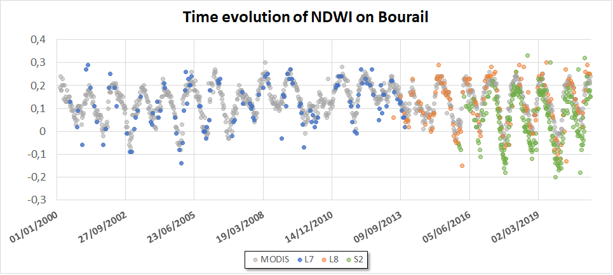
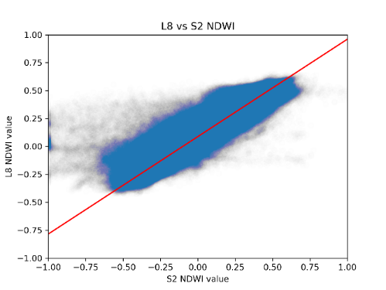
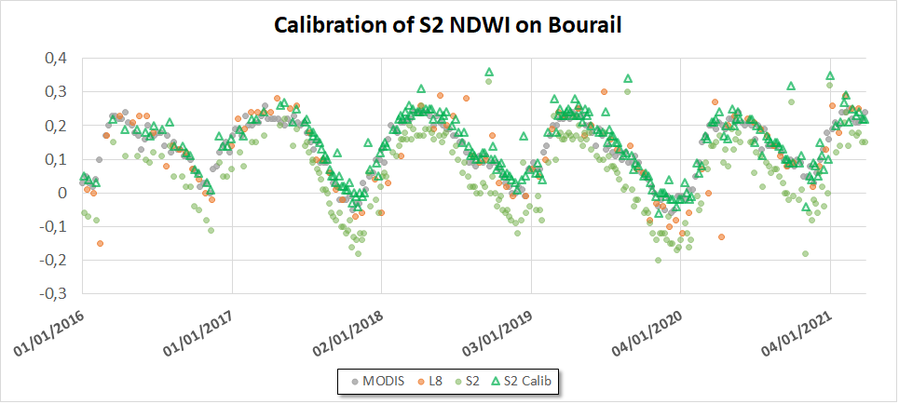
Methodology at LOCAL SCALE
Radiometric differences S2 vs L8
RADIOMETRIC CALIBRATION
Linear least-squares regression
L8 NDWI
S2 NDWI

Slide 12
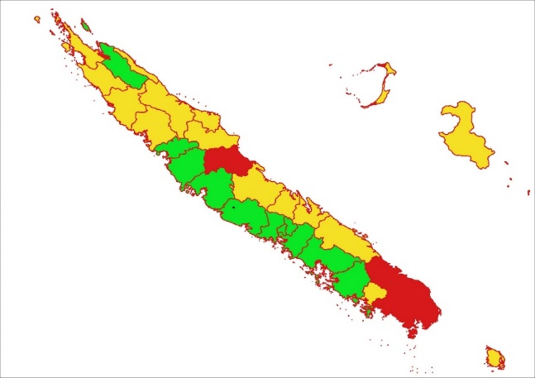
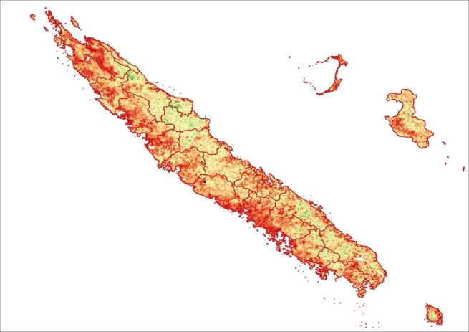
Some results at GLOBAL SCALE November 2019
CONFIDENCE INDEX
R-SCORES SPI-3 vs VHI
GLOBAL INDICATOR
Vegetation Health Index (VHI)*
(MODIS, 500 m)
* $VHI=α×VCI+(1−α$)$×TCI$
With $VCI = \frac{{NDWI − NDWI}_{min}}{{{NDWI}_{max} − NDWI}_{min}}$
$TCI=\frac{LST − {LST}_{max}}{{{LST}_{max} − LST}_{min}}$
α = 0.5
R-scores :
Bourail
R > 0,6
Good
0,4 < R < 0,6
Medium
R < 0,4
Bad
Healthy
Stress
Good correlation SPI-3 vs VHI on Bourail :
R-score = 0.7
p-value << 0.01
Bourail
DETECTION OF IMPORTANT DROUGHT EVENTS

Slide 13
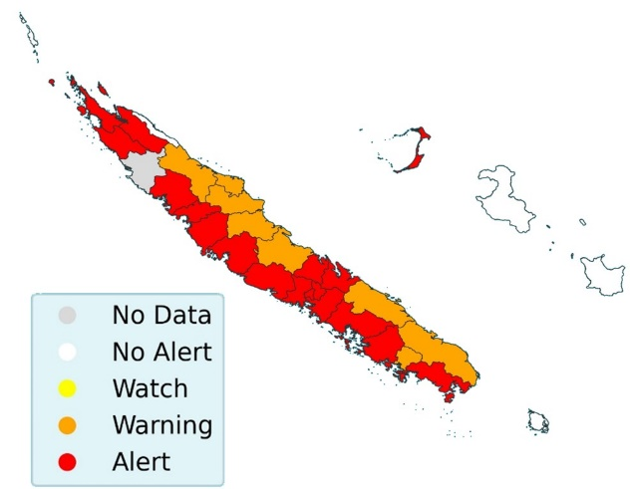
Some results at GLOBAL SCALE November 2019
DROUGHT ALERTS
VHI + MAI + SPI/SPEI
GLOBAL INDICATOR
Vegetation Health Index (VHI)*
(MODIS, 500 m)
* $VHI=α×VCI+(1−α$)$×TCI$
With $VCI = \frac{{NDWI − NDWI}_{min}}{{{NDWI}_{max} − NDWI}_{min}}$
$TCI=\frac{LST − {LST}_{max}}{{{LST}_{max} − LST}_{min}}$
α = 0.5
Bourail
Healthy
Stress
Bourail
Combining with complementary drought products
DETECTION OF IMPORTANT DROUGHT EVENTS

Slide 14
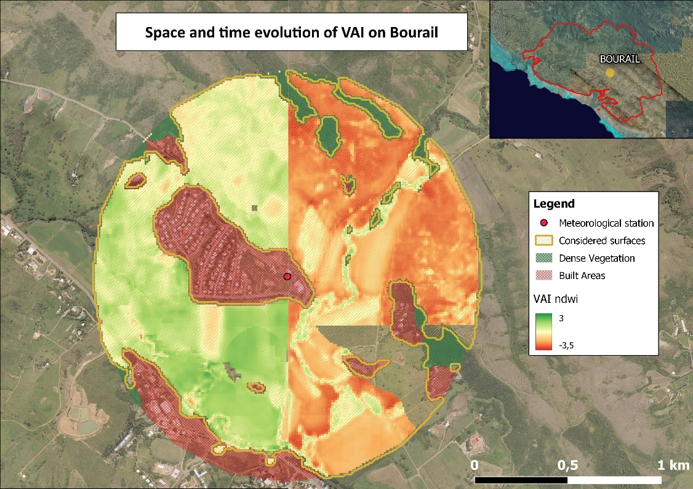
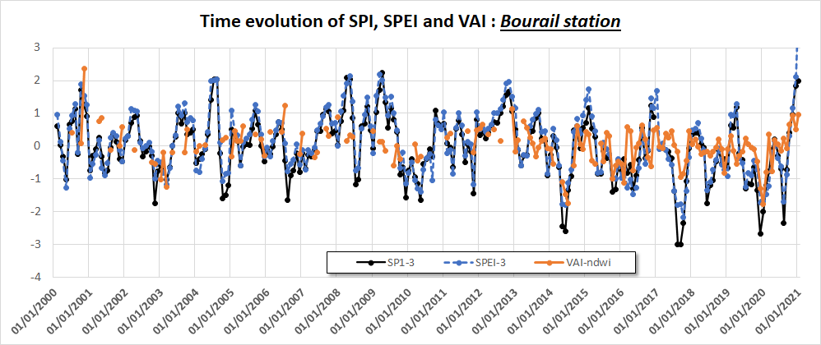
Some results at LOCAL SCALE
* Vegetation Anomaly Index (10 m) :
$${VAI}_{D,M} = \frac{NDWI − {NDWI}_{mean}}{{NDWI}_{std}}$$
VAI* December 2017
VAI* January 2020
1 km
Dec 2017
Meteo
Station
Jan 2020
Notes:
- To evaluate the local drought indicator, areas of 1 km radius centered around two meteorological stations were defined

Slide 15
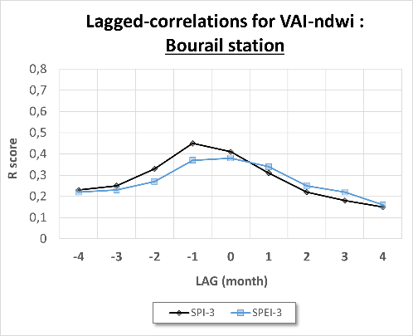
Some results at LOCAL SCALE
VEGETATION DROUGHT INDICATORS :
AFFECTED BY LOCAL FACTORS (human activity, soils…)
LOCAL SCALE
Medium R-scores
METEO DROUGHT
BEFORE VEGET DROUGHT
METEO DROUGH
AFTER VEGET DROUGHT
R-SCORES

Slide 16
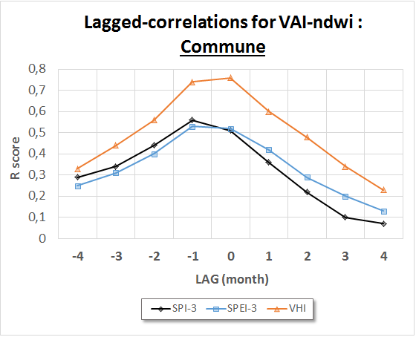
Some results at LOCAL SCALE
VEGETATION DROUGHT INDICATORS :
WELL-RELATED TO METEOROLOGICAL DROUGHT
REGIONAL SCALE
Good R-scores
R-SCORES

Slide 17
DROUGHT PROCESSING CHAINS

Slide 18
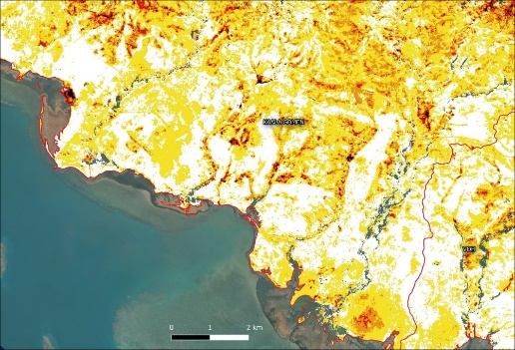
Local processing chain
Vegetation Drought Indicator (10 m)
VAI
No Drought
Near Normal
Moderate Drought
Severe Drought
Extreme Drought

Slide 19
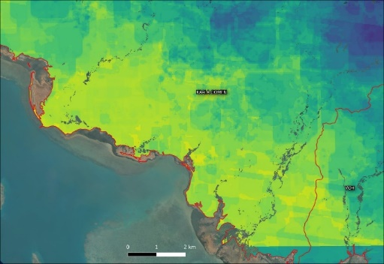
Local processing chain
Vegetation Drought Indicator (10 m)
VAI
Index informing on data Quality (10 m)
$$Q SCORE= {COUNT}_{valid}/{COUNT}_{expect}$$
No Drought
Q SCORE
Near Normal
Moderate Drought
1
Severe Drought
Extreme Drought
0

Slide 20
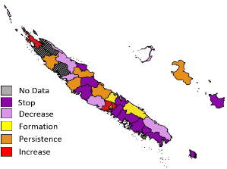
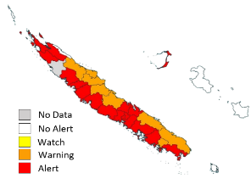
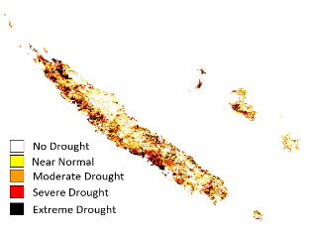
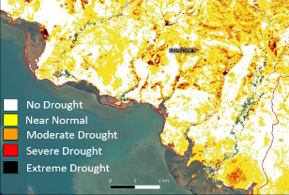
Overview of all chains
ASCAT
SWI
MODIS
LST
MODIS
NDWI
L7-8-9
NDWI
S2
NDWI
Python
Radiometric calibration
ALERT CHAIN
GLOBAL CHAIN
LOCAL CHAIN
FORECAST CHAIN
Time compositing
Meteorological data
SPI / SPEI weather station,
Ensemble rain forecasts
Comparison with Historical reference state
Historical reference
MAI
12.5 km
VHI
500 m
VAI
10 m
Evolution trends
Alerts maps production
Extracting specific types of vegetation
L7-8-9 / S2
NDVI
Drought Forecast
Regional level
Drought Alerts
Regional level
Global Vegetation Drought
Intra-regional level
Local Vegetation Drought
Parcel level

Slide 21
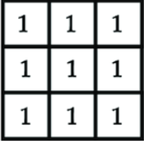
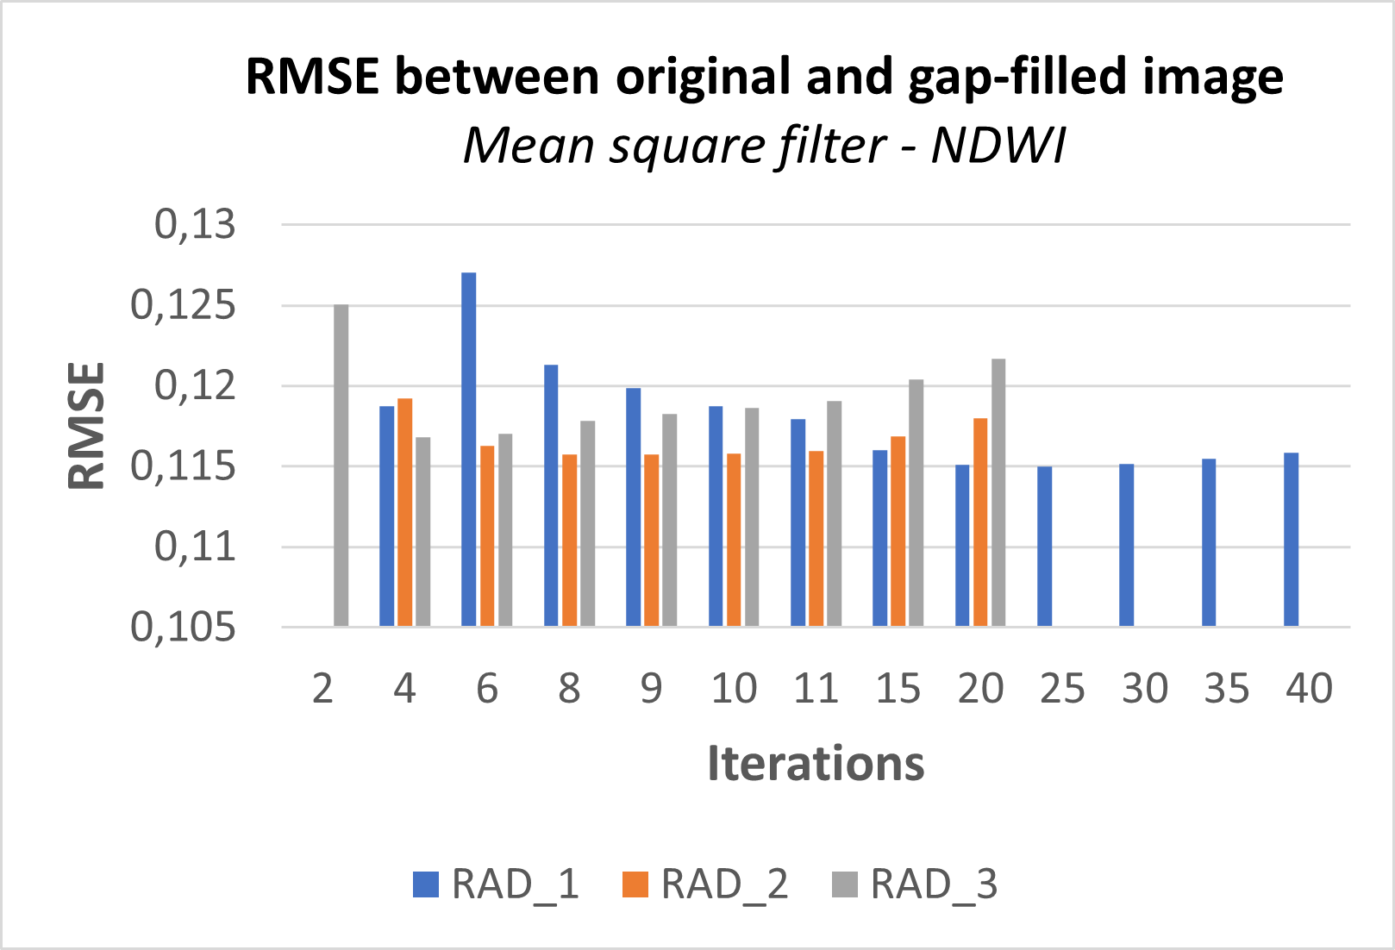
Overview of all chains
Google
Earth
Engine
ASCAT
SWI
MODIS
LST
MODIS
NDWI
L7-8-9
NDWI
S2
NDWI
Radiometric calibration
Satellite imagery access
Online pre-processing
Python
Time compositing
Meteorological data
SPI / SPEI weather station,
Ensemble rain forecasts
Comparison with Historical reference state
Historical reference
Gap-filling of Historical Landsat indices (L7)
Failure of the system’s Scan Line Corrector (SLC)
Corrected by application of morphological filter
(Ali et al., 2013 ; Yin et al., 2017)
Estimation of filter parameters by error minimization
MAI
12.5 km
VHI
500 m
VAI
10 m
Evolution trends
FILTER
Alerts maps production
Extracting specific types of vegetation
L7-8-9 / S2
NDVI
MIN ERROR
Drought Forecast
Regional level
Drought Alerts
Regional level
Global Vegetation Drought
Intra-regional level
Local Vegetation Drought
Parcel level

Slide 22
EXTERNALITIES FOR VALORISATION

Slide 23
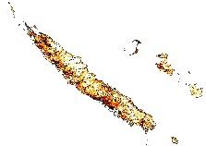
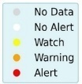
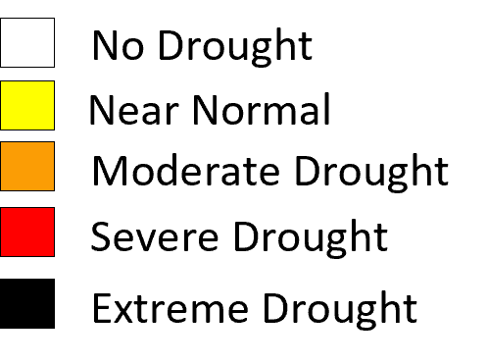
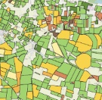
Monitoring and anticipating Vegetation Drought in the Pacific Island Countries and Territories
Development of Drought indicators
Drought Alerts
Vegetation Drought
Industrialization and Pacific
Thematic valorizations
Global scale (500 m)
Local scale (10 m)
Regionalization
Pacific Island Territories
Agriculture
Crops water management
Industrialization
New-Caledonia
French Polynesia
Vanuatu
Fires
Anticipating bush fires in the Pacific
Fiji
Number of fires
MARCH 2010
OCTOBER 2010
CURRENT PROJECT
April 2021
July 2022
Sept 2022

Slide 24
THANK YOU FOR YOUR ATTENTION Vinaka Vaka Levu

