Slide 1
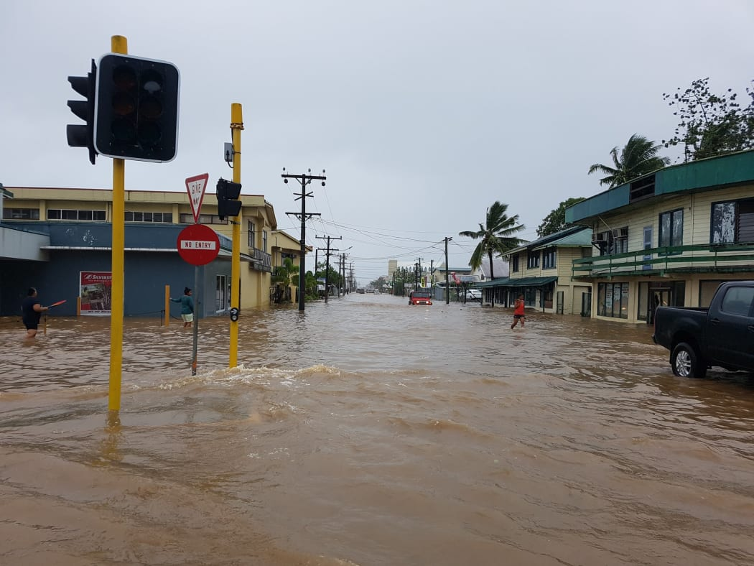
Enhancing Resilience to Pluvial Flooding in Pacific Island Nations: A Novel Approach to Rapid Rain-on-Grid Modelling and Risk Assessment
Pacific Risk Tool for Resilience, Phase 2 (PARTneR-2)
James Battersby
Climate Risk Scientist, NIWA
Notes:
Kia ora tatou
Ko _ toku ingoa
He _ ahau ki Taihoro Nukurangi
No reira Tena koutou katoa

Slide 2
PARTneR-2
Pacific Risk Tools for Resilience, Phase 2 Cook Islands | Republic of Marshall Islands | Samoa | Tonga | Tuvalu | | Vanuatu
Notes:
- Builds off Partner-1 (2016-2019)
- Partner-2 is finishing up next year
- Talks about Partner-3 next, to expand involvement to more countries

Slide 3
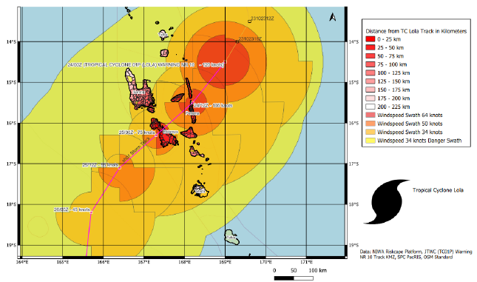
Use Case 2: Tropical Cyclone Forecast Exposure & PDNA
Creating national risk models and hazard maps
Detailing tropical cyclone and flood inundation exposure
Used pre-event and in Post Disaster Needs Assessment (PDNA)
To Help build resilient communities and sustainable development
Notes:
Use case 2 also involves the creation of wind driven wave models and exposure models from wind forecast to impacts

Slide 4
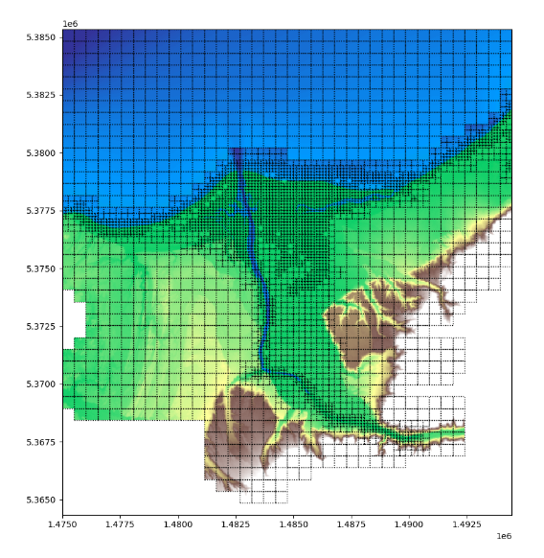
Rapid Rainfall (Pluvial) Modelling Using Rain-on-Grid
Notes:
- Challenging part I am involved with is the need for rapid rainfall modelling
- Been testing the Rain-on-Grid pluvial modelling Approach
- Input temporal rainfall pattern is distributed across a grided spatial network onto a DEM

Slide 5
Rain-on-Grid Modelling Process
Forecasted Rainfall
Temporal Rainfall Distribution
River Base Flow
Surface Roughness Map
Hydraulically Conditioned Digital Elevation Model
Model Configuration Parameters: Timestep, boundary condition etc.
Output Raster Layers: Flood Depth, Velocity
RoG Model

Slide 6
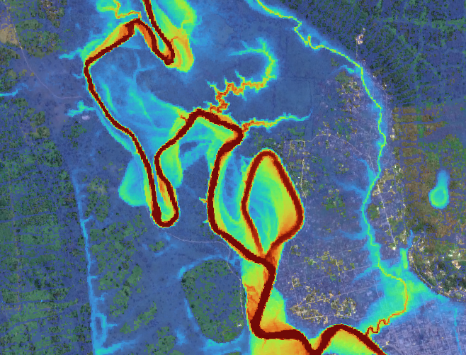
BG-Flood Modelling Software
BG-Flood is a shallow water equation (SWE) model, built upon the Saint-Venant formulation and adapted to a block Uniform Quadtree memory structure on the GPU.
This model is designed to simulate inundations caused by various factors such as rivers, rainfall, tsunamis, tides, storm surges, or any combination of these.
https://github.com/CyprienBosserelle/BG_Flood
Notes:
Example to the right is from a test run we did in Vanuatu for the recent Cyclone Lola

Slide 7
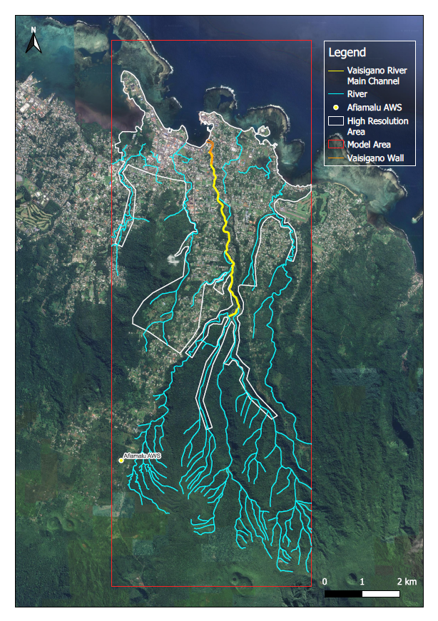
Vaisigano Test Model Set Up
Boundary box
Channels, walls, other features
Model High Resolution/ focus area
Notes:
We have been doing testing in the Vaisigano Catchment in Samoa
Highly studied catchment with good observational data available from weather stations and flow gauges
High resolution flood modelling has been done here in the past
GIS is an important tool that can be used to understand a catchment area and set up a model.

Slide 8
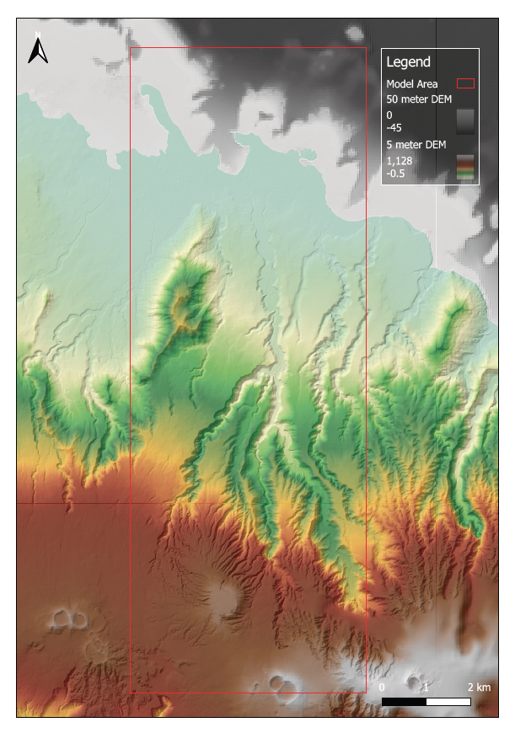
Model DEMs
50-meter Ocean Bathymetry DEM
5-meter composite DEM

Slide 9
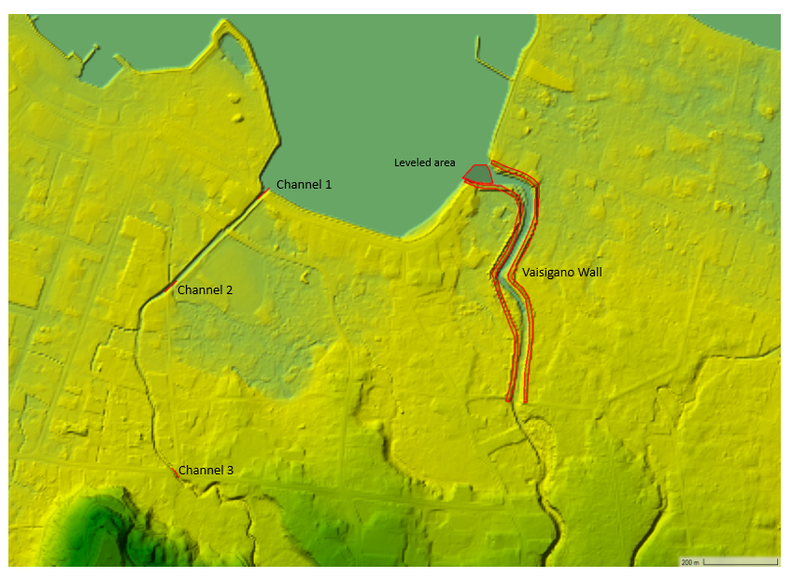
Hydraulic Conditioning of the Digital Elevation Model
Manual conditioning in HEC-RAS RAS-Mapper software
Automated process is being developed in New Zealand
Notes:
Like the 5meter DEMS that we have created we are also looking into a Hydraulic conditioning algorithm to automatically condition DEMS from using infrastructure data.
Which this is being developed for New Zealand with hope to transfer it to the Pacific, but this may be hindered but data availability challenges that we all know

Slide 10
Rainfall Input
Seconds | Rainfall Intensity (mm/hr)
0 | 0.00
7200 | 90.85
14400 | 0.00
Notes:
For testing we have used DDF values for tables developed in the Pacific High Intensity Design Rainfall research that was done at NIWA last year. The report is still currently under review.
I’ll keep moving forward as that us a whole ‘nother discussion.
But basically, DDF values for storm durations and ARI scenarios are taken from the table and distributed in a triangular temporal pattern where the peak rainfall intensity occurs at half the duration.
Input into the model looks like the table on the left.

Slide 11
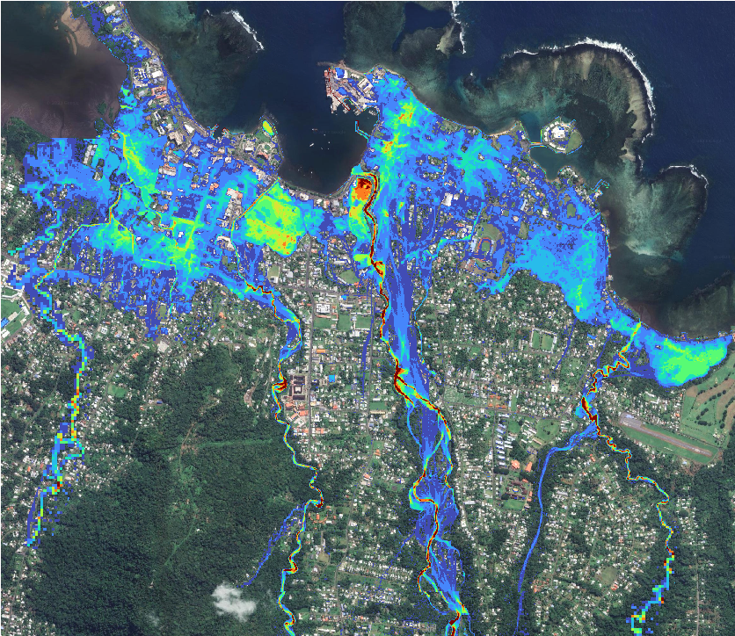
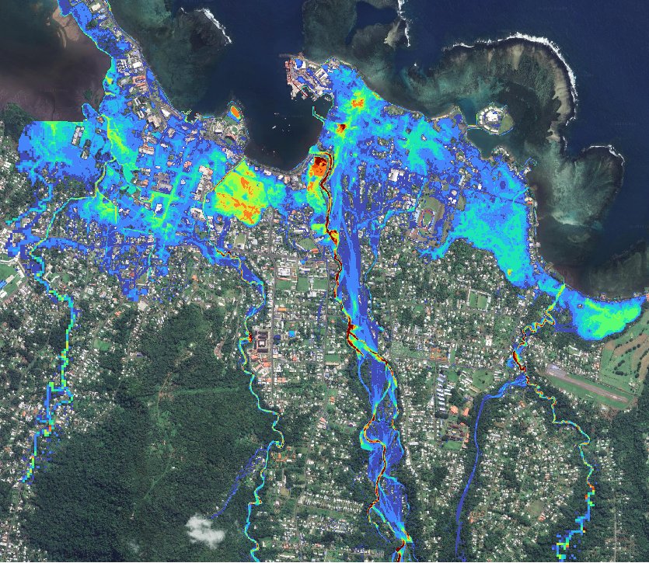
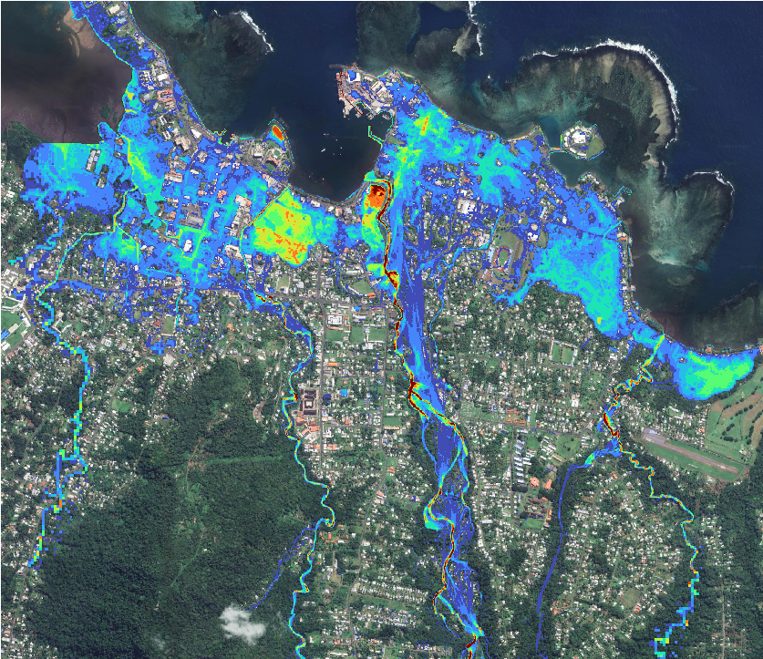
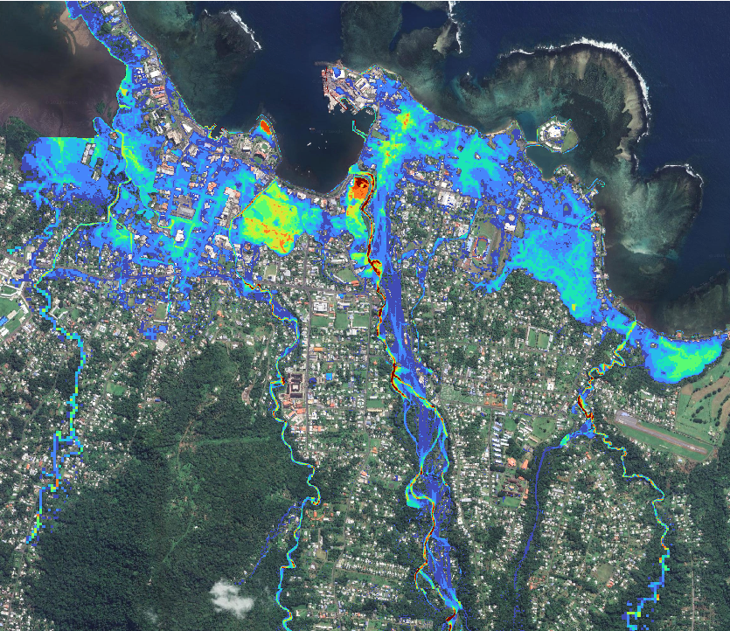
1hr 100Y
2hr 100Y
4hr 100Y
6hr 100Y
8hr 100Y
12hr 100Y

Slide 12
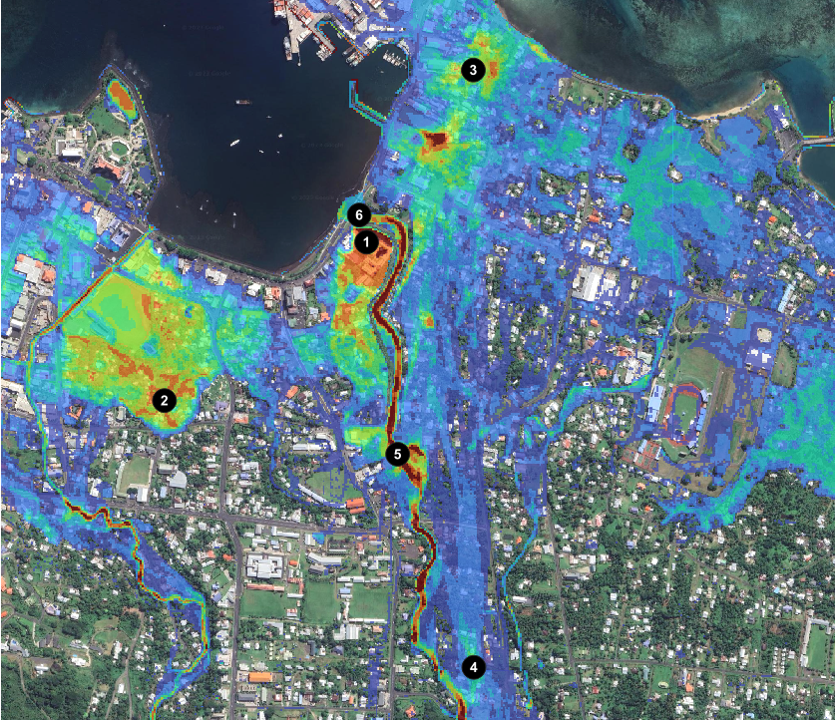
Time of Peak Flooding

Slide 13
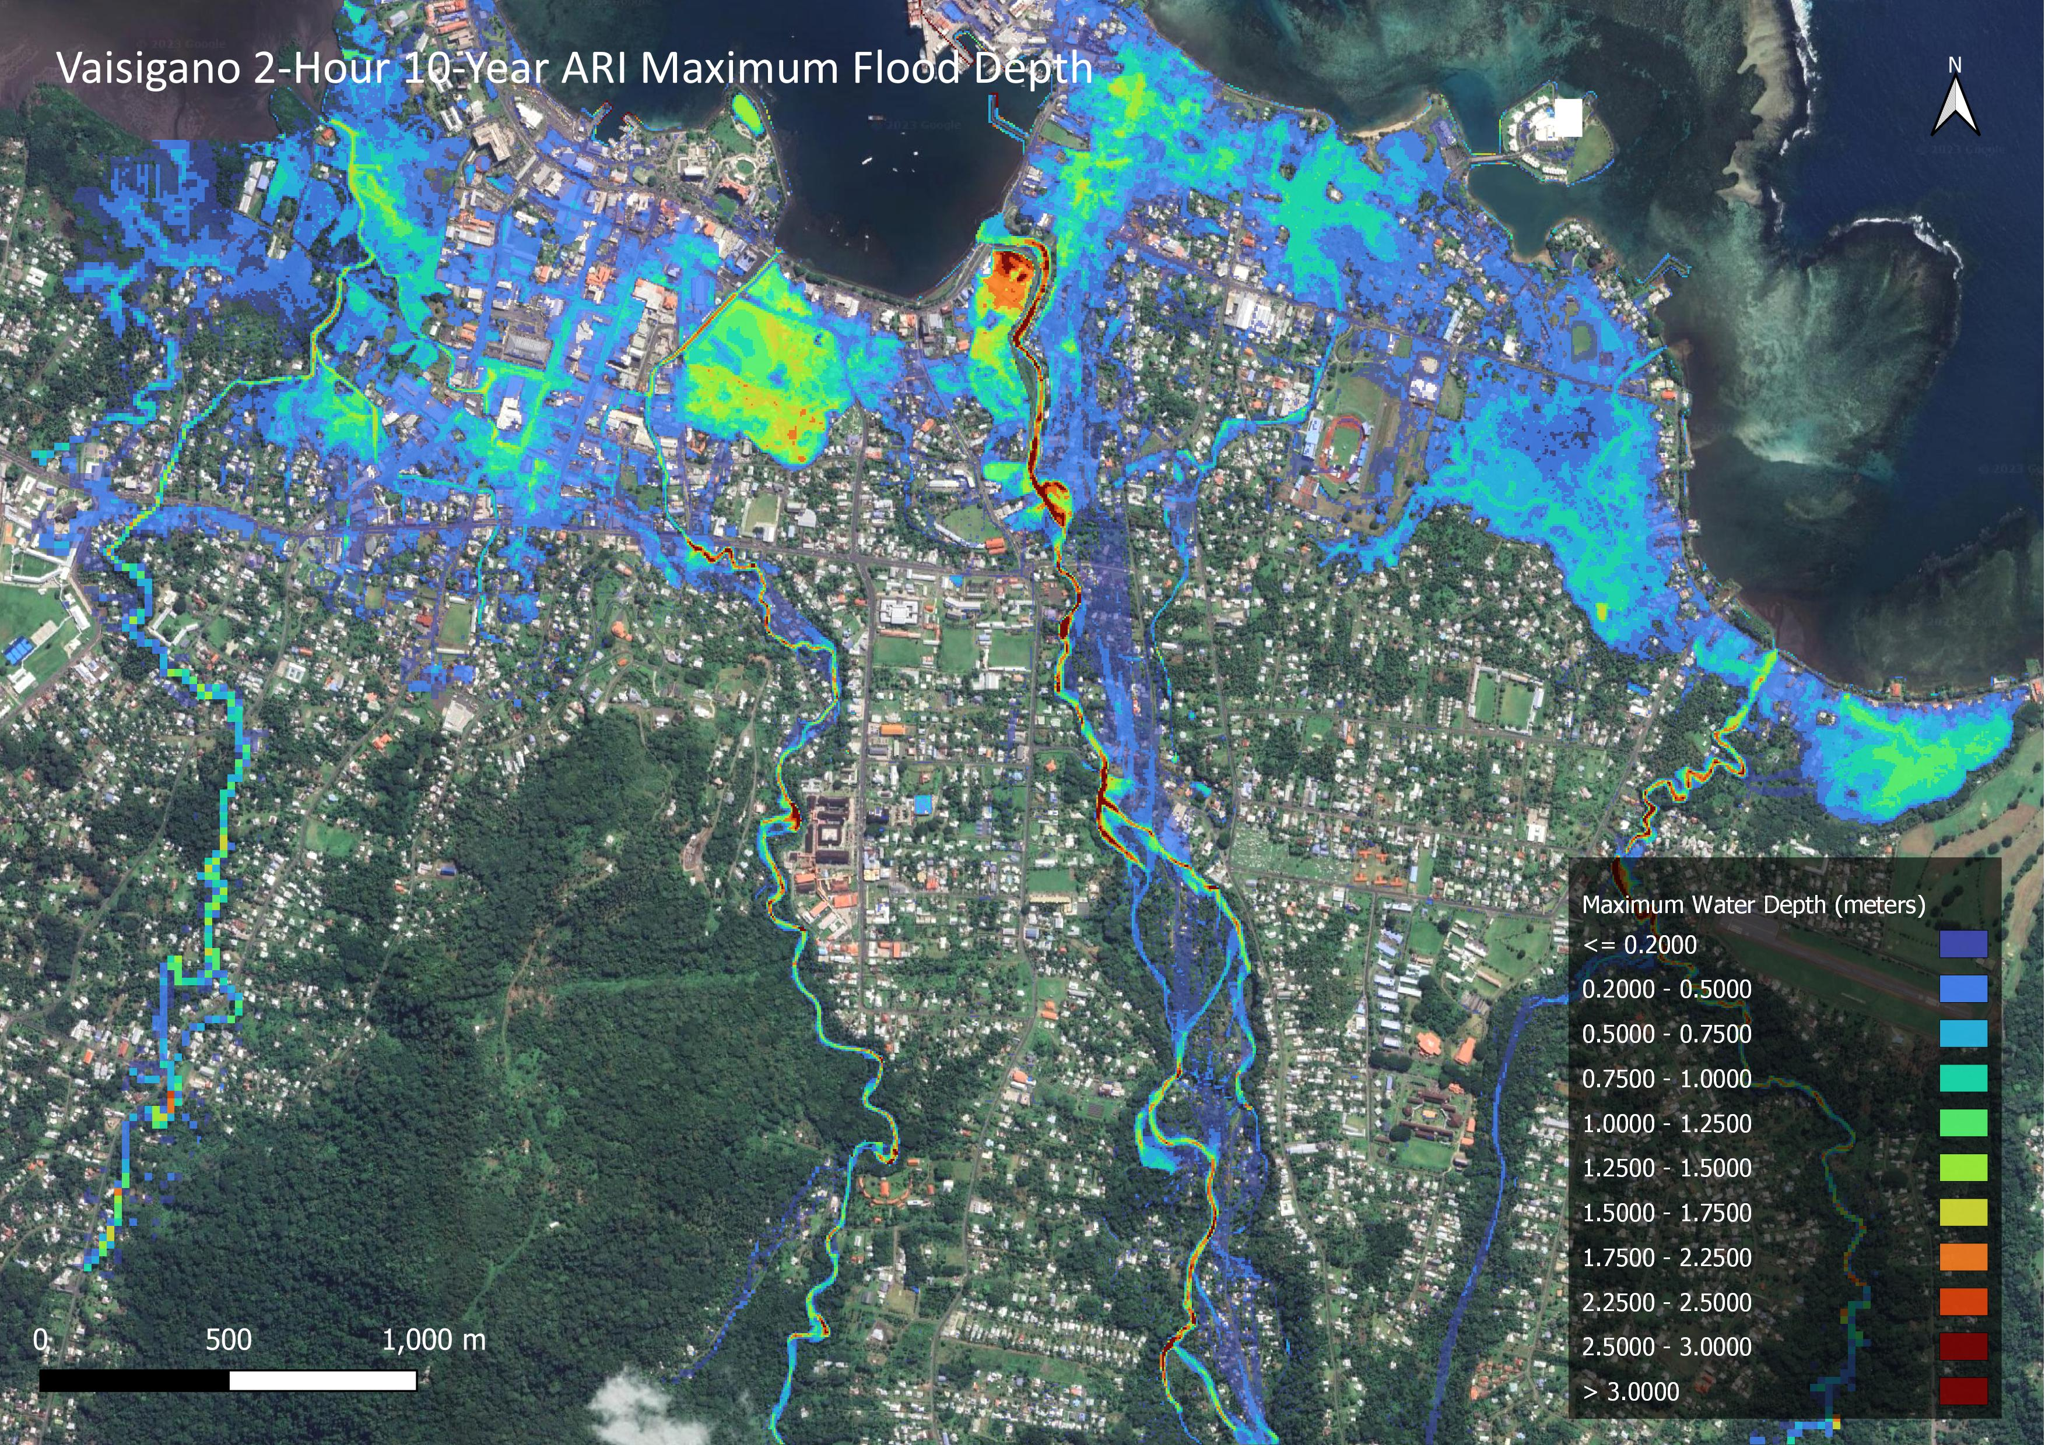

Slide 14
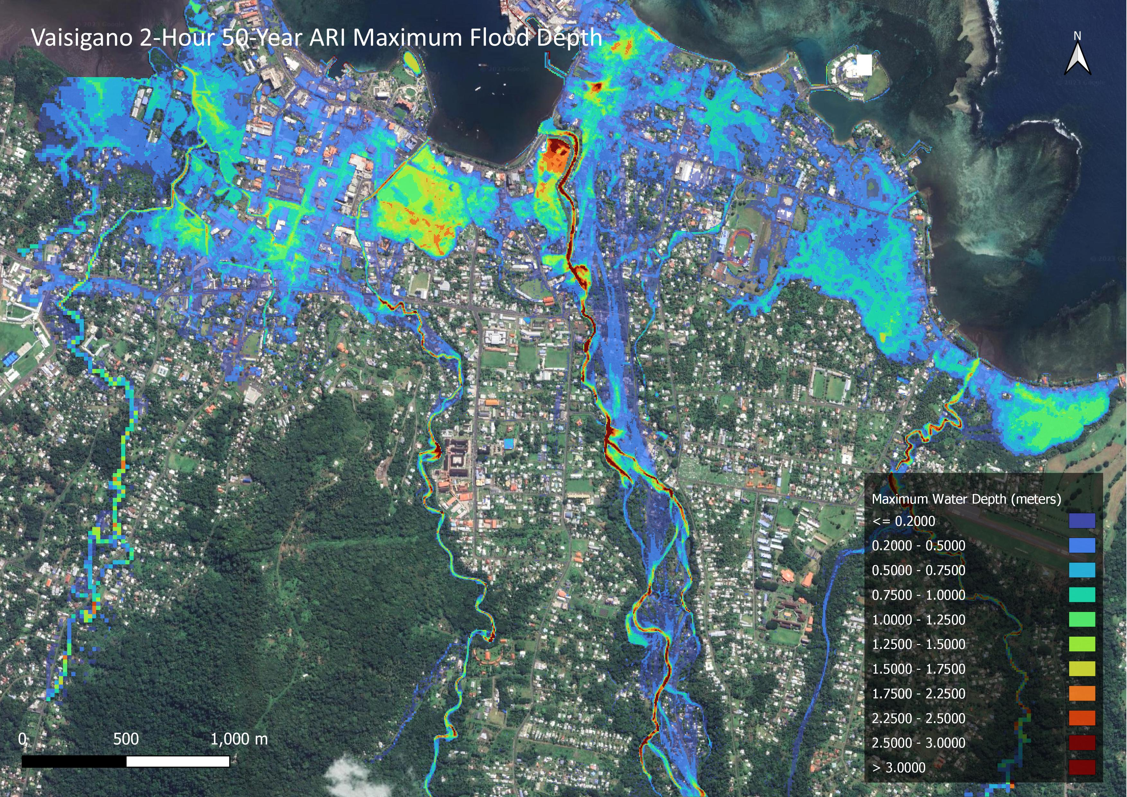

Slide 15
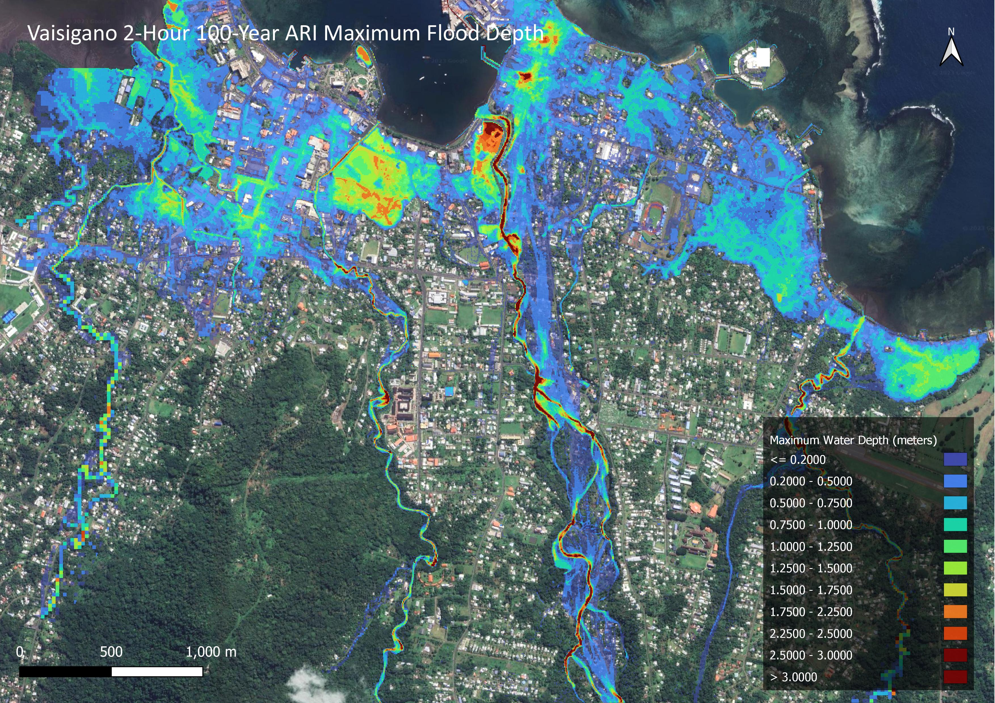

Slide 16
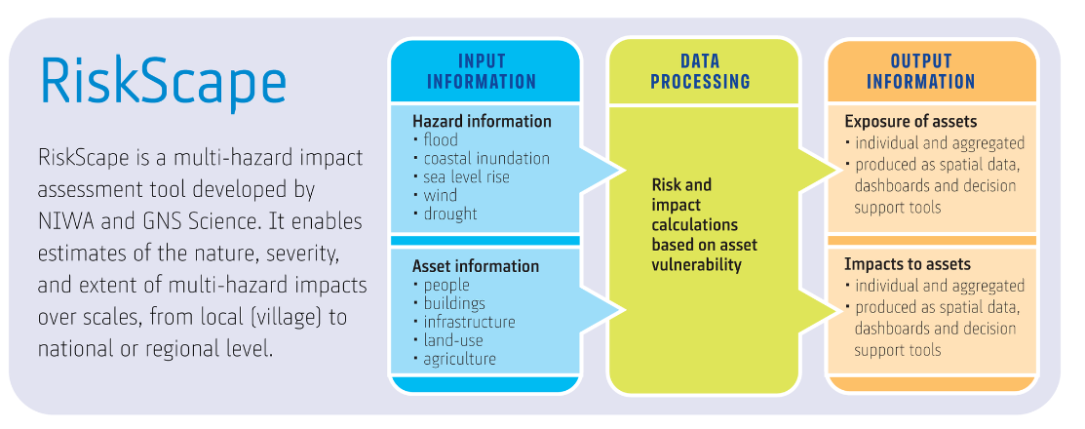
Riskscape Hazard Exposure Analysis

Slide 17
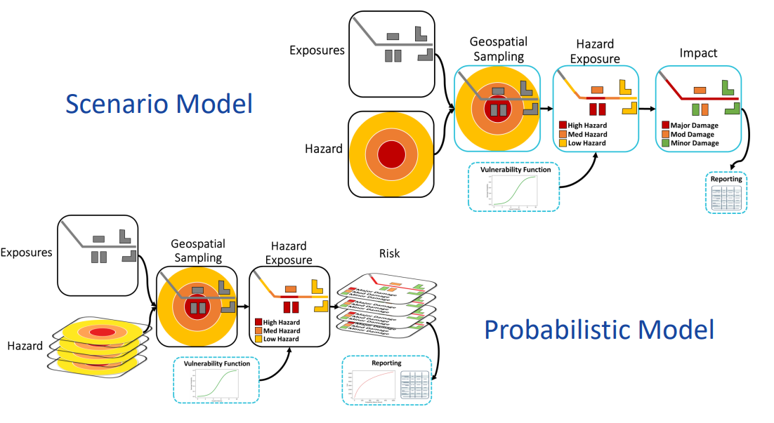
Riskscape Hazard Exposure Analysis
Fast computation times
Calculates loss functions on the fly
Flexible configuration
Can be used at national scale for hundreds of thousands of features

Slide 18
https://riskscape.org.nz/

Slide 19
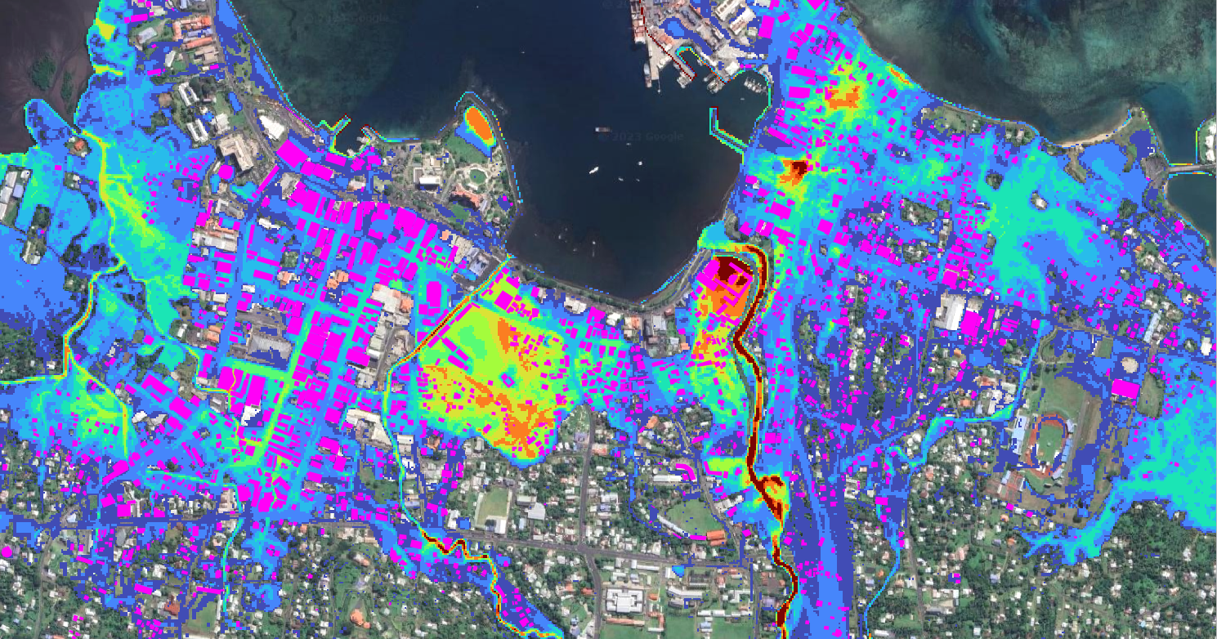
Identify Buildings Exposed

Slide 20
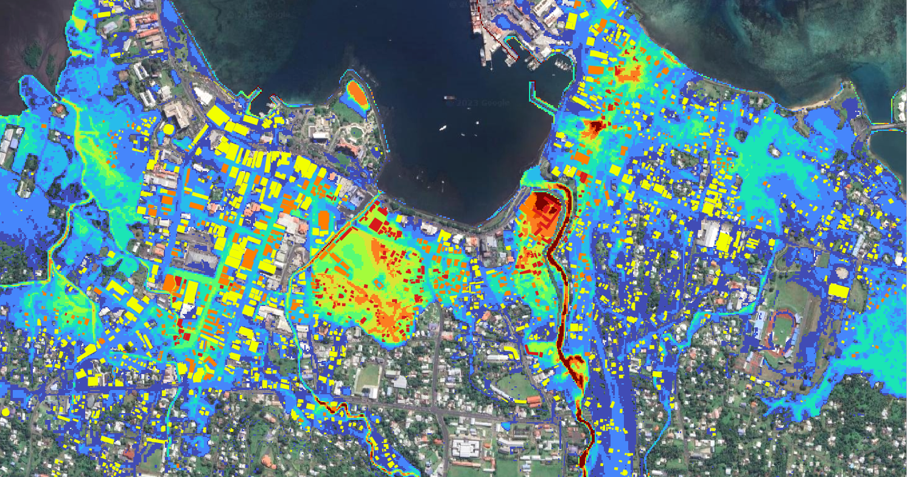
Assign Risk Levels

Slide 21
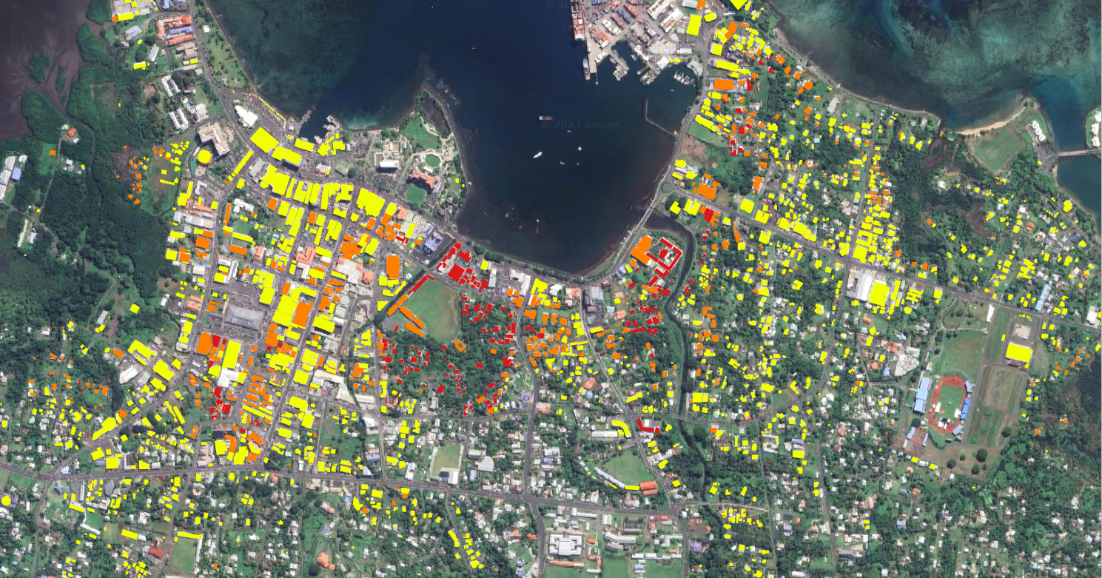
Quantify Loss Metrics

Slide 22
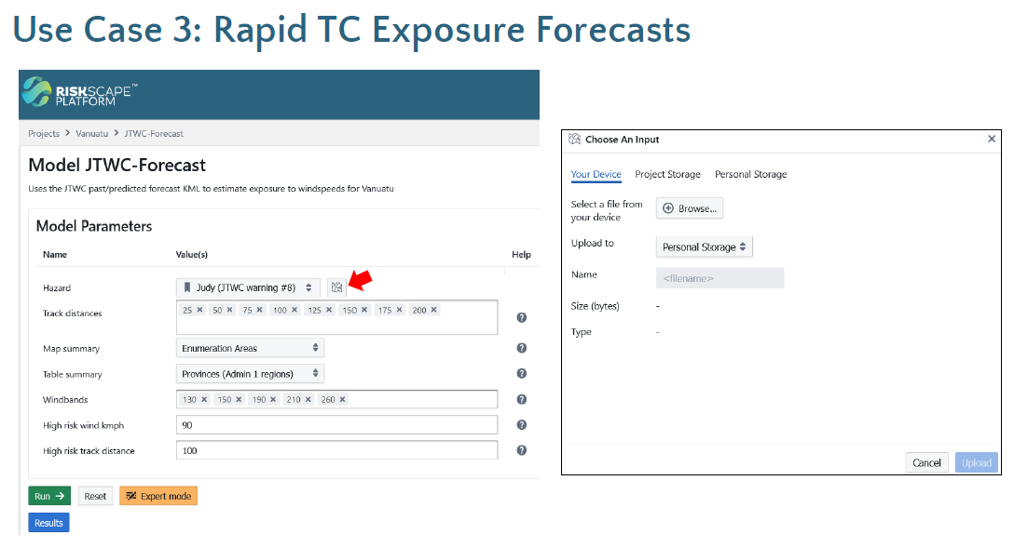

Slide 23
Final Remarks
Open-Source Software used in this study
QGIS – https://qgis.org/en/site/
HEC-RAS (RAS Mapper) - https://www.hec.usace.army.mil/software/hec-ras/
BG-Flood - https://github.com/CyprienBosserelle/BG_Flood
Riskscape – Risk and exposure analysis - https://riskscape.org.nz/
Next steps
Further validation and testing of model outputs against observational data
Collection and refinement of input data sets
Working with our Partner-2 countries to design operational means of delivery

Slide 24
Ka nui Tēnā mō tēnei wā Vinaka
(that’s enough for now)

