Slide 1
A Standardised approach to generating 5m DEMs of countries across the Pacific
Rose Pearson, Judith Giblin, Rebecca Welsh, Nicholas Metherall, Luisa Hosse, Shaun Williams
Nov 29th 2023

Slide 2
What is a DEM?
A digital representation of bare ground topography with trees, buildings and other ground cover excluded
Useful in hazard and risk assessment including storm surge, flood and landslides modelling
charim.net/datamanagement/32
https://www.sciencedirect.com/science/article/abs/pii/S0016706100000811
Notes:
Background – give an image of what a DEM is in the audiences head

Slide 3
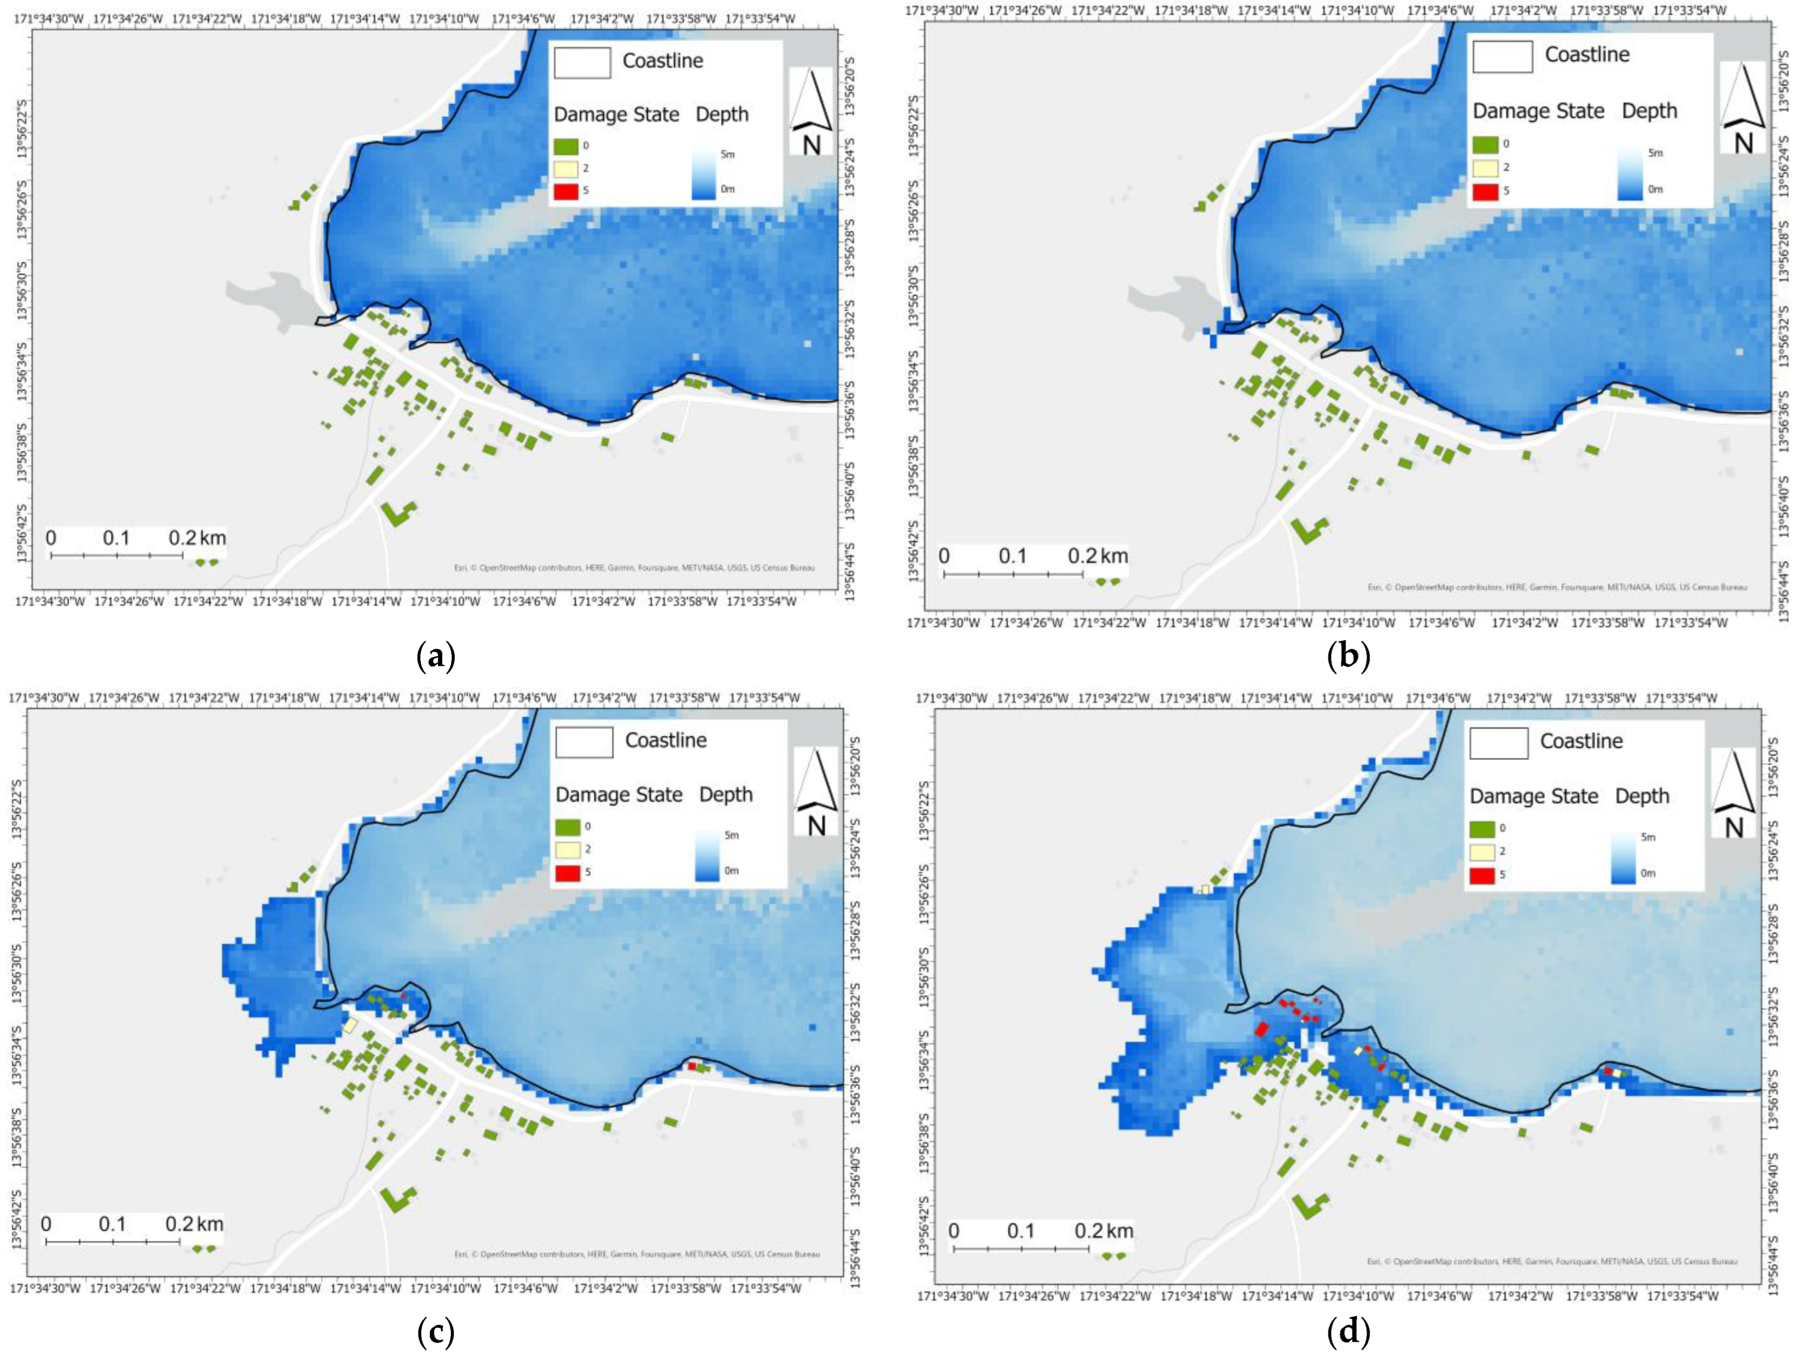
DEMs for increased resilience
Multihazard modelling
Tsunami Modelling
Storm Surge
Flood modelling
Contribute to land use planning
https://www.mdpi.com/2077-1312/11/5/945
Notes:
Why DEMs are useful and why the audience should care about DEMs

Slide 4
Limited Data in the Pacific
0.02% global population
15% global surface area
Large area & low population
Incomplete hi-res DEM coverage across many countries
Instances of satellite & other data behind paywalls
10.13140/RG.2.1.2678.3849
Notes:
The historical and ongoing challenges related to data in the pacific – the reason why there aren’t already high quality DEMs across all Pacific countries

Slide 5
Aim
Produce national-scale DEM datasets for all PARTneR-2 countries
Use LiDAR where it exists, global DEMs elsewhere
Ensure consistent and repeatable process to allow regeneration with new LiDAR
Notes:
The motivation behind this work is all around creating robust datasets for hazard risk modelling as part of PARTneR-2

Slide 6
PARTneR-2 Nations
Cook Islands
Republic of Marshall Islands
Samoa
Tonga
Tuvalu
Vanuatu
https://storymaps.arcgis.com/stories/399f72f61b47411c83633363a6472f20

Slide 7
Data Available
LiDAR
Point Cloud; 1m DEM
30m Global DEMs
Shuttle Radar Topography Mission (SRTM) DTM 2000
Multi-Error-Removed Improved-Terrain DEM (MERIT) DTM 2017-2018
Forest And Building removed DEM (FABDEM) 2022-2023
Country | LiDAR
Cook Islands | All islands (Release Q1 2024)
Republic of Marshall Islands | Ebeye (partial), Majuro (all)
Samoa | Savai’i (all), Upolu (all)
Kingdom of Tonga | Tongatapu, Lifuka, ‘Eua, Tafahi, Vava’u
Tuvalu | All
Vanuatu | Espiritu (partial), Efate, Malakula, Tanna
https://iopscience.iop.org/article/10.1088/1748-9326/ac4d4f/pdf

Slide 8
FABDEM selection where no LiDAR
Analysis by others
Pacific specific analysis
LiDAR DEMs vs SRTM, MERIT & FABDEM
Samoa (High volcanic), RMI (Atolls), Vanuatu (High islands)
FABDEM selected as lowest overall bias across the datasets
https://www.fathom.global/insight/fabdem-versus-merit-dem-a-visual-comparison/
Notes:
Best with the most momentum. We have chosen to do this but we can do this with others, SRTM is older
Analysis internally (Samoa, RMI, Vanuatu) of FABDEM and LiDAR, SRTM was worse but FABDEM & MERIT was similar but MERIT did less well for one island so we chose FABDEM.
Also FABDEM is being actively worked on. The latest FABDEM release was a few months ago.

Slide 9
Approach – example Efate
Island outline from OSM
30m FABDEM clipped
Up-sample FABDEM
Down-sample LiDAR DEM
Patch in LiDAR DEM
Upload to Nexus
Notes:
This shows the approach applied everywhere
Start with OSM, too find island boundary and then clip the FABDEM, then combine with LiDAR and resample to 5m.
Uploading it to NEXUS so it is available to the audience
Where there is no LiDAR data available (or that we have access too) the FABDEM is used exclusively.

Slide 10
Produced products
Country | Grouping | Number of DEMs* | DEMs from LiDAR (2023) | DEMs from LiDAR (Q1 2024)
Cook Islands | Main Island | 13 | 0 | 12
Republic of Marshall Islands | Island/Atolls | 28 | 2 | 2
Samoa | Main Island | 2 | 2 | 2
Tonga | Main Island | 9 | 0 | 5
Tuvalu | Island/Atoll | 9 | 9 | 9
Vanuatu | Provinces | 6 | 2 | 4
* All Islands/Atolls included. Some DEMs include multiple Islands/Atolls.

Slide 11
NEXUS Access
V1 Uploading
Periodic releases expected
Next release Feb. 2024
Tonga, Vanuatu & Cook Islands LiDAR
FABDEM V1-2
https://nexus.pacificdata.org/#/
Notes:
Thanks to Samantha Krawczyk for overseeing the upload
Meta data included with datasets
Will be periodically updated

Slide 12
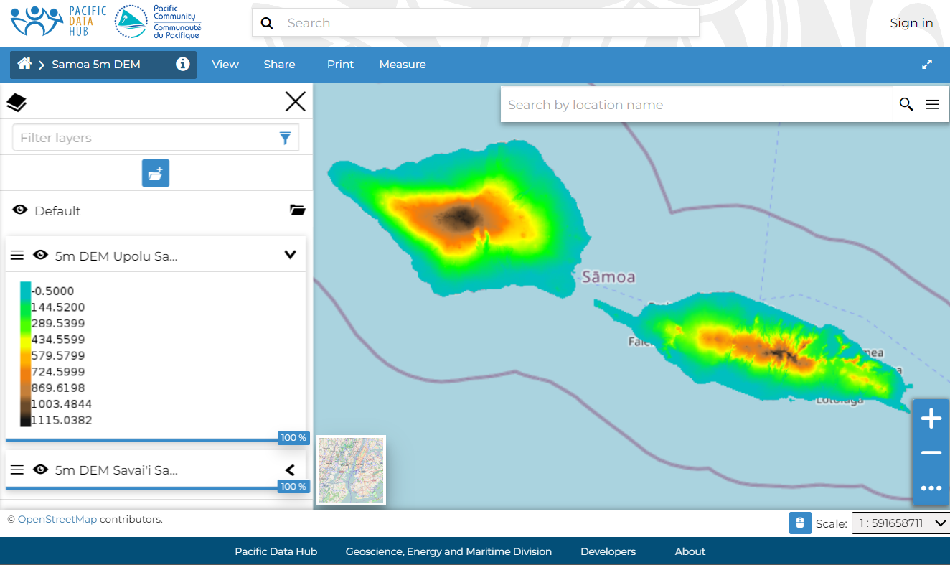
Samoa DEM
Savai’i: https://nexus.pacificdata.org/catalogue/#/dataset/21419
Upolu: https://nexus.pacificdata.org/catalogue/#/dataset/21420
https://nexus.pacificdata.org/catalogue/#/map/21421

Slide 13
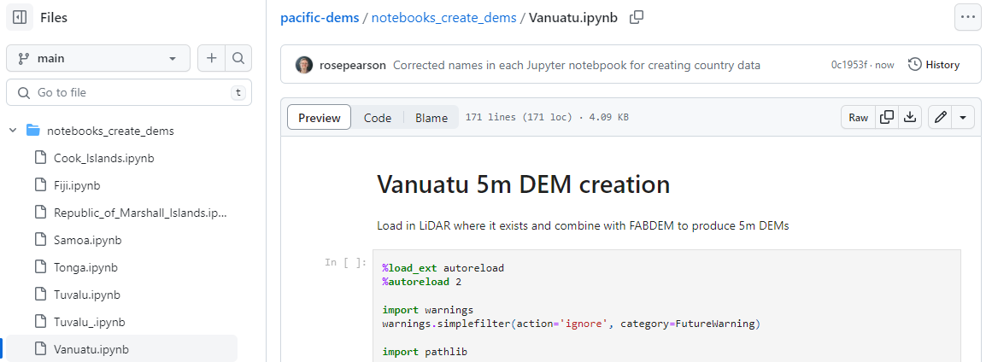
Generating your own DEMs
Open-Source GitHub Repository
Python Scripts and Jupyter Notebooks
Easy re-run as new data available
Free for others to use
https://github.com/niwa/pacific-dems

Slide 14
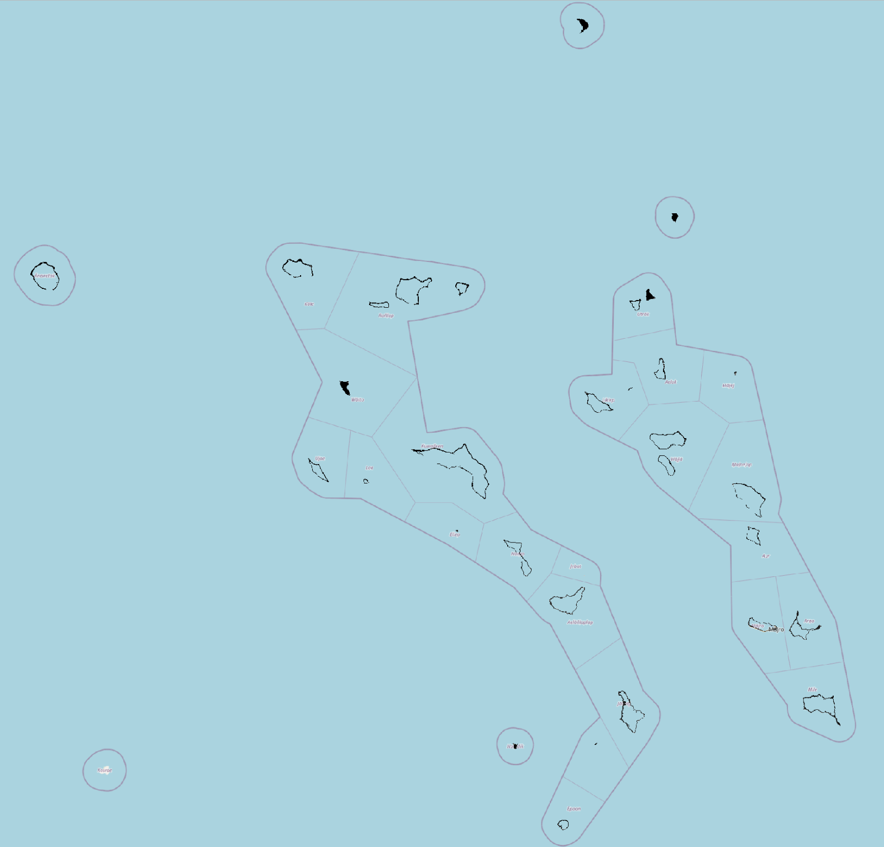
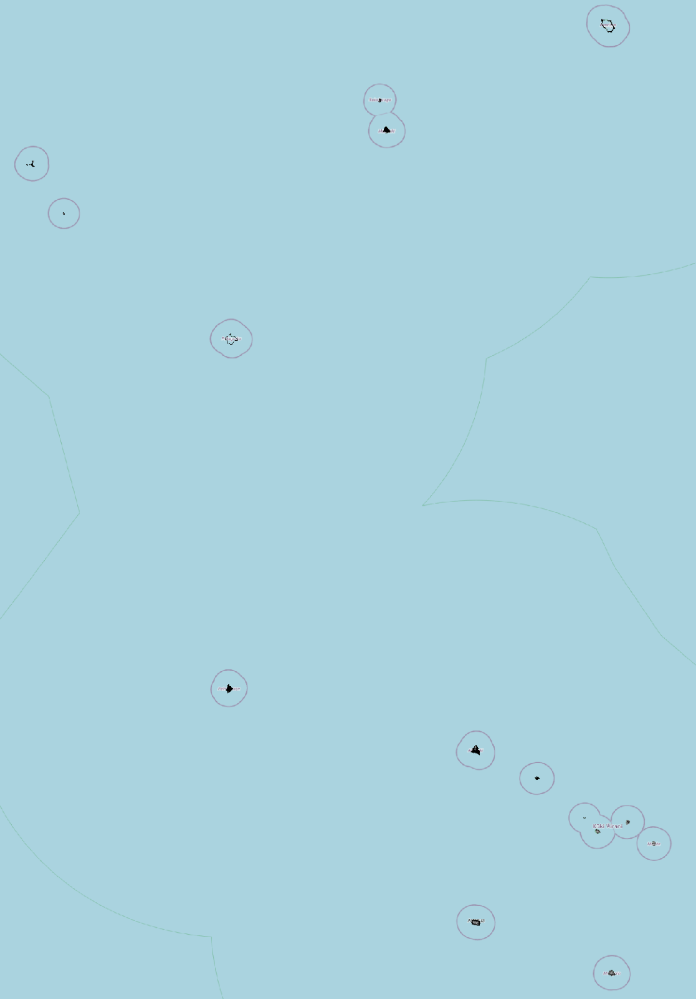
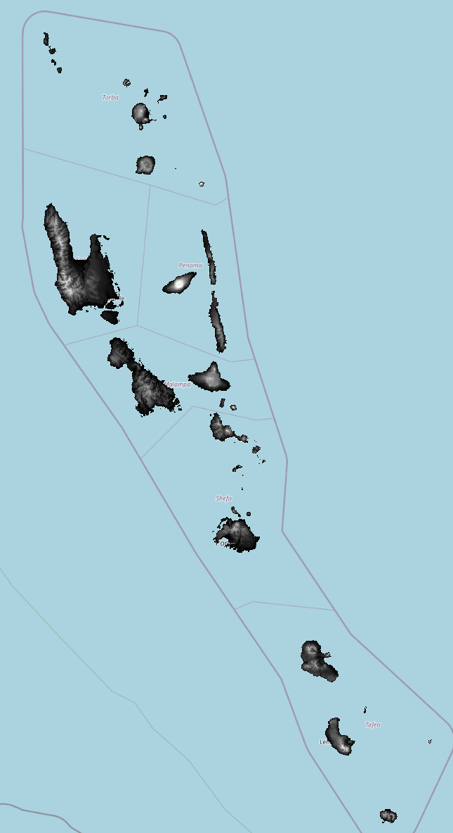
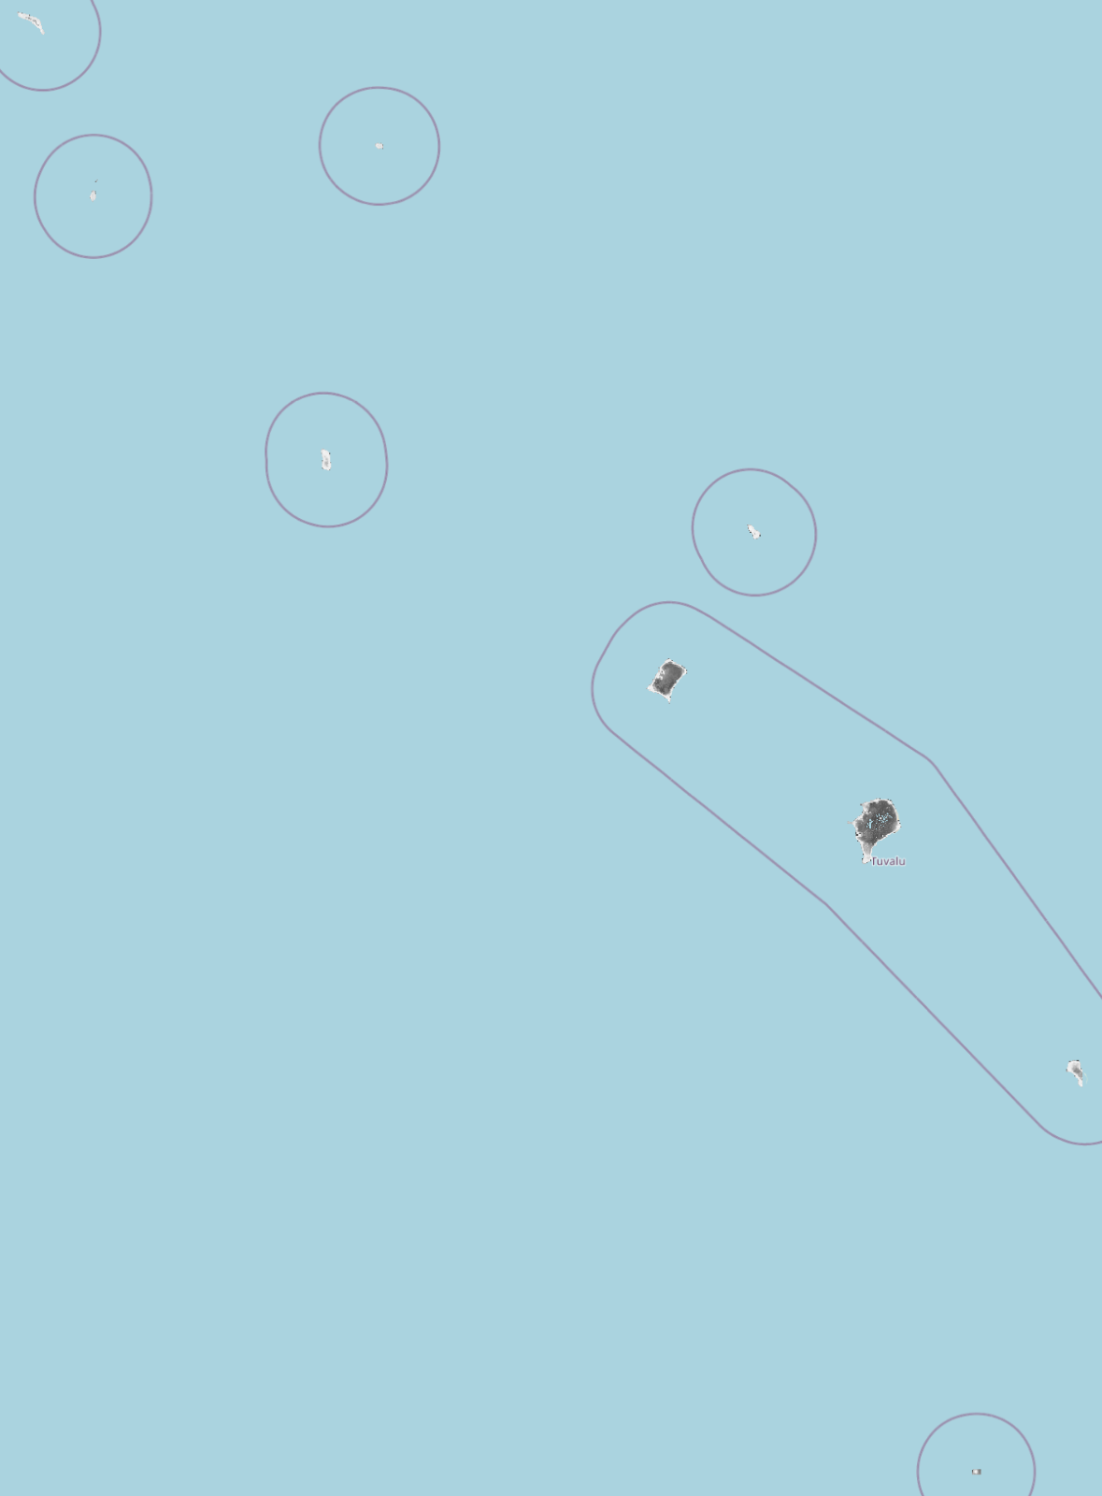
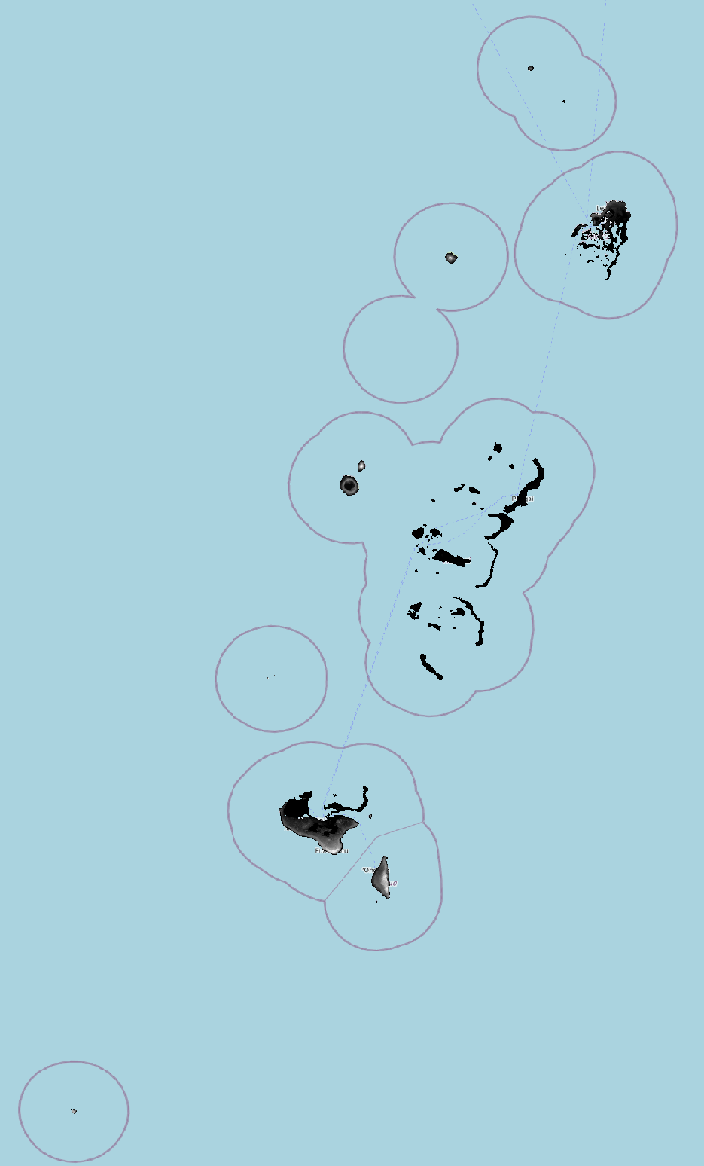
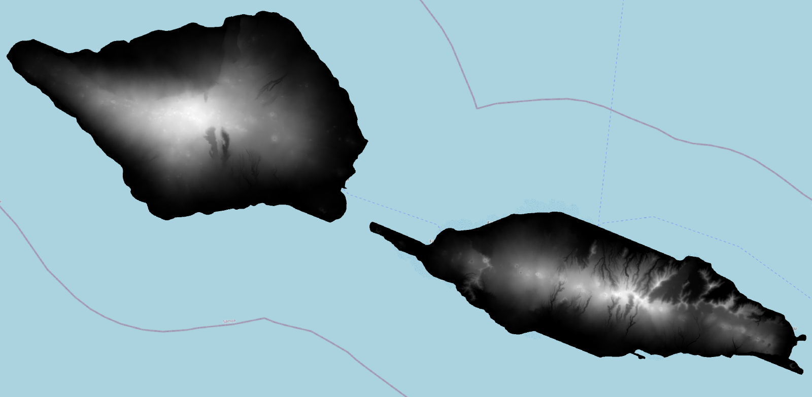
Country DEMs
Cook Islands
Republic of Marshall Islands
Samoa
Tonga
Tuvalu
Vanuatu

Slide 15
Future work
Rerun for new LiDAR & FABDEM
Apply to new Countries
Produce other resolution DEMs

Slide 16
Thank you
Vinaka Vakalevu
Tangkiu tumas Meitaki Ma’ata Kommol tata Faafetai Malo ’aupito Fakafetai
Contact:
Rose Pearson – Rose.Pearson@niwa.co.nz
Judith Giblin -
judithg@spc.int

