Slide 1
Monitoring the state of mangrove in the pacific
Pierre Audisio
Marc Despinoy
Lea Moyon
Franck Nivole
27/11/2023

Slide 2
Summary
I. MangMap - Prototype platform for operational satellite monitoring of mangroves
II. Mangrove products for the Pacific
a) Field data acquisition
b) Data processing and analysis
III. Outlook for the platform

Slide 3
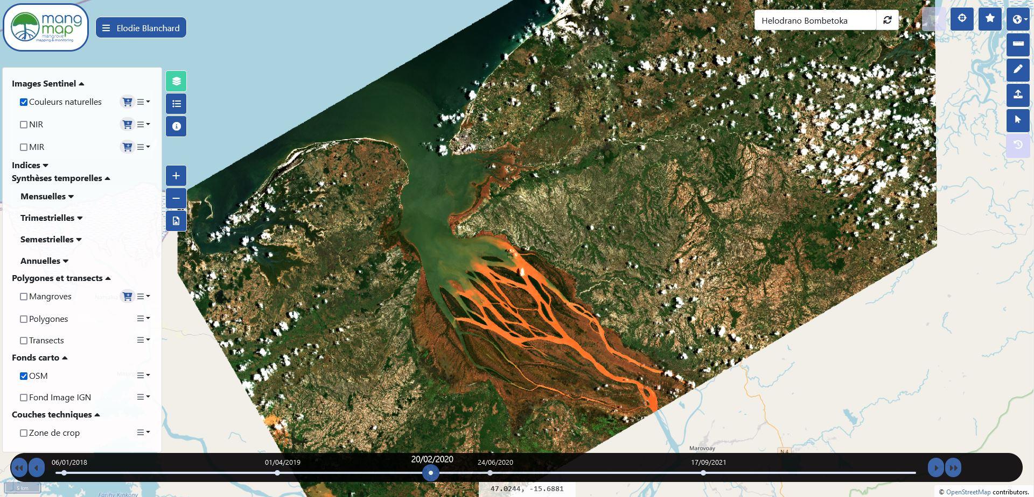
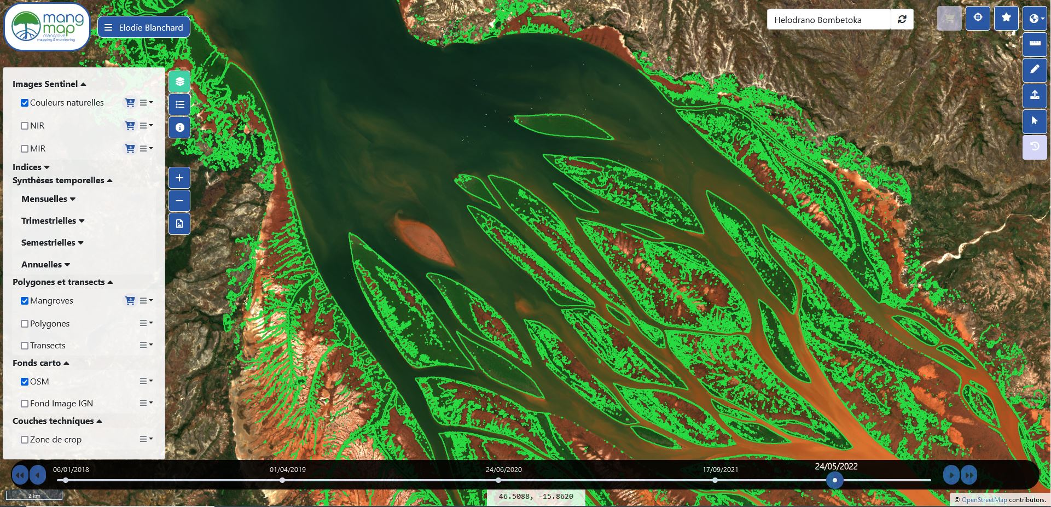
I. Prototype - General interface and display of data over time 3/12
Interface overview
Bombetoka Bay - Madagascar
Mangrove map
Bombetoka Bay - Madagascar

Slide 4
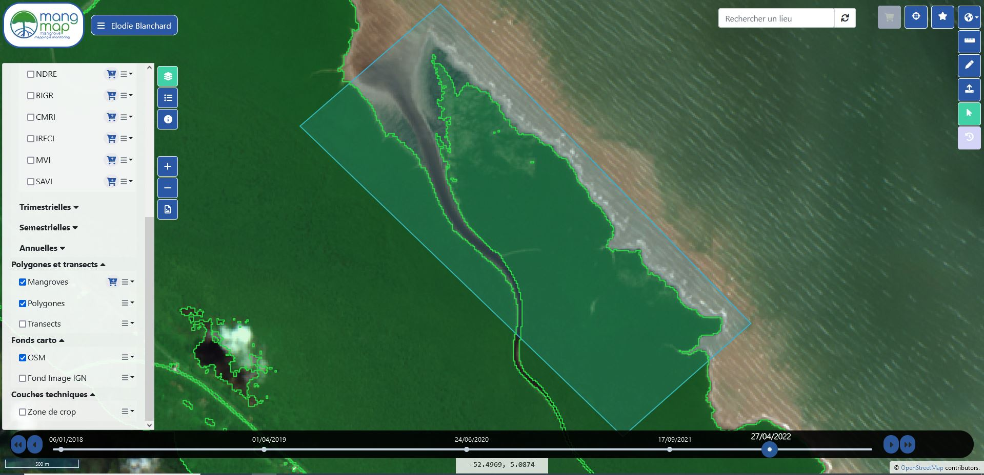
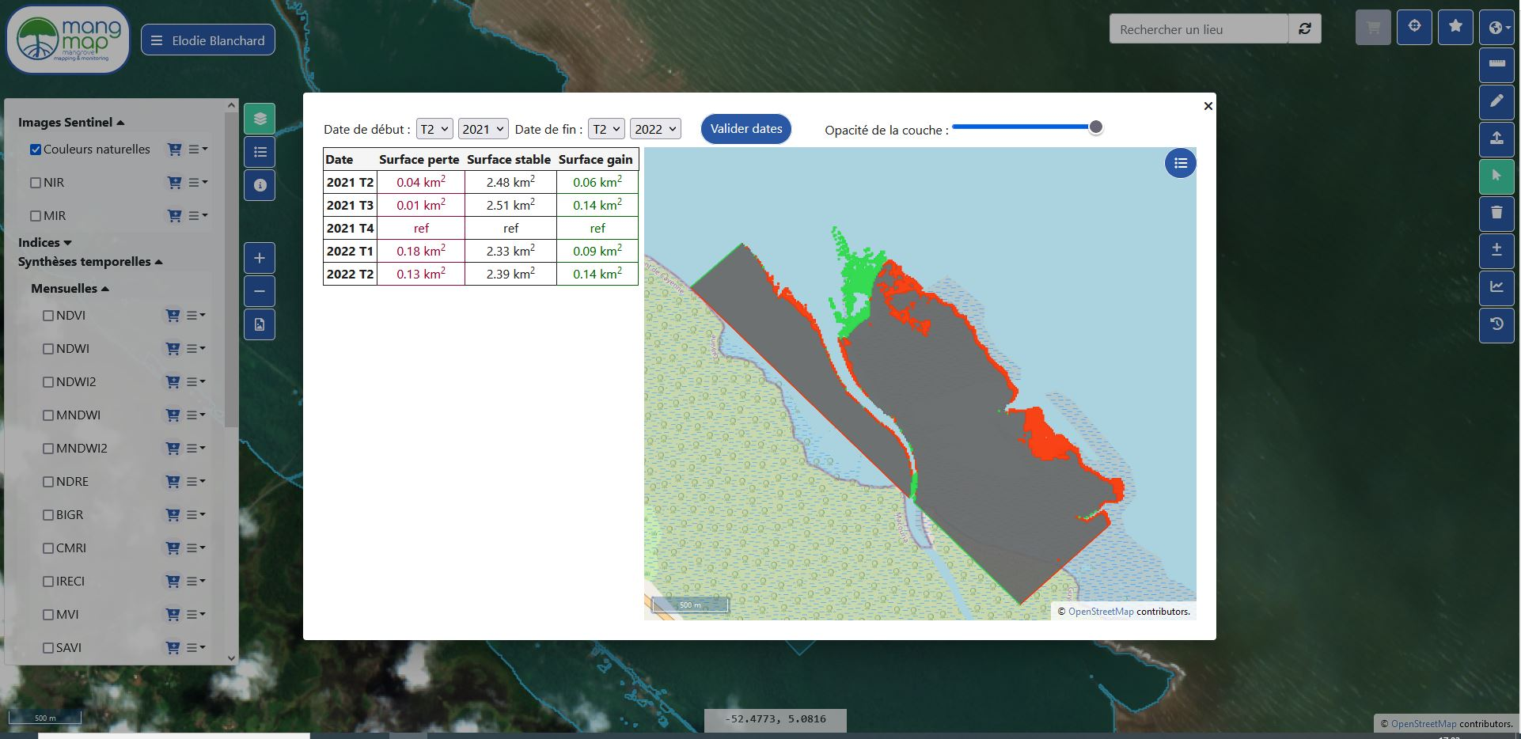
I. Prototype - Estimation of mangrove areas and trends 4/12
Creating a polygon around an area of interest
French Guiana mangrove
Analysis of mangrove spatial evolution

Slide 5
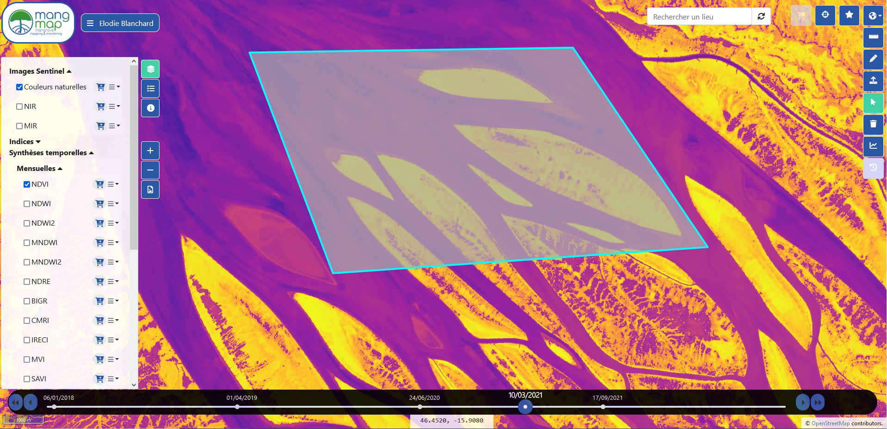
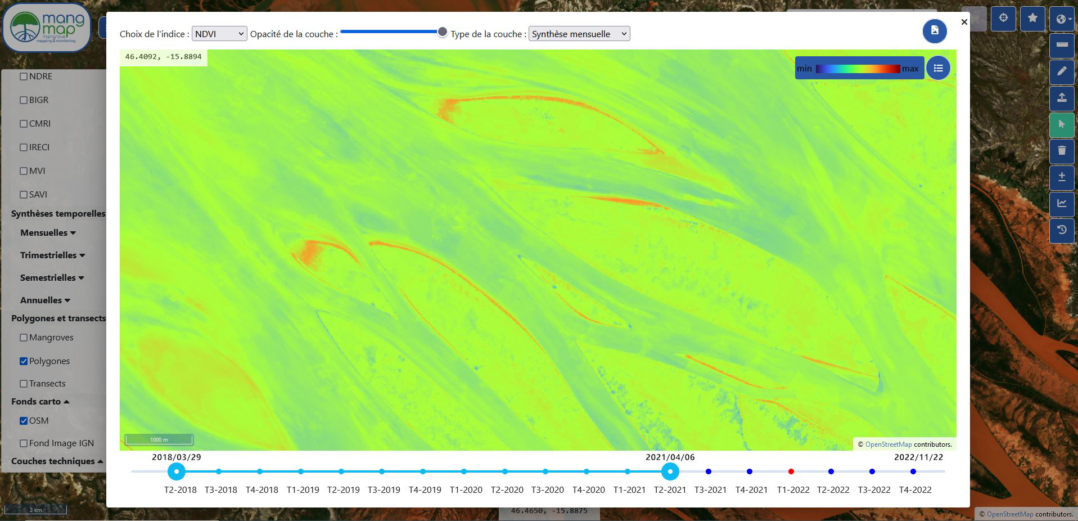
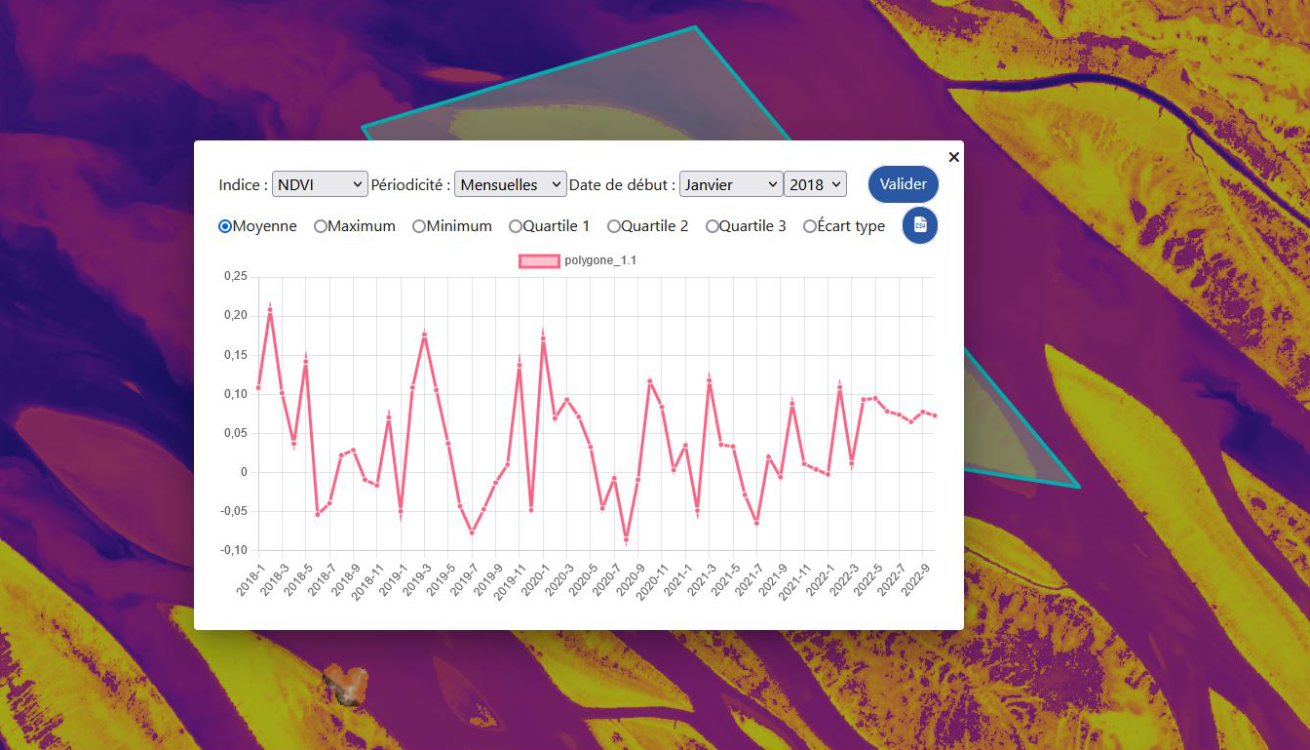
I. Prototype - Display the temporal evolution of an index over a selected area 5/12
Various possibilities for visualizing variations in a spectral index over time.
Choice between twelve spectral indices
Possibility of defining the periodicity of readings

Slide 6
II. Mangrove products for the Pacific 6/12
What we would like
1. Map of above-ground biomass in mangrove forests
2. Estimating carbon storage
3. Estimating foliage density
What we need
Empirical data
Forest inventory:
Tree height / diameter
Species recognition
Tree count
Bio-physical data
Canopy cover
Leaf Area Index

Slide 7
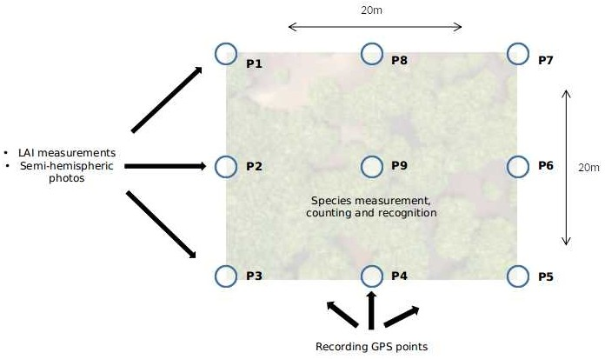
II. Mangrove products for the Pacific - Field data acquisition 7/12
To each point:
- Measurement with LAI meter
- Taking of semi-hemispherical photos
- Recording of GPS coordinates
In the entire plot :
- Measuring tree heights and diameters
- Species recognition
- Counting all trees in the plot

Slide 8
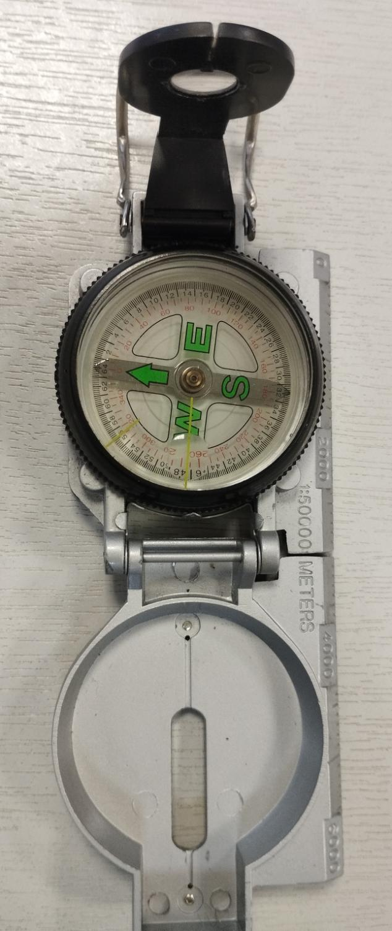
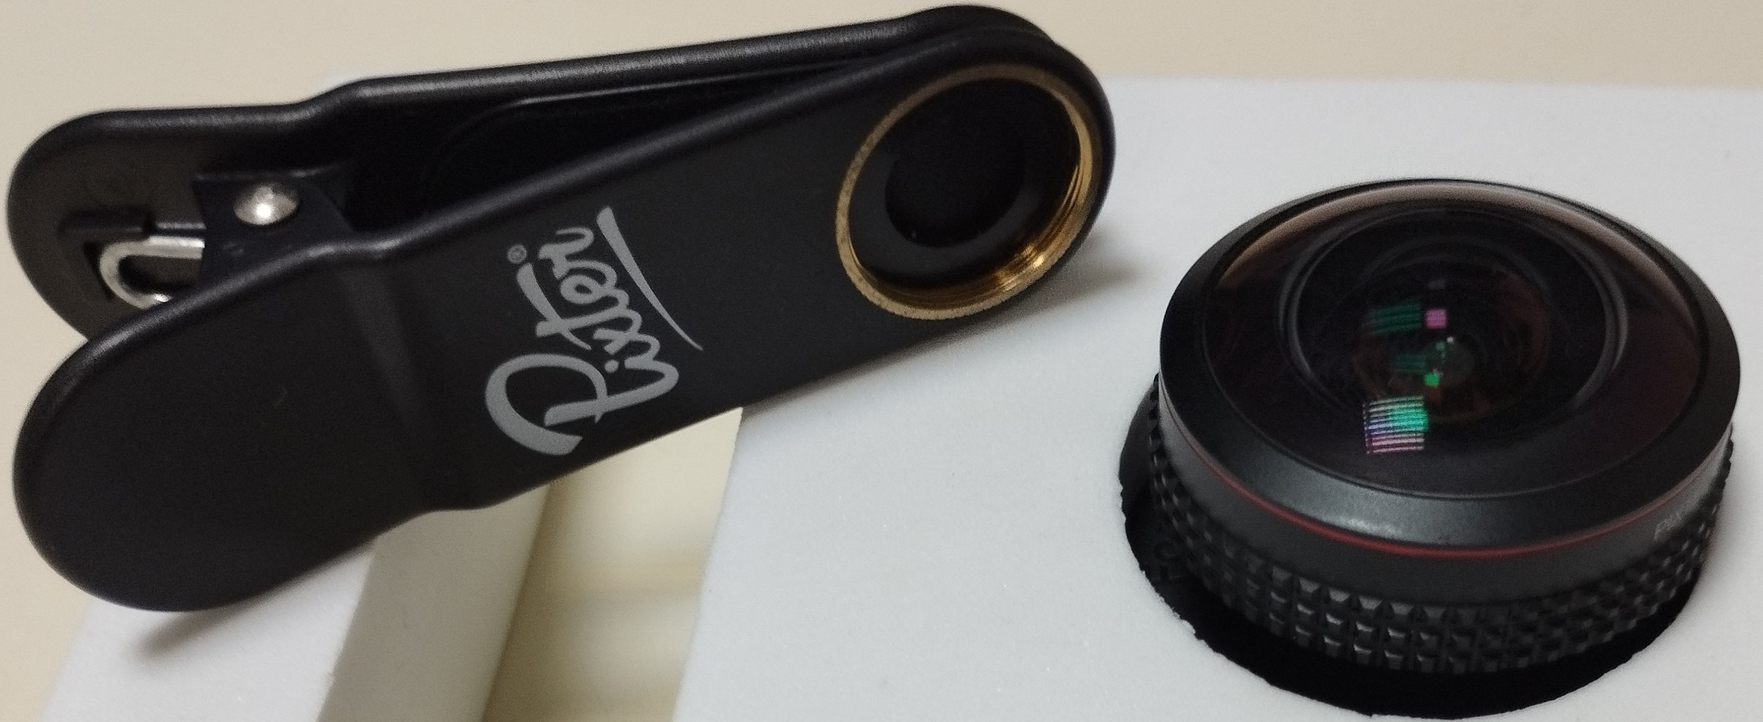
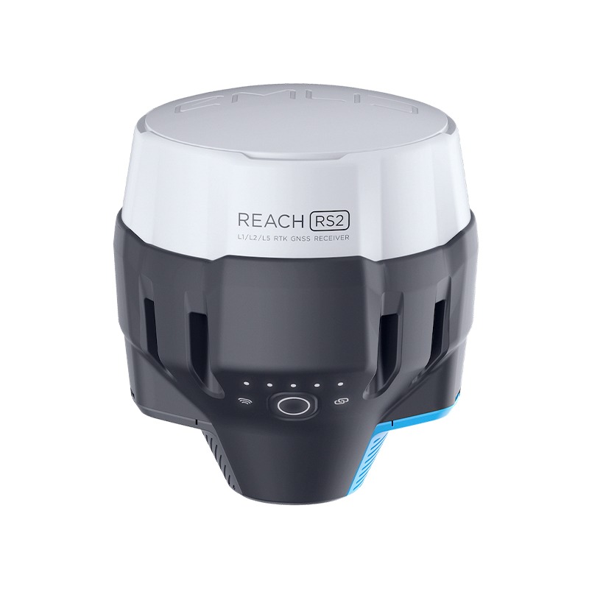
II. Mangrove products for the Pacific - Field data acquisition 8/12
Instruments used :
* Compass (a)
* Colored tape (b)
* Fish Eye lens (c)
* Decameter (d)
* GPS Emlid reach rs2 (e)
* LAI meter (f)
(b)
(c)
(a)
(d)
(e)
(f)

Slide 9
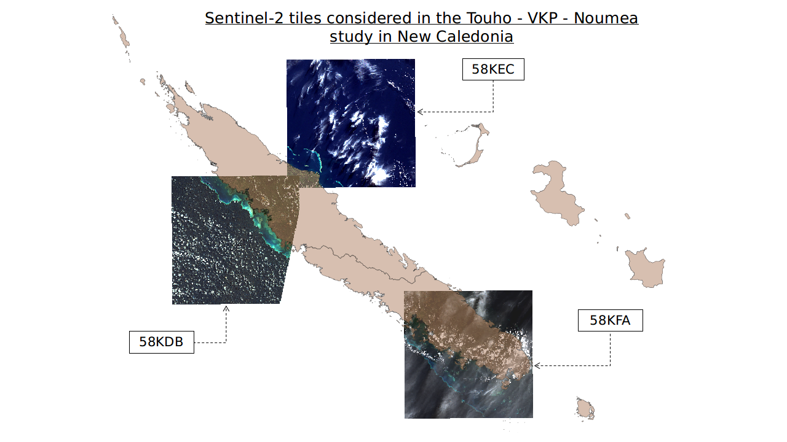
II. Mangrove products for the Pacific - Field data acquisition 9/12

Slide 10
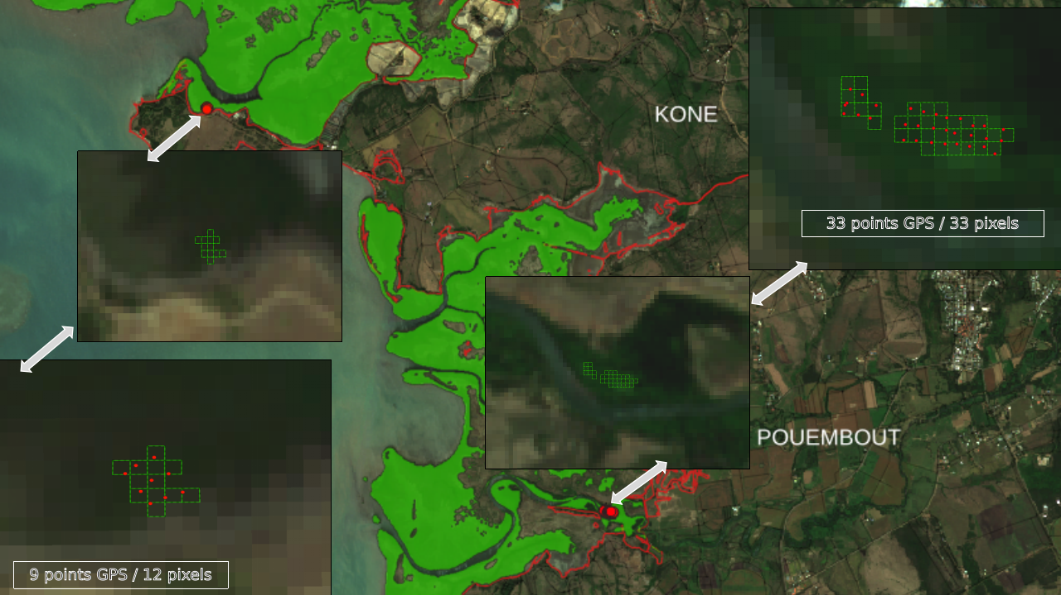
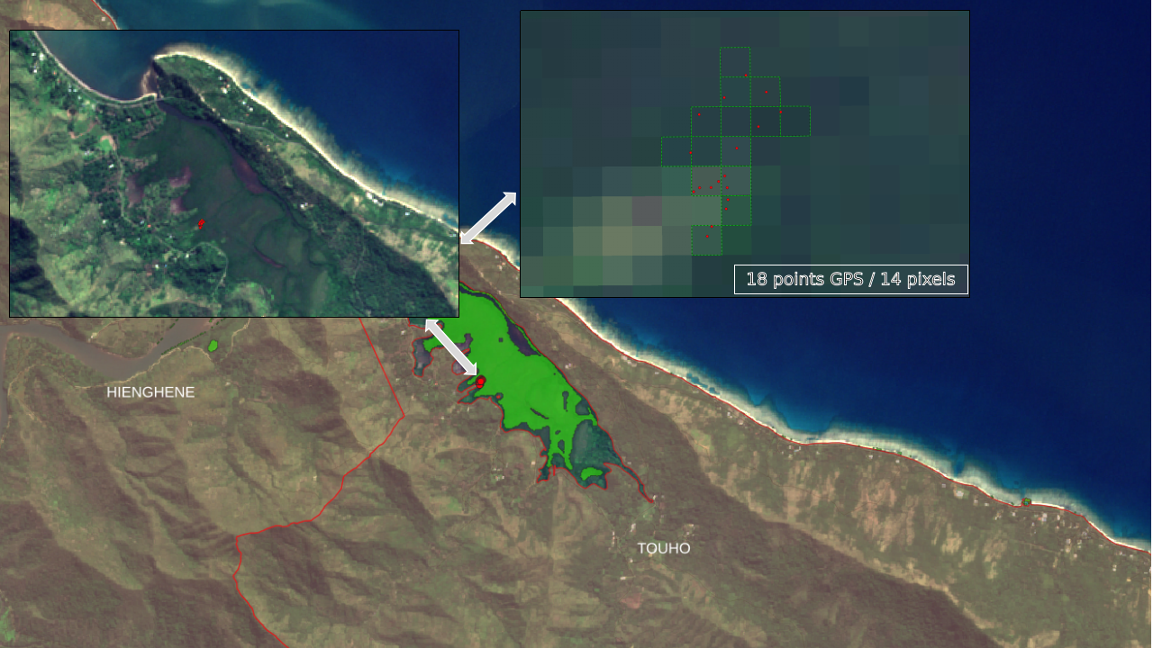
II. Mangrove products for the Pacific - Field data acquisition 9/12
New-Caledonia, West coast
Towns of Koné and Pouembout
New-Caledonia, East coast
Tiouande Bay

Slide 11
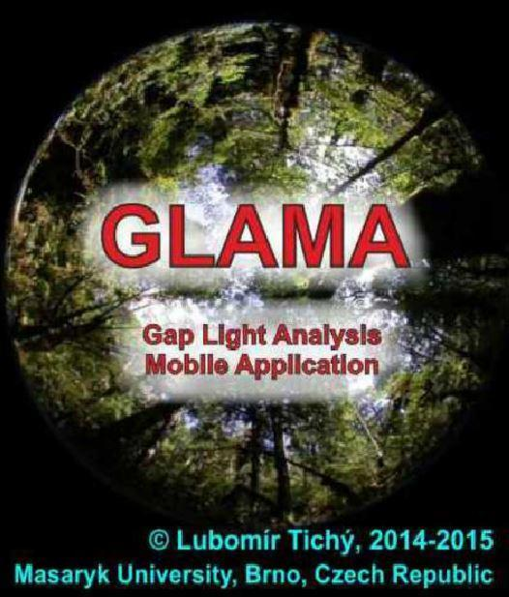
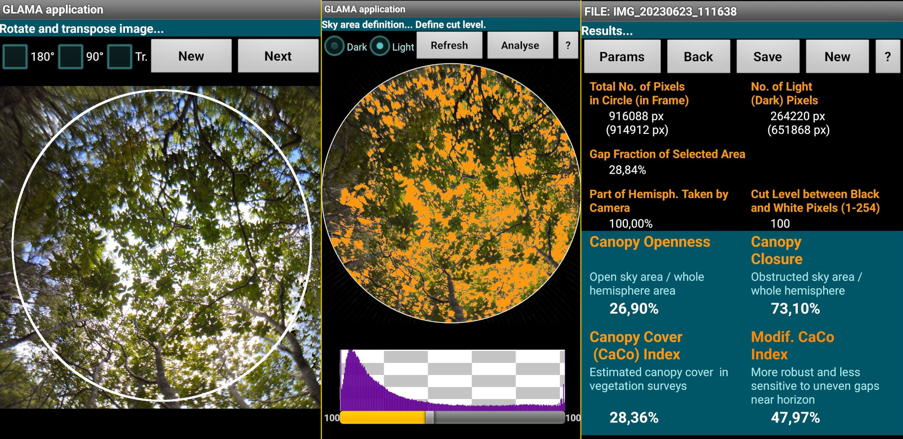
II. Mangrove products for the Pacific - Data processing and analysis 10/13
Two methods were tested for the analysis of semi-hemispherical photos:
One uses a freely accessible R code, Hemiphot.R
The other uses GLAMA an application that can be downloaded onto a cell phone
Hemiphot.R
(Hans ter Steege (2018))
This enabled us to determine the following indicators:
Canopy Cover
Canopy Closure
Leaf Area Index
Gap Fraction
Use example of use of GLAMA

Slide 12
II. Mangrove products for the Pacific - Data processing and analysis 11/13
To calculate above-ground biomass, we used and compared different allometric equations.
The equations have been separated into two broad categories :
Specific equations
Non-specific equations
The abbreviations used :
AGB : Above Ground Biomasse
DBH : Diameter Breast High
Specific equations
Non-specific equations
Avicennia Marina
Nom vernaculaire: Paletuvier gris (NC), Palétuvier Blanc (Mayotte)
ABG = 0.308*DBH^{2.11}
A. Komiyama et al. (2008)
AGB = 0.1848*DBH^{2.3524}
Dharmawan and Siregar (2008)
Rhizophora Stylosa
Nom vernaculaire: paletuvier rouge
AGB = 0.105*DBH^{2.68}
Clough and Scott (1989)
Chave et al. (2005)

Slide 13
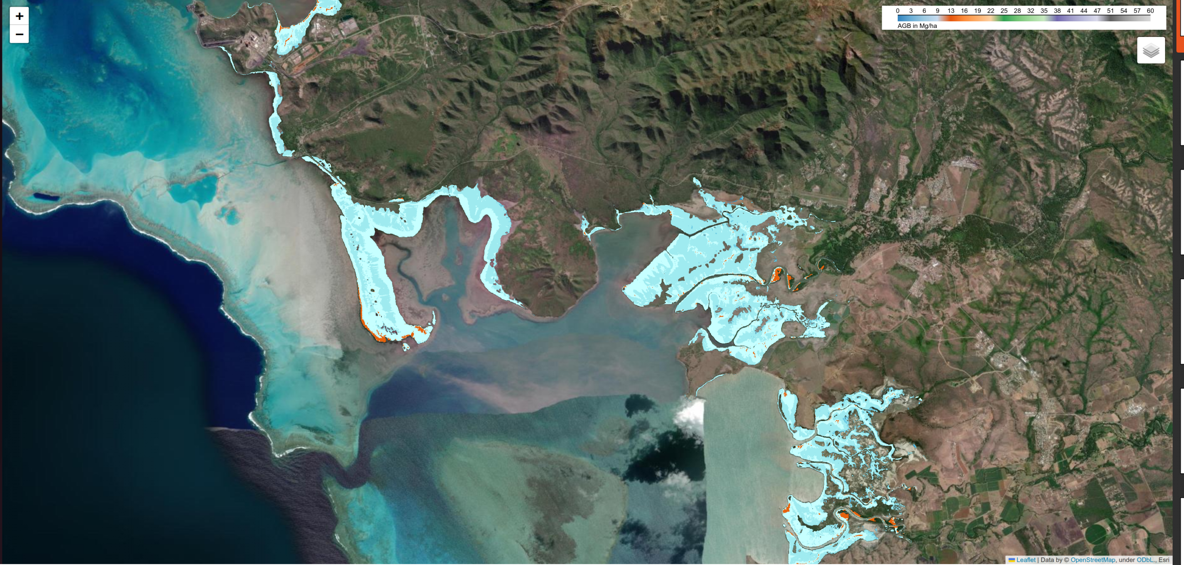
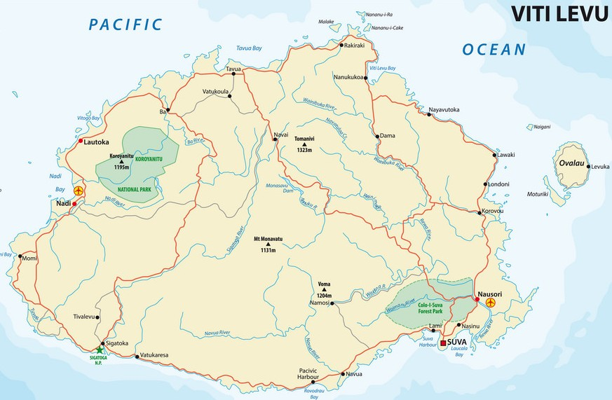
III. Outlook for the platform 12/13
Improvement of aerial biomass maps using field data collected.
Organization of a field mission to Viti Levu in the provinces of Ba - Rewa -Tailevu
Determination of carbon storage from above-ground biomass of mangrove forests.
Search for a regression model to terminate CCover values via spectral indicators specific to vegetation:
NDVI, EVI, SAVI, IRECI, MVI

Slide 14
Vinaka vaka levu
Thank you for your attention
marc.despinoy@ird.fr
pierreaudisio05@gmail.com

