Slide 1
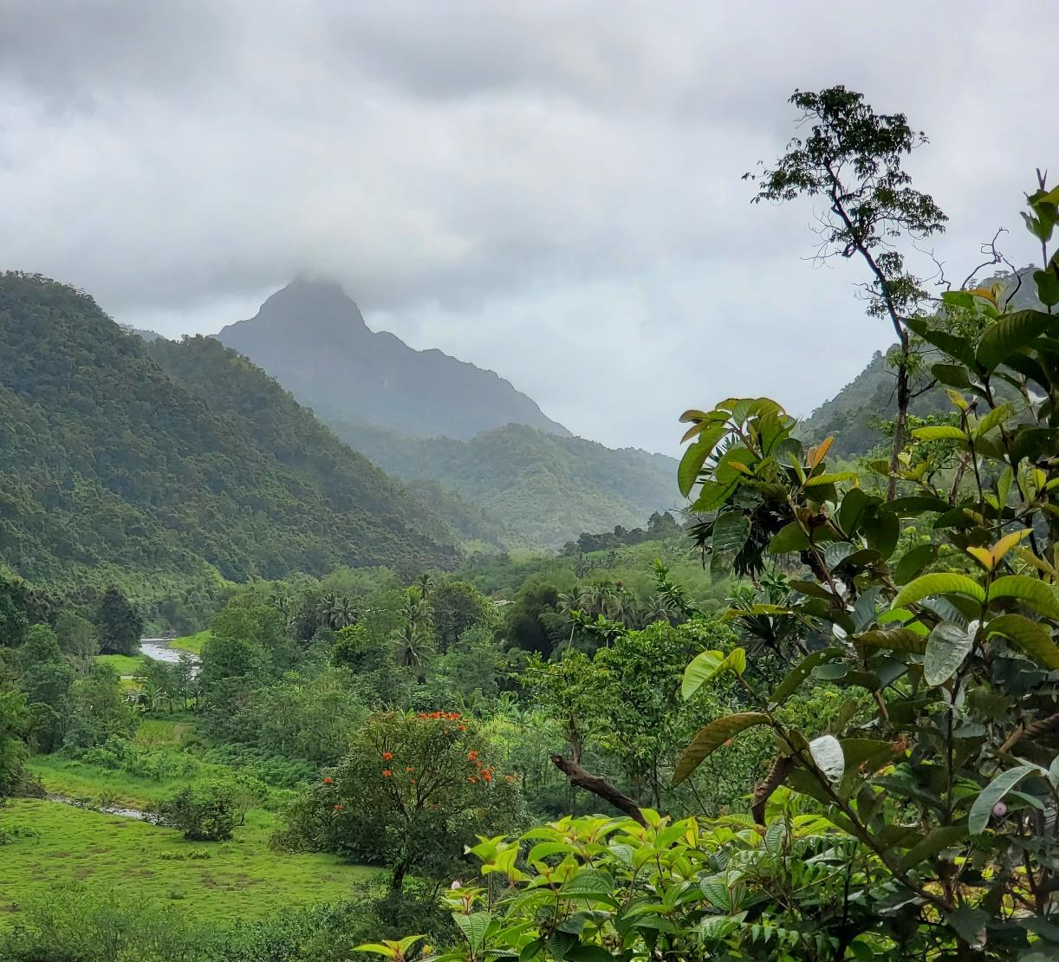
Developing Fiji’s National Land Cover Change Mapping System
Dr. Randy Hamilton
US Forest Service, Fiji
Mohammed Shorab
Ministry of Forestry, Fiji

Slide 2
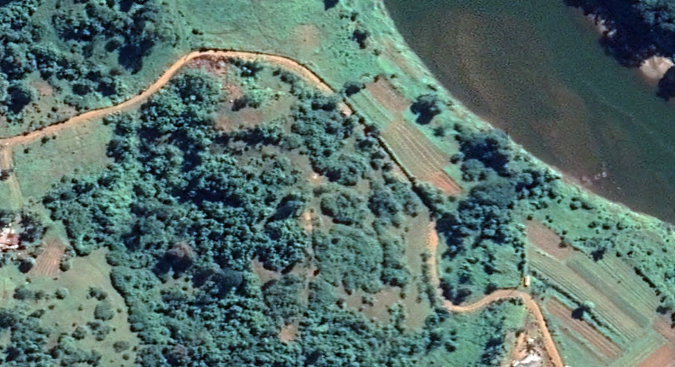
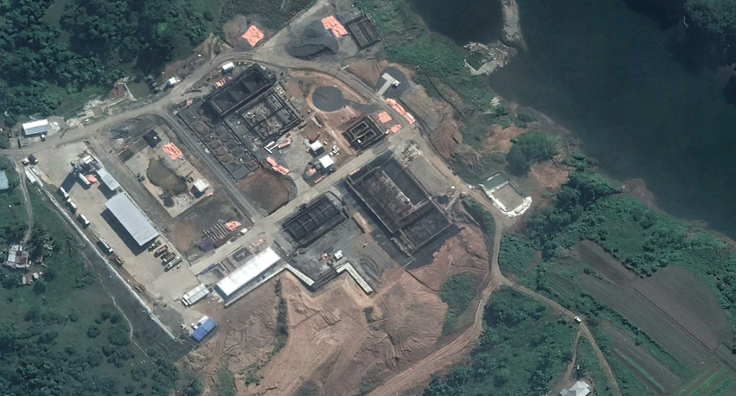
Background
2018
Accurate and current data on the distribution, extent and changes in Fiji’s land cover and land use is essential for:
National and international reporting
Informing and tracking the effectiveness of environmental and developmental policies
Guiding land use planning
Guiding land management
Informing decisions
Etc.
2021

Slide 3
International & National Reporting
Fiji is a signatory to various international agreements that require accurate data on the country’s land cover and land use
United Nations Framework Convention on Climate Change (UNFCCC)
Reducing Emissions from Deforestation and forest Degradation (REDD+)
Sustainable Developments Goals (SDGs)
Convention on Biological Diversity (CBD)
United Nations Convention to Combat Desertification (UNCCD)
UN Forest Instrument
State of the Environment Report
State of Forest Genetics Report
FAO’s Global Forest Resource Assessment
Others required by Ministry of Agriculture, Lands, Environment, Etc.

Slide 4
Land Use/Cover Classification System
IPCC Classes
Forestland
Cropland
Grassland
Wetlands
Settlements
Other Land
The agreements & initiatives frequently require data from broad land use classes described by the Intergovernmental Panel on Climate Change (IPCC)

Slide 5
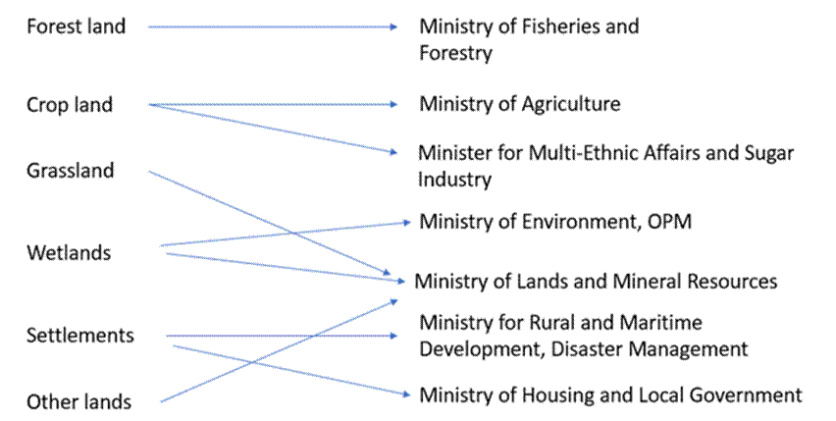
Fiji’s Climate Change Act of 2021
PART 7—MEASUREMENT, REPORTING AND VERIFICATION OF EMISSIONS AND EMISSIONS REDUCTIONS
30.—(1) The following permanent secretaries must biennially estimate, and compile data related to emissions and emissions reductions activities from within their portfolio and submit it to the Committee—
(c) the permanent secretary or permanent secretaries responsible for agriculture, forestry and other land use in relation to the agriculture, forestry and other land use sector;

Slide 6
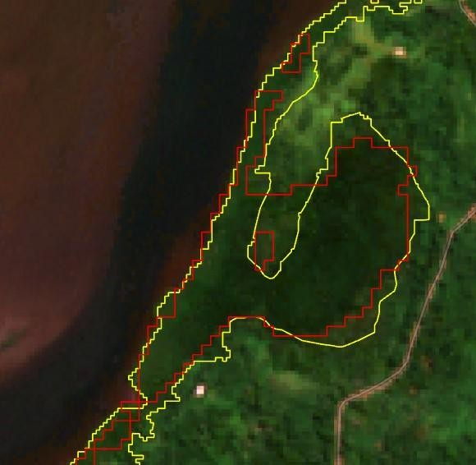
Data Inconsistency
Different ministries must report on land cover and changes in land cover for various international agreements & national initiatives (e.g. climate change, SDGs)
However, each ministry uses its own methodology, leading to data inconsistencies
Mangrove maps created with different methodologies
Notes:
According to their specific mandates, different ministries must report on land cover and changes in land cover for various international agreements & national initiatives (e.g. climate change, SDGs)

Slide 7
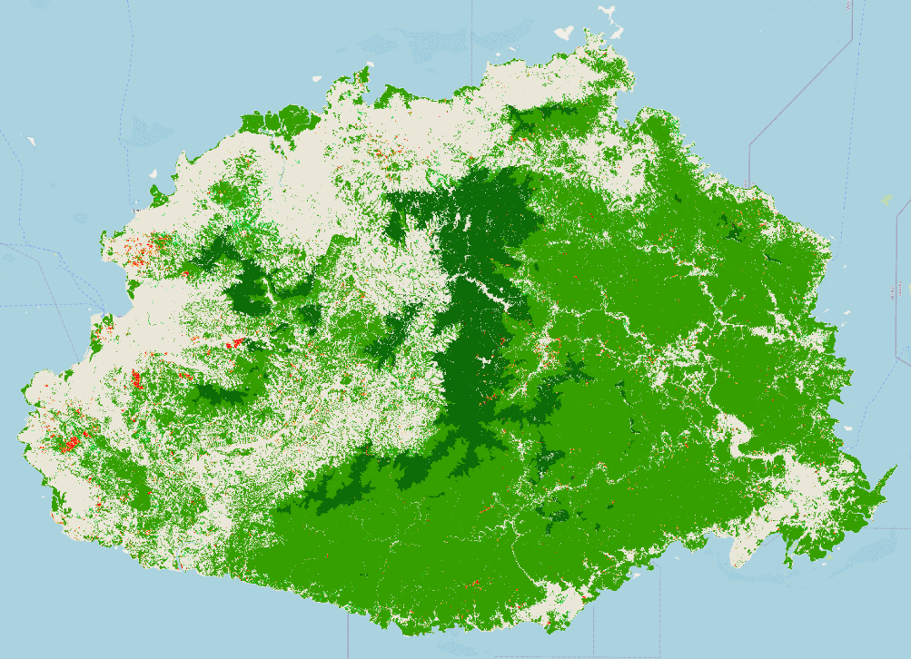
What is Needed?
Nationally adopted land cover and land cover change data for Fiji
Consistent, comparable, reliable, and transparent data
Everyone on the same page with a common system!
Courtesy: Ministry of Forestry, REDD+

Slide 8
Fiji Geospatial Information Management Council Endorsement
On 5 April 2023, the FGIMC acknowledged the need:
For land cover change mapping in Fiji
To have a common nationally adopted land cover change dataset for Fiji
Established a technical working group under the guidance of the Fiji Geospatial Technical Advisory Committee (FGTAC)
Members | Advisors
Ministry of Fisheries and Forestry (lead) | US Forest Service
Ministry of Lands and Mineral Resources | Fiji National University
Climate Change Division (Office of the Prime Minister) | The University of the South Pacific
Ministry of Agriculture and Waterways | SPC
Ministry of Sugar Industry
Ministry of Local Government
iTaukei Lands Trust Board
Notes:
National Mapping Committee
Working group can leverage support (Ex USFS right now) for this annual activity.

Slide 9
System Elements
Needs Assessment Consultation (September 20-21, 2023)
Maps of the 6 IPCC land use classes & change
Tables of numbers from Sample-based Area Estimation quantifying:
Number of hectares of each class and changes
Level of uncertainty associated with the numbers
Base year 2005
Refreshed every 2 years
Where? 12 main islands of Fiji

Slide 10
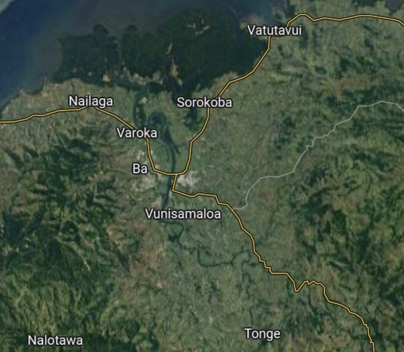
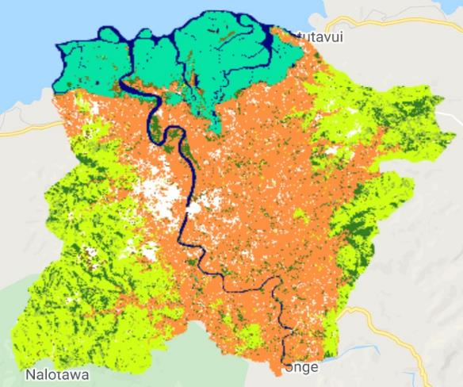
Mapping Component
Remote sensing–based mapping
Show land cover distribution
Locations of changes
Landsat and Sentinel-2
Example: Ba Catchment 2016. Map adapted from: Davies, K. 2021. Draft Landcover Transitions in the Ba Catchment 2016 – 2020. University of Sydney, School of Geosciences.

Slide 11
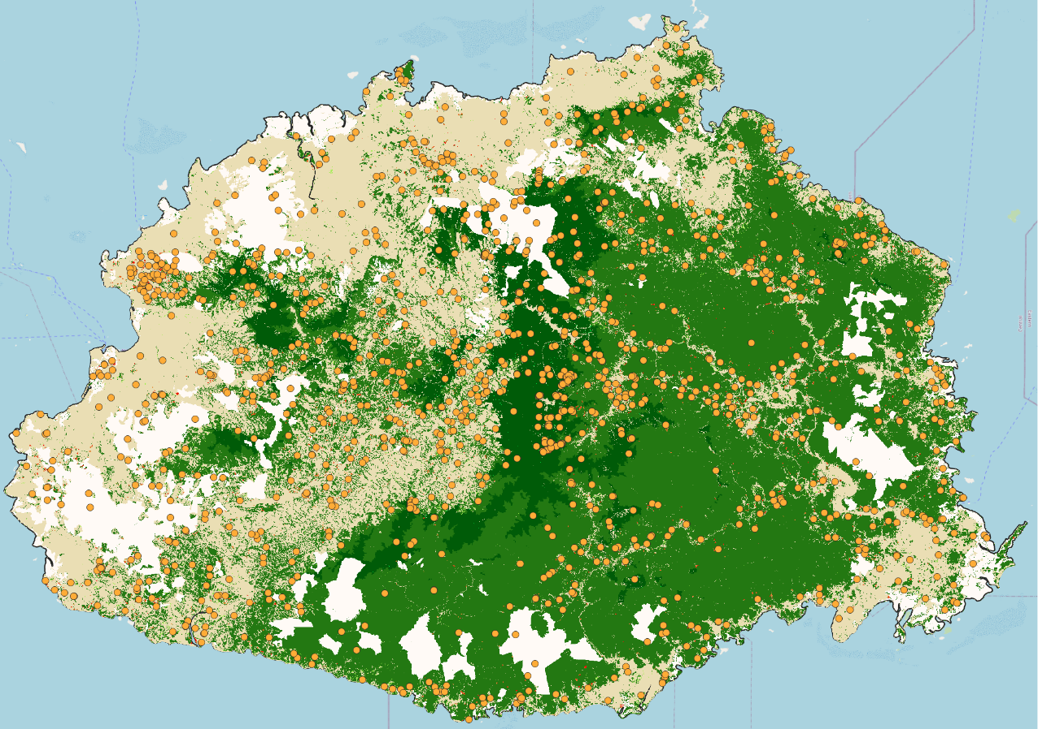
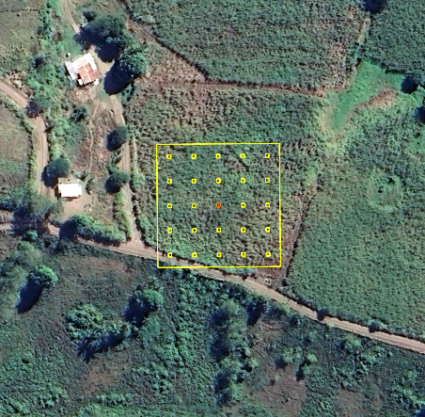
Sample-based Area Estimation
Can calculate area of each map class (e.g., 8,100 km² Lowland Forest)
However, all maps have errors, and the uncertainty of the numbers is unknown
Variation of “Accuracy Assessment”
Sample-based area estimation involves visually interpreting the land cover (and/or type of change), from a set of sample units distributed in a systematic, random, or stratified random fashion, using high-resolution imagery
Forest/Non-Forest & Change 2019-2020
Courtesy: REDD+ Fiji

Slide 12
Sample-based Area Estimation
Map areas
Lowland forest: 8,100 km²
Upland forest: 1,050 km²
Non-forest: 5,320 km²
Adjusted areas, 90% confidence (from samples)
Lowland forest:
8,430 ± 1,100 km²
Upland forest:
1,030 ± 50 km²
Non-forest:
5,270 ± 1,120 km²
Forest/Non-Forest & Change 2019-2020
Stratified Random Sample
Courtesy: REDD+ Fiji

Slide 13
Mapping Component
Example: Ba Catchment 2016. Map adapted from: Davies, K. 2021. Draft Landcover Transitions in the Ba Catchment 2016 – 2020. University of Sydney, School of Geosciences.

Slide 14
Tabular Data from Sample-based Area Estimation
Landcover transition | km²
Stable forest | 41.2
Stable cropland | 124.8
Stable grassland | 286.4
Stable wetland | 46.7
Stable settlement | 10.0
Forest→cropland | 3.1
Forest→grassland | 7.3
Cropland→forest | 10.4
Cropland→settlement | 6.4
Grassland→cropland | 4.4
Etc. | Etc.
Key element not reported in this draft study:
CONFIDENCE INTERVALS
Data from: Davies, K. 2021. Draft Landcover Transitions in the Ba Catchment 2016 – 2020. University of Sydney, School of Geosciences.

Slide 15
Current Status and Future Plans
Goal: Develop and implement a government-endorsed National Land Cover Change Mapping System
Current Status
Defining scope and methodologies
Evaluating platforms for creating the maps (e.g., Digital Earth Pacific, Google Earth Engine, etc.)
Conducting initial testing of mapping approaches
Future
Capacity building among working group members
Target completion of development phase: June 2024
Cabinet endorsement

Slide 16
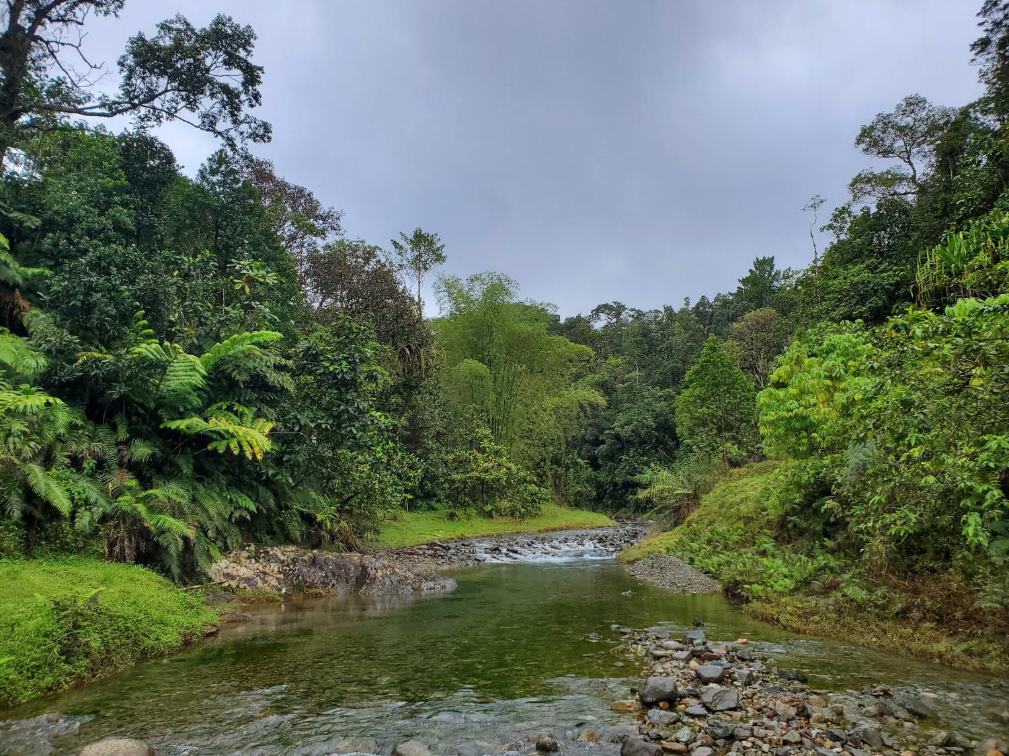
Thanks! Vinaka!
Randy Hamilton
rhamilton.usfs@gmail.com

