Slide 1
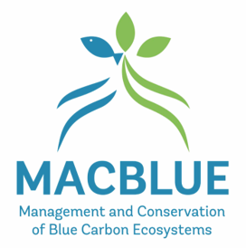
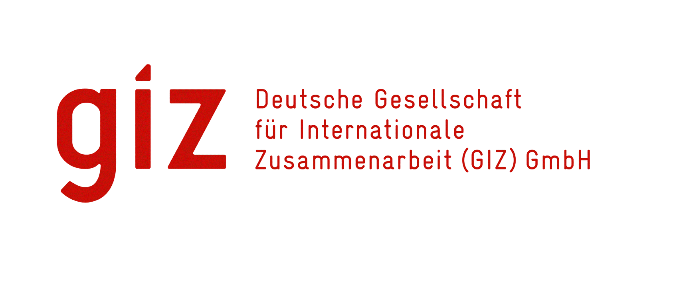
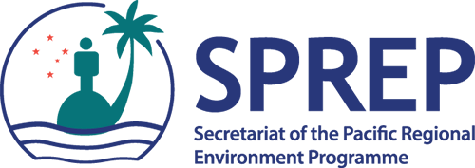
MAPPING & MONITORING THE EXTENT OF SEAGRASS AND MANGROVE ECOSYSTEMS THROUGH CLOUD COMPUTING
The Role of Digital Earth Pacific in the MACBLUE Project.
Presenter: Shyam Lodhia
Affiliation: GIZ
Notes:
Good morning everyone!
Ever wondered how cloud computing is making waves even in the most unexpected places?
Today, I am excited to share a glimpse into a project I am involved in, focused on mapping seagrass and mangroves.
It may sound simple, but the impact is far reaching.
So let dive in...
I am Shyam Lodhia and my presentation is on:
Mapping & Monitoring The Extent Of Seagrass And Mangrove Ecosystems Through Cloud Computing - The Role Of Digital Earth Pacific In The MACBLUE Project

Slide 2
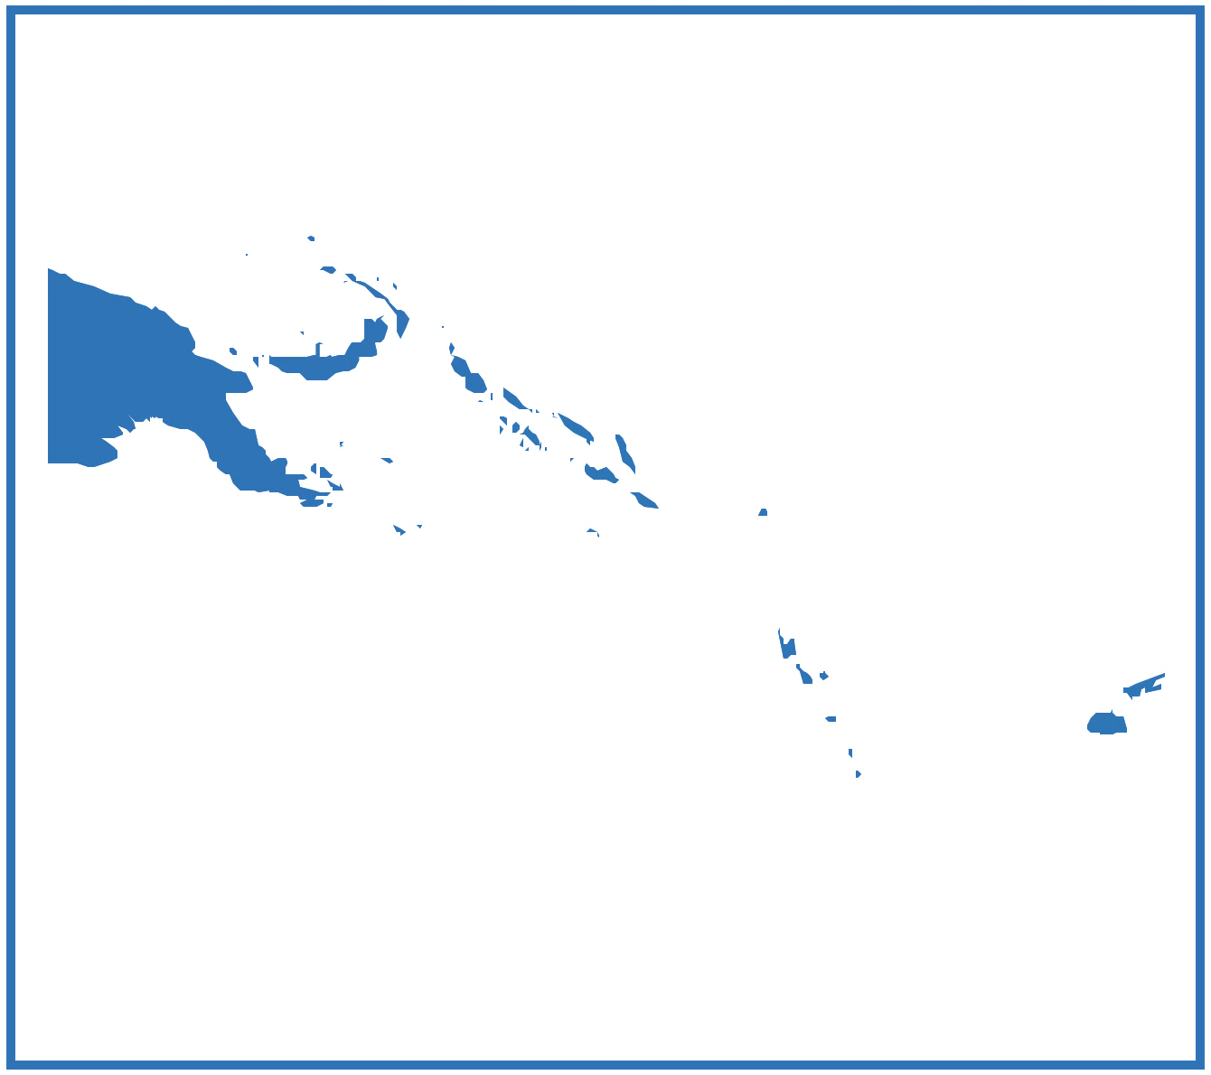
What is MACBLUE ?
Commissioned:
German Federal Ministry of Environment, Nature Conservation, Nuclear Safety and Consumer Protection (BMUV) under the International Climate Initiative (IKI).
Implemented:
GIZ, in close collaboration with regional partners SPC and SPREP.
Partner Countries:
Fiji, Papua New Guinea, Solomon Islands, Vanuatu
Objectives:
Mapping Seagrass and Mangrove Ecosystems
Quantifying Ecosystem Services
Strengthening Policies and Regulations
Effective Management and Rehabilitation
Knowledge Sharing
Notes:
MACBLUE is: The Management and Conservation of Blue Carbon Ecosystems. The project is designed to enhance coastal biodiversity conservation and management in Pacific Island countries.
It is commissioned by the German Federal Ministry for the Environment, Nature Conservation, Nuclear Safety and Consumer Protection, under the International Climate Initiative and implemented by the Deutsche Gesellschaft für Internationale Zusammenarbeit (GIZ) which is the German agency for international cooperation, in close collaboration with regional partners The Pacific Community (SPC) and Pacific Regional Environment Programme (SPREP).
Objectives of MACBLUE:
Mapping Seagrass and Mangrove Ecosystems: This is achieved by utilizing remote sensing to map the extent of seagrass and mangrove ecosystems.
Quantifying Ecosystem Services: This is to document and quantify associated ecosystem services, with an emphasis on carbon stocks, emission factors, and anthropogenic threats.
Strengthening Policies and Regulations: This is to support partner countries in strengthening national policies and regulations to incentivize the conservation and rehabilitation of seagrass and mangrove ecosystems.
Effective Management and Rehabilitation: By documenting, developing, and demonstrating effective management and rehabilitation systems at priority sites for national replication.
Knowledge Sharing: This is sharing tested concepts and instruments for assessment, conservation, and sustainable management at the national, regional, and international levels.
The MACBLUE project aims to use innovative remote sensing approaches such as DEP to create accurate maps of seagrass and mangrove coverage in Fiji and its partner countries.
This foundational work sets the stage for subsequent activities related to quantifying ecosystem services and supporting policy and management efforts.

Slide 3
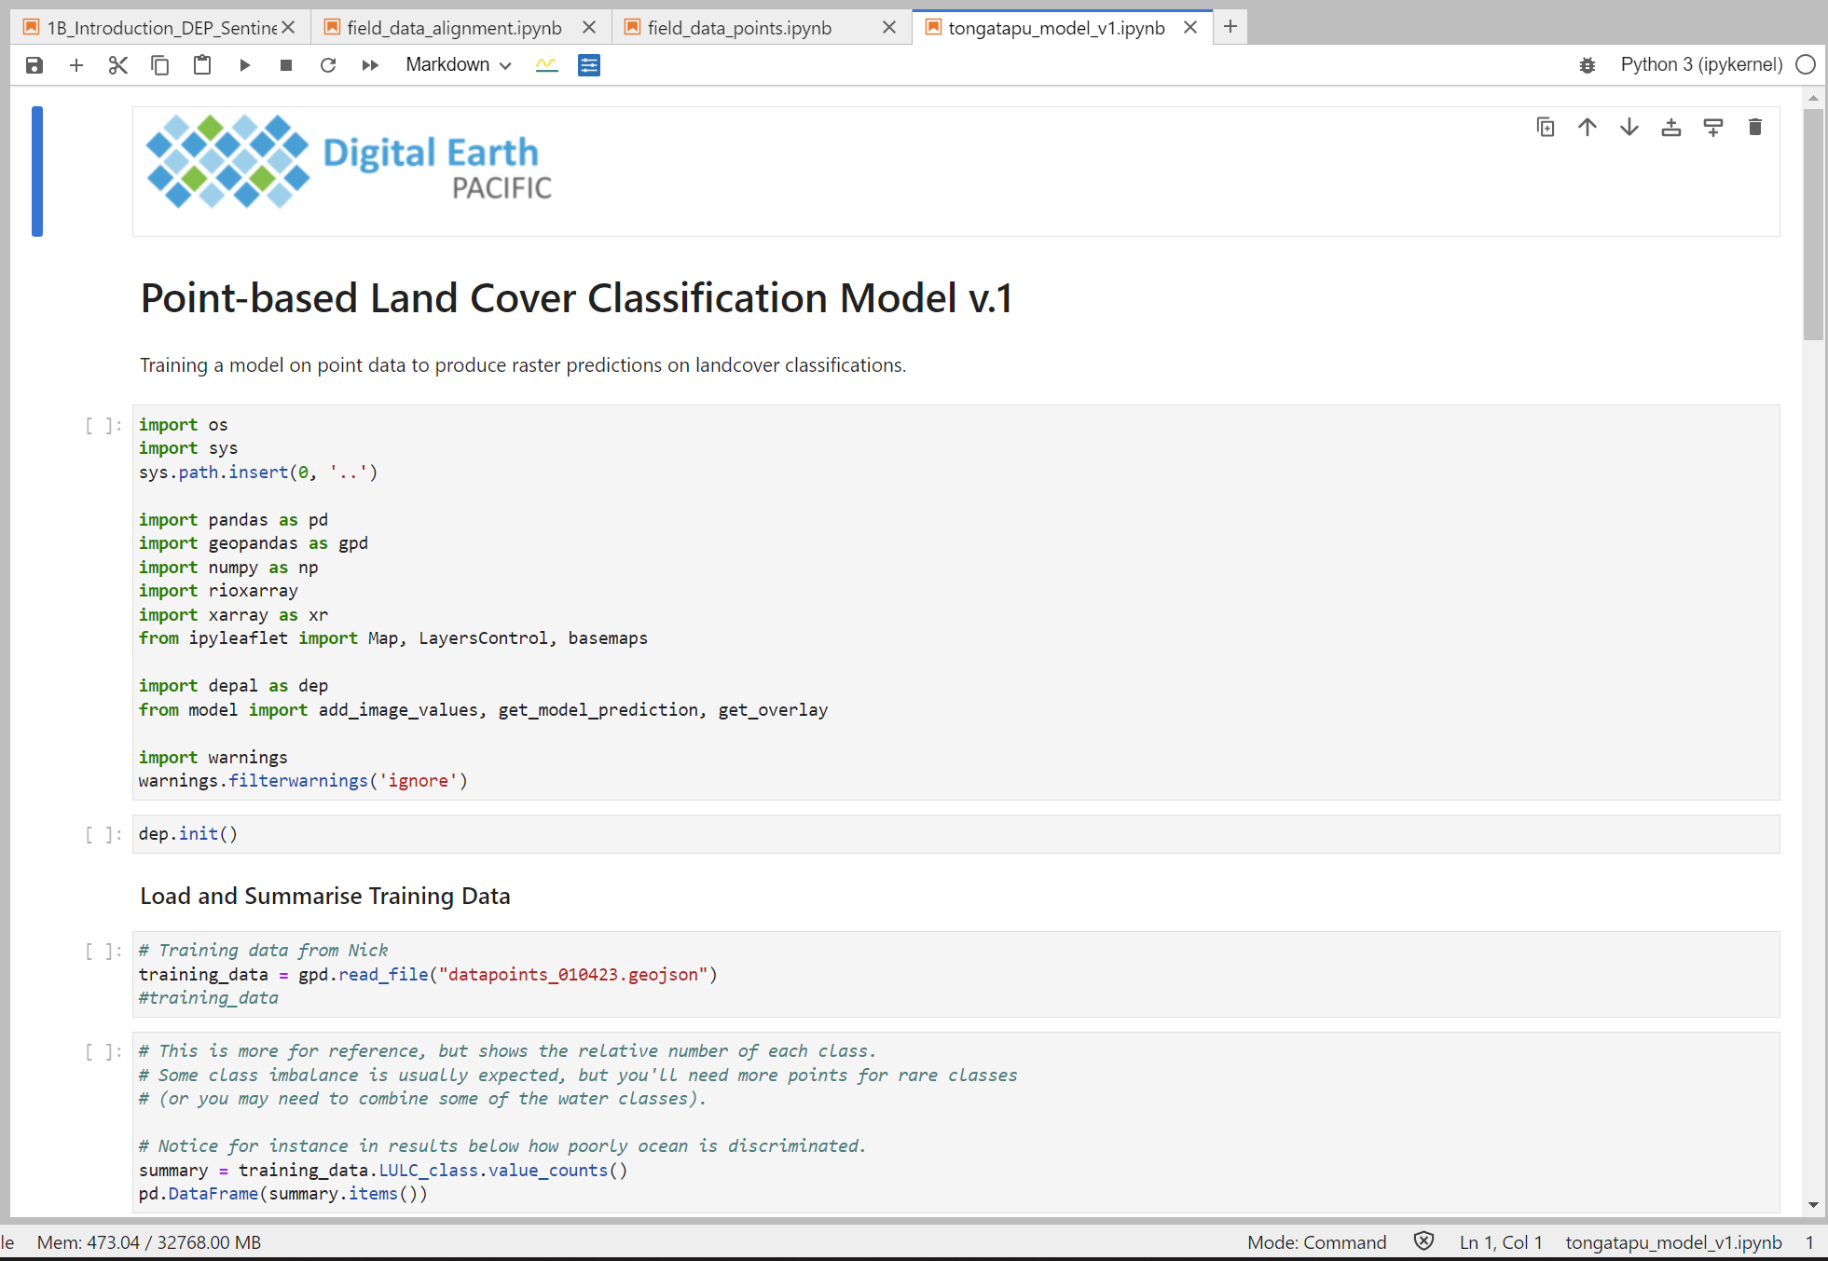
What is Digital Earth Pacific (DEP)?
DEP is a cloud computing platform designed to deliver an operational earth and marine observation system.
In the context of the MACBLUE project, the utilization of DEP for mapping the extent of seagrass and mangrove ecosystems aligns with the MACBLUE projects first objective.
Notes:
DEP is a cloud computing platform designed to deliver an operational earth and marine observation system. It takes decades of satellite data and makes it easily accessible and usable.
Digital Earth Pacific (DEP) operates within the PanGeo environment, utilizing robust libraries like Xarray, GeoPandas, Rasterio, and TorchGeo for advanced data processing and machine learning.
While these tools have a steep learning curve, DEP addresses the challenge by integrating the DEP Abstraction Library (DEPAL) into its computing hub. DEPAL streamlines common tasks, allowing non-programmers and intermediate GIS technicians to perform essential functions with minimal code. (For more technical details on DEPs capabilities and DEPALs functionality, please contact Sachindra Singh from SPC).
DEP is powered by Microsoft's Planetary Computer, indicating a reliance on advanced cloud computing capabilities provided by Microsoft. This association suggests a commitment to leveraging cutting-edge technology for earth observation.
The platform is designed to empower decision-makers across the Pacific by providing easy access to historical satellite data. This access is intended to aid decision-making related to climate change, food insecurity, disaster risk, and other challenges.
DEP serves as a fundamental digital infrastructure, ensuring that every nation in the Pacific has access to tools, technologies, and capacity for routine monitoring and tracking. This infrastructure is intended to support robust decision-ready products that are regularly updated with new satellite data.
The program is founded on a demand-driven, co-creation process, emphasizing the identification of needs and priorities of the communities served. This approach ensures that DEP addresses real-world challenges faced by Pacific communities.
In the context of the MACBLUE project, the utilization of DEP for mapping the extent of seagrass and mangrove ecosystems demonstrates a commitment to leveraging advanced technology for environmental monitoring and conservation efforts.

Slide 4
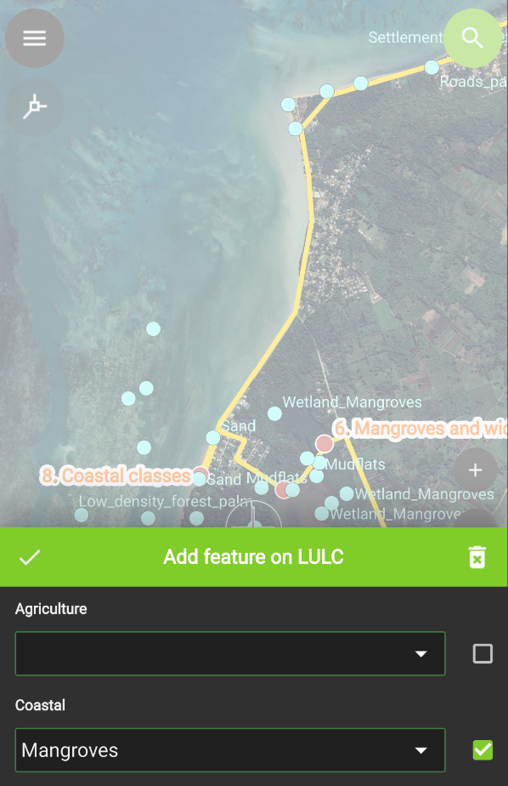
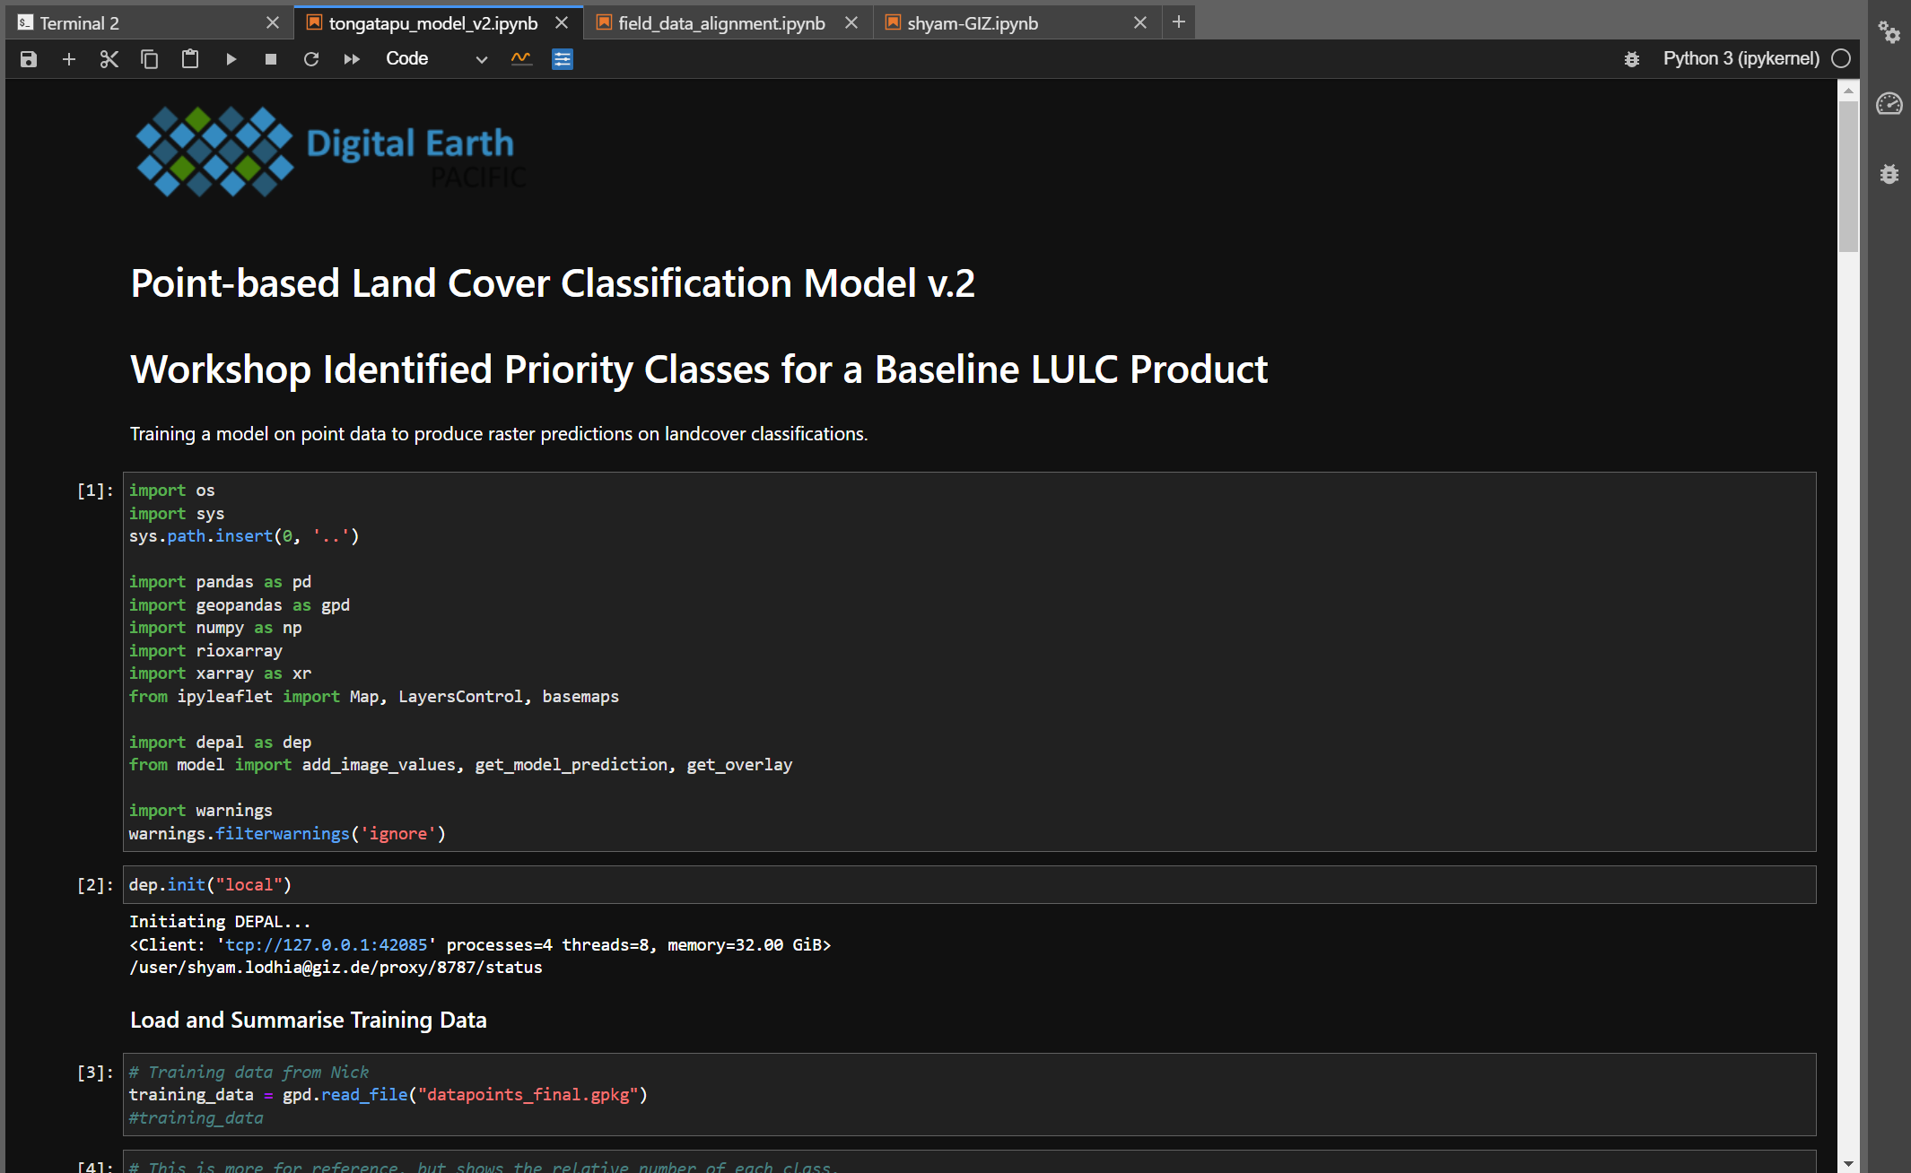
DEP - Supervised Land Cover Classification
Field Data Collection
Supervised LULC classification using training data
Import refined data points as training data
Notes:
I will briefly discuss the steps taken to conduct land cover classification using DEP:
1. Field Data Collection:
- Data points on target land cover classes are collected using mobile data collection applications such Q-Field or ArcGIS Field Maps.
- The data points Include attribute information like GPS coordinates, land cover class type, feature type, date/time, and a photo of the location.
2. Field Data Quality Control:
- GIS software such as QGIS or ArcMap is utilized to sort, review and omit any points that contain errors. This helps to refine the quality of the traing data points.
3. Importing Training Data:
- The refined data points are imported into DEP to be used as training data for running supervised image classification models.
4. Running a supervised classification model:
5. Refinement of Supervised Classification:
- The results from the classification model, are assessed and verified using ground truthing data and the results are refined accordingly.
This streamlined version on the steps taken to create land cover maps on DEP.

Slide 5
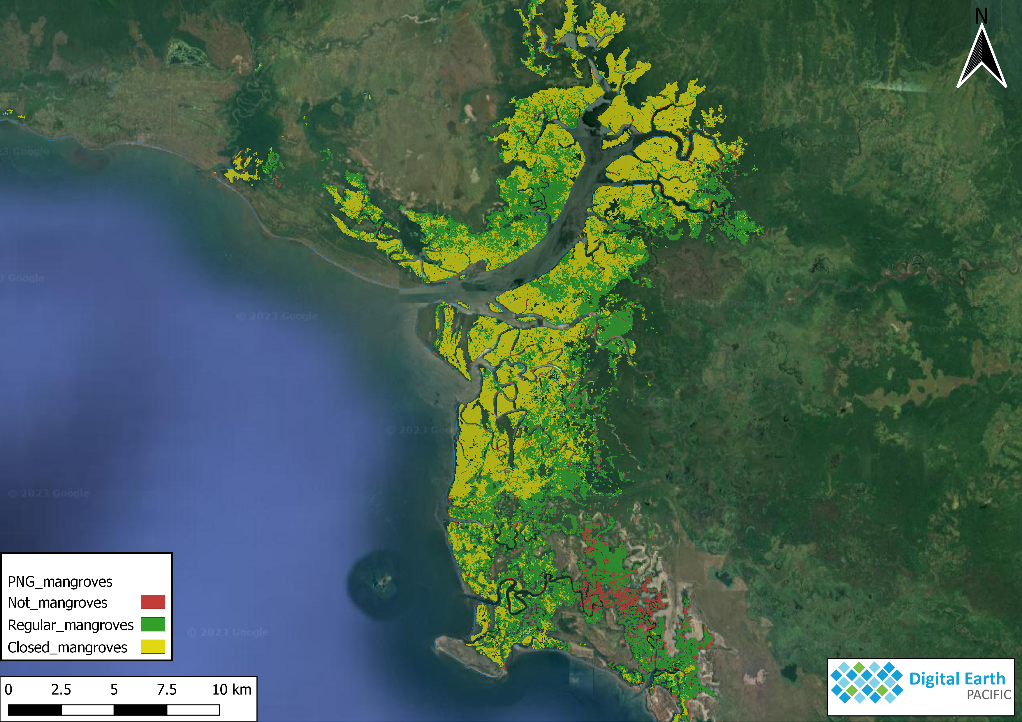
DEP - Mangrove Extent Map Example
Using DEPs robust machine learning models the resulting land cover maps can provide accurate extent values for target ecosystems.
Notes:
Here is an example of a land cover map created by DEP.
The resulting mangrove extent maps are analyzed in conjunction with canopy height, species information and above ground/below ground biomass data to accurately determine the sequestration, storage and potential emission values of carbon within these ecosystems.
The methodology used to monitor, evaluate and verify carbon sequestration, storage and emission values are adopted by following established blue carbon initiative guidelines.

Slide 6
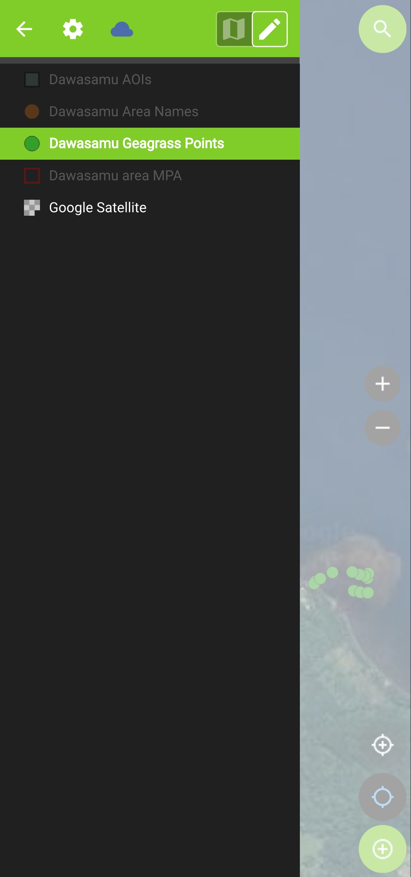
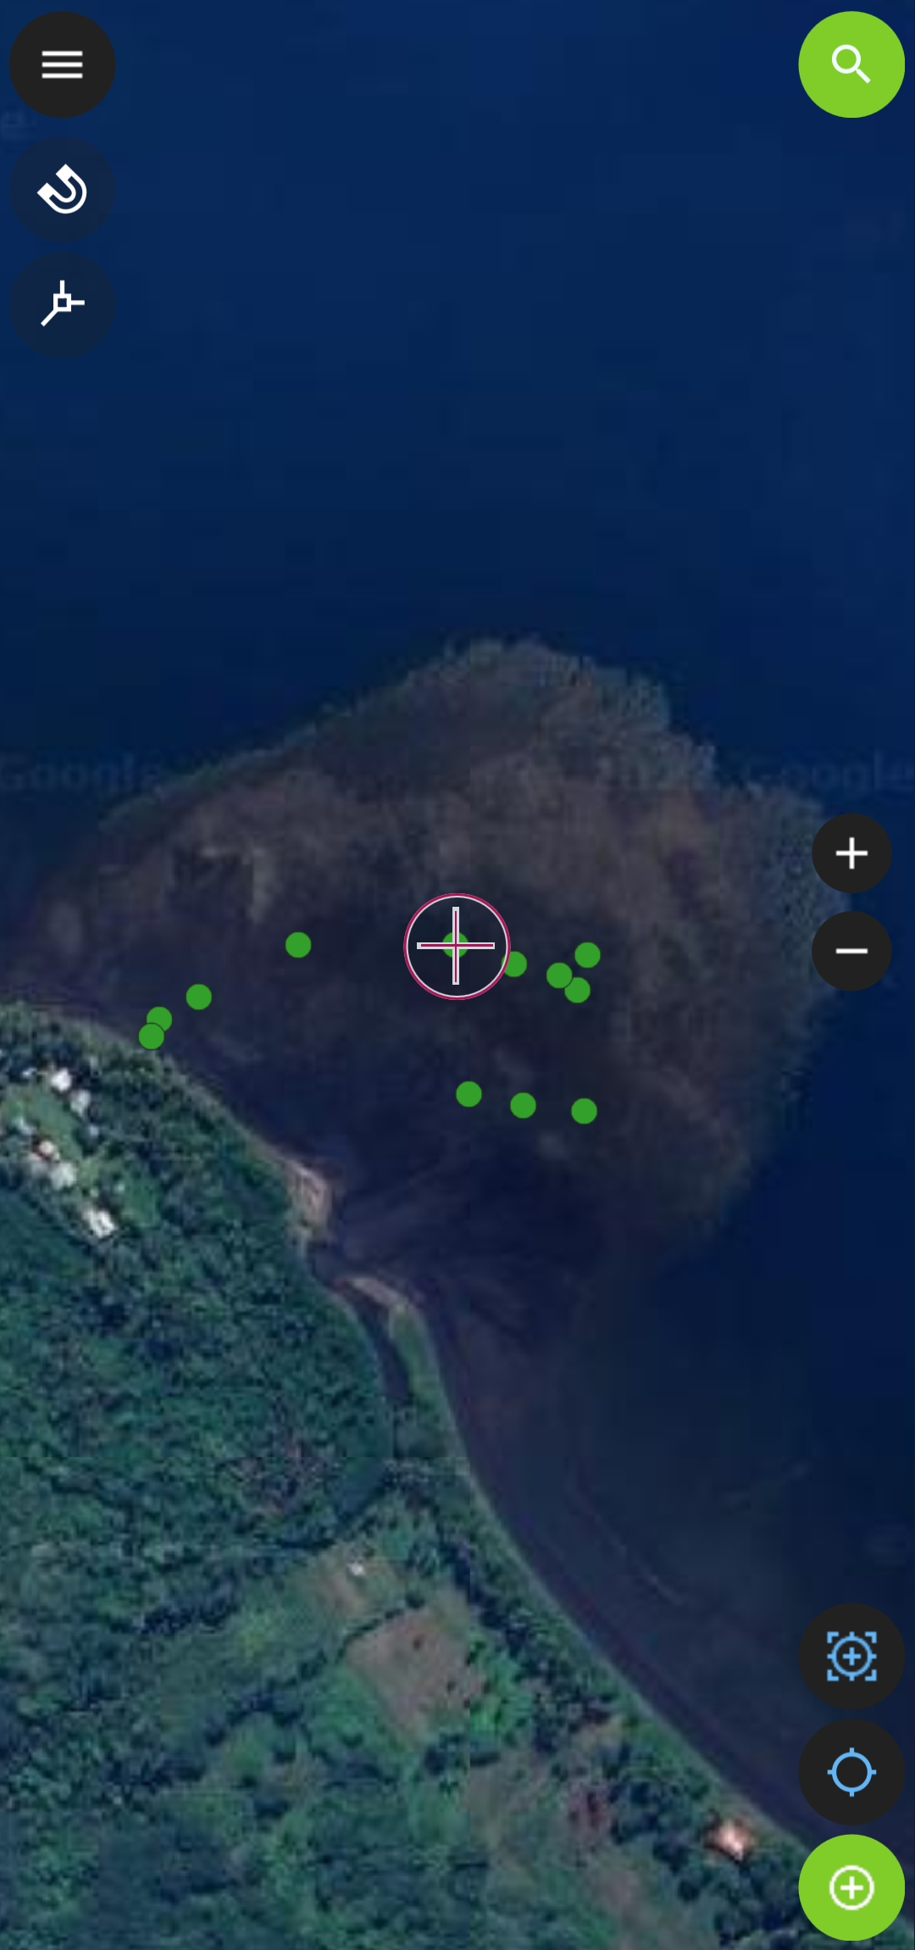
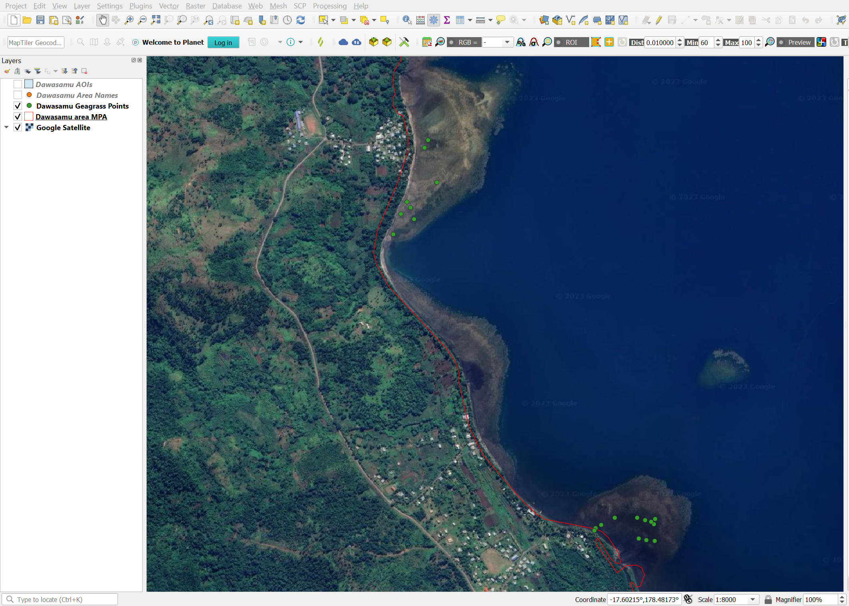
DEP - Seagrass Extent Map…Almost
Seagrass data points collected from a seagrass restoration pilot site in Dawasamu.
Seagrass data points
Notes:
Data collection campaigns for seagrass ecosystems have been conducted at a pilot site in Dawasamu.
Unlike mangrove extent maps, the mapping of seagrass ecosystems come with its own challenges.
Some of the challenges faced are: the availability of high spatial resolution EO data, tide level, water turbidity, sufficient seagrass data points and sun glint have to be considered and resolved before running classification models which would yield accurate seagrass extent maps.
The team at SPC are currently working of refining their classification model to find solutions to the challenges of mapping seagrass.
There may be something available by 2024…so stay tuned.

Slide 7
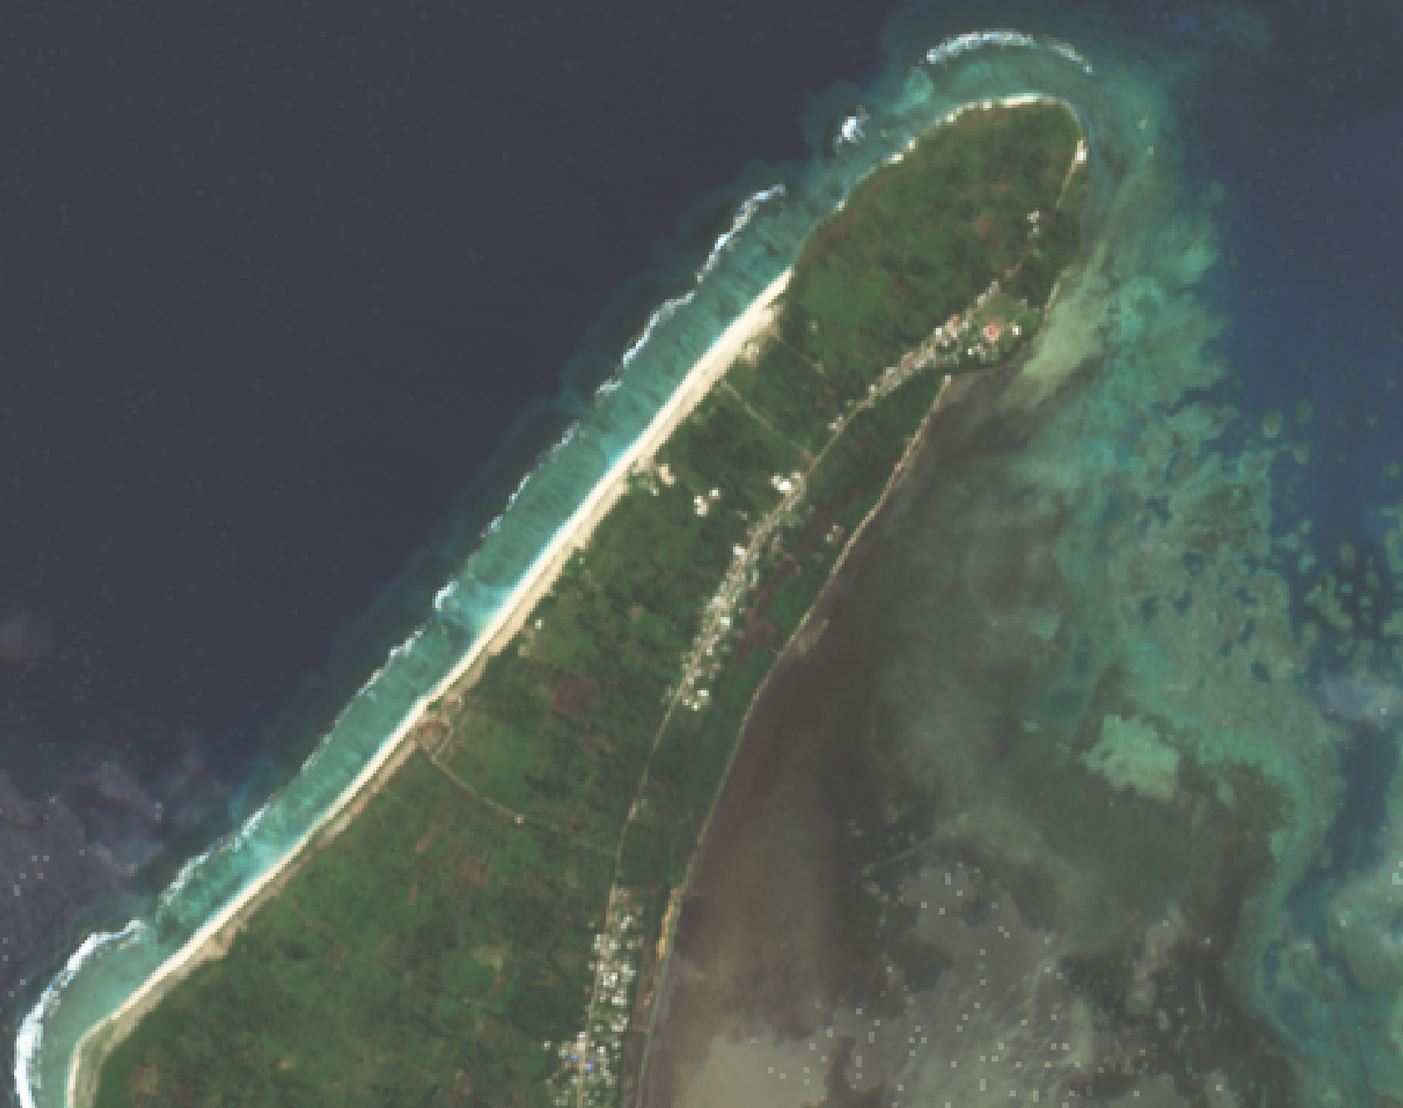
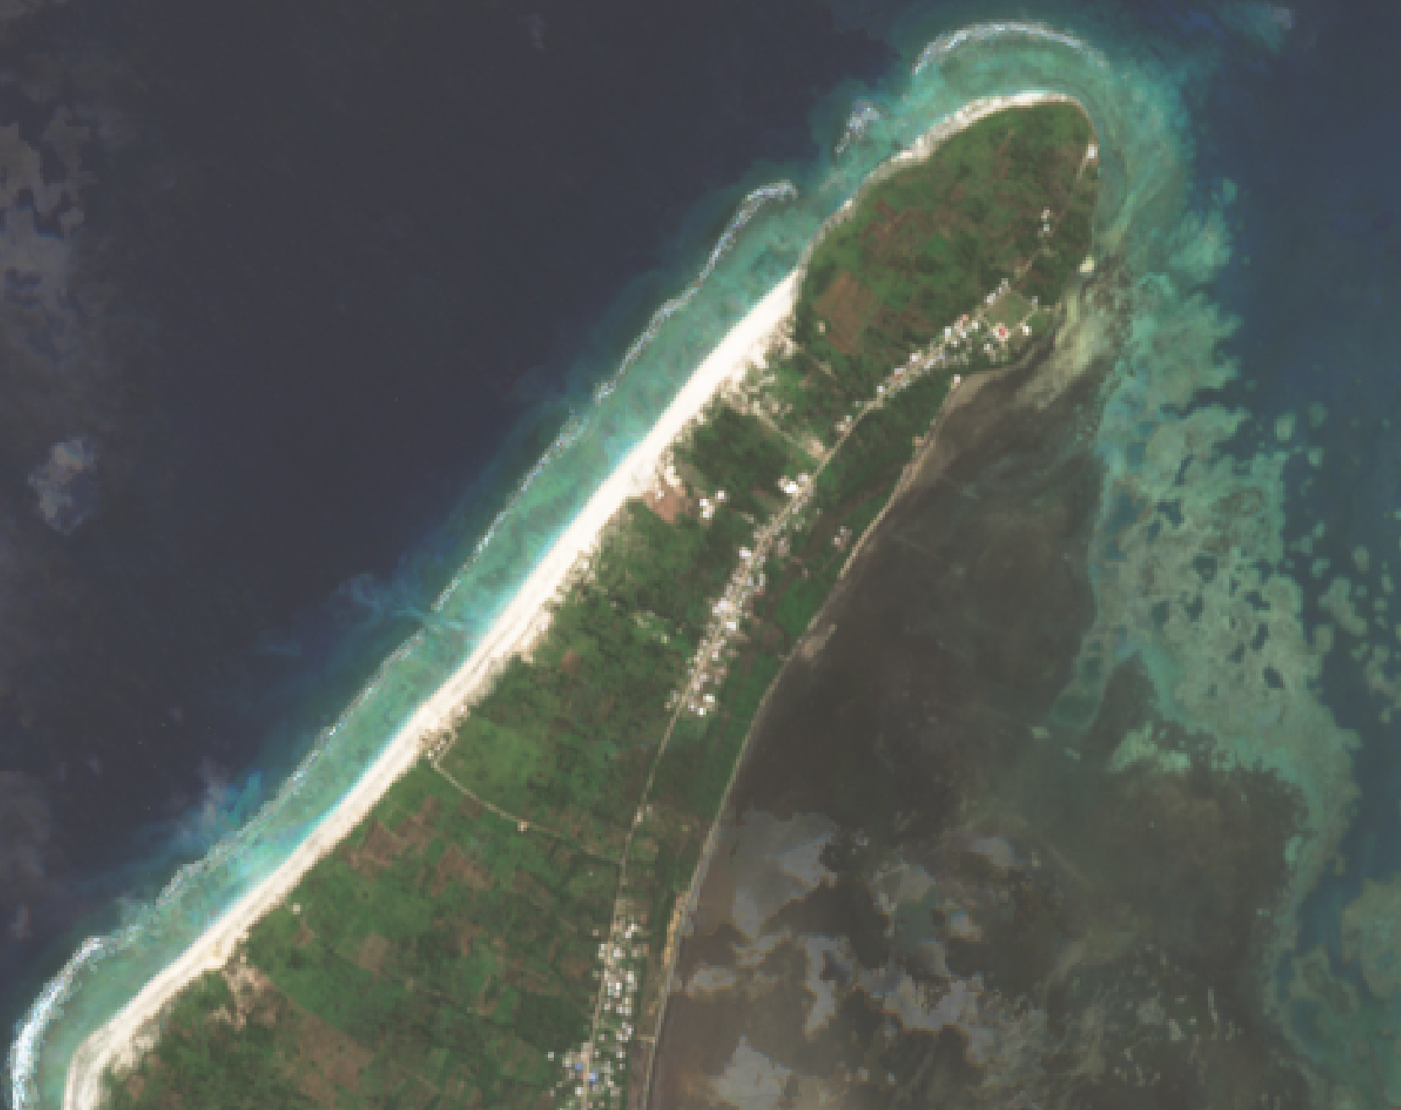
DEP - Cloud Free Earth Observation Data
Ha’atafu Beach, Nuku’alofa 2016
Ha’atafu Beach, Nuku’alofa 2023
Foreshore before Hunga eruption
Foreshore after Hunga eruption
Notes:
DEP be used to create and export cloud free analysis ready earth observation data (raster data) using freely available remote sensing platforms such as Landsat or Sentinel.
The data sets can be used to conduct spatial analysis to determine land cover change detection, such as urban development and expansion, agricultural land development or post disaster assessment to name a few.
The example above shows images processed via DEP around the Ha’atafu beach before and after the Hunga volcanic eruption.

Slide 8
Collaboration Between MACBLUE and DEP
Strategic Partnership
Utilizing DEP's Technology
Robust Mapping Techniques
Setting the Stage for Success
Aligning with Community Needs
Empowering Decision-Makers
Notes:
Collaboration between the MACBLUE Project and Digital Earth Pacific (DEP) has advantages for both programs.
1. Strategic Partnership: The collaboration leverages DEP's processing capabilities to map the extents of seagrass and mangrove ecosystems in Fiji, Papua New Guinea, the Solomon Islands, and Vanuatu.
2. Utilizing DEP's Technology: This involves the identification and selection of remote sensing tools, comprehensive analysis using open-source GIS applications, and ground-truthing in priority sites.
3. Robust Mapping Techniques: By integrating remote sensing data and ground-truthing, the project can create reliable and up-to-date maps of seagrass and mangrove ecosystems.
4. Setting the Stage for Success: The mapped extent data generated through DEP forms the foundational dataset for later components of the MACBLUE Project. This includes the evaluation of stored carbon using the IPCC Wetlands guidelines and supporting conservation efforts.
5. Aligning with Community Needs: DEP's technology, combined with the MACBLUE Project's demand-driven and co-creation process, ensures that the mapping efforts align with the specific needs and priorities of the communities served.
6. Empowering Decision-Makers: The collaboration facilitates informed decision-making regarding coastal biodiversity conservation, carbon sink management, and the sustainable use of vital ecosystems.

Slide 9
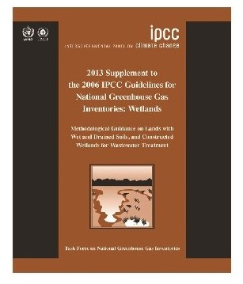
IPCC Wetlands Guidelines
Accurate Mapping of Ecosystem Extents
Integration of Remote Sensing Data
Ground-Truthing Validation
Quantification of Carbon Sequestration and Emission Potential
Development of Monitoring Approaches
Consideration of Historical Data for Change Detection
Supporting National and Global Reporting Requirements
The use of DEP for mapping mangrove and seagrass extents helps to ensure that the resulting data complies with IPCC wetland inventories guidelines.
Notes:
Mapping mangrove and seagrass ecosystem extents within Digital Earth Pacific (DEP) for carbon sequestration, storage and GHG emissions evaluation, aligns with the guidelines provided by the Intergovernmental Panel on Climate Change (IPCC) for wetland ecosystems.
Here's an explanation of how this compliance is achieved:
Accurate Mapping of Ecosystem Extents:
Integration of Remote Sensing Data:
Ground-Truthing Validation:
Quantification of Carbon Sequestration and Emission Potential:
Development of Monitoring Approaches:
Consideration of Historical Data for Change Detection:
Supporting National and Global Reporting Requirements:
This compliance is achieved through accurate mapping, integration of historical data, ground-truthing validation, and adherence to standardized monitoring approaches. The mapped data, when used in carbon storage evaluations, contributes to a scientifically sound and policy-relevant understanding of the role of mangroves and seagrasses in sequestering and emitting carbon.

Slide 10
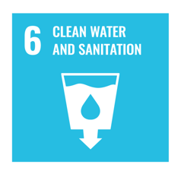
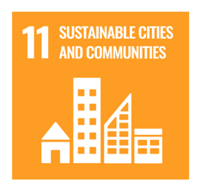
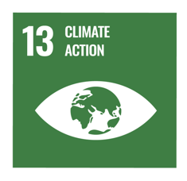
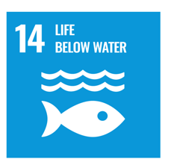
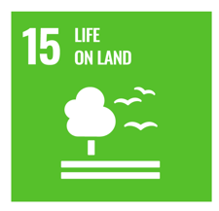
MACBLUE Projects Contribution to SDGs
SDG 13 - Climate Action
SDG 14 - Life Below Water
SDG 15 - Life on Land
SDG 17 - Partnerships for the Goals
SDG 6 - Clean Water and Sanitation
SDG 11 - Sustainable Cities and Communities
In summary, the MACBLUE Project and DEP align with multiple sustainable development goals (SDGs), primarily those related to environmental conservation, climate action, partnerships, and sustainable development, contributing to the broader goals of the 2030 Agenda for Sustainable Development.
Notes:
1. SDG 13 - Climate Action:
2. SDG 14 - Life Below Water:
3. SDG 15 - Life on Land:
4. SDG 17 - Partnerships for the Goals:
- The MACBLUE Project is a collaborative effort involving multiple partners, including the German Federal Ministry for the Environment, GIZ, SPC, and SPREP. This collaboration exemplifies the spirit of SDG 17 by fostering partnerships to achieve shared goals.
5. SDG 6 - Clean Water and Sanitation:
6. SDG 11 - Sustainable Cities and Communities:
In summary, the MACBLUE Project aligns with multiple SDGs, primarily those related to environmental conservation, climate action, partnerships, and sustainable development, contributing to the broader goals of the 2030 Agenda for Sustainable Development.

Slide 11
Future Steps
Analysis and Interpretation
Community Engagement and Needs Assessment
Tailoring Conservation Strategies
Development of Conservation Policies
Implementation of Monitoring Programs
Capacity Building and Training
Education and Awareness Campaigns
Notes:
After obtaining the mapped extent data in Component I of the MACBLUE project, the next steps involve leveraging this data to fulfill the project's goals and furthering the demand-driven, co-creation process.
Here are the next appropriate steps:
Analysis and Interpretation:
- Begin by conducting a thorough analysis and interpretation of the mapped extent data. This involves understanding the distribution patterns, identifying key hotspots, and assessing the overall health and status of seagrass and mangrove ecosystems in the partner countries.
Community Engagement and Needs Assessment:
- Engage with local communities and stakeholders in the project partner countries. Conduct a needs assessment in a participatory manner to understand the specific challenges, priorities, and aspirations of the communities in relation to mangrove and seagrass ecosystems. This step ensures that the project aligns with the actual needs of the communities it serves.
Tailoring Conservation Strategies:
- Utilize the mapped extent data to tailor conservation and management strategies that directly address the identified needs of the communities. This could include measures to protect critical areas, enhance ecosystem resilience, and promote sustainable use of resources.
Development of Conservation Policies:
- Work collaboratively with government partners to develop or enhance conservation policies and regulations based on the insights gained from the mapped data and community needs assessment. The goal is to ensure that these policies are not only effective in environmental conservation but also align with the socio-economic needs of the communities.
Implementation of Monitoring Programs:
- Establish monitoring programs that integrate the mapped extent data for ongoing assessments. This involves setting up a system for continuous monitoring of seagrass and mangrove ecosystems, allowing for adaptive management based on real-time data.
Capacity Building and Training:
- Implement capacity-building programs and training initiatives for local communities and stakeholders. This ensures that they have the necessary skills and knowledge to actively participate in the monitoring and conservation efforts, fostering a sense of ownership and sustainability.
Education and Awareness Campaigns:
- Develop and implement education and awareness campaigns to communicate the importance of mangrove and seagrass ecosystems to the broader community. This step contributes to building a strong community understanding of the role they play in environmental conservation.
By integrating the mapped extent data into a demand-driven, co-creation process, the MACBLUE project can ensure that conservation efforts are not only scientifically sound but also responsive to the unique needs and aspirations of the communities relying on these critical coastal ecosystems.
After obtaining mapped data in Component I of the MACBLUE project, the next steps involve a flexible approach that integrates community input. Starting with a detailed analysis of the data, the project engages local communities in understanding their challenges. Tailored conservation strategies are then crafted, using insights from data and community assessments. Collaborating with governments, the project contributes to conservation policies aligned with socio-economic needs. Continuous monitoring, capacity-building, and education campaigns follow, promoting community involvement. With an iterative process, the project regularly reassesses community needs, monitors ecosystems, and adjusts strategies. This holistic approach ensures the MACBLUE project remains responsive to both environmental changes and the specific needs of the communities it serves.

Slide 12
Conclusion
In conclusion, today's exploration emphasizes the strong collaboration between the MACBLUE project and Digital Earth Pacific (DEP) for advancing coastal biodiversity conservation.
By utilizing DEP's capabilities, we simplify the process for non-programmers and GIS technicians, streamlining mapping, monitoring, and documentation of seagrass and mangrove changes nationally.
Notes:
In conclusion, today's exploration emphasizes the strong collaboration between the MACBLUE project and Digital Earth Pacific (DEP) for advancing coastal biodiversity conservation. We've delved into the complexities of mapping seagrass and mangrove ecosystems, highlighting the importance of accurate data for understanding these vital habitats. DEP's integration, featuring sophisticated tools and the user-friendly DEP Abstraction Library (DEPAL), plays a crucial role in achieving the project's first component.
By utilizing DEP's capabilities, we simplify the process for non-programmers and GIS technicians, streamlining mapping, monitoring, and documentation of seagrass and mangrove changes nationally. The efficiencies gained not only enhance our understanding of these ecosystems but also support robust conservation strategies. The seamless integration of technology, scientific rigor, and community engagement positions the MACBLUE project to make significant progress in preserving and enhancing coastal resources. Through the innovative use of DEP, we embark on a journey towards a more sustainable and resilient future for our coastal environments.

Slide 13
ANY QUESTIONS?

Slide 14
THANK YOU ! Shyam Lodhia - shyam.lodhia@giz.de GIS Officer MACBLUE
Notes:
Thank you for listening

