Slide 1
Integrating GIS Map Products Within the Climate Data for the Environment Services Client (CliDEsc) Climate Information System
Presentation for the Pacific Islands GIS and Remote Sensing User Conference 2023, Suva
27 November – 1 December, 2023
James Sturman, Alan Porteous, Hannah Marley, Luke Wang, Bernard Miville and John Powell
Notes:
Our climate information products cover themes such as extreme weather, the relationship between climate conditions and health, agriculture, renewable energy and generally supporting climate resilience in the region.

Slide 2
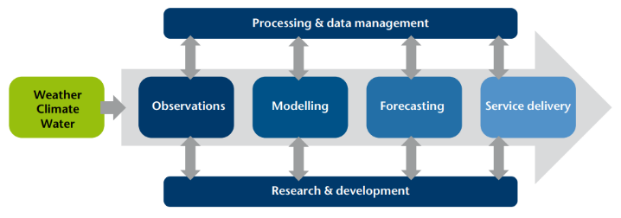
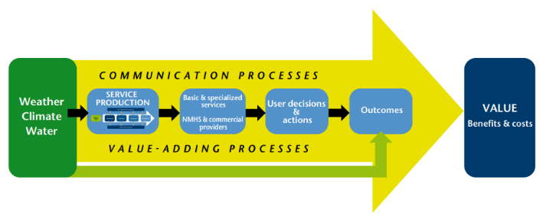
Global context: Global Framework for Climate Services
System infrastructure for production and delivery
Information and services value chain
Source: WMO_1153_en.pdf: Valuing Weather and Climate: Economic assessment of Meteorological and Hydrological Services

Slide 3
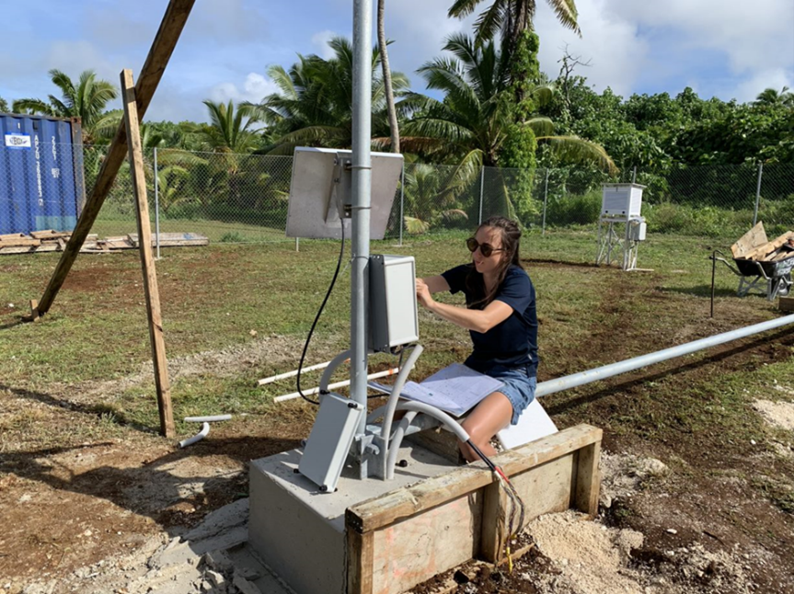
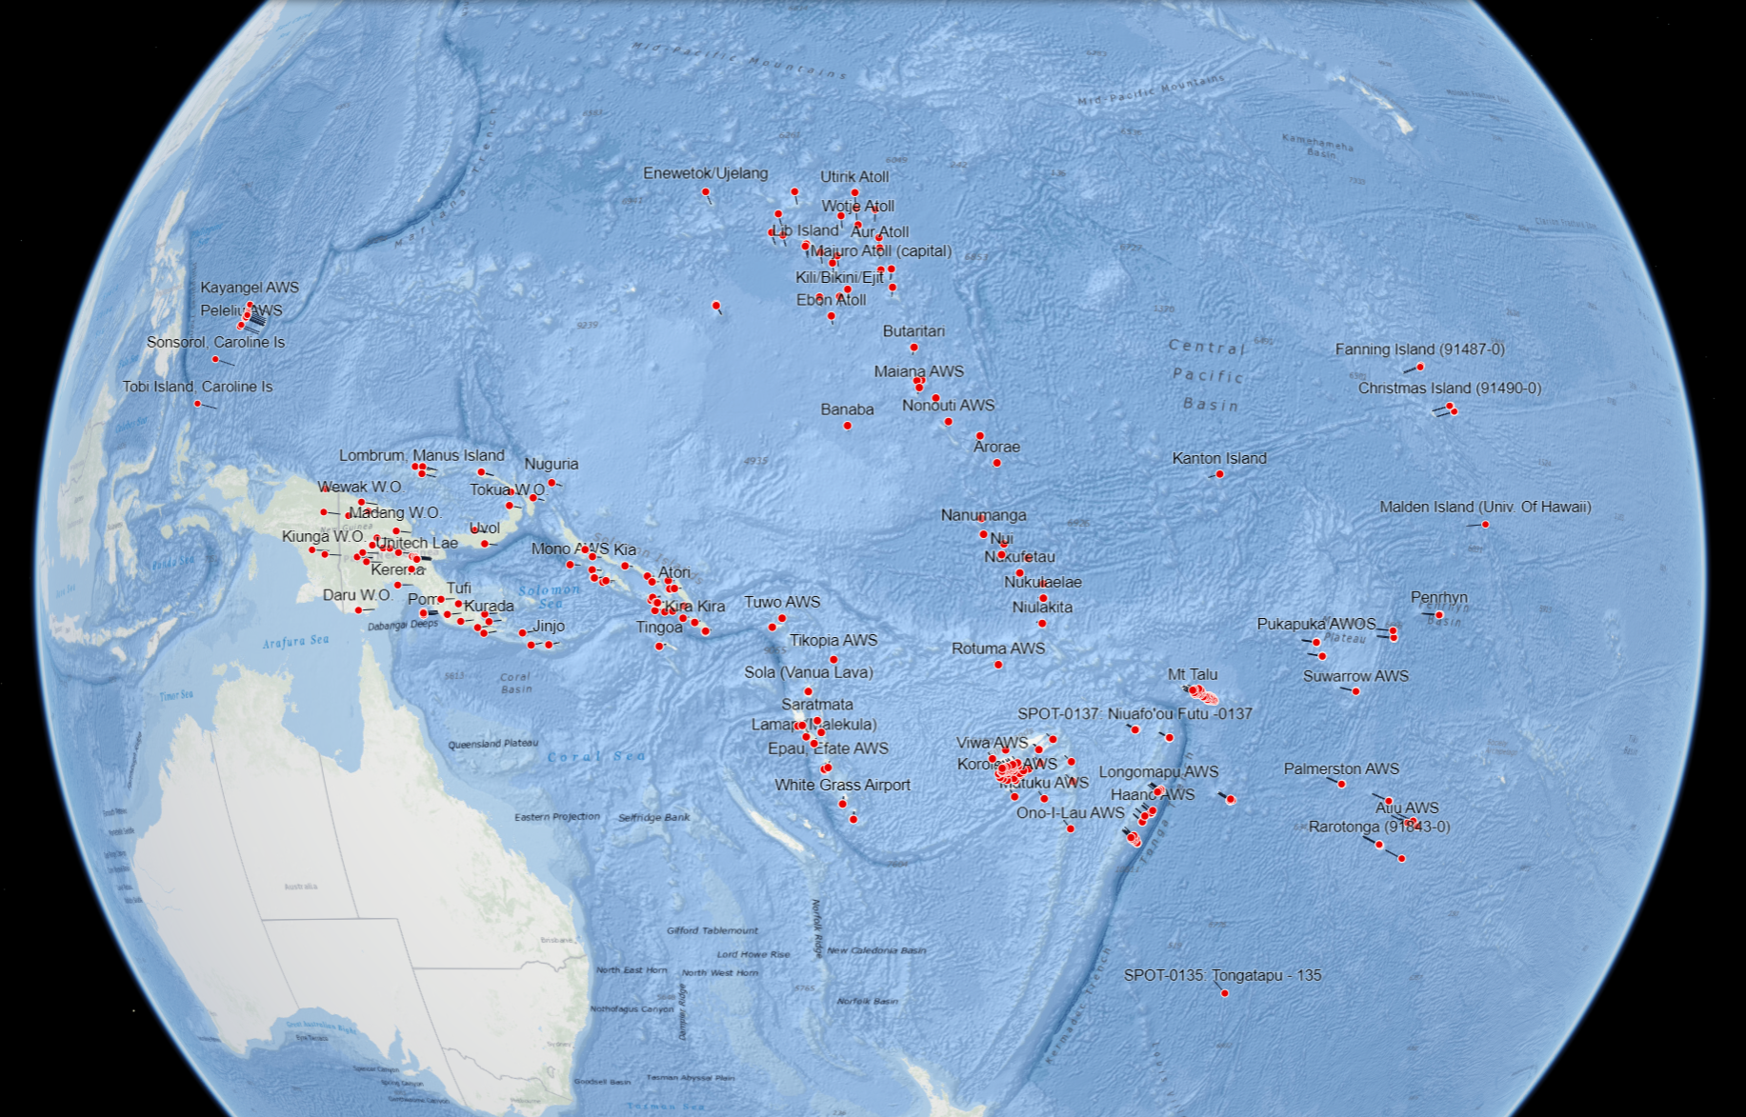
Weather and Climate Observations
Pacific Island network of weather and climate observation stations
Providing a valuable record of long-term climate information for the region

Slide 4
CliDE – Climate Data for the Environment
Climate Data Management System (CDMS)
Providing countries with a central database for climate records
Free and open-source software
Developed by the Bureau of Meteorology, Australia
http://www.bom.gov.au/climate/pacific/about-clide.shtml

Slide 5
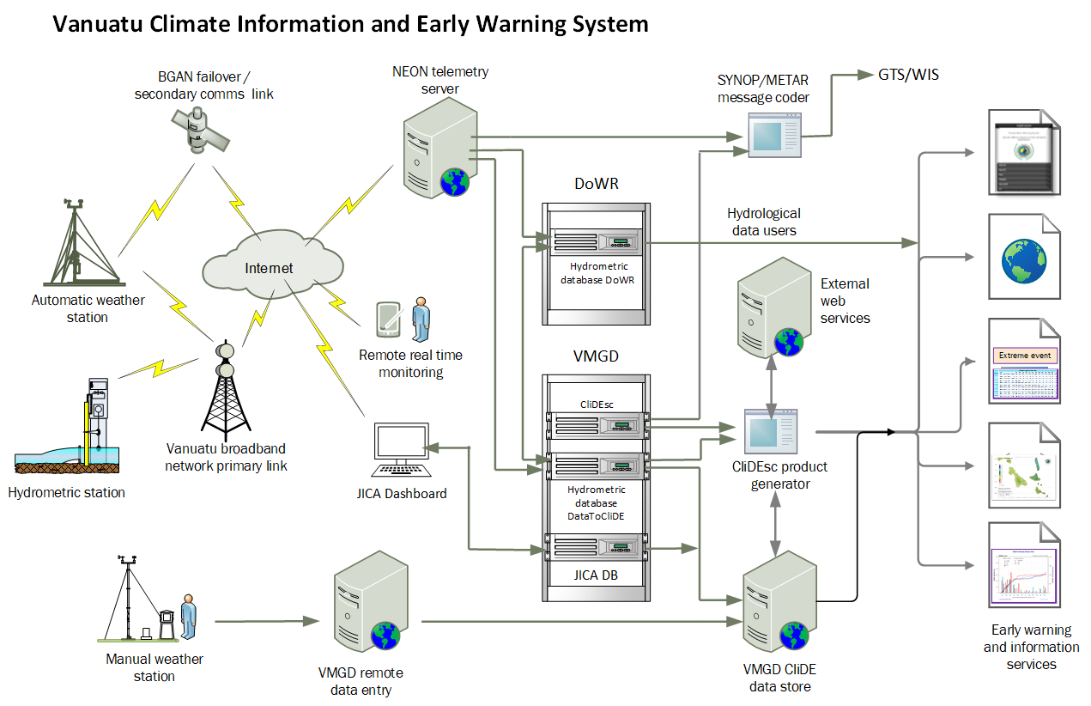

Slide 6
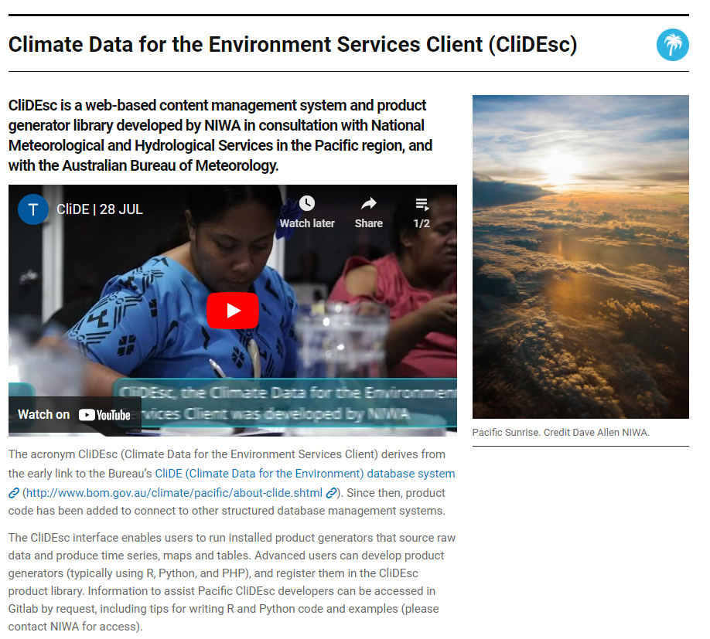
What is the Climate for the Environment Service Client (CliDEsc)?
Notes:
Installed in many Pacific Island nations accessible to local Meteorology Services.
Cook Islands, Marshall Islands, Kiribati, Micronesia, Naru, Palau, Papa New Guinea, Samoa, Solomon Islands, Tokelau, Tuvalu, Tonga, Fiji

Slide 7
The CliDEsc System

Slide 8
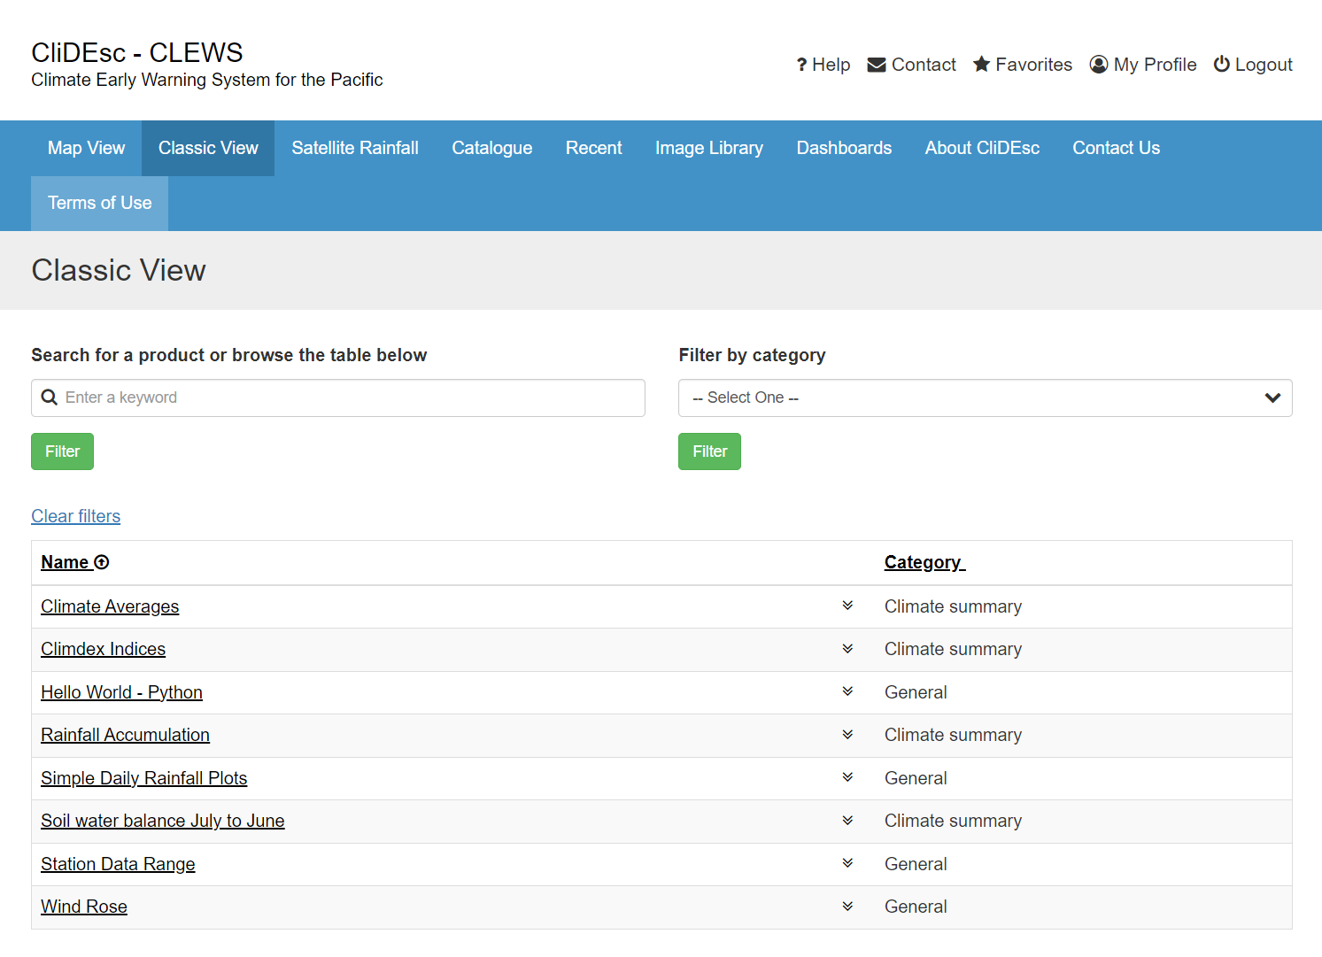
CliDEsc Product Catalogue
Library of custom product generators
Python and R programming languages used for product generation
Products can be accessed through the Map and Classic View

Slide 9
Product Types
Charts
Infographics
Tables
Datasets
Reports
Maps
Interactive dashboards

Slide 10
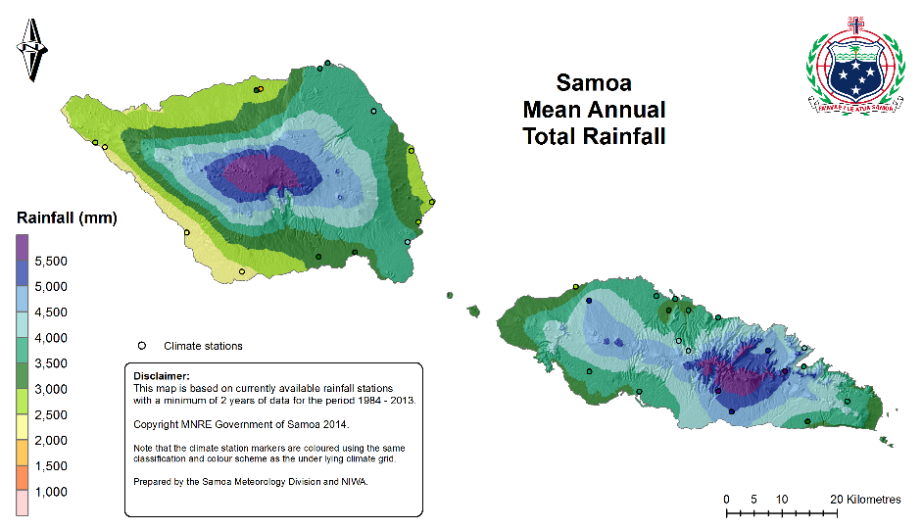
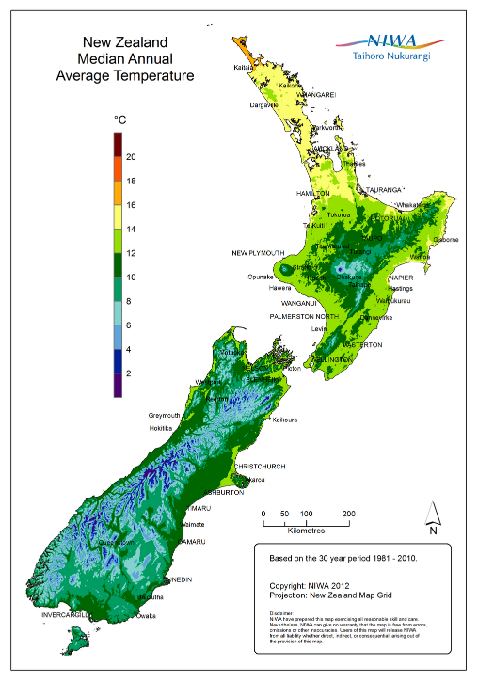
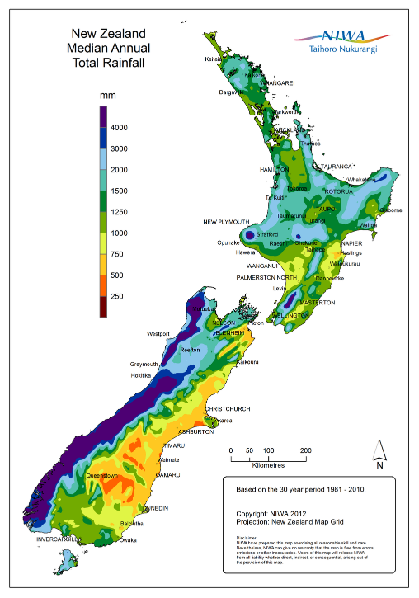
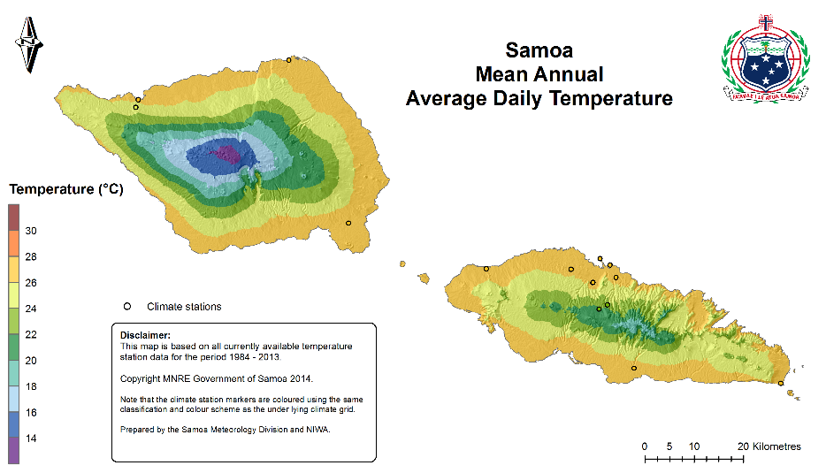
Climate Map Product Examples - 1
New Zealand 30-year climatology maps
Samoa historical climatology maps
Reference: National and Regional Climate Maps | NIWA

Slide 11
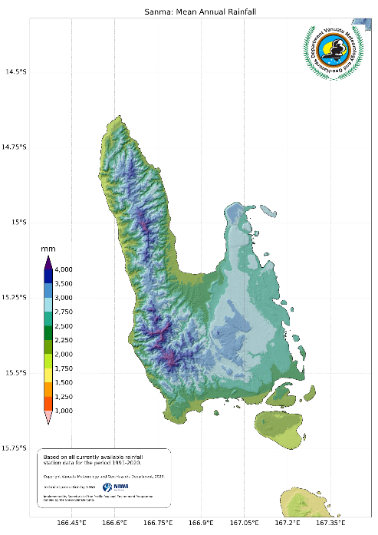
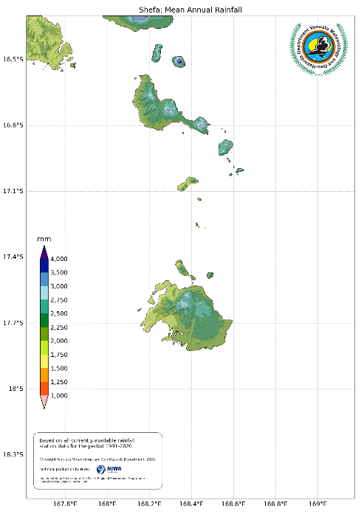
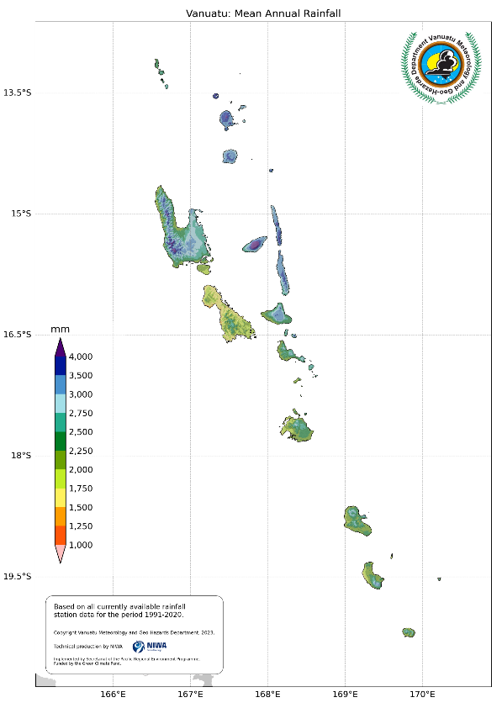
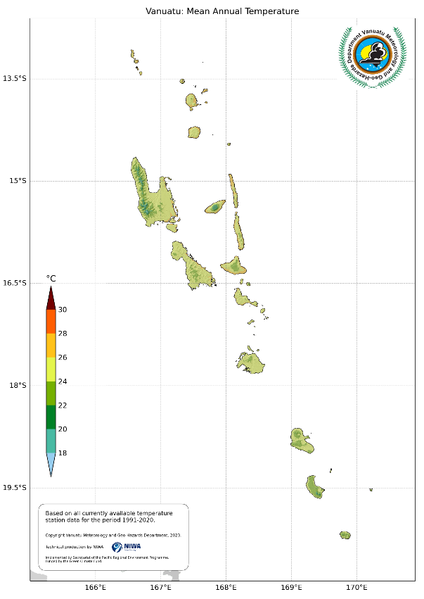
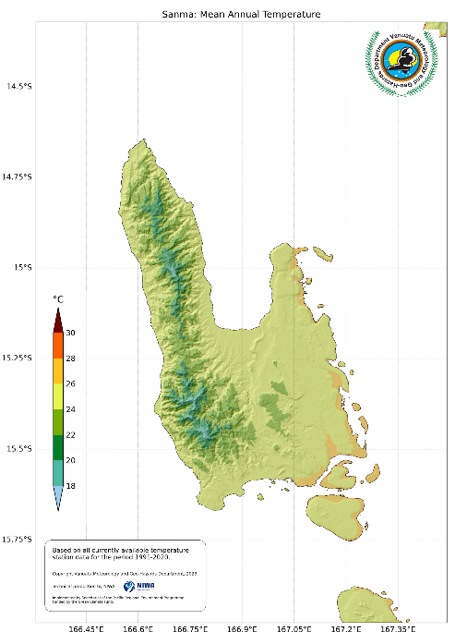
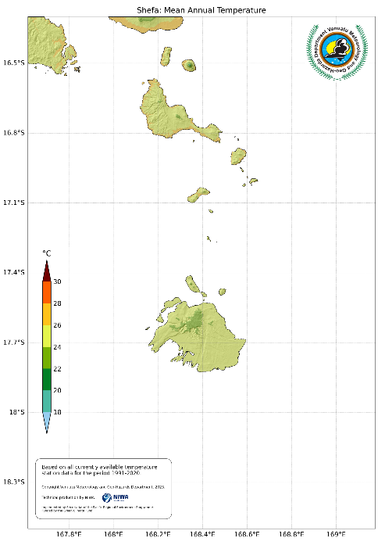
Climate Map Product Examples - 2
Vanuatu historical climatology maps
Reference: National and Regional Climate Maps | NIWA

Slide 12
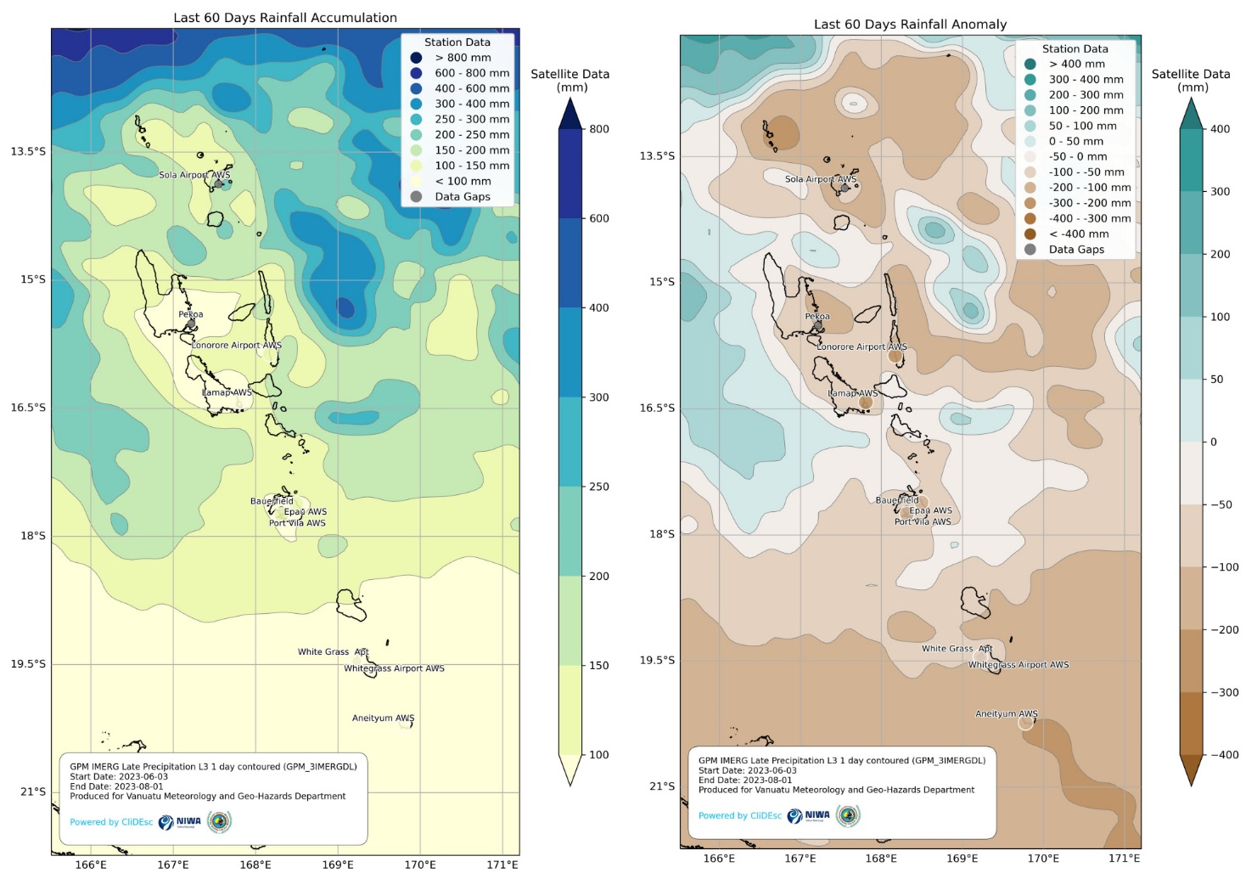
Climate Map Product Examples - 3
Vanuatu daily operational climate maps
Combining satellite and surface climate observation data
Reference: National and Regional Climate Maps | NIWA

Slide 13
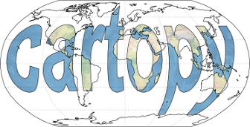
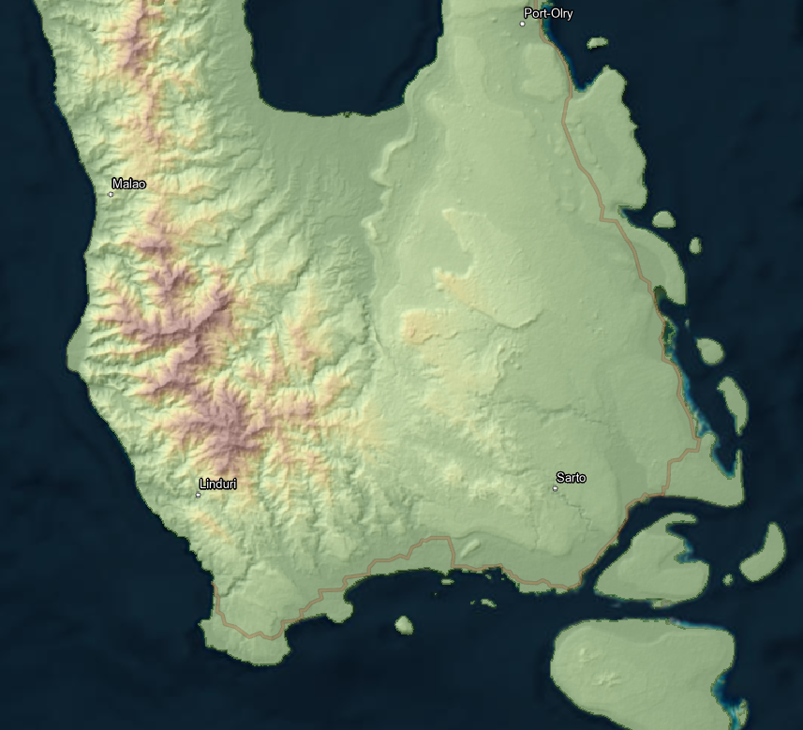
How do we create these climate maps?
Historical weather station data
Access to other climate related data such as satellite observations or weather forecast data
Topographic data – (a digital elevation model)
Data review, analysis, and manipulation tools (e.g. Python, Pandas, xarray)
Spatial analysis tools (e.g. GDAL, Rasterio, GeoPandas, ANUSplin)
Contextual spatial layers e.g. coastlines, placenames and hillshade grids
Mapping software (e.g. Cartopy)
ASTER
Notes:
Representative climate station locations
Spatial - homogeneity
Vertical - lapse rate and aspect to dominant wind flow

Slide 14
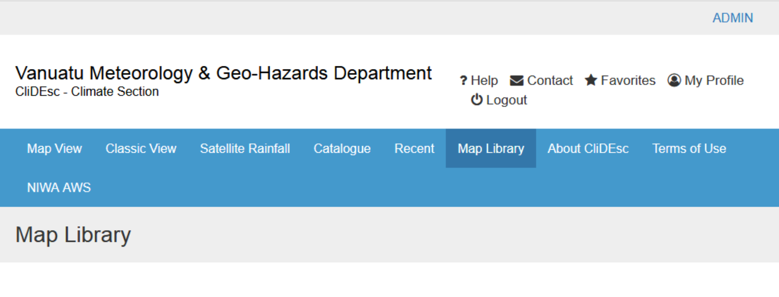
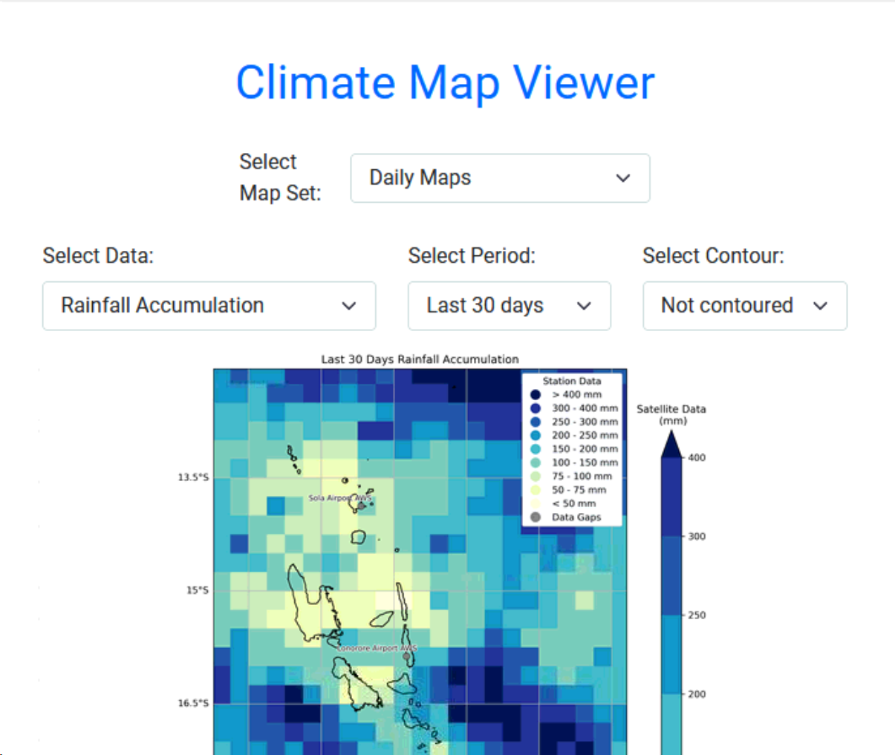
How are the maps accessed in CliDEsc?
HTML and Javascript application
Added to the CliDEsc web interface
Maps are accessed via the CliDEsc Map Library

Slide 15
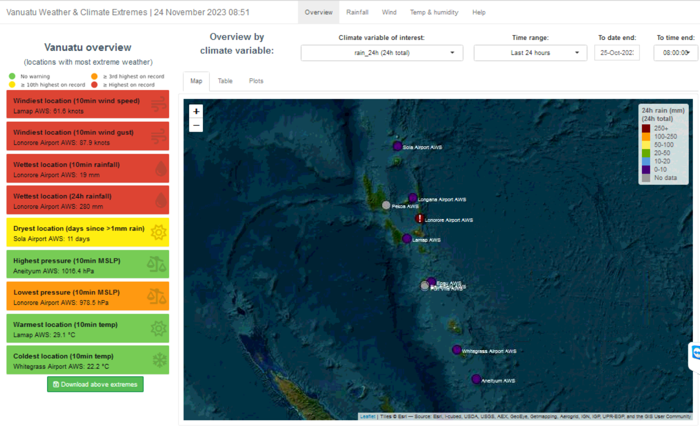
Web Dashboard Example - Weather & Climate Extremes
R Shiny Dashboard
Leaflet web map
Near real-time weather data from CliDE
Map shows the location of extreme weather conditions
Allows the users to assess the severity of extreme weather events and compare this with historical data

Slide 16
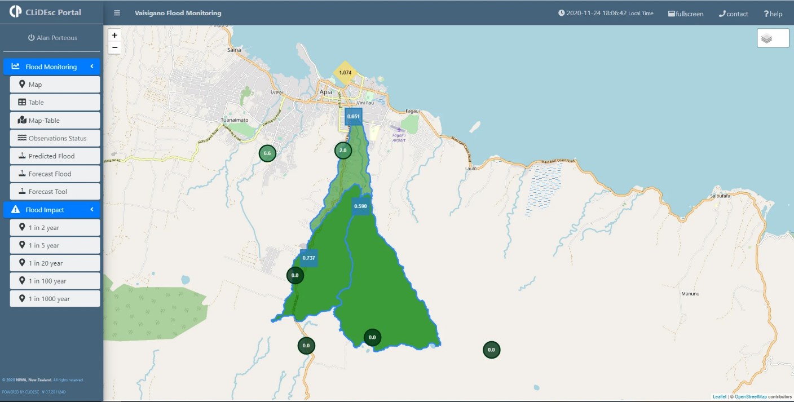
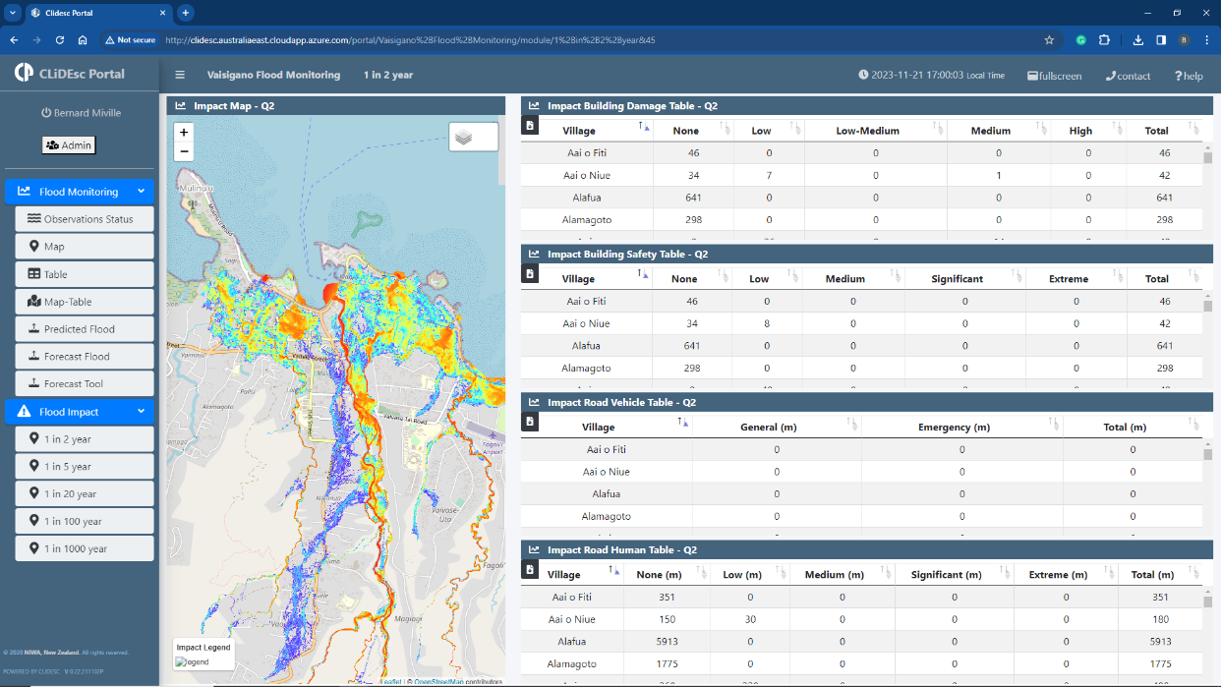
Web Dashboard Example – CliDEsc Portal
Vaisigano Flood Monitoring
Cloud hosted Javascript application
Leaflet web mapping
Raster data hosted in NIWA’s ArcGIS Portal Platform providing OGC compliant WMS services
Enables users to review and scenario test flood forecasts
Predicted rainfall, river level, flow rate and time of peak level

Slide 17
James.Sturman@niwa.co.nz
Vinaka and Thank You.
https://niwa.co.nz/pacific-rim/research-projects/climate-data-for-the-environment-services-client-clidesc

