Slide 1
Investigating remote sensing datasets to model natural flood management options in the Ba River catchment, Viti Levu Eleanor Earl, PhD Candidate at UNSW
PGRSC
November 2023
Supervisors:
A/Prof Fiona Johnson
Prof Lucy Marshall
Prof David Sanderson

Slide 2
Acknowledgements
We’d like to acknowledge the support of many individuals and organisations who have made this research possible:
Ms Swastika Prasad and Mr Bipen Prakash at Fiji Metrological Service
Mr Vilimone Raqona at Fiji Ministry of Lands and Minerals
Mr Ravuama Nagatalevu (PA Ba), Mr Sivendra Michael (UNDP) and Mr Joshua Elisha (Rise Beyond the Reef)
Dr John Duncan at the University of Western Australia, Prof Andreas Neef at the University of Auckland, Dr Floris van Ogtrop, Dr Kevin Davies at the University of Sydney,
Ms Jacqui Reid, Mr Nicholas Metherall and Mr Amit Singh from SPC, Fiji.
The Vinaka Family in Ba

Slide 3
What is the impact of flooding?
In the past 20 years floods have affected 570,000+ lives in the Pacific Islands¹
(1) EM-DAT and CRED/UCLouvain (2023). Emergency Events Database. Brussels, Belgium, The Centre for Research on the Epidemiology of Disasters (CRED).

Slide 4
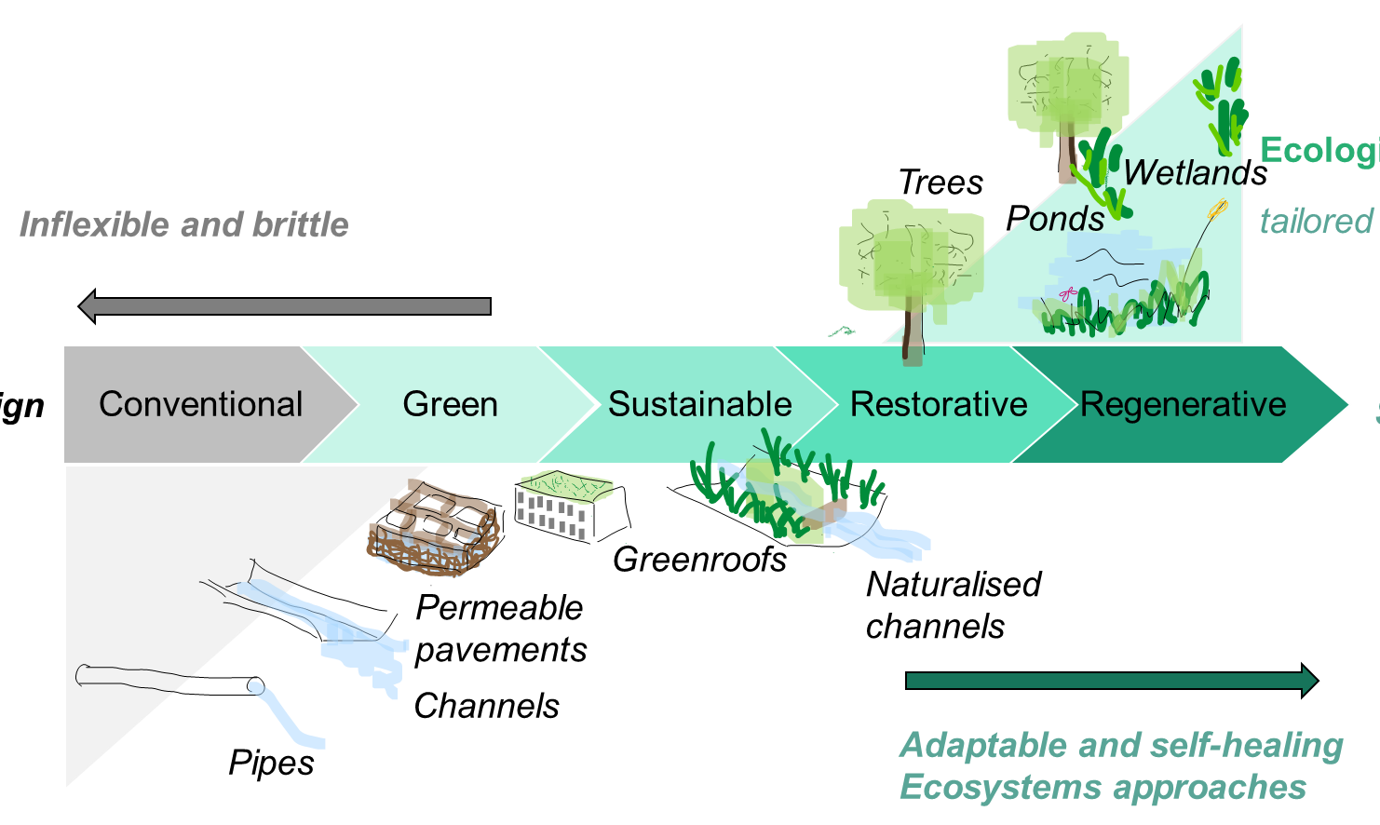
Why use natural flood management to improve resilience?
Tailored to the local ecology
Sketch by E. Earl adapted from Reed, B (2007) Shifting from ‘sustainability’ to regeneration and CIRIA SUDS Manual (2015)

Slide 5
Natural Flood Management Tunnel Vision
Livelihoods
Health
Food
Education
Peace & justice
Energy
Infrastructure
Nature-based approaches
Governance & policy
Social inequality
Natural Flood Management
Air pollution
Climate change
Biodiversity loss
Freshwater withdrawals
Land & resources
Nitrogen & phosphorus loading
Ocean acidification
Chemical pollution
Ozone depletion
Sketch by E. Earl adapted from Konietzko, J. (2007) Moving-beyond-carbon tunnel vision with a sustainability data strategy with ideas from Raworth, K. (2017) Doughnut Economics: Seven Ways to Think Like a 21st-Century Economist and the IUCN Global Standard for Nature-based Solutions (2021)

Slide 6
Research question…
What available data sets can be used and can NFM be spatially optimised?

Slide 7
Can NFM be spatially optimised using free software?
HEC-RAS
Python
ArcGIS/GIS
Software can be downloaded for free (but not open source)
Since 2016 2D Unsteady analysis
Since 2021 hydrology and hydraulics can now be modelled seamlessly
Linux version compatible with High Performance Computers (HPCs)
Call command used in shell script to run python code on UNSW HPCs
Python code identifies which land use areas are in each grid cell
Python code iteratively changes land use parameters in each grid cell
Processing geospatial datasets for input in to the ‘seed’ HEC-RAS model
Choosing model grid

Slide 8
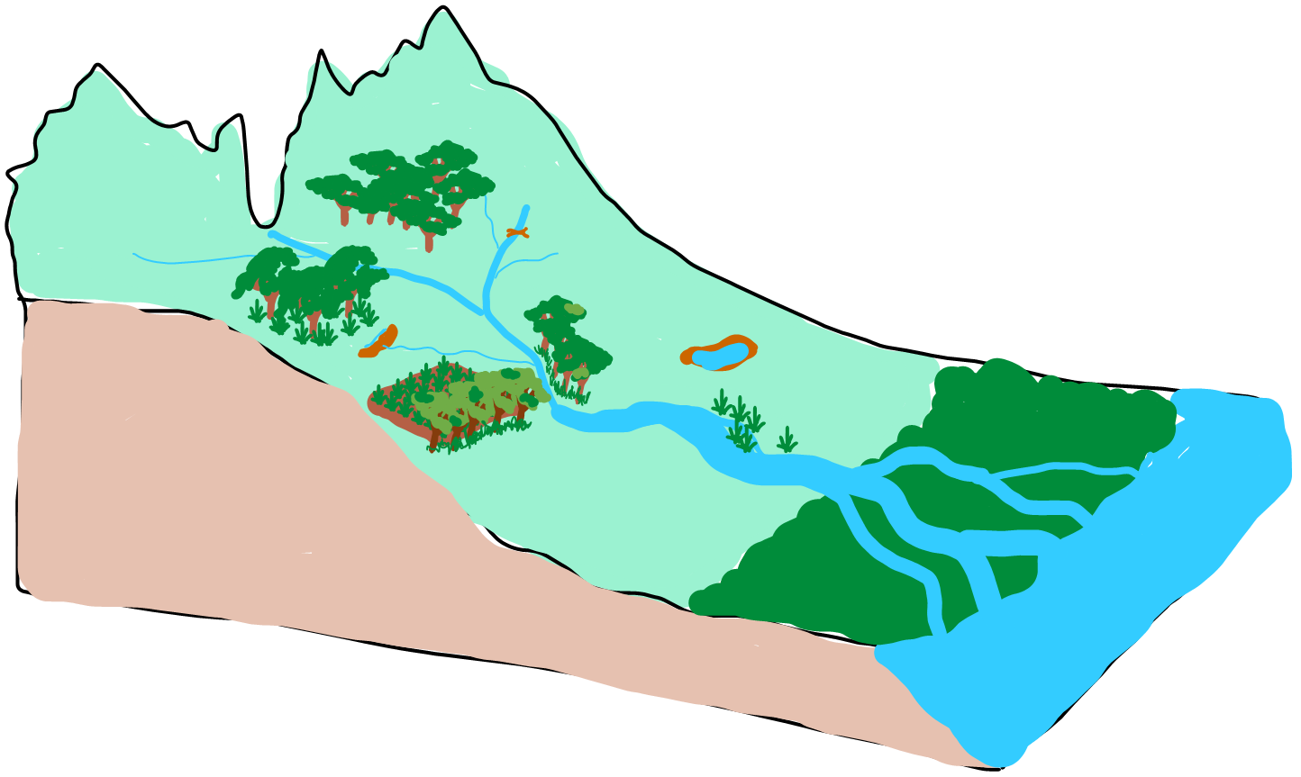
How do NFM mechanisms reduce flooding?
Reduce runoff
Infiltrate
Natural Flood Management
Model Parameters
Mechanisms
Abstraction Ratio
Mannings N
Curve Number
Impermeable Area
Store
Slow

Slide 9
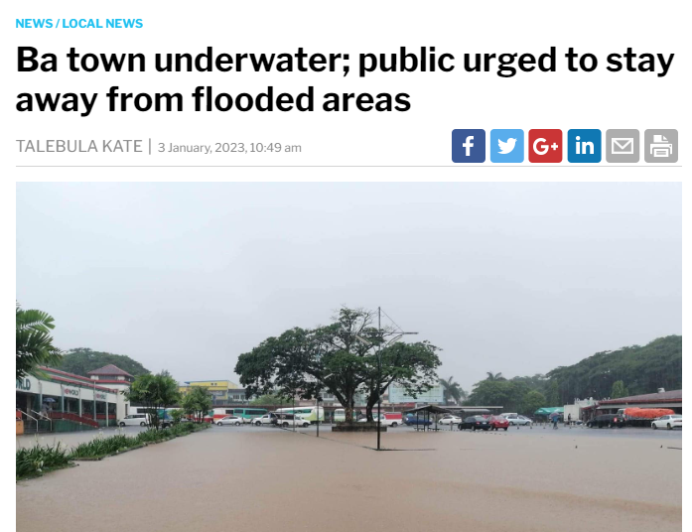
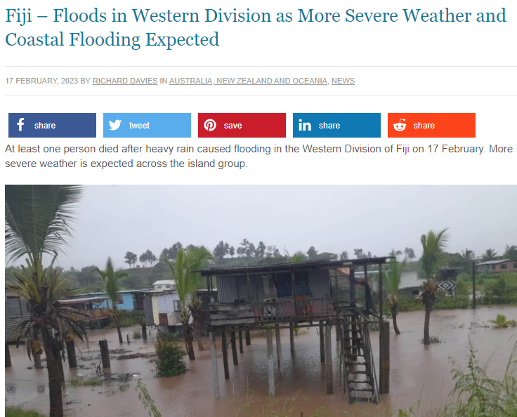
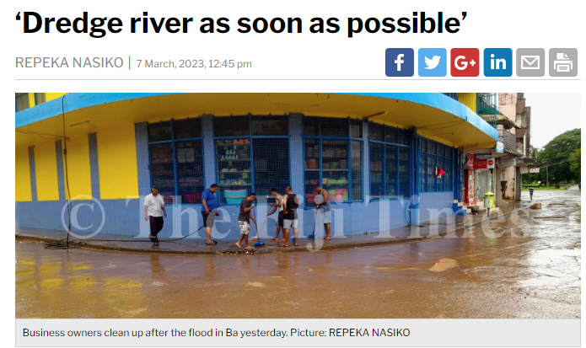
Why Ba?
3 Jan 2023
17 Feb 2023
7 Mar 2023
Recent newspaper articles from Ba, Fiji

Slide 10
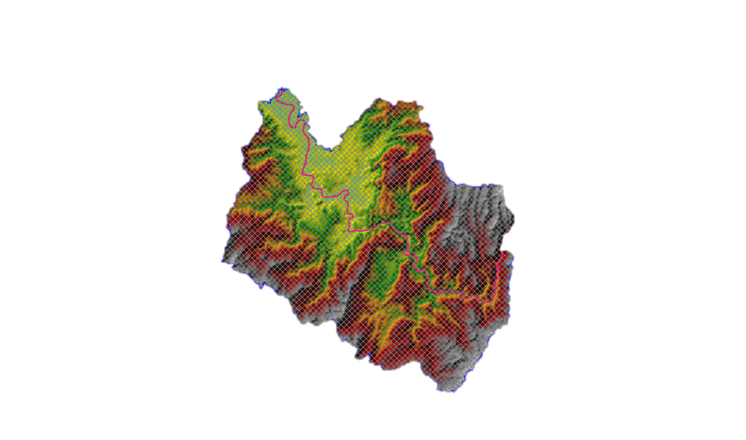
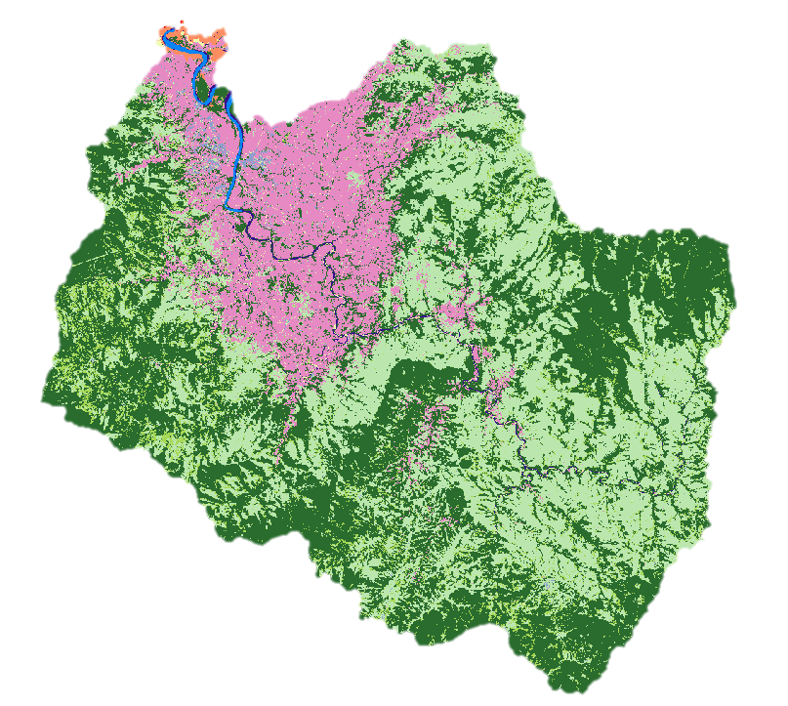
What were the main remote sensing data inputs?
Topography
Land use
Lower catchment 1m LiDAR (Neef et al. 2020) remaining areas 30m Copernicus DEM GLO30 (2010 to 2014)
Land use (Davies et al. 2021)
ML model using Sentinel-2 10m land use data
Neef, A., Boruff, B., Bruce, E., Ngin, C., Pauli, N., Davies, K., Van Ogtrop, F., Varea, R., Weber, E. (2020). Climate change adaptation in disaster-prone communities in Cambodia and Fiji. Science Bulletin, 10(1), 67-75.
Copernicus WorldDEM-30 © DLR e.V. 2010-2014 and © Airbus Defence and Space GmbH 2014-2018 provided under COPERNICUS by the European Union and ESA; all rights reserved
NASA JPL (2013). NASA Shuttle Radar Topography Mission Global 1 arc second [Data set]. NASA EOSDIS Land Processes DAAC. Accessed 2020-12-03 from https://doi.org/10.5067/MEaSUREs/SRTM/SRTMGL1.003
Davies et al. 2021. A Dynamic, Cloud-based LULC Mapping Methodology Using Sentinel-2 to Support Climate-Smart Landscape Management in Vulnerable Fijian Communities, Environmental Science.

Slide 11
Why did I choose Copernicus DEM GLO30?
Topography
30m SRTM
GLO-30
Rough river channel profile
Values at boundary poorly fit with LiDAR data
Flattening of water bodies and consistent river flow, leading to smoother river channel profile
Values at boundary closely fit with LiDAR data
Lower catchment 1m LiDAR (Neef et al. 2020) remaining areas 30m Copernicus DEM GLO30 (2010 to 2014)
Neef, A., Boruff, B., Bruce, E., Ngin, C., Pauli, N., Davies, K., Van Ogtrop, F., Varea, R., Weber, E. (2020). Climate change adaptation in disaster-prone communities in Cambodia and Fiji. Science Bulletin, 10(1), 67-75.
Copernicus WorldDEM-30 © DLR e.V. 2010-2014 and © Airbus Defence and Space GmbH 2014-2018 provided under COPERNICUS by the European Union and ESA; all rights reserved
NASA JPL (2013). NASA Shuttle Radar Topography Mission Global 1 arc second [Data set]. NASA EOSDIS Land Processes DAAC. Accessed 2020-12-03 from https://doi.org/10.5067/MEaSUREs/SRTM/SRTMGL1.003

Slide 12
What were the main remote sensing data inputs?
Land use
Land Cover type | Percentage land cover (%)
 | Davis et al. 2021 | ESA WorldCover 10 m 2021 v200
Water | 0.8 | 0.5
Mangrove/ Woody wetland | 0.5 | 0.6
Bare soil | 0.6 | 0.3
Urban | 0.7 | 0.32
Crop | 15.7 | 1.0
Grassland | 34.7 | 34.6
Shrubland | 39.7 | 0
Forest | 7.38 | 63
Land use (Davies et al. 2021)
ML model using Sentinel-2 10m land use data
Zanaga, D., Van De Kerchove, R., De Keersmaecker, W., Souverijns, N., Brockmann, C., Quast, R., Wevers, J., Grosu, A., Paccini, A., Vergnaud, S., Cartus, O., Santoro, M., Fritz, S., Georgieva, I., Lesiv, M., Carter, S., Herold, M., Li, Linlin, Tsendbazar, N.E., Ramoino, F., Arino, O., 2021. ESA WorldCover 10 m 2020 v100. https://doi.org/10.5281/zenodo.5571936
Davies et al. 2021. A Dynamic, Cloud-based LULC Mapping Methodology Using Sentinel-2 to Support Climate-Smart Landscape Management in Vulnerable Fijian Communities, Environmental Science.

Slide 13
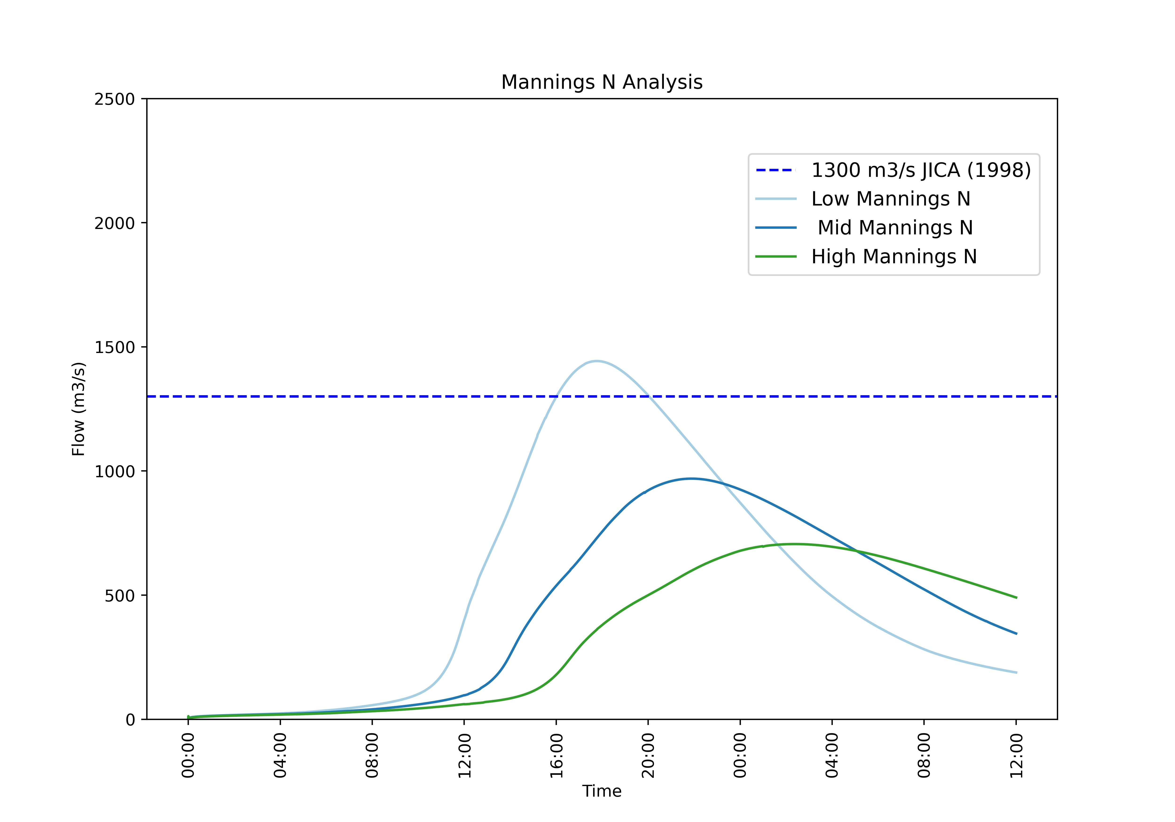
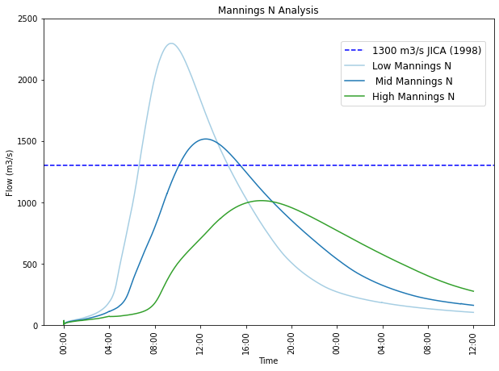
How does land use data impact the model?
ML model using Sentinel 10m land use data (Davies et al. 2021)
Mannings N Parameter Sensitivity
ESA WorldCover 10m (Zanaga, D. et al. 2020)
Mannings N Parameter Sensitivity
PEAK FLOWS HIGHER IN
ML MODEL
AVERAGE PEAK FLOW CLOSER TO EXPECTED VALUE IN ML MODEL
TIME OF CONCENTRATION EARLIER IN ML MODEL
JICA 1998. The study on watershed management and flood control for the four major Viti Levu rivers, Final Report, Yachiyo Engineering Co. Ltd.
Zanaga, D., Van De Kerchove, R., De Keersmaecker, W., Souverijns, N., Brockmann, C., Quast, R., Wevers, J., Grosu, A., Paccini, A., Vergnaud, S., Cartus, O., Santoro, M., Fritz, S., Georgieva, I., Lesiv, M., Carter, S., Herold, M., Li, Linlin, Tsendbazar, N.E., Ramoino, F., Arino, O., 2021. ESA WorldCover 10 m 2020 v100. https://doi.org/10.5281/zenodo.5571936
Davies et al. 2021. A Dynamic, Cloud-based LULC Mapping Methodology Using Sentinel-2 to Support Climate-Smart Landscape Management in Vulnerable Fijian Communities, Environmental Science.

Slide 14
Can NbS be spatially optimised to reduce flooding?
UPPER CATCHMENT
Compare NFM changes anywhere across the catchment
B
A
C
LOWER
CATCHMENT

Slide 15
What different scenarios can be modeled?
Land cover parameters
Rainfall event
Grid
Scenarios
Location
Flow
Depth

Slide 16
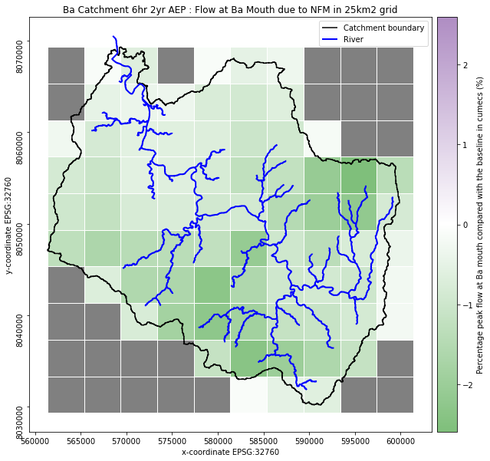
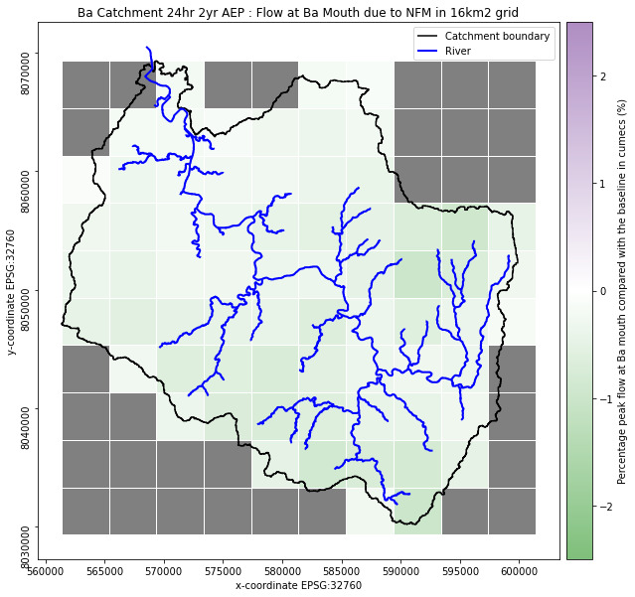
Can NFM be spatially optimised to reduce flooding?
Ba Catchment 16km² grid 6hr 2yr AEP
Ba Catchment 16km² grid 24hr 2yr AEP
Values = No relative change
Values = No relative change

Slide 17
Key opportunities for the RS/GIS community
Monitoring and evaluation
Computational demand
Working at macro and micro scales
RS could improve model inputs

Slide 18
How could remote sensing improve modelling NFM?
Flow measurements
Land use
Biodiversity change
DEM
Natural Flood Management
Sediment transport
Soil moisture
Evaporation
Transpiration

Slide 19
Conclusions and gaps for future research
Numerical models could be used more in flood management decision-making in Pacific Islands¹
Remote sensing research is needed to reflect these complex systems.
Next steps to trial on a smaller catchment
(1) Earl, E. et al., 2023. A critical review of Natural Flood Management application and spatial prioritisation approaches in tropical island catchments, Science of The Total Environment, Volume 878, 2023,doi.org/10.1016/j.scitotenv.2023.162776.

Slide 20
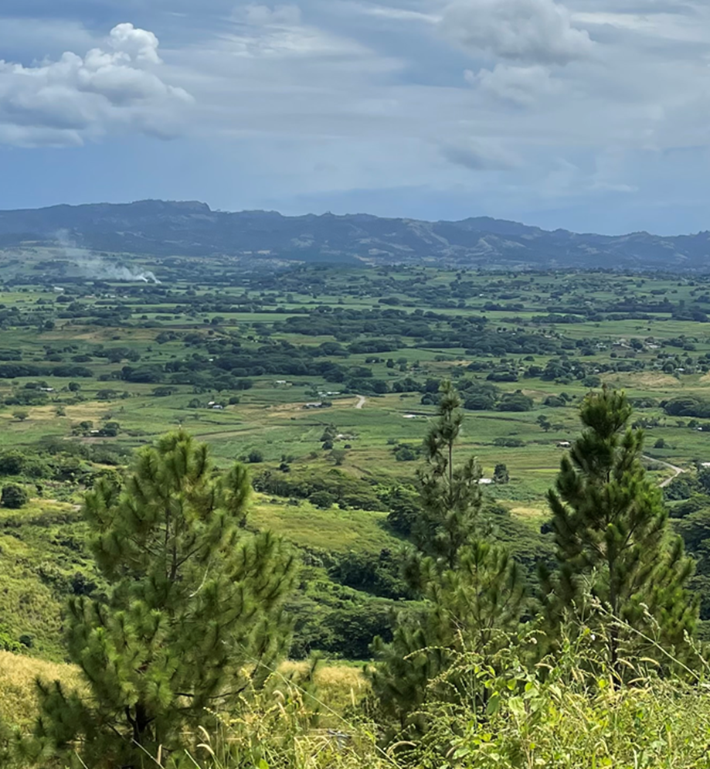
Ba Catchment, Fiji (E. Earl 2022)
Vinaka vaka levu!
Eleanor Earl
e.earl@unsw.edu.au
www.linkedin.com/in/eleanor-earl-32186635
Scientia PhD Scholar
UNSW Water Research Centre

